Slide 1
Structural Design and Inspection-Energy method
By
Dr. Mahdi Damghani
2022-2023

Slide 2
Suggested Readings
Reference 1
Reference 2

Slide 3
Objective(s)
Familiarisation with Total Potential Energy (TPE)
Familiarisation with stationary value of TPE
Familiarisation with Rayleigh Ritz method

Slide 4
Review
Principle of virtual work
Castigliano’s First Theorem
Differential of the strain energy (U) of a structure with respect to a load is equated to the deflection of the load. To be mathematically correct, however, it is the differential of the complementary energy C which should be equated to deflection.
Castigliano’s Second Theorem
Principle of Complimentary Energy Method
Unit Load Theorem
In any elastic structure, if strain energy is expressed in terms of displacements then derivative of energy to displacement is force.
Linearly Elastic Structures
Linear elastic and geometric nonlinear (large deflections) elastic
Both linear and nonlinear structures

Slide 5
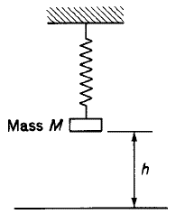
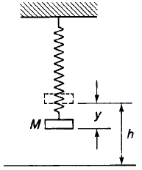
Total Potential Energy (TPE)
Deflection can be associated with the loss of potential energy.
In equilibrium
In deflected equilibrium
Loss of energy for -Mgy
Potential Energy of the mass= Mgh
Potential Energy= Mg(h-y)
If instead of weight we had force P then V=–Py (loss of energy).
Arbitrary datum

Slide 6

Note
Assuming that the potential energy of the system is zero in the unloaded state, then the loss of potential energy of the load P as it produces a deflection y is Py;
The potential energy V of P in the deflected equilibrium state is given by;

Slide 7
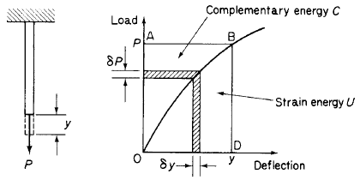
Note (strain energy in a system)
Strain energy produced by load P

Slide 8
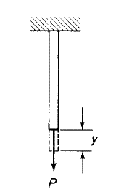
Total potential energy for single force-member configuration in deflected equilibrium state
Internal/strain energy
Internal/strain energy
Potential energy of external/applied loads
Potential energy of external/applied loads
Total potential energy of a system in deflected equilibrium state

Slide 9
Total potential energy for a general system
A system consisting of loads P₁,P₂, . . . , P_{n} producing corresponding displacements Δ₁, Δ₂, . . . , Δ_{n} in the direction of load
Potential energy of all loads

Slide 10
The principle of the stationary value of the total potential energy
P₁
Let’s assume an elastic system in equilibrium under real applied forces P₁, P_{2,} ..., P_{n}
Go through virtual displacements δΔ₁, δΔ_{2,} ..., δΔ_{n} in the direction of load
Virtual work done by force is;
P₂
δΔ₁
δΔ₂
Work done by external forces
Strain energy is generated
TPE of the system
Stationary vale of TPE
δΔ_{n}
P_{n}

Slide 11
Reminder
In the complementary energy method (previous lecture) we assumed virtual forces going through real displacements in the direction of the displacement intended;
Now we assume real forces go trough virtual displacements that are in direction of forces.

Slide 12
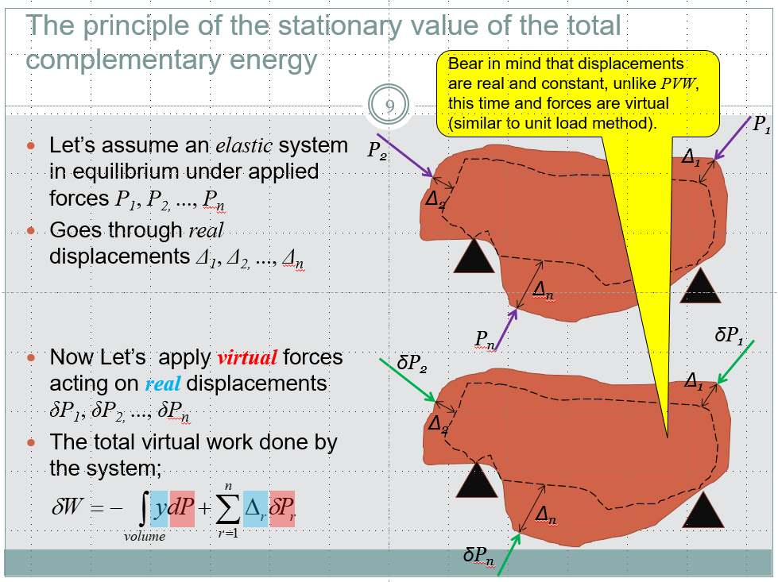
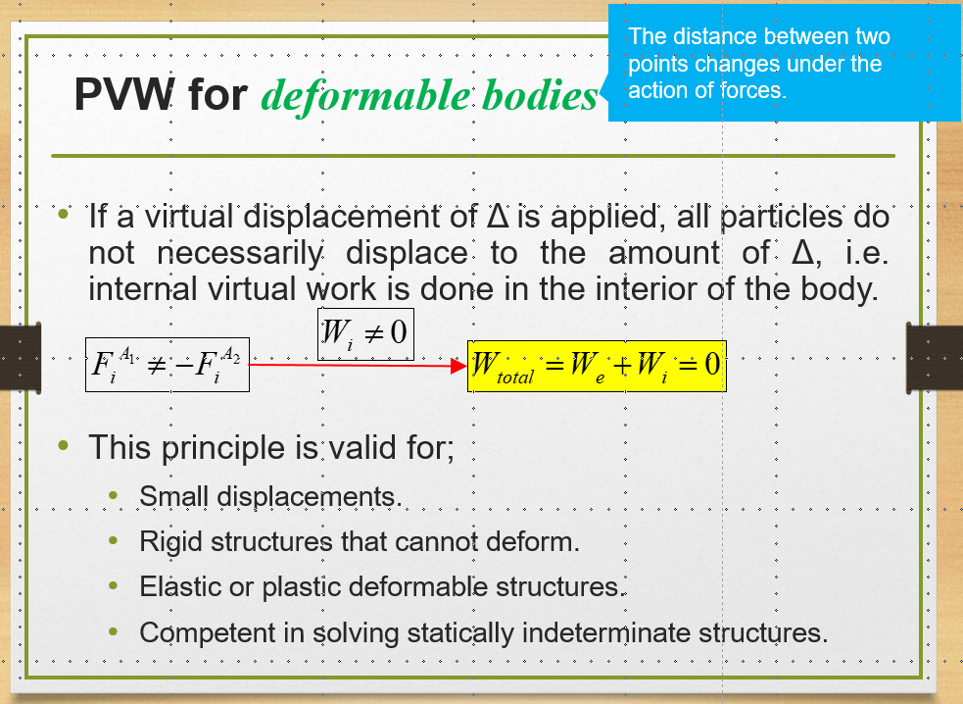
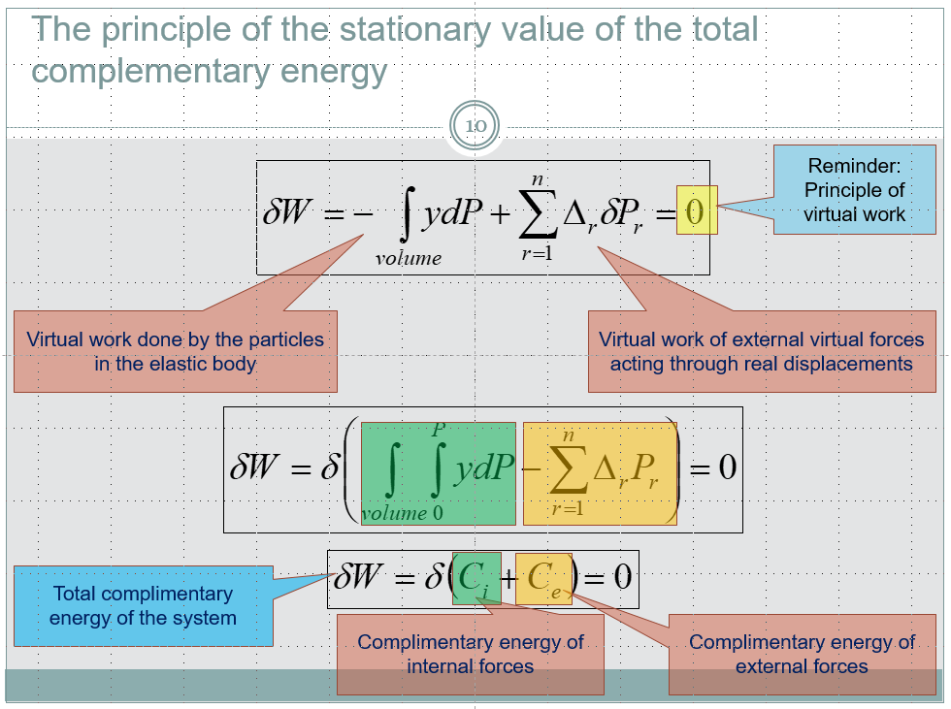
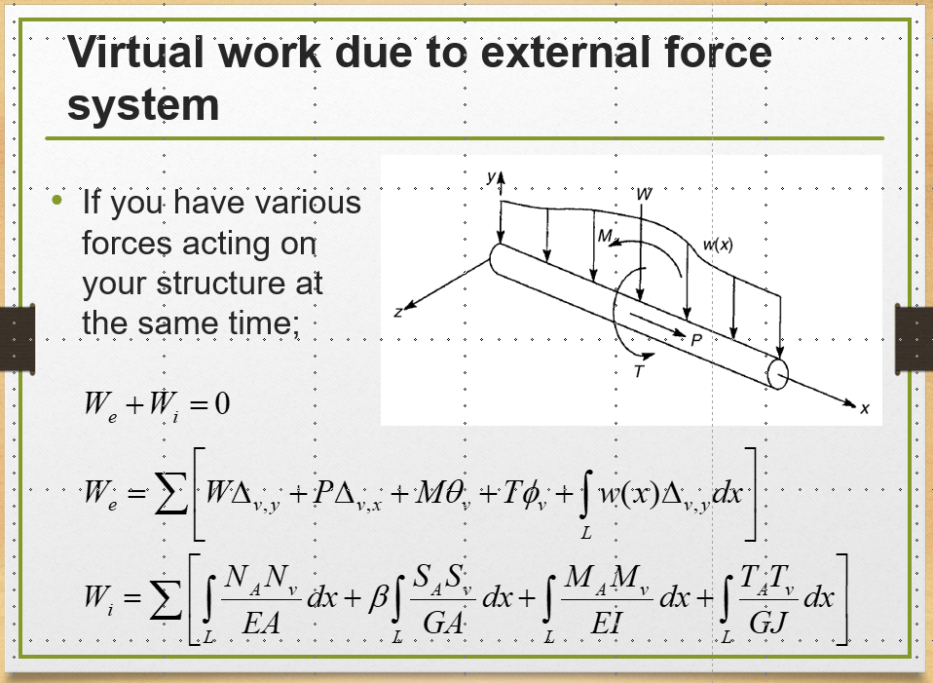
Reminder (similarities with previous methods)
For TPE, the assumed displacement needs to be as accurate as that of real displacement field. The more accurate the assumed displacement field, the more accurate becomes the final solution.
Virtual forces going through real displacements
Real forces going through virtual displacements

Slide 13
What is stationary value?
Above equation means variation of total potential energy of system is zero;
This quantity does not vary when a virtual displacement is applied;
The total potential energy of the system is constant and is always minimum.

Slide 14
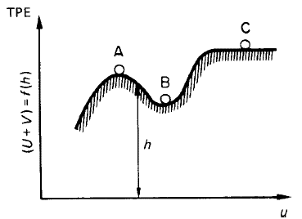
Qualitative demonstration
Neutral equilibrium
Unstable equilibrium
TPE_{C}
TPE_{A}
Different equilibrium states of particle
TPE_{B}
Means if we trigger particle, its total potential energy does not change (balance equilibrium)
Means if we trigger particle, its total potential energy does not change (balance equilibrium)

Slide 15
The principle of the stationary value of the total potential energy (definition)
The total potential energy of an elastic system has a stationary value for all small displacements when the system is in equilibrium;
The equilibrium is stable if the stationary value is a minimum (see previous slide);
This principle can be used for approximate solution of structures.

Slide 16
Note
In this method often a displaced form of the structure is unknown;
A displaced form is assumed for the structure (also called Rayleigh-Ritz or simply Ritz method);
Ritz developed the method proposed by Rayleigh;
Ritz method is a derivative of stationary value of potential energy;
By minimising the potential energy unknowns can be obtained;
This method is very useful when exact solutions are not known;
Let’s see it in some examples.

Slide 17
Task for the students
Find out how the strain energy stored in a member is derived for the following loading conditions:
Axial force N (like truss members)
E is Young’s modulus
EA is the axial stiffness
Bending moment M (beam members)
E is Young’s modulus
EI is the flexural stiffness
Shear force V (shear beams)
G is shear modulus
GA is the shear stiffness
Torsion T
G is shear modulus
GI_{t} is the torsional stiffness (GJ/L)

Slide 18
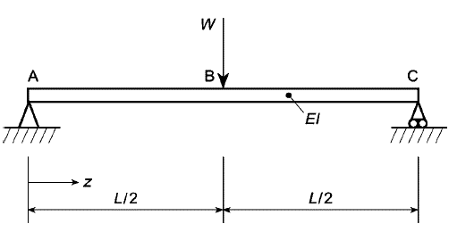
Example
Determine the deflection of the mid-span point of the linearly elastic, simply supported beam. The flexural rigidity of the beam is EI.
x

Slide 19
Solution
For this kind of problems we need to assume a displacement function;
Displacement function must be compatible with boundary conditions;
By way of experience we know that the beam would have some sort of sinusoidal deflected shape;
Let’s assume deflection and …

Slide 20
Solution
The result is approximate since we assumed a deformed shape.
The more exact the assumed deformed shape, the more exact is the solution

Slide 21

Solution using complementary energy method
x₁
x₂
R_{A}
R_{B}

Slide 22
Example
Find displacements in all three cables supporting a rigid body with concentrated force F.
k
k
k
F
a
Rigid Body
4a
2a

Slide 23
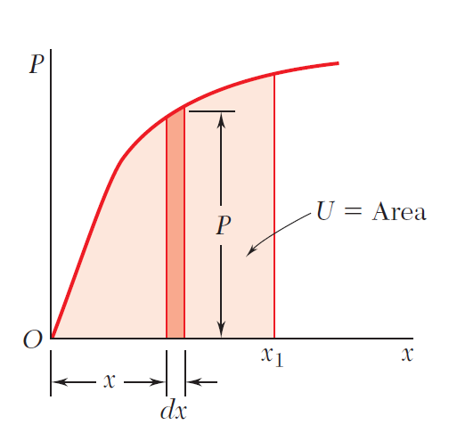
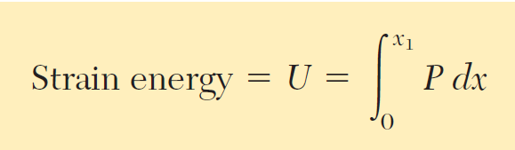
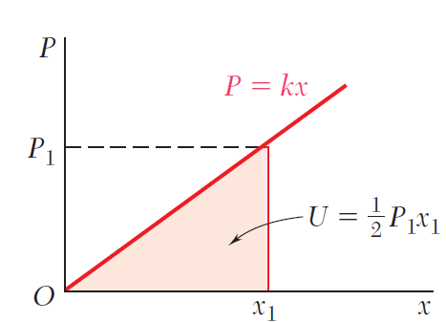
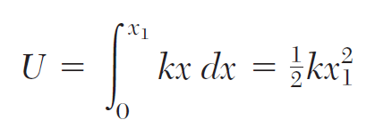
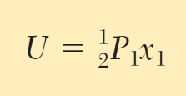
Reminder
General system
General system
Linear system
Linear system

Slide 24
Solution
4a
2a
u₁
u₂
u₃
Rigid Body

Slide 25
Solution
Find displacement field meeting boundary conditions
Set up the term for TPE
Set derivative of TPE to zero
4a
2a
u₁
u₂
u₃
Rigid Body

Slide 26
Solution
Important note:
In this example the displacement field was exact so the solution would be exact;
In the example before, the displacement field was assumed so the solution was approximate.

Slide 27
Example
Consider the simplest model of an elastic structure, i.e. a mass suspended by a linear spring. Find the static equilibrium position of the mass when a force F is applied.

Slide 28
Solution
Second derivative is positive meaning the function or TPE is minimum at the equilibrium

Slide 29
Example
Find deflected equation of cantilevered beam structure with a concentrated moment at one end using stationary value of TPE method. You may assume the deflected shape is approximated by;

Slide 30
Solution
Let’s investigate whether the assumed shape is admissible, i.e. meets kinematics conditions (boundary conditions), i.e. both displacement and slope at support must be zero;

Slide 31
Solution
Total Potential Energy (TPE) can be calculated as summation of energy stored in the structure plus potential of external work;
Notes:
2cos^2(x)=1+cos(2x)

Slide 32
Solution
We pointed out that the total potential energy (TPE) of a system has stationary value, i.e. its derivative must become zero;
Finally, the deflected shape will be;
At x=L we have;
Very close to the exact solution of 0.5M_{o}L²/EI

Slide 33
Example
A load P is supported at B by two uniform rods of the same cross-sectional area A. Determine the vertical deflection of point B.

Slide 34
Solution

Slide 35

Example
Consider the rigid, massless bar. Determine the stable and unstable equilibrium states of this simple structural system.

Slide 36
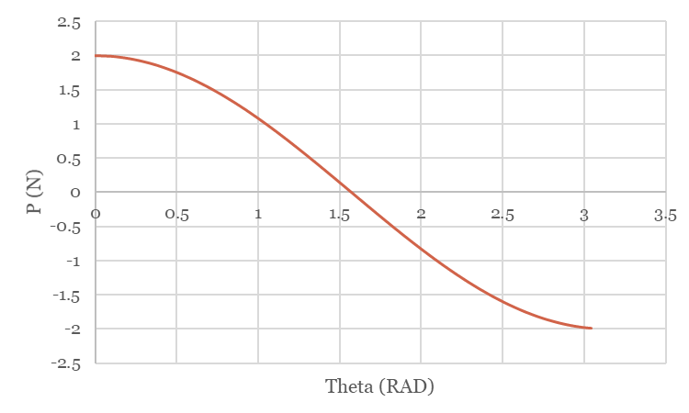
Solution
For k=1 N/m² and L=1 m
Unstable equilibrium and load path
Stable equilibrium and load path

Slide 37
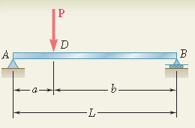
Tutorial 1
(a) Taking into account only the effect of normal stresses due to bending, determine the strain energy of the prismatic beam AB for the loading shown.
(b) Evaluate the strain energy, knowing that the beam has second moment of inertia of I= 248 in⁴, P=40 kips, L=12 ft, a=3 ft, b=9 ft, and E=29x10⁶ psi.

Slide 38
Tutorial 2
Find the vertical deflection at C of the structure. Assume the flexural rigidity EI and torsional rigidity GJ to be constant for the structure. Use Castigliano's first theorem, i.e.
b
B
A
(clamped)
P
a
C

Slide 39
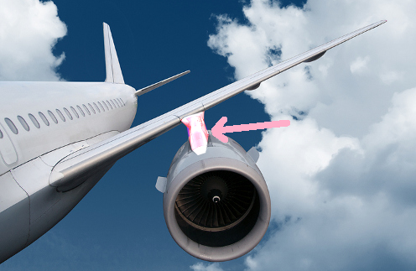
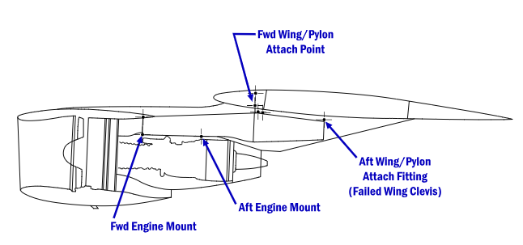
Practical Example of Tutorial 2

Slide 40

Tutorial 3
Find vertical deflection at C using Castigliano’s first theorem.
P
C
a
A
(clamped)
B
b

Slide 41


Tutorial 4
A simply supported beam AB of span L and uniform section carries a distributed load of intensity varying from zero at A to w₀/unit length at B according to the law
per unit length. If the deflected shape of the beam is given approximately by the expression
Evaluate the coefficients a₁ and a₂
Find the deflection of the beam at mid-span.

Slide 42
Tutorial 5
A uniform simply supported beam, span L, carries a distributed loading which varies according to a parabolic law across the span. The load intensity is zero at both ends of the beam and w₀ at its midpoint. The loading is normal to a principal axis of the beam cross section, and the relevant flexural rigidity is EI. Assuming that the deflected shape and loading of the beam can be represented by:
Find the coefficients a_{i} and the deflection at the mid-span of the beam using the first term only in the above series.

