Slide 1
Structural Design and Inspection-Deflection and Slope of Beams
By
Dr. Mahdi Damghani
2018-2019

Slide 2
Suggested Readings
Reference 1
Chapter 16

Slide 3
Questions
Please post here;
https://padlet.com/mahdi_damghani/lecture2

Slide 4
Objective
To obtain slope and deflection of beam and frame structures using slope-deflection method

Slide 5
Introduction
Structural analysis method for beams and frames introduced in 1914 by George A. Maney
This method was later replaced by moment distribution method which is more advanced and useful (students are encouraged) to study this separately

Slide 6
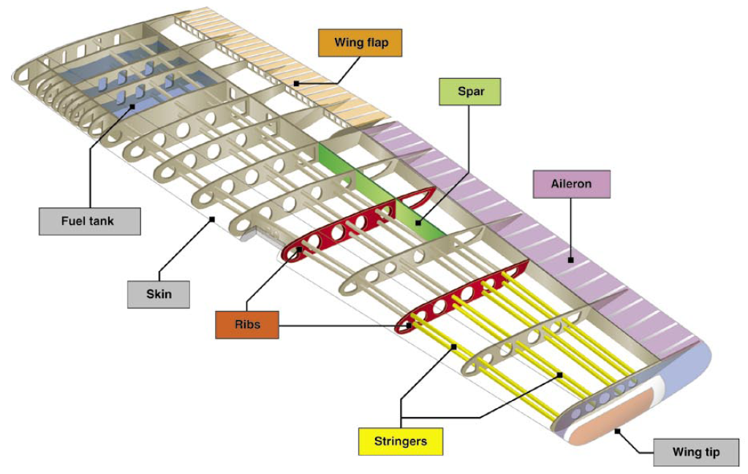
Example of beam in wing structure
Stringers in a semi-monocoque wing structure can be readily analysed using slope-deflection method (we will see an example of modern aircraft later).
Notes:
Because the external skin is now a working part of the structure this type of construction became to be known as stressed skin or semi-monocoque, where monocoque means “shell in one piece” and “semi” is an english addition to describe the discrete discontinuities of internal stiffeners. The adoption of the semi-monocoque construction and a change from wood to metal naturally coincided since sheet metal production allowed a variety of thin skins to be easily manufactured quite cheaply, with better surface finish and superior material properties. Furthermore, metal construction was conducive to riveting which would overcome the adhesive problems of early wooden semi-monocoque aircraft such as the deHavilland Mosquito.

Slide 7
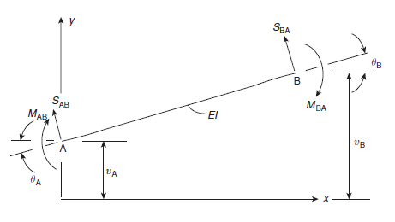
Slope-Deflection Method
Sign convention:
Moments, slopes, displacements, shear are all in positive direction as shown
Axial forces are ignored

Slide 8
Slope-Deflection Method
Solving for M_{AB} and S_{AB}

Slide 9
Slope-Deflection Method
Last 4 equations obtained in previous slide are called slope-deflection equations
They establish force-displacement relationship
This method can find exact solution to indeterminate structures

Slide 10
Slope-Deflection Method
The beam we considered so far did not have any external loading from A to B
In the presence of mid-span loading (common engineering problems) the equations become:

Slide 11
Fixed End Moment/Shear
M_{AB}^{F}, M_{BA}^{F} are fixed end moments at nodes A and B, respectively.
Moments at two ends of beam when beam is clamped at both ends under external loading (see next slides)
S_{AB}^{F}, S_{BA}^{F} are fixed end shears at nodes A and B, respectively.
Shears at two ends of beam when beam is clamped at both ends under external loading (see next slides)

Slide 12
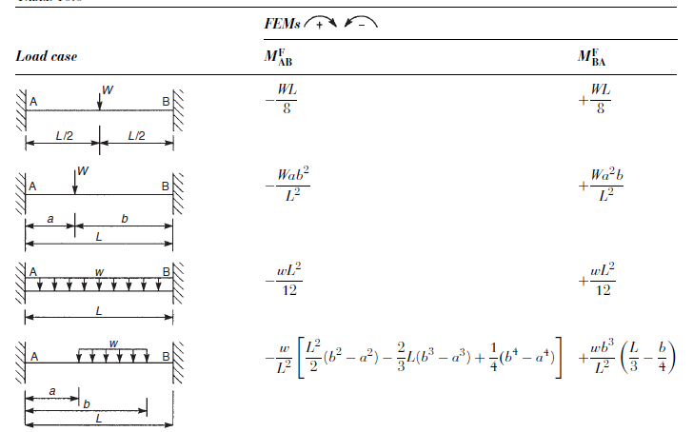
Fixed End Moment/Shear

Slide 13
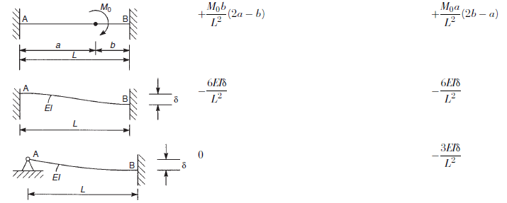
Fixed End Moment/Shear

Slide 14
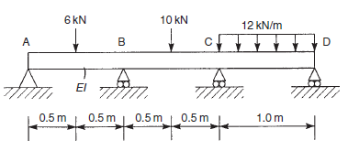
Example
Find support reactions.

Slide 15
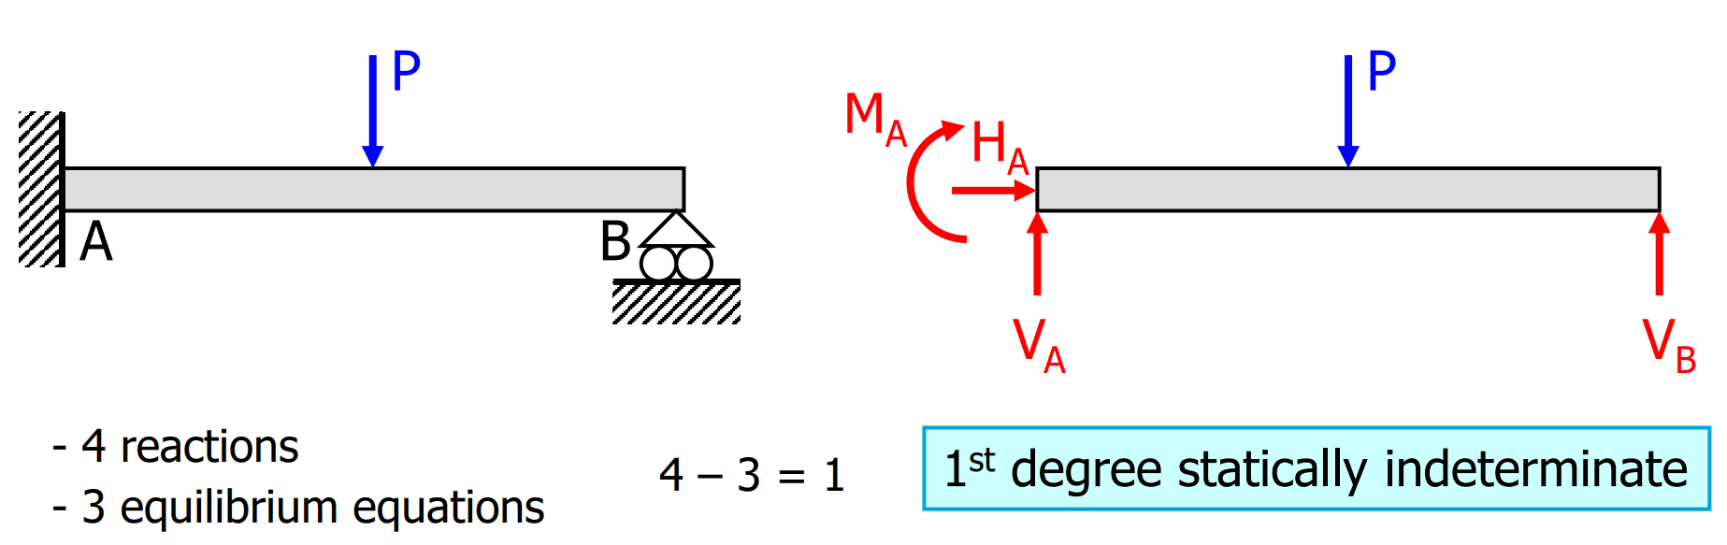
Reminder
The number of reactions in excess of the number of equilibrium equations is called the degree of static indeterminacy
The excess reactions are called static redundants
Each redundancy gives rise to the need for a compatibility equation

Slide 16
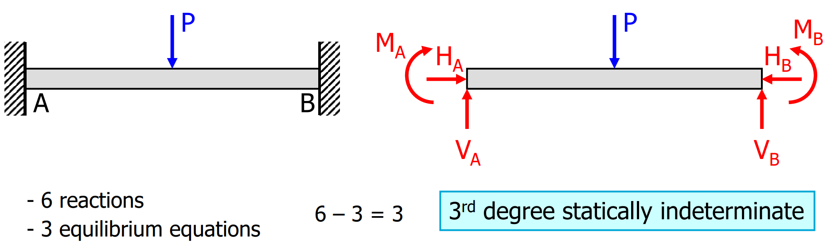
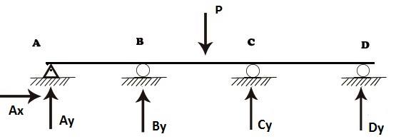
Reminder

Slide 17
Solution
This beam has 2 degrees of indeterminacy
1- Assume all beams are fixed & calculate FEM
2- Establish Slope-Deflection equations
3- Enforce boundary conditions & equilibrium conditions at joints
4- Solve simultaneous equations to get slopes/deflections

Slide 18


Solution

Slide 19
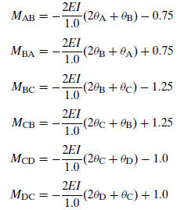
Solution
v_{i}=0 and v_{j}=0 for all cases

Slide 20
Solution
4 extra equations are obtained
Equilibrium moments at the joints (shear force exists in FBD but we are not considering it for now);
6 kN
10 kN
12 kN/m
M_{AB}=0
M_{BA}
M_{BC}
M_{CB}
M_{CD}
M_{DC}=0
M_{BA}
M_{BC}
M_{CB}
M_{CD}

Slide 21
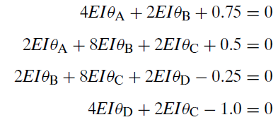
Solution
The reason for needing equilibrium at joints is that we have 6 slope deflection equations but 10 unknowns (6 moments and 4 slopes). Joints give us 4 extra needed equations.
Substitution into slope deflection equations gives 4 equations and 4 unknown slopes.
By simultaneously solving the equations

Slide 22
Solution
Simply operation of substitution:

Slide 23
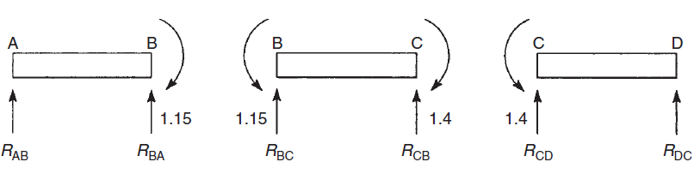

Solution
Now support reactions can easily be calculated as below (considering shear forces in FBD);
6
10
12

Slide 24
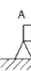
Solution
1.85
4.15
4.75
5.25
7.4
4.6
1.85
8.9
12.65
4.60

Slide 25
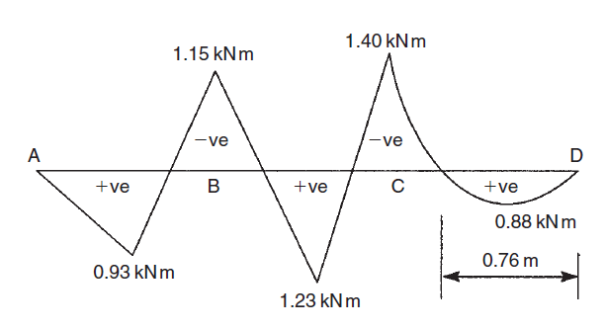
Solution

Slide 26
Example 2
Obtain moment reaction at the clamped support B for 6m long beam if support A settles down by 5mm. EI=17×10¹² Nmm²
4kN/m
A
B

Slide 27
Solution
4kN/m
5mm
A
B

Slide 28
Solution
4kN/m
5mm
A
B

Slide 29
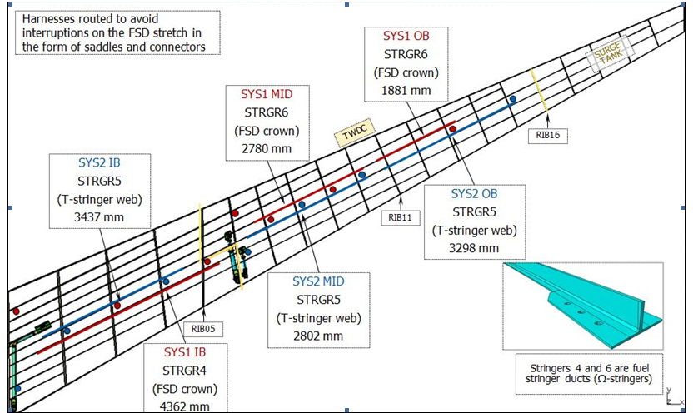
Case study

Slide 30
Case study

Slide 31
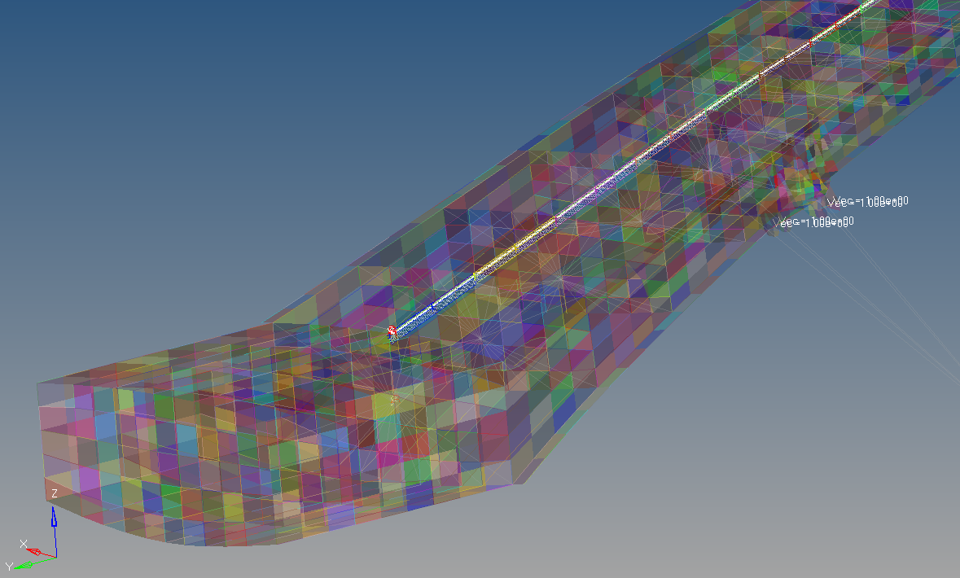
Case study
Rotation and displacement can be obtained from the FEM
Wire in composite beam

Slide 32
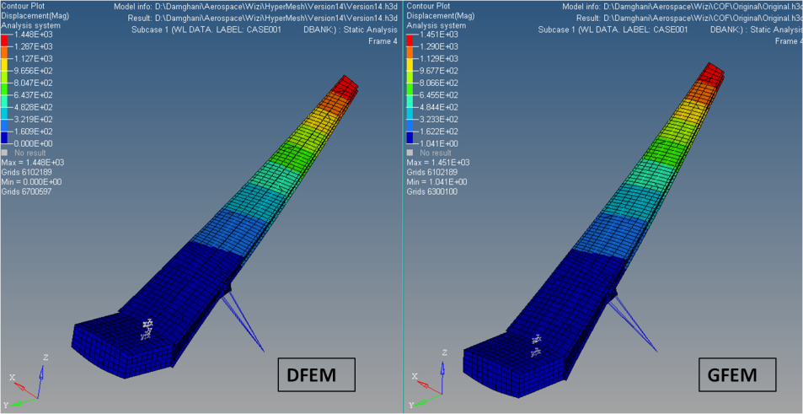
Case study
Rotation and displacement can be obtained from the FEM

Slide 33
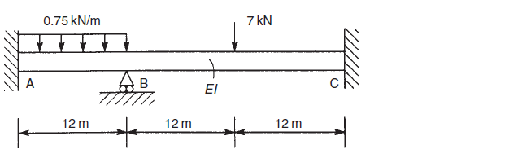
Q1
Determine the support reactions in the beam shown below. Draw bending moment diagram for the structure.

Slide 34
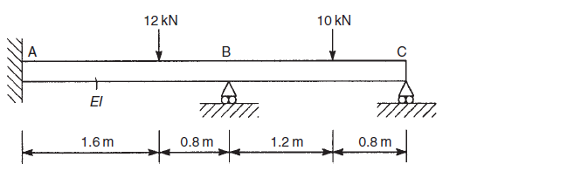
Q2
Calculate the support reactions in the beam shown below.

Slide 35
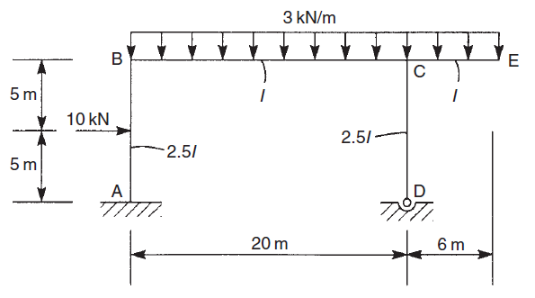
Q3
Determine the end moments in the members of the portal frame shown. The second moment of area of the vertical members is 2.5I while that of the horizontal members is I.

Slide 36
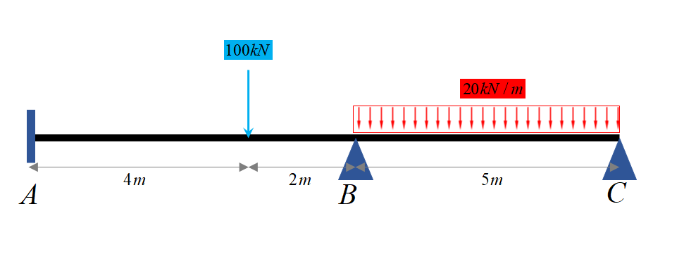
Q4
Analyze two span continuous beam ABC by slope deflection method. Then draw Bending moment & Shear force diagram. Take EI constant.

