Slide 1
Moment Distribution Method
By
Dr. Mahdi Damghani
2022-2023

Slide 2
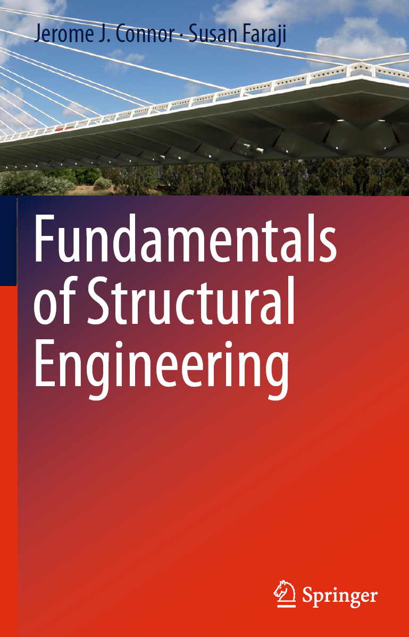
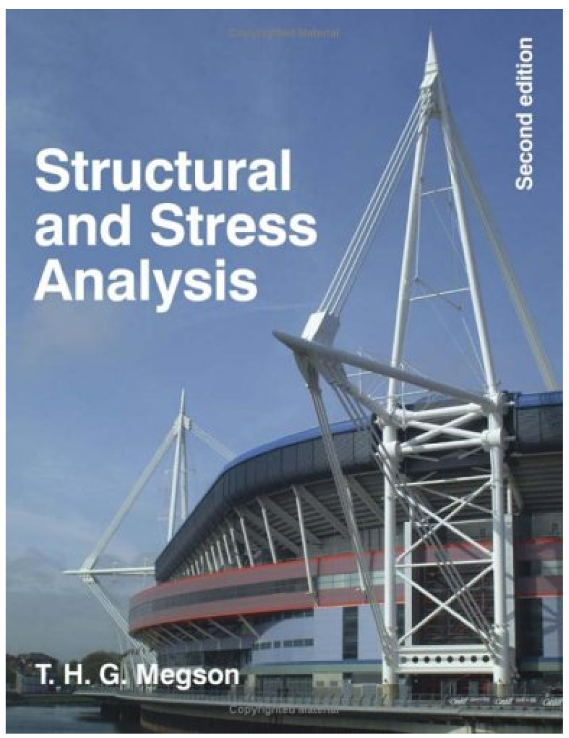
Suggested Readings

Slide 3
Introduction
It is an approximate hand calculation method for analysis of continuous beams and planar frames.
It is also known as Hardy Cross method (by Prof Hardy Cross) presented in year 1932 to speed up the slope deflection method and remedy its complexity when dealing with large structures. i.e. solving many simultaneous equations).
Its computational simplicity is praised.
In order to explain the method, the best approach is to show it through some examples.
However, we need familiarity with some concepts and terminology before we begin.

Slide 4
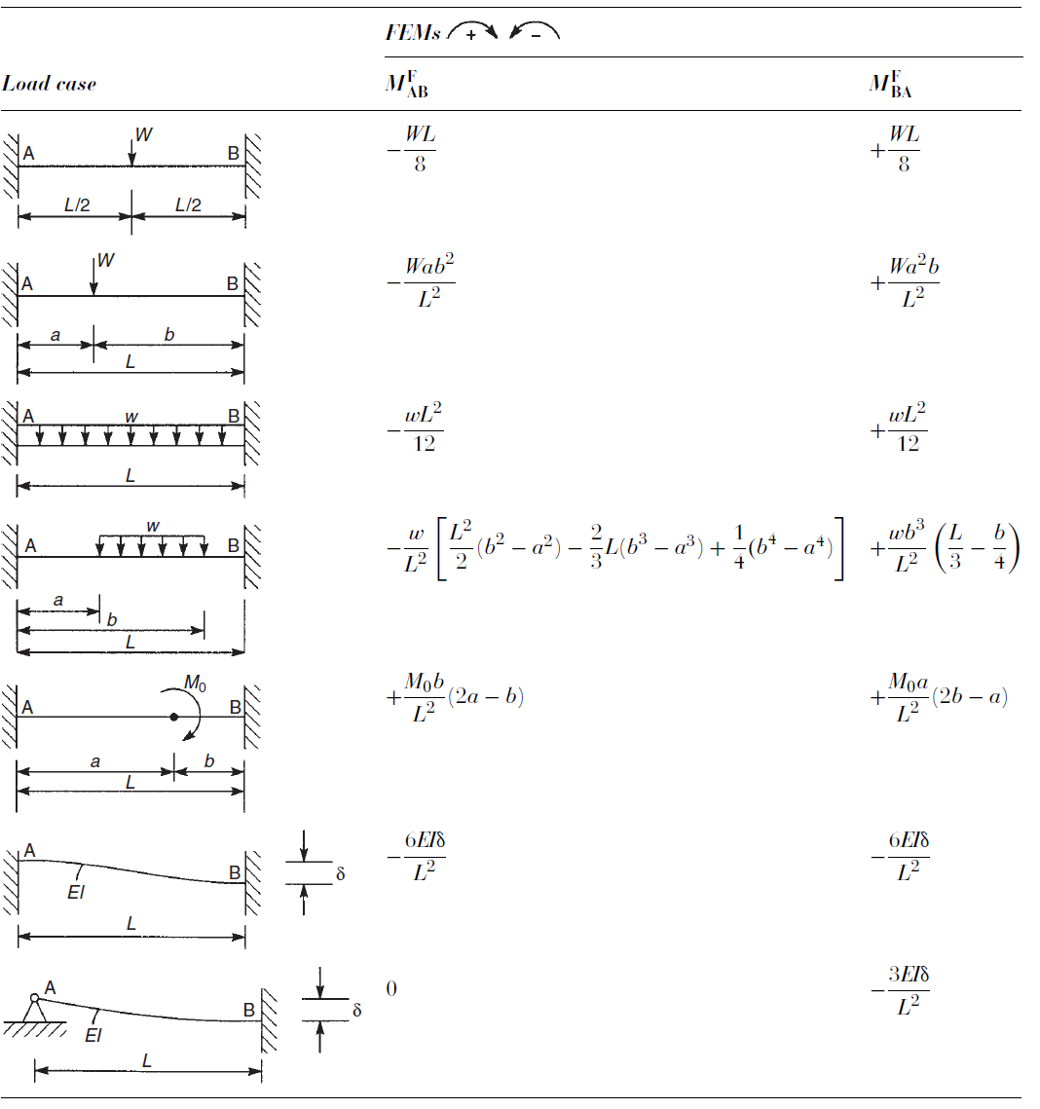
Fixed End Moments (FEM)
Bending moments at the end of beams assuming both ends are fully clamped under various loading.

Slide 5
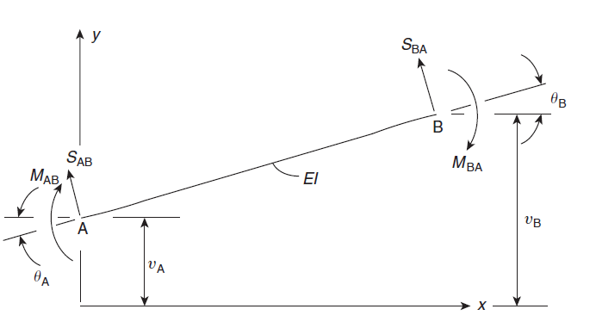
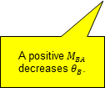
Positive sign conventions
Shear forces acting upward are positive
Effect of axial forces are neglected
Moment is positive when it is applied in clockwise sense
Positive rotations and displacements
Positive rotations and displacements
A positive $M_{BA}$ decreases $θ_{B}$.

Slide 6

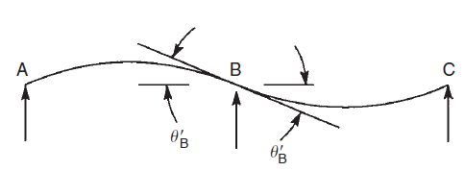
Stiffness coefficients
A moment applied at a point on a beam causes a rotation of the beam at that point, the angle of rotation being directly proportional to the applied moment
The value of K_{AB} depends on the support conditions at the end of the beam.
A positive moment reduces rotation based on previous slide
Rotational stiffness of beam AB

Slide 7
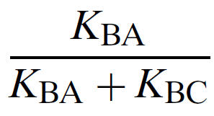
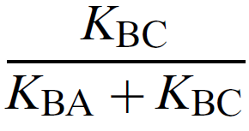
Distribution factors (DF)
Distribution factor for the left of joint B (span BA)
Distribution factor for the right of joint B (span BC)

Slide 8





Stiffness coefficients and Carry Over Factor (COF)
Fixed or clamped
Simply supported

Slide 9
Process
Assume all BCs are artificially clamped before any loading is applied (Fixed End Moment are generated)
Release the joints (net unbalancing moment is generated)
Distribute unbalanced moments to either side of the joint based on their stiffness and DFs
Carry over the unbalanced moments to the adjacent joints using COF
Repeat this for all the joints until COF becomes zero
Sum up the moments

Slide 10
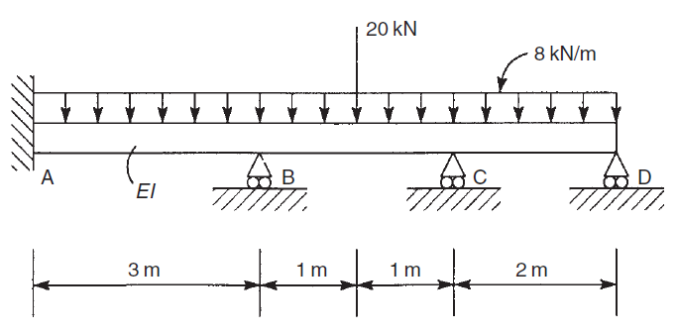
Method illustration through an example
Draw bending moment and shear force diagram of the structure below.

Slide 11
Solution
Firstly, the structure has 3 degrees of indeterminacy (6-3=3).
Number of knowns: 3 equations of equilibrium
Number of unknowns: 6 support reactions:

Slide 12
Solution
(clamping joints)
The same as slope-deflection method, we assume all joints are clamped and calculate FEMs (fixed end moments).
Fixed End Moments
Fixed End Moments

Slide 13
Solution
(releasing joints-stiffness calc-DFs)
The moment at clamped end is always balanced (infinitely stiff BC)
Final moment must be zero for simply supported BC
Distribution factor (DF)
Distribution factor (DF)
Distribution factor (DF)
Distribution factor (DF)
Distribution factor (DF)

Slide 14
Solution
(calculate unbalanced moments & distribute them)

Slide 15
Solution
(sum up moments)

Slide 16
Reaction at support locations

Slide 17
Reaction at support locations

Slide 18


Shear force diagram
+12.59
+17.38
+9.38
+5.03
-10.62
-11.41
-18.62
-10.97

Slide 19
Bending moment diagram
+7.43
+2.70
-5.42
-5.95
-7.19

Slide 20
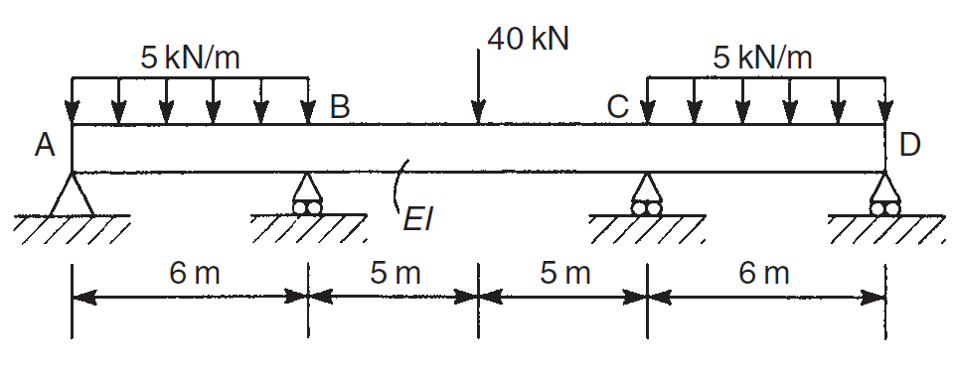
Example
Calculate internal bending moments on either sides of joints B and C for the beam shown below.

Slide 21
Solution
The structure is symmetric in terms of both the geometry and the loading.
Thus, we will use half the structure to save on computational cost.

Slide 22
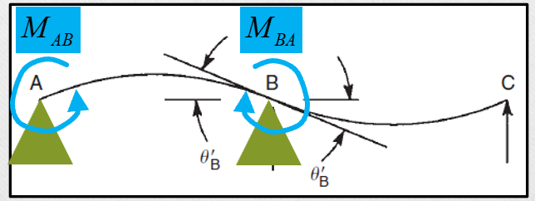
Solution
The beam is cut at mid-span and replaced with sliding clamped boundary condition. The 40kN concentrated load is replaced by 20kN, i.e. half of the original structure as we are halving the structure.
Fixed end moments are calculated as
FEM is halved as there will be no COF from B to C or vice versa

Slide 23
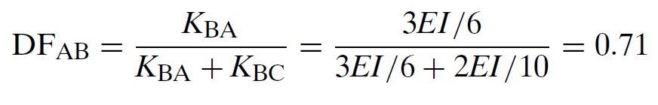

Solution
The distribution factors (DFs) are then calculated as
Case 2 of DFs
Case 3 of DFs

Slide 24
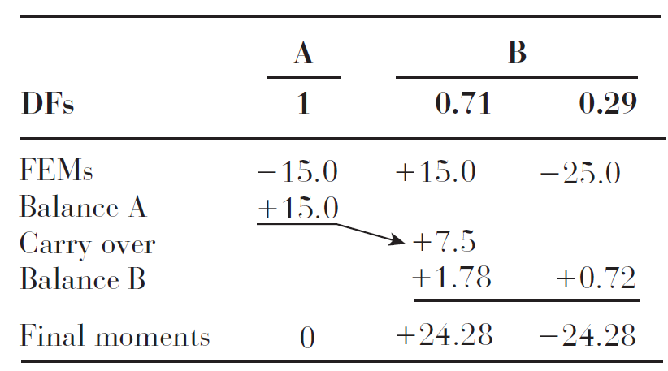
Solution
Note that by using symmetry we only balance the joint B bot needing to worry about other joint, significantly reducing the computational cost.
Out of balance moment here is
-25.00 + 15.00 + 7.50 = -2.50.
Thus, +2.50 is added and distributed to both side of the joint based on 0.71 and 0.29.
Out of balance moment here is
-25.00 + 15.00 + 7.50 = -2.50.
Thus, +2.50 is added and distributed to both side of the joint based on 0.71 and 0.29.
+15.00 * 0.5 = +7.50

Slide 25
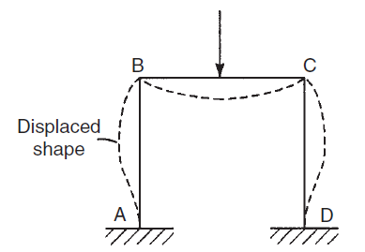
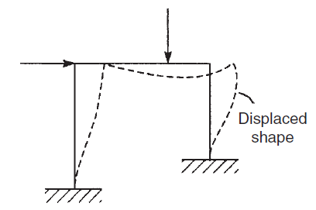
Moment distribution method for frames
Symmetric (geometry and loading)
  Joints B and C remain where they are (ignoring axial and shear deformations).
  Joints B and C are rigid so angles do not change after deformation.
Unsymmetric (either geometry or loading)
  Additional displacements takes place due to sway.
  The sway causes additional moments at the end of the members.

Slide 26
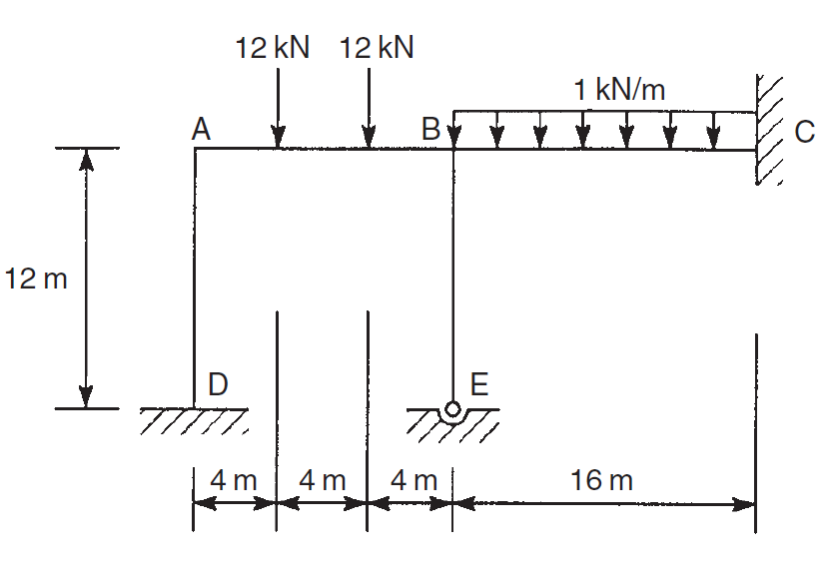
Example (symmetric geometry and loading)
Obtain the bending moment diagram for the frame shown below. Note that the flexural rigidity EI is the same for all members

Slide 27
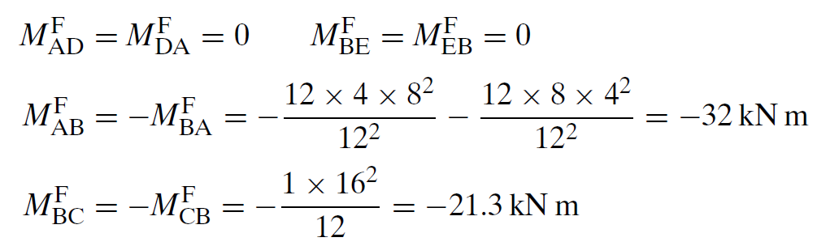
Solution
The geometry is unsymmetrical, however the horizontal member BC hinders the sway of the DABE frame.
Fixed end moments are calculated as

Slide 28
Solution (reminder)
The loading scenarios for calculation of fixed end bending moments are obtained from the highlighted cases.

Slide 29
Solution
The vertical member EB is pinned at E.
The final moment at E is zero.
We treat E as an outside pinned support, balance E initially and reduce the stiffness coefficient, K_{BE}, as before.
There is no FEM at E so that the question of balancing E initially does not arise.

Slide 30
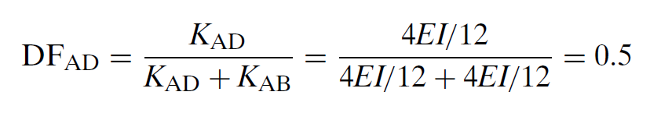
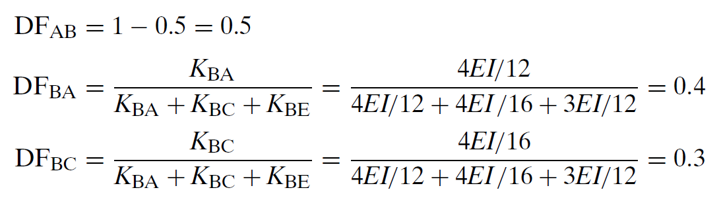

Solution
The DFs are now calculated

Slide 31
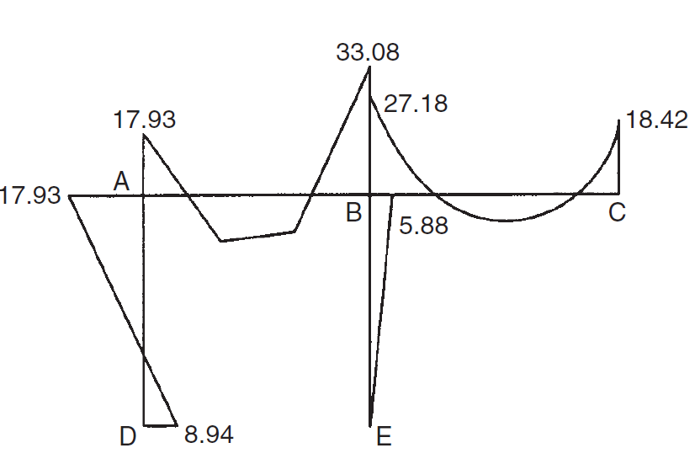
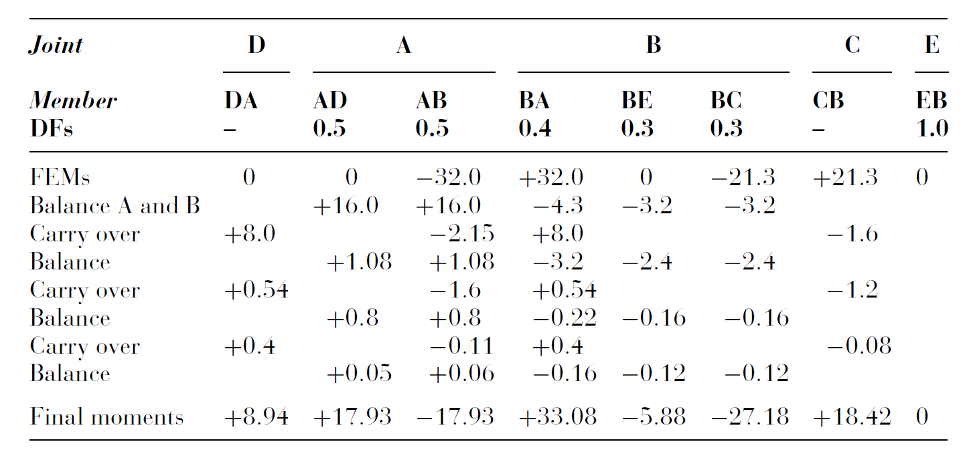
Solution
Added to make it balanced
0 - 32.00 = -32.00
+32.00 - 21.30 = +10.70
Added to make it balanced

Slide 32
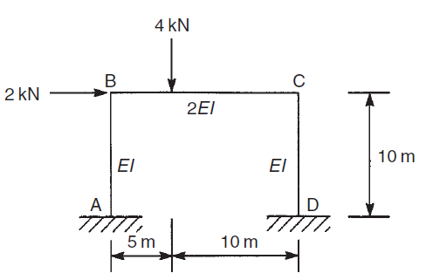
Example (Unsymmetric either geometry or loading)
Obtain the bending moment diagram for the portal frame shown. The flexural rigidity of the horizontal member BC is 2EI while that of the vertical members AB and CD is EI.

Slide 33
Solution
In such scenarios, sway (lateral displacement) of the structure takes place.
The approach is two superimpose two scenarios.
In scenario 1, the structure is constrained from sway,
In scenario 2, the sway is allowed.
Let’s see this in practice.

Slide 34
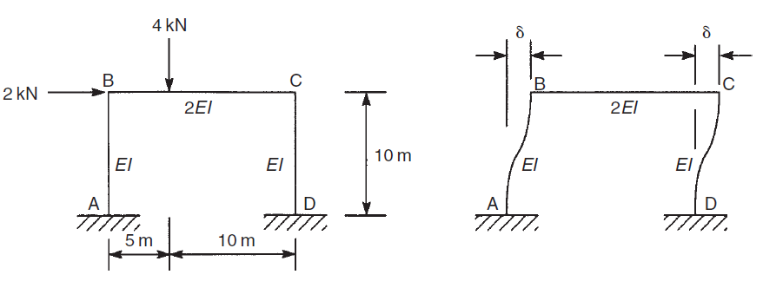
Solution
R
R
Scenario 1
  An unwanted reaction R takes place at C
Scenario 2
  Equal but opposite direction R is applied back

Slide 35
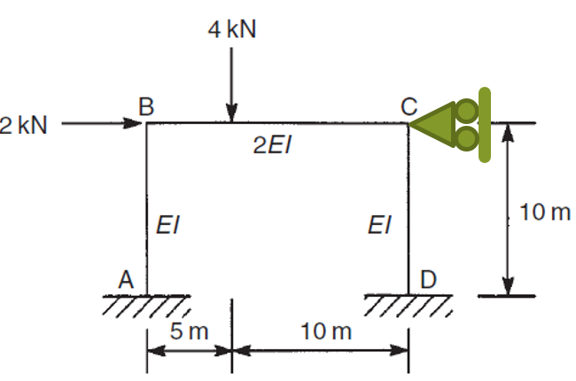
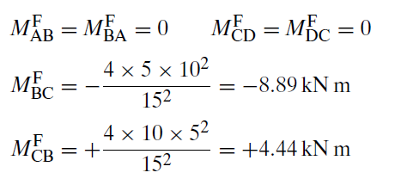
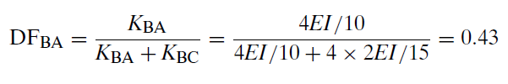

Solution (scenario 1)
Fixed end moments are as below for non-sway condition
Distribution factors (DFs) are

Slide 36
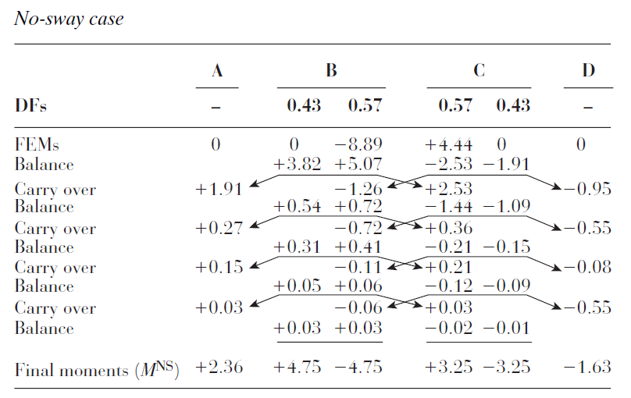
Solution (scenario 1)

Slide 37
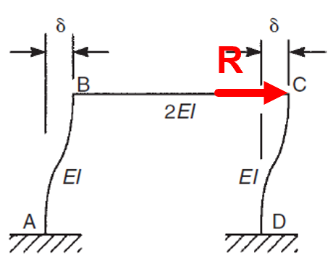
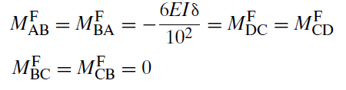
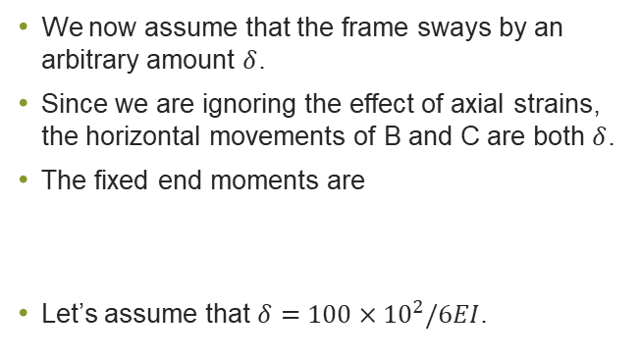
Solution (scenario 2)
We now assume that the frame sways by an arbitrary amount $δ$.
Since we are ignoring the effect of axial strains, the horizontal movements of B and C are both $δ$.
The fixed end moments are
Let’s assume that $δ=100×{10}^{2}/6EI$.

Slide 38
Solution reminder
The fixed end moments for this scenario come from the opposite table.

Slide 39
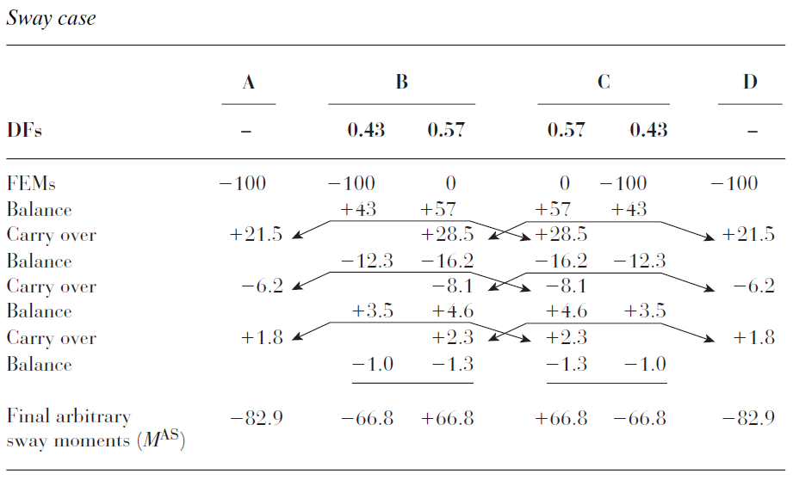
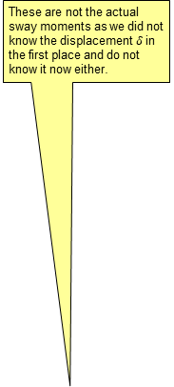
Solution (scenario 2)
These are not the actual sway moments as we did not know the displacement $δ$ in the first place and do not know it now either.
We can use these values as long as they represent the real lateral displacement of the frame. What is the solution then?

Slide 40
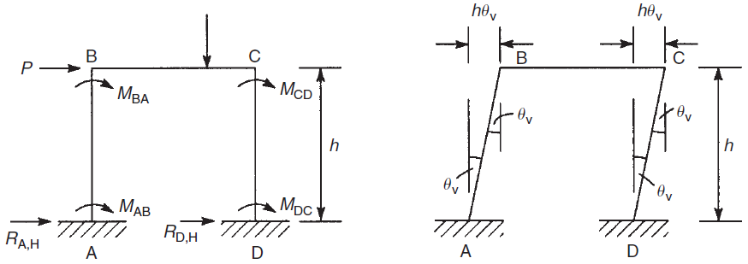

Solution (scenario 2-theory development-method 1)
Let’s do a bit of maths in a general form before embracing our problem.
Actual moment AB of the structure
Moment for non-sway case
Moment for the sway case

Slide 41



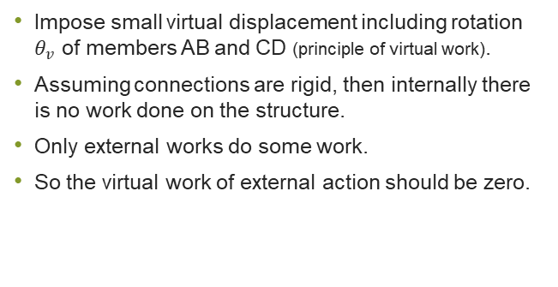
Solution (scenario 2-theory development-method 1)
Impose small virtual displacement including rotation $θ_{v}$ of members AB and CD (principle of virtual work).
Assuming connections are rigid, then internally there is no work done on the structure.
Only external works do some work.
So the virtual work of external action should be zero.
Since the problem is linear, the end moments associated to arbitrary sway needs to be multiplied by k to represent those of structure.
Since the problem is linear, the end moments associated to arbitrary sway needs to be multiplied by k to represent those of structure.

Slide 42
Solution (scenario 2-theory development-method 2)
If using potential energy approach is too difficult to comprehend then we may use the following approach (Free Body Diagrams).
The same outcome as the previous slide.

Slide 43
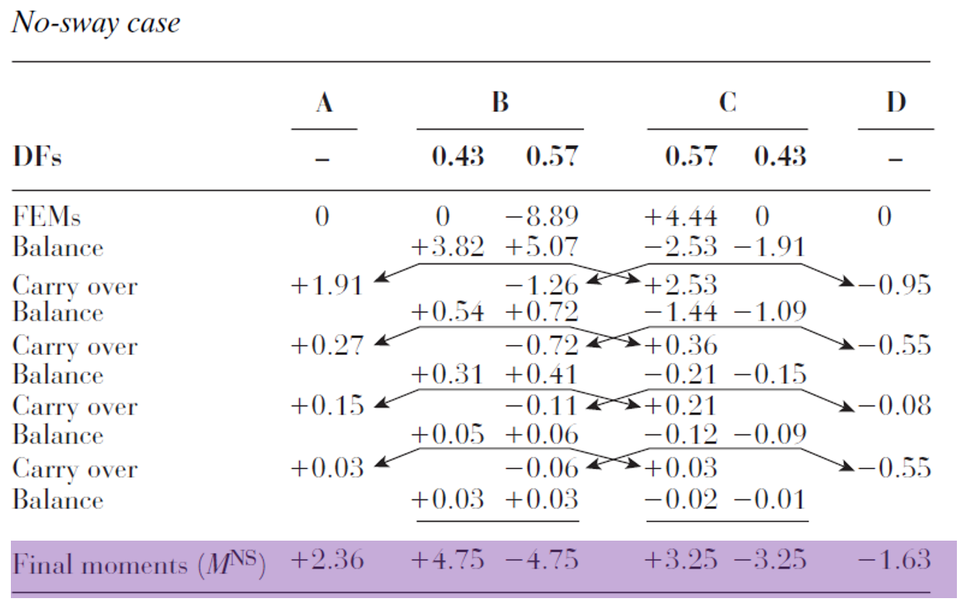
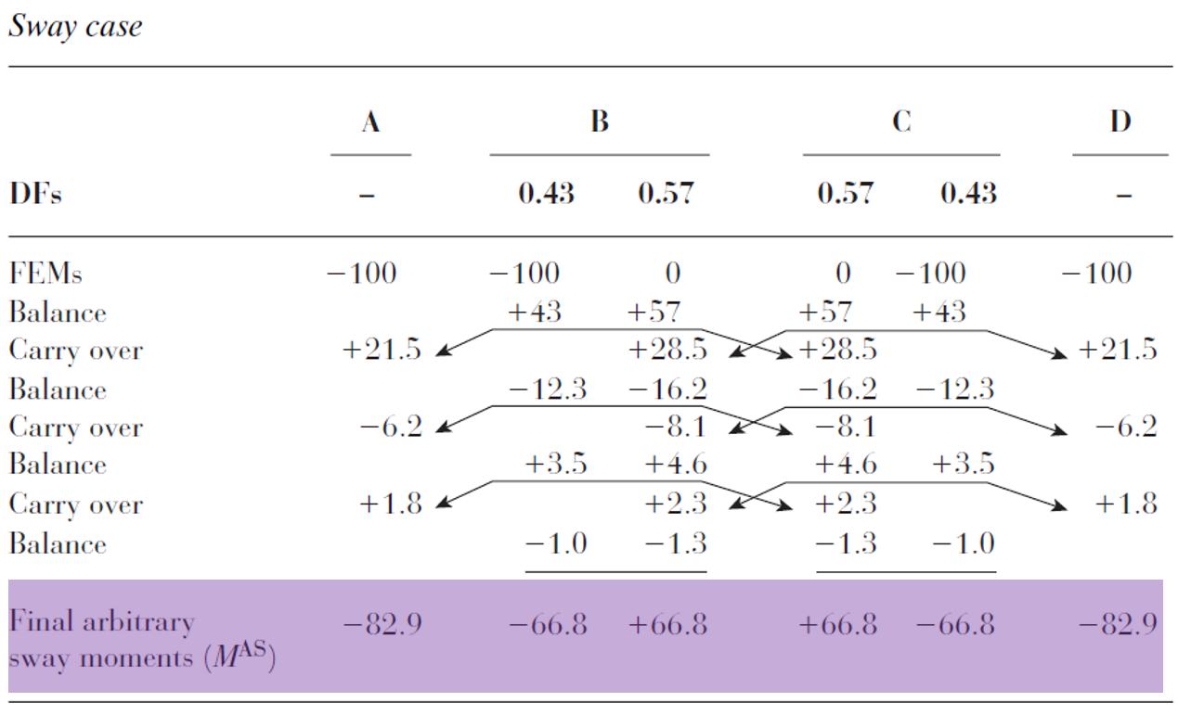

Solution
Now let’s go back to the problem at hand.
We determine k as below

Slide 44

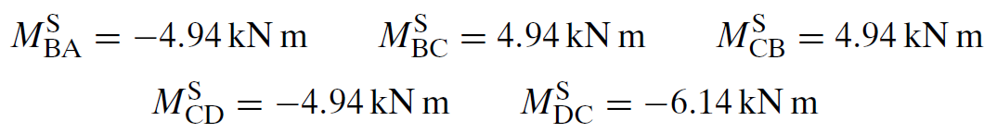
Solution
Now we can combine sway and non-sway moments to obtain the moments of the structure using coefficient k.
But before that let’s get the actual sway moments as below.

Slide 45
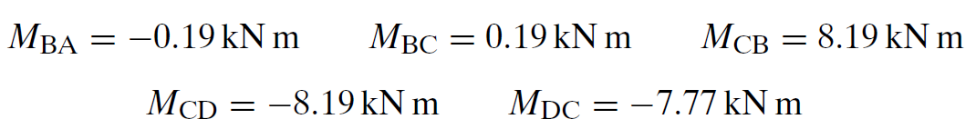
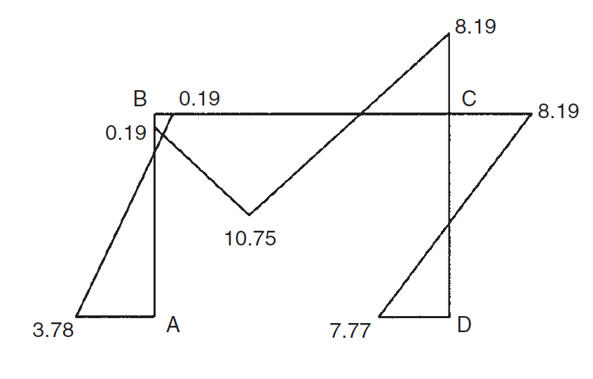
Solution
The final end moments are then as below.

Slide 46
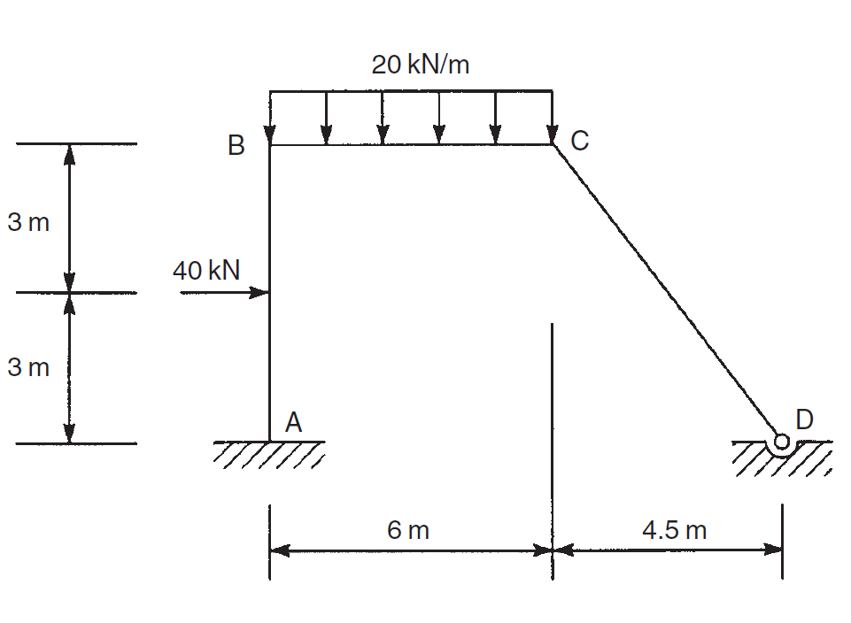
Tutorial
Calculate the end moments in the members of the frame. All members have the same flexural rigidity, EI; note that the member CD is pinned to the foundation at D.

