Slide 1
Structural Design and Inspection-Energy method
By
Dr. Mahdi Damghani
2022-2023

Slide 2
Suggested Readings
Reference 1
Reference 2

Slide 3
Objective(s)
Familiarisation with force method (flexibility method) also known as Maxwell-Mohr method;
Ability to solve indeterminate structures (most structures in the real world are indeterminate).

Slide 4
Introduction
Refer to chapter 5 of Reference 1;
Refer to chapter 4 of Reference 2;
This method is for solving indeterminate structures;
Also known by name Maxwell-Mohr method;
In this method the governing equations express compatibility requirements (deformed members must fit together) in terms of the redundant forces and component flexibilities;
Forces are determined first and then strains and displacements are found.

Slide 5
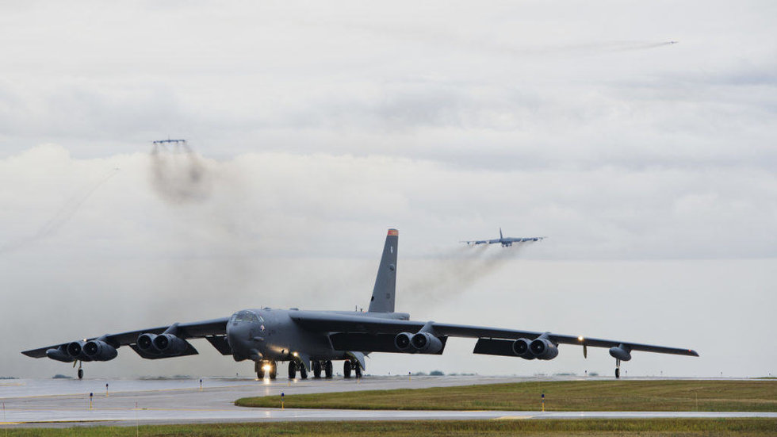
Application (B52 bomber landing)
Indeterminate structure with 1 degree of indeterminacy

Slide 6
Procedure
This method is also called force method because:
  Internal forces are found first
  Then displacements and strains are calculated
1
Determine degree of redundancy of the structure (N_{R})
2
Remove N_{R} members of the structure
3
Represent each removed member by its associated force
4
Calculate displacement for each force using unit load method
5
Apply compatibility of displacements
6
Solve a set of linear equations to calculate redundant forces
7
Calculate displacements and strains
Let’s see this in some examples
Notes:
An alternative approach to the solution of statically indeterminate beams and frames is to release the structure—that is, remove redundant members or supports—until the structure becomes statically
determinate. The displacement of some point in the released structure is then determined by, say, the unit load method. The actual loads on the structure are removed and unknown forces applied to the
points where the structure has been released; the displacement at the point produced by these unknown forces must, from compatibility, be the same as that in the released structure. The unknown forces are
then obtained; this approach is known as the flexibility method.

Slide 7
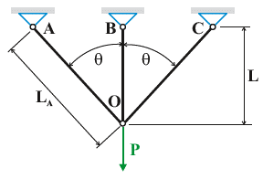
Example
Determine internal forces in the truss structure shown below. The cross-sectional area A and Young’s modulus E are the same for all members.

Slide 8
Solution
Is the structure determinate or indeterminate?
What is the degree of redundancy?
  3 members (m)
  6 reaction forces (r)
  4 joints=8 equilibrium equations (2j)
1
2
3
At each node we have:
N_{R}=m+r-2j=1

Slide 9
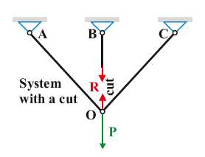
Solution
The redundant member is removed;
The redundant member is replaced by a force R;
Now the structure is determinate and can be solved under two forces P and R.

Slide 10
Solution
A
B
C
O
R
P
O
1
R
P
O
1
2
3
2
3

Slide 11
Solution
O
A
C
A
C
O
F_{A}
θ
F_{C}
f_{A}
θ
f_{C}
O
O
P
1
F_{A} | F_{C} | f_{A} | f_{C} | F_{A}f_{A}L/EA | F_{C}f_{C}L/EA

Slide 12
Solution
A
C
A
C
R
1
F_{A}
F_{C}
f_{A}
f_{C}
R
1
O
O
F_{A} | F_{B} | F_{C} | f_{A} | f_{B} | f_{C} | F_{A}f_{A}L/EA | F_{B}f_{B}L/EA | F_{C}f_{C}L/EA

Slide 13
Solution
A
B
C
R
θ
O
P

Slide 14
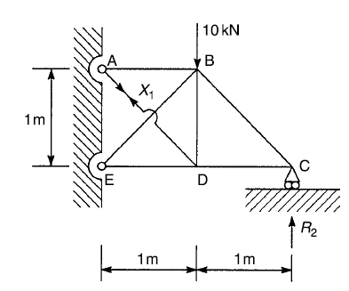
Example
Calculate the forces in the members of the truss. All members have the same cross-sectional area A and Young’s modulus E.

Slide 15
Solution
How many degrees of redundancy are in the structure?
  m=7
  r=5
  j=5
1
7
2
5
6
4
3
N_{R}=m+r-2j=2

Slide 16
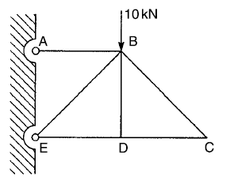
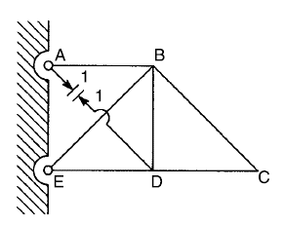
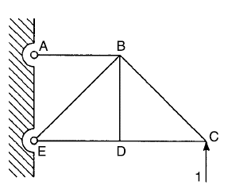
Solution
1
2
3
4
X₁
X₁
R₂

Slide 17

Solution
2
3
4
X₁
X₁
R₂

Slide 18
Solution (Displacement for configuration 2)
2
F=10
f=-0.71
1
-14.14
1
0
0
0
1
-0.71
0
0
-0.71
0

Slide 19
Reminder (method of joints to solve truss structure)
2
10
B
C
-14.14
0
0
0
D
0
C
D
B

Slide 20
Solution (Displacement for configuration 3)
3
X₁
X₁
F=-0.71X₁
f=-0.71
X₁
1
X₁
0
1
0
X₁
-0.71X₁
1
-0.71
-0.71X₁
0
-0.71
0

Slide 21
Solution (Displacement for configuration 4)
4
R₂
F=-2R₂
f=-0.71
1
1.41R₂
-1.41R₂
1
0
0
1
-0.71
R₂
R₂
-0.71
0
R₂

Slide 22
Solution
Therefore, our first linear equation becomes;
Now we need another equation to solve two unknowns X₁ and R₂;
This time we make sure vertical displacement at node C becomes zero.

Slide 23
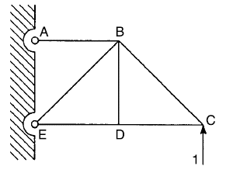
Solution
2
F=10
f=-2
-14.14
0
0
1.41
0
-1.41
0
0
1
1

Slide 24
Solution
3
X₁
X₁
F=-0.71X₁
f=-2
X₁
X₁
0
1.41
0
-1.41
X₁
-0.71X₁
-0.71X₁
0
1
1

Slide 25
Solution
4
R₂
F=-2R₂
f=-2
1.41R₂
-1.41R₂
1.41
0
-1.41
0
R₂
R₂
1
1
R₂

Slide 26
Solution
Hence, our second linear equation becomes;
Now by solving the two linear equations simultaneously;

Slide 27
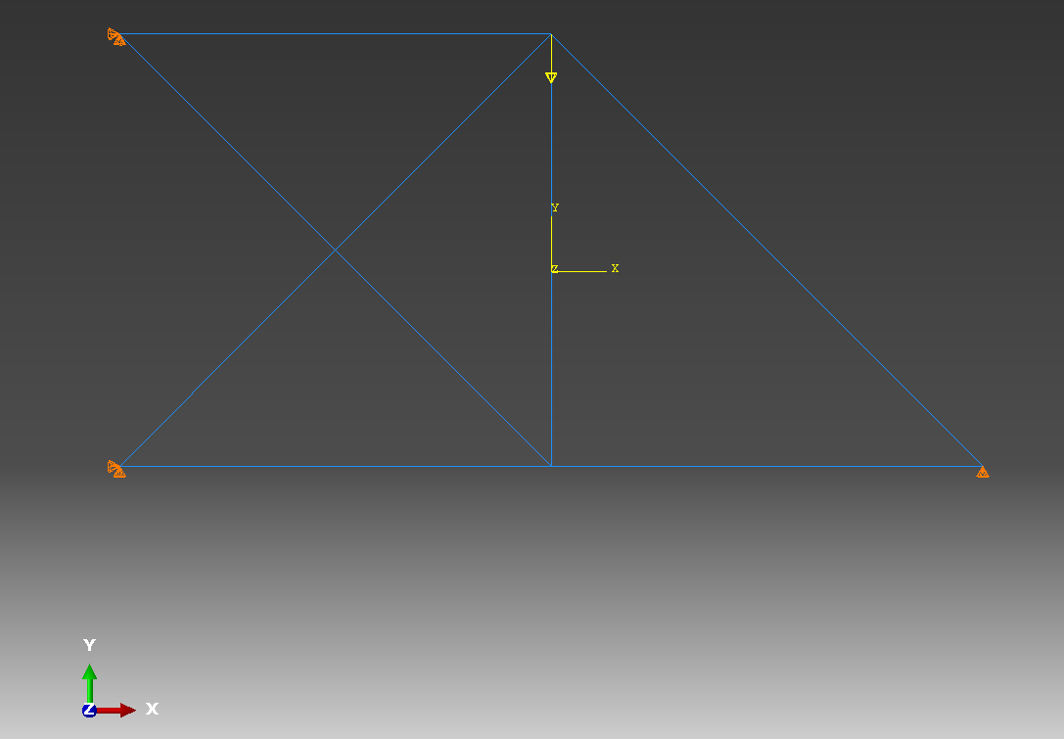
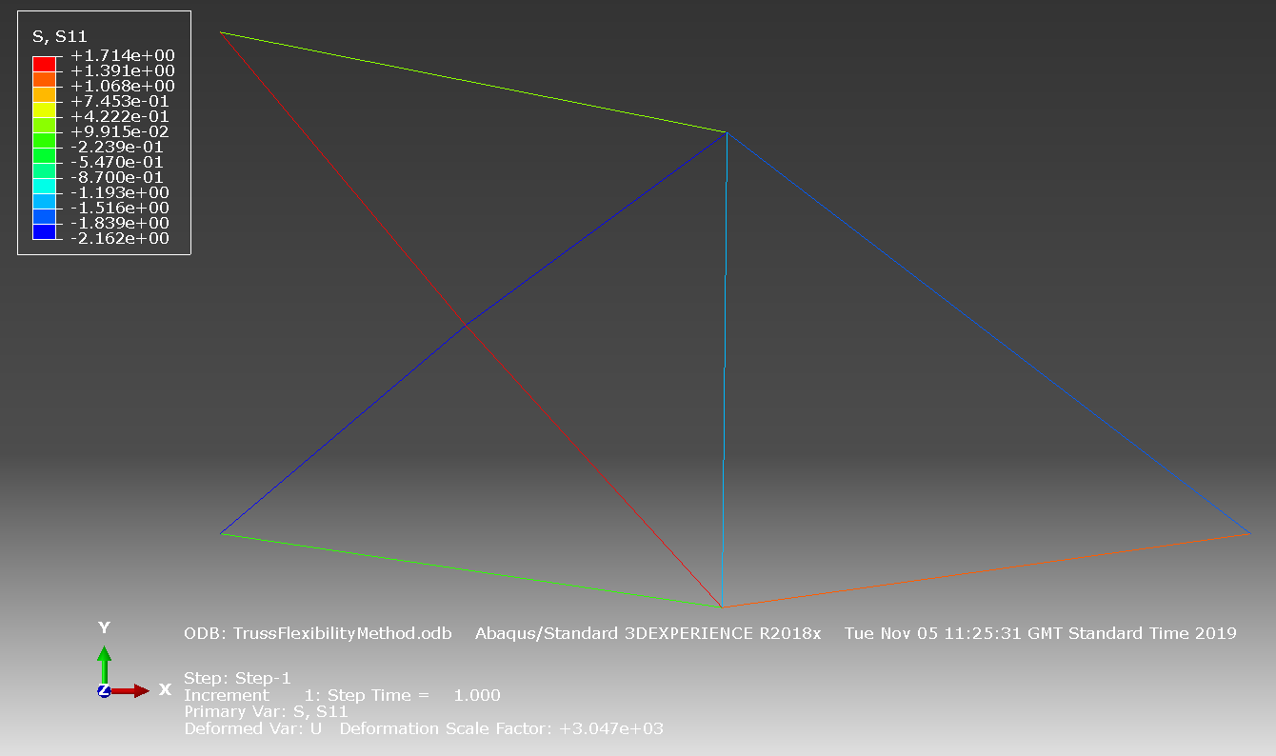
FEA results (units are in N and mm)
Geometry, Loading and BCs

Slide 28
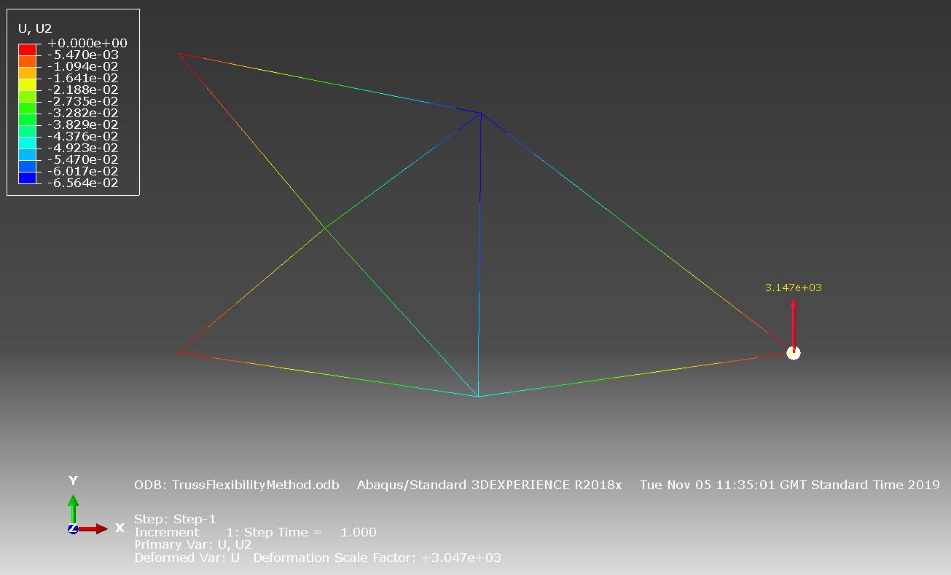
FEA results (units are in N and mm)
Reaction force in N at the far right end

Slide 29

Example
Determine the reactions of the continuous beam in the beam structure below, using force method.
w
A
B
C
L
L

Slide 30
Solution
Is the structure determinate or indeterminate?
What is the degree of indeterminacy?
3 equations (knowns)
4 reactions (unknowns)
w
A
B
C

Slide 31
Solution
I intentionally choose support at B as the redundant;
The released structure is then loaded by redundant member;
Vertical displacement at B must be zero.
w
A
B
C
R_{B}=X_{B}
R_{A}
R_{C}

Slide 32
Solution
To determine redundant, we superimpose deflection due to external load and a unit value of the redundant multiplied by the magnitude of redundant X_{B}.
w
A
C
wL
wL
C
A
B
0.5
1
0.5

Slide 33
Solution
w
A
C
wL
wL
C
A
B
-0.5
1
-0.5

Slide 34
Solution
w
A
C
wL
wL
C
A
B
-0.625wL
X_{B}
-0.625wL

Slide 35
Solution
w
A
B
C
(3/8)wL
(5/4)wL
(3/8)wL
Shear
(5/8)wL
(3/8)wL
(-5/8)wL
(-3/8)wL

Slide 36
Solution
w
A
B
C
(3/8)wL
(5/4)wL
(3/8)wL
Moment
(9/128)wL²
(9/128)wL²
(-1/8)wL²

Slide 37
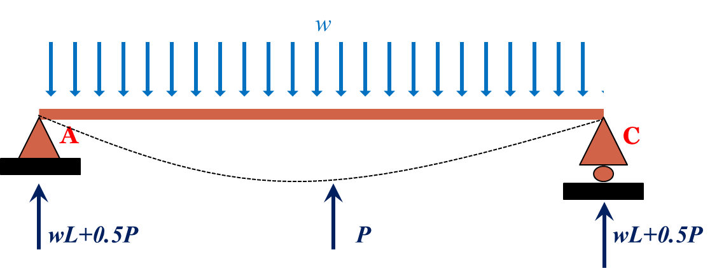
Let’s see the solution using TPE

Slide 38
Example
Analyse three span beam given below. Assume that EI is constant L=9m and w=20kN/m.
w
A
B
C
D
L
L
L

Slide 39
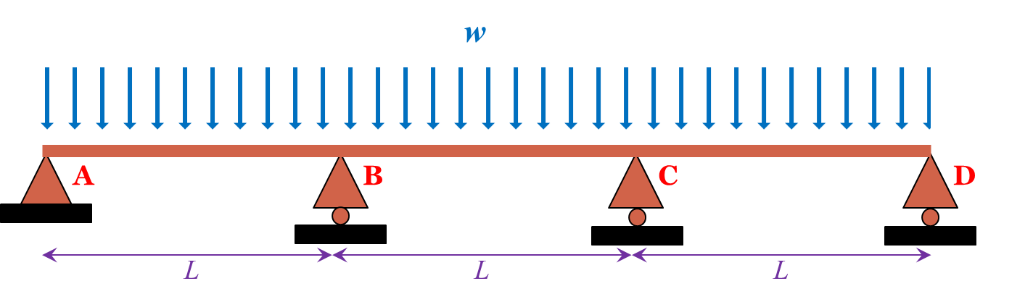
Solution
The beam in indeterminate to the second degree;
Let’s remove supports at B and C;
Find deflection in the structure due to X₁ and X₂;
See the next slide.

Slide 40
Solution
w
A
B
C
D
A
B
C
D
A
B
C
D

Slide 41
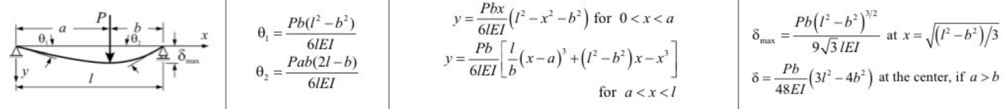
Solution (note)
Displacement values in the previous slide were obtained from the following table as opposed to calculating them directly;

Slide 42
Solution
Then the remaining reactions are determined as;
W=20kN/m
A
B
C
D
9m
9m
9m

Slide 43
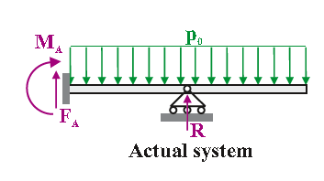
Example
How do you solve the following?

Slide 44
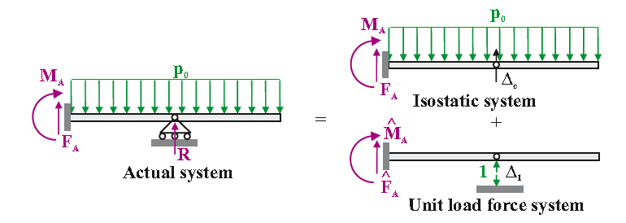

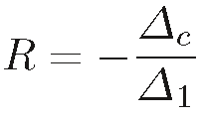
Solution

Slide 45
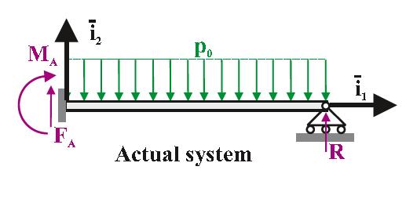
Example
How about this one?

Slide 46
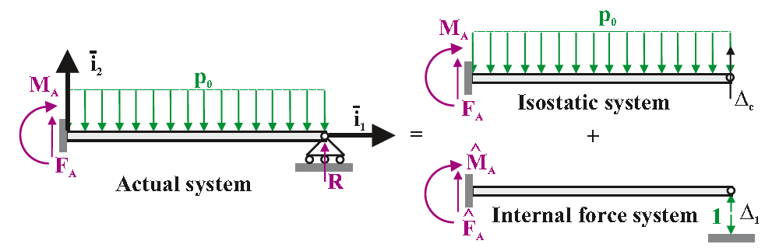

Solution

Slide 47
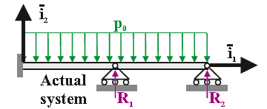
Example
How about this one?

Slide 48
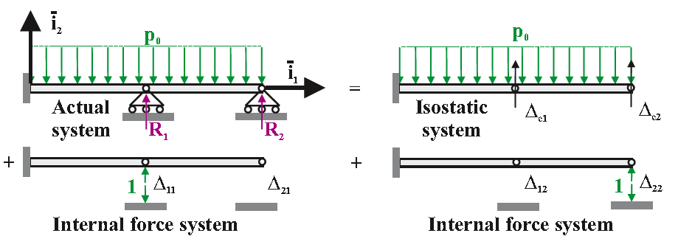
Solution

Slide 49
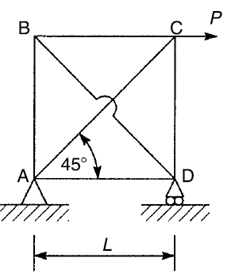
Tutorial 1
Determine member forces and reaction at supports of truss structure shown below. EA is constant for all members.

Slide 50
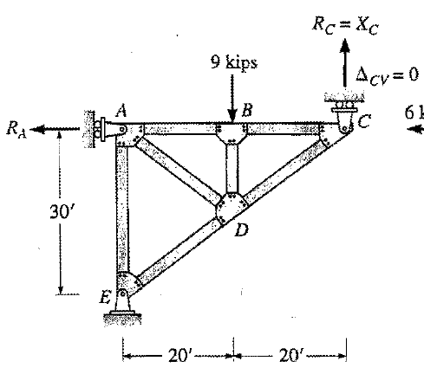
Tutorial 2
Determine forces in the truss structure shown below. EA is constant for all members.

Slide 51
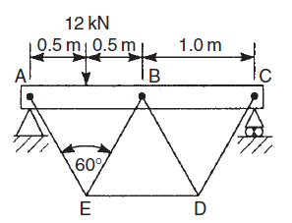
Tutorial 3
The beam ABC shown in Figure is simply supported and stiffened by a truss whose members are capable of resisting axial forces only. The beam has a cross-sectional area of 6000mm² and a second moment of area of 7.2×106 mm⁴. If the cross-sectional area of the members of the truss is 400mm², calculate the forces in the members of the truss and the maximum value of the bending moment in the beam. Young’s modulus, E, is the same for all members.

Slide 52
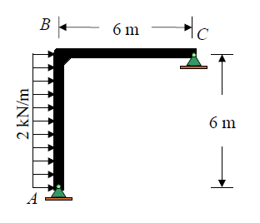
Tutorial 4
Draw the quantitative shear and moment diagram and the qualitative deflected curve for the Frame shown below. EI is constant.

