Slide 1
Structural Design and Inspection-Finite Element Method (Trusses)
By
Dr. Mahdi Damghani
2022-2023

Slide 2

Suggested Readings
Reference 1
Reference 2

Slide 3
Objective(s)
Familiarisation with Finite Element Analysis and Methods (FEA) of truss elements;
Familiarity with the concepts of local and global stiffness matrices, strain matrix, shape functions, force matrix, displacement matrix etc;
Ability to assemble global stiffness matrix for a truss shape structure;
Familiarisation with Finite Element Modelling (FEM) of truss structures using ABAQUS CAE (Tutorial).

Slide 4
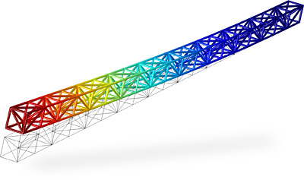
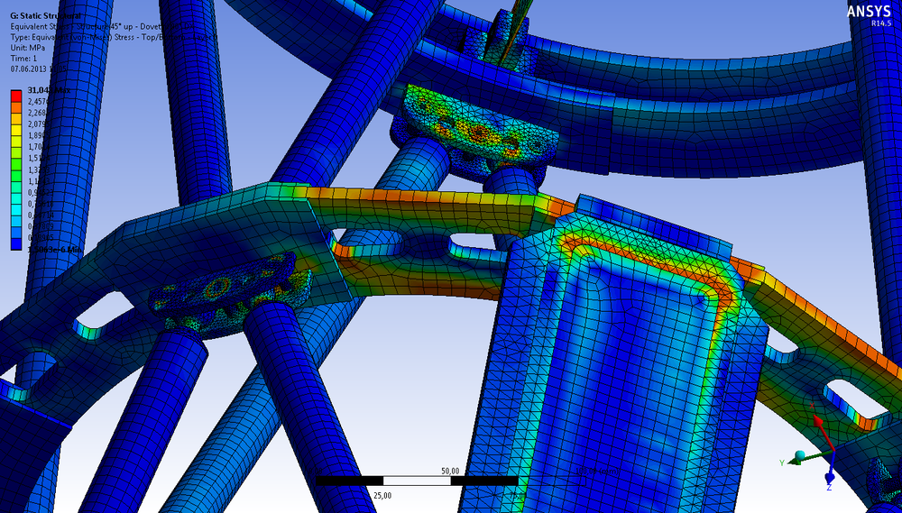
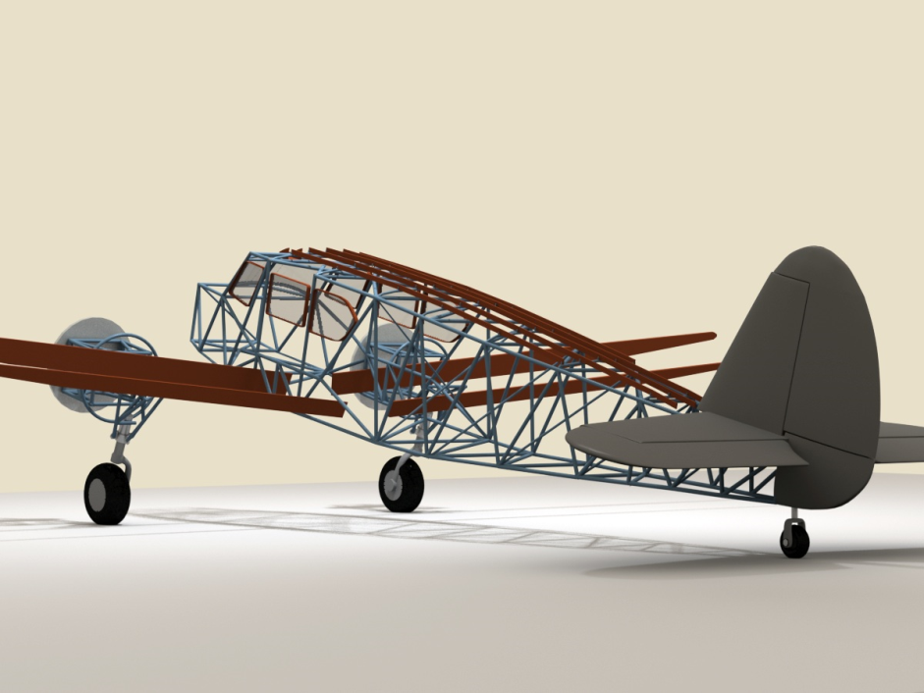
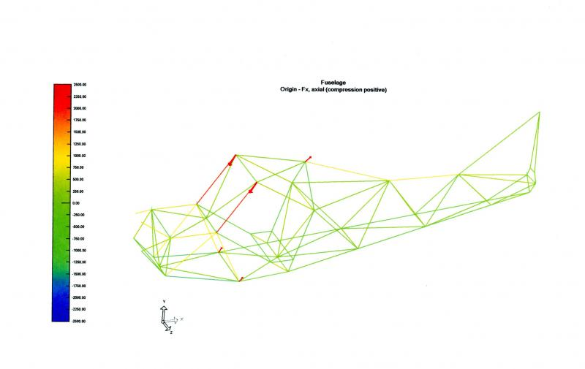
Introduction

Slide 5
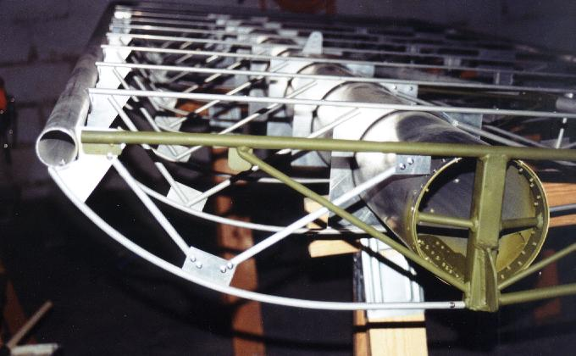
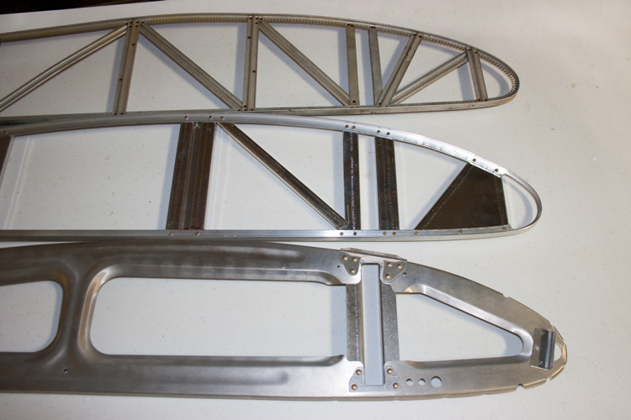
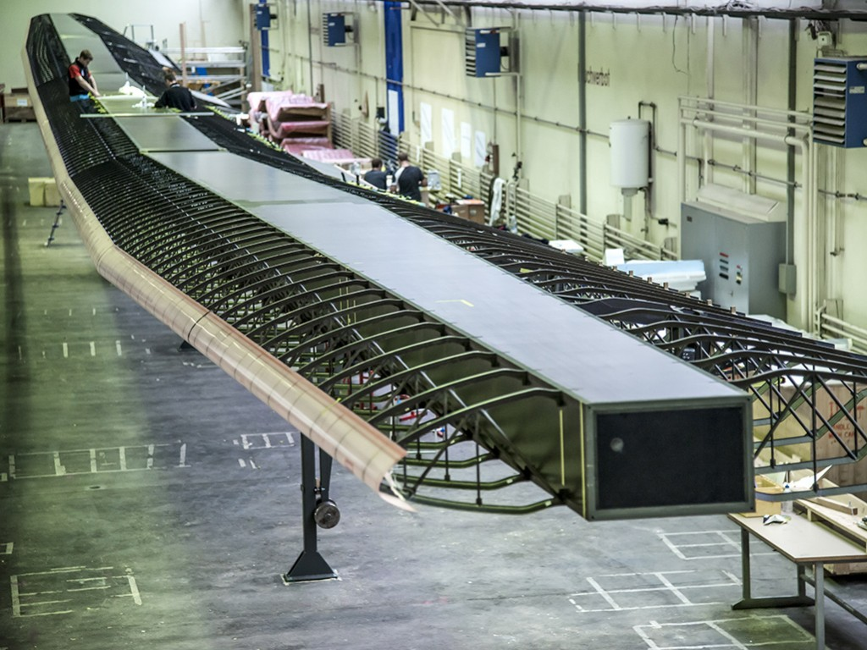
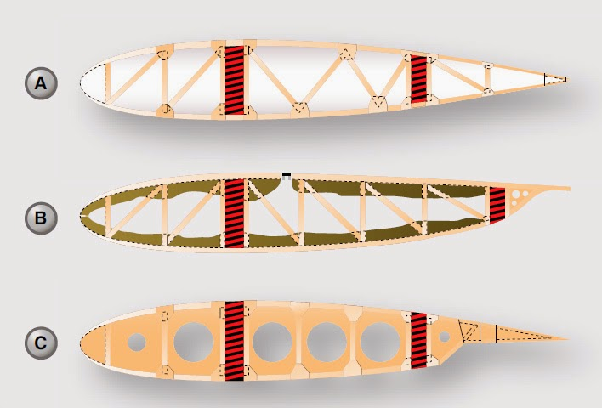
Introduction
Solar Impulse 2

Slide 6
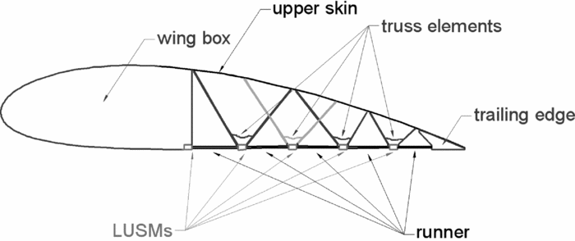
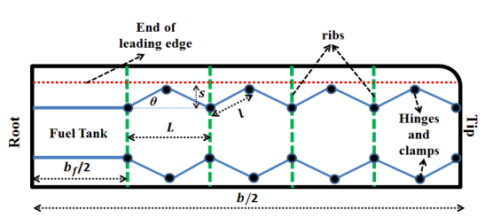
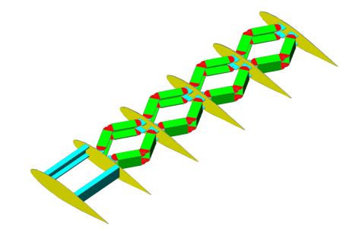
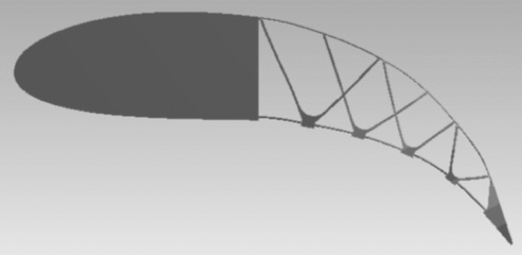
Introduction
Camber morphing wing and truss structural system
Span morphing wing and truss structural system (zig zag wing)
Notes:
A morphing aerofoil with highly controllable aerodynamic performance
The Aeronautical Journal, Volume 121, Issue 1235
January 2017 , pp. 54-72
R. Wu ^{(a1)}C. Soutis ^{(a2)}S. Zhong ^{(a1)}A. Filippone ^{(a1)}

Slide 7
Introduction
Refer to chapter 6 of Reference 1;
Refer to chapter 4 of Reference 2;
This method is used in most of commercially available FE based software to solve structural problems;
Some typical software in aerospace industry are;
  Altair HyperWorks (mostly for optimisation purposes)
  MSC Nastran (mostly for linear analysis)
  Abaqus (mostly for non-linear analysis)
  Ansys (mostly for non-linear analysis)

Slide 8
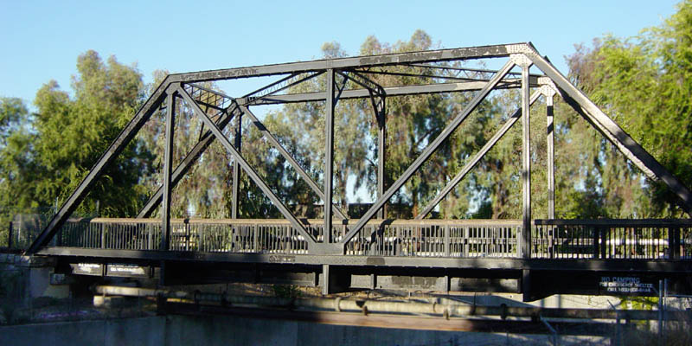
Note
Consider a truss structure, pin jointed, having a number of truss or bar members carrying axial load only;
Each member can be called as a truss/bar element of a uniform cross section bounded by two nodes, i.e. n_{d}=2.

Slide 9
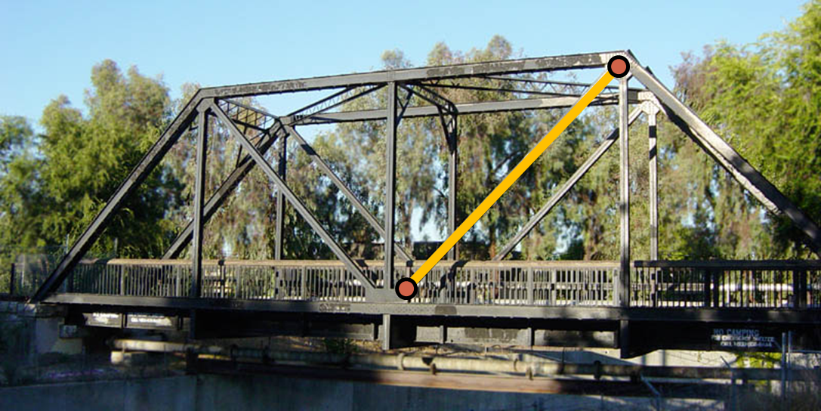
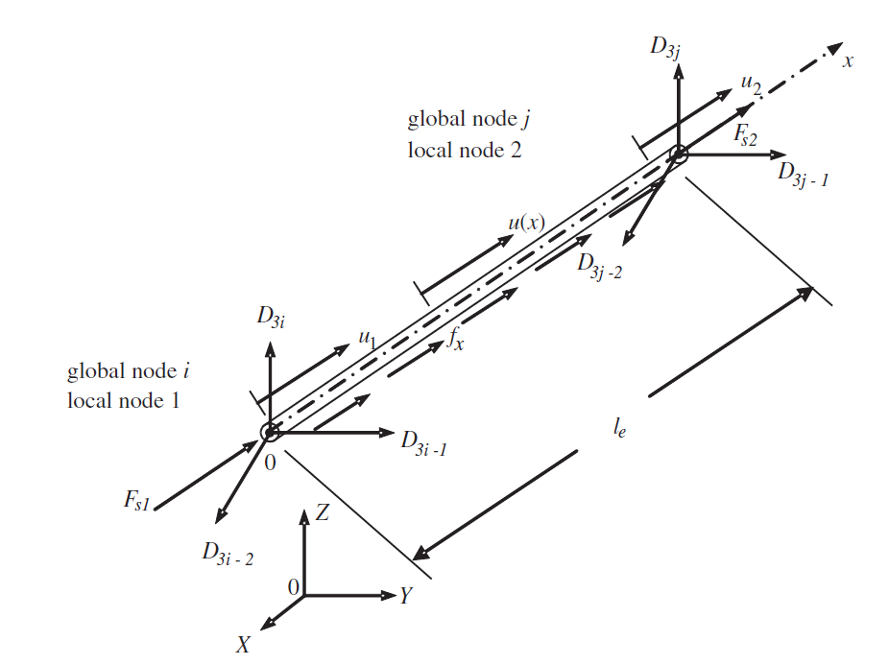
2D/3D truss element
Local coordinate system with origin at node 1 which is aligned to the member
Node 2 has only 1 DOF (axial) in local system
Node 1 has only 1 DOF (axial) in local system
The length of element
Therefore, this truss element has 2 DOFs in total
Global coordinate system

Slide 10
The Finite Element Analysis (FEA) process
Construction of Shape Functions
Calculation of Strain Matrix
Construction of Element Stiffness/Mass/Force Matrices in Local Coordinate System
Forming Global Stiffness/Mass/Force Matrices in Global Coordinate System

Slide 11
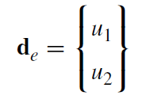
Displacement in FEM
In finite element methods, the displacement for an element is written in the form;
Approximated displacement within the element
Shape function
Vectors of displacements at the two nodes of the element
This function approximates displacements within the element by just having displacements at the two nodes, i.e. d_{e}.
Question:
What should be N(x)???

Slide 12
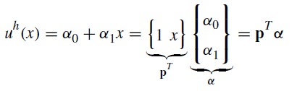
Shape function
If we assume the axial displacement in the truss element is linear;
It can be approximated as below;
Vector of polynomial basis functions
Two unknowns in the form of 2x1 matrix
This matrix is 1x2 because we have a 2 DOF element

Slide 13
Reminder from maths
The multiplication of a 1x2 matrix by 2x1 matrix is a 1x1 matrix or a scalar value;

Slide 14
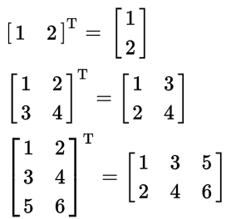
Reminder from maths
Transpose of matrix A is shown as A^{T};

Slide 15
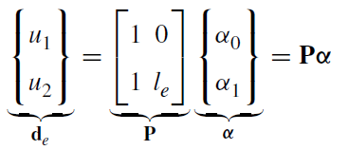

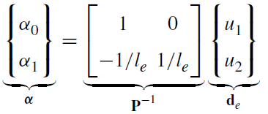
Shape function
In order to construct the shape function, boundary conditions must be met;
Inverting the matrix

Slide 16
Note
How did the following come about?
Reason;

Slide 17
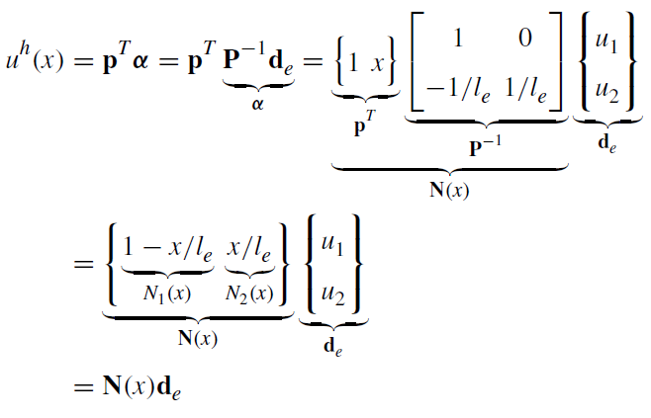
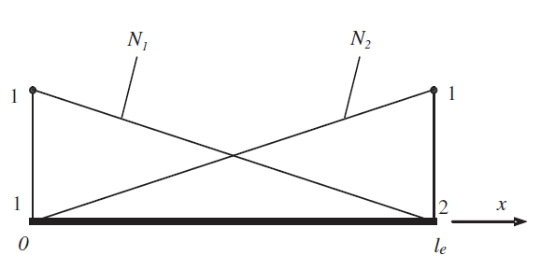

Shape function for the truss element
We have 2 shape functions because the element has 2 DOFs
N₁ is contribution of node 1 to the overall displacement of element and is unit at node 1
N₂ is contribution of node 2 to the overall displacement of element and is unit at node 2

Slide 18
Note
Since the shape functions bring about linear change of displacements within the element, these elements are called Linear Element.

Slide 19

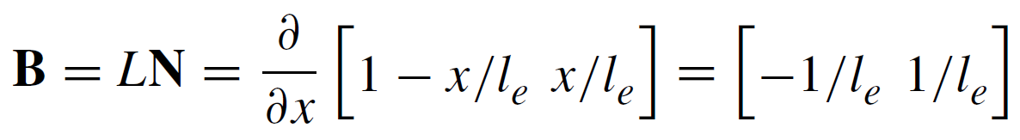
Strain calculation
B is called strain matrix
L is differential operator

Slide 20
Reminder

Slide 21

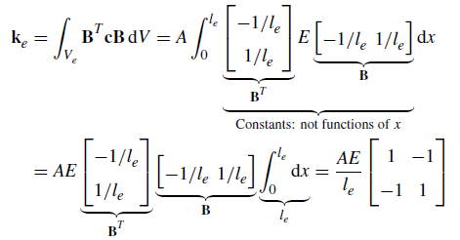
Element local stiffness matrix
Element stiffness matrix
(see chapter 3 of Ref. 2)
E is modulus of elasticity (material constant)
A is cross sectional area

Slide 22
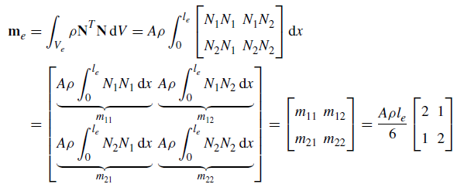
Elements mass matrix
Following similar procedure as stiffness matrix;
  Students are advised to familiarise themselves with chapter 3 of ref. 2

Slide 23
Nodal forces
Note that in FEA, body forces are always transferred to the nodes
Surface force (applied at the node 1)
Surface force (applied at the node 2)
Body forces (applied between nodes)

Slide 24
Global stiffness matrix
A structure is comprised of lots of members and each member consists of a set of elements;
So far, we got stiffness matrix of each element in its local coordinate system;
Now the challenge is;
  To convert stiffness matrix of each element from local to global coordinate system;
  Assemble global stiffness matrix of each element into global stiffness of the entire structure.

Slide 25
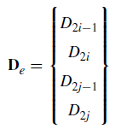

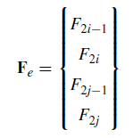
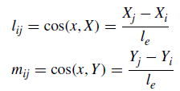
Global stiffness matrix
1, 2 is the node ID in local system
i, j is the node ID in global system
x is the axial direction of element

Slide 26
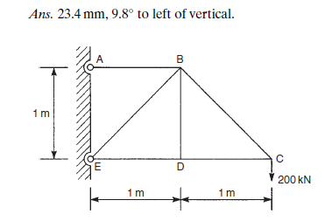
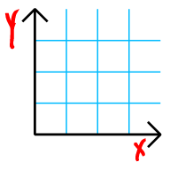
Demonstration
Look at element 4
5
5
4
4
2
Node numbering in global system
Node numbering in local system
6
4
3
x
α
2
1
1
1
2
2
3
Cosα
Sinα

Slide 27
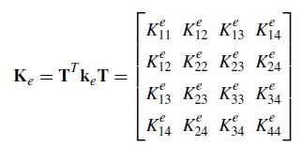
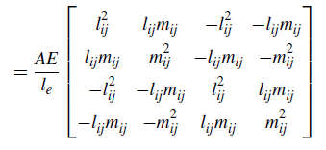
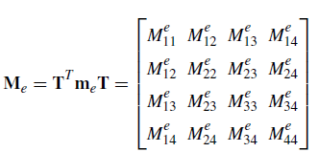
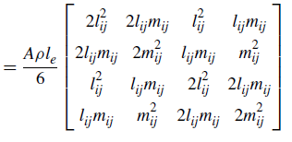
Global stiffness matrix

Slide 28
Summary in global system
We know for springs;
Using similar concept for truss elements we have (in global system);
Node i
Node j
Node i
Node j

Slide 29
Note
Node i
Node j
Node i
Node j

Slide 30

Recover stresses/strain
Therefore in FEA, the entire structure is discretised into elements;
Displacements at nodes are calculated;
Then strains within elements are obtained;
Then stresses within elements are obtained.

Slide 31
Tutorial 1a
follow instructions in “T1a.pdf” document to familiarise yourself with Abaqus CAE.

Slide 32
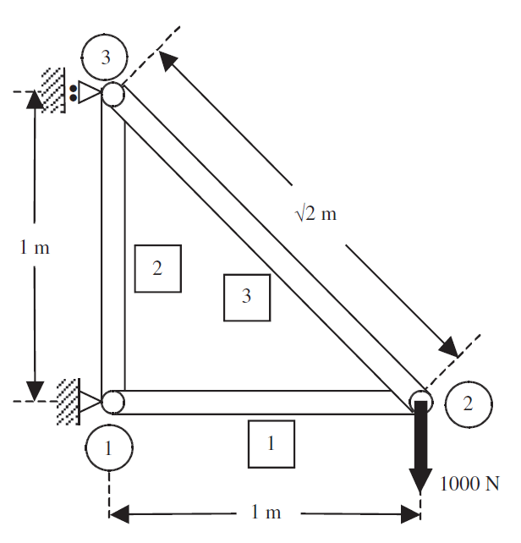
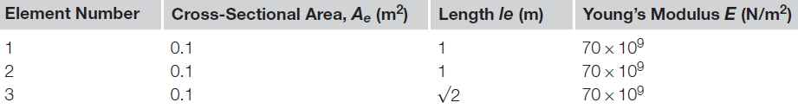
Tutorial 1b
Consider the plane truss structure. Obtain;
  Nodal displacements
  Forces in each member
  Stresses in each member
  using FEA and record them for the next lecture session.
  Assume Poisson’s ratio of 0.3

Slide 33
Summary of last lecture
Element stiffness in local system;
Element stiffness in global system;
Element strains;
Element stresses;
Converting local displacements to global ones;

Slide 34
Summary of last lecture
Linear shape function to approximate inter-nodal displacements.

Slide 35
Example
Consider a bar of uniform cross-sectional area. The bar is fixed at one end and is subjected to a horizontal load of P at the free end. The dimensions of the bar are shown in the figure, and the bar is made of an isotropic material with Young’s modulus E.

Slide 36

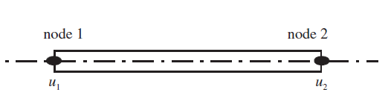
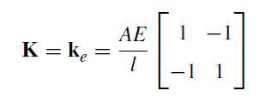
Solution
We know that the exact solution for this simple example is:
Now let’s see how Finite Element Method (FEM) deals with such problems;
Modelling the structure with one element only

Slide 37
Solution
y
Y
x
X
No transformation of stiffness matrix is required as local (xy) and global coordinate (XY) system are the same;
There is no need for assembling stiffness matrix as only one element is used.

Slide 38
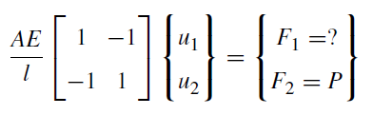
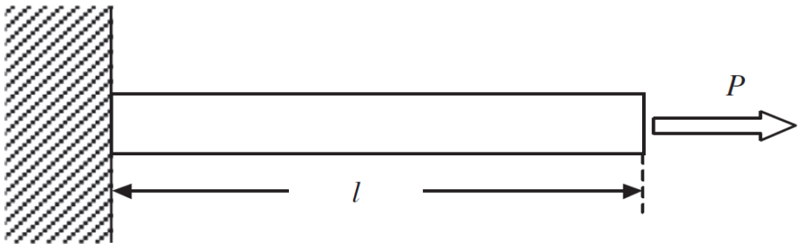




Solution
1
2
We do not know F₁ , however it is not important as this is on the boundary. What we know is:
Therefore;
Rows and column of nodes with zero displacement are omitted

Slide 39
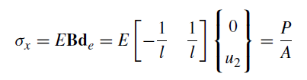
Solution
Stress in the bar is then calculated as;
This was a very simple example showing the process now let’s look at a more practical and challenging example.

Slide 40
Example
Consider the plane truss structure. Obtain stresses in each element using FEA.

Slide 41
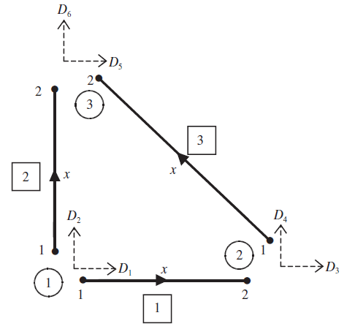
Solution
Counter-clockwise node numbering
Y
X
Global node numbers in circles
Element numbers in squares
Structure global coordinate system
Element local coordinate system
As a good practice, use node numbering strategy such as anti-clockwise direction (in this example) as for large problems this saves both computational and memory storage costs.
In the global system each node has two DOFs (as denoted by D_{i}), whereas in local system each element has only one DOF.

Slide 42
Note
Good node numbering leads to computational saving;
Most commercial software have in-built optimiser (bandwidth minimising algorithm) that optimises node numbering prior to assembling global stiffness matrix to reduce solution time;
For 2D problems and hand calculation use counter-clockwise node numbering scheme;
For computer simulation you do not need to worry about this.

Slide 43
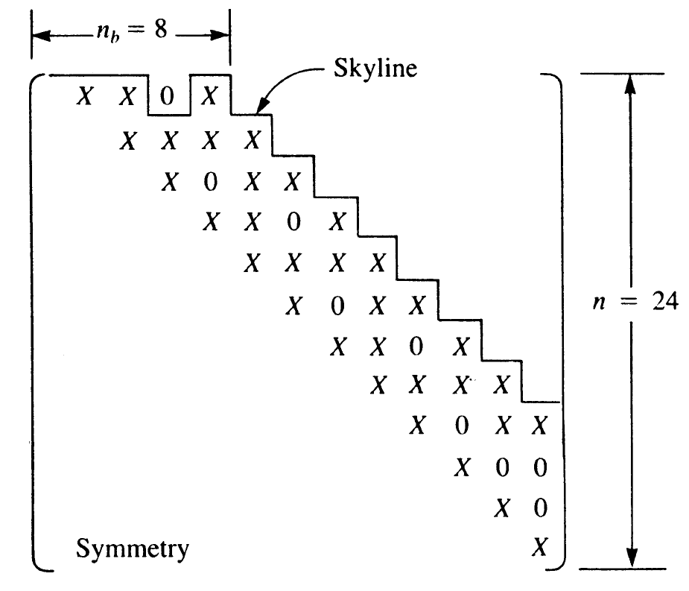
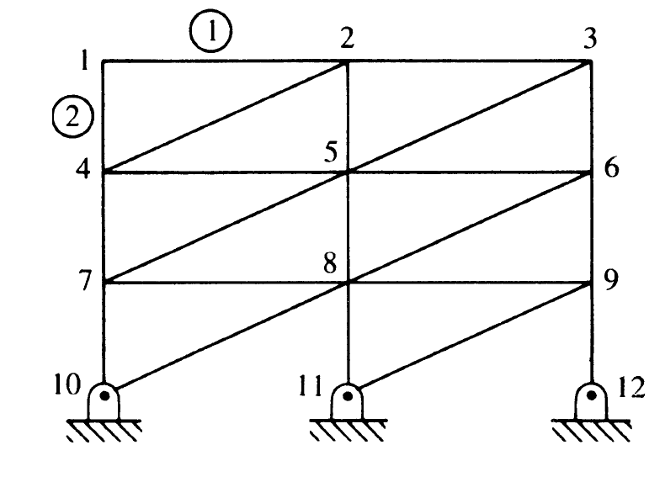
Illustration of node numbering effects for a truss structure
In skylining method only the coefficients between the main diagonal and skyline is stored in the computer for efficiency.
bandwidth
The skyline is an envelope that begins with the first nonzero coefficient in each column of the stiffness matrix.
In banded method only coefficients in half-bandwidth are stored in the computer.
A matrix is banded if the nonzero terms of the matrix are gathered about the main diagonal.
Notes:
Half-Bandwidth=n_{b}=n_{d}*(m+1)=8. Note that n_{d} is the number of DOFs at each node =2, i.e. each node has two degrees of freedom one horizontal and one vertical. m=Max difference between node numbers of each element=4-1=3 (for element 2 where the node ID of 1 is subtracted from node ID of 4) and this is the largest difference in the whole structure.

Slide 44
Illustration of node numbering effects for a truss structure
There are other storage methods such as Wavefront (frontal) metohd etc that is beyond the scope of this lecture;
Wavefront method is the most efficient method adopted by most FE software;
Skylining is more efficient than bandwidth method due to storing less data.

Slide 45
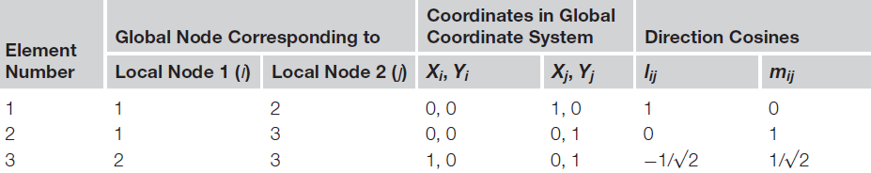
Solution
Y
X

Slide 46
Solution
Please note that;
θ
Represents the orientation of each element in relation to the global coordinate system

Slide 47
Solution
Elements stiffness matrix in global system;
Also note that since we are performing static analysis (not dynamic or vibration analysis) there is no need for mass matrix and therefore we ignore it.

Slide 48
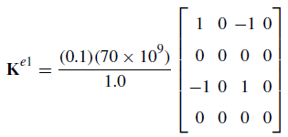
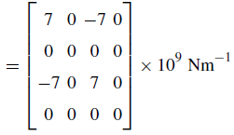
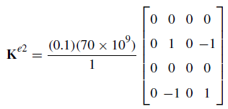
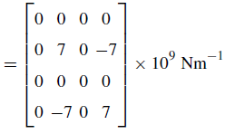
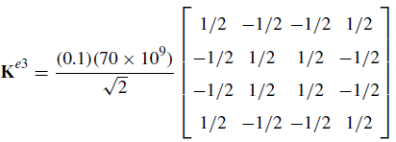

Solution
el 1
el 2
el 3

Slide 49
Solution
So far, we have stiffness matrix of each element in the global coordinate system;
The questions is how to assemble them to get stiffness matrix of the entire structure!!!
Structure has 3 nodes and each node has 2 DOFs, therefore the stiffness matrix of structure should be a 6x6 matrix.
As a general rule of thumb, the size of stiffness matrix is the number of nodes in the structure times the number of DOF at each node.

Slide 50
Solution
This is how structure’s stiffness matrix should look like;
Global DOF numbers
Node 1
Node 2
Node 3
D1
D2
D3
D4
D5
D6
Remember D_{2i}
D1
Node 1
Remember D_{2i-1}
D2
D3
Node 2
D4
D5
Node 3
D6

Slide 51
Solution
Node 1
Node 2
Node 1
Node 2
Node 3
Node 1
D1
D2
D3
D4
D5
D6
Node 2
D1
Node 1
Node 1
Node 3
D2
Node 1
D3
Node 2
Node 3
D4
Node 2
Node 3
D5
Node 2
Node 3
D6
Node 3

Slide 52
Solution
Node 1
Node 2
Node 1
Node 2
Node 3
Node 1
D1
D2
D3
D4
D5
D6
Node 2
D1
Node 1
D2
D3
Node 2
D4
D5
Node 3
D6

Slide 53
Solution
Node 1
Node 2
Node 1
Node 2
Node 3
Node 1
D1
D2
D3
D4
D5
D6
Node 2
D1
Node 1
D2
D3
Node 2
D4
D5
Node 3
D6

Slide 54
Solution
Node 1
Node 2
Node 1
Node 2
Node 3
Node 1
D1
D2
D3
D4
D5
D6
Node 2
D1
Node 1
D2
D3
Node 2
D4
D5
Node 3
D6

Slide 55
Solution
Node 1
Node 2
Node 1
Node 2
Node 3
Node 1
D1
D2
D3
D4
D5
D6
Node 2
D1
Node 1
D2
D3
Node 2
D4
D5
Node 3
D6

Slide 56
Solution
Node 1
Node 2
Node 1
Node 2
Node 3
Node 1
D1
D2
D3
D4
D5
D6
Node 2
D1
Node 1
D2
D3
Node 2
D4
D5
Node 3
D6

Slide 57
Solution
Node 1
Node 2
We already have this populated!!!
Add them up
Node 1
Node 2
Node 3
Node 1
D1
D2
D3
D4
D5
D6
Node 2
D1
Node 1
Node 1
Node 3
D2
Node 1
D3
Node 2
Node 3
D4
D5
Node 3
D6

Slide 58
Solution
Node 1
Node 2
Node 1
Node 2
Node 3
Node 1
D1
D2
D3
D4
D5
D6
Node 2
D1
Node 1
Node 1
Node 3
D2
Node 1
D3
Node 2
Node 3
D4
D5
Node 3
D6

Slide 59
Solution
Node 1
Node 2
Node 1
Node 2
Node 3
Node 1
D1
D2
D3
D4
D5
D6
Node 2
D1
Node 1
Node 1
Node 3
D2
Node 1
D3
Node 2
Node 3
D4
D5
Node 3
D6

Slide 60
Solution
Node 1
Node 2
Node 1
Node 2
Node 3
Node 1
D1
D2
D3
D4
D5
D6
Node 2
D1
Node 1
Node 1
Node 3
D2
Node 1
D3
Node 2
Node 3
D4
D5
Node 3
D6

Slide 61
Solution
Node 1
Node 2
Node 1
Node 2
Node 3
Node 1
D1
D2
D3
D4
D5
D6
Node 2
D1
Node 1
Node 1
Node 3
D2
Node 1
D3
Node 2
Node 3
D4
D5
Node 3
D6

Slide 62
Solution
We already have this populated!!!
Add them up
Node 1
Node 2
Node 3
D1
D2
D3
D4
D5
D6
D1
Node 1
D2
D3
Node 2
D4
Node 2
Node 3
D5
Node 3
Node 2
D6
Node 3

Slide 63
Solution
Node 1
Node 2
Node 3
D1
D2
D3
D4
D5
D6
D1
Node 1
D2
D3
Node 2
D4
D5
Node 3
D6
Node 2
Node 3
Node 2
Node 3

Slide 64
Solution
Node 1
Node 2
Node 3
D1
D2
D3
D4
D5
D6
D1
Node 1
D2
D3
Node 2
D4
D5
Node 3
D6
Node 2
Node 3
Node 2
Node 3

Slide 65
Solution
Node 1
Node 2
Node 3
D1
D2
D3
D4
D5
D6
D1
Node 1
D2
D3
Node 2
D4
D5
Node 3
D6
Node 2
Node 3
Node 2
Node 3

Slide 66
Solution
Node 1
Node 2
Node 3
D1
D2
D3
D4
D5
D6
D1
Node 1
D2
D3
Node 2
D4
D5
Node 3
D6
Node 2
Node 3
Node 2
Node 3

Slide 67
Solution
Finally, the structure’s stiffness matrix is;
The half bandwidth (n_{b}) of the global stiffness matrix is n_{d}*(m+1)=2*(2+1)=6 (see notes of slide 43).

Slide 68
Solution
How about global force matrix?
Fx
Node 1
Fy
Fx
Node 2
Fy
Fx
Node 3
Fy

Slide 69



Solution
Condensed global stiffness matrix

Slide 70

Solution

Slide 71



Solution

Slide 72
Reminder

Slide 73
Reminder

Slide 74
Reminder

Slide 75

Solution

Slide 76
Task
Students are required to obtain strain in each member;
An excel file is uploaded to BB with solved examples for two truss examples. The file is designed to give you infinite number of problem combinations to solve by hand for further practice.

Slide 77
Note
Students are advised to study about second , third and … order elements
What is their difference with first order elements?
How many shape functions do they have?
How does using higher order elements affect the solution time of analysis?

Slide 78

Tutorial 2a
The pin-jointed truss shown in the figure is attached to a vertical wall at the points A, B, C and D; the members BE, BF, EF and AF are in the same horizontal plane. The truss supports vertically downward loads of 9 and 6kN at E and F, respectively, and a horizontal load of 3kN at E in the direction EF. Obtain forces in the truss members using Abaqus. Note that ABFE is on a horizontal plane.

Slide 79

Tutorial 2b
The truss shown in the figure is supported by a hinge at A and a cable at D which is inclined at an angle of 45◦ to the horizontal members. Calculate the tension, T, in the cable and hence the forces in all the members.

Slide 80
Tutorial 2c
Use the FEA to find the magnitude and direction of the deflection of the joint C in the truss. All members have a cross-sectional area of 500mm² and a Young’s modulus of 200,000 N/mm².

