Slide 1
Structural Design and Inspection-Finite Element Method (Frames)
By
Dr. Mahdi Damghani
2021-2022

Slide 2
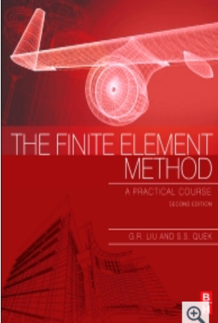
Suggested Readings
Reference 1
Reference 2
Reference 3

Slide 3
Objective(s)
Familiarisation with Finite Element Analysis and Methods (FEA);
Ability to assemble global stiffness matrix for a 2D-frame shape structure;
Familiarisation with Finite Element Modelling (FEM) of 2D frame structures using ABAQUS CAE (Tutorial).

Slide 4
Introduction
Refer to chapter 6 of Reference 1
Refer to chapter 6 of Reference 2
This method is used in most of commercially available FE based software to solve structural problems
Some typical software in aerospace industry are;
  Altair HyperWorks (mostly for optimisation purposes)
  MSC Nastran (mostly for linear analysis)
  Abaqus (mostly for non-linear analysis)
  Ansys (mostly for non-linear analysis)

Slide 5
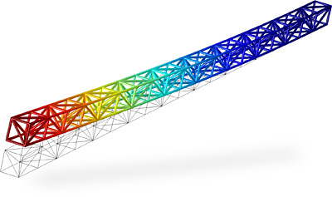
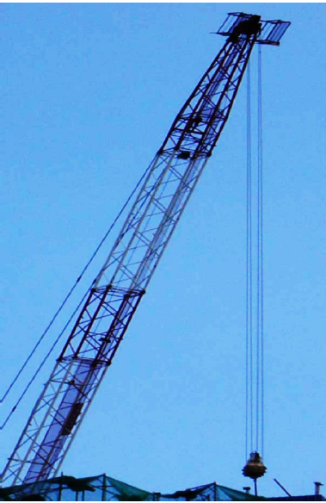
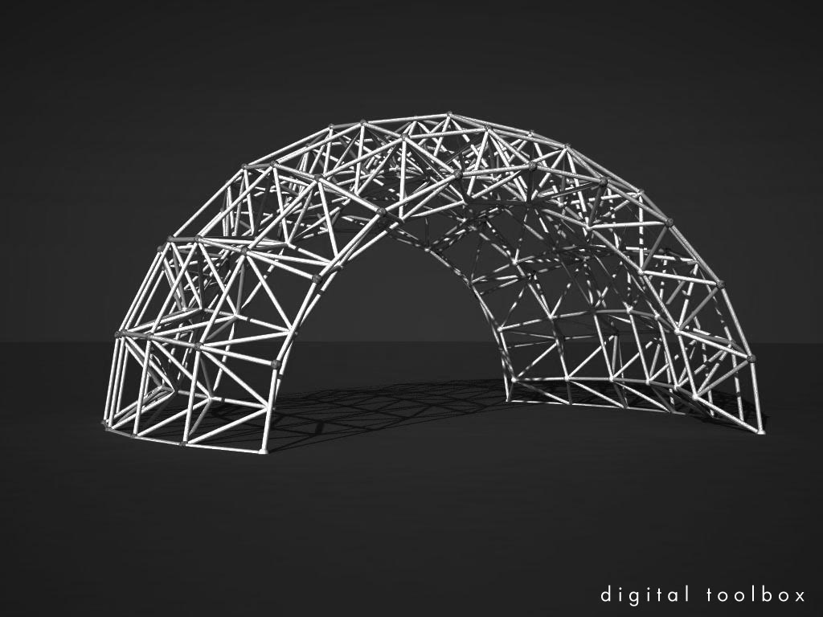
Introduction

Slide 6
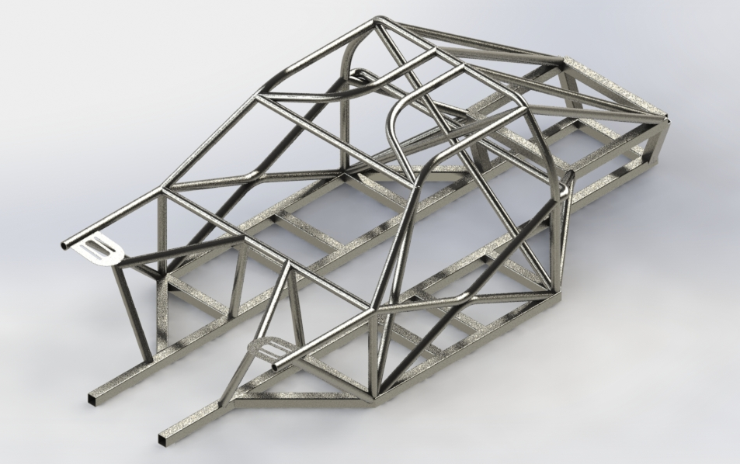
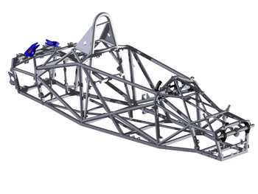
Introduction
Car chassis

Slide 7
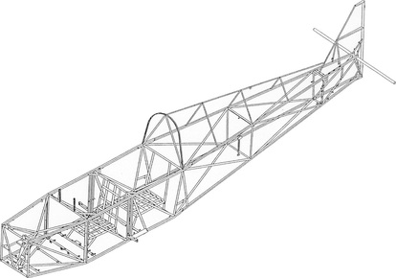
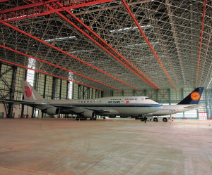
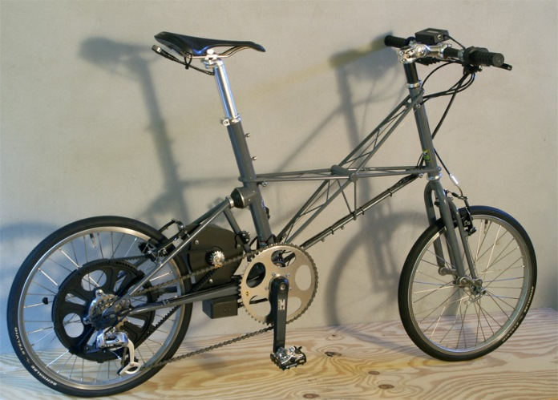
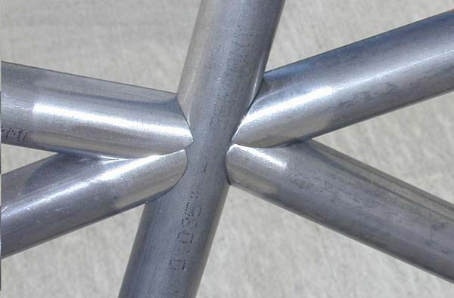
Introduction

Slide 8
Introduction
In previous lecture, for beam elements, we just looked at transverse deformation;
In this lecture we look at elements capable of carrying both axial and transverse deformation;
This behaviour is typical of frame structures.

Slide 9
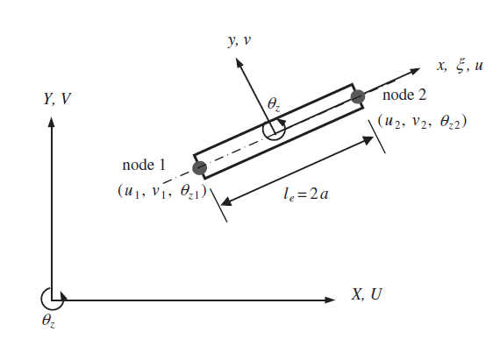
General 2D beam element
Node 1 has only 3 DOF
Local coordinate system with origin at the middle of beam
Node 2 has only 3 DOF
Global coordinate system
The length of element
Therefore this beam element has 6 DOFs in total

Slide 10
The Finite Element Analysis (FEA) process
Construction of Shape Functions
Calculation of Strain Matrix
Construction of Element Stiffness/Mass/Force Matrices in Local Coordinate System
Forming Global Stiffness/Mass/Force Matrices in Global Coordinate System

Slide 11
Displacement in FEM
In finite element methods the displacement for an element is written in the form;
Approximated displacement within the element
Shape function
Vectors of displacements at the two nodes of the element
This function approximates displacements within the element by just having displacements at the two nodes, i.e. d_{e}
Question:
What should be N(x)???

Slide 12
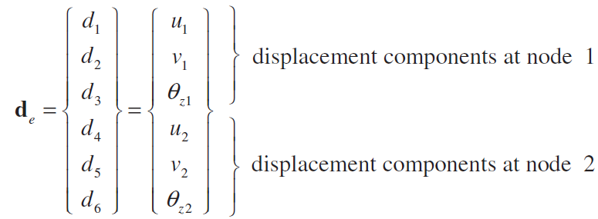
Displacement in FEM
Element displacement vector for general 2D frame element is;

Slide 13
Shape function
For this case we do not need to re-calculate shape functions as we have already done this for truss (axial deformation) elements and beam (transverse deformation and in plane rotation) elements;
For frame elements we just combine stiffness matrix of truss elements with beam elements.

Slide 14
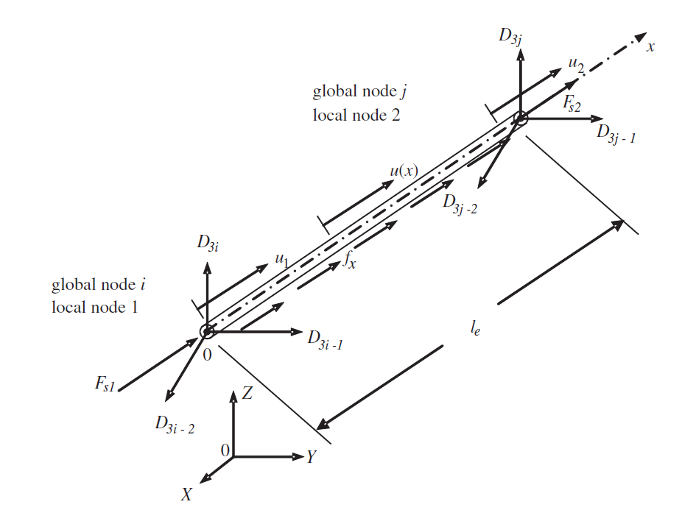
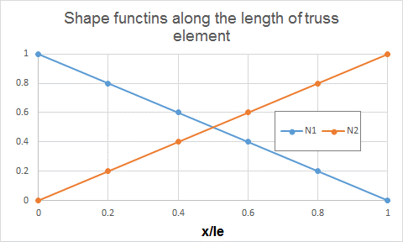
Reminder: Shape function for truss elements

Slide 15
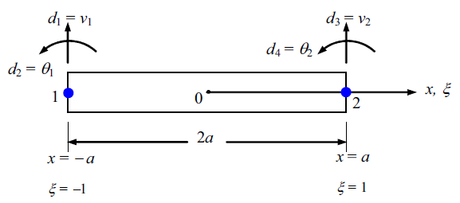
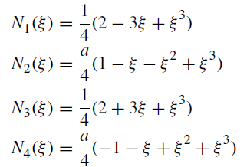
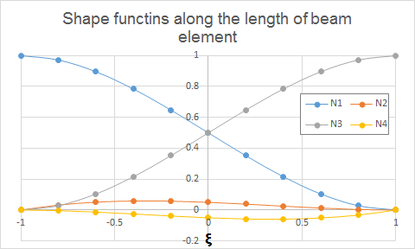
Reminder: Shape function for beam elements

Slide 16
Stiffness matrix in local coordinate system
What is the order of stiffness matrix for frame structures?

Slide 17
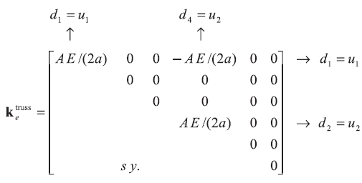
Stiffness matrix in local coordinate system
In order to assemble stiffness matrix of frame element, let’s assume a 6x6 matrix with zero elements;
Intersection of rows 1 and 4 with columns 1 and 4 get populated
Now adding truss elements contribution to this matrix gives;

Slide 18
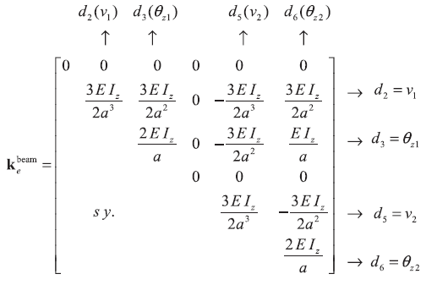
Stiffness matrix in local coordinate system
Intersection of rows 2, 3, 5 and 6 with columns 2, 3, 5 and 6 get populated
Now adding beam element contribution to this matrix gives

Slide 19
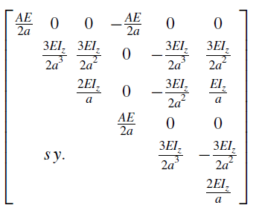
Stiffness matrix in local coordinate system

Slide 20
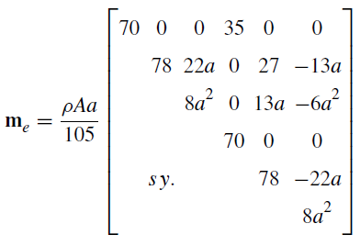
Mass matrix in local coordinate system
Following similar procedure we get the following for mass matrix;

Slide 21
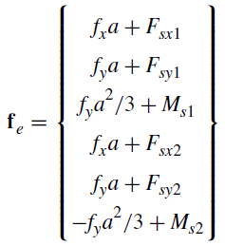
Force vector in local coordinate system
Truss contribution
F_{sy2}
F_{sx2}
M_{s2}
F_{sy1}
F_{sx1}
M_{s1}
f_{x}
f_{y}
Beam contribution

Slide 22
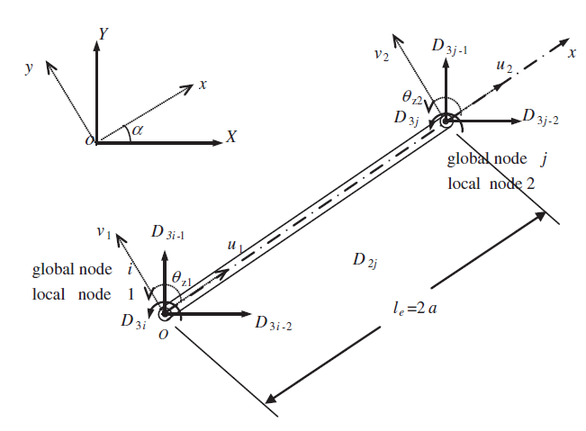
Transformation to global coordinate system

Slide 23

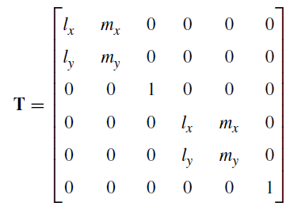
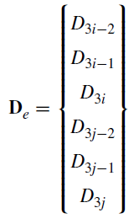
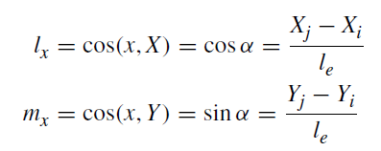
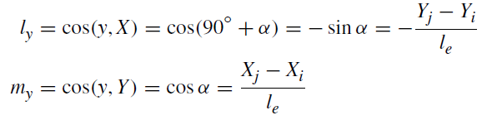
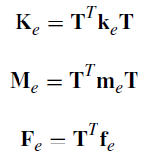
Transformation to global coordinate system
Global displacement
Local displacement

Slide 24
Global equations for the whole structure
Point loads directly acting on nodes of structure in global coordinate system
Forces and moments on the nodes as the result of clamping the internal nodes in global coordinate system (equivalent nodal forces)
Global stiffness matrix of the structure
Global nodal displacements

Slide 25
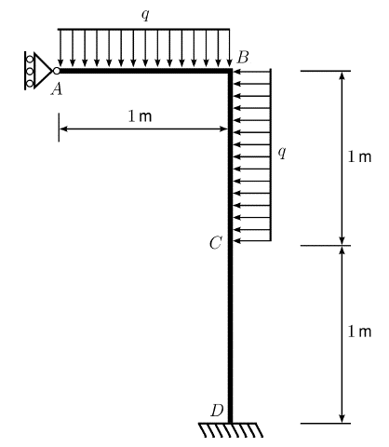
Example 1
The structure is clamped at point D and simply supported at point A. It carries a uniform distributed load q = 10 kN/m as shown. Assuming that modulus of elasticity for beam AB and column BD is constant and equal to E = 200 N/m² and second moment of inertia (I) is 50 m⁴. Assume cross section area is 0.0077 m². For this structure assemble global stiffness matrix.

Slide 26
Solution
4
3
2
Y
X
1

Slide 27
Solution
Look at the excel file attached for the comprehensive solution (i.e. Lec10_Solved Example For Frame Structures.xlsx)

Slide 28
Example 2
Solve the rigid plane problem using FEA. Both element shave similar geometric properties.

Slide 29
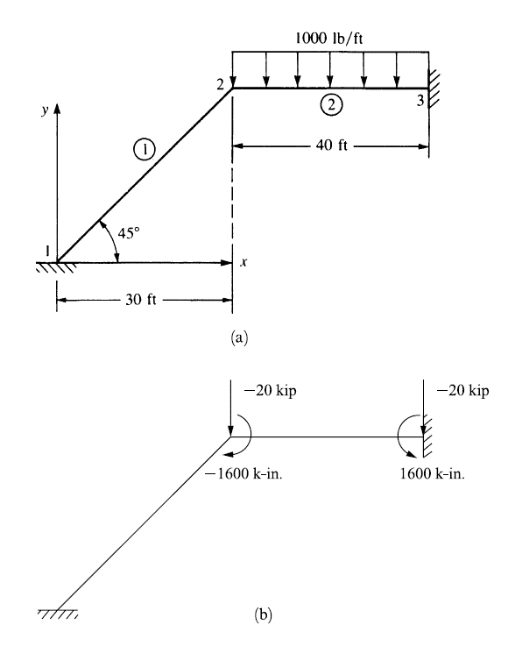
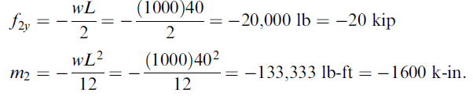
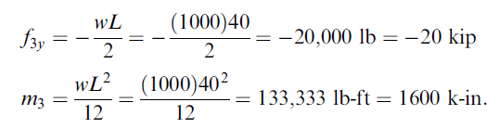
Solution
Equivalent nodal forces and moments are calculated as;

Slide 30
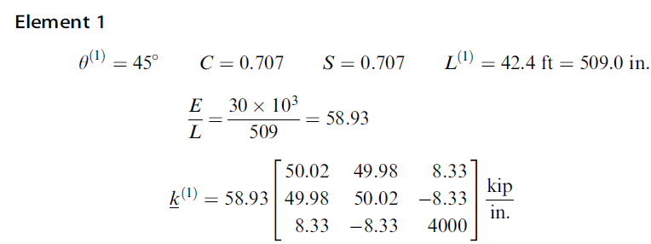
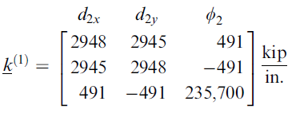
Solution
Considering only parts of stiffness matrix associated with degrees of freedom at node 2 (because node 1 is fixed);

Slide 31
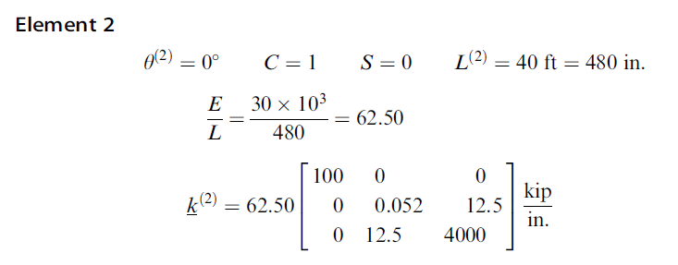
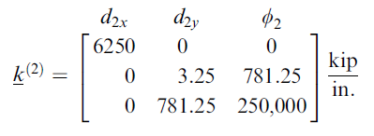
Solution
Considering only parts of stiffness matrix associated with degrees of freedom at node 2 (because node 3 is fixed);

Slide 32
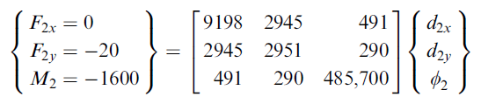
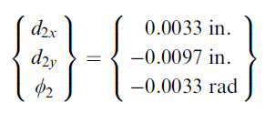
Solution
By assembling the global stiffness matrix and eliminating rows and columns of zero displacements, i.e. at nodes 1 and 3, we have;

Slide 33

Solution
In order to obtain local forces in each element;
Local forces in each element
Local stiffness of each element
Global displacement vector

Slide 34
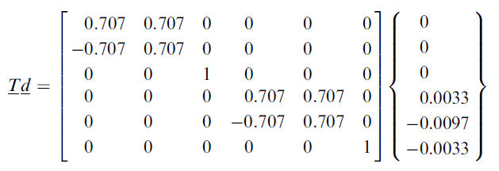
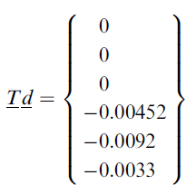
Solution
Transforming global displacements to local displacement for element 1;

Slide 35
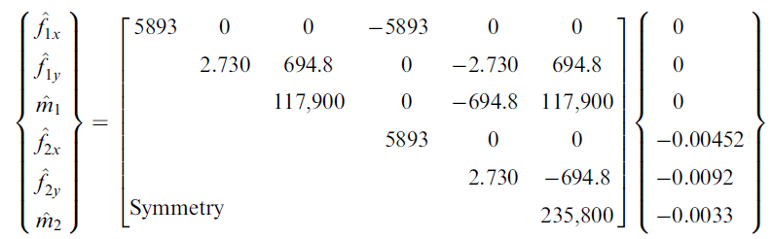
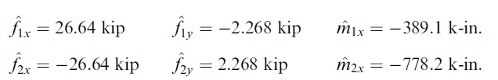
Solution
Local forces in element 1 are written as;

Slide 36
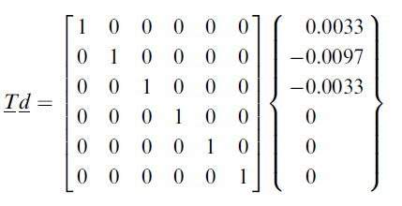
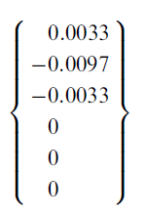
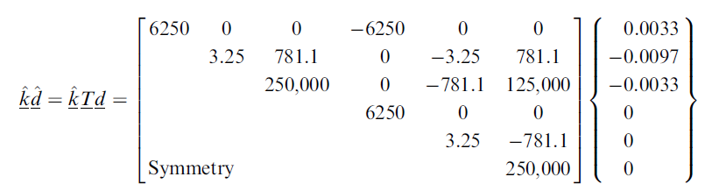
Solution
Local forces in element 2 are written as;

Slide 37
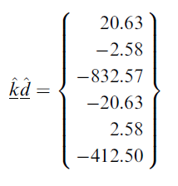
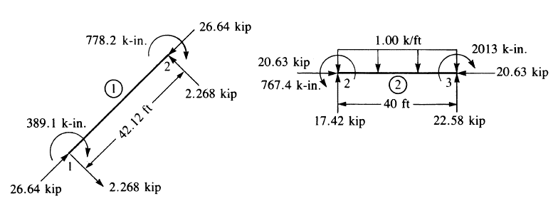
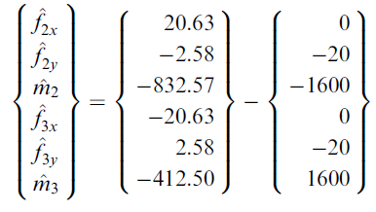
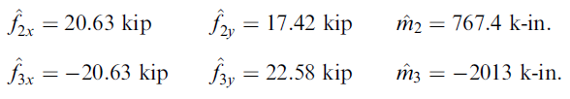
Solution
To obtain the actual element local nodal forces, we must subtract the equivalent nodal forces from effective nodal forces as;
Free body diagram

Slide 38
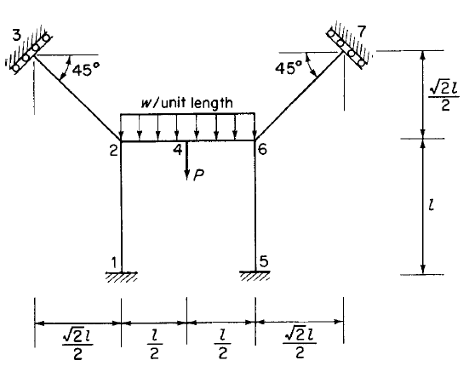
Example 3
Consider the symmetrical plane rigid-jointed frame 1234567 shown below. Assuming the same flexural rigidity EI for all members, set up the global stiffness matrix for structure.

Slide 39
Solution
member | 12 | 23 | 24 | 46 | 56 | 67
Length | l | l | l/2 | l/2 | l | l
a | 0.5l | 0.5l | 0.25l | 0.25l | 0.5l | 0.5l
l_{x}=m_{y} | 0 | -0.7 | 1 | 1 | 0 | 0.7
m_{x}=-l_{y} | 1 | 0.7 | 0 | 0 | 1 | 0.7

Slide 40

Solution
We will do this for element 67 only and the rest is left to students;
member | 67
Length | l
a | 0.5l
l_{x}=m_{y} | 0.7
m_{x}=-l_{y} | 0.7

Slide 41



Solution
Now we have stiffness matrix in local coordinate system. Let’s transform it to global system;

Slide 42

Solution

Slide 43
Solution
After performing similar procedure for all members and obtaining global stiffness matrix of each member, each individual stiffness need to be assembled as elaborated for truss structures lecture to give final global stiffness of entire structure.

Slide 44
Tutorial 4a
Open and follow instructions given in pdf file for modelling frame structures uploaded on blackboard

Slide 45

Tutorial 4b
Model the frame structure in Abaqus and extract end moments in the members of the frame; all members have the same flexural rigidity, EI.

Slide 46
Tutorial 4c
The symmetrical rigid jointed structure is encastré at 6, 7, 8 and 9 and rests on simple supports at 1, 2, 4 and 5. It is loaded with a vertical point load P at 3. Use Abaqus to find the displacements of the structure and hence calculate the support reactions and the forces in all the members. Plot the bending moment diagram for 123. All members have the same section properties and GJ =0.8EI.

Slide 47



Tutorial 4c

