Slide 1
Structural Design and Inspection-Finite Element Method (Beams)
By
Dr. Mahdi Damghani
2021-2022

Slide 2

Suggested Readings
Reference 1
Reference 2
Reference 3

Slide 3
Objectives
Familiarisation with equivalent nodal forces;
Familiarisation with global nodal forces;
Familiarisation with effective global nodal forces;
Solving beam problems using Finite Element Analysis having distributed loading between nodes.

Slide 4
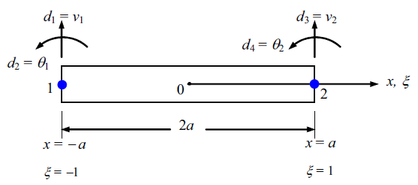
Beam element
Node 1 has only 2 DOF (vertical displacement and rotation)
Local coordinate system with origin at the middle of beam
Node 2 has only 2 DOF (vertical displacement and rotation)
The length of element
Therefore, this beam element has 4 DOFs in total
This slide shows positive direction of shear forces, bending moments, displacements and rotations.

Slide 5
Example 1
For the cantilever beam subjected to the uniform load w, solve for the right-end vertical displacement and rotation and then for the nodal forces. Assume the beam to have constant EI throughout its length.

Slide 6
Solution
We begin by discretizing the beam;
Only one element will be used to represent the whole beam;
Next, the distributed load is replaced by its work-equivalent nodal forces.

Slide 7
Note
Equivalent nodal loading for a distributed loading can be obtained by calculation of fixed end reactions as we saw in slope deflection method;
We have replaced the uniformly distributed load by a statically equivalent force system consisting of a concentrated nodal force and moment at each end of the member carrying the distributed load;
These statically equivalent forces are always of opposite sign from the fixed-end reactions.

Slide 8
Note
If we want to analyse the behaviour of loaded member 2–3 in better detail, we can place a node at mid-span;
Use the same procedure just described for each of the two elements representing the horizontal member.

Slide 9
Note

Slide 10
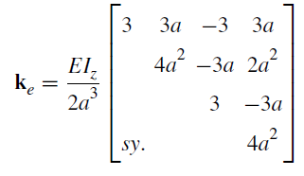
Solution
Local and global axis are coincident.
Reduced stiffness matrix

Slide 11
Solution
Negative sign for displacement means it is downward;
Negative sign for rotation means it is clockwise;
Remind yourselves of positive sign conventions.

Slide 12
Solution
In order to obtain reaction at the support it is essential to find global nodal forces;
For convenience let’s denote Kd=F^{(e)};
F^{(e)} are called the effective global nodal forces;

Slide 13
Note
Note that when there are distributed loading between nodes, the general relationship between forces and stiffness are obtained from;
Concentrated nodal forces
Equivalent nodal forces

Slide 14
Solution
Positive shear means upward
Positive moment means counter-clockwise

Slide 15
General flowchart of steps
Replace distributed loads by its equivalent nodal forces
Assemble GLOBAL stiffness matrix
Apply BCs to obtain reduced stiffness matrix
Solve for unknown displacements & rotations
Obtain GLOBAL nodal forces

Slide 16
Example 2
For the cantilever beam subjected to the concentrated free-end load P and the uniformly distributed load w acting over the whole beam as, determine the free-end displacements and the nodal forces.

Slide 17
Solution

Slide 18
Solution
Effective global nodal forces;
Correct nodal forces (global nodal forces);

Slide 19
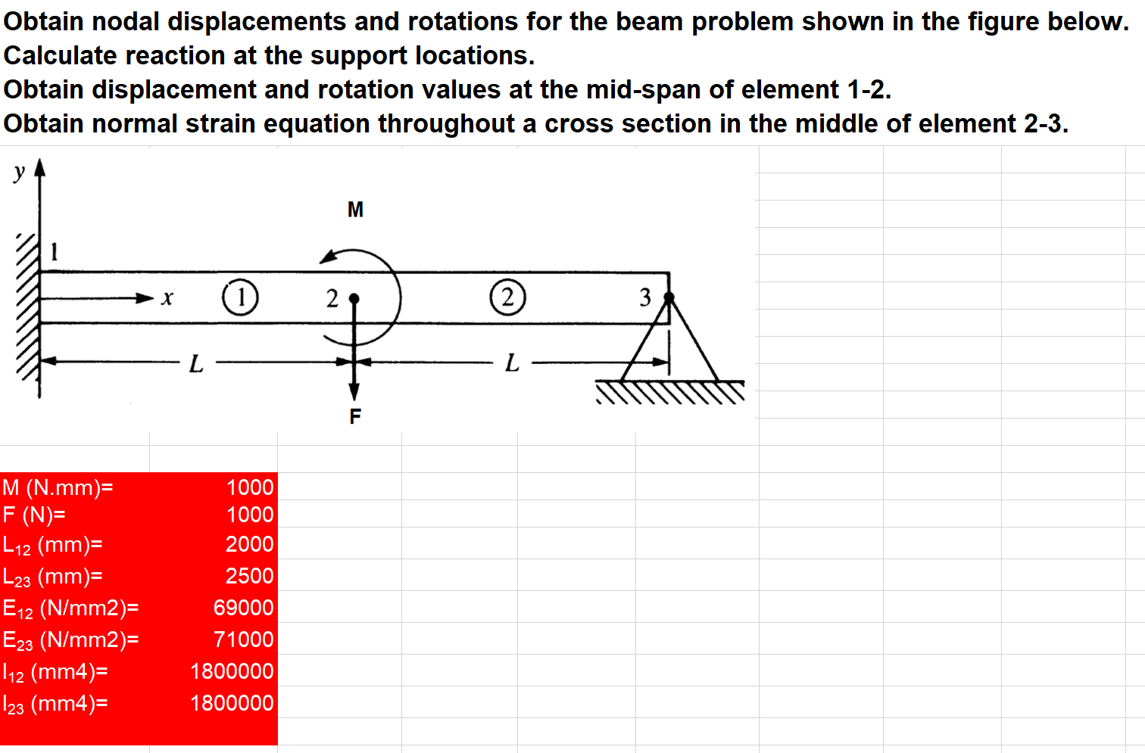
Example 3
See the uploaded excel file called “BeamProblems.xlsx”

Slide 20
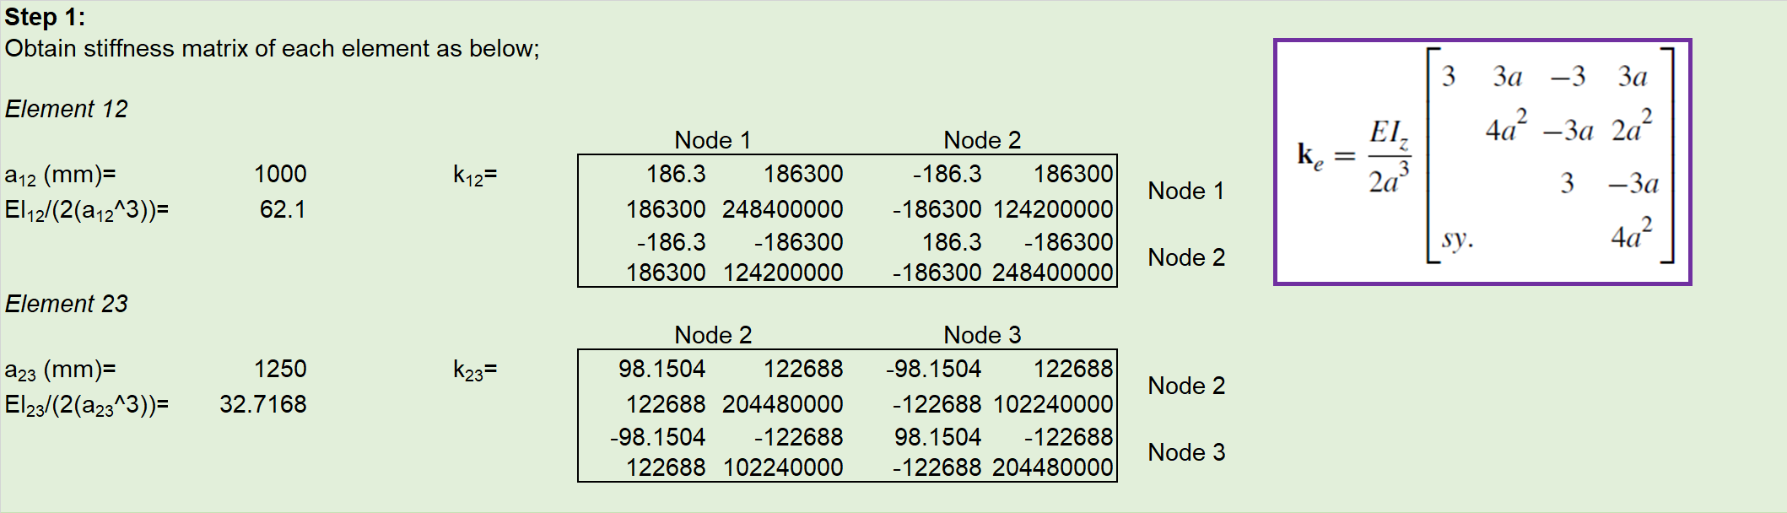
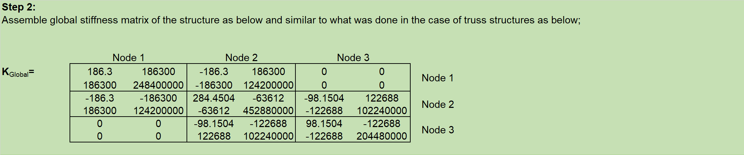
Solution

Slide 21
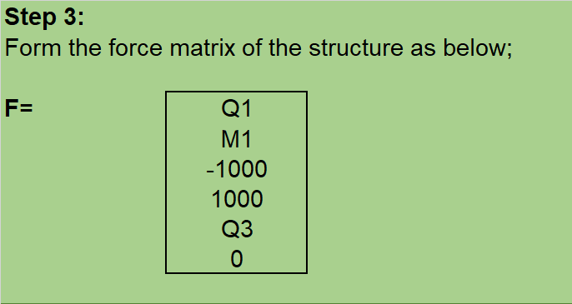
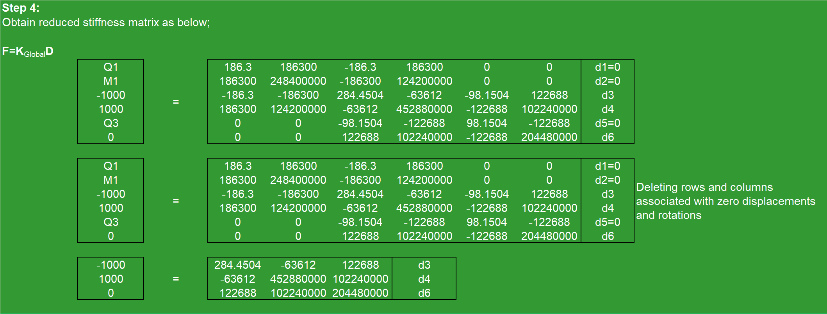
Solution

Slide 22
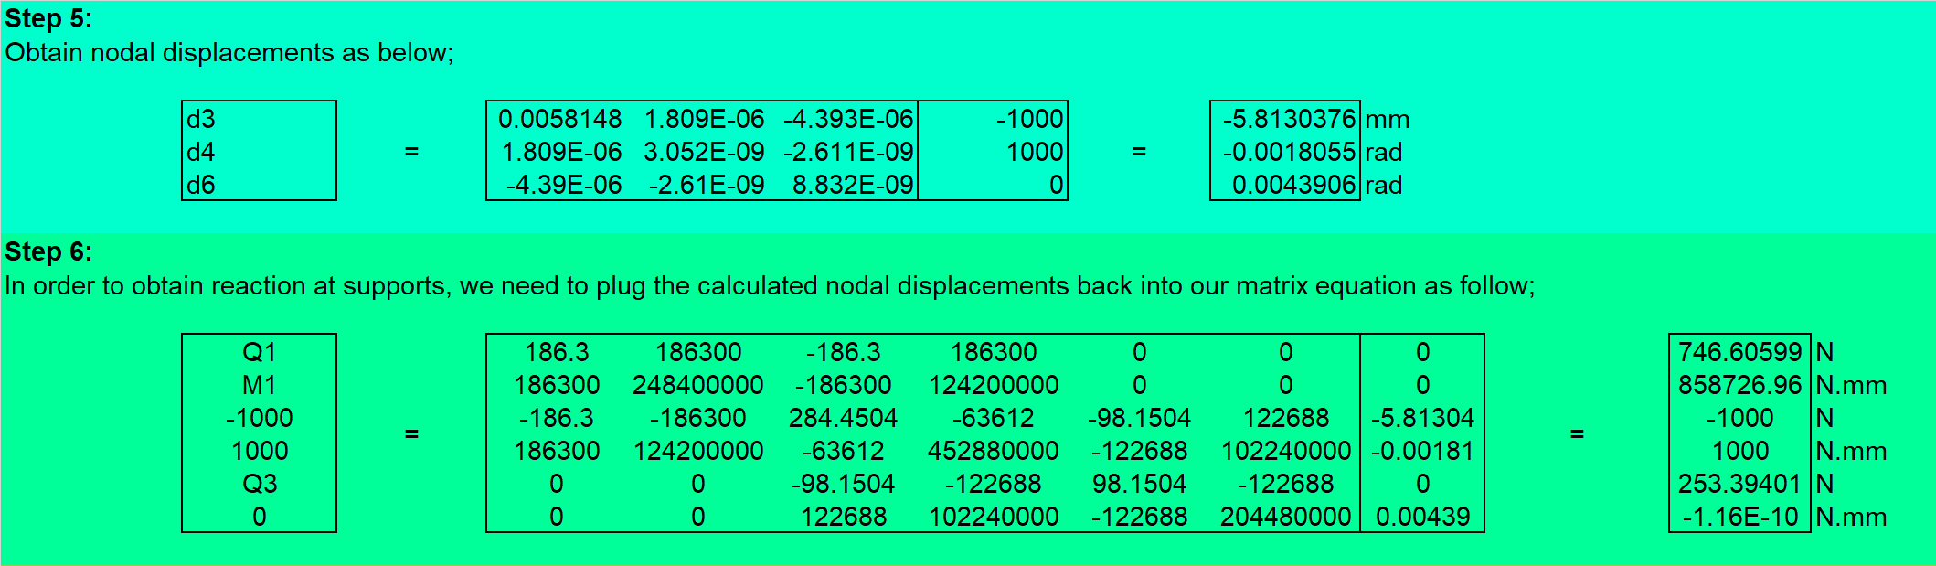
Solution

Slide 23
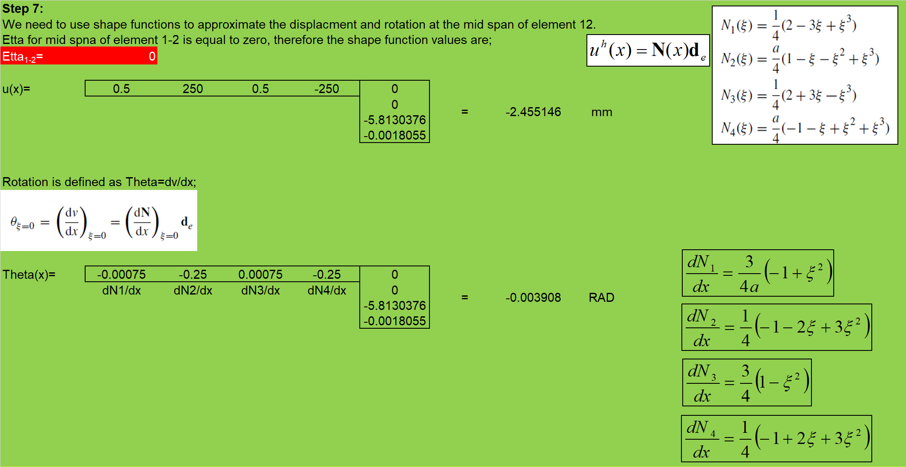
Solution

Slide 24
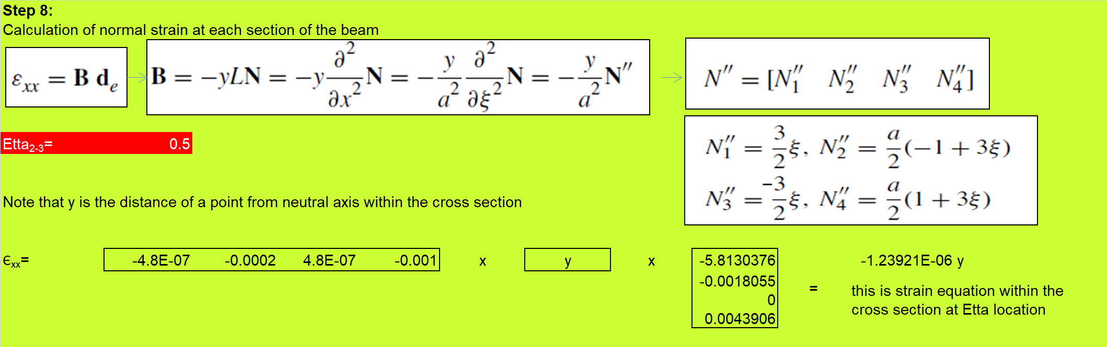
Solution

