Slide 1
Structural Design and Inspection-Finite Element Method (Beams)
By
Dr. Mahdi Damghani
2022-2023

Slide 2

Suggested Readings
Reference 1
Reference 2

Slide 3
Objective(s)
Familiarisation with Finite Element equations for beam structures;
Ability to assemble global stiffness matrix for a beam shape structure;
Familiarisation with Finite Element Modelling (FEM) of beam structures using ABAQUS CAE (Tutorial).

Slide 4
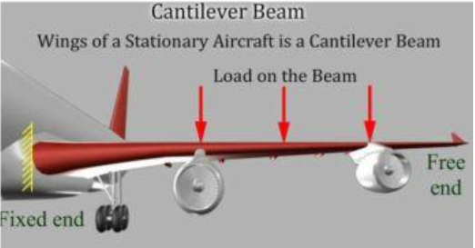
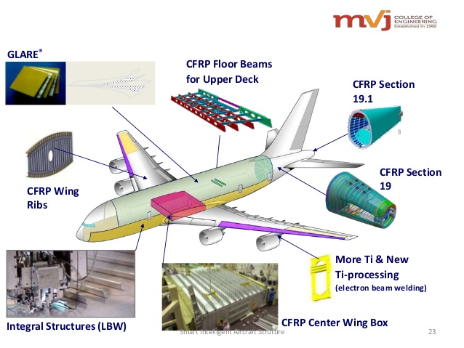
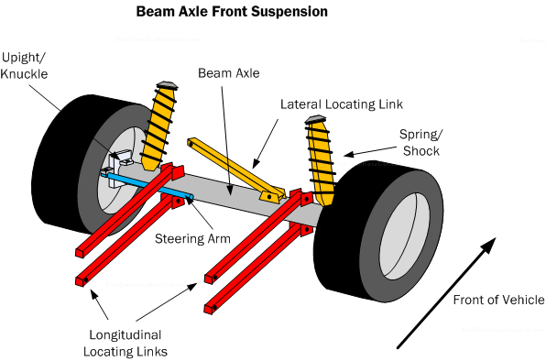
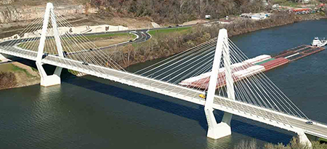
Introduction

Slide 5
Introduction
Refer to chapter 6 of Reference 1;
Refer to chapter 5 of Reference 2;
This method is used in most of commercially available FE based software to solve structural problems;
Some typical software in aerospace industry are;
  Altair HyperWorks (mostly for optimisation purposes)
  MSC Nastran (mostly for linear analysis)
  Abaqus (mostly for non-linear analysis)
  Ansys (mostly for non-linear analysis)

Slide 6
Introduction
Unlike truss elements that are joined together by hinges, beams are connected by welding so they transfer both bending moment and forces across each other;
In this lecture, we would be using Euler-Bernoulli beam theory that is applicable to thin beams.

Slide 7
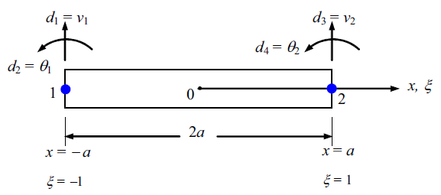
Beam element
Node 1 has only 2 DOF (vertical displacement and rotation)
Local coordinate system with origin at the middle of beam
Node 2 has only 2 DOF (vertical displacement and rotation)
The length of element
Therefore, this beam element has 4 DOFs in total
This slide shows positive direction of shear forces, bending moments, displacements and rotations.

Slide 8
The Finite Element Analysis (FEA) process
Construction of Shape Functions
Calculation of Strain Matrix
Construction of Element Stiffness/Mass/Force Matrices in Local Coordinate System
Forming Global Stiffness/Mass/Force Matrices in Global Coordinate System

Slide 9

Displacement in FEM
In finite element methods, the displacement for an element is written in the form;
Approximated displacement within the element
Shape function
Vectors of displacements at the two nodes of the element
This function approximates displacements within the element by just having displacements at the two nodes, i.e. d_{e}
Question:
What should be N(x)???

Slide 10
Note
It is convenient if the shape functions are derived from a special set of local coordinates (natural coordinate system);
The natural coordinate system is dimensionless, has its origin at the centre of the element and is defined from −1 to +1.

Slide 11
Note
The relationship between the natural coordinate system and the local coordinate system can simply be given as a scaling function, i.e.

Slide 12

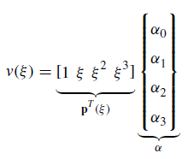
Shape function
Since we have four DOFs for the element we need to find 4 shape functions;
We assume displacement within element has the form where ;
Vector of polynomial basis functions
Four unknowns in the form of 4x1 matrix
This matrix is 1x4 because we have a 4-DOF element
Notes:
The complete cubic displacement function is appropriate because there are
four total degrees of freedom (a transverse displacement and a small rotation at each node).
The cubic function also satisfies the basic beam differential equation (y’’=M/EI and Eiy’’’’=0)—
further justifying its selection. In addition, the cubic function also satisfies the conditions
of displacement and slope continuity at nodes shared by two elements.

Slide 13

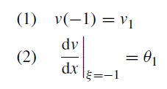
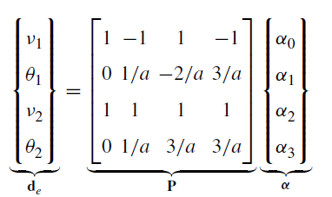

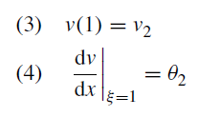
Shape function
We also know;

Slide 14
Note

Slide 15

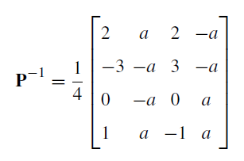

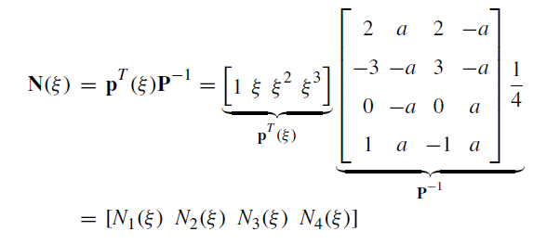


Shape function

Slide 16
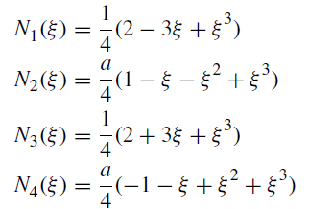
Shape function
Shape functions for displacement are functions of natural coordinates
Shape functions for rotations are functions of natural coordinates and length of element
Shape functions for displacement are functions of natural coordinates
Shape functions for displacement are functions of natural coordinates
These cubic shape (or interpolation) functions are known as Hermite cubic interpolation (or cubic spline) functions.

Slide 17
Shape functions

Slide 18



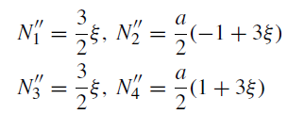
Strain calculation
B is called strain matrix
L is differential operator

Slide 19
Note
First derivative of the shape function is important as it will be used to obtain rotations within each element (we will see this in some examples);
How first derivative of shape function (dN/dx) is obtained?

Slide 20
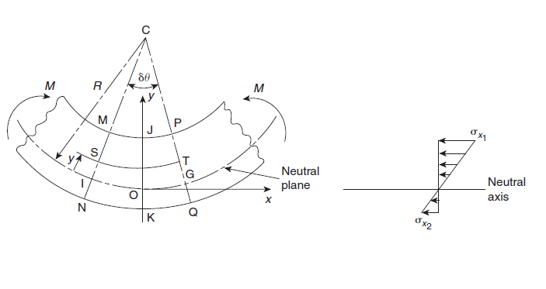
Reminder
Fibre ST has shortened in length whilst NQ increased in length so they have gone through strains
Remember that the length of neutral axis does not change and remains as
Positive y gives negative strain, i.e. compression

Slide 21
Reminder
How did the following come about?
Euler-Bernoulli beam curvature (1/R) is used for this formula;

Slide 22
Reminder

Slide 23

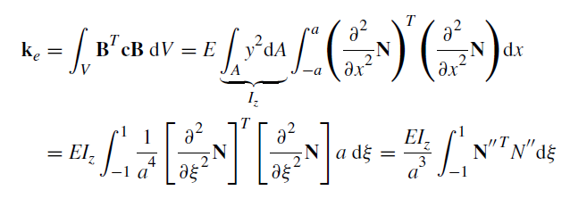
Element local stiffness matrix
Element stiffness matrix
(see chapter 3 of Ref. 2)
E is modulus of elasticity (material constant)
A is cross sectional area

Slide 24
Further elaboration
Some might ask where did the following come from?
See below;

Slide 25
Further elaboration

Slide 26
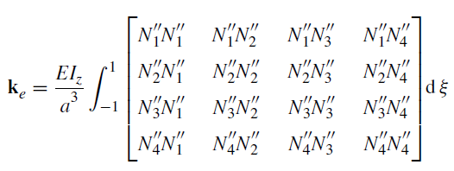
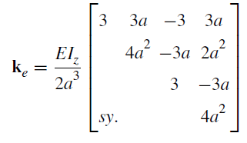
Element local stiffness matrix

Slide 27
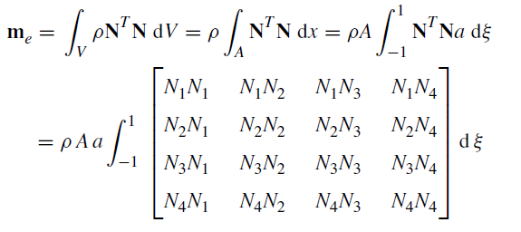
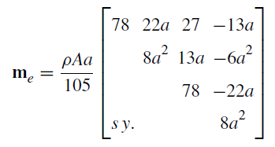
Elements mass matrix
Following similar procedure as stiffness matrix;
  Students are advised to familiarise themselves with chapter 3 of ref. 2

Slide 28
Nodal forces
Note that in FEA, body forces are always transferred to the nodes
F_{s1}
F_{s2}
M_{s1}
f_{y}
M_{s2}
Surface force (applied at the node)
Surface force (applied at the node)
Body forces (applied between nodes)

Slide 29
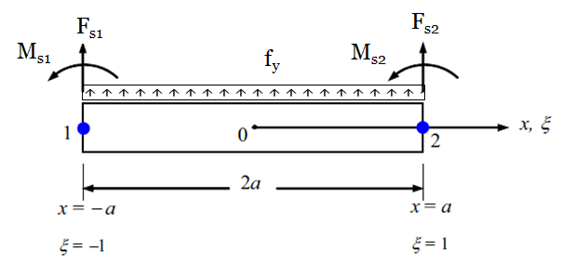
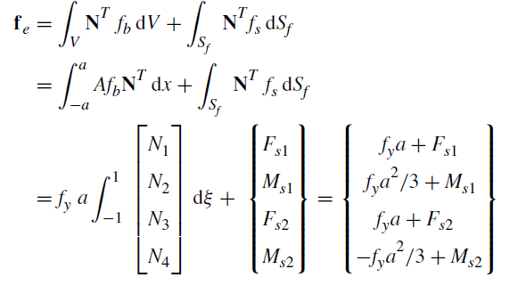
Nodal forces

Slide 30
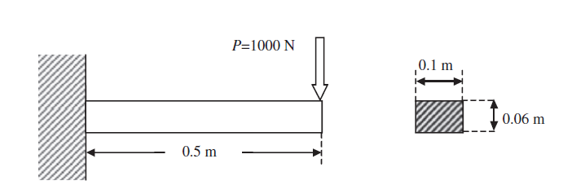
Example 1
Obtain tip deflection and rotation of the beam shown below using FEA. (E=69.0 GPa and Poisson’s ratio is 0.33)

Slide 31

Solution
For practical purposes, a beam must be divided into more than 1 element to obtain precise enough results;
However, for the sake of showing the process and simplicity, let’s divide the beam into one element only.

Slide 32
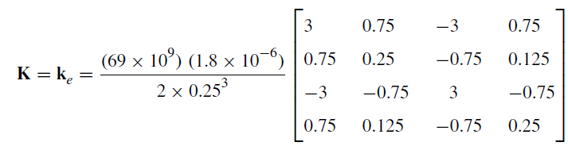
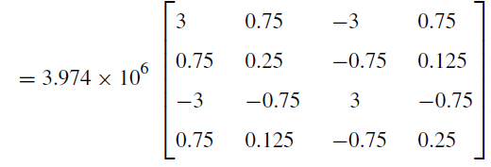
Solution

Slide 33
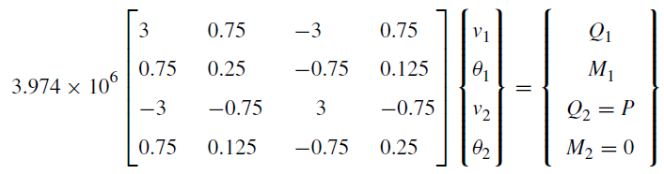
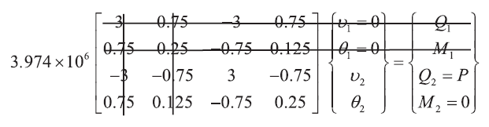
Solution
Reaction forces at clamped boundary that are unknown
Applying BC, i.e. v₁ =0 and θ₁=0

Slide 34

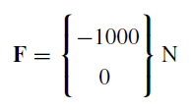



Solution
The reduced stiffness matrix becomes;

Slide 35
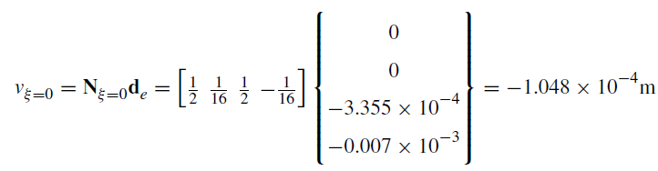
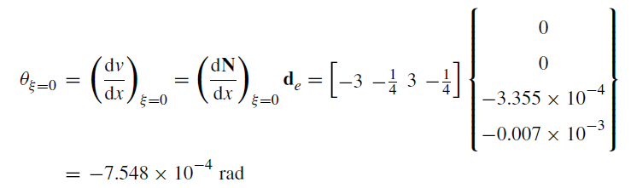
Example 2
In previous example, what are the deflection and rotation at mid-point of beam structure?

Slide 36
Tutorials 3a
See T3a.pdf

Slide 37
Tutorial 3b
Model beam problem of example 1 in Abaqus and extract deflection and rotation at the tip and mid point of the structure.

Slide 38
Tutorial 3c
See T3c.pdf

