Slide 1
Good Practices in Finite Element Analysis (FEA)
Dr. Mahdi Damghani (2022-2023)
Notes:
Good practice reflects my knowledge and experience including lessons learnt.
Feedback will be used to convert this presentation to be part of a Atkins FEA training course

Slide 2
Learning Objectives
Understanding of the pre-requisites to FEA
Overview of the FEA build process
Guidance on good practice in FEA
Notes:
This presentation is primarily aimed for graduates or engineers with no or limited experience in FEA.
The content of the presentation is a reflection of the presenter’s experience in FEA and lessons learnt.

Slide 3
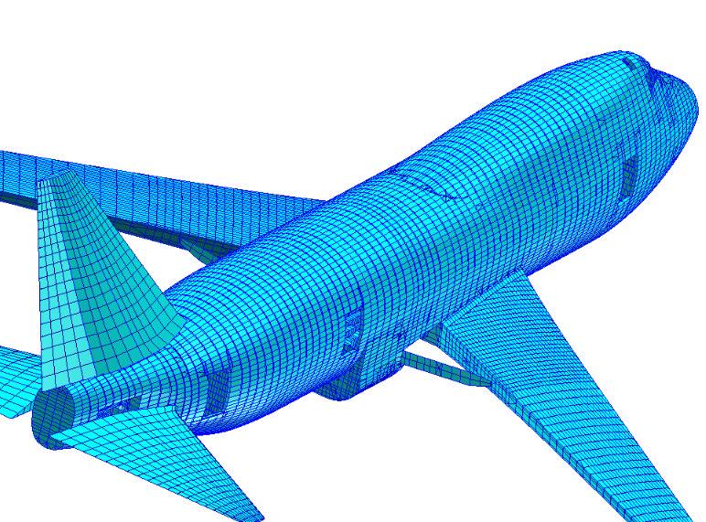
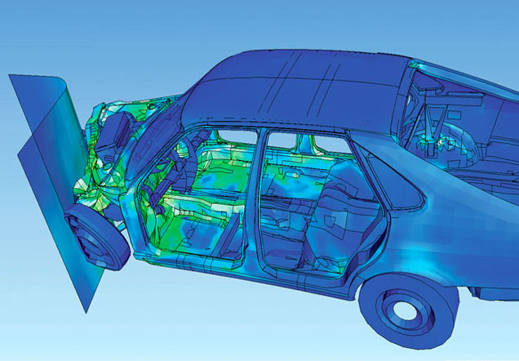
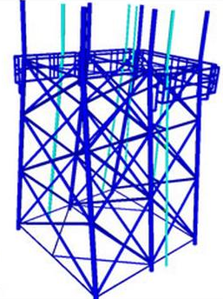
What is FEA?
Finite Element Analysis is a method of breaking down a physical structure into substructures called "finite elements“;
The finite elements and their interrelationships are converted into equation form and solved mathematically.

Slide 4

Design process (traditional)
Design (CAD)
Virtual test
SolidWorks
Catia
AutoCAD
Pro/E …
Solid Edge
Abaqus
Radioss
NX Nastran
Ansys
LS-Dyna …
Optistruct
Build
Test
A lot of trial and error and depends highly on engineers past experience and knowledge
Notes:
Key point – not to waste time, be sure that what is going to be done is appropriate.
Ensure the method chosen is having the highest chance to give required results
If select to do FE – agree in advance what are the key results, which area of the model is of the most interest.
Is it required to have a very refined model for areas of little interest?
St Venant’s principle
"... the difference between the effects of two different but statically equivalent loads becomes very small at sufficiently large distances from load.“

Slide 5
Design process (modern)
Design (CAD)
Virtual test (CAE)
SolidWorks
Catia
AutoCAD
Pro/E …
Solid Edge
Radioss
Optistruct
Build
Test
Conceive (optimisation)
Much faster and more economical as optimisation takes place from very beginning

Slide 6
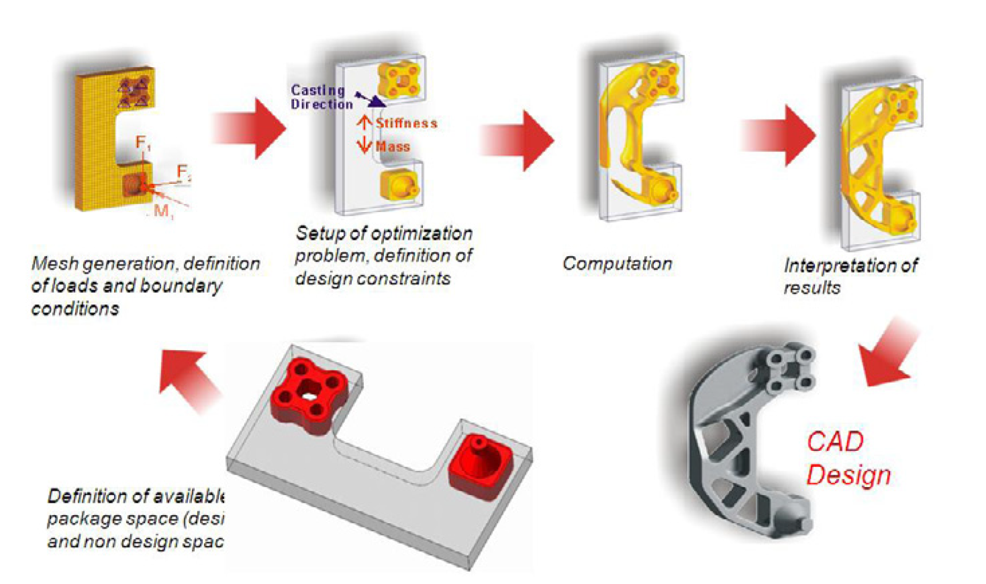
Example of a modern design process

Slide 7
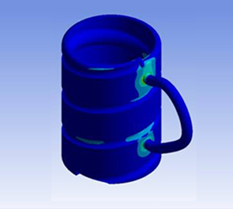
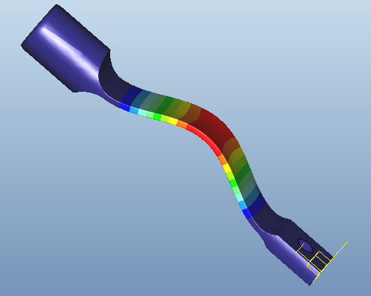
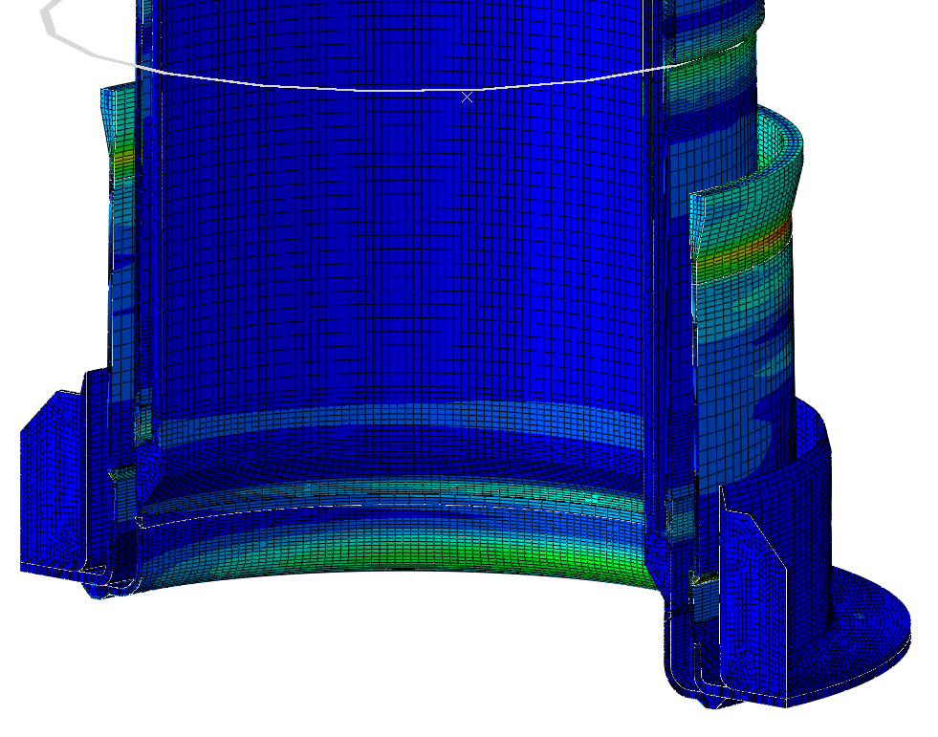
Analysis type
Linear static analysis
Non-linear analysis
  Geometric nonlinearity
  Material nonlinearity
  Contact
Dynamic analysis
Buckling analysis
Thermal analysis
Fatigue analysis
Optimisation
CFD analysis
Crash analysis
NVH analysis (Noise Vibration and Harshness)
Notes:
Linear refers to linear variation in displacement with load
Material non-linear – plastic, creep
Iteration procedures are used to determine the point at which the material properties are compatible with the strains produced.
Geometric non-linear – load/displacement non linear relation i.e. Combined compressive and pressure loading for buckling pipes.
Occurs for cases with large deflections where the small deflection theory is incorrect. The second order displacement effects have to be included and also it may be necessary to re-compute the model stiffness based on the new grid positions.
FIGURES:
Mug – linear stress analysis
Bar – buckling – geometric non-linear
GH96 standpipe – thermal, material non-linear

Slide 8
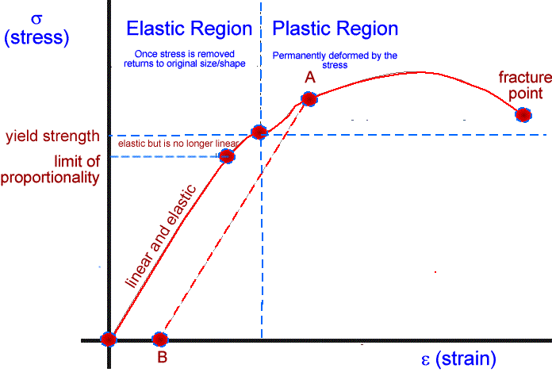
Analysis type
Linear
  Linear means straight line;
  The FE solver will therefore always follow a straight line from base to deformed state;
  An example in terms of linear material behaviour, σ =ε E.

Slide 9
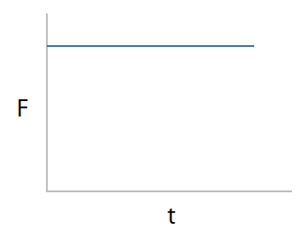
Analysis type
Static
  There is no variation of force with respect to time;
  Equilibrium condition is valid;
  FEA solves the opposite equation (non of the matrices are time dependant).

Slide 10
Analysis type (nonlinear)
Deals with true stress & strain as opposed to engineering stress & strain
Nonlinear analysis
Geometric
Large deformation
Material
Beyond elastic limit (metals)
Contact
Within elastic limits (non-metals)
Creep (long time process)
Gap elements and contact simulation
Stiffness is changing due to change in displacement
Stress strain curve is polynomial
Stiffness is changing due to change in displacement
Notes:
Maximum deflection between1/10 to 1/5 the thickness is considered as small deflection.

Slide 11
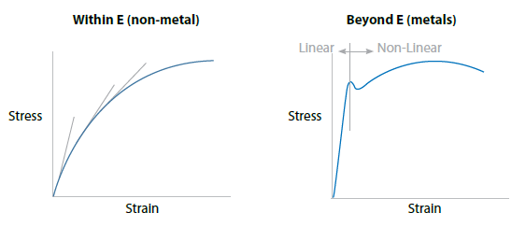
Analysis type (nonlinear)
Material nonlinearity;

Slide 12
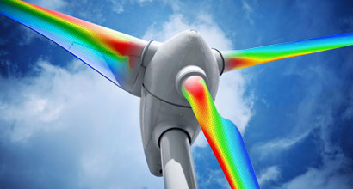
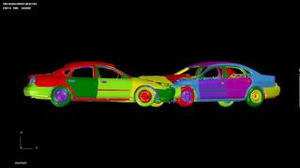
Analysis type
Dynamic analysis
Free vibration
Forced vibration
Frequency response
Transient response
Random vibration

Slide 13
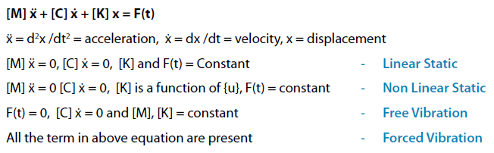
Analysis type (dynamic)
Dynamic analysis vs. static analysis;

Slide 14
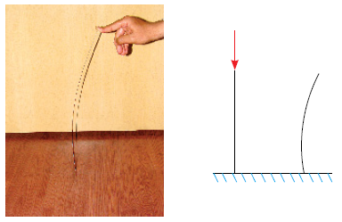
Analysis type (buckling)
Buckling (Eigenvalue analysis)
  For compressive loads only;
  Slender beams and sheet metal parts;
  The output is critical buckling load.

Slide 15
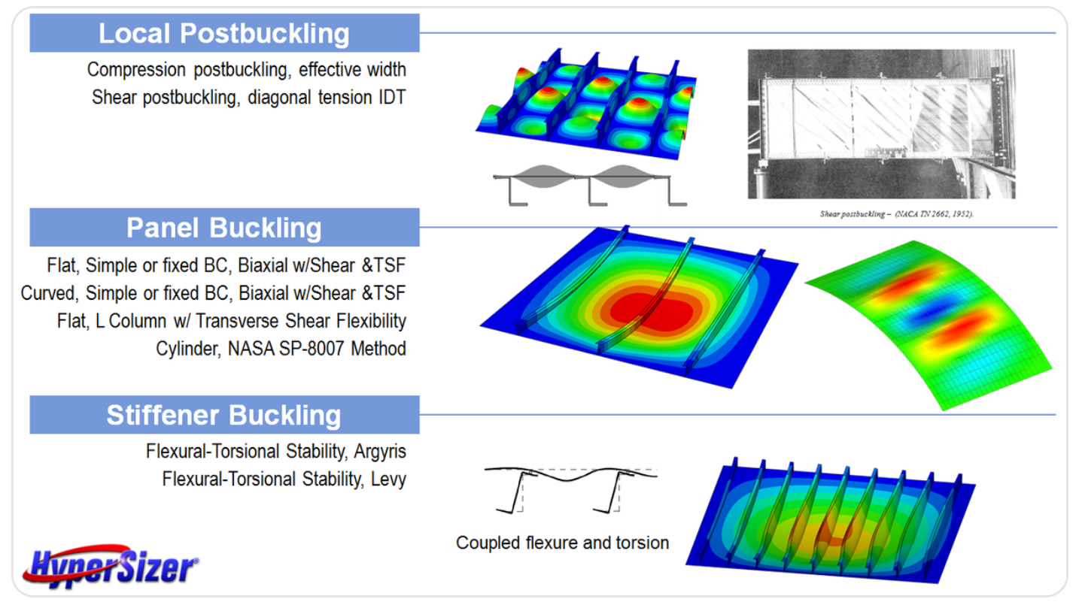
Analysis type (buckling)

Slide 16
Analysis type (fatigue)
The progressive and localised structural damage that occurs when a material is subjected to cyclic loading.
  Nominal maximum stress values are less than the ultimate tensile stress limit, & may be below the yield stress limit of the material.
Fatigue
Low cycle
High cycle
(>10⁵ cycles)

Slide 17
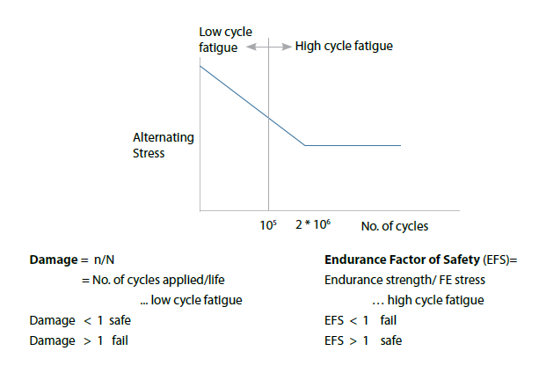
Analysis type (fatigue)

Slide 18
Analysis type (optimisation)
Optimization for geometry
parameters, work well at the individual component level rather than with complicated
assemblies.
Usually restricted to only
linear static and normal
mode dynamics.
Good tool for innovative
products (when the initial shape is not known or fixed).
Software cannot add or
remove geometry on its own but can only play with pre-defined parameters within specified limits
Optimisation
Geometrical parameters
Shape optimisation
Software can give hints for the addition or removal of geometry.

Slide 19
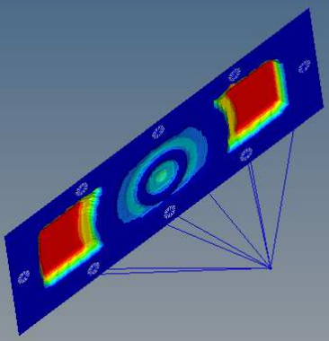
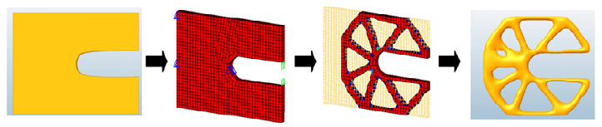
Analysis type (optimisation)
The design variable of a topology optimization is the elements density (figure below);
The design variable of a size optimisation is the thickness of a sheet metal.
Topography optimization is a special class of shape optimization, which can be used to change shapes of shell structures by introducing stamped beads for a better structural performance.

Slide 20
Geometry, Element Type and Mesh Density
Elements are defined by the following properties:
  Geometry (dimensionality)
  Structural behaviour (i.e. dof)
  Geometric order of the element
  Integration points
  Mesh quality
  Element quality

Slide 21
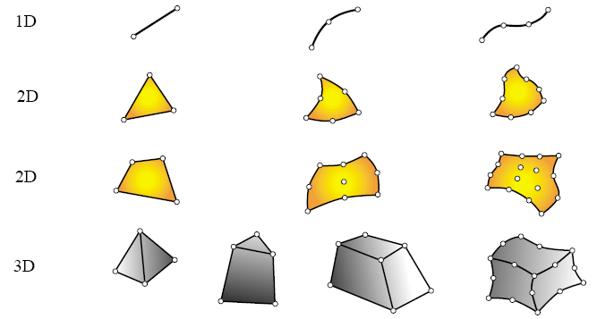
Geometry
1D Line – 2D Plate – 3D Solid

Slide 22
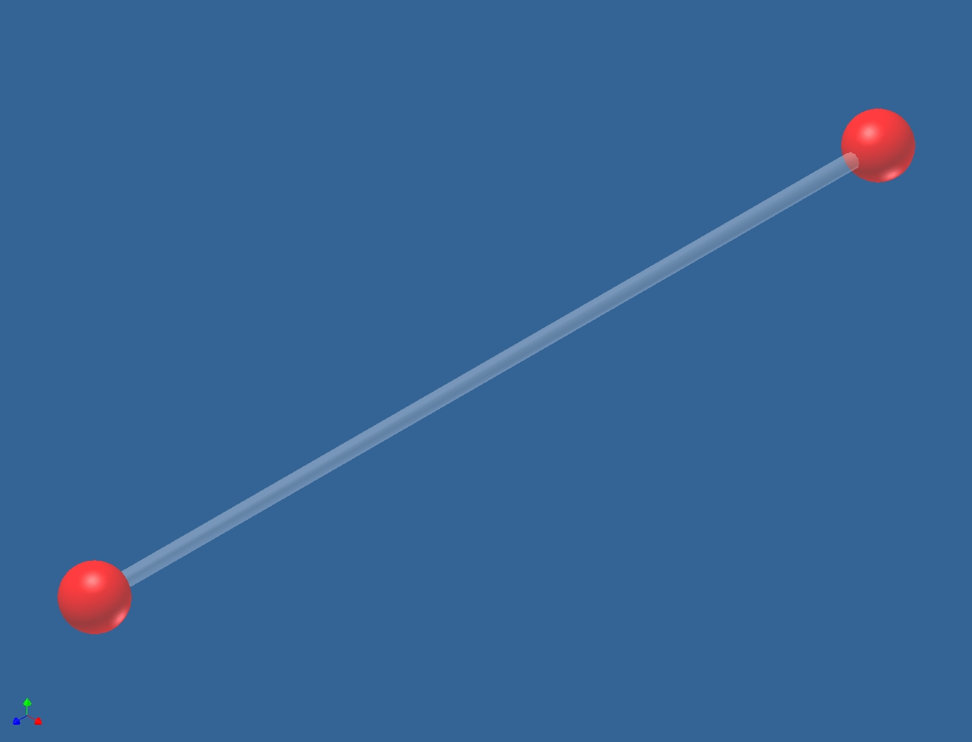
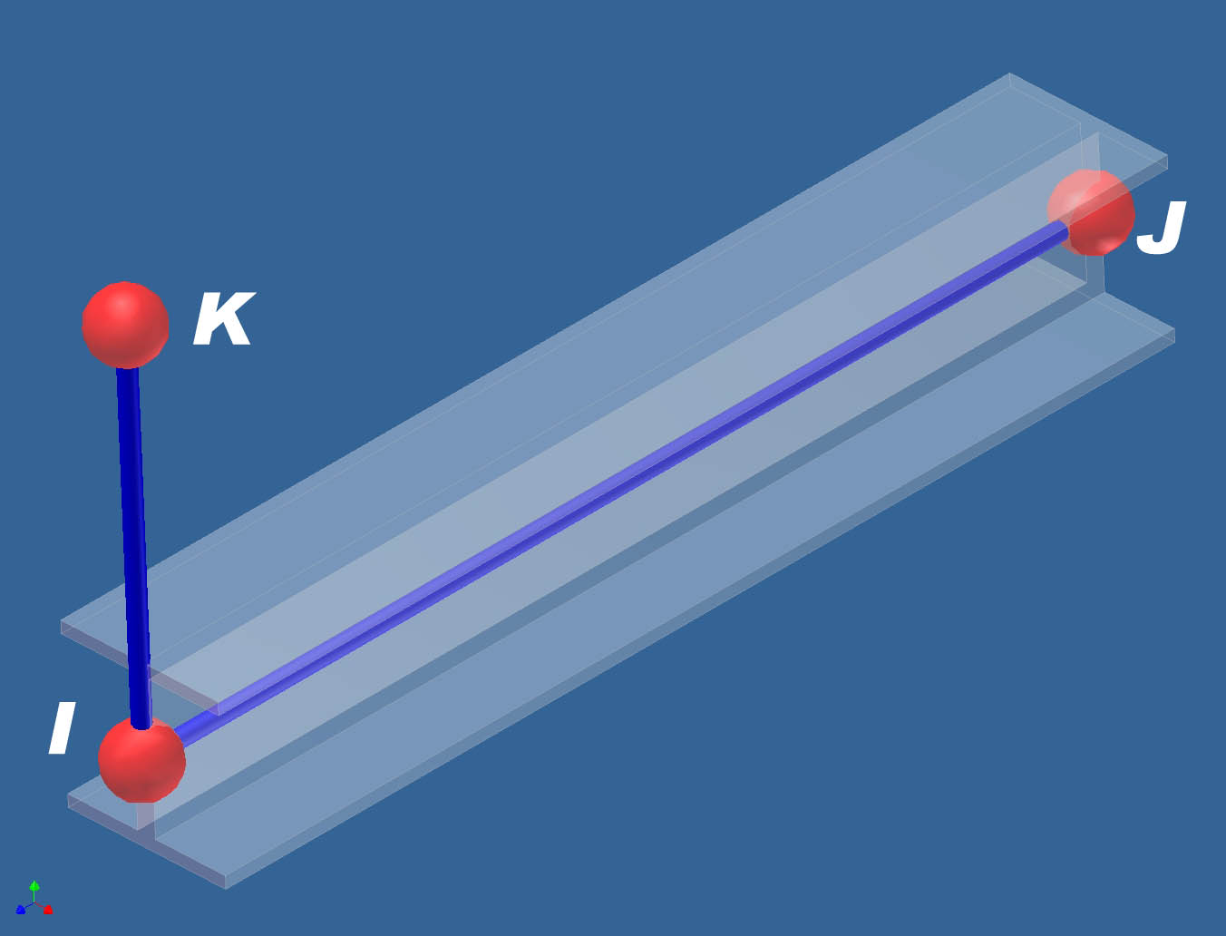
Element type – Structural behaviour (1D Elements)
-Truss/Rod/Bar elements;
-3 translational dof at each node
-Transmit axial force only
-Beam elements;
-6 dof at each node
-I-J defines element geometry
-I-K defines the beam normal

Slide 23
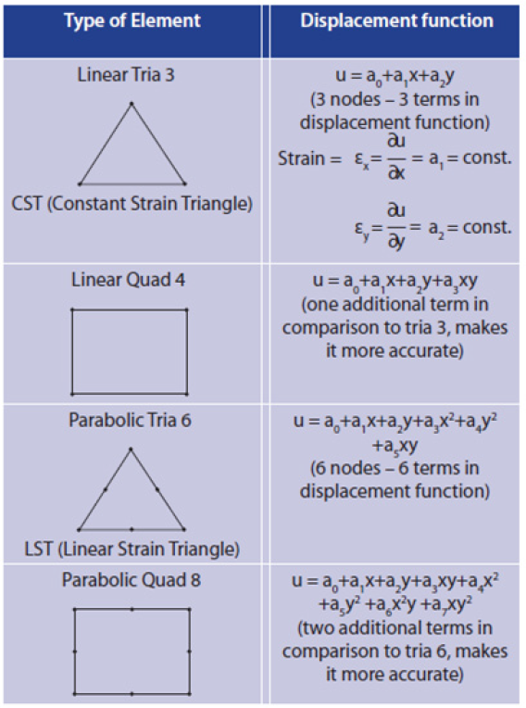
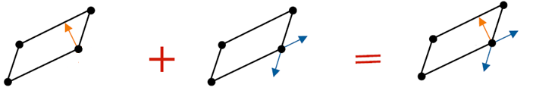
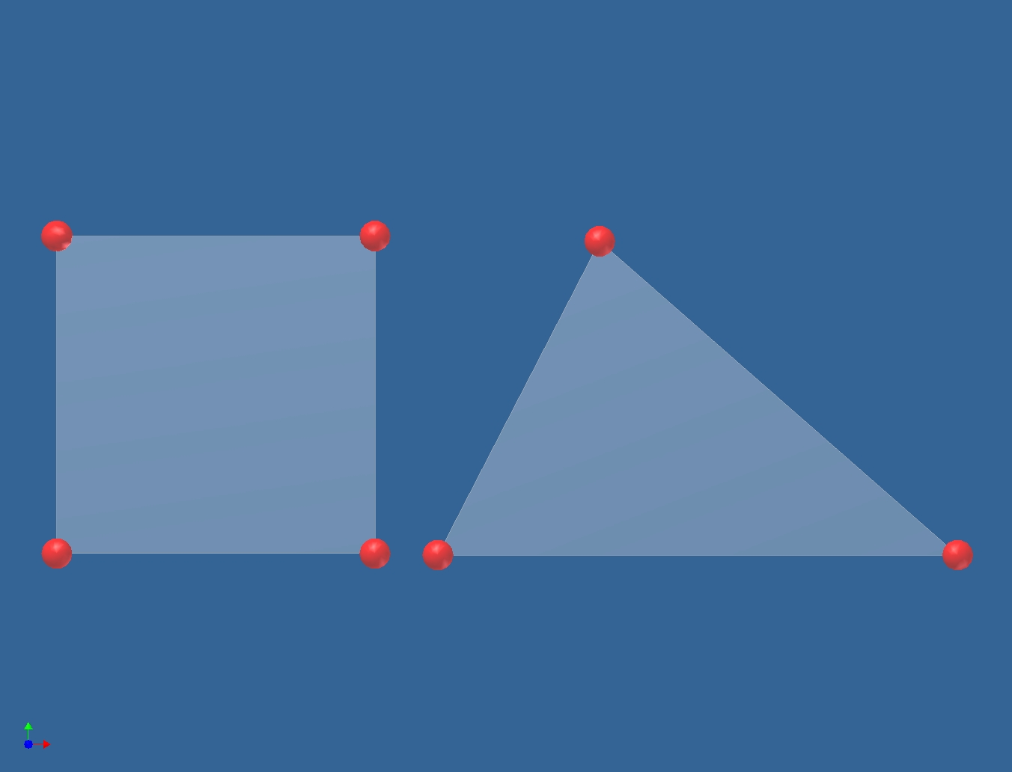
Element type – Structural behaviour (2D Elements)
Plate element;
1 out of plane translation dof
2 in-plane axes rotation dof
Membrane element;
2 in-plane translation dof
Shell element;
3 translation dof
2 in-plane axes rotation dof
2D elements can be either quadrilaterals or triangular

Slide 24
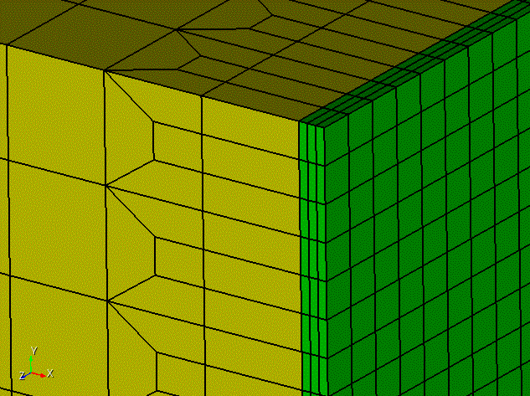
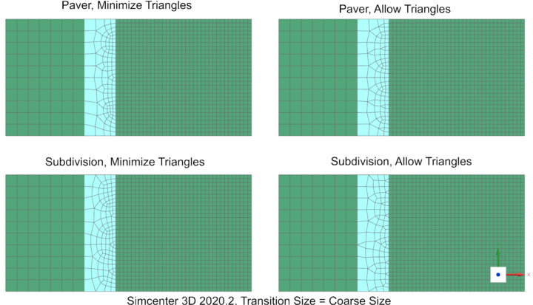
Element type – Structural behaviour (2D Elements)
It is best to minimise the use of triangular elements to less than 5% of total elements;
Why does FEA provide triangular elements?
  Mesh transition:
    In structural and fatigue analysis, rather than a uniform mesh, what helps is a small element size in the critical areas and a coarse mesh or bigger elements in general areas. This type of mesh gives good accuracy with manageable dofs. Trias help in creating a smooth mesh transition from a dense mesh to a coarse mesh.
  Complex geometry:
    Geometry features like rib ends or sharp cut-outs demand for the use of triangular elements. If quads are used instead of trias, then it will result in poor quality elements.
  Better mesh flow:
    For crash or nonlinear analysis, systematic mesh flow lines where all the elements satisfy the required quality parameters is very important. Using a mix-mode element type instead of pure quad element type helps to achieve better flow lines and convergence of solution.
  Tetra meshing & Mould flow analysis .

Slide 25
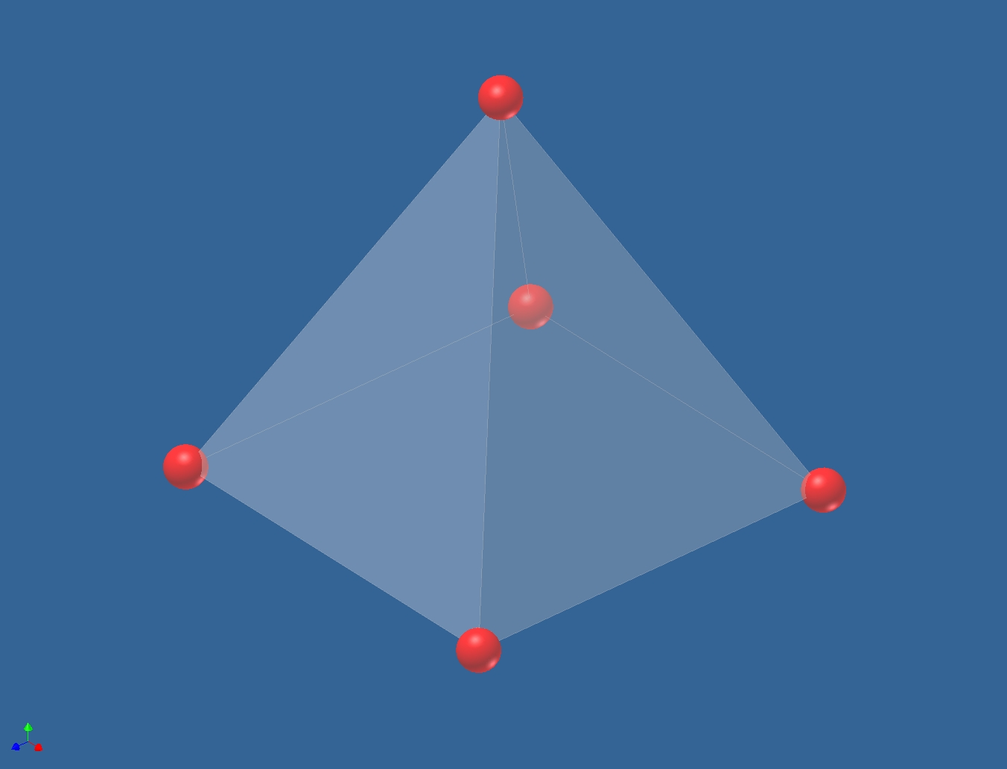
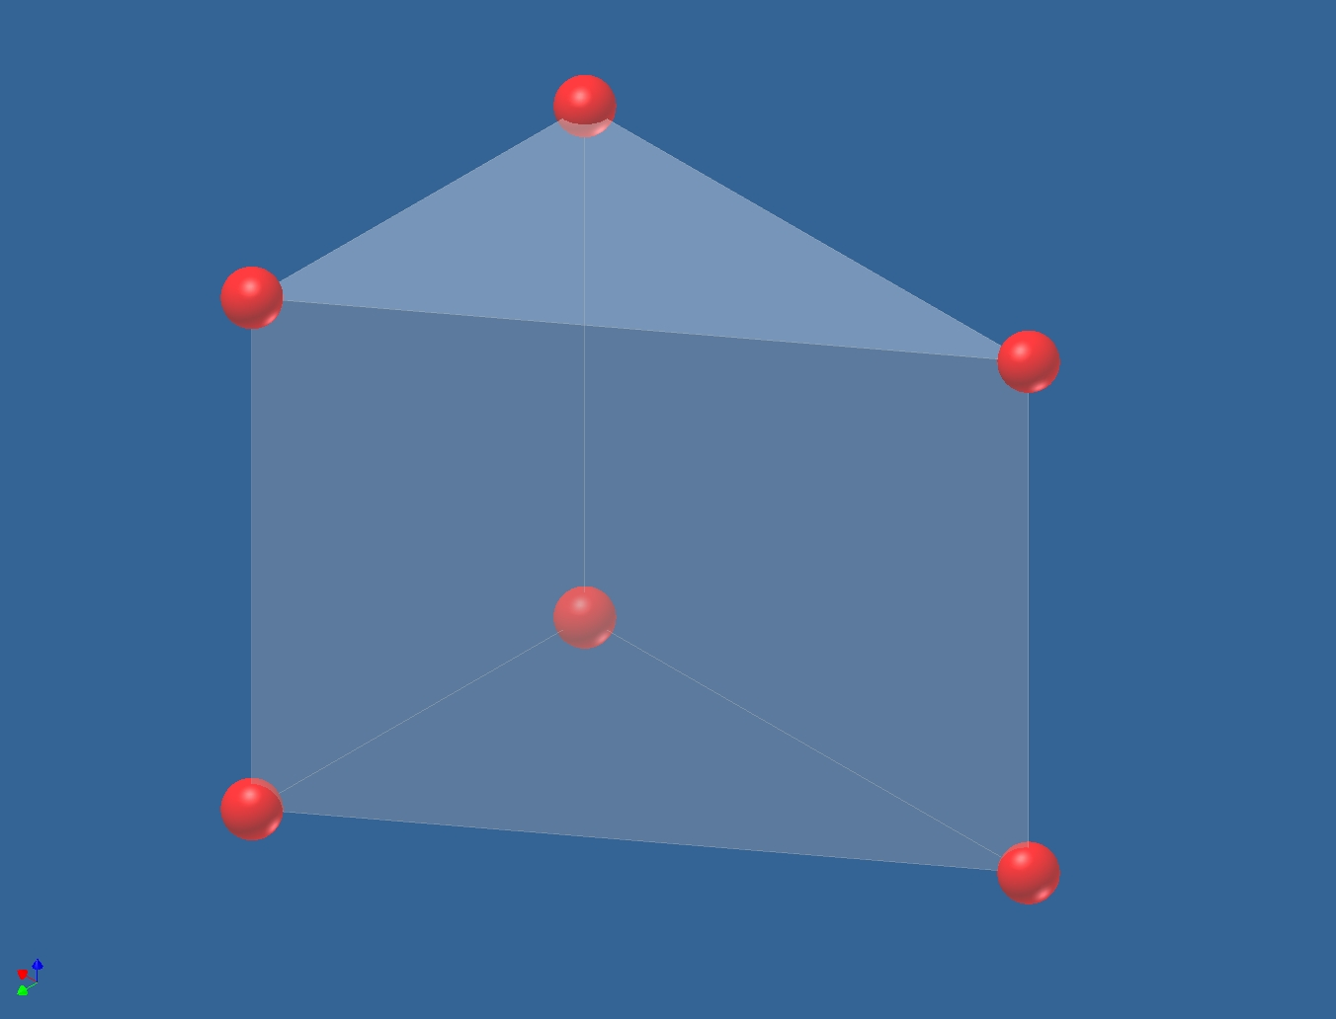
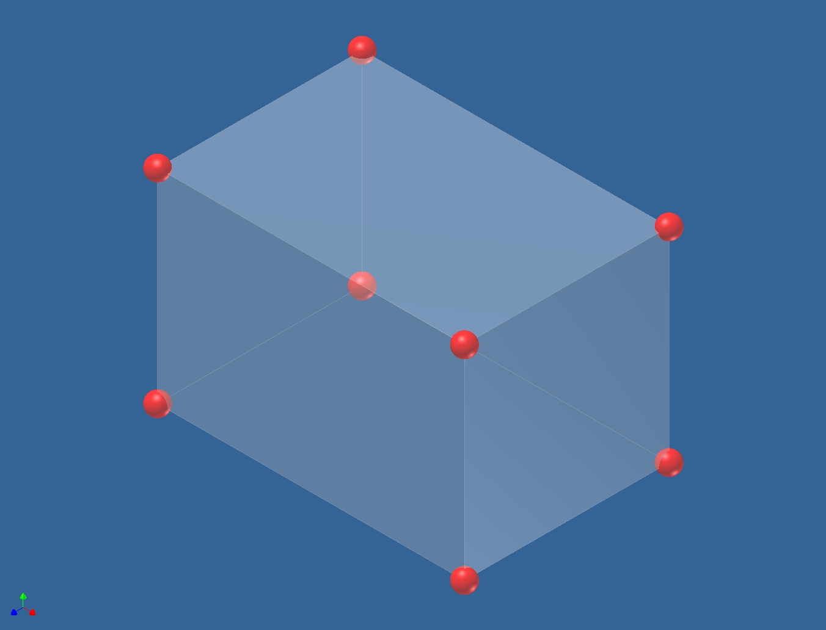
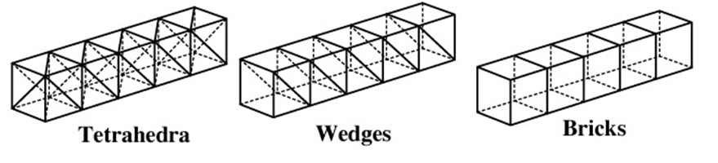
Element type – Structural behaviour (3D Elements)
There are only 3 translational dofs per node.
Notes:
Solids – 3 translational dofs
Brick elements may have 4, 5, 6, 7, or 8 nodes and support only translational DOF. They are normally used to model solid objects for which plate elements are not appropriate. You can usually specify either all tetrahedra, all bricks, or a mixture of both with most automatic mesh generators. This is the most common, and frequently the only element type supported by automatic mesh generators. Bricks work quite well for any "blocky" structures which are typical of machined, cast, or forged fabricated parts. Structural and thermal bricks exist so the same model geometry can be used for both the initial steady state heat transfer and subsequent thermal stress computations. Bricks compute stress through the thickness of a part – if sufficient elements are present through the thickness.

Slide 26
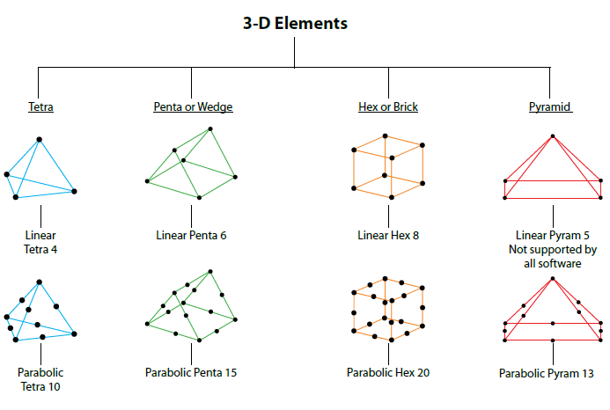
Element type – Structural behaviour (3D Elements)

Slide 27
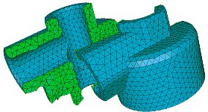
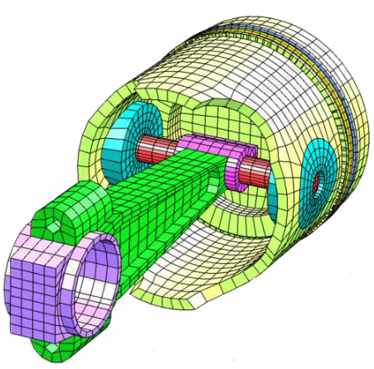
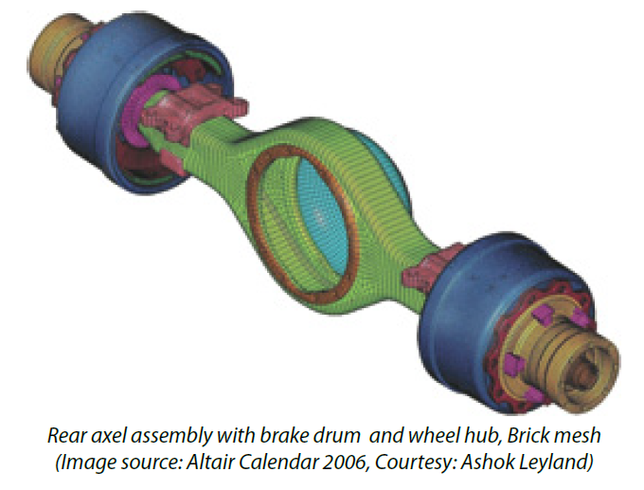
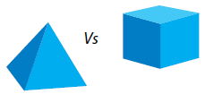
Element type – Structural behaviour (3D Elements)
Number of elements and nodes are 1/2 and 1/50 of tetras so good for solution time.
For crash and nonlinear go for bricks to reduce solution time.
Tetra meshing requires experience and patience.
In terms of accuracy tetra10 and brick 8 are similar.

Slide 28
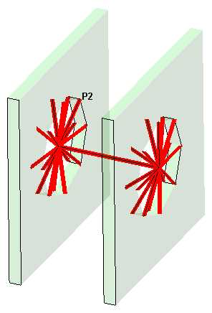
Element type – Structural behaviour (Special Elements)
These elements do not fall into the simple 1D, 2D or 3D element type categories;
Most common Special Elements are:
  Rigid - infinitely rigid connection;
    RBE2 in Nastran, Hypermesh
    Coupling elements in Abaqus
  Spring - stiffness defined for each dof.
Rigid ‘spider’ element
Notes:
These special elements are normally classified as constraints.

Slide 29
Element type (Geometric order)
Linear displacement;
Quadratic displacement;
  One extra node in the middle.
Higher order displacement.
  Requires more mid point nodes.
Linear
Quadratic
Cubic
Constant stress/strain
Varied stress/strain to capture realistic behaviour response
Notes:
Order – defined by how is displacement described within the element.
Linear – usually 2 nodes per side, etc
Higher order – generally better results
Higher order leads to more CPU time requirements

Slide 30
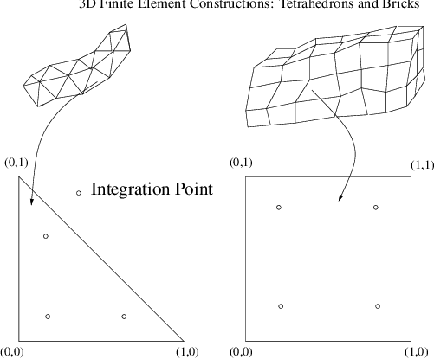
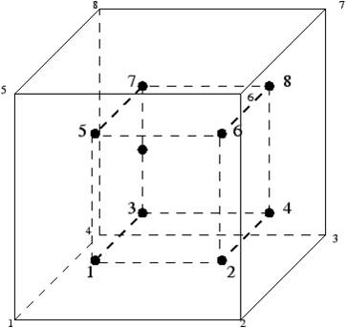
Element type (integration point)
Displacements are calculated at the element nodes;
Elements have internal integration points which represent the most accurate stress values in the element;
Stress and strain values are extrapolated from the integration points to the element nodes.
Notes:
Forces and displacements are computed at nodal locations, stresses and strains are computed at integration points.
The figure above for a typical 8-noded, linear, three-dimensional element illustrates the difference between nodal locations and integration points.
The nodal locations are at the corners of the cube while the integration points are located within the element.

Slide 31

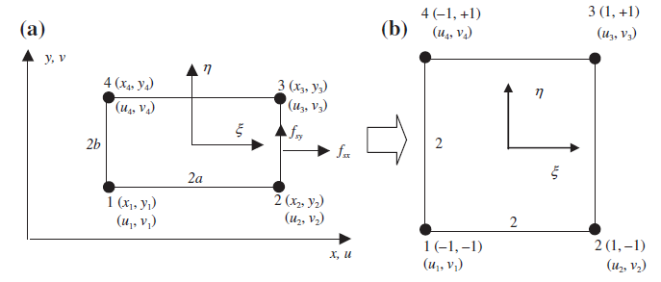

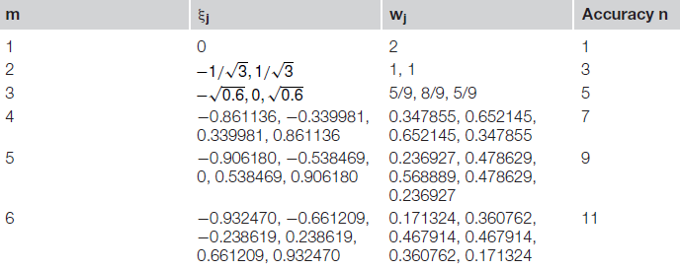
Element type (integration point)
Integration is not straightforward as B matric is a function of
Although it is possible to solve it analytically but numerical method is adopted in FEA;
This is done via Gauss Integration Scheme.

Slide 32
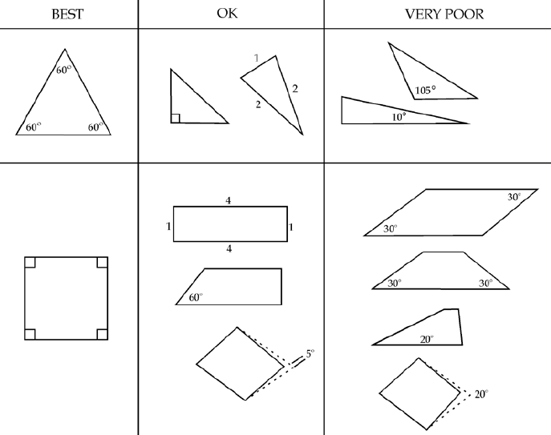
Mesh quality

Slide 33
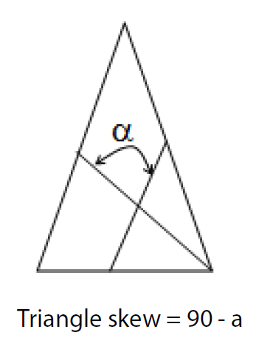
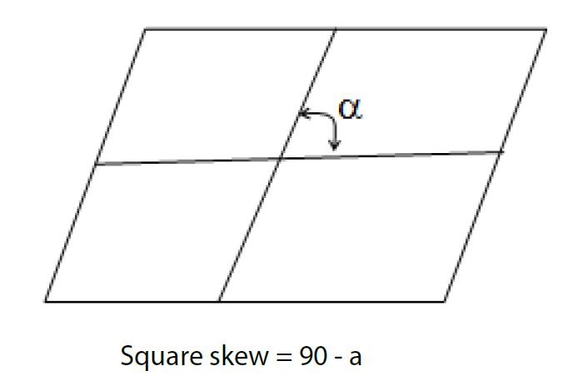
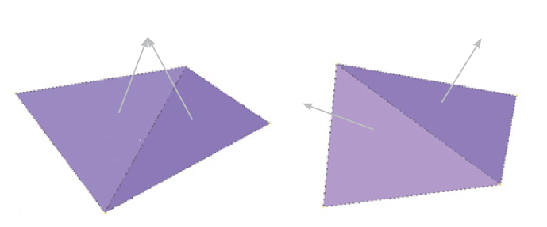
Element quality (shells)
Skewness;
  Ideal =0 but <45 is acceptable.
Aspect ratio;
  L_{max}/L_{min}<5.
Warpage;
  For QUAD only.
Jacobian;
  Ideal 1
  >0.6 acceptable
L_{max}
L_{min}
Notes:
Warpage:
Warpage in two-dimensional elements is calculated by splitting a quad into two trias and finding
the angle between the two planes which the trias form. The quad is then split again, this time using
the opposite corners and forming the second set of trias. The angle between the two planes which
the trias form is then found. The maximum angle found between the planes is the warpage of the
Element
Jacobian:
The Jacobian ratio is a measure of the deviation of a given element from an ideally shaped element.
The Jacobian value ranges from -1.0 to 1.0, where 1.0 represents a perfectly shaped element. The
ideal shape for an element depends on the element type. The check is performed by mapping an
ideal element in parametric coordinates onto the actual element defined in global coordinates. For
example, the coordinates of the corners of an ideal quad element in parametric coordinates are (-1,-
1), (1,-1), (1,1), and (-1,1).

Slide 34
Element quality (solids)
Tetra collapse;
Volumatic skew;
Stretch;
Distortion;
Aspect ratio;
  For bricks only.
Jacobian.

Slide 35
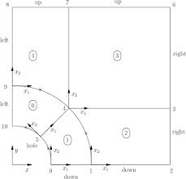
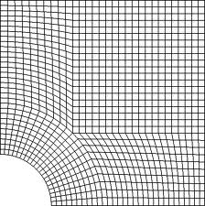
Mesh density
Generally – more refined mesh – more accurate results;
Structure the mesh to regions of interest.
  Run Time Scale Factor = (Mesh density Scale Factor)²
Notes:
Need to pick up appropriate behaviour:
- in case of flexural behaviour – number of elements must be sufficient to pick up and show results for bending moments.
- in case of dynamic analysis – number of elements must be sufficient to pick up dominant modes (in case of bending ~5 / span).
Accurate SCFs used for fatigue and fracture mechanics assessments

Slide 36
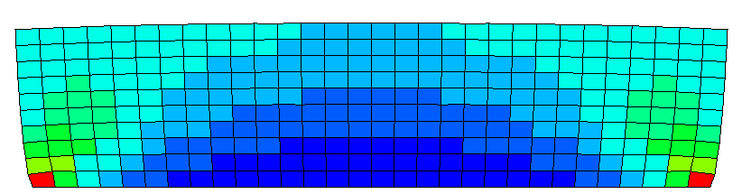
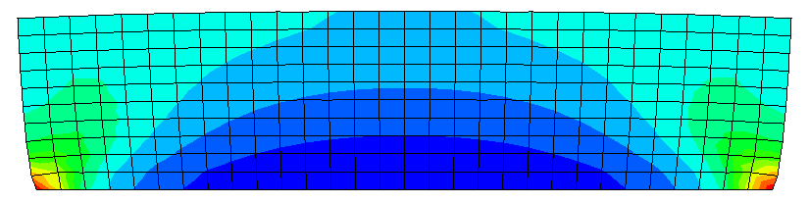
Output control (averaging)
Contour plots are provided for UN-AVERAGED and AVERAGED element results. (e.g. plate fixed at bottom edge and tensile load at the top edge);
If the regions of concern are the bottom corners then the mesh needs to be refined as the un-averaged plot does not show stress continuity.
The most reliable stress/strain result is to get values at integration points
Fixed Bottom Edge
FEA finds displacements at nodes but stresses and strains are found at integration points inside the elements.
Notes:
Be careful about averaging in contour plots - check un-averaged values to ensure smooth results first!
If we are really interested in the corners, the mesh would need to be refined as non-averaged plots shows a big step in the results between the adjacent elements
Averaging results can be undertaken in two ways:
Averaged nodal stresses at corners
Averaged corner stresses extrapolated to element centroids
Contouring through centroid values
Averaged nodal stresses within each element directly to centroid
Contouring through centroid values
Forces and displacements are computed at nodal locations, stresses and strains are computed at integration points.
The figure above for a typical 8-noded, linear, three-dimensional element illustrates the difference between nodal locations and integration points.
The nodal locations are at the corners of the cube while the integration points are located within the element.
- Since each node in a model will generally be shared by more than one element these extrapolated values will also have to be averaged in order to produce a smooth contour plot.
The degree to which the contour plot data differs from the actual data depends on the element type/formulation and particularly on the steepness of the underlying field variable gradient (i.e. non-linear variation in displacement, stress,...) and to a large extent the quality of the underlying finite element mesh.
Large gradients and a coarse mesh will obviously produce a greater degree of difference between the integration point data and extrapolated nodal averages.
- Relying upon discrete data taken from contour plots for stress or strain can be misleading and inconsistent between various analysis runs. One reliable method for extracting specific stress and strain values is to use “integration point” data. In this way, you are assured of getting an accurate stress or strain value that relates directly to the solution of the underlying mechanics equations. It is the analyst’s responsibility to understand the impact of using either integration point data or averaged nodal data.

Slide 37
Validation
Validation is the process of determining the degree to which a model, simulation, and their associated data are accurate representations of the real world from the perspective of the intended uses;
Validation considers if the results of the FEA are reasonable and appropriate:
  Reasonableness or sanity checks using hand calculations;
  Comparison to standard results – structural design codes;
  Comparison to physical test data;
  Comparison to other FEA results.

Slide 38
Validation (sanity check)
Note 1
  We make complex structural models from relatively simple basic elements, we have to be careful not to overextend them.
Note 2
  Hand calculations can be tedious and simplified – but we need them to make sure we don’t create ‘Garbage In, Garbage Out’.
Note 3
  Are the FEA output results reasonable? Does it make sense in reference to the real structure’s behaviour?
Notes:
Fact of life 1: for example using 2D elements to model stress concentrations, coarse mesh,...

Slide 39
Quality Assurance (QA) requirements
Self check first;
Include both verification and validation;
Document scope and depth of checking;
  Meet client requirements for FEA checking procedures
  Verification Plan
Lead verifier should be independent;
Assess and record competency of lead verifier;
Keep records of checking and approval.

Slide 40
QA requirements (Good practice)
Basis of Analysis (BoA)
Maintain a model register
  FEA models (descriptions, intent, analyst and status)
  Supporting calculation files
  Subroutines or other programming used (Fortran/Python)
Clear records of checking evidence
  Stage gate approach during the FEM (Finite Element Model) development – start with a simplified model!

Slide 41
QA requirements (Good Practice Process)
BoA
The BoA should be authored and agreed prior to commencing FEA. The BoA is kept as a live document while the model is being developed. The BoA should provide a record of self-checks completed during the construction of the model
FEM register
The FEM register provides a live, accurate record of the FEA models along with the unique reference numbers assigned to each FEM.
Verification plan
The verification plan sets out and records the methods used by the verifier / verification team to verify the FEM. Competency assessments of the verification team should be carried out by the Lead engineer.
Verification comments
Issues raised in verification should be recorded either on a verification comments form, or by producing marked up versions of relevant documentation. All issues identified in verification need to be addressed by the FEM analyst. Verification will have to adhere to the client’s QA requirements which could include client specific FEA or calculation check sheets.
Competency Assessment of verifying Engineers

Slide 42
QA requirements (verification plan example)
Verification plan is different from company to company but a good example of this is as below;
Low level checker (Engineer/Senior engineer)
High level checker (Principal/Chief engineer)
FE analyst
Read client’s requirements
Simplifying the problem
Modeling
Element quality check
Mesh density check
BCs and loading check (quantity and quality)
Element offset check
Validation run checks…
Methodology check
Results check
Authorizing the model

Slide 43
Errors & Lessons
Units:
  For some FEA software such as Abaqus, Hyperworks, Nastran etc.
Model is not fully constrained (rigid body motion);
Discontinuities in contour plots;
Poor element behaviour:
  Free edges, hour-glassing, distortions;
  Few element distortions can contaminate the system stiffness matrix.
Interpret result component directions correctly;
Use the element mesh quality tools present in the FEA software.
Notes:
Some FE software (civil engineering applications) allows the user to specify the unit series to be used.
Discontinuities in contour plots could result from low mesh density, element type, connection between different element types, constraints (ties,…)
Stress discontinuity error = highest stress – lowest stress at a node
Stress discontinuity error = largest difference (Neighbour element stresses – average nodal stress)
Free edge and free surface checks can be undertaken by the pre-processor
Re-check all element assignment for materials!! Check all offsets for shells to beam/bar !!
FEA software checks:
Element quality checks (aspect ratios, interior angles, taper…)
Free edge checks
Pivot ratio check:
Mechanisms due to DOF mismatch between dissimilar element types
Very stiff elements near flexible elements
Unreasonable material properties
Method:
Run a linear static solution
Identify where the maximum pivot ratio is reported and when is too large (>10^7) or negative stiffness terms --- then stop solution or flag

Slide 44
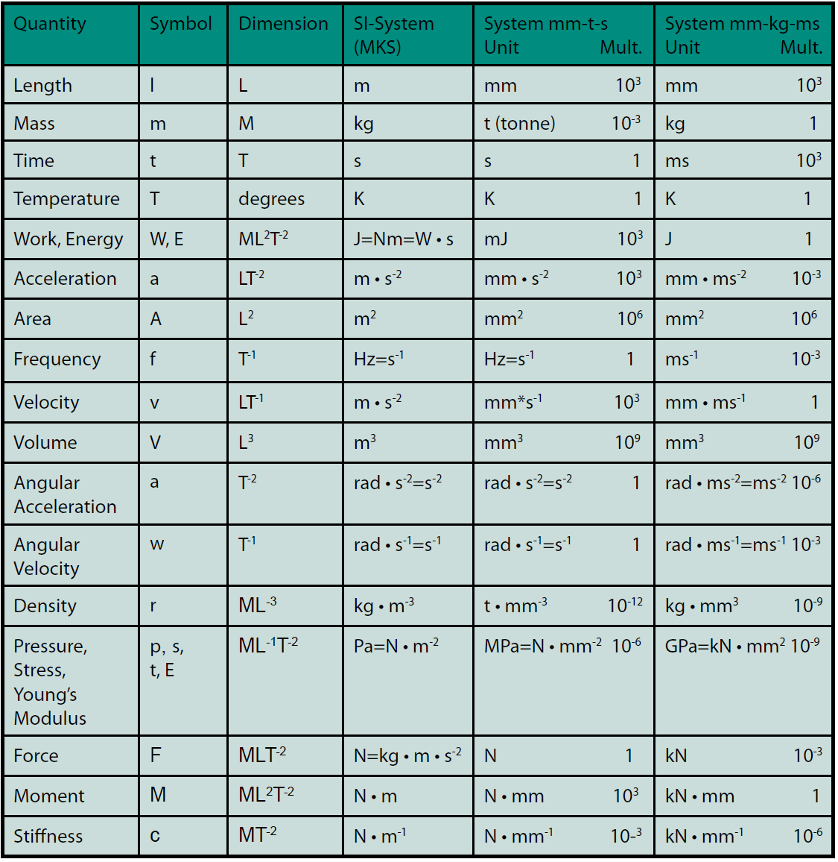
Errors (units)

Slide 45
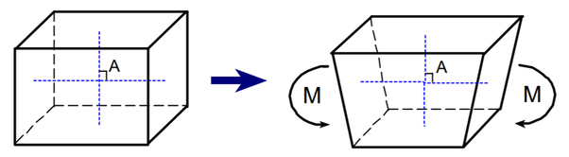

Errors (hour-glassing)
Refine the mesh to avoid it.
Add artificial stiffness to the element.
Use fully integrated elements (second order).
In terms of accuracy tetra10 and brick 8 are similar.
One integration point for reduced integration elements where mesh is deformed for zero strain.
Notes:
If this element is of reduced integration type, then there is only one point for integration. These are the points where the strains are measured. Now, in the figure, it is clearly indicated that even though there is distortion of the mesh, the distances from the integration point to the faces and its location hasn’t changed. That means there is now a deformation which produces no strains, hence no forces to resist. This pattern can grow unbounded and easily destroy the whole simulation.

Slide 46
Deliverables
Basis of Analysis;
FEA model register;
FEA models input and output files including sensitivity studies;
Analysis report or technical note – describing the FEA;
FEA verification plan;
Evidence of verification and validation;
FEA verification comments and approval;
Provide sufficient information for the model to be recreated independently.

Slide 47

Engineering problem
The following engineering problem is used as a supporting example to understand the FEA building process. The project was done by Atkins offshore department.
Notes:
Typical offshore wind structural assessment – common issue for a number of wind farms

Slide 48

Engineering problem
Observed slipping of the Transition Piece relative to the grout and Mono-pile;
Increased local stresses in the stoppers due to the Mono-pile, leading to higher SCF and lower fatigue life.
Stopper*
*Simplified sketch of the stopper
Notes:
MWL – mean water line
Emphasis why only concerned with grouted connection – slipping of the Transition Piece vs monopile – need restraint support – fatigue assessment of remedial solution (SCF)
Two concentric structures with grout in between.
Wind loading applied, not modelling the turbine – only the structures in the grouted connection
The SCF is a pre-requisite to determine the fatigue life of the wind tower structure
Project aim is to model the remedial solution to reduce the peak SCF in the structure

Slide 49


Engineering problem
A remedial design solution has been proposed to prevent further slippage of the Transition Piece and improve the fatigue life;
The stoppers of the as-built structure are modified or removed such that they no longer impact upon the top of the Monopile.
Welded to the Transition Piece
Stopper
Fits to the Monopile

Slide 50
Engineering problem (FEA purpose)
The aims of the FEA are the following:
  Model structures in the grouted connection – region of interest;
  Incorporate the remedial solution into the as-built structure;
  Identify the peak stress location and extract the stress path profile.
In line with the design codes for offshore structures, the SCF is calculated based on the stress path profile;
Subsequent fatigue assessments are undertaken outside of the FEA which consider the SCFs calculated.

Slide 51
Engineering problem (analysis type)
Abaqus FEA Software;
Static analysis;
No material non-linearity behaviour;
The analysis is broken down into eight steps:
  Equilibrium – no load;
  Weight of the structure (as a displacement);
  Grout to steel contact interactions are enabled;
  Weight of the structure;
  25% of the maximum wind loading;
  50% of the maximum wind loading;
  75% of the maximum wind loading;
  100% of the maximum wind loading.
Notes:
The analysis needs to be broken down into a sequence of events to allow for a solution to be attained for the loaded structure (i.e. final step in the analysis).
- Can describe the constraints, boundary conditions, loadings,... per analysis step

Slide 52


Engineering problem (geometry)
3D solid
2D cylinder
3D solid
2D cylinder
Notes:
NO WELDS WERE MODELLED – IN LINE WITH OFFSHORE WIND DESIGN CODE REQUIREMENTS FOR FEA
Top section of Transition Piece and bottom section of Monopile are made of shells instead of 3D solids.
Through thickness response is not essential at these regions away from the region of interest (i.e. Grouted connection). Shell is sufficient to transmit the bending load down the structure.
The entire wind tower structure is not modelled and only a certain height above and below the grouted connection is modelled.
It is judged that these extents are far enough from the point of interest such that local effects of the boundary conditions and load couplings applied should not negatively influence the local result
Stiffeners are modelled but they do not transmit

Slide 53


Engineering problem (element type and mesh density)
2D shell (D/t > 20)
3D solid
2D shell
Notes:
2D above region of interest
Mesh refined to capture the localised stresses to calculate the SCF.
Detail of the remedial solution and the existing stiffeners are required to calculate the SCF. No other local features are included in the structure (e.g. Ladders,...)
All 3D solid elements are of type: C3D8R – 8 node brick, reduced integration points, hourglass control
All 2D shell elements are of type: S4R – 4 node curved thin/thick shell, reduced integration points, hourglass control, finite membrane strains
Higher mesh density of linear order elements are used. Previous experience has shown that they are more suitable for contact interactions than less mesh density of quadratic order elements.

Slide 54

Engineering problem (material behaviour)
Linear elastic behaviour
S355 steel – GREEN regions
Density: 7850 kg/m³
Young’s modulus: 210 GPa
Poisson ratio: 0.3
Ducorit S5 grout – GREY Region
Density: 2400 kg/m³
Young’s modulus: 53 GPa
Poisson ratio: 0.19
Notes:
Elastic material behaviour is required to calculate the SCF for fatigue purposes.
Only linear elastic material properties are available for the grout material from source documents. Cannot model the grout in any other way without justification.

Slide 55


Engineering problem (constraints)
Kinematic coupling from central reference node to top edge of Transition Piece
Shell to solid coupling
Uni-directional springs defined for 5 dof based on test data. No torsional stiffness included
Notes:
Kinematic coupling applied to allow for boundary condition and loading definition to be applied – see slides to follow
Shell to solid coupling for Transition Piece and Monopile
Spring stiffness data is obtained from manufacturer for different dof

Slide 56
Engineering problem (constraints)
Steel-steel friction and normal contact interactions defined between each component pair:
Frictional and normal contact interaction between steel to grout + grout to steel
Notes:
Contact definition is based on design code guidance and engineering judgement on best estimate values.
Coefficient of friction of 0.4 for steel to grout and 0.3 for steel to steel – tangential
Hard contact for steel to steel and exponential pressure overclosure for steel to grout – normal

Slide 57
Engineering problem (constraints)
Analysis Step | Steel to steel contact | Steel to grout contact
Equilibrium | Inactive | Inactive
Structure weight (imposed displacement) | Active | Inactive
Grout- steel contact enabled | Active | Active
Structure weight (load) | Active | Active
25% of wind loading | Active | Active
50% of wind loading | Active | Active
75% of wind loading | Active | Active
100% of wind loading | Active | Active

Slide 58

Engineering problem (boundary conditions)
BC1: No relative translational displacement allowed at the top of the Transition Piece. This is defined via a central reference node.
BC2: No translational displacement allowed at the bottom surface of the grout
BC3: Bottom surface of the Monopile is fixed in all 6 dof
Notes:
The entire wind tower structure is not modelled and only a certain height above and below the grouted connection is modelled.
It is judged that the boundary conditions at these extents are far enough from the point of interest such that local effects of the boundary conditions and load couplings applied should not negatively influence the local result
The three boundary conditions shown above are present at the initial analysis step i.e. at equilibrium.
BC1: The top of the Transition Piece retains its circular shape with no ovalisation until wind loading is applied.
BC2: Retains the grout (prevents it slipping off) until steel to grout contact is enabled and wind loading has been applied
BC3: The bottom of the modelled Monopile is fixed at all times – restrained structure

Slide 59
Engineering problem (boundary conditions)
Analysis Step | BC1: Transition Piece | BC2: Grout | BC3: Monopile
Equilibrium | Active | Active | Active
Structure weight (imposed displacement) | Imposed vertical displacement due to structure weight | Imposed vertical displacement due to structure weight | Active
Grout- steel contact enabled | Imposed vertical displacement due to structure weight | Imposed vertical displacement due to structure weight | Active
Structure weight (load) | Allow for vertical translation | Allow for vertical translation | Active
25% of wind loading | No relative translational displacement in direction of wind loading* | Inactive | Active
50% of wind loading | Inactive | Inactive | Active
75% of wind loading | Inactive | Inactive | Active
100% of wind loading | Inactive | Inactive | Active
*This boundary condition was enabled to allow for convergence of a solution.
Notes:
Due to the contact between the Transition Piece/grout/Monopile, an imposed vertical displacement is applied first to represent the structure’s weight then contact is enabled for Transition Piece/grout/Monopile.

Slide 60

Engineering problem (loading definition)
Shear
Moment
Weight
All bending and weight loading is applied at the central reference point at the top of the Transition Piece:
Weight of the structure
Shear load applied horizontally
Bending moment applied along the transverse axis (y-axis)
Notes:
There are three load components:
Shear load
Bending Moment
Weight of the structure – full deadload of the structure modelled

Slide 61
Engineering problem (solution control)
Linear static analysis has been used, therefore minimal solution control is required;
Ramp increase in load for each step in the analysis;
Default values are considered to be reasonable;
  Total analysis time = 1 sec;
  Minimum time increment = 1E-5 sec;
  Maximum time increment = 1 sec;
  Permit maximum of 100 time increments.
Notes:
For static analyses:
If solution not reached – usually boundary conditions are insufficient, unrestrained dofs, unconnected parts of the mesh

Slide 62




Engineering problem (output control)
von Mises stress and all directional stresses and strains;
Contact displacement and forces;
Un-averaged von Mises Stress
Averaged von Mises Stress
All directional displacements and reaction forces.
Notes:
Minimal difference between stress plots of the most loaded remedial solution (compressively loaded side)
Stresses in grey are above 350MPa – yield limit of steel

Slide 63


Engineering problem (output control)
Un-averaged von Mises stress at peak stress location – region of interest
Averaged von Mises stress at peak stress location – region of interest
Grey plots are beyond the yield of material (>350 MPa)
Notes:
Good stress continuity in un-averaged stress plot.
Stresses in grey are above 350MPa – yield limit of steel
Calculating the SCF using hot spot stress method from the offshore design code standards.
Calculating the SCF at each load step (25%, 50%,...) to calculate the Stress Transfer Function – fed into stress histogram for fatigue assessment

Slide 64
Engineering problem (sensitivity studies)
Geometry sensitivity
  Reduction in grout height modelled – grout damage
  Reduced Transition Piece thickness – corrosion wall loss
  Remove one of the remedial solutions – lost/damaged
  No remedial solution installed – as-built structure
Mesh sensitivity
  Mesh density increase in region of interest
Constraint sensitivity
  Grout to steel coefficient of friction
  Spring stiffness – uncertainty in manufacturer test results
Notes:
No elastic plastic material behaviour was needed because the elastic stress was required for the subsequent fatigue assessment

Slide 65




Engineering problem (sensitivity studies)
Baseline analysis
Increased mesh density by 50% at region of interest
Notes:
Stresses in grey are above 350MPa – yield limit of steel
Small difference in the SCF using the Hot Spot Stress Method – 2% reduction in SCF due to increased mesh density

Slide 66



Engineering problem (validation)
Wind loading
The deflection of the tower is in the correct direction
Load transfer through the remedial solution from the transition piece to the monopile
The displacement of the transition piece and the monopile (vertical displacement)
Contact pressure (CPRESS)
Hand calculation of displacement value to validate the model
Notes:
Pressure due to contact surfaces – remedial solution
Reasonableness checks:
The deflection of the tower is in the correct direction
Load transfer through the remedial solution from the Transition Piece to the Monopile
The displacements of the Transition Piece and the Monopile (vertical displacement)
Contact displacement from steel to grout was acceptable – not significant (defined as pressure overclosure – 50kN for 0.0005m?)
And others as well
No elastic plastic material behaviour was needed because the elastic stress was required for the subsequent fatigue assessment

Slide 67
Engineering problem (validation)
In addition to checking for the reasonable behaviour response of the structure, the following calculations were undertaken:
  Comparison of strains of the as-built structural model to strain gauge data – increases confidence in the behaviour of the FEA analysis;
  Comparison of the global stress at the top of the Transition Piece solid section – away from the local effects at remedial solution height level.
Notes:
Reasonableness checks:
The deflection of the tower is in the correct direction
Load transfer through the remedial solution from the Transition Piece to the Monopile
The displacements of the Transition Piece and the Monopile (vertical displacement)
Contact displacement from steel to grout was acceptable – not significant (defined as pressure overclosure – 50kN for 0.0005m?)
And others as well
No elastic plastic material behaviour was needed because the elastic stress was required for the subsequent fatigue assessment

