Slide 1
Structural Design and Inspection-Deflection and Slope of Beams
By
Dr. Mahdi Damghani
2022-2023

Slide 2
Suggested Readings
Chapter 15 of Reference 1

Slide 3
Post your comments
https://padlet.com/damghani_mahdi/SDI

Slide 4
Topics
Direct integration method to obtain slope and deflection of beams
Macaulay’s bracket method (singularity functions) to obtain slope and deflection of beams

Slide 5
Introduction
Structural Analysis
Analytical Methods
Numerical Methods
Matrix Methods
Direct integration method
Singularity functions method …
Finite Element Analysis
Finite Strip Analysis
Semi-Analytical Methods (Numerical-Analytical)
Energy Methods
Castigliano’s
Unit load …
Isogeometric Analysis

Slide 6
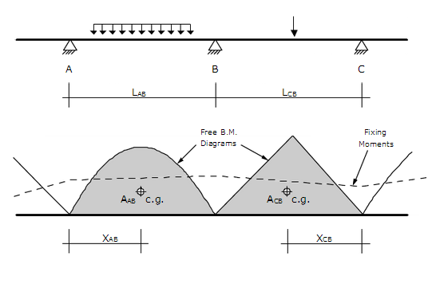
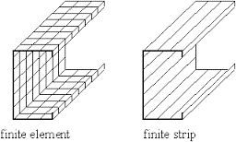
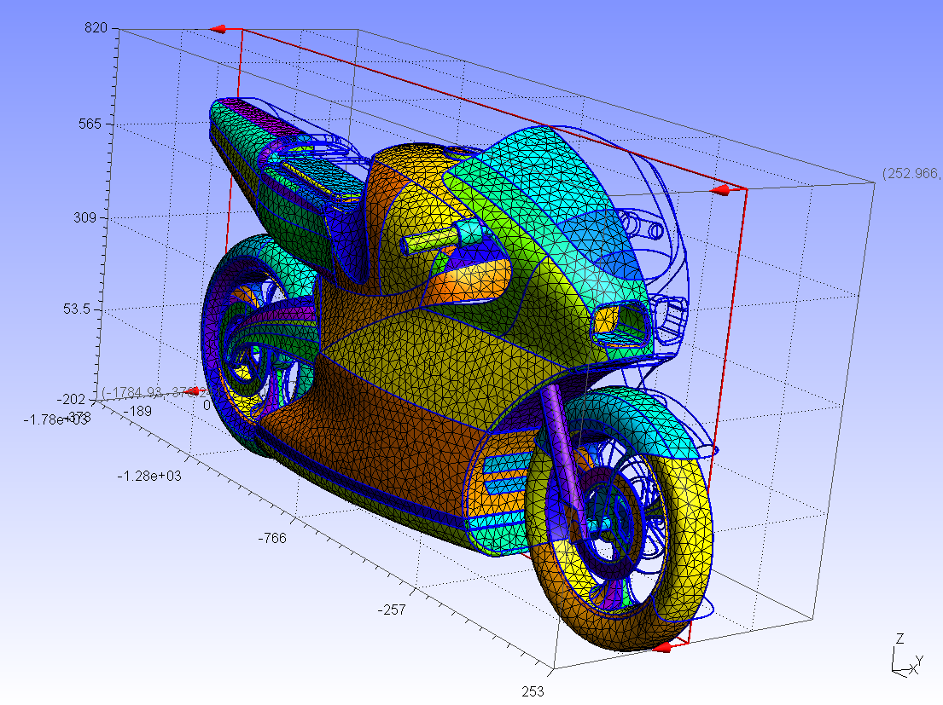
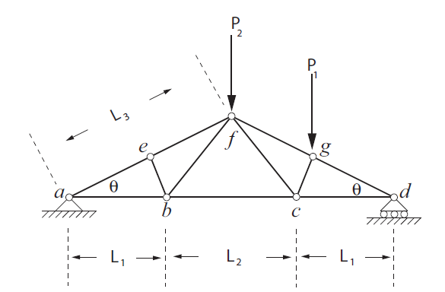
Introduction

Slide 7
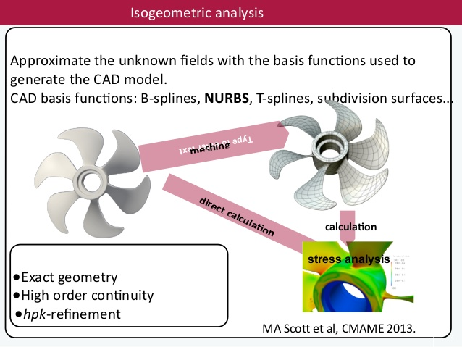
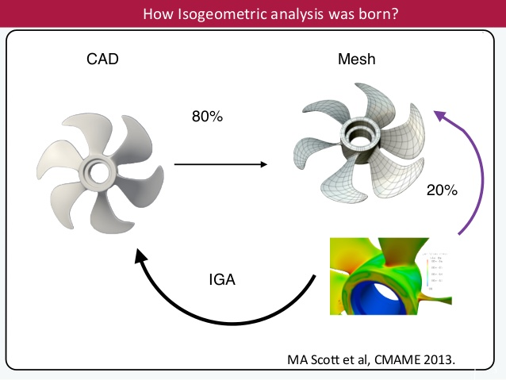
Introduction

Slide 8
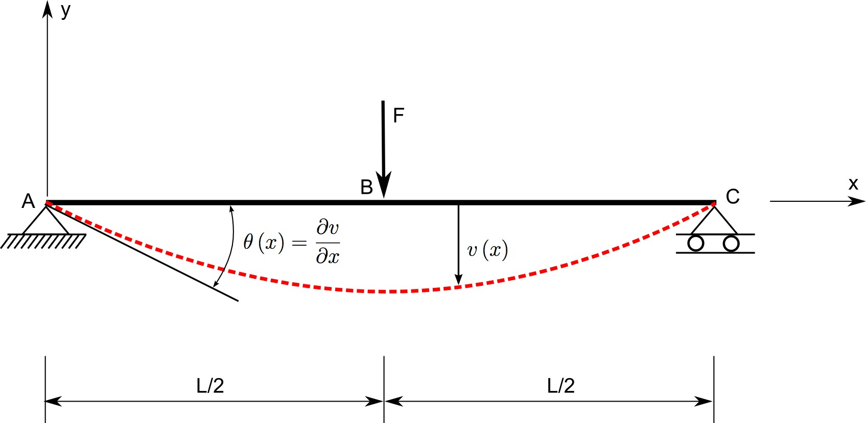
Deflection and Slope of Beams
The deflection v(x) is the transverse displacement of any point x of the beam while the slope θ(x) is the beam’s rotation. For small displacement/rotation problems, it can safely be assumed that:

Slide 9
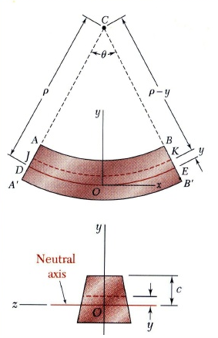
Integration Method
Euler-Bernoulli beam curvature;
Integrate once;
Integrate twice;
M_{z}
M_{z}
Notes:
The relationship between bending moment and radius of curvature of a beam
Radius of a circle that has a tangent at that point=Radius of curvature

Slide 10
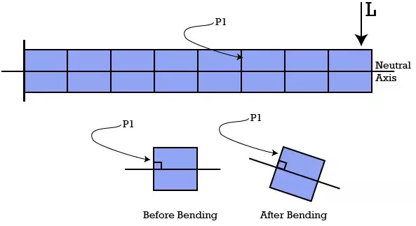
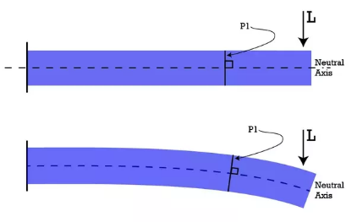
Reminder
Euler-Bernoulli beam
  Small deflection
  Subjected to lateral loads only
  1D beam
  Cross section of the beam does not deform under transverse loading, i.e. rigid cross section in its plane (cross sections remain planar after deformation)
Notes:
If we make the assumption of plane section before bending remains plane after bending, that would imply that there would be no shear distortion of the cube (i.e. it would not change its shape and all the sides would be perpendicular) as shown in the figure above.
Since there is no shear strain (as all the sides are perpendicular to each other) there would be no shear stress and thus we could greatly simplify the theory by not considering shear stress in the formulation.
It is important to note that this theory is applicable only to small deformation of beams. If the deformations are large we have to consider the shear strains developed. This phenomena is covered in Timoshenko beam theory which is for large deformations.

Slide 11
Integration Method: Example 1
y
2F
F
x
D
A
B
C
L/3
L/3
L/3
A simply supported beam with two concentrated loads is represented in the above figure. Assume that the cross-section has constant second moment of area I and a constant Young modulus E. By using the integration method determine the deflection at point B and the slope at point A.

Slide 12
Example 1 continued
y
From the equilibrium equation for the forces along the vertical direction:
From the equilibrium equation for the moments about point A:
2F
F
x
D
A
B
C
F_{A}
F_{D}
L/3
L/3
L/3

Slide 13
Example 1 continued
y
Beam bending equation;
2F
F
x
D
A
B
C
5F/3
4F/3
L/3
L/3
L/3

Slide 14
Example 1 continued
First integration of bending equation yields the slope equation throughout the length of the beam;
Second integration produces deflection equation throughout the length of the beam;

Slide 15
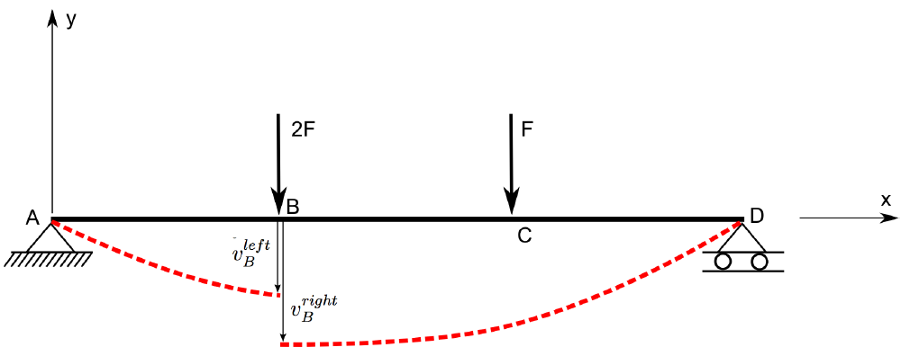
Example 1 continued
In order to obtain 6 constants, i.e. C₁ to C₆ , boundary conditions and continuity conditions must be employed;

Slide 16
Example 1 continued
We established C₂=0
Now let’s apply conditions;

Slide 17
Example 1 continued
Finally, we have 6 constants and six linear equations and therefore by solving these equations simultaneously we have;

Slide 18
Example 1 continued
Hence slope at node A becomes;

Slide 19
Example 1 continued
Displacement at node B becomes;

Slide 20
Task 1
Where does the maximum deflection take place in the beam?
  Refer to Reference 1
Where does the maximum slope take place in the beam?
  Make use of approach for the above question

Slide 21
Macaulay’s method
See the following for more information:
  Chapter 1 of Reference 1
  Chapter 15 of Reference 2
Integration method is lengthy and labour intensive particularly as the number of point loads increases
  Previous example required 6 equations for only two point load
  What if we had 3 point loads? (8 equations are required etc.)
Macaulay put forward this method in 1919 to overcome disadvantage of integration method
He employed singularity, also known as half-range, functions

Slide 22
Macaulay’s method and Singularity function

Slide 23
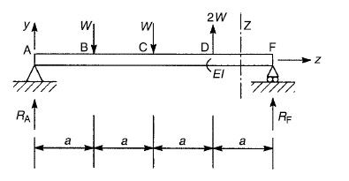
Macaulay’s method: Example 2
Determine slope and deflection equations for the beam given below.
x

Slide 24
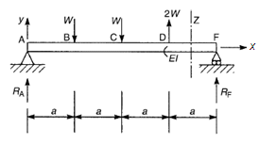
Example 2 continued
Let’s take node A as origin and write the moment Eq for a section within a region furthest from the origin and covering all loading applied
x

Slide 25
Example 2 continued
Integrate once to get slope;
Integrate twice to get deflection;

Slide 26

Example 2 continued
Now we need to determine 2 constants as opposed to 8 constants in the integration method
Let’s look at the boundary conditions;

Slide 27
Example 2 continued
Finally;
Question
  What happens for the deflection at the point where slope becomes zero?

Slide 28
Example 2 continued
Find maximum upward and downward deflection for the beam using Macaulay’s method.
  Where slope becomes zero maximum deflection occurs.
Zero slope whereabouts investigation:
  Zero slope lies within the bay where slope changes sign at extremities of the bay from negative to positive or vice versa.
  In each bay find where . If the obtained x is within the bay then you found it, otherwise keep doing this for successive bays until you find it.

Slide 29
Example 2 continued
By using engineering judgement it looks like that the maximum downward deflection could happen within bay BC.
x

Slide 30
Example 3
For a beam with patch loading how do you represent the singularity function?
w
a
b
x
R

Slide 31
Example 3 continued
w
M
a
b
x
R
Notes:
Supposing that a uniformly distributed load is applied from a to b. Then in order to obtain an expression for the Bending Moment at a distance x from the end, it is necessary to continue the loading up to the section at x, compensating this with an equal negative load from b to x

Slide 32
Example 4
The simply supported prismatic beam AB carries a uniformly distributed load w per unit length. Determine the equation of the elastic curve and the maximum deflection of the beam using direct integration method.
w
A
B
L

Slide 33
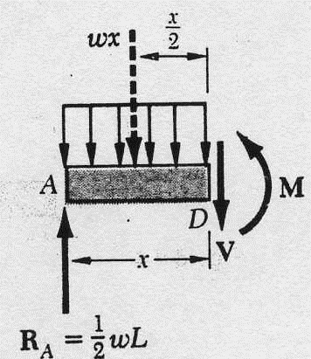

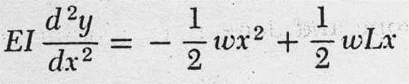
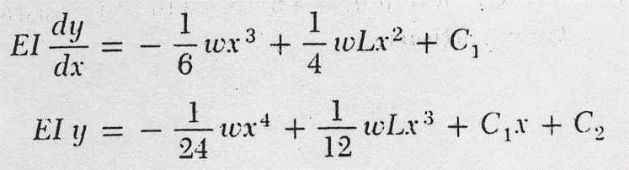
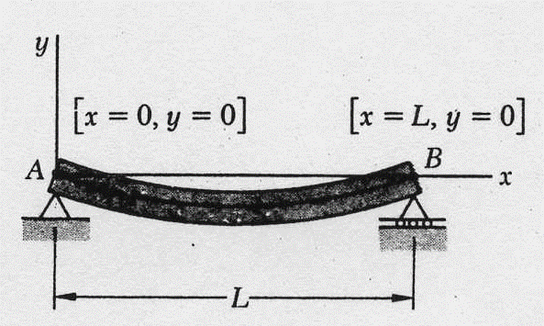
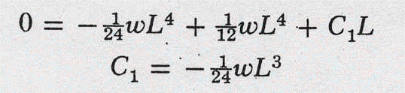
Example 4 continued
Boundary conditions

Slide 34


Example 4 continued
So by substituting the constants of integration we get the following;
Maximum deflection occurs where slope becomes zero;
Deflection at x=0.5L becomes;

Slide 35
Example 5
Obtain slope and deflection equations for the following problem using Macaulay’s method
2kN
4kN/m
1m
2m
1m

Slide 36
Example 5 continued
2kN
4kN/m
M
1m
2m
4kN/m

Slide 37
Example 5 continued
Applying the boundary conditions;
Unknowns are found as;

Slide 38
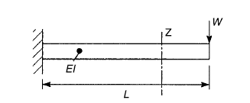
Tutorial 1
Determine the deflection curve and the deflection of the free end of the cantilever beam carrying a point load using integration method. The cantilever has a doubly symmetrical cross section.

Slide 39
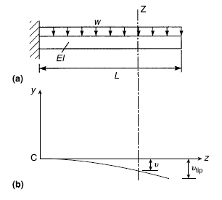
Tutorial 2
Determine the deflection curve and the deflection of the free end of the cantilever beam carrying a uniformly distributed load using integration method. The cantilever has a doubly symmetrical cross section.
Answer: WL⁴/8EI

Slide 40
Tutorial 3
A uniform beam is simply supported over a span of 6 m. It carries a trapezoidally distributed load with intensity varying from 30kN/m at the left-hand support to 90kN/m at the right-hand support. Considering The second moment of area of the cross section of the beam is 120×10⁶mm⁴ and Young’s modulus E=206,000N/mm² and using direct integration method:
  Find the equation of the deflection curve
  Find the deflection at the mid-span point
Answer: 41 mm

Slide 41
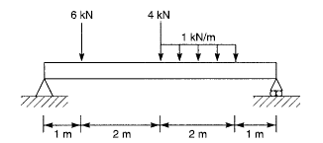
Tutorial 4
Determine the position and magnitude of the maximum deflection of the simply supported beam in terms of its flexural rigidity EI.
Answer: 38.8/EI at 2.9m from left

Slide 42
Tutorial 5
A cantilever of length L and having a flexural rigidity EI carries a distributed load that varies in intensity from w/unit length at the built-in end to zero at the free end. Find the deflection of the free end.

