Slide 1
Structural Design and Inspection-Energy method
By
Dr. Mahdi Damghani
2021-2022

Slide 2
Suggested Readings
Reference 1
Reference 2

Slide 3
Objective(s)
Familiarisation with strain energy and complimentary energy
Obtaining displacements in structures using complementary energy method

Slide 4
Introduction
So far we looked at:
  Newtonian based methods (use of equilibrium equations)
  Principle of Virtual Work (PVW)
Now we look at another powerful method called energy method (similar to PVW)
  For some problems give exact solution
  For others an approximate and rapid solution can be obtained
  Useful for statically indeterminate structures
  Generally used for determining deflections in the structure
  For determining forces we use potential energy method (next lecture)

Slide 5
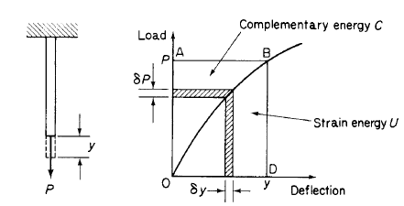
Strain energy & complimentary energy (stress energy)
Conservation of energy
Steadily increasing load P causes deflection and hence work is generated
Work is stored as strain energy in the member
Defined by Engesser (1889). It has no physical meaning and is just for mathematical convenience
Strain energy produced by load P

Slide 6
Reminder
Differential of potential energy is load
Differential of complimentary energy is deflection

Slide 7
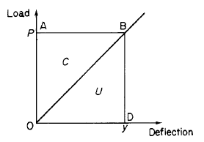
Strain energy and complimentary energy
For non-linear elastic material we can assume load-deflection curve follows;
Linear elastic
For linear elastic material n=1 and therefore;

Slide 8
What is the point?
For linear elastic materials, the quantity of complimentary energy is equal to that of strain energy, U=C
The differential of strain energy to the load P is equal to deflection of the load (Castigliano’s first theorem)
Notes:
This method can be used for both linear and nonlinear systems.

Slide 9
The principle of the stationary value of the total complementary energy
Bear in mind that displacements are real and constant, unlike PVW, this time and forces are virtual (similar to unit load method).
P₁
Let’s assume an elastic system in equilibrium under applied forces P₁, P_{2,} ..., P_{n}
Goes through real displacements Δ₁, Δ_{2,} ..., Δ_{n}
P₂
Δ₁
Δ₂
Δ_{n}
P_{n}
δP₁
Now Let’s apply virtual forces acting on real displacements δP₁, δP_{2,} ..., δP_{n}
The total virtual work done by the system;
δP₂
Δ₁
Δ₂
Δ_{n}
δP_{n}

Slide 10
The principle of the stationary value of the total complementary energy
Reminder:
Principle of virtual work
Virtual work done by the particles in the elastic body
Virtual work of external virtual forces acting through real displacements
Total complimentary energy of the system
Complimentary energy of internal forces
Complimentary energy of external forces

Slide 11
The principle of the stationary value of the total complementary energy
For an elastic body in equilibrium under the action of applied forces, the true internal forces (or stresses) and reactions are those for which the total complementary energy has a stationary value;
The true internal forces (or stresses) and reactions are those which satisfy the condition of compatibility of displacement;
This property of the total complementary energy of an elastic system is particularly useful in the solution of statically indeterminate structures, in which an infinite number of stress distributions and reactive forces may be found to satisfy the requirements of equilibrium.

Slide 12
Note
Generally, deflection problems are most readily solved by the complementary energy approach;
For linearly elastic systems there is no difference between the methods of complementary and potential energy, since as we have seen, complementary and strain energy then become completely interchangeable.

Slide 13
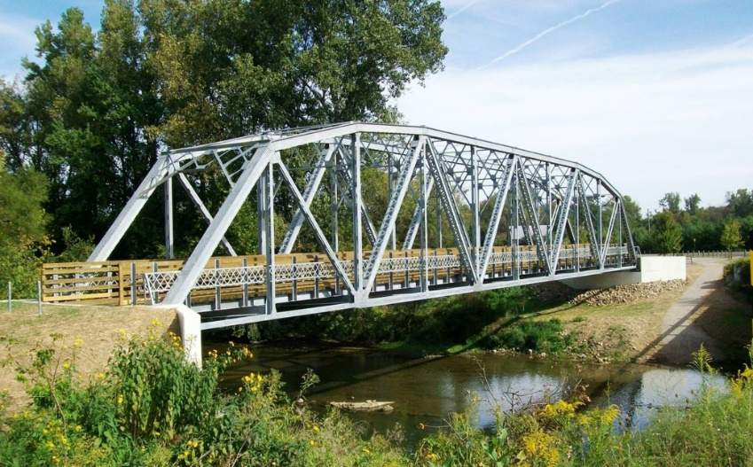
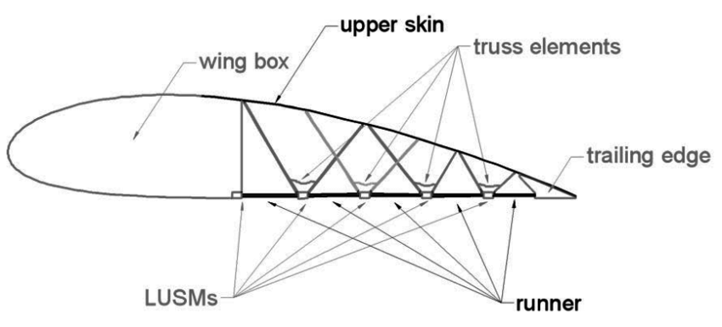

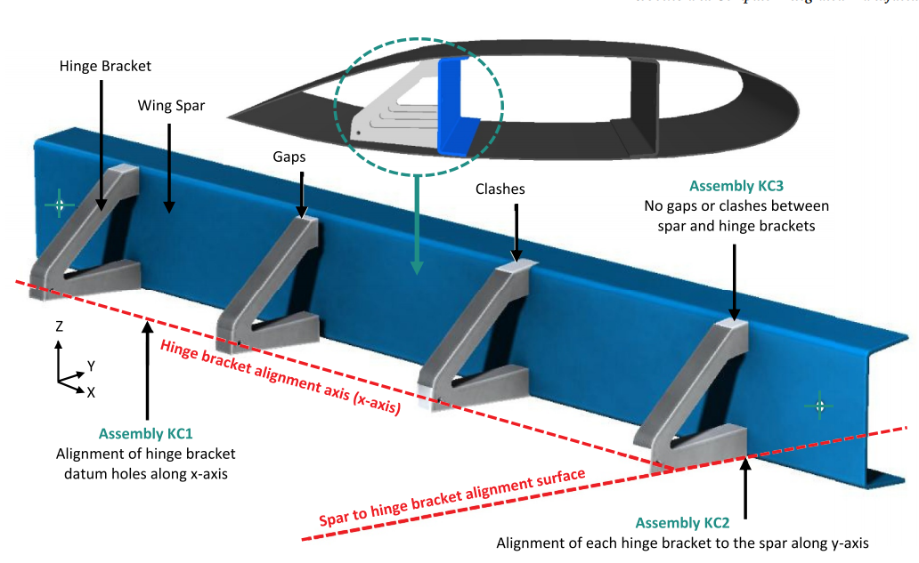
Wing and truss structures
Low-Drag Truss-Braced Wing

Slide 14
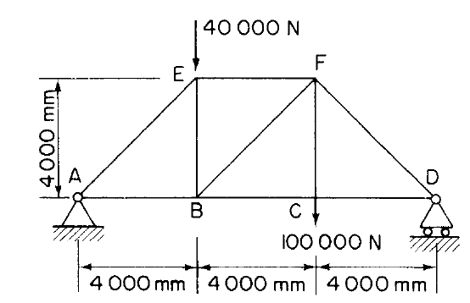
Application to deflection problems
Determine vertical deflection of point B and horizontal displacement of point D. All members of the framework are linearly elastic.
A=1,800mm² E=200,000N/mm²

Slide 15
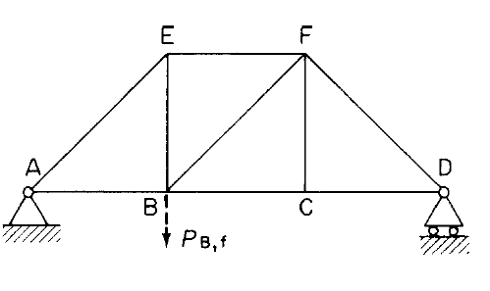
Solution
For a linear truss structure, since we have finite member of elements (k number) throughout its volume, i.e. k=9 in this example, we have;
Stiffness of each member
In this example we apply a virtual force P at the point B and in the direction we want to get the displacement;

Slide 16
Solution
We previously proved that;
This means derivative of complimentary energy to virtual force P gives real deflection in the direction of applied virtual force;
Using the same concept for this example we get;

Slide 17
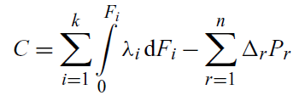
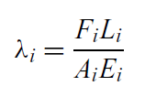

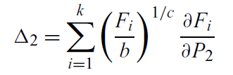
Note
For non-linear truss see Ref. [2] chapter 5 (beyond scope of lecture)

Slide 18
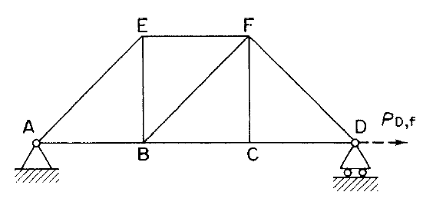
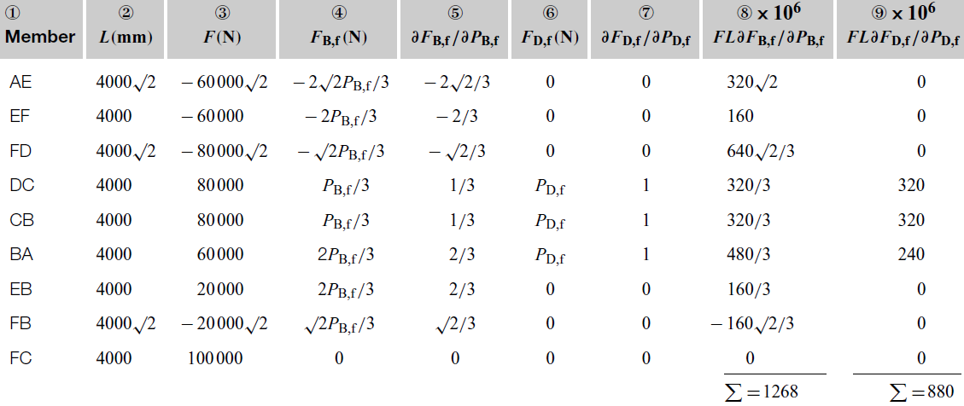
Solution
Real system
Virtual system
Virtual system

Slide 19
Solution

Slide 20
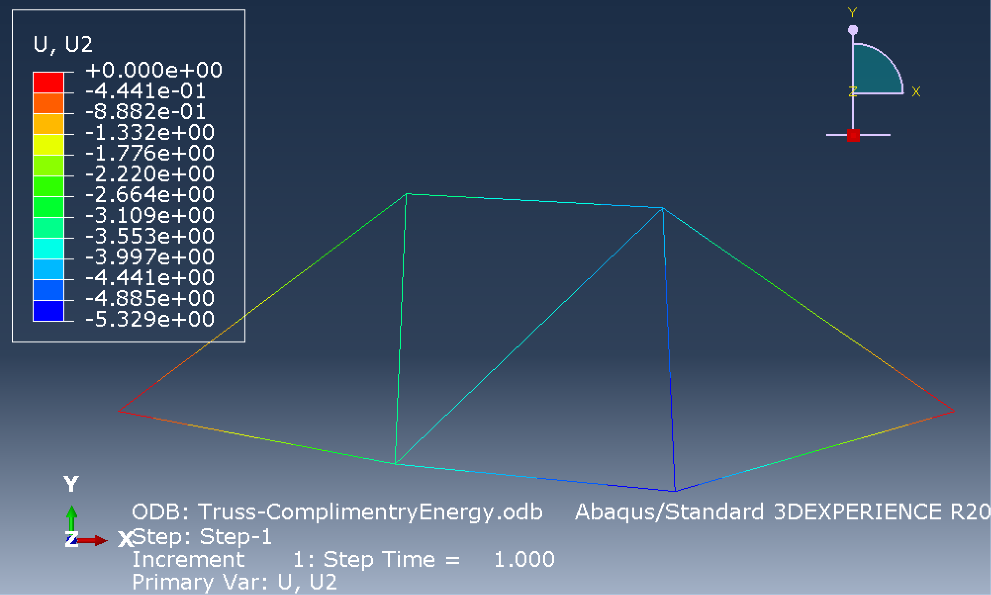
FEA result of vertical displacements
-3.5 mm

Slide 21
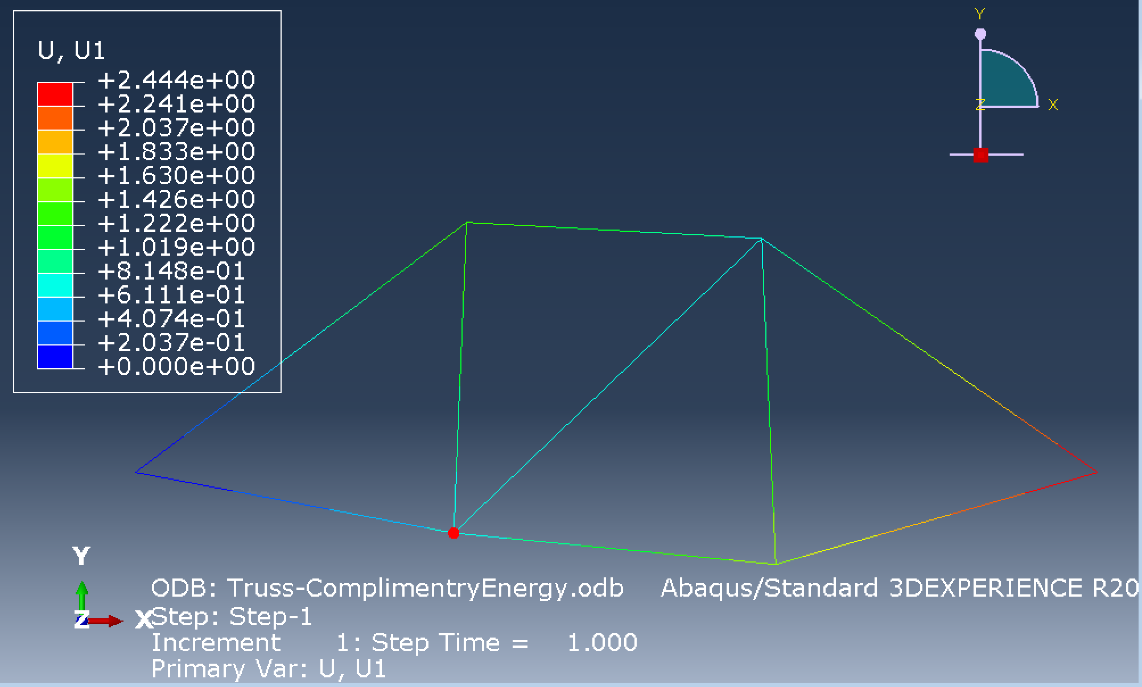
FEA result of horizontal displacements
2.44 mm

Slide 22
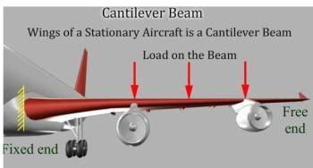
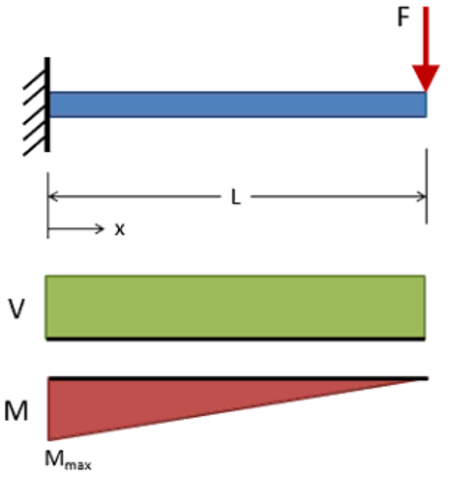
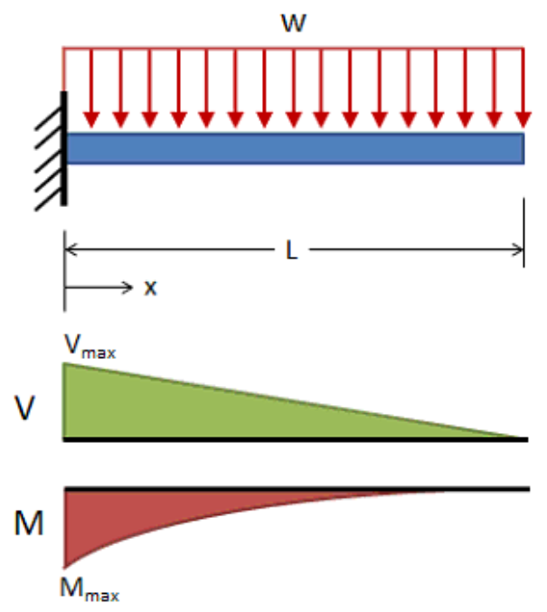
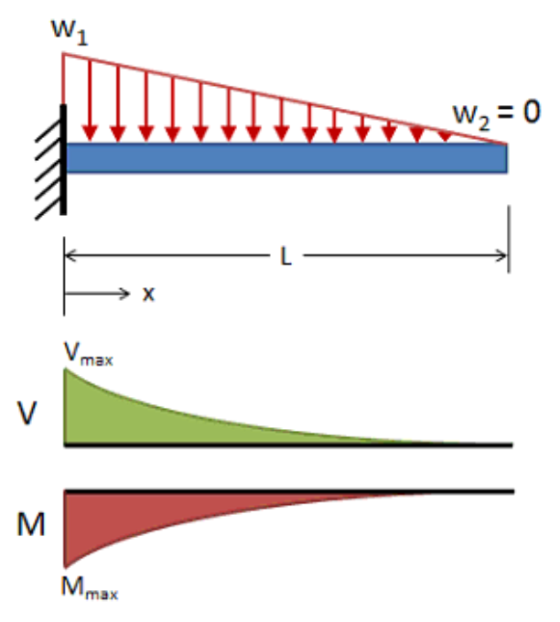
Idealising wing as a cantilevered beam

Slide 23

Example for beams
Find vertical deflection at point A?
w per unit length
A
L

Slide 24
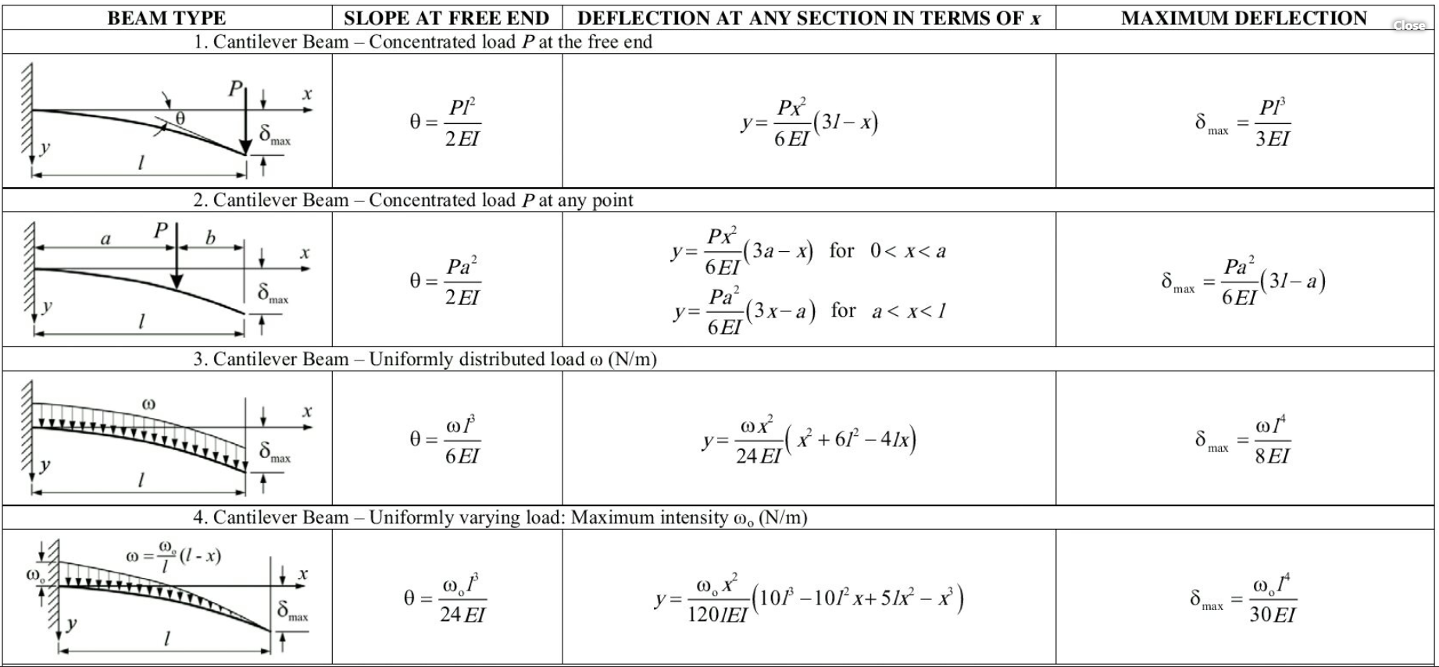
Analytical solutions widely available

Slide 25
Solution
For beam structures deformations due to shear and axial force is negligible so can be disregarded;
Most of deflection results from bending moment and therefore the total complimentary energy of the system is;

Slide 26
Solution
Let’s apply a virtual (dummy) load P at the point and in the direction on which the displacement is required
w
P
Δ
y
x

Slide 27

Example
The cantilever beam AB supports a uniformly distributed load $ω$ and a concentrated load P. If L=2m and $ω=$4kN/m, P=6kN and EI=5MN.m2 determine deflection at A.

Slide 28
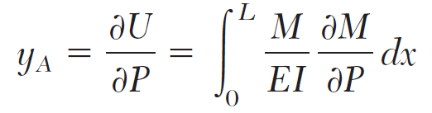
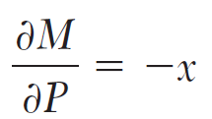
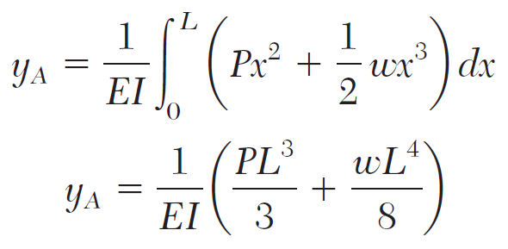
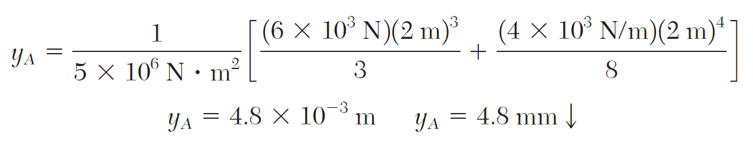
Solution

Slide 29
Indeterminate structures
So far we were dealing with determinate structures;
We could readily obtain moment equation throughout the length of the beam or member forces in the truss structure using equations of equilibrium, i.e. ∑F_{x}=0, ∑F_{y}=0, ∑M_{z}=0;
How can we obtain moment equation if equilibrium equations are not enough to calculate reaction forces and therefore moment equation???

Slide 30
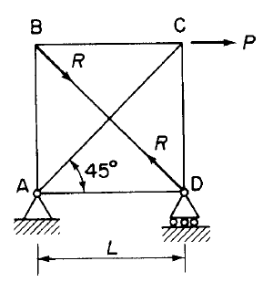
Example of indeterminate structures
Determine the degree of indeterminacy
Choose a member as the redundant member, i.e. by removing that member from structure, the structure becomes determinate;
Remove the redundant member and replace it with its associated force(s);
Let’s choose BD for this example.

Slide 31
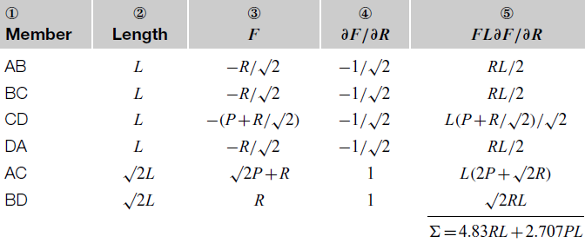
Solution
B
C
Displacement in the axial direction of the member is zero, therefore;
R
P
R
A
D

Slide 32
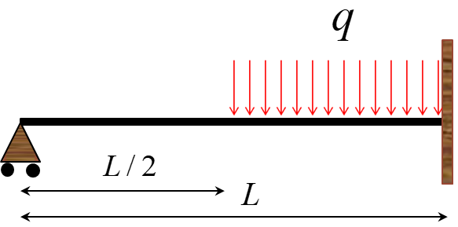
Example for indeterminate structures
For the beam shown, calculate reaction forces using complimentary energy method. Assume that EI=const.

Slide 33
Solution
Calculate degree of indeterminacy (redundancy)
  4 (reaction forces)-3(known Eqs)=1
Remove redundant member, i.e. simply supported end;
Replace it with its associated force;
Find displacement and set it equal to zero (compatibility of displacements at the support).
R_{A}
Displacement at this point must be zero

Slide 34
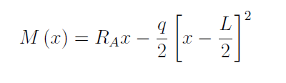
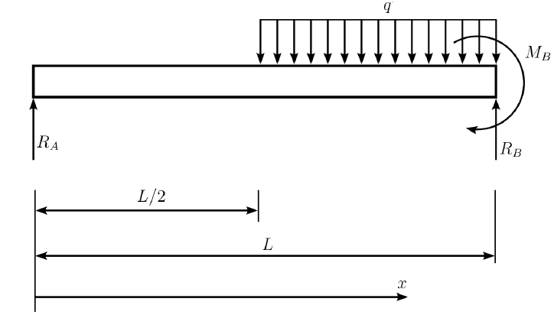

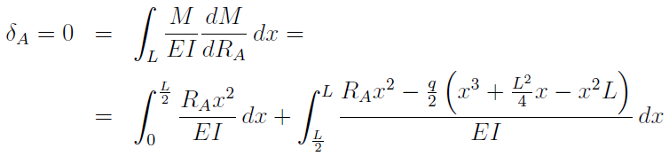
Solution

Slide 35
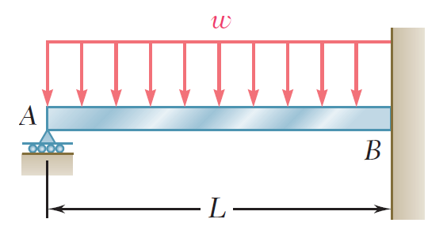
Example
Determine reaction at the supports for the prismatic beam and loading shown below.

Slide 36
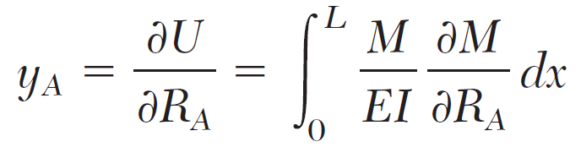
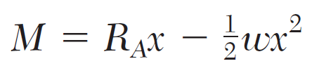
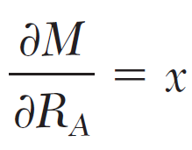
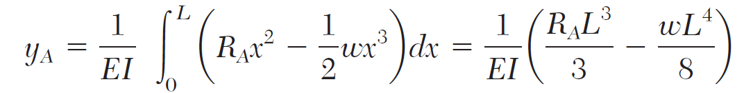
Solution
The beam is indeterminate to the first degree;
Based on castigiliano’s theory;
U is strain energy of the beam under both UDL and R_{A};

Slide 37
Solution

Slide 38
Example
A thin circular ring of radius r and uniform flexural stiffness carries two radial loads W applied along a diameter. Estimate the maximum bending moment in the ring.

Slide 39

Solution
Making use of symmetry, let’s look at half of the structure as below;

Slide 40
Solution
Bending moment at any given section in the shell is;
The complementary energy of the system is;
The complementary energy is stationary meaning its differential with respect to the unknown , i.e. M₀, is equal to zero;

Slide 41
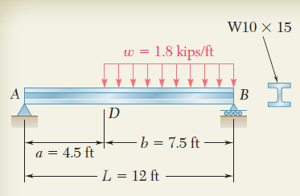
Tutorial 1
For the beam and loading shown, determine the deflection at point D. Use E = 29 x 10⁶ psi.

Slide 42
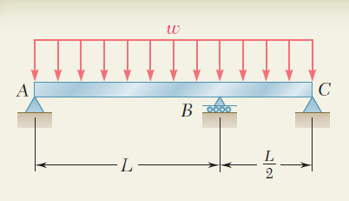
Tutorial 2
For the uniform beam and loading shown, determine the reactions at the supports.

Slide 43
Tutorial 3
A horizontal beam is of uniform material throughout but has a second moment of area of I for the central half of the span L and I/2 for each section in both outer quarters of the span. The beam carries a single central concentrated load P.
  Derive a formula for the central deflection of the beam, due to P, when simply supported at each end of the span.
  If both ends of the span are encastré, determine the magnitude of the fixed end moments.

Slide 44
Tutorial 4
Determine the vertical deflection at point B as the result of load P.
(EA is constant for all members)

Slide 45
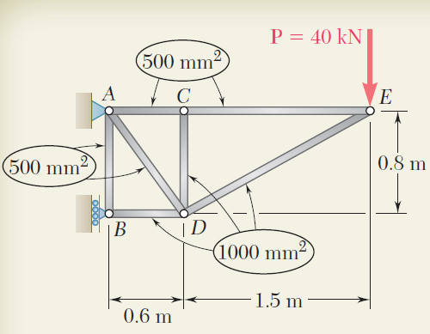
Tutorial 5
For the truss and loading shown below determine the vertical deflection of joint C.

