Slide 1
Torsion of thin walled beams
By dr. mahdi damghani

Slide 2
Suggested Readings
Chapters 17 and 22
of
Aircraft Structural Analysis

Slide 3
Learning objectives
Familiarity with the source for torsional force in the wing structure
Review of shear stresses as a result of torsion force in solid sections.
Obtaining the shear stresses as a result of torsional force in thin-walled closed section beams

Slide 4
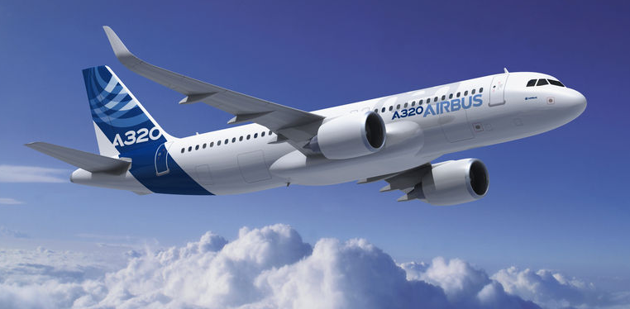
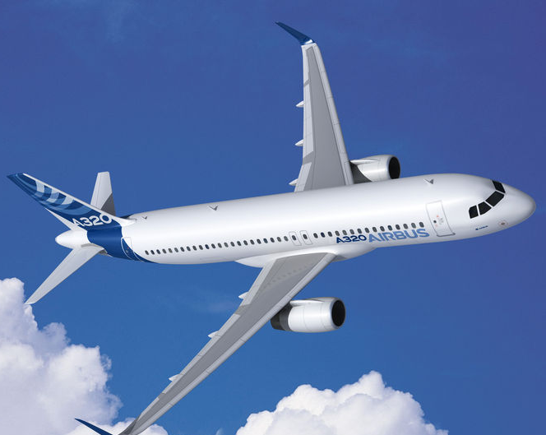
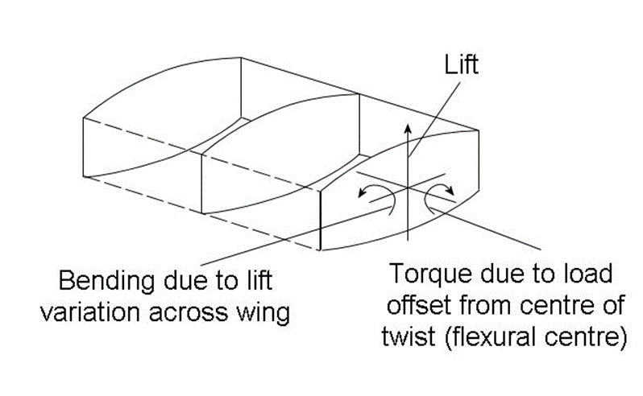
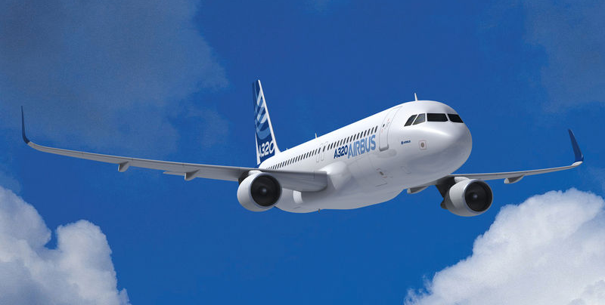
How loads are carried in the wing box
Yaw
Pitch
Pitch affected by elevators on the Horizontal Stabilizer
Lift
Yaw input from Rudder on the Vertical Stabilizer and by differential thrust from the engines
Roll
Roll produced by Ailerons
Digital mock up of A320 NEO with sharklet
Lift produced by aerodynamic shape of wing & can be increased by deployment of flaps and slats at low speeds, or by an increase of pitch and/or speed.

Slide 5
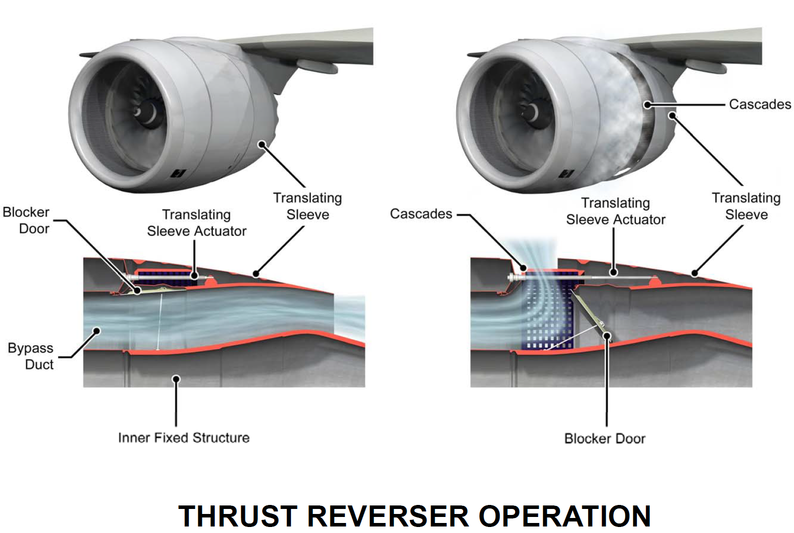
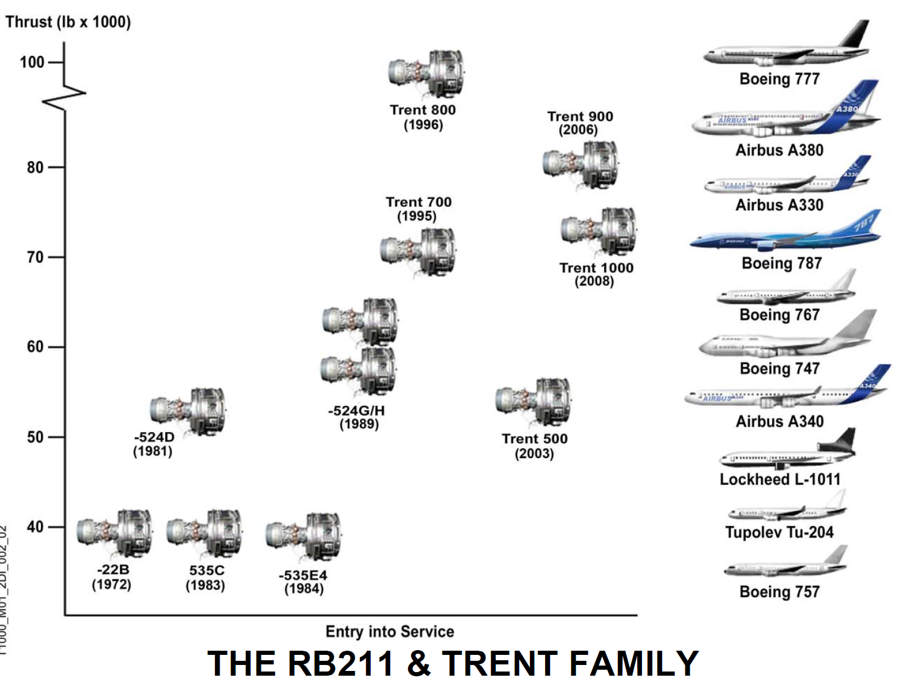
Torsion on wing coming from engine
Torsion
-Wing location.
-Engine mounted on pylon attachment with an offset from wing box producing torsion in the wing structure.
Offset
Thrust

Slide 6
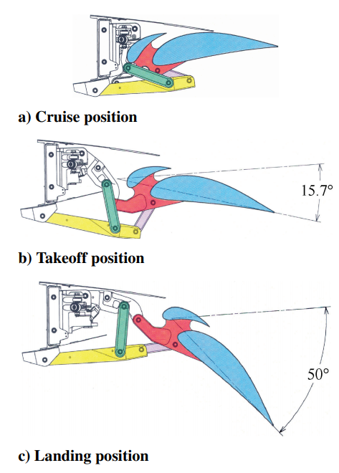
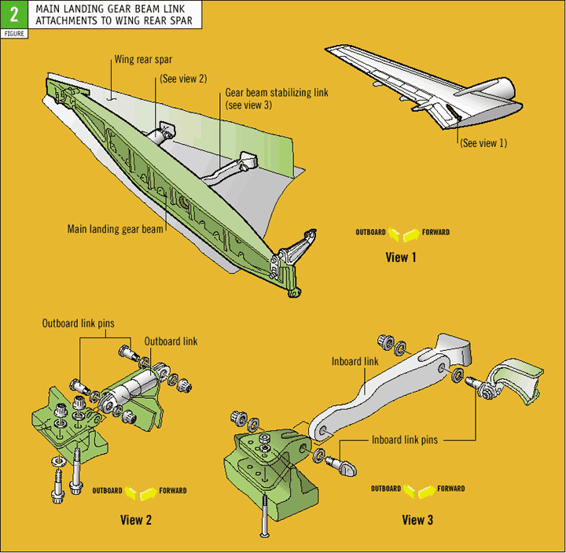
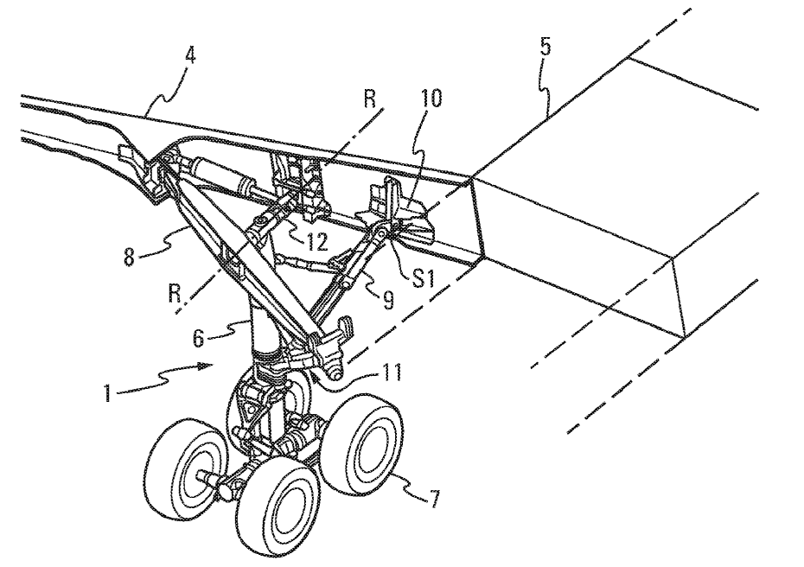
Torsion coming from control surfaces and landing gear

Slide 7
More on source of torsion
In majority of practical cases, it is impossible to guarantee that the shear load would act at the shear centre of the cross section;
Any shear load (lift, engine, landing gear, etc.) may be represented by the combination of the shear load applied through the shear centre and a torque;
The stresses produced by the separate actions of torsion and shear may then be added by superposition;

Slide 8
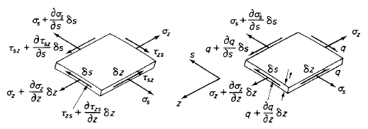
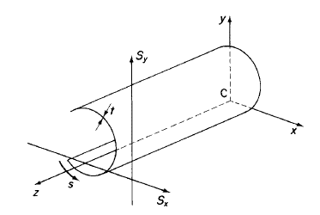
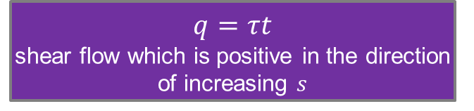


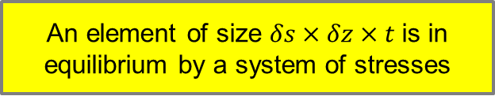
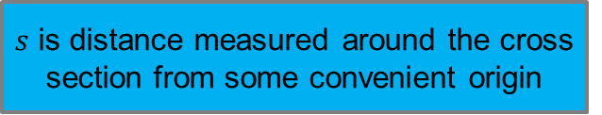
reminder
We isolate this element of the beam as of the next slide
$s$ is distance measured around the cross section from some convenient origin
$q=τt$
shear flow which is positive in the direction of increasing $s$
An element of size $δs×δz×t$ is in equilibrium by a system of stresses
t is assumed to be constant along $δs$
$τ_{zs}=τ_{sz}=τ$

Slide 9





reminder
Equilibrium of forces in $z$direction
Equilibrium of forces in $s$direction

Slide 10
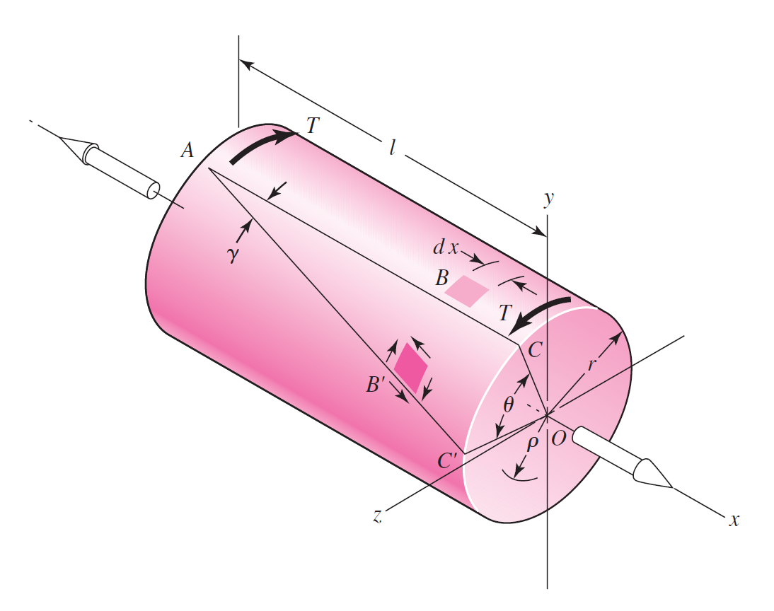
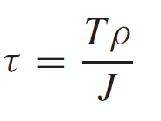
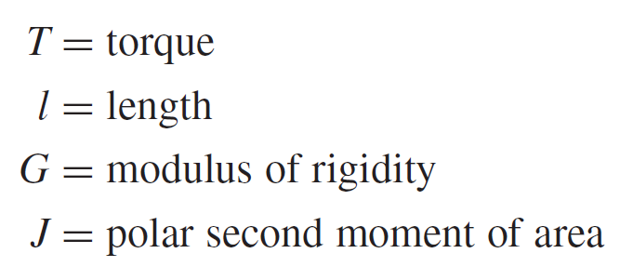
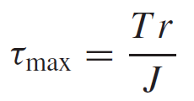
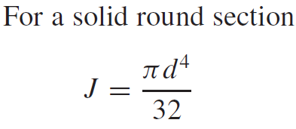
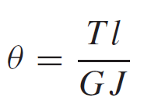
Reminder

Slide 11
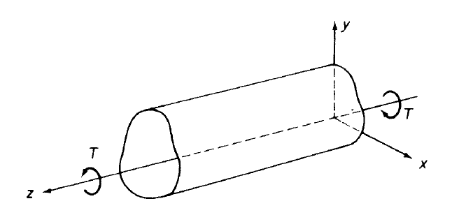
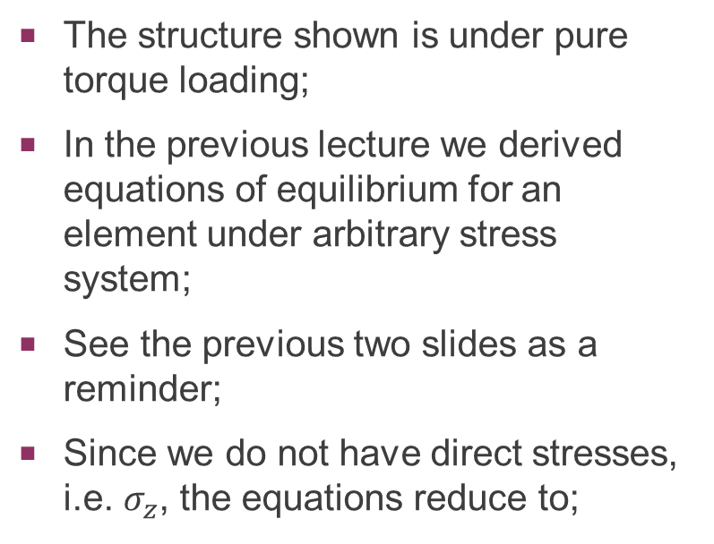
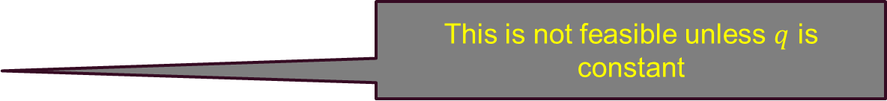
Torsion of closed section beams
Torsion produces constant shear flow in the section.
The structure shown is under pure torque loading;
In the previous lecture we derived equations of equilibrium for an element under arbitrary stress system;
See the previous two slides as a reminder;
Since we do not have direct stresses, i.e. $σ_{z}$, the equations reduce to;
0
0
This is not feasible unless $q$ is constant

Slide 12
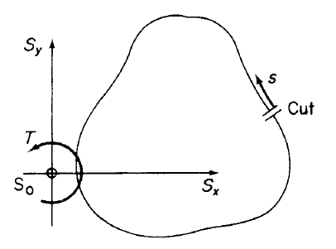
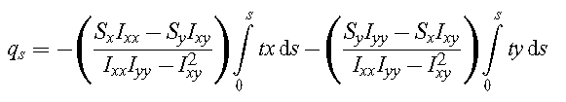

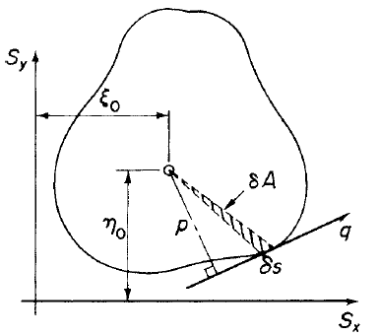





Reminder (from shear of closed section beams)
For open section we had;
Value of shear flow at the cut ($s=0$) can be found by;
We also know;
A is the area enclosed by midline of the beam section.

Slide 13
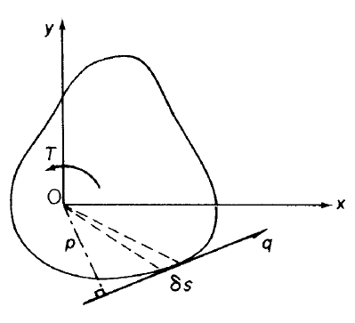
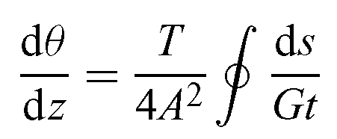

Relationship between torque and shear flow
We balance the external torque, i.e. $T$, with the torque created by constant shear flow, i.e. $q$;
The theory is known as Bredt-Batho theory

Slide 14
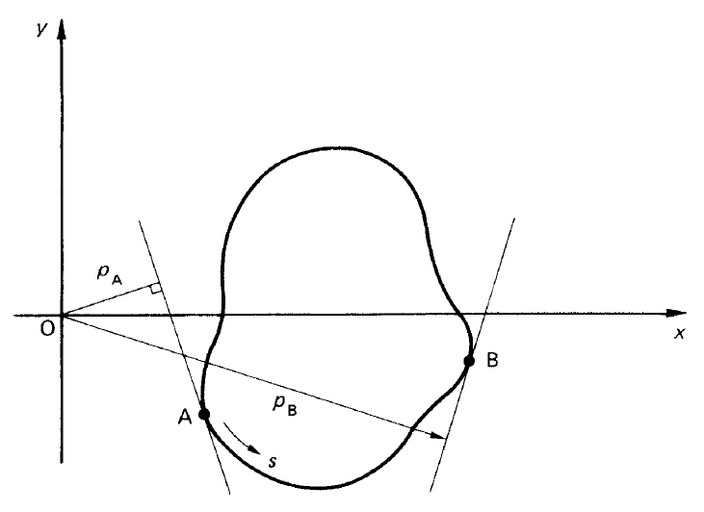
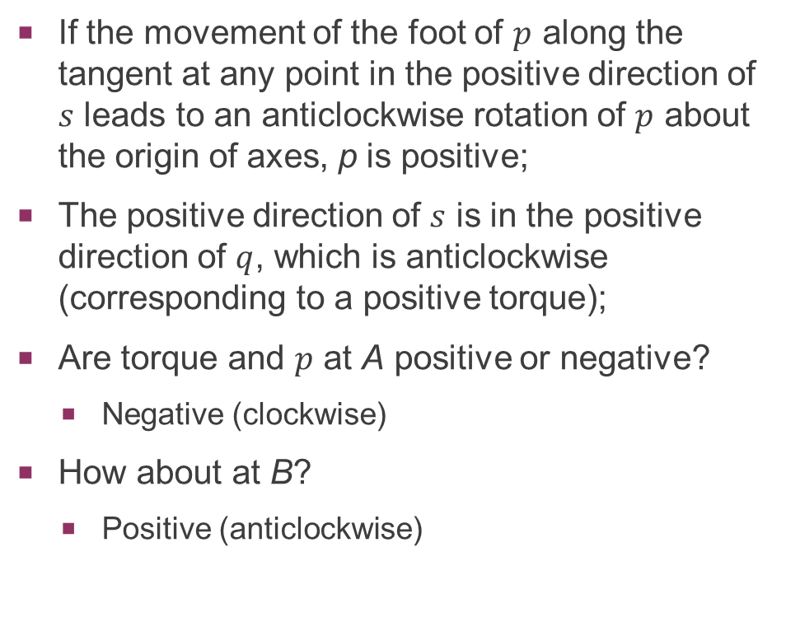
Sign convention
If the movement of the foot of $p$ along the tangent at any point in the positive direction of $s$ leads to an anticlockwise rotation of $p$ about the origin of axes, p is positive;
The positive direction of $s$ is in the positive direction of $q$, which is anticlockwise (corresponding to a positive torque);
Are torque and $p$ at A positive or negative?
Negative (clockwise)
How about at B?
Positive (anticlockwise)

Slide 15
Example
In the tube structure shown, the maximum shear stress is limited to 200 N/mm² and the maximum angle of twist is 2º. The torque is applied at the mid-span. What is the minimum thickness of the beam walls?
You may assume that the shear modulus is 25,000 N/mm².
clamped
30kNm
clamped
200 mm
2000 mm

Slide 16
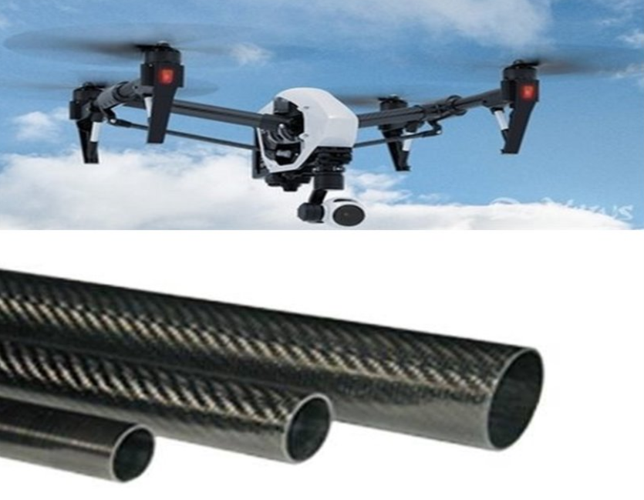
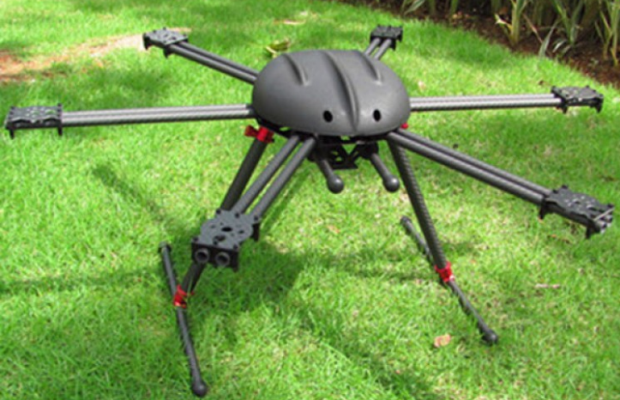
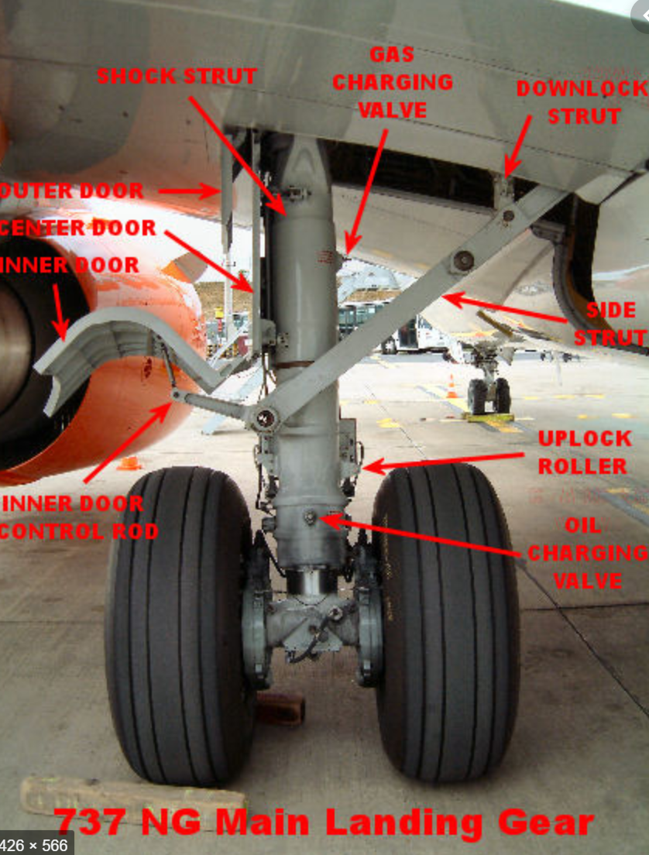
Examples of tube applications in torsion
Carbon fibre tube for UAV
Dual arm carbon fibre Hexacopter
Landing gear axle

Slide 17
Solution
Torsion diagram along the length of the beam;
Remember that we assume counter-clockwise torsion as positive.
clamped
30kNm
clamped
200 mm
T
+15kNm
z
-15kNm

Slide 18
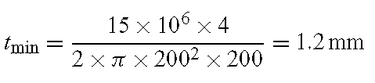


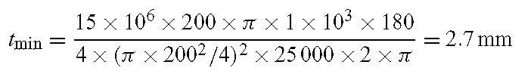
Solution
clamped
30kNm
clamped
15kNm
200 mm
15kNm
2000 mm

Slide 19
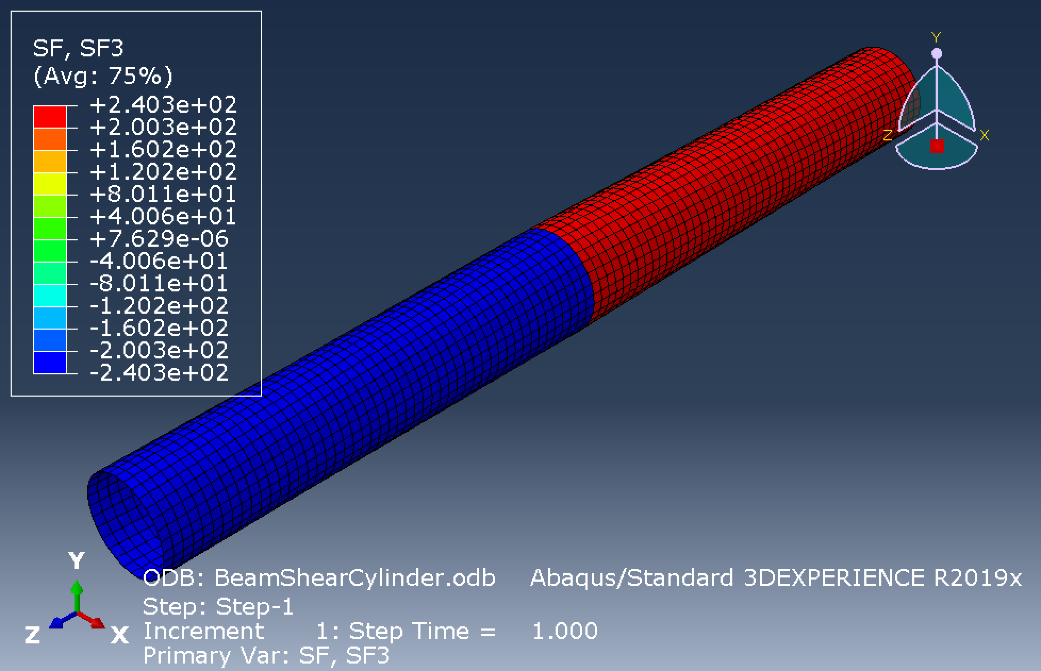
FEA result
Shear flow is constant for entire length of the beam

Slide 20
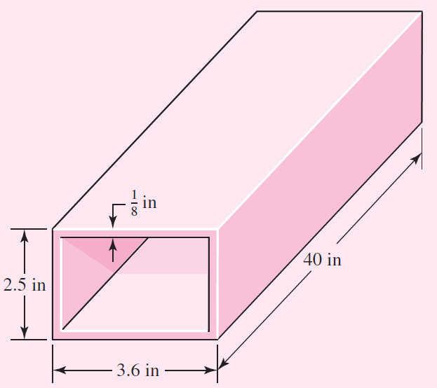
Example
A welded steel tube is 40-in long, has a 1/8-in wall thickness, and a 2.5-in by 3.6-in rectangular cross section as shown. Assume an allowable shear stress of 11,500 psi and a shear modulus of 11.5x10⁶ psi.
Estimate the allowable torque T.
Estimate the angle of twist due to the torque.
Note that this example is taken from the book;
Shigley’s Mechanical Engineering Design (Ninth Edition)

Slide 21
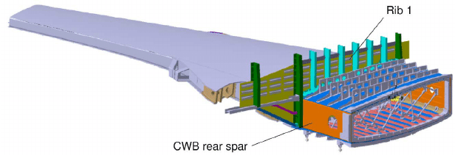
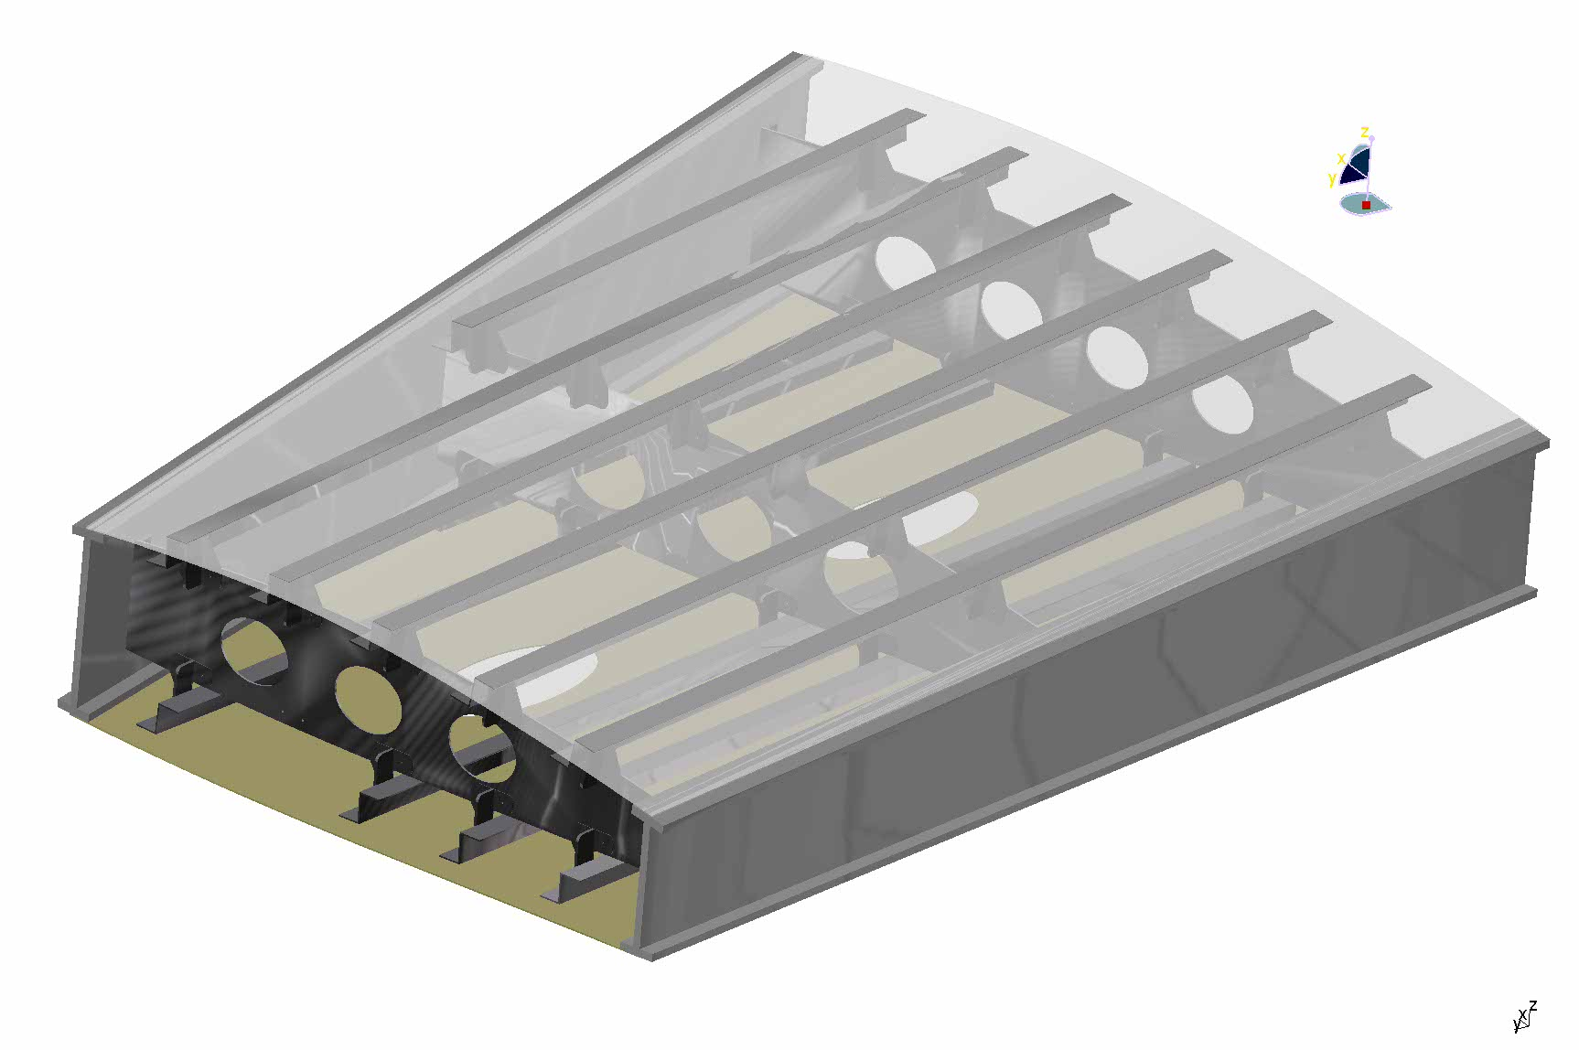
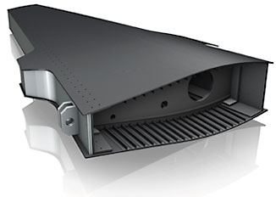
Examples of single cell box applications in torsion

Slide 22
solution
The area enclosed within the median line of the section is as follow;
Length of the median perimeter is;
Torsion is calculated by;
The angle of twist is calculated by;

Slide 23
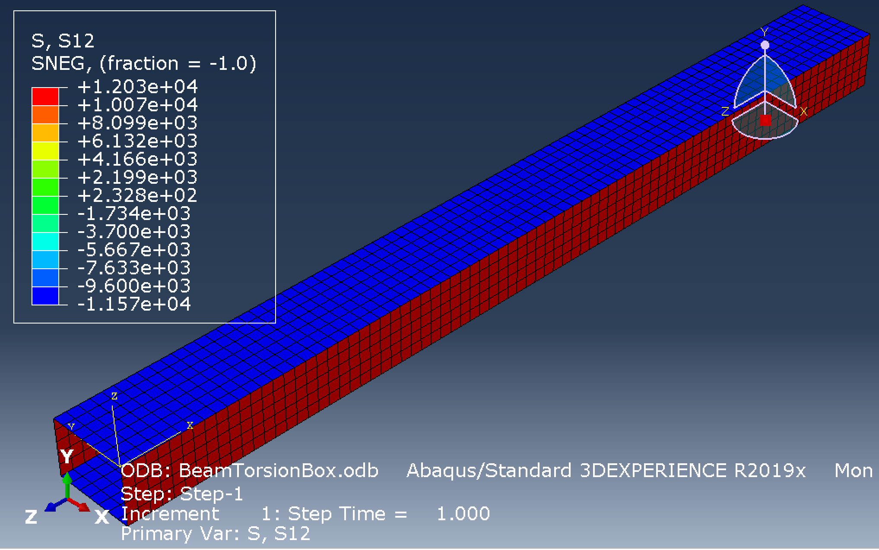
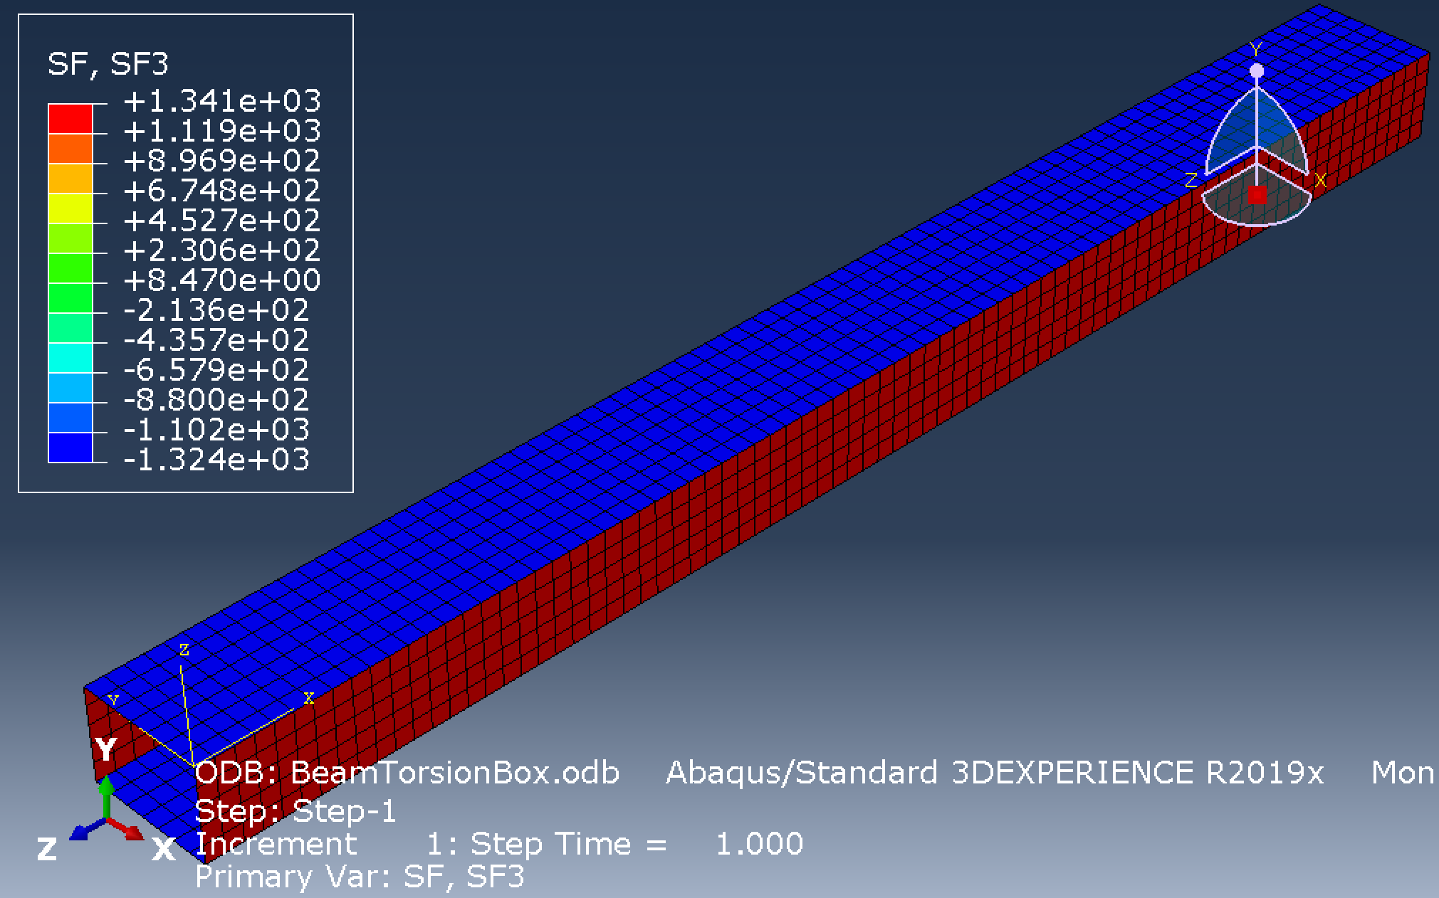
Fea results

Slide 24
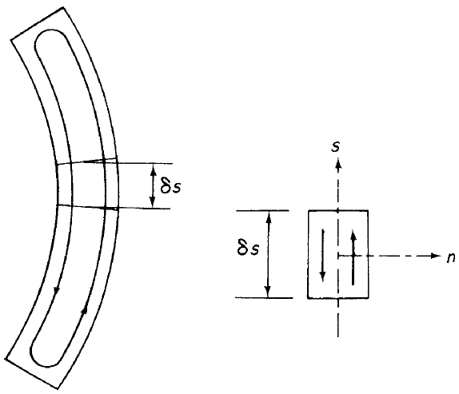
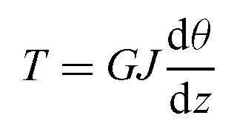
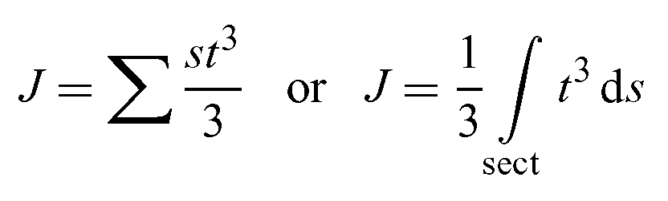
Torsion of open section beams
Pay attention to the direction of shear flow in open section due to torsion
The solutions provided hereafter are approximate for open section beams (median line is not closed);
In the opposite figure, a rectangular open section beam is shown;
Torsion constant for cross section with constant wall thickness
Torsion constant for cross section with variable wall thickness

Slide 25
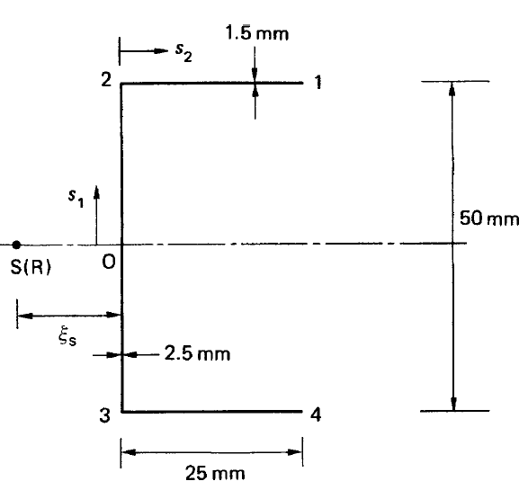
Example
Determine the maximum shear stress in the channel section when it is subjected to an anticlockwise torque of 10Nm. Consider the shear modulus of material as G=25,000N/mm².

Slide 26

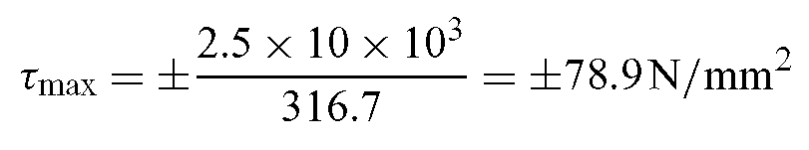
Solution
Calculate torsion constant of the section;
This section is comprised of 3 rectangular walls, i.e. rectangles 12, 23 and 34, respectively;

Slide 27
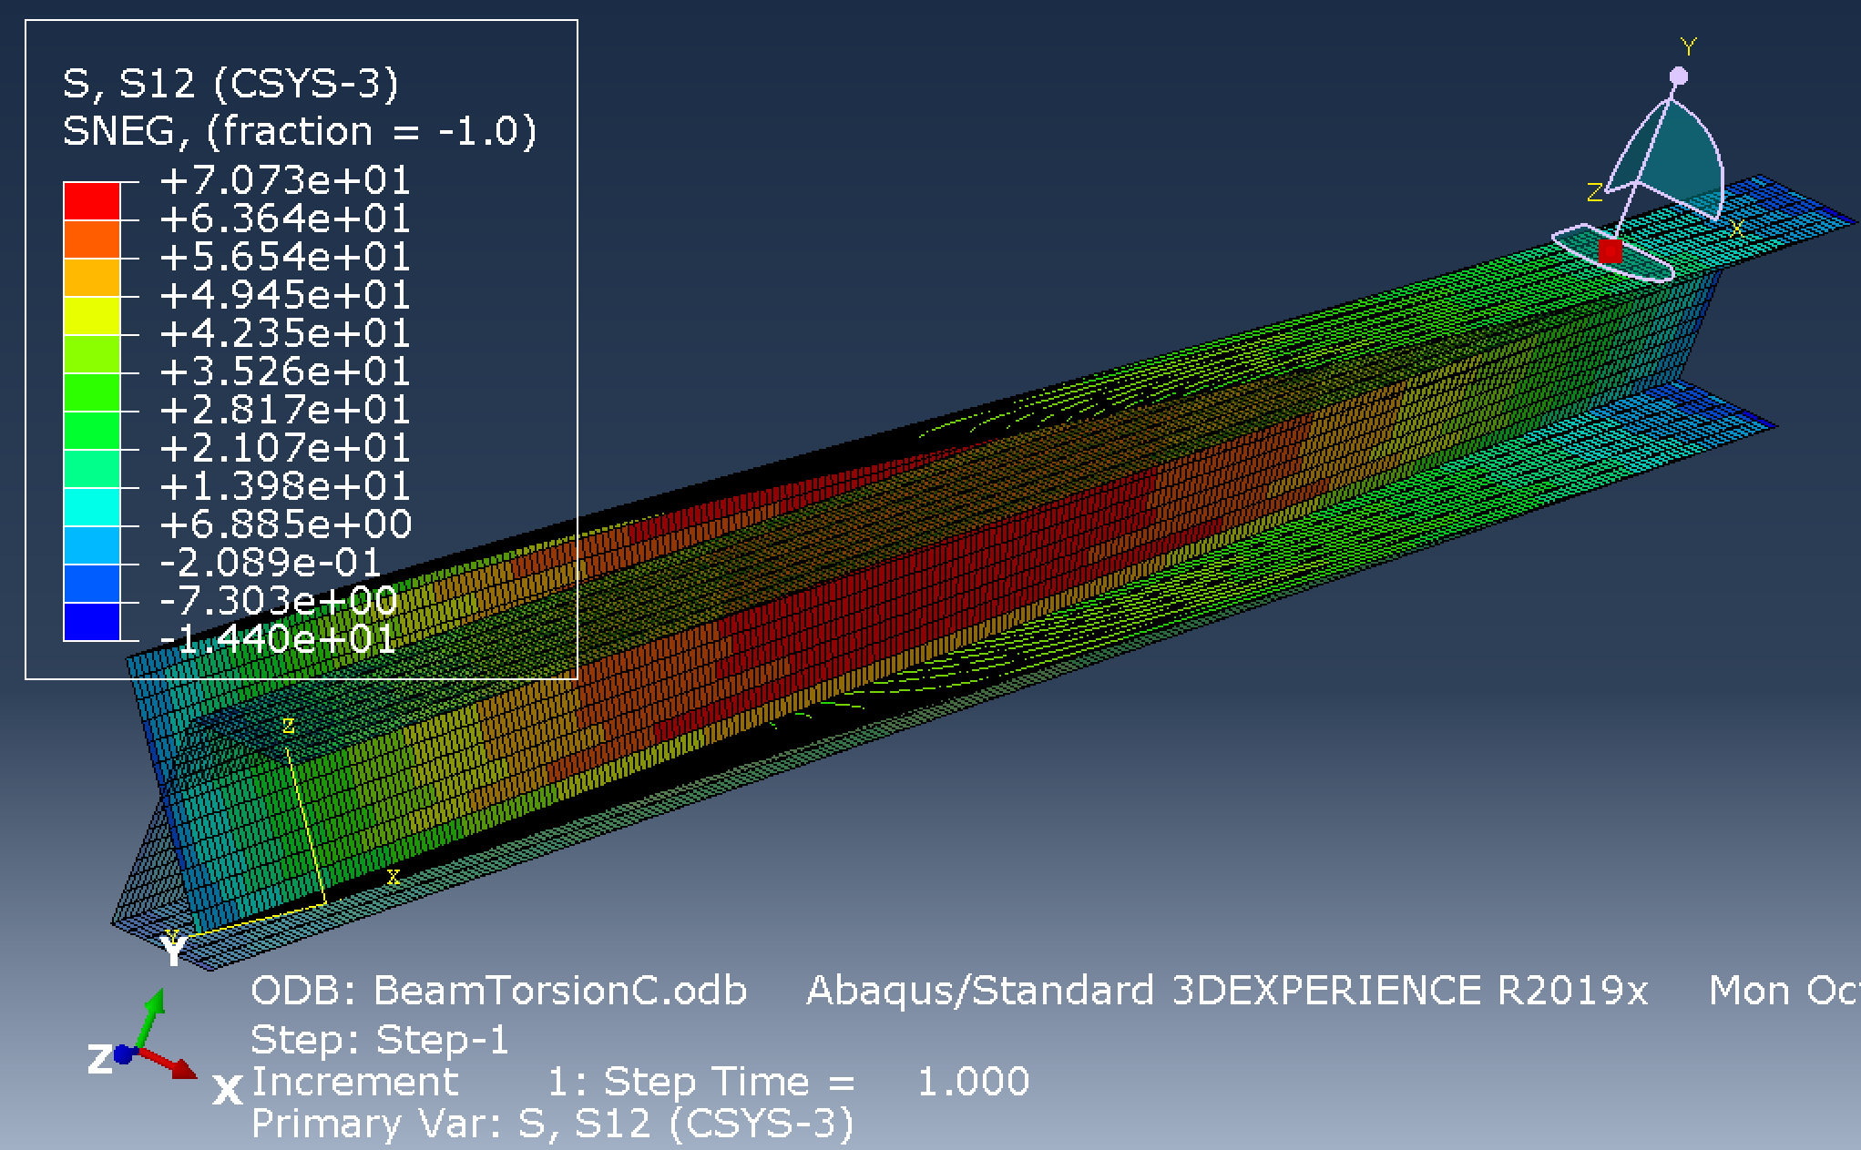
Fea result
12.8% less than the hand calculation.
Bear in mind that the torsional stiffness calculation was approximate, hence hand calculation was an approximate solution.
Also, FEA is approximate. Higher mesh density will give a more accurate result.

Slide 28



Torsion of multicellular wing section
The wing section is comprised of N cells and carries a torque of T.
The wing section is comprised of N cells and carries a torque of T
The wing section is comprised of N cells and carries a torque of T
Unknown torque is generated in each cell as the result of T.
Constant shear flow in each cell due to cellular torque
Constant shear flow in each cell due to cellular torque
Constant shear flow in each cell due to cellular torque.
All cells have the same rate of twist (compatibility condition).

Slide 29



Examples of multicellular wing box (high shear loads such as jet fighters)
Wing box
Wind turbine blade

Slide 30




Torsion of multicellular wing section
Let’s look at cell R and its neighbouring cells;
By doing this for all N cells N equation will be obtained that allows to extract shear flow in each cell;
Let’s illustrate this with an example.
Constant shear flow in each wall
Simplified, $δ=\int{ds/t}$

Slide 31


Useful tip
Often in practical cases, top skin, bottom skin and spar webs are made up of different materials (particularly if they are Carbon Fibre Reinforced Polymer where homogenised value of shear modulus will be taken) and thickness;
To simplify our calculations it is best to tweak the formula in previous slides as;

Slide 32

example
Calculate the shear stress distribution in the walls of the three-cell wing section when it is subjected to a counter clockwise torque of 11.3kNm.
Wall | Length (mm) | Thickness (mm) | G(N/mm²) | Cell area (mm²)
12º | 1650 | 1.22 | 24200 | A_{I}=258000
12^{i} | 508 | 2.03 | 27600 | A_{II}=355000
13, 24 | 775 | 1.22 | 24200 | A_{III}=161000
34 | 380 | 1.63 | 27600
35, 46 | 508 | 0.92 | 20700
56 | 254 | 0.92 | 20700
The superscript o and I are used to distinguish between outer and inner walls connecting the same two booms.

Slide 33




Solution
Choose 27,600 N/mm² as the reference, belonging to walls 12 and 34;

Slide 34


solution
For cell 1;
For cell 2;
For cell 3;
We need one more equation to get shear flows

Slide 35


solution
Shear stresses are obtained by dividing shear flow by the thickness, i.e. $q/t=τ$, giving the shear stress distribution as;

Slide 36

Fea solution (for approximated airfoil shape)
7.8N/mm of FEA vs 7.1N/mm of hand calc
8.8N/mm of FEA vs 8.9N/mm of hand calc
4.5N/mm of FEA vs 4.1N/mm of hand calc
Note that +/- signs show direction of shear flow.

Slide 37

Fea solution (shear stresses)

Slide 38

Understanding +/- for section forces
The local material 1- and 2-directions lie in the plane of the shell.
The default local 1-direction is the projection of the global 1-axis onto the shell surface.
If the global 1-axis is normal to the shell surface, the local 1-direction is the projection of the global 3-axis onto the shell surface.
The local 2-direction is perpendicular to the local 1-direction in the surface of the shell, so that the local 1-direction, local 2-direction, and the positive normal to the surface form a right-handed set

Slide 39

Example
The thin-wall cross section represents a highly idealised airfoil structure for which the curved portion is the leading edge, the thicker vertical web is the spar, and the trailing straight segments form the aft portion of the airfoil. Calculate shear flow distribution as the result of torque.

Slide 40
solution
1
Eq. 1 for Cell 1
3
Eq. 2 for Cell 2
2

Slide 41
solution
Eq. 3
1
Simultaneous solution of Eq. 1, 2 and 3 gives
3
2

Slide 42

solution
Note that shear flow in leading cell is 6% greater than the aft cell;
Shear flow in spar, i.e. $q_{2}−q_{1}=−0.06\frac{T}{6+1.04π}$, almost vanishes;
Torsional stiffness of a closed section is proportional to square of the enclosed area leading to largest stiffness contribution from the outermost closed section, i.e. union of leading and aft cells;
This leads the spar with almost zero shear flow (almost unloaded).

Slide 43

Tutorial 1

Slide 44


Tutorial 2
A thin-walled wing box structure which has two cells is shown along with the dimensions. The wing box is subjected to a torque of $T=10×{10}^{6} Nmm$ and the length of the wingbox is $1.20 m$ and the material of the wing box has a shear modulus, $G=28.0 GPa$.
Calculate the shear flows due to the applied torque.
Determine the average shear stresses in all the sections, i.e. walls or skins 1 and 2 and the webs 3 and 4.
Calculate the twist angle of the wing box under the applied loading.
Calculate the torsional rigidity GJ.

Slide 45
Note for tutorial 2
The solution uploaded on BB is based on a book different from Megson. In the tutorial session we will use the sign convention based on Megson.
Either way students must be able to obtain the same final result regardless of what sign conventions they use.

