Slide 1
Aero Structures-Spar Analysis
By
Dr. Mahdi Damghani
2022-2023

Slide 2
Suggested Readings
Chapters 8 and 9

Slide 3
Topics
Familiarisation with buckling of columns with various boundary conditions
Spar function
Spar loading
Buckling of web of spars

Slide 4
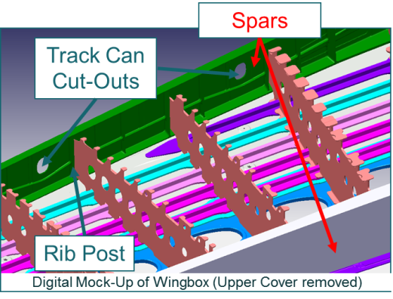
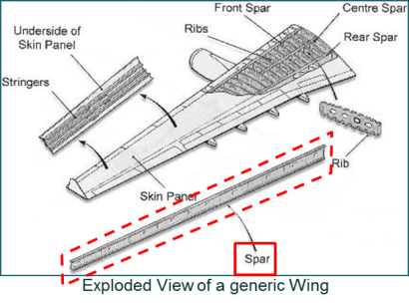
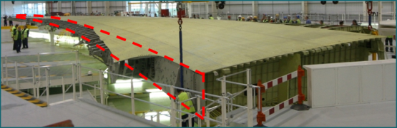
Spars
comprise an upper and a lower flange connected by thin, stiffened webs.
Span-wise members that carry shear loads.
Fuel Tank Boundary.
Provide mounting for WLG Fittings and Leading and Trailing edge fittings.

Slide 5
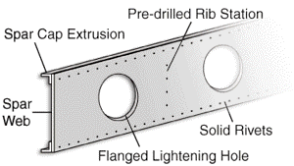
Spars loading
F
The distance between the centroid of spar caps
M
d
F

Slide 6
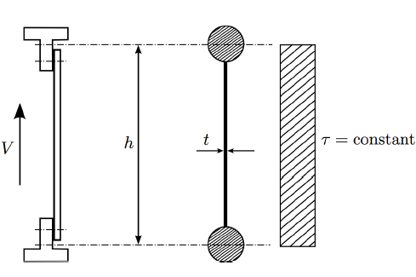
Spar loading
Spar caps (boom) is assumed to carry axial load only
d
Spar web is assumed to carry constant shear stresses (average shear) only
Please note that direct stresses exist on spar web

Slide 7
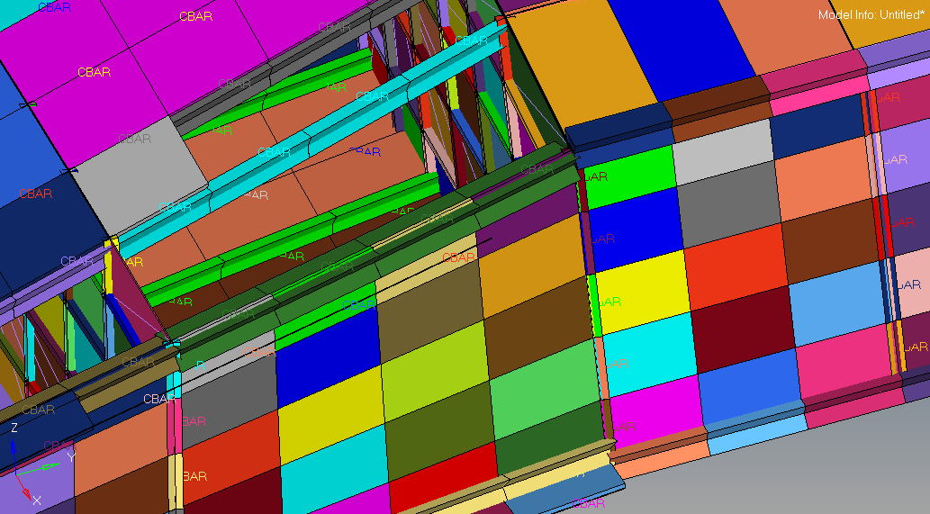
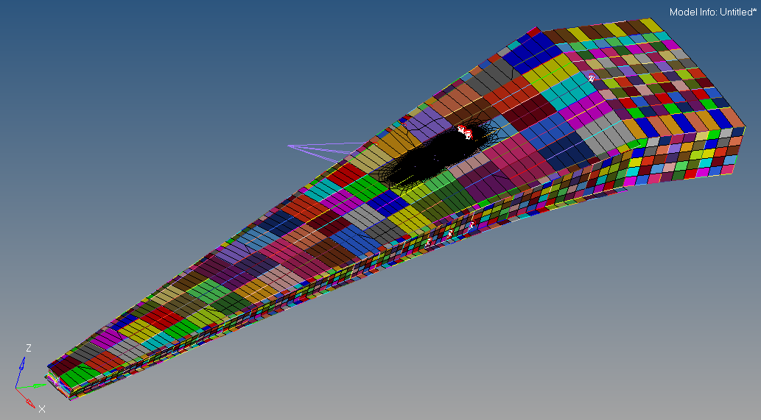
A320 Neo Wing
Spar cap modelled as Bar elements with spar web (composite) thickness of 9 mm

Slide 8
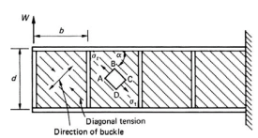

Spar buckling
Spar web is so thin that it is susceptible to buckling under shear loading
The web of the beam buckles under the action of internal diagonal compressive stresses produced by shear
This leads to a wrinkled web capable of supporting diagonal tension only in a direction perpendicular to that of the buckle
The beam is then said to be a complete tension field beam

Slide 9
Reminder
How does compression come about?

Slide 10
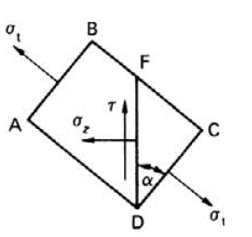

Complete diagonal tension
At any section where shear force is S, average shear stress for spar web is;

Slide 11



Complete diagonal tension
Let’s isolate element ABCD at a chosen section
Tensile stresses σ_{t} are present on faces AB and CD
The angle of diagonal tension is α
On vertical plane FD we have both shear and direct stresses
Let’s write equation of equilibrium for element FDC;

Slide 12




Complete diagonal tension
Let’s write equation of equilibrium for element FDC;

Slide 13
Complete diagonal tension
Both tensile stress and shear stress are constant through the depth of the beam
σ_{z} is also constant

Slide 14
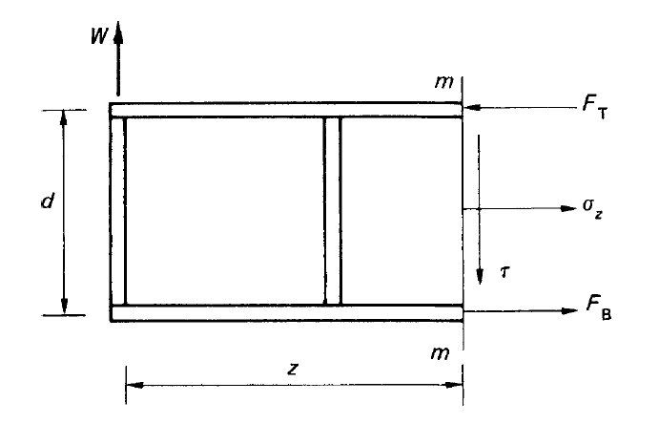




Complete diagonal tension
Direct forces in the flanges (booms) can be calculated by drawing a free body diagram at length z of the beam;

Slide 15
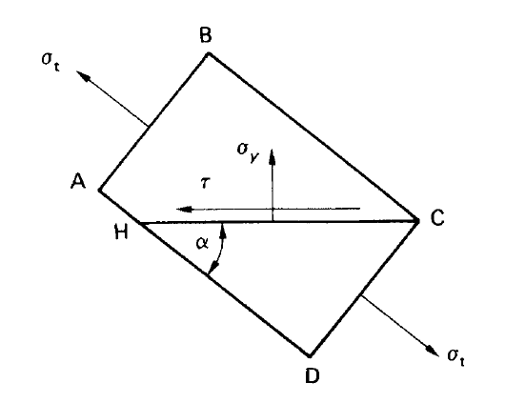
Complete diagonal tension
The diagonal tensile stress (σ_{t}) induces a direct stress (σ_{y}) on horizontal planes at any point in the web
On a horizontal plane HC in the element ABCD, there is a direct stress (σ_{y}) and a complementary shear stress

Slide 16
Reminder
Why do we have horizontal stress on plane HC?

Slide 17




Complete diagonal tension
σ_{y} causes compression in the vertical stiffeners so we can find axial compressive force in the stiffener P as of the next slide;

Slide 18
Complete diagonal tension

Slide 19
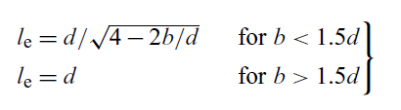
Buckling of stiffeners
If P is high then stiffeners can buckle similar to columns
Effective length of stiffener is then taken as;
Load P also brings about another affect. Can any body indicate as to what could happen next?

Slide 20


Bending of flanges

Slide 21
Angle α
Adjusts itself for potential energy to become minimum
If stiffeners and flanges are assumed to be rigid then α=45º
In real life nothing is rigid and therefore 38º<α< 45º

Slide 22





Angle α
The angle can be calculated as follow (for beams made of the same material);
Uniform direct compressive stress in the flange because of diagonal tension
We know
Uniform direct compressive stress in the stiffener because of diagonal tension

Slide 23

Note
An alternative term for finding Alpha is set as below;
This term is obtained by consideration of total strain energy of the beam
From now on, we use this term for angle of principle planes
A_{F} and A_{S} are cross sectional area of flange and stiffener, respectively
70

Slide 24
Example 5
The beam is assumed to have a complete tension field web. If the cross-sectional areas of the flanges and stiffeners are, respectively, 350mm² and 300mm² and the elastic section modulus of each flange is 750mm³
Determine the maximum stress in a flange
Determine whether or not the stiffeners will buckle
The thickness of the web is 2mm, and the second moment of area of a stiffener about an axis in the plane of the web is 2,000mm⁴; E = 70,000N/mm².

Slide 25
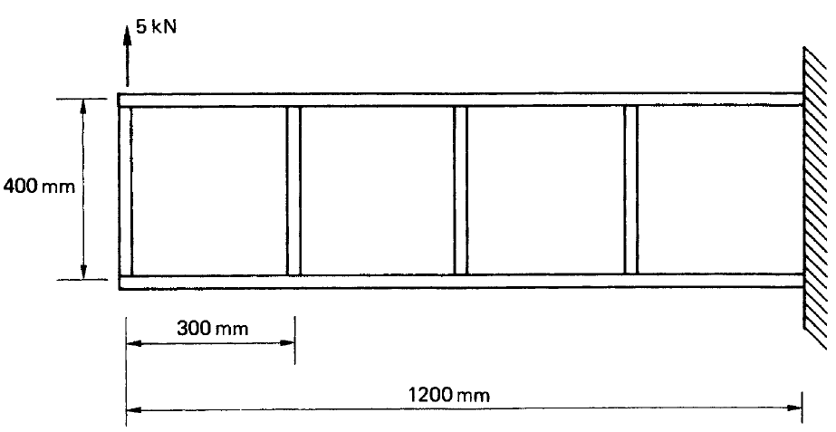


Solution
The first step is to find the angle Alpha for the correct positioning of principle planes

Slide 26



Solution

Slide 27
Solution
Which flange undergoes more stress and why?
Think about this for 5 mins and post your replies on Padlet;
https://padlet.com/mahdi_damghani/Spars_Diagonal_Tension

Slide 28
Solution

Slide 29




Solution

Slide 30
Example 6
A cantilevered spar has a constant web depth of 300mm and equally spaced posts (stiffeners). The web thickness is constant and equal to 1mm. The spar carries a 40kN and a 20kN loads. Assume that A_{s}/A_{f}=2.67. The loading has resulted in a fully developed diagonal tension field throughout the spar.
(a) Plot the Shear Force (SF) and the Bending Moment (BM) diagrams for the spar.
(b) Calculate the maximum compressive force in the beam flanges (booms) due to the combination of primary bending moment and the tension field effect
(c) Calculate the forces in post A and post B.

Slide 31
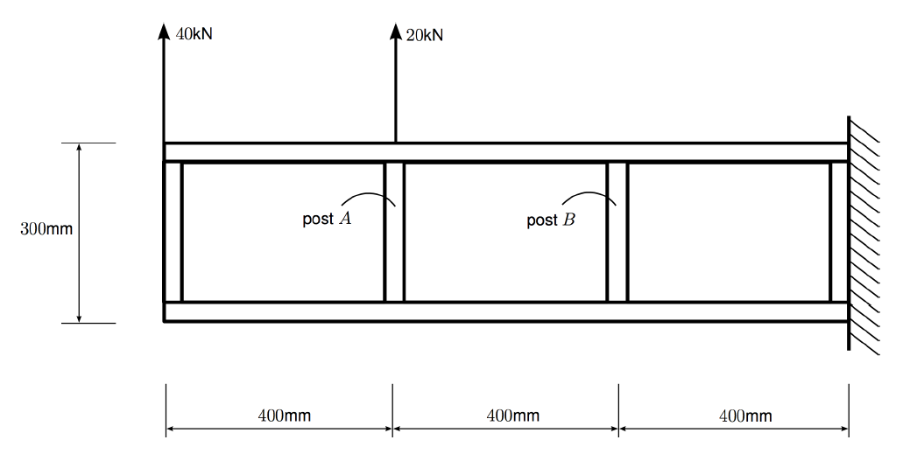
Example 6

Slide 32
Solution
V
x
-40 kN
-60 kN

Slide 33
Solution
64,000 kN.mm
M
16,000 kN.mm
x

Slide 34
Solution
As discussed in the previous example, maximum force occurs in the top flange
See next slide

Slide 35
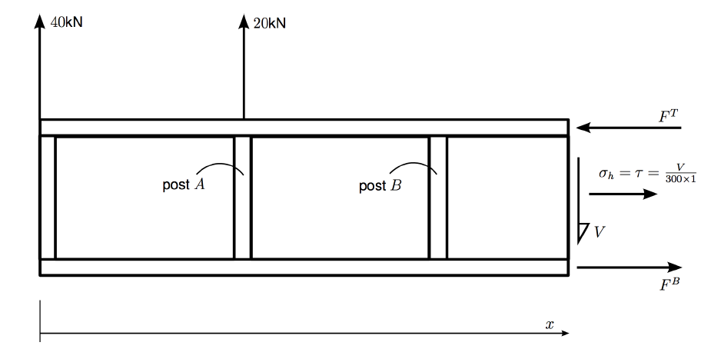
Solution

Slide 36
Solution

Slide 37
Tutorial 1
The beam shown in the next slide is clamped at one end and has a point load of 7.0kN at the other end. The beam is assumed to have a complete tension field web. The cross-sectional areas of the flanges and stiffeners are, respectively, 385mm² and 300mm² and the elastic section modulus of each flange is 750mm³. The thickness of the web is 2mm, and the second moment of area of a stiffener about an axis in the plane of the web is 1,500mm⁴. Assume modulus of elasticity of material E = 71,700N/mm².
Determine the maximum stress in a flange
Determine whether or not the stiffeners will buckle

Slide 38
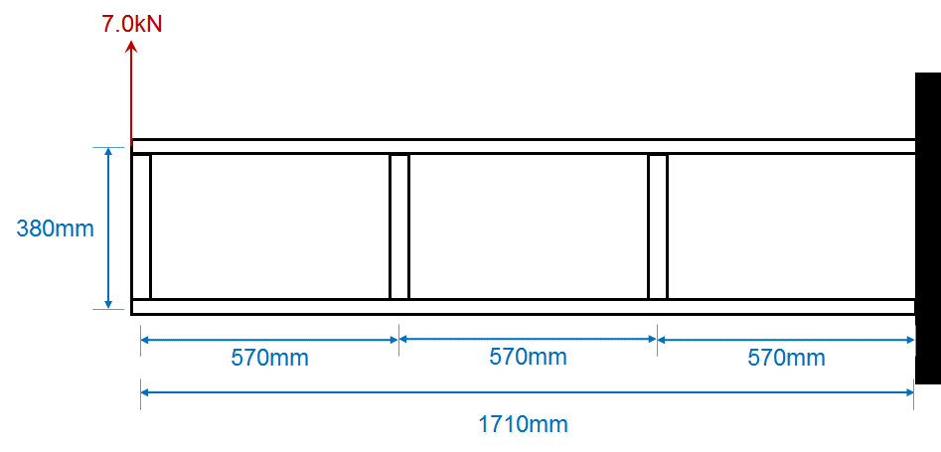
Tutorial 1

Slide 39
Tutorial 2
A simply supported beam has a span of 2.4m and carries a central concentrated load of 10 kN. The flanges of the beam each have a cross-sectional area of 300mm², while that of the vertical web stiffeners is 280mm². If the depth of the beam, measured between the centroids of area of the flanges, is 350mm and the stiffeners are symmetrically arranged about the web and spaced at 300mm intervals, determine the maximum axial load in a flange and the compressive load in a stiffener. It may be assumed that the beam web, of thickness 1.5mm, is capable of resisting diagonal tension only.

