Slide 1
Structural idealisation
By dr. mahdi damghani

Slide 2
Suggested Readings
Chapters 19
of
Aircraft Structural Analysis

Slide 3
Learning objectives
Impact of idealisation on bending of beam cross section;
Impact of idealisation on shear flow and its distribution within the beam cross section;
Impact of idealisation on torsion of beam cross section;

Slide 4
Effect of idealisation on analysis of open and closed section beams
Let’s remind ourselves of the bending equation;
For I_{xx}, I_{yy} and I_{xy} it is essential to obtain the location of neutral axis;
The position of the neutral axis is derived from the condition that the resultant load on the beam cross section is zero;
By concentrating the area for idealization, we are essentially manipulating the A and the location of the centroid of the cross section.
Note that we must use I_{xx}, I_{yy} and I_{xy} for the direct stress carrying section (see next example).

Slide 5
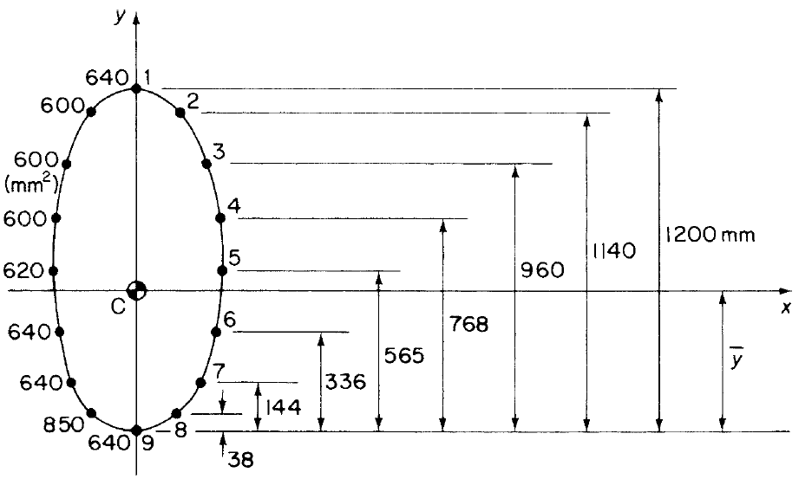
Bending of open and closed section booms
The fuselage section is subjected to a bending moment of 100kNm applied in the vertical plane of symmetry. If the section has been completely idealised into a combination of direct stress-carrying booms and shear-stress-only-carrying panels, determine the direct stress in each boom.

Slide 6


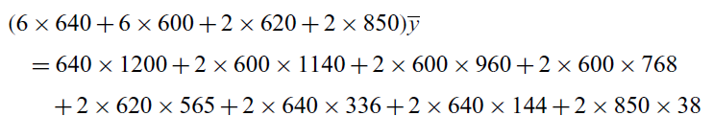

Solution
0
0
0
Axis of symmetry
0
0
Taking moment about 9
Taking moment about 9

Slide 7
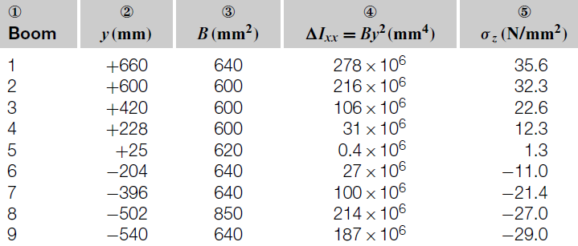
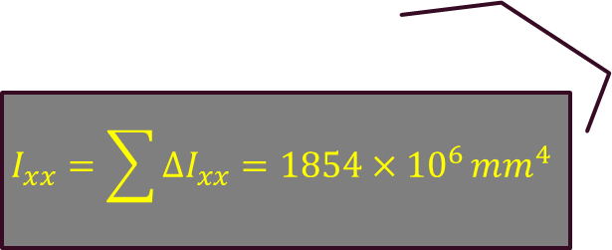
Solution
540 mm=
$$I_{xx}=\sum{∆I_{xx}=1854×{10}^{6}}{mm}^{4}$$
=-540+38
=1200-540
=-540+38

Slide 8
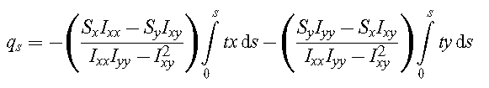
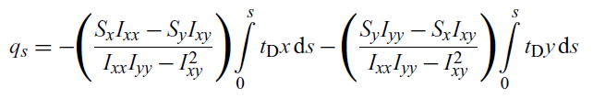
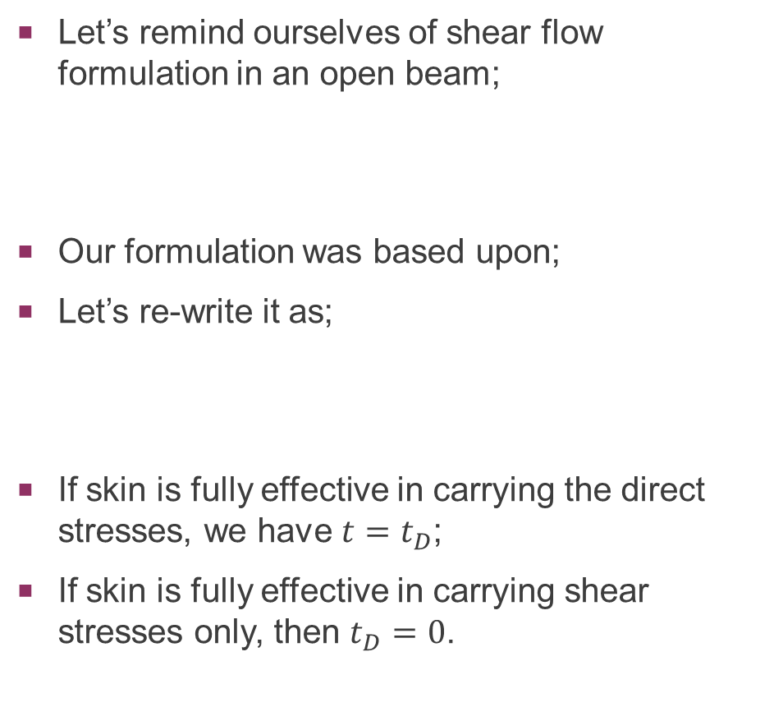
Effect of idealisation on Shear of open section beams
Let’s remind ourselves of shear flow formulation in an open beam;
Our formulation was based upon;
Let’s re-write it as;
If skin is fully effective in carrying the direct stresses, we have $t=t_{D}$;
If skin is fully effective in carrying shear stresses only, then $t_{D}=0$.

Slide 9
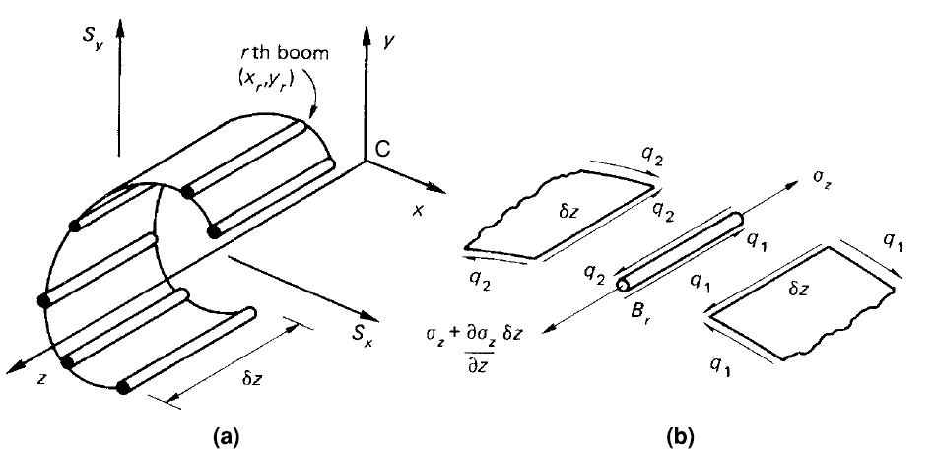
Shear of open section beams
When we have booms, the shear flow gets disturbed but this is not reflected in the opposite equation!!!
The beam carries shear forces S_{x} and S_{y} applied at the shear centre;
Let’s look at r^{th} boom in the section;
Shear forces impose direct stresses in both booms and skins as well as shear stresses in the skins;
Writing equation of equilibrium for the element.

Slide 10


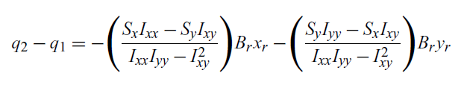
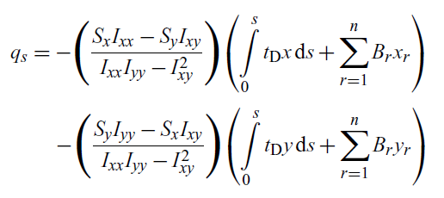
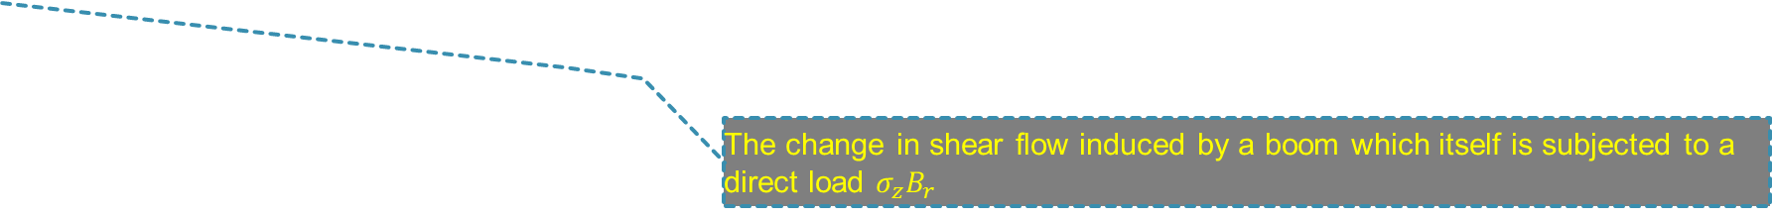
Shear of open section beams
The change in shear flow induced by a boom which itself is subjected to a direct load $σ_{z}B_{r}$

Slide 11
Shear of open section beams
Previous equation without idealisation;
Shear flow equation after idealisation;
If at any distance s around the profile of the section, n booms have been passed, the shear flow at the point is given by this equation (let’s see this in an example)

Slide 12
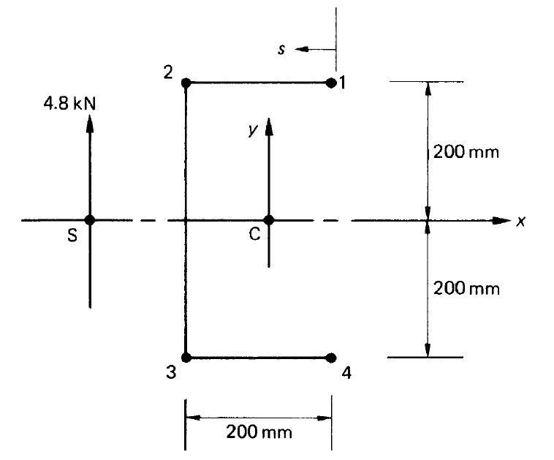
Example
Calculate the shear flow distribution in the channel section produced by a vertical shear load of 4.8kN acting through its shear center. Assume that the walls of the section are only effective in resisting shear stresses, while the booms, each of area 300mm², carry all the direct stresses.

Slide 13


solution
Walls are only effective in shear means $t_{D}=0$;

Slide 14


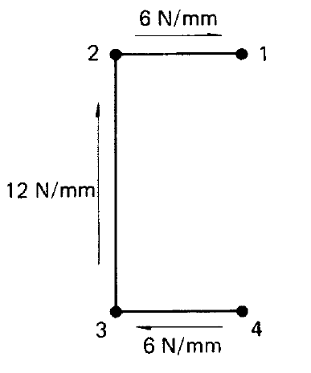


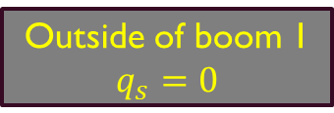
solution
$$q_{12}=q_{s}+∆q_{1}=−6N/mm$$
Outside of boom 1
$$q_{s}=0$$
Outside of boom 4

Slide 15
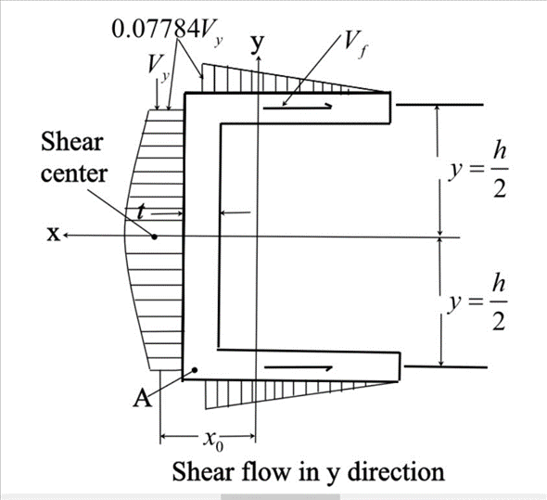
Important note
In a real structure the shear flow distribution for a channel section looks similar to the opposite figure, i.e. parabolic in the web and linear in the flanges;
However, by idealising, the shear flow between booms are constant values (see previous slide);
By idealising we lost the correct shear flow distribution;
The constant shear flows in idealised section are the average values of the un-idealised section.

Slide 16
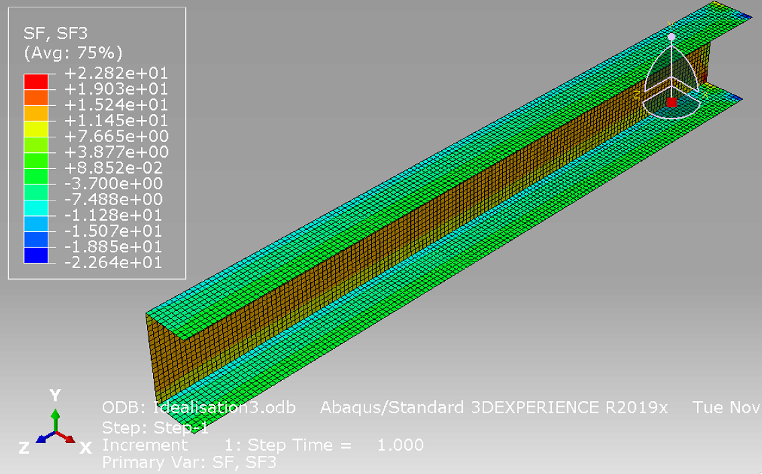
FEA result (SF3 shear flow at elements’ centroid)
Almost linear. FEA is approximation.

Slide 17
FEA result (SF3 shear flow at elements’ centroid)
Almost quadratic. FEA is approximation.

Slide 18
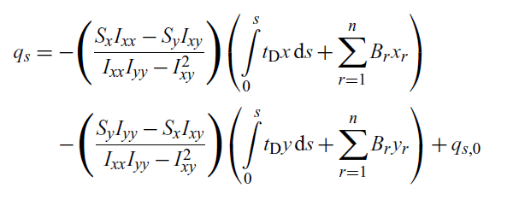
Effect of idealisation on Shear of closed section beams
Open section
Closed section

Slide 19
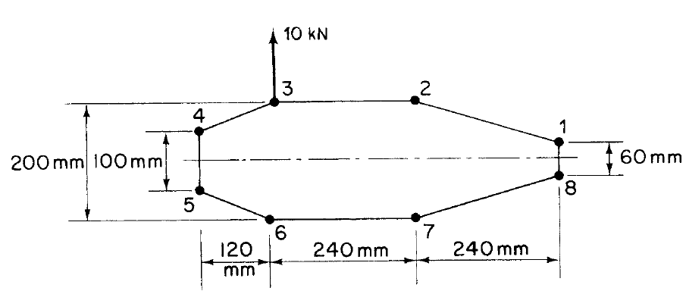
example
The thin-walled single cell beam has been idealised into a combination of direct stress-carrying booms and shear-stress-only-carrying walls. If the section supports a vertical shear load of 10kN acting in a vertical plane through booms 3 and 6, calculate the distribution of shear flow around the section.
Boom areas:
B₁=B₈=200mm², B₂=B₇=250mm²
B₃=B₆=400mm², B₄= B₅=100mm²

Slide 20



Solution
Cut the section in wall 23 to find basic shear flow

Slide 21
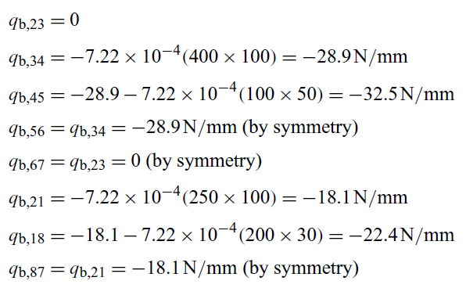


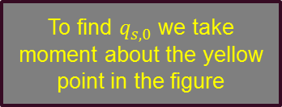
Solution
By creating the cut we have an open section now
Cut
B₁=B₈=200mm², B₂=B₇=250mm²
B₃=B₆=400mm², B₄= B₅=100mm²
To find $q_{s,0}$ we take moment about the yellow point in the figure

Slide 22
note (maybe an amendment to megson’s solution)
For wall 12 we have;
Shear force and its components are;
The torque from 12 must be;
Not what is given in Ref. [1] as;
However, for the sake of consistency we will go with solution given in Ref. [1].
2
V
250mm
V_{y}
70mm
V_{x}
1
240mm
65mm
240+120=360mm

Slide 23
Note
For wall 34 we have;
Shear force and its components are;
The torque from 34 must be;
3
130mm
V_{x}
50mm
V
25mm
4
60mm
120mm
V_{y}
50mm

Slide 24

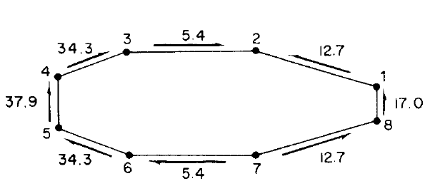
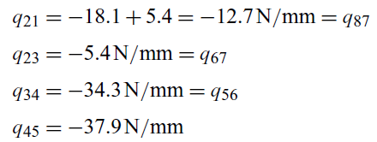


solution
In any wall, the final shear flow is the summation of basic shear flow and $q_{s,0}$;

Slide 25
Effect of idealisation on torsion of open and closed section beams
Shear due to torsion is not affected by idealisation and previous methods we discussed in earlier lectures hold valid for idealised beam sections

Slide 26
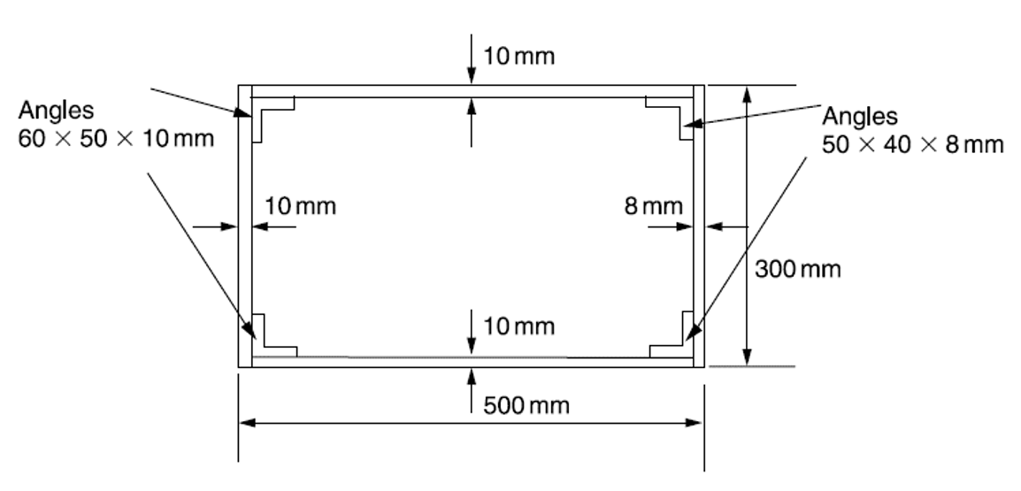
Tutorial 1
In the example of Lecture 6 and Tutorial 1, determine the distance of the shear centre from the left-hand web.

Slide 27
solution
To obtain the second moment of area, it is essential to find the neutral axis location;
Taking moment about bottom skin, line 43;
Taking moment about spar 14;
1
2
300 mm
4
3
500 mm

Slide 28
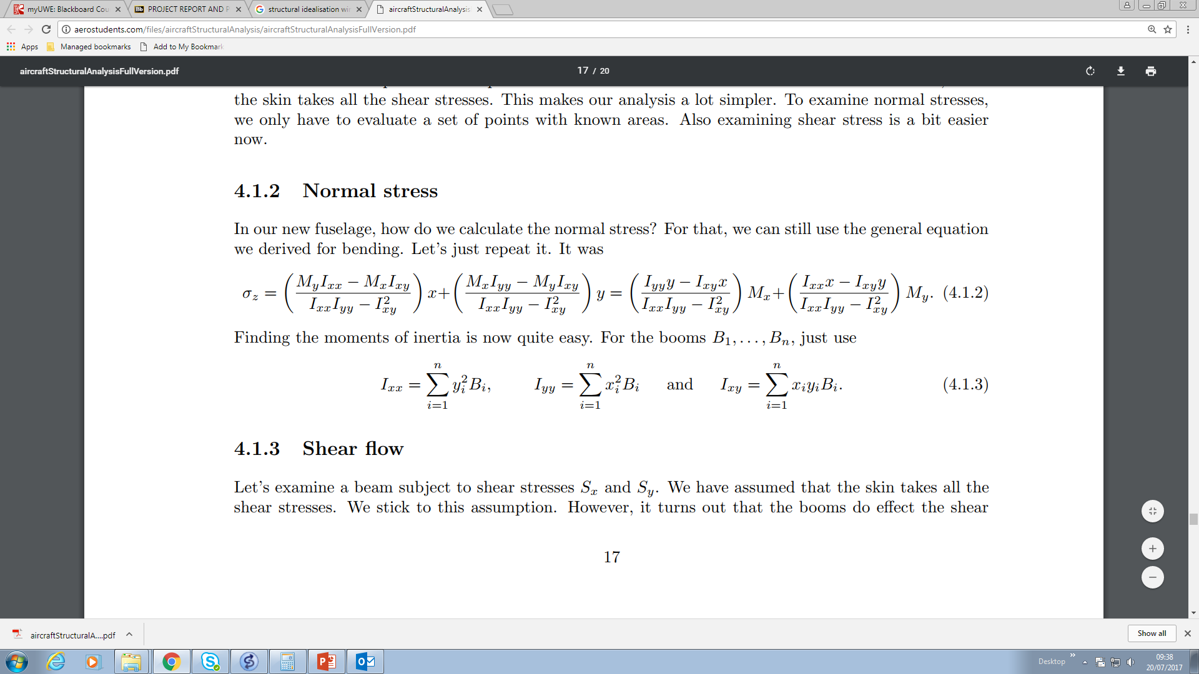
solution
1
2
y
300 mm
x
234.75
150
4
3
500 mm
No need to calculate as it is singly symmetric

Slide 29
solution
The closed box section is cut at the purple line location to make it open. Then we follow exactly the same procedure as previous example.
1
2
y
300 mm
x
234.75
150
4
3
500 mm

Slide 30
solution
By creating the cut we have an open section now
1
2
300 mm
The rate of twist must be zero
4
3
500 mm

Slide 31
solution
Shear centre is obtained by equating the torsion of external shear force to the torsion of internal shear flows about boom 1.
Sy
1
1
2
2
300 mm
300 mm
4
3
500 mm

Slide 32
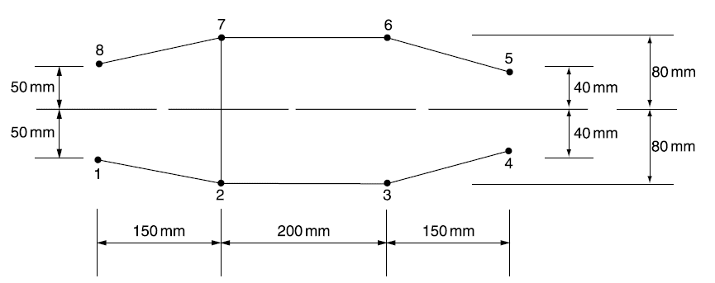
Tutorial 2
The beam section has been idealised into an arrangement of direct stress-carrying booms and shear-stress-only-carrying panels. If the beam section is subjected to a vertical shear load of 1495N through its shear centre, booms 1, 4, 5, and 8 each have an area of 200mm², and booms 2, 3, 6, and 7 each have an area of 250mm², determine the shear flow distribution and the position of the shear centre.

Slide 33
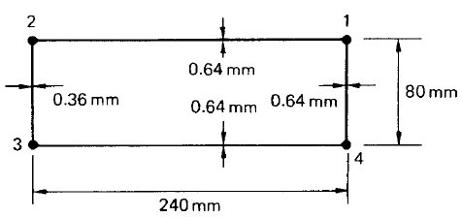
Tutorial 3
Find the position of the shear centre of the rectangular four-boom beam. The booms carry only direct stresses, but the skin is fully effective in carrying both shear and direct stress. The area of each boom is 100mm².

