Slide 1
Structural idealisation
By dr. mahdi damghani

Slide 2
Suggested Readings
Chapters 19
of
Aircraft Structural Analysis

Slide 3
Learning objectives
This Lecture (Lecture 6):
Familiarisation with the functions of various structural components in an aircraft;
Familiarisation with simplifying complex wing structure into an idealised structure for stress analysis purposes;
Next lecture (Lecture 7):
Impact of idealisation on bending of beam cross section;
Impact of idealisation on shear flow and its distribution within the beam cross section;
Impact of idealisation on torsion of beam cross section;

Slide 4
Note to the students
You are requested to read the following paper before attending this lecture;
Note that this document is uploaded on blackboard;
Odeh Dababneh, Altan Kayran, (2014) "Design, analysis and optimization of thin walled semi-monocoque wing structures using different structural idealization in the preliminary design phase", International Journal of Structural Integrity, Vol. 5 Issue: 3, pp.214-226, https://doi.org/10.1108/IJSI-12-2013-0050

Slide 5
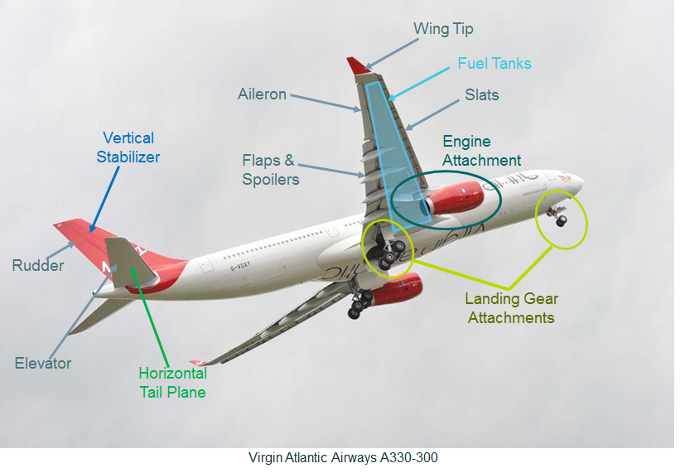
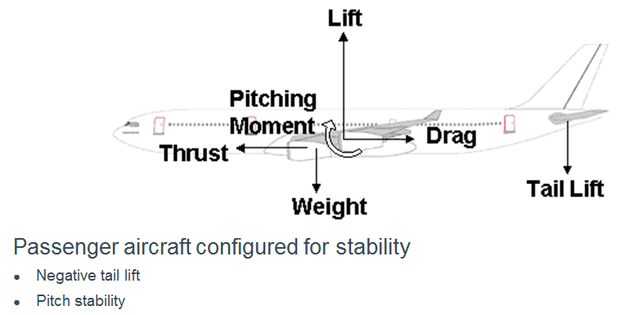
overview

Slide 6
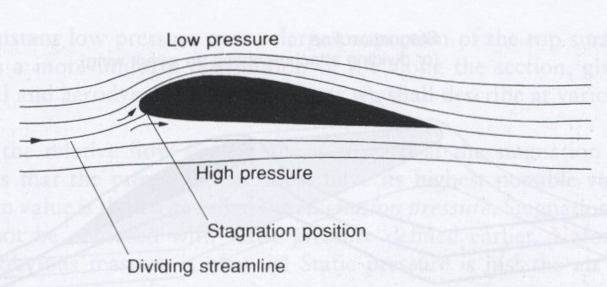
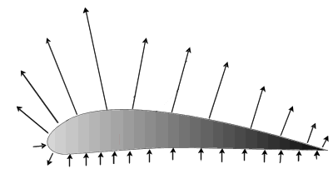
lift loads
Lift is generated by producing a higher pressure below the wing than above it.
Higher speed airflow above wing than below (streamlines closer together).
Lift
Streamlines around an aerofoil.
Pressure Distribution around an aerofoil.
Resultant lift force (red arrow) acts through centre of pressure (cop), normal to stream
cop varies with α (angle of attack)
Pitching Moment caused by unequal pressure distribution around aerofoil.

Slide 7
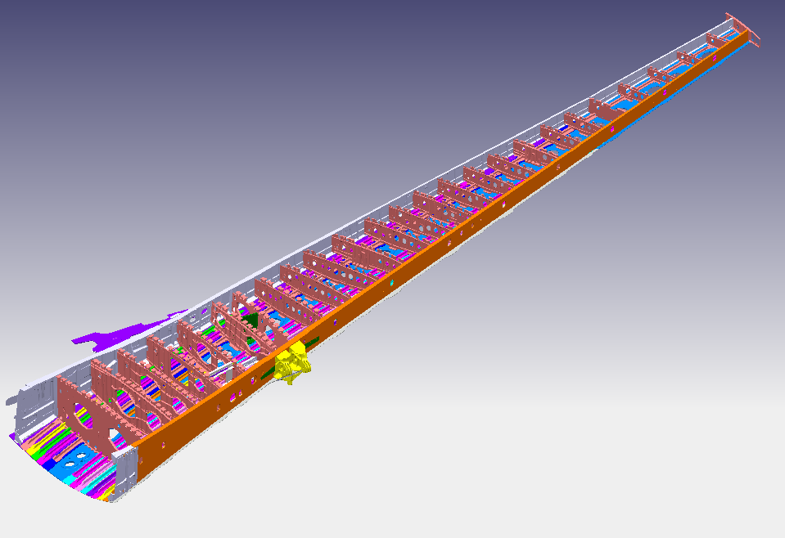
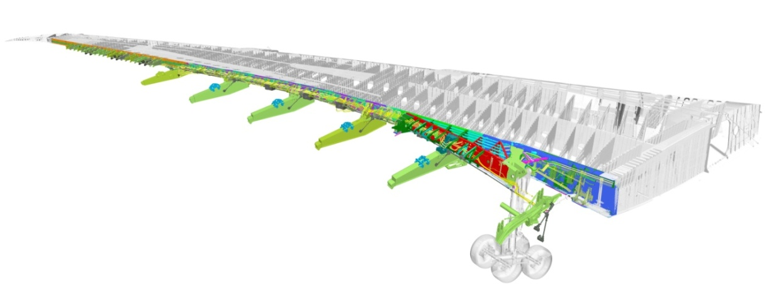
Wing structure
The Wing
Wingbox
Primary wing structure
Leading edge
Fixed Leading Edge
Slats
Droop Nose
Pylon (Engine) Attachments
Trailing Edge
Fixed Trailing Edge
Spoilers
Ailerons
Flaps
Wing Landing Gear Attachments
Wingtip and Fairings
Digital Mock-Up of a Wing-Box
(Upper Cover removed)
Digital Mock-Up of the A350 Wing

Slide 8
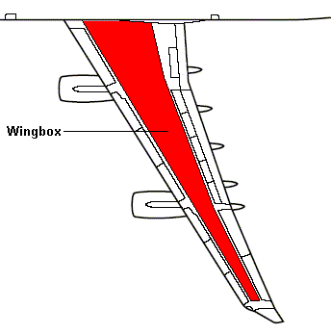
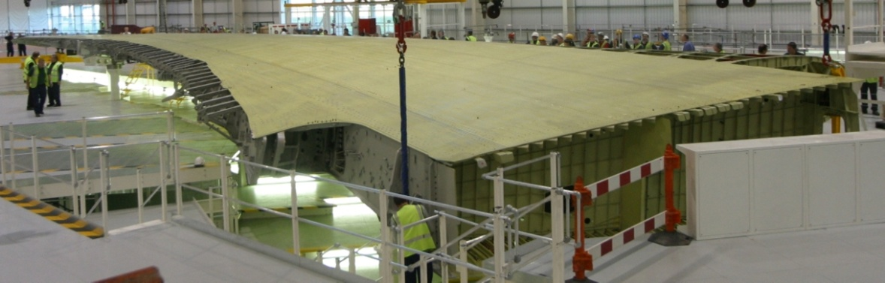
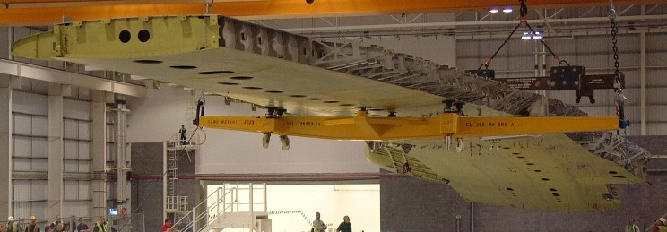
Wing-box
Carries the main structural loads from the wing;
Aerodynamic, inertial, movables, fuel;
Closed-cell structure allowing resistance to shear, torsion and tension loads;
Location of fuel tanks;
Supports the landing gear and engines, if they are wing mounted.
Wing in Plan View
A380 Wingbox in Production

Slide 9
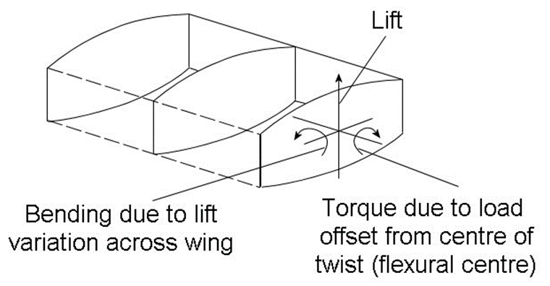
Wing loads
In Wing Finite Element Models the external loads are applied as Shear, Moment and Torque

Slide 10
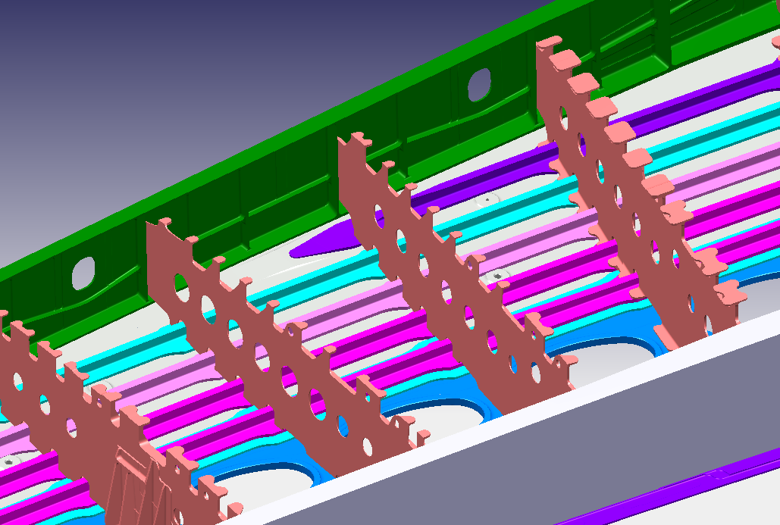
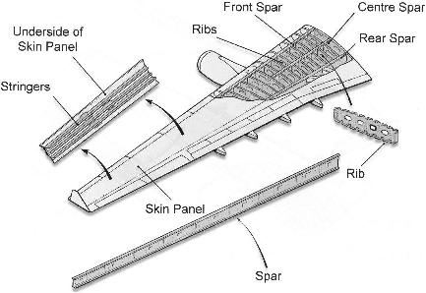
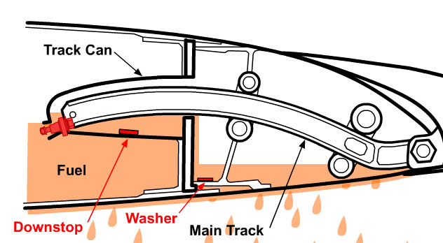
Wing complexity (spars)
Digital Mock-Up of Wingbox (Upper Cover removed)
Span-wise members that carry shear loads;
Fuel Tank Boundary;
Spars
Exploded View of a generic Wing
Track Can Cut-Outs
Rib Post
Provide mounting for WLG Fittings and Leading and Trailing edge fittings.

Slide 11
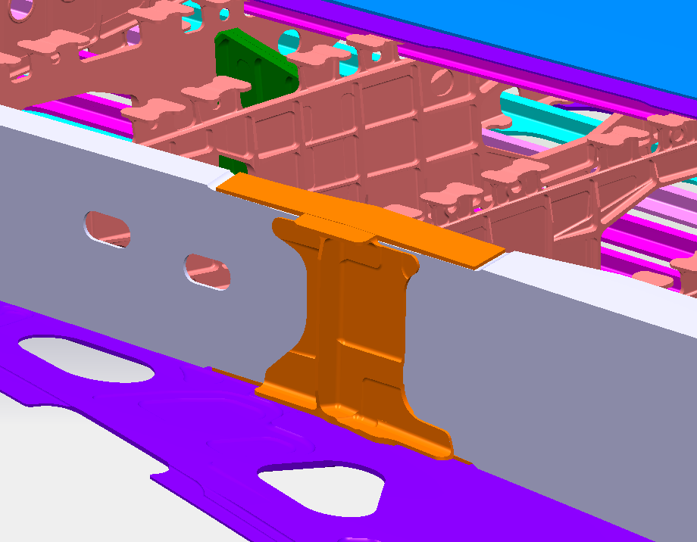
Wing complexity (spars)
For larger aircraft, the spars are usually made up from multiple sections;
Sections are normally joined together with joint plates and straps.
Spar
Boom Straps
Web Joint Plate
Spar
Digital Mock-Up of Wingbox (Upper Cover removed)

Slide 12
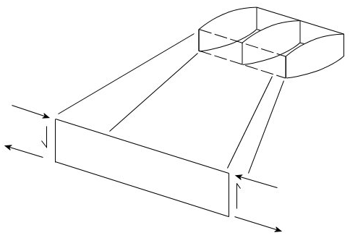
Load carrying mechanism of spars

Slide 13
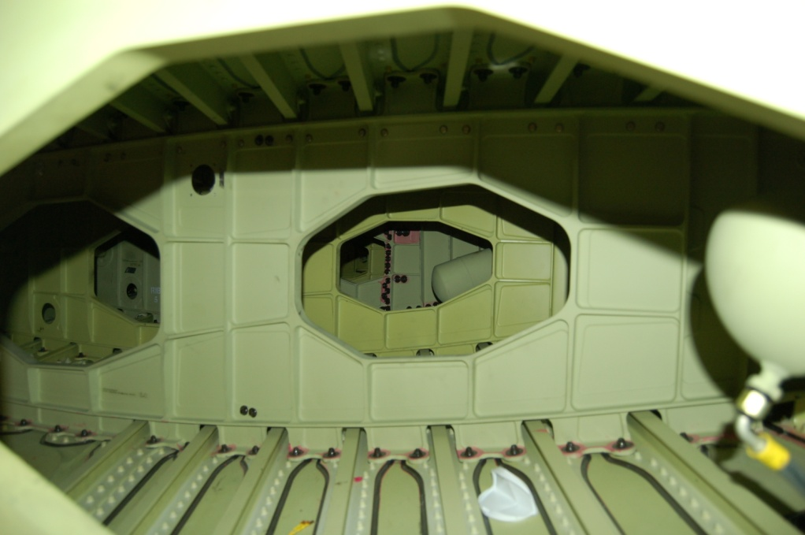
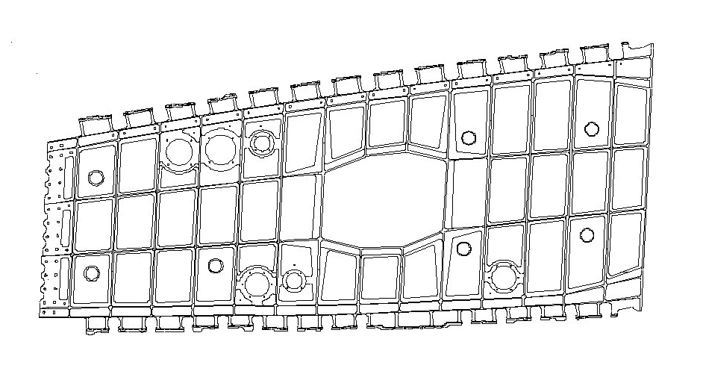
Wing complexity (RIBS)
Manhole
Castellation
Stringer
Stiffener/
Crack stopper
View inside the Wing Box onto Rib looking outboard
Computer Rendering of Typical Large Rib
Castellated edge allows the stringers to pass through rib feet to attached to the skin.
Manholes allow access within the wingbox and movement of fuel.
Stiffeners and crack stoppers are machined or bolted on to increase the strength of the overall structure.

Slide 14
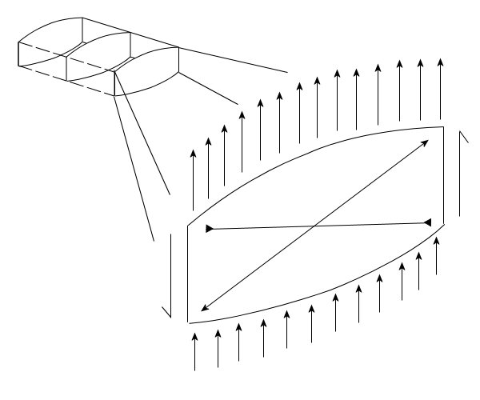
Load carrying mechanism of ribs

Slide 15
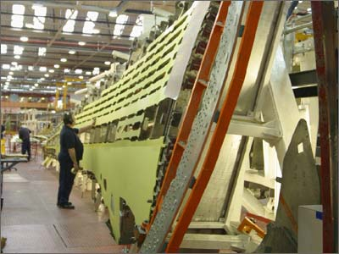
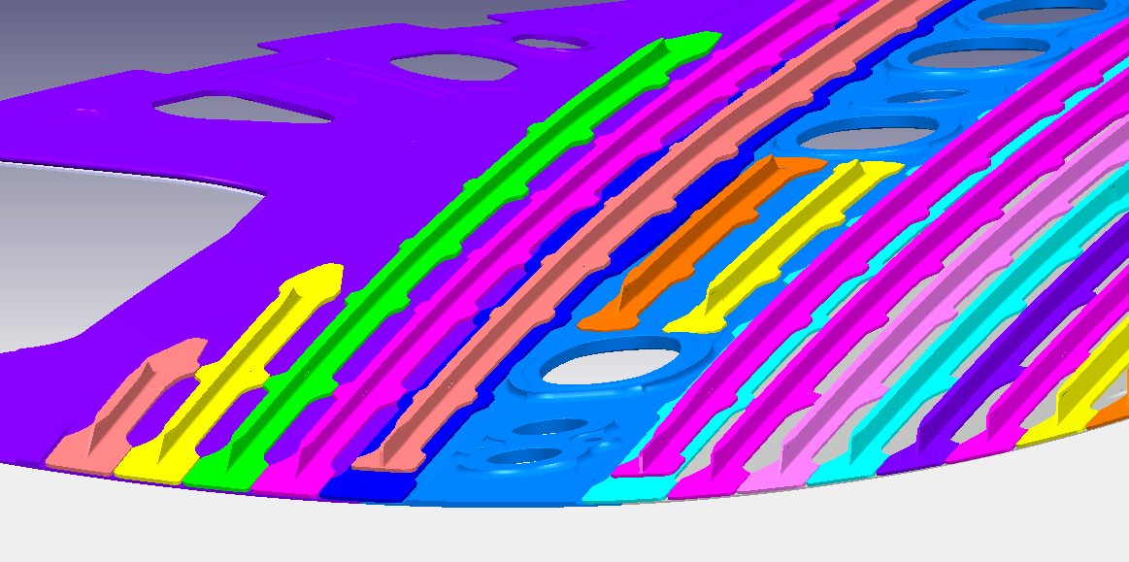
Wing complexity (skins and stringers)
Skin Panel
Skin Panel
The skin may be assembled from multiple panels. Joints between skin panels are made at stringer locations and reinforced with Butt Straps.
Stringers prevent skin buckling in compression and aid with bending strength in tension.
Stringer
Butt Strap
Digital Mock-Up of Lower Wing Skins with Stringers
Stringer being installed on an A340 Wing
Stringers are riveted onto the skin or integrally machined/formed onto the panel.
Access holes on the bottom skin allow entry into the wing-box for inspection of the internal structure and cleaning of the fuel tanks.
The Tension (Lower Cover) – Fatigue & Damage Tolerance
Compression (Top Cover) - Strength

Slide 16
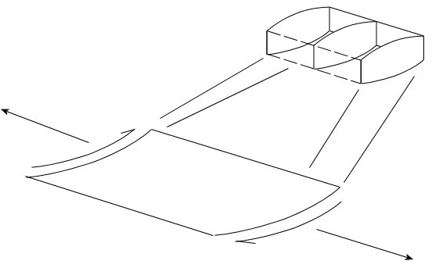


Load carrying mechanism of skins

Slide 17
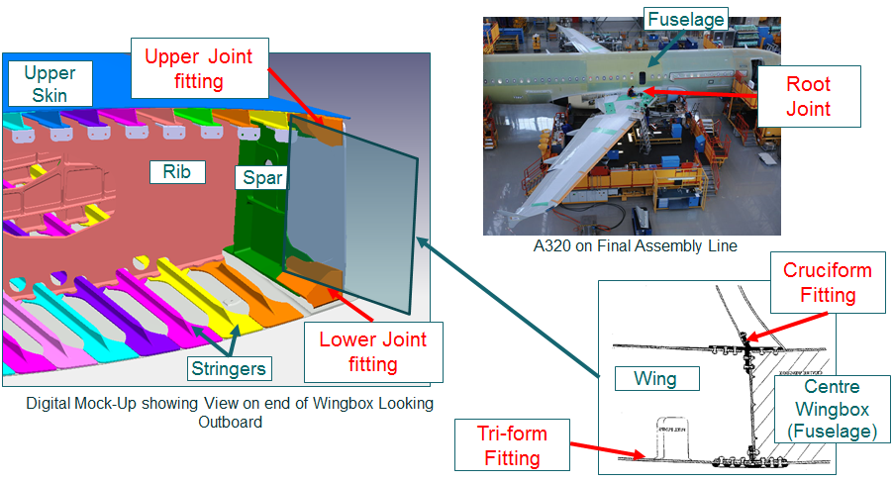
Root joint
Where the wing attaches to the centre wing box in the fuselage;
The cruciform and tri-form fittings are used to attach the upper and lower covers respectively to the centre wing box.
Upper and lower joint fittings are used to attach the spars.

Slide 18
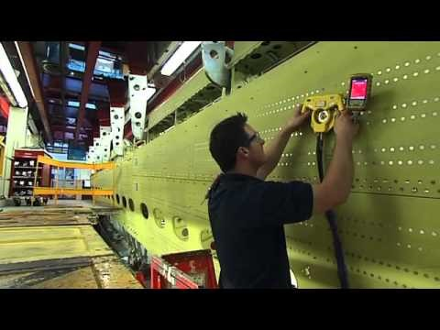
Watch
Notes:
https://www.youtube.com/watch?v=60CmDTly8Dg

Slide 19
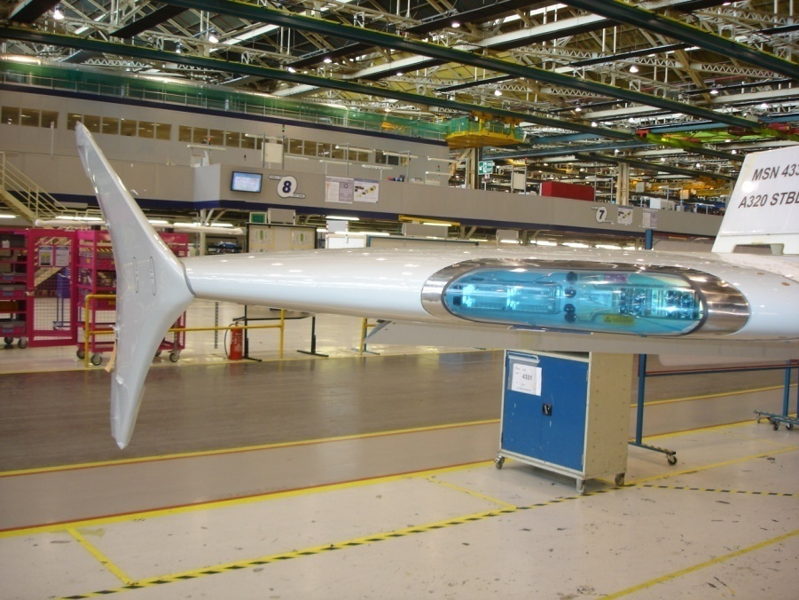
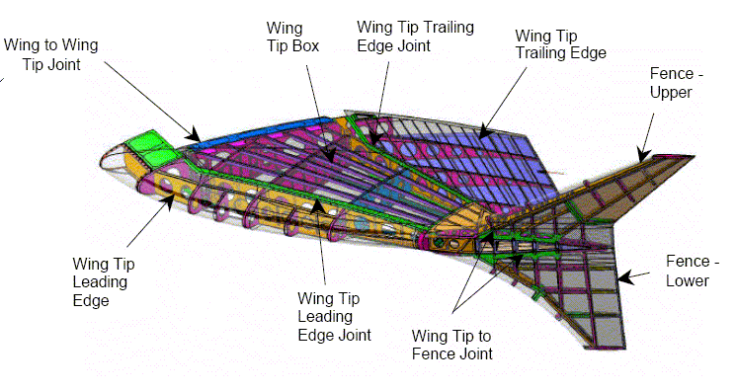
Wing tip
Wing Tip Fence
Navigation Lights
Wing Tip
A320 Wing tip installed on end of Wing at Broughton
Illustration of Wing Tip Structure
Rigid structure fixed to end of the wing-box;
The structure is built in a similar way to the wing-box, with spars, ribs, stringers and skin forming the structure;
Contains the navigation and strobe lights.

Slide 20

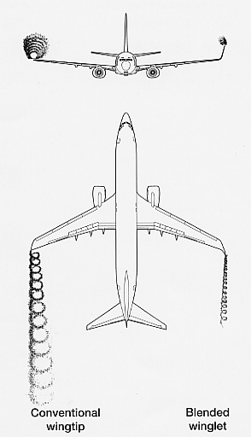
Wingtip (Winglet & Wing Fence)
Wing Tip with blended Winglet installed
Illustration of vortices created at the Wing Tip
A winglet or wing fence can be added to the end of the wingtip to reduce the induced drag effect of the wing;
A winglet generates more load than a wing fence but design of the wing and wingtip considers these extra forces;
“Sharklet” is Airbus’s trade name for the winglets being added to the A320 family.
Blended Winglet

Slide 21
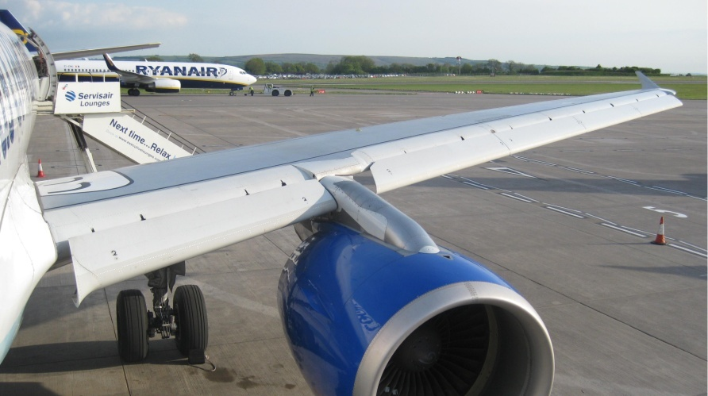
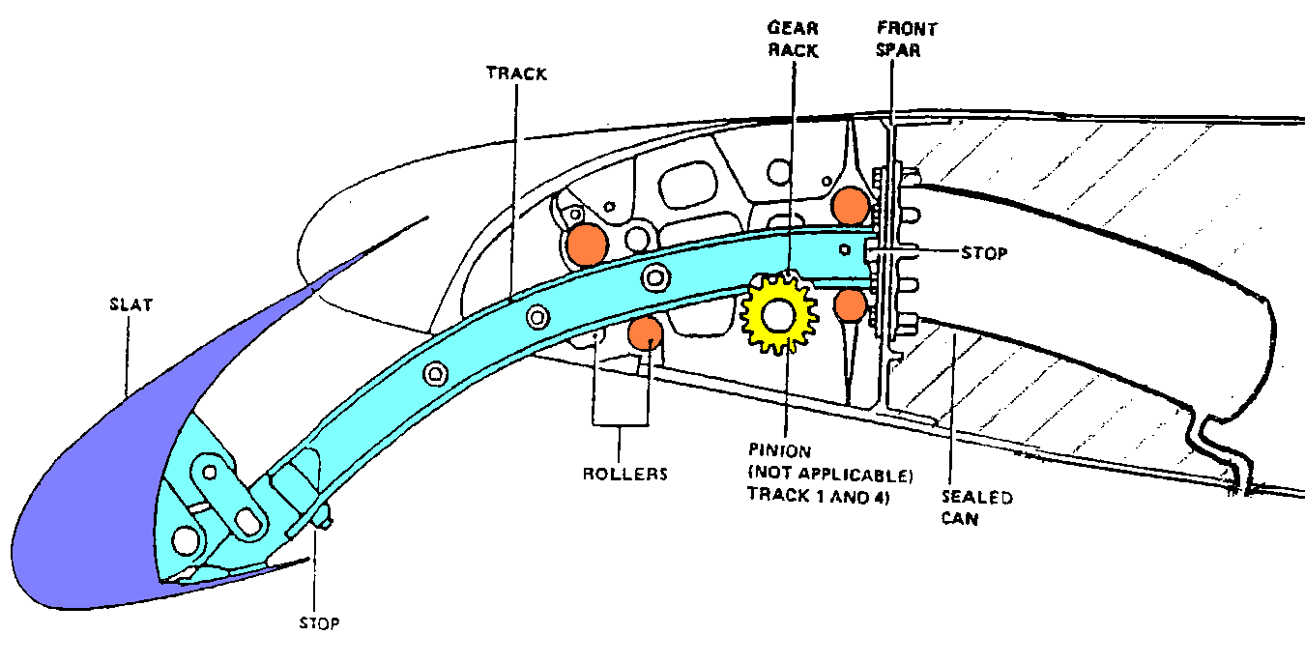
slats
Slats
Extend out from the leading edge to increase lift and allow the wing to be flown at a higher angle of attack (i.e. slower speeds);
Extended by a rack and pinion arrangement. Protection exists to avoid inadvertent asymmetric deployment of slats;
Supported by slat tracks which run along a set of rollers carrying the vertical and side loads;
Slat Cans house the slat tracks when retracted and act as a fuel boundary;
Aircraft Wing with Slats deployed
Cross-Sectional diagram of Slat arrangement

Slide 22
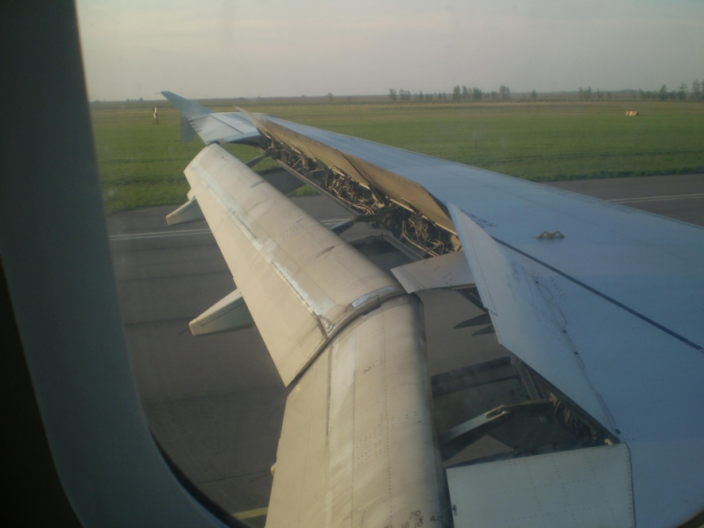
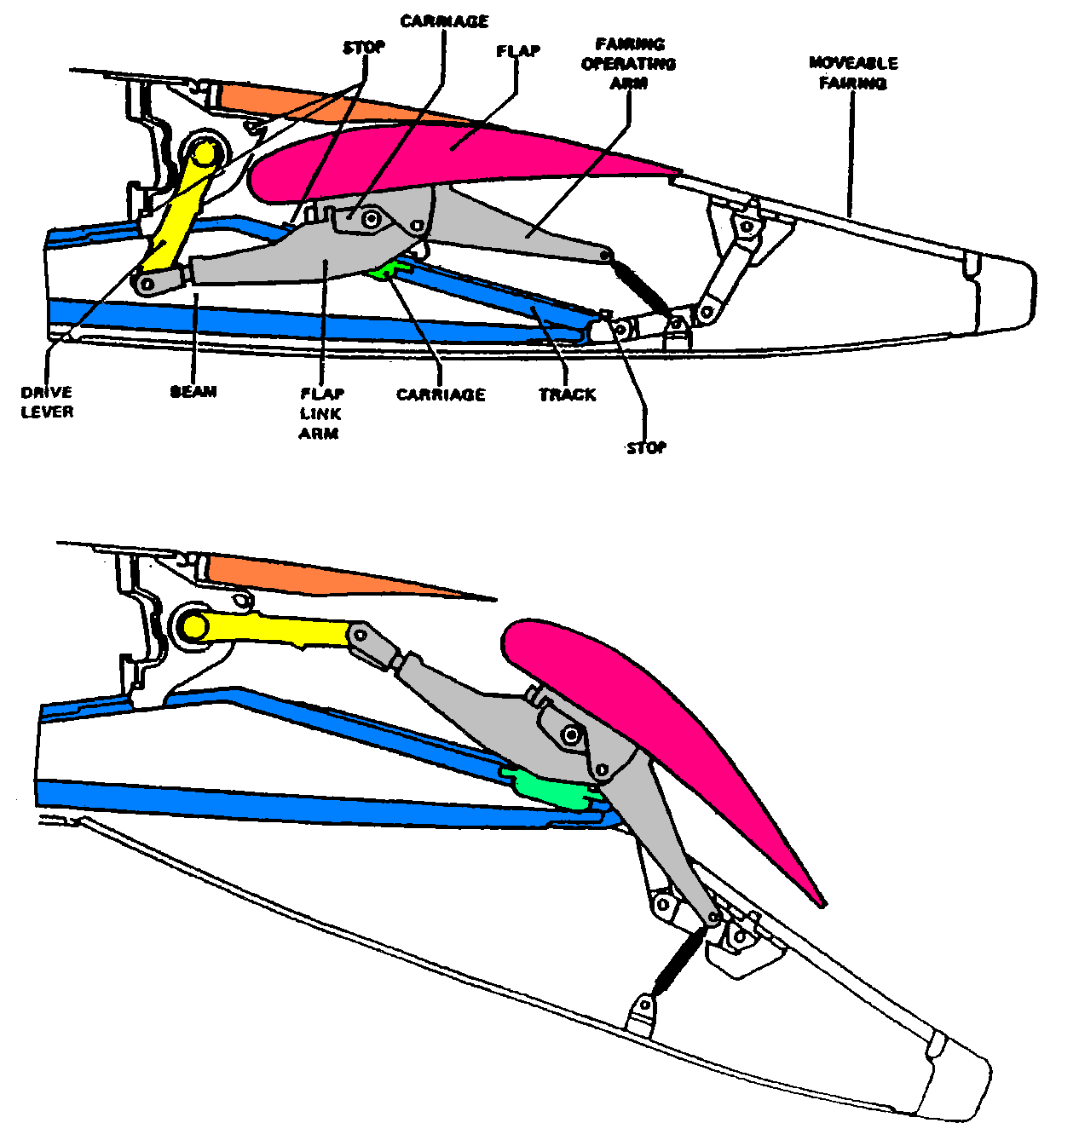
flaps
Extend to increase the effective wing area and camber;
This increases wing lift and also increases drag to enable a steeper descent when landing without the increase in airspeed.
Flaps
View of wing with flaps and spoilers fully deployed
Diagram of Flap in un-deployed and deployed states

Slide 23
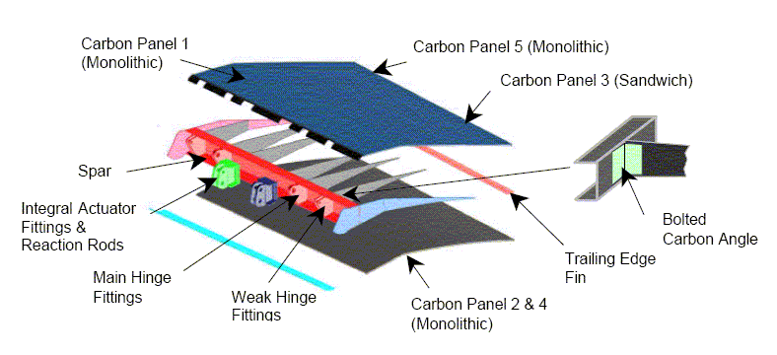
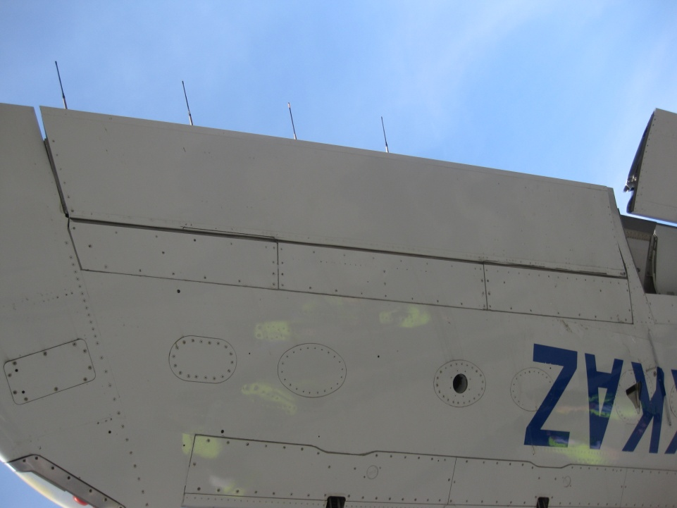
ailerons
Static discharger
Controls the roll rate of the aircraft, but may also be used for Load Alleviation Function in conjunction with the spoilers;
Larger aircraft may have more than one aileron on each wing;
Attached onto trailing edge ribs aft of the rear spar;
Mass weights are usually added forward of the hinge line to reduce flutter.
Aileron
Exploded view of Aileron composite structure
View on underside of wing, looking up

Slide 24
Wing structure categorisation
Category A;
Structure identified as Principal Structural Elements (PSE).
These are the elements that contribute significantly to carrying flight, ground or pressurisation loads and whose failure could result in catastrophic failure of the aircraft.(Ref. ACJ 25.571(a) 2.2; AC 25.571-1C 6d.)
These structures must be replaced or repaired on the discovery of any damage unless specific rational is provided.
Category B;
Structures whose failure or detachment could indirectly compromise continued safe flight or landing by an adverse effect on a Category A structure.
These structures must be replaced or repaired on the discovery of any damage unless specific rational is provided.
Category C;
Structures whose failure or detachment will not compromise continued safe flight or landing but where the potentially large size of released elements needs to be considered.
As these structures are not identified as either category A or B, any failure or departure from the aircraft must be demonstrated as not preventing continued safe flight and landing and the probability of occurrence is acceptably low (Ref. ACJ 25C- 571 (a)2.1.1e.). No detachment of structure is allowed (Ref. NPA 25C-290).
These structures must be replaced or repaired on discovery of element failure at an appropriate time.
Category D;
Structures whose failure or detachment has no airworthiness consequence but only has an economic impact.
These structures may have to be replaced or repaired on discovery of failure if they form part of the aircraft external envelop.

Slide 25
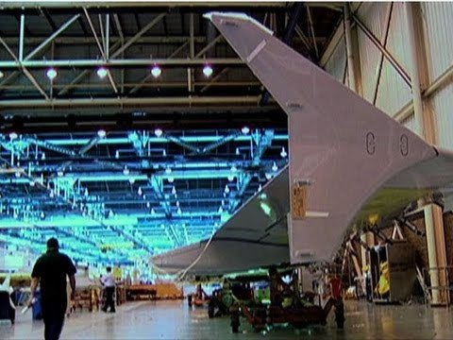
watch
Notes:
https://www.youtube.com/watch?v=qbBhg8xISug

Slide 26
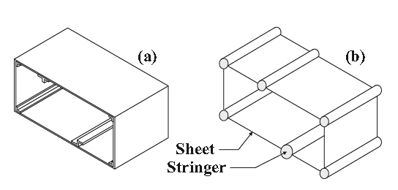
What is the point?
So far, we have been dealing with simple structural components such as plates and beams;
Real life structures are complex and in order to analyse them simplification must be made;
The behaviour of the simplified/idealised structure must be as close as that of the real structure;
Stresses/strains obtained from the idealised structure are representative of the real complex structure.
Sheet-stringer idealisation of the same section
Actual cross-section of a thin-walled beam

Slide 27
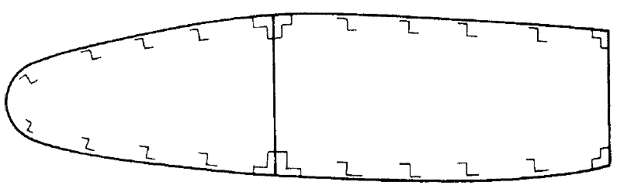
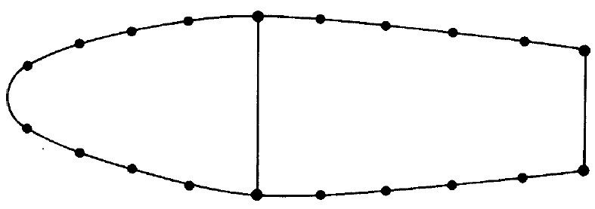
idealisation
We will further assume all direct stresses are taken by stringers and spar flanges. Skin takes all the shear
The variation of stress (due to bending) over the cross section is small
Replace with booms (concentration of area) at the midline of skin
Replace with booms (concentration of area) at the midline of skin
Replace with booms (concentration of area) at the midline of skin
Carrying direct and shear stresses
Stringers and spar flanges have small cross-sectional dimensions compared to the complete section
Assuming the direct stress is constant over stringers’ cross section
Carrying direct stresses only

Slide 28
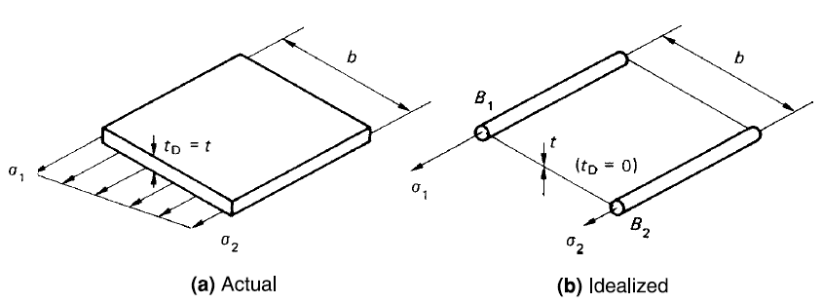
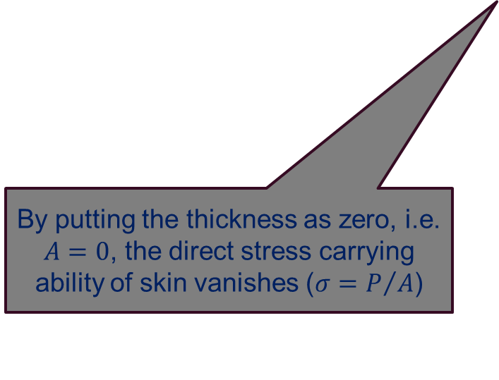
Panel idealisation
Direct stress carrying thickness of skin
Actual thickness of skin
We would like to idealise the panel into the following;
Direct stress carrying booms
Shear stress carrying skins
All direct stresses are given to booms;
Note that the distribution of stress has disappeared in idealised structure though;
As long as we can get the extremes of stress, it is fine;
What should be the area of booms?
By putting the thickness as zero, i.e. $A=0$, the direct stress carrying ability of skin vanishes ($σ=P/A$)

Slide 29
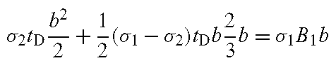
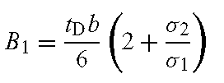
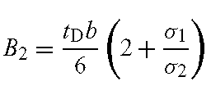
Panel idealisation
For idealisation;
Taking moment about the orange line
Taking moment about the orange line

Slide 30
notes
If the cross-section does not include discrete stringers, or in the presence of a few stringers with a total cross-sectional area far smaller than that of the thin walls, it is still possible to construct a sheet-stringer model.
In this case, an idealisation process is used to create “virtual stringers” that are assumed to carry the axial stresses, whereas the thin-walled portions are assumed to carry only shear stresses.
Lumping of the axial stress-carrying portions of the thin-walled section into stringers using previous slide is based on an a priori assumption for the axial stress distribution in the section.
If different distributions are considered that correspond to different loading conditions, equivalent idealised areas must be recomputed for each case.
It is useful to keep in mind that the idealisation process might be closely linked to the type of analysis that is being performed.

Slide 31
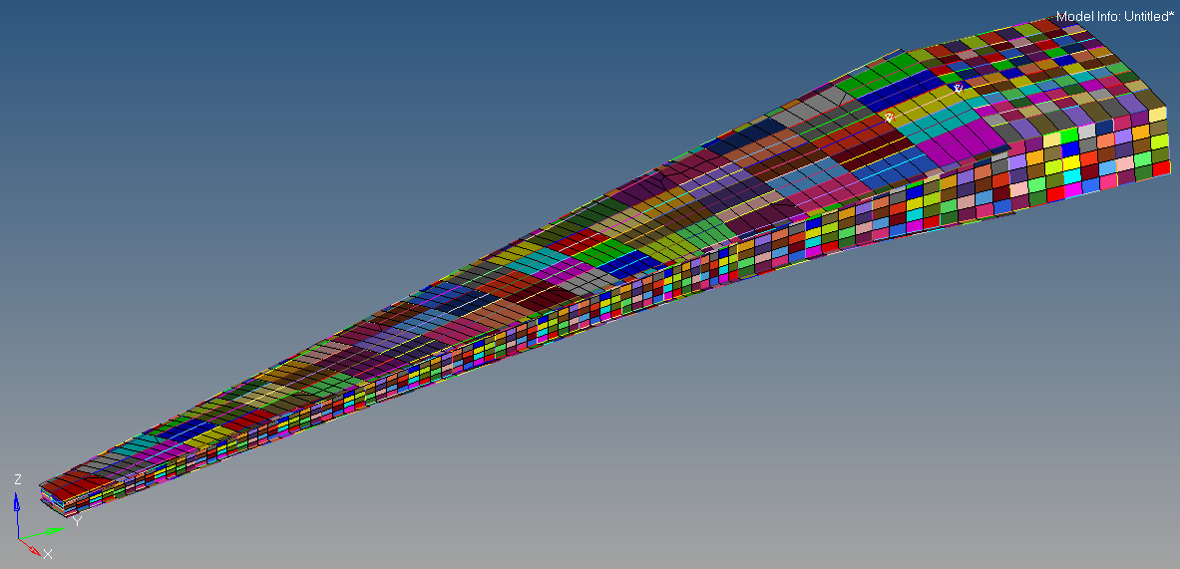
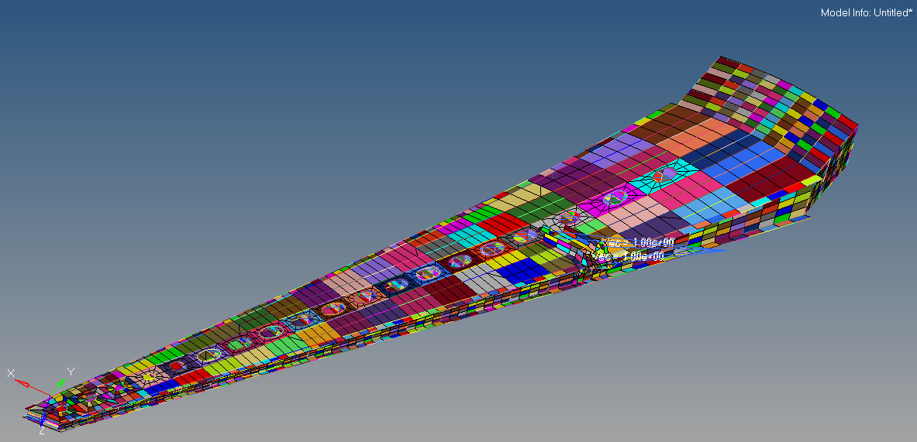
Wing idealisation as done in industry (Global FEM)
View from the top
Skin is modelled as shell elements
Stringers as bar elements
Spar caps as bar elements
View from the bottom

Slide 32
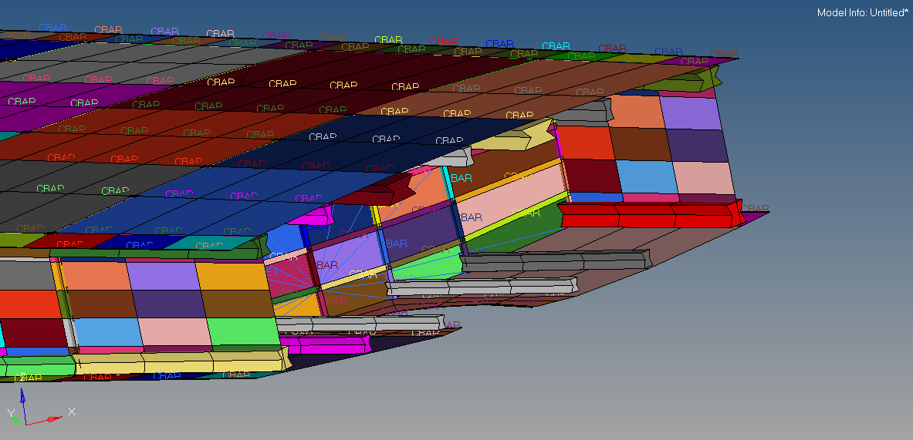
GFEM of A section through the wing
Spar cap
Upper skin
Rib
Lower skin
Stringer

Slide 33
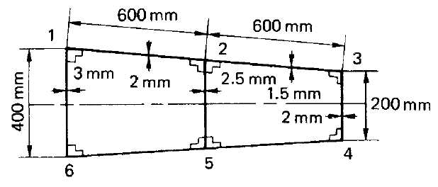
Example
Part of a wing section is in the form of the two-cell box shown in figure, in which the vertical spars are connected to the wing skin through angle sections, all having a cross-sectional area of 300mm². Idealise the section into an arrangement of direct stress-carrying booms and shear-stress-only-carrying panels suitable for resisting bending moments in a vertical plane. Position the booms at the spar/skin junctions.

Slide 34
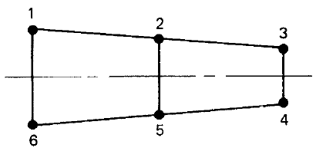



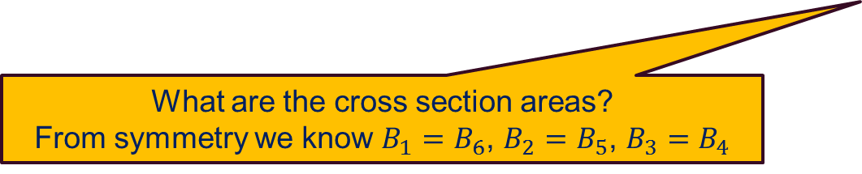
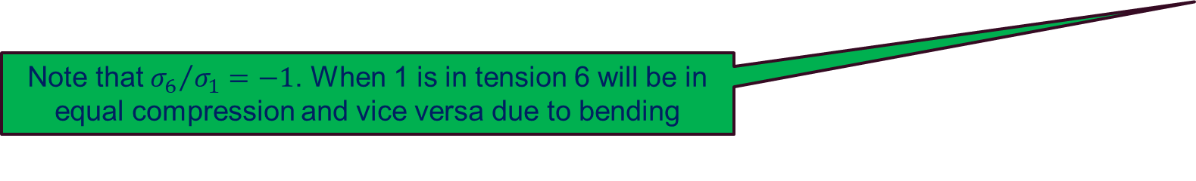
solution
The idealised structure with booms modelled as concentration of area located at the mid-plane of skins
What are the cross section areas?
From symmetry we know $B_{1}=B_{6}$, $B_{2}=B_{5}$, $B_{3}=B_{4}$
Note that ${σ_{6}}/{σ_{1}=−1}$. When 1 is in tension 6 will be in equal compression and vice versa due to bending

Slide 35


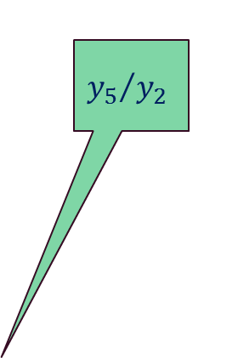
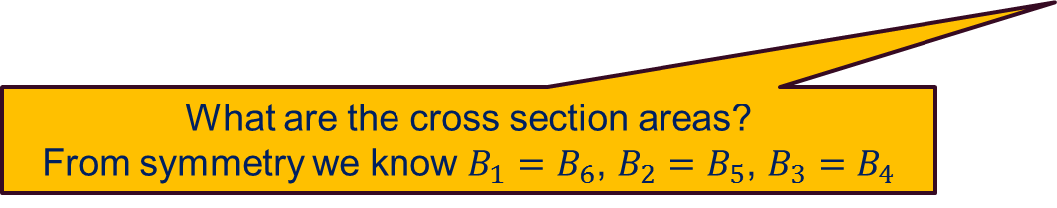


solution
The idealised structure with booms modelled as concentration of area located at the mid-plane of skins
$${y_{1}}/{y_{2}}$$
$${y_{5}}/{y_{2}}$$
$${y_{3}}/{y_{2}}$$
What are the cross section areas?
From symmetry we know $B_{1}=B_{6}$, $B_{2}=B_{5}$, $B_{3}=B_{4}$

Slide 36



solution
The idealised structure with booms modelled as concentration of area located at the mid-plane of skins
What are the cross section areas?
From symmetry we know $B_{1}=B_{6}$, $B_{2}=B_{5}$, $B_{3}=B_{4}$

Slide 37


FEA of original section
Load applied at shear centre
Von Mises stresses
7 ribs equally spaced

Slide 38

Second moment of area for idealised sections
We have n booms with areas B₁, B₂, … B_{n} the second moment of areas are;
The next two examples demonstrate this.

Slide 39

example
Construct an idealised cross-section by evaluating the boom areas at points A, B, C, D, E and F. Use the method based on the equilibrium of bending stresses. Moreover, calculate the second moment of area of the idealised section.

Slide 40



solution
The area of the booms for F=A, E=B and D=C based on symmetry.

Slide 41

solution
B_{A}
B_{B}
B_{C}
B_{D}
B_{F}
B_{E}

Slide 42
TUTORIAL

Slide 43

Example
Construct the idealised section for the following airfoil. It can be assumed that stringers are spaced at 50 mm interval and 45º in the straight and curved section, respectively. It can be further assumed that the only loading is M_{x}. Obtain centroidal location and second moment of areas for the idealised section. Calculate direct stress in the booms under bending moment of -500,000 N.mm. All dimensions are in millimetres.
y
x

Slide 44
Solution (Boom cross section areas)
2
3
4
5
6
y
1
x
12
11
10
9
8
7

Slide 45
Solution (Boom cross section areas)
The vertical distance between boom 1 and 2 (blue arrow in opposite figure) is as below;
The length of chord from boom 1 to boom 2 is a quarter of circumference of the semi circle;
Therefore, we have;
2
3
4
5
6
y
1
x
12
11
10
9
8
7

Slide 46
Solution (Boom cross section areas)
The length of chord from boom 1 to boom 12 is half of the circumference of semi circle as below;
Therefore, we have;
2
3
4
5
6
y
1
x
12
11
10
9
8
7

Slide 47
Solution (second moment of areas)
Centroidal location can be found by taking the moment of concentrated areas about 6-7 and 11-7:
2
3
4
5
6
y
1
x
12
11
10
9
8
7
Second moment of areas can be readily calculated as below:

Slide 48
Solution (direct stresses)
2
3
4
5
6
y
Normal stress can be calculated as;
At booms 2-6, we have;
At booms 7-11, we have;
At booms 1, we have;
At boom 12, we have;
1
x
12
11
10
9
8
7

Slide 49


Solution (FEA-displacements)
In the FEM, an upward 1,000N force is applied at the tip at the location of the shear centre.
By plotting the displacement contours in the vertical direction, i.e. U2, it can be confirmed that at each section the vertical displacements are almost equal suggesting that the load is applied at the shear centre with no twist of the section.

Slide 50

Solution (fea-direct stresses)
At a section 500mm from the tip, the direct stresses are plotted in the opposite figure.
The direct stress on the upper skin is -12.13MPa whereas for the bottom skin it reads as +12.13MPa.
This value is 1.2% more than hand calculation for the idealised section.

Slide 51

Solution (FEA-shear flow)
Point with zero shear flow
Point with zero shear flow
Let’s look at shear flow distribution, i.e. SF3, in the section.
The shear flow is as the result of shear force only as the force was applied at the shear centre meaning no twist of the section, hence no shear stresses due to twist.
Pay attention to the location of zero shear flow and linear distribution of shear flow in flanges and quadratic in the webs.
Linear shear flow distribution
Quadratic shear flow distribution

Slide 52

Tutorial 1
Idealise the box section into an arrangement of direct stress-carrying booms positioned at the four corners and panels which are assumed to carry only shear stresses. Find the centroid location of the idealised section and then calculate second moment of area for the idealised section about x and y axis.

Slide 53
Solution
1
2
300 mm
4
3
500 mm

Slide 54
solution
To obtain the second moment of area, it is essential to find the neutral axis location;
Taking moment about bottom skin, line 43;
Taking moment about spar 14;
1
2
300 mm
4
3
500 mm

Slide 55
solution
1
2
y
300 mm
x
234.75
150
4
3
500 mm
No need to calculate as it is singly symmetric

