Slide 1
Aero Structures – Impact of cut-outs on aircraft structural panels
By
Dr. Mahdi Damghani
Copyrighted to DSE Ltd & Belcan
Nov 2023

Slide 2
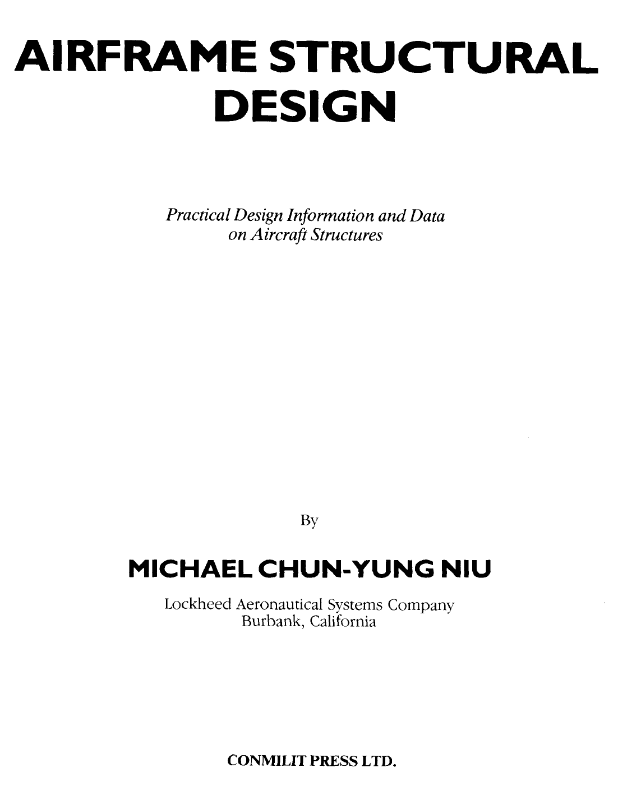
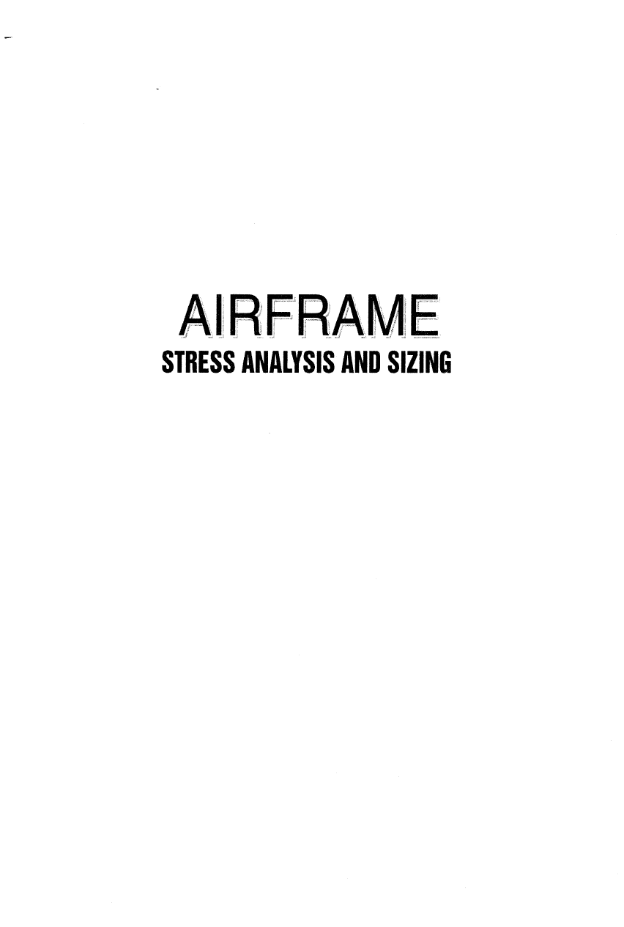
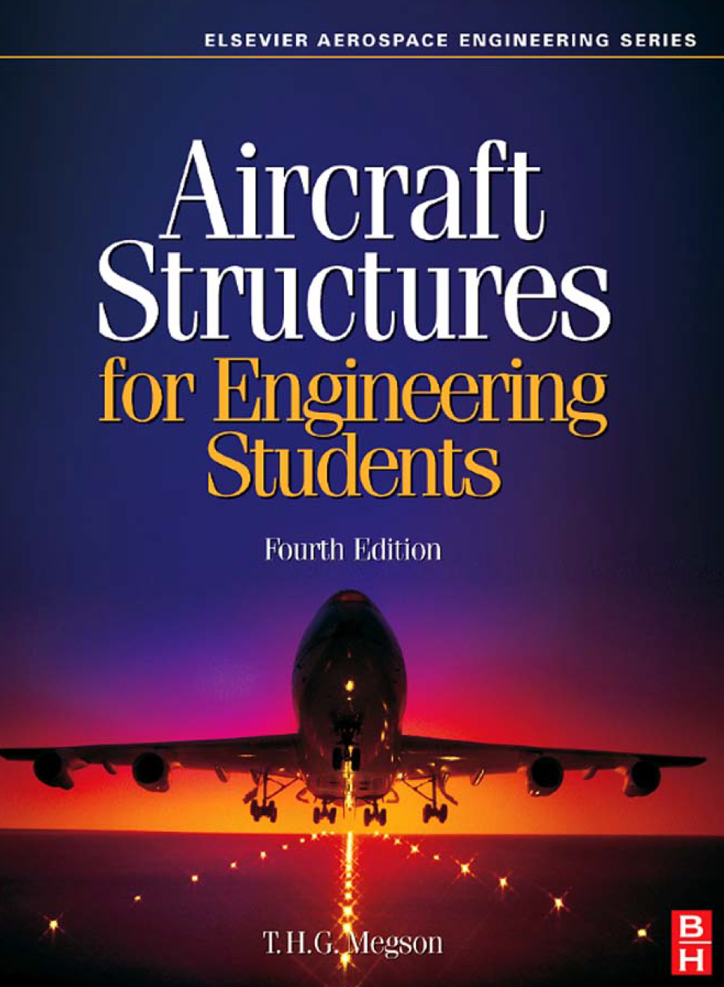
Suggested Readings
By
Niu
Chapter 13
Chapter 6
Chapters 22 & 23

Slide 3
Topics
Introduction
Fuselage
Wing

Slide 4
Introduction
Aircraft is often required to accommodate for openings in load bearing structures.
These openings serves many purposes amongst which are:
Access openings in webs and panels.
Passage for control rods or cables, hydraulic lines, electrical wire bundles.
Windows, doors, servicing panels, hatches, bomb bays, inspection access holes, cockpits.
Lightening holes (holes in ribs).

Slide 5
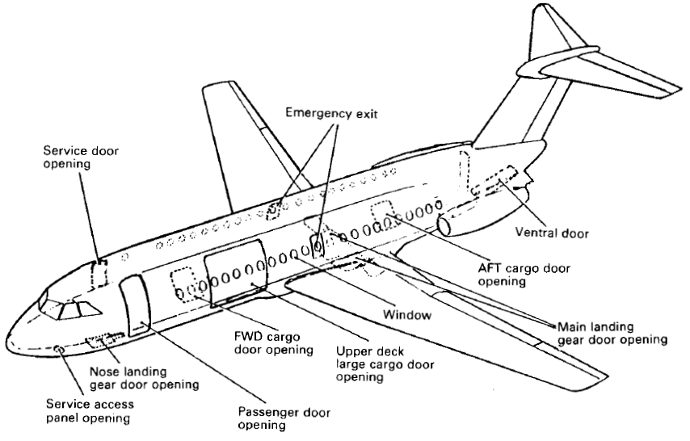
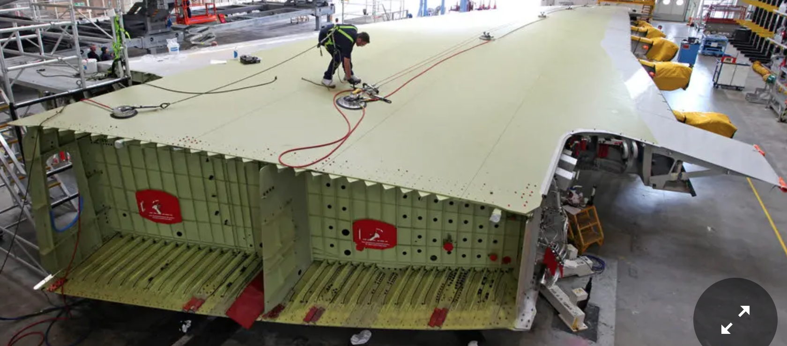
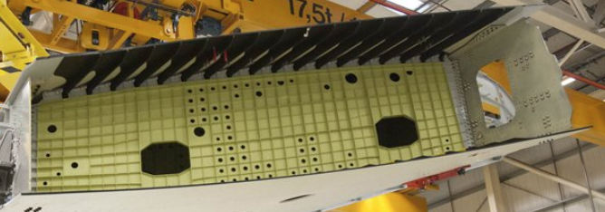
Examples of aircraft opening

Slide 6
Introduction
Existence of openings (otherwise known as discontinuities) lead to high stress concentrations.
The value of stress concentration is generally very high depending on the size of the opening, the size of the panel and loading type (uni-axial, bi-axial, bi-axial and shear)
The stress concentration values for metallic structures could reach > 4 and for composites even higher > 5.
See next slide for some examples in metallic structures.

Slide 7
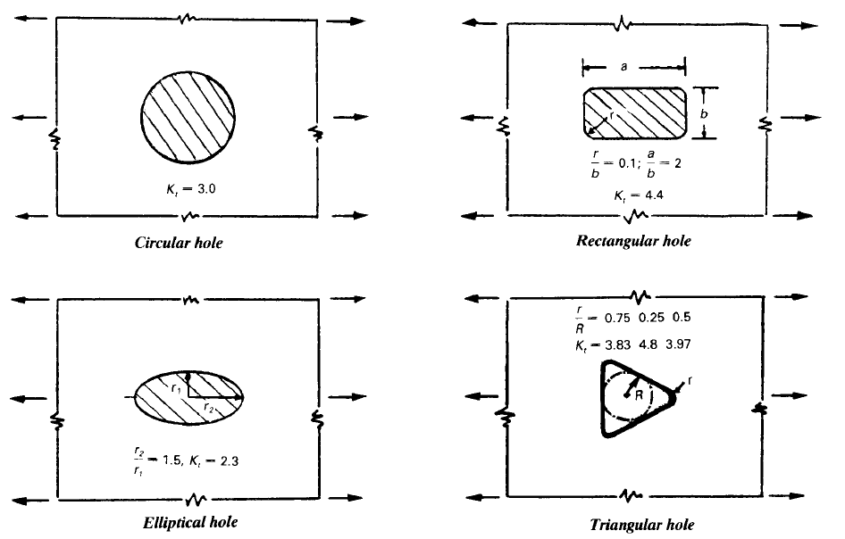
Stress concentration

Slide 8
Introduction
For an efficient structure, the load path must be direct.
Cut-outs do lead to increase in weight as the surrounding structure needs to be reinforced to redistribute the load from the cut-out to the surrounding one.

Slide 9
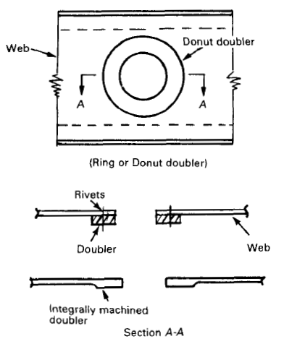
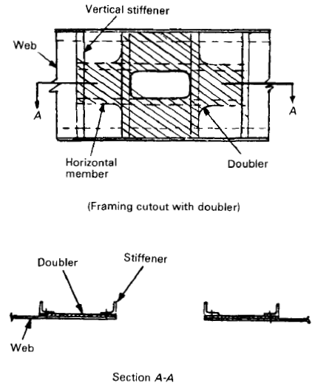
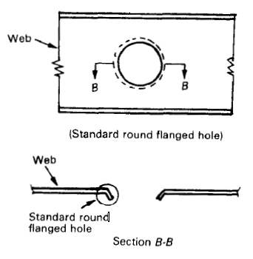
Introduction
Doubler or integrally machined
doubler around the cut-out
Cut-out size
Small
Large
Shear beam with framing members and doubler around the large cut-out
Local reinforcing is needed
The entire section is affected
Standard round flanged holes

Slide 10
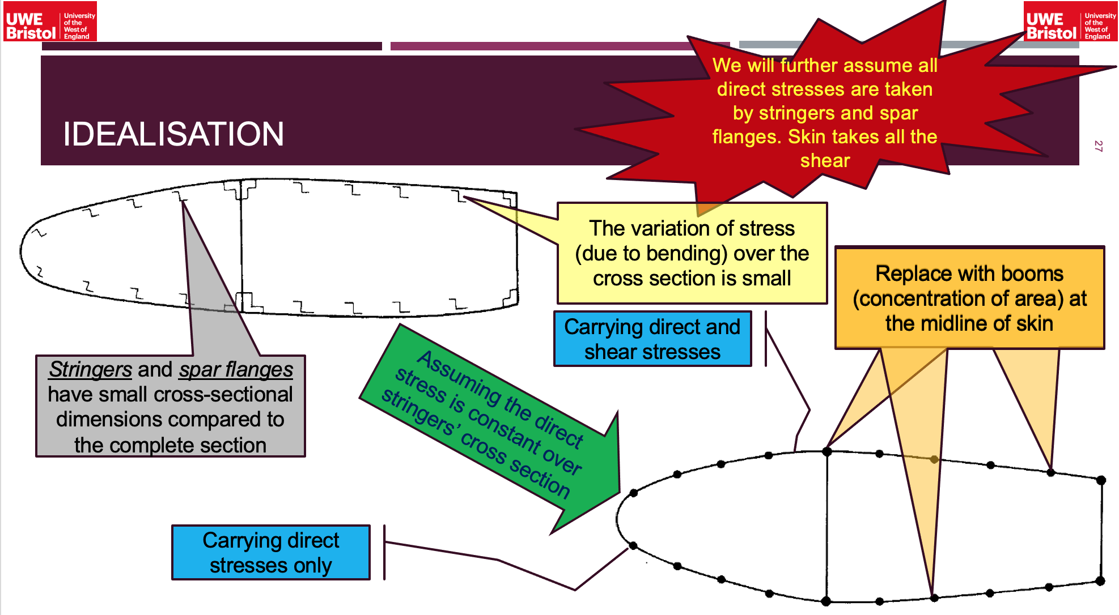
Reminder 1- (structural idealization-material can be provided upon request)

Slide 11
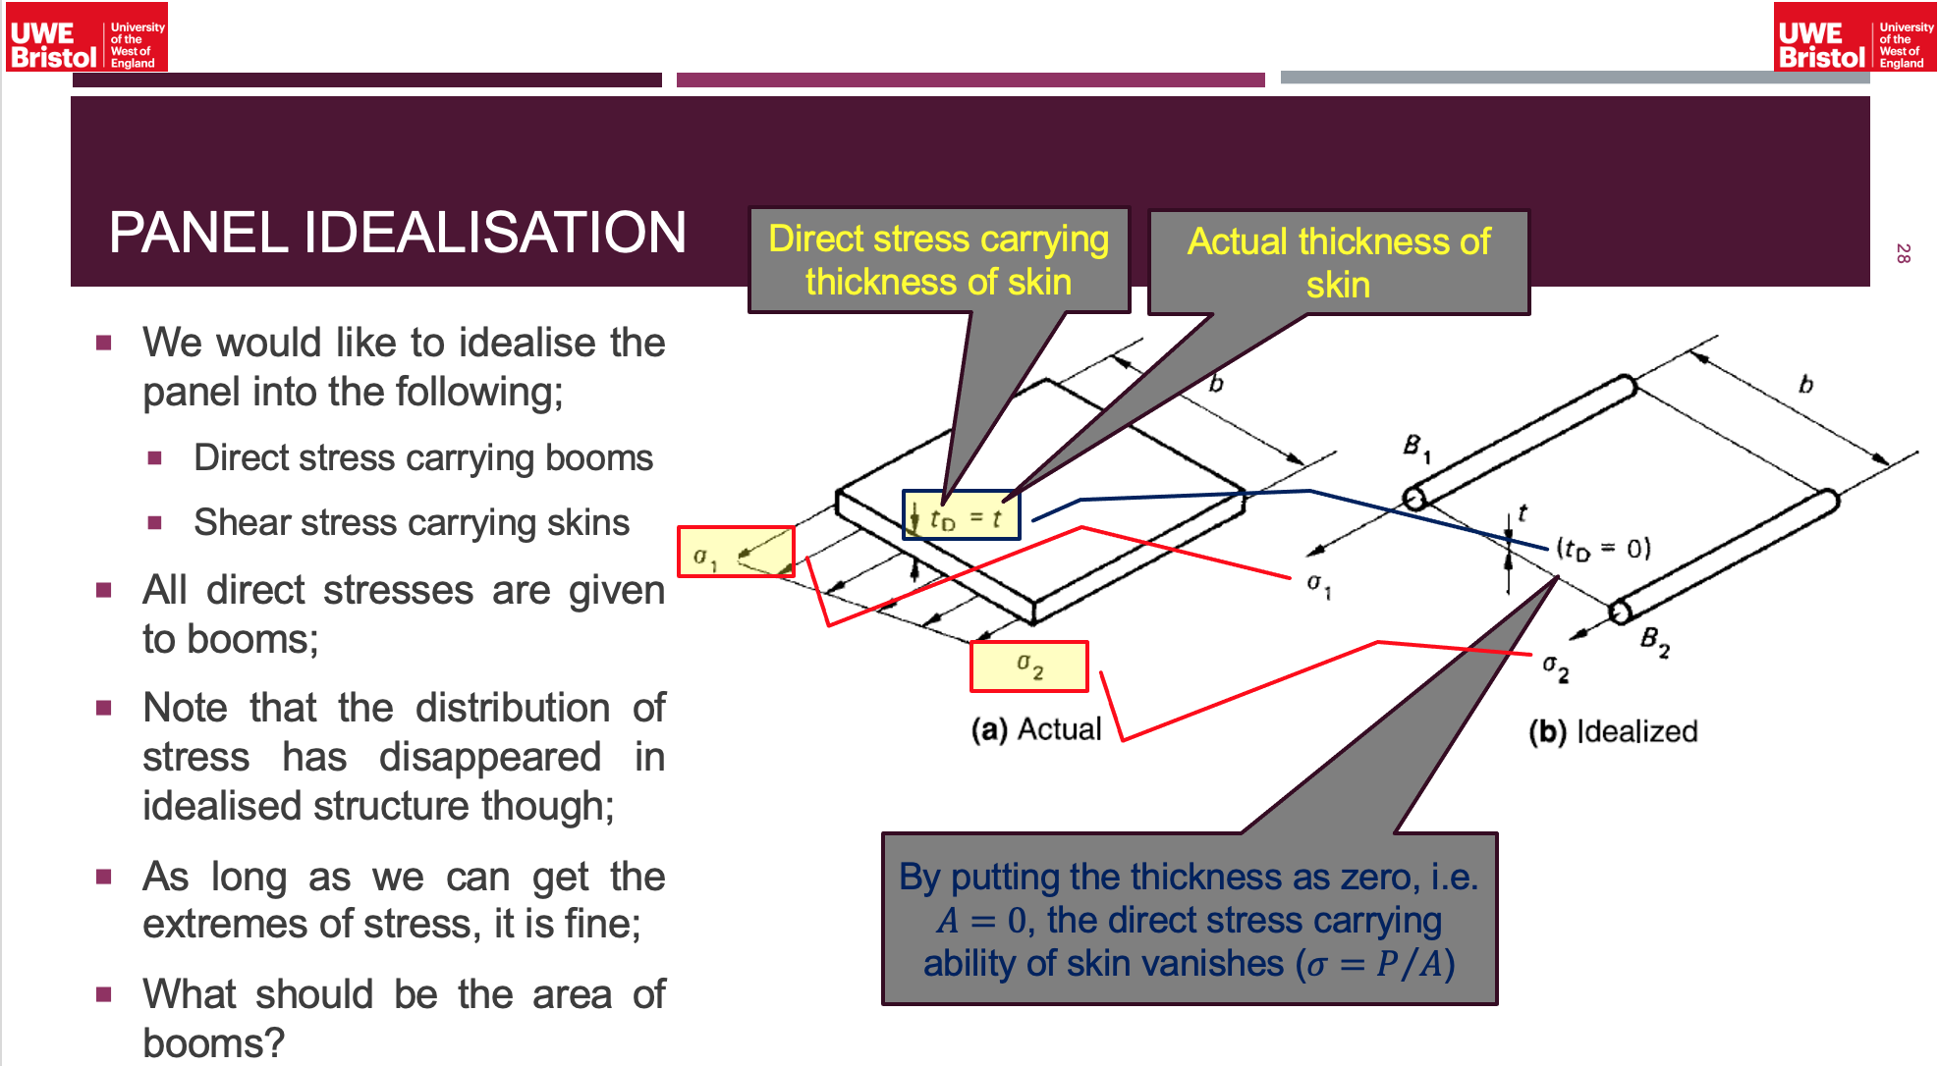
Reminder 2- (structural idealization-material can be provided upon request)

Slide 12
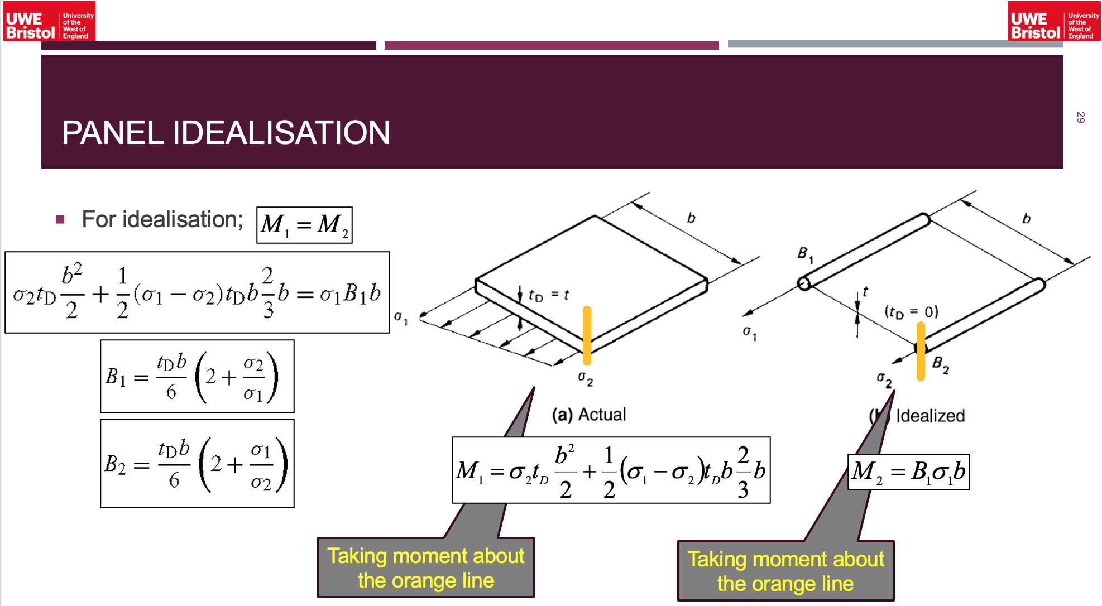
Reminder 3- (structural idealization-material can be provided upon request)

Slide 13
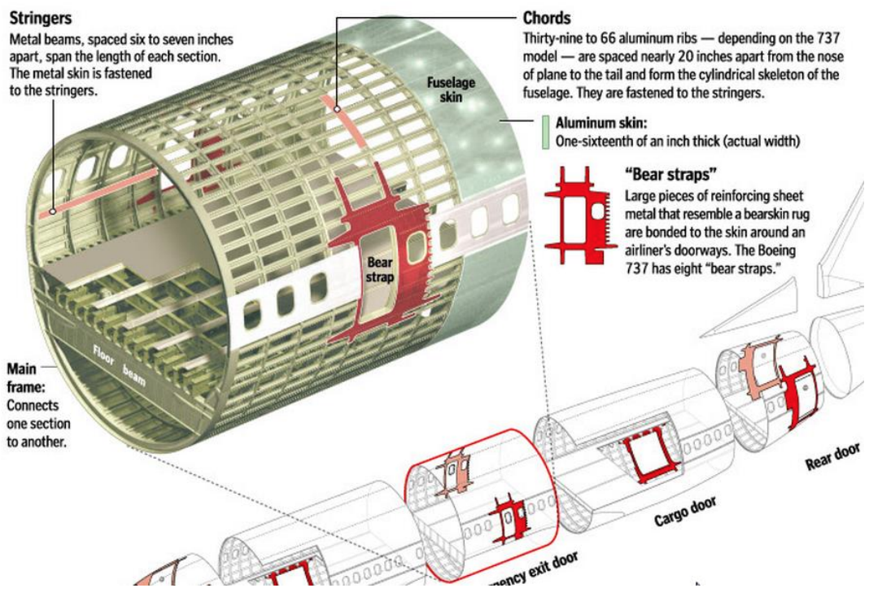
Fuselage
Comprised of thin sheets stiffened by large number of longitudinal stringers combined with transverse frames.
The fuselage is exposed to bending moments, shear forces and torsional load.
This leads to axial stresses in stringers and skin and shear stress in the skin.
The resistance of stringers to shear is ignored.
To understand the effect(s) of cut-outs on the stress distribution we need a bench mark analysis for the case without cut-out (next examples).

Slide 14
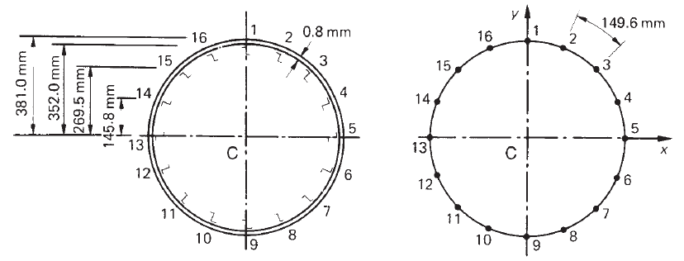
Example
The fuselage of a light passenger carrying aircraft has the circular cross-section. The cross-sectional area of each stringer is 100 mm² and the vertical distances are to the mid-line of the section wall at the corresponding stringer position. If the fuselage is subjected to a bending moment of 200 kN.m applied in the vertical plane of symmetry, at this section, calculate the direct stress distribution.

Slide 15



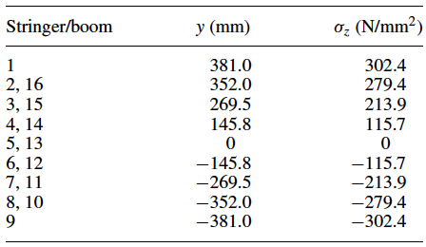




Solution- (bending stresses)
$$B_{2}=216.6 {mm}^{2}$$
$$B_{3}=216.6 {mm}^{2}$$
$$B_{4}=216.7 {mm}^{2}$$

Slide 16
Example
Assuming a vertical shear load of 100kN applied at a distance of 150 mm from the vertical axis of symmetry, obtain distribution of shear flow in the section.
100kN
150mm

Slide 17

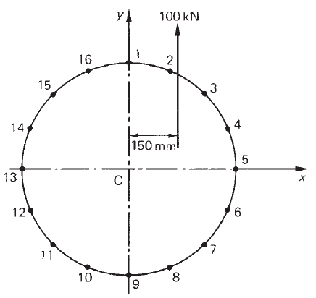



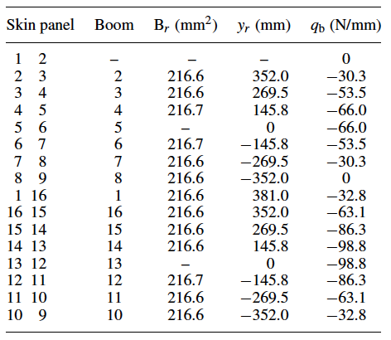

Solution- (shear flow distribution due to shear load)
Open section shear flows by cutting fuselage at 12
Open section shear flows by cutting fuselage at 12

