Slide 1

Aero Structures-Shear of beams
By
Dr. Mahdi Damghani
2022-2023

Slide 2
Suggested Readings
Chapter 16
of
Aircraft Structural Analysis
Notes:
Questions here please:
https://padlet.com/mahdi_damghani/SDIAero

Slide 3
Comments
https://padlet.com/damghani_mahdi/aerostructures

Slide 4
Topics
Familiarisation with the following concepts;
Shear of open section beams
Shear centre of open section beams
Shear of closed section beams
Shear centre of closed section beams
Twist of shear loaded closed section beams

Slide 5
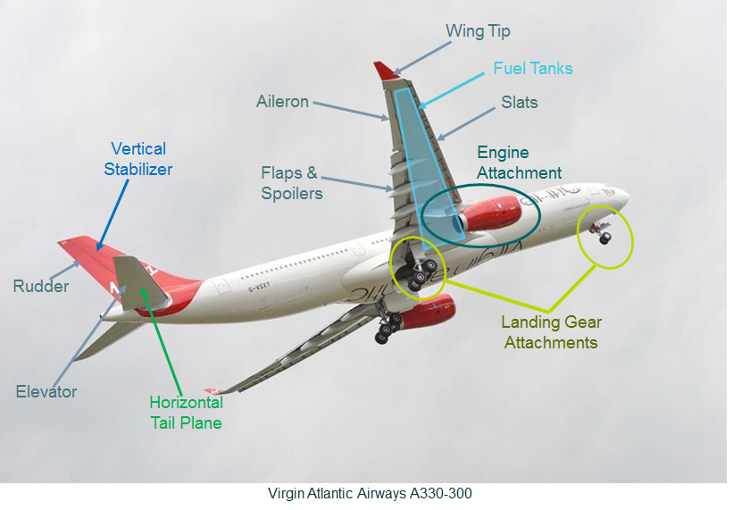
Overview

Slide 6
Introduction
In this lecture we address thin-walled beams loaded in shear typical sections in the wing
Topics discussed here do not apply to thick and solid sections as they are not typical cross sections used in aircraft structures

Slide 7
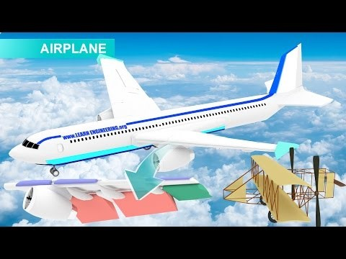
Why shear force in the wing section? (https://www.youtube.com/watch?v=YyeX6ArxCYI)
Notes:
https://www.youtube.com/watch?v=YyeX6ArxCYI

Slide 8
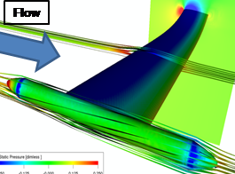
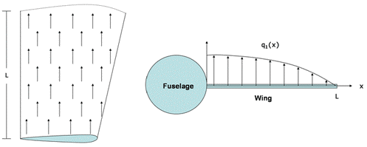
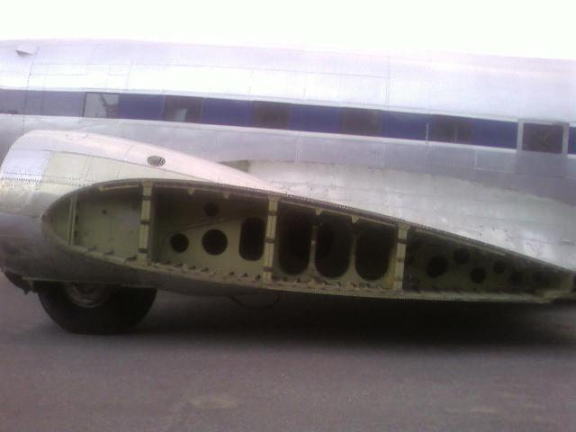
Why shear loading?
For symmetric loading can be assumed clamped
Lift
Pitching moment
Front spar
Aerodynamic centre
Centre spar
Rear spar

Slide 9
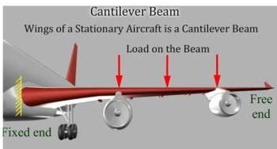
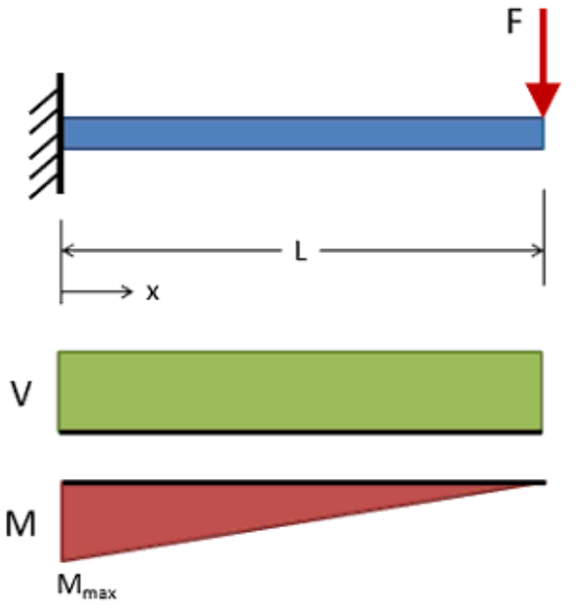
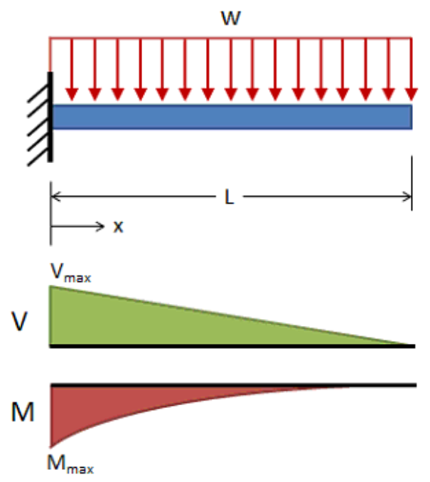
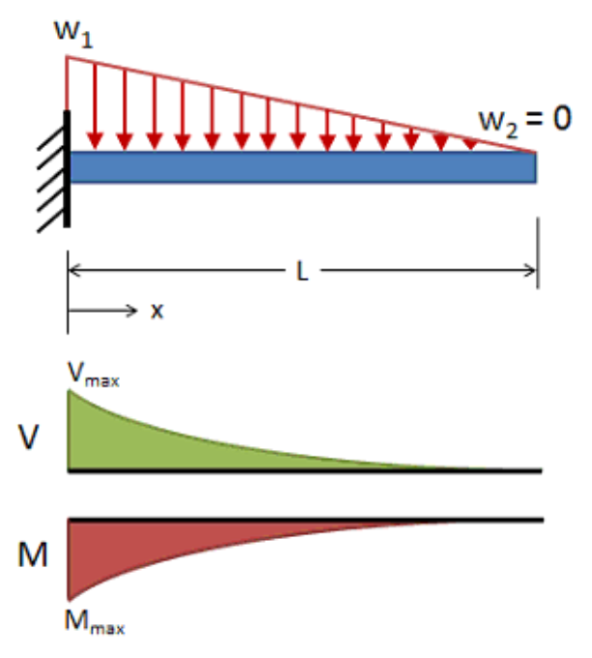
Idealising wing as a cantilevered beam

Slide 10
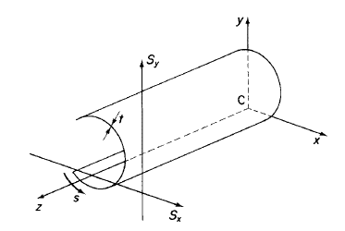
Stress system on element of a beam
We isolate this element of the beam as of the next slide
Direction of positive shears
Direction of positive shears

Slide 11
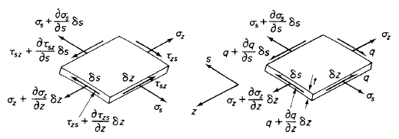




Stress system on element of a beam
s is distance measured around the cross section from some convenient origin
$q=τt$
shear flow which is positive in the direction of increasing $s$
An element of size $δs×δz×t$ is in equilibrium by a system of stresses
t is assumed to be constant along $δs$
$τ_{zs}=τ_{sz}=τ$

Slide 12





Stress system on element of a beam
Equilibrium of forces in $z$direction
Equilibrium of forces in s direction

Slide 13
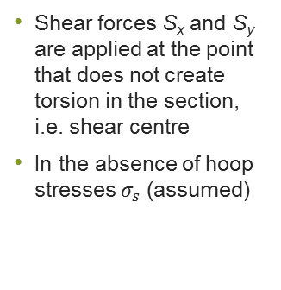
Shear of open section beams
Shear forces S_{x} and S_{y} are applied at the point that does not create torsion in the section, i.e. shear centre
In the absence of hoop stresses $σ_{s}$ (assumed)

Slide 14




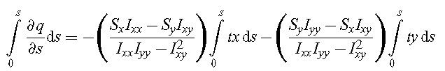
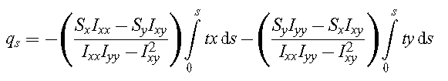

Shear of open section beams
If we take the origin of $s$ at the open edge of the cross section then $q=0$ when $s=0$

Slide 15

Shear of open section beams
For a section having either Cx or Cy as an axis of symmetry I_{xy}=0 and hence the relationship simplifies to;
0
0
0
0

Slide 16
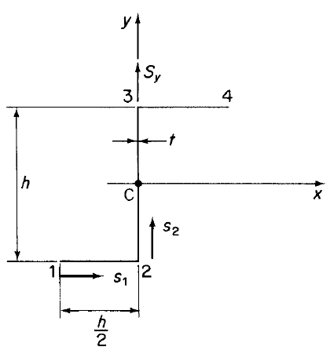


Example
Determine the shear flow distribution in the thin-walled Z-section shown in the figure due to a shear load $S_{y}$ applied through the shear centre of the section.

Slide 17
Solution
Since the load is applied at shear centre that means no torsion takes place in the section
Therefore, shear stress and shear flow as the result of torsion does not exist
There is no axis of symmetry, hence we use the following equation for shear flow determination

Slide 18
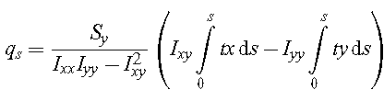
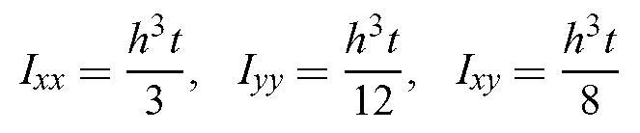

Solution
0
0

Slide 19


Solution
Integration must be performed for the whole length of the cross section, i.e. path 12, 23 and 34

Slide 20
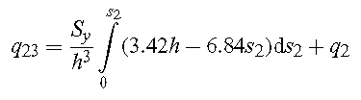

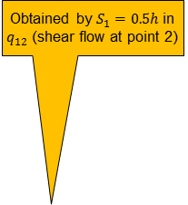
Solution
Obtained by $S_{1}=0.5h$ in $q_{12}$ (shear flow at point 2)
Integration must be performed for the whole length of the cross section, i.e. path 12, 23 and 34
20

Slide 21
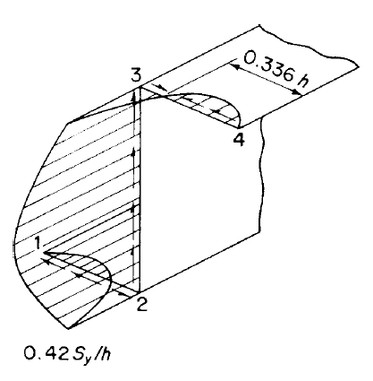
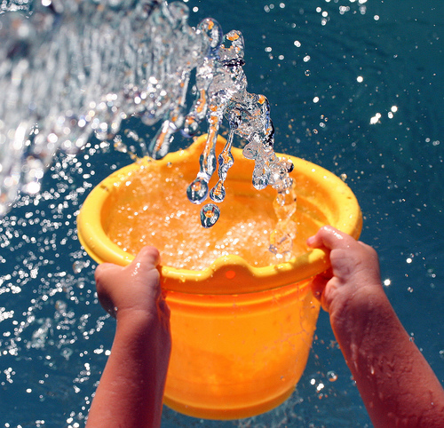
Solution
Positive q means that the shear flows in direction of s
You may use the following analogy to have a physical understanding of this phenomenon;
Emptying a bucket of water at points of zero shear flow (brown spot) causes some of the water to go to the left and some to the right. Each path continues flowing until it gets drained, i.e. reach another zero point (red spot)

Slide 22
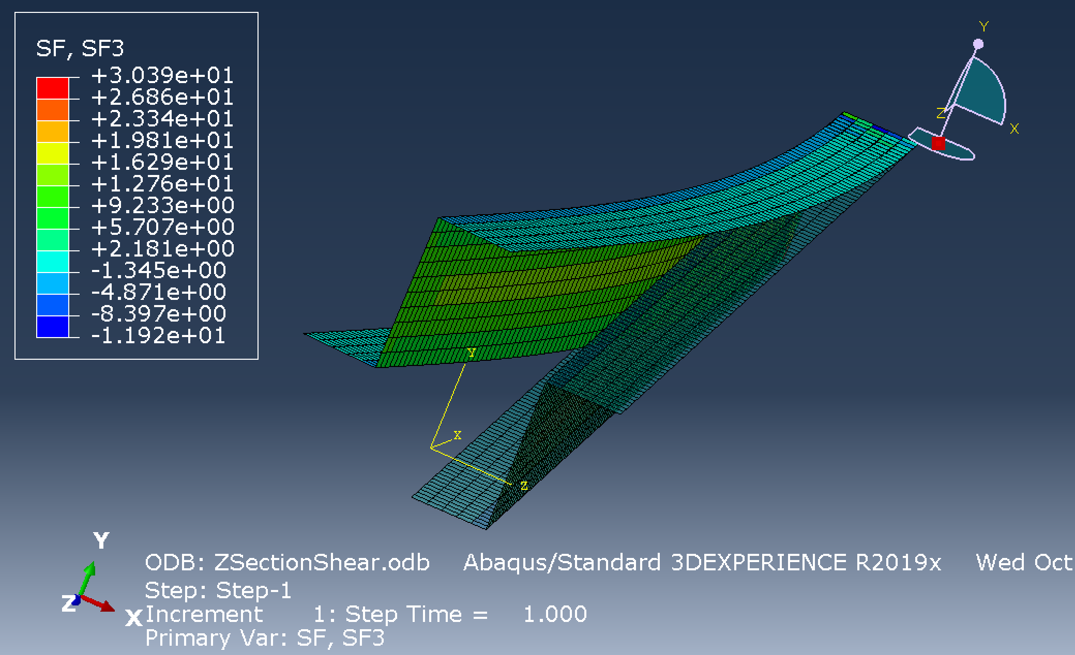
Finite element simulation of previous example
Shear flow
Deformed shape
Undeformed shape

Slide 23
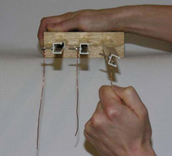
Shear centre
Shear load applied at shear centre does not create torsion in the section
You could see the wooden support as fuselage and the channel beam as wing

Slide 24
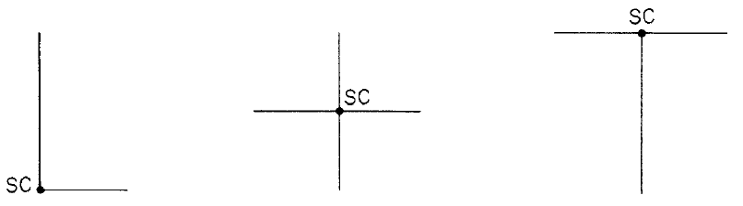
Shear centre
For cruciform or angle sections below, the shear centre lies at the intersection of the sides
Students are required to go through section 16.2.1 of Ref [1] (student centred activity) for obtaining the location of shear centre

Slide 25

Example
Obtain shear flow distribution for a cantilevered beam with the C channel section with constant thickness $t$. Assume the value of shear force acting on the section is $S_{y}$. The section can be treated as thin wall section.
B
b
A
h
C
D

Slide 26
Solution
The location of centroid from the mid line of BC;
B
b
A
y
d
h
h
x
h/2
C
D

Slide 27
Solution
B
b
A
y
d
h
x
h/2
C
D

Slide 28
Solution
B
b
A
y
s₃
d
h
x
h/2
s₂
s₁
C
D

Slide 29
Solution
B
b
A
y
s₃
d
h
x
h/2
s₂
s₁
C
D

Slide 30
Solution
B
b
A
y
s₃
d
h
x
h/2
s₂
s₁
C
D

Slide 31
Solution
Shear flow distribution becomes;
y
x

Slide 32
Students’ task
Find the location of shear centre (distance e) for the C section of previous example.
B
b
A
S_{y}
y
s₃
e
d
x
h/2
s₂
s₁

Slide 33
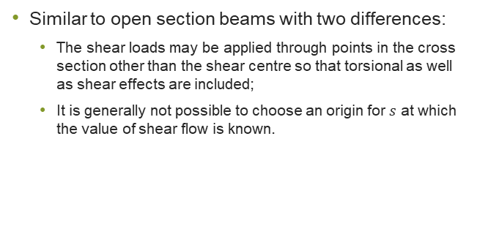
Shear of closed section beams
Similar to open section beams with two differences:
The shear loads may be applied through points in the cross section other than the shear centre so that torsional as well as shear effects are included;
It is generally not possible to choose an origin for $s$ at which the value of shear flow is known.

Slide 34
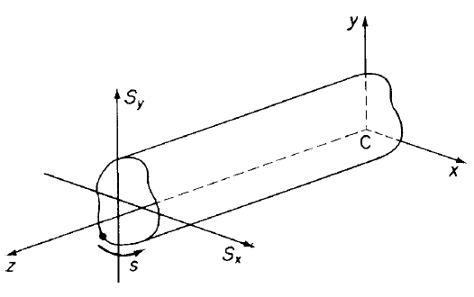
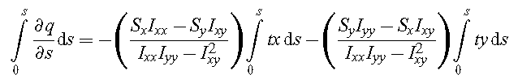


Shear of closed section beams
Just the same as open section beams
Unknown value of shear flow at origin (we choose where origin is)
Notes:
Assuming there is no hoop stress and body forces

Slide 35

Shear of closed section beams
Unknown shear flow at an assumed origin
Basic shear flow (that of an open section)
Shear flow of a closed section beam

Slide 36

Shear of closed section beams
Now the question arises as how do we find the unknown shear flow at an assumed origin ($q_{s,0}$) and open section flow ($q_{b}$)?
Convert the closed section to an open section
Equate torsion created by external shear force with that generated by internal shear flow
$q_{s,0}$ is obtained
𝑞_(𝑠,0) is obtained
Cut the section at a convenient point
At the cut $s=0$ and $q=0$
At the cut 𝑠=0 and 𝑞=0
Obtain $q_{b}$ as you did for an open section
Obtain 𝑞_𝑏 as you did for an open section

Slide 37
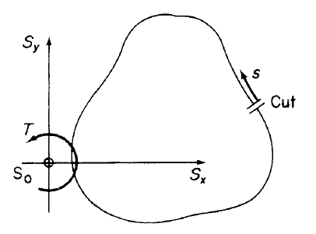

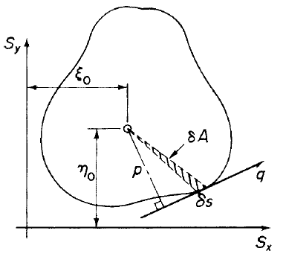





Shear of closed section beams
For open section we had;
Value of shear flow at the cut ($s=0$) can be found by;
We also know;
A is the area enclosed by midline of the beam section

Slide 38


Shear of closed section beams
Note that if the moment centre chosen coincide with point of action of shear forces $S_{x}$ and $S_{y}$ then the equation can be simplified as;
0
0

Slide 39

Twist of shear loaded closed section beams
If shear load is not applied to shear centre, twist of the section takes place
For detailed information of extracting the twist formula refer to section 16.3.1 of Ref [1]
The final twist equation is;
Rate of twist

Slide 40

Example/Tutorial
Determine the shear flow distribution for a boxed beam under $S_{y}$ shear loading passing through the shear centre of the cross section.
S_{y}
t
a
b

Slide 41
Solution
The shear load passes through the shear centre, so there is no torsion in the section;
The section is a closed section, hence we need to make it an open section first;
For this, we cut the section at an arbitrary point;
It is best to cut it at a point that passes through the neutral axis as normally shear flow is maximum at that point.
cut

Slide 42
Solution
Let’s deal with basic shear flow first (open section shear flow);
y
cut
x

Slide 43
Solution
Shear flow at the cut is zero
s₂
3
2
y
s₁
x
1
6
4
5

Slide 44
Solution
s₂
3
2
s₃
y
s₁
x
1
6
4
s₄
5

Slide 45
Solution
s₂
3
2
s₃
y
s₁
x
1
6
s₅
4
s₄
5

Slide 46
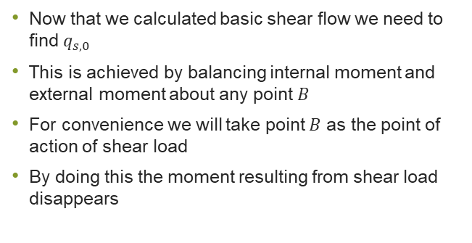
Solution
Now that we calculated basic shear flow we need to find $q_{s,0}$
This is achieved by balancing internal moment and external moment about any point $B$
For convenience we will take point $B$ as the point of action of shear load
By doing this the moment resulting from shear load disappears

Slide 47
Solution
Since it is a thin wall section, I could ignore thickness effects. This will have negligible impact on the final solution.
S_{y}
3
2
t
B
a
1
6
4
b
5

Slide 48
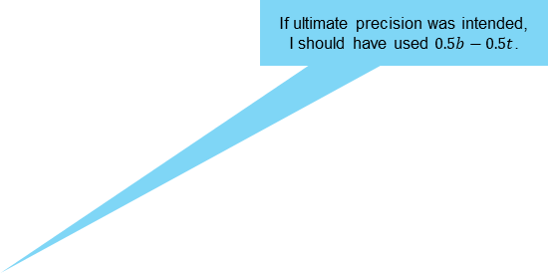
Solution
If ultimate precision was intended, I should have used $0.5b−0.5t$.
S_{y}
3
2
t
B
a
1
6
4
b
5

Slide 49
Solution
S_{y}
3
2
t
B
a
1
6
4
b
5

Slide 50

Solution
Now the total shear flow will become (note that $q_{s,0}>0$);
So far, we solved this problem parametically, i.e. in terms of section variables, and now this could be used for optimisation process

Slide 51
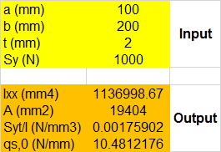
Solution
I now embed this into excel that enables me to find shear flow for any box section of any dimension;
For illustration purposes I use the following values;

Slide 52
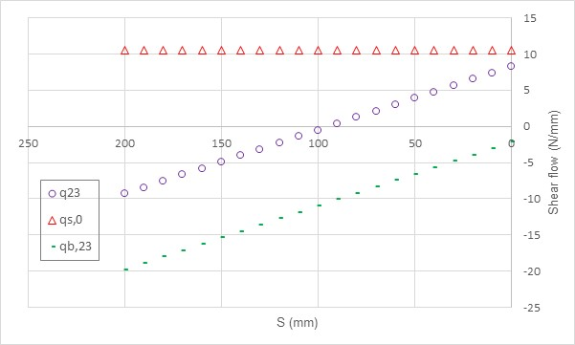
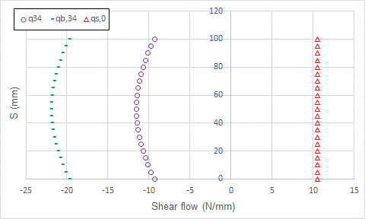
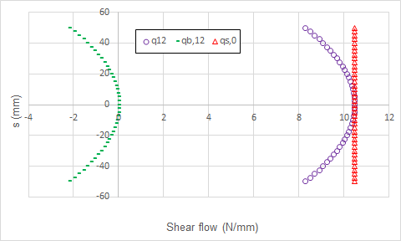
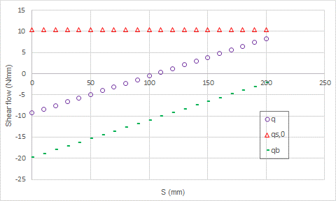
Solution
Basic shear flow
qs,o is constant

Slide 53
Solution
A tidier illustrative shear flow distribution is;
What does negative mean?
-
+
-
+
-
+

Slide 54
Important note
Determination of shear flow distribution in multi-cellular section thin walled beams as stipulated in chapters 18 and 22 of Ref. [1] is fulfilled through successful implementation of student centered coursework released at the start of the semester;

Slide 55
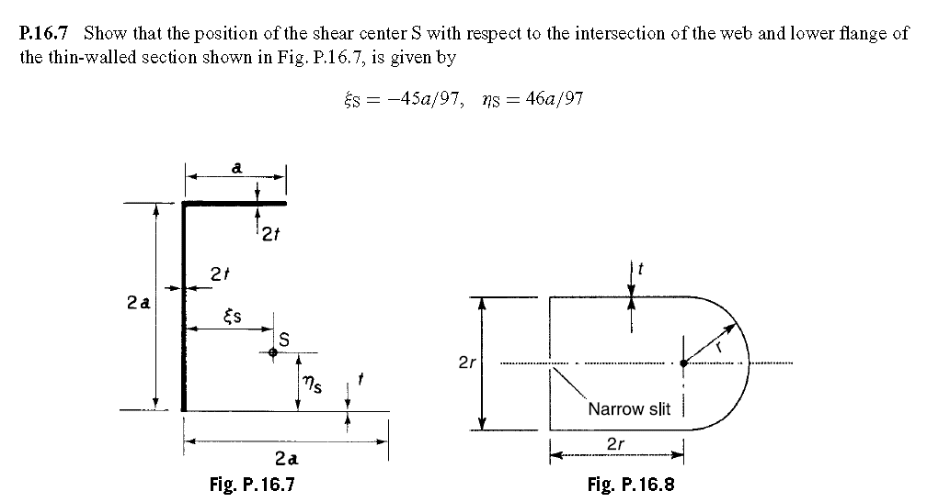
Tutorial 1

Slide 56
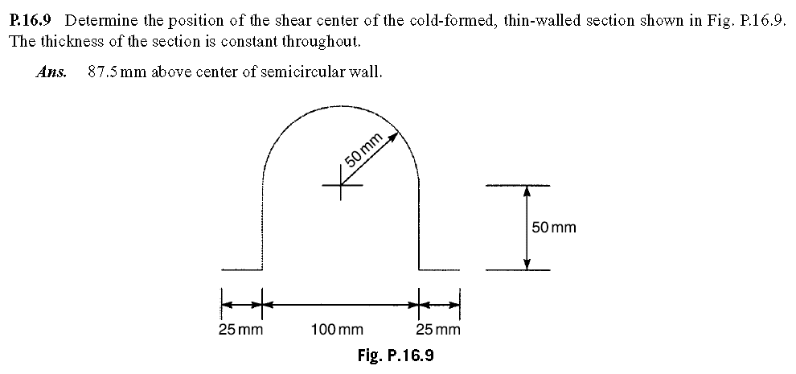
Tutorial 2

Slide 57
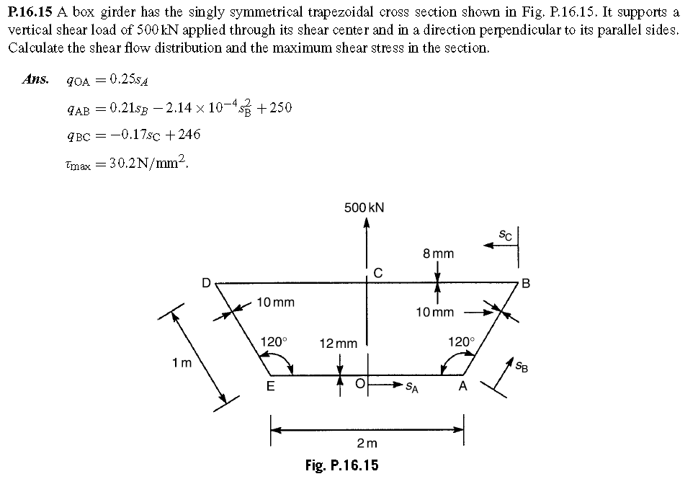
Tutorial 3

