Slide 1
Structural Design and Inspection-Principle of Virtual Work
By
Dr. Mahdi Damghani
2021-2022

Slide 2
Suggested Readings
Reference 1
Reference 2
Notes:
https://padlet.com/mahdi_damghani/SDIAero

Slide 3
Objective(s)
Familiarity with the definition of work
Familiarity with the concept of virtual work by
Axial forces
Transverse shear forces
Bending
Torsion
Familiarisation with unit load method

Slide 4
Comments
Please post any comments either here or on BB:
https://padlet.com/damghani_mahdi/SDI

Slide 5
Introduction
They are based on the concept of work and are considered within the realm of “analytical mechanics”
Energy methods are fit for complex problems such as indeterminate structures
They are essential for using Finite Element Analysis (FEA)
They provide approximates solutions not exact
The Principle of Virtual Work (PVW) is the most fundamental tool of analytical mechanics

Slide 6
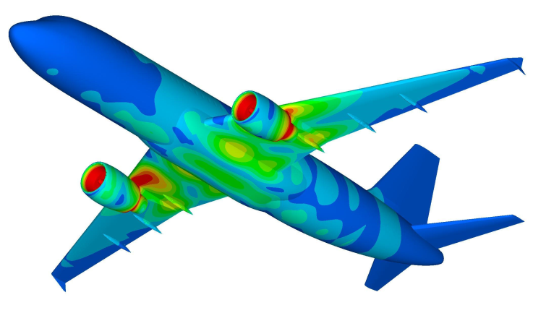
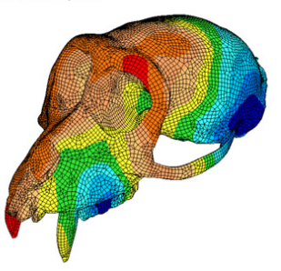
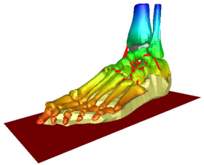
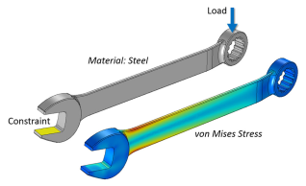
Complexity Demonstration

Slide 7
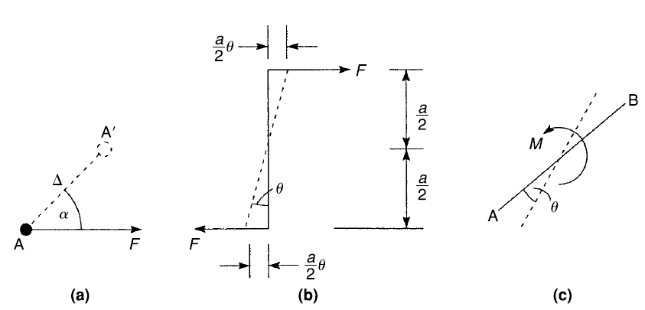
Work
Displacement of force times the quantity of force in the direction of displacement gives a scalar value called work

Slide 8
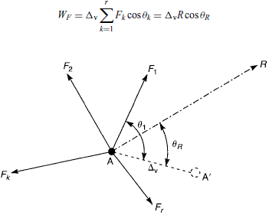
Work on a particle
Point A is virtually displaced (imaginary small displacement) to point A’
R is the resultant of applied concurrent forces on point A
If particle is in equilibrium?
R=0
W_{F}=0

Slide 9
Principle of Virtual Work (PVW)
If a particle is in equilibrium under the action of several forces, the total work done by the forces for a small arbitrary displacement of the particle is zero. (Equivalent to Newton’s First Law)
Can we say?
If a particle is not in equilibrium under the action of a number of forces, the total work done by the forces for a small arbitrary displacement of the particle is not zero.
R could make a 90 degree angle with displacement

Slide 10
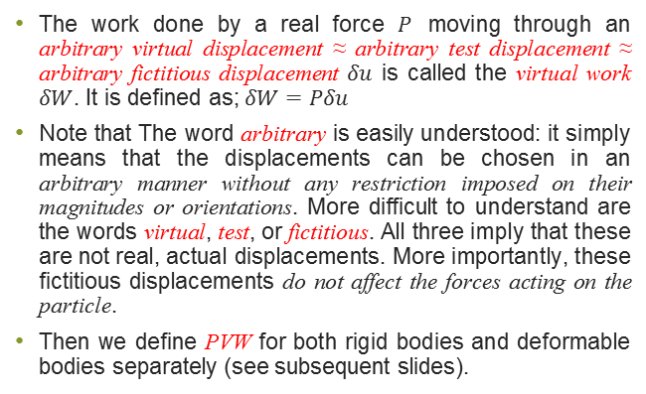
In other words
The work done by a real force $P$ moving through an arbitrary virtual displacement ≈ arbitrary test displacement ≈ arbitrary fictitious displacement $δu$ is called the virtual work $δW$. It is defined as; $δW=Pδu$
Note that The word arbitrary is easily understood: it simply means that the displacements can be chosen in an arbitrary manner without any restriction imposed on their magnitudes or orientations. More difficult to understand are the words virtual, test, or fictitious. All three imply that these are not real, actual displacements. More importantly, these fictitious displacements do not affect the forces acting on the particle.
Then we define PVW for both rigid bodies and deformable bodies separately (see subsequent slides).

Slide 11
Note 1
Note that, Δ_{v} is a small and purely imaginary displacement and is not related in any way to the possible displacement of the particle under the action of the forces, F;
Δ_{v} has been introduced purely as a device for setting up the work-equilibrium relationship;
The forces, F, therefore remain unchanged in magnitude and direction during this imaginary displacement;
This would not be the case if the displacements were real.

Slide 12
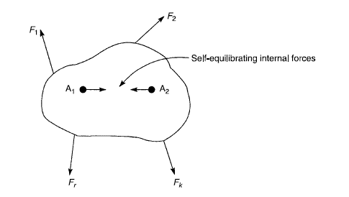
PVW for rigid bodies
It does not undergo deformation (change in length, area or shape) under the action of forces.
Internal forces act and react within the system and external forces act on the system
External forces (F₁ ... F_{r}) induce internal forces;
Suppose the rigid body is given virtual displacement;
Internal and external forces do virtual work;
There are a lot of pairs like A₁ and A₂ whose internal forces would be equal and opposite;
We can regard the rigid body as one particle.
Notes:
The total virtual work done by all forces acting on a rigid body in static equilibrium is zero for small and admissible virtual displacements from the equilibrium state. In equation form it is written as above.

Slide 13
PVW for deformable bodies
The distance between two points changes under the action of forces.
If a virtual displacement of Δ is applied, all particles do not necessarily displace to the amount of Δ, i.e. internal virtual work is done in the interior of the body.
This principle is valid for;
Small displacements.
Rigid structures that cannot deform.
Elastic or plastic deformable structures.
Competent in solving statically indeterminate structures.

Slide 14
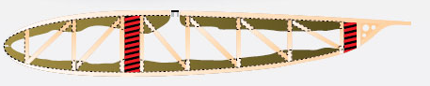
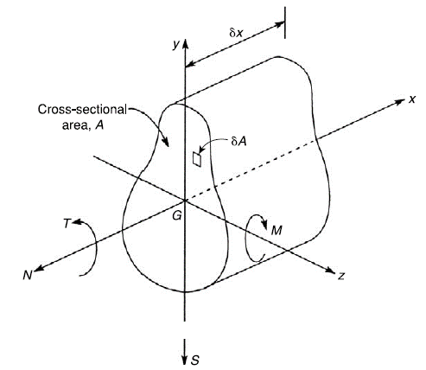
Work of internal axial force on mechanical systems/structures
Isolate
This truss element is working under the action of axial load only as a result of external aerodynamic loading.
Section
After imposing a virtual displacement, the axial load does virtual work on this truss element.
Arbitrary section shape
To obtain the amount of virtual work, we obtain the work on the section and then throughout the length (next slide).

Slide 15
Work of internal axial force
Work done by small axial force due to small virtual axial strain for an element of a member:
δN=N/A δA
Work done by small axial force due to small virtual axial strain for a member:
Work done by small axial force due to small virtual axial strain for a structure having r members:

Slide 16
Work of internal axial force for linearly elastic material
Based on Hook’s law (subscript v denotes virtual);
Therefore, we have (subscript m denotes member m);

Slide 17
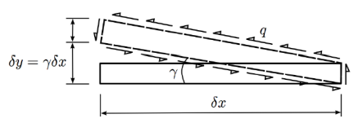
Work of internal shear force
Work done by small shear force due to small virtual shear strain for an element of a member (β is form factor):
δS
Work done by small shear force due to small virtual shear strain for a member of length L:
Work done by small shear force due to small virtual shear strain for a structure having r members:

Slide 18
Work of internal shear force for linearly elastic material
Based on Hook’s law (subscript v denotes virtual);
Therefore, we have (subscript m denotes member m);

Slide 19
Work of internal bending moment
Work done by small bending due to small virtual axial strain for an element of a member:
Work done by small bending due to small virtual axial strain for a member:
Work done by small bending due to small virtual axial strain for a structure having r members:
Radius of curvature due to virtual displacement

Slide 20
Work of internal bending moment for linearly elastic material
We have (subscript m denotes member m);

Slide 21
Work of internal torsion
See chapter 2 of Reference 1, chapter 15 of Reference 2 or chapter 9 of Reference 3 for details of this
Following similar approach as previous slides for a member of length L we have;
For a structure having several members of various length we have;

Slide 22
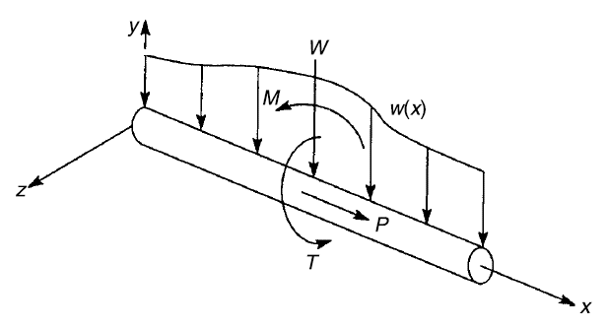
Virtual work due to external force system
If you have various forces acting on your structure at the same time;

Slide 23
Note
So far virtual work has been produced by actual forces in equilibrium moving through imposed virtual displacements;
Based on PVW, we can alternatively assume a set of virtual forces in equilibrium moving through actual displacements;
Application of this principle, gives a very powerful method to analyze indeterminate structures;

Slide 24
Example 1
Determine the bending moment at point B in the simply supported beam ABC.

Slide 25
Solution
We must impose a small virtual displacement which will relate the internal moment at B to the applied load;
Assumed displacement should be in a way to exclude unknown external forces such as the support reactions, and unknown internal force systems such as the bending moment distribution along the length of the beam.

Slide 26
Solution
Using conventional equations of equilibrium method;
R_{A}
R_{C}

Slide 27
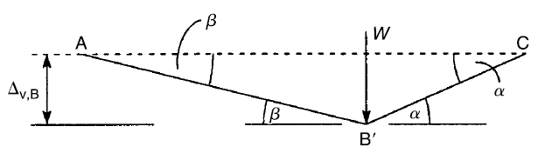
Solution
Rigid
Rigid
β
Let’s give point B a virtual displacement;

Slide 28
Example 2
Using the principle of virtual work, derive a formula in terms of a, b, and W for the magnitude P of the force required for equilibrium of the structure below, i.e. ABC (you may disregard the effects of weight).
W
P

Slide 29
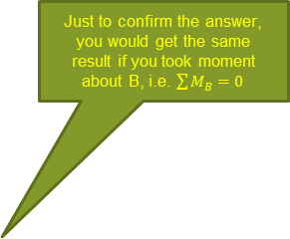
Solution
We assume that AB and AC are rigid and therefore internal work done by them is zero
Apply a very small virtual displacement to our system
Just to confirm the answer, you would get the same result if you took moment about B, i.e. $\sum{M_{B}=0}$
W
P

Slide 30
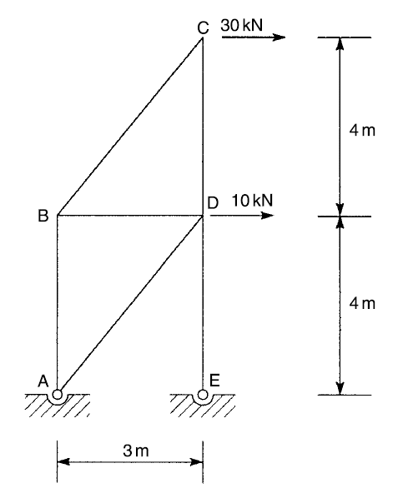
Example 3
Calculate the force in member AB of truss structure?

Slide 31
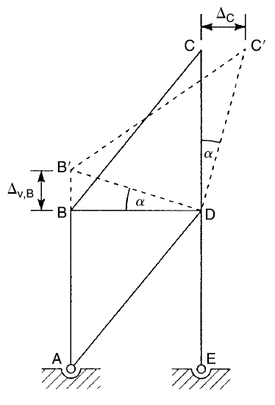
Solution
This structure has 1 degree of indeterminacy, i.e. 4 reaction (support) forces, unknowns, and 3 equations of equilibrium
Let’s apply an infinitesimally small virtual displacement where we intend to get the force
Equating work done by external force to that of internal force gives

Slide 32
Example 4
We would like to obtain slope for the portal frame below;
P

Slide 33
Solution
P

Slide 34
Note
The amount of virtual displacement can be any arbitrary value;
For convenience lets give it a unit value. For example, in the previous example lets say Δ_{v,B}=1;
In this case the method could be called unit load method.

Slide 35
Note
If you need to obtain force in a member, you should apply a virtual displacement at the location where force is intended;
If you need to obtain displacement in a member, you should apply a virtual force at the location displacement is intended.

Slide 36
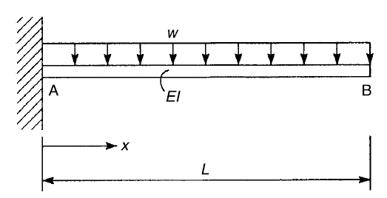
Example 5
Determine vertical deflection at point B using unit load method.

Slide 37
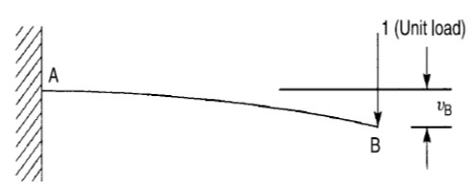
Solution
Real system
Virtual system
Apply a virtual unit load in the direction of displacement to be calculated
Work done by virtual unit load
Work done by internal loads
Equating external work with internal

Slide 38
Example 6
Using unit load method determine slope and deflection at point B.
5kN/m
8kN
I_{AB}=4x10⁶ mm⁴
I_{BC}=8x10⁶ mm⁴
E=200 kN/mm²
C
B
D
A
2m
0.5m
0.5m

Slide 39
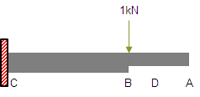
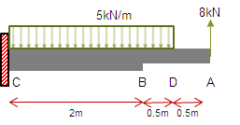
Solution
For deflection we apply a unit virtual load at point B in the direction of the intended displacement;
Real system
Virtual system
Segment | Interval | I (mm⁴) | M _{v} (kN.m) | M (kN.m)
AD | 0<x<0.5 | 4x10⁶ | 0 | 8x
DB | 0.5<x<1 | 4x10⁶ | 0 | 8x-2.5(x-0.5)²
BC | 1<x<3 | 8x10⁶ | -x+1 | 8x-2.5(x-0.5)²

Slide 40
Solution
For slope we apply a unit virtual moment at point B
1kN.m

Slide 41
Solution
Segment | Interval | I (mm⁴) | M _{v} (kN.m) | M (kN.m)
AD | 0<x<0.5 | 4x10⁶ | 0 | 8x
DB | 0.5<x<1 | 4x10⁶ | 0 | 8x-2.5(x-0.5)²
BC | 1<x<3 | 8x10⁶ | 1 | 8x-2.5(x-0.5)²

Slide 42
Q1
Use the principle of virtual work to determine the support reactions in the beam ABCD.

Slide 43
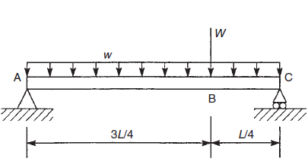
Q2
Find the support reactions in the beam ABC using the principle of virtual work.

Slide 44
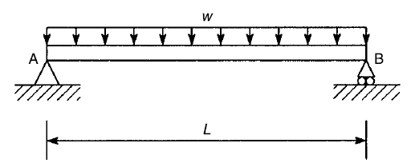
Q3
Find the bending moment at the three-quarter-span point in the beam. Use the principle of virtual work.

Slide 45
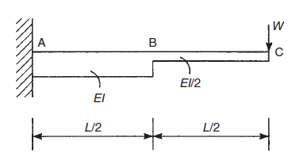
Q4
Use the unit load method to calculate the deflection at the free end of the cantilever beam ABC.

Slide 46
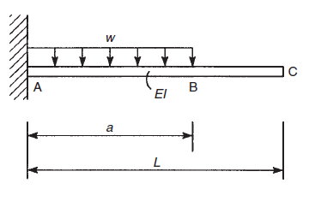
Q5
Calculate the deflection of the free end C of the cantilever beam ABC using the unit load method.

Slide 47
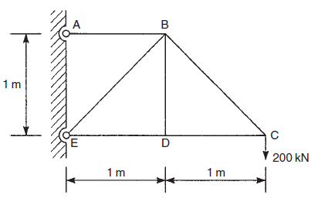
Q6
Use the unit load method to find the magnitude and direction of the deflection of the joint C in the truss. All members have a cross-sectional area of 500mm² and a Young’s modulus of 200,000 N/mm².

Slide 48
Q7
Calculate the forces in the members FG, GD, and CD of the truss using the principle of virtual work. All horizontal and vertical members are 1m long.

