Slide 1
Aero Structures-Lug Analysis
By
Dr. Mahdi Damghani
Copyrighted to DSE Ltd & Belcan
July 2023

Slide 2


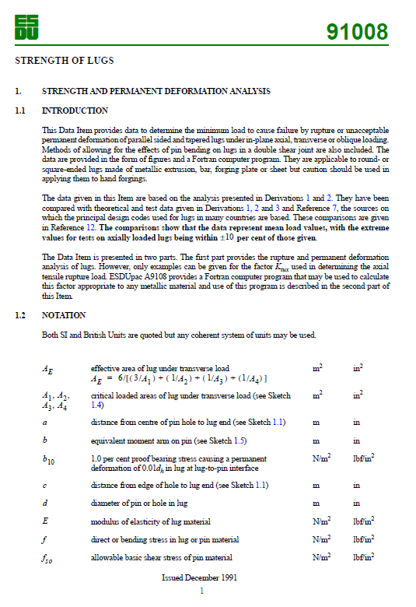
Suggested Readings
Chapter 13
Chapter 30
ESDU 91008
ESDU 81006

Slide 3
Topics
Familiarisation with lug structure and its function
Lug loading
Lug analysis
Pin analysis
Bush analysis
Special scenarios
Stress concentration factor considerations in lugs (ESDU vs Research)
Stresses due to bush press-fit
Sample example
Research trends

Slide 4
Topics
Familiarisation with lug structure and its function

Slide 5
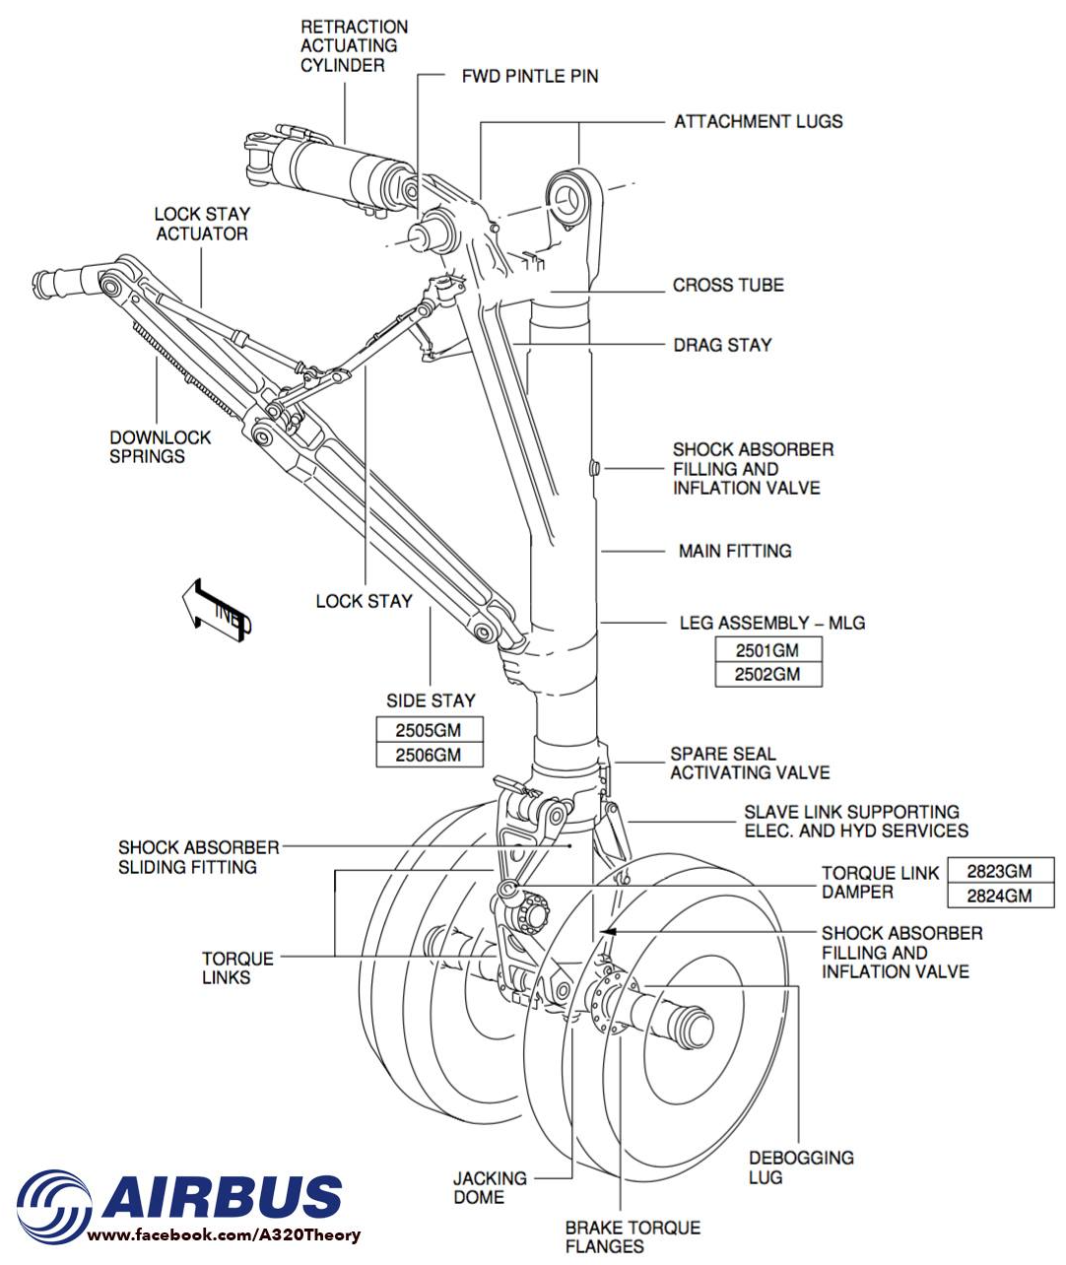
Introduction
Lugs are connector elements and act as structural support for a pin connection.
Landing gear structures are dominated by a variety of lugs to permit connection to the aircraft, torque links, and braces, as well as the mounting of secondary components.
Wing-fuselage connection is lugged and responsible for significant load transfer.

Slide 6
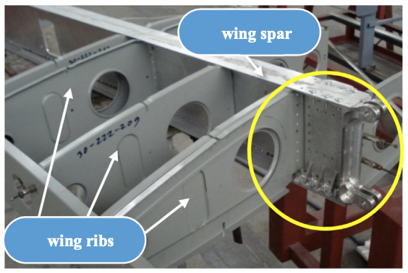
Introduction-
Wing-fuselage lug connection for a light aircraft

Slide 7
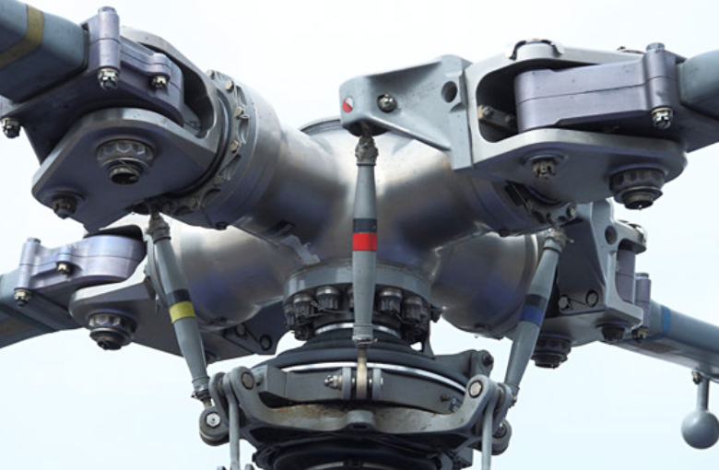
Introduction-
Helicopter main rotor head

Slide 8
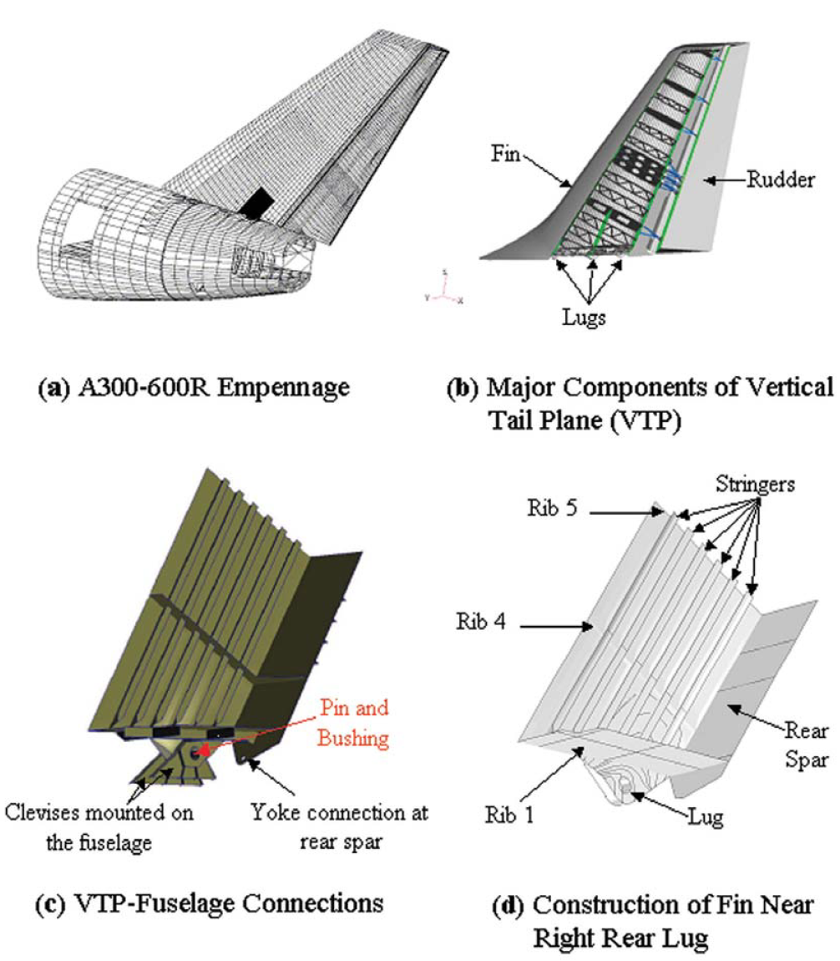
Introduction-
Tail plane connection to fuselage

Slide 9
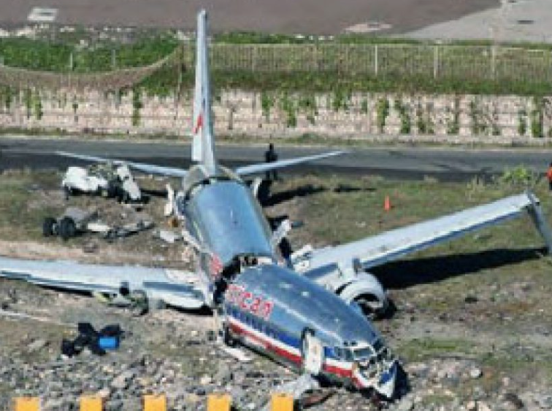
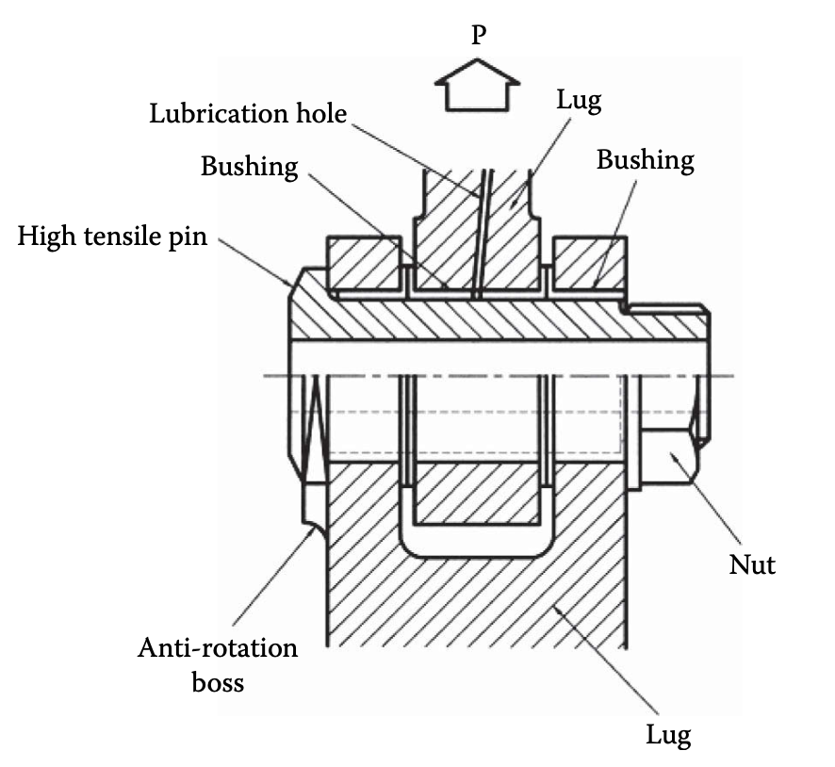
Introduction
A lug assembly is one of the most critical structural elements in aerospace applications.
This connector-type structure has been responsible for several incidences, including the crash of AA587 in November 2001.
During operation, a lug joint will experience significant fatigue loads and environment variations.
Several damage conditions could be initiated in this structure, including fatigue cracks and connection (joint) failures.

Slide 10
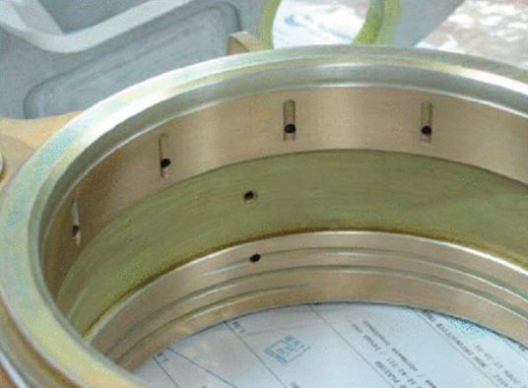
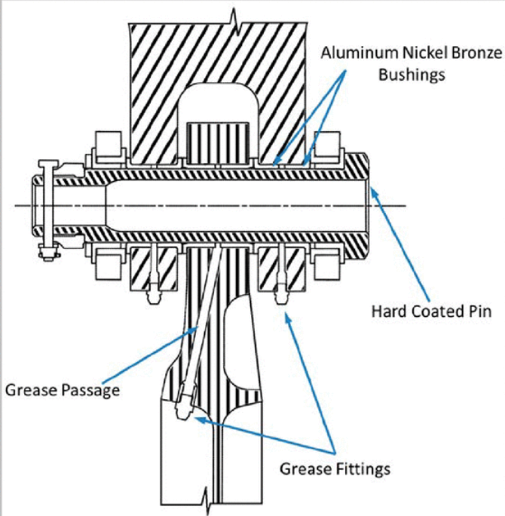
Introduction
Lug bore
Lug bushing
Under service loading, the bearing capacity of such a mechanical assembly may be threatened because of appearance of fretting and corrosion in a stress-raised zone at the lug hole.
Such a complex stress state can lead to the formation and propagation of fatigue cracks, and even to an abrupt failure.
Landing gear lug assembly

Slide 11
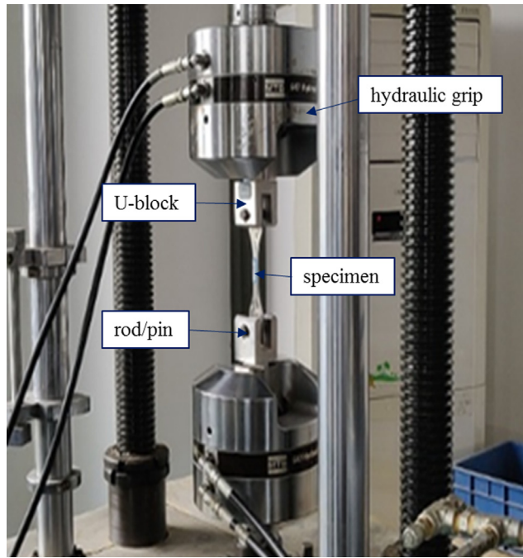
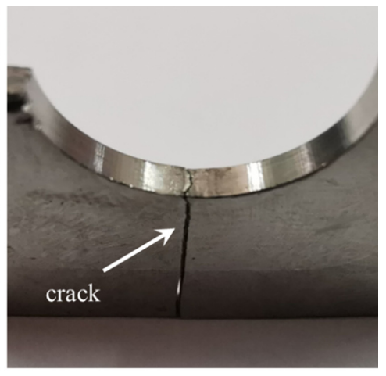
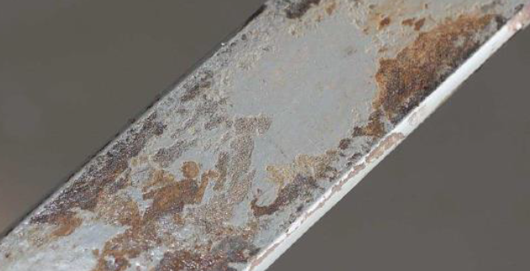
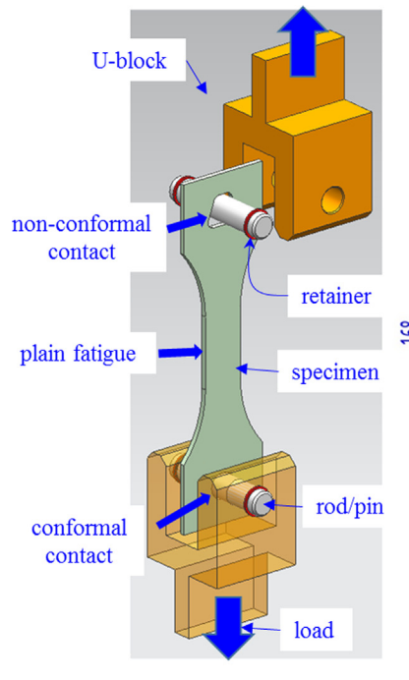
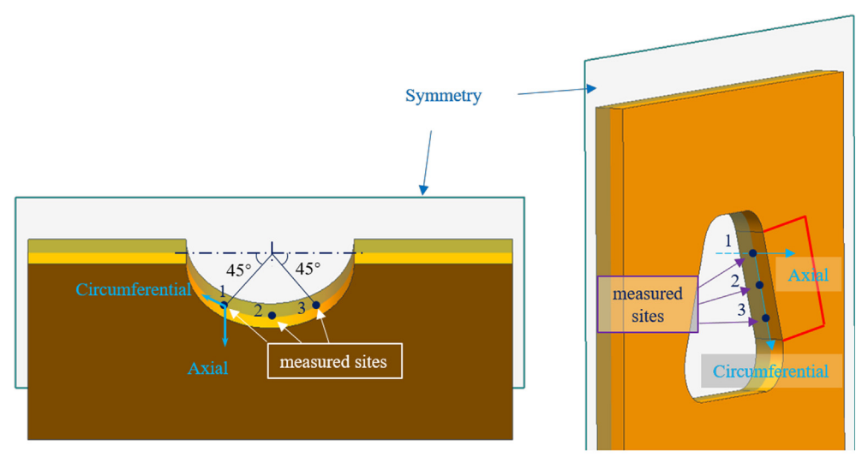
Note
Fretting occurs at the junction of contacting bodies due to the presence of small oscillatory movements, which generate small relative displacements.
These relative displacements cause surface degradation and heat at the expense of frictional energy.
These motions produce oscillatory stresses in the contact zone that can lead to surface cracking.
In the presence of stress, these cracks can grow until the component fails (regarded as fretting fatigue as shown in the opposite illustration).
Non-conformal fatigue at dovetail hole
Conformal fatigue at circular hole

Slide 12
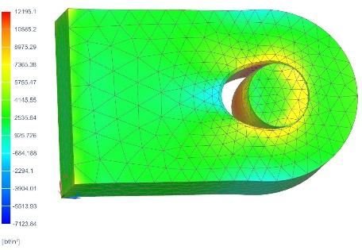
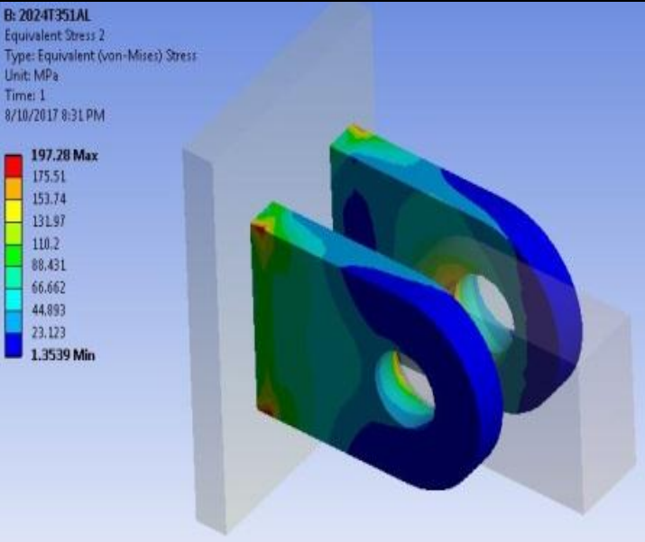
Introduction
Most lug analysis is performed using classical methods, which are validated by test evidence to exploit some of the material’s plastic capability.
Finite element analysis of pins and lugs will quickly show local regions exceeding the yield capability of the material and a lug design which attempts to ensure the lug remains completely within the elastic region at limit loads will tend to be heavy.
It is typically preferred to design lugs using proven classical methods while reserving finite element analysis for small details within the lug (such as grease passageways).

Slide 13
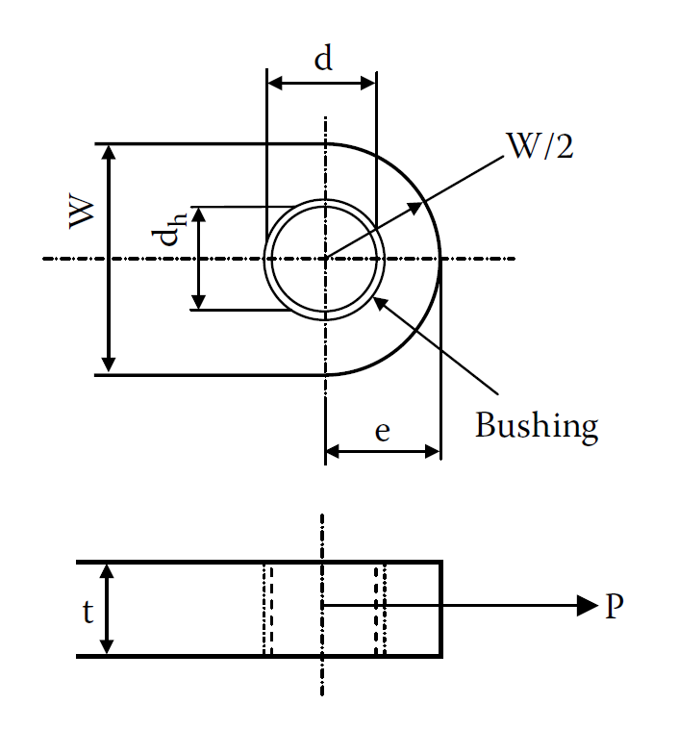
Good practice in design
It is good practice, especially when designing with corrodible materials, to provide an allowance in all joints for overhaul and repair activities.
The design of pins and lugs should provide additional material such that damaged or corroded material can be removed at overhaul and the interface restored either with thicker coatings (typically on pins) or by oversize bushings (typically on lug bores).
The following rules of thumb are typical repair allowances (particularly for landing gear):
  0.060 inch (1.524 mm) on lug bore inner diameters (d)
  0.015 inch (0.381 mm) on lug faces (t)
  0.020 inch (0.508 mm) on pin outside diameters (d_{h})

Slide 14
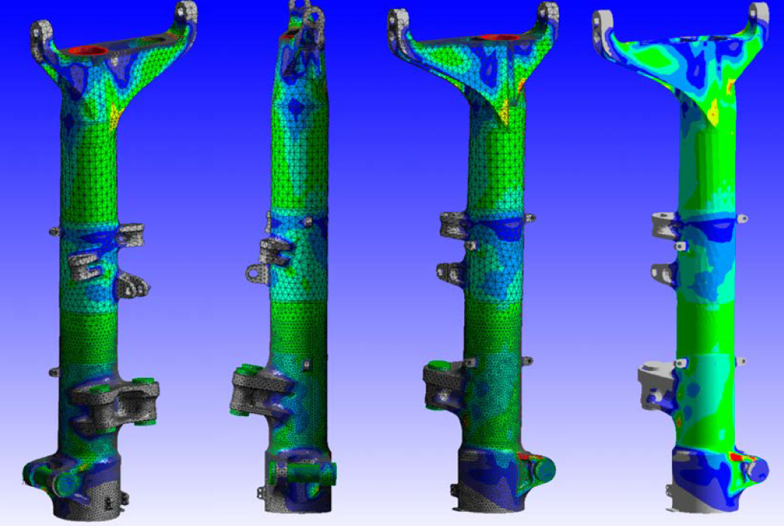
FEA examples
(showing max principal stresses)
FEA of torque link assembly (right)
FEA main landing gear main fitting (left)

Slide 15
Topics
Familiarisation with lug structure and its function
Lug loading

Slide 16
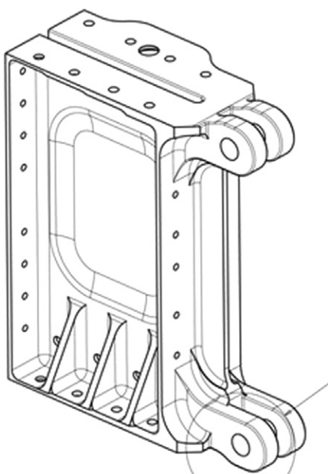
General lug loading
Out of plane
$$α$$
Axial
Transverse
Oblique

Slide 17
Topics
Familiarisation with lug structure and its function
Lug loading
Lug analysis

Slide 18
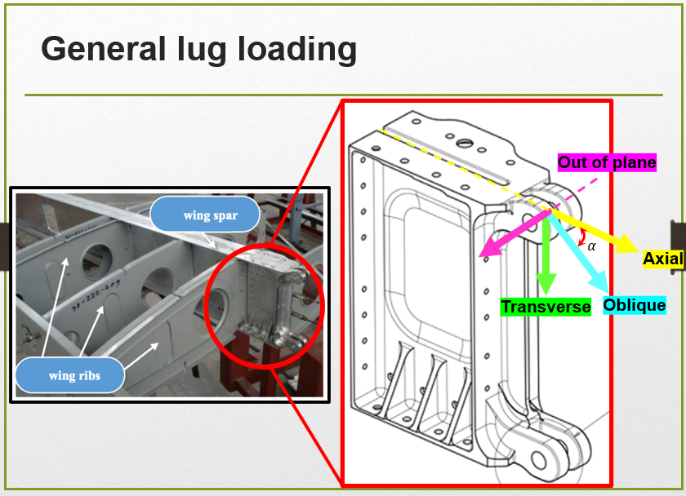
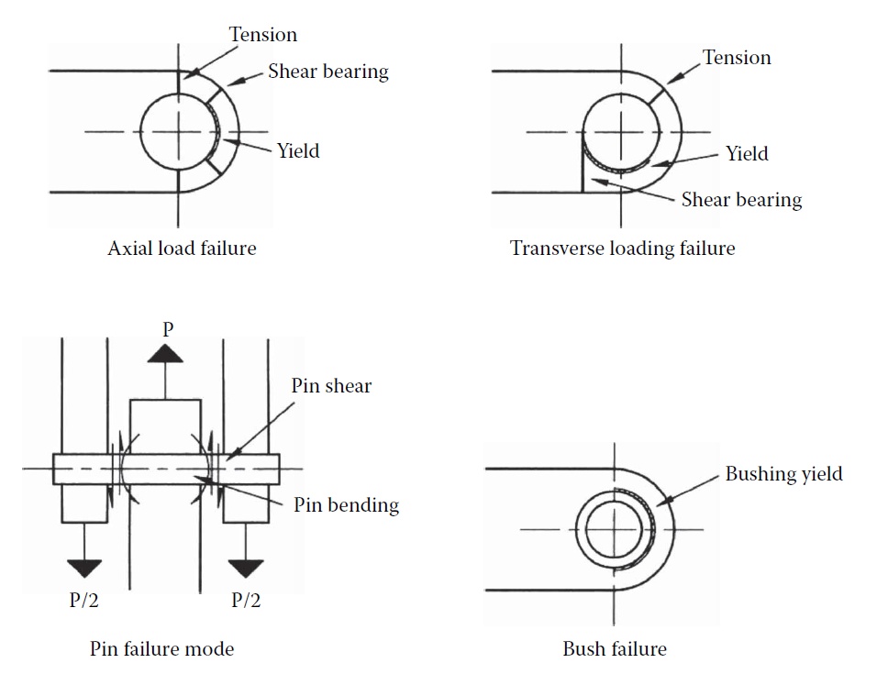
Failure modes
Shear tear out or bearing labelled as shear bearing
and a bit more failure modes depending on the location of bushing
(see bushing analysis section)

Slide 19
Axially loaded lugs
Yielding
Tension across the net section.
Shear tear-out or bearing.
Shear acting on the pin (see pin analysis section).
Bending of the shear pin (see pin analysis section).
Excessive yielding of bushing.
Net section tension
$${40}^{°}$$
P
Shear bearing

Slide 20
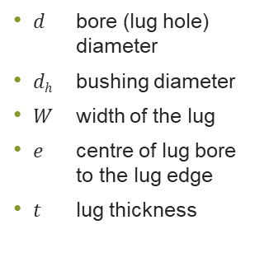
Geometric parameters
$d$ bore (lug hole) diameter
$dh$ bushing diameter
$W$ width of the lug
$e$ centre of lug bore to the lug edge
$t$ lug thickness

Slide 21
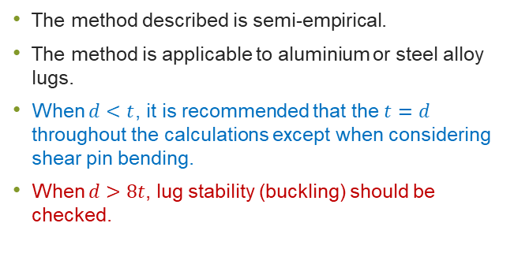
Some notes before analysis
The method described is semi-empirical.
The method is applicable to aluminium or steel alloy lugs.
When $d<t$, it is recommended that the $t=d$ throughout the calculations except when considering shear pin bending.
When $d>8t$, lug stability (buckling) should be checked.

Slide 22
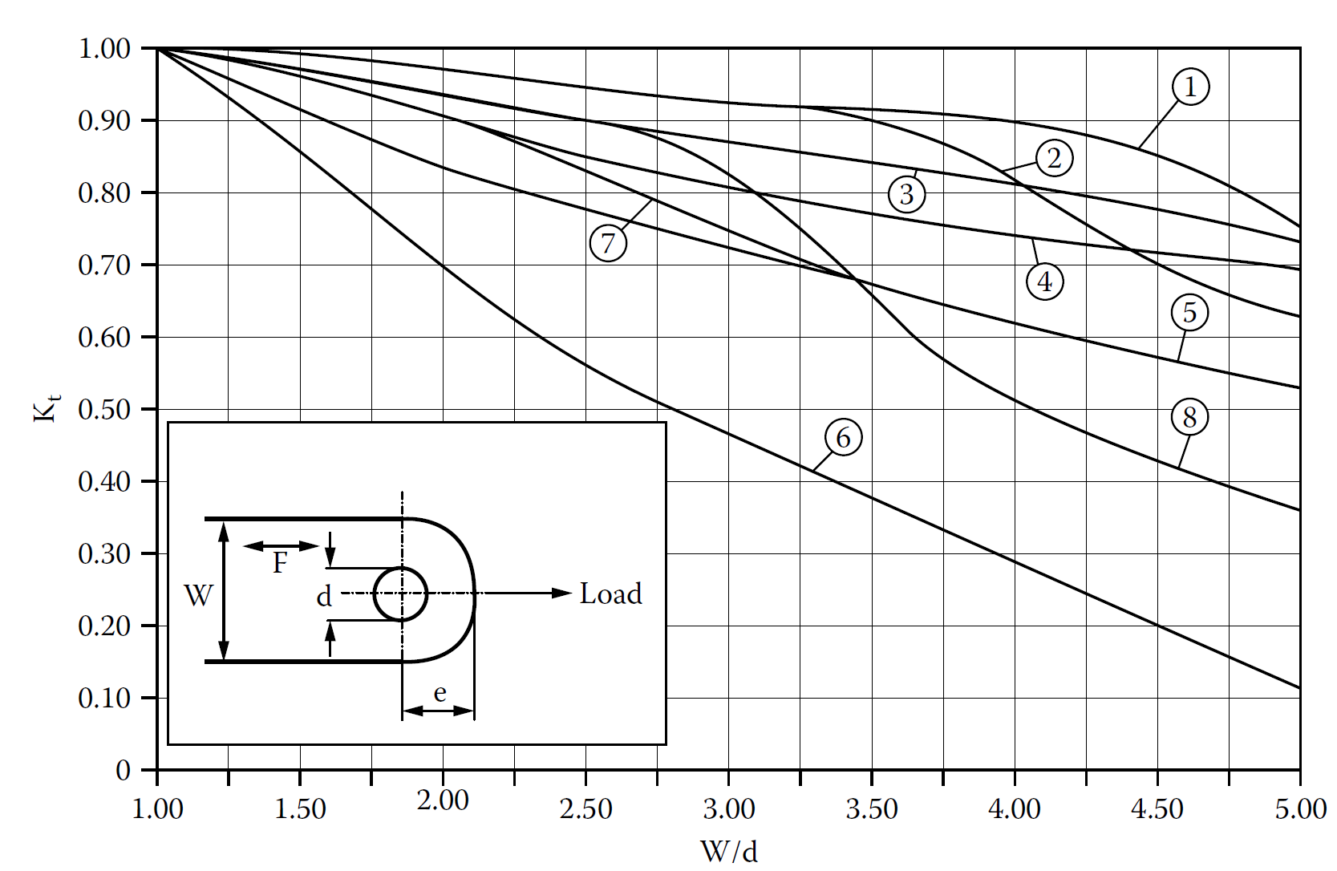

Axially loaded lugs
(tension)
Ultimate load of lug:
$$A_{t}=\left(W−d\right)×t$$
Grain direction
$$0.5(W−d)$$
$$d$$
$$0.5(W−d)$$
$$t$$
Notes:
Ftu= Ultimate tensile strength of the lug
Fty= Yield tensile stress of the lug
Fcy= compressive yield stress of bushing material

Slide 23
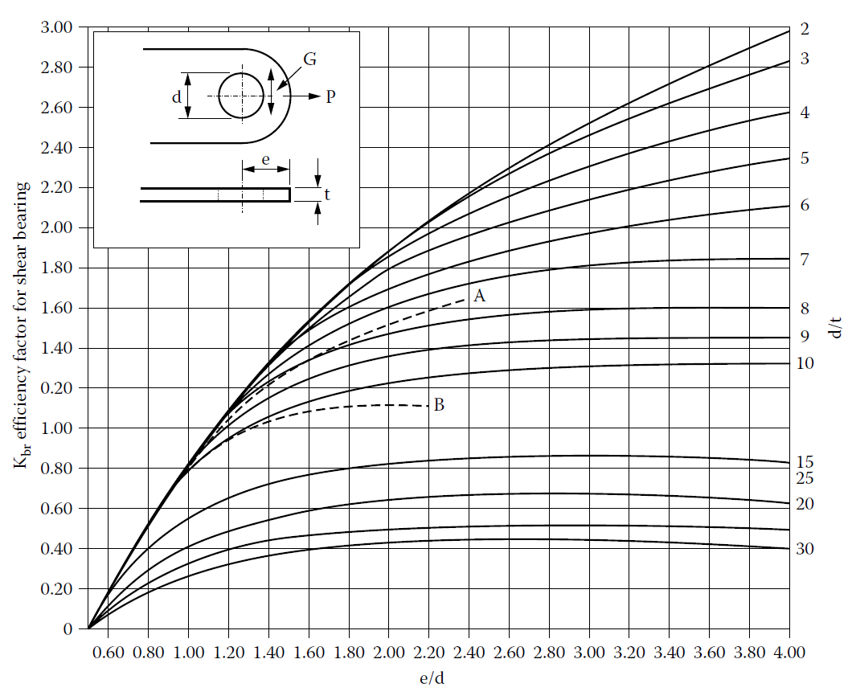

Axially loaded lugs
(shear tear off)
K_{br} greater than 2.00 shall not be used for lugs made from 12.7 mm thick or thicker aluminium alloy plate, bar or hand-forged billets
Curve A is a cut off to be used for all aluminium alloy hand-forged billets when LT grain has direction G
Ultimate load of bearing-shear mode:
Curve B for all aluminium alloy plates, bars and hand-forged billets when ST grain has direction G
$$d$$
$$t$$
Notes:
Ftu= Ultimate tensile strength of the lug
Fty= Yield tensile stress of the lug
Fcy= compressive yield stress of bushing material

Slide 24
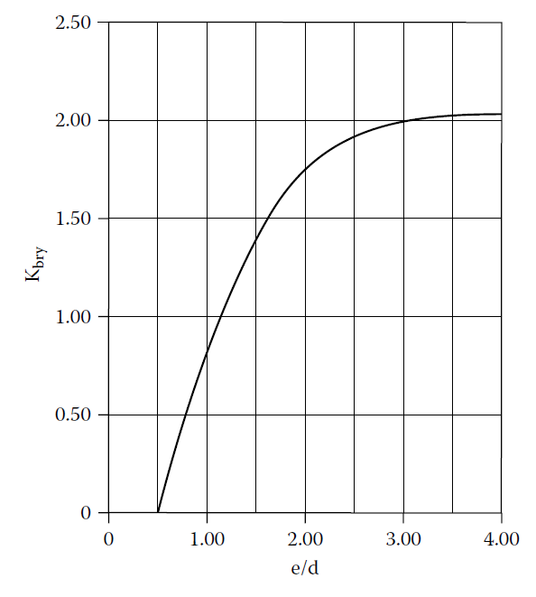


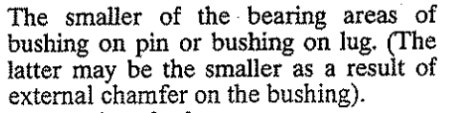
Axially loaded lugs
(bearing)
Yield load of lug:
Yield of bushing:
$$d$$
$$d_{h}$$
$$t$$
Notes:
Ftu= Ultimate tensile strength of the lug
Fty= Yield tensile stress of the lug
Fcy= compressive yield stress of bushing material

Slide 25
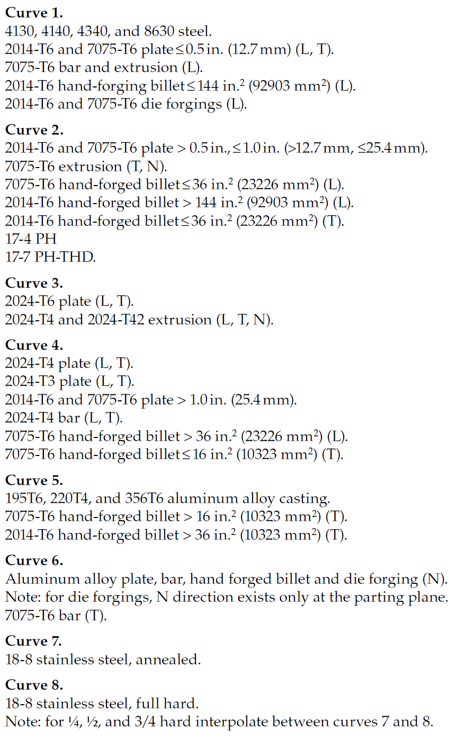
Note

Slide 26
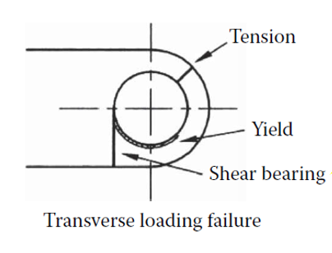
Transversely loaded lugs
Yielding
Tension across the net section.
Shear tear-out or bearing.
Shear acting on the pin (see pin analysis section).
Bending of the shear pin (see pin analysis section).
Excessive yielding of bushing.
Net section tension
Shear bearing
P
For this type of lug, the shape of the lug should be considered by use of shape parameter.

Slide 27
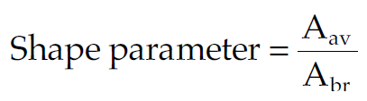
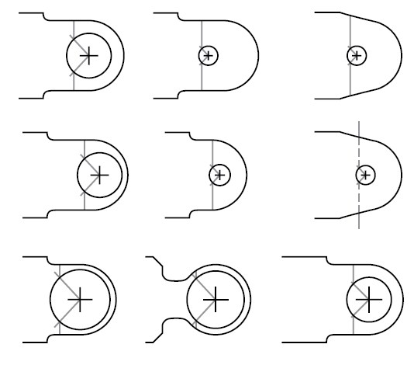

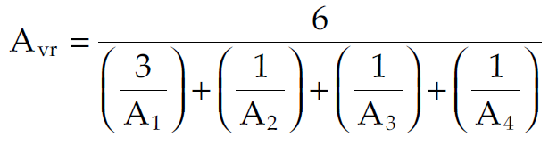
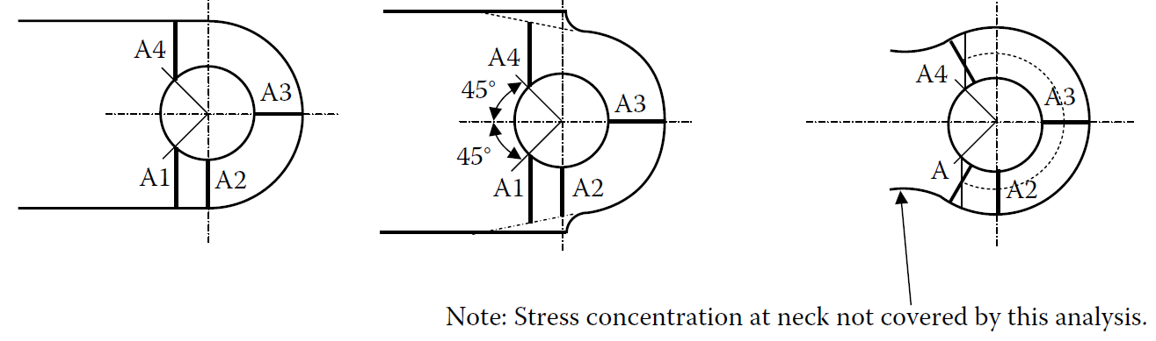
Transversely loaded lugs
Weighted average area
Substantiated lug shapes
Least area in radial section around the hole
$${45}^{°}$$
1

Slide 28
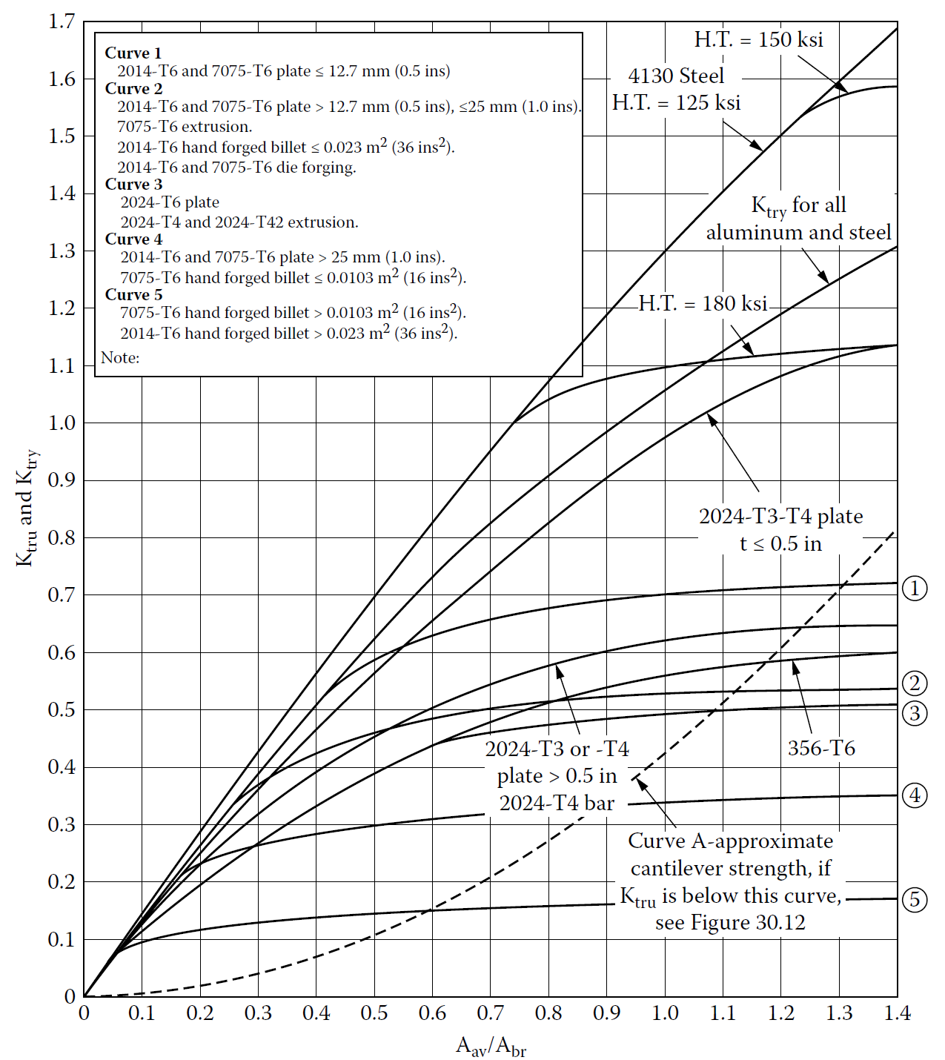

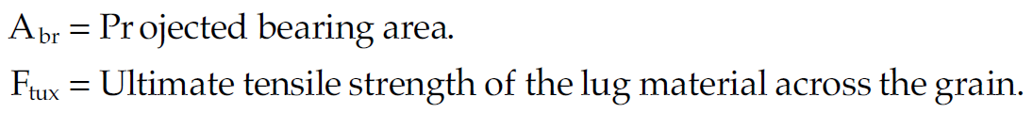

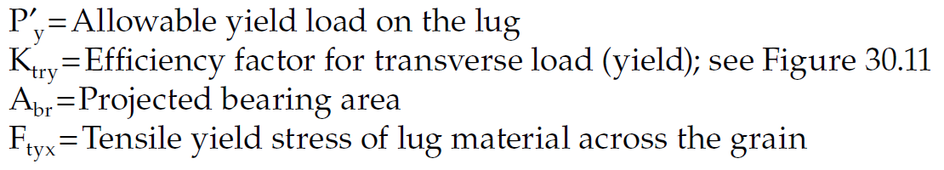
Transversely loaded lugs
(tension)
Ultimate load of lug:
Yield load of lug:

Slide 29
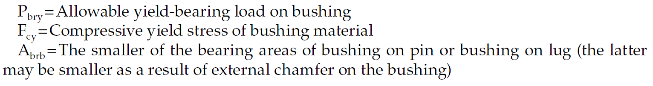
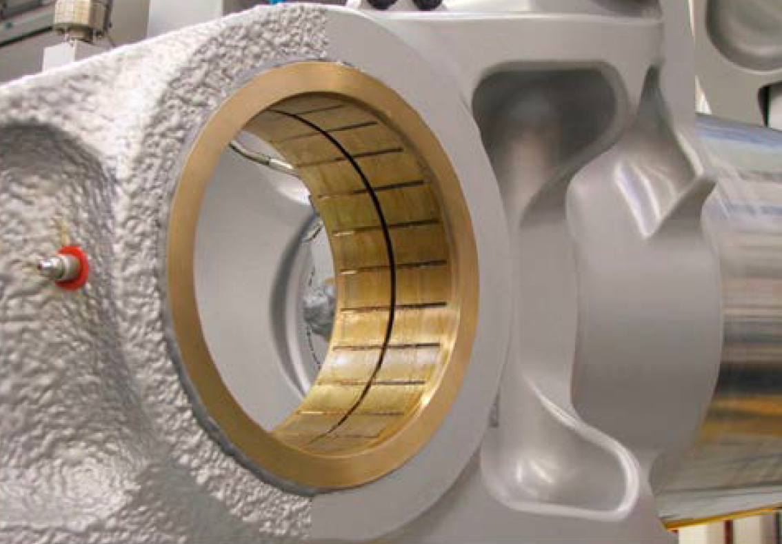
Transversely loaded lugs
(bearing)
Yield of bushing:
External chamfer on brass bushing
$$d_{h}$$
$$t$$
$$d$$

Slide 30

Obliquely loaded lugs
Resolve the load into axial and transverse components.
Make use of interaction formula to obtain failure load as below.
R_{a}
P
R_{tr}
For ultimate case:
For yield case:

Slide 31
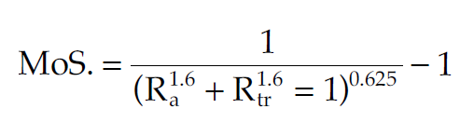
Obliquely loaded lugs
Resolve the load into axial and transverse components.
Make use of interaction formula to obtain failure load as below.
R_{a}
P
R_{tr}
Depending on what Margin of Safety is intended, required loads can be obtained from below.
MoS for aerospace lug is 0.2 but can increase to 0.3 if needed and weight penalty is not that crucial.

Slide 32
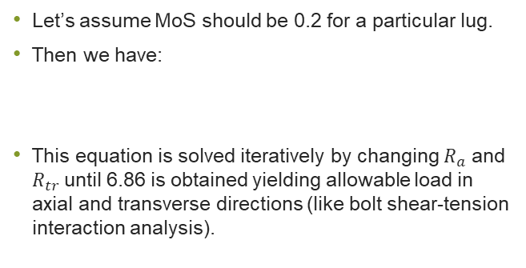

Obliquely loaded lugs
Let’s assume MoS should be 0.2 for a particular lug.
Then we have:
This equation is solved iteratively by changing $R_{a}$ and $R_{tr}$until 6.86 is obtained yielding allowable load in axial and transverse directions (like bolt shear-tension interaction analysis).
$$\frac{1}{{\left(R_{a}^{1.6}+R_{tr}^{1.6}\right)}^{0.625}}−1=0.2\underset{→}{\text{yields}}\left(R_{a}^{1.6}+R_{tr}^{1.6}\right)=6.86$$

Slide 33
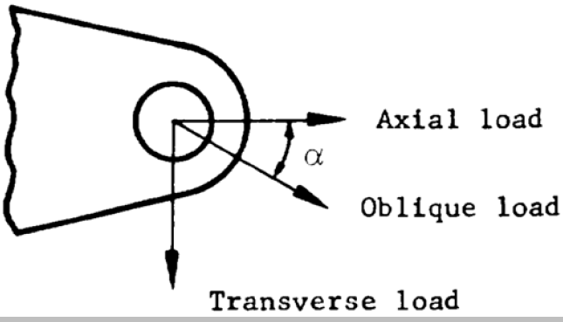
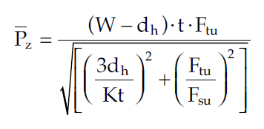
Out-of-plane loaded lugs
A
d_{h}/2
In general, this scenario should be avoided.
In case this is inevitable, allowable load at section A-A is:
Allowable oblique load is then:
P_{x}
Needs to be estimated.
If not available minimum 10º.
Bending form factor
A
P_{y}
P_{x}
P_{z}
P

Slide 34


Note
$$σ=\frac{Mc}{I}$$
$$σ=\frac{1}{K}\frac{Mc}{I}$$
homogenous materials
Non-homogenous materials
Bending form factor (K) ?
  Flexural strength or modulus of rupture is maximum stress the material experiences at yield.
  Flexural strength is the same as tensile strength of material if it was homogenous.
  In practice, materials such as wood and metal have grains/fibres in their micro-structure and defects in manufacturing are likely (so cannot be considered as fully homogenous).
  Modulus of rupture are often obtained by experiment on rectangular sections of standard size.
  To account for the use of experimental modulus of rupture to other section shapes and sizes, form factor is defined.
Notes:
fibre stress at elastic limit is greatly influenced by the shape of the section. There is every reason to believe that the ordinary assumption a to distribution of stress hold quite well up to the elastic limit when considering the stress in the extreme fibre, yet a wood I beam, for example, may have an elastic limit stress 30 per cent Iess than a solid rectangular beam made of the same material.
Consider a rectangular beam of Sitka-pluce at 15% moisture content. The elastic limit of this material in compression parallel to the grain is 2,960 pounds per quare inch. It might be expected that when the specimen is tested in bending that the elastic limit would be reach d wh n th e_·tr me fib I' on the compr es ion side wa stre ed to 2,960 pound per quare inch as calculated by the standard f= J~ e formula. Tests show, however, that the elastic limit in bending i not r eached until the extreme compressive fiber has a calculated stre s of 5,100 pounds per quare inch. A imila,r condition i found at ultimate load. We believe that the common theory of fl exme holds quite well up to the elastic limit. What then operates to develop a much greater compressiv stJ'e at ela tic limit in fl exure than under direct compre - sion ~ If we consider the minute fibers on the compressive ide as miniatme Euler column somewhat bound together, we may a,crount for thi increa e. These little column when r einforced laterally will exceed the load neces ary to cau e buckling when un upported, and as the fib ers near the neutral axis are less tre ed they may 'ivelllend uch upport. The out ide fiber are r einforced by those in the layer below them and 0 on down through the beam. At the ela tic . 5 100 -2 960 limit the total reinforcement in th example cIted amount to ' 2,960' 0.72 of the strength at cla tic limit in compres ion.

Slide 35
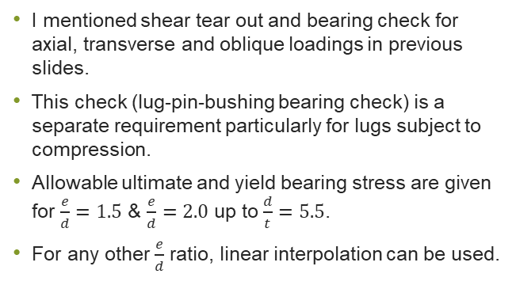
Bearing at Lug-Pin or Bushing Interface
I mentioned shear tear out and bearing check for axial, transverse and oblique loadings in previous slides.
This check (lug-pin-bushing bearing check) is a separate requirement particularly for lugs subject to compression.
Allowable ultimate and yield bearing stress are given for $\frac{e}{d}=1.5$ & $\frac{e}{d}=2.0$ up to $\frac{d}{t}=5.5$.
For any other $\frac{e}{d}$ ratio, linear interpolation can be used.

Slide 36


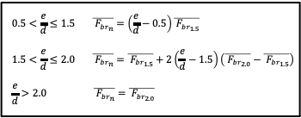
Bearing at lug-pin or bushing interface
Allowable bearing stress
$$0.5<\frac{e}{d}≤1.5 \overline{{ F}_{{br}_{n}}}=\left(\frac{e}{d}−0.5\right)\overline{{ F}_{{br}_{1.5}}}$$
$$1.5<\frac{e}{d}≤2.0 \overline{{ F}_{{br}_{n}}}=\overline{{ F}_{{br}_{1.5}}}+2\left(\frac{e}{d}−1.5\right)\left(\overline{{ F}_{{br}_{2.0}}}−\overline{{ F}_{{br}_{1.5}}}\right)$$
$$\frac{e}{d}>2.0 \overline{{ F}_{{br}_{n}}}=\overline{{ F}_{{br}_{2.0}}}$$
Allowable bearing force
Ultimate bearing force
Yield bearing force

Slide 37
Topics
Familiarisation with lug structure and its function
Lug loading
Lug analysis
Pin analysis

Slide 38
Pin bending
In static tests of a single bolt fitting, failure of the shear pin due to bending failure is not a factor in the failure of the lug.
It is important to provide sufficient bending strength to ensure permanent bending deformation does not occur for limit loads.
This ensures the shear pin can be readily removed for inspection and maintenance operations.

Slide 39
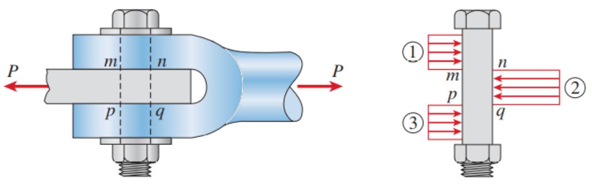
Pin bending
Weakness in the shear pin can cause peaking up non-uniform-bearing loads on the lugs.
This influences the lug tension and shear strength.
The big unknown factor in shear pin bending is the true value of the bending moment acting on the pin because the moment arm to the resultant bearing forces is difficult to quantify.
Uniform bearing stresses as a result of strong pin

Slide 40
Pin bending analysis approaches
Three approaches are presented here that are to be followed in order.
If the first approach leads to low MoS then, the second approach is adopted.
If the second approach fails, then use the third approach.
Approaches are as follow:
  Method 1- Standard pin bending (uniform bearing force distribution).
  Method 2- Pin bending based on non-uniform bearing force distribution.
  Method 3- Pin bending based on including excess strength of lug.

Slide 41
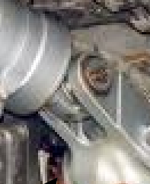
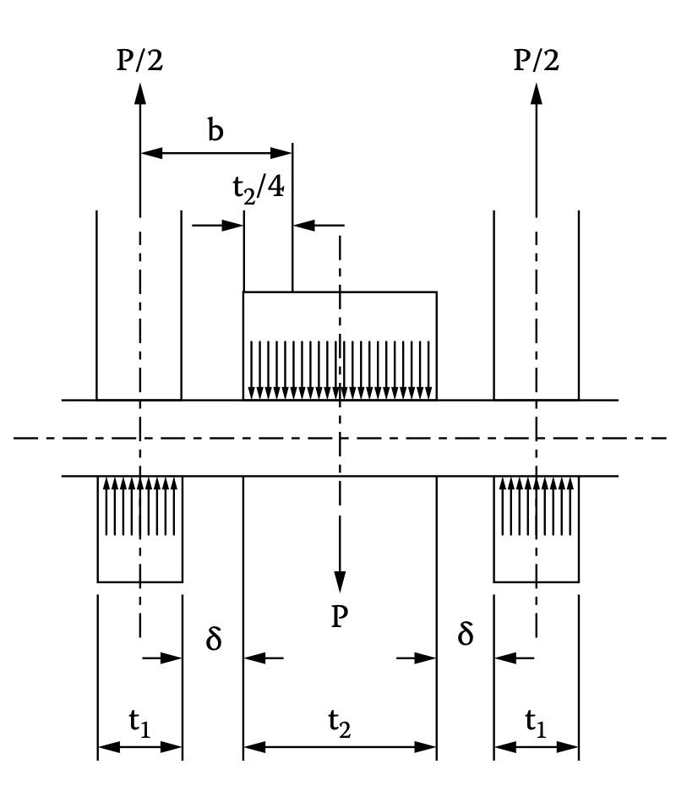






Pin bending
(Method 1)
Approximate method for moment arm:
If $δ=0$:
Applied moment:
Bending stress:
M
d
Minimum failure load for the centre lug or twice that of the edge lugs
$$M=b×\frac{P}{2}$$

Slide 42
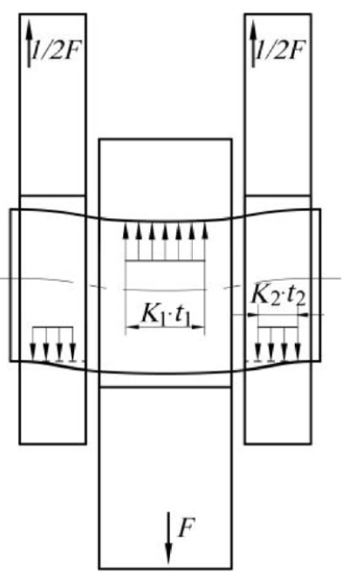
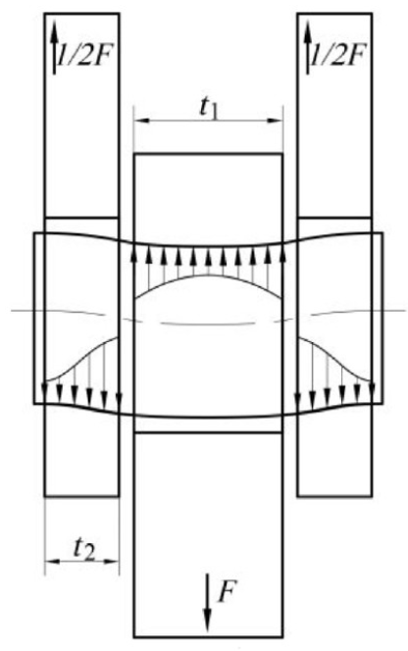
Note
If the pin using the above checks is not adequate, this leads to peaking of forces at pin shear face reducing the bending moment arm.
The actual force distribution of contact surfaces
Due to deformation of the pin
Shift of resultant force from red (uniform bearing stress distribution) to purple
Load peaking
Equivalent force distribution of contact surfaces
Equivalent forces will be biased towards the peak distribution hence reduction in moment arm

Slide 43








Bending moment arm reduction
(Method 2)
Pin diameter
Lug ultimate strength
e
$${\left(P_{u}\right)}_{min}=min\left(P_{bru},P_{tu}\right)$$
e
e
e
Pin moment of inertia
Theoretical data are not substantiated by test data
Modulus of rupture
Modulus of rupture
Notes:
Modulus of rupture is the maximum stress in bending that pin can undergo at failure.

Slide 44




Pin bending
(Method 3)
This approach should only be used if there is an excess margin in the strength of the lug and the pin is still inadequate.
In this circumstance it may be assumed that a portion of the lug thickness in the joint is inactive.
The active thicknesses are chosen by trial and error to give approximately equal margins of safety (MoS) for the lug and the pin.
The analysis procedure is the same as Method 2 but the r for inner lug is calculated as shown below:
e
$t_{a}=t_{2}$- $t_{s}$

Slide 45





Pin shear
Allowable shear force in a double lap shear joint configuration
Curve limitation
Solid pin
$K_{s}$ accounts for variation of $d_{h}/t$ in a double lap shear joint to elevate allowable stress.
For a single lap shear case $K_{s}=1$.

Slide 46
Topics
Familiarisation with lug structure and its function
Lug loading
Lug analysis
Pin analysis
Bush analysis

Slide 47


Bushing analysis
The allowable yield load is
$A_{brb}$ is the smaller area of the bushing on the shear pin or bushing on lug.
The bearing on the lug may be less if the bushing has been chamfered.
Allowable compressive yield on the bushing material

Slide 48


Bush analysis-
Extra considerations
(Airbus specific)
Pin bearing against the bush bore (covered in previous slide).
Bush bearing against lug bore (covered in previous slide).
Bush flange bearing against lug face (next slide)
Bush shear (next slide).

Slide 49


Bush flange bearing and bush shear
Bearing surface at limit load (line tangent to fillet extending at 45deg angle)
Lateral load
Conical shear surface (A)
For shear strength calculation at ultimate load, i.e. P_{lat} / A. Connects two areas of high stress concentration (orange points) at the tip of the chamfers

Slide 50
Topics
Familiarisation with lug structure and its function
Lug loading
Lug analysis
Pin analysis
Bush analysis
Special scenarios

Slide 51

Lubrication holes
Axial load
  Account for net section reduction in tension and bearing in the presence od the hole.
Transverse load
  Proceed as normal but multiply the ultimate load by reduction factor $0.9\left(1−\frac{d_{Lubrication hole}}{t}\right)$.
Oblique load
  Proceed as normal and obtain strength in axial and transvers as above. Then use interaction formula for the above obtained forces.

Slide 52


Eccentric hole
Proceed the calculations for the equivalent lug and multiply the final load by the following load factor.
Equivalent lug

Slide 53

Multiple shear connection
4
7
3
6
2
5
1

Slide 54
Topics
Familiarisation with lug structure and its function
Lug loading
Lug analysis
Pin analysis
Bush analysis
Special scenarios
Stress concentration factor considerations in lugs (ESDU vs Research)

Slide 55


Stress concentration for fatigue considerations-1
With lug-shaped components there is a general shortage of reliable stress data.
References such as Peterson and ESDU do not supply appropriate stress concentration factor charts for lugs, and published data for normalised stress intensity factors is lacking.
As you will see I the next slides, stress concentration factors from ESDU do not cover transverse loading either.

Slide 56



Note 1
(stress concentration from ESDU 81006)
Stress concentration factor for square ended lugs.
$K_{e}^{′}$ is stress concentration factor at $e$ (pin to hole clearance as a $\%$ of $d$) for lugs with $t/d<0.5$.
$f_{max}=K_{e}^{′}f_{ref}$ and $f_{ref}=\frac{P}{\left(W−d\right)t}$

Slide 57




Note 2
(stress concentration from ESDU 81006)
Effect of lug thickness
Stress concentration factor for round ended lugs.
Correction factor for clearance

Slide 58







Example of stress concentration for round-ended lugs
The maximum clearance for a pin${35}_{−0.01}^{−0.08}$ is:
Hence,
$$0.10+0.08=0.18 mm$$
$$K_{100}^{′}=3.61$$
$$e=\frac{0.18×100}{35}=0.51$$
$$\frac{d}{W}=\frac{35}{35×2}=0.50$$
$$K_{0.2}^{′}=2.68$$
$$\frac{a}{W}=\frac{42}{35×2}=0.60$$
$$η_{e}=0.22$$
$$K_{e}^{′}=2.68+0.22×\left(3.61−2.68\right)=2.88$$

Slide 59






Note 3
(stress concentration from ESDU 81006)
Stress concentration factor for waisted lugs ($K_{w}$).
$K_{0.27}^{′}$ is taken from test data for round-ended lugs
$$\frac{a}{W}=\frac{42}{35×2}=0.60$$
We can conservatively use stress concentration factor for $e=0.51$ of previous example as the one for $e= 0.27$ is from testing which might not be widely available.
$$\frac{K_{w}}{K_{0.27}^{′}}=1.26$$
$$K_{w}=1.26{K′}_{0.51}=$$
$$1.26×2.88=3.63$$

Slide 60




Note 4
(stress concentration from ESDU 81006)
Stress concentration factor for waisted lugs with additional side flat ($K_{wf}).$
$$\frac{a}{W}=\frac{42}{35×2}=0.60$$
We can conservatively use stress concentration factor for $e=0.51$ of previous example as the one for $e= 0.27$ is from testing which might not be widely available.
$$\frac{K_{wf}}{K_{0.27}^{′}}=1.13$$
$$K_{w}=1.13{K′}_{0.51}=$$
$$1.13×2.88=3.25$$

Slide 61







Note 5
(stress concentration from ESDU 81006)
Stress concentration factor for waisted lugs with additional side flat and slot ($K_{s}$).
$$\frac{a}{W}=\frac{42}{35×2}=0.60$$
$$\frac{d}{L}=\frac{35}{17.5}=2.00$$
$$\frac{K_{s}}{K_{0.27}^{′}}=\frac{K_{s}}{K_{wf}}×\frac{K_{wf}}{K_{0.27}^{′}}=1.093×1.13=1.24$$
$$\frac{K_{s}}{K_{wf}}=1.093$$
$$K_{s}=2.88×1.24=3.57$$
Note that this graph is for $a/w=0.5$but the example is for the case of $a/w=0.6$so the results should be considered with caution.

Slide 62

Stress concentration for fatigue considerations-2
There is very little difference in tangential stress magnitude between the concentrated and partially distributed load cases.
Pin-loaded case, in addition to being different in the region of contact, also shows a marked reduction in stress magnitude in the peak stress region as well as in the vicinity of the applied load.
The stress ratio significantly reduces from a peak value of 7.4 to just 5.4 (a reduction of 27%) because of assuming that the load is distributed through the pin and into the lug.
d = 65 mm
w = 130 mm
t = 10 mm
7.4
$$σ_{θ}$$
5.4
FEA results for longitudinally (axial) loaded lug joint
Notes:
Failure in lug joints and plates with holes
Vogwell, J. ; Mínguez, J.M.
Engineering failure analysis, 1995, Vol.2 (2), p.129-135

Slide 63


Stress concentration for fatigue considerations-3
Pin-loaded case is markedly different compared to the concentrated or distributed laterally loaded cases.
Except at the $θ$ = 165° position where the laterally loaded pin case reaches a maximum stress magnitude of 3.8 closely matching the value of 3.8 reached by the concentrated and locally distributed loaded cases.
The maximum stress ratio reached for the concentrated loaded case of 4.2 (at the $θ$= 0° position).
d = 65 mm
w = 130 mm
t = 10 mm
4.2
3.8
FEA results for transversely loaded lug joint
Notes:
Failure in lug joints and plates with holes
Vogwell, J. ; Mínguez, J.M.
Engineering failure analysis, 1995, Vol.2 (2), p.129-135

Slide 64
Stress concentration for fatigue considerations-4
Key take away points:
  The general lack of adequate design data which are available for carrying out stress, fracture and fatigue analyses of standard lugs.
  The way the load is applied significantly affects the resulting tangential stress magnitude.
  Close-fitting bolts, pins or rivets generally result in lower magnitudes of peak stress than loose-fitting bolts.
  The specifying of as tight a fit as possible would appear to be a desirable objective from lug strength considerations.
  Lugs loaded in the longitudinal direction (axial) experience a greater tangential stress peak than when loaded laterally (transversely).

Slide 65
Topics
Familiarisation with lug structure and its function
Lug loading
Lug analysis
Pin analysis
Bush analysis
Special scenarios
Stress concentration factor considerations in lugs (ESDU vs Research)
Stresses due to bush press-fit

Slide 66




Stresses due to bush press-fit (Interference fit)
These fittings are intended for when the bushing is not designed to be replaced throughout the lifespan of the part.
$$σ_{r}$$
$$σ_{t}$$
C-Lug
D
Bush
A
$$δ=u_{lug}−u_{bush}$$
B-bush
Increase in the radius of the lug
due to internal pressure P
Decrease in the radius of bushing due to external pressure P
Lug
$$u_{bush}=−P\frac{B}{E_{bush}}\left(\frac{B^{2}+A^{2}}{B^{2}−A^{2}}−θ_{bush}\right)$$
$$u_{lug}=P\frac{D}{E_{lug}}\left(\frac{C^{2}+D^{2}}{C^{2}−D^{2}}−θ_{lug}\right)$$
Poisson’s ratio
$$P=\frac{δ}{\frac{D}{E_{lug}}\left(\frac{C^{2}+D^{2}}{C^{2}−D^{2}}+θ_{lug}\right)+\frac{B}{E_{bush}}\left(\frac{B^{2}+A^{2}}{B^{2}−A^{2}}−θ_{bush}\right)}$$

Slide 67






Stresses due to bush press-fit (Interference fit)
$$σ_{r}$$
$$σ_{t}$$
$$P=\frac{δ}{\frac{D}{E_{lug}}\left(\frac{C^{2}+D^{2}}{C^{2}−D^{2}}+θ_{lug}\right)+\frac{B}{E_{bush}}\left(\frac{B^{2}+A^{2}}{B^{2}−A^{2}}−θ_{bush}\right)}$$
C-Lug
D
Max tangential stress
in lug due to P on inner surface
Max radial stress
in lug due to P on inner surface
Max shear stress
in lug
Bush
A
$$σ_{t}=P\left(\frac{C^{2}+D^{2}}{C^{2}−D^{2}}\right)$$
B-bush
$$σ_{r}=−P$$
$$σ_{s}=\frac{σ_{t}−σ_{r}}{2}$$
Max tangential stress
in bushing due to P on outer surface
Max radial stress
in bushing due to P on outer surface
Lug
Stress corrosion: This maximum allowable press fit stress in magnesium alloys should not exceed 8000 psi. For all aluminium alloys, the maximum press fit stress should not exceed 0.50F_{ty}.
Static fatigue: For steels heat treated to above 200 ksi, where there is any risk of hydrogen embrittlement the press fit stress should not exceed 0.25F_{tu}.
Ultimate strength: F_{tu} should not be exceeded. However, it is rare to create stresses of this magnitude in a press fit bushing installation.
$$σ_{t}=−\frac{2.P.B^{2}}{B^{2}−A^{2}}$$
$$σ_{r}=−P$$

Slide 68
Topics
Familiarisation with lug structure and its function
Lug loading
Lug analysis
Pin analysis
Bush analysis
Special scenarios
Stress concentration factor considerations in lugs (ESDU vs Research)
Stresses due to bush press-fit
Sample example

Slide 69








Example
Two lugs that connect to two struts. The fitting is used in an engine nacelle and is subject to engine heat.
Considering the dimensional and material properties of the lug in below and subsequent slides. We intend to obtain ultimate load bearing capacity of the lug.
$$e$$
$$e$$
$e$=30.00 mm
$e$=30.00 mm
$$(e−0.5d_{h})$$
Bolt maximum ultimate shear strength 32.74 kN
Bolt maximum ultimate tension strength 45.37 kN
Nut maximum ultimate tension strength 32.87 kN

Slide 70







Solution-
Allowable tensile load
$$\frac{w}{d}=\frac{60}{16.00}=3.75$$
$$A_{t}=\left(60−17.5\right)×7.5=318.75 {mm}^{2}$$
$$e=30.00 mm$$
$$d_{h}=17.50 mm$$
$$d=16.00 mm$$
$$t=7.50 mm$$
$${e/d}_{h}=1.875$$
$$d_{h}/t=2.133$$
$$K_{t}=0.9231$$
Ultimate tensile strength
Applied load
Ultimate load bearing capacity
The margins of safety should be reduced by the relevant fitting or casting factors

Slide 71





Solution-
Allowable shear load
$$K_{br}≈1.6$$
$$\frac{e}{d}=\frac{30}{17.5}=1.714$$
$$\frac{d_{h}}{t}=\frac{17.5}{7.5}=2.33$$
$$A_{br}=16×7.5=120.00$$
Enveloping exercise for d and d_{h} to give us the lowest e/d and highest
d/t giving low K_{br}
$$P_{qu}=K_{br}×A_{br}×F_{tu}$$
$P_{qu}=1.6×120$ ${mm}^{2}×972.51 MPa=186721.92 N$
$$RF=\frac{P_{qu}}{F_{a}×ff}=\frac{186721.92 N}{76330 N ×1.15}=2.13$$

Slide 72





Solution-
Yield of lug and bushing
$$K_{bry}=1.586$$
$$\frac{e}{d}=\frac{30}{17.5}=1.71$$
$$A_{br}=16×7.5=120.00 {mm}^{2}$$
$$A_{brb}=17.5×7.5=131.25 {mm}^{2}$$
Enveloping exercise for d and d_{h} to give us the lowest e/d producing low K_{bry}
${P′}_{y}=1.586×120$ ${mm}^{2}×877.50 MPa=167005.80 N$
$$RF=\frac{{P′}_{y}}{F_{a}×ff}=\frac{167005.80 N}{76700 N ×1.15}=1.89$$
${P′}_{bry}=1.85×131.50$ ${mm}^{2}×350.00 MPa=85146.25 N$
$$RF=\frac{{P′}_{bry}}{F_{a}×ff}=\frac{85146.25 N}{76700 N ×1.15}=0.96$$
Failure of bushing under bearing stress for yield

Slide 73

Solution- bushing low RF resolution
Instead of considering the yield of bushing material (brass), we consider the ultimate bearing capacity not yield.
${P′}_{bru}=1.85×131.50$ ${mm}^{2}×389.00 MPa=94633.97 N$
$$RF=\frac{{P′}_{bry}}{F_{a}×ff}=\frac{94633.97 N}{76700 N ×1.15}=1.07$$

Slide 74






Solution-
Pin
Bolt maximum ultimate shear strength 32.74 kN
Bolt maximum ultimate tension strength 45.37 kN
Nut maximum ultimate tension strength 32.87 kN
$b=0.5t_{1}+0.25t_{2}$= ${0.75t}_{1}=0.75×7.5 mm=5.652 mm$
$$M=\frac{5.625 mm×76700 N}{2}=215718.75 N.mm$$
$$Z=\frac{π×{16}^{3}}{32}=401.92 {mm}^{3}$$
$$σ_{m}=\frac{215718.75}{401.92}=536.72 MPa$$
$$σ_{allowable}=\frac{45370 N}{\frac{π×{16}^{2}}{4}}=225.76 MPa$$
$$RF=\frac{225.76}{536.73}=0.42$$

Slide 75
Topics
Familiarisation with lug structure and its function
Lug loading
Lug analysis
Pin analysis
Bush analysis
Special scenarios
Stress concentration factor considerations in lugs (ESDU vs Research)
Stresses due to bush press-fit
Sample example
Research trends

Slide 76
Research trends
Majority of research are focused on fatigue strength calculations by means of FEA.
Some of such works are reviewed here in this presentation.
This aspect is intended to give engineers an overview of research direction.
Notes:
A. Solob, Aleksandar Grbović, Ž. Božić, S.A. Sedmak, XFEM based analysis of fatigue crack growth in damaged wing fuselage attachment lug, Engineering Failure Analysis, 112 (2020) 104516

Slide 77







XFEM based analysis of fatigue crack growth in damaged wing fuselage attachment lug
Engineering Failure Analysis, 112 (2020) 104516
Steel
crack
Applied load
Both the crack and its path needs to be defined using collapsed element for the crack tip
(traditional way of modelling crack propagation in FEA)
Extended FEM (XFEM), crack does not need to be necessarily modelled and re-meshing is not required for crack propagation (more advanced).
Initial through crack using XFEM
Notes:
A. Solob, Aleksandar Grbović, Ž. Božić, S.A. Sedmak, XFEM based analysis of fatigue crack growth in damaged wing fuselage attachment lug, Engineering Failure Analysis, 112 (2020) 104516.
You can study the onset and propagation of cracking in quasi-static problems using the extended finite element method (XFEM). XFEM allows you to study crack growth along an arbitrary, solution-dependent path without needing to re-mesh your model. XFEM is available only for three-dimensional solid and two-dimensional planar models; three-dimensional shell models are not supported. You can use XFEM to study a crack in parts containing geometry, orphan mesh elements, or a combination of the two. You can choose to study a crack that grows arbitrarily through your model or a stationary crack. You define an XFEM crack in the Interaction module. You can specify the initial location of the crack. Alternatively, you can allow Abaqus to determine the location of the crack during the analysis based on the value of the maximum principal stress or strain calculated in the crack domain.

Slide 78










A new specimen geometry to determine the through-thickness tensile strength of composite laminates
Composites Part B 77 (2015) 145-152
$$σ_{33}$$
Milling processes A and B. In A, only one roughing and one finishing operation.
$$ε_{33}$$
In process B, the number of roughing operations increased to reduce the cutting volume and the forces, which the specimen is subjected to during the milling process.
$$ε_{22}$$
Use of composite lugs is challenging.
Locally concentrated load is introduced leading to complex 3D stress state.
Leads to small edge distances and thick laminates well above 30 mm.
Typical application is vertical tail attachments, linkage of high-lift systems, main landing gear fittings or main rotor head of helicopter.
Use of composite lugs is based on extensive testing as design guidelines are lacking.
Design guidelines need to consider out-of-plane design allowables.
Delamination is the main driver in failure mode so through thickness failure loads under pure tension, pure shear and mixed mode needs to be considered.
$$ε_{11}$$
$$σ_{33}$$
In this paper a simple test setup which introduces the load into the specimen by a form fit was chosen to determine the through-thickness tensile strength of quasi-isotropic carbon/epoxy laminates.

Slide 79





On the fatigue and fracture behavior of necked double shear lugs for aircraft applications
Materialwiss. Werkstofftech. 51 (2020), 284-296
Load frequency of 10 Hz
Load amplitude = 5.78 kN – 22.50 kN
Load ratio (R) = 0.01
Lug used for interior of aircraft made of aluminum alloy T2024-T351

