Slide 1
Aerostructure-Fracture Mechanics and Damage Tolerant Design
By
Dr. Mahdi Damghani
2022-2023

Slide 2

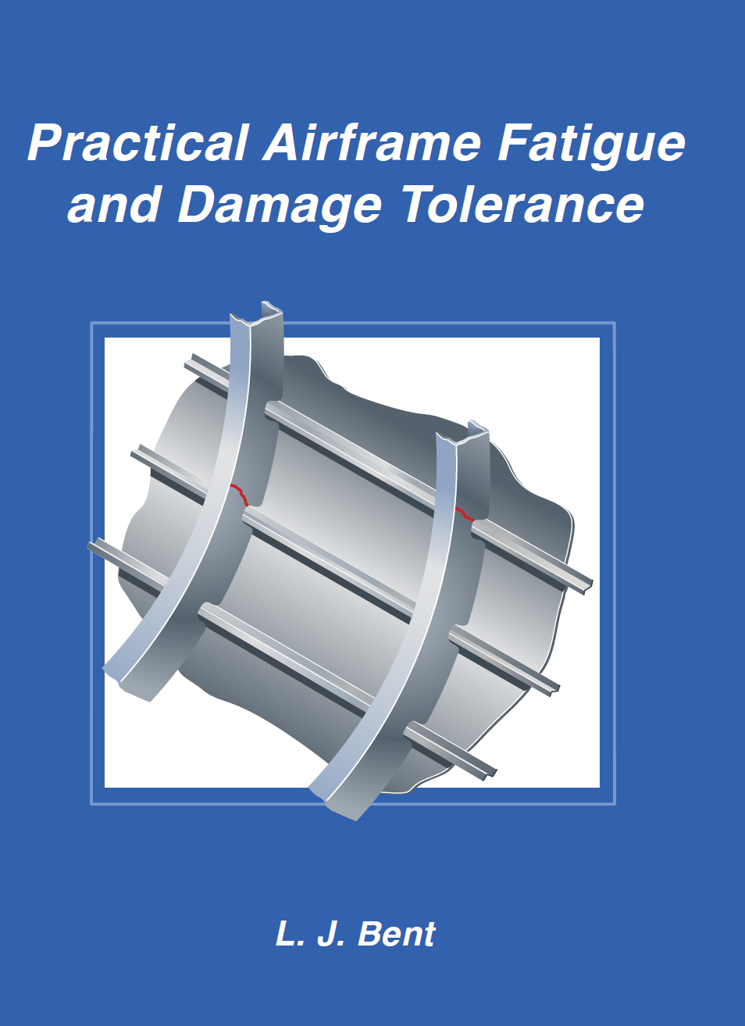

Suggested Readings
Reference 1
Reference 2
Reference 3

Slide 3

Scope
Safe-life design (developed in the early 60s)
Scope of this lecture.
The structure is assumed to be flaw free.
Is not adequate due to in-service damage and manufacturing defects.
Is based on uncertainty that crack will not initiate at some time during the aircraft life and these crack must be detected before the strength drops below a certain level.
Damage tolerant design (developed in the early 70s)
Formation of crack (nucleation) and monitoring its progression and growth up to the point of part rupture.
Is based on fracture mechanics, to size structure so that crack grows at a stable, slow rate and not achieve a size large enough to fail the structure before detection.
Determination of inspection intervals.
Requires understanding structural performance in the presence of damage.

Slide 4
Introduction
In this lecture, you will be provided with the following to enable you perform damage tolerant design based on the fracture mechanics theories:
Cracks are assumed to exist in the structure.
Fracture parameters like K and J are used to characterize stress and strain around the crack tip.
Griffiths fracture theory will be discussed.
Energy release rate will be presented.
Linear elastic stress intensity factors are introduced.
Paris law will be introduced.

Slide 5
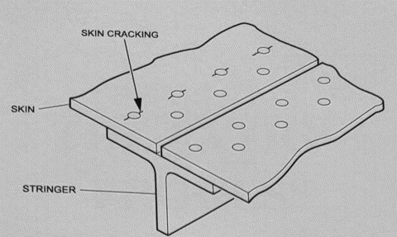
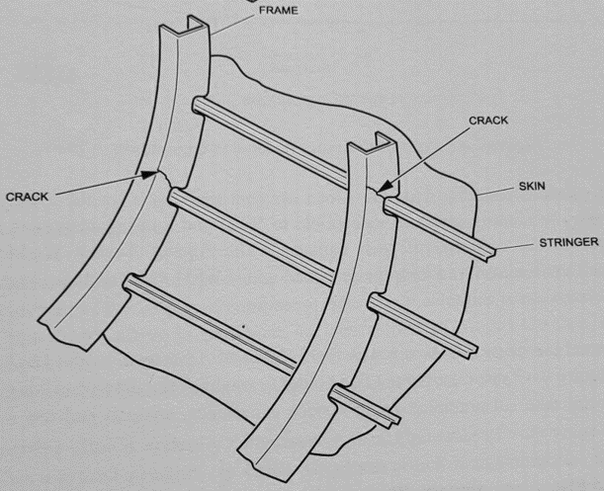
Some definitions
Multiple Site Damage (MSD)
Simultaneous cracking at multiple locations of a single load path, as a result of similar geometry, stress concentration, and stress level allowing fatigue damage.
Multiple Element Damage (MED)
Simultaneous cracking at multiple instances of an identical load path.
Widespread Fatigue Damage (WFD)
Combination of MSD and MED

Slide 6
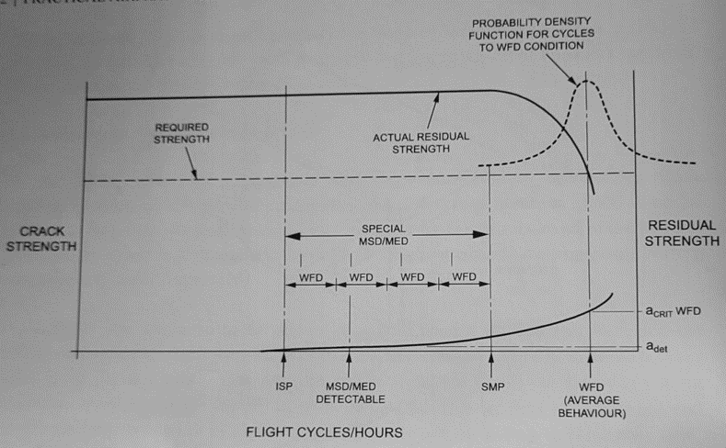
Damage tolerance
FAA requires manufacturers to identify structure susceptible to WFD and to adopt inspection programs appropriate for the detection of such damage
At SMP, the structure considered susceptible to WFD must be replaced or refurbished
The cost of carrying inspections and modifications may result to the retirement of the aircraft once they reach ISP
SMP is a point on lower tail of probability density function for cycles to WFD condition
A certain number of inspections required before Structure Modification Point (SMP)
Inspection start point to detect MSD and MED

Slide 7


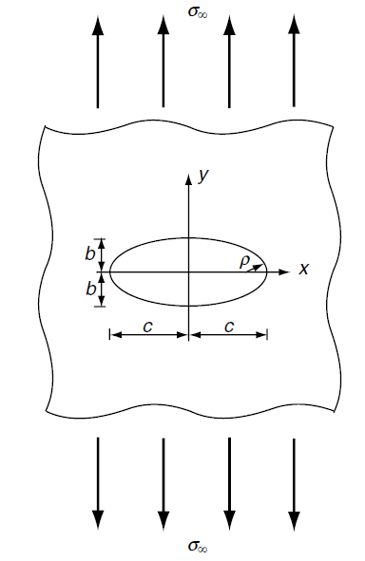



Elliptical hole (in infinite plate)
Stress at the hole edge:
Stress concentration factor:

Slide 8
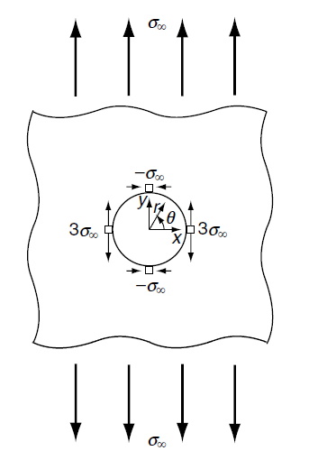
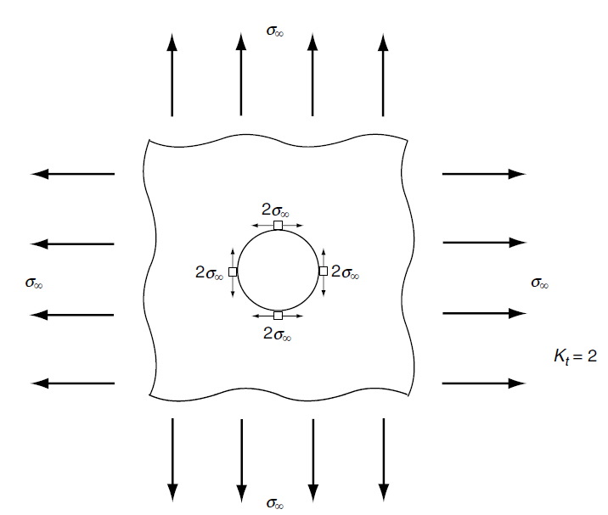
Circular hole (in infinite plate)

Slide 9
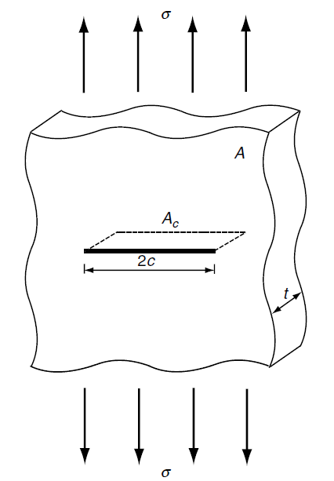
Griffith’s fracture theory (year 1921)
Centre through thickness crack of length 2c in a 2D plate under plane-stress loading condition and remote uniform tensile stress σ.
Fracture occurs when;
The decrease of the potential energy due to an increment of crack area = Surface energy of newly created crack surfaces

Slide 10




Griffith’s fracture theory (year 1921)
Potential energy of the plate where V is the plate volume and E is Young’s modulus;
The energy release rate per unit crack area where A_{c} = 2ct is the crack area;
Stress at fracture (σ_{f}) becomes;
Gamma is surface energy of newly created crack surface

Slide 11
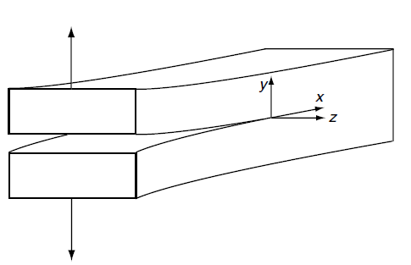
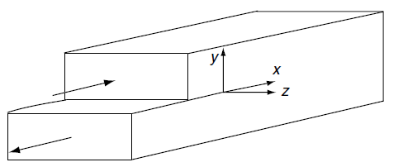
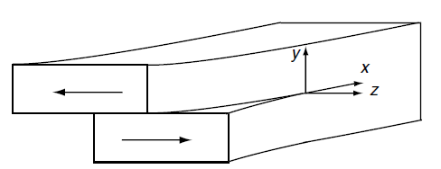
Three primary loading modes
Cracks progress in one of the
following three modes or combination
of the following:
Opening mode (mode I)
In-plane shear mode (mode II)
Out-of-plane shear mode (mode III)

Slide 12
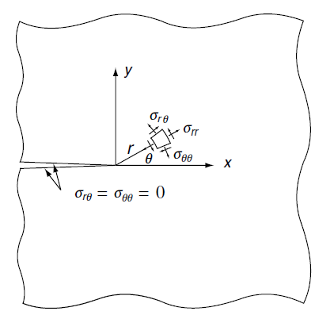



Crack tip field
Stress intensity factor for mode I:
Stress intensity factor for mode II:
Stress intensity factor for mode III:

Slide 13
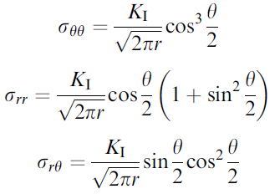
Crack tip field for mode I
Asymptotic stresses under mode I:

Slide 14
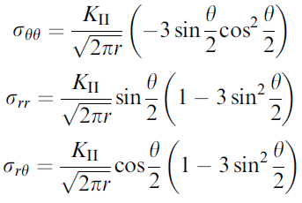
Crack tip field for mode II
Asymptotic stresses under mode II:

Slide 15
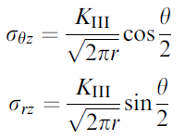
Crack tip field for mode III
Asymptotic stresses under mode III:

Slide 16
Stress Intensity Factor (SIF)
So far, we characterised stress field around a crack tip.
We have seen that the characterisation formulae are in terms of SIFs, i.e. K_{I}, K_{II} and K_{III}.
The question is that what are the values of K_{I}, K_{II} and K_{III}.
The units of SIF is MPa.m^{1/2} or ksi.in^{1/2}. This can be readily concluded from the formulation of previous slides.

Slide 17
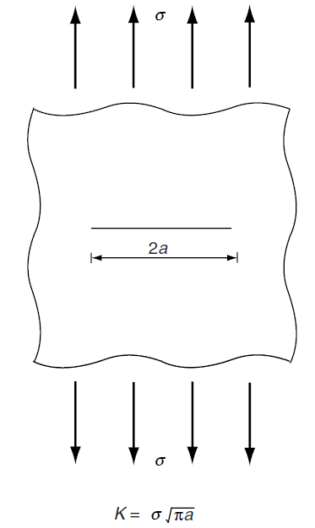
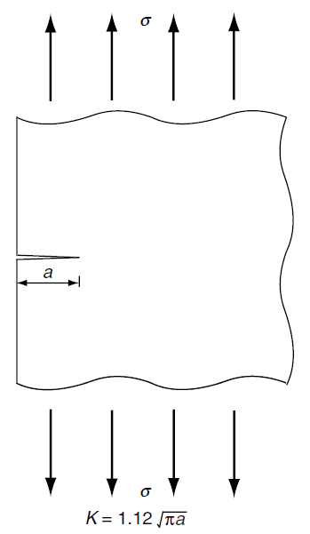
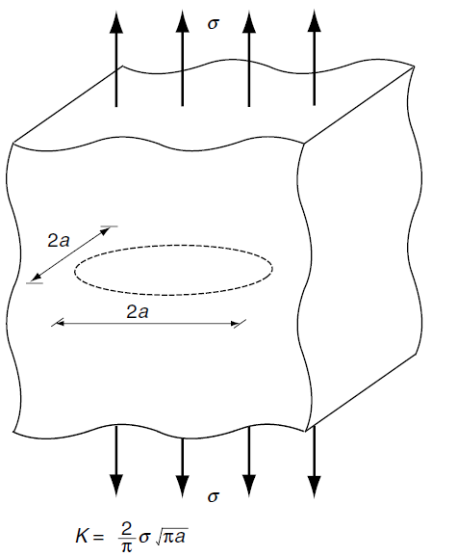
Stress intensity factor
Centre crack in 2D infinite solid under remote uniform tensile stress σ
Edge crack in 2D infinite solid under remote uniform tensile stress σ
Penny shaped crack in 3D infinite solid under remote uniform tensile stress σ

Slide 18
Notes
The SIF solutions for these three cracks have the same form except the proportionality constants or modification factors for different geometries and loading conditions.
SIF must be proportional to the magnitude of remote tensile stress σ.
SIF must be proportional to the square root of the only significant length dimension, which is crack length a.
For relatively simple loading and geometries, FEA and other numerical methods can be used to find proportionality constants.

Slide 19

SIF
The general form of SIF for centre-cracked panel or an edge-cracked panel of finite size:
Note that in some references, symbol β is used for modification factor. So the formula might be written alternatively as below:
Modification factor which is geometric function of the normalised crack length α. Also, α = a / b where b is the width of the panel.
The gross nominal stress. Either the nominal stress or maximum nominal bending stress

Slide 20
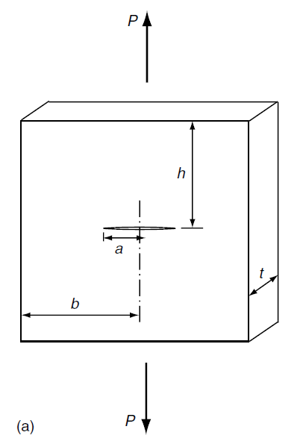
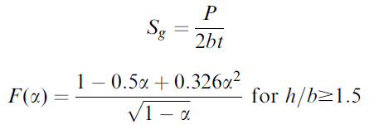
Proportionality factors
A centre cracked panel subject to tensile remote load.

Slide 21
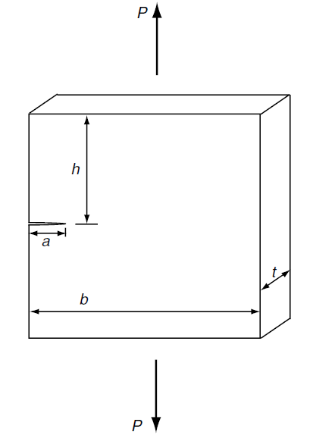
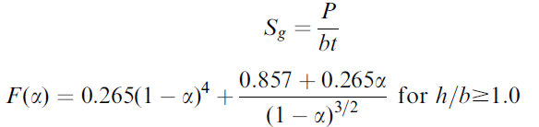
Proportionality factors
An edge cracked panel subject to tensile remote load.

Slide 22
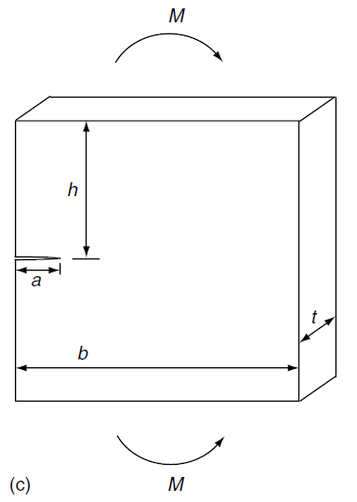
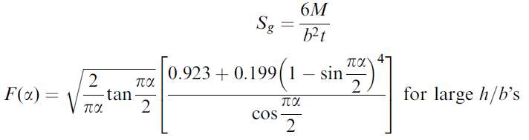
Proportionality factors
An edge cracked panel subject to bending.

Slide 23
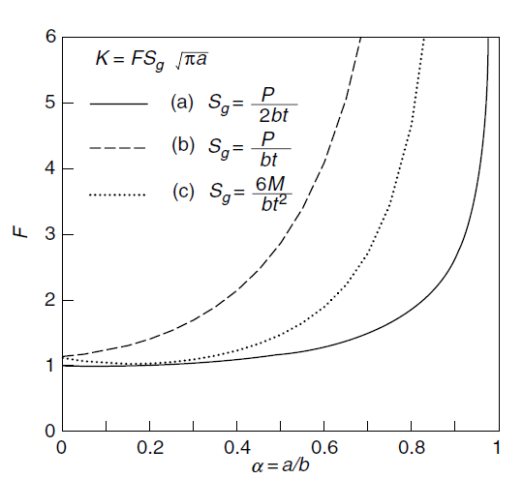
Plots of F(α)
For the last three crack problems.
As α increases so does the F(α).
For small α, the F(α) gets closer to unity (infinite plate condition).

Slide 24
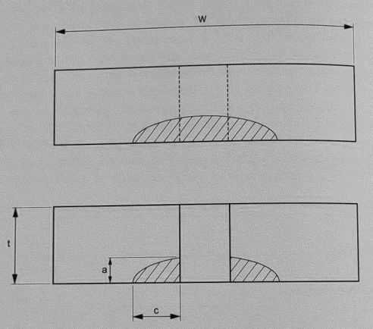

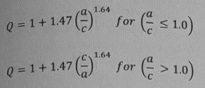

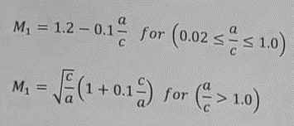
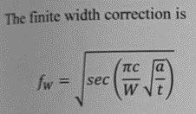

Proportionality factors
Due to complexity of these scenarios, companies normally have their own tool to calculate SIF accordingly. Airbus has its own program called ISAMI.
For small corner cracks at holes.

Slide 25
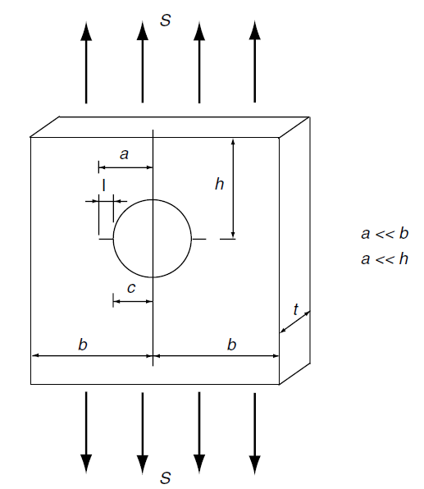





Proportionality factors
Small cracks of length l emanating from hole with radius c under remote uniform tensile stress.
When l << c then
When l is the same order as c then
Or alternatively

Slide 26
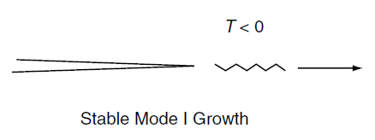
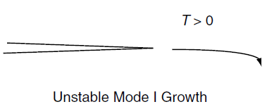


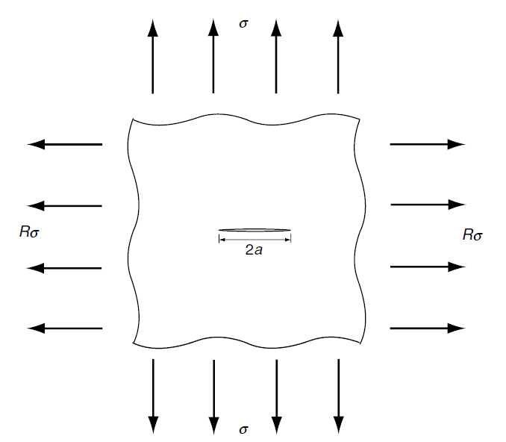
Note
So far, in all loading conditions we discussed about uniaxial loading.
The question arises as to what happens in the presence of bi-axial loading.
Uniaxial tension R = 0.
Equal bi-axial tension R = 1 and T = 0.
When R > 1 then T > 0 and when R < 1 then T < 0.
When T < 0, there should be stable mode I crack growth.
When T > 0 there should be unstable mode I crack growth.

Slide 27
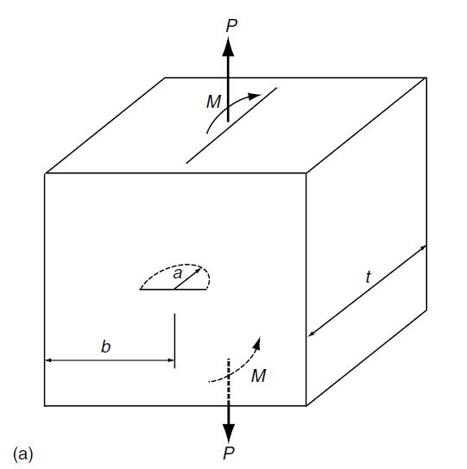
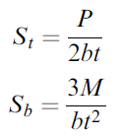

SIF for other crack types
A semi-circular surface crack in a rectangular bar under tension (subscript t) and bending (subscript b).

Slide 28
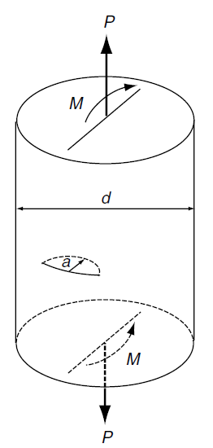
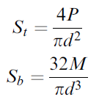

SIF for other crack types
A semi-circular surface crack in a circular bar under tension (subscript t) and bending (subscript b).

Slide 29
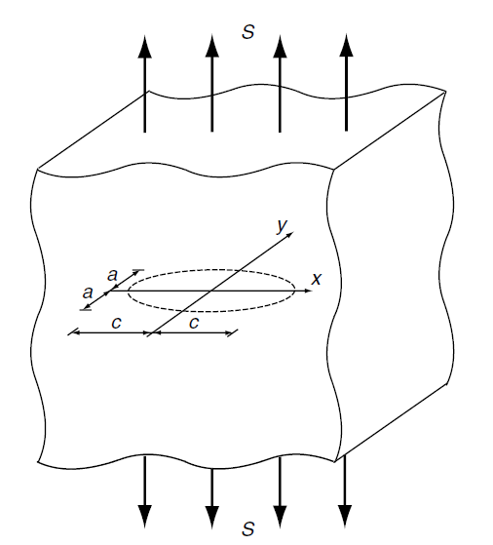
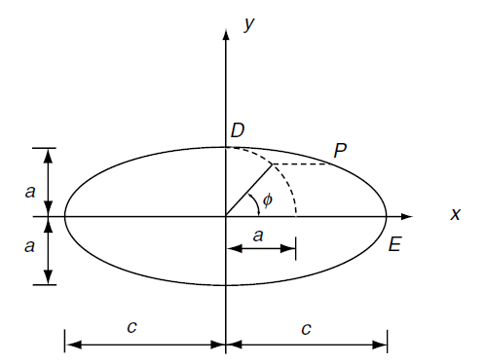


SIF for other crack types
An elliptical crack in an infinite solid under remote unform tensile stress S.
Maximum at D
Minimum at E

Slide 30
SIF for other crack types
For a semi-elliptical crack in an infinite solid under remote uniform tensile stress S, the following applies:
When a/c is small, maximum SIF occurs at D.
When a/c is close to unity, maximum SIF occurs at E.
The values of SIF are exactly the same as elliptical ones multiplied by free surface factor of 1.12.

Slide 31

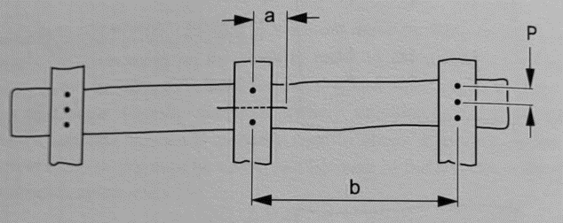
SIF for stiffened panels
Parameters to include:
Stiffener cross section area and centroid (A_{s})
Stiffener section modulus
Fastener flexibility
Fastener pitch (P)
Stiffener pitch (b)
Young’s modulus for the sheet (E) and the stiffener (E_{s})

Slide 32
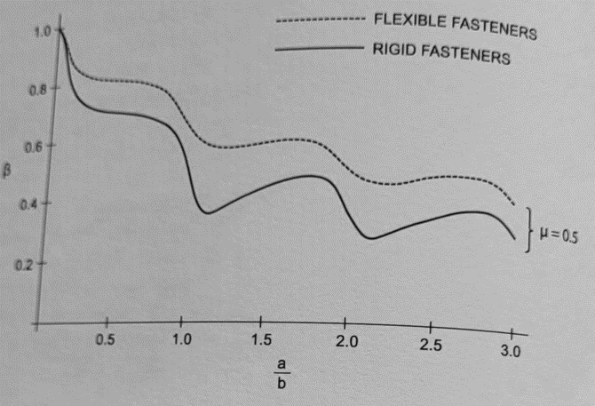
SIF for stiffened panels

Slide 33
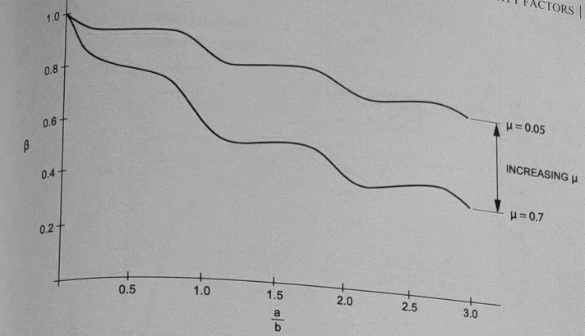
SIF for stiffened panels

Slide 34
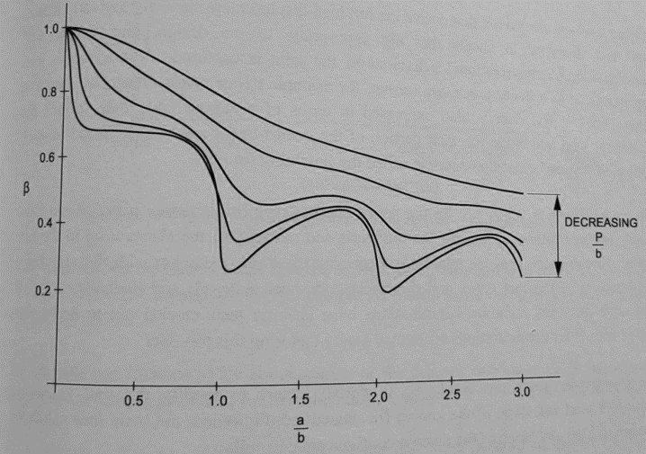
SIF for stiffened panels

Slide 35
Note
For complicated loading, decompose the loading into simple cases of previous slides and then add SIFs for each case to obtain total SIF of the complicated problem, i.e. superposition.

Slide 36
Fracture toughness

Slide 37
Fracture toughness
When the magnitude of the mode I stress intensity factor reaches a critical value (K_{Ic}), crack propagation initiates.
Its value depends on:
The material, Crack mode, Processing of the material, Temperature, Loading rate, The state of stress at the crack site (such as plane stress versus plane strain).
K_{Ic} is also called the fracture toughness.
The fracture toughness for plane strain is normally lower than that for plane stress.
For this reason, the term K_{Ic} is typically defined as the mode I, plane strain fracture toughness.
For engineering metals 20 ≤ K_{IC} ≤ 200 MPa.m^{1/2}.

Slide 38
Fracture toughness (at room temperature)
Material | K_{Ic} (MPa.m^{1/2}) | S_{y} (MPa)
Aluminium
2024 | 26 | 455
7075 | 24 | 495
7178 | 33 | 490
Titanium
Ti-6AL-4V | 115 | 910
Ti-6AL-4V | 55 | 1035
Steel
4340 | 99 | 860
4340 | 60 | 1515
52100 | 14 | 2070

Slide 39
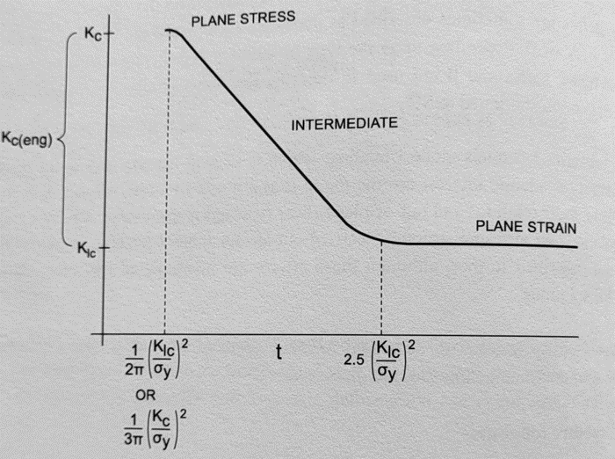
Important note
2124-T851 plate was tested to give L-T, T-L and S-L fracture toughness values, respectively, 42 ksi.in^{0.5}, 39 ksi.in^{0.5}, 31 ksi.in^{0.5}
The graph shows thickness dependence of fracture toughness.
The fracture toughness that is being used should be appropriate to the thickness of material being analysed.
For instance, if a 3 in. thick test piece is machined from 3 in. thick plate, cracked and pulled to failure, then it will have a much lower toughness than a 0.5 in. thick specimen machined from 3 in. plate.

Slide 40
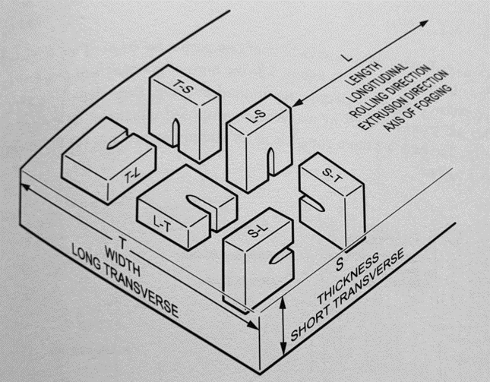
Important note
The orientation of the crack relative to the grain direction is very important with regard to the level of fracture toughness that can be achieved.
The first letter shows the direction of loading and the second letter shows direction of crack.
For example, S-T means load is applied in the short direction (S) whilst the crack is running in the transverse direction (T).

Slide 41
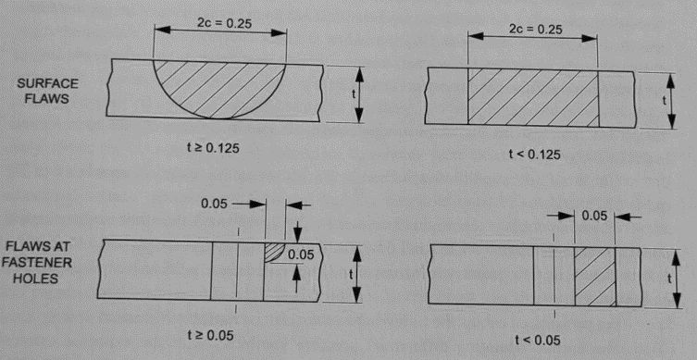
Important note
The assumed initial imperfections due to material and structure manufacturing
and processing operations (in inches). These flaws are assumed to grown
during service

Slide 42
Example 1
A steel ship deck plate is 30 mm thick and 12 m wide. It is loaded with a nominal uniaxial tensile stress of 50 MPa. It is operated below its ductile-to-brittle transition temperature with K_{Ic} equal to 28.3 MPa.m^{1/2}. If a 65-mm-long central transverse crack is present, estimate the tensile stress at which catastrophic failure will occur. Compare this stress with the yield strength of 240 MPa for this steel.

Slide 43
Solution
We need to find SIF for the geometry and the loading given.

Slide 44
Solution
The stress at which failure takes place can now be expressed as below:
The present stress of 50 MPa is below yield stress of 240 MPa. Not considering the fracture mechanics, the inexperienced engineer will consider the Safety Factor (SF) as 240 / 50 = 4.8 whereas the actual SF is 1.77.

Slide 45
Example 2
A plate of width 1.4 m and length 2.8 m is required to support a tensile force in the 2.8-m direction of 4.0 MN. Inspection procedures will detect only through-thickness edge cracks larger than 2.7 mm. The two Ti-6AL-4V alloys in Table below are being considered for this application, for which the safety factor must be 1.3 and minimum weight is important. Which alloy should be used?
Material | K_{Ic} (MPa.m^{1/2}) | S_{y} (MPa)
Titanium
Ti-6AL-4V | 115 | 910
Ti-6AL-4V | 55 | 1035

Slide 46
Solution
We need to find SIF but we do not have the nominal gross stress value or thickness of the plate.
For weaker alloy we have:
For stronger alloy we have:

Slide 47
Solution
What is the thickness that des not lead to crack growth?
Clearly this stress is above the yield point of weaker alloy.

Slide 48
Solution
542.9 MPa is less than yield stress (1035 MPa) of stronger alloy.
Therefore, this stress will be the criteria for thickness calc to avoid crack growth.
This example shows that the fracture toughness K_{Ic} limits the geometry when the stronger alloy is used, and so a thickness of 6.84 mm or larger is required. When the weaker alloy is used the geometry is limited by the yield strength, giving a thickness of only 4.08 mm or greater. Thus, the weaker alloy leads to a thinner and lighter weight choice since the failure modes differ.

Slide 49
Requirements of Linear Elastic Fracture Mechanics, i.e. LEFM
(beyond scope but essential to know)

Slide 50
Irwin’s model
For elastic–plastic materials, plastic yielding will occur at the crack tip to relax singular stresses.
Fracture behaviour is basically governed by the elastic stress field outside the crack-tip plastic zone under small-scale yielding conditions.
The plastic zone at the crack tip may alter the elastic stress field outside it.
To determine the plastic zone at the crack tip, Irwin presented a simple model assuming the material is elastic-perfectly plastic.
Let’s see what Irwin proposed in the subsequent slides.

Slide 51
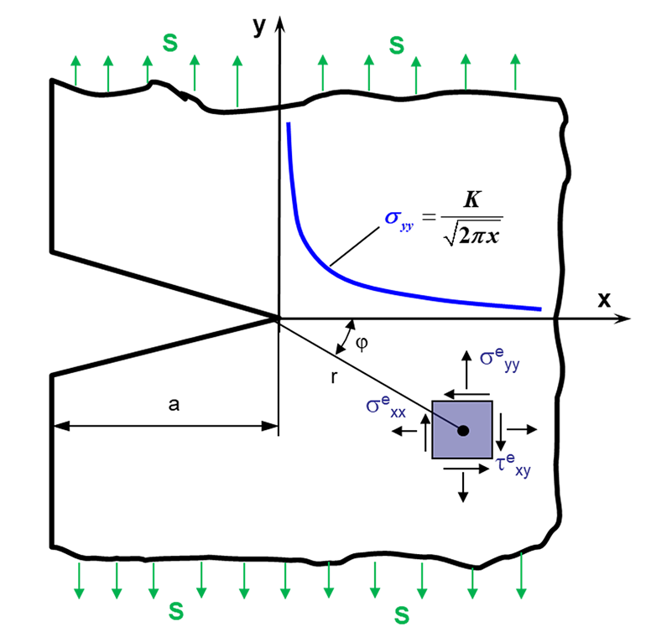
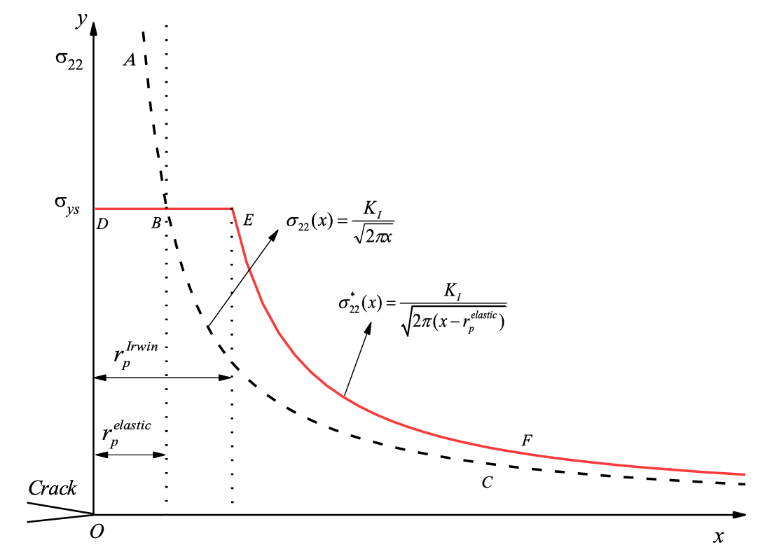
Irwin’s model
Tensile yield strength of material
Isotropic elastic material stress distribution
New stress distribution based on Irwin’s proposal
Plastic zone
For linear isotropic elastic material, elastic stress field ahead of a sharp crack is as above. But the question arises as how stress exceeds the yield strength?
For elastic-plastic materials, the area near the crack tip yields and plastic zone is formed after which the load must re-distribute. The red line becomes the stress distribution in front of the crack tip for elastic perfectly plastic material.

Slide 52
What is the point?
Given the limitation of assumption for linear elastic isotropic material, Irwin proposed his model.
This means that instead of considering the crack length a, we use crack length of (a_{eff} = a + r_{y}^{elastic}) regarded as effective crack length.
In other words, new crack length is extended to the centre of a circular plastic zone (blue circle of previous slide) and the stress distribution is shifted r_{y}^{elastic} distance with respect to the elastic case.
Based on Irwin, this should be the basis for calculation of SIF.
SIF calculated this way is always greater than SIF calculated by using a only as of previous slides.

Slide 53
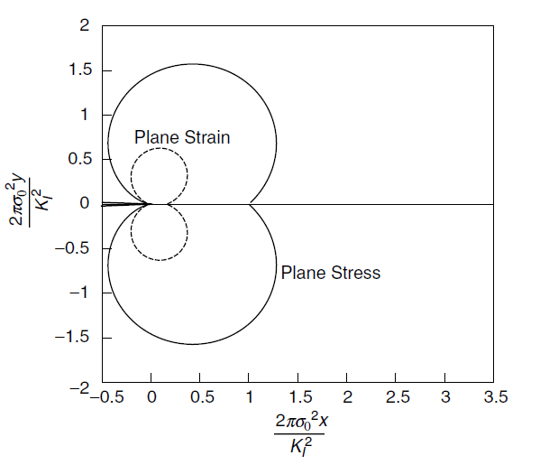
Size of plastic zone
crack
The most essential requirement is that the size of plastic zone near the crack tip must be much smaller than any relevant dimension in the structure.
Opposite graph shows estimation of the size of plastic zone for material with Poisson’s ratio of 0.3.
In Plane Strain loading, plastic zone size is smaller than that of Plane Stress.

Slide 54
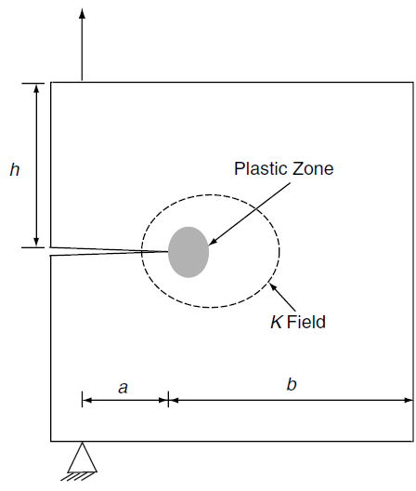


Size of plastic zone
The requirement of LEFM:
Plane strain:
Plane stress:
Tensile yield stress

Slide 55



Shape of plastic zone
Crack in plane strain condition
Remember that for T < 0 we need to have R < 1.
For T > 0 then we need to have R > 1.
For T = 0 then we need to have R = 1.
Crack in plane stress condition

Slide 56
Energy release rate under displacement controlled conditions
(beyond scope)

Slide 57





Energy release rate G
The area under load-displacement curve represents strain energy stored in cracked solid.
The potential energy of cracked solid is Φ.
General term
Plane Stress
For nonlinear elastic power law hardening material, G can be related to path independent J integral.

Slide 58
Fatigue crack growth based on Linear Elastic Fracture Mechanics

Slide 59





Crack detection methods
Visual inspection
X-ray
Ultrasound
Electric potential drop method

Slide 60

Extended life
Once the crack is detected by methods mentioned in the previous slide, fracture mechanic methods can be used to determine the extended life of a structure or a component.
The damage tolerant approach used in the aerospace industry is based on the worst case analysis with assumption that the largest cracks missed by each inspection exist in the structures and components.
Critical crack length
Detectable crack length
Extended life is
N_{cd} = N_{c}-N_{d}
Initial crack length
Number of cycles when the crack is detected
Number of cycles when the crack reaches critical length

Slide 61







Crack growth behaviour
Crack growth rate
Almost linear (Paris law)
Significant crack growth when K_{max}=K_{c}
Based on experimental results
Stress intensity factor rate
Spacing between atoms
Threshold range below which no fatigue crack growth happens

Slide 62


Paris law (1961-1963)
We intend to keep crack in region II (approximately linear portion) as opposed to I and III. Therefore, Paris law can be used as below:
C and m are material constants.

Slide 63
Note
We said that load ratio (R) is quite important as it effects the SIF and hence SIF range (ΔK).
How do we take this into account?
How do we take critical stress intensity factor into account?

Slide 64
R effect
Walker (1970) showed that:
is a constant between 0.4 and 0.9.

Slide 65


R effect
Forman (1967) showed that:
K_{c} is critical stress intensity factor.

Slide 66
Important note
When the crack-tip plastic zone becomes large compared with the relevant physical length of the cracked solid, linear elastic fracture mechanics should not be used.
In these scenarios, instead, use crack-tip opening displacement or the J-integral to model the fatigue crack growth.
FEA is a good approach to use J-integral method.

Slide 67








Life estimation
Lets keep ΔS constant:
Initial crack length
Final crack length
Number of cycles for crack propagation from initial crack to final crack length

Slide 68
Note
From LEFM viewpoint, a structure of interest contains initial defects or cracks.
A dominant crack with an initial crack length can be found to correlate the fatigue life of the structure under cyclic loading condition.
From fatigue stress-life and/or strain-life methods perspective, the fatigue initiation life for the material near the notches or stress raisers in the structure can be estimated using experimental S-N curves.
The fatigue life due to crack propagation can be estimated by LEFM methods based on Paris law.
The total fatigue life of the structure is the combination of the initiation life and propagation life.

Slide 69
Example 3
Consider a very large plate with a small centre crack. The initial total crack length 2a is 20 mm. The plate is subjected to repeated remote stress cycles from σ_{min} = 0 MPa to σ_{max} = 75 MPa. The initial crack grows as the stress cycles are applied. The critical stress intensity factor K, for fracture initiation for the plate is 25 MPa.m^{0.5}. The material is assumed to have a very high yield stress such that the plastic zone size is small compared to the crack size under the applied stresses. Assume that the Paris law will be applicable to the plate material to characterize the fatigue crack growth. C = 1 x l0 ⁻¹⁰ and m = 3. The value of C is obtained with the units of MPa.m^{0.5} for ΔK and mm/cycle for da/dN.
1. Determine the final half crack length a_{f} at fracture initiation.
2. Determine the number of cycles before the fracture initiation of the plate.

Slide 70




Solution
Fracture takes place when the following occurs at the final half crack length under maximum applied stress (σ_{max} = 75 MPa):
Initial crack length is:

Slide 71

Solution
The number of cycles required to grow the crack from initial length to the final length under the given stress range is obtained as follows:
71

Slide 72

Example 4
The bar shown is subjected to a repeated moment 0 ≤ M ≤ 1200 lbf.in. The bar is AISI 4430 steel with S_{ut} = 185 kpsi, S_{y} = 170 kpsi, and K _{Ic} = 73 kpsi√in. Material tests on various specimens of this material with identical heat treatment indicate worst-case constants of C = 3.8(10⁻¹¹)(in/cycle)/(kpsi√in)^{m} and m = 3.0. As shown, a nick of size 0.004 in. has been discovered on the bottom of the bar. Estimate the number of cycles of life remaining.

Slide 73


Solution

Slide 74


Solution

Slide 75

Example 5
Determine the Paris law coefficient and exponent for the following material data, by using the crack growth rates found at ΔK=2 ksi.in^{0.5} and ΔK=20 ksi.in^{0.5}.

Slide 76
Solution

Slide 77
Example 6
Carry out a tubular crack growth calculation for an edge crack growing from a=0.10 in. to a=2.5 in. for a geometry in which F(α)=1.12+(a/W)² where W=6 in. the stress range is 20 ksi and Paris law crack growth is assumed, where da/dN=6.17x10⁻¹⁰ΔK³. it is worth noting that in some references F(α) is denoted as β.

Slide 78
Solution
First carry out a tubular calculation, splitting the crack growth into eight equal increments of 0.3 in.
This is a very course increment, and if the crack growth program required a constant increment, a much smaller value would usually be used.

Slide 79





Solution
Average crack length over the increment
Calculated for average crack length using $1.12+{\left(a_{avg}/W\right)}^{2}$
Calculated for average crack length using $β∆σ\sqrt{πa_{avg}}$
Calculated using $da/dN=6.17×{10}^{−10}{∆K}^{3}$
Calculated by ${\left(da/dN\right)}^{−1}×da$
For example, $0.3×\frac{1}{0.0001526}=1966$

Slide 80

Solution
We could use the direct integration method which gives a more precise result.
In the tubular format if we increased the crack intervals from 0.3 in. to let’s say 0.1 in. we would have got closer answer to the opposite figure of direct integration.

Slide 81

Solution
The MathCAD code will give you the same answer.

