Slide 1
Aerostructures Design of Mechanically Fastened Joints
By
Dr. Mahdi Damghani
2022-2023

Slide 2

Suggested Readings
By
Niu
Reference 1
Reference 2
Chapter 11 of Ref [1] and Chapter 9 of Ref [2]

Slide 3
Topics
Familiarisation with joining structures
Familiarisation with mechanically fastened joints
Familiarisation with sizing of bolted joints
Familiarisation with some design rules of bolted joints

Slide 4
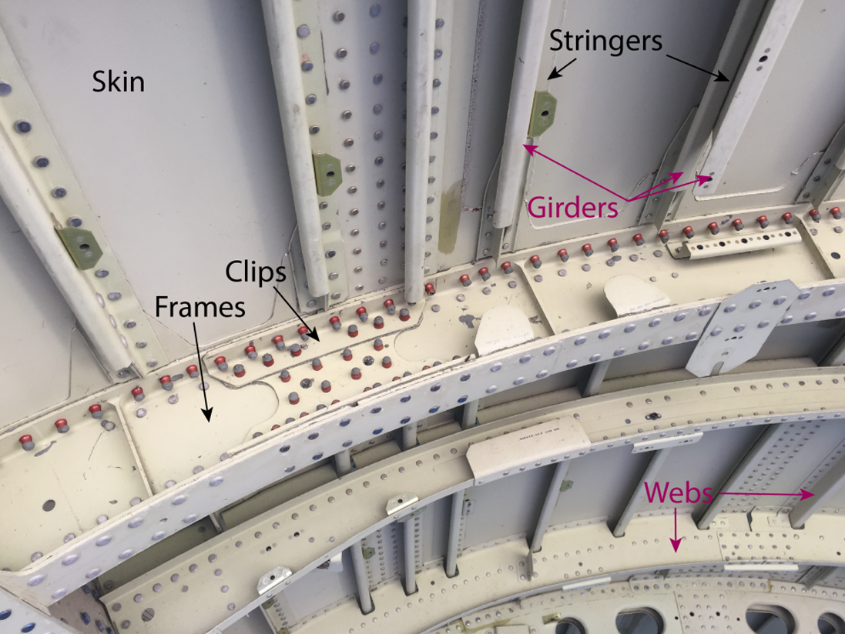
Structural joints
Joints are the most common source of failure in airframes
The affect is not only on static strength but to great extent on fatigue life

Slide 5
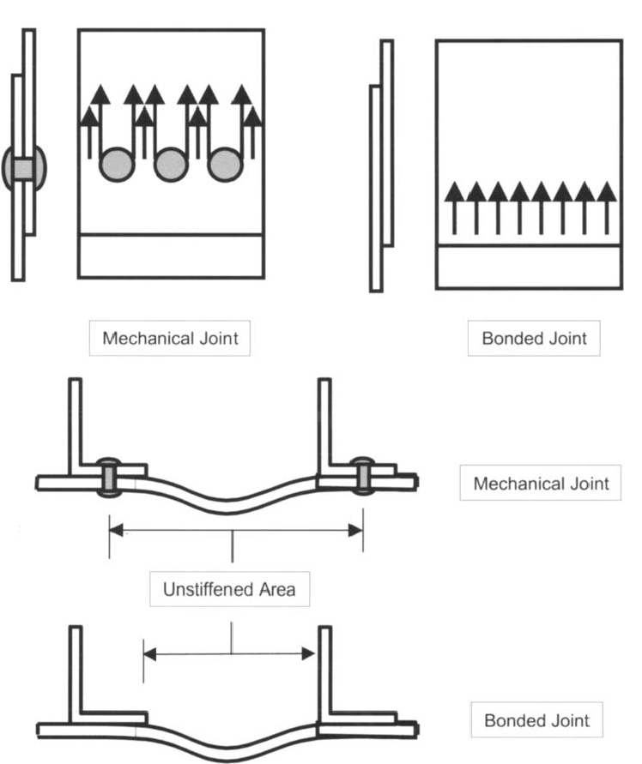
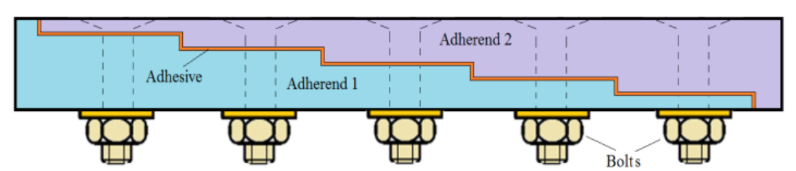
Joints
Mechanically fastened joints (scope of this lecture)
Bonded joints (beyond scope of this lecture)
Hybrid of the above two (beyond scope of this lecture)

Slide 6
Advantages of mechanically fastened joints
Low production cost
Utilization of conventional metal-working tools and techniques,
Possibility of the riveting process automation,
Ease of inspection
Possibility of their repeated assembling and disassembling for the fabrication replacement or repair
Good hole filling properties of the rivets
A long-standing experience of the industry with riveted joints

Slide 7
Disadvantages of mechanically fastened joints
A fatigue critical element in metallic airframe construction;
The rivet installation process imparts elevated stress in the vicinity of the holes.
The rivet installation process imparts residual stresses in the vicinity of the holes.
frictional forces between the mating sheets induced due to the clamp-up which contribute to fretting damage at the faying surface.

Slide 8
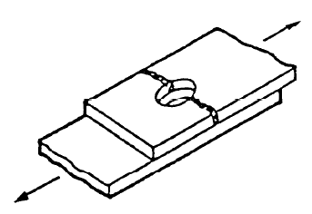
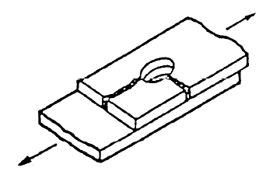
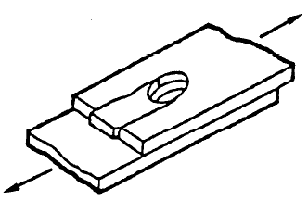
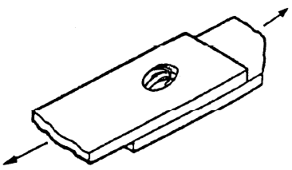
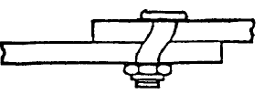
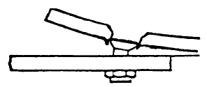
Failure modes of mechanically fastened joints
Tension failure
Tension cleavage failure
Shear-out failure
Bearing failure
Fastener shear-off
Fastener pull-through

Slide 9
Common types of joint configurations (Single lap shear joint)
d
F
F
t
Interface load
P = F
F

Slide 10
Common types of joint configurations (Double lap shear joint)
0.5F
F
0.5F
P = 0.5F
Interface load
F
P = 0.5F

Slide 11
Common types of joint configurations (Butt joint)
F
F
F
P = F
Interface load

Slide 12
Common types of joint configurations (L or T joint-1 bolt scenario)
F
F
Prying force can be obtained by conservatively approximating a triangular load distribution and taking moment about the axis of the bolt (see next slide for illustration).
Prying effect
P = F * C_{pr}

Slide 13
Illustration of prying force calculation
F
This approach is conservative and approximate.
c
e
2/3*(e-0.5d)
P_{pr-eq}
P_{pr}
P
13

Slide 14
Common types of joint configurations (L or T joint-more than 1 bolt scenario)
F
F
Assuming P₂ = 0 is a conservative assumption.
Prying effect
P₁ = F * C_{pr}
P₂ = 0

Slide 15
Common types of joint configurations (L or T joint-more than 1 bolt scenario)
F
Some companies use the following C_{pr} which is very close to the approximate value given in the previous two slides:
c
e
t
d
Prying effect
P₁ = F * C_{pr}
P₂ = 0

Slide 16
Some General Design Rules

Slide 17
Design rules 1
d
Pan head bolts
For especial circumstances:
Edge distance e
Spacing s
Countersunk
holes
For fatigue critical locations:
h
t
For other locations:
Countersunk connections are used for flushed aerodynamic surfaces.
Notes:
Edge distances larger than two times the hole diameter are recommended, because small edge distances tend to reduce the bearing yielding and ultimately stress (Niu,1989; MMPDS, 2012) and decrease the fatigue life (Niu, 1999).
Besides static failure because of limit loads, the most critical problem observed in metallic joints is failure because of fatigue. When the joint is subjected to cyclic loading during long periods, small cracks may nucleate from hole edges and propagate on the way to the adjacent holes. When compared to static failure, damage because of fatigue presents a larger variability and is influenced by other aspects like hole finishing, interference and plate surface treatments.

Slide 18
Design rules 2
No threads in bearing (Good practice)
Threads in bearing (Avoid)

Slide 19
Structural Integrity Assessment Consideration

Slide 20
Structural integrity assessment 1
The joint must pass all failure modes mentioned in previous slides (Let’s see this in an example).
It is of paramount importance that the efficiency of the joint will be equal to or greater than that of the parent structure.
One side of the joint should not be designed for maximum efficiency at the expense of weight and fabrication cost penalty on the other.
The joint should be located at support structures such as stringers, stiffeners, bulkheads, etc to improve joint efficiency (see next slides for some real examples).
We use average stresses as opposed to real stress distribution for integrity checks (see next slides for illustration).

Slide 21
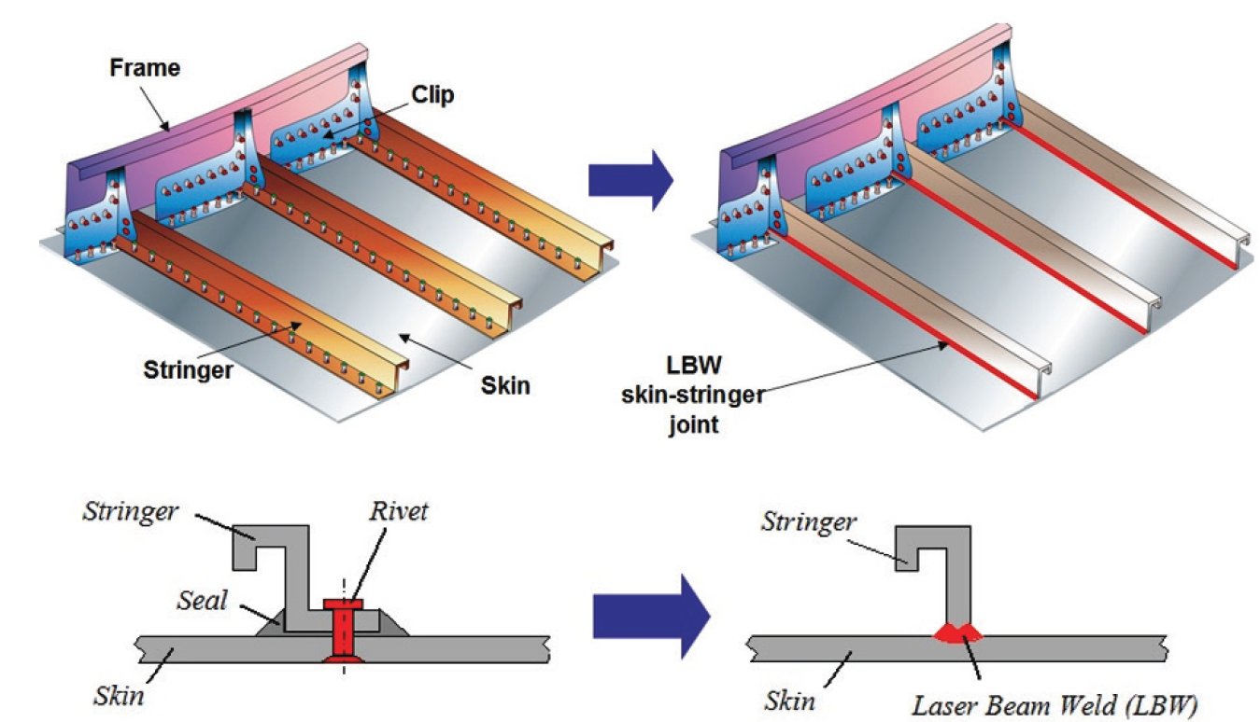
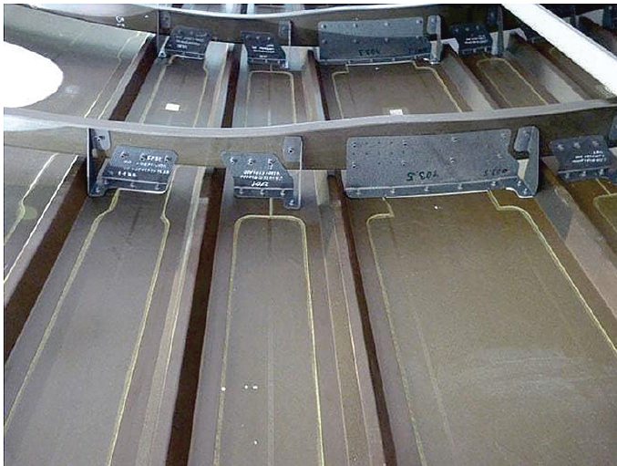
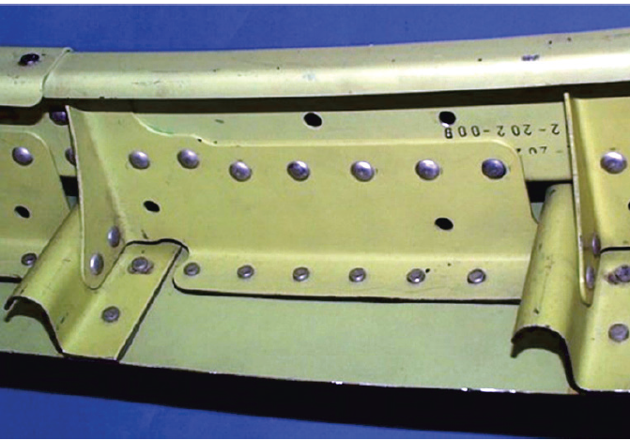
Structural integrity assessment 2

Slide 22
Structural integrity assessment 3
Shear-out planes
Bearing plane
Net-tension plane
F
F
F

Slide 23
Some terminologies and load path for integrity assessment of joints
The load that passes across the members, usually named the bypass load.
The load that is effectively transferred from one member to the other through the fasteners, that is known as the bearing load.
Bypass load
Bypass load
Bypass load
Bypass load
0
0.35F
0.65F
F
F
F
F
0.65F
0.35F
0
0.35F
0.35F/dt
0.3F
0.3F/dt
0.35F
0.35F/dt
Fastener load:
Fastener bearing
stress:

Slide 24
Fastener flexibility for integrity assessment of joints
Infinitely stiff fasteners:
F
F
Fastener load:
0.5F
0
0.5F
Infinitely flexible fasteners:
F
F
Fastener load:
0.33F
0.33F
0.33F
Actual fasteners:
F
F
Fastener load:
0.35F
0.3F
0.35F
Notes:
The load distribution between the fasteners in the joint has a large impact on factors that affect the strength and fatigue life of the joint, such as bearing pressure and stress concentrations, and is therefore of interest when designing and sizing such a structure.
Fastener flexibility is a property of interest when calculating the load distribution in a joint. It is a measure of the fastener's influence on the flexibility of the joint, and has a large impact on load distribution

Slide 25
Calculation of fastener flexibility
Available methods are
Douglas
Boeing
Grumman
Huth (Airbus preferred method)
Tate and Rosenfeld …

Slide 26
Calculation of fastener flexibility-Huth
Flexibility = 1/stiffness or mathematically C = 1/K
E₁:Young’s modulus of plate 1, t₁: Thickness of plate 1
E_{f}
E₁
F
E₂:Young’s modulus of plate 2, t₂: Thickness of plate 2
F
E₂
E_{f} is Young’s modulus of fastener, d: Fastener shank diameter
Fastener deformation:
Single shear joint n=1
Double shear joint n=2
Bolted metallic joint a=2/3, b=3.0
Riveted metallic joint a=2/5, b=2.2
Bolted composite joint a=2/3, b=4.2
Bearing deformation:

Slide 27
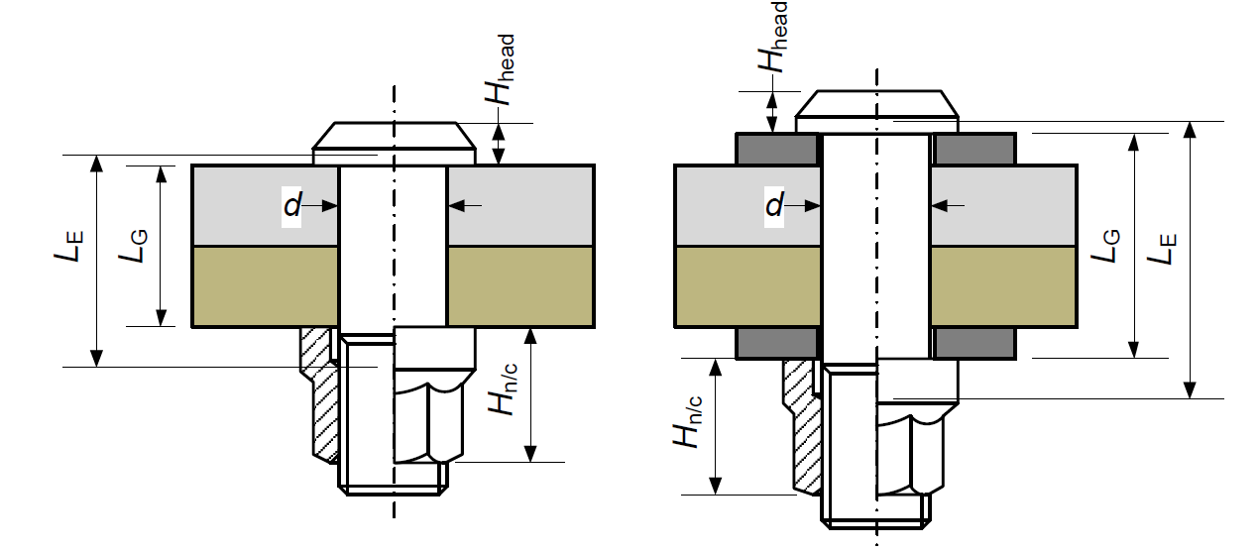
Calculation of fastener axial stiffness
Notes:
N: nut
C: collar

Slide 28
Finite Element Idealisation

Slide 29
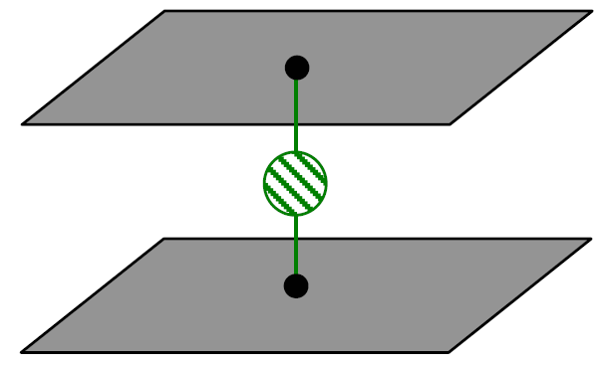
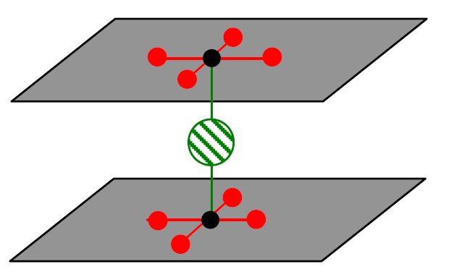
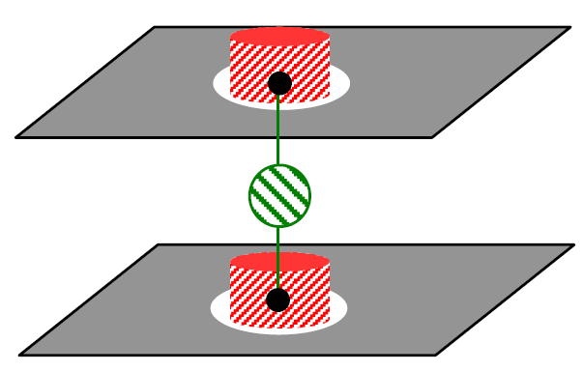
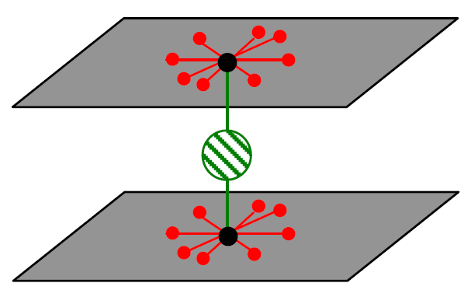
Idealisation on FEM
Rigid connections (RBE2)
Spring element (CBUSH) with axial and shear stiffness calculated as of previous slides
Hole model:
Advantage: Better contact representation, different results for tension and compression loading expected.
Disadvantage: Higher level of modelling is required which results to increased calculation
time. In addition, the magnitude of the extracted loads may be affect by the SCF around the hole. This leads to ‘double counting’ the hole influence, since in the filled hole module the SCF is also considered.
1 point model:
Advantage: Reduced time of modelling.
Disadvantage: Model is simplified with the possibility of stress concentration influence due to FEM singularity.
4/8 point model:
Advantage: Better stress distribution around the diameter, which represents the fastener.
Disadvantage: Meshing is more complicated (depending on the bolt diameter) and time
consuming (TCPU).

Slide 30
Example 1
Determine the load capacity of the single lap shear joint of next slide. Assume that sections are thin so effects of load eccentricity can be ignored. The plates are 1.5 mm thick and 25 mm wide made of aluminium 2024-T3. The diameter of fastener is 4 mm. the shear off strength of fastener is 3620 N (2024-T31).
2024-T3 tensile strength = 483 MPa
2024-T3 yield strength = 345 MPa
2024-T3 shear strength = 283 MPa
2024-T3 yield bearing strength = 524 MPa
2024-T3 ultimate bearing strength = 855 MPa
2024-T3 Poisson’s ratio = 0.33
2024-T3 Young’s modulus of elasticity = 73.1 GPa
2024-T3 shear modulus of elasticity = 28 GPa

Slide 31
Example 1
F
25 mm
F
10 mm
1.5 mm
F
F
1.5 mm

Slide 32
Solution of example 1
Tension failure:
F
25 mm
F
We are using yield strength as opposed to ultimate strength. This is because after yield, plasticity takes place (particularly at the edge of the hole) then load re-distribution occurs. This is beyond the scope of the lecture.

Slide 33
Solution of example 1
Tension cleavage failure:
0.5(w-d)
e = 10
P₁
F
w = 25
F
P₂
P₁ is the force in tension section and P₂ is the shear force in the shear-out section.

Slide 34
Solution of example 1
Shear out failure:
e = 10 mm
F
25 mm
F

Slide 35
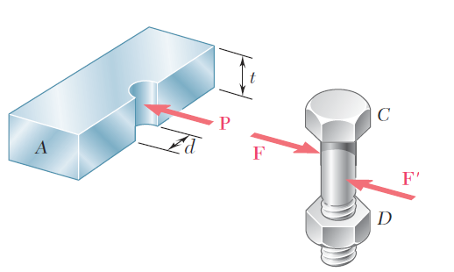
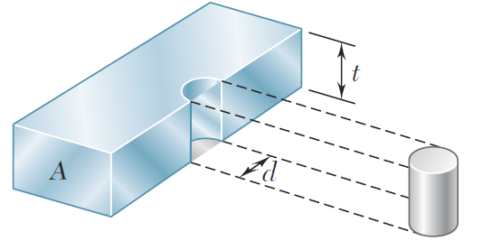
Solution of tutorial 1
Bearing failure:
We are using yield bearing strength (limit load of an aircraft). This is because after yield, plasticity takes place and this is local to the hole. Often when this leads to small loads, we do improve the load by accounting for plasticity. This will help design structures that are not prohibitively heavy. So, for aircraft ultimate load then we will use 855MPa as the ultimate bearing stress not 524MPa of yield bearing stress.

Slide 36
Important note for bearing stress at joints
It is desirable to have joints critical at bearing than shear to achieve the following mechanism particularly at extremely high and short flight manoeuvres loading conditions.
F
F
maximum ultimate bearing allowable
As the external force F increases, extreme bolts will yield and stay at a maximum force called ultimate bearing allowable (purple points). Then the loads of extreme bolts redistribute to internal bolts and they pick up more load. When all the bolts reach maximum force (purple line) the joint fails.
Ultimate load
Fastener load
Limit load

Slide 37
Solution of example 1
Fastener shear-off failure:
P
F
1.5 mm

Slide 38
Solution of example 1
Since we assumed load eccentricity is negligible, the fastener works only in shear and this check is not required.
The joint capacity will be the minimum of all forces of failure modes calculated, i.e. 3.144 kN associated to bearing analysis.

Slide 39
Solution of example 1
P’
At bolt in rigid metallic fitting in T config and CFRP with symmetric loading:
Pull-through failure:
P
F
At bolt in rigid metallic fitting in L config:
t
D
Depending on the company (Boeing, Aribus, Bombardier, Piaggio, etc), this formula may have some coefficients associated to them such as environmental effects, statistical knockdown factors. However, the core formulation is as above. It is clear that pull-through takes place if there is axial load in the bolt. This scenario is most predominant in T or L joints. For single lap, double lap and butt joints, the pull through can be ignored. For such joints (to take into account effect of load eccentricity) the best practice is the use of Finite Element Analysis to obtain axial and shear forces in the bolts. Then the joint integrity assessment is performed via excel spreadsheet using hand calculation as above. This is the common practice in aerospace industry.

Slide 40
Secondary Bending Moment
(beyond the scope and for information only)

Slide 41
Effects of secondary bending moment and load eccentricity
This is beyond the scope of the lecture.
The subsequent slides show a simplified approach based on Euler-Bernoulli beam theory which requires solving the governing differential equations of the joint.

Slide 42
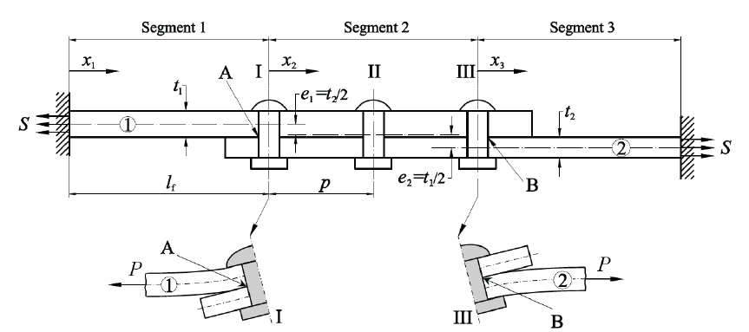


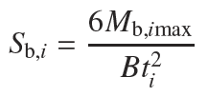

Load eccentricity and secondary bending moment
Maximum total nominal stresses that occur at A and B:
The nominal stresses due to the secondary bending can equal or even exceed the applied stresses. Fractographic investigations of riveted joints indicate that fatigue crack nucleation occurs at the sites of maximum bending stresses.
Notes:
See “MODELLING THE SECONDARY BENDING IN RIVETED JOINTS WITH ECCENTRICITIES” by MAŁGORZATA SKORUPA & ADAM KORBEL

Slide 43



Load eccentricity and secondary bending moment
Neutral axis of segment 1
Neutral axis of segment 2
Neutral axis of segment 3
Simplified approach: In order to derive the bending moment at any site of a joint with eccentricities, the out of plane deformations of the sheets must be known (Euler-Bernoulli). Concepts which enable to compute these deformations, represented by deflections of the joint neutral axis.
The sheets are assumed to act as a single integral beam, the flexural rigidity of which corresponds to the combined thickness of the sheets.
Plane stress
Plane strain
Notes:
See “MODELLING THE SECONDARY BENDING IN RIVETED JOINTS WITH ECCENTRICITIES” by MAŁGORZATA SKORUPA & ADAM KORBEL

Slide 44
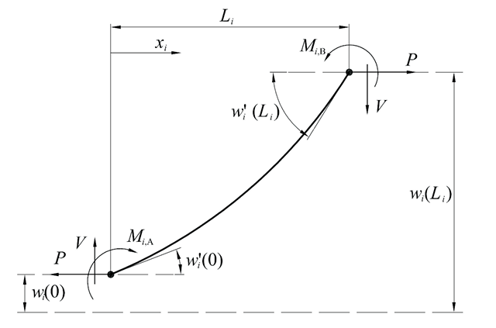

Load eccentricity and secondary bending moment
In the case of hinge clamping:
Notes:
See “MODELLING THE SECONDARY BENDING IN RIVETED JOINTS WITH ECCENTRICITIES” by MAŁGORZATA SKORUPA & ADAM KORBEL

Slide 45
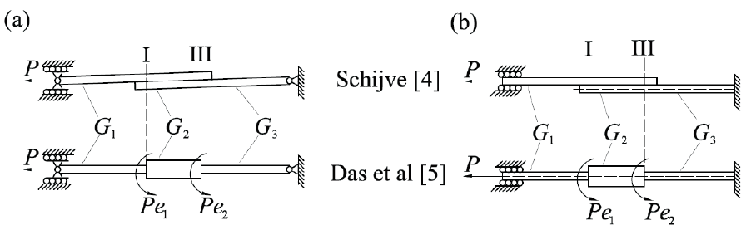
Modelling the eccentricities for the lap joint (a) hinged and (b) rigid clamping of the sheet ends
In the case of hinged clampings of the sheet ends, the fixing moments M_{1A} and M_{n, B} and the reaction V equal zero.

Slide 46
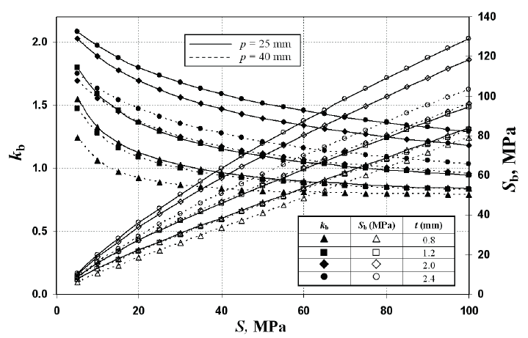
Why for single lap & double lap shear joints in aerospace applications, the secondary bending moments may be often ignored?
At service loads, due to combination of both high membrane stresses (S) and thin sections, k_{b} tends to hover around unity.
Note that K_{b} and S_{b} are nonlinear functions of load (S).
K_{b} is more sever at lower applied stress (S).
Increasing rivet spacing reduces secondary bending.
Effect of the applied stress level (S), sheet thickness (t) and the rivet row pitch (p) on the bending factor (k_{b}) and the bending stresses (S_{b}) at the critical rivet rows for the lap joint

Slide 47
Tutorial Questions & Their Solutions

Slide 48
Tutorial 1
Determine the load capacity of the single lap shear joint of next slide. Assume that sections are thin so effects of load eccentricity can be ignored. The plates have different thickness and 25 mm wide made of aluminium 2024-T3. The diameter of fastener is 4 mm. the shear off strength of fastener is 3620 N (2024-T31).
2024-T3 tensile strength = 483 MPa
2024-T3 yield strength = 345 MPa
2024-T3 shear strength = 283 MPa
2024-T3 yield bearing strength = 524 MPa
2024-T3 ultimate bearing strength = 855 MPa
2024-T3 Poisson’s ratio = 0.33
2024-T3 Young’s modulus of elasticity = 73.1 GPa
2024-T3 shear modulus of elasticity = 28 GPa

Slide 49
Tutorial 1
F
25 mm
F
10 mm
1 mm
F
F
1.5 mm

Slide 50
Solution of tutorial 1
Tension failure:
F
25 mm
F

Slide 51
Solution of tutorial 1
Tension cleavage failure:
0.5(w-d)
e = 10
P₁
F
w = 25
F
P₂
P₁ is the force in tension section and P₂ is the shear force in the shear-out section.

Slide 52
Solution of tutorial 1
Shear out failure:
e = 10 mm
F
25 mm
F

Slide 53
Solution of tutorial 1
Bearing failure:

Slide 54
Solution of tutorial 1
Fastener shear-off failure:
P
F
1.5 mm
P
F
1.0 mm

Slide 55
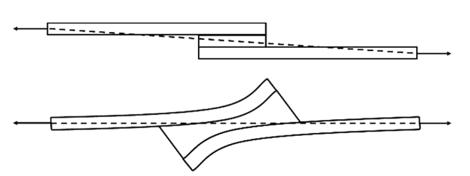
Tutorial 2
As a design engineer, propose methods and approaches to reduce joint secondary moments.

Slide 56
Solution of tutorial 2
Preferably use double lap shear joints instead of single lap shear joint.
Enlarge the joint overlap area by increasing the number of rows and distance between each row.
Use staggered joints leading to smaller k_{b}.

Slide 57
Tutorial 3
Determine the load capacity of the L joint of next slide. Assume that sections are thin so effects of load eccentricity can be ignored. The plates have different thickness and 25 mm wide made of aluminium 2024-T3. The diameter of fastener is 4 mm. The shear off strength of fastener is 3620 N (2024-T31) - Consider ultimate loading scenario.
2024-T3 tensile strength = 483 MPa
2024-T3 yield strength = 345 MPa
2024-T3 shear strength = 283 MPa
2024-T3 yield bearing strength = 524 MPa
2024-T3 ultimate bearing strength = 855 MPa
2024-T3 Poisson’s ratio = 0.33
2024-T3 Young’s modulus of elasticity = 73.1 GPa
2024-T3 shear modulus of elasticity = 28 GPa

Slide 58
Solution of tutorial 3
F
The following failure types do not apply in this joint:
Tension failure
Bearing failure
Tension cleavage
Fastener shear-off
Shear-out failure
The following failure types apply:
Fastener pull-through
Fastener tension failure
Failure of joined sheets
20 mm
4 mm
4 mm

Slide 59
Solution of tutorial 3
F
Maximum possible force to avoid fastener tensile failure:
Check what force causes pull-through:
20 mm
15 mm
4 mm
4 mm
P

Slide 60
Solution of tutorial 3
15 mm
Sheet bending
13 mm
4 mm
8.67 mm
F
Check if the sheet itself fails due to prying effect:
P_{pr-eq}
20 mm
15 mm
4 mm
If needed we can reduce conservatism and use 8.67 mm instead of e = 15 mm
P_{pr-eq}
P

Slide 61
Solution of tutorial 3
Check if the flange of the sheet itself fails due to shear force:
20 mm
15 mm
4 mm
F
P_{pr-eq}
P

Slide 62
Solution of tutorial 3
F
Check if the web of the sheet itself fails due to tensile loading:
20 mm
15 mm
4 mm
P_{pr-eq}
P

Slide 63
Solution of tutorial 3
The final load capacity of the joint is the minimum of previous five calculated forces, i.e. 1209.23 N.

