Slide 1
Dr. Chris
Harrison
Dr. Mahdi Damghani
Aerostructures
Column Buckling (and its similarity with Plate Buckling)
Engineering Design and Mathematics
2020-2021

Slide 2
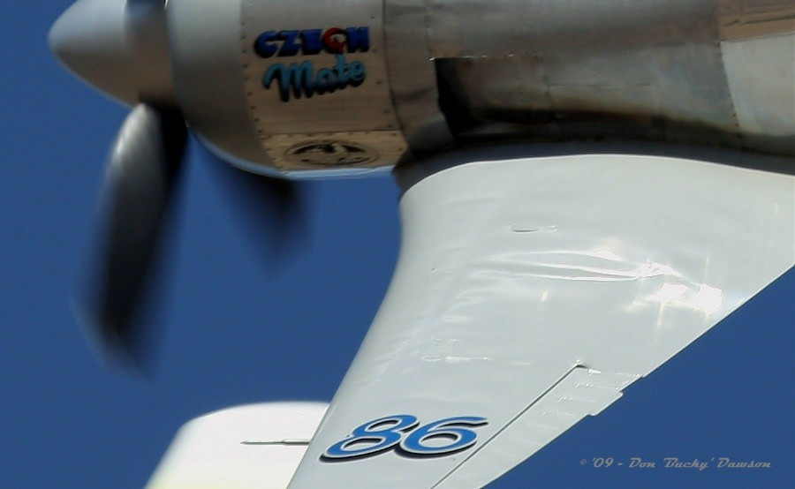
Lecture Content
The function of a wing spar
Buckling in the context of aerostructures
Buckling of columns with various boundary conditions
The effect of eccentricity
Similarities with buckling of plates

Slide 3

Suggested Reading
‘Aircraft Structural Analysis’
THG Megson
Chapters 8 and 9
Notes:
5:00

Slide 4
Context
Under in-plane compressive loads an initally straight or slightly curved member or panel will suddenly deform out-of-plane – this is buckling:
P
P
P
P

Slide 5
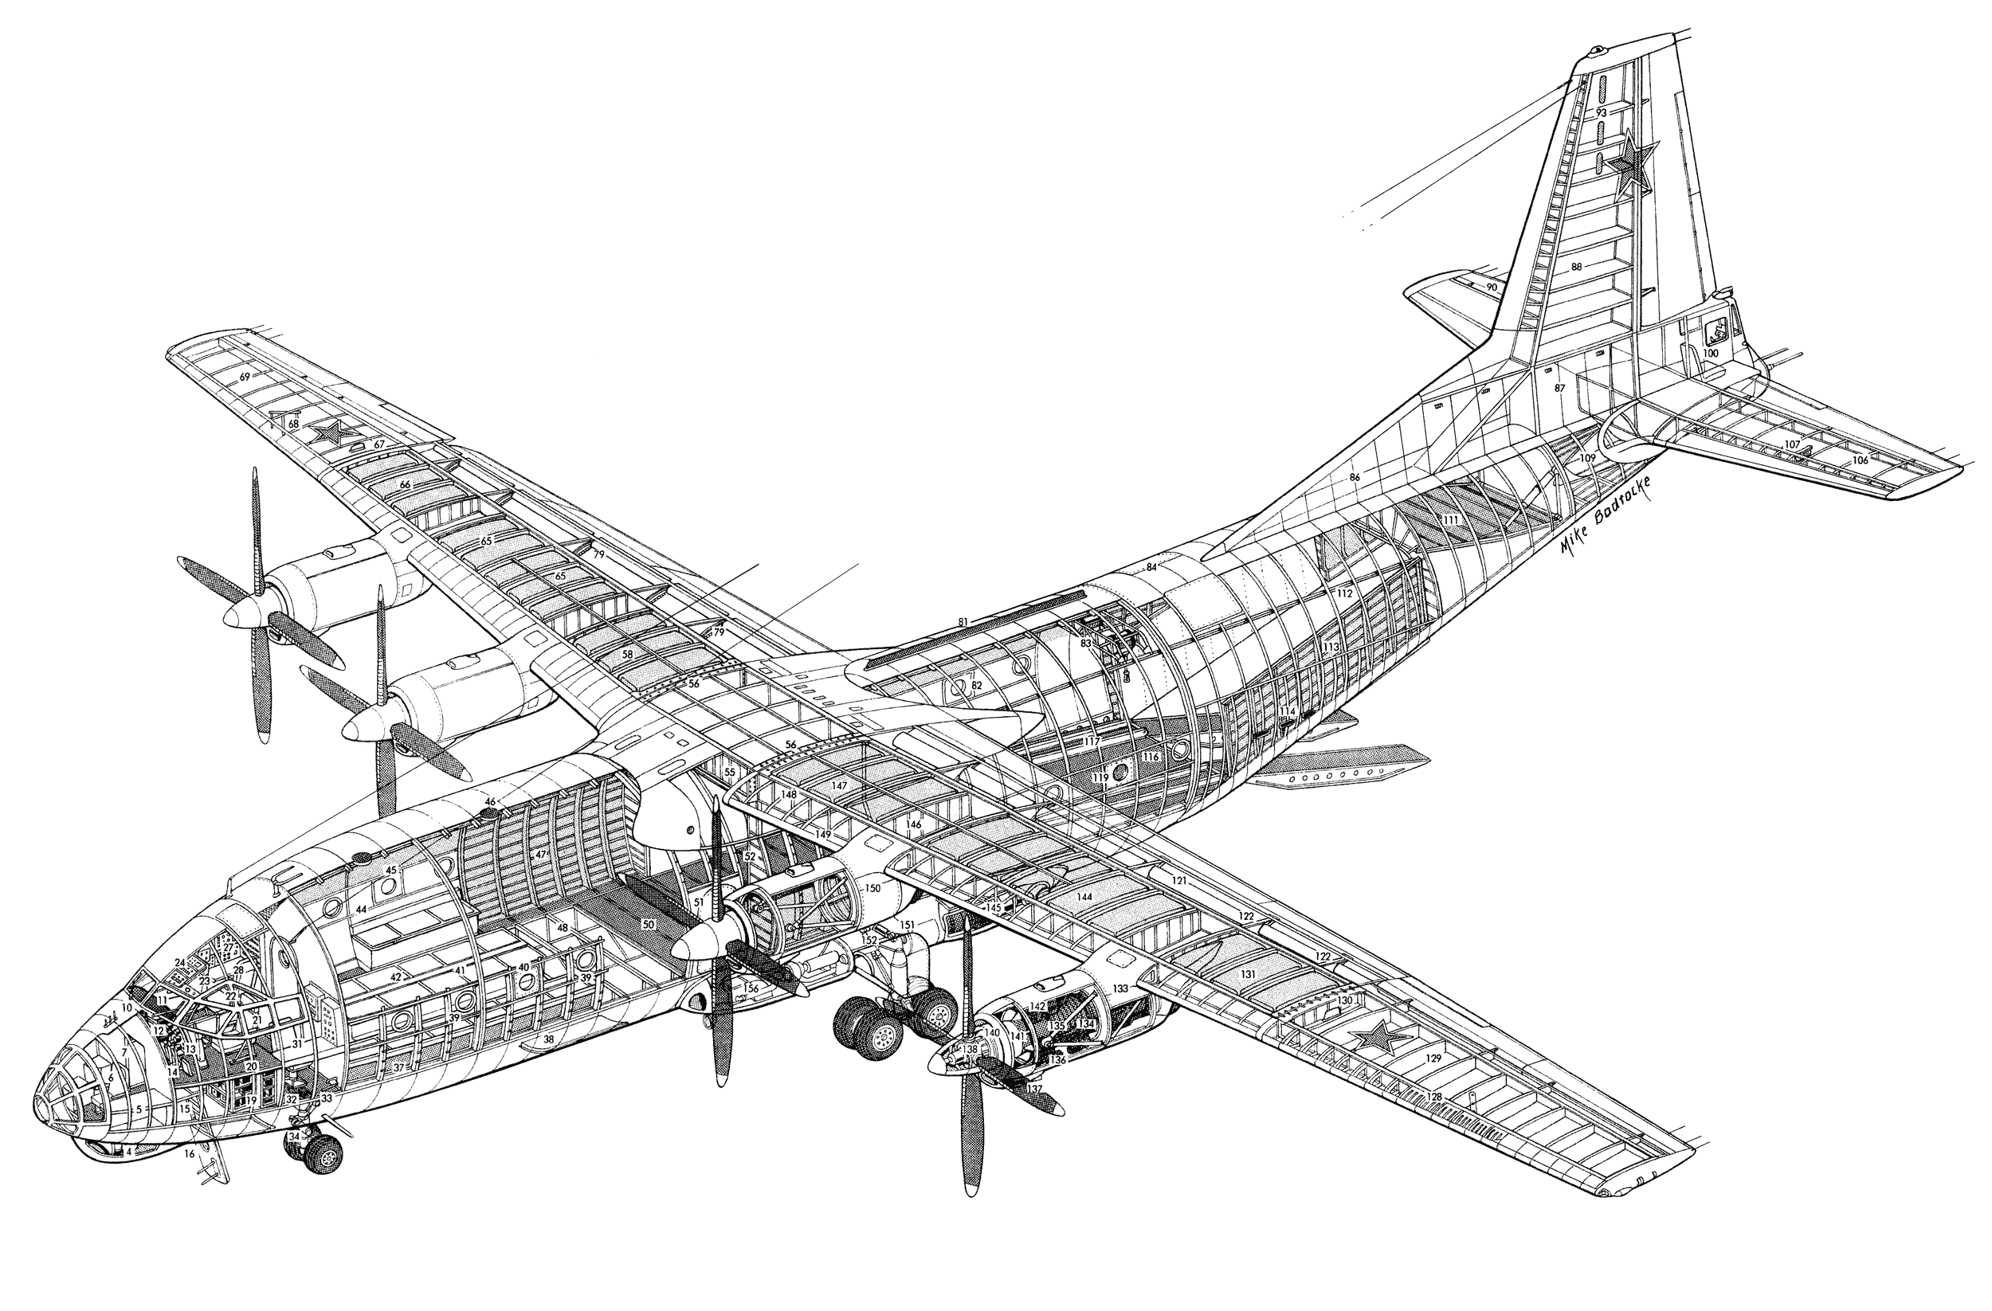
Context
An aircraft is a weight-optimised structure, consisting of thin skins that form a streamlined shape.
As these skins are thin, they are flexible, and buckling dominates the design of the structure.
The skins are therefore reinforced by internal stiffening members.

Slide 6
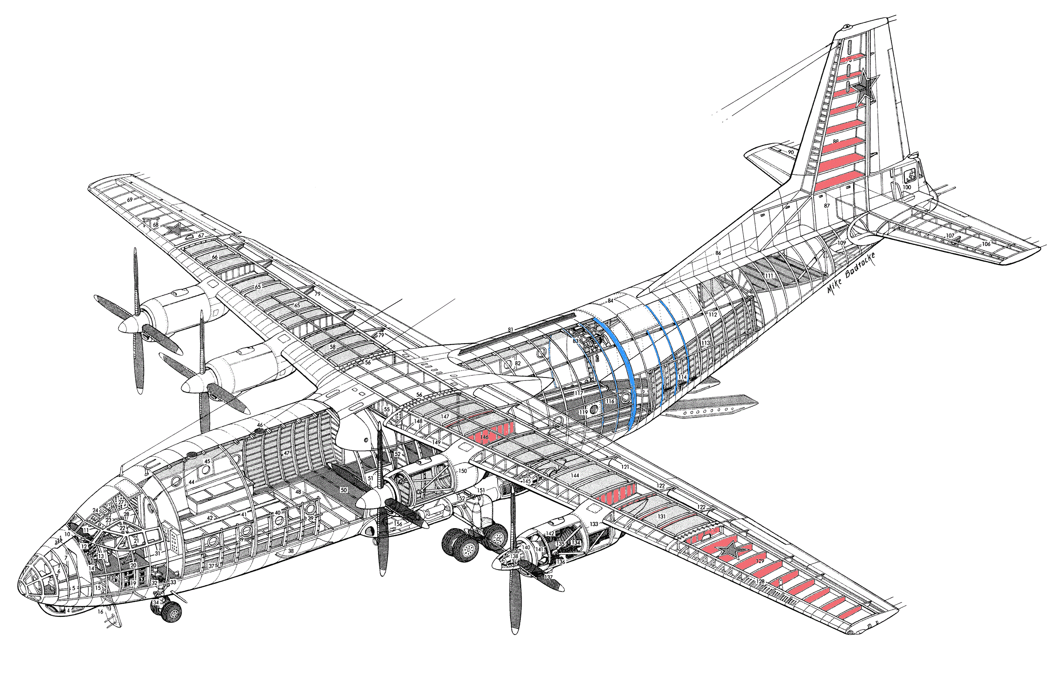
Context
Internal stiffening members:
Wing/Tail ribs
Fuselage frames

Slide 7
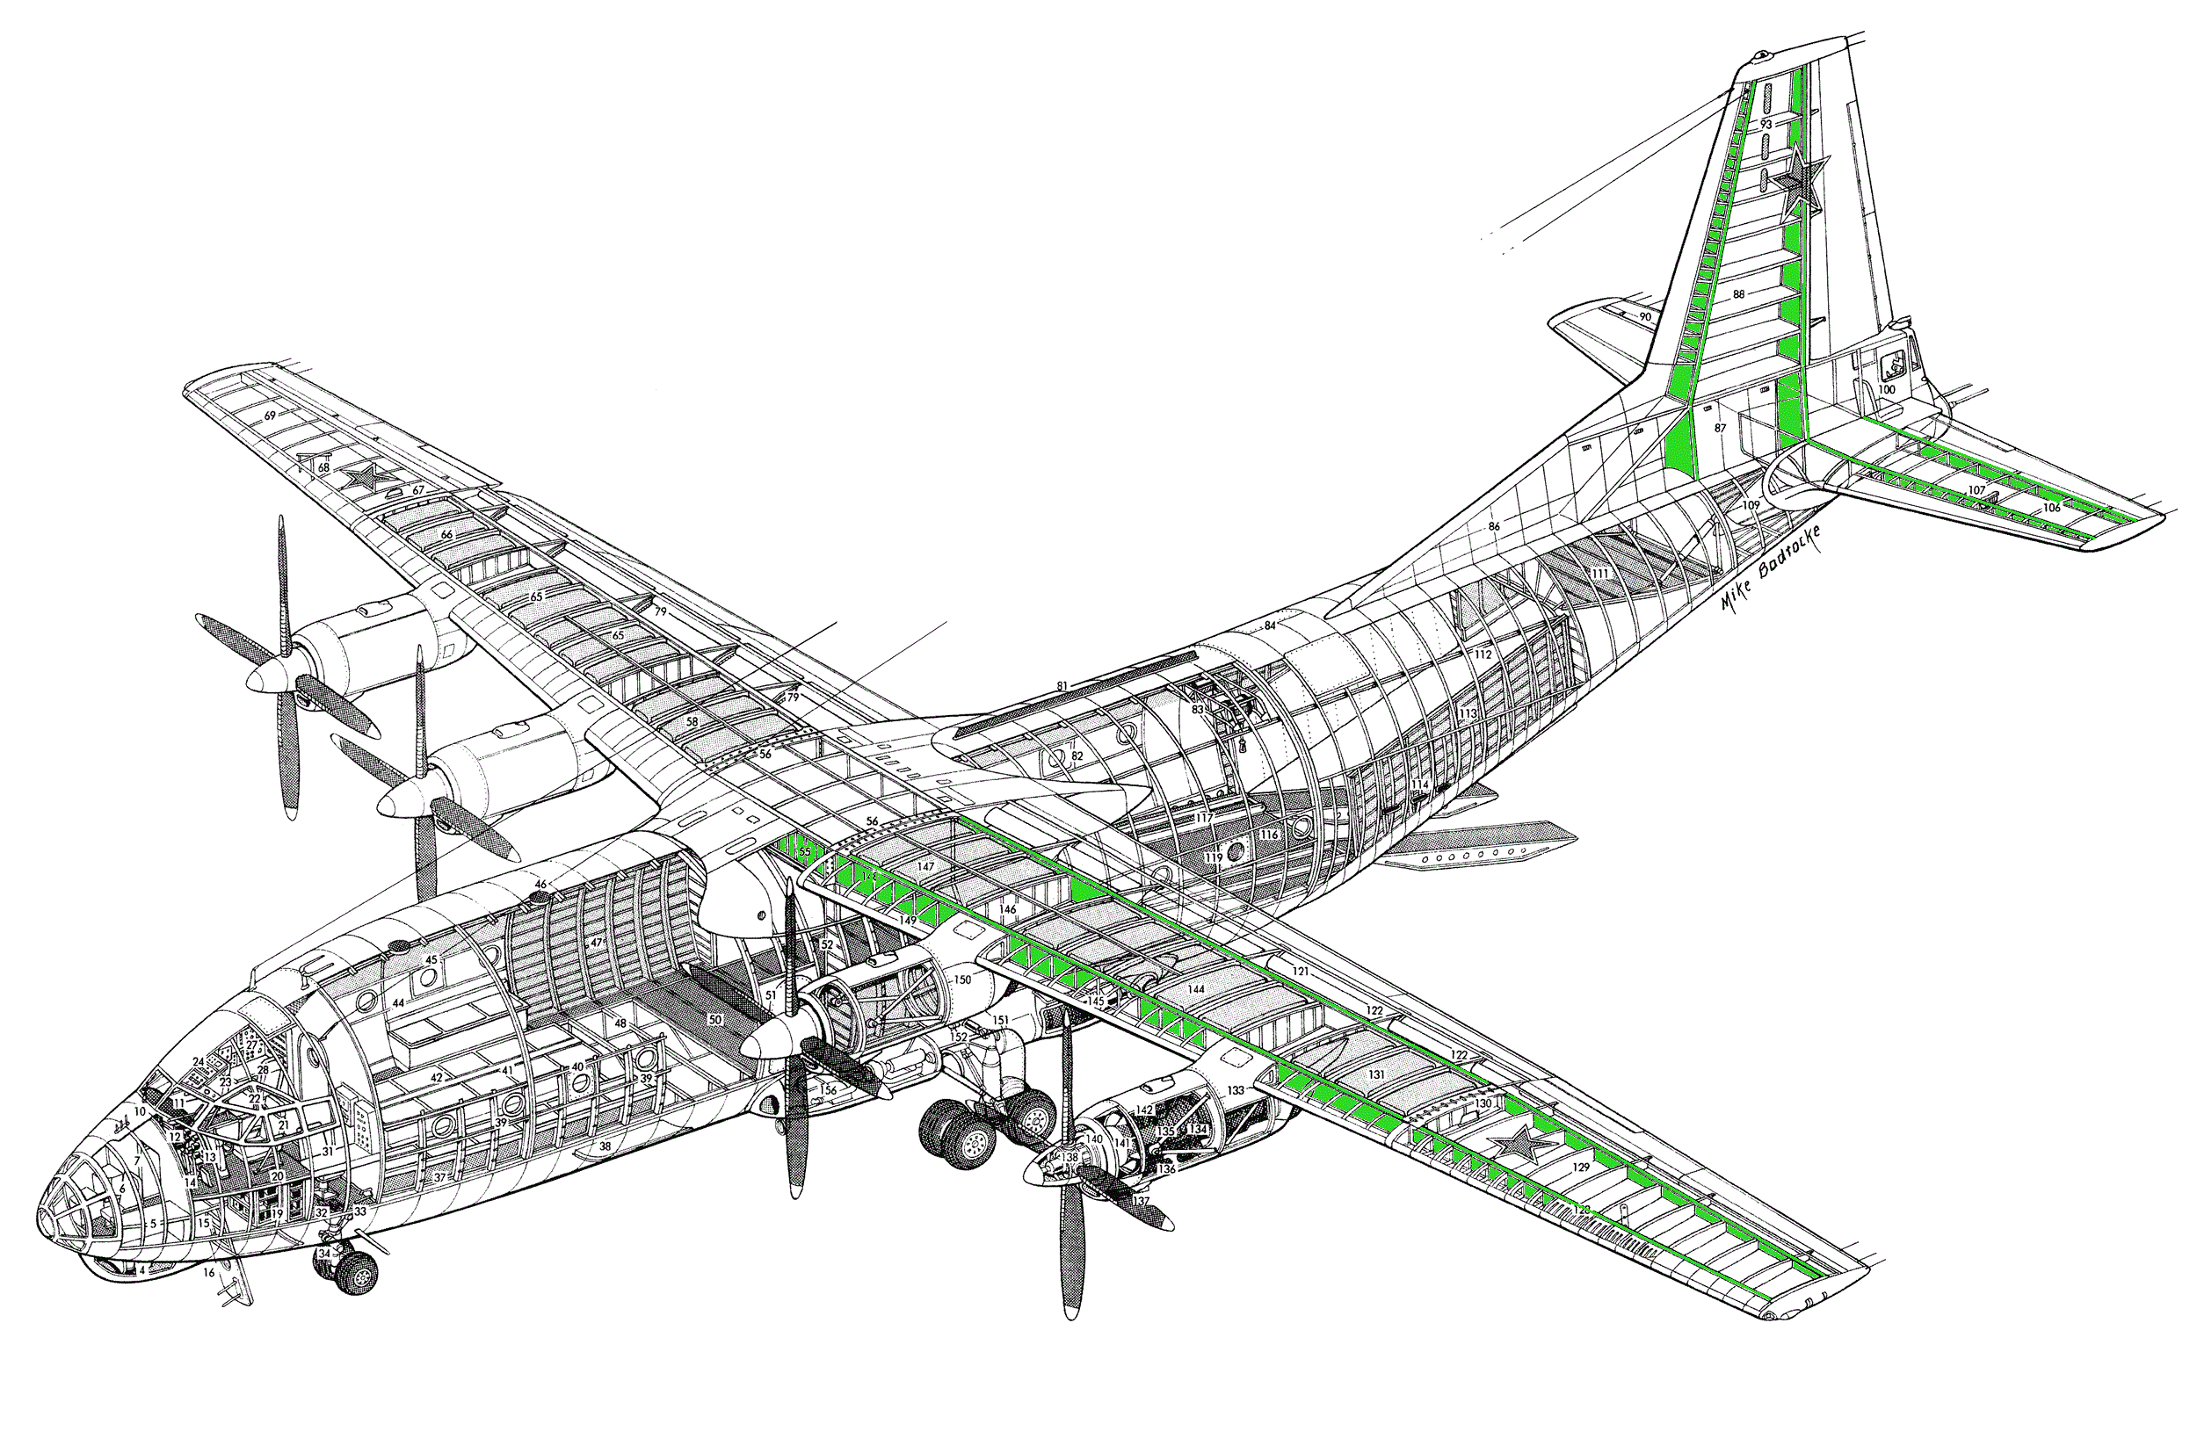
Context
Internal stiffening members:
Spars

Slide 8
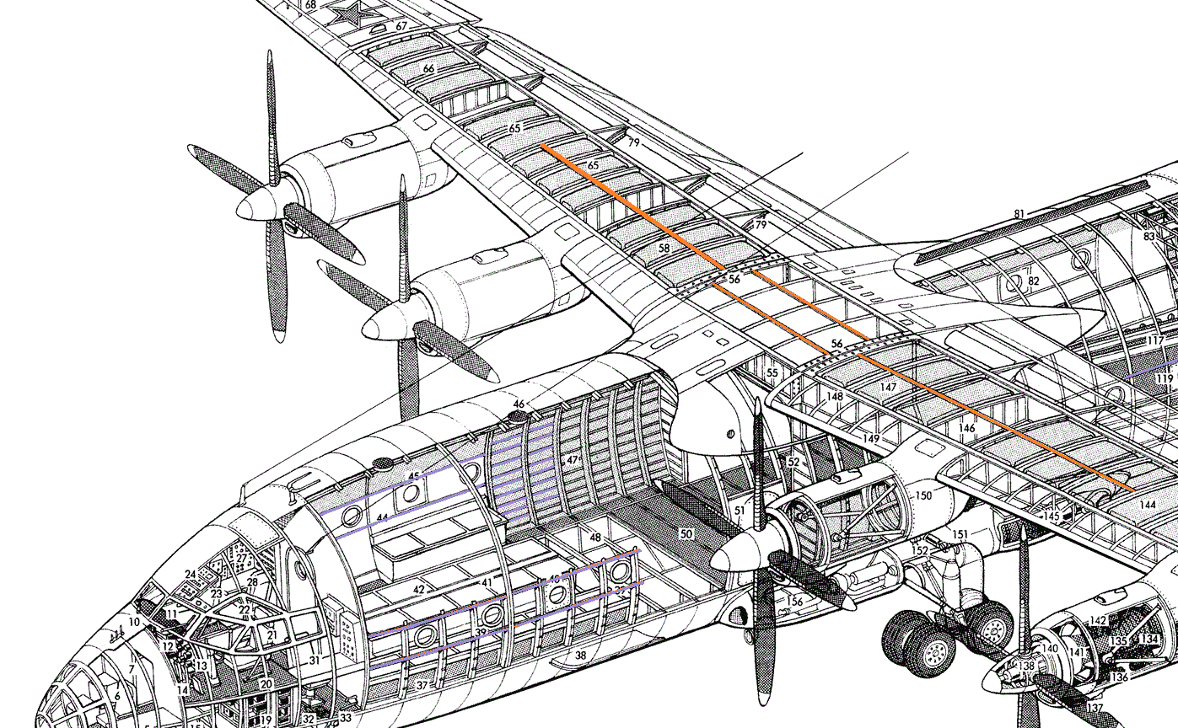
Context
Internal stiffening members:
Wing stringers
Stringers (wing) and longerons (fuselage) are collectively called ‘stiffeners’.
Fuselage longerons

Slide 9
Context
Internal stiffening members:
Stringers (wing) and longerons (fuselage) are collectively called ‘stiffeners’.
Stiffeners on ribs

Slide 10
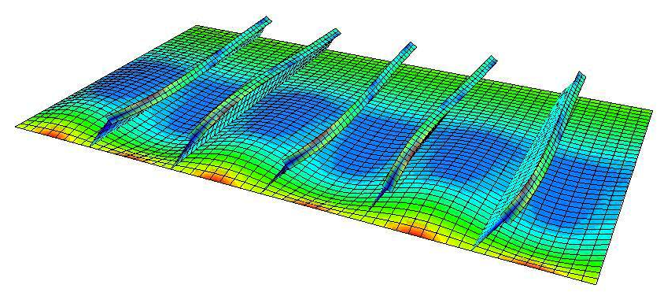
Context: Panel Buckling
The stiffners act to reduce the effective size of the panel which increases the load required to buckle it:
P
(Restraint on all four edges)
P
P

Slide 11
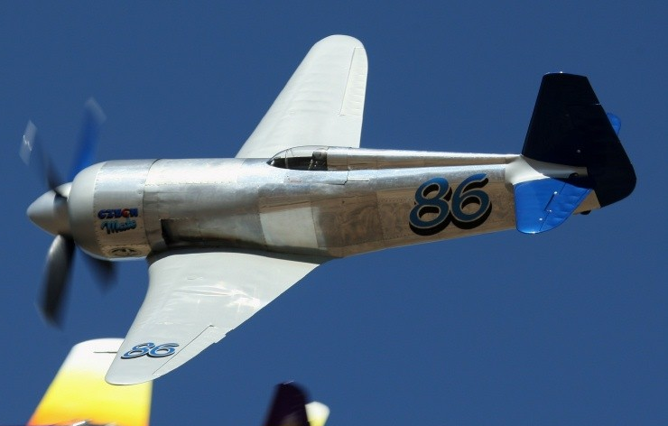
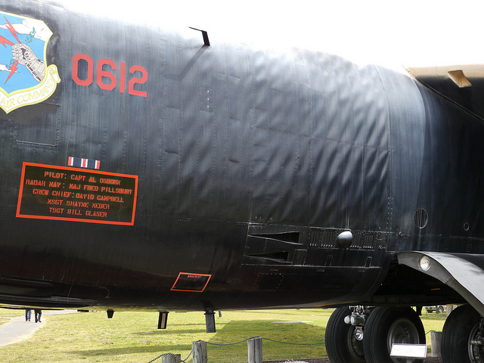
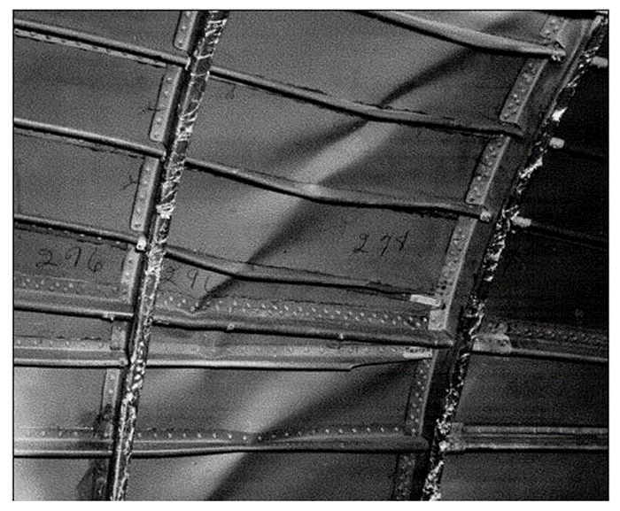
B52
Context: Elastic or Yield?
Racing Bearcat wing skin buckling – Temporary!
B52 Fuselage Buckling – Permanent!

Slide 12
Column Buckling
Notes:
15:00

Slide 13
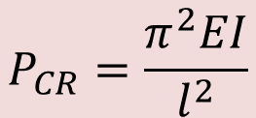
Column Buckling
A column is a straight slender rod carrying axial compressive forces.
Column buckling was studied in 1744 by Euler, resulting in an ‘Euler column’ and ‘Euler buckling’.
Bifurcation point
EI
P
P
P_{CR}
P_{CR}
l
v
v
(At this point, any of these three solutions are possible.)
v=0
v
P
P_{CR}
Critical buckling load:
$$P_{CR}=\frac{π^{2}EI}{l^{2}}$$

Slide 14

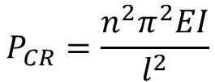
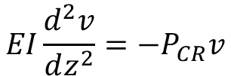
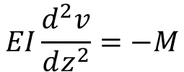
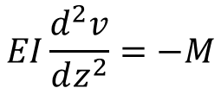
$$EI\frac{d^{2}v}{dz^{2}}=−M$$
Column Buckling Derivation
When the column is buckled, it has a deformed circular shape. The compressive force and the displacement causes a bending moment to act on the column:
$$EI\frac{d^{2}v}{dz^{2}}=−M$$
EI
P_{CR}
P
$$EI\frac{d^{2}v}{dz^{2}}=−P_{CR}v$$
l
v
z
v
M
Solution gives eigenmodes:
$$P_{CR}=\frac{{n^{2}π}^{2}EI}{l^{2}}$$
P_{CR}
$$P_{CR}=\frac{π^{2}EI}{l^{2}}$$
Note: For the full derivation of critical buckling load, P_{CR}, refer to ‘8-1 - Derivation of Critical Buckling Load.pdf’ on blackboard.

Slide 15
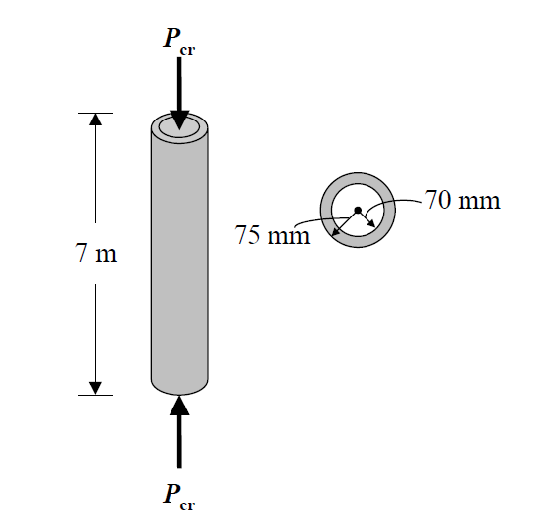




Example 1
The steel tube shown is to be used as a pin-ended column. Determine the maximum load the column can support so that it does not buckle or yield.
For steel:
E = 200 GPa
σ_{yield} = 250 MPa
Critical buckling load:
$$P_{CR}=\frac{π^{2}EI}{l^{2}}$$
Where second moment of area, I, for a tube section is:
$$I=\frac{π\left(r_{o}^{4}−r_{i}^{4}\right)}{4}$$
$$r_{i}$$
$$r_{o}$$
Notes:
15:00

Slide 16


Example 1
The steel tube shown is to be used as a pin-ended column. Determine the maximum load the column can support so that it does not buckle or yield.
For steel:
E = 200 GPa
σ_{yield} = 250 MPa
So r_{o} = 0.075m, r_{i} = 0.07m and I = 5.99x10⁻⁶ m⁴.
Then:
$$P_{CR}=\frac{π^{2}x200x109x5.99x{10}^{−6}}{7^{2}}=241425 N$$
At this force, the axial stress is:
$$σ=\frac{P_{CR}}{A}=106x{10}^{6} Pa=106 MPa$$
Notes:
15:00

Slide 17
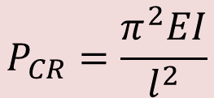

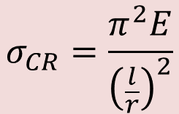
1:20
Column Buckling
$$P_{CR}=\frac{π^{2}EI}{l^{2}}$$
Buckling is an elastic phenomena – it depends on the stiffness (E and I), not the strength of the material.
But we can also re-cast this equation in terms of a critical stress, as σ = P/A :
$$r=\sqrt{\frac{I}{A}}$$
$$σ_{CR}=\frac{π^{2}E}{{\left(\frac{l}{r}\right)}^{2}}$$
r is the radius of gyration
1:5
$$\frac{l}{r}$$
is the slenderness ratio
Rule of thumb: Euler buckling formula appropriate for slenderness ratio > 70 for pin-jointed column, and > 17.6 for fixed-fixed column, for Aluminium.
Slenderness ratio
(square cross-section)
17.3
69.3

Slide 18

Column Buckling
$$P_{CR}=\frac{π^{2}EI}{l^{2}}$$
Buckling is an elastic phenomina – it depends on the stiffness (E and I), not the strength of the material.
For stable equibrium, the load can be removed, and the column returns to its undeformed position.
Force increases with deflection = Stable = Safe
EI
P
P
P_{CR}
Neutral
l
v
Force reduces with deflection = Unstable = Collapse!
v=0
v
P

Slide 19

Effect of Half-Wavelength
P
$$P_{CR}=\frac{{n^{2}π}^{2}EI}{l^{2}}$$
n=Number of half-waves along the length.
n=3
Column restrained at these points.
P
P
P
n=2
v
v
l
x
v
x
x
n=1
v=0
v
P
P
P
n=1
n=2
n=3

Slide 20
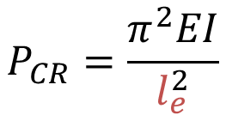
Effect of Boundary Conditions
Fixed-Free
Pinned-Pinned
Fixed-Fixed
P
P
P
l_{e}=l
l
l
l_{e}=0.5l
l_{e}=2l
P
P
$$P_{CR}=\frac{π^{2}EI}{l_{e}^{2}}$$
le=kl is the effective length and is the length of a pin-ended column that would have the same critical load.
Note: For the derivation of the critical load for fixed-fixed boundary conditions, refer to ‘8-2 - Derivation of Fixed-Fixed Critical Buckling Load.pdf’ on blackboard.

Slide 21
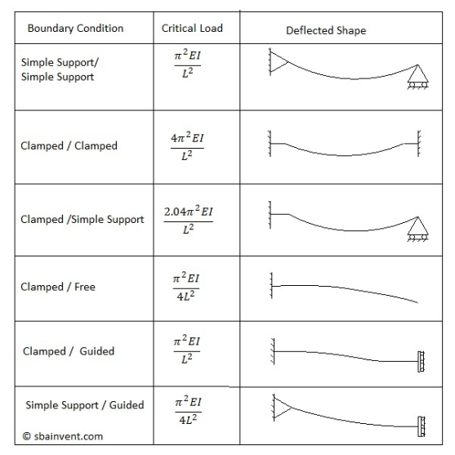
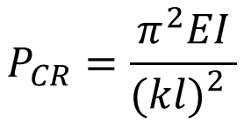
Effect of Boundary Conditions
$$P_{CR}=\frac{π^{2}EI}{{(kl)}_{}^{2}}$$
k =1
k =0.5
k =0.7
k =2
k =1
k =2

Slide 22
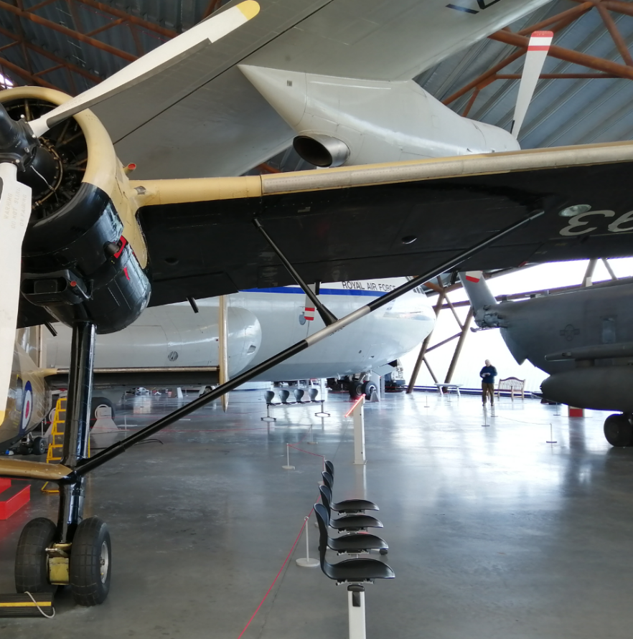
Example 2
The Scottish Aviation Twin Pioneer aircraft employs an aluminium truss to support the wing.
The geometry of the main and jury strut are shown below.
B
0.4m
B-B: Jury Strut
B
1.1m
A
20mm
100mm
A
A-A: Main Strut
1.1m
45mm
25mm
200mm
Notes:
15:00

Slide 23
Example 2
When landing, the truss supports the weight of the outer part of the wing under a vertical decceleration of 1.5g, and the axial compressive force in the main strut and the jury strut are 750 kN and 525 kN, respectively.
The connection between the struts can be considered to be pin-jointed. The ends of the struts are built in.
Check that the truss and jury strut do not buckle, using a safety factor of 1.5.
Notes:
15:00

Slide 24



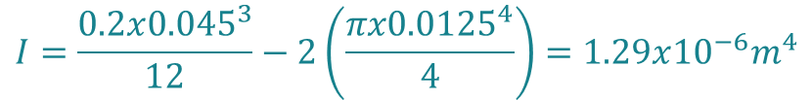



Example 2
$$P_{CR}=\frac{{n^{2}π}^{2}EI}{{\left(kl\right)}^{2}}$$
For aluminium: E = 70 GPa
1.1m
Main Strut
45mm
1.1m
25mm
200mm
$$I=\frac{0.2x{0.045}^{3}}{12}−2\left(\frac{πx{0.0125}^{4}}{4}\right)=1.29x{10}^{−6}m^{4}$$
$$l=2.2m$$
$$P_{CR}=2947kN$$
$$k=0.5$$
(Fixed – Fixed)
$$\frac{P_{CR}}{1.5}=1965kN$$
Safe!
$$n=2$$
Notes:
15:00

Slide 25






Example 2
$$P_{CR}=\frac{{n^{2}π}^{2}EI}{{\left(kl\right)}^{2}}$$
0.4m
For aluminium: E = 70 GPa
Jury Strut:
Jury Strut
$$I=\frac{0.1x{0.02}^{3}}{12}=6.67x{10}^{−8}m^{4}$$
20mm
$$l=0.4m$$
100mm
$$k=0.7$$
(Fixed – Pinned)
$$n=1$$
$$\frac{P_{CR}}{1.5}=391.65kN$$
Not Safe!
$$P_{CR}=587.47kN$$
Notes:
15:00

Slide 26
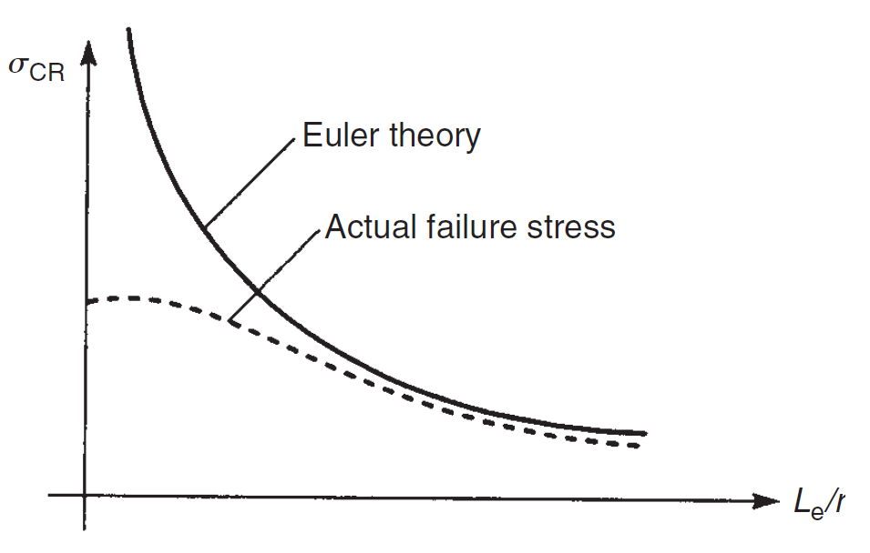



Limitations of Euler Theory
$$σ_{CR}=\frac{π^{2}EI}{{\left(\frac{l_{e}}{r}\right)}^{2}}$$
$$\frac{l_{e}}{r}$$
is the slenderness ratio
Euler theory valid
Euler theory invalid
$$\frac{l_{e}}{r}$$
Below this point the material is likely to Yield at a lower load than P_{CR}. This depends upon the Youngs modulus and Yield strength of the material.

Slide 27
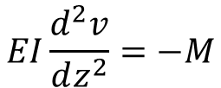
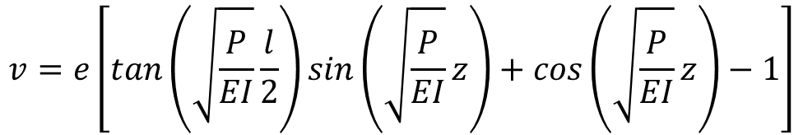
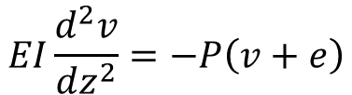
Effect of Imperfections
An initial imperfection (or end moment) can be represented as an eccentric load. The eccentricity is e:
e
e
EI
P
P
$$EI\frac{d^{2}v}{dz^{2}}=−M$$
$$EI\frac{d^{2}v}{dz^{2}}=−P\left(v+e\right)$$
l
v
z
v
M
The solution is:
P
$$v=e\left[tan\left(\sqrt{\frac{P}{EI}}\frac{l}{2}\right)sin\left(\sqrt{\frac{P}{EI}}z\right)+cos\left(\sqrt{\frac{P}{EI}}z\right)−1\right]$$

Slide 28
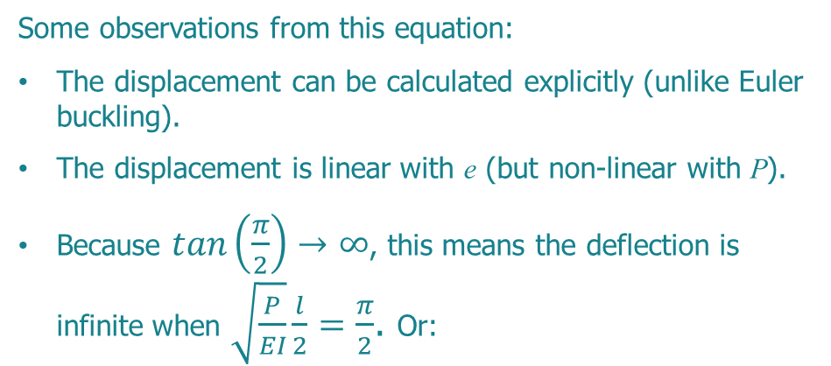
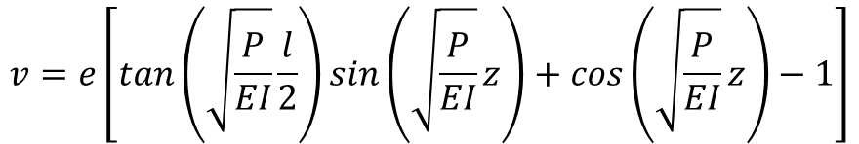
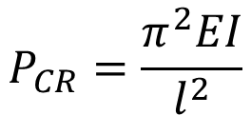
Effect of Imperfections
e
$$v=e\left[tan\left(\sqrt{\frac{P}{EI}}\frac{l}{2}\right)sin\left(\sqrt{\frac{P}{EI}}z\right)+cos\left(\sqrt{\frac{P}{EI}}z\right)−1\right]$$
EI
P
Some observations from this equation:
The displacement can be calculated explicitly (unlike Euler buckling).
The displacement is linear with e (but non-linear with P).
Because $tan\left(\frac{π}{2}\right)→∞$, this means the deflection is infinite when $\sqrt{\frac{P}{EI}}\frac{l}{2}=\frac{π}{2}$. Or:
l
v
P
$$P_{CR}=\frac{π^{2}EI}{l^{2}}$$

Slide 29
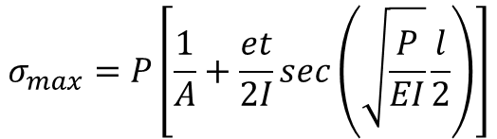
Effect of Imperfections
The maximum stress in the column can be calculated from the previous equation. This gives the secant formula:
$$σ_{max}=P\left[\frac{1}{A}+\frac{et}{2I}sec\left(\sqrt{\frac{P}{EI}}\frac{l}{2}\right)\right]$$
P_{CR}
A = Cross sectional area
t = Thickness
P
Increasing eccentricity
σ_{max}

Slide 30

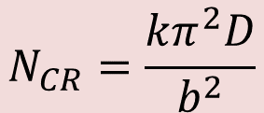
Buckling of Plates
a
The plate is simply supported along all four edges.
Nx is a uniformly distributed load along the edge of the plate. Units N/m.
N
b
N
The bending stiffness of the plate is given the parameter D:
$$D=\frac{Et^{3}}{12\left(1−ν^{2}\right)}$$
Critical buckling load:
$$N_{CR}=\frac{{kπ}^{2}D}{b^{2}}$$
By inspection it is clear that there are similarities with Euler column buckling. D is similar to EI. b is similar to l. What about k?

Slide 31
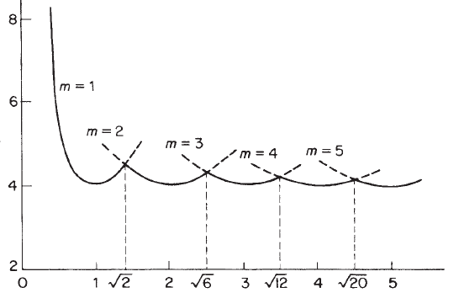
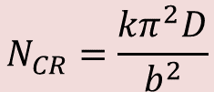

Buckling of Plates
a
$$N_{CR}=\frac{{kπ}^{2}D}{b^{2}}$$
N
b
N
k is known as the plate buckling coefficient.
k
$$k={min\left(\frac{mb}{a}+\frac{a}{mb}\right)}^{2}$$
a/b

Slide 32
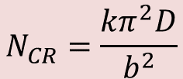



a
Buckling of Plates
N
b
N
$$m=1,\frac{a}{b}=1$$
$$N_{CR}=\frac{{kπ}^{2}D}{b^{2}}$$
$$m=2,\frac{a}{b}=2$$
k
$$m=3,\frac{a}{b}=3$$
a/b

Slide 33
Key Learning Points
Buckling is a key design driver for aircraft structures.
Buckling is an elastic phenomina.
Stringers and longerons are aircraft structural components that can be approximated as an Euler column.
An Euler column has a critical compressive load at which buckling occurs.
The boundary conditions affect the buckling load, calculated using effective length.
Imperfections can mean failure before critical buckling load.
Many structural relationships in Euler columns are the same for plates.
Notes:
15:00

Slide 34
Thanks for your attention!
mahdi.damghani@uwe.ac.uk
Notes:
55:00

Slide 35
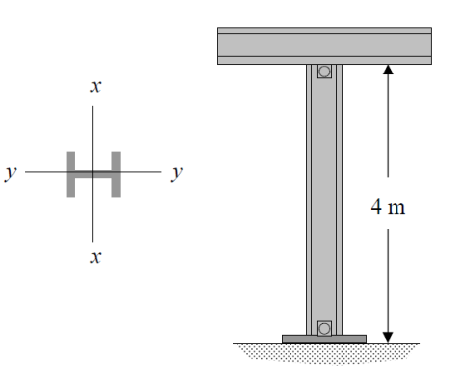
Tutorial 1
The structural member shown is to be used as a pin-connected column. Determine the largest axial load it can support before it either begins to buckle or the steel yields. Section properties are as;
Assume modulus of elasticity of 200 GPa and material stress allowable of 250MPa.

Slide 36
Tutorial 2
A 3m column with the following cross section is constructed of material with E=13GPa and is simply supported at its two ends.
  Determine Euler buckling load
  Determine stress associated with the buckling load
150 mm
50 mm
50 mm
50 mm
50 mm

Slide 37
Tutorial 3
Vertical stabiliser
1
The vertical stabiliser of an aircraft shown is made from 3mm thick aluminium with material properties:
E=70GPa, v=0.3
The stabiliser is swept aft with a ratio of 1:5
5
2.5m
Fairing
2m
Rudder
Approximating the stabiliser as a panel, and assuming edges are simply supported,
Calculate the critical buckling force from bending of the stabiliser panel
Decide which is better for buckling:
a. Two equally spaced stringers running parallel to the leading edge of the stabaliser, or
b. A rib at the centre of the stabiliser, running
normal to the leading edge:
or
?

Slide 38
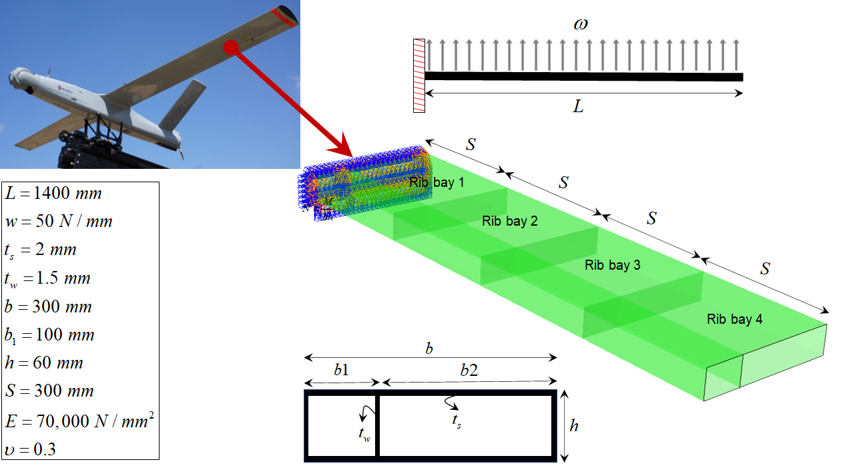
Tutorial 4
For the loading given, which panels are more susceptible to buckling phenomenon. Ignoring the effects of membrane shear stresses and assuming that only membrane direct stresses due to wing bending act on panels, i.e. direct stresses in the wing spanwise direction, determine the conservative buckling load of panels in Rib Bay 1.
To enable your calculations, consider conservative boundary conditions for the panels of rib bay 1 to represent spars and ribs.
Specify whether the panels buckle or not. If they do buckle, put forward a solution to delay buckling of panels.

