Slide 1
Aero Structures-Bending of section
By
Dr. Mahdi Damghani
2022-2023

Slide 2
Suggested Readings
Chapter 15
of
Aircraft Structural Analysis

Slide 3
Topics
Familiarisation with the following concepts;
Symmetrical bending
Second moment of inertia
Stress distribution for symmetrical cross sections
Unsymmetrical bending
Stress distribution for unsymmetrical sections
Equation of neutral axis for unsymmetrical bending

Slide 4
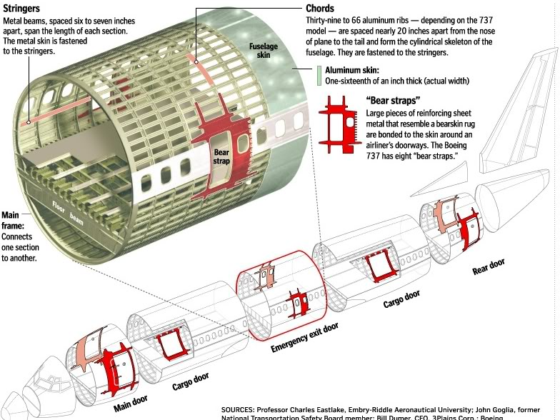


Introduction
They are subjected to bending loads
Floor beams
They could cause sagging or hogging shape

Slide 5
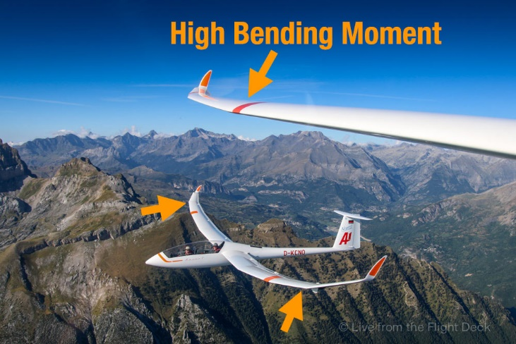
Introduction

Slide 6

Watch wing flexing (https://www.youtube.com/watch?v=StQneURTciU)
Notes:
https://www.youtube.com/watch?v=StQneURTciU

Slide 7
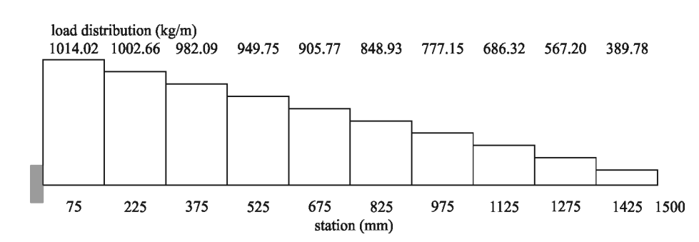
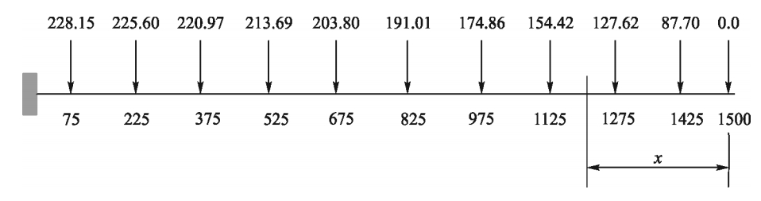
Load distribution at different sections of a wing (modelled as a cantilevered structure)
Notes:
Conversion of the distributed loads into design loads (kg) at various sections for the load case

Slide 8
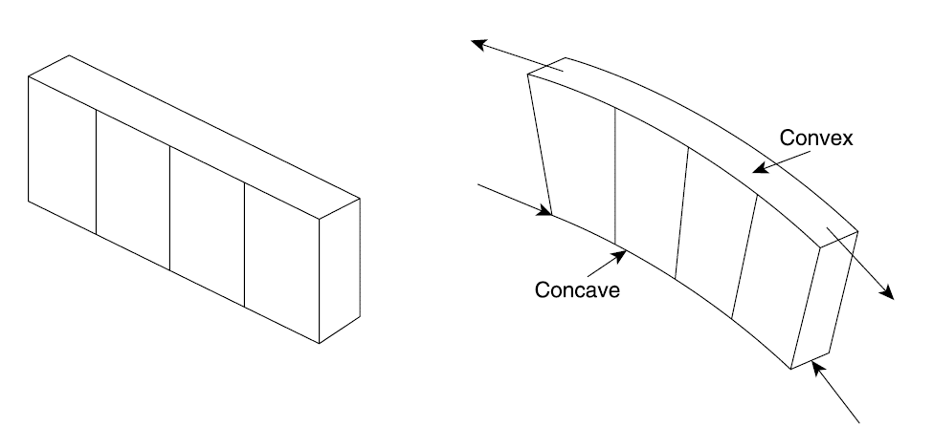
Introduction
Somewhere fibres are neither in compression nor in tension “neutral plane”
Tensile on top fibres
Straight lines remain straight (green lines)
compressive on bottom fibres

Slide 9
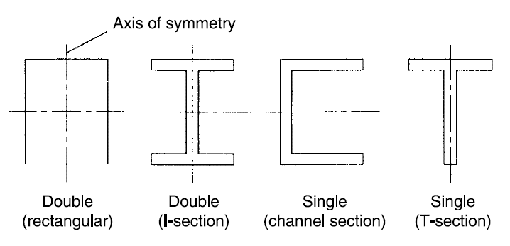
Symmetrical bending
Let’s look at symmetrical bending (special case of general bending) to enable us understand un-symmetrical bending later on
Occurs for either singly or doubly symmetrical cross sections

Slide 10
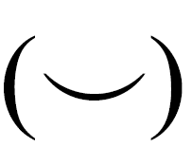
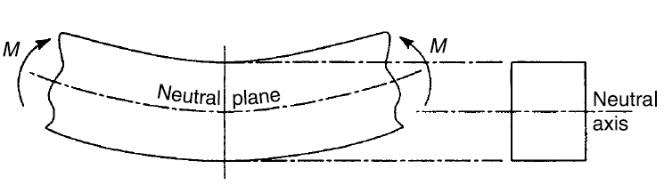
Symmetrical bending
From now on we consider sagging bending moment as negative moment
Material follows Hooke’s law (linearly elastic)
Material of the beam is homogenous
Plain sections remain plain after bending

Slide 11
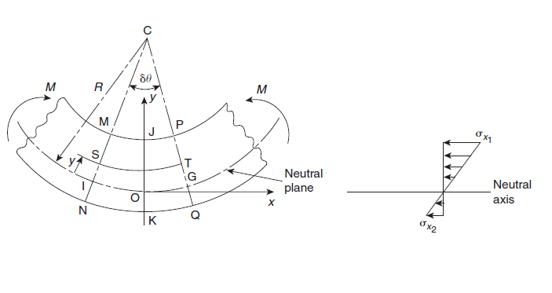
Direct stress distribution
Fibre ST has shortened in length whilst NQ increased in length so they have gone through strains
Remember that the length of neutral axis does not change and remains as
Positive y gives negative strain, i.e. compression

Slide 12
Direct stress distribution
Look at the beam cross section now;
dA
F
y
dA
y
F
Neutral axis
Second moment of area
Flexural rigidity

Slide 13
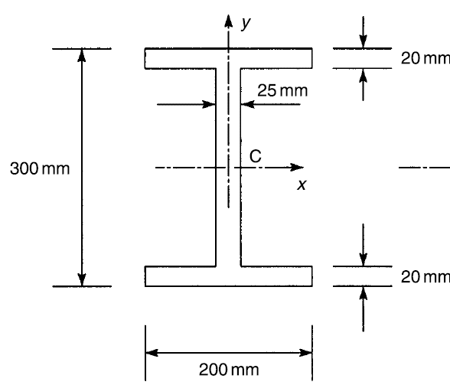
Example
The cross section of a beam has the dimensions shown in the figure. If the beam is subjected to a negative bending moment of 100kNm applied in a vertical plane, determine the distribution of direct stress through the depth of the section.

Slide 14
Reminder 1 before solution
Centroid of a section, also known as centre of area or the centre of mass, represents the point about which the area of the section is evenly distributed
If the area is doubly symmetric about two orthogonal axes, the centroid lies at the intersection of those axes
If the area is symmetric about only one axis, then the centroid lies somewhere along that axis (the other coordinate will need to be calculated)

Slide 15
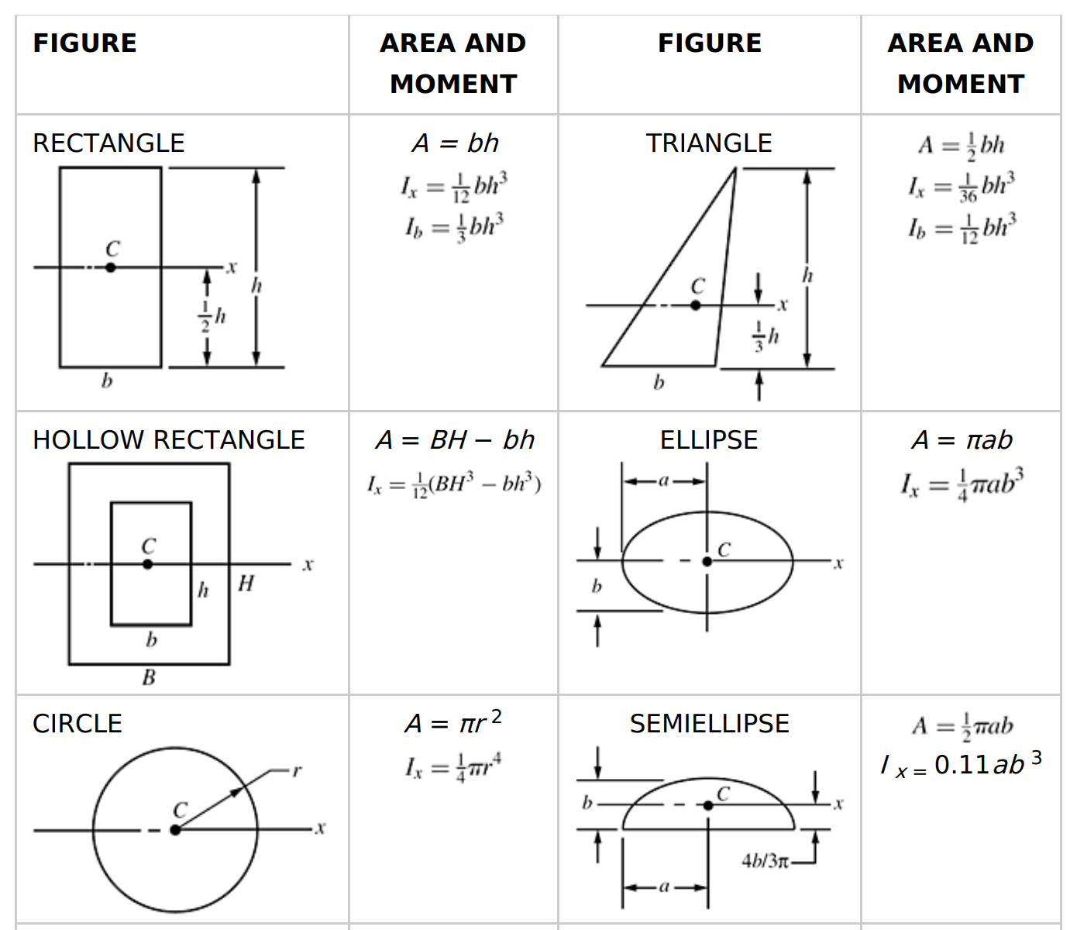
Reminder 2 before solution

Slide 16
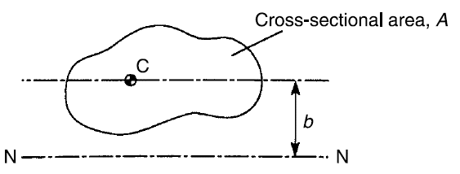

Reminder 3 before solution
I_{C} is the second moment of area about an the axis going through centroid
The second moment of area about NN is then;

Slide 17
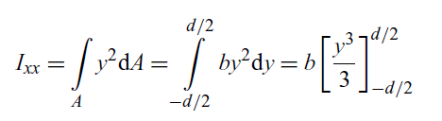
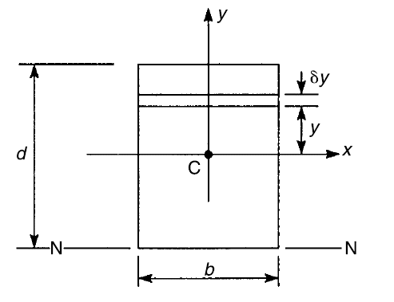



Reminder 4 before solution

Slide 18
Reminder 5 before solution
If the section is symmetric, isotropic, is not curved before a bend occurs, and stresses are linear below yield stress then the neutral axis is at the geometric centroid
When stresses go beyond yield and material plasticity takes place then the location of neutral axis changes (beyond the scope of this lecture) as in majority of aerospace cases we do not allow material plasticity to happen (unless in buttstraps analysis to allow a higher Reserve Factor)

Slide 19
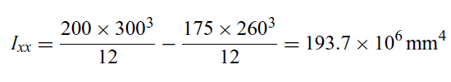

Solution
The cross section is doubly symmetrical
The centroid and the origin of the axis coincide at mid point of the web

Slide 20
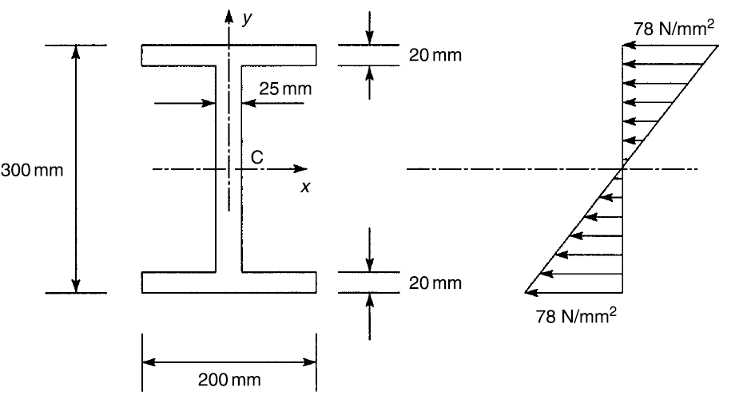
Solution

Slide 21
Students task/note
Go through example 15.3 on page 430 of Ref. [1]
Now we will be looking at a very general bending of beams
Remember that symmetrical bending was a special case of general bending and was outlined for better understanding of what is about to come in subsequent slides

Slide 22
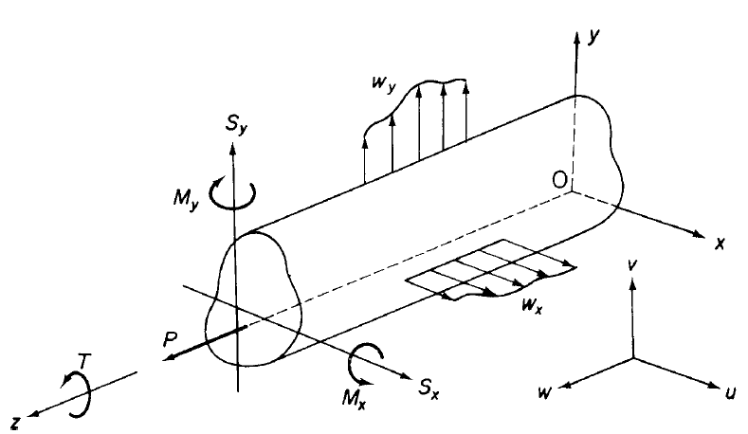
Unsymmetrical bending
Similar assumptions to those of symmetrical bending
General shape cross section
We shall first establish sign convention for forces, moments and torsions
Direct and shear loads are always positive in the direction of associated axis
Bending moments are positive if they bring about tension in positive xy quadrant of beam cross section

Slide 23
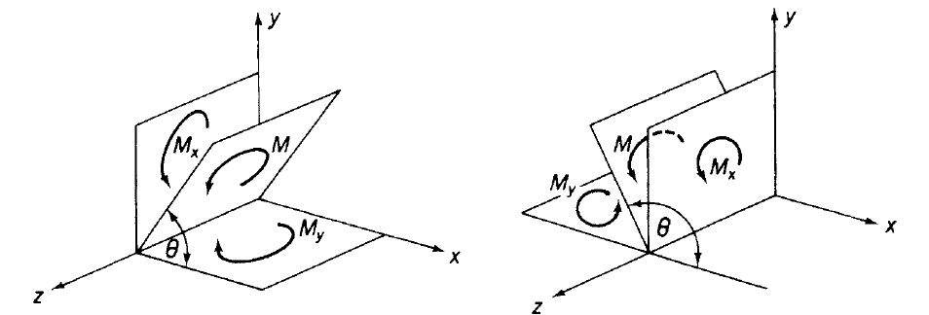

Resolving moment into components
Bending applied in any longitudinal plane parallel to z axis maybe resolved into two components

Slide 24
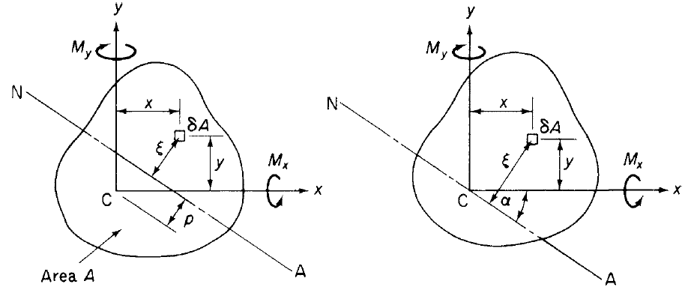






Stress distribution
The first moment of area about the neutral axis is zero
Pure bending in the beam
Notes:
$ρ$ is radius of curvature
$α$is inclination of netral axis to x axis in clockwise direction

Slide 25




Stress distribution
Let’s assume that inclination of neutral axis with Cx axis is α (measured clockwise from Cx)

Slide 26




Stress distribution
Re-write in matrix format

Slide 27



Position of the neutral axis
Stresses are zero on neutral axis, so;

Slide 28
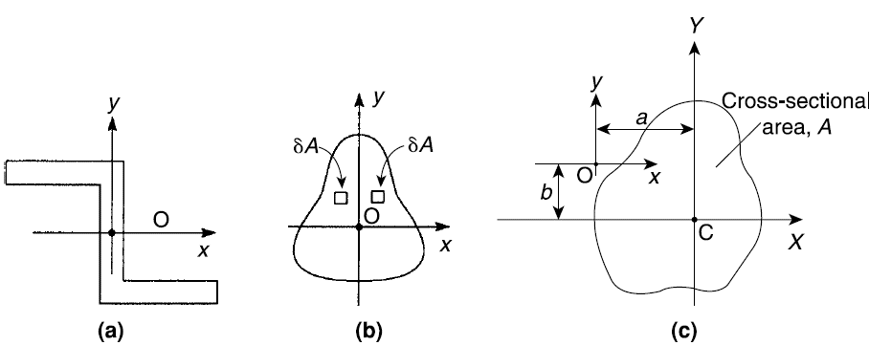




Reminder of section property
Product second moment of area
If CX or CY are axis of symmetry then

Slide 29
Reminder Example
Obtain product second moment of area for the following rectangle about an axis passing through its centroid (H=height, B=width).
Y
dA
H
C
X
B

Slide 30
Reminder Example
Now consider rectangle of previous example. Obtain product second moment of area about axis xy.
Y
dA
y
H
C
X
o
x
B
To avoid confusion: a and b are coordinates of centroid system (XCY) in the intended system (xoy)
Notes:
Therefore, for a section component having an axis of symmetry that is parallel to either of the
section reference axes, the product second moment of area is the product of the coordinates of its
centroid multiplied by its area.

Slide 31
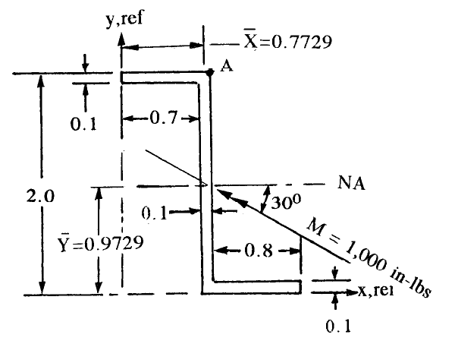
Example
Determine the bending stress at point A. The section properties are as follow;
I_{x}=0.202 in⁴
I_{y}=0.0346 in⁴
I_{xy}=-0.0606 in⁴

Slide 32

Solution
Notes:
1 ib.in=112.98 N.mm
1 Psi=0.00689476 MPa,-→-19908.9 psi=137.25 MPa

Slide 33
Note
For the sake of demonstration, in the previous example the location of neutral axis was given
However, this is never the case and students are required to find the location of neutral axis themselves
See the next problem

Slide 34
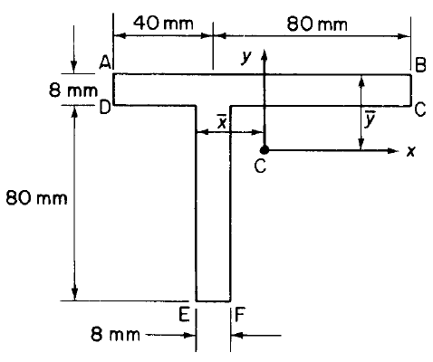
Example
A beam having the cross section shown in the figure is subjected to a bending moment of 1500Nm in a vertical plane. Calculate the maximum direct stress due to bending stating the point at which it acts.

Slide 35
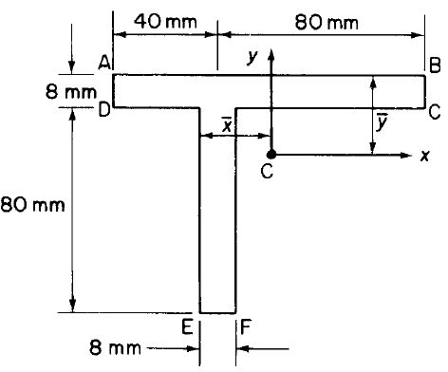


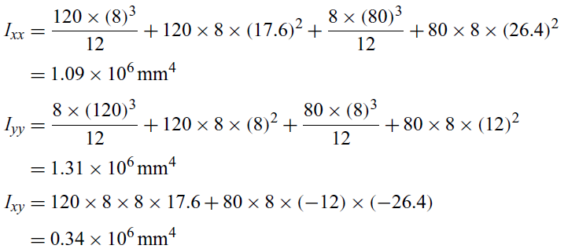
Solution
Find centroid location
Take moment of areas about line AB
Calculate second moment of inertia

Slide 36
Reminder
8
a=+8mm
b=+17.6mm
17.6
12
26.4
a=-12mm
b=-26.4mm

Slide 37


Solution
M_{x}=1500Nm
M_{y}=0
I_{xx}=1.09x10⁶mm⁴ I_{yy}=1.31x10⁶mm⁴ I_{xy}=0.34x10⁶mm⁴
Point F will have maximum stress
x=-8mm, y=-66.4mm

Slide 38
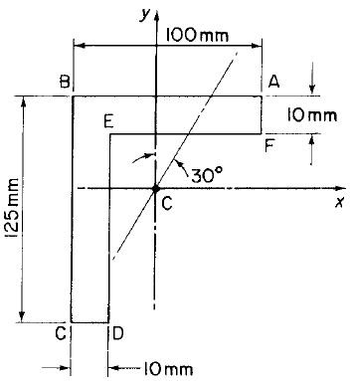
Example
Figure shows the section of an angle purlin. A bending moment of 3000Nm is applied to the purlin in a plane at an angle of 30º to the vertical y axis. If the sense of the bending moment is such that its components M_{x} and M_{y} both produce tension in the positive xy quadrant, calculate the maximum direct stress in the purlin, stating clearly the point at which it acts.

Slide 39




Solution
Where is the location of centroid?

Slide 40
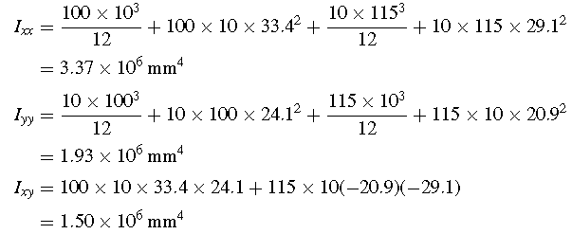
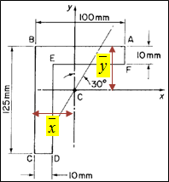
Solution
The second moments of area are;

Slide 41

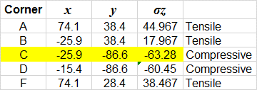
Solution
Plug in all the previous values in the following equation;
Max stress occurs always
at the outermost corners;

Slide 42
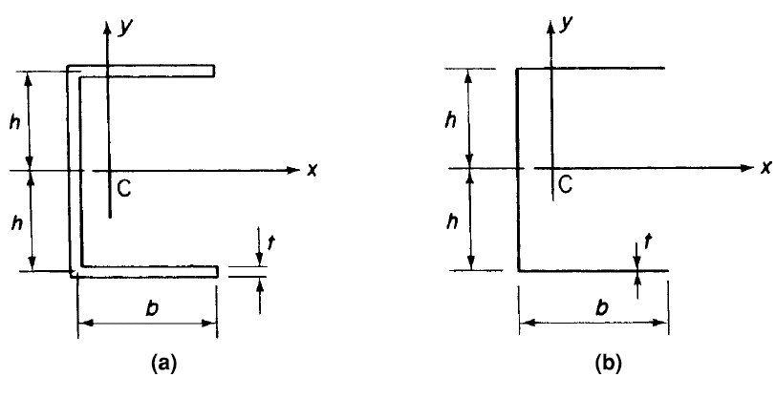

Second moment of area for thin-walled sections

Slide 43
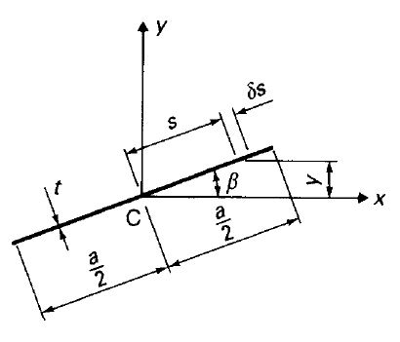



Second moment of area for thin-walled sections
You will need this for your coursework

Slide 44
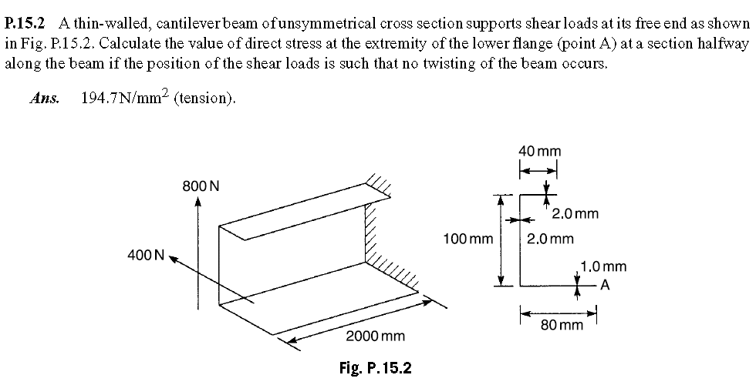
Tutorial 1
(see P15.2 of Ref [1] on page 472 for answers. You may also refer to “Bending_Tutorial_Solution.pdf” uploaded on BB for detailed solution).

Slide 45
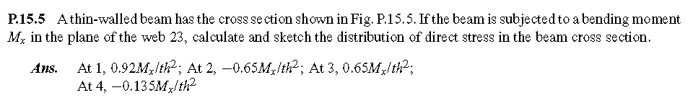
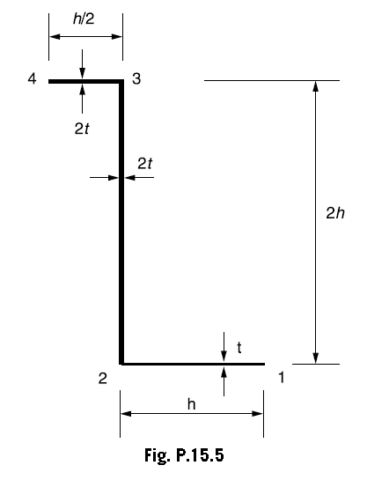
Tutorial 2
(see P15.5 of Ref [1] on page 473 for answers. You may also refer to “Bending_Tutorial_Solution.pdf” uploaded on BB for detailed solution).

