Slide 1
Test Methods of Composite Materials
By Dr. Mahdi Damghani

Slide 2
Testing types
Tensile testing
  Longitudinal tension
  Transverse tension
  Off-axis tension
Compressive testing
V-notched beam testing
Open hole tension testing
Open hole compression testing
Short beam shear testing
Flexural testing
Mode-I interlaminar fracture toughness testing
Mode-II interlaminar fracture toughness testing
Single lap shear strength testing

Slide 3
Notes
American Society for Testing and Materials (ASTM)
International Organisation for Standardisation (ISO)
  ISO is not an acronym and ISO is derived from Greek word isos meaning equal which reflects the organisation's goal of equalising standards worldwide.
Deutsches Institut für Normung (DIN)
  German institute for standardisation
Japanese Industrial Standard (JIS)
In all the testing outlined henceforth, the loading rate (quasi-static) is 1 mm/min but the standard needs to be referred to in case of deviations.

Slide 4
Tensile
Testing

Slide 5
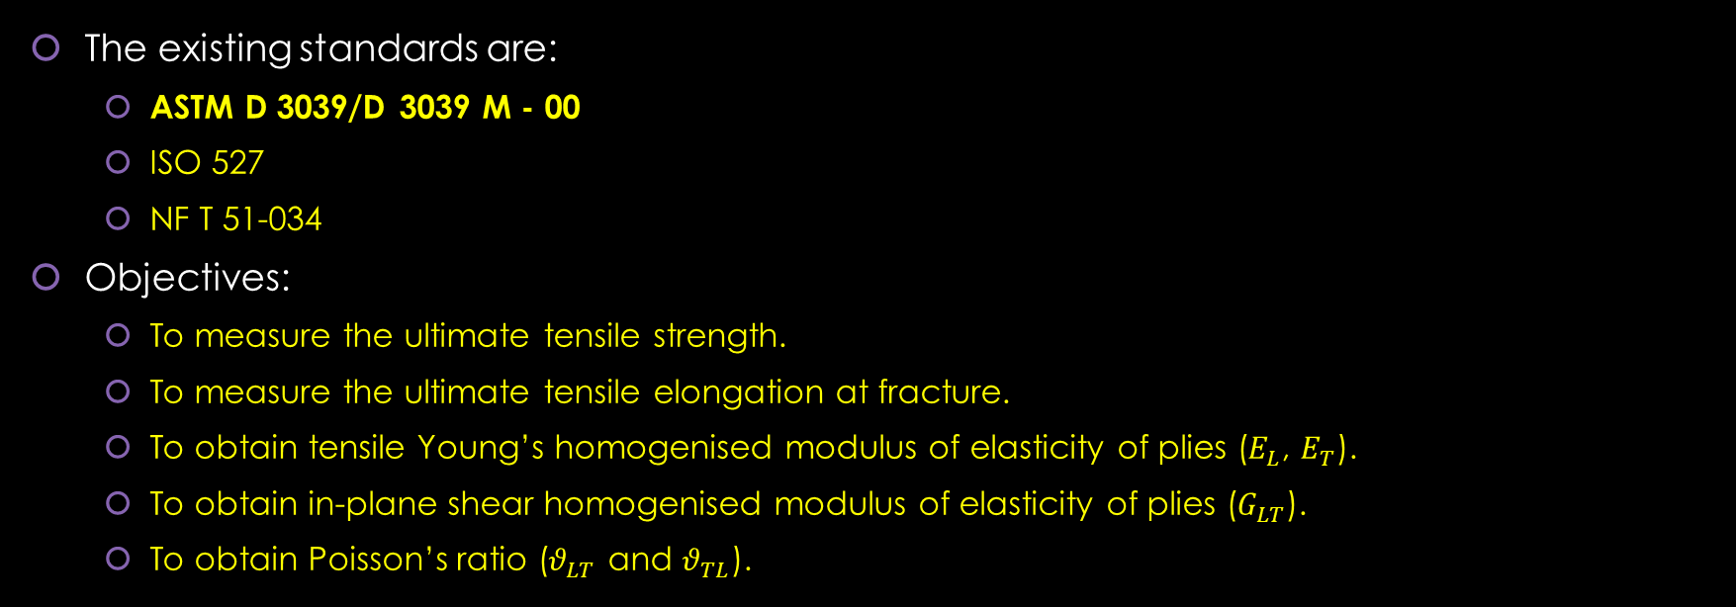
Tensile testing
The existing standards are:
  ASTM D 3039/D 3039 M - 00
  ISO 527
  NF T 51-034
Objectives:
  To measure the ultimate tensile strength.
  To measure the ultimate tensile elongation at fracture.
  To obtain tensile Young’s homogenised modulus of elasticity of plies ($E_{L}$, $E_{T}$).
  To obtain in-plane shear homogenised modulus of elasticity of plies ($G_{LT}$).
  To obtain Poisson’s ratio ($θ_{LT}$ and $θ_{TL}$).

Slide 6
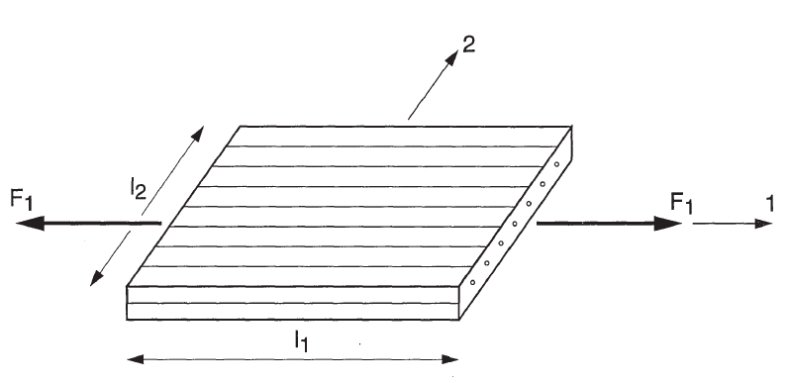

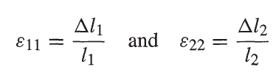

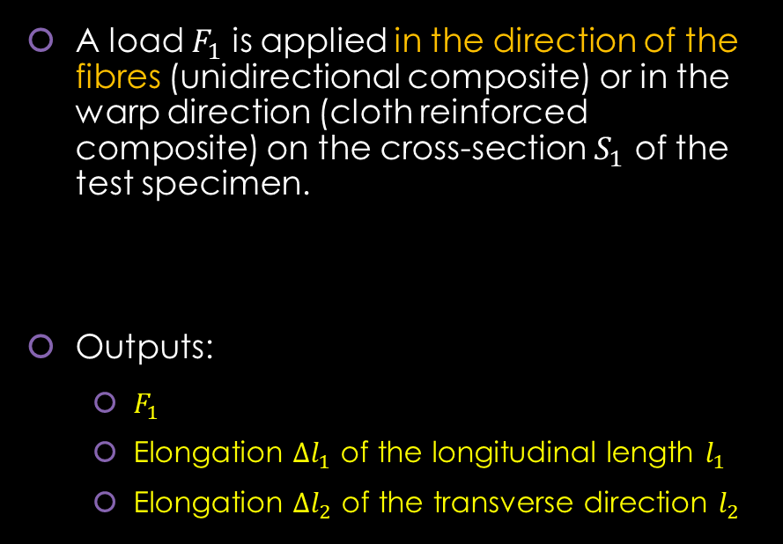
Tensile testing-
Longitudinal tension
A load $F_{1}$ is applied in the direction of the fibres (unidirectional composite) or in the warp direction (cloth reinforced composite) on the cross-section $S_{1}$ of the test specimen.
Outputs:
  $F_{1}$
  Elongation $∆l_{1}$ of the longitudinal length $l_{1}$
  Elongation $∆l_{2}$ of the transverse direction $l_{2}$

Slide 7
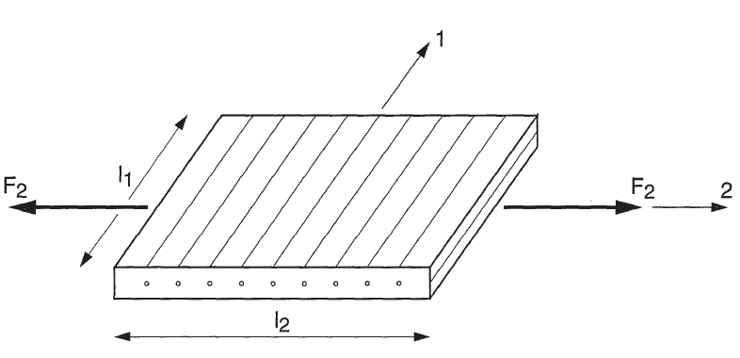



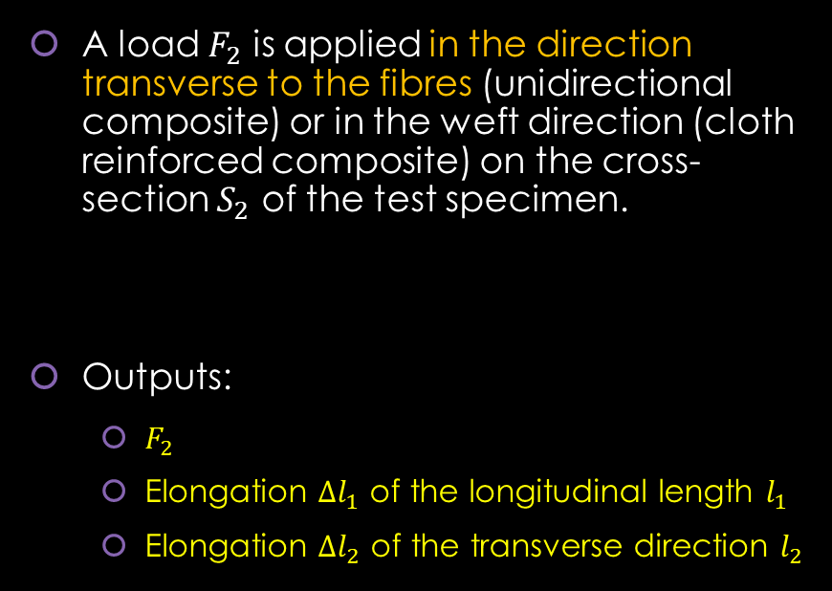
Tensile testing-
Transverse tension
A load $F_{2}$ is applied in the direction transverse to the fibres (unidirectional composite) or in the weft direction (cloth reinforced composite) on the cross-section $S_{2}$ of the test specimen.
Outputs:
  $F_{2}$
  Elongation $∆l_{1}$ of the longitudinal length $l_{1}$
  Elongation $∆l_{2}$ of the transverse direction $l_{2}$

Slide 8

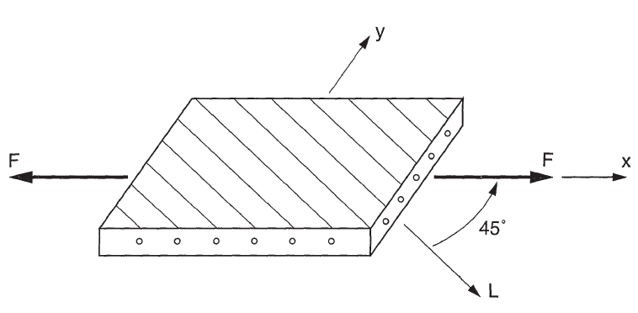



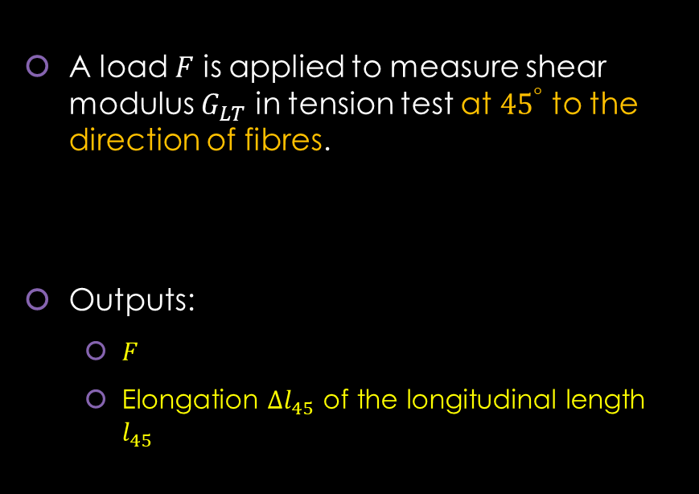
Tensile testing-
Off-axis tension
A load $F$ is applied to measure shear modulus $G_{LT}$ in tension test at ${45}^{°}$ to the direction of fibres.
Outputs:
  $F$
  Elongation $∆l_{45}$ of the longitudinal length $l_{45}$

Slide 9
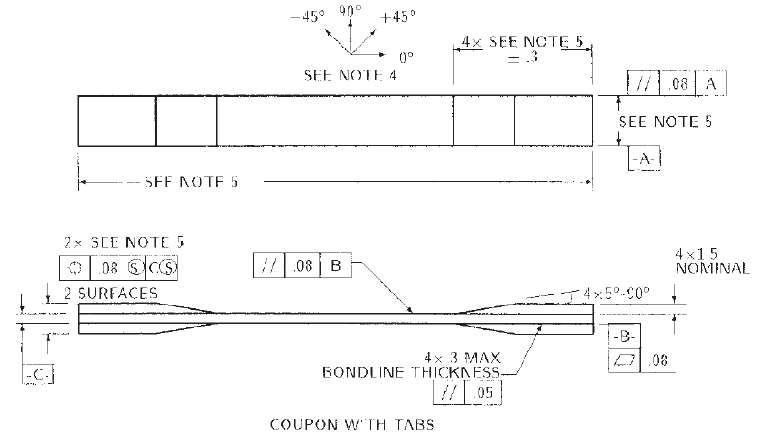
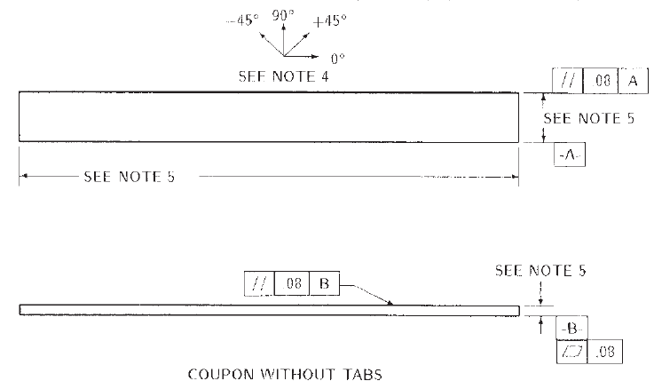
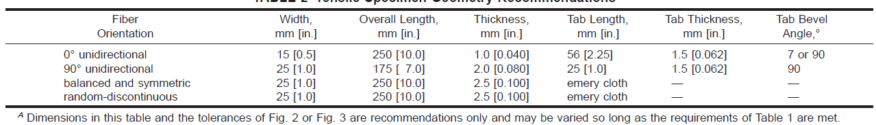
Tensile testing-
Specimen geometry based on D 3039/D 3039M-00

Slide 10
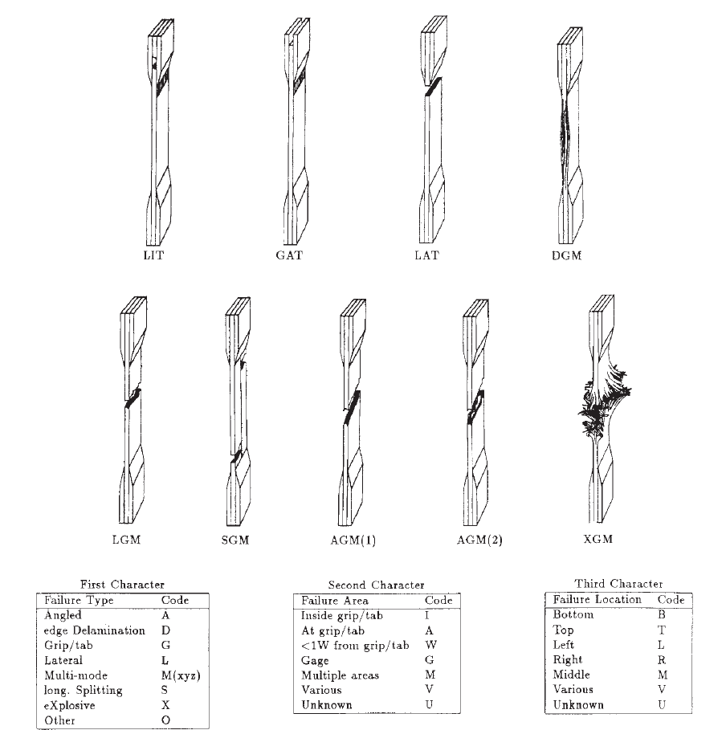
Tensile testing-
Typical failure modes

Slide 11
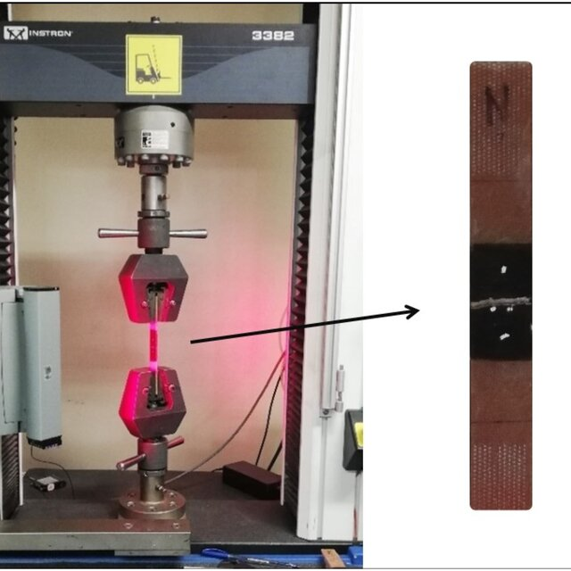
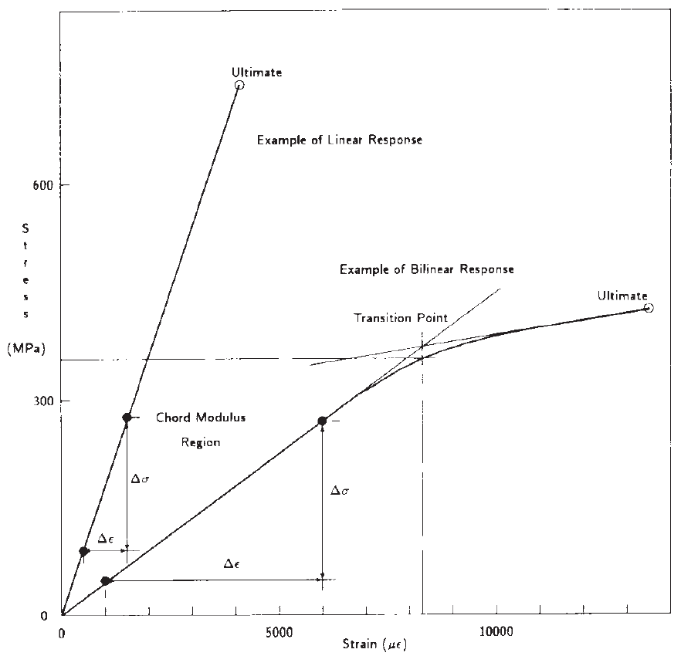
Tensile testing-
Illustration & typical stress-strain behaviour

Slide 12
Compressive
Testing

Slide 13
Compressive testing
The existing standards are:
  ASTM D 3410/D 3410M - 03
  ISO 14126
  DIN 35375
Objectives:
  To measure the ultimate compressive strength.
  To measure the ultimate compressive strain at fracture.
  To measure compressive modulus of elasticity.
  To measure Poisson’s ratio in compression.
  To measure transition strain.

Slide 14
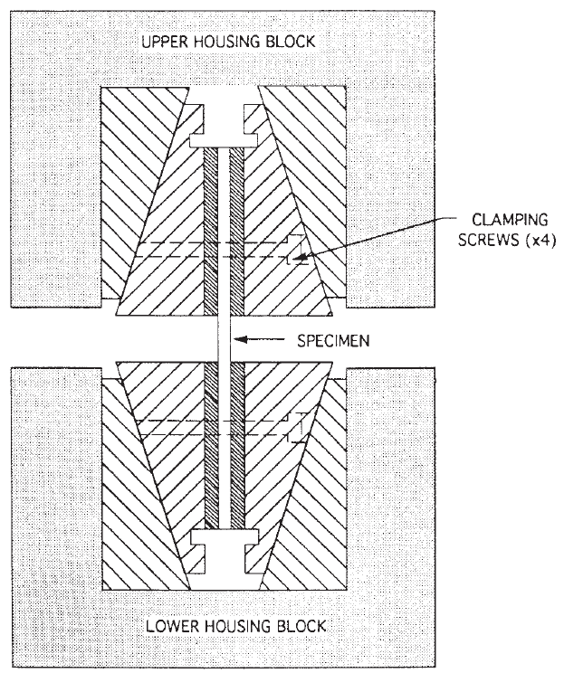
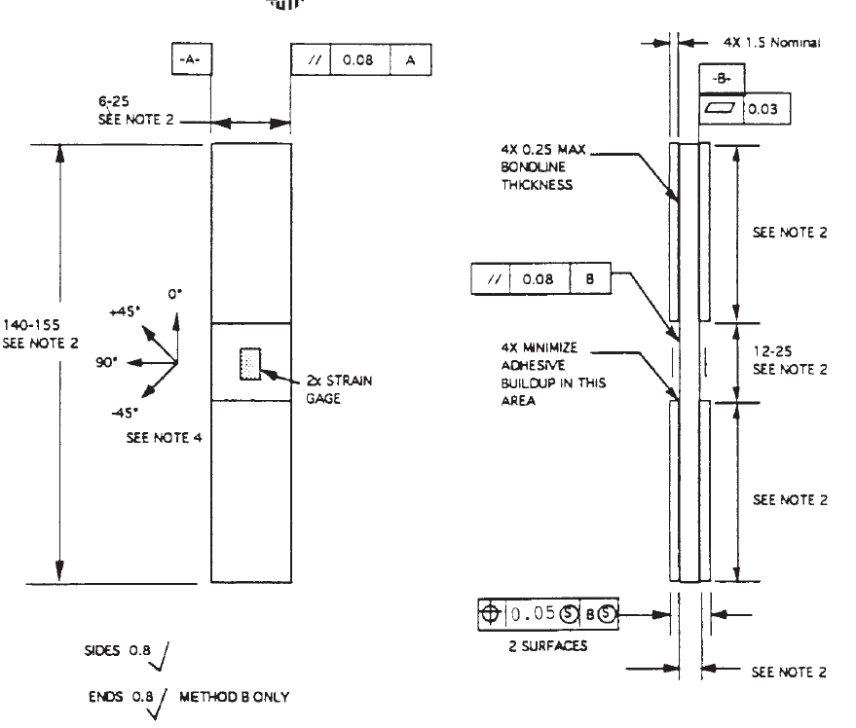
Compressive testing-
Specimen geometry and test set-up based on
D 3410/D 3410M - 03

Slide 15
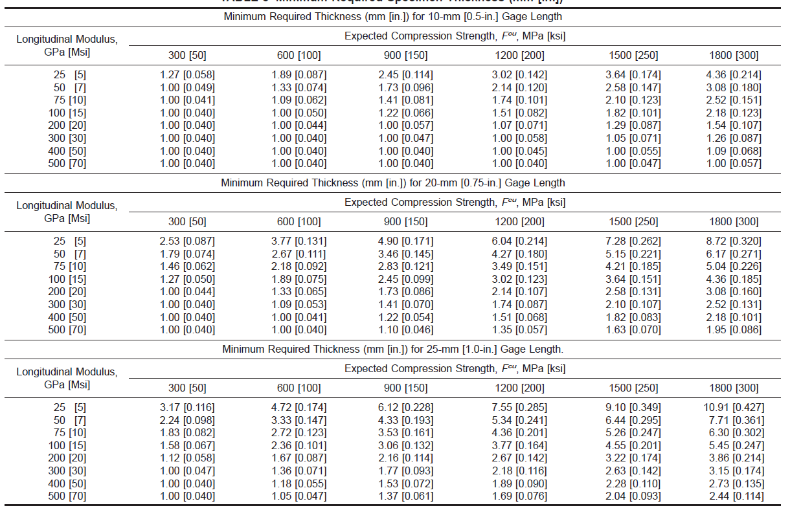
Compressive testing-
Specimen geometry and test set-up based on
D 3410/D 3410M – 03-Minimum required thickness

Slide 16
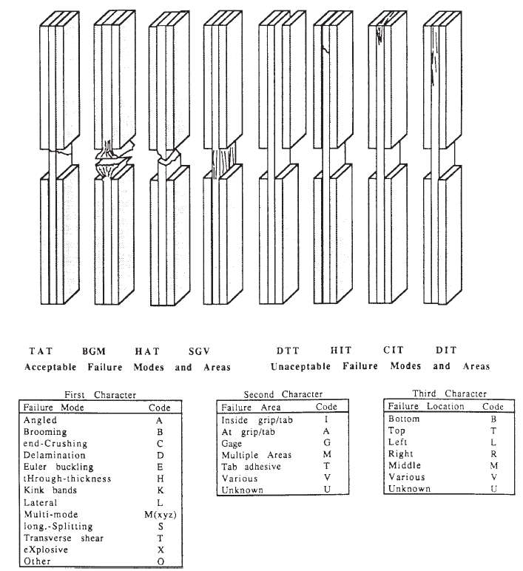
Compressive testing- acceptable vs unacceptable failure modes

Slide 17
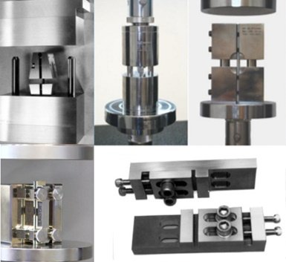
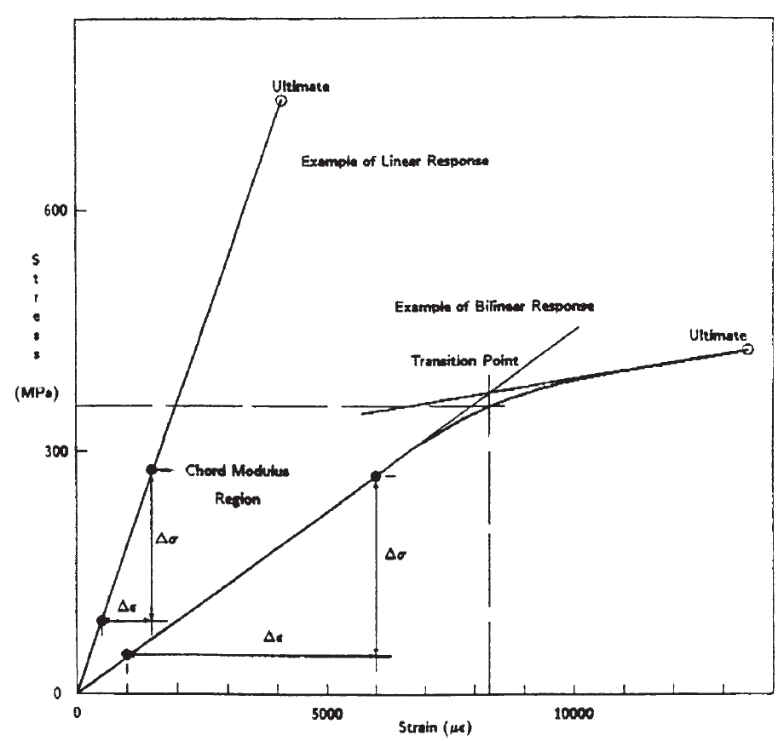
Compressive testing-
Illustration & typical stress-strain behaviour

Slide 18
V-Notched Beam
Testing

Slide 19
V-Notched testing-
Iosipescu shear test
The existing standards are:
  ASTM D 5379/D 5379M - 12
  ISO 15310:2009
Objectives:
  To measure ultimate shear strength.
  To measure ultimate shear strain.
  To measure the shear modulus of composite plies.
Important note:
  There are no standard test methods that can produce a perfectly pure shear stress condition to failure for every material, although some test methods can come acceptably close for a specific material for a given engineering purpose.

Slide 20
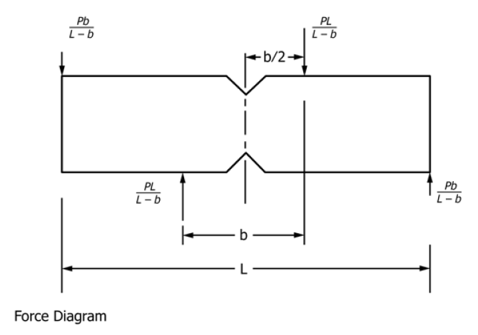
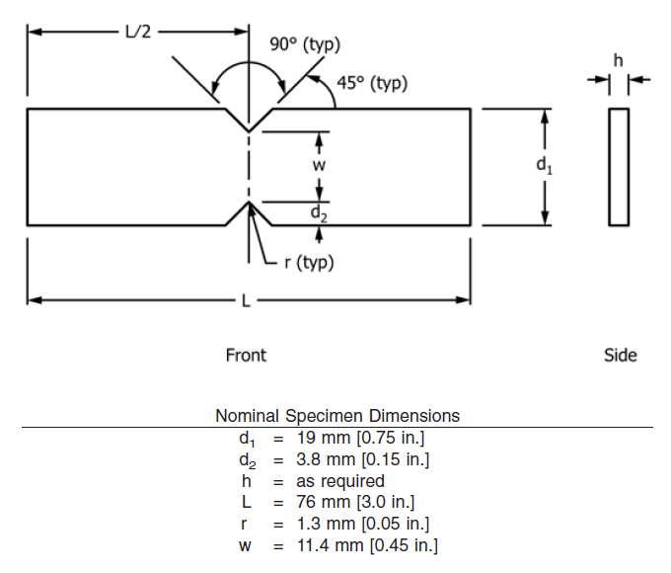
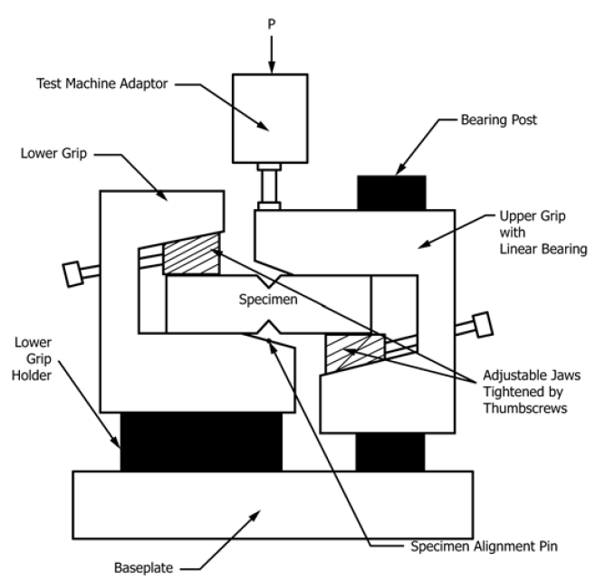
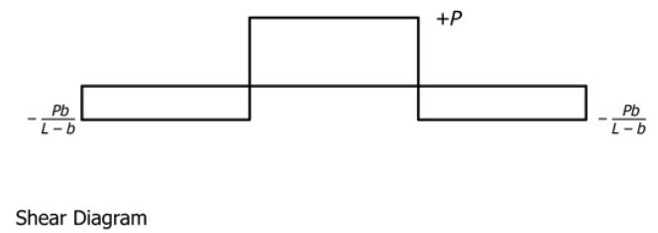
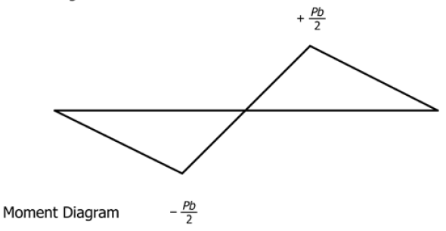
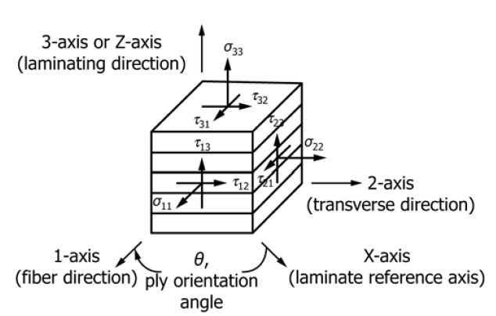
V-Notched testing-
Specimen geometry and test set-up

Slide 21
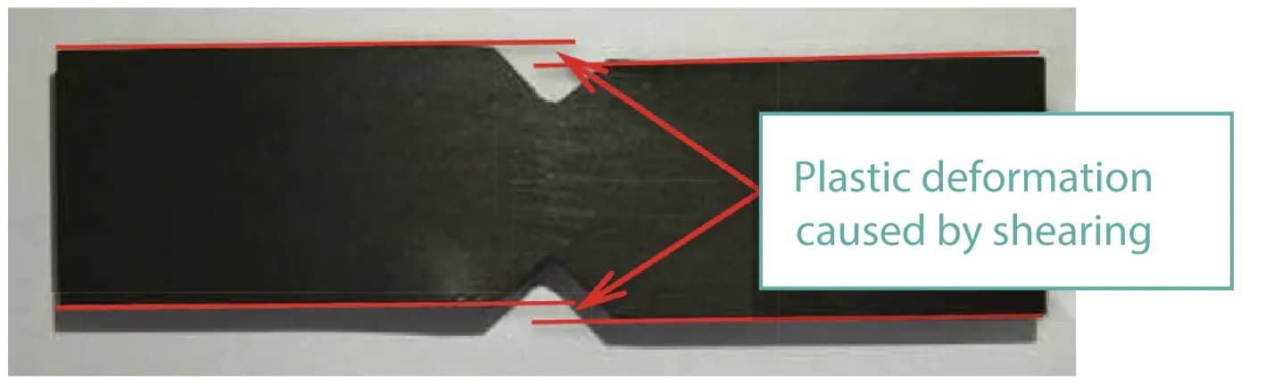
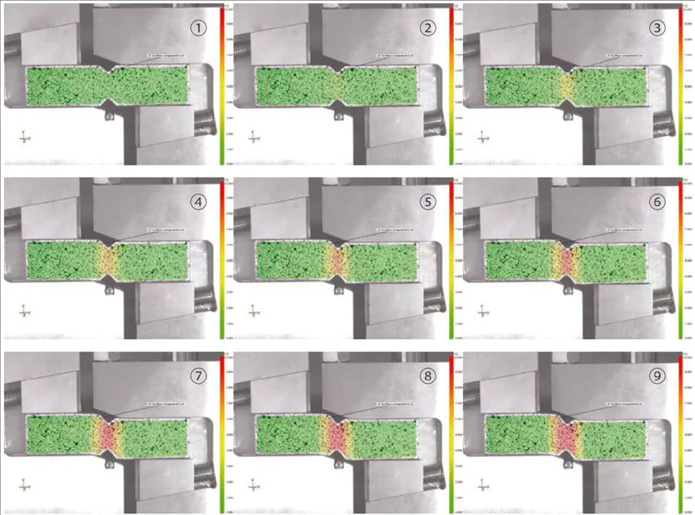
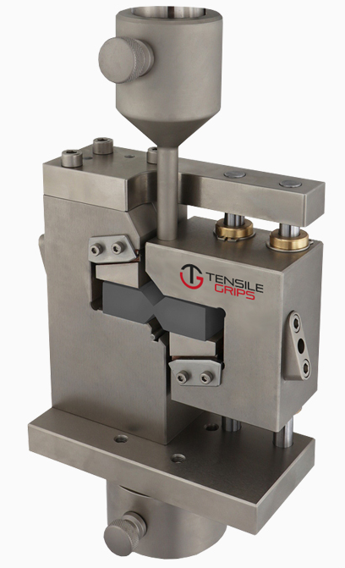
V-Notched testing-
Illustration

Slide 22
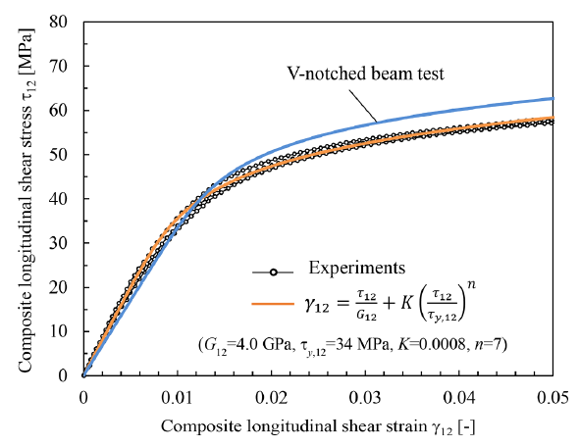
V-Notched testing-
Typical stress-strain behaviour

Slide 23
Open Hole Tension
Testing

Slide 24
Open hole tension testing
The test method is also known as Open Hole Tension (OHT)
The existing standards are:
  ASTM D 5766/D 5766M - 11
  ISO 527-4
  EN 6034
Objectives:
  To determine the open-hole tensile strength of multidirectional polymer matrix composite laminates reinforced by high-modulus fibres (balanced and symmetric laminates).
  Uses D 3039/D3039 M as the baseline approach.
  To measure ultimate tensile strength of plate containing a circular cut-out.

Slide 25
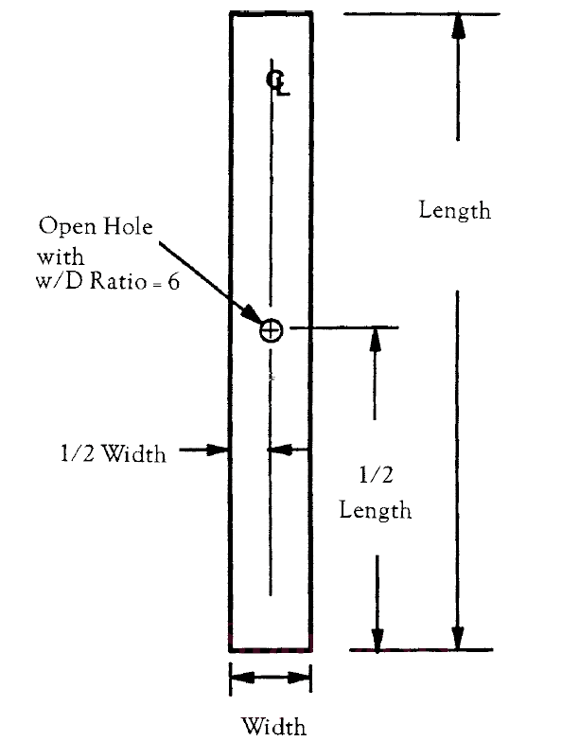
Open hole tension testing-
Specimen geometry and test set-up
For geometrical details refer to ASTM D 3039/ D 3039 M
Nominal thickness of laminate is 2.5 mm with the permissible range of 2 to 4 mm.
Two configurations are proposed:
  Config A: w = 36 ± 1 mm, L = 200-300 mm, D = 6 ± 0.06 mm
  Config B: w = 36 ± 1 mm, L = 150-200 mm, D = 6 ± 0.06 mm. Limited to quasi-isotropic laminates, grip length = 35-55 mm

Slide 26
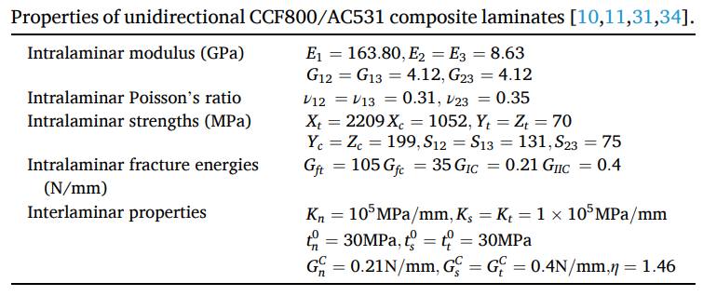
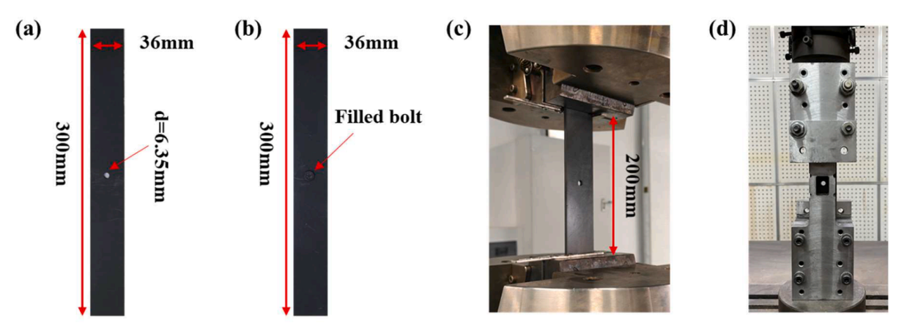
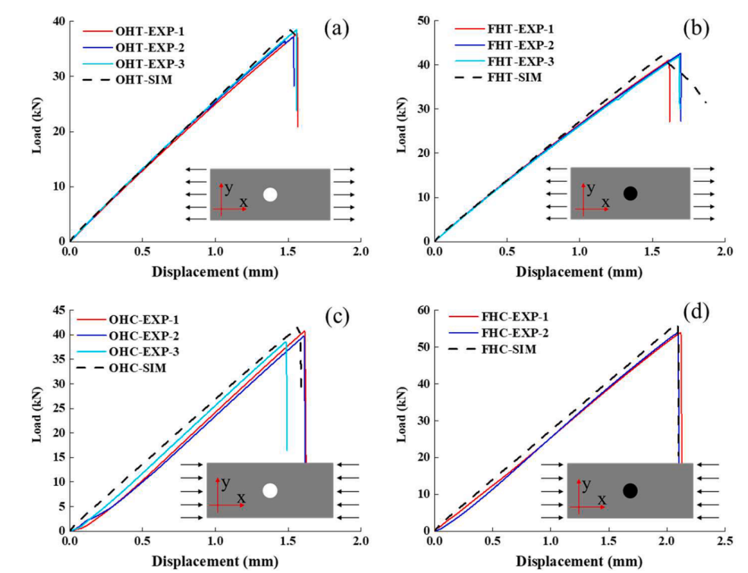
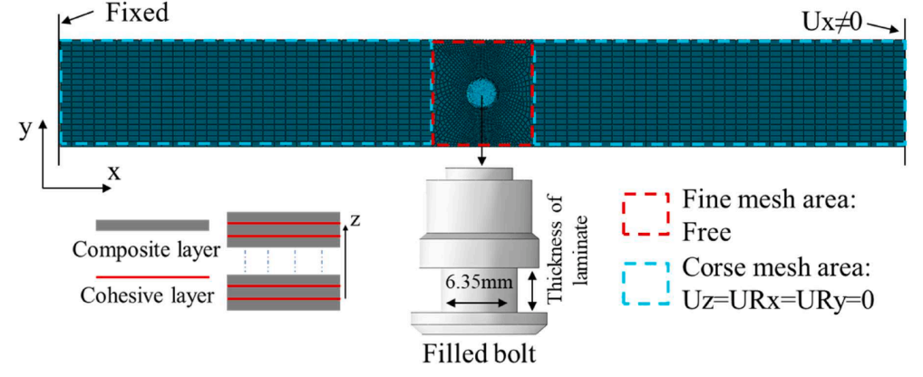
Open hole tension testing-
Illustration & typical stress-strain behaviour

Slide 27
Open Hole Compression
Testing

Slide 28
Open hole tension testing
The test method is also known as Open Hole Compression (OHC)
The existing standards are:
  ASTM D 6484/D 6484M - 20
  ISO 12817:2013
  EN 6036
Objectives:
  To determine the open-hole compressive strength of multidirectional polymer matrix composite laminates reinforced by high-modulus fibres (balanced and symmetric laminates).
  To measure ultimate compressive strength of plate containing a circular cut-out.

Slide 29
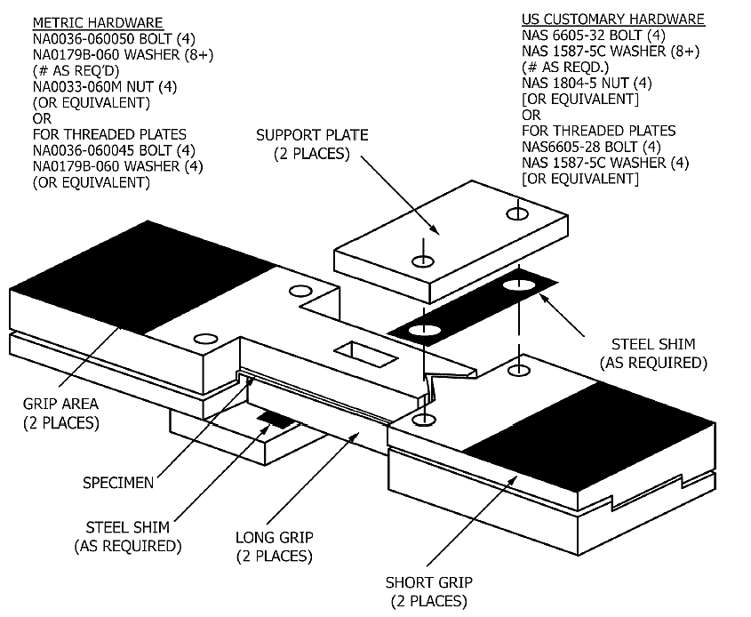
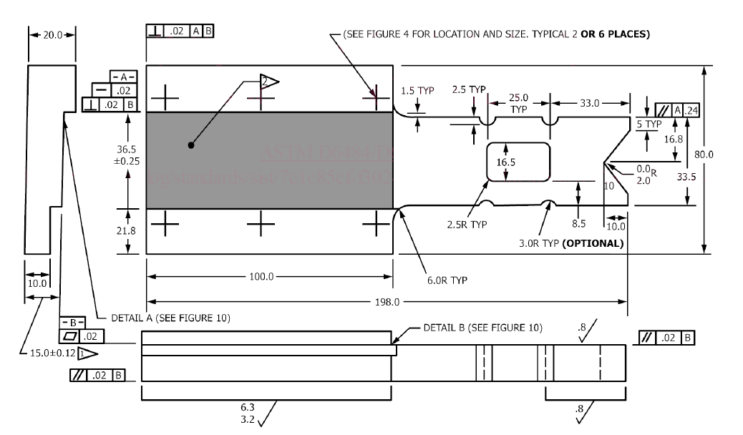
Open hole compression testing-
Specimen geometry and test set-up (dims are in mm)

Slide 30
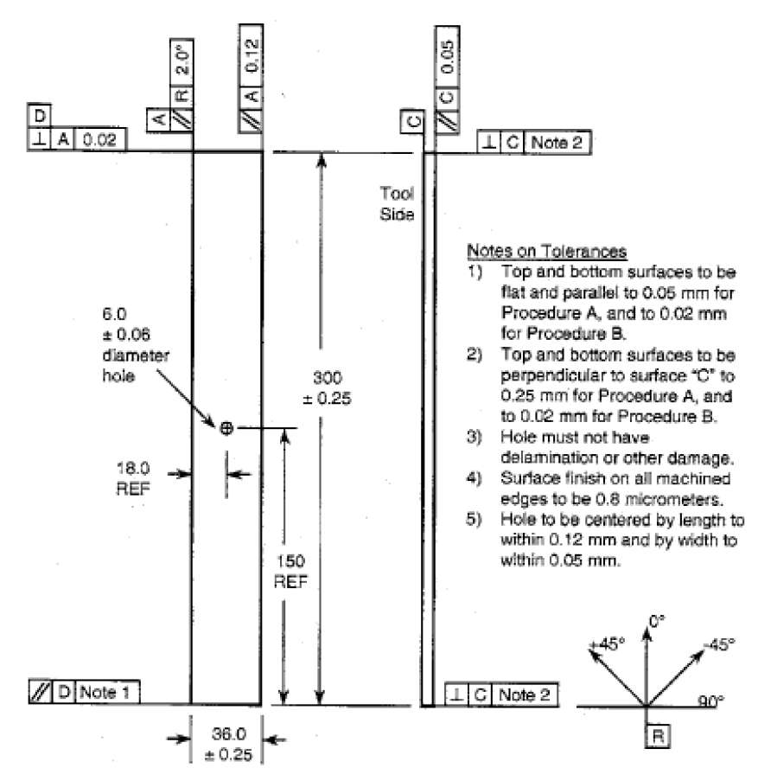
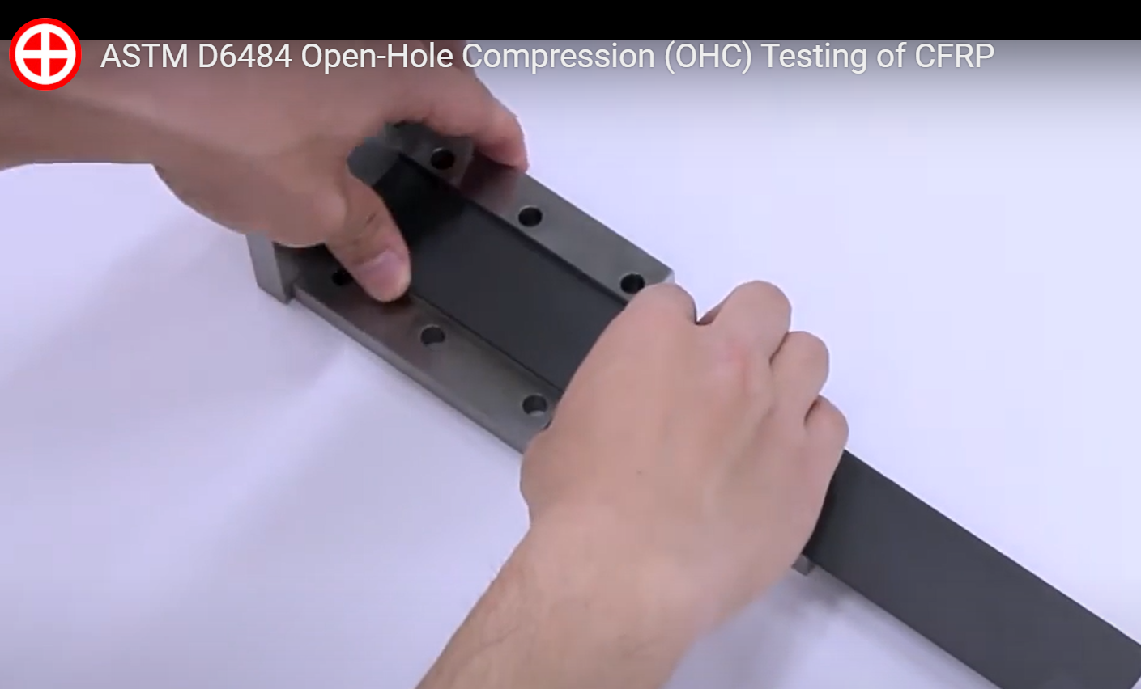
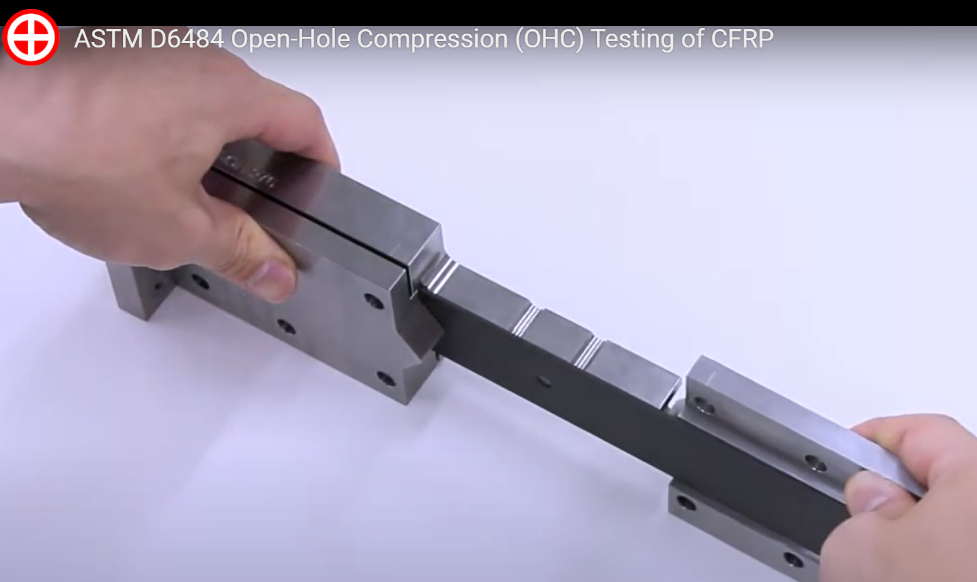
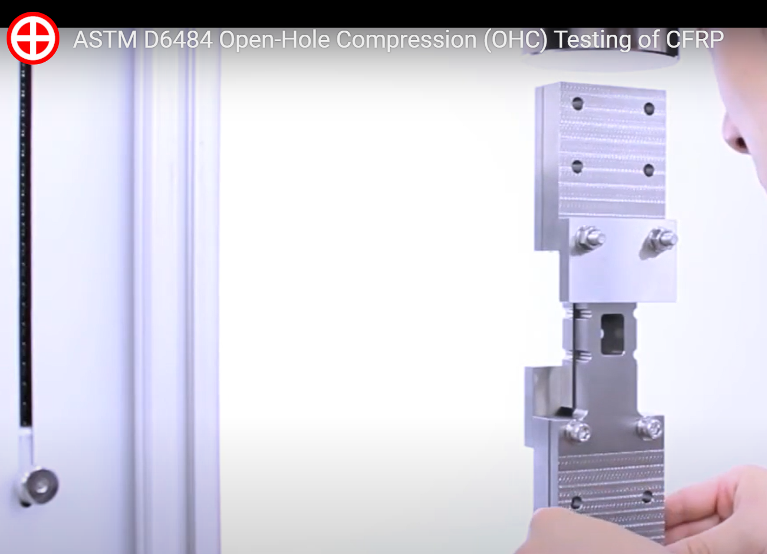
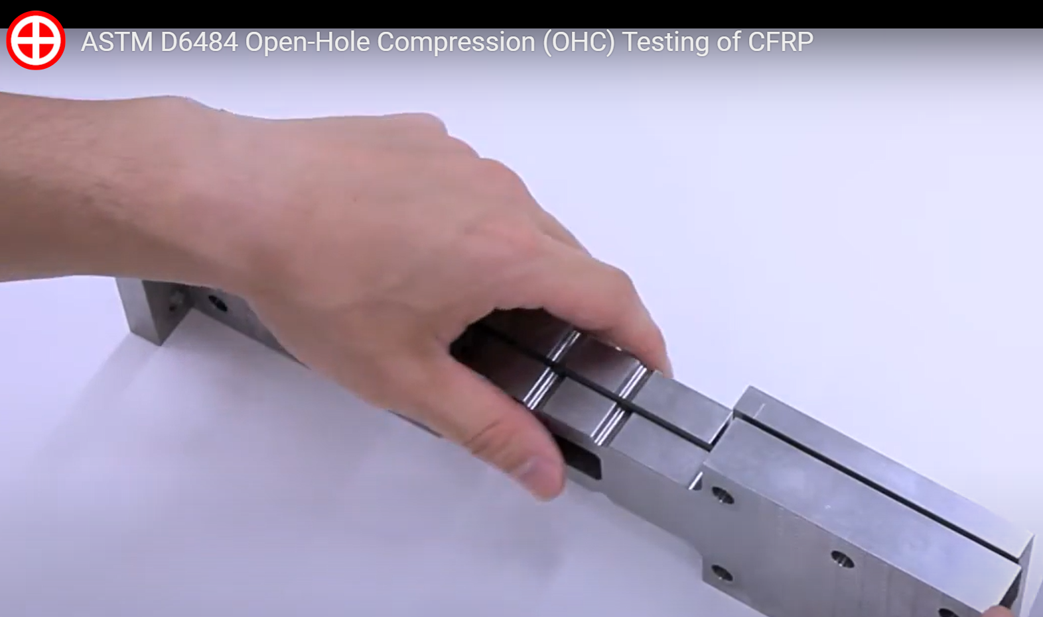
Open hole compression testing-
Specimen geometry and test set-up

Slide 31
Open hole tension testing-
Illustration & typical stress-strain behaviour

Slide 32
Short Beam Shear
Testing

Slide 33
Short beam shear testing
The existing standards are:
  ASTM D 2344/D 2344M - 20
  ISO 14130
  EN 2563
Objectives:
  In most cases, because of the complexity of internal stresses and the variety of failure modes that can occur in this specimen, it is not generally possible to relate the short-beam strength to any one material property. However, failures are normally dominated by resin and interlaminar properties, and the test results have been found to be repeatable for a given specimen geometry, material system, and stacking sequence
  Used for quality control and process specification purposes.
  Used for comparative testing of composite materials, if failures occur consistently in the same mode

Slide 34
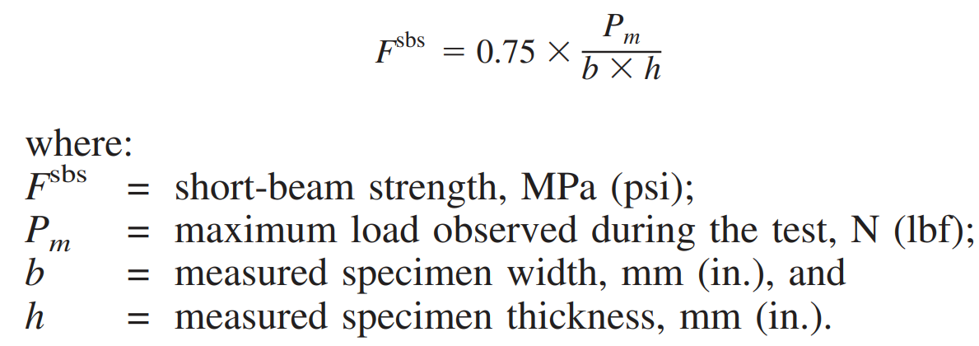
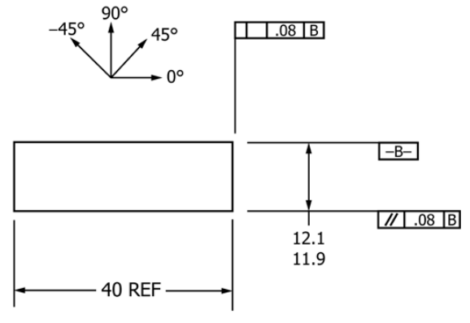
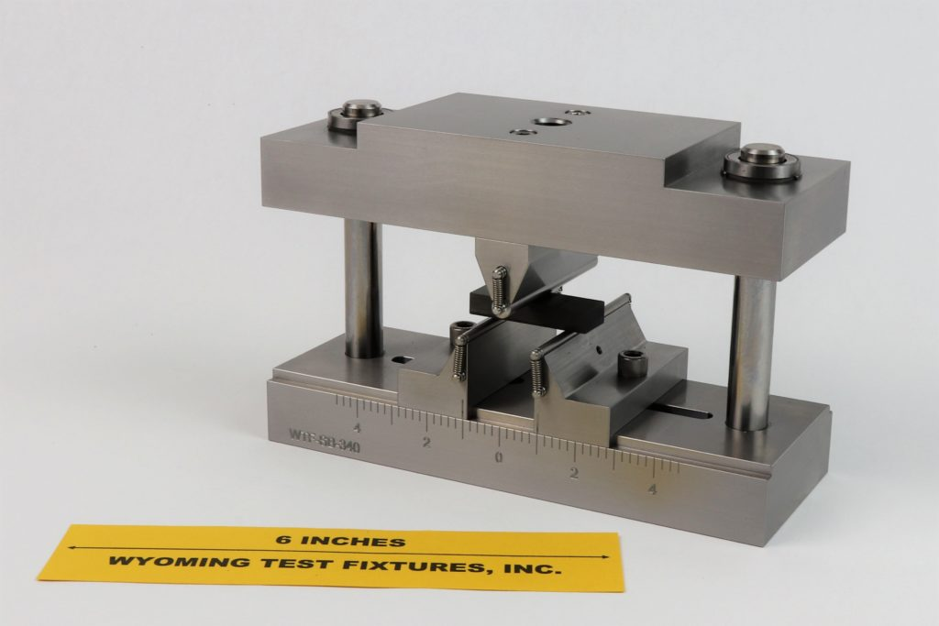
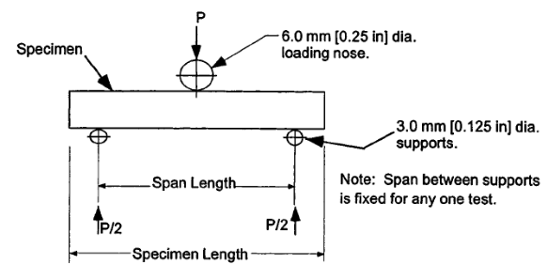
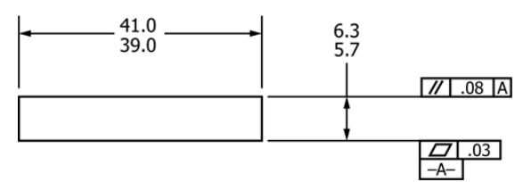
Short beam shear testing-
Specimen geometry and test set-up
(dims are in mm)
Span to thickness ratio = 4.0
Specimen length to thickness ratio = 6.0
Specimen width to thickness ratio = 2.0
Both the loading nose and side supports should overhang the specimen width by at least 2mm at each side.

Slide 35
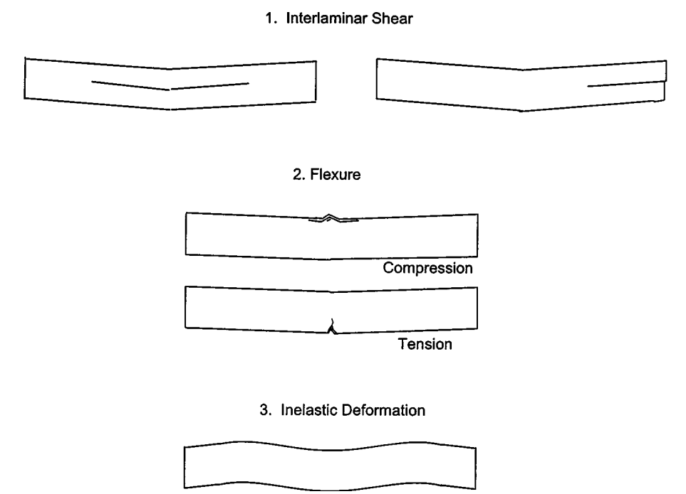
Short beam shear testing-
Typical failure modes

Slide 36
Flexural
Testing

Slide 37
Flexural testing
The existing standards are:
  ASTM D 7264/D 7264M - 07
  ISO 14125
  EN 2562
Objectives:
  To determine the flexural properties (including strength, stiffness, and load/deflection behaviour) of polymer matrix composite materials using 3- or 4- point bending test.
  This is a long beam test as opposed to short beam test.
  Flexural properties can be used for quality control.
  These procedures can be useful in the evaluation of multiple environmental conditions to determine which are design drivers and may require further testing.

Slide 38
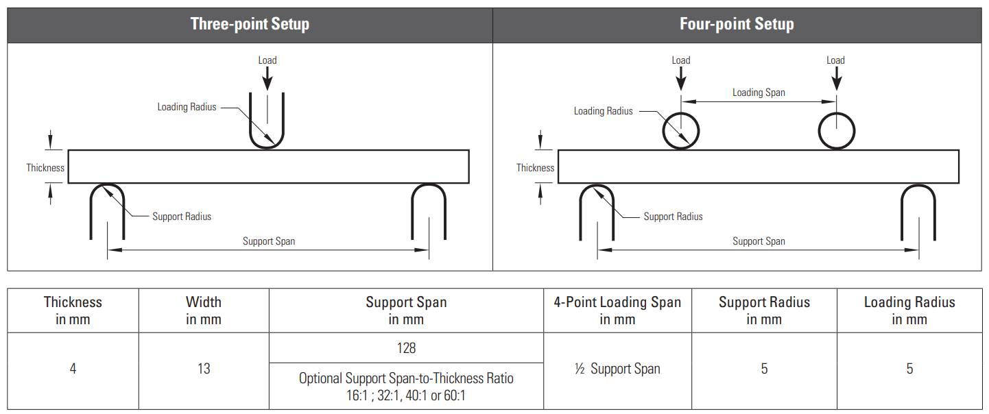
Flexural testing-
Specimen geometry and test set-up
(dims are in mm)

Slide 39
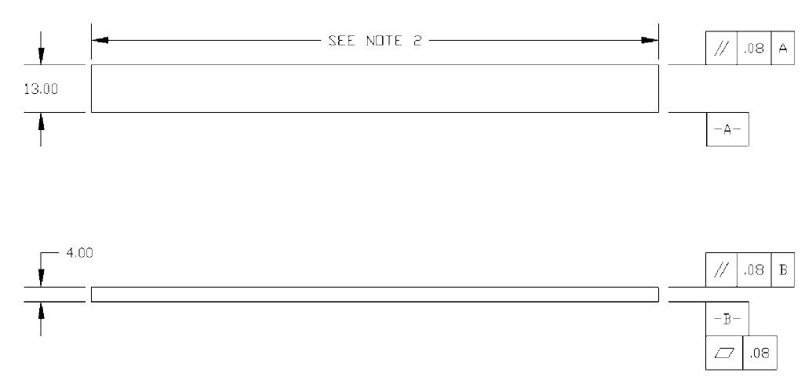







Flexural testing-
Specimen geometry and test set-up
(dims are in mm)

Slide 40



Flexural testing-
Specimen geometry and test set-up
For correct values of flexural modulus and deflection at failure, this must be compensated for to give correct zero point on the deflection or extension axis.
Type B Non-Hookean response
Flexural chord modulus is the slope of this line (B’G’)
Tangent line at H’
Type A Hookean response
AC is due to slack and alignment or seating of the specimen and should be excluded from material behaviour studies
AH’ is due to slack and alignment or seating of the specimen and should be excluded from material behaviour studies
Correct ZERO point.
Correct ZERO point.

Slide 41
Mode-I Interlaminate Fracture
Toughness
Testing

Slide 42


Mode-I interlaminate fracture toughness testing
Also known as Double Cantilever Beam (DCB) test.
The existing standards are:
  ASTM D 5528 - 13
  ISO 15024
Objectives:
  To determine opening mode-I interlaminar fracture toughness $G_{Ic}$.
  To Establish quantitatively the effect of fibre surface treatment, local variations in fibre volume fraction, and processing and environmental variables on $G_{Ic}$.
  To develop delamination failure criteria for composite damage tolerance and durability analyses.
  For unidirectional CFRP and GFRP.

Slide 43







Mode-I interlaminate fracture toughness testing-Specimen geometry and Test set-up
Strain energy release rate:
dU is the loss of energy in the test specimen per unit of specimen width for an infinitesimal increase of delamination length da.
This criterion is for material with high interlaminar fracture toughness to avoid bending of laminate.
(we need to make sure energy is consumed by delamination only)
L > 125 mm
20 mm < b < 25 mm
3 mm < h < 5 mm
a₀ = 50 mm
Loading (speed of 1-5 mm/min) is stopped if the length of delamination becomes 3 mm-5 mm then unload (with speed of 25 mm/min). Then re-load again. Do the same until final delamination length is achieved

Slide 44




Mode-I interlaminate fracture toughness testing-Test set-up

Slide 45


Mode-I interlaminate fracture toughness testing-Resistance curve (R curve)
The critical energy release rate or fracture toughness is the point of deviation from linearity.
For each delamination length, G_{I} is plotted.
A resistance-type fracture behaviour typically develops where the calculated G_{Ic} first increases monotonically, and then stabilizes with further delamination growth.
The principal reason for the observed resistance to delamination is the development of fibre bridging.

Slide 46
Mode-II Interlaminate Fracture
Toughness
Testing

Slide 47

Mode-II interlaminate fracture toughness testing
Also known as End Notched Flexure (ENF) test.
The existing standards are:
  ASTM D 7905 / D 7905 M - 19
  ISO 15114
Objectives:
  To determine shearing mode-II interlaminar fracture toughness $G_{IIc}$.
  To Establish quantitatively the effect of fibre surface treatment, local variations in fibre volume fraction, and processing and environmental variables on $G_{IIc}$.
  To develop delamination failure criteria for composite damage tolerance and durability analyses.
  For unidirectional CFRP and GFRP.

Slide 48







Mode-II interlaminate fracture toughness testing-Specimen geometry and Test set-up
(dims are in mm)
Strain energy release rate:
4.7 mm < r₁ < 9.6 mm
3.0 mm < r₂ < 6.4 mm

Slide 49



Mode-II interlaminate fracture toughness testing-Specimen geometry and Test set-up
(dims are in mm for Japanese Industrial Standard)

Slide 50


Mode-I interlaminate fracture toughness testing-Test set-up

Slide 51



Mode-I interlaminate fracture toughness testing-Compliance test for m determination
The compliance calibration (CC) method is performed on the non-pre cracked (NPC) fracture tests.
This method involves loading the specimens at different crack lengths to obtain a value of compliance from each test.
For each test Compliance (C) is obtained (inverse of stiffness or inverse of slope of load displacement graph).

Slide 52
Adhesively Bonded
Single Lap Shear Joint
Testing

Slide 53
Single lap shear joint testing
The existing standards are:
  ASTM D 3164 - 03
Objectives:
  To determine shear strength of single lap shear joints employing plastic adherends.

Slide 54



Single lap shear joint testing-
Specimen geometry
$$τ=\frac{P_{max}}{LB}$$
Deutsches Institut für Normung (DIN)

Slide 55
Tests Specific to
Composite
Sandwich Structures

Slide 56
Flexural
Testing

Slide 57
Flexural testing-Sandwich structures
The existing standards are:
  ASTM D 7250/D 7250M – 20
Important Note:
  This standard is limited to sandwich beams exhibiting linear force-displacement response. This practice uses test results obtained from C393/C393M (for the core material) or D 7249/D 7249 M.
Objectives:
  To determine the sandwich flexural stiffness.
  To determine the core shear strength and shear modulus.
  To determine the facing’s compressive and tensile strengths.

Slide 58


Flexural testing-Sandwich structures
Specimen geometry and test set-up (dims are in mm)
For detailed formulation see
The snapshot in the next slide

Slide 59



Flexural testing-
Sandwich structures
Specimen geometry and test set-up

Slide 60

Flexural testing-
Sandwich structures-Typical response and correction for nonlinear portion

Slide 61
Core Shear Properties of
Sandwich Construction
by Beam Flexure
Testing

Slide 62
Flexural testing-Sandwich structures-
Core material
The existing standards are:
  ASTM C 393/D 393M
Objectives:
  To determine the core shear properties of flat sandwich constructions subjected to flexure in such a manner that the applied moments produce curvature of the sandwich facing planes.

Slide 63








Flexural testing-Sandwich structures-
Core material-Specimen geometry and test set-up (dims are in mm)
Non-standard tests are kept for historical record in the standard.

Slide 64
Flatwise Compressive Properties of
Sandwich Cores
Testing

Slide 65
Compressive testing-Sandwich structures-
Core material
The existing standards are:
  ASTM C 365/C 365M
Objectives:
  To determine compressive strength and modulus of sandwich cores.

Slide 66









Compressive testing-
Sandwich structures-
Core material-
Specimen geometry and test set-up (dims are in mm)

