Slide 1
Laminate Theory
By Dr. Mahdi Damghani

Slide 2
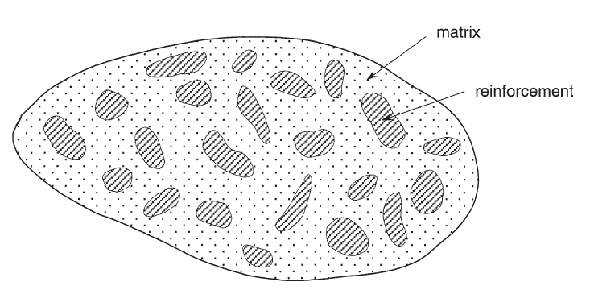
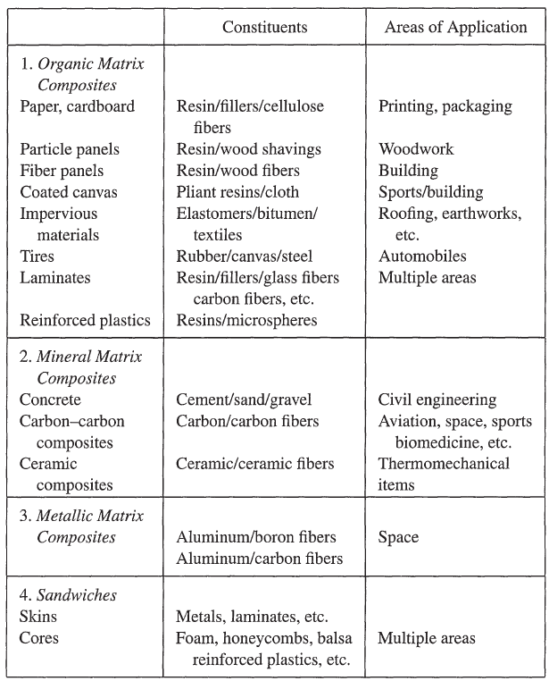
Composite materials
Materials having strong fibres (continuous or noncontinuous) surrounded by a weaker matrix material.
The matrix serves to
Distribute the fibres.
Transmit the load to the fibres.
Notes:
Intro
“This slide introduces the fundamental idea of composite materials: a combination of strong reinforcement and a weaker matrix, engineered to achieve properties unattainable by either alone.”
Concept
Reinforcement (fibres or particles): carries most of the load, providing stiffness and strength.
Matrix (polymer, metal, or ceramic): surrounds the reinforcement and has two key roles:
Distributes and supports the fibres.
Transfers external load into the reinforcement.
This synergy is what gives composites their superior performance-to-weight ratio.
Details
The figure illustrates fibres (dark regions) embedded in a matrix (lighter region).
The table highlights the main families of composites:
Organic matrix composites (paper, plastics, laminates).
Mineral matrix composites (concrete, carbon–carbon, ceramics).
Metallic matrix composites (aluminium with boron or carbon).
Sandwich structures (skins and cores for stiffness-to-weight efficiency).
Applications span from packaging and construction to aerospace and automotive, showing the versatility of composites.

Slide 3
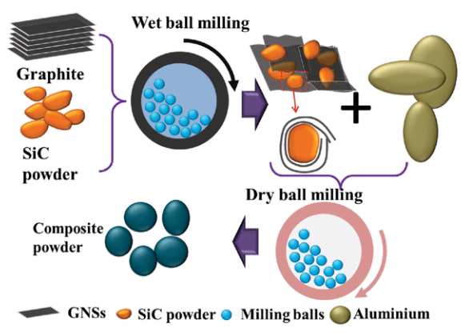
Example- Metal Matrix Composite
SiC (Silicon Carbide):
Increases strength and stiffness.
Improves wear resistance due its hardness.
Excellent thermal stability.
High thermal conductivity.
Reduced thermal fatigue.
Improves creep resistance
Improves corrosion resistance.
Aluminum matrix composites reinforced with SiC-Graphene Core-Shell Nano particles:
Metal matrix composites (MMCs) are an advanced group of structural and functional materials, which combine and tailor the properties of metal matrix and reinforcements.
MMCs have a combination of the inherit ductility and toughness of the matrix (the metal), and high modulus and strength of the reinforcements (such as ceramic particulates).
The tensile modulus (1.002 TPa) and strength (130 GPa) of graphene is 100 times higher than steel.
Graphene has excellent electrical conductivity.
Aluminum is ductile, light weight, corrosion resistant, and has outstanding conductivity
Notes:
Intro
“This slide shows an example of a metal matrix composite (MMC): aluminum reinforced with SiC–graphene core–shell nanoparticles. It demonstrates how metals can be enhanced by combining them with high-performance ceramic and carbon nanomaterials.”
Concept
MMC definition: Structural and functional materials where a metallic matrix (e.g., aluminum) is reinforced with ceramics (SiC) or carbon nanostructures (graphene).
Synergy:
Matrix (aluminum): ductile, lightweight, corrosion-resistant, high conductivity.
Reinforcements (SiC + graphene): high stiffness, hardness, modulus, and excellent thermal/electrical properties.
Processing: ball milling techniques allow uniform distribution of nanoparticles within the aluminum.
Details
SiC (Silicon Carbide) contributions:
Increases stiffness and strength.
Improves wear, creep, and corrosion resistance.
Enhances thermal conductivity and stability.
Graphene contributions:
Exceptional tensile modulus (≈1 TPa) and strength (≈130 GPa) — about 100× steel.
Outstanding electrical conductivity.
Aluminum contributions:
Lightweight, ductile, corrosion-resistant, high conductivity.
Combined result: a composite that is lightweight yet extremely strong, thermally stable, and multifunctional.

Slide 4
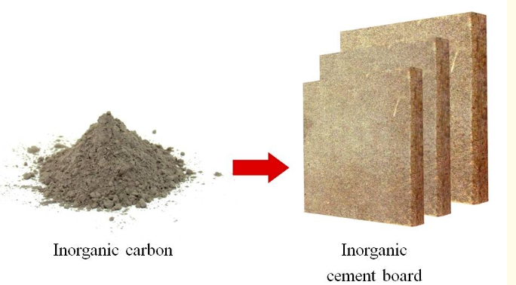
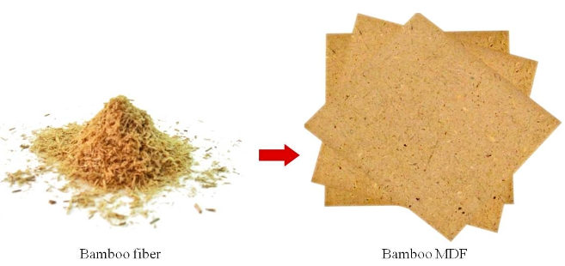
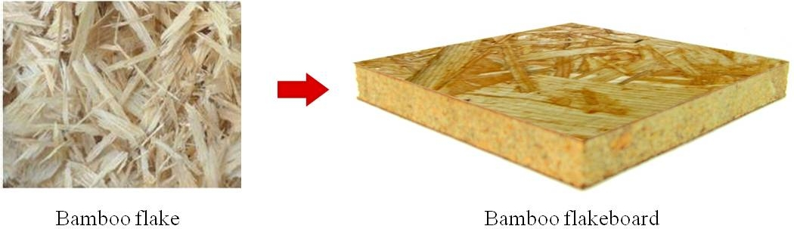
Example- Bio composite
Thermoplastic polypropylene matrices
Notes:
Intro
“This slide presents an example of a bio-composite — composites that use natural fibers such as bamboo combined with inorganic fillers or polymer matrices to create sustainable structural materials.”
Concept
Bio-composites: Reinforced with natural, renewable fibers (bamboo, flax, hemp, jute) and combined with either polymeric or inorganic matrices.
Motivation: Low cost, renewable resources, reduced environmental impact, biodegradability, and moderate mechanical performance.
Bamboo case: Bamboo is abundant, has high specific strength, and is easily processed into fibers, flakes, or MDF panels.
Details
Reinforcements shown:
Bamboo fibers (fine scale).
Bamboo flakes (larger elements).
Bamboo MDF (medium-density fiberboard).
Bamboo flakeboard.
Matrix options:
Thermoplastic polypropylene.
Inorganic binders (cement boards, inorganic carbons).
Applications:
Panels, furniture, flooring, and eco-friendly construction materials.
Packaging and automotive interior parts when combined with polypropylene.
Performance:
Not as strong as metal or carbon composites, but sufficient for low- to medium-load structural elements.
Key advantage is sustainability and reduced lifecycle environmental footprint.

Slide 5
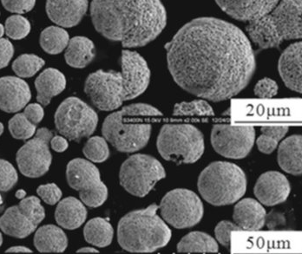
Classification of composite materials
Classification by the form of constituents
Fibre composites (reinforcement is in the form of continuous or discontinuous fibres)
Particles composites (reinforcement is particles)
Example 1: ceramic-metal (cermet) composites adapted to high temperature applications. For example, oxide-based cermet are used for high-speed cutting tools and for protectors at high temperatures.
Example 2: lead inclusions in copper alloys make them easier to machine. Particles of brittle metals such as tungsten, chromium, and molybdenum incorporated in ductile metals improves their properties at higher temperatures while preserving their ductility at room temperatures.
Notes:
Cermet-ceramic composites refer to a type of material that combines ceramics and metals to enhance the desirable properties of both constituents. These composites are sometimes referred to as cermets (a combination of the words ceramic and metal). They are designed to provide the hardness, wear resistance, and high-temperature stability of ceramics with the toughness, ductility, and thermal conductivity of metals. This balance allows Cermet-ceramic composites to be used in a variety of advanced applications, including aerospace, defense, and high-temperature industrial settings.
Characteristics of Cermet-Ceramic Composites:
High Hardness and Strength: The ceramic component provides high hardness and resistance to wear, making these materials useful in abrasive environments.
Thermal Resistance: Ceramics are generally stable at high temperatures, allowing sermet composites to be used in high-heat applications like gas turbines, cutting tools, and high-temperature engine components.
Toughness and Ductility: The metal component enhances the toughness and ductility of the composite, which can mitigate the brittleness often associated with ceramics alone.
Resistance to Oxidation and Corrosion: Many sermet composites also exhibit excellent resistance to oxidation and corrosion due to the inert nature of ceramics, making them suitable for harsh environments.
Tailored Properties: The proportions of ceramic to metal can be adjusted to create materials with specific mechanical, thermal, and electrical properties for different applications.
Common Applications:
Cutting Tools: Due to their hardness and wear resistance, cermets are used in cutting tools, where they offer a balance between tool life and cost-effectiveness.
Aerospace Components: Sermet composites are employed in high-performance turbine blades and other aerospace parts that must endure extreme temperatures and mechanical stresses.
Armor: The combination of hardness and toughness makes these composites ideal for use in military armor systems, where they provide resistance to penetration without being excessively brittle.
Medical Devices: Cermets can be used in medical applications, such as dental implants or joint replacements, where both biocompatibility and mechanical strength are essential.
Fabrication Techniques:
Powder Metallurgy: A common method where ceramic and metal powders are mixed, pressed, and sintered at high temperatures to create dense composites.
Thermal Spray Coating: Sermet composites can also be applied as coatings to improve the surface properties of metals, such as increasing wear resistance.
Hot Pressing: Involves the application of heat and pressure simultaneously to densify the composite material, producing a more uniform structure with enhanced properties.

Slide 6
Classification of composite materials
Composite materials with an organic matrix can be used only in a temperature range not exceeding 200 to 300°C.
Composite materials with a metallic or mineral matrix are used beyond that up to 600°C for a metallic matrix and up to 1,000°C for a ceramic matrix.
Classification by the nature of constituents
Organic matrix composites (polymer resins with fillers)
Natural fibres: jute, hemp, flax, bamboo, cotton, etc.
Synthetic polymeric fibres: Kevlar (aramid), polyamides, UHMWPE, etc.
Mineral fibres: glass, carbon.
Metallic fibres: boron, aluminium.
Metallic matrix composites (light and ultralight alloys of aluminium, magnesium, titanium)
Mineral fibres: carbon, silicon carbide (SiC).
Metallic fibres: boron.
Metallo-mineral fibres: boron fibres coated with silicon carbide (BorSiC).
Mineral matrix composites (ceramic)
Metallic fibres: boron.
Metallic particles: cermets.
Mineral particles: carbides, nitrides, etc.
Silicon carbide CMCs are capable of operating temperatures as high as 1,600℃ and have excellent radiation resistance. They have been identified as viable candidates to withstand the conditions within a future fusion reactor. It’s been calculated that a future fusion reactor exhibits a +200% energy yield if SiC/SiC CMCs are deployed instead of steels.
Notes:
Intro “This slide presents the classification of composite materials based on the nature of their constituents: organic, metallic, and mineral matrix systems.”
Purpose “The goal is to highlight how different matrix types dictate processing routes, service temperature, and performance limits. This classification helps engineers choose appropriate systems for structural, thermal, or multifunctional applications.”
Concept
Organic matrix composites (OMCs): Polymer resins reinforced with mineral, organic, or metallic fibres. They are lightweight and easily processed but limited to service temperatures of 200–300 °C.
Metallic matrix composites (MMCs): Light alloys of Al, Mg, or Ti reinforced with ceramic or metallic fibres/particles. They extend service temperatures up to 600 °C.
Mineral (ceramic) matrix composites (CMCs): Reinforced ceramics such as carbides and nitrides. They achieve service limits up to 1000 °C or higher.
Details
Organic matrix composites
Reinforcements: mineral fibres (glass, carbon), synthetic polymeric fibres (Kevlar, polyamides), metallic fibres (boron, aluminium).
Applications: aerospace primary structures, automotive components, sporting goods.
Metallic matrix composites
Reinforcements: carbon, SiC, boron, BorSiC (boron fibres coated with silicon carbide).
Applications: aerospace engine components, automotive brakes, armour systems.
Mineral (ceramic) matrix composites
Reinforcements: boron fibres, cermets, carbides, nitrides.
Applications: turbines, high-temperature reactors, hypersonic vehicles.
Special case (highlight box)
SiC-based CMCs can withstand up to 1600 °C and resist radiation.
Fusion energy potential: predicted +200% energy yield if steels are replaced with SiC/SiC composites in reactor environments.
Teaching Point “Classification is more than labels: it reflects the balance between weight, toughness, thermal stability, and manufacturability. Each system is chosen according to performance–cost–environment trade-offs.”

Slide 7
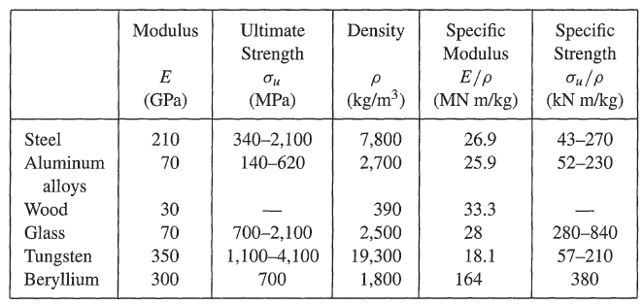
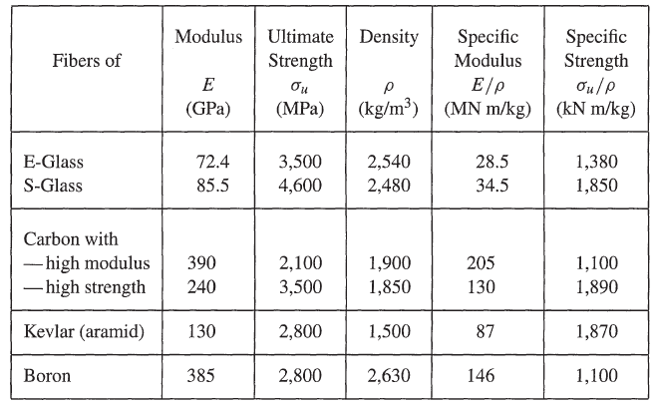
Mechanical characteristics of materials
Common materials made in bulk
Materials made in the form of fibres
Notes:
Intro “This slide presents the mechanical characteristics of materials, comparing bulk engineering materials with materials made in the form of fibres.”
Purpose “The goal is to illustrate how strength and stiffness per unit weight differ between bulk materials and high-performance fibres. This comparison underlines why fibres such as carbon, aramid, and boron are preferred in advanced composite design.”
Concept
Bulk materials: Conventional engineering materials like steel, aluminium, wood, glass, tungsten, and beryllium. Their properties depend heavily on density and processing route.
Fibres: Engineered at smaller scales, fibres achieve much higher specific modulus and specific strength compared to bulk forms, making them ideal reinforcements in composites.
Details
Common materials made in bulk
Examples: Steel (E ≈ 210 GPa), aluminium alloys (E ≈ 70 GPa), tungsten (E ≈ 350 GPa), beryllium (E ≈ 300 GPa).
Specific properties: Aluminium has lower density (2700 kg/m³) than steel (7800 kg/m³), which improves specific modulus despite lower absolute stiffness. Tungsten is extremely stiff but very dense, reducing efficiency in weight-sensitive applications.
Applications: Structural frames, load-bearing components, and traditional engineering uses.
Materials made in the form of fibres
Examples: E-glass (E ≈ 72 GPa), S-glass (E ≈ 85 GPa), carbon fibres (high modulus up to 390 GPa, high strength ~240 GPa), Kevlar (130 GPa), boron (385 GPa).
Specific properties: Carbon fibres exhibit outstanding specific modulus (up to 205 MN·m/kg) and specific strength (>1800 kN·m/kg). Kevlar has excellent strength-to-weight ratio, while boron offers high modulus with moderate density.
Applications: Aircraft fuselages, automotive composites, protective gear, turbine blades, and sporting goods.
Special case (highlight box)
Carbon fibres represent a breakthrough: with densities near 1900 kg/m³, they outperform metals in stiffness-to-weight and strength-to-weight metrics.
Kevlar and boron fibres provide unique combinations of toughness, stiffness, and low density, making them indispensable for ballistic protection and aerospace structures.
Teaching Point “Comparing bulk materials with fibres shows why composite technology is transformative: fibres deliver far superior specific properties, which means higher performance without weight penalties. This is the foundation for lightweight, high-strength engineering design.”
E-glass (Electrical glass) and S-glass (Structural glass) are both types of fiberglass used in composites, but they have distinct differences in terms of their composition, mechanical properties, and applications. Here is a comparison between the two:
1. Composition:
E-glass:
Primarily composed of silica (SiO₂), with additions of alumina (Al₂O₃), calcium oxide (CaO), and other oxides.
It is specifically formulated for excellent electrical insulation properties.
S-glass:
Composed of silica (SiO₂) and alumina (Al₂O₃), but with a higher percentage of alumina compared to E-glass.
S-glass is designed for superior mechanical properties, especially strength.
2. Mechanical Properties:
Strength:
E-glass: Lower tensile strength compared to S-glass. Tensile strength typically ranges from 2000 to 3500 MPa.
S-glass: Has significantly higher tensile strength, typically around 4500 MPa. This makes it ideal for applications requiring high structural integrity.
Modulus of Elasticity:
E-glass: The modulus of elasticity is around 72-73 GPa, which is adequate for many general-purpose applications.
S-glass: Offers a higher modulus of elasticity, typically around 85-90 GPa, providing greater stiffness.
3. Thermal Properties:
E-glass:
Has lower thermal resistance compared to S-glass, with a maximum service temperature of around 300°C.
S-glass:
Higher thermal resistance and can withstand temperatures up to 450°C, making it more suitable for high-temperature environments.
4. Density:
E-glass:
The density of E-glass is typically around 2.54 g/cm³.
S-glass:
Slightly higher density, around 2.48 g/cm³, due to its higher alumina content.
5. Cost:
E-glass:
Less expensive and widely used in various industries due to its lower cost and good balance of properties.
S-glass:
More expensive than E-glass due to its superior mechanical and thermal properties. It is used in specialized applications where higher performance is required.
6. Applications:
E-glass:
Widely used in general-purpose applications such as electrical insulation, boat hulls, automotive parts, pipes, and structural panels. It is the most common form of fiberglass.
S-glass:
Primarily used in high-performance applications such as aerospace components, military armor, ballistic protection, sporting goods (e.g., golf clubs, tennis rackets), and high-stress structural parts in aircraft and spacecraft.
7. Electrical Properties:
E-glass:
Designed for excellent electrical insulation properties, making it suitable for electrical and electronic applications.
S-glass:
While it has good electrical properties, it is not primarily designed for this purpose and is instead optimized for mechanical performance.

Slide 8
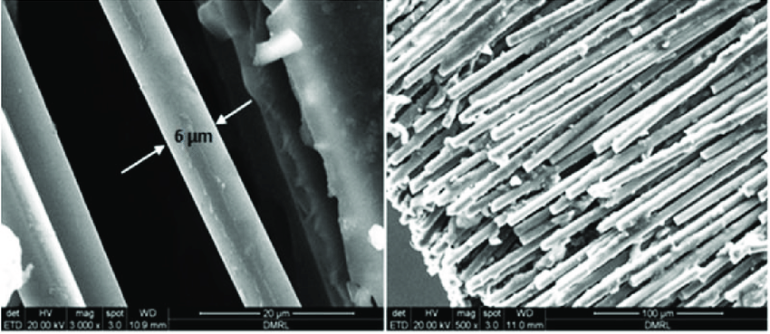
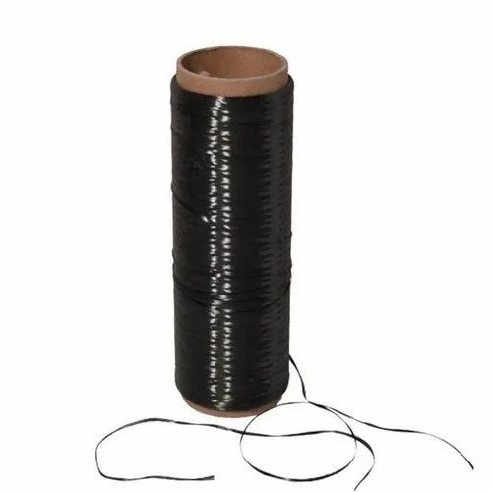
Fibre and cloth reinforcements
Fibre forms:
Fibers are made with a diameter of a few microns (ten or so).
Fibres cannot be used in a single form.
Fibers are gathered into a bundle called a strand or yarn.
A single fibre is usually called an elementary filament, or monofilament.
Surface tissues: strands and yarns can be used to make surface tissues of various types:
Mats
Woven fabrics
Ribbons
Carbon fibres
Carbon yarns
Notes:
Composites made from woven fabric ribbons and mats are widely used in structural and functional materials due to their superior mechanical properties and flexibility in design. These types of composites are generally based on reinforcing fibers (like glass, carbon, or aramid fibers) embedded in a polymer matrix, though metal matrices and ceramics are also used. Let’s break down these materials:
1. Composite Mats:
Composite mats refer to non-woven or semi-woven fiber reinforcements that are used in composites. These mats are typically used for laminating and reinforcing resin-based systems, offering good mechanical strength and bonding with the matrix.
Types of Mats:
Chopped Strand Mat (CSM): Composed of randomly oriented fibers that are bonded together. It's commonly made of glass fibers and is often used in hand lay-up or spray-up processes.
Advantages: Good isotropic properties (strength is fairly equal in all directions), relatively inexpensive, and offers good bonding with resins.
Applications: Boat hulls, automotive components, and general-purpose fiberglass laminates.
Continuous Filament Mat (CFM): Similar to chopped strand mats, but the fibers are continuous and provide improved mechanical properties, particularly in tension and bending.
Needle Mat: Consists of fibers that are mechanically interlocked through a needling process, offering improved thickness and toughness compared to chopped strand mats.
Stitched Mat: Made from layers of non-woven fiber sheets stitched together. These mats have improved strength and stiffness due to the stitched reinforcement.
2. Woven Fabric Ribbon:
Woven fabrics are produced by interlacing yarns (or fibers) in a systematic manner (warp and weft), creating a two-dimensional fabric with high strength. Woven ribbons are typically narrow strips of these fabrics that are used in specific reinforcement areas where localized strength is needed.
Characteristics of Woven Fabric:
Increased Strength and Stiffness: The systematic interlacing of fibers in the warp and weft directions provides anisotropic mechanical properties, which can be tailored depending on the direction of applied loads.
Flexibility in Design: Woven fabrics can be produced in a wide variety of architectures, such as plain weave, twill weave, and satin weave, depending on the required mechanical performance and flexibility.
Tightly Controlled Thickness: The woven nature of the fabric allows for precise control over thickness and fiber content, which is critical in applications like aerospace, automotive, and sports equipment.
Common Types of Woven Fabrics in Composites:
Glass Fiber Fabrics: These are the most commonly used woven fabrics, providing good strength, stiffness, and chemical resistance at a relatively low cost.
Carbon Fiber Fabrics: Offer superior stiffness-to-weight ratios, excellent fatigue resistance, and high thermal conductivity, making them ideal for high-performance applications like aerospace, automotive, and sporting goods.
Aramid (Kevlar) Fabrics: Known for their impact resistance and toughness, these fabrics are often used in ballistic and impact-resistant applications such as body armor or helmets.
Applications of Woven Fabric Ribbons:
Localized Reinforcement: Woven fabric ribbons can be applied to specific areas where localized strength or stiffness is needed (e.g., edge reinforcements in aerospace or automotive panels).
Tapes for Seam Strengthening: In structures like boat hulls or tanks, woven fabric ribbons can reinforce seams or joints to improve structural integrity.
Structural Components: Woven fabric composites are used in load-bearing structures due to their superior strength, particularly in aerospace and automotive industries.
3. Differences Between Mats and Woven Fabrics:
Fiber Orientation: Mats generally have random or semi-random fiber orientation, providing more isotropic mechanical properties, whereas woven fabrics have oriented fibers that provide anisotropic properties tailored to specific load directions.
Strength: Woven fabrics generally offer higher strength and stiffness compared to mats due to their orderly structure, but mats can be more cost-effective and easier to handle, especially in large-scale applications.
Application: Mats are often used for bulk reinforcement or as a base layer, while woven fabrics (especially in ribbon form) are used in applications that require precise strength and stiffness, such as aerospace components, sporting goods, and automotive body panels.
Manufacturing Processes:
Hand Lay-Up: Involves placing woven fabric or mat reinforcements into a mould and manually applying resin. This is a traditional process used in boat building, automotive parts, and more.
Resin Transfer Moulding (RTM): A closed-mould process where resin is injected into a mould containing pre-placed woven fabrics or mats, leading to high-quality, high-strength composites.
Filament Winding: Used to create cylindrical or spherical parts (such as pipes or tanks) by winding continuous fibers (often in the form of woven ribbons or tapes) onto a rotating mandrel.
Conclusion:
Composite mats are cost-effective, generally isotropic reinforcements used for bulk properties, while woven fabric ribbons offer high precision and strength for specific, directional reinforcements. Both materials are crucial in different industries, including aerospace, automotive, marine, and construction, and the choice between mats and woven fabrics depends on the performance requirements and application specifics.

Slide 9
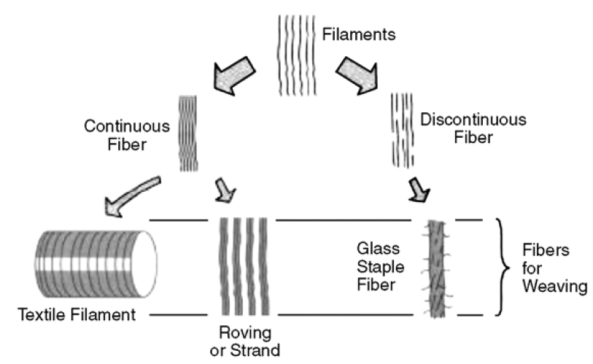
Fibre and cloth reinforcements- Different fibre forms
Notes:
Breakdown:
Filaments: The basic building blocks, which can be classified into:
Continuous fibers: These are long, uninterrupted fibers that are typically used in applications requiring high strength and stiffness, such as roving or strand.
Discontinuous fibers: These are shorter fibers, which are often used in applications where ease of processing and more isotropic properties are required.
Continuous Fiber Pathway:
Textile Filament: Continuous filaments can be processed into textile filaments, which can be woven into fabric or ribbons for reinforcement.
Roving or Strand: Continuous filaments are also bundled together to form roving or strands, which are often used in processes like filament winding or pultrusion.
Discontinuous Fiber Pathway:
Glass Staple Fiber: This refers to chopped or staple glass fibers, which are often used in chopped strand mats or for molding applications.
Fibers for Weaving: Both types of fibers can be further processed into materials suited for weaving, contributing to the fabrication of composite structures.
This process highlights the versatility of fiber reinforcements in composite materials, where the form of the fiber (continuous or discontinuous) plays a key role in determining the properties of the final composite structure. Continuous fibers offer superior directional strength, while discontinuous fibers are used when more uniform, isotropic properties are needed.

Slide 10
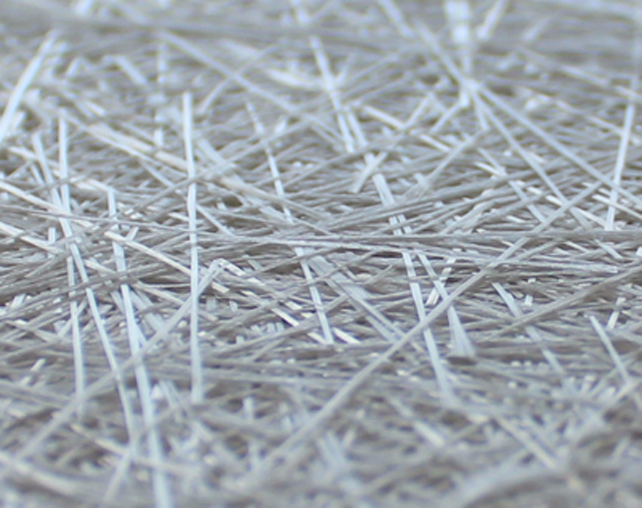
Fibre and cloth reinforcements- Mats
Mats
Sheets of continuous or discontinuous strands or yarns randomly distributed in a plane.
The fibres are bounded together with either a high or low solubility binder.
The absence of a preferred orientation leads to isotropic mechanical properties in the plane of the mat.
There are often two types, i.e. chopped strand mats (hardly deformable) and continuous strand mats (complex curves by regular stretching in all directions good for moulding).
Notes:
Definition “Mats are sheets of fibres—either continuous filaments or chopped strands—laid down in random orientations within a single plane. Unlike a woven fabric, there’s no deliberate pattern. The fibres are lightly bonded with a binder that can dissolve or soften during resin infusion so the mat stays intact until we wet it out.”
Key property “Because the fibres point in all directions, the mat behaves almost isotropically in its own plane. That means the mechanical properties—stiffness, strength—are roughly the same no matter which way you pull, which is quite different from a unidirectional tape where properties are very directional.”
Types of mats “We usually talk about two commercial types. • Chopped-strand mats—these are made from short pieces of glass or carbon fibre. They’re stiff, not very drapable, and give good bulk but limited directional strength. • Continuous-strand mats—these use long continuous filaments that loop and swirl. They can stretch and drape, so they conform to complex mould shapes and curves much more easily.”
Design implications “So if you need an inexpensive reinforcement for a part with gentle curves and you don’t need high directional strength—think boat hulls, panels, fairings—a chopped-strand mat is ideal. If you’re trying to cover complex geometry and need better in-plane properties, a continuous-strand mat lets you do that without breaking fibres.”
Wrap-up “The takeaway is that mats are the go-to when you want quasi-isotropic reinforcement, fast lay-up, and the ability to fill space, but you accept lower strength and stiffness than carefully oriented fabrics or tapes.”

Slide 11
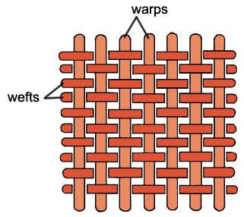
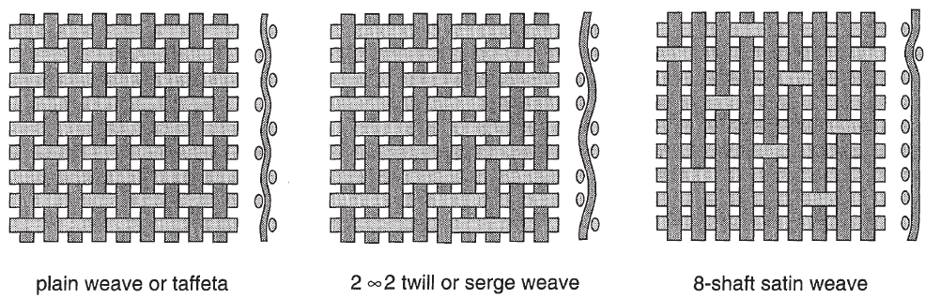
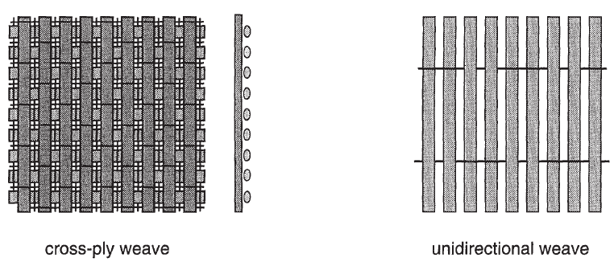
Fibre and cloth reinforcements- Woven fabrics
Woven fabrics
Lengthwise strand is called warp.
Crosswise strand is called weft (or fill).
They may have various types of weave as shown in the opposite figure.
Notes:
Basic structure “Woven fabrics are made from two perpendicular sets of fibres. • The warp runs lengthwise—the long direction of the roll. • The weft, sometimes called the fill, runs crosswise. The warp provides continuous strength along the roll, while the weft locks everything together across the width.”
Weave types “By changing the way warp and weft interlace, we create different mechanical behaviours and drape characteristics. Look at the figures:
Plain weave or taffeta: a simple over-under pattern. It gives excellent stability and resists fraying, but it’s stiff and not very drapable.
2×2 twill: each weft passes over two warp strands, then under two. This produces the familiar diagonal rib and more flexibility—ideal when we need the fabric to conform to complex shapes.
8-shaft satin: long floats of yarn produce a smooth surface and high drape, often used for aerospace skins where we need a good surface finish.
Cross-ply weave: essentially two layers oriented at 0 and 90 degrees for balanced properties.
Unidirectional: technically not a traditional “weave,” but a fabric where almost all fibres run in one direction and a light transverse thread just holds them together. This maximises strength along a single axis.”
Design implications “Choice of weave influences resin flow, surface finish, and how stresses transfer between fibres. Plain weave resists distortion, twill is easier to drape, satin gives high fibre straightness and smoothness, and unidirectional offers the highest directional stiffness.”
Wrap-up “So when you specify a composite lay-up, you’re not just choosing carbon or glass—you’re also choosing the weave, which directly sets how the laminate will handle loads and conform to a mould.”

Slide 12
Fibre and cloth reinforcements- Woven fabrics
Plain weave
Mechanical properties identical in both weft and warp directions.
It is not very deformable.
Twill weave (2 x 1 or 2 x 2)
Good drapability in the case of complex shapes.
In a 2 x 1 twill weave, weft threads pass over one and under two warp threads, and in a 2 x 2 twill the weft threads pass over two and under two warp threads.
Satin weave (4 or 8)
Excellent drapability of complex shapes (such as wing skin).
4 or 8, indicating that the warp threads pass over 4 or 8 weft threads.
Cross-ply weave
Crossed threads are held together by fine thread.
Very high performance.
Unidirectional weave
Best performance.
Notes:
Plain weave “Start with the simplest: the plain weave, sometimes called taffeta. Warp and weft alternate one over, one under. Because the fibres are locked in tightly and evenly, the mechanical properties are virtually identical in the warp and weft directions, giving balanced strength. But that tight interlacing also makes it the least drapable—hard to form over compound curves.”
Twill weave (2×1 or 2×2) “Next is twill. You’ll notice the diagonal pattern in the figure. Here the weft goes over one and under two warps for a 2×1, or over two and under two for a 2×2. That extra float gives better drape and flexibility, so it’s easier to fit complex shapes while still keeping good in-plane strength. Many aerospace and automotive skins use 2×2 twill for precisely that reason.”
Satin weave (4 or 8) “Push the floats even longer and you have satin weaves—4-shaft or 8-shaft in the examples. Warp fibres pass over 4 or 8 weft threads before dipping under. The result is a very smooth surface and exceptional ability to conform to complex moulds, such as wing skins, but with a little less interlacing stability than plain or twill.”
Cross-ply weave “Here layers are woven at 0 and 90 degrees and held by fine stitching or binder threads. It’s a way to create quasi-isotropic laminates in a single fabric, giving high stiffness and strength in both principal directions.”
Unidirectional weave “Finally, unidirectional fabric isn’t a true weave. Almost all fibres run in one direction with a light cross thread just to hold them together. It provides the highest strength and stiffness along that primary axis and is the go-to when you need maximum performance in a single load direction.”
Closing “The key takeaway: weave style controls fibre alignment, drapability, surface finish, and resin flow. When you design a composite lay-up, you choose not only the fibre type but also the weave that best balances strength, formability, and manufacturing ease.”

Slide 13
Laminate theory
This section aims to address mechanical analysis of continuous Fibre Reinforced Composite Polymers (CFRP).
The fundamentals required to understand the mechanical behaviour through the theory of elasticity will be discussed.
In considering the forthcoming behaviours, simplified assumption are made:
The laminate is assumed to be thin.
The behaviour is 2-Dimensional (2D) elastic.
Notes:
Opening “Now we move into laminate theory, the backbone of mechanical analysis for continuous fibre-reinforced polymer composites, or CFRPs.”
Purpose “This section introduces the fundamentals of how a composite laminate carries load, using classical elasticity as our starting point. We’re not solving the full 3-D continuum just yet—we start with simplifying assumptions to keep the maths tractable and to highlight the dominant behaviour.”
Simplified assumptions “Two key simplifications guide the classical laminate theory:
Thin-laminate assumption We treat each laminate as thin relative to its in-plane dimensions. That lets us neglect through-thickness stresses and assume that plane sections remain plane after deformation.
Two-dimensional elastic behaviour Because through-thickness stresses are small, we model each ply with 2-D orthotropic elasticity. This means we consider only in-plane stresses—normal and shear in the x-y plane—and their coupling to bending.”
Implication “These assumptions allow us to build the A-B-D matrices you’ll see later, which relate in-plane forces and bending moments to strains and curvatures. It’s a powerful framework that captures how stacking sequence, fibre orientation, and material properties combine to give the overall laminate response.”

Slide 14
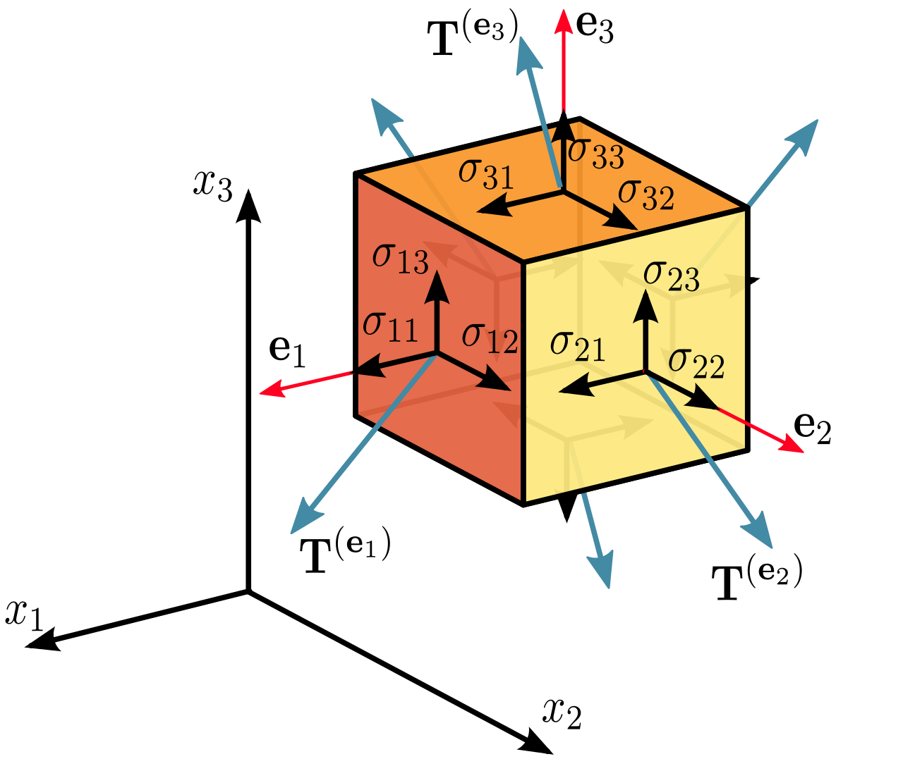
Elastic theory- Reminder
Direct stresses are positive if they point out of the surface, i.e. tensile stresses.
Shear stresses are positive if they act in the positive direction of the relevant axis in a plane on which the direct tensile stress is in the positive direction of the axis.
Notes:
Intro “Before we jump deeper into laminate mechanics, let’s pause for a quick elastic theory reminder—a refresher on stress sign conventions and the stress tensor.”
Direct stresses “Start with the normal or direct stresses, the σ11, σ22, σ33 on the cube faces. By convention, these are positive when they act outward from the surface. In other words, tensile stresses—pulling the face away from the body—are positive. Compressive stresses, pushing in, are negative.”
Shear stresses “Now for the shear components, like σ12 or σ13. These are positive if they act in the positive direction of the axis they’re named for, on the plane whose normal is the first subscript. So σ12 is the shear stress acting in the x2 direction on the plane whose normal is x1. Think ‘first index = plane normal, second index = direction of action.’”
Visualising the cube “On the right, each face of the cube shows the stresses. The arrows coming off each face are the traction vectors T(e1), T(e2), T(e3). Together these nine components form the stress tensor, which we’ll use in two-dimensional form when we analyse a thin laminate.”
Why it matters “Getting these signs right is critical. If you reverse a sign convention in composite calculations, you can predict the wrong failure mode or incorrectly transform stresses between coordinate systems.”

Slide 15
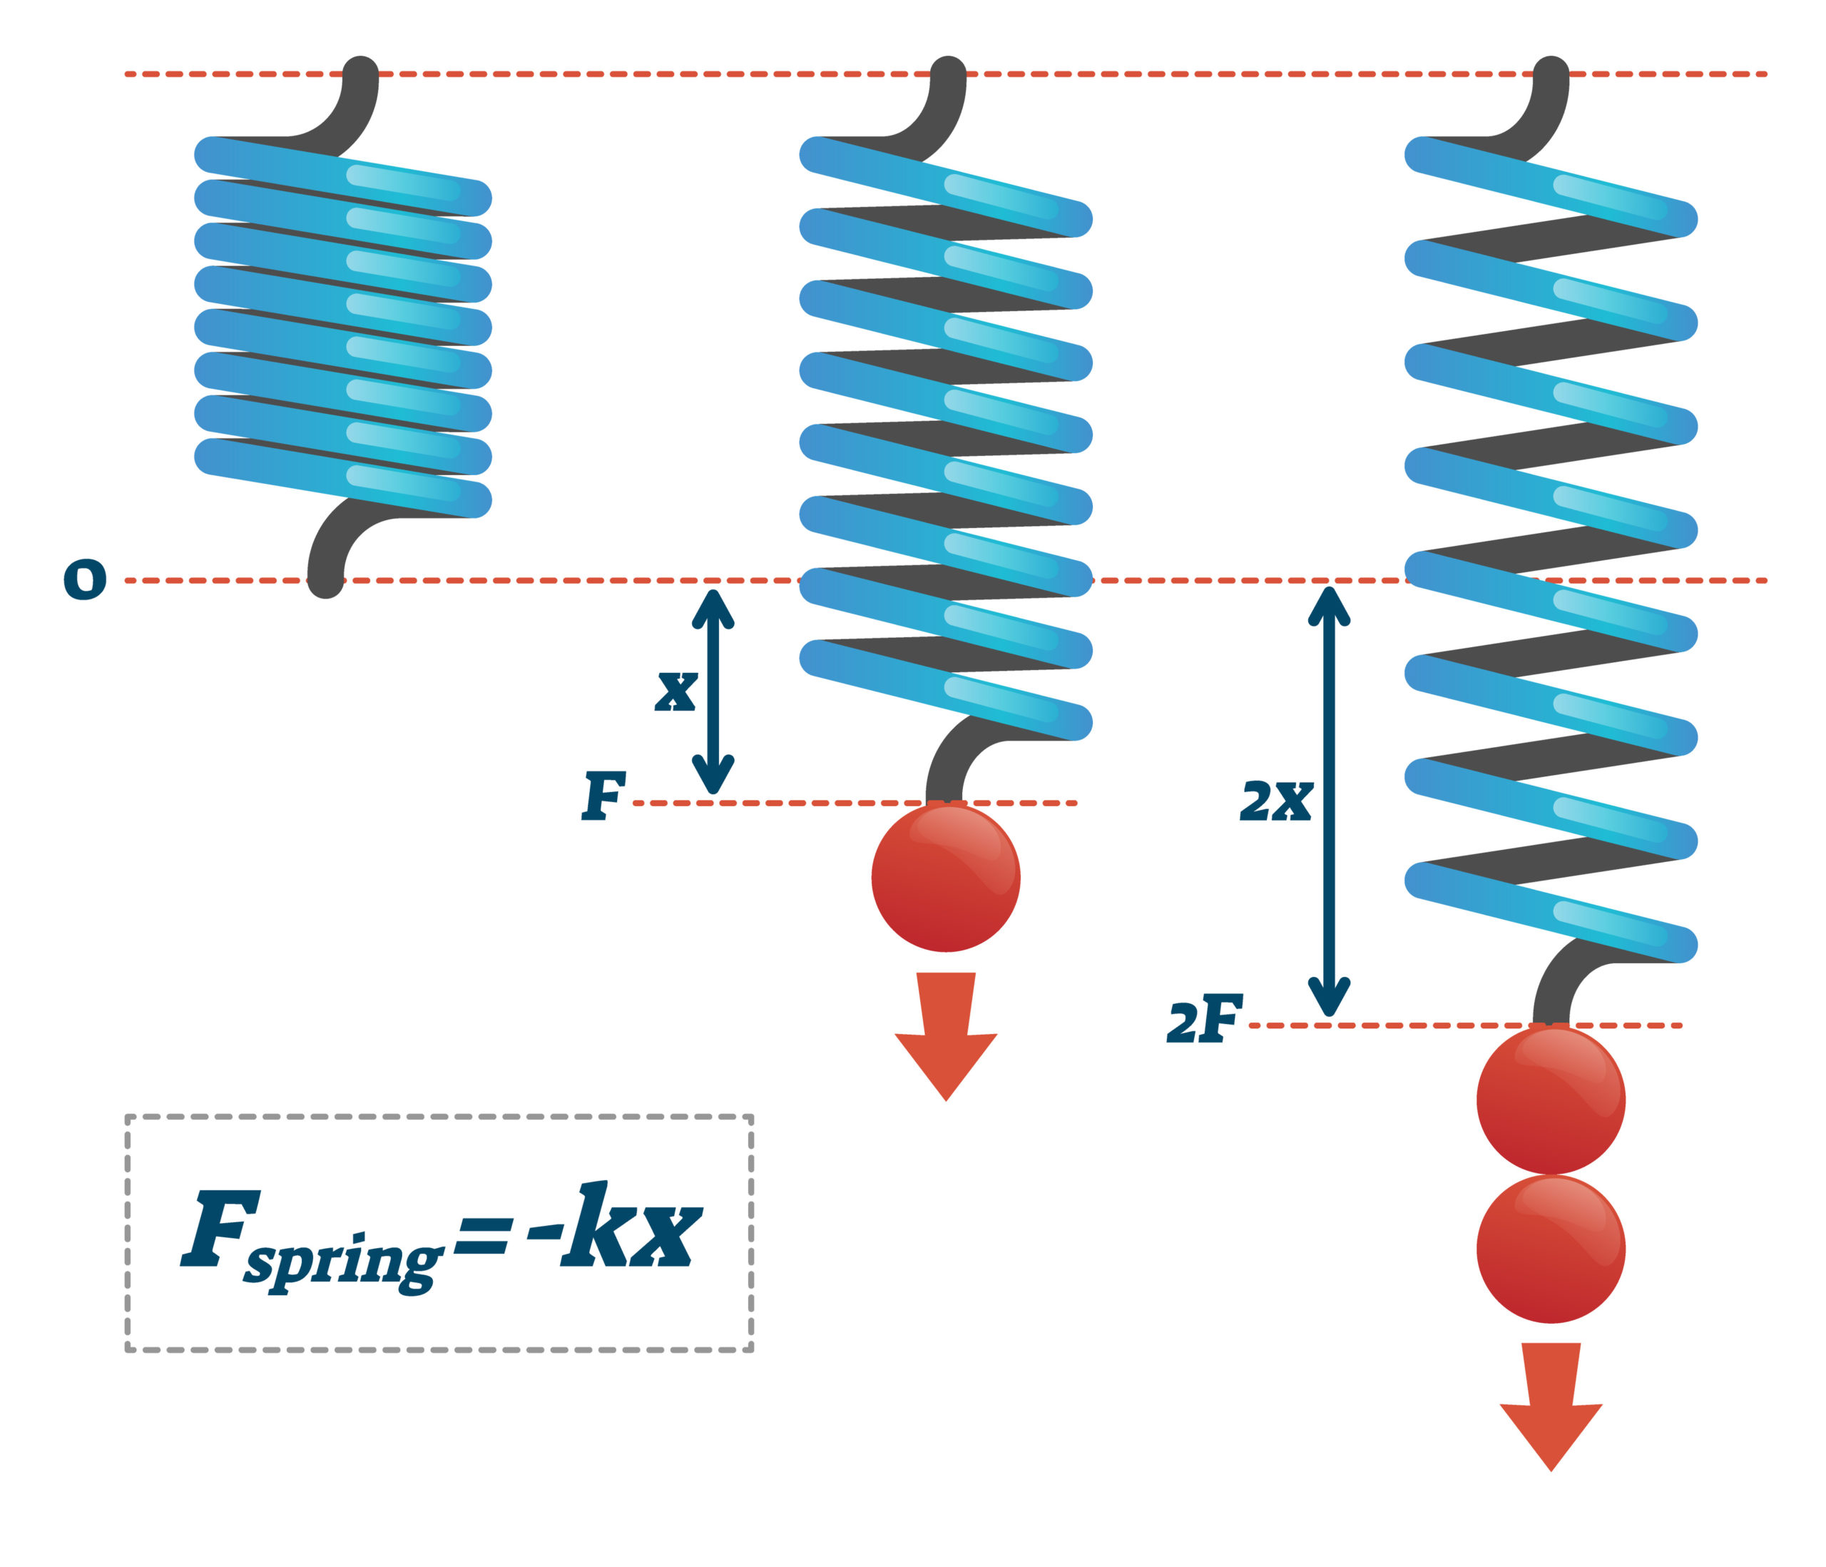
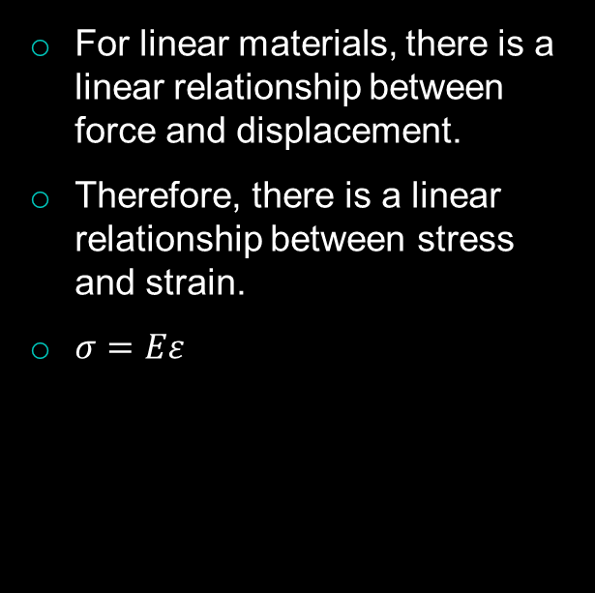
Hooke’s law- Reminder
For linear materials, there is a linear relationship between force and displacement.
Therefore, there is a linear relationship between stress and strain.
$σ=Eε$
Notes:
Opening “Before we dive deeper into composite stress analysis, let’s revisit a cornerstone of elasticity—Hooke’s law.”
Concept “For materials that respond linearly, force and displacement are proportional. If you double the force on a spring, the displacement doubles. This is captured by the familiar equation $F=kx$, where $k$is the spring constant.”
From force–displacement to stress–strain “Scale that idea up to a solid material. Instead of a single wire or spring, we talk about stress—force per unit area—and strain—the fractional change in length. The same proportionality applies:
$$σ=E ε$$
where $E$is the Young’s modulus. So doubling the strain doubles the stress, as long as we stay in the elastic region.”
Visual on the slide “Look at the right side: – The first spring is unloaded. – Add a force $F$, it stretches by $x$. – Double the force to $2F$, the stretch doubles to $2x$. That’s the linear response we assume for many metals and for composite fibres in their elastic range.”
Key reminder “This relationship is the foundation for the laminate theory we’re building toward. Once we know $E,$for a given ply direction, we can predict stresses from measured strains and vice versa—essential for design and failure analysis.”

Slide 16

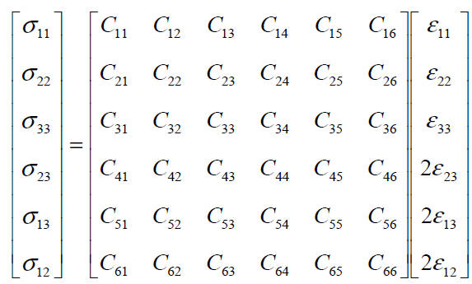
Elastic theory- Stiffness matrix 1
The stiffness matrix is symmetric
Only 21 of the 36 elastic constants are unknown
Generalised Hooke’s law:
For material with no plane of symmetry (anisotropic):
Symmetric
Notes:
Opening “Moving deeper into elastic theory, we introduce the stiffness matrix—the mathematical backbone that links stress and strain in three dimensions.”
Generalised Hooke’s law “Recall that in simple tension we wrote σ = E ε. For a fully anisotropic solid we need the tensor form:
$$σ_{i}=C_{ij} ε_{j}$$
Here σ is the stress vector, ε is the strain vector, and C is the stiffness matrix that holds all the elastic constants.”
Anisotropic material “In the most general case—no planes of symmetry—the material could respond differently along every direction and shear combination. That means six independent stress components and six independent strain components, so C is a 6×6 matrix with 36 coefficients.”
Symmetry of the matrix “But energy conservation requires C to be symmetric. That cuts the number of unique elastic constants from 36 to 21, as highlighted on the slide. So Cij = Cji, which halves the experimental work needed to characterise a material.”
Visual cue “On the cube to the right you see the stress components σ11, σ22, σ33, and the shear terms like σ12 and σ23. These populate the stress vector. Each is linearly related to all six strains through the C matrix.”
Why it matters for composites “For composites like CFRP, additional material symmetries—orthotropy, transversely isotropy—reduce the unknowns even further. We’ll exploit those reductions to simplify the stiffness matrix for plies and then build up the laminate stiffness matrices A, B, and D.”
Note:
For ordinary engineering solids—metals, polymers, ceramics, fibre composites—the stiffness matrix is always symmetric. That symmetry follows from two very general requirements:
the existence of a strain-energy function, and
Maxwell–Betti reciprocity (work done is independent of loading path).
To break that symmetry a material must violate one of those conditions. Several research-grade examples exist, but they are not conventional structural materials:
Active or “odd” elastic media – Suspensions of self-propelled particles, active gels, or specially driven metamaterials can display odd elasticity, where internal energy is continually supplied and the elastic tensor gains antisymmetric parts. (Chen et al., Nature Physics 2021).
Nonreciprocal/gyroscopic lattices – Mechanical metamaterials with rotating masses or gyroscopic elements break time-reversal symmetry and show effective nonsymmetric stiffness under dynamic excitation (Nash et al., PNAS 2015).
Willis-type dynamic composites – Periodic media under high-frequency loading can exhibit effective constitutive relations with coupling terms that are not symmetric, though the underlying constituents remain ordinary (Milton & Willis, Proc. R. Soc. A 2007).
Cosserat or micropolar solids – Engineered lattices with couple-stresses and micro-rotations possess asymmetric stress and need extra moduli beyond the classical 6×6 matrix.
So yes, materials with an effective nonsymmetric stiffness matrix exist, but they are exotic active or architected metamaterials, not everyday metals, ceramics, or polymer composites. For all passive, static engineering materials you design with, the classical 6×6 stiffness matrix remains symmetric.

Slide 17
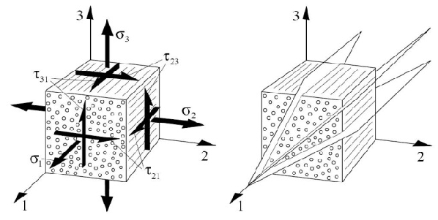
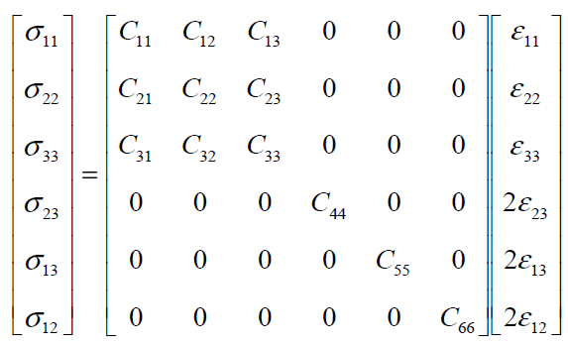
Elastic theory- Stiffness matrix 2
If material symmetry exists, then the stiffness matrix reduces.
See the example below which is shown for an orthotropic material:
[C] is called the stiffness matrix.
In this case, elastic constants have reduced from 21 to 9.
A material is orthotropic if its mechanical or thermal properties are unique and independent in three mutually perpendicular directions.
Examples of orthotropic materials are wood, many crystals, CFRP laminates, and rolled metals.
Notes:
Introduction “Having seen the fully anisotropic stiffness matrix with 21 independent constants, let’s look at what happens when a material has symmetry—specifically orthotropic symmetry.”
Material symmetry cuts down constants “When planes of material symmetry exist, many coupling terms in the stiffness matrix drop to zero or become equal. For an orthotropic material—one with three mutually perpendicular planes of symmetry—the independent elastic constants shrink from 21 to just 9.”
Matrix form “On the left you can see the 6×6 stiffness matrix [C]. Notice the zeros in the off-diagonal shear–normal coupling blocks. Those zeros represent directions where stress and strain are uncoupled because of the orthotropic symmetry.”
Definition of orthotropy “A material is orthotropic if its mechanical properties are unique and independent along three perpendicular directions. That means the 1, 2, and 3 axes shown in the figure are principal material directions—properties along each are different, but there’s no coupling between them.”
Examples “Classic examples include: • Wood, which has different stiffness along grain, across grain, and through the thickness. • Continuous-fibre composites such as CFRP laminates, where fibre, transverse, and through-thickness properties differ. • Rolled or extruded metals, where processing creates strong directionality.”
Key point “By recognising and exploiting material symmetry, we greatly simplify analysis and reduce the amount of experimental testing needed to characterise a material—from 21 independent stiffness constants down to just 9.”

Slide 18

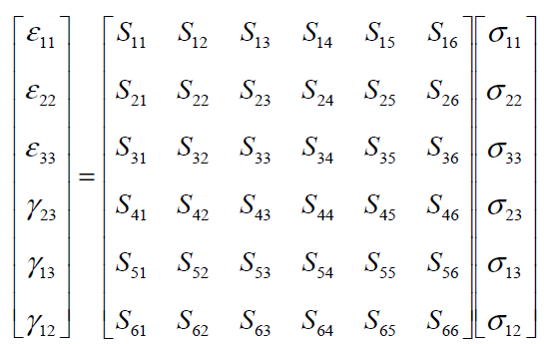
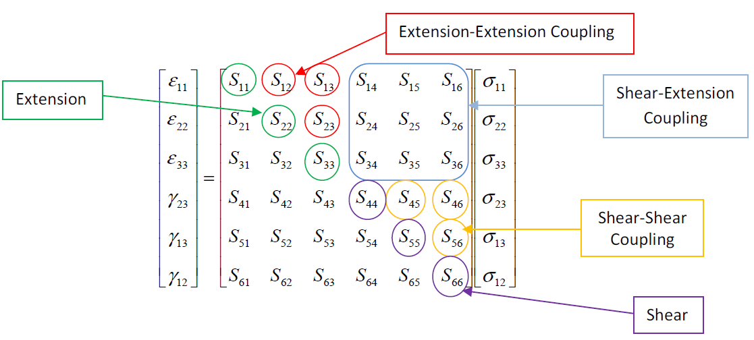
Elastic theory- Compliance matrix 1
Solving the generalised Hooke’s law for strains leads to:
[S] is called the compliance matrix.
For an anisotropic material, there is marked coupling between applied stresses and the resulting deformations (strains):
Notes:
Intro “Having covered the stiffness matrix [C], we now look at its inverse—the compliance matrix, noted [S].”
From stiffness to compliance “Generalised Hooke’s law can be rearranged from $$σ_{i}=C_{ij} ε_{j}$$ to give strain as a function of stress:
$$ε_{i}=S_{ij} σ_{j},$$
where [S] is simply the inverse of [C]. Every entry $S_{ij}$ tells you how much strain in the i-direction results from a unit stress in the j-direction.”
Matrix structure “On the left you see the full 6×6 form for a completely anisotropic solid. The diagonal terms, like S11 or S22, represent the familiar direct relationships—extension along one axis due to stress along the same axis. The off-diagonal terms capture coupling between directions.”
Coupling effects “Check the highlighted blocks on the right:
Extension–extension coupling: terms like S12 show that stress in direction 2 can cause strain in direction 1.
Shear–extension coupling: terms S14, S15, etc., indicate that a pure shear stress can produce a normal strain.
Shear–shear coupling: off-diagonal shear terms represent interaction between different shear planes.
Such couplings are pronounced in anisotropic composites such as unidirectional CFRP.”
Key point “The compliance matrix is powerful because it tells you directly how an applied stress state transforms into measurable strains, which is exactly what we use in strain-gauge experiments or laminate analysis.”

Slide 19
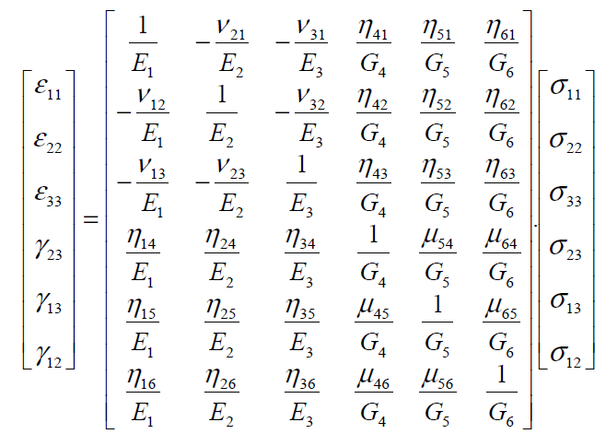
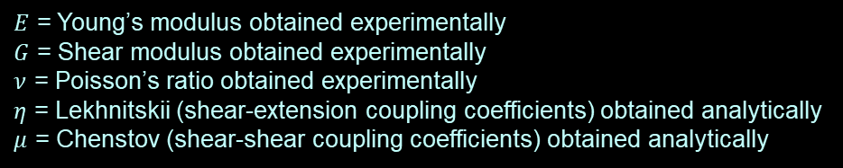
Elastic theory- Compliance matrix 2
The compliance matrix can be expressed in terms of engineering constants as shown below:
$E$ = Young’s modulus obtained experimentally
$G$ = Shear modulus obtained experimentally
$ν$ = Poisson’s ratio obtained experimentally
$η$ = Lekhnitskii (shear-extension coupling coefficients) obtained analytically
$μ$ = Chenstov (shear-shear coupling coefficients) obtained analytically
Notes:
Intro “We’ve defined the compliance matrix [S] as the inverse of the stiffness matrix. Now let’s express [S] directly in terms of the engineering constants we measure in the lab.”
Engineering constants “Each entry of [S] can be written with familiar properties:
E – the Young’s moduli along the principal material axes (E₁, E₂, E₃).
G – the shear moduli for the three orthogonal shear planes (G₄, G₅, G₆).
ν – the Poisson’s ratios, like ν₁₂ or ν₂₃, which describe how a material contracts laterally when stretched longitudinally.”
Coupling coefficients “Anisotropic materials can also have special coupling terms:
η – the Lekhnitskii coefficients, which capture shear–extension coupling.
μ – the Chenstov coefficients, which represent shear–shear coupling.
These appear as the η and μ terms off the diagonal in the matrix.”
Matrix layout “Notice the pattern: – The top-left 3×3 block shows normal strains related to normal stresses, with the familiar 1/E on the diagonal and the negative Poisson ratios off-diagonal. – The lower-right block involves the inverse shear moduli 1/G along the diagonal. – The off-diagonal η and μ terms show how shear and normal responses couple in a fully anisotropic medium.”
Key takeaway “This form of the compliance matrix lets you plug in directly measurable constants—E, G, ν—from experiments, plus analytically derived coupling coefficients, to predict strain for any applied stress. For orthotropic composites many η and μ terms drop out, simplifying the matrix dramatically.”
***Note:
1. Lekhnitskii shear-extension coupling $η$
Origin Named after S. G. Lekhnitskii, who developed the anisotropic elasticity framework used for layered composites (Anisotropic Plates, Gordon & Breach, 1968).
Meaning In a fully anisotropic (triclinic) solid, an in-plane shear stress (for example $τ_{23}$) can produce a normal strain (for example $ε_{11}$) even when no direct normal stress is applied. This cross-effect is called shear–extension coupling.
Appearance in compliance matrix The $η$terms occupy positions such as $S_{14},S_{15},S_{16}$etc. in the 6 × 6 compliance matrix:
$$ε_{i}=S_{ij} σ_{j},$$
where an off-diagonal coefficient $η_{41}$means “shear strain $γ_{23}$produced per unit normal stress $σ_{11}$.”
Analytical determination For a crystal or composite with no planes of symmetry, these coefficients are derived from the fundamental stiffness tensor $C_{ijkl}$by tensor inversion:
$$η_{41}=S_{41}=\left(C^{−1}{\left.)\right.}_{41}.\right.$$
Because they involve no simple experiment (you can’t independently apply a “pure” state to isolate them), they are usually calculated from single-crystal or ply-level elastic constants once those are measured.
References – Lekhnitskii, Anisotropic Plates (1968) – Jones, Mechanics of Composite Materials, 2nd ed., Ch. 2–3.
2. Chenstov shear-shear coupling $μ$
Origin Associated with M. M. Chentsov (also transliterated Chenstov), who extended Lekhnitskii’s work to the general coupling of different shear planes.
Meaning These coefficients quantify how a shear stress in one plane causes shear strain in a different plane—for example, $τ_{23}$causing $γ_{13}$. That is shear–shear coupling.
Appearance in matrix They are the off-diagonal terms in the 3 × 3 shear block of [S], e.g. $S_{45},S_{46}$. A value $μ_{45}$represents strain $γ_{23}$per unit stress $τ_{13}$.
Analytical determination Again obtained from the inverse stiffness tensor. Given the full 21 independent elastic constants for a triclinic material, the sub-matrix for shear components is inverted to give $μ$.
References – Ting, Anisotropic Elasticity: Theory and Applications (1996), Sect. 2.2–2.4. – Jones, Mechanics of Composite Materials, Appendix on triclinic elasticity.
Engineering relevance
Most engineering composites (orthotropic laminas, isotropic metals) have enough symmetry that all $η$and $μ$terms are zero. They matter only in materials with the least symmetry—triclinic single crystals, low-symmetry polymer crystals, or specially tailored metamaterials.
So, $η$and $μ$are formal placeholders in the general compliance matrix. They remind us that in the absolute most general anisotropic solid, normal and shear behaviors can couple in every possible way, and those couplings can be computed once the full stiffness tensor is known.

Slide 20
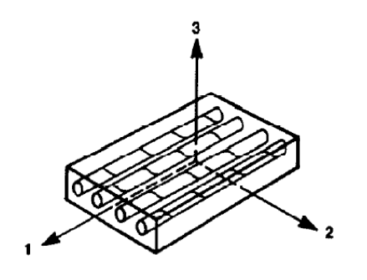


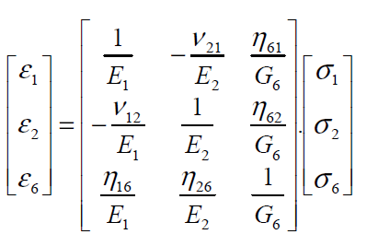
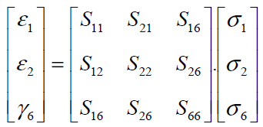
Elastic theory- Compliance matrix 3
In engineering problems of thin plates (panel type composites), 2D plane stress is often encountered leading to further simplification as below:
Therefore, the compliance matrix reduces to:
Notes:
Intro “Now we simplify the compliance matrix for plane-stress conditions—exactly what we use for thin laminated plates.”
Concept “For thin composite panels the through-thickness normal and transverse shear stresses are negligible. So we set $σ_{3}=σ_{23}=σ_{31}=0$. That collapses the 6×6 compliance relationship down to just the in-plane components.”
Reduced strain relations “The only remaining strains are the in-plane normal strains $ε_{1},ε_{2}$ and the in-plane shear strain $γ_{6}$. Through-thickness strain is given by $$ε_{3}=S_{13}σ_{1}+S_{23}σ_{2}$$ but it doesn’t feed back into the in-plane response.”
Resulting matrix “The compliance matrix therefore reduces to
$$\left[\begin{matrix}ε_{1} \\ ε_{2} \\ γ_{6}\end{matrix}\right]=\left[\begin{matrix}S_{11} & S_{12} & S_{16} \\ S_{12} & S_{22} & S_{26} \\ S_{16} & S_{26} & S_{66}\end{matrix}\right]\left[\begin{matrix}σ_{1} \\ σ_{2} \\ σ_{6}\end{matrix}\right].$$
If we express it with engineering constants you see the familiar 1/E terms on the diagonal and Poisson ratios in the off-diagonals, plus any shear-extension couplings $η$ if the laminate is fully anisotropic.”
Engineering relevance “This 3×3 form is exactly what we use in classical laminate theory to build the A, B and D matrices for composite plate analysis.”

Slide 21
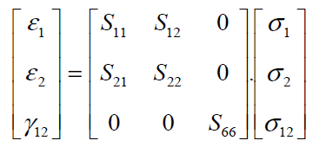
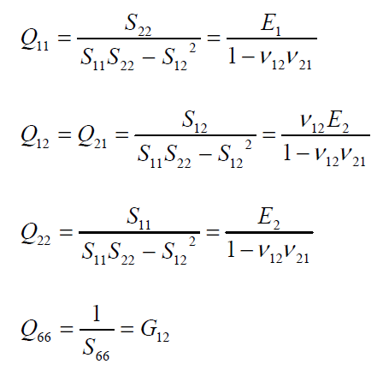

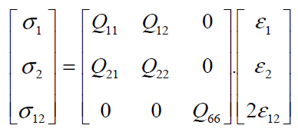

Elastic theory- Orthotropic lamina
A composite lamina is orthotropic:
4 independent constants exist:
Expressing in terms of Hooke’s law:
$Q_{ij}$ are the reduced stiffness of the lamina
Notes:
Intro “This slide wraps up our move from the general anisotropic case to the special case of an orthotropic lamina—the single composite ply with three mutually perpendicular planes of symmetry.”
Concept “Because of that symmetry, all shear–extension couplings vanish and the in-plane elastic behaviour can be described with only four independent engineering constants: $E_{1}, E_{2}, G_{12}, ν_{12}$( with $ν_{21}=ν_{12}E_{2}/E_{1}$). That greatly simplifies both the compliance matrix and the stiffness matrix used in laminate theory.”
Details
Compliance form
$$\left[\begin{matrix}ε_{1} \\ ε_{2} \\ γ_{12}\end{matrix}\right]=\left[\begin{matrix}S_{11} & S_{12} & 0 \\ S_{12} & S_{22} & 0 \\ 0 & 0 & S_{66}\end{matrix}\right]\left[\begin{matrix}σ_{1} \\ σ_{2} \\ σ_{12}\end{matrix}\right],$$
where $S_{11}=1/E_{1}, S_{22}=1/E_{2}, S_{12}=−ν_{12}/E_{1}, S_{66}=1/G_{12}$.
Reduced stiffness form Inverting gives
$$\left[\begin{matrix}σ_{1} \\ σ_{2} \\ τ_{12}\end{matrix}\right]=\left[\begin{matrix}Q_{11} & Q_{12} & 0 \\ Q_{12} & Q_{22} & 0 \\ 0 & 0 & Q_{66}\end{matrix}\right]\left[\begin{matrix}ε_{1} \\ ε_{2} \\ γ_{12}\end{matrix}\right],$$
with
$$Q_{11}=\frac{E_{1}}{1−ν_{12}ν_{21}}, Q_{22}=\frac{E_{2}}{1−ν_{12}ν_{21}}, Q_{12}=\frac{ν_{12}E_{2}}{1−ν_{12}ν_{21}}, Q_{66}=G_{12}.$$
These $Q_{ij}$ values are the reduced stiffness terms used to build the laminate A, B and D matrices.

Slide 22
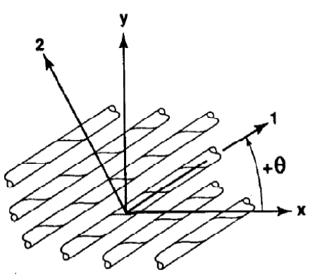
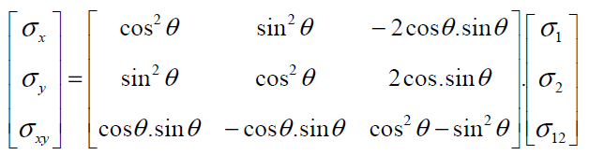
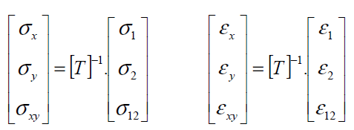
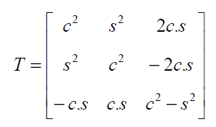
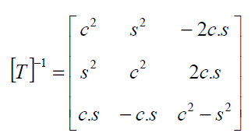
Elastic theory- Ply orientation
It is often necessary to move between the principal coordinates and oriented coordinates of the lamina.
Notes:
Intro “This slide introduces ply orientation transformations—the mathematics we use to move between a lamina’s material axes (1–2) and the global laminate axes (x–y).”
Concept “In a laminate, each ply can be laid at an angle θ relative to the global reference. To analyse the entire laminate, we must transform stresses and strains from the local fibre axes (1, 2) to the global axes (x, y). This requires the transformation matrix T and its inverse.”
Details Stress transformation
$$\left[\begin{matrix}σ_{x} \\ σ_{y} \\ τ_{xy}\end{matrix}\right]=\left[\begin{matrix}{\cos{}}^{2}θ & {\sin{}}^{2}θ & −2\cos{θ}\sin{θ} \\ {\sin{}}^{2}θ & {\cos{}}^{2}θ & 2\cos{θ}\sin{θ} \\ \cos{θ}\sin{θ} & −\cos{θ}\sin{θ} & {\cos{}}^{2}θ−{\sin{}}^{2}θ\end{matrix}\right]\left[\begin{matrix}σ_{1} \\ σ_{2} \\ τ_{12}\end{matrix}\right].$$
Matrix shorthand This is compactly written as $$\left\{σ{\left.\}\right.}_{x}=\left[T{\left.]\right.}^{−1}\left\{σ{\left.\}\right.}_{1}\right.\right.\right.$$ and similarly for strains $\left\{ε{\left.\}\right.}_{x}=\left[T\right]\left\{ε{\left.\}\right.}_{1}\right.\right.$.
Transformation matrix
$$\left[T\right]=\left[\begin{matrix}c^{2} & s^{2} & 2cs \\ s^{2} & c^{2} & −2cs \\ −cs & cs & c^{2}−s^{2}\end{matrix}\right],$$
with $c=\cos{θ}, s=\sin{θ}$.
Diagram The figure shows local axes 1–2 rotated by θ relative to the global x–y axes of the panel.

Slide 23
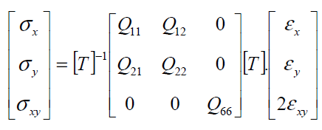
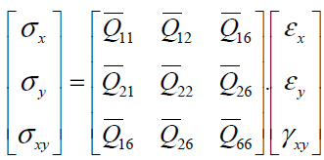

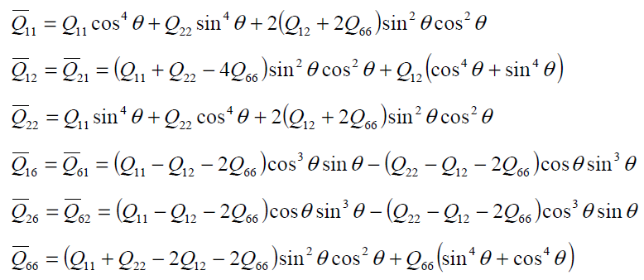
Elastic theory- Transformed stiffness matrix
Stress-strain in oriented or off-axis coordinates can be expressed in the form:
Transformed reduced stiffness matrix
Notes:
Intro “This slide shows how we obtain the transformed reduced stiffness matrix $\left[\overset{ˉ}{Q}\right]$for a lamina oriented at an angle θ to the global x–y axes.”
Concept “When a ply is rotated, the local 1–2 stiffnesses $\left[Q\right]$must be expressed in the global axes to analyse the whole laminate. We do this with the transformation
where [T] is the stress–strain transformation matrix from the previous slide.”
Details Stress–strain relation in global coordinates
$$\left[\begin{matrix}σ_{x} \\ σ_{y} \\ τ_{xy}\end{matrix}\right]=\left[\begin{matrix}{\overset{ˉ}{Q}}_{11} & {\overset{ˉ}{Q}}_{12} & {\overset{ˉ}{Q}}_{16} \\ {\overset{ˉ}{Q}}_{12} & {\overset{ˉ}{Q}}_{22} & {\overset{ˉ}{Q}}_{26} \\ {\overset{ˉ}{Q}}_{16} & {\overset{ˉ}{Q}}_{26} & {\overset{ˉ}{Q}}_{66}\end{matrix}\right]\left[\begin{matrix}ε_{x} \\ ε_{y} \\ γ_{xy}\end{matrix}\right].$$
Transformed stiffness terms
$$\begin{matrix}{\overset{ˉ}{Q}}_{11} & =Q_{11}{\cos{}}^{4}θ+Q_{22}{\sin{}}^{4}θ+2\left(Q_{12}+2Q_{66}\right){\sin{}}^{2}θ{\cos{}}^{2}θ, \\ {\overset{ˉ}{Q}}_{12} & =\left(Q_{11}+Q_{22}−4Q_{66}\right){\sin{}}^{2}θ{\cos{}}^{2}θ+Q_{12}\left({\cos{}}^{4}θ+{\sin{}}^{4}θ\right), \\ {\overset{ˉ}{Q}}_{22} & =Q_{11}{\sin{}}^{4}θ+Q_{22}{\cos{}}^{4}θ+2\left(Q_{12}+2Q_{66}\right){\sin{}}^{2}θ{\cos{}}^{2}θ, \\ {\overset{ˉ}{Q}}_{16} & =\left(Q_{11}−Q_{12}−2Q_{66}\right){\cos{}}^{3}θ\sin{θ}−\left(Q_{22}−Q_{12}−2Q_{66}\right)\cos{θ}{\sin{}}^{3}θ, \\ {\overset{ˉ}{Q}}_{26} & =\left(Q_{11}−Q_{12}−2Q_{66}\right)\cos{θ}{\sin{}}^{3}θ−\left(Q_{22}−Q_{12}−2Q_{66}\right){\cos{}}^{3}θ\sin{θ}, \\ {\overset{ˉ}{Q}}_{66} & =\left(Q_{11}+Q_{22}−2Q_{12}−2Q_{66}\right){\sin{}}^{2}θ{\cos{}}^{2}θ+Q_{66}\left({\sin{}}^{4}θ+{\cos{}}^{4}θ\right).\end{matrix}$$
These relations let us combine plies of different fibre orientations into a single laminate stiffness matrix.
Diagram The figure shows the global x–y axes and the local 1–2 fibre directions rotated by angle θ.

Slide 24
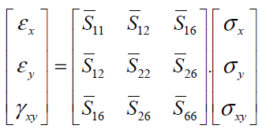
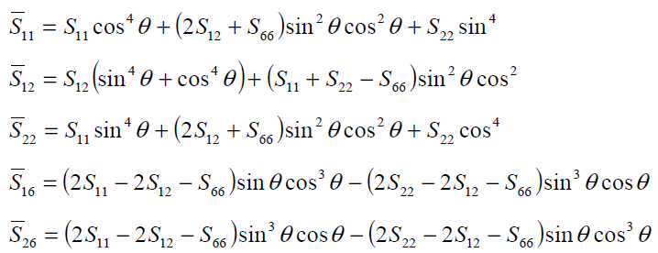

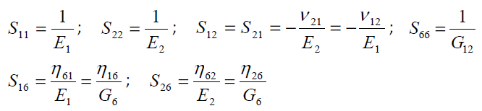
Elastic theory- Transformed compliance matrix
Stress-strain in oriented or off-axis coordinates can be expressed in the form:
Notes:
Intro “This slide presents the transformed compliance matrix—how we express strain–stress relations for a lamina rotated by an angle θ relative to the global x–y axes.”
Concept “When a ply is oriented off-axis, the in-plane compliance matrix [S] in its local 1–2 coordinates must be transformed to the global x–y system. This is the inverse of the transformed stiffness matrix you saw earlier and is required for strain calculations under global stress states.”
Details Global compliance relation
$$\left[\begin{matrix}ε_{x} \\ ε_{y} \\ γ_{xy}\end{matrix}\right]=\left[\begin{matrix}{\overset{ˉ}{S}}_{11} & {\overset{ˉ}{S}}_{12} & {\overset{ˉ}{S}}_{16} \\ {\overset{ˉ}{S}}_{12} & {\overset{ˉ}{S}}_{22} & {\overset{ˉ}{S}}_{26} \\ {\overset{ˉ}{S}}_{16} & {\overset{ˉ}{S}}_{26} & {\overset{ˉ}{S}}_{66}\end{matrix}\right]\left[\begin{matrix}σ_{x} \\ σ_{y} \\ τ_{xy}\end{matrix}\right].$$
Key transformation formulas
$$\begin{matrix}{\overset{ˉ}{S}}_{11} & =S_{11}{\cos{}}^{4}θ+\left(2S_{12}+S_{66}\right){\sin{}}^{2}θ{\cos{}}^{2}θ+S_{22}{\sin{}}^{4}θ, \\ {\overset{ˉ}{S}}_{12} & =S_{12}\left({\sin{}}^{4}θ+{\cos{}}^{4}θ\right)+\left(S_{11}+S_{22}−S_{66}\right){\sin{}}^{2}θ{\cos{}}^{2}θ, \\ {\overset{ˉ}{S}}_{22} & =S_{11}{\sin{}}^{4}θ+\left(2S_{12}+S_{66}\right){\sin{}}^{2}θ{\cos{}}^{2}θ+S_{22}{\cos{}}^{4}θ, \\ {\overset{ˉ}{S}}_{16} & =\left(2S_{11}−2S_{12}−S_{66}\right)\sin{θ}{\cos{}}^{3}θ−\left(2S_{22}−2S_{12}−S_{66}\right){\sin{}}^{3}θ\cos{θ}, \\ {\overset{ˉ}{S}}_{26} & =\left(2S_{11}−2S_{12}−S_{66}\right){\sin{}}^{3}θ\cos{θ}−\left(2S_{22}−2S_{12}−S_{66}\right)\sin{θ}{\cos{}}^{3}θ, \\ {\overset{ˉ}{S}}_{66} & =2\left(S_{11}+S_{22}−4S_{12}−S_{66}\right){\sin{}}^{2}θ{\cos{}}^{2}θ+S_{66}\left({\sin{}}^{4}θ+{\cos{}}^{4}θ\right).\end{matrix}$$
These follow directly from the transformation $\left[\overset{ˉ}{S}\right]=\left[T\right]\left[S\right]\left[T{\left.]\right.}^{ \text{⁣}−1}\right.$.
Engineering constants reminder $S_{11}=1/E_{1}, S_{22}=1/E_{2}, S_{12}=−ν_{12}/E_{1}, S_{66}=1/G_{12}$.
Diagram The figure again shows a ply at an angle θ relative to global x–y axes.

Slide 25
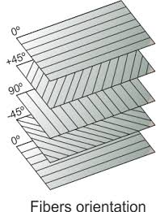
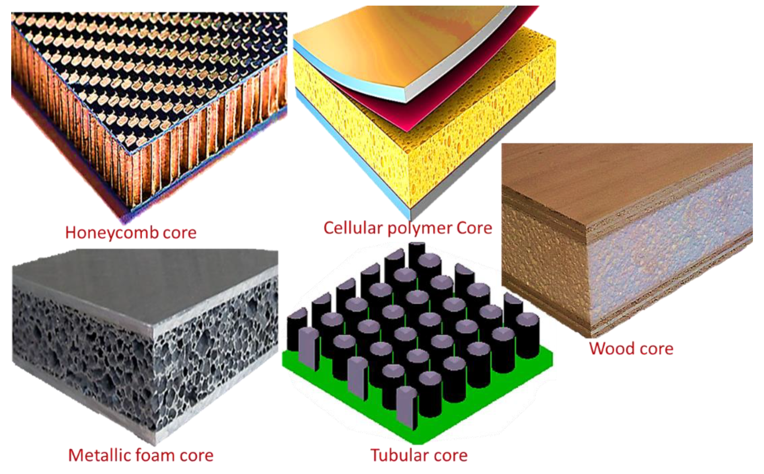
Laminate formulation
Thus far, we have discussed the mechanical properties of a single ply (lamina) in detail.
However, a laminate is comprised of multiple plies each with different orientation.
The question now is how to characterise the mechanical behaviour of a laminate based on the properties of each individual lamina.
Notes:
Intro “This slide makes the transition from analysing a single ply to analysing a full laminate—a stack of many plies, each with its own fibre orientation and material properties.”
Concept “So far we examined the mechanics of one lamina using compliance and stiffness matrices. A real composite structure is a laminate: multiple plies at different angles bonded together. The mechanical response of the whole laminate depends on how these plies interact.”
Details Key idea – Each ply (0°, ±45°, 90° etc.) contributes its transformed stiffness $\left[\overset{ˉ}{Q}{\left.]\right.}_{k}\right.$. – Laminate theory integrates these contributions through the A, B, and D matrices to capture in-plane, coupling, and bending behaviour. – The images on the right illustrate common sandwich or core constructions—honeycomb, cellular polymer, metallic foam, tubular, and wood cores—which can all be part of a laminate system.
Next step “The question now is how to combine the individual lamina properties to predict the overall in-plane and bending stiffness of the laminate. This is the foundation of classical laminate theory.”

Slide 26
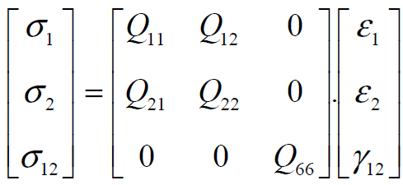
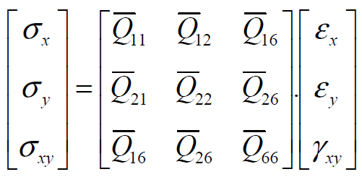

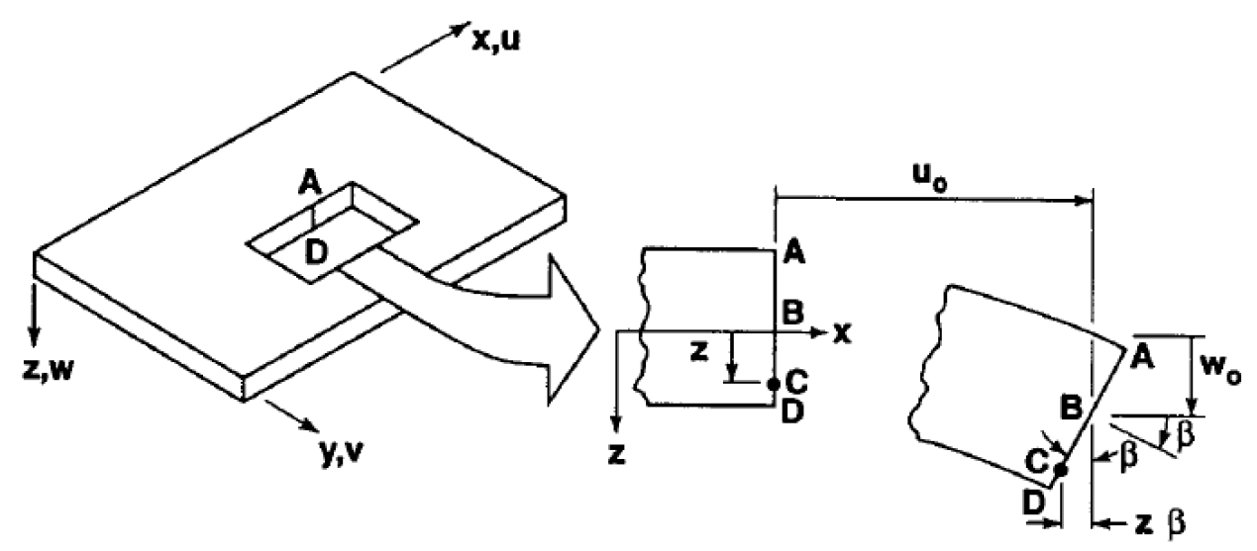
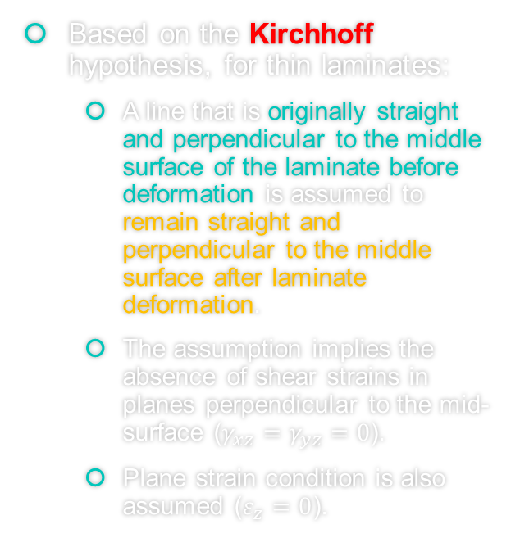
Laminate formulation
Based on the Kirchhoff hypothesis, for thin laminates:
A line that is originally straight and perpendicular to the middle surface of the laminate before deformation is assumed to remain straight and perpendicular to the middle surface after laminate deformation.
The assumption implies the absence of shear strains in planes perpendicular to the mid-surface ($γ_{xz}=γ_{yz}=0$).
Plane strain condition is also assumed ($ε_{z}=0$).
Notes:
Intro “This slide introduces the Kirchhoff hypothesis—the key assumption behind classical laminate plate theory for thin laminates.”
Concept “The hypothesis states: a line initially straight and perpendicular to the laminate mid-surface remains straight and perpendicular after deformation. This simplifies the kinematics by eliminating transverse shear deformation.”
Details Implications – Because normals remain perpendicular, transverse shear strains vanish: $γ_{xz}=γ_{yz}=0$. – Plane strain in the thickness direction is assumed: $ε_{z}=0$. – Displacements u, v, w vary linearly through the thickness, enabling the use of the A, B, D stiffness matrices to relate mid-plane strains and curvatures to forces and moments.
Illustration The figure shows a laminate plate with a normal AB before and after bending. Even as the plate deflects (w) and twists (β), the AB line remains straight and orthogonal to the mid-surface, consistent with Kirchhoff kinematics.

Slide 27

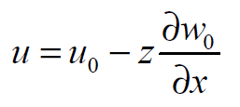







Laminate formulation
Mid-plane strains
Stress in k-th lamina
Coordinate of kth lamina
Mid-plane curvatures
Notes:
Intro “This slide assembles the full classical laminate plate formulation—linking mid-plane displacements and curvatures to strains and stresses through the laminate thickness.”
Concept “In Kirchhoff thin-plate theory, displacements u and v vary linearly through the thickness z while the transverse displacement w is constant through z. From these kinematics we derive in-plane strains and curvatures, then compute stresses in any ply k using its transformed stiffness matrix $\left[\overset{ˉ}{Q}{\left.]\right.}^{k}\right.$.”
Details Displacement field
$$u=u_{0}−z\frac{∂w_{0}}{∂x}, v=v_{0}−z\frac{∂w_{0}}{∂y}.$$
Strain–displacement relations
$$\begin{matrix}ε_{x} & =\frac{∂u}{∂x}=\frac{∂u_{0}}{∂x}−z\frac{∂^{2}w_{0}}{∂x^{2}}, \\ ε_{y} & =\frac{∂v}{∂y}=\frac{∂v_{0}}{∂y}−z\frac{∂^{2}w_{0}}{∂y^{2}}, \\ γ_{xy} & =\frac{∂u}{∂y}+\frac{∂v}{∂x}=\frac{∂u_{0}}{∂y}+\frac{∂v_{0}}{∂x}−2z\frac{∂^{2}w_{0}}{∂x∂y}.\end{matrix}$$
Mid-plane strain/curvature split
$$\left\{ε\right\}=\left\{ε^{0}\right\}+z\left\{κ\right\},$$
where $\left\{ε^{0}\right\}$are mid-plane strains and $\left\{κ\right\}$are curvatures.
Stress in the k-th lamina
$$\left\{σ{\left.\}\right.}^{k}=\left[\overset{ˉ}{Q}{\left.]\right.}^{k}\left(\left\{ε^{0}\right\}+z\left\{κ\right\}\right).\right.\right.$$
This is the foundation for integrating through the thickness to obtain the global laminate A, B, D stiffness matrices.

Slide 28


Laminate formulation
The components of the stiffness matrix $\overline{Q_{ij}}$ can be different for each ply.
Stresses through the thickness are discontinuous.
Strains through the thickness are continuous.
Notes:
Intro “This slide highlights how stresses and strains vary through the laminate thickness, and why their behaviour differs from ply to ply.”
Concept “Each ply can have a different transformed stiffness matrix $\left[{\overset{ˉ}{Q}}_{ij}\right]$because of fibre orientation and material properties. When the laminate bends or stretches, the strain field is continuous through the thickness, but the stress field changes abruptly at each interface.”
Details Key points – Different Qij per ply: Every lamina may have its own stiffness values, so the constitutive relation $σ=\left[\overset{ˉ}{Q}\right]ε$ is ply-dependent. – Continuous strain (ε): Mid-plane strain varies linearly with z and must remain continuous to satisfy compatibility—no sudden jumps across interfaces. – Discontinuous stress (σ): Because $\left[\overset{ˉ}{Q}\right]$changes from ply to ply, the same strain produces different stresses, giving step changes at each interface (as the right-hand plot shows). – Interlaminar shear (Q): The central diagram emphasises shear force (Q) and its distribution; interlaminar stresses must equilibrate these jumps.
Illustration The graphic shows a 4-ply laminate with – blue band: continuous strain profile, – red band: variable Q matrix, – yellow band: piecewise stress profile.

Slide 29

Laminate formulation
So far, stresses and curvatures are obtained for a laminate and each lamina within it.
The final stage is to relate forces and moments to the strains and curvatures.
Force per unit width (N/mm)
Moment per unit width (N.mm/mm)
Notes:
Intro “This slide completes the laminate formulation by connecting laminate-level forces and moments to the mid-plane strains and curvatures.”
Concept “In classical laminate theory, once we know the strain and curvature fields, we integrate the ply stresses through the thickness to obtain resultant forces $N_{x},N_{y},N_{xy}$ and resultant moments $M_{x},M_{y},M_{xy}$. These represent forces and bending/twisting moments per unit width of the laminate.”
Details Definitions – Force resultants $N_{x},N_{y},N_{xy}$ have units of N/mm (or N/m in SI) and represent the in-plane loads. – Moment resultants $M_{x},M_{y},M_{xy}$ have units of N·mm/mm and represent bending and twisting moments. – These are related to mid-plane strain $\left\{ε^{0}\right\}$and curvature $\left\{κ\right\}$through the ABD matrix:
$$\left[\begin{matrix}\left\{N\right\} \\ \left\{M\right\}\end{matrix}\right]=\left[\begin{matrix}A & B \\ B & D\end{matrix}\right]\left[\begin{matrix}\left\{ε^{0}\right\} \\ \left\{κ\right\}\end{matrix}\right].$$
Here, A is the extensional stiffness, D the bending stiffness, and B captures bending–extension coupling.
Illustration The figure shows a laminate element with all in-plane forces $N_{x},N_{y},N_{xy}$and bending/twisting moments $M_{x},M_{y},M_{xy}$acting about the mid-surface.

Slide 30






Laminate formulation
Notes:
Intro “This slide shows how laminate forces and moments are calculated by integrating ply stresses through the thickness, arriving at the final A, B, D matrix formulation.”
Concept “In classical laminate theory, in-plane force resultants $\left\{N\right\}$and moment resultants $\left\{M\right\}$are obtained by summing the contributions of all plies. The stress in each ply, expressed as $\left\{σ{\left.\}\right.}^{k}=\left[\overset{ˉ}{Q}{\left.]\right.}^{k}\left(\left\{ε^{0}\right\}+z\left\{κ^{0}\right\}\right)\right.\right.$, is integrated across the thickness to give the laminate-level resultants.”
Details Force resultants
Moment resultants
Substituting $\left\{σ{\left.\}\right.}^{k}\right.$gives
$$\left\{N\right\}=A\left\{ε^{0}\right\}+B\left\{κ^{0}\right\}, \left\{M\right\}=B\left\{ε^{0}\right\}+D\left\{κ^{0}\right\},$$
where
These A, B, D matrices are the extensional, bending–extension coupling, and bending stiffnesses of the laminate.
Illustration The diagram highlights the layer-by-layer integration of stresses, with coloured bands showing the different plies and how their individual stiffness matrices $\left[\overset{ˉ}{Q}{\left.]\right.}^{k}\right.$contribute to the global resultants.

Slide 31



Laminate formulation
Finally, the equation becomes:

Slide 32



Laminate formulation- ABD stiffness matrix
Some key and important points:
$A_{ij}$ are extensional stiffness.
$A_{16}$and $A_{26}$ are shear-extension coupling.
$B_{ij}$ are bending-extension coupling stiffness.
$D_{ij}$ are bending stiffness.
$D_{16}$and $D_{26}$ are bending-twisting coupling.
Notes:
Intro “This slide presents the ABD stiffness matrix, the core of classical laminate theory, which links in-plane forces and bending moments to mid-plane strains and curvatures.”
Concept “The laminate stiffness matrix is partitioned into three key submatrices:
$$\left[\begin{matrix}\left\{N\right\} \\ \left\{M\right\}\end{matrix}\right]=\left[\begin{matrix}A & B \\ B & D\end{matrix}\right]\left[\begin{matrix}\left\{ε^{0}\right\} \\ \left\{κ^{0}\right\}\end{matrix}\right].$$
Here,
A is the extensional stiffness, relating in-plane loads to in-plane strains.
B is the bending–extension coupling stiffness, capturing coupling between bending and stretching.
D is the bending stiffness, relating bending moments to curvatures.”
Details
$A_{ij}($extensional stiffness): in-plane forces vs. mid-plane strains. – $A_{16},A_{26}$describe shear–extension coupling when the laminate is unsymmetric.
$B_{ij}($bending–extension coupling): coupling between in-plane loads and bending curvatures. – Vanishes for symmetric laminates.
$D_{ij}($bending stiffness): bending moments vs. curvatures. – $D_{16},D_{26}$represent bending–twisting coupling.
The adjacent diagram effectively illustrates how each submatrix produces specific deformation modes.

Slide 33


Important note-1
Normally, applied forces are known and what we seek for are strains and curvatures.
Therefore, we can re-write the equation as below:
-1
Notes:
Intro “This slide shows how to invert the ABD matrix to obtain mid-plane strains $\left\{ε^{0}\right\}$and curvatures $\left\{κ\right\}$directly from the known in-plane forces and bending moments $\left\{N\right\}$and $\left\{M\right\}$.”
Concept “In practice we usually know the applied loads, not the deformations. The original relation
$$\left[\begin{matrix}\left\{N\right\} \\ \left\{M\right\}\end{matrix}\right]=\left[\begin{matrix}A & B \\ B & D\end{matrix}\right]\left[\begin{matrix}ε^{0} \\ κ\end{matrix}\right]$$
is inverted to
$$\left[\begin{matrix}ε^{0} \\ κ\end{matrix}\right]=\left[\begin{matrix}α & β \\ β^{T} & δ\end{matrix}\right]\left[\begin{matrix}N \\ M\end{matrix}\right].$$
The submatrices are:
$α$: in-plane compliance (inverse of extensional stiffness adjusted for coupling)
$β$: coupling between in-plane forces and curvatures
$δ$: bending compliance.”
Details “The right-side expressions define these submatrices:
Correct inverse of the ABD system (via the Schur complement $S=D−BA^{−1}$
$$α=A^{−1}+A^{−1}BS^{−1}BA^{−1}, β=−A^{−1}BS^{−1}, δ=S^{−1}.$$
These follow directly from the Schur complement of the ABD matrix.”

Slide 34
Important note-2
We may have various lay-ups.
The most common of them are:
Symmetric
Balanced
Cross-ply
Angle-ply
Quasi-isotropic

Slide 35



Important note-3
Summary of previous formulation:
0
0
Symmetric: symmetric stacking sequence with respect to the mid-plane such as:
The B matrix becomes zero.
Notes:
Intro “This slide explains the special case of a symmetric laminate where the stacking sequence is mirrored about the mid-plane. In this situation the coupling matrix $B$in the ABD formulation vanishes, greatly simplifying the inversion used to obtain mid-plane strains $\left\{ε^{0}\right\}$and curvatures $\left\{κ\right\}$from the known in-plane forces $\left\{N\right\}$and bending moments $\left\{M\right\}$.”
Concept “For a symmetric lay-up the extensional–bending coupling is zero:
$$\left[\begin{matrix}N \\ M\end{matrix}\right]=\left[\begin{matrix}A & 0 \\ 0 & D\end{matrix}\right]\left[\begin{matrix}ε^{0} \\ κ\end{matrix}\right].$$
The absence of $B$means that in-plane loads and bending moments are uncoupled. Mid-plane strains depend only on $A$, and curvatures depend only on $D$.”
Details “The inverse of the ABD system reduces directly to
$$α=A^{−1}, β=0, δ=D^{−1}.$$
Thus
$$\left[\begin{matrix}ε^{0} \\ κ\end{matrix}\right]=\left[\begin{matrix}α & 0 \\ 0 & δ\end{matrix}\right]\left[\begin{matrix}N \\ M\end{matrix}\right].$$
This follows from the general Schur-complement form $$α=A^{−1}+A^{−1}BS^{−1}BA^{−1}, β=−A^{−1}BS^{−1}, δ=S^{−1}$$ with $S=D−BA^{−1}B$. Setting $B=0$gives the simplified relations above.”

Slide 36

Important note-4
Summary of previous formulation:
0
0
Balanced: for each $+θ$ ply, there is $−θ$ of the same material type and thickness in the laminate such as ${[+45, −45, 0, 90]}_{s}$.
Coupling between direct and shear terms vanishes.
If not balanced, when thermal curing the component comes out warped from the autoclave.
$A_{16}=$ $A_{26}=$0.
Notes:
Intro “This slide defines the cross-ply laminate, a fundamental lay-up in composite design used for panels requiring high in-plane stiffness in two orthogonal directions.”
Concept “A cross-ply laminate consists solely of 0° and 90° plies, typically arranged symmetrically, for example $[0 , 0 , 9090{\left.]\right.}_{s},$. Because plies are oriented only along the principal material axes, the extensional stiffness matrix $A$becomes nearly orthotropic with negligible coupling terms $A_{16}$and $A_{26}$.”
Details
Mechanical behaviour – High longitudinal stiffness from 0° plies, transverse stiffness from 90° plies, and good dimensional stability.
Analysis simplification – The ABD matrix reduces to an orthotropic form: no in-plane shear–normal coupling.
Applications – Common in aerospace fuselage skins and stiffened panels where bidirectional load capacity is required.
Reference – See Jones, Mechanics of Composite Materials, Ch. 4, which provides full derivation of the ABD matrix for [0/90] cross-ply laminates.

Slide 37

Important note-5
Summary of previous formulation:
Cross-ply: contain only $0^{°}$ or ${90}^{°}$ plies such as ${[0, 0, 90, 90]}_{s}$.
Notes:
Intro “This slide introduces angle-ply laminates, which are built from plies placed at oblique angles rather than the principal 0° or 90° directions.”
Concept “Angle-ply laminates contain only off-axis plies, for example $[+ , 45 , −45+60−60{\left.]\right.}_{s},$. Because no ply is aligned with the main material axes, the laminate exhibits strong in-plane shear stiffness and improved torsional behaviour. The absence of pure 0° or 90° plies also creates coupling between normal and shear responses, giving nonzero $A_{16}$and $A_{26}$terms in the ABD matrix unless the lay-up is both symmetric and balanced.”
Details
Mechanical traits – High in-plane shear strength, good fatigue resistance in torsion, and more uniform stress distribution under multiaxial loading.
Design notes – To suppress bending–twisting coupling, the laminate is usually arranged in balanced ±θ pairs, e.g. $\left[+45/−45{\left.]\right.}_{s}\right.$.
Applications – Helicopter blades, pressure vessels, and structures requiring combined shear and axial load capacity.
Typo – Slide heading spells “Anlge-ply”; correct spelling is Angle-ply.
Reference: Jones, Mechanics of Composite Materials, Chapter 5, for full ABD derivations of ±θ laminates.

Slide 38

Important note-6
Summary of previous formulation:
Anlge-ply: do not contain $0^{°}$ or ${90}^{°}$ plies such as ${[+45, −45, +60, −60]}_{s}$.
Notes:
Intro “This slide introduces angle-ply laminates, which are built from plies placed at oblique angles rather than the principal 0° or 90° directions.”
Concept “Angle-ply laminates contain only off-axis plies, for example $[+ , 45 , −45+60−60{\left.]\right.}_{s},$. Because no ply is aligned with the main material axes, the laminate exhibits strong in-plane shear stiffness and improved torsional behaviour. The absence of pure 0° or 90° plies also creates coupling between normal and shear responses, giving nonzero $A_{16}$and $A_{26}$terms in the ABD matrix unless the lay-up is both symmetric and balanced.”
Details
Mechanical traits – High in-plane shear strength, good fatigue resistance in torsion, and more uniform stress distribution under multiaxial loading.
Design notes – To suppress bending–twisting coupling, the laminate is usually arranged in balanced ±θ pairs, e.g. $\left[+45/−45{\left.]\right.}_{s}\right.$.
Applications – Helicopter blades, pressure vessels, and structures requiring combined shear and axial load capacity.
Typo – Slide heading spells “Anlge-ply”; correct spelling is Angle-ply.

Slide 39

Important note-7
Summary of previous formulation:
Quasi-isotropic: have the same stiffness (analogous to isotropic material) in any direction in their plane $xy$ such as:
Notes:
Intro “This slide introduces quasi-isotropic laminates, which are designed to behave as if they were isotropic in their in-plane stiffness. In other words, the laminate shows nearly identical elastic properties in every direction of its plane.”
Concept “A quasi-isotropic lay-up mixes plies at 0°, ±45°, and 90° in a symmetric and balanced pattern. Typical sequences include [0/45/90/−45]s or [45/−45/0/90]s. This arrangement averages the directional properties so that the in-plane response—stiffness, Poisson’s ratio, and thermal expansion—appears the same regardless of the loading direction.”
Details
Key feature – In-plane stiffness is uniform (Ex ≈ Ey) and bending–twisting coupling is suppressed.
Design note – The laminate must be both symmetric and balanced to achieve this behaviour.
Applications – Aerospace skins, wind-turbine blades, and automotive panels where isotropic in-plane performance is desired with minimal weight.

Slide 40

Example
Determine ABD matrices of the following laminate using hand calculation methods and formulation mentioned in previous slides with stacking sequence [0/45]. The material used is unidirectional glass fibre epoxy with mechanical properties given below.
Notes:
Intro “Let’s work the example: a two-ply laminate $\left[0/45\right]$with ply thicknesses 3 mm and 5 mm made from UD glass–epoxy. We’ll compute the ABD matrices by hand-method formulas.”
Given $E_{L}=46$GPa, $E_{T}=10$GPa, $G_{LT}=4.6$GPa, $ν_{LT}=0.31$. Reciprocity: $ν_{TL}=ν_{LT}E_{T}/E_{L}=0.06739$. Denominator $1−ν_{LT}ν_{TL}=0.97911$.
Ply reduced stiffness $\left[Q\right]$(UD lamina) $Q_{11}=46.98$GPa, $Q_{22}=10.21$GPa, $Q_{12}=3.166$GPa, $Q_{66}=4.60$GPa.
Transformed $\left[\overset{ˉ}{Q}\right]$
$0^{∘}$: $\overset{ˉ}{Q}=$diag$\left(Q_{11} , Q_{22} , Q_{66}\right)$ with ${\overset{ˉ}{Q}}_{12}=3.166$GPa, ${\overset{ˉ}{Q}}_{16}={\overset{ˉ}{Q}}_{26}=0$.
${45}^{∘}$: ${\overset{ˉ}{Q}}_{11}={\overset{ˉ}{Q}}_{22}=20.482$GPa, ${\overset{ˉ}{Q}}_{12}=11.282$GPa, ${\overset{ˉ}{Q}}_{16}={\overset{ˉ}{Q}}_{26}=9.192$GPa, ${\overset{ˉ}{Q}}_{66}=12.716$GPa.
Layer boundaries (about mid-plane, thickness $t=8$mm): $z_{0}=−4$mm, $z_{1}=−1$mm (after 3-mm 0° ply), $z_{2}=+4$mm (after 5-mm 45° ply).
ABD results Units below are per unit width. I show the convenient engineering units (N/mm, N·mm, N·mm) and keep 3 sig figs for readability.
A (N/mm):
$$A≈\left[\begin{matrix}2.43 × {10}^{5} & 6.59 × {10}^{4} & 4.60 × {10}^{4} \\ 6.59 × {10}^{4} & 1.33 × {10}^{5} & 4.60 × {10}^{4} \\ 4.60 × {10}^{4} & 4.60 × {10}^{4} & 7.74 × {10}^{4}\end{matrix}\right]$$
B (N·mm):
$$B≈\left[\begin{matrix}−1.99 × {10}^{8} & 6.09 × {10}^{7} & 6.89 × {10}^{7} \\ 6.09 × {10}^{7} & 7.70 × {10}^{7} & 6.89 × {10}^{7} \\ 6.89 × {10}^{7} & 6.89 × {10}^{7} & 6.09 × {10}^{7}\end{matrix}\right]$$
D (N·mm):
$$D≈\left[\begin{matrix}1.43 × {10}^{6} & 3.11 × {10}^{5} & 1.99 × {10}^{5} \\ 3.11 × {10}^{5} & 6.58 × {10}^{5} & 1.99 × {10}^{5} \\ 1.99 × {10}^{5} & 1.99 × {10}^{5} & 3.72 × {10}^{5}\end{matrix}\right]$$
Notes and checks
The lay-up $\left[0/45\right]$is unsymmetric, so $B≠0$(bending–extension coupling present).
Signs and magnitudes are consistent with $z$measured from the mid-plane (bottom ply is 0°, top is 45°).
If you mirror the stack to $\left[[0/45{\left.]\right.}_{s}\right.$, all $B$terms cancel and bending–extension coupling vanishes.

Slide 41

Solution
See the excel file solution named “ABD matrix.xls” for detailed information and solution.

Slide 42

Laminate membrane homogenized stiffnesses
Hooke’s law ($σ=Eε$) can be generalised to the laminated composites.
Force per unit width (N/mm)
Moment per unit width (N.mm/mm)
Notes:
Intro This slide generalizes Hooke’s law ($σ=Eε$) to laminated composite plates. For a multi-ply laminate, the in-plane load–strain relationship can be expressed in homogenized form by defining equivalent membrane stiffnesses that act analogously to the modulus and Poisson ratio of an isotropic sheet. These equivalent constants are obtained from the α-matrix, which is the in-plane (membrane) compliance submatrix of the inverse [ABD] stiffness matrix.
Concept A laminate does not have a single modulus like a monolithic material. Instead, it carries in-plane loads ($N_{x},N_{y},N_{xy}$) per unit width (N/mm), which relate to midplane strains $\left(ε_{x} , ε_{y} , γ_{xy}\right)$through:
$$\left\{\begin{matrix}ε_{x} \\ ε_{y} \\ γ_{xy}\end{matrix}\right\}=\left[α\right]\left\{\begin{matrix}N_{x} \\ N_{y} \\ N_{xy}\end{matrix}\right\},$$
where $\left[α\right]$is the membrane compliance matrix extracted from the inverted ABD matrix:
$$\left[α\right]=\left[\begin{matrix}α_{11} & α_{12} & 0 \\ α_{12} & α_{22} & 0 \\ 0 & 0 & α_{66}\end{matrix}\right].$$
By analogy to Hooke’s law, these coefficients define the laminate’s effective in-plane engineering constants — the homogenized moduli and Poisson’s ratios.
Details
From the above relation, the equivalent in-plane stresses can be written as:
$$σ_{x}=\frac{N_{x}}{t}, σ_{y}=\frac{N_{y}}{t}, τ_{xy}=\frac{N_{xy}}{t}.$$
Substituting into the laminate constitutive form gives the homogenized elastic constants per unit width:
$$E_{x}=\frac{1}{t α_{11}}, E_{y}=\frac{1}{t α_{22}}, G_{xy}=\frac{1}{t α_{66}}.$$
The membrane Poisson’s ratios follow directly from the off-diagonal compliance term:
$$ν_{xy}=− \frac{α_{12}}{α_{11}}, ν_{yx}=− \frac{α_{12}}{α_{22}}.$$
Interpretation: For a unit-width laminate, $N_{x}$and $N_{y }$are force resultants (N/mm). They act on a plate of thickness $t$, producing average in-plane stresses $σ_{x},σ_{y},τ_{xy}$. This formulation provides equivalent elastic constants $E_{x},E_{y},G_{xy}$ that describe the laminate’s membrane response as if it were a single orthotropic sheet.
Key Takeaway The laminate’s membrane stiffness is defined through the $α$-matrix, linking in-plane forces per unit width to midplane strains. By inverting this relation, we obtain homogenized moduli and Poisson’s ratios that represent the laminate’s effective orthotropic behaviour. This allows complex multi-ply systems to be replaced by an equivalent homogeneous orthotropic layer for in-plane stress analysis.

Slide 43
Laminate bending homogenized stiffnesses
Force per unit width (N/mm)
Moment per unit width (N.mm/mm)
Notes:
Intro “This slide defines homogenized bending properties of a laminate by equating the laminate’s bending response to that of an equivalent isotropic plate/beam of thickness $t$.”
Concept “For unit width, an isotropic plate has bending rigidity $E I=E t^{3}/12$. In laminate theory the bending compliance submatrix $δ$(bottom-right block of the inverse ABD) maps moments $\left\{M\right\}$ to curvatures $\left\{κ\right\}$: $\left\{κ\right\}=δ \left\{M\right\}$. By matching these two descriptions we extract effective bending moduli and bending Poisson ratios.”
Details Using $δ=\left[\begin{matrix}δ_{11} & δ_{12} & ⋯ \\ δ_{12} & δ_{22} & ⋯ \\ ⋯ & ⋯ & δ_{66}\end{matrix}\right]$ and plate thickness $t$:
Effective bending moduli (per unit width):
$$E_{x}^{\left(b\right)}=\frac{12}{t^{3}δ_{11}}, E_{y}^{\left(b\right)}=\frac{12}{t^{3}δ_{22}}, G_{xy}^{\left(b\right)}=\frac{12}{t^{3}δ_{66}}.$$
Bending Poisson ratios:
$$ν_{xy}^{\left(b\right)}=−\frac{δ_{12}}{δ_{11}}, ν_{yx}^{\left(b\right)}=−\frac{δ_{12}}{δ_{22}}.$$
Interpretation: apply a unit bending moment $M_{x}$; curvature is $κ_{x}=δ_{11}M_{x}$.
Setting $κ_{x}=M_{x}/\left(E_{x}^{\left(b\right)}t^{3}/12\right)$ gives the first relation; the others follow analogously.

Slide 44

Example
Determine the homogenised membrane and bending stiffnesses for a laminated CFRP with lay-up ${[+45/−45/60/90\text{/}\text{0}]}_{s}$ made of the following composite material.

Slide 45


Solution
Use the tool provided to obtain ABD matrices.
Note: Delve into the tool to familiarise yourself with how ABD matrices are calculated.

Slide 46

Solution- Membrane stiffnesses
B matrix is almost ZERO as the lay-up is symmetric (small non-zero numbers of B matrix are numerical rounding off errors).
0
0
Notes:
Given
Lay-up (symmetric): $\left[[+45/−45/60/90/0{\left.]\right.}_{s}\right.$⇒ 10 plies, $t_{\text{ply}}=0.15 \text{mm}$⇒ total $h=1.50 \text{mm}$.
UD ply properties (plane-stress): $$E_{1}=131 \text{GPa}, E_{2}=11.7 \text{GPa}, G_{12}=4.82 \text{GPa}, ν_{12}=0.29$$ $ν_{21}=ν_{12} E_{2}/E_{1}$.
From these,
$$\begin{matrix}Q_{11} & =\frac{E_{1}}{1−ν_{12}ν_{21}}=131.991 \text{GPa}, \\ Q_{22} & =\frac{E_{2}}{1−ν_{12}ν_{21}}=11.789 \text{GPa}, \\ Q_{12} & =\frac{ν_{12}E_{2}}{1−ν_{12}ν_{21}}=3.4187 \text{GPa}, \\ Q_{66} & =G_{12}=4.820 \text{GPa}.\end{matrix}$$
For each ply at angle $θ∈\left\{45 , − , 45 , 60 , 90 , 0 , 0 , 90 , 60 , −4545\right\}$the transformed reduced stiffness $\overset{ˉ}{Q}\left(θ\right)$is formed and integrated through thickness.
Because the stacking is symmetric, $B=0$. It is not balanced (there is no $−{60}^{∘}$ply), so $A_{16},A_{26}≠0$.
Results (per unit width)
Membrane stiffness $A=\sum{{\overset{ˉ}{Q}}^{\left(k\right)}} t_{k}\left[N/mm\right]$
$$A = \left[\begin{matrix} 74551.8 & 29395.9 & 3986.2 \\ 29395.9 & 92582.3 & 11628.6 \\ 3986.2 & 11628.6 & 31497.9\end{matrix}\right]$$
Bending stiffness $D=\sum{{\overset{ˉ}{Q}}^{\left(k\right)}}\frac{\left(z_{k}^{3}−z_{k−1}^{3}\right)}{3}\left[N⋅mm\right]$
$$D = \left[\begin{matrix}10693.7 & 8390.79 & 2190.77 \\ 8390.79 & 14885.80 & 3279.82 \\ 2190.77 & 3279.82 & 8784.92\end{matrix}\right]$$
(Units: $1 \text{GPa}=1000 N/mm^{2}$.)
Homogenised in-plane engineering constants (from $A^{−1}$)
Let $a=A^{−1}$and $h=1.50 \text{mm}$. Then
$$E_{x}^{\text{eff}}=\frac{1}{a_{11}h}, E_{y}^{\text{eff}}=\frac{1}{a_{22}h}, G_{xy}^{\text{eff}}=\frac{1}{a_{66}h}, ν_{xy}^{\text{eff}}=−\frac{a_{12}}{a_{11}}, ν_{yx}^{\text{eff}}=−\frac{a_{12}}{a_{22}}.$$
Numerically:
$$E_{x}^{\text{eff}}≈43.5 \text{GPa}$$
$$E_{y}^{\text{eff}}≈51.8 \text{GPa}$$
$$G_{xy}^{\text{eff}}≈20.0 \text{GPa}$$
$ν_{xy}^{\text{eff}}≈0.316$, $ν_{yx}^{\text{eff}}≈0.377$
Notes for students
Symmetry ⇒ $B=0$(no bending–extension coupling).
Not balanced ⇒ $A_{16},A_{26}≠0$( extension–shear coupling present).
The relatively high $G_{xy}^{\text{eff}}$is expected for a near-quasi-isotropic lay-up with strong off-axis content (±45°, 60°).

Slide 47

Solution- Bending stiffnesses
0
0

Slide 48







Temperature and moisture effects
An increase in temperature $∆T$ causes a thermal expansion of each ply given by $ε_{thermal}^{∗}=α∆T$ where $α$ is coefficient of thermal expansion.
An increase in concentration of swelling agent (moisture) $∆C$ causes a moisture expansion of each ply given by $ε_{swelling}^{∗}=β∆C$ where$β$ is swelling coefficient.
The total combined strain in the laminate then becomes:
Finally:
UD material and plain stress
Notes:
Intro “This slide explains how temperature and moisture introduce additional in-plane strains in a laminate. These are independent of external loads and must be included when predicting stresses and deformations.”
Concept
A temperature change ΔT produces a free thermal strain $ε_{i}^{∗\left(thermal\right)}=α_{i} ΔT$, where $α_{i}$ is the coefficient of thermal expansion in direction i.
A change in moisture concentration ΔC produces a hygroscopic swelling strain $ε_{i}^{∗\left(swelling\right)}=β_{i} ΔC$, where $β_{i}$ is the swelling coefficient.
Total free strain is the sum:
$$ε_{i}^{∗}=ε_{i}^{∗\left(thermal\right)}+ε_{i}^{∗\left(swelling\right)}.$$
Details
In the laminate constitutive relation $σ=\left[Q\right]\left(ε−ε^{∗}\right)$, these free strains act like “built-in” strains, so even without external loads internal stresses arise if the laminate is constrained.
The lower matrix shows how these terms enter the reduced stiffness form for a unidirectional ply under plane stress.
Make sure that α and β are expressed in consistent units (per °C for α, per % moisture content for β).
For hybrid or asymmetric laminates, non-uniform thermal or moisture expansion can also induce bending (warpage) even with no applied mechanical loads.
Critical Note:
The Principle of Mechanical Strain
The total, measurable strain (ϵtotal​) in a composite ply can come from three distinct sources:
Mechanical Strain (ϵmech​): The change in shape due to an external force stretching or compressing the material. This is the only component that creates stress.
Thermal Strain (ϵthermal​): The expansion or contraction caused by a change in temperature (ΔT).
Swelling Strain (ϵswelling​): The expansion caused by absorbing moisture (ΔC).
The overall relationship is a simple sum: ϵtotal​=ϵmech​+ϵthermal​+ϵswelling​
The fundamental stress-strain relationship for a composite, which connects stress (σ) to strain via the stiffness matrix ([Q]), is only valid for the mechanical part of the strain. To correctly calculate the stress, we must first find the mechanical strain by rearranging the equation: ϵmech​=ϵtotal​−ϵthermal​−ϵswelling​
This is why the final matrix equation in your slide shows the thermal and swelling components being subtracted from the total strain to find the resulting stresses.
An Analogy: The Constrained Bar
Imagine a metal bar lying freely on the ground on a hot day.
It expands due to the heat, so it has a positive thermal strain.
However, since it was free to expand without any resistance, there is zero stress inside it.
Now, imagine that same bar is wedged tightly between two immovable concrete walls and then heated.
The bar wants to expand, but the walls prevent it, so its total strain is zero.
Despite this, there is now a massive compressive stress in the bar.
Why? Because the walls are applying a compressive mechanical strain that is equal and opposite to the thermal strain it wants to undergo. It's this externally imposed mechanical strain that creates the stress, not the temperature change itself.

Slide 49





Temperature and moisture effects
When principal directions 1, 2 and 3 make and angle of $θ$ with the reference direction, then
Notes:
Intro “This slide extends the temperature and moisture effects to off-axis plies. When the material principal axes 1-2-3 are rotated by an angle θ relative to the global laminate x-y-z system, both the stiffness matrix and the free thermal/moisture strains must be transformed.”
Concept
Stresses and strains must be expressed in the global coordinates to assemble the laminate ABD matrices.
The rotated stiffness matrix $\left[C^{′}\right]$ is obtained from the material principal stiffness $\left[C\right]$ by the usual 3-D transformation using the strain transformation matrix $T_{ε}$.
Free thermal or moisture strains $ε^{∗}$ are also transformed:
$$ε_{global}^{∗}=T_{ε}^{−1} ε_{principal}^{∗}.$$
This ensures the laminate analysis includes correct coupling between anisotropic material properties and global loads.
Details
The large matrix shows the global stress–strain relation $σ=\left[C^{′}\right]\left(ε−ε^{∗}\right)$.
$T_{ε}^{−1}$listed below is the standard transformation for 3D strain components including shear terms.
Practical tip: for thin laminates under plane stress you typically reduce this to the 2D transformation used earlier, but the 3D form is shown for completeness.

Slide 50


Temperature and moisture effects
For plane stress ($ε_{zz}^{∗}=0$), the equation simplifies to:
Notes:
Intro “This slide concludes the temperature and moisture section by reducing the general 3-D relation to the practical 2-D plane-stress form used for thin laminates.”
Concept
In most laminate analyses the through-thickness normal strain $ε_{zz}^{∗}$ is negligible (plane stress).
The transformed stiffness matrix $\left[Q^{′}\right]$ now operates only on the in-plane strain vector $[ε_{xx} , ε_{yy}γ_{xy}{\left.]\right.}^{T},$.
Free thermal and moisture strains $ε^{∗}$appear as an additive “eigen-strain” that is subtracted from the mechanical strain.
Details
The final expression $σ=\left[Q^{′}\right]\left(ε−ε^{∗}\right)$ is the standard constitutive law for a single ply under combined mechanical, thermal, and moisture loading.
Submatrices $Q_{ij}^{′}$ are obtained from the earlier off-axis transformation.
Ensure consistent units: thermal strain uses the laminate temperature rise, and moisture strain uses the concentration change.

Slide 51



Final constitutive equation of composite laminate
For plane stress ($ε_{zz}^{∗}=0$), the equation simplifies to:
Stress in each ply
Mid-plane strains
Thermal strains
in each ply in isolation
Notes:
Final Constitutive Equation of a Composite Laminate
This equation, known as the final constitutive equation of a composite laminate, is the cornerstone of Classical Laminate Theory (CLT). It relates the external loads applied to a multi-layered laminate to its global deformation, incorporating both mechanical and thermal (or hygrothermal) effects. It is the fundamental link between the micromechanics of individual plies and the macromechanics of the whole laminate.
Mathematically:
$$\left\{\begin{matrix}N_{x} \\ N_{y} \\ N_{xy} \\ M_{x} \\ M_{y} \\ M_{xy}\end{matrix}\right\}=\left[\begin{matrix}A_{11} & A_{12} & A_{16} & B_{11} & B_{12} & B_{16} \\ A_{12} & A_{22} & A_{26} & B_{12} & B_{22} & B_{26} \\ A_{16} & A_{26} & A_{66} & B_{16} & B_{26} & B_{66} \\ B_{11} & B_{12} & B_{16} & D_{11} & D_{12} & D_{16} \\ B_{12} & B_{22} & B_{26} & D_{12} & D_{22} & D_{26} \\ B_{16} & B_{26} & B_{66} & D_{16} & D_{26} & D_{66}\end{matrix}\right]\left\{\begin{matrix}ε_{xx}^{0} \\ ε_{yy}^{0} \\ γ_{xy}^{0} \\ κ_{x} \\ κ_{y} \\ κ_{xy}\end{matrix}\right\}−\left\{\begin{matrix}N_{x}^{∗} \\ N_{y}^{∗} \\ N_{xy}^{∗} \\ M_{x}^{∗} \\ M_{y}^{∗} \\ M_{xy}^{∗}\end{matrix}\right\}$$
What the Equation Represents
The matrix form provides a complete physical picture of how a laminate behaves under complex loading. It couples forces, moments, and curvatures within a single framework.
1. Load Vector (Left Side)
Represents the resultant forces and moments per unit width acting on the entire laminate:
$N_{x},N_{y},N_{xy}$: in-plane (membrane) forces generated by axial, transverse, or shear loading.
$M_{x},M_{y},M_{xy}$: bending and twisting moments caused by curvature or thermal gradients.
These resultants are not ply-level quantities but rather summations through the laminate thickness, integrating stresses from all plies.
2. [ABD] Stiffness Matrix (Centre Block)
The laminate stiffness matrix encapsulates the anisotropic response of the entire laminate. It is partitioned into three distinct sub-matrices:
[A] – Extensional Stiffness Matrix Relates in-plane forces ($N$) to mid-plane strains ($ε^{0}$). It determines the in-plane stiffness — essentially how the laminate resists stretching and shearing.
[B] – Coupling Stiffness Matrix Describes bending–extension coupling, a phenomenon unique to composites. It relates in-plane forces to curvatures ($κ$) and moments to mid-plane strains. For symmetric laminates, $\left[B\right]=0$, which decouples bending and extension. For asymmetric laminates, $\left[B\right]≠0$, meaning that stretching induces bending and vice versa — a non-intuitive but powerful feature of anisotropy.
[D] – Bending Stiffness Matrix Relates applied moments ($M$) to curvatures ($κ$). It defines the laminate’s flexural rigidity, equivalent to $EI$for beams but directionally dependent.
Physically, these sub-matrices are obtained by integrating the transformed reduced stiffnesses of individual plies across the laminate’s thickness. Each entry contains the accumulated stiffness contribution of all plies, weighted by their distance from the mid-plane.
3. Deformation Vector (Right Side)
Describes the laminate’s global deformation state:
$ε_{xx}^{0},ε_{yy}^{0},γ_{xy}^{0}$: mid-plane strains — the average in-plane stretching or shearing of the neutral surface.
$κ_{x},κ_{y},κ_{xy}$: curvatures — measures of bending or twisting about the laminate’s axes.
This vector defines the shape and extension of the laminate under given loads. It is what finite element codes (like Abaqus shell elements) directly solve for.
4. Thermal and Moisture Resultant Vector (Far Right)
$$\left\{N^{∗} , M^{∗}\right\}$$
represents the equivalent loads arising from hygrothermal expansion:
Each ply experiences “free” thermal and moisture strains when unconstrained.
If the laminate is restrained (e.g. bonded in a structure), these free strains create internal stresses and moments.
Hence, $N^{∗},M^{∗}$quantify the self-equilibrating internal forces and moments that must exist to prevent free expansion. They are essential for predicting residual stresses, curing distortions, and thermal warpage.
Stress in an Individual Ply
The global equation governs the laminate as a whole, but local ply stresses are recovered using:
$$\left\{\begin{matrix}σ_{xx} \\ σ_{yy} \\ σ_{xy}\end{matrix}\right\}=\left[\begin{matrix}{\overset{ˉ}{Q}}_{11}^{′} & {\overset{ˉ}{Q}}_{12}^{′} & {\overset{ˉ}{Q}}_{16}^{′} \\ {\overset{ˉ}{Q}}_{12}^{′} & {\overset{ˉ}{Q}}_{22}^{′} & {\overset{ˉ}{Q}}_{26}^{′} \\ {\overset{ˉ}{Q}}_{16}^{′} & {\overset{ˉ}{Q}}_{26}^{′} & {\overset{ˉ}{Q}}_{66}^{′}\end{matrix}\right]\left(\left\{\begin{matrix}ε_{xx} \\ ε_{yy} \\ γ_{xy}\end{matrix}\right\}−\left\{\begin{matrix}ε_{xx}^{∗} \\ ε_{yy}^{∗} \\ ε_{xy}^{∗}\end{matrix}\right\}\right)$$
where:
$\left[{\overset{ˉ}{Q}}^{′}\right]$: the transformed reduced stiffness matrix of the ply in its actual fibre orientation.
$ε_{xx},ε_{yy},γ_{xy}$: the total strain at that ply’s position (from mid-plane strain + curvature × z).
$ε^{∗}$: the free thermal/hygroscopic strain, which would occur if the ply expanded unconstrained.
Subtracting these free strains isolates the mechanical strain that generates stress. The resulting stresses are then checked against failure criteria such as Tsai–Hill, Tsai–Wu, or Hashin, as taught in the Failure Theory lecture.
Key Takeaways
The ABD matrix equation is the unifying expression of laminate mechanics — every design, analysis, or FEA validation traces back to it.
Symmetry eliminates coupling; balance eliminates in-plane shear coupling.
Thermal and moisture effects must be treated as load equivalents, not as material property changes.
The ply-stress recovery equation allows zooming from global laminate response to local ply-level failure prediction.
In symmetric, quasi-isotropic laminates, this framework reduces to classical isotropic plate theory — a remarkable simplification emerging from a highly anisotropic system.

Slide 52



Example
Consider the case of a symmetric cross-ply laminate made of three unidirectional layers 1 mm thick, with the mechanical characteristics:
The curing process of the laminate was carried out at a temperature of $120 ℃$. We need to determine the residual stresses at the working temperature of $20 ℃$.
Notes:
Example – Residual thermal stresses in a symmetric cross-ply
Lay-up: $\left[90/0/90\right]$each ply $t=1 \text{mm}$; total $h=3 \text{mm}$) Material (UD, principal axes 1–2): $E_{1}=45 \text{GPa}$, $E_{2}=10 \text{GPa}$, $ν_{12}=0.31$, $G_{12}=4.5 \text{GPa}$ CTEs: $α_{1}=5×{10}^{−6}/^{∘}\text{C}$, $α_{2}=20×{10}^{−6}/^{∘}\text{C}$ Thermal history: cure at ${120}^{∘}\text{C}$→ work at ${20}^{∘}\text{C}$⇒ $ΔT=−{100}^{∘}\text{C}$
Intro
We want the residual ply stresses at ${20}^{∘}\text{C}$ caused by cooldown from cure. The laminate is free (no external $N$or $M$), so any mismatch in free thermal strain between the 0° and 90° plies must self-equilibrate internally.
Concept
Use the final constitutive equation with $\left\{N , M\right\}=0$and uniform $ΔT$.
Symmetry ⇒ $\left[B\right]=0$and, under uniform $ΔT$, $κ=0$.
Solve $\left[A\right]ε^{0}=N^{∗}$for the mid-plane strains.
Recover ply stresses by
$$σ^{\left(k\right)}={\overset{ˉ}{Q}}^{\left(k\right)}\left(ε^{0}−ε^{∗\left(k\right)}\right), ε^{∗\left(k\right)}=α^{\left(k\right)}ΔT.$$
Details
Reduced stiffness (orthotropic, plane stress) with $ν_{21}=ν_{12}E_{2}/E_{1}$:
$$Q_{11}=\frac{E_{1}}{1−ν_{12}ν_{21}}, Q_{22}=\frac{E_{2}}{1−ν_{12}ν_{21}}, Q_{12}=\frac{ν_{12}E_{2}}{1−ν_{12}ν_{21}}, Q_{66}=G_{12}.$$
Numerically: $Q_{11}=45.98 \text{GPa}$, $Q_{22}=10.22 \text{GPa}$, $Q_{12}=3.168 \text{GPa}$, $Q_{66}=4.50 \text{GPa}$.
Transformed $\overset{ˉ}{Q}$: 0 ° ply → $\overset{ˉ}{Q}=Q$. 90 ° ply → swap 11↔22 (no $16/26$terms for 0/90).
Thermal strains in laminate axes: 0°: $ε^{∗}=[α_{1} , α_{2}0{\left.]\right.}^{T}ΔT,$. 90°: ${ ε}^{∗}=[α_{2} , α_{1}0{\left.]\right.}^{T}ΔT,$.
Assemble $\left[A\right]=\sum{{\overset{ˉ}{Q}}^{\left(k\right)}}t_{k}$and $N^{∗}=\sum{{\overset{ˉ}{Q}}^{\left(k\right)}}ε^{∗\left(k\right)}t_{k}$over the three plies, solve
$$\left[A\right]\{ε_{xx}^{0} , ε_{yy}^{0}γ_{xy}^{0}{\left.\}\right.}^{T}=\{N_{x}^{∗} , N_{y}^{∗}N_{xy}^{∗}{\left.\}\right.}^{T}.,,$$
Result (mid-plane strains): $ε_{xx}^{0}=−1.005×{10}^{−3}$, $ε_{yy}^{0}=−6.96×{10}^{−4}$, $γ_{xy}^{0}=0$. (Uniform contraction; no mid-plane shear; curvature zero by symmetry.)
Ply stresses (laminate axes = material axes for 0/90):
0° ply (middle) $σ_{xx}=−19.1 \text{MPa}$(longitudinal compressive) $σ_{yy}=+11.7 \text{MPa}$(transverse tensile) $$σ_{xy}=0$$
90° plies (top & bottom; identical) $σ_{xx}=+9.55 \text{MPa}$(along laminate $x$, i.e., transverse to fibers) $σ_{yy}=−5.86 \text{MPa}$(along fibers of the 90° plies) $$σ_{xy}=0$$
Self-equilibration check: $\sum{t_{k}} σ_{xx}^{\left(k\right)}=0$, $\sum{t_{k}} σ_{yy}^{\left(k\right)}≈0$⇒ no external resultants, as required.
Key Takeaway
Cooling from cure creates balanced internal stresses even when the laminate is free: the stiff/low-CTE direction (0°) goes into compression along its fibers while the compliant/high-CTE direction (90°) takes tension in the orthogonal sense. Symmetry kills curvature, but ply-level residual stresses survive and must be considered in failure checks (matrix cracking in 90°, transverse tension in 0°) and in warpage risk if the lay-up isn’t symmetric.

Slide 53


Solution
It should be noted that the stress in the 0° layer reaches the value of 11.7 MPa in the direction transverse to the fibres, of the order of a quarter to a third of the strength in this direction.
It appears that the stresses of thermal origin, related to the method of fabrication (curing at a temperature higher than the working temperature) must be taken into consideration in some design processes.
See “Thermal Expansion.xls” file for full detailed solution.

