Slide 1
Fatigue of Carbon Fibre Reinforced Polymers (CFRP)
Mechanisms, governing parameters, and aerospace design
Dr Mahdi Damghani
Senior Lecturer – Aerostructures & Composites
University of the West of England
Aerospace Stress Analysis Consultant

Slide 2
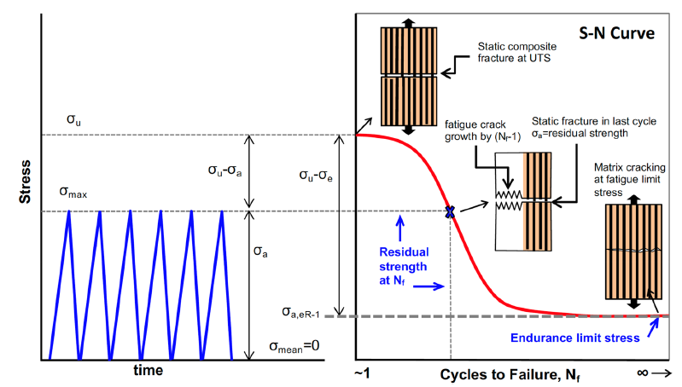
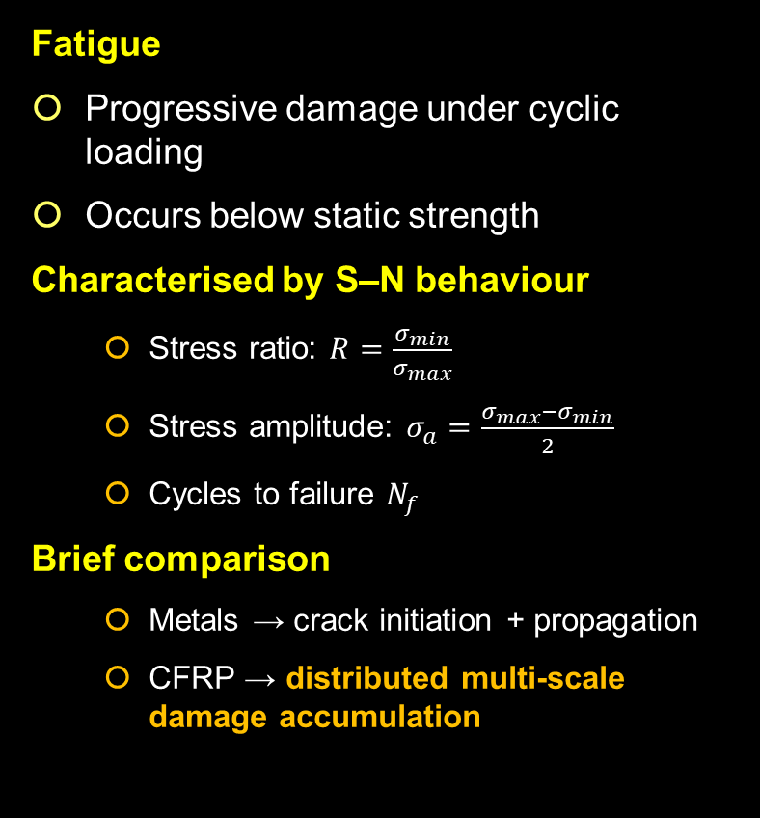
Introduction- What is fatigue?
Fatigue
Progressive damage under cyclic loading
Occurs below static strength
Characterised by S–N behaviour
  Stress ratio: $R=\frac{σ_{min}}{σ_{max}}$
  Stress amplitude: $σ_{a}=\frac{σ_{max}−σ_{min}}{2}$​​
  Cycles to failure $N_{f}$
Brief comparison
  Metals → crack initiation + propagation
  CFRP → distributed multi-scale damage accumulation
Notes:
Figure from Ref. [1]

Slide 3
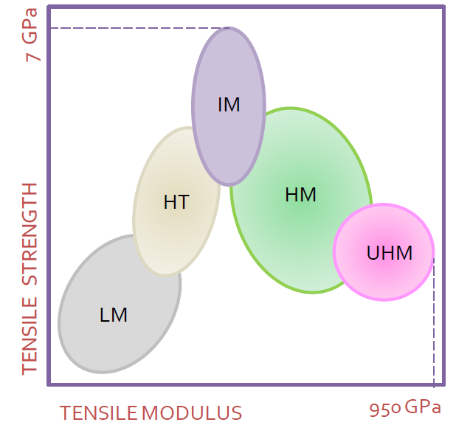
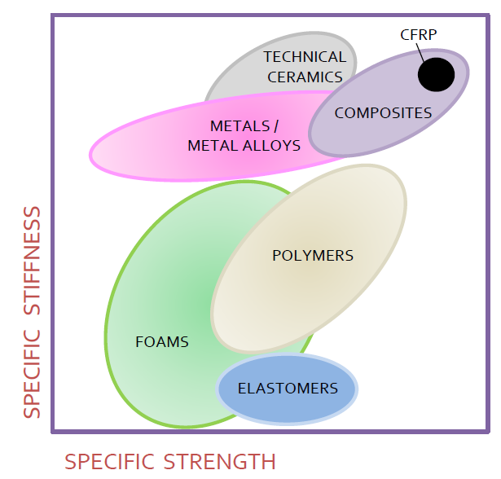
Introduction- Why CFRP?
Mechanical efficiency
Exceptional strength-to-weight ratio
Specific stiffness up to ~100 MN·m/kg
Specific strength up to ~700 kN·m/kg
Near-apex performance on Ashby material charts
Durability
High corrosion resistance
No galvanic rusting as in steels
Good fatigue performance under fibre-dominated loading
Design freedom
Complex geometry manufacturability
Reduced part count through structural integration
Tailorable anisotropic properties via lay-up
Optimised load-path alignment

Slide 4
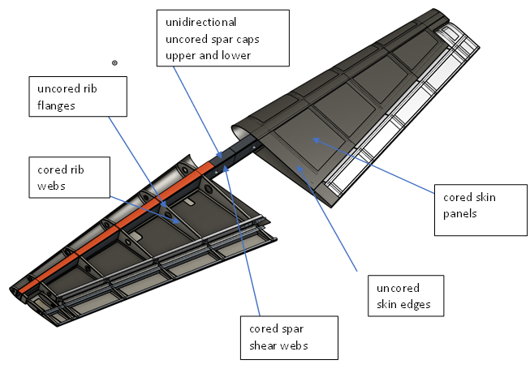
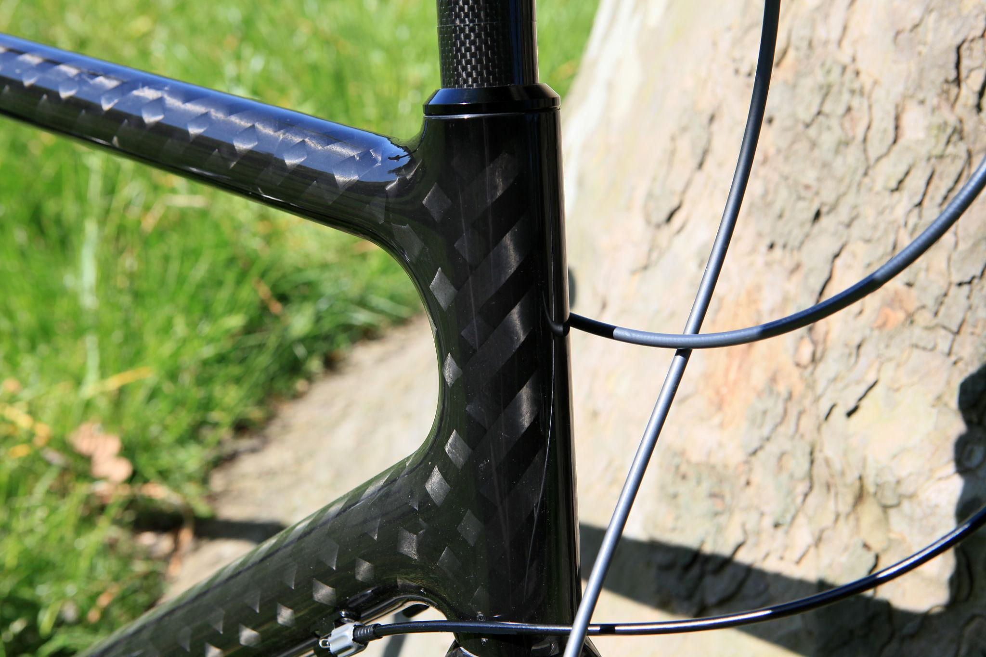
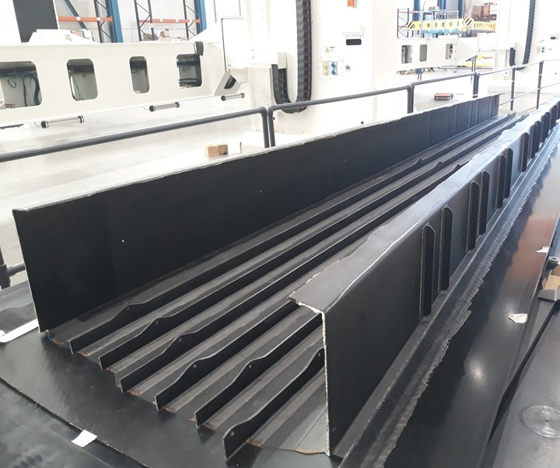
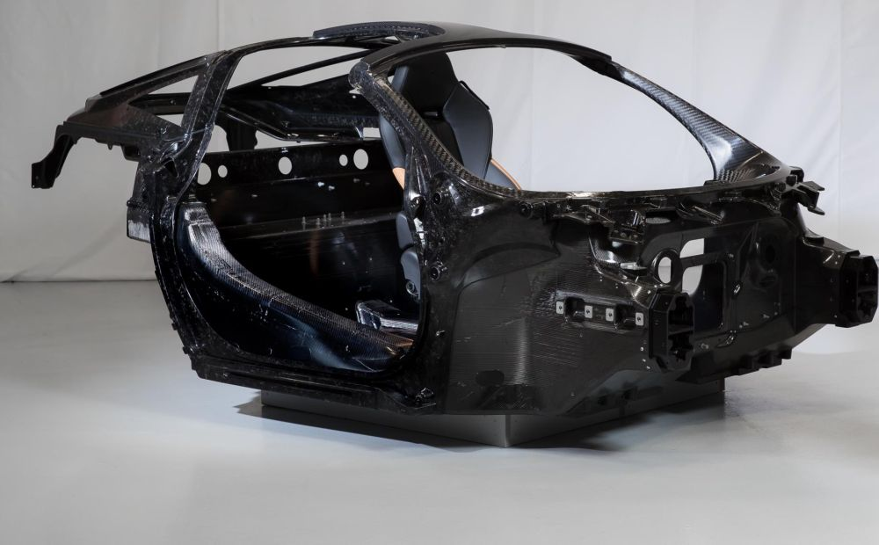
Introduction- CFRP Applications
Aerospace primary structures
Wind turbine blades
Automotive lightweighting structures
Hydrogen pressure vessels
Fatigue is one of the dominant structural failure mechanisms in engineering structures
CFRP behaves fundamentally differently from metals
Fatigue often governs the life of lightweight composite structures

Slide 5
Key Factors Influencing Fatigue Behaviour in CFRP
CFRP fatigue behaviour emerges from the interaction of material system, laminate architecture, loading, environment, and manufacturing quality
Fibre modulus and strength
Matrix toughness
Fibre–matrix interface strength
Fatigue Behaviour of CFRP
Material System
Laminate Architecture
Loading Conditions
Environment
Thermo-Mechanical Effects
Manufacturing Quality
Voids
Fibre waviness
Consolidation defects
Fibre orientation
Stacking sequence / lay-up
Fibre volume fraction
Self-heating
Frequency
Stress amplitude
R ratio
Tension tension / tension compression
Temperature
Moisture
Hygrothermal exposure

Slide 6
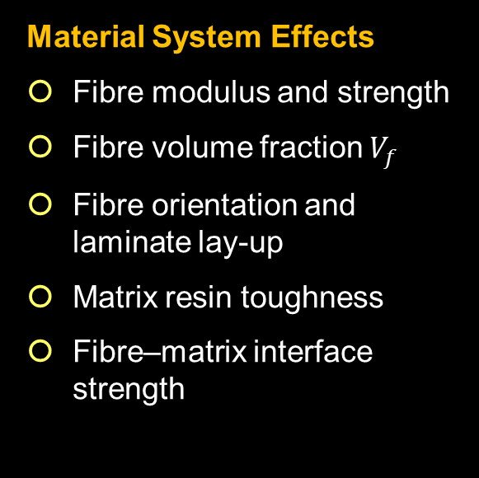
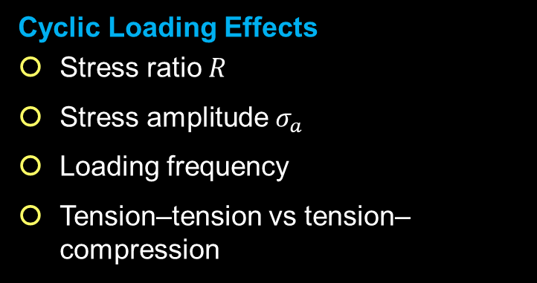
Determinants of CFRP Fatigue Behaviour
Material System Effects
Fibre modulus and strength
Fibre volume fraction $V_{f}$
Fibre orientation and laminate lay-up
Matrix resin toughness
Fibre–matrix interface strength
Environmental Effects
Temperature
Moisture absorption
Hygrothermal ageing
Cyclic Loading Effects
Stress ratio $R$
Stress amplitude $σ_{a}$
Loading frequency
Tension–tension vs tension–compression
For metals:
$$N_{f}=f(σ_{a})$$
For composites:
$N_{f}$ = $f$(fibre, matrix, interface, lay-up, environment, $R$, $σ_{a}$​)
Notes:
Fatigue life in composites is a system property, not a single material property

Slide 7
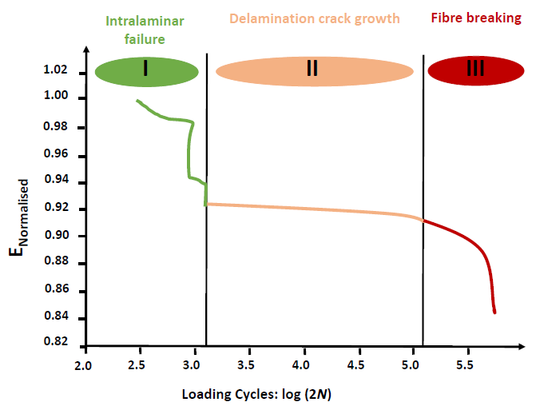
Micro-mechanisms of Fatigue Damage in CFRP
Fatigue in CFRP arises from interacting damage mechanisms across multiple length scales, rather than single crack propagation as in metals
Fatigue Damage Mechanisms
Stage I:
Matrix Dominated Damage (Initiation)
Stage III:
Fibre Dominated Final Failure
Stage II:
Damage Interaction and Delamination
Damage
Accumulation
Stiffness
degradation
Energy driven
Delamination
Delamination
growth
Catastrophic
failure
Fibre failure

Slide 8
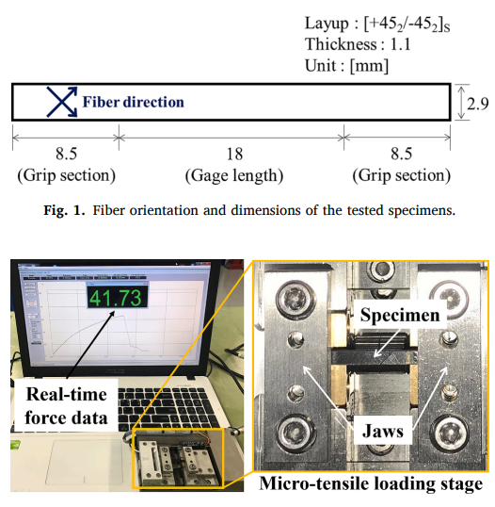
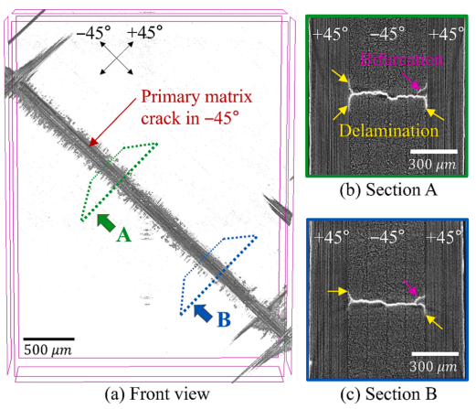
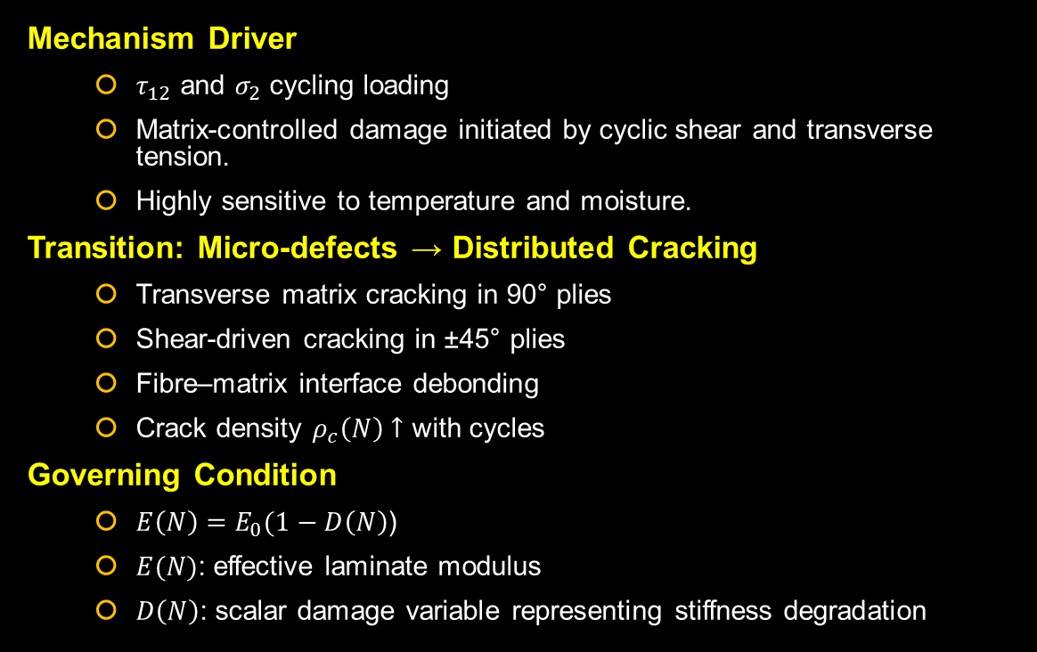
Micro-mechanisms of Fatigue Damage in CFRP
- Stage I
Mechanism Driver
  $τ_{12}$ and $σ_{2}$ cycling loading
  Matrix-controlled damage initiated by cyclic shear and transverse tension.
  Highly sensitive to temperature and moisture.
Transition: Micro-defects → Distributed Cracking
  Transverse matrix cracking in 90° plies
  Shear-driven cracking in ±45° plies
  Fibre–matrix interface debonding
  Crack density $ρ_{c}\left(N\right)↑$ with cycles
Governing Condition
  $E\left(N\right)=E_{0}(1−D\left(N\right)$)
  $E(N)$: effective laminate modulus
  $D\left(N\right)$: scalar damage variable representing stiffness degradation
Stage I typically consumes 30–50% of life in cross-ply laminates
Matrix cracking increases local stress concentration in neighbouring plies

Slide 9
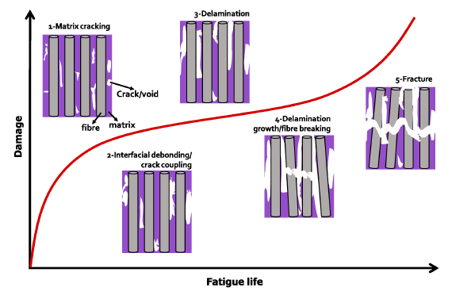
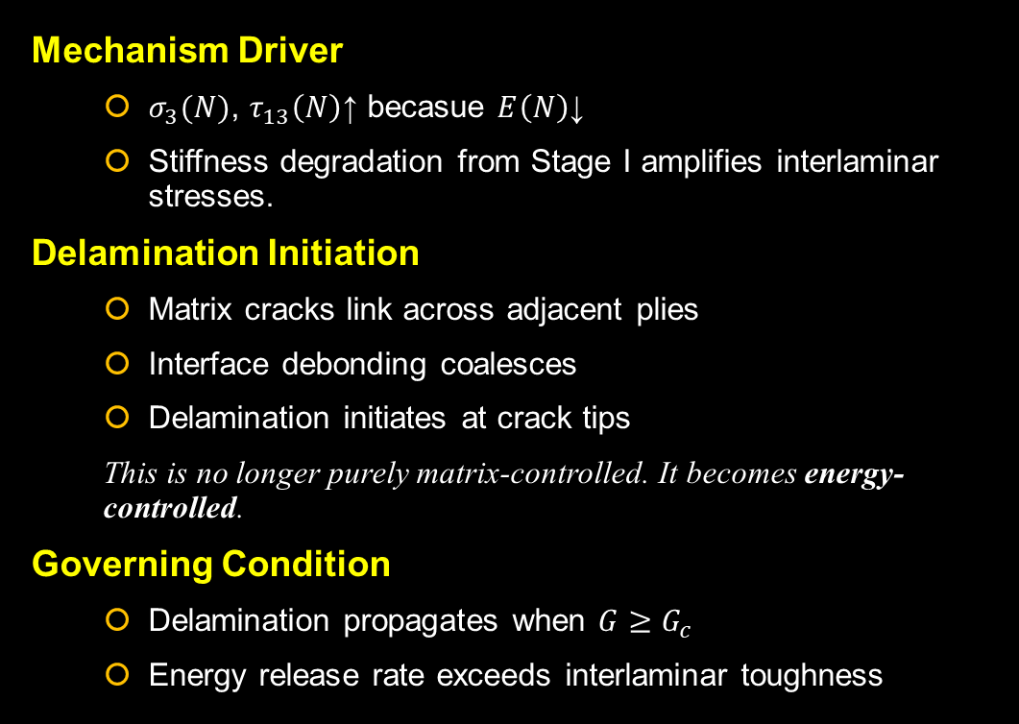
Micro-mechanisms of Fatigue Damage in CFRP
- Stage II
Mechanism Driver
  $σ_{3}(N)$, $τ_{13}\left(N\right)$​↑ becasue $E\left(N\right)$↓
  Stiffness degradation from Stage I amplifies interlaminar stresses.
Delamination Initiation
  Matrix cracks link across adjacent plies
  Interface debonding coalesces
  Delamination initiates at crack tips
  This is no longer purely matrix-controlled. It becomes energy-controlled.
Governing Condition
  Delamination propagates when $G≥G_{c}$
  Energy release rate exceeds interlaminar toughness
Stage II typically consumes 20–40% of life
Stage II marks the shift from stiffness degradation to fracture mechanics dominance

Slide 10
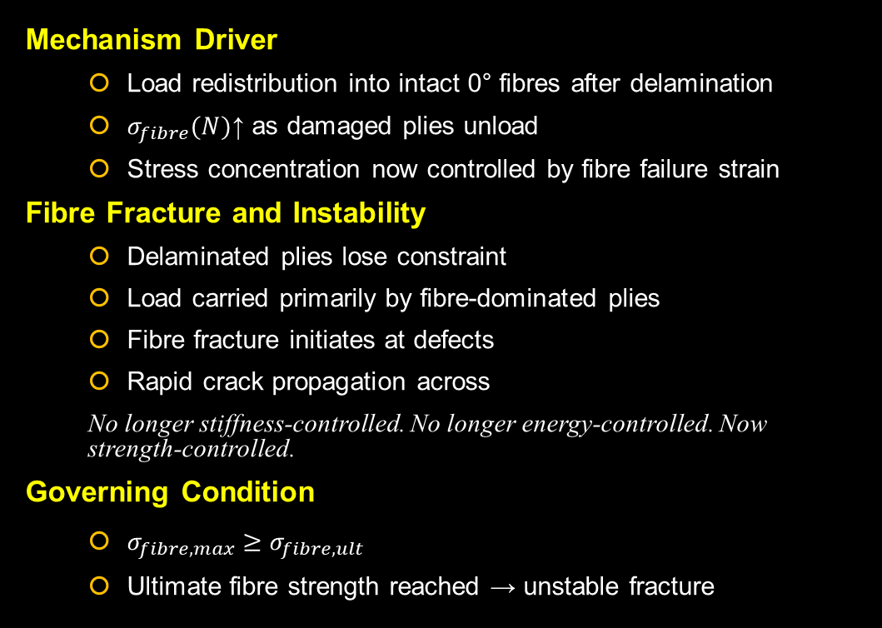
Micro-mechanisms of Fatigue Damage in CFRP
- Stage III
Mechanism Driver
  Load redistribution into intact 0° fibres after delamination
  $σ_{fibre}(N)$​↑ as damaged plies unload
  Stress concentration now controlled by fibre failure strain
Fibre Fracture and Instability
  Delaminated plies lose constraint
  Load carried primarily by fibre-dominated plies
  Fibre fracture initiates at defects
  Rapid crack propagation across
  No longer stiffness-controlled. No longer energy-controlled. Now strength-controlled.
Governing Condition
  $σ_{fibre,max}≥σ_{fibre,ult}$
  Ultimate fibre strength reached → unstable fracture
Stage III marks the transition from progressive damage to catastrophic structural failure

Slide 11
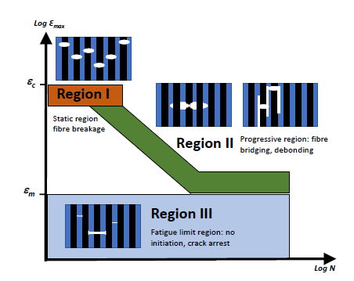
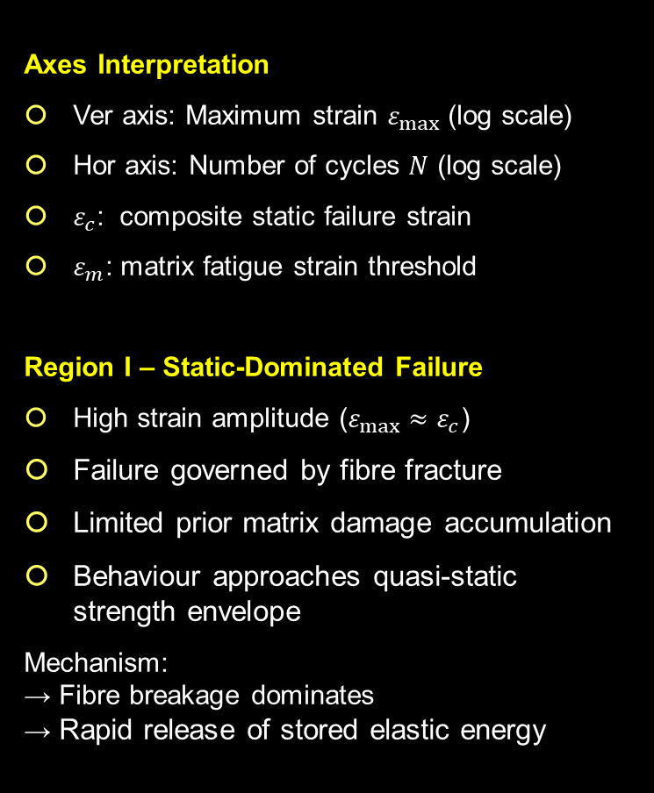

Fatigue Life Mechanism Map in Longitudinal CFRP (T-T)
Axes Interpretation
Ver axis: Maximum strain $ε_{max}$ (log scale)
Hor axis: Number of cycles $N$ (log scale)
$ε_{c}$: composite static failure strain
$ε_{m}$: matrix fatigue strain threshold
Region I – Static-Dominated Failure
High strain amplitude ($ε_{max}≈ε_{c}$)
Failure governed by fibre fracture
Limited prior matrix damage accumulation
Behaviour approaches quasi-static strength envelope
Mechanism:
→ Fibre breakage dominates
→ Rapid release of stored elastic energy
Region II – Progressive Fatigue Damage
Intermediate strain amplitude
Matrix cracking initiates in transverse plies
Fibre–matrix debonding develops
Delamination growth becomes dominant
Mechanism:
→ Damage evolution becomes energy-controlled
→ Delamination growth governed by $ΔG$
→ Progressive stiffness degradation
This is the primary structural fatigue regime in UD CFRP
Region III – Low-Strain Regime
Low strain amplitude ($ε_{max}<ε_{m}$)
Crack initiation strongly suppressed
Damage growth extremely slow
CFRP does not exhibit a true metallic endurance limit.
At low strains damage growth may slow or arrest, but infinite life cannot be guaranteed.

Slide 12
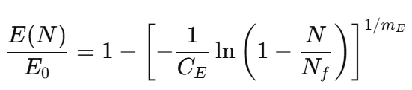
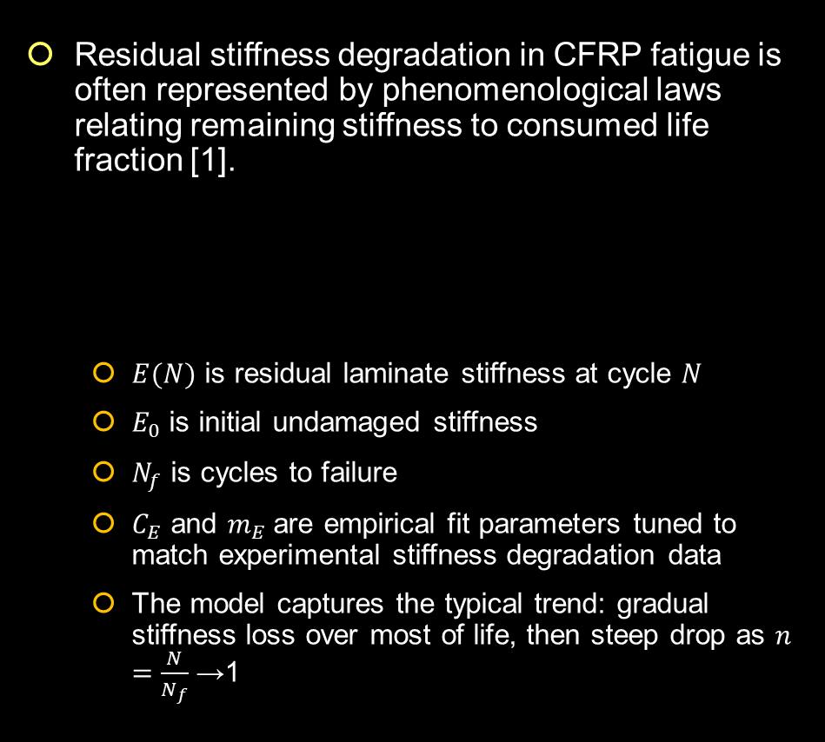
Residual Stiffness Degradation in CFRP Fatigue
Residual stiffness degradation in CFRP fatigue is often represented by phenomenological laws relating remaining stiffness to consumed life fraction [1].
  $E(N)$ is residual laminate stiffness at cycle 𝑁
  $E_{0}$ is initial undamaged stiffness
  $N_{f}$ is cycles to failure
  $C_{E}$ and $m_{E}$are empirical fit parameters tuned to match experimental stiffness degradation data
  The model captures the typical trend: gradual stiffness loss over most of life, then steep drop as $n=\frac{N}{N_{f}}$→1
C_{E} = 4.5
m_{E} = 2.2
Notes:
n is the normalized fatigue life fraction.

Slide 13
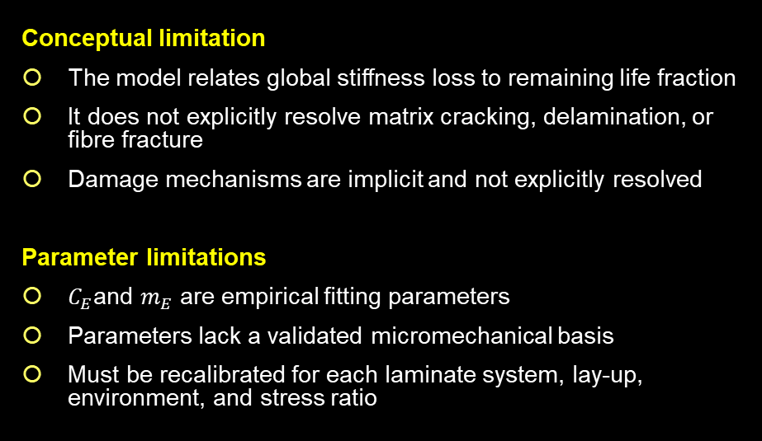
Limitations of Phenomenological Models
Conceptual limitation
The model relates global stiffness loss to remaining life fraction
It does not explicitly resolve matrix cracking, delamination, or fibre fracture
Damage mechanisms are implicit and not explicitly resolved
Parameter limitations
$C_{E}$and $m_{E}$ are empirical fitting parameters
Parameters lack a validated micromechanical basis
Must be recalibrated for each laminate system, lay-up, environment, and stress ratio
Predictive limitations
Cannot predict delamination initiation threshold
Cannot capture mode-mixity effects
Does not distinguish tension–tension from tension–compression behaviour
Limited extrapolation capability outside calibrated stress range
Fundamental issue
Residual stiffness is an observable consequence of damage, not a state variable governing failure
A model that predicts stiffness does not necessarily predict failure mechanisms
Phenomenological models enable life correlation but do not predict mechanism transition. Mechanism-based or fracture-mechanics approaches are required for design-level prediction

Slide 14
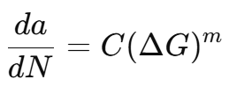
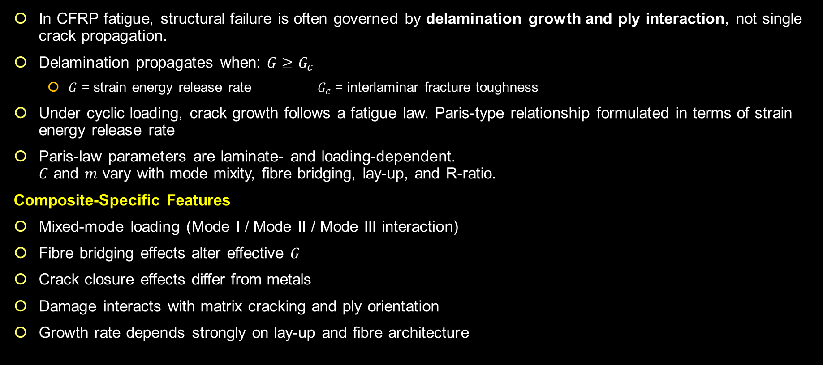
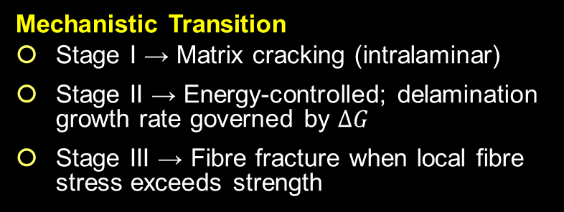
Energy-Based Delamination Growth Modelling
In CFRP fatigue, structural failure is often governed by delamination growth and ply interaction, not single crack propagation.
Delamination propagates when: $G≥G_{c}$
  $G$ = strain energy release rate $G_{c}$= interlaminar fracture toughness
Under cyclic loading, crack growth follows a fatigue law. Paris-type relationship formulated in terms of strain energy release rate
Paris-law parameters are laminate- and loading-dependent.
$C$ and $m$ vary with mode mixity, fibre bridging, lay-up, and R-ratio.
Composite-Specific Features
Mixed-mode loading (Mode I / Mode II / Mode III interaction)
Fibre bridging effects alter effective $G$
Crack closure effects differ from metals
Damage interacts with matrix cracking and ply orientation
Growth rate depends strongly on lay-up and fibre architecture
Mechanistic Transition
Stage I → Matrix cracking (intralaminar)
Stage II → Energy-controlled; delamination growth rate governed by $ΔG$
Stage III → Fibre fracture when local fibre stress exceeds strength
In CFRP fatigue, the dominant transition occurs when intralaminar cracking saturates and damage evolution becomes governed by interlaminar energy release rate.
Notes:
Composite fatigue cannot be captured by a single S–N curve. It requires a combination of damage mechanics and fracture mechanics

Slide 15
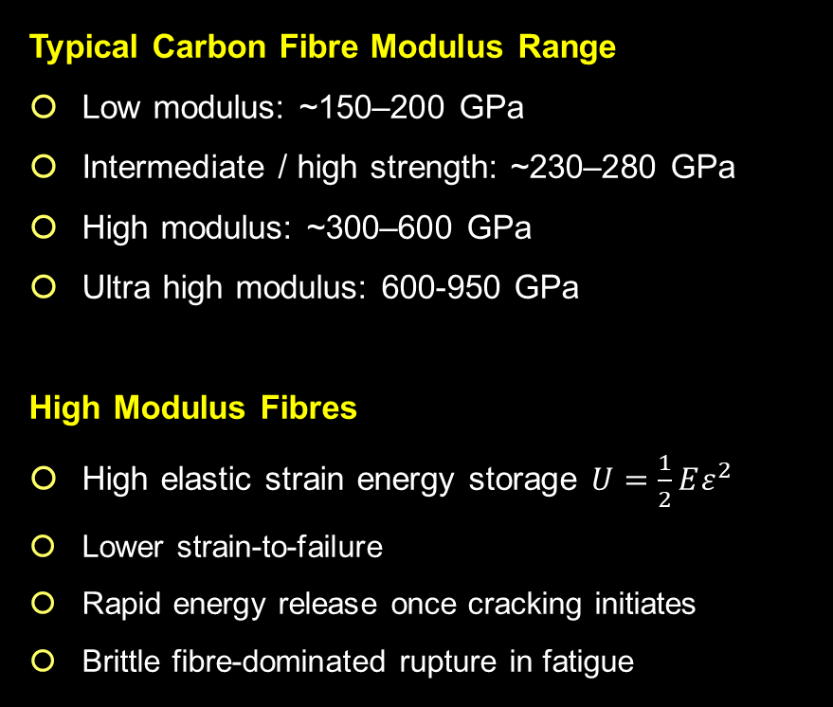
Influence of Fibre Modulus on CFRP Fatigue Failure Mode
Typical Carbon Fibre Modulus Range
Low modulus: ~150–200 GPa
Intermediate / high strength: ~230–280 GPa
High modulus: ~300–600 GPa
Ultra high modulus: 600-950 GPa
High Modulus Fibres
High elastic strain energy storage $U=\frac{1}{2}Eε^{2}$
Lower strain-to-failure
Rapid energy release once cracking initiates
Brittle fibre-dominated rupture in fatigue
High-Strength / Medium-Modulus Fibres
Higher strain-to-failure
Stable load redistribution after matrix cracking
Progressive damage accumulation
Gradual stiffness degradation
Low Modulus Fibres
Lower stored elastic energy
Reduced local energy release during crack propagation
More stable damage evolution
Slower delamination growth
Higher fibre modulus → higher stored elastic strain energy → greater local energy release during cracking → earlier transition to fibre-dominated failure (Stage III)
Lower fibre modulus → reduced energy release rate → extended Stage II delamination growth → more progressive fatigue behaviour

Slide 16
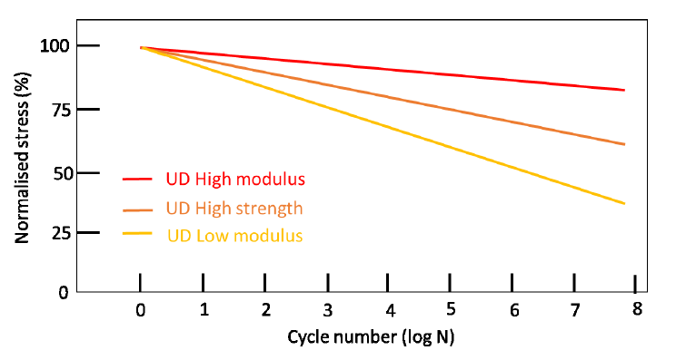
Influence of Fibre Modulus on Fatigue Response in UD CFRP
Observed Behaviour
High modulus UD laminates retain the highest normalised stress across cycles
High strength systems show intermediate degradation
Low modulus systems exhibit the steepest stress reduction
Interpretation
The stress–life trend reflects:
  Higher axial stiffness in high modulus systems
  Lower cyclic strain amplitude for a given applied stress
  Slower global stiffness degradation in early fatigue stages
Critical Clarification
Global stress retention ≠ benign failure mode
High modulus laminates:
  Maintain stiffness for a larger fraction of fatigue life
  Store greater elastic strain energy
  Once critical damage initiates → rapid energy release
  Exhibit abrupt fibre-dominated rupture
Low modulus laminates:
  Degrade earlier in stress capacity
  Release energy more gradually
  Exhibit more progressive failure modes

Slide 17
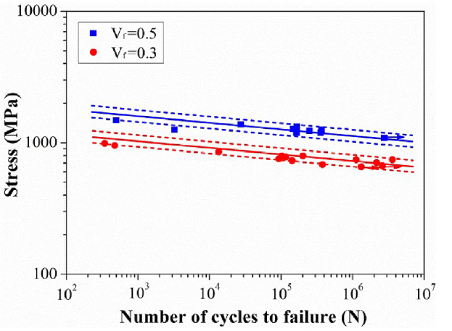
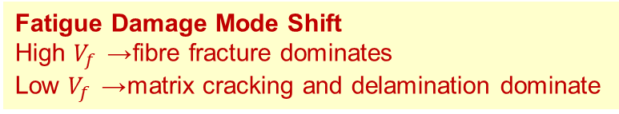
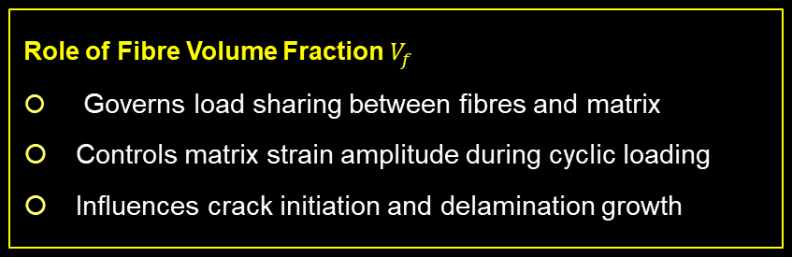
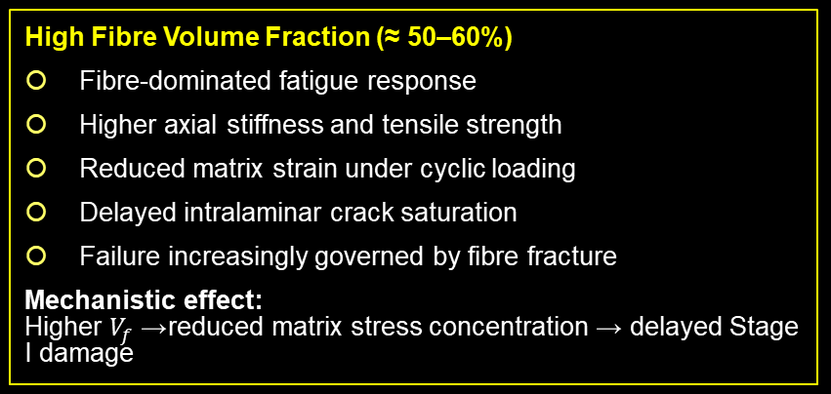
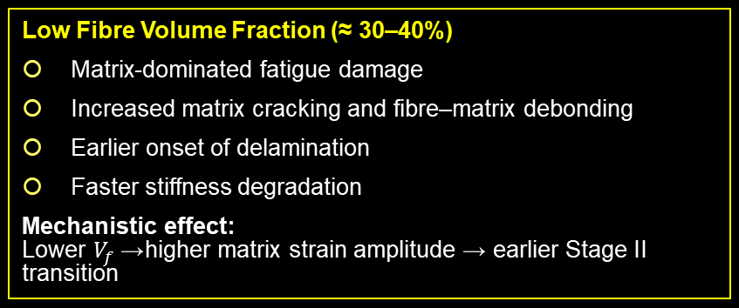
Influence of Fibre Volume Fraction (Vf) on CFRP Fatigue
Fatigue Damage Mode Shift
High $V_{f }$→ fibre fracture dominates
Low $V_{f }$→ matrix cracking and delamination dominate
The stress-life curves of unidirectional CFRP plates
with 30% and 50% carbon fibre volume fraction
Role of Fibre Volume Fraction $V_{f}$
Governs load sharing between fibres and matrix
Controls matrix strain amplitude during cyclic loading
Influences crack initiation and delamination growth
High Fibre Volume Fraction (≈ 50–60%)
Fibre-dominated fatigue response
Higher axial stiffness and tensile strength
Reduced matrix strain under cyclic loading
Delayed intralaminar crack saturation
Failure increasingly governed by fibre fracture
Mechanistic effect:
Higher $V_{f}$→ reduced matrix stress concentration → delayed Stage I damage
Low Fibre Volume Fraction (≈ 30–40%)
Matrix-dominated fatigue damage
Increased matrix cracking and fibre–matrix debonding
Earlier onset of delamination
Faster stiffness degradation
Mechanistic effect:
Lower $V_{f}$→ higher matrix strain amplitude → earlier Stage II transition

Slide 18
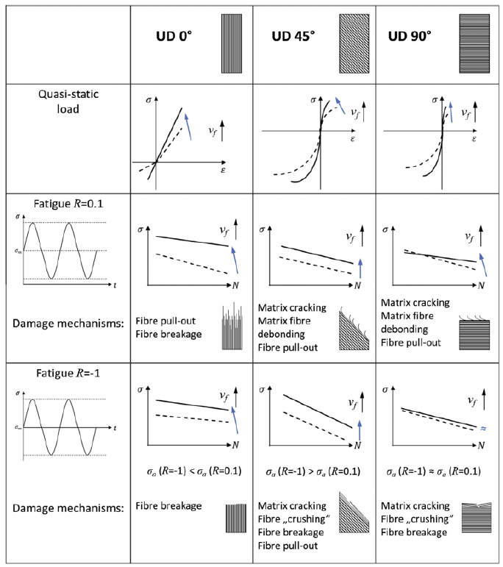
Influence of Fibre Orientation on CFRP Fatigue
Governing Role of Fibre Orientation
Controls stress transfer pathway (fibre vs matrix dominated)
Determines dominant fatigue damage mechanism
Alters sensitivity to T–T and T–C loading
UD 0° (Load ‖ Fibres)
Fibre-dominated response
T–T → fibre fracture governs
T–C → micro-buckling and bundle breakage
Steeper S–N slope in compression
→ Rapid transition to fibre-controlled failure once critical stress reached
UD 90° (Load ⟂ Fibres)
Matrix-dominated behaviour
Early matrix cracking
Delamination driven by crack interaction
Strong dependence on FVF
→ Earlier Stage I → Stage II transition
UD 45° (Shear-Dominated)
High matrix shear stresses
Fibre–matrix debonding and crack deflection
Progressive stiffness degradation
→ Enhanced energy dissipation via shear mechanisms
Loading Mode Effect
T–T (R ≈ 0.1):
  Matrix cracking + fibre pull-out dominant
T–C (R ≈ −1):
  Local fibre buckling
  Fibre crushing
  Bundle breakage
  S–N slope steeper than T–T

Slide 19
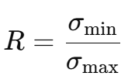
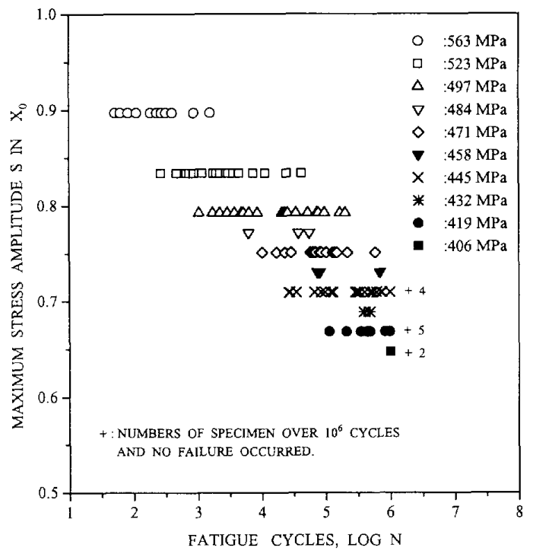
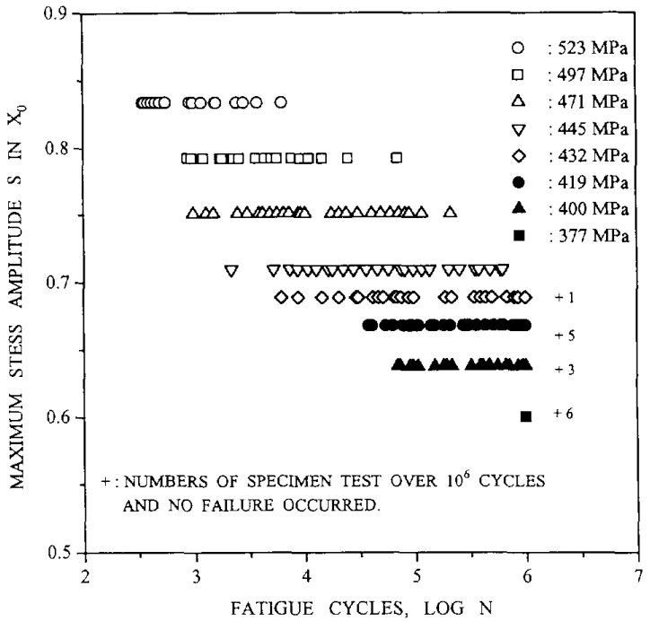
Effect of Loading Mode (R-Ratio) on Fatigue Life of UD CFRP- Experimental Evidence
Experimental data for stress levels-fatigue life of AS-4/PEEK laminates under T-T [4]
Experimental data of stress levels fatigue life of AS-4/PEEK laminates under T-C loading [4]

Slide 20
Effect of Loading Mode (R-Ratio) on Fatigue Life of UD CFRP- Mechanistic Interpretation
Experimental Observation
Left: T–T loading (R ≈ 0.1)
Right: T–C loading (R ≈ −1)
For equivalent stress amplitudes, T–C fatigue shows shorter life
S–N trend is steeper in T–C
Greater scatter at lower stress amplitudes
Run-outs (>10⁶ cycles) occur at lower normalised stress in T–C
Mechanistic Interpretation
T–T (Positive Mean Stress)
Matrix cracking initiates first
Fibre pull-out and debonding dominate
Progressive stiffness degradation
More stable load transfer
→ Damage evolution primarily matrix-controlled
T–C (Zero / Negative Mean Stress)
Local fibre micro-buckling
Fibre crushing
Bundle fracture
Reduced compressive stability
→ Compression instability accelerates fibre-dominated failure
Critical Insight
Fatigue life in CFRP is strongly R-dependent because:
Mean stress alters local fibre stress state
Compressive cycling promotes instability rather than progressive cracking
Damage mechanisms shift from matrix-driven (T–T) to fibre-instability-driven (T–C)
Therefore:
CFRP fatigue behaviour cannot be represented by a single S–N curve.

Slide 21
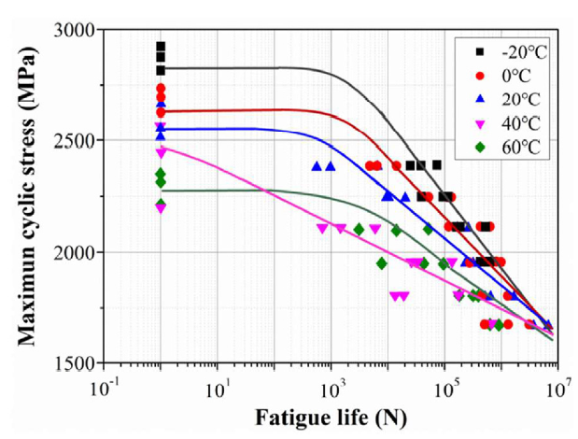
Environmental Effects on Fatigue –
Temperature Influence on Fatigue Behaviour
Experimental Observations
Fatigue strength decreases with increasing temperature
S–N curves shift downward as temperature rises
Stiffness degradation accelerates at elevated temperatures
Lower temperatures yield longer fatigue life at the same cyclic stress
Mechanistic Interpretation
Temperature primarily affects the polymer matrix and fibre–matrix interface, while carbon fibres remain relatively insensitive
Key mechanisms
Matrix softening and increased viscoelastic behaviour
Reduced fibre–matrix stress transfer efficiency
Increased matrix cracking and interfacial damage
Accelerated delamination growth
Temperature Dependence Across Fatigue Regimes
Low–cycle / medium–cycle fatigue
  Strong temperature sensitivity
  Matrix softening increases damage accumulation
High–cycle fatigue
  Temperature influence less pronounced
  Fatigue behaviour increasingly governed by stress concentrations and fibre response
S–N curves for CFRP laminates at different environmental temperatures (−20°C to 60°C), showing reduced fatigue strength with increasing temperature (after Mivehchi et al. [6])
Notes:
Temperature sensitivity is stronger in the low-cycle regime because matrix deformation and interface damage dominate early fatigue processes. In high-cycle fatigue, fibre behaviour and stress concentrations increasingly control failure.

Slide 22
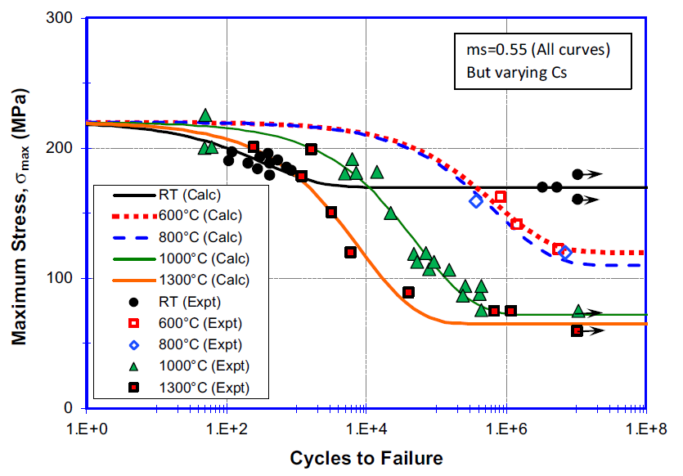
Environmental Effects on Fatigue –
Temperature Effects on Fatigue Across Composite Systems (Supporting Evidence)
Experimental Observations
Elevated temperature reduces fatigue strength in many composite systems
S–N curves shift downward as temperature increases
Degradation becomes pronounced as matrix softening increases
Mechanistic Interpretation
Moderate Temperature:
  Limited degradation of fibre and interface properties
  Fibre-dominated behaviour largely retained
  Fatigue trend follows static strength trend
Elevated Temperature:
  Increased matrix viscoelasticity
  Reduced fibre–matrix stress transfer
  Accelerated crack propagation and reduced load-carrying capacity
Critical Insight
Temperature primarily modifies matrix and interface behaviour, which govern fatigue damage initiation in composite laminates
Effect of test temperature on S–N fatigue behaviour of SiC/SiC ceramic-matrix composites (after Zhu et al.). Behaviour is material-system specific but illustrates the general temperature sensitivity of composite fatigue

Slide 23
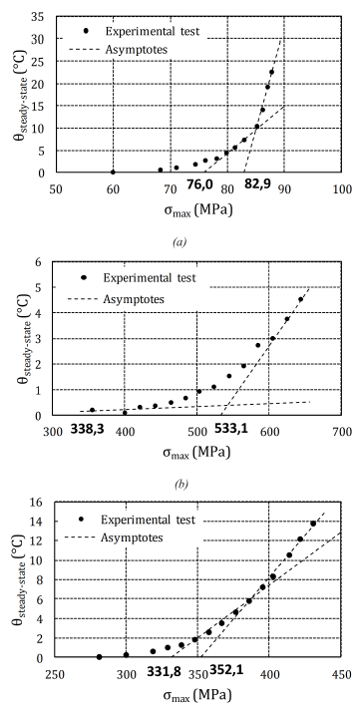
Environmental Effects on CFRP Fatigue –
Self-heating during cyclic loading
Self-heating in epoxy CFRP laminates under cyclic loading: (a) [±45]2s, (b) [0/90]2s, (c) [±45/-45/90/0]s (after Gornet et al.). Temperature rise vs stress amplitude
Experimental Observations (Epoxy CFRP)
Internal temperature rise increases nonlinearly with stress amplitude
±45° laminates exhibit significantly higher self-heating than UD or cross-ply
Temperature rise becomes pronounced at high fractions of UTS
Heat generation is spatially inhomogeneous (local hot spots observed via IR)
Higher loading frequency → greater temperature rise
Physical Origin
Cyclic fibre–matrix shear → hysteretic energy dissipation
Mechanical energy converted into thermal energy
±45° laminates experience higher internal shear strain → greater heat generation
Heat is generated primarily by fibre–matrix shear interactions
Thermo-Mechanical Feedback
Local temperature rise → matrix softening and increased viscoelasticity
→ Reduced fibre–matrix stress transfer
→ Increased strain amplitude
→ Localised crack density increase
→ Reduced fatigue life
Stacking sequence strongly influences self-heating sensitivity
([±45] more affected than [0] laminates)
Frequency Effect
Low frequency:
  Heat dissipates to environment
  Limited internal temperature rise
High frequency:
  Heat accumulation
  Increased matrix mobility
  Reduced stress transfer
  Accelerated damage
Self-heating can become the controlling fatigue damage mechanism at high stress amplitudes or frequencies, even when ambient temperature is moderate.

Slide 24
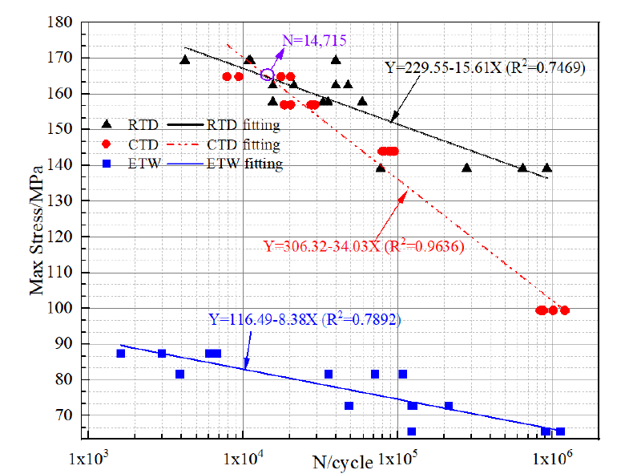
Environmental Effects on CFRP Fatigue –
Moisture & Hygrothermal Exposure-1
Graph (Right Side – Dominant Element) [5]
Comparative S–N curves for cross-ply CFRP under:
  RTD – Room Temperature Dry
  CTD – Cool Temperature Dry
  ETW – Elevated Temperature Wet

Slide 25
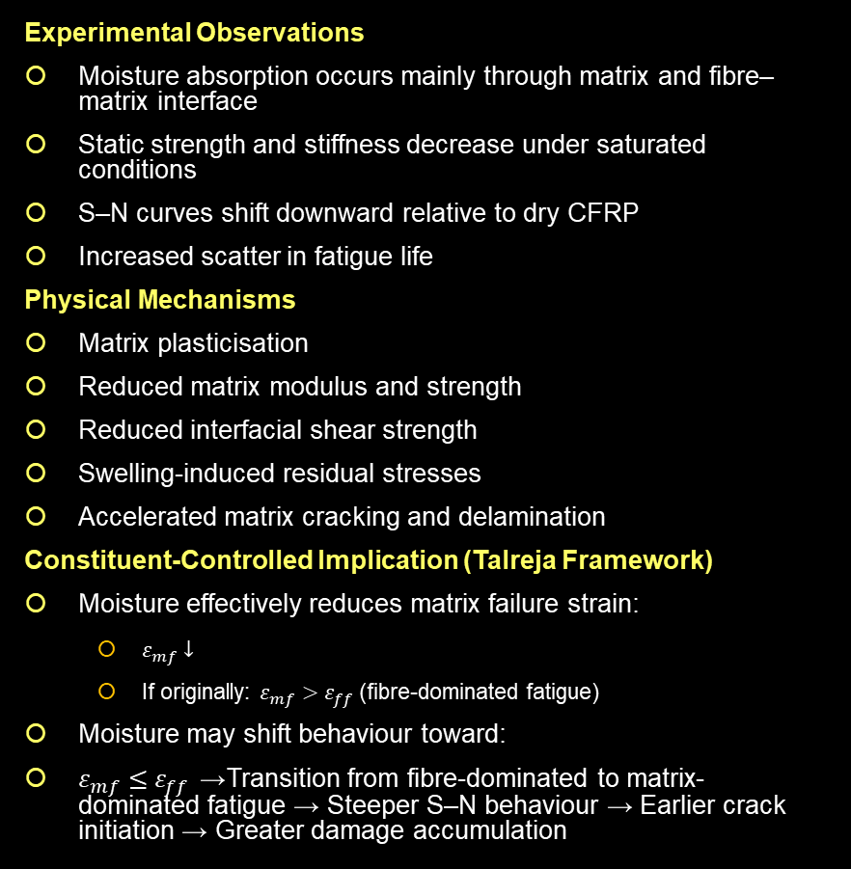
Environmental Effects on CFRP Fatigue –
Moisture & Hygrothermal Exposure-2
Experimental Observations
Moisture absorption occurs mainly through matrix and fibre–matrix interface
Static strength and stiffness decrease under saturated conditions
S–N curves shift downward relative to dry CFRP
Increased scatter in fatigue life
Physical Mechanisms
Matrix plasticisation
Reduced matrix modulus and strength
Reduced interfacial shear strength
Swelling-induced residual stresses
Accelerated matrix cracking and delamination
Constituent-Controlled Implication (Talreja Framework)
Moisture effectively reduces matrix failure strain:
  $ε_{mf}↓$
  If originally: $ε_{mf}>ε_{ff}$ (fibre-dominated fatigue)
Moisture may shift behaviour toward:
$ε_{mf}≤ε_{ff }$→ Transition from fibre-dominated to matrix-dominated fatigue → Steeper S–N behaviour → Earlier crack initiation → Greater damage accumulation
Moisture does not simply “reduce strength. It can shift the dominant fatigue mechanism by degrading matrix and interface properties

Slide 26
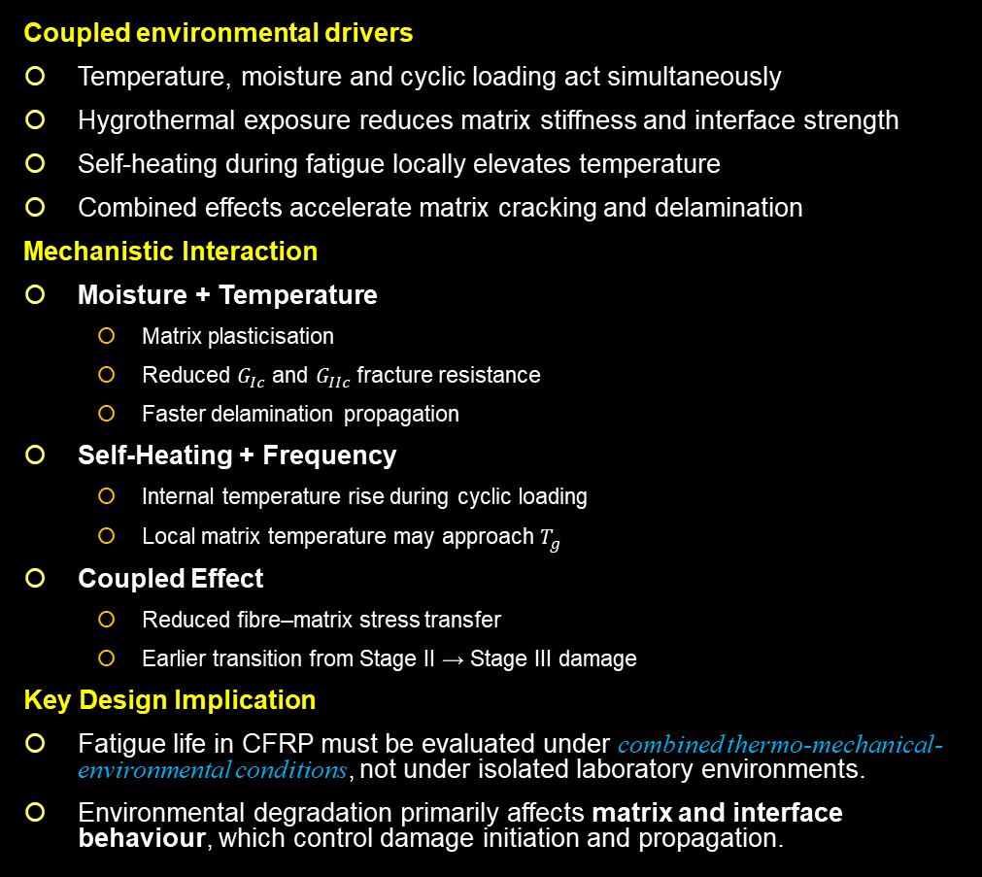
Environmental Effects on CFRP Fatigue –
Temperature + Moisture + Self-Heating
Coupled environmental drivers
Temperature, moisture and cyclic loading act simultaneously
Hygrothermal exposure reduces matrix stiffness and interface strength
Self-heating during fatigue locally elevates temperature
Combined effects accelerate matrix cracking and delamination
Mechanistic Interaction
Moisture + Temperature
  Matrix plasticisation
  Reduced $G_{Ic}$ and $G_{IIc}$ fracture resistance
  Faster delamination propagation
Self-Heating + Frequency
  Internal temperature rise during cyclic loading
  Local matrix temperature may approach $T_{g}$
Coupled Effect
  Reduced fibre–matrix stress transfer
  Earlier transition from Stage II → Stage III damage
Key Design Implication
Fatigue life in CFRP must be evaluated under combined thermo-mechanical-environmental conditions, not under isolated laboratory environments.
Environmental degradation primarily affects matrix and interface behaviour, which control damage initiation and propagation.
Mechanical Cyclic Loading
Moisture Diffusion
→
Matrix Plasticisation
Temperature / Self-Heating
→
Matrix Softening
Damage Evolution
Delamination / Fibre Failure
Structural Failure
Environmental exposure alters the governing fatigue mechanism, not merely the strength level
Notes:
Glass transition temperature $T_{g}$
In a polymer matrix such as epoxy, the molecules are long chains tangled together. At low temperature these chains are effectively frozen in place. The material behaves stiff and glassy. As temperature rises, the chains gain mobility. There is a temperature range where the material transitions from that rigid glass-like behaviour to a softer, rubber-like state. That transition region is called the glass transition temperature, written $T_{g}$.
Below $T_{g},$ the matrix is relatively stiff and can transfer load efficiently between fibres. Above $T_{g},$ the matrix softens, its modulus drops dramatically, and fibre–matrix load transfer deteriorates. In fatigue this matters because matrix softening increases local strain, promotes matrix cracking, and accelerates delamination growth. Self heating during cyclic loading can locally push the matrix temperature toward or even above $T_{g}.$
Hygrothermal conditions
“Hygrothermal” simply means the combined influence of moisture and temperature on a material. In composites the two rarely act independently. Moisture diffuses primarily into the polymer matrix and along the fibre–matrix interface. The absorbed water plasticises the matrix, reducing its modulus and strength, while also weakening interfacial bonding. Temperature then amplifies these effects because higher temperatures increase molecular mobility and accelerate diffusion.
In practice, hygrothermal exposure leads to several coupled changes in CFRP: matrix plasticisation, swelling stresses, reduced interfacial shear strength, and greater susceptibility to matrix cracking and delamination. Under cyclic loading this shifts the fatigue response toward matrix-controlled damage mechanisms and reduces fatigue life compared with dry conditions.
Seen together, these concepts explain why environmental fatigue in composites is not simply a strength reduction problem. Temperature relative to $T_{g}$governs matrix stiffness, while moisture alters matrix and interface behaviour. When both are present, the governing fatigue mechanisms themselves can change.

Slide 27
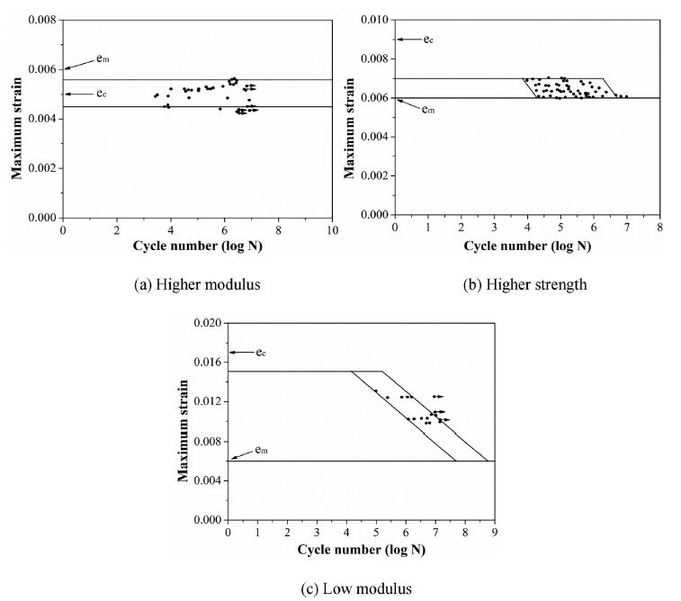
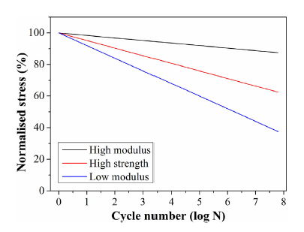
Material System Engineering for Fatigue Performance
Fatigue behaviour in CFRP is strongly influenced by fibre mechanical properties, which control the transition from matrix-dominated to fibre-dominated failure.
Key Material Parameters
Fatigue behaviour in CFRP depends not only on laminate architecture but also on constituent material properties:
  Fibre modulus and strength influence fatigue failure mode
  Matrix toughness controls crack initiation and delamination growth
  Fibre–matrix interface governs stress transfer during cyclic loading
Example: Fibre Modulus Effect
Different carbon fibre systems exhibit distinct fatigue responses:
  High-modulus fibres
    Higher stiffness and elastic energy storage
    Rapid transition to fibre-dominated failure
  High-strength fibres
    Higher strain tolerance
    More progressive fatigue degradation
  Low-modulus fibres
    Lower energy release rate during crack propagation
    Slower and more stable damage evolution
Notes:
Fatigue behaviour is not only governed by laminate architecture. The fibre system itself matters. High-modulus fibres store more elastic energy and tend to fail abruptly, while lower modulus systems dissipate energy more gradually and exhibit more progressive damage.

Slide 28
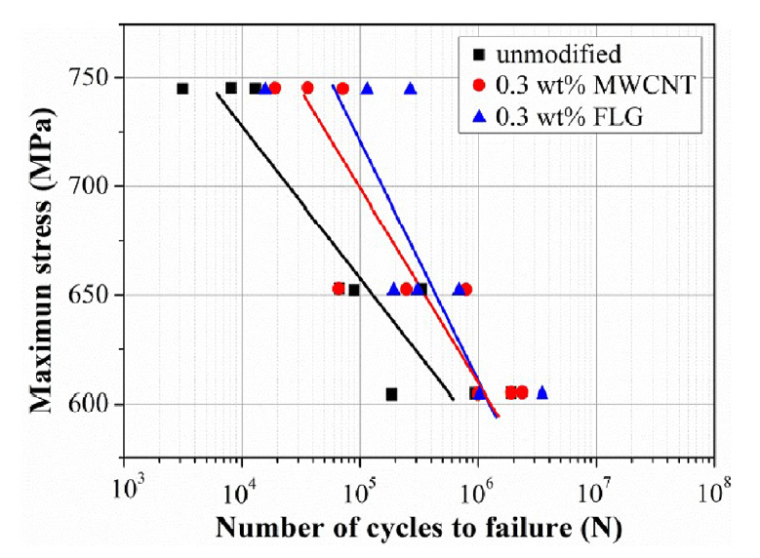
Matrix Engineering for Improved Fatigue Resistance
Matrix toughening delays crack initiation and slows matrix-dominated fatigue damage
Motivation
Fatigue damage in CFRP laminates is often matrix-dominated in the early stages, involving:
  Matrix cracking
  Fibre–matrix debonding
  Delamination initiation
Improving matrix toughness can therefore delay fatigue damage initiation and slow damage accumulation
Matrix Modification Approaches
Fatigue performance can be enhanced through nano-scale matrix reinforcement
Common strategies include:
  Multi-wall carbon nanotubes (MWCNT)
  Few-layer graphene (FLG)
  Rubber or thermoplastic toughening agents
  These modifications primarily improve matrix fracture toughness and interfacial load transfer
Observed Effects on Fatigue Behaviour
Experimental studies show that matrix modification can:
  Increase matrix fracture toughness
  Improve energy absorption during cyclic loading
  Reduce stiffness degradation rate
  Extend fatigue life
S–N curves for CFRP laminates with carbon nanoparticle reinforcement showing improved fatigue life due to nanoparticle-modified matrix systems
Notes:
Fatigue damage in CFRP begins in the matrix. If we increase matrix toughness, we delay crack initiation and reduce damage growth. One approach is nano-reinforcement using carbon nanotubes or graphene, which increases fracture toughness and slows stiffness degradation, leading to longer fatigue life

Slide 29
Influence of Manufacturing Defects on CFRP Fatigue
Manufacturing defects reduce the fatigue initiation threshold by introducing local stress concentrations and weak interfaces
Origin of Manufacturing Defects
Defects may arise during lay-up, curing, or consolidation processes
Typical defects include:
  Voids and porosity from trapped air or incomplete resin flow
  Fibre waviness or misalignment during lay-up or compaction
  Resin-rich pockets due to non-uniform fibre distribution
  Incomplete wet-out or poor consolidation
These imperfections introduce local stiffness heterogeneity and stress concentrations within the laminate
Influence on Fatigue Behaviour
Manufacturing defects primarily reduce the fatigue damage initiation threshold:
  Voids → local stress concentration → early matrix cracking
  Fibre waviness or misalignment → reduced compressive stability → earlier fibre micro-buckling
  Resin-rich zones → weak regions prone to crack initiation
  Poor fibre–matrix bonding → premature debonding and delamination
Mechanistic Consequence
Manufacturing defects do not introduce new fatigue mechanisms but accelerate existing damage processes:
  matrix cracking → interfacial debonding → delamination growth → fibre rupture

Slide 30
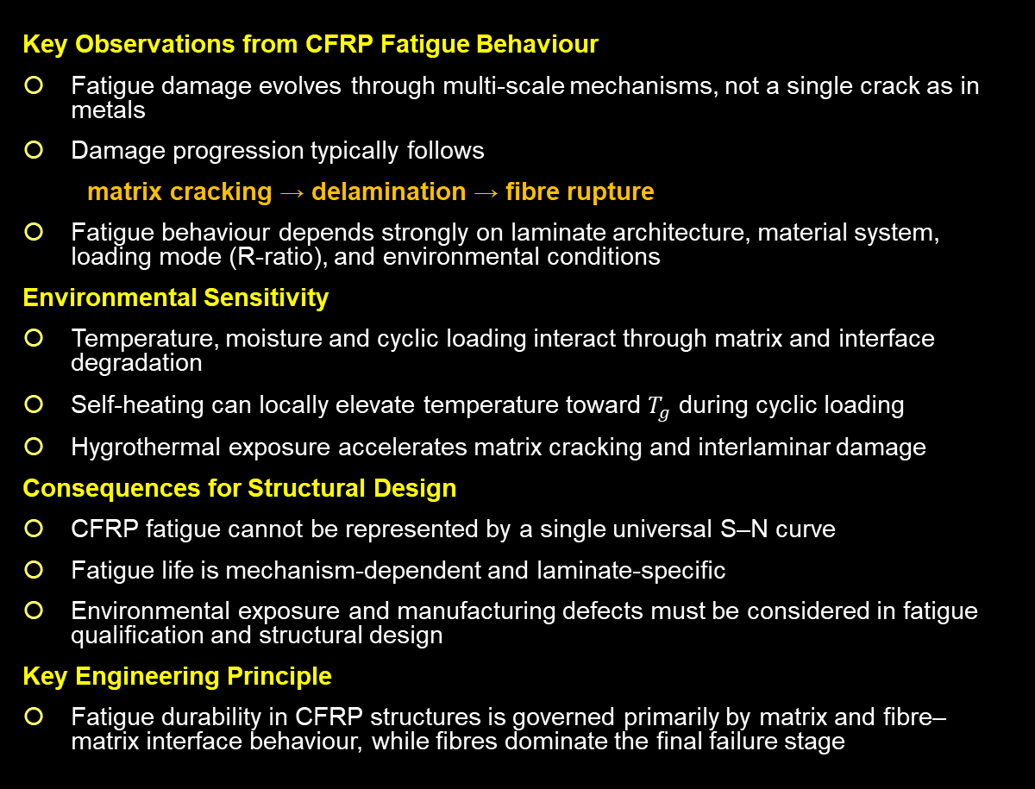
Implications for Fatigue Design in CFRP Structures
Fatigue durability in CFRP structures is governed primarily by matrix and fibre–matrix interface behaviour, while fibres control the final structural failure
Key Observations from CFRP Fatigue Behaviour
Fatigue damage evolves through multi-scale mechanisms, not a single crack as in metals
Damage progression typically follows
matrix cracking → delamination → fibre rupture
Fatigue behaviour depends strongly on laminate architecture, material system, loading mode (R-ratio), and environmental conditions
Environmental Sensitivity
Temperature, moisture and cyclic loading interact through matrix and interface degradation
Self-heating can locally elevate temperature toward $T_{g}$ during cyclic loading
Hygrothermal exposure accelerates matrix cracking and interlaminar damage
Consequences for Structural Design
CFRP fatigue cannot be represented by a single universal S–N curve
Fatigue life is mechanism-dependent and laminate-specific
Environmental exposure and manufacturing defects must be considered in fatigue qualification and structural design
Key Engineering Principle
Fatigue durability in CFRP structures is governed primarily by matrix and fibre–matrix interface behaviour, while fibres dominate the final failure stage
Matrix Cracking
Delamination Growth
Load Redistribution
Fibre Fracture
Structural Failure

Slide 31
Fatigue in Aerospace Composite Structures: Engineering Perspective
Strength-Driven Design Philosophy
Unlike metallic aircraft structures, many composite primary structures are not fatigue-governed in design.
Metallic structures
  Fatigue driven
  Crack initiation and propagation control life
Composite structures
  Strength driven with fatigue verification
  Damage develops through distributed mechanisms
Typical fatigue damage mechanisms in CFRP:
  Matrix cracking
  Fibre–matrix debonding
These mechanisms evolve gradually and redistribute loads within the laminate rather than forming a single dominant crack.
Engineering Consequence
For fibre-dominated laminates, fatigue damage growth can be extremely slow when cyclic strain levels are low relative to fibre failure strain.
Design therefore focuses on maintaining low operational strain levels.
  Delamination growth
  Fibre rupture

Slide 32
Environmental Allowables, Static Reserve Factors (RFs), and Their Influence on Fatigue Behaviour
Indicative environmental knock-down factor ranges
(material-, laminate-, and exposure-dependent; for design guidance, not universal values)
ETD / RTD strength KDF: 0.7 to 0.9
ETW / RTD strength KDF: 0.45 to 0.7
Wet / dry fatigue strength at room temperature: often about 0.85 to 0.9
Matrix-/shear-/interlaminar-dominated properties: typically, at the lower end of these ranges
Fibre-dominated 0° tension properties: typically, at the upper end of these ranges
Actual KDFs are material-system specific and depend on resin system, lay-up, property type, temperature, and moisture conditioning.
Environmental Design Conditions
Composite structural allowables are defined under certification environments:
  RTD — Room Temperature Dry
  ETD — Elevated Temperature Dry
  ETW — Elevated Temperature Wet
These conditions account for:
  Matrix softening
  Moisture plasticisation
  Reduced fibre–matrix load transfer efficiency
Environmental Knock-Down Factors (KDF) reduce allowable strength relative to RTD values
Static Reserve Factor Philosophy
Because allowables already include environmental knock-downs, composite structures often operate at very low fractions of ultimate strain
Engineering consequence:
  Reduced allowable stress → lower operational strain → lower cyclic strain amplitude → slower fatigue damage growth
If the laminate remains fibre dominated and the static reserve factor exceeds unity under worst case environmental conditions, cyclic strains remain low and fatigue damage growth may not become life limiting
Key Insight
Environmental knock-down factors and conservative strain limits indirectly enhance fatigue durability by ensuring that cyclic loads remain far below critical damage thresholds

Slide 33
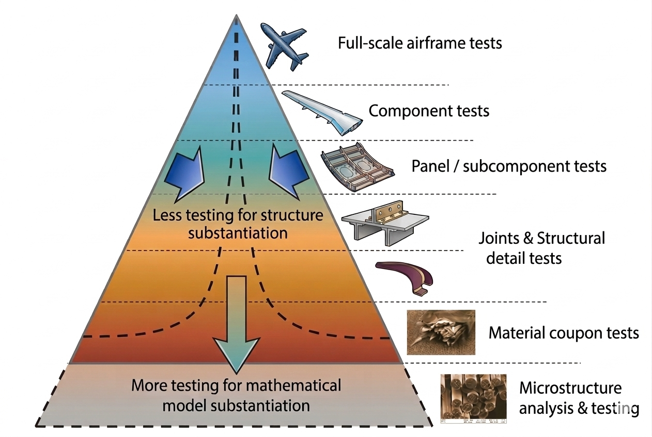
Certification Verification of Composite Fatigue Durability
(FAR/CS-25.571 & FAA AC 20-107B)
Composite aircraft structures must demonstrate that fatigue, environmental effects, and manufacturing defects do not lead to catastrophic failure during the aircraft’s operational life.
Building-Block Certification Approach
Fatigue durability is verified through progressively representative testing:
  Full-scale structural tests
  Panel or sub-component tests
Testing establishes:
  Fatigue behaviour under repeated loading
  Environmental sensitivity
Damage Conditions Considered
Fatigue testing must include realistic damage states:
  Category 1 — allowable undetected damage (e.g. BVID)
  Category 2 — detectable damage requiring scheduled inspection
  Category 3 — discrete source damage (impact or handling events)
Certification Insight
Composite fatigue durability is substantiated primarily through testing supported by analysis
Instead, certification relies on:
  Environmental knock-down allowables
  Conservative strain limits
  Repeated-load testing
to ensure damage initiation and growth remain slow and controlled throughout the certified service life
  Structural detail or joint tests
  Material coupon tests
  Statistical scatter
  Flaw sensitivity

Slide 34
Conclusion — CFRP Fatigue Behaviour
Fatigue in CFRP is mechanism‑driven
Matrix cracking → delamination → fibre rupture govern damage evolution across multiple length scales
Laminate architecture sets the dominant fatigue mechanism
Fibre orientation, fibre volume fraction, and fibre modulus determine whether fatigue is matrix‑ or fibre‑dominated
Loading conditions fundamentally reshape fatigue response
Mean stress, R‑ratio, and compression cycling accelerate fibre instability and reduce fatigue life
Aerospace design practice reflects these mechanisms
Strain‑based design, environmental allowables, and multi‑level testing replace reliance on a single S–N curve
Key Insight
Reliable composite structures are achieved by controlling damage evolution, not by preventing cracks entirely

Slide 35
References
K. S. Ravi Chandran, “Review: Fatigue of Fiber-Reinforced Composites, Damage and Failure,” J. Indian Inst. Sci., vol. 102, no. 1, pp. 439–460, 2022, doi: 10.1007/s41745-021-00280-y
C. Hong, S. Lee, and W. Ji, “Shear strength determining mechanism of a +/−45 laminate under tensile loading,” Compos. Struct., vol. 326, p. 117627, 2023, doi: https://doi.org/10.1016/j.compstruct.2023.117627
P. Alam, D. Mamalis, C. Robert, C. Floreani, and C. M. Ó Brádaigh, “The fatigue of carbon fibre reinforced plastics - A review,” Compos. B Eng., vol. 166, pp. 555–579, 2019, doi: https://doi.org/10.1016/j.compositesb.2019.02.016
N. H. Tai, C. C. M. Ma, and S. H. Wu, “Fatigue behaviour of carbon fibre/PEEK laminate composites,” Composites, vol. 26, no. 8, pp. 551–559, 1995, doi: https://doi.org/10.1016/0010-4361(95)92620-R
M. Xu, B. Zeng, Z. An, X. Xiong, and X. Cheng, “Experimental and Numerical Investigation on Fatigue Properties of Carbon Fiber Cross-Ply Laminates in Hygrothermal Environments,” Polymers (Basel)., vol. 14, no. 9, 2022, doi: 10.3390/polym14091857
H. Mivehchi and A. Varvani-Farahani, “The effect of temperature on fatigue strength and cumulative fatigue damage of FRP composites,” Procedia Eng., vol. 2, no. 1, pp. 2011–2020, 2010, doi: https://doi.org/10.1016/j.proeng.2010.03.216

