Slide 1
Buckling of Composite Plates
By Dr. Mahdi Damghani

Slide 2
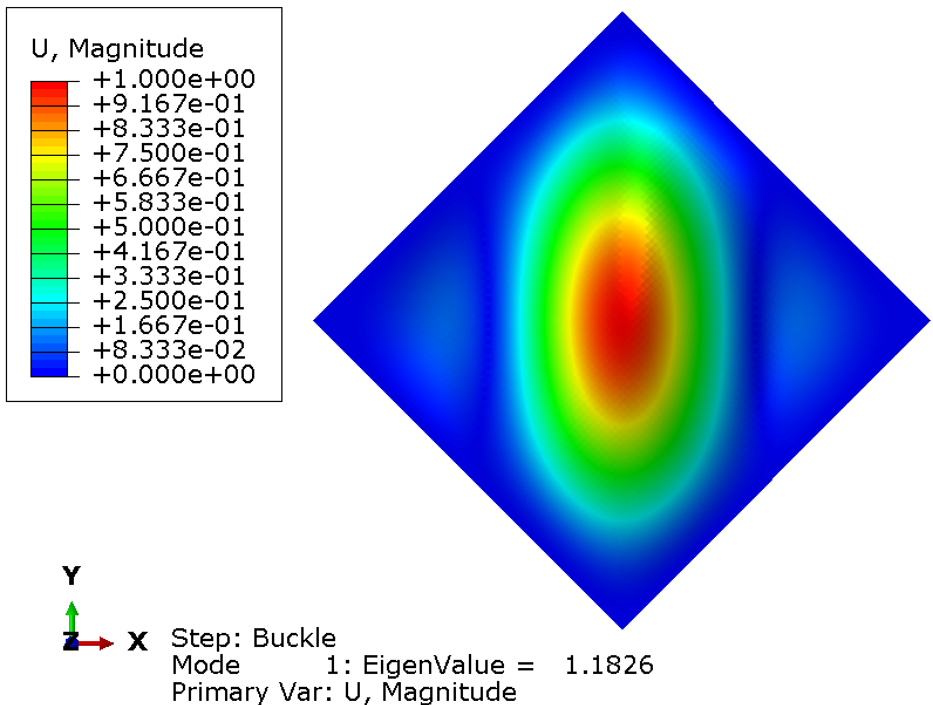
Governing equations of Classical Laminate Theory (CLT)
Prior to addressing the buckling problem, it is of paramount importance to understand the governing equations of a composite laminate.
It is equally important to have awareness of how these equations are obtained.
Then, some practical examples will be provided.
Notes:
Intro
This slide sets the stage for understanding how composite laminates behave under load by introducing the governing equations of Classical Laminate Theory (CLT). These equations form the backbone of all structural analysis in composites, from stiffness prediction to buckling and failure.
Concept
CLT links external loads and moments applied to a laminate with its in-plane strains and curvatures.
It combines the responses of individual plies, each with its own orientation and stiffness, into an overall laminate behaviour through the ABD stiffness matrices.
The A-matrix represents in-plane (membrane) stiffness, the D-matrix captures bending stiffness, and the B-matrix couples the two when the laminate is unsymmetric.
Understanding CLT is essential before tackling advanced topics like buckling, vibration, or progressive failure, as these analyses rely directly on the same governing equations.
Details
The figure shows a buckling mode shape from a finite element analysis, visualising one of the outcomes that CLT helps predict.
Before analysing buckling, engineers must know how in-plane and bending effects interact through the ABD matrix.
Symmetric laminates (where B = 0) behave predictably, while unsymmetric ones exhibit coupling between in-plane and bending responses, complicating stability.
CLT equations emerge by integrating stress–strain relationships through the laminate thickness and linking resultant forces and moments to mid-plane deformations.
Key Takeaway
Classical Laminate Theory provides the mathematical bridge between the behaviour of individual plies and the overall response of a multi-layered composite. Mastering these equations allows accurate prediction of stiffness, deflection, and buckling, making CLT the foundation of all composite structural analysis.

Slide 3
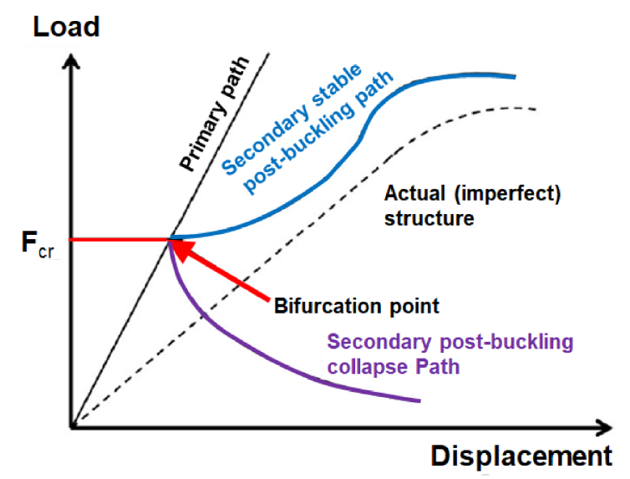
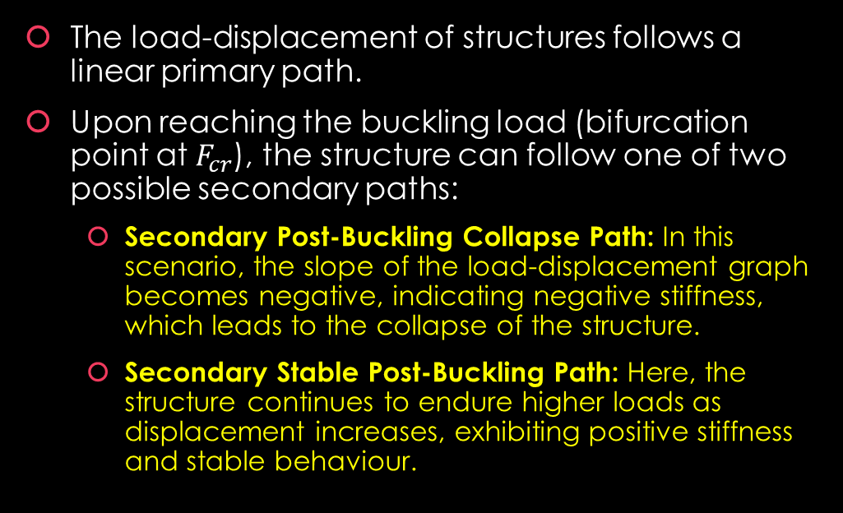
Typical response
The load-displacement of structures follows a linear primary path.
Upon reaching the buckling load (bifurcation point at $F_{cr}$), the structure can follow one of two possible secondary paths:
  Secondary Post-Buckling Collapse Path: In this scenario, the slope of the load-displacement graph becomes negative, indicating negative stiffness, which leads to the collapse of the structure.
  Secondary Stable Post-Buckling Path: Here, the structure continues to endure higher loads as displacement increases, exhibiting positive stiffness and stable behaviour.
Notes:
Intro
This slide explains how a structure behaves once it begins to buckle. The load–displacement relationship reveals whether the structure will fail suddenly or continue to carry load in a stable manner after buckling begins.
Concept
Before buckling, the load–displacement curve follows a straight, linear path known as the primary path.
When the critical buckling load (Fcr) is reached, the structure can take one of two possible post-buckling routes:
Secondary post-buckling collapse path: The slope of the curve becomes negative, showing that the structure loses stiffness and collapses rapidly.
Secondary stable post-buckling path: The slope remains positive, meaning the structure can carry additional load with increasing displacement, demonstrating stable post-buckling behaviour.
Details
The figure shows a typical load–displacement curve. The bifurcation point marks the transition between the pre-buckling and post-buckling regimes.
In the collapse path, negative stiffness indicates instability and sudden failure.
In the stable path, stiffness remains positive, and the structure adapts to load redistribution through geometric changes.
Real structures often exhibit slight imperfections, so their curves deviate smoothly rather than showing a sharp bifurcation.
Key Takeaway
After reaching its buckling load, a structure does not always fail immediately. Some follow a stable post-buckling path and continue to carry load safely, while others collapse. Understanding which path a structure will take is essential for designing lightweight, resilient composite components.

Slide 4
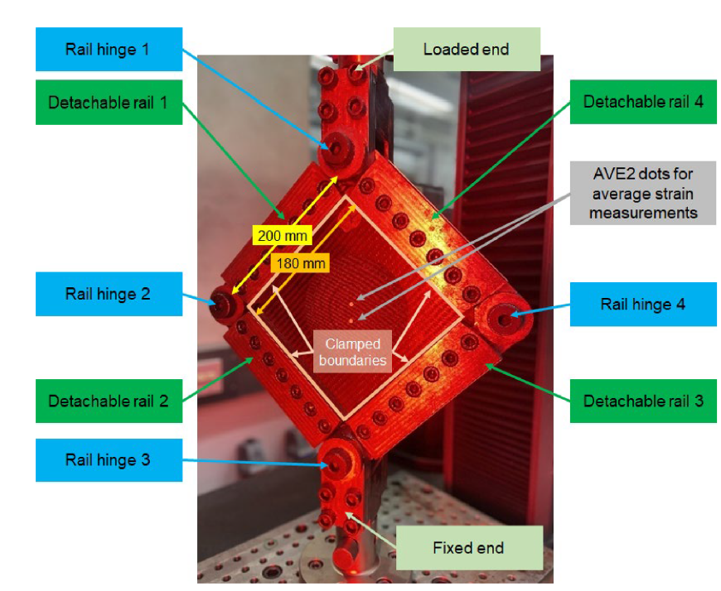
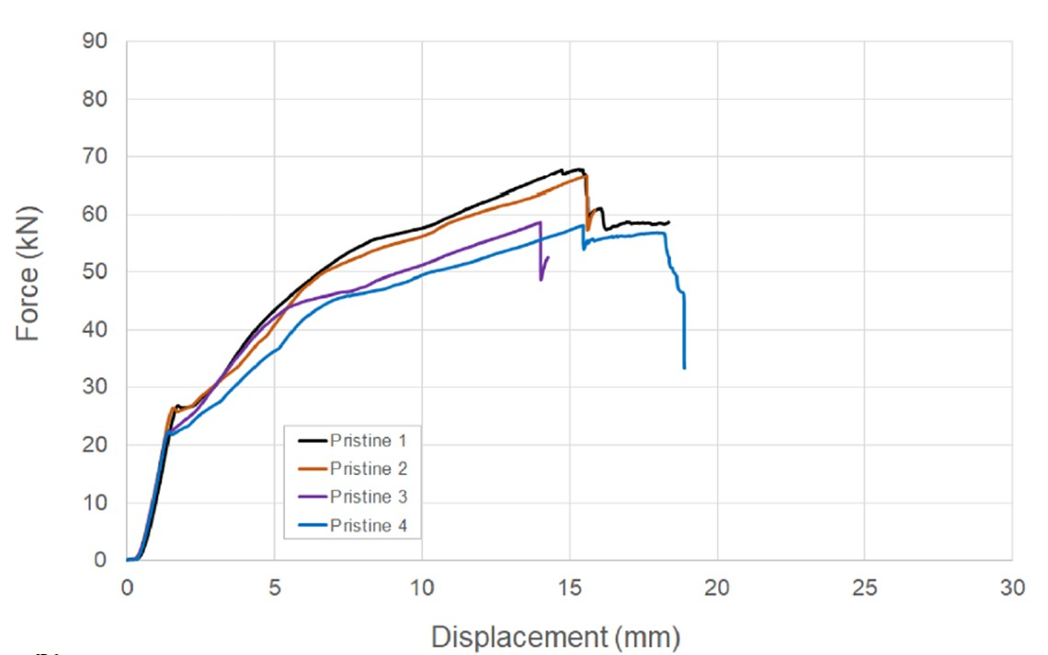
Typical response
Notes:
Intro
This slide demonstrates how a slender panel behaves under compression, highlighting the visual stages of buckling from initial deformation to full post-buckling. It bridges the theory of elastic instability with real physical observation.
Concept
When a thin plate or panel is loaded in compression, it first deforms elastically along a straight path. As load increases, the panel reaches its critical buckling load (Fcr) and deforms laterally out of plane.
The top image shows the undeformed state, where load and deflection remain proportional.
The middle stage shows onset of buckling, where the panel loses linear stiffness and starts to deflect laterally.
The final stage shows post-buckling deformation, where the structure still carries load but with redistributed stresses.
This transition matches the CLT-derived behaviour explained in earlier slides.
Details
These experiments are visually striking examples of post-buckling mechanics in action. They reveal how panels can deform significantly while continuing to carry load.
In aerospace structures, such behaviour is exploited for lightweight design — engineers allow controlled buckling but ensure it remains stable.
The curvature patterns shown in the images correspond to mode shapes predicted by finite element eigenvalue analysis.
Key Takeaway
Buckling is not always a failure but a predictable, often stable, change in structural stiffness. Controlled post-buckling can be designed safely into thin-walled structures for weight efficiency, provided that the response remains stable and recoverable.
Watch:
🔗 https://youtu.be/xRRrNafmpJk
🔗 https://www.youtube.com/watch?v=BVuwR4XtQjM
🔗 https://www.youtube.com/watch?v=igKl3_JnhJY

Slide 5
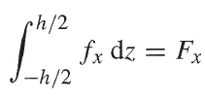
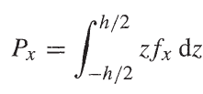

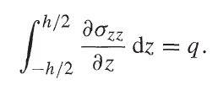
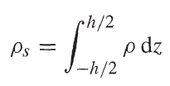
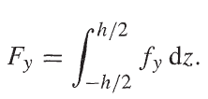
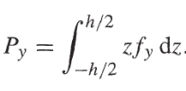


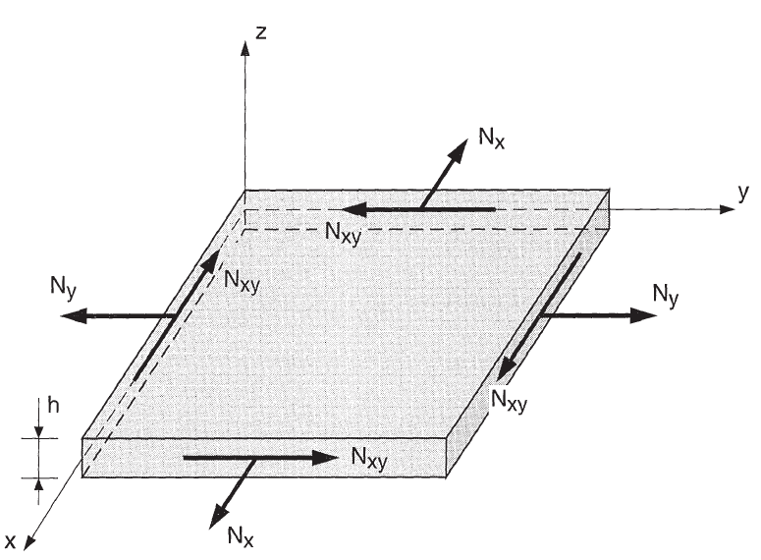
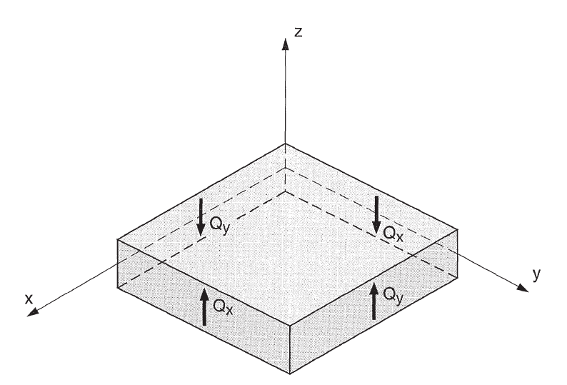
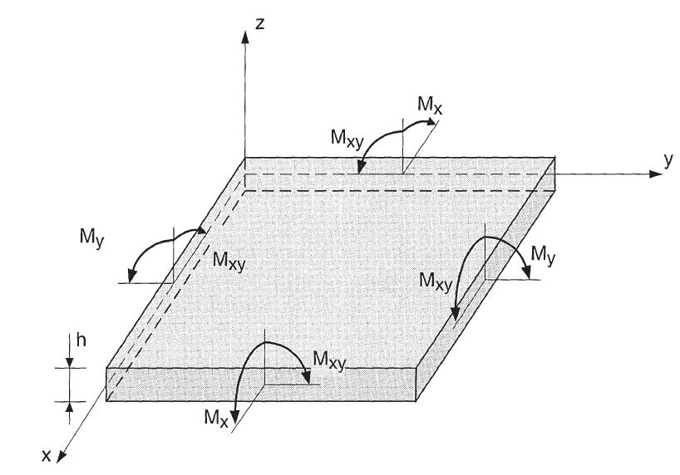
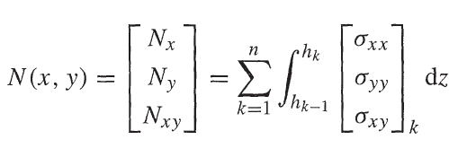
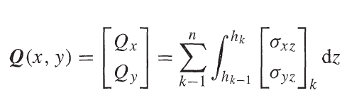
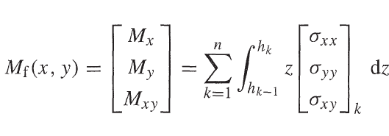
CLT
Notes:
Intro
This slide presents the fundamental stress resultants in Classical Laminate Theory (CLT). It shows how in-plane forces, transverse shear forces, and bending moments are obtained by integrating stresses through the laminate thickness.
Concept
In CLT, a laminate is treated as a stack of plies that together carry loads distributed through the thickness.
In-plane forces $N_{x},N_{y},N_{xy}$: Represent membrane actions per unit width caused by in-plane stresses $σ_{xx},σ_{yy},τ_{xy}$.
Transverse shear forces $Q_{x},Q_{y}$: Represent shear effects per unit width caused by out-of-plane stresses $σ_{xz},σ_{yz}$.
Moments $M_{x},M_{y},M_{xy}$: Represent bending and twisting effects per unit width due to the variation of in-plane stresses through the thickness.
Each resultant is obtained by integrating the corresponding stress components over the total laminate thickness $h$.
Details
The three diagrams illustrate the three main categories of resultant loads:
Membrane resultants $N\left(x , y\right)$:
These represent in-plane normal and shear forces acting along the laminate plane.
Shear resultants $Q\left(x , y\right)$:
These are the through-thickness shear forces acting perpendicular to the laminate surface.
Moment resultants $M_{f}\left(x , y\right)$:
These bending and twisting moments arise from stress variations along the laminate thickness.
These resultants form the foundation of the CLT governing equations, which relate the applied loads to the laminate’s mid-plane strains and curvatures via the ABD stiffness matrices.
Additional Integration Relations
The general form of equilibrium through the thickness of a laminate can be expressed as:
$$F_{x}=\int_{−h/2}^{h/2}{f_{x}} dz, F_{y}=\int_{−h/2}^{h/2}{f_{y}} dz$$
$$P_{x}=\int_{−h/2}^{h/2}{z}f_{x} dz, P_{y}=\int_{−h/2}^{h/2}{z}f_{y} dz$$
$$τ_{2y}=σ_{yz}\left(−\frac{h}{2}\right), τ_{1y}=σ_{yz}\left(\frac{h}{2}\right)$$
$$\int_{−h/2}^{h/2}{\frac{∂σ_{xx}}{∂z}} dz=q$$
$$ρ_{s}=\int_{−h/2}^{h/2}{ρ} dz, R=\int_{−h/2}^{h/2}{ρ}z dz$$
These relations connect three-dimensional stresses and body forces to their corresponding two-dimensional resultants, enabling the reduction of the 3D stress field into an equivalent 2D laminate model.
Key Takeaway
By integrating stresses through the thickness, Classical Laminate Theory transforms the complex three-dimensional stress state of a laminate into simplified two-dimensional resultants $N$, $Q$, and $M$. This mathematical condensation preserves the essential physics of bending, membrane, and shear coupling, making it the cornerstone of efficient composite laminate analysis.
Note:
Each equation expresses how stresses or body forces acting through the laminate thickness $h$ are condensed into resultant quantities that act in the plane of the laminate:
$F_{x}=\int_{−h/2}^{h/2}{f_{x}} dz$ and $F_{y}=\int_{−h/2}^{h/2}{f_{y}} dz$ represent total body forces per unit width.
$P_{x}=\int_{−h/2}^{h/2}{z}f_{x} dz$ and $P_{y}=\int_{−h/2}^{h/2}{z}f_{y} dz$ represent bending moments caused by distributed body forces.
$τ_{2y}=σ_{yz}\left(−\frac{h}{2}\right)$ and $τ_{1y}=σ_{yz}\left(\frac{h}{2}\right)$ represent boundary shear stresses at the top and bottom surfaces.
$\int_{−h/2}^{h/2}{\frac{∂σ_{xx}}{∂z}} dz=q$expresses the balance between internal stress variation and transverse shear flow.
$ρ_{s}=\int_{−h/2}^{h/2}{ρ} dz$ and $R=\int_{−h/2}^{h/2}{ρ}z dz$ represent mass per unit area and mass moment, respectively.

Slide 6
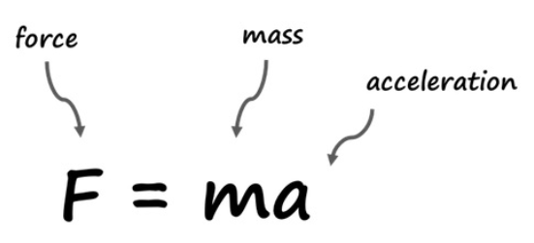
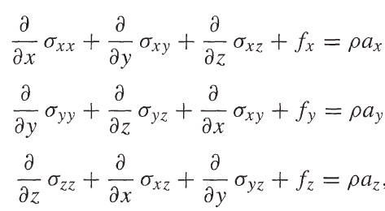
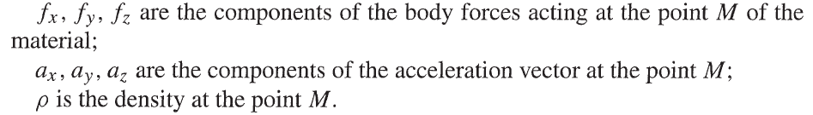

Fundamental equations of the mechanics of materials-General equation
The following equation is essentially a more detailed version of Newton’s second law by which it suggests $F=ma$.
Notes:
Intro
This slide introduces the general equilibrium equations of mechanics of materials. They express Newton’s second law $F=ma$ in its full three-dimensional, continuum form, showing how stresses, body forces, and accelerations interact within a material element.
Concept
In a solid body, each small element must satisfy equilibrium under applied loads, body forces, and inertia effects.
The three governing equations are:
$$\frac{∂σ_{xx}}{∂x}+\frac{∂σ_{xy}}{∂y}+\frac{∂σ_{xz}}{∂z}+f_{x}=ρa_{x}$$
$$\frac{∂σ_{yy}}{∂y}+\frac{∂σ_{yz}}{∂z}+\frac{∂σ_{xy}}{∂x}+f_{y}=ρa_{y}$$
$$\frac{∂σ_{zz}}{∂z}+\frac{∂σ_{xz}}{∂x}+\frac{∂σ_{yz}}{∂y}+f_{z}=ρa_{z}$$
Here:
$f_{x},f_{y},f_{z}$ are body force components (e.g., gravity or inertia).
$a_{x},a_{y},a_{z}$are the acceleration components of the material point.
$ρ$ is the material density.
These equations are the foundation of all stress analysis, forming the link between internal stresses $σ_{ij}$ and the external actions applied to a solid.
Details
The left-hand terms represent internal stress gradients in each direction, while the right-hand term $ρa_{i}$ represents inertia (mass times acceleration).
When the accelerations are negligible, these equations reduce to static equilibrium:
$$\frac{∂σ_{xx}}{∂x}+\frac{∂σ_{xy}}{∂y}+\frac{∂σ_{xz}}{∂z}+f_{x}=0$$
and similarly for the y and z directions.
This simplification is used in most structural applications, including composite laminate analysis under steady loading.
Key Takeaway
The general equilibrium equations describe how stress gradients, body forces, and accelerations balance in any solid. In the context of composites, they provide the basis for Classical Laminate Theory, where the 3D stress field is later integrated through the thickness to derive the 2D governing equations for laminates.

Slide 7
CLT-Illustration
Notes:
What each term means
$\frac{∂σ_{xx}}{∂x}$ This is the rate of change (gradient) of normal stress $σ_{xx}$along the x-direction.
It represents how the direct stress $σ_{xx}$varies across the element in the x-direction.
$\frac{∂σ_{xy}}{∂y}$ This is the gradient of the shear stress $σ_{xy}$in the y-direction.
It contributes to the internal forces acting on planes parallel to the x–y faces.
$\frac{∂σ_{xz}}{∂z}$ The gradient of the shear stress $σ_{xz}$in the z-direction.
This term accounts for the variation of shear stress on planes parallel to x–z faces.
$f_{x}$ The body force per unit volume in the x-direction (for example, gravity or inertial force).
$ρa_{x}$The mass density $ρ$multiplied by the acceleration $a_{x}$.
This is the inertial term, representing the dynamic reaction of the mass to applied forces.

Slide 8
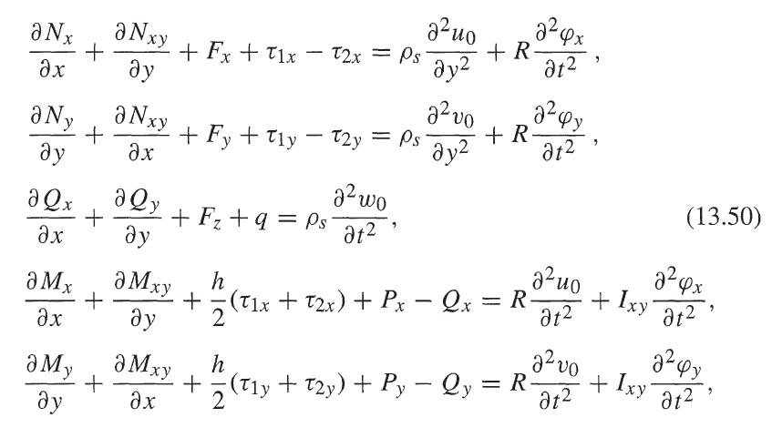
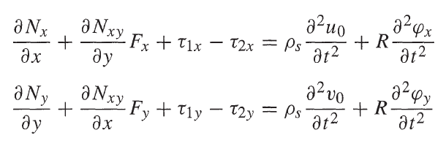
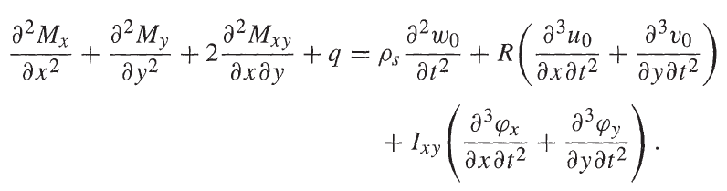
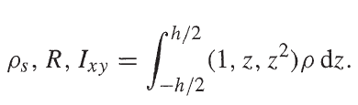
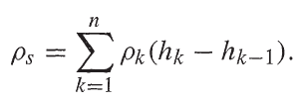


Fundamental equations of the mechanics of materials-General equation-Expanded
Assuming transverse shear (Q) is negligible
Notes:
Intro
This slide expands the general 3D equilibrium equations into their laminate form by introducing the resultant forces and moments ($N,M,Q$) through the laminate thickness. It shows how the equations of motion evolve when translated from local stress terms to laminate-level quantities used in Classical Laminate Theory (CLT).
Concept
Starting from the three-dimensional equilibrium equations, we integrate through the laminate thickness to obtain two-dimensional governing equations in terms of force and moment resultants:
$N_{x},N_{y},N_{xy}$: in-plane force resultants per unit width.
$M_{x},M_{y},M_{xy}$: bending and twisting moment resultants per unit width.
$Q_{x},Q_{y}$: transverse shear resultants per unit width (often neglected in CLT).
The equations on the left show the complete form including transverse shear and rotary inertia terms. The simplification on the right shows the Classical Laminate Theory (CLT) assumption that transverse shear ($Q$) is negligible, reducing the system to pure membrane–bending coupling.
Details
The general set of equations expresses dynamic equilibrium in the x, y, and z directions:
$$\frac{∂N_{x}}{∂x}+\frac{∂N_{xy}}{∂y}+F_{x}+τ_{1x}−τ_{2x}=ρ_{s}\frac{∂^{2}u_{0}}{∂t^{2}}+R\frac{∂^{2}φ_{x}}{∂t^{2}}$$
$$\frac{∂N_{y}}{∂y}+\frac{∂N_{xy}}{∂x}+F_{y}+τ_{1y}−τ_{2y}=ρ_{s}\frac{∂^{2}v_{0}}{∂t^{2}}+R\frac{∂^{2}φ_{y}}{∂t^{2}}$$
$$\frac{∂^{2}M_{x}}{∂x^{2}}+2\frac{∂^{2}M_{xy}}{∂x∂y}+\frac{∂^{2}M_{y}}{∂y^{2}}+q=ρ_{s}\frac{∂^{2}w_{0}}{∂t^{2}}+R\left(\frac{∂^{3}u_{0}}{∂x∂t^{2}}+\frac{∂^{3}v_{0}}{∂y∂t^{2}}\right)+I_{xy}\left(\frac{∂^{3}φ_{x}}{∂x∂t^{2}}+\frac{∂^{3}φ_{y}}{∂y∂t^{2}}\right)$$
Here:
$u_{0},v_{0},w_{0}$ are the mid-plane displacements.
$φ_{x},φ_{y}$ are the rotations of the mid-plane normal.
$ρ_{s},R,I_{xy}$ are the mass-related stiffness integrals through thickness:
$$ρ_{s}=\sum_{k=1}^{n}{ρ_{k}}\left(h_{k}−h_{k−1}\right), R=\frac{1}{2}\sum_{k=1}^{n}{ρ_{k}}\left(h_{k}^{2}−h_{k−1}^{2}\right), I_{xy}=\frac{1}{3}\sum_{k=1}^{n}{ρ_{k}}\left(h_{k}^{3}−h_{k−1}^{3}\right)$$
When transverse shear ($Q_{x},Q_{y}$) is assumed negligible, the equations simplify to the pure CLT form used in most laminate analysis, where bending and in-plane effects are coupled via the $\left[A\right],\left[B\right],\left[D\right]$matrices.
Key Takeaway
These expanded equations form the bridge between 3D solid mechanics and 2D Classical Laminate Theory. By neglecting transverse shear, CLT provides an efficient yet accurate description of thin laminates where in-plane and bending effects dominate. The mass integrals ($ρ_{s},R,I_{xy}$) ensure dynamic and inertia effects are still captured in the simplified plate model.
Note:
The $N$ terms (membrane or in-plane force resultants) and $M$terms (bending/twisting moment resultants) come directly from integrating the 3D stresses through the laminate’s thickness. This transforms the full 3D continuum problem into a 2D plate problem. Let’s go step by step.
1. The starting point: 3D stress equilibrium
In a solid laminate, each layer has its own stresses:
$$σ_{xx}\left(z\right), σ_{yy}\left(z\right), τ_{xy}\left(z\right)$$
that vary through the thickness $h$.
The x-direction equilibrium equation is:
$$\frac{∂σ_{xx}}{∂x}+\frac{∂τ_{xy}}{∂y}+\frac{∂τ_{xz}}{∂z}+f_{x}=ρa_{x}$$
and similarly for y and z directions.
For a thin laminate, it’s very inefficient to solve these at every $z$coordinate, so we “collapse” the problem into resultant quantities that represent the total effect of stress across thickness.
2. Defining the force resultants
We define the in-plane force resultants per unit width as:
$$\left[\begin{matrix}N_{x} \\ N_{y} \\ N_{xy}\end{matrix}\right]=\int_{−h/2}^{+h/2}{\left[\begin{matrix}σ_{xx} \\ σ_{yy} \\ τ_{xy}\end{matrix}\right]}dz$$
Each $N$therefore represents the total force per unit width carried by all plies through the laminate thickness.
3. Defining the moment resultants
Similarly, the bending and twisting moments per unit width are:
$$\left[\begin{matrix}M_{x} \\ M_{y} \\ M_{xy}\end{matrix}\right]=\int_{−h/2}^{+h/2}{z} \left[\begin{matrix}σ_{xx} \\ σ_{yy} \\ τ_{xy}\end{matrix}\right]dz$$
The factor $z$(distance from the mid-plane) gives these moments their rotational effect — it’s a first moment of stress distribution about the laminate mid-plane.
4. Physical meaning
$N_{x}$: total normal force per unit width acting along x.
$N_{y}$: total normal force per unit width acting along y.
$N_{xy}$: total in-plane shear per unit width.
$M_{x},M_{y},M_{xy}$: total bending/twisting moments per unit width caused by the stress distribution varying with $z$.
These integrated quantities now represent everything about the internal forces in the laminate — no need to track each ply’s stress field individually in the global equilibrium equations.
5. Why this integration is valid
Because CLT assumes:
The laminate is thin ($h≪$ in-plane dimensions).
Plane sections remain plane (Kirchhoff–Love assumption).
Transverse stresses $σ_{xz},σ_{yz}$are small and can be neglected.
So, the through-thickness variation of stress is predictable and can be collapsed into integrals.
6. Substituting into equilibrium
When you substitute these definitions into the integrated form of the 3D equilibrium equations, you get:
$$\frac{∂N_{x}}{∂x}+\frac{∂N_{xy}}{∂y}+F_{x}=ρ_{s}\frac{∂^{2}u_{0}}{∂t^{2}}$$
and so on — this is how $N$naturally replaces $σ$in the 2D CLT governing equations.
Key takeaway
The $N$terms are simply thickness-integrated stresses, representing total in-plane forces per unit width.
They condense the continuous 3D stress field into manageable 2D quantities — the foundation of all laminate and plate analysis.
In short:
$$N_{x}=\int_{−h/2}^{h/2}{σ_{xx}}dz, N_{y}=\int_{−h/2}^{h/2}{σ_{yy}}dz, N_{xy}=\int_{−h/2}^{h/2}{τ_{xy}}dz$$
and those are the force resultants that make CLT so powerful.

Slide 9
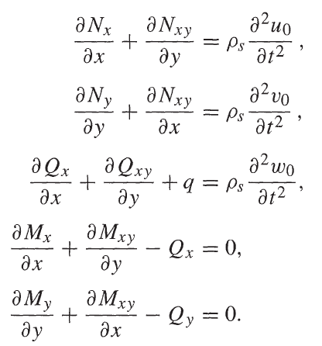
Fundamental equations of the mechanics of materials-General equation-Simplified
Rotational inertia negligible (R = 0)
No body forces
No shear stresses on the faces of the laminate
Notes:
Intro
This slide shows how the general equations of motion for a composite laminate are simplified under typical engineering assumptions. These simplifications remove small or negligible effects such as rotational inertia, body forces, and shear stresses on free surfaces, leaving the clean form used in Classical Laminate Theory (CLT) for static and low-frequency dynamic analyses.
Concept
The full equilibrium equations of mechanics include terms for:
Rotational inertia $R\frac{∂^{2}φ_{x}}{∂t^{2}}$, $R\frac{∂^{2}φ_{y}}{∂t^{2}}$
Body forces $F_{x},F_{y},F_{z}$(e.g., gravity or distributed loads)
Shear tractions $τ_{1x},τ_{2x},τ_{1y},τ_{2y}$acting on the top and bottom laminate surfaces
For most composite plates, these effects are small compared to in-plane and bending loads. Neglecting them simplifies the equilibrium to the reduced CLT form, where only in-plane resultants $N$, shear resultants $Q$, and bending moments $M$appear.
Details
After removing these secondary effects, the governing equations reduce to:
$$\frac{∂N_{x}}{∂x}+\frac{∂N_{xy}}{∂y}=ρ_{s}\frac{∂^{2}u_{0}}{∂t^{2}}$$
$$\frac{∂N_{y}}{∂y}+\frac{∂N_{xy}}{∂x}=ρ_{s}\frac{∂^{2}v_{0}}{∂t^{2}}$$
$$\frac{∂Q_{x}}{∂x}+\frac{∂Q_{y}}{∂y}+q=ρ_{s}\frac{∂^{2}w_{0}}{∂t^{2}}$$
$$\frac{∂M_{x}}{∂x}+\frac{∂M_{xy}}{∂y}−Q_{x}=0$$
$$\frac{∂M_{y}}{∂y}+\frac{∂M_{xy}}{∂x}−Q_{y}=0$$
Here:
$N_{x},N_{y},N_{xy}$: in-plane force resultants
$M_{x},M_{y},M_{xy}$: bending and twisting moments
$Q_{x},Q_{y}$: transverse shear resultants
$q$: external distributed load per unit area
$ρ_{s}$: mass per unit area $\left(ρ_{s}=\sum_{k=1}^{n}{ρ_{k}}\left(h_{k}−h_{k−1}\right)\right)$
By neglecting the rotational inertia term ($R=0$) and higher-order mass moments ($I_{xy}$), we assume that the plate’s motion is dominated by mid-plane inertia only — valid for thin laminates under moderate frequency or quasi-static loading.
Key Takeaway
These simplified equations represent the core of Classical Laminate Theory: the in-plane and bending behaviors of a thin composite plate, free from shear and rotary effects. They provide an accurate yet computationally efficient way to predict deflection, stress distribution, and buckling in most aerospace-grade composite structures.

Slide 10
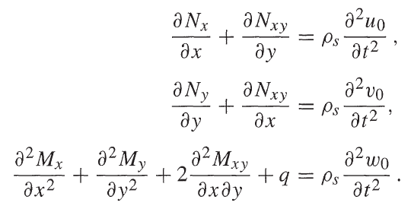
Fundamental equations of the mechanics of materials-General equation-Further simplified (no transverse shear)
No transverse shear
Notes:
Intro
This slide shows the final step in simplifying the fundamental equations of Classical Laminate Theory (CLT). By neglecting the effect of transverse shear, the system reduces to the pure bending and in-plane form used for thin laminates. This is the version most commonly implemented in analytical and numerical laminate models.
Concept
When a plate or laminate is thin, the through-thickness shear deformation ($Q_{x},Q_{y}$) is extremely small compared to in-plane and bending responses.
Neglecting these terms means assuming that:
Plane sections remain plane after deformation (Kirchhoff–Love assumption).
Normals to the mid-surface do not rotate independently, i.e., no shear strains $γ_{xz}$or $γ_{yz}$.
This simplification removes transverse shear resultants $Q_{x}$and $Q_{y}$from the governing equations, yielding a purely bending–membrane coupled system.
Details
After neglecting the shear resultants, the equilibrium equations reduce to:
$$\frac{∂N_{x}}{∂x}+\frac{∂N_{xy}}{∂y}=ρ_{s}\frac{∂^{2}u_{0}}{∂t^{2}}$$
$$\frac{∂N_{y}}{∂y}+\frac{∂N_{xy}}{∂x}=ρ_{s}\frac{∂^{2}v_{0}}{∂t^{2}}$$
$$\frac{∂^{2}M_{x}}{∂x^{2}}+\frac{∂^{2}M_{y}}{∂y^{2}}+2\frac{∂^{2}M_{xy}}{∂x∂y}+q=ρ_{s}\frac{∂^{2}w_{0}}{∂t^{2}}$$
Here:
$N_{x},N_{y},N_{xy}$: in-plane force resultants
$M_{x},M_{y},M_{xy}$: bending and twisting moments
$q$: external transverse load per unit area
$ρ_{s}$: mass per unit area
$u_{0},v_{0},w_{0}$: mid-plane displacements in the x, y, and z directions
By eliminating shear resultants, the coupling between in-plane and bending behavior remains only through the $\left[B\right]$-matrix of the ABD formulation.
Key Takeaway
The “no transverse shear” assumption is valid for thin laminates where $h/L<1/20$. This final simplified form represents the core of Classical Laminate Theory, providing accurate predictions for most aerospace-grade composite panels where shear deformation is negligible and bending–membrane coupling dominates.

Slide 11
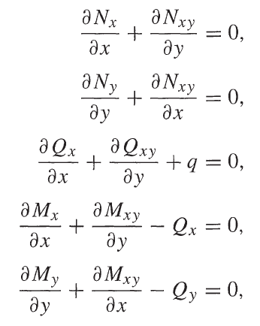
Fundamental equations of the mechanics of materials-General equation-Simplified-for static problems
Rotational inertia negligible (R = 0)
No body forces
No shear stress on the faces of the laminate
No dynamic problem
Notes:
Intro
This slide presents the static form of the fundamental equilibrium equations used in Classical Laminate Theory (CLT). It represents the simplest, most widely used case — when the laminate is not accelerating, body forces and inertia effects are negligible, and the problem is purely static.
Concept
Starting from the full dynamic equations of motion, several simplifying assumptions are applied:
Rotational inertia is negligible ($R=0$)
No body forces ($F_{x}=F_{y}=F_{z}=0$)
No shear tractions ($τ_{1x}=τ_{2x}=τ_{1y}=τ_{2y}=0$)
Static case — no time-dependent terms ($\frac{∂^{2}}{∂t^{2}}=0$)
These assumptions lead to the static equilibrium equations, which describe force and moment balance in a composite laminate under mechanical loading only.
Details
After eliminating the time-dependent and inertia terms, the simplified static equilibrium equations become:
$$\frac{∂N_{x}}{∂x}+\frac{∂N_{xy}}{∂y}=0$$
$$\frac{∂N_{y}}{∂y}+\frac{∂N_{xy}}{∂x}=0$$
$$\frac{∂Q_{x}}{∂x}+\frac{∂Q_{y}}{∂y}+q=0$$
$$\frac{∂M_{x}}{∂x}+\frac{∂M_{xy}}{∂y}−Q_{x}=0$$
$$\frac{∂M_{y}}{∂y}+\frac{∂M_{xy}}{∂x}−Q_{y}=0$$
Here:
$N_{x},N_{y},N_{xy}$: in-plane (membrane) force resultants
$M_{x},M_{y},M_{xy}$: bending and twisting moment resultants
$Q_{x},Q_{y}$: transverse shear resultants
$q$: external transverse load per unit area
These equations ensure equilibrium of forces and moments within a differential laminate element under static conditions.
Key Takeaway
This static form of the governing equations is the foundation of structural analysis for thin composite plates and shells. It provides the baseline for studying buckling, static deflection, and load-carrying capacity — where dynamic and inertial effects are minimal. From this point, CLT couples these equilibrium equations with the constitutive relations defined by the ABD stiffness matrices to fully describe laminate behaviour.

Slide 12
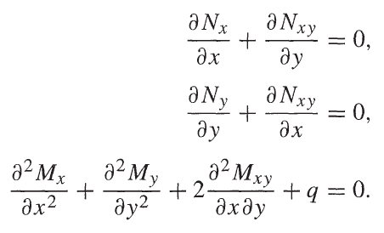
Fundamental equations of the mechanics of materials-General equation-Further simplified (no transverse shear)-for static problems
Rotational inertia negligible (R = 0)
No body forces
No shear stress on the faces of the laminate
No dynamic problem
No transverse shear
Notes:
Intro
This slide shows the final and most compact form of the governing equations of Classical Laminate Theory (CLT). All secondary effects — such as inertia, body forces, and transverse shear — have now been removed, leaving only the core static equilibrium relations. This form applies directly to thin laminates under steady loads, which is the foundation for most analytical laminate analysis and buckling formulations.
Concept
The process of simplification follows this physical logic:
Neglect rotational inertia ($R=0$): applicable to low-frequency or static cases.
Ignore body forces (such as gravity): small compared to external or in-plane loads.
Assume traction-free top and bottom surfaces: no shear stress ($τ_{xz}=τ_{yz}=0$).
Static problem: remove all time derivatives.
No transverse shear: adopt the Kirchhoff–Love assumption that normals remain perpendicular to the mid-plane.
After applying these assumptions, only in-plane force equilibrium and bending moment equilibrium remain, capturing the laminate’s primary static behaviour.
Details
The resulting fully simplified static CLT equations are:
$$\frac{∂N_{x}}{∂x}+\frac{∂N_{xy}}{∂y}=0$$
$$\frac{∂N_{y}}{∂y}+\frac{∂N_{xy}}{∂x}=0$$
$$\frac{∂^{2}M_{x}}{∂x^{2}}+\frac{∂^{2}M_{y}}{∂y^{2}}+2\frac{∂^{2}M_{xy}}{∂x∂y}+q=0$$
Here:
$N_{x},N_{y},N_{xy}$: in-plane force resultants per unit width
$M_{x},M_{y},M_{xy}$: bending and twisting moment resultants per unit width
$q$: externally applied transverse pressure or distributed load
The first two equations ensure in-plane equilibrium, while the third ensures bending equilibrium under an applied transverse load $q$.
Key Takeaway
These are the static governing equations of Classical Laminate Theory — the foundation for analysis of thin composite plates in tension, compression, or bending. They represent the perfect balance of mathematical simplicity and physical accuracy for most aerospace laminates, where shear deformation and dynamic effects are minimal.

Slide 13
Fundamental equations of the mechanics of materials-Summary of key equations
Equation for static problems
with transverse shear
Equation for static problems
with no transverse shear
Notes:
Intro
This slide provides a concise summary of the key static equilibrium equations derived from Classical Laminate Theory (CLT). It distinguishes between two important formulations: one that includes transverse shear effects (suitable for thick laminates) and one that neglects them (suitable for thin laminates).
Concept
Composite laminates can behave differently depending on their thickness:
Thin laminates (Kirchhoff–Love theory): transverse shear deformation is negligible; normals to the mid-surface remain perpendicular after bending.
Thick laminates (First-Order Shear Deformation Theory): transverse shear deformation is significant; shear resultants $Q_{x},Q_{y}$must be retained in the equilibrium equations.
These two formulations provide the mathematical bridge between Classical Laminate Theory (CLT) and higher-order plate theories like Mindlin–Reissner.
Details
(1) Static equilibrium with transverse shear
For thick laminates or sandwich panels where shear cannot be neglected:
$$\frac{∂N_{x}}{∂x}+\frac{∂N_{xy}}{∂y}=0$$
$$\frac{∂N_{y}}{∂y}+\frac{∂N_{xy}}{∂x}=0$$
$$\frac{∂Q_{x}}{∂x}+\frac{∂Q_{y}}{∂y}+q=0$$
$$\frac{∂M_{x}}{∂x}+\frac{∂M_{xy}}{∂y}−Q_{x}=0$$
$$\frac{∂M_{y}}{∂y}+\frac{∂M_{xy}}{∂x}−Q_{y}=0$$
These equations balance in-plane forces, bending moments, and transverse shear forces, giving a more complete picture of laminate behavior under loading.
(2) Static equilibrium without transverse shear
For thin laminates where transverse shear deformation is negligible:
$$\frac{∂N_{x}}{∂x}+\frac{∂N_{xy}}{∂y}=0$$
$$\frac{∂N_{y}}{∂y}+\frac{∂N_{xy}}{∂x}=0$$
$$\frac{∂^{2}M_{x}}{∂x^{2}}+\frac{∂^{2}M_{y}}{∂y^{2}}+2\frac{∂^{2}M_{xy}}{∂x∂y}+q=0$$
Here, the shear resultants $Q_{x},Q_{y}$have been eliminated, leading to the pure CLT form used in most analytical and finite element formulations for thin composite plates.
Key Takeaway
The left set of equations applies to moderately thick laminates or sandwich panels, where shear effects influence stiffness and load transfer.
The right set applies to thin aerospace-grade laminates, where the Kirchhoff–Love assumption holds true.
Together, they form the backbone of structural modelling for composite plates and shells across thickness regimes.

Slide 14
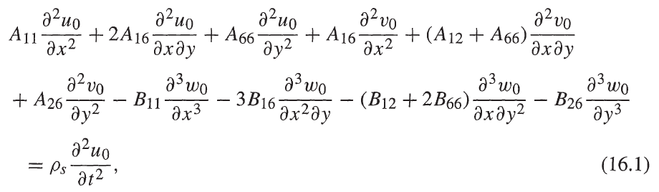
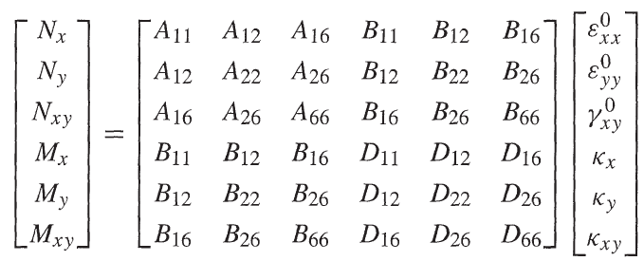
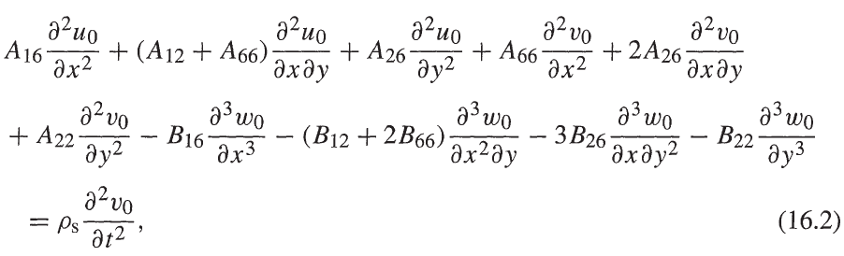
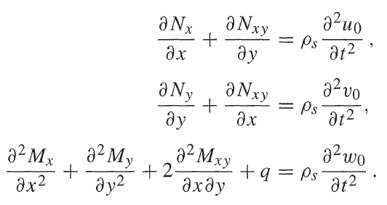
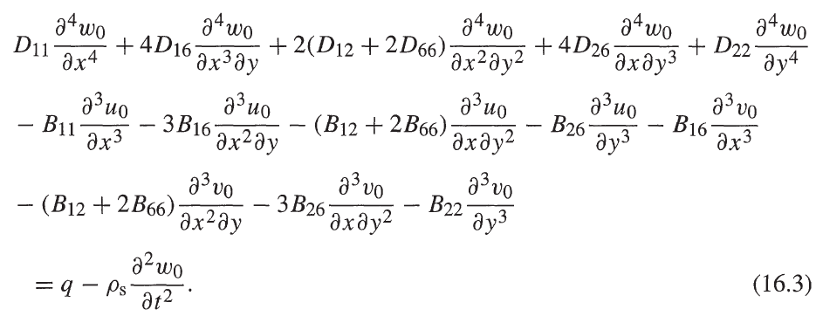
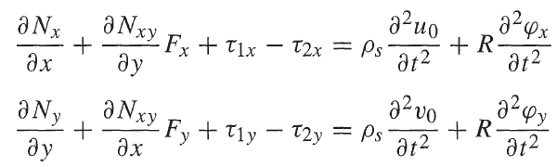

Governing equations-
Classical Laminate Theory (CLT)
Note that the equations below do NOT consider:
Body forces
Shear stresses on the face of laminate
Inertia in rotation
$u_{0}(x,y,t)$, $v_{0}(x,y,t)$ and $w_{0}(x,y,t)$ are displacements that need to meet the equation for boundary conditions.
Solving these equations analytically is complex and can be done for special cases.
OR
Notes:
Intro
This slide presents the governing equations of Classical Laminate Theory (CLT), which combine the laminate’s constitutive relations with the static equilibrium equations. These equations describe how a laminated composite plate deforms under mechanical and thermal loads, linking the internal resultants $N$and $M$to the mid-plane displacements $u_{0},v_{0},w_{0}$.
Concept
At the heart of CLT lies the constitutive relationship between in-plane forces, bending moments, and laminate stiffness:
$$\left[\begin{matrix}N_{x} \\ N_{y} \\ N_{xy} \\ M_{x} \\ M_{y} \\ M_{xy}\end{matrix}\right]=\left[\begin{matrix}A_{ij} & B_{ij} \\ B_{ij} & D_{ij}\end{matrix}\right]\left[\begin{matrix}ε_{x}^{0} \\ ε_{y}^{0} \\ γ_{xy}^{0} \\ κ_{x} \\ κ_{y} \\ κ_{xy}\end{matrix}\right]$$
Here:
[A] matrix: in-plane stiffness (membrane behavior)
[B] matrix: coupling stiffness (links membrane and bending)
[D] matrix: bending stiffness
$ε_{x}^{0},ε_{y}^{0},γ_{xy}^{0}$: mid-plane strains
$κ_{x},κ_{y},κ_{xy}$: curvatures (second derivatives of deflection $w_{0}$)
When these stiffness matrices are substituted into the static equilibrium equations, we obtain a system of partial differential equations (PDEs) in terms of displacements $u_{0},v_{0},w_{0}$.
Details
The full set of CLT governing equations (neglecting rotational inertia, body forces, and transverse shear) are:
$$A_{11}\frac{∂^{2}u_{0}}{∂x^{2}}+2A_{16}\frac{∂^{2}u_{0}}{∂x∂y}+A_{66}\frac{∂^{2}u_{0}}{∂y^{2}}+A_{26}\frac{∂^{2}v_{0}}{∂y^{2}}−B_{11}\frac{∂^{3}w_{0}}{∂x^{3}}−3B_{16}\frac{∂^{3}w_{0}}{∂x^{2}∂y}−\left(B_{12}+2B_{66}\right)\frac{∂^{3}w_{0}}{∂x∂y^{2}}−B_{26}\frac{∂^{3}w_{0}}{∂y^{3}}=ρ_{s}\frac{∂^{2}u_{0}}{∂t^{2}}$$
$$A_{16}\frac{∂^{2}u_{0}}{∂x^{2}}+\left(A_{12}+A_{66}\right)\frac{∂^{2}u_{0}}{∂x∂y}+A_{26}\frac{∂^{2}u_{0}}{∂y^{2}}+A_{22}\frac{∂^{2}v_{0}}{∂y^{2}}−B_{16}\frac{∂^{3}w_{0}}{∂x^{3}}−3B_{26}\frac{∂^{3}w_{0}}{∂x∂y^{2}}−\left(B_{12}+2B_{66}\right)\frac{∂^{3}w_{0}}{∂x^{2}∂y}−B_{22}\frac{∂^{3}w_{0}}{∂y^{3}}=ρ_{s}\frac{∂^{2}v_{0}}{∂t^{2}}$$
$$D_{11}\frac{∂^{4}w_{0}}{∂x^{4}}+4D_{16}\frac{∂^{4}w_{0}}{∂x^{3}∂y}+2\left(D_{12}+D_{66}\right)\frac{∂^{4}w_{0}}{∂x^{2}∂y^{2}}+4D_{26}\frac{∂^{4}w_{0}}{∂x∂y^{3}}+D_{22}\frac{∂^{4}w_{0}}{∂y^{4}}−B_{11}\frac{∂^{3}u_{0}}{∂x^{3}}−3B_{16}\frac{∂^{3}u_{0}}{∂x^{2}∂y}−\left(B_{12}+2B_{66}\right)\frac{∂^{3}u_{0}}{∂x∂y^{2}}−B_{26}\frac{∂^{3}u_{0}}{∂y^{3}}−\left(B_{12}+2B_{66}\right)\frac{∂^{3}v_{0}}{∂x^{2}∂y}−3B_{26}\frac{∂^{3}v_{0}}{∂x∂y^{2}}−B_{22}\frac{∂^{3}v_{0}}{∂y^{3}}=q−ρ_{s}\frac{∂^{2}w_{0}}{∂t^{2}}$$
Each term represents either in-plane stretching, bending curvature, or coupling between the two through the $\left[B\right]$-matrix.
Key Takeaway
These coupled differential equations form the core of Classical Laminate Theory.
They describe the full mechanical behavior of a laminate under general loading, including bending–membrane coupling. Solving them analytically is only feasible for simple geometries and boundary conditions (e.g., simply supported rectangular plates), while most real-world cases require numerical solutions such as the finite element method (FEM).

Slide 15
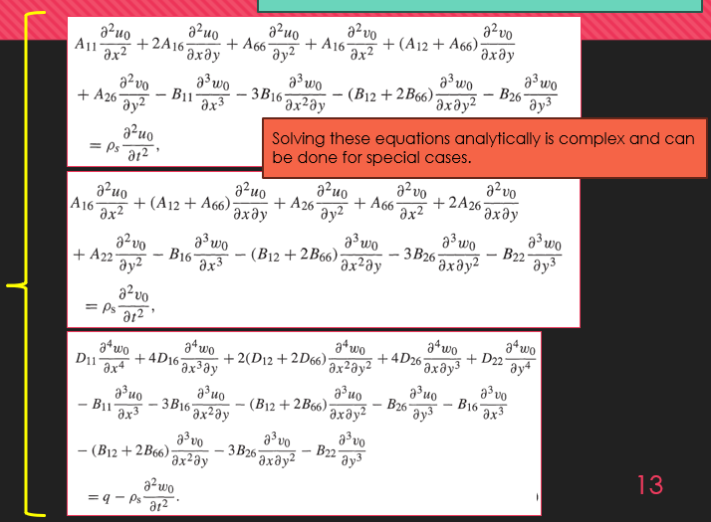
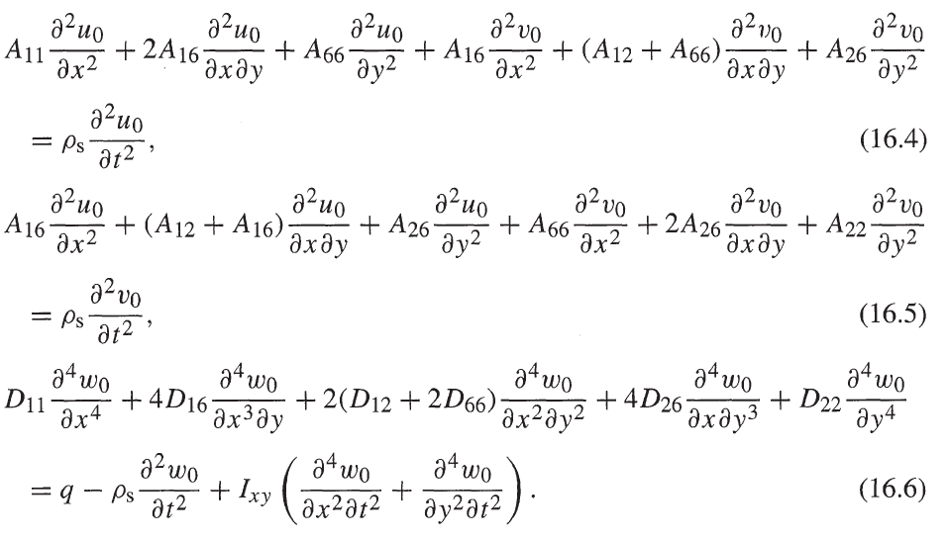
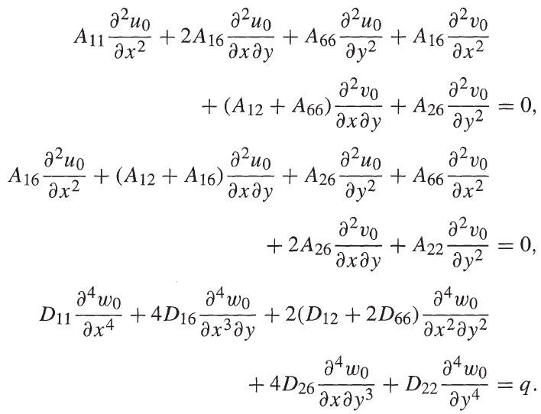
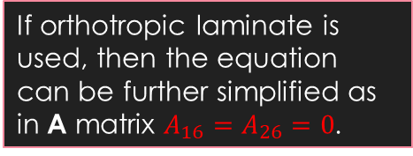
Governing equations-
CLT-Special cases-Symmetric laminates
B matrix becomes ZERO. R is also ZERO.
In-plane displacements are de-coupled from out of plane displacements.
If orthotropic laminate is used, then the equation can be further simplified as in A matrix $A_{16}=A_{26}=0$.
Equation for dynamic problems
Equation for static problems
Notes:
Intro
This slide presents a special case of Classical Laminate Theory (CLT) for symmetric laminates. When the stacking sequence is symmetric about the mid-plane, the coupling matrix $\left[B\right]$becomes zero, greatly simplifying the governing equations. In this condition, the in-plane and out-of-plane behaviors are fully decoupled, allowing the laminate to deform without bending–membrane interaction.
Concept
For a general laminate, the constitutive relationship couples in-plane forces and bending moments:
$$\left[\begin{matrix}N \\ M\end{matrix}\right]=\left[\begin{matrix}A & B \\ B & D\end{matrix}\right]\left[\begin{matrix}ε^{0} \\ κ\end{matrix}\right]$$
where:
$\left[A\right]$is the extensional stiffness matrix,
$\left[B\right]$is the coupling stiffness matrix,
$\left[D\right]$is the bending stiffness matrix.
In a symmetric laminate, the stacking sequence satisfies $z_{i}=−z_{n−i+1}$. This symmetry causes all terms of $\left[B\right]$to cancel out:
$$B_{ij}=\frac{1}{2}\int_{−h/2}^{+h/2}{z} Q_{ij}\left(z\right) dz=0$$
Thus, there is no coupling between in-plane stretching and bending.
Details
Dynamic case:
When $\left[B\right]=0$and rotational inertia ($R$) is negligible, the equations reduce to:
$$A_{11}\frac{∂^{2}u_{0}}{∂x^{2}}+2A_{16}\frac{∂^{2}u_{0}}{∂x∂y}+A_{66}\frac{∂^{2}u_{0}}{∂y^{2}}+A_{16}\frac{∂^{2}v_{0}}{∂x^{2}}+\left(A_{12}+A_{66}\right)\frac{∂^{2}v_{0}}{∂x∂y}+A_{26}\frac{∂^{2}v_{0}}{∂y^{2}}=ρ_{s}\frac{∂^{2}u_{0}}{∂t^{2}}$$
$$A_{16}\frac{∂^{2}u_{0}}{∂x^{2}}+\left(A_{12}+A_{16}\right)\frac{∂^{2}u_{0}}{∂x∂y}+A_{26}\frac{∂^{2}u_{0}}{∂y^{2}}+A_{66}\frac{∂^{2}v_{0}}{∂x^{2}}+2A_{26}\frac{∂^{2}v_{0}}{∂x∂y}+A_{22}\frac{∂^{2}v_{0}}{∂y^{2}}=ρ_{s}\frac{∂^{2}v_{0}}{∂t^{2}}$$
$$D_{11}\frac{∂^{4}w_{0}}{∂x^{4}}+4D_{16}\frac{∂^{4}w_{0}}{∂x^{3}∂y}+2\left(D_{12}+D_{66}\right)\frac{∂^{4}w_{0}}{∂x^{2}∂y^{2}}+4D_{26}\frac{∂^{4}w_{0}}{∂x∂y^{3}}+D_{22}\frac{∂^{4}w_{0}}{∂y^{4}}=q−ρ_{s}\frac{∂^{2}w_{0}}{∂t^{2}}$$
Static case:
When time-dependent and inertia terms vanish ($\frac{∂^{2}}{∂t^{2}}=0$):
$$A_{11}\frac{∂^{2}u_{0}}{∂x^{2}}+2A_{16}\frac{∂^{2}u_{0}}{∂x∂y}+A_{66}\frac{∂^{2}u_{0}}{∂y^{2}}+A_{16}\frac{∂^{2}v_{0}}{∂x^{2}}+\left(A_{12}+A_{66}\right)\frac{∂^{2}v_{0}}{∂x∂y}+A_{26}\frac{∂^{2}v_{0}}{∂y^{2}}=0$$
$$D_{11}\frac{∂^{4}w_{0}}{∂x^{4}}+4D_{16}\frac{∂^{4}w_{0}}{∂x^{3}∂y}+2\left(D_{12}+D_{66}\right)\frac{∂^{4}w_{0}}{∂x^{2}∂y^{2}}+4D_{26}\frac{∂^{4}w_{0}}{∂x∂y^{3}}+D_{22}\frac{∂^{4}w_{0}}{∂y^{4}}=q$$
Further simplification (orthotropic laminate)
If the laminate is orthotropic (plies aligned with principal material axes), then $A_{16}=A_{26}=0$, and the equations decouple further, simplifying into independent expressions for $u_{0},v_{0},w_{0}$.
Key Takeaway
For symmetric laminates, the $\left[B\right]$-matrix vanishes, eliminating bending–membrane coupling and simplifying the CLT equations.
The in-plane and out-of-plane responses can be solved separately.
For orthotropic symmetric laminates, this decoupling becomes complete, giving the simplest and most computationally efficient form of CLT — widely used in analytical plate bending and buckling formulations.

Slide 16
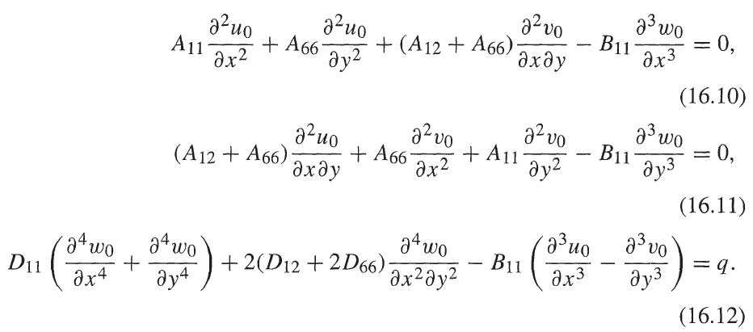
Governing equations-
CLT-Special cases-Antisymmetric cross-ply laminates
Since we have B matrix then the in-plane and out-of-plane displacements are coupled.
$A_{11}=A_{22}$ and $A_{16}=A_{26}=0$.
$D_{11}=D_{22}$ and $D_{16}=D_{26}=0$.
Equation for static problems
Notes:
Intro
This slide focuses on a special case of Classical Laminate Theory (CLT): the antisymmetric cross-ply laminate. In this configuration, the laminate stacking sequence alternates between $0^{∘}$and ${90}^{∘}$plies in a way that is antisymmetric about the mid-plane (for example, $\left[[0/90{\left.]\right.}_{a}\right.$). Unlike symmetric laminates, antisymmetric ones possess a non-zero $\left[B\right]$matrix, meaning bending and membrane responses are coupled.
Concept
In an antisymmetric cross-ply laminate:
The material axes of each ply alternate between $0^{∘}$and ${90}^{∘}$.
The geometric arrangement is such that the laminate is not symmetric about the mid-plane.
As a result, the $\left[B\right]$coupling matrix is non-zero, producing bending–membrane coupling.
In-plane loads can therefore produce bending or twisting, and bending loads can cause in-plane deformation — a key difference from symmetric laminates.
The simplified stiffness terms for this case are:
$$A_{11}=A_{22}, A_{16}=A_{26}=0$$
$$D_{11}=D_{22}, D_{16}=D_{26}=0$$
The $\left[B\right]$matrix, however, retains non-zero terms such as $B_{11}$, which cause coupling between $u_{0},v_{0},$and $w_{0}$.
Details
The static governing equations for an antisymmetric cross-ply laminate are:
$$A_{11}\frac{∂^{2}u_{0}}{∂x^{2}}+A_{66}\frac{∂^{2}u_{0}}{∂y^{2}}+\left(A_{12}+A_{66}\right)\frac{∂^{2}v_{0}}{∂x∂y}−B_{11}\frac{∂^{3}w_{0}}{∂x^{3}}=0$$
$$\left(A_{12}+A_{66}\right)\frac{∂^{2}u_{0}}{∂x∂y}+A_{66}\frac{∂^{2}v_{0}}{∂x^{2}}+A_{11}\frac{∂^{2}v_{0}}{∂y^{2}}−B_{11}\frac{∂^{3}w_{0}}{∂y^{3}}=0$$
$$D_{11}\left(\frac{∂^{4}w_{0}}{∂x^{4}}+\frac{∂^{4}w_{0}}{∂y^{4}}\right)+2\left(D_{12}+2D_{66}\right)\frac{∂^{4}w_{0}}{∂x^{2}∂y^{2}}−B_{11}\left(\frac{∂^{3}u_{0}}{∂x^{3}}−\frac{∂^{3}v_{0}}{∂y^{3}}\right)=q$$
Here:
$A_{ij}$: in-plane stiffness terms
$B_{ij}$: coupling stiffness terms (non-zero)
$D_{ij}$: bending stiffness terms
$q$: external transverse load per unit area
Because $\left[B\right]≠0$, bending and stretching cannot be treated independently, which makes these equations more complex to solve.
Key Takeaway
For antisymmetric cross-ply laminates, the non-zero $\left[B\right]$matrix introduces coupling between in-plane and out-of-plane displacements. This means:
In-plane loading can cause bending or twisting.
Bending loads can induce in-plane extension.
This coupling effect is critical in aerospace structures where cross-ply or angle-ply stacking is used to tailor stiffness and deformation behavior for improved load distribution and damage tolerance.

Slide 17
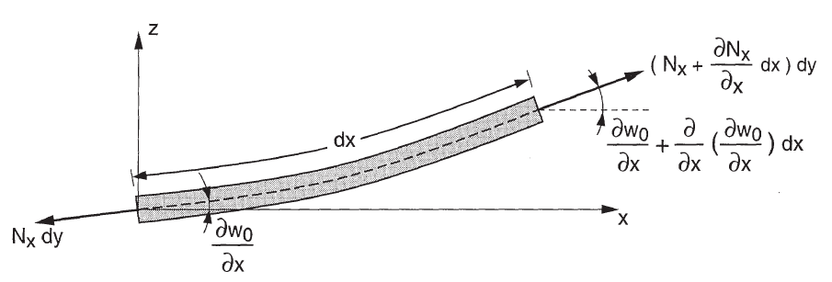
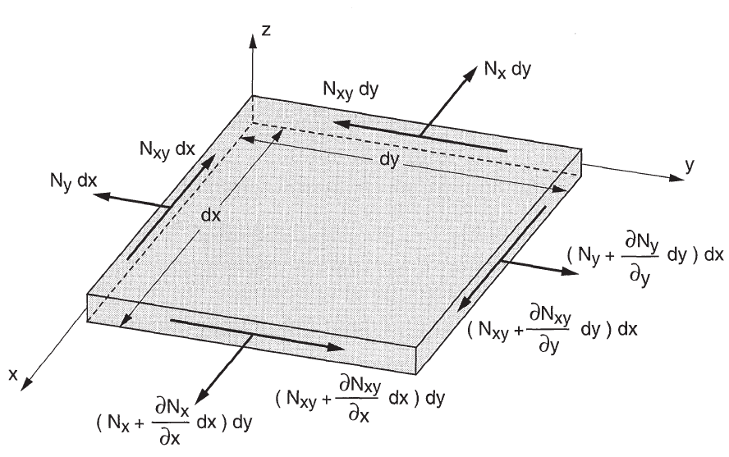
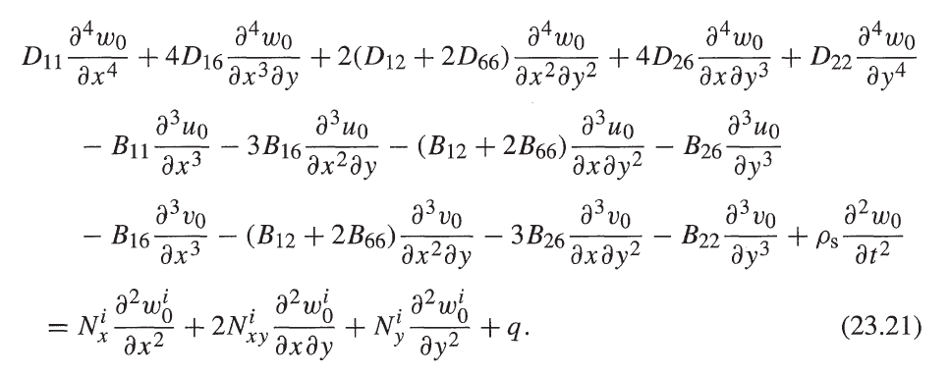
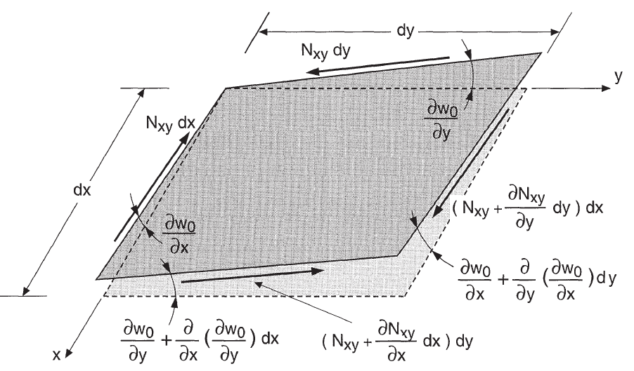
Buckling of rectangular composite plates
The governing equation for buckling given here is a very general equation and can be simplified for various problems and special cases.
Notes:
Intro
This slide introduces the general governing equation for buckling of rectangular composite plates. The equation is derived from Classical Laminate Theory (CLT) and represents the equilibrium between bending stiffness, in-plane loads, and transverse deformation. It forms the foundation for analyzing local and global buckling in thin composite panels under compressive or shear loading.
Concept
When a flat composite plate is loaded in compression or shear, it may reach a critical load where it suddenly deflects out of plane — this is buckling. The governing equation couples the laminate’s bending stiffness properties ($D_{ij}$), the in-plane forces ($N_{x},N_{y},N_{xy}$), and the transverse deflection $w_{0}$.
The general form of the buckling equation includes:
Bending stiffness terms $D_{11},D_{12},D_{16},D_{22},D_{26},D_{66}$
In-plane stress resultants $N_{x}^{i},N_{y}^{i},N_{xy}^{i}$
Coupling terms involving $B_{ij}$ (if the laminate is unsymmetric)
Transverse load $q$(if external pressure is applied)
Details
The full governing equation for buckling is:
$$D_{11}\frac{∂^{4}w_{0}}{∂x^{4}}+4D_{16}\frac{∂^{4}w_{0}}{∂x^{3}∂y}+2\left(D_{12}+2D_{66}\right)\frac{∂^{4}w_{0}}{∂x^{2}∂y^{2}}+4D_{26}\frac{∂^{4}w_{0}}{∂x∂y^{3}}+D_{22}\frac{∂^{4}w_{0}}{∂y^{4}}$$
$$−B_{11}\frac{∂^{3}u_{0}}{∂x^{3}}−3B_{16}\frac{∂^{3}u_{0}}{∂x^{2}∂y}−\left(B_{12}+2B_{66}\right)\frac{∂^{3}u_{0}}{∂x∂y^{2}}−B_{26}\frac{∂^{3}u_{0}}{∂y^{3}}−B_{16}\frac{∂^{3}v_{0}}{∂x^{3}}−\left(B_{12}+2B_{66}\right)\frac{∂^{3}v_{0}}{∂x^{2}∂y}−3B_{26}\frac{∂^{3}v_{0}}{∂x∂y^{2}}−B_{22}\frac{∂^{3}v_{0}}{∂y^{3}}$$
$$=N_{x}^{i}\frac{∂^{2}w_{0}^{i}}{∂x^{2}}+2N_{xy}^{i}\frac{∂^{2}w_{0}^{i}}{∂x∂y}+N_{y}^{i}\frac{∂^{2}w_{0}^{i}}{∂y^{2}}+q+ρ_{s}\frac{∂^{2}w_{0}}{∂t^{2}}$$
This equation balances internal bending resistance with external compressive forces and inertia.
The left-hand side represents the laminate’s bending response and coupling terms.
The right-hand side includes the work done by in-plane stresses (the “geometric stiffness” effect that drives buckling).
In static buckling problems, the inertia term $ρ_{s}\frac{∂^{2}w_{0}}{∂t^{2}}$ is omitted.
Key Takeaway
This general buckling equation is valid for any laminate configuration and can be simplified for specific cases:
Symmetric laminates: $\left[B\right]=0$, eliminating the coupling terms.
Orthotropic laminates: $A_{16}=A_{26}=D_{16}=D_{26}=0$, simplifying further.
Isotropic plates: reduces to the classical plate buckling equation
$$D∇^{4}w_{0}+N_{x}\frac{∂^{2}w_{0}}{∂x^{2}}+2N_{xy}\frac{∂^{2}w_{0}}{∂x∂y}+N_{y}\frac{∂^{2}w_{0}}{∂y^{2}}=0$$
This framework allows engineers to predict critical buckling loads and post-buckling behavior for aerospace-grade composite panels under varied boundary conditions and loading states.

Slide 18
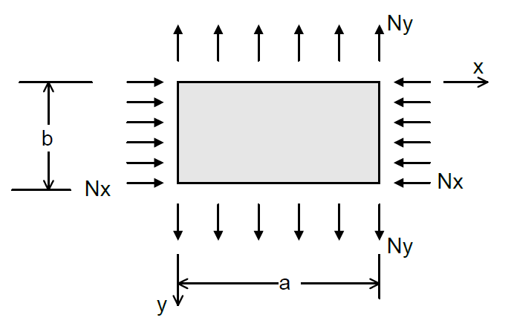
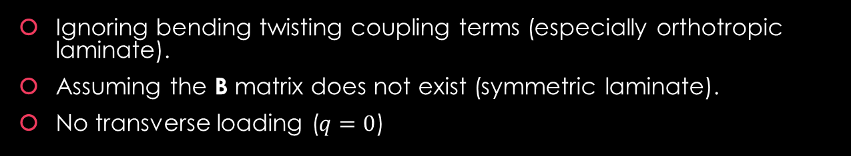
Buckling of rectangular composite plates-
Static biaxial loading of symmetric and especially orthotropic laminate
Ignoring bending twisting coupling terms (especially orthotropic laminate).
Assuming the B matrix does not exist (symmetric laminate).
No transverse loading ($q=0$)
Notes:
Intro
This slide presents the simplified governing equation for the buckling of symmetric or orthotropic composite plates under biaxial in-plane loading. It represents a static case where coupling terms and bending–twisting effects are neglected, giving the classical buckling equation commonly used for thin symmetric laminates such as [0/90]ₛ or [±45/0/90]ₛ panels.
Concept
When a composite laminate is symmetric, the coupling matrix $\left[B\right]$vanishes, eliminating in-plane–bending coupling. If the laminate is also orthotropic (principal material axes aligned with the plate axes), additional simplifications occur:
Twisting stiffness terms vanish: $D_{16}=D_{26}=0$
Only pure bending and coupling between $D_{11},D_{22},D_{12},D_{66}$remain
Under static biaxial loading (with compressive loads $N_{x}$and $N_{y}$), the governing equation for out-of-plane deflection $w_{0}\left(x , y\right)$simplifies to a two-dimensional plate buckling equation that balances bending stiffness against in-plane compressive forces.
Details
The simplified buckling equation for symmetric orthotropic laminates is:
$$D_{11}\frac{∂^{4}w_{0}}{∂x^{4}}+2\left(D_{12}+2D_{66}\right)\frac{∂^{4}w_{0}}{∂x^{2}∂y^{2}}+D_{22}\frac{∂^{4}w_{0}}{∂y^{4}}=N_{x}\frac{∂^{2}w_{0}}{∂x^{2}}+N_{y}\frac{∂^{2}w_{0}}{∂y^{2}}$$
Here:
$D_{11}$and $D_{22}$: bending stiffnesses along x and y directions
$D_{12}$: coupling stiffness between x- and y-bending
$D_{66}$: twisting stiffness of the laminate
$N_{x},N_{y}$: in-plane compressive loads per unit width
$w_{0}$: transverse deflection of the mid-plane
For orthotropic laminates, the axes of stiffness coincide with the geometric axes, ensuring $D_{16}=D_{26}=0$.
For isotropic materials, where $D_{11}=D_{22}=D$ and $D_{12}=D_{66}=νD$, the equation reduces to the classical isotropic buckling form:
$$D∇^{4}w_{0}=N_{x}\frac{∂^{2}w_{0}}{∂x^{2}}+N_{y}\frac{∂^{2}w_{0}}{∂y^{2}}$$
Key Takeaway
For symmetric and orthotropic composite laminates, the governing buckling equation becomes uncoupled and computationally manageable. It captures the essential relationship between bending stiffness and in-plane compression, serving as the baseline for evaluating critical buckling loads in aerospace panels and stiffened composite structures.
This simplification is the cornerstone of classical composite buckling analysis, from which analytical and finite element solutions are developed.

Slide 19
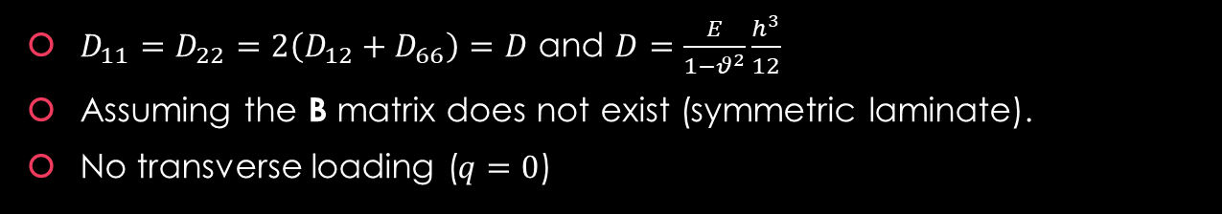

Buckling of rectangular composite plates-
Static biaxial and shear loading of symmetric and isotropic laminate
$D_{11}=D_{22}=2\left(D_{12}+D_{66}\right)=D$ and $D=\frac{E}{1−θ^{2}}\frac{h^{3}}{12}$
Assuming the B matrix does not exist (symmetric laminate).
No transverse loading ($q=0$)
$$N_{xy}$$
Notes:
Intro
This slide presents the classical buckling equation for a rectangular composite plate under biaxial compression and in-plane shear, simplified for the special case of a symmetric isotropic or quasi-isotropic laminate. It represents the final reduction of the general CLT buckling equation, valid when the laminate behaves isotropically (equal stiffness in all directions).
Concept
For symmetric isotropic laminates:
The coupling matrix $\left[B\right]$vanishes because the laminate is symmetric.
Bending stiffnesses are directionally equal, so $D_{11}=D_{22}=D$and the coupling between bending in x and y directions is balanced by $D_{12}=D_{66}$.
There is no external transverse loading ($q=0$).
Under these conditions, the plate behaves like a homogeneous isotropic sheet with effective stiffness $D$, and the governing buckling equation simplifies dramatically.
Details
Starting from the general orthotropic plate buckling form:
$$D_{11}\frac{∂^{4}w_{0}}{∂x^{4}}+2\left(D_{12}+2D_{66}\right)\frac{∂^{4}w_{0}}{∂x^{2}∂y^{2}}+D_{22}\frac{∂^{4}w_{0}}{∂y^{4}}=N_{x}\frac{∂^{2}w_{0}}{∂x^{2}}+2N_{xy}\frac{∂^{2}w_{0}}{∂x∂y}+N_{y}\frac{∂^{2}w_{0}}{∂y^{2}}$$
For isotropic behavior,
$$D_{11}=D_{22}=2\left(D_{12}+D_{66}\right)=D$$
and $D$ is the flexural rigidity of the equivalent plate:
$$D=\frac{Eh^{3}}{12\left(1−ν^{2}\right)}$$
Thus, the governing buckling equation becomes:
$$D\left(\frac{∂^{4}w_{0}}{∂x^{4}}+2\frac{∂^{4}w_{0}}{∂x^{2}∂y^{2}}+\frac{∂^{4}w_{0}}{∂y^{4}}\right)=N_{x}\frac{∂^{2}w_{0}}{∂x^{2}}+2N_{xy}\frac{∂^{2}w_{0}}{∂x∂y}+N_{y}\frac{∂^{2}w_{0}}{∂y^{2}}$$
Here:
$N_{x},N_{y}$: in-plane compressive loads per unit width.
$N_{xy}$: in-plane shear load per unit width.
$w_{0}\left(x , y\right)$: out-of-plane deflection.
This equation represents the balance between bending resistance (LHS) and membrane compression/shear (RHS) at the onset of buckling.
Key Takeaway
For a symmetric and isotropic laminate, the buckling behavior reduces to the same governing form as a homogeneous isotropic plate, with the flexural rigidity $D$modified to represent the equivalent stiffness of the laminate.
This classical form serves as the foundation for analytical buckling solutions of rectangular plates under:
Uniaxial compression ($N_{y}=N_{xy}=0)$
Biaxial compression ($N_{x},N_{y}≠0)$
Combined shear and compression ($N_{xy}≠0)$
It’s the most compact and widely used version of the composite buckling equation, especially for panels where the laminate lay-up behaves nearly isotropic, such as quasi-isotropic aerospace skins.

Slide 20
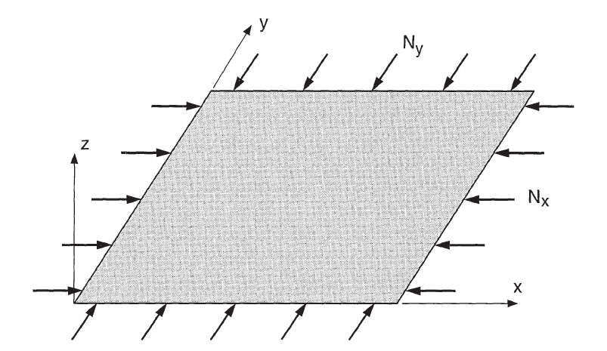
Example 1
Consider a rectangular plate simply supported along its four edges, made of an orthotropic laminate.
The laminate is under biaxial compressive loading.
Under the above conditions, find the critical buckling load of the laminate.
Notes:
Intro
This slide sets up a textbook CLT buckling problem: a simply supported rectangular plate made of an orthotropic laminate, loaded in biaxial compression. The goal is to extract a clean critical load expression mode by mode.
Concept
For simply supported edges, use a Navier shape for the out-of-plane deflection
$$w_{0}\left(x , y\right)=W \sin{ }\left(\frac{mπx}{a}\right)sin\left(\frac{nπy}{b}\right),$$
with integers $m,n≥1$. Substituting this into the symmetric-laminate buckling equation gives an algebraic relation between bending stiffnesses $\left(D_{ij}\right)$, in-plane loads $\left(N_{x} , N_{y}\right)$, and the plate wave numbers. Define
$$α=\frac{mπ}{a}, β=\frac{nπ}{b}.$$
Details
For a symmetric orthotropic laminate $\left(B_{ij}=0\right)$ under biaxial compression $\left(N_{x} , N_{y}\right)$ and no transverse load, the modal buckling relation is
$$D_{11}α^{4}+2 \left(D_{12}+2D_{66}\right)α^{2}β^{2}+D_{22}β^{4}=N_{x} α^{2}+N_{y} β^{2}.$$
It is often convenient to prescribe a load ratio $k=N_{y}/N_{x}$. Then the critical $N_{x}$for the $\left(m , n\right)$ mode is
$$N_{x,cr}^{\left(m , n\right)}=\frac{D_{11}α^{4}+2 \text{⁣}\left(D_{12}+2D_{66}\right)α^{2}β^{2}+D_{22}β^{4}}{α^{2}+k β^{2}}.$$
Symmetrically,
$$N_{y,cr}^{\left(m , n\right)}=\frac{D_{11}α^{4}+2 \text{⁣}\left(D_{12}+2D_{66}\right)α^{2}β^{2}+D_{22}β^{4}}{k^{−1}α^{2}+β^{2}}.$$
Useful special cases:
Uniaxial in x $\left(N_{y}=0\right)$
$$N_{x,cr}^{\left(m , n\right)}=D_{11}\frac{m^{2}π^{2}}{a^{2}}+2 \text{⁣}\left(D_{12}+2D_{66}\right)\frac{n^{2}π^{2}}{b^{2}}+D_{22}\frac{a^{2}n^{4}π^{2}}{m^{2}b^{4}}.$$
Uniaxial in y $\left(N_{x}=0\right)$
$$N_{y,cr}^{\left(m , n\right)}=D_{22}\frac{n^{2}π^{2}}{b^{2}}+2 \text{⁣}\left(D_{12}+2D_{66}\right)\frac{m^{2}π^{2}}{a^{2}}+D_{11}\frac{b^{2}m^{4}π^{2}}{n^{2}a^{4}}.$$
Isotropic equivalent $\left(D_{11}=D_{22}=2\left(D_{12}+D_{66}\right)=D\right)$reduces to
$$D{\left(α^{2}+β^{2}\right)}^{2}=N_{x} α^{2}+N_{y} β^{2}.$$
The governing critical load for the plate is the minimum over all admissible integer pairs $\left(m , n\right)$; for most aspect ratios $a/b$, the first mode is $\left(m , n\right)=\left(1 , 1\right)$.
Key Takeaway
Buckling of a simply supported orthotropic laminate under biaxial compression collapses to a tidy modal formula: stiffness terms $D_{ij}$on the left, membrane loads on the right. Pick a load ratio $k$, evaluate $N_{x,cr}^{\left(m , n\right)}$, and the smallest value across $\left(m , n\right)$gives the plate’s critical load.

Slide 21
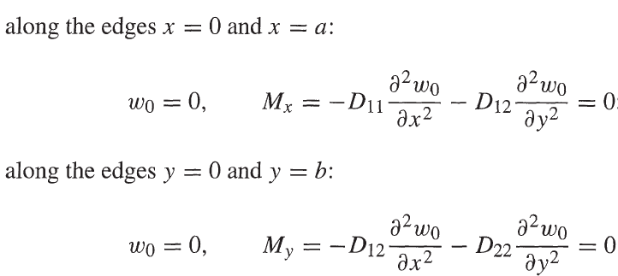
Solution-
Example 1
Boundary conditions are:
Notes:
Intro
This slide continues the solution for Example 1, showing how the governing buckling equation of a rectangular orthotropic laminate is applied together with the appropriate boundary conditions for a simply supported plate under biaxial compression. These conditions ensure that the edges remain straight and cannot lift off the supports, which is consistent with classical buckling theory assumptions.
Concept
The governing buckling equation for a symmetric orthotropic laminate under static biaxial compression is:
$$D_{11}\frac{∂^{4}w_{0}}{∂x^{4}}+2\left(D_{12}+2D_{66}\right)\frac{∂^{4}w_{0}}{∂x^{2}∂y^{2}}+D_{22}\frac{∂^{4}w_{0}}{∂y^{4}}=N_{x}\frac{∂^{2}w_{0}}{∂x^{2}}+N_{y}\frac{∂^{2}w_{0}}{∂y^{2}}$$
This equation relates the plate’s bending stiffness terms $D_{ij}$to the in-plane compressive loads $N_{x}$and $N_{y}$that induce instability.
To obtain analytical solutions, boundary conditions must reflect the simply supported edges, which permit rotation but not deflection or bending moment along each support.
Details
For a simply supported plate along all four edges ($x=0,a$ and $y=0,b$):
At $x=0$and $x=a$:
$$w_{0}=0, M_{x}=−D_{11}\frac{∂^{2}w_{0}}{∂x^{2}}−D_{12}\frac{∂^{2}w_{0}}{∂y^{2}}=0$$
At $y=0$and $y=b$:
$$w_{0}=0, M_{y}=−D_{22}\frac{∂^{2}w_{0}}{∂y^{2}}−D_{12}\frac{∂^{2}w_{0}}{∂x^{2}}=0$$
These boundary conditions correspond to:
Zero deflection ($w_{0}=0$) → edges remain in-plane.
Zero bending moment → edges are free to rotate (no built-in restraint).
Using these, the assumed deflection shape function satisfying the boundary conditions is:
$$w_{0}\left(x , y\right)=W\sin{ }\left(\frac{mπx}{a}\right)\sin{ }\left(\frac{nπy}{b}\right)$$
where $m$and $n$ represent the buckling mode numbers in the x and y directions, respectively.
Key Takeaway
For a simply supported orthotropic laminate, the edge conditions $w_{0}=0$and $M_{x}=M_{y}=0$allow clean analytical substitution into the governing buckling equation.
This leads directly to the critical buckling load expression—the next step in solving for $N_{x,cr}$and $N_{y,cr}$—which depends on the laminate’s bending stiffnesses $D_{ij}$, the plate aspect ratio $a/b$, and the mode numbers $\left(m , n\right)$.

Slide 22


Solution-
Example 1-Reminder of previous lectures
Notes:
Intro
This slide revisits a key concept from earlier lectures — the moment–curvature relationship in Classical Laminate Theory (CLT). It connects the bending moments in a symmetric laminate to the curvature of the mid-plane, reminding us that for symmetric laminates the coupling matrix $\left[B\right]$is zero, leading to a direct and simplified relationship between applied moments and plate curvature.
Concept
In the general CLT formulation, the force and moment resultants are related to mid-plane strains and curvatures as:
$$\left[\begin{matrix}N \\ M\end{matrix}\right]=\left[\begin{matrix}A & B \\ B & D\end{matrix}\right]\left[\begin{matrix}ε^{0} \\ κ\end{matrix}\right]$$
where:
$\left[A\right]$: extensional stiffness matrix
$\left[B\right]$: coupling stiffness matrix
$\left[D\right]$: bending stiffness matrix
For symmetric laminates, $\left[B\right]=0$. This eliminates membrane–bending coupling, allowing bending moments to depend only on curvature terms.
Details
From the simplified bending relation:
$$\left[\begin{matrix}M_{x} \\ M_{y} \\ M_{xy}\end{matrix}\right]=\left[\begin{matrix}D_{11} & D_{12} & D_{16} \\ D_{12} & D_{22} & D_{26} \\ D_{16} & D_{26} & D_{66}\end{matrix}\right]\left[\begin{matrix}κ_{x} \\ κ_{y} \\ κ_{xy}\end{matrix}\right]$$
For orthotropic laminates where $D_{16}=D_{26}=0$, the relationships reduce to:
$$M_{x}=D_{11}κ_{x}+D_{12}κ_{y}$$
$$M_{y}=D_{12}κ_{x}+D_{22}κ_{y}$$
Using curvature definitions ($κ_{x}=\frac{∂^{2}w_{0}}{∂x^{2}}$, $κ_{y}=\frac{∂^{2}w_{0}}{∂y^{2}}$), we obtain the practical working form:
$$M_{x}=D_{11}\frac{∂^{2}w_{0}}{∂x^{2}}+D_{12}\frac{∂^{2}w_{0}}{∂y^{2}}$$
$$M_{y}=D_{12}\frac{∂^{2}w_{0}}{∂x^{2}}+D_{22}\frac{∂^{2}w_{0}}{∂y^{2}}$$
These equations express how bending moments vary directly with the curvature of the laminate — the essential link between plate deformation and internal moment resultants.
Key Takeaway
In symmetric laminates, the absence of the $\left[B\right]$-matrix makes analysis elegantly simple: bending moments are linearly related to plate curvatures through the $\left[D\right]$-matrix. This is the foundation for analyzing deflection, stiffness, and buckling of composite plates — and the starting point for deriving the full buckling equations used in the next slides.

Slide 23


Solution-
Example 1
Now we need to assume a deformed shape that fits into the equation and meets the boundary conditions.
For simple problems, we know the deformed shape but for complicated ones we need to assume a deformed shape, so the solution becomes approximate.
Plug in the deformed shape into equation
R = a / b
Notes:
Intro
This slide shows how the assumed buckling mode shape is substituted into the governing differential equation to obtain the critical buckling condition. This is a classic analytical approach in plate buckling analysis — using an assumed deflection function that satisfies the boundary conditions to simplify a complex partial differential equation into an algebraic relation between load and stiffness.
Concept
The key idea is to assume a deflected shape $w_{0}\left(x , y\right)$ that satisfies the boundary conditions of a simply supported plate.
The simplest form that meets these conditions is:
$$w_{0}\left(x , y\right)=A_{mn}\sin\left(\frac{mπx}{a}\right)\sin\left(\frac{nπy}{b}\right)$$
where:
$A_{mn}$ is the amplitude of the $\left(m , n\right)$ buckling mode,
$m,n$ are mode numbers (integers),
$a,b$ are the plate dimensions.
This function automatically satisfies $w_{0}=0$at $x=0, a$ and $y=0,b$.
Details
Substituting this assumed $w_{0}\left(x , y\right)$ into the orthotropic buckling equation:
$$D_{11}\frac{∂^{4}w_{0}}{∂x^{4}}+2\left(D_{12}+2D_{66}\right)\frac{∂^{4}w_{0}}{∂x^{2}∂y^{2}}+D_{22}\frac{∂^{4}w_{0}}{∂y^{4}}=N_{x}\frac{∂^{2}w_{0}}{∂x^{2}}+N_{y}\frac{∂^{2}w_{0}}{∂y^{2}}$$
yields, after differentiation and simplification:
$$π^{2}A_{mn}\left[D_{11}m^{4}+2\left(D_{12}+2D_{66}\right)m^{2}n^{2}R^{2}+D_{22}n^{4}R^{4}\right]=−A_{mn}\left(N_{x}m^{2}+N_{y}n^{2}R^{2}\right)a^{2}$$
where $R=\frac{a}{b}$ is the aspect ratio.
Dividing through by $−A_{mn}a^{2}$ gives the critical buckling condition:
$$N_{x}m^{2}+N_{y}n^{2}R^{2}=\frac{π^{2}}{a^{2}}\left[D_{11}m^{4}+2\left(D_{12}+2D_{66}\right)m^{2}n^{2}R^{2}+D_{22}n^{4}R^{4}\right]$$
This equation defines all possible buckling modes $\left(m , n\right)$, and the lowest value of $N_{x}$ or $N_{y}$** marks the first buckling mode**.
Key Takeaway
By assuming a mathematically convenient deflection shape, the complex plate buckling PDE collapses into a simple algebraic equation.
The resulting expression directly connects stiffness terms $D_{ij}$, plate geometry $a/b$, and buckling loads $N_{x},N_{y}$— forming the foundation for calculating critical biaxial buckling loads of orthotropic and isotropic laminates.

Slide 24





Solution-
-Example 1-Uniform compression
$$m=4, n=1$$
$$m=8, n=1$$
The critical buckling load corresponds to the values of m and n (number of half-wavelength in x and y directions, respectively) leading to the
lowest values of N_{o}.
Notes:
Intro
This slide finalises the derivation of the critical buckling load for an orthotropic laminate plate under uniform biaxial compression. It introduces the load parameters and shows how the governing buckling relation simplifies to give a compact expression for $N_{0}$, the reference buckling load per unit width.
Concept
When a rectangular composite plate is compressed along both $x$- and $y$-directions, the in-plane stress resultants are expressed as:
$$N_{x}=−N_{0}, N_{y}=−αN_{0}$$
Here:
$N_{0}$ is the reference compressive load in the $x$-direction.
$α$ represents the load ratio between the $y$- and $x$-directions (for example, $α=1$ for equibiaxial compression, $α=0$ for uniaxial compression).
Substituting these into the orthotropic buckling equation allows expressing the load directly in terms of geometric and stiffness parameters.
Details
Starting from the general buckling condition:
$$N_{x}m^{2}+N_{y}n^{2}R^{2}=−\frac{π^{2}}{a^{2}}\left[D_{11}m^{4}+2\left(D_{12}+2D_{66}\right)m^{2}n^{2}R^{2}+D_{22}n^{4}R^{4}\right]$$
and substituting $N_{x}=−N_{0}$ and $N_{y}=−αN_{0}$, we get:
$$N_{0}\left(m^{2}+αn^{2}R^{2}\right)=\frac{π^{2}}{a^{2}}\left[D_{11}m^{4}+2\left(D_{12}+2D_{66}\right)m^{2}n^{2}R^{2}+D_{22}n^{4}R^{4}\right]$$
Rearranging yields the critical buckling load per unit width:
$$N_{0}=\frac{π^{2}\left[D_{11}m^{4}+2\left(D_{12}+2D_{66}\right)m^{2}n^{2}R^{2}+D_{22}n^{4}R^{4}\right]}{a^{2}\left(m^{2}+αn^{2}R^{2}\right)}$$
where $R=\frac{a}{b}$ is the aspect ratio.
The actual buckling mode corresponds to the smallest $N_{0}$ obtained by varying integers $m,n$ (the number of half-waves in the $x$- and $y$-directions).
Key Takeaway
The critical buckling load $N_{0}$ depends on:
The bending stiffness matrix components ($D_{11},D_{22},D_{12},D_{66}$)
The geometry ($a/b$ ratio and mode numbers $m,n$)
The loading ratio $α$
For typical orthotropic laminates, buckling tends to occur for low $m,n$ combinations (such as $m=1,n=1$), but as stiffness anisotropy or aspect ratio increases, higher modes ($m>1$) may dominate, as illustrated by the deformation plots showing modes $m=4,n=1$ and $m=8,n=1$.

Slide 25

Example 2
In the previous example, consider the situation of uniaxial compression ($N_{y}=0$).
Notes:
Intro
This slide introduces Example 2, which simplifies the previous biaxial case into uniaxial compression — a common loading scenario in composite panels such as stiffened skins or wing covers. The goal is to determine the critical buckling load when compression acts only along one direction, typically the longitudinal $x$-axis.
Concept
In the biaxial buckling problem, the in-plane stresses were $N_{x}$and $N_{y}$, where $N_{y}$could take any ratio to $N_{x}$ depending on the load case.
For uniaxial compression, however:
$$N_{y}=0$$
meaning the load is applied only in the $x$-direction.
This assumption simplifies the governing buckling equation, eliminating all terms involving $N_{y}$. The analysis then focuses solely on how the compressive load $N_{x}$ interacts with the laminate’s flexural stiffness terms $D_{11},D_{12},D_{22},D_{66}$.
Details
Under uniaxial loading, the general buckling condition derived earlier reduces from:
$$N_{x}m^{2}+N_{y}n^{2}R^{2}=\frac{π^{2}}{a^{2}}\left[D_{11}m^{4}+2\left(D_{12}+2D_{66}\right)m^{2}n^{2}R^{2}+D_{22}n^{4}R^{4}\right]$$
to
$$N_{x}=\frac{π^{2}}{a^{2}m^{2}}\left[D_{11}m^{4}+2\left(D_{12}+2D_{66}\right)m^{2}n^{2}R^{2}+D_{22}n^{4}R^{4}\right]$$
where $R=a/b$ and $m,n$ are the half-wave numbers in the $x$- and $y$-directions.
The critical buckling load corresponds to the smallest value of $N_{x}$ as $m,n$vary — usually $m=1$ and $n>1$ for long, narrow panels.
Key Takeaway
By setting $N_{y}=0$, the buckling analysis becomes simpler but still captures how anisotropy influences stability. Orthotropic laminates may buckle in non-intuitive patterns, as coupling terms like $D_{12}$and $D_{66}$redistribute bending stiffness between directions.
This uniaxial case forms the baseline for comparing how additional in-plane shear or biaxial effects modify the buckling strength in more advanced examples.

Slide 26





Solution-
Example 2
Width
Length
$α=0$
For any $m$, $n=1$ gives the smallest $N_{0}$
$n=1$ means only one half-wavelength in the $y$ direction
Buckling load is dependent on plate aspect ratio $R=Length/Width$
Buckling load is dependent on the number of half wavelength $m$ in the loading direction $x$
Notes:
Intro
This slide completes the solution for Example 2, showing how the general buckling equation simplifies for a uniaxial compression case. By setting $α=0$, only the compressive load in the $x$-direction remains, which makes the relationship between the laminate stiffness terms and the critical buckling load much clearer.
Concept
Starting from the general biaxial expression:
$$N_{0}=\frac{π^{2}\left[D_{11}m^{4}+2\left(D_{12}+2D_{66}\right)m^{2}n^{2}R^{2}+D_{22}n^{4}R^{4}\right]}{a^{2}\left(m^{2}+αn^{2}R^{2}\right)}$$
we let $α=0$ for uniaxial compression, which gives:
$$N_{0}=\frac{π^{2}}{m^{2}a^{2}}\left[D_{11}m^{4}+2\left(D_{12}+2D_{66}\right)m^{2}n^{2}R^{2}+D_{22}n^{4}R^{4}\right]$$
Here:
$R=\frac{a}{b}$ is the aspect ratio (length / width).
$m,n$ are integers representing the number of half-waves in $x$and $y$directions.
$D_{ij}$ are elements of the laminate bending stiffness matrix.
Details
For any mode number $m$, the lowest buckling load $N_{0}$ occurs when $n=1$, corresponding to a single half-wavelength in the $y$-direction.
Thus, the critical buckling load simplifies further to:
$$N_{0}=\frac{π^{2}}{m^{2}a^{2}}\left[D_{11}m^{4}+2\left(D_{12}+2D_{66}\right)m^{2}R^{2}+D_{22}R^{4}\right]$$
This expression shows that:
Increasing the plate’s aspect ratio $R$ (making it longer or narrower) changes the relative influence of $D_{22}$ and $D_{66}$.
Increasing $m$ (more half-waves along the load direction) raises the buckling load, but only up to the point where bending stiffness dominates over geometry effects.
Key Takeaway
For uniaxial compression of orthotropic laminates:
Buckling is controlled primarily by $D_{11}$, $D_{12}$, $D_{22}$, and $D_{66}$.
The aspect ratio $R=\text{Length}\text{/}\text{Width}$ strongly affects the shape and value of the first buckling mode.
The lowest buckling load typically occurs for $n=1$ and small $m$, corresponding to a long-wave buckle spanning the width — a pattern commonly observed in aerospace skin panels under axial compression.

Slide 27




Solution-
Example 2
This figure is provided for a plate of length $508 mm$.
As the aspect ratio increases, the number of half-waves $m$ in the direction of the load increases.
For each $m$, there is a value of $R$ that minimises the buckling load (see yellow highlighted circles).
Intersection points of curves for successive $m$ values indicate the plate may buckle in two modes (differing by one half-wave) with the same buckling load.
In practice, due to eccentricities and fabrication flaws, these cusps cannot be reproduced. The plate will buckle in one of the two modes and will not switch to the other.
For a quasi-isotropic laminate
$$t=0.5715 mm$$
Notes:
Intro
This slide presents the numerical illustration of the uniaxial buckling solution, showing how the critical buckling load $N_{x,crit}$ varies with the aspect ratio $R=\text{Length}\text{/}\text{Width}$ for a given laminate. The plot reveals how the number of half-waves $m$ in the loading direction changes as the plate geometry becomes more elongated.
Concept
The figure shows results based on the analytical buckling relation:
$$N_{0}=\frac{π^{2}}{m^{2}a^{2}}\left[D_{11}m^{4}+2\left(D_{12}+2D_{66}\right)m^{2}R^{2}+D_{22}R^{4}\right]$$
for a quasi-isotropic laminate with
$$t=0.5715 \text{mm}, \left[±45/0/90/0/±45\right], D_{11}=D_{22}=0.66 \text{Nm}, D_{12}=0.47 \text{Nm}, D_{66}=0.49 \text{Nm}.$$
The plate length is fixed at 508 mm, while the width varies to produce different aspect ratios $R=a/b$.
Details
Trend: As the aspect ratio $R$ increases (the plate becomes longer and narrower), the number of half-waves $m$ in the buckling pattern increases.
Mode transitions: Each curve represents a specific $m$-value. The yellow circles highlight points where $N_{x,crit}$ reaches a minimum for that mode — the most likely buckling shape for that geometry.
Mode intersection: When two curves intersect (cusps), it means two buckling modes (e.g. $m=1$ and $m=2$) produce the same critical load.
Practical note: Real plates have imperfections, residual stresses, and small geometric deviations. Therefore, at these intersections, the plate will choose one mode to buckle in — it will not switch between them during loading.
Key Takeaway
The critical buckling load depends strongly on the aspect ratio and the mode shape (m).
Each aspect ratio has a preferred buckling mode that minimizes $N_{0}$.
Cusps in the theoretical plot mark transitions between buckling modes — but in practice, fabrication imperfections lock the plate into one mode.
This relationship between geometry and mode shape is fundamental for designing stiffened composite panels, where the plate’s length/width ratio is tuned to control buckling patterns and ensure stable post-buckling behaviour.

Slide 28
Example 3
Compare the buckling load of example 2 with that of a laminate made of aluminum material.
The geometry, loading and boundary conditions stay the same as Example 2.

Slide 29


Solution-
Example 3
For aluminum as an isotropic material, the equations obtained do not change.
Only D matrix needs to be calculated as of previous slides (see snapshot opposite)
It is evident using aluminum of the same thickness will lead to stiffer plate ($1.22 N.m$ compared to $0.66 N.m$).
Notes:
Intro
These slides set up and solve a like-for-like buckling comparison between the Example 3 composite plate and an aluminum plate with the same geometry, supports, and loading. The trick is to compare fairly: first match buckling performance, then compare weight.
Concept
For an isotropic plate such as aluminum, the laminate bending stiffness collapses to one parameter
$D_{11}=D_{22}=2\left(D_{12}+D_{66}\right)=D=\frac{E h^{3}}{12\left(1−ν^{2}\right)}$.
If thickness $h$ is kept the same for both plates, aluminum usually has a higher $D$ than a thin quasi-isotropic composite of the same thickness, so its buckling load comes out higher. To compare materials fairly, we adjust composite thickness so that the two plates have the same critical buckling load, then we compare mass.
Details
With the same $a,b$ and simply supported edges, the orthotropic buckling equation from Example 3 applies. For quasi-isotropic laminates it reduces to the isotropic form with an effective $D_{\text{QI}}$.
Using $D=\frac{Eh^{3}}{12\left(1−ν^{2}\right)}$ for aluminum with the given $E,ν,h$ gives $D_{\text{Al}}≈1.22 \text{N}\text{.}\text{m}$ in the slide, which is about twice the composite example value $D_{\text{QI}}≈0.66 \text{N}\text{.}\text{m}$. With equal thickness this makes aluminum’s critical buckling load about 20 percent higher over the plotted aspect-ratio range.
To equalize buckling performance, we scale thickness. For plates in compression $N_{\text{cr}}∝D∝h^{3}$. Matching a 20 percent shortfall requires scaling composite thickness by the one-third power rule:
$h_{\text{new}}=h_{\text{old}} \left(1.2{\left.)\right.}^{1/3}≈1.063 h_{\text{old}}\right.$.
Weight comparison for equal buckling load then uses the density ratio times the thickness ratio. With a typical density ratio $ρ_{\text{GFRP}}/ρ_{\text{Al}}≈0.58$ and the thickness factor $1.063$, the mass ratio becomes
$\frac{W_{\text{GFRP}}}{W_{\text{Al}}}≈0.58×1.063≈0.616$.
So, the quasi-isotropic composite plate that matches aluminum’s buckling load is roughly 38 percent lighter.
Key Takeaway
Equal-thickness comparisons can be misleading. Match the structural task first by scaling thickness using the one-third power rule $N_{\text{cr}}∝h^{3},$ then compare mass. For this case, a quasi-isotropic composite plate achieving the same buckling load as aluminum is about one-third lighter, noting real-world caveats: stacking-sequence choices, environmental knockdowns, and damage tolerance can all erode that advantage.

Slide 30



Solution-
Example 3
A quasi-isotropic composite with the same buckling load is 38% lighter than aluminum.
We assumed any thickness is achievable by composites which is not necessarily correct.
Environmental effects in composites (hot, cold and moisture) will reduce this weight saving.
Sensitivity to damage (delamination, matrix cracking etc) will affect the weight saving.
Design rule over stacking sequence will affect the weight saving.
Buckling load of aluminum with the same thickness as quasi-isotropic plate is 20% higher.
Was it not that GFRP was supposed to be better? What happened here?
We need to match the buckling load of aluminum and GFRP and then compare the weight.
For this, we need to use one-third power rule.
To increase GFRP buckling load, we need to increase its thickness by ${(1.2)}^{1/3}=1.063$.
Now compare the weight of CFRP and aluminum that have the same buckling load.
Notes:
Intro
These slides set up and solve a like-for-like buckling comparison between the Example 3 composite plate and an aluminum plate with the same geometry, supports, and loading. The trick is to compare fairly: first match buckling performance, then compare weight.
Concept
For an isotropic plate such as aluminum, the laminate bending stiffness collapses to one parameter
$D_{11}=D_{22}=2\left(D_{12}+D_{66}\right)=D=\frac{E h^{3}}{12\left(1−ν^{2}\right)}$.
If thickness $h$ is kept the same for both plates, aluminum usually has a higher $D$ than a thin quasi-isotropic composite of the same thickness, so its buckling load comes out higher. To compare materials fairly, we adjust composite thickness so that the two plates have the same critical buckling load, then we compare mass.
Details
With the same $a,b$ and simply supported edges, the orthotropic buckling equation from Example 3 applies. For quasi-isotropic laminates it reduces to the isotropic form with an effective $D_{\text{QI}}$.
Using $D=\frac{Eh^{3}}{12\left(1−ν^{2}\right)}$ for aluminum with the given $E,ν,h$ gives $D_{\text{Al}}≈1.22 \text{N}\text{.}\text{m}$ in the slide, which is about twice the composite example value $D_{\text{QI}}≈0.66 \text{N}\text{.}\text{m}$. With equal thickness this makes aluminum’s critical buckling load about 20 percent higher over the plotted aspect-ratio range.
To equalize buckling performance, we scale thickness. For plates in compression $N_{\text{cr}}∝D∝h^{3}$. Matching a 20 percent shortfall requires scaling composite thickness by the one-third power rule:
$h_{\text{new}}=h_{\text{old}} \left(1.2{\left.)\right.}^{1/3}≈1.063 h_{\text{old}}\right.$.
Weight comparison for equal buckling load then uses the density ratio times the thickness ratio. With a typical density ratio $ρ_{\text{GFRP}}/ρ_{\text{Al}}≈0.58$ and the thickness factor $1.063$, the mass ratio becomes
$\frac{W_{\text{GFRP}}}{W_{\text{Al}}}≈0.58×1.063≈0.616$.
So, the quasi-isotropic composite plate that matches aluminum’s buckling load is roughly 38 percent lighter.
Key Takeaway
Equal-thickness comparisons can be misleading. Match the structural task first by scaling thickness using the one-third power rule $N_{\text{cr}}∝h^{3},$ then compare mass. For this case, a quasi-isotropic composite plate achieving the same buckling load as aluminum is about one-third lighter, noting real-world caveats: stacking-sequence choices, environmental knockdowns, and damage tolerance can all erode that advantage.

Slide 31

Example 4
Consider a rectangular composite plate simply supported on three edges and free at the other.
The applied force is uniaxial compression.
Find the critical buckling load.

Slide 32




Solution-
Example 4
We need to assume a deflected shape that meets the Boundary Conditions (BCs) subject to the governing equation.
$λ$ is a parameter appropriately selected to meet the BC
BCs
$λ$ must be chosen so that $w (x,y=b)=0$

Slide 33


Solution-
Example 4-Clarification
The figure shows the deflected shape along the $y$ axis for various values of parameter $λ$.
$λ=1$ is for the case of both end being simply supported:
  $w(x,y=0)=w(x,y=b)=0$
$λ≈0.5$ seems to be giving reasonable representation but the slope at the free end ($y=b$) becomes zero which is not correct.
Also, this assumption leads to $M_{y}=0$ which yet again is not necessarily valid.
Therefore, the accuracy of your solution heavily depends on the accuracy of the assumed deformed shape. Hence, solutions are approximate.
Notes:
Intro
This example tackles buckling of a rectangular laminate that is simply supported on three edges and free on the fourth, under uniaxial compression. The twist is the free edge: it breaks the neat symmetry and forces us to use an assumed shape with a tuning parameter to satisfy the boundary conditions as best as we can.
Concept
Boundary conditions: $w=0$ on the three simply supported edges; along the simply supported edges the bending moments vanish $\left(M_{x}=0\right.$ on $x=0,a$; $M_{y}=0$ on $\left.y=0\right)$. At the free edge $y=b$ the exact conditions are $M_{y}=0$ and $Q_{y}=0$( zero bending moment and zero transverse shear).
Assumed shape:
$$w\left(x , y\right)=\sum_{m,n}{A_{mn}} \sin{(\frac{mπx}{a}) }\sin{(λ \frac{nπy}{b}),}$$
where $λ$ is a tuning parameter chosen to better honour the free–edge behaviour while keeping the simply supported edges exact.
Details
Substitute the assumed $w\left(x , y\right)$ into the orthotropic plate buckling equation for a symmetric laminate under uniaxial compression $N_{x}$:
$$D_{11}\frac{∂^{4}w}{∂x^{4}}+2 \left(D_{12}+2D_{66}\right)\frac{∂^{4}w}{∂x^{2}∂y^{2}}+D_{22}\frac{∂^{4}w}{∂y^{4}}=N_{x}\frac{∂^{2}w}{∂x^{2}}.$$
Enforce the simply supported conditions exactly and pick $λ$ to best represent the free edge $y=b$. Typical choices you explored: $λ=1$ (too stiff at the free edge), $λ≈\frac{1}{2}$, and $λ=\frac{5}{12}$. Note: $λ=\frac{1}{2}$ sets the slope at the free edge to zero, which is not strictly correct; $λ=\frac{5}{12}$ often gives a more realistic curvature near the free edge.
With $R=a/b$ and mode number $m$ in the loading direction, the resulting approximate critical load per unit width is
$$N_{0,\text{approx}}=\frac{π^{2}}{a^{2}}[D_{11}m^{2}+2 \left(D_{12}+2D_{66}\right)λ^{2}R^{2}+D_{22} \frac{R^{4}}{m^{2}}λ^{4}].$$
Accuracy check: for very long plates $\left(R→∞\right)$ the exact result tends to
$$N_{0,\text{exact}} → \frac{12D_{66}}{b^{2}},$$
while the approximate expression tends to a $λ$–dependent value (e.g. with $λ=\frac{1}{2}$ the error is about 12.5% in the long–plate limit; with $λ=\frac{5}{12}$ it is about 46.9%). Moral of the story: the assumed shape matters.
Key Takeaway
Buckling of an SS–SS–SS–free plate cannot be captured perfectly with a single sine product; the free edge requires a tuned shape. The $λ$ parameter is a pragmatic hack that yields useful engineering estimates, but different choices shift the answer. Use the approximate formula for quick sizing, validate against the exact long–plate limit $12D_{66}/b^{2}$, and lean on numerical eigenvalue tools when precision is critical.

Slide 34





Solution-
Example 4
Unfortunately, in any cases we do not have the exact solution and must resort to the approximate one.
VICONOPT is a software that provides very precise eigenvalue calculations.
Note that we know the exact solution to this problem is:
We now compare the approximate solution (resulting from an approximate assumed deflected shape) with the exact one.
For infinitely long plate and $λ=5/12$ see the opposite (12.5% difference).
For infinitely long plate and $λ=1/2$ see the opposite (46.9% difference).
Exact solution
(R)
Approximate solution
Notes:
Intro
This example tackles buckling of a rectangular laminate that is simply supported on three edges and free on the fourth, under uniaxial compression. The twist is the free edge: it breaks the neat symmetry and forces us to use an assumed shape with a tuning parameter to satisfy the boundary conditions as best as we can.
Concept
Boundary conditions: $w=0$ on the three simply supported edges; along the simply supported edges the bending moments vanish $\left(M_{x}=0\right.$ on $x=0,a$; $M_{y}=0$ on $\left.y=0\right)$. At the free edge $y=b$ the exact conditions are $M_{y}=0$ and $Q_{y}=0$( zero bending moment and zero transverse shear).
Assumed shape:
$$w\left(x , y\right)=\sum_{m,n}{A_{mn}} \sin{(\frac{mπx}{a}) }\sin{(λ \frac{nπy}{b}),}$$
where $λ$ is a tuning parameter chosen to better honour the free–edge behaviour while keeping the simply supported edges exact.
Details
Substitute the assumed $w\left(x , y\right)$ into the orthotropic plate buckling equation for a symmetric laminate under uniaxial compression $N_{x}$:
$$D_{11}\frac{∂^{4}w}{∂x^{4}}+2 \left(D_{12}+2D_{66}\right)\frac{∂^{4}w}{∂x^{2}∂y^{2}}+D_{22}\frac{∂^{4}w}{∂y^{4}}=N_{x}\frac{∂^{2}w}{∂x^{2}}.$$
Enforce the simply supported conditions exactly and pick $λ$ to best represent the free edge $y=b$. Typical choices you explored: $λ=1$ (too stiff at the free edge), $λ≈\frac{1}{2}$, and $λ=\frac{5}{12}$. Note: $λ=\frac{1}{2}$ sets the slope at the free edge to zero, which is not strictly correct; $λ=\frac{5}{12}$ often gives a more realistic curvature near the free edge.
With $R=a/b$ and mode number $m$ in the loading direction, the resulting approximate critical load per unit width is
$$N_{0,\text{approx}}=\frac{π^{2}}{a^{2}}[D_{11}m^{2}+2 \left(D_{12}+2D_{66}\right)λ^{2}R^{2}+D_{22} \frac{R^{4}}{m^{2}}λ^{4}].$$
Accuracy check: for very long plates $\left(R→∞\right)$ the exact result tends to
$$N_{0,\text{exact}} → \frac{12D_{66}}{b^{2}},$$
while the approximate expression tends to a $λ$–dependent value (e.g. with $λ=\frac{1}{2}$ the error is about 12.5% in the long–plate limit; with $λ=\frac{5}{12}$ it is about 46.9%). Moral of the story: the assumed shape matters.
Key Takeaway
Buckling of an SS–SS–SS–free plate cannot be captured perfectly with a single sine product; the free edge requires a tuned shape. The $λ$ parameter is a pragmatic hack that yields useful engineering estimates, but different choices shift the answer. Use the approximate formula for quick sizing, validate against the exact long–plate limit $12D_{66}/b^{2}$, and lean on numerical eigenvalue tools when precision is critical.

Slide 35


Note
Read the following papers to become familiar with VICONOPT and the exact stiffness analysis methodology.

Slide 36

Example 5
Consider the rectangular composite plate.
Assume the lay-up is symmetric.
Assume there is negligible bending-twisting coupling.
Assume the plate is simply supported on all four edges.
Obtain the critical buckling load.
Notes:
Intro
This slide explains how a laminate plate under in-plane shear (that’s when you try to “slide” the top of the plate sideways while the bottom is fixed) starts to buckle. We’re looking at a simply supported plate, so all edges can rotate freely but cannot move up or down.
Concept
When shear load $N_{xy}$ increases, the flat plate first stays stable. After a certain point — the critical shear load — the plate suddenly deflects out of plane into a diagonal wave pattern.
The plate bends because the bending stiffness terms ($D_{11},D_{22},D_{12},D_{66})$ resist curvature in different directions.
Buckling happens when the work done by the shear load equals the bending energy stored in the plate.
We find that “balance point” by assuming a shape for the buckled plate and using math to link the stiffness and the load.
Details
We assume the plate’s deflection looks like a wavy surface:
$$w\left(x , y\right)=A\sin\left(\frac{mπx}{a}\right)\sin\left(\frac{nπy}{b}\right)$$
That shape automatically satisfies the boundary conditions (edges can rotate but not lift).
We substitute that shape into the governing equation for a composite plate:
$$D_{11}w_{,xxxx}+2\left(D_{12}+2D_{66}\right)w_{,xxyy}+D_{22}w_{,yyyy}=2N_{xy}w_{,xy}$$
Don’t panic at the symbols — they just mean “how much the plate bends in each direction.”
This gives us a relationship between bending stiffness (the $D$’s), geometry ($a/b$, the aspect ratio), and the critical shear load $N_{xy,cr}$.
The smallest value of $N_{xy}$ that satisfies the equation is when buckling starts.
The buckled shape looks like diagonal ripples across the plate — one corner lifts while the opposite one drops — because shear makes the plate twist.
Key Takeaway
The plate’s ability to resist shear buckling depends on its bending stiffness (the $D$-matrix) and aspect ratio $a/b$.
Adding more ±45° plies increases $D_{66}$, which means better shear stiffness and higher buckling load.
The first buckling mode is usually a single diagonal wave across the plate.
In simple terms:
A shear-loaded laminate plate stays flat until the sideways load becomes too large. Then it “pops” into a wavy shape. The exact load where that happens depends on how stiff the laminate is in bending and how long and wide the plate is. Buckling doesn’t mean failure — it’s just the point where the plate changes shape to carry load differently.

Slide 37


Solution-
Example 5
0
0
0
B matrix iz zero because of symmetric lay-up ($B=0$).
Negligible bending-twisting coupling $D_{16}=D_{26}=0$.
Let’s find out the suitable governing equation.

Slide 38

Solution-
Example 5
0
0
0
Integrate over the entire domain of the plate $0≤x≤a$ and $0≤y≤b$
Notes:
Intro
We already have the governing buckling equation for the plate, but it’s too complex to solve directly.
To make progress, we assume what the buckled shape looks like — a sine wave that fits perfectly between the supported edges.
Concept
The deflected shape $w\left(x , y\right)$ is written as a sum of sine functions.
Each sine term represents one possible buckling pattern (or “mode”).
This shape automatically satisfies the simply supported boundary conditions, because sine is zero at the edges.
We substitute this assumed shape into the buckling equation:
$$D_{11}\frac{∂^{4}w}{∂x^{4}}+2\left(D_{12}+2D_{66}\right)\frac{∂^{4}w}{∂x^{2}∂y^{2}}+D_{22}\frac{∂^{4}w}{∂y^{4}}=2N_{xy}\frac{∂^{2}w}{∂x∂y}$$
This gives us an equation that links bending stiffness ($D$ terms) to the applied shear load ($N_{xy})$.
Then, we multiply both sides by the same sine function and integrate over the plate area (that’s the double integral).
This step — called the Galerkin method — filters out unnecessary terms and gives one clean equation per buckling mode.
Details
The integration limits (0 to $a$ and 0 to $b$) cover the full plate surface.
Doing this integration ensures the equation satisfies equilibrium everywhere on the plate, not just at one point.
The result is a matrix of coefficients ($A_{mn}$) — each representing a possible buckling wave combination.
Key Takeaway
By assuming a realistic deflected shape and applying energy balance (through integration), we turn the complicated differential equation into a simple algebraic equation.
This makes it possible to calculate the critical shear load $N_{xy,cr}$ that causes buckling.
In short:
We guessed the plate’s wavy shape → plugged it into the governing equation → multiplied and integrated → got an equation we can actually solve for the buckling load.

Slide 39



Solution-
Example 5
0
0
0
Plate aspect ratio
$$R=a/b$$
Nontrivial solution to the equation requires the determinant of the coefficient matrix to be zero
Keynotes:
The eigenvalue is the buckling load and eigenvector is the buckling mode.
Sometimes eigenvalues becomes negative which means if the direction of load changes, the plate will buckle when the applied load reaches the same magnitude.
Notes:
Intro
Now that we’ve substituted the deflected shape into the buckling equation and integrated, we end up with a large equation that links all the possible wave shapes (modes) of the plate together.
To find when buckling actually happens, we need to find the exact load that makes this system of equations just unstable — that is, when the plate begins to deflect without any extra load.
Concept
Each pair of integers $\left(m , n\right)$ represents a possible buckling wave pattern (number of half-waves in $x$ and $y$directions).
All these possible modes interact with each other through the matrix equation:
$$\left[E\right]\left\{A_{mn}\right\}=0$$
where:
$\left[E\right]$ is a matrix containing stiffness and loading effects.
$\left\{A_{mn}\right\}$ are the amplitudes of the assumed sine-wave deflections.
For the plate to buckle, this system must have a non-trivial solution — meaning the plate moves even if the amplitude isn’t zero.
That only happens when the determinant of $\left[E\right]$ is zero:
This gives us the critical shear buckling load $N_{xy,cr}$.
Details
The formula in the top box is a simplified version of this matrix equation.
It shows that stiffness terms ($D_{11},D_{22},D_{12},D_{66})$ and the applied shear $N_{xy}$ combine in a way that depends on the aspect ratio $R=a/b$.
The term $T_{ij}$ represents how different wave patterns (different $m,n$) interact.
Notice it only works for odd combinations — this is why buckling shapes have diagonal symmetry.
The determinant must be calculated separately for cases where $m+n$ is odd or even, since these form independent sets of modes.
Key Takeaway
The determinant going to zero means buckling starts.
The corresponding value of $N_{xy}$ is the critical load.
The associated shape (the eigenvector) shows the buckling mode pattern.
In simple words: we are finding when the plate “loses stiffness” under shear.
Simplified explanation
We turned the messy differential equation into a matrix problem.
When the plate just starts to buckle, the matrix becomes singular — meaning it can’t hold equilibrium anymore.
That’s the physical meaning of setting
The value of $N_{xy}$ that makes this happen is the buckling load, and the pattern it forms is the buckling shape.

Slide 40


Solution-
Example 5
0
0
0
The adopted approach is very accurate given enough number of terms are used.
A simplified approach for the solution of this problem is as below:
For $a/b=0$, use the results of the next example for long plates.
For $0<a/b<0.5$, interpolate linearly between the result for $a/b=0$ and $0<a/b<0.5$.
The accuracy of this approach depends on the bending stiffnesses of the plate and its aspect ratio $a/b$, and ranges from less than 1% to 20% for typical layups used in practice.
Notes:
Intro
Up to this point, we solved the buckling equation in a fairly exact way using the Galerkin approach — but that method can get messy fast.
This slide gives a simplified formula for estimating the critical shear buckling load $N_{xy,cr}$ of a composite plate, especially when the plate’s shape (its aspect ratio $a/b$) is between 0.5 and 1.
Concept
The simplified formula helps avoid solving big matrix equations. It captures the same physical behaviour — how bending stiffness resists shear buckling — but with much less effort.
The expression
$$N_{xy,cr}=\frac{π^{4}b}{a^{3}}\frac{1}{\sqrt{\frac{14.28}{D_{1}^{2}}+\frac{40.96}{D_{1}D_{2}}+\frac{40.96}{D_{1}D_{3}}}}$$
shows that:
Buckling load increases with bending stiffness ($D_{11},D_{22},D_{66})$.
Buckling load decreases when the plate becomes longer (larger $a/b$), because longer plates buckle more easily.
The parameters $D_{1},D_{2},D_{3}$ are combinations of the plate’s bending stiffness terms and aspect ratio $a/b$. They effectively capture how stiffness varies with geometry.
Details
The formula is valid for moderate aspect ratios $0.5≤a/b<1$.
If the plate is very long ($a/b>1$), you use the “long plate” formula from the next example.
If $a/b<0.5$, interpolate between this case and the one for long plates.
The simplified approach typically matches the full solution within 1–20% error, which is acceptable in engineering design.
Key Takeaway
This formula is a shortcut that captures the same trend as the detailed method:
Stiffer plates (higher $D_{ij})$ resist buckling better.
More square plates ($a/b≈1$) buckle at higher loads.
Long, thin plates buckle sooner.
In simple terms
Instead of solving complicated equations, we can use this handy formula to quickly estimate when a shear-loaded composite plate will buckle — and it’s surprisingly accurate for most real-world laminates.

Slide 41

Example 6
Obtain buckling load of a long laminate simply supported on all four edges under shear loading.
Assume the laminate is symmetric.
Assume bending-twisting coupling is negligible.

Slide 42


Solution-
Example 6
This type of panel is typical of aircraft wing spar web.
The long dimension does not affect the buckling load.
The buckling pattern is confined over length $L$ (significantly lower than the panel long dimension).
The assumed deflected shape is as below.
The deflected shapes are often obtained via experimental observations.

Slide 43

Solution-
Example 6-Note
The assumed deflected shape satisfies:
  For $x=0$ and $x=a$, the displacement $w=0$.
  For lines inclined by an angle $α$ to the $x$ axis separated by distance $L,\text{the} \text{displacement} w=0$.
It should be noted that in the actual buckling pattern these inclined lines of zero $w$ are not perfectly straight) as the assumed deflection implies, but the error in assuming perfectly straight lines is small.
Notes:
Intro
This example looks at shear buckling of a long composite plate — the kind you’d find in an aircraft wing spar web.
Because the plate is long, buckling happens in small repeating waves near the middle rather than across the entire length.
Concept
We assume:
The laminate is symmetric, so no bending–extension coupling.
Bending–twisting coupling ($D_{16},D_{26}$) is small enough to ignore.
The plate is simply supported along all four edges.
In a long plate under pure shear, diagonal bands form where the material alternately bends up and down — those are the shear buckling waves.
Deflected shape (Slides 42–43)
The shape of the plate when it buckles is assumed as:
$$w=w_{0}\sin{ \text{⁣}}\left(\frac{πx}{a}\right)\sin{ \text{⁣}}\left[\frac{π\left(y−x\tan{α}\right)}{L}\right]$$
where
$a$= plate width,
$L$= half-wavelength of the buckling wave,
$α$= angle of the buckling bands.
This function automatically satisfies the boundary conditions (zero displacement along the supported edges).
In real tests, the diagonal buckling lines are not perfectly straight, but assuming straight ones makes only a small error.
Energy approach (Slide 44)
We find the critical shear load by balancing:
Internal strain energy stored in bending ($U$).
Work done by the external shear load ($W$).
Buckling occurs when the total potential energy
$$Π=U−W$$
is stationary (neither increasing nor decreasing).
Setting $\frac{∂Π}{∂w_{0}}=0$gives the buckling condition.
Key equations (Slide 45)
After substituting and simplifying, we get:
$$N_{xy,cr}=\frac{π^{2}}{2a^{2}AR^{2}\tan{α}}[D_{11}\left(1+6{\tan{}}^{2}αAR^{2}+{\tan{}}^{4}αAR^{4}\right)+2\left(D_{12}+2D_{66}\right)\left(AR^{2}+AR^{4}{\tan{}}^{2}α\right)+D_{22}AR^{4}]$$
where $AR=a/L$.
To find the minimum (critical) buckling load, we differentiate with respect to both $AR$and $\tan{α}$and solve simultaneously — this gives the optimum wavelength and buckling-band angle.
Results (Slide 46)
For a quasi-isotropic laminate $\left((0/90{\left.)\right.}_{8}\right.$:
$$E_{x}=E_{y}=68.9 \text{GPa}$$
$G_{xy}=4.83 \text{GPa}$, $ν_{xy}=0.05$, $t=0.1905 \text{mm}$
The predicted buckling load matches experimental data (Seydel [8]) very closely.
As the plate becomes longer (larger $a$), the buckling load drops rapidly and then levels off — showing that long plates buckle at lower loads.
Key Takeaway
This example shows how energy methods can accurately predict shear buckling in long composite panels.
Even though the math looks complex, the physical idea is simple:
buckling happens when the stored bending energy and the work done by the load balance each other, and the plate finds its easiest mode of deformation (lowest energy path).

Slide 44







Solution-
Example 6
Internal potential energy of the laminate
Work done by the external load
Notes:
Intro
This slide shows the energy method used to find the critical shear buckling load of a long composite plate.
The idea is simple:
The plate stores strain energy when it bends.
The external shear load does work as it deforms the plate.
At the point of buckling, these two effects balance — the system’s total potential energy reaches a stationary (neutral) value.
Concept
We assume the deflected shape:
$$w=w_{0}\sin{ }\left(\frac{πx}{a}\right)\sin{ }\left[\frac{π\left(y−x\tan{α}\right)}{L}\right]$$
This describes diagonal buckling waves at angle $α$, just like those seen in aircraft web panels.
The shape automatically satisfies the boundary conditions (zero displacement on the supported edges).
Now we substitute this $w$into two key energy expressions:
Internal strain energy $U$– due to bending.
External work $W$– done by the applied shear load $N_{xy}$.
Details
1. Internal potential energy of the laminate
This comes from the bending curvatures of the plate:
$$U=\frac{1}{2}\iint_{A}{[}D_{11} {\left(\frac{∂^{2}w}{∂x^{2}}\right)}^{2}+2D_{12}\frac{∂^{2}w}{∂x^{2}}\frac{∂^{2}w}{∂y^{2}}+4D_{66} {\left(\frac{∂^{2}w}{∂x∂y}\right)}^{2}+D_{22} {\left(\frac{∂^{2}w}{∂y^{2}}\right)}^{2}] dx dy$$
After substituting the assumed shape and simplifying:
$$U=\frac{w_{0}^{2}π^{4}L}{8a^{3}}[D_{11}\left(1+6{\tan{}}^{2}αAR^{2}+{\tan{}}^{4}αAR^{4}\right)+2\left(D_{12}+2D_{66}\right)\left(AR^{2}+AR^{4}{\tan{}}^{2}α\right)+D_{22}AR^{4}]$$
where $AR=a/L$is the aspect ratio of one buckling wave.
2. Work done by the external shear load
The external load $N_{xy}$ does work as the plate deflects:
$$W=−\frac{1}{2}\iint{2}N_{xy}\left(\frac{∂w}{∂x}\frac{∂w}{∂y}\right)dx dy$$
Substituting the same shape gives:
$$W=\frac{w_{0}^{2}ARπ^{2}}{4}\tan{α} N_{xy}$$
3. Buckling condition
The total potential energy of the system is:
$$Π=U−W$$
At buckling, the system is neutrally stable, so:
$$\frac{∂Π}{∂w_{0}}=0$$
This gives the governing equation for the critical shear buckling load.
Key Takeaway
The energy method avoids solving complex differential equations directly.
It uses physical reasoning — the balance of bending energy and external work — to find the same buckling load efficiently.
The next slide (45) shows how this balance gives the formula for the critical shear buckling load $N_{xy,crit}$.

Slide 45







Solution-
Example 6
Critical buckling load is a function of $α$ and $L$via $AR$
Since the critical buckling load MUST be minimum then
These equations are solved simultaneously to find $α$ and $AR$
Plug $α$ and $AR$ back into the equation
Notes:
Intro
Now that we’ve expressed the total potential energy in terms of the plate’s deformation, we can find the critical shear buckling load — the load that just causes instability.
This happens when the system is in equilibrium but barely stable — any extra load makes it buckle.
Concept
We already know from the energy method:
$$\frac{∂Π}{∂w_{0}}=0$$
gives us a relationship between the load $N_{xy}$, the geometry, and the material stiffness terms ($D_{11},D_{22},D_{12},D_{66})$.
That leads to the long equation at the top of the slide.
Simplifying gives:
$$N_{xy,crit}=\frac{π^{2}}{2AR^{2}a^{2}\tan{α}}[D_{11}\left(1+6{\tan{}}^{2}αAR^{2}+{\tan{}}^{4}αAR^{4}\right)+2\left(D_{12}+2D_{66}\right)\left(AR^{2}+AR^{4}{\tan{}}^{2}α\right)+D_{22}AR^{4}]$$
This shows that the critical shear buckling load depends on two main geometric parameters:
$α$: the buckling wave angle, and
$AR=a/L$: the aspect ratio of the buckling wave.
Details
The critical load we find from that equation is not automatically the lowest load — and buckling always happens at the minimum possible value.
To find that minimum, we set the partial derivatives of $N_{xy,crit}$ with respect to both parameters to zero:
$$\frac{∂N_{xy,crit}}{∂\left(AR\right)}=0 \text{and} \frac{∂N_{xy,crit}}{∂\left(\tan{α}\right)}=0$$
These two equations are solved simultaneously to find:
the optimum buckling angle $α$, and
the optimum wavelength ratio $AR$.
When these values are substituted back into the expression for $N_{xy,crit}$, we get the minimum critical buckling load — the point where buckling first occurs.
Key Takeaway
The logic of this slide is simple:
Write down the total energy equation.
Differentiate to find the condition for equilibrium.
Minimize it to find the first buckling load.
Even though the algebra is complex, the physics is elegant — the plate chooses the buckling pattern (α and AR) that requires the least energy to deform, and that’s what defines its critical buckling load.

Slide 46


Solution-
Example 6
This approach is done for a laminate plate of the following information and the results are provided in the opposite figure.
Lay-up:
  ${\left(0/90\right)}_{8}$
Mechanical properties:
  $E_{x}=E_{y}=68.9 GPa$
  $G_{xy}=4.83 GPa$
  $θ_{xy}=0.05$
Ply thickness
  $t=0.1905 mm$
Notes:
Intro
Now that we’ve derived the equations for the critical shear buckling load, this slide shows how the method is applied to a real composite laminate and how the analytical predictions compare with published results.
Concept
We analyse a symmetric cross-ply laminate, which is one of the simplest and most common stacking sequences used in practice:
$$(0/90{\left.)\right.}_{8}$$
This means there are 16 plies in total (eight pairs of 0° and 90°), giving a balanced and symmetric lay-up — ideal for validation.
The mechanical properties of the material are:
$E_{x}=E_{y}=68.9 \text{GPa}$→ equal stiffness in both fibre directions (quasi-isotropic in plane)
$G_{xy}=4.83 \text{GPa}$→ shear stiffness
$ν_{xy}=0.05$→ in-plane Poisson’s ratio
Ply thickness $t=0.1905 \text{mm}$
Details
The figure on the right plots the buckling load per unit width (N/mm) versus the panel dimension $a$ for this laminate.
Two curves are shown:
“Seydel [8]” – published experimental or high-fidelity numerical data from literature.
“Present” – the results obtained using the analytical energy method described in previous slides.
The close match between both curves confirms the accuracy of the energy-based approach.
Interpretation of the Curve
When the plate is shorter (small $a$), the buckling load is high — the panel is stiffer because the shear waves are short and constrained.
As the plate gets longer, the buckling load drops sharply, meaning it becomes easier for the plate to form diagonal shear waves.
Beyond roughly 200–300 mm, the curve levels off — making the plate effectively behave like an infinitely long panel, where further length increase doesn’t affect the buckling load.
Key Takeaway
The figure validates the theory:
the shear buckling load predicted analytically aligns very well with experimental and numerical data.
It also shows an important engineering insight —
longer panels buckle more easily, but beyond a certain length, the critical load stabilises.
This type of curve is crucial for aircraft web design, where panel proportions are chosen to prevent premature shear buckling while keeping weight low.

Slide 47

Example 7
Consider the rectangular plate under combined shear and compressive loading.
The plate is simply supported on all four edges.
Assume a symmetric lay-up.
Assume no bending-twisting coupling.
Obtain the buckling load of such configuration.

Slide 48




Solution-
Example 7
Boundary conditions are met using the assumed deflected shape
One of equations of equilibrium (see next slide)
Nonzero shear force at plate boundaries
We know that shear force at the plate boundaries MUST be ZERO. However, using the assumed deflected shape, this does not materialise. Therefore, the solution obtained hereafter is deemed as approximate.

Slide 49



Solution-
Example 7-Reminder-
Equation of equilibrium for a composite plate

Slide 50





Solution-
Example 7-Reminder-Energy equation
Often, in solving buckling problems we use the principal of minimising the Total Potential Energy (TPE) of a structure.
TPE = Internal strain energy (U) – work of external forces (W).
For any structure in equilibrium the value of TPE is stationary meaning its derivative is ZERO.
V is volume of body forces
A_{p} is the plate area
Notes:
Intro – Why this matters
When a plate bends or buckles, it stores strain energy (like a spring being deformed).
At the same time, external loads (forces or moments) do work on it.
If the structure is in equilibrium, it naturally settles in the shape where the total potential energy (TPE) is neither increasing nor decreasing — that is, it’s stationary (a minimum or a saddle point).
This idea is the Principle of Stationary Total Potential Energy.
Concept
The Total Potential Energy (Π) of a structure is given by:
$$Π=U−W$$
Where:
$U$= internal strain energy stored due to deformation
$W$= work done by external loads (forces, pressure, etc.)
At equilibrium:
$$\frac{∂Π}{∂\left(\text{deflection}\right)}=0$$
or in variational form:
$$δΠ=δU−δW=0$$
This is the general energy principle used for buckling, vibrations, and elasticity problems.
Details (Line by Line)
1️⃣ Internal strain energy $U$
This term represents the elastic energy stored in the material when it’s stretched, compressed, or bent.
It depends on the stiffness matrices $\left[A\right],\left[B\right],\left[D\right]$and the strain fields.
For a laminate, the total energy includes:
In-plane energy (A-matrix terms) → stretching of the midplane.
Coupling energy (B-matrix terms) → bending-stretching interaction (zero if laminate is symmetric).
Bending energy (D-matrix terms) → plate curvature energy (the one we use in buckling).
In the slide, that big integral:
$$U=\frac{1}{2}\iint_{ \text{⁣}A}{(}A_{ij} ε_{i} ε_{j}+B_{ij} ε_{i} κ_{j}+D_{ij} κ_{i} κ_{j}) dx dy$$
is the complete internal energy of a laminate plate, summing the contributions of all deformation modes.
For buckling, we focus mainly on the bending part (the bottom set of terms involving $D_{ij}$) since the plate mainly bends out-of-plane.
2️⃣ External work $W$
This term accounts for the work done by external forces or in-plane stresses during the deformation.
It has two parts:
$δW_{b}$: work done by body forces (e.g., gravity — usually neglected in buckling)
$δW_{s}$: work done by surface loads (e.g., in-plane compression, shear)
Mathematically:
$$δW=\iint_{A_{p}}{(}N_{x}\frac{∂w}{∂x}δw_{x}+N_{y}\frac{∂w}{∂y}δw_{y}+2N_{xy}\frac{∂w}{∂x}δw_{y})dx dy$$
In simple words: the in-plane forces assist or resist the out-of-plane deformation — depending on whether they are tensile (stabilising) or compressive/shear (destabilising).
This interaction is what gives us the buckling condition.
3️⃣ The Equilibrium (Stationary Condition)
Once we have:
$$Π=U−W$$
we apply the equilibrium condition:
$$δΠ=0$$
which means a balance between internal resistance and external work.
In practice, this is done by assuming a shape $w\left(x , y\right)$, plugging it into $U$and $W$, integrating, and setting:
$$\frac{∂Π}{∂A}=0$$
to find the critical load at which $U=W$.
That’s exactly what you did for:
Example 6 (shear buckling, long panel)
The clamped shear plate (Rayleigh–Ritz method)
Key Takeaway
TermPhysical MeaningMathematical Role$U$Stored bending energyResists deformation$W$Work of applied loadsDrives deformation$Π=U−W$Total potential energyStability criterion$δΠ=0$Equilibrium conditionGives governing buckling equation
So when you see those second derivatives of $w$(e.g., $w_{xx},w_{yy},w_{xy}$) — those are curvatures of the deflected shape.
They directly correspond to bending strains, and the material stiffness $D_{ij}$determines how much energy is stored for each curvature component.
Summary in 2 sentences
To find a buckling load, we balance the strain energy stored in bending ($U$) against the destabilising work done by the compressive or shear loads ($W$).
At the critical load, a small increase in deflection no longer increases $U$more than $W$, so the plate snaps into buckling — the point where $δΠ=0$.
Would you like me to follow this up with a step-by-step symbolic derivation showing exactly how those curvature terms (the $w_{xx},w_{yy},w_{xy}$) create the $D_{ij}$energy expression? That’s the missing “intuition gap” for most students.

Slide 51



Solution-
Example 7
Work of external force
Potential energy of the structure
Notes:
Intro
This slide shows the step where we use the energy method to derive the buckling condition for a plate under combined compression and shear.
The idea:
When a plate deforms out of plane, it stores bending energy (U) and does work against in-plane stresses (W).
Buckling happens when these two effects balance, i.e. $δΠ=δ\left(U−W\right)=0$.
Concept
The total potential energy of the system is written as:
$$Π_{c}=U−W$$
1️⃣ The green box — Internal (bending) strain energy
This represents the resistance of the plate to bending.
Each term inside the integral corresponds to curvature in different directions:
$$U=\frac{1}{2}\iint{[}D_{11}{\left(\frac{∂^{2}w}{∂x^{2}}\right)}^{2}+2D_{12}\frac{∂^{2}w}{∂x^{2}}\frac{∂^{2}w}{∂y^{2}}+D_{22}{\left(\frac{∂^{2}w}{∂y^{2}}\right)}^{2}+4D_{66}{\left(\frac{∂^{2}w}{∂x∂y}\right)}^{2}]dx dy$$
$D_{11},D_{22}$: bending stiffness along x and y
$D_{12}$: coupling between x- and y-direction bending
$D_{66}$: twisting stiffness (resists shear-type curvature $w_{xy}$)
$w_{xx},w_{yy},w_{xy}$: second derivatives of deflection = curvatures
In short: this integral measures the elastic energy stored as the plate bends.
Since the laminate is symmetric, the coupling terms $D_{16},D_{26}$are negligible, hence the note:
$$D_{16}≈D_{26}≈0$$
2️⃣ The blue box — Work done by external (in-plane) forces
This part represents how in-plane forces do work as the plate deflects.
$$W=\frac{1}{2}\iint{[}N_{x}{\left(\frac{∂w}{∂x}\right)}^{2}+2N_{xy}\frac{∂w}{∂x}\frac{∂w}{∂y}]dx dy$$
$N_{x}$: compressive load per unit length in x
$N_{xy}$: shear load per unit length
$w_{x},w_{y}$: slopes of the deflection surface
When the plate deflects under compression, $N_{x}$and $N_{xy}$contribute negative work — they destabilize the plate. That’s why the total potential energy is written as $Π_{c}=U−W$.
3️⃣ The right-hand side — Substitute the assumed shape
At this point, we substitute an assumed deflected shape $w\left(x , y\right)$that satisfies the boundary conditions.
For Example 7, the deflection shape is a combination of modes:
$$w=w_{1}\sin\left(\frac{πx}{a}\right)\sin\left(\frac{πy}{b}\right)+w_{2}\sin\left(\frac{2πx}{a}\right)\sin\left(\frac{2πy}{b}\right)$$
This allows us to compute second derivatives like:
$${\left(\frac{∂^{2}w}{∂x^{2}}\right)}^{2}$$
and plug them into $U$and $W$.
For instance:
$${\left(\frac{∂^{2}w}{∂x^{2}}\right)}^{2}=w_{1}^{2}\frac{π^{4}}{a^{4}}(1−\cos{\frac{2πx}{a}})(1−\cos{\frac{2πy}{b}})+…$$
This expansion shows how bending curvatures vary across the plate and how they interact between different modes $w_{1},w_{2}$.
Details
So the equation you see on the slide:
is the energy balance for the entire plate.
After substituting $w\left(x , y\right)$, we integrate over the plate area $0<x<a,0<y<b$.
That gives an algebraic expression in terms of the amplitude constants $w_{1},w_{2}$.
Then we apply $∂Π_{c}/∂w_{1}=0$and $∂Π_{c}/∂w_{2}=0$to find the critical load.
Key Takeaway
TermRepresentsRole in Buckling$U$Internal bending strain energyStabilizing (resists deflection)$W$Work of in-plane forcesDestabilizing (encourages deflection)$Π_{c}=U−W$Total potential energyEquilibrium when stationary$δΠ_{c}=0$Stationary conditionGives buckling equation
In short:
The top part (green) stores elastic energy; the bottom part (blue) represents how the load “pays for” that deformation.
When both balance exactly, you reach the critical buckling load — the plate cannot resist further bending without snapping into a new equilibrium shape.

Slide 52

Solution-
Example 7
Integrate twice
Notes:
We take the 2-term trial shape (meets SS edges and is rich enough to capture mode interaction):
$$w\left(x , y\right)=w_{1}\sin{\frac{πx}{a}}\sin{\frac{πy}{b}}+w_{2}\sin{\frac{2πx}{a}}\sin{\frac{2πy}{b}}.$$
Useful orthogonality integrals (0–a in $x$, 0–b in $y$)
$$\int_{0}^{a}{sin}{\frac{mπx}{a}}\sin{\frac{nπx}{a}} dx=\left\{\begin{matrix}\frac{a}{2}, & m=n, \\ 0, & m≠n,\end{matrix}\right. \int_{0}^{a}{cos}{\frac{mπx}{a}}\cos{\frac{nπx}{a}} dx=\left\{\begin{matrix}\frac{a}{2}, & m=n, \\ 0, & m≠n.\end{matrix}\right.$$
Same statements hold replacing $a→b$and $x→y$. Mixed over the full span as well.
1) $\iint{ \text{⁣}}{\left(\frac{∂^{2}w}{∂x^{2}}\right)}^{2}dx dy$
Differentiate twice in $x$:
$$w_{xx}=−\frac{π^{2}}{a^{2}}[w_{1}\sin{\frac{πx}{a}}\sin{\frac{πy}{b}}+4w_{2}\sin{\frac{2πx}{a}}\sin{\frac{2πy}{b}}].$$
Square it:
$$w_{xx}^{2}=\frac{π^{4}}{a^{4}}[w_{1}^{2}{\sin{}}^{2} \text{⁣}\frac{πx}{a}{\sin{}}^{2} \text{⁣}\frac{πy}{b}+8w_{1}w_{2}\left(⋯ \right)+16w_{2}^{2}{\sin{}}^{2} \text{⁣}\frac{2πx}{a}{\sin{}}^{2} \text{⁣}\frac{2πy}{b}].$$
The cross term integrates to zero by orthogonality (different spatial frequencies in both $x$and $y$). Thus
$$\iint{w_{xx}^{2}} dxdy=\frac{π^{4}}{a^{4}}[w_{1}^{2}\frac{a}{2}\frac{b}{2}+16w_{2}^{2}\frac{a}{2}\frac{b}{2}]=\frac{π^{4}}{4a^{4}} ab \left(w_{1}^{2}+16w_{2}^{2}\right).$$
2) $\iint{ \text{⁣}}{\left(\frac{∂^{2}w}{∂y^{2}}\right)}^{2}dx dy$
By symmetry (swap $a↔b$):
$$w_{yy}=−\frac{π^{2}}{b^{2}}[w_{1}\sin{\frac{πx}{a}}\sin{\frac{πy}{b}}+4w_{2}\sin{\frac{2πx}{a}}\sin{\frac{2πy}{b}}],$$
$$\iint{w_{yy}^{2}} dxdy=\frac{π^{4}}{4b^{4}} ab \left(w_{1}^{2}+16w_{2}^{2}\right).$$
3) $\iint{ \text{⁣}}{\left(\frac{∂^{2}w}{∂x∂y}\right)}^{2}dx dy$
Differentiate once in $x$and once in $y$:
$$w_{xy}=\frac{π^{2}}{ab}[w_{1}\cos{\frac{πx}{a}}\cos{\frac{πy}{b}}+4w_{2}\cos{\frac{2πx}{a}}\cos{\frac{2πy}{b}}].$$
Square and integrate; cross term vanishes again:
$$\iint{w_{xy}^{2}} dxdy=\frac{π^{4}}{a^{2}b^{2}}[w_{1}^{2}\frac{a}{2}\frac{b}{2}+16w_{2}^{2}\frac{a}{2}\frac{b}{2}]=\frac{π^{4}}{4a^{2}b^{2}} ab \left(w_{1}^{2}+16w_{2}^{2}\right).$$
These three feed the bending energy $U$.
4) $\iint{ \text{⁣}}{\left(\frac{∂w}{∂x}\right)}^{2}dx dy$
This goes into the work of in-plane compression term with $N_{x}$.
$$w_{x}=\frac{π}{a}[w_{1}\cos{\frac{πx}{a}}\sin{\frac{πy}{b}}+2w_{2}\cos{\frac{2πx}{a}}\sin{\frac{2πy}{b}}].$$
Square, integrate; cross term zero:
$$\iint{w_{x}^{ 2}} dxdy=\frac{π^{2}}{a^{2}}[w_{1}^{2}\frac{a}{2}\frac{b}{2}+4w_{2}^{2}\frac{a}{2}\frac{b}{2}]=\frac{π^{2}}{4a^{2}} ab \left(w_{1}^{2}+4w_{2}^{2}\right).$$
5) $\iint{ \text{⁣}}\left(\frac{∂w}{∂x}\frac{∂w}{∂y}\right)dx dy$
This multiplies $N_{xy}$in the shear work term.
$$w_{y}=\frac{π}{b}[w_{1}\sin{\frac{πx}{a}}\cos{\frac{πy}{b}}+2w_{2}\sin{\frac{2πx}{a}}\cos{\frac{2πy}{b}}].$$
Form the product $w_{x}w_{y}$. Each summand is either $\cos{⋅}\sin{}$in $x$or in $y$, hence every piece integrates to zero on $\left[0 , a\right]×\left[0 , b\right]$(orthogonality of sine–cosine over full spans). Therefore
$$\iint{w_{x}}w_{y} dxdy=0.$$
That last result is a quiet but important simplifier: for this standard double-sine trial shape (modes 1 and 2 in both directions), the shear-work cross integral vanishes because the integrand is odd in at least one direction over the integration domain.
Put them into the energy functionals
With the laminate bending stiffnesses $D_{11},D_{22},D_{12},D_{66}$(and $D_{16}≈D_{26}≈0$for a symmetric laminate), the bending energy is
$$\begin{matrix}U=\frac{1}{2}\iint{} & [D_{11}w_{xx}^{2}+2D_{12}w_{xx}w_{yy}+D_{22}w_{yy}^{2}+4D_{66}w_{xy}^{2}]dx dy \\ =\frac{ab}{8} & \{\left(\frac{π^{4}}{a^{4}}D_{11}+2\frac{π^{4}}{a^{2}b^{2}}D_{12}+\frac{π^{4}}{b^{4}}D_{22}\right)\left(w_{1}^{2}+16w_{2}^{2}\right)+4\frac{π^{4}}{a^{2}b^{2}}D_{66}\left(w_{1}^{2}+16w_{2}^{2}\right)\}.\end{matrix}$$
The work of in-plane forces (compression $N_{x}$, shear $N_{xy}$) is
$$W=\frac{1}{2}\iint{[}N_{x} w_{x}^{ 2}+2N_{xy} w_{x}w_{y}]dx dy=\frac{1}{2} N_{x}\left(\frac{π^{2}}{4a^{2}}ab\right)\left(w_{1}^{2}+4w_{2}^{2}\right) \left(\text{since} \iint{w_{x}}w_{y}=0\right).$$
Hence the total potential energy
$$Π\left(w_{1} , w_{2}\right)=U−W.$$
Buckling condition (eigenproblem)
Set the first variations to zero:
$$\frac{∂Π}{∂w_{1}}=0, \frac{∂Π}{∂w_{2}}=0.$$
That gives a $2×2$homogeneous linear system in $\left(w_{1} , w_{2}\right)$. Non-trivial solutions exist only if its determinant is zero. Solving that determinant for the load parameter(s) ($N_{x}$ or $N_{xy}$or both) produces the critical load(s).
Because all the integrals above reduce to compact constants multiplying $w_{1}^{2},w_{2}^{2}$(with orthogonality killing cross terms), assembling the algebra is straightforward and you can extend the same recipe to any other derivative appearing in $U$or $W$.

Slide 53





Solution-
Example 7
To minimise the total potential energy of the system
Final form of total potential energy

Slide 54






Solution-
Example 7
For simplicity
To minimise the total potential energy of the system

Slide 55



Solution-
Example 7
Standard eigenvalue problem
Notes:
What’s the problem?
A rectangular laminate plate (symmetric lay-up, so no $B$matrix) has in-plane compression $N_{x}$and in-plane shear $N_{xy}$at the same time.
All four edges are simply supported (deflection $w=0$and bending moment $M$conditions satisfied along the edges).
We want the buckling load—i.e., the pair $\left(N_{x} , N_{xy}\right)$at which the plate first becomes unstable.
1) Pick a shape that fits the supports (Slide 48)
We assume a buckling shape that automatically satisfies the simply-supported edges:
$$w\left(x , y\right)=w_{1}\sin{\text{ ⁣}}\frac{πx}{a} \sin{\text{ ⁣}}\frac{πy}{b} + w_{2}\sin{\text{ ⁣}}\frac{2πx}{a} \sin{\text{ ⁣}}\frac{2πy}{b}.$$
Using two terms gives the mode the freedom to skew/rotate a bit, which shear likes to do.
This assumed shape does not make the edge shear forces identically zero, so the method is approximate (but it’s the standard, good-accuracy approach).
2) The tool we use: total potential energy (Slide 50)
We minimize
$$Π=\underset{\text{strain} \text{energy} \text{from} \text{bending}}{\underbrace{U}}−\underset{\text{work} \text{of} \text{in}\text{−}\text{plane} \text{loads}}{\underbrace{W}}.$$
$U$depends on curvatures $w_{,xx}, w_{,yy}, w_{,xy}$through the bending stiffnesses $D_{11},D_{22},D_{12},D_{66}$.
$W$has two pieces:
Compression part $∝N_{x}\int{\text{ ⁣}}\text{ ⁣}\int{{\left(\frac{∂w}{∂x}\right)}^{2}} dxdy$.
Shear part $∝N_{xy}\int{\text{ ⁣}}\text{ ⁣}\int{\frac{∂w}{∂x}}\frac{∂w}{∂y} dxdy$.
3) Grind the integrals once (Slides 51–52)
Substitute the two-term $w$into the curvature and slope expressions, square them, and integrate over the plate.
After those integrals you get a clean quadratic form in the amplitudes $\left(w_{1} , w_{2}\right)$:
$$Π_{c}=\frac{1}{2} w^{⊤}\underset{\text{bending} \text{“}\text{stiffness}\text{”}}{\underbrace{K}}w − \frac{1}{2} N_{0} w^{⊤}\underset{\text{load} \text{“}\text{geometric} \text{stiffness}\text{”}}{\underbrace{B\left(k\right)}}w,$$
where $w=\left[w_{1} w_{2}{\left.]\right.}^{⊤}\right.$, $N_{0}$is the compression reference level and $k=\frac{N_{xy}}{N_{x}}$measures how much shear you have relative to compression.
4) Make it an eigenvalue problem (Slides 53–54)
Buckling = the amplitudes $\left(w_{1} , w_{2}\right)$can be non-zero with no net energy penalty, i.e. $∂Π_{c}/∂w_{1}=∂Π_{c}/∂w_{2}=0$.
That yields
$$(K−N_{0} B\left(k\right))w=0 ⇒ \det{\text{ ⁣}}(K−N_{0} B\left(k\right))=0.$$
This is a 2×2 eigenvalue equation: the eigenvalue is $N_{0}$(the buckling load), and the eigenvector $w$gives the mode shape mix between the two terms.
After a bit of algebra you get a neat closed-form expression for $N_{0}$that depends on:
the plate aspect ratio $a/b$,
the laminate bending stiffnesses $D_{11},D_{22},D_{12},D_{66}$,
and the shear-to-compression ratio $k=N_{xy}/N_{x}$.
5) Read what the formula means (Slide 55)
Setting $k=0$collapses the result to pure compression buckling.
Setting $N_{x}→0$(so $k→∞$) tracks toward a pure shear buckling limit.
For intermediate $k$, the plate buckles earlier than with either load alone—combined loads interact.
The lower of the two eigenvalues (“$−$” branch) is the critical one.
How to use this in practice
Compute laminate bending terms $D_{11},D_{22},D_{12},D_{66}$from your lay-up and ply data.
Pick $a,b$→ get $a/b$.
Choose the target loading mix $k=N_{xy}/N_{x}$.
Evaluate the closed-form $N_{0}\left(a , / , bD_{ij}k\right)$.
Convert back to the actual $\left(N_{x} , N_{xy}\right)$pair that sits on your interaction curve.
Key intuition to keep
Shear tries to rotate the buckle pattern; allowing two sine terms lets the pattern “tilt,” which is why this two-term Ritz model captures the interaction well.
More shear (larger $k$) → lower buckling capacity for a given compression.
Stiffer laminates in bending (bigger $D$’s) push the curve up—i.e., higher buckling loads.
If you want, I can plug your specific $D_{ij}$, $a/b$, and $k$into a tiny calculator and spit out the predicted $N_{x}$–$N_{xy}$ pair for buckling, plus a quick plot of the interaction curve.
Critical Note:
1. What strain energy really is
Strain energy $U$is just energy stored because something bends or stretches.
For a beam or plate, when it bends, the material fibers on one side are stretched, and on the other side they’re compressed.
That elastic distortion stores energy — like a spring.
For a simple spring:
$$U=\frac{1}{2}kδ^{2}$$
where $k$is stiffness and $δ$is deformation.
In a plate, the “springiness” comes from bending stiffness, and the “deformation” comes from curvature.
2. From deflection $w\left(x , y\right)$to curvature
When a plate bends, the mid-surface deflects out of plane by an amount $w\left(x , y\right)$.
The second derivatives of $w$describe how sharply the plate curves.
Imagine bending a ruler:
$\frac{∂^{2}w}{∂x^{2}}$: curvature along $x$— like bending the ruler lengthwise.
$\frac{∂^{2}w}{∂y^{2}}$: curvature along $y$— bending sideways.
$\frac{∂^{2}w}{∂x∂y}$: twisting curvature — shape changes like a saddle.
The first derivative $\frac{∂w}{∂x}$gives slope (tilt),
but the second derivative gives curvature (how much the slope changes).
Bending strain in the laminate is proportional to curvature.
3. Relating curvature to stress
Each tiny ply layer at a distance $z$from the mid-plane is stretched or compressed by an amount proportional to curvature:
$$ε_{x}=−z\frac{∂^{2}w}{∂x^{2}}, ε_{y}=−z\frac{∂^{2}w}{∂y^{2}}, γ_{xy}=−2z\frac{∂^{2}w}{∂x∂y}.$$
That’s why the second derivatives of $w$appear — they’re the bending curvatures that generate strain through the plate thickness.
Multiply by the laminate’s stiffness matrix $\left[Q\right]$, integrate through the thickness, and you get the bending stiffness terms:
$$M_{x}=D_{11}\frac{∂^{2}w}{∂x^{2}}+D_{12}\frac{∂^{2}w}{∂y^{2}}+2D_{16}\frac{∂^{2}w}{∂x∂y}$$
and similarly for $M_{y}$, $M_{xy}$.
Each $M$is a bending moment per unit width — it’s the plate’s resistance to curvature.
4. The energy stored in bending
Now, think of each small plate element $dx dy$as a tiny spring storing energy $\frac{1}{2}M×\text{curvature}$:
$$dU=\frac{1}{2}\left(M_{x}κ_{x}+M_{y}κ_{y}+M_{xy}κ_{xy}\right) dxdy$$
Substitute the definitions of curvature ($κ=∂^{2}w/∂x^{2}$ etc.)
and of moments $M_{x},M_{y},M_{xy}$in terms of $D_{ij}$.
You get:
$$U=\frac{1}{2}\int{\text{ ⁣}}\text{ ⁣}\int{[}D_{11}(\frac{∂^{2}w}{∂x^{2}})^{2}+2\left(D_{12}+2D_{66}\right)\frac{∂^{2}w}{∂x^{2}}\frac{∂^{2}w}{∂y^{2}}+D_{22}(\frac{∂^{2}w}{∂y^{2}})^{2}+4D_{66}(\frac{∂^{2}w}{∂x∂y})^{2}]dxdy$$
This is exactly what you see in your slides.
5. Physical meaning of each term
Each term represents energy stored by a specific bending mode:
$D_{11}\left(∂^{2}w/∂x^{2}{\left.)\right.}^{2}\right.$→ bending curvature in $x$
$D_{22}\left(∂^{2}w/∂y^{2}{\left.)\right.}^{2}\right.$→ bending curvature in $y$
$4D_{66}\left(∂^{2}w/∂x∂y{\left.)\right.}^{2}\right.$→ twisting deformation
$2\left(D_{12}+2D_{66}\right)\left(∂^{2}w/∂x^{2}\right)\left(∂^{2}w/∂y^{2}\right)$→ coupling between $x$and $y$bending.
6. Analogy to beams
For a beam (1D case), it’s simpler:
$$U=\frac{1}{2}\int{E}I(\frac{d^{2}w}{dx^{2}})^{2}dx$$
That’s the direct 1D analogue of the 2D plate expression above.
So those second derivatives are nothing mystical — they’re just curvature.
The more you bend the plate (the sharper the curvature), the more strain energy it stores.
7. The overall logic chain
StepQuantityMeaning$w\left(x , y\right)$DeflectionShape of bent plate$w_{,x},w_{,y}$SlopeTilt of the surface$w_{,xx},w_{,yy},w_{,xy}$CurvatureHow sharply it bendsCurvature × stiffness $D_{ij}$MomentInternal bending resistanceMoment × curvatureEnergy densityStored strain energyIntegrate over area$U$Total strain energy
Key Takeaway
The second derivatives of $w$appear because bending strains are caused by curvature, not by deflection itself.
Energy methods always multiply stress (or moment) by strain (or curvature).
So for plates, strain energy per area involves $M×κ∼D\left(∂^{2}w{\left.)\right.}^{2}\right.$.
Would you like me to show a numerical example — say, computing the strain energy of a small square plate deflecting as ?
It’s the cleanest way to see all the derivatives fall into place.

Slide 56


Solution-
Example 7-Another perspective
Another approach for combined loading is to use interaction curves.
This means find the buckling load in shear in isolation.
Find buckling load for compression in isolation.
The buckling load under combined shear and compression then is obtained using an experimentally determined interaction curve such as below
Notes:
Intro
After all the heavy algebra, there’s a more practical and visual way to deal with combined compression and shear buckling — by using interaction curves.
These curves give engineers a shortcut to estimate the combined buckling load without re-deriving all the equations.
Concept
When a plate is loaded by both compression ($N_{x}$) and shear ($N_{xy}$), the two effects interact:
Compression alone → one buckling mode and critical load $N_{x,crit}$
Shear alone → another mode and critical load $N_{xy,crit}$
Together → the actual failure (buckling) happens earlier than either load acting alone.
We can describe this interaction using a non-dimensional relationship between the two loads:
$$\frac{N_{x}}{N_{x,crit}}+{\left(\frac{N_{xy}}{N_{xy,crit}}\right)}^{2}=1$$
This is an empirical (experimentally validated) equation that represents the approximate boundary between safe and buckled states.
Details
Step 1 – Find pure compression buckling load
Use the equations or FEM analysis for $N_{x,crit}$(when $N_{xy}=0$).
Step 2 – Find pure shear buckling load
Similarly, obtain $N_{xy,crit}$(when $N_{x}=0$).
Step 3 – Combine them using the interaction curve
Substitute your actual combination of $N_{x}$and $N_{xy}$into the interaction equation.
If the left-hand side equals 1 → the plate is on the verge of buckling.
If it’s less than 1 → the plate is safe.
Understanding the Graph
On the right, the plot shows $N_{xy}/N_{xy,crit}$versus $N_{x}/N_{x,crit}$:
The curve represents all combinations of shear and compression that cause buckling.
The upper left region (below the curve) is safe.
The lower right region (above the curve) means failure (buckling).
“Exact” and “Approx” curves show the difference between theoretical and simplified methods — the difference is usually small, so the approximation works well for design.
Key Takeaway
Instead of solving long equations for every loading case:
Compute the pure shear and compression buckling strengths once.
Then use the interaction curve to estimate combined cases efficiently.
This approach is widely used in aircraft design — especially for skin panels, ribs, and webs, where both shear and compression always coexist.

Slide 57
Other boundary conditions
Thus far, we have covered simply supported or free edge boundary conditions.
In practice, we may face clamped or combination of boundary conditions.
There are tables available to tackle such scenarios.
In the next slides these scenarios are presented.
Note that the assumption is that bending-twisting coupling does not exist or is negligible.

Slide 58

Other boundary conditions
Notes:
Intro
These final slides catalogue a set of generalised buckling coefficients and boundary-condition cases for orthotropic rectangular laminates. Each boundary combination (simply supported, clamped, or free) modifies how bending and twisting stiffnesses interact through the $D$-matrix, altering the critical buckling load $N_{0}$. The equations consolidate decades of analytical and semi-empirical research—especially for conditions where closed-form solutions are impractical.
Concept
Critical buckling behaviour depends on how much rotation or translation is allowed at plate edges. Each case corresponds to a different effective stiffness boundary frame.
The governing orthotropic buckling form remains
$$N_{0}=\frac{π^{2}}{a^{2}}\left[D_{11}m^{4}+2\left(D_{12}+2D_{66}\right)m^{2}n^{2}R^{2}+D_{22}n^{4}R^{4}\right],$$
where $R=a/b$ and $m,n$ are half-wavelength counts. Boundary conditions adjust the effective wavelength ratio through a correction parameter such as $λ=\left(a/b\right){\left(\frac{D_{22}}{D_{11}}\right)}^{1/4}$or a stiffness multiplier $K$. These parameters reshape the plate’s buckling mode and therefore the critical load.
Details
• Simply supported edges (SS–SS–SS–SS) yield the classic orthotropic expression with $m,n$ integers and the above $N_{0}$ form directly valid.
• Clamped edges (C) increase rotational restraint, thus raising $K$ and the effective critical load. Typical correction factors appear in the range $K≈4/π^{2}$ up to $K≈16λ^{2}/m^{2}$, depending on whether one or both axes are clamped.
• Mixed (SS–C or SS–C–C) cases introduce $λ=\left(a/b\right)\left(D_{22}/D_{11}{\left.)\right.}^{1/4}\right.$ and a non-integer mode-shape constant. This parameter tunes the effective half-wave curvature between the free and clamped sides.
• SS–SS–SS–Free (the one from Example 4) is recovered when $K=12/π^{2} D_{66}/\sqrt{D_{11}D_{22}}$.
• Pure moment loading (M–SS–SS–M) produces an elastic-foundation type solution where the effective load per unit width is proportional to both bending moments and orthotropic coupling terms; here $K=0.047π^{2}\left(D_{11}D_{22}{\left.)\right.}^{1/4}\right.$ modifies the expression to include bending–moment boundary restraint.
• For combined in-plane compression and shear, the slide uses interaction equations such as
$$R_{b}^{1.76}+R_{c}=1, R_{b}^{2}+R_{s}^{2}=1,$$
where $R_{b},R_{c},R_{s}$ are nondimensional ratios of applied stress resultants to their corresponding critical values—useful for mixed-mode buckling or combined compression and bending.
Key Takeaway
Boundary conditions profoundly influence buckling predictions in composite plates. Each restraint type changes how bending ($D_{11},D_{22}$)and coupling ($D_{12},D_{66})$ stiffnesses share load. The parameters $λ$, $K$, and $β=\left(D_{11}/D_{22}{\left.)\right.}^{1/4}\right.$ serve as shortcuts for expressing these effects without solving the full PDEs every time. For quick design use, these tables give analytical or semi-empirical factors, but for certification-level accuracy, eigenvalue FE analysis (e.g. VICONOPT) remains the definitive reference.

Slide 59

Other boundary conditions

