Slide 1

Mechanically Fastened Joints in Composite Structures
Mechanics • Analysis • Design • Structural Assessment
Dr Mahdi Damghani
Director, DSE Ltd (dse-engineering.co.uk)
Aerospace Stress Analysis Consultant
Senior Lecturer in Aerostructures and Composites
University of the West of England

Slide 2
Mechanically Fastened Composite Joints
Joint configurations and fastener systems
Load transfer mechanisms
Failure modes and design philosophy
Analytical sizing and bearing–bypass assessment
Worked design example
PART A
  Mechanics and Preliminary Joint Design
PART B
  Numerical Assessment, Manufacturing and Durability
Finite element idealisation and load extraction
Model verification and validation
Manufacturing quality and assembly effects
Durability, fatigue and environmental influences
Structural substantiation and engineering workflow

Slide 3
Learning Outcomes
By the end of this lecture, you should be able to:
  Explain how mechanically fastened composite joints transfer load.
  Identify the governing failure mechanisms in composite bolted joints.
  Calculate bearing stresses, bypass stresses and reserve factors for mechanically fastened joints.
  Interpret bearing–bypass interaction diagrams and identify governing failure modes.
  Explain how finite element analysis supports joint sizing and structural assessment.
  Evaluate how manufacturing, assembly quality and service environment influence joint performance and structural integrity.
Joint Design
Load Transfer
Failure
Sizing
FE Analysis
Manufacture
Certification / Substantiation

Slide 4
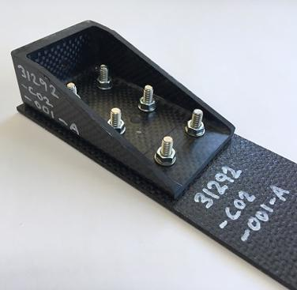
Why Mechanically Fastened Joints Matter
Joints transfer load between structural elements and preserve the global structural load path.
Fastener holes, geometric discontinuities and material interfaces introduce severe local stress concentrations.
Joints therefore frequently become the locations governing structural failure.
In composite structures, anisotropy and relatively weak through-thickness behaviour further increase joint complexity.
Joint design can govern structural efficiency, durability, inspectability and substantiation.
Keynote: In many aerospace structures, the joint -not the undisturbed laminate - governs structural performance.

Slide 5
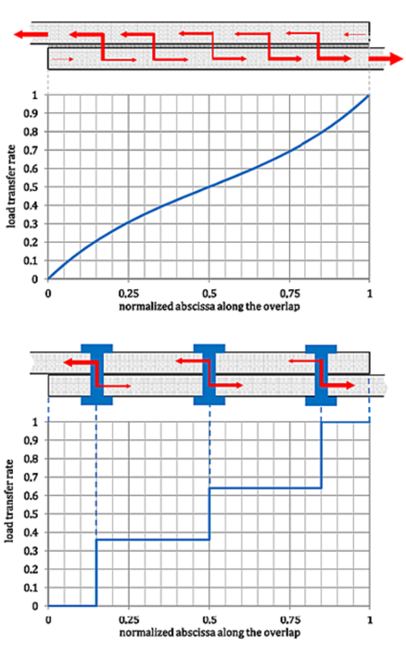
Joining Strategies for Composite Structures
Keynote: Joining methods differ fundamentally in their load-transfer mechanism and therefore require different analytical and experimental assessment methods.
Mechanically fastened | Adhesively bonded | Hybrid bonded–bolted
Load transferred through fastener–hole bearing contact | Load transferred through bondline shear and peel stresses | Load shared between adhesive and mechanical fasteners
Inspectable, removable and repairable | Smooth distributed load transfer | Potential redundancy and damage tolerance
Holes create stress concentrations and damage risk | Sensitive to surface preparation, defects and environment | Load sharing depends strongly on relative stiffness
Mature structural substantiation route | Commonly assessed using fracture mechanics and bondline strength | Requires coupled adhesive–fastener assessment

Slide 6
Why Mechanical Fasteners Remain Essential
Predictable and inspectable load-transfer path.
Suitable for assembly, disassembly, maintenance and structural repair.
Compatible with composite - metal and other hybrid material interfaces.
Provides redundancy and alternative load paths in multi-fastener joints.
Supported by established test methods, design databases and substantiation practice.
Metals: local plasticity can redistribute peak stresses.
CFRP: limited plastic redistribution leaves the hole and bearing region highly critical.
Keynote: Mechanical fastening is mature and practical, but its metallic design heritage cannot be transferred directly to anisotropic and comparatively brittle composite laminates.
Notes:
Mechanical fastening was perfected for ductile metallic structures, where plasticity reduces stress concentrations.
Composite laminates, however, are anisotropic and relatively brittle, which makes the mechanics of bolted joints significantly more complex.

Slide 7
Typical Fastener Types –
Definition
Bolts
Conventional threaded fasteners used with nuts or threaded inserts
Provide high clamp-up forces and are commonly used in structural joints
Hi-Lok / Hi-Lite fasteners
Aerospace pin-and-collar fasteners designed for controlled preload
Provide high strength with consistent installation torque
Lockbolts
Two-piece fasteners with a swaged collar instead of threads
Provide very high shear strength and vibration resistance
Rivets
Permanent fasteners installed by plastic deformation of the tail
Common in metallic airframes and selected composite assemblies
Titanium fasteners
Common in CFRP structures due to corrosion compatibility and high strength-to-weight ratio
Prevent galvanic corrosion between carbon fibres and metallic fasteners
Carbon fibre composites are electrically conductive and can promote galvanic corrosion when coupled with less noble metals such as aluminum in the presence of an electrolyte

Slide 8
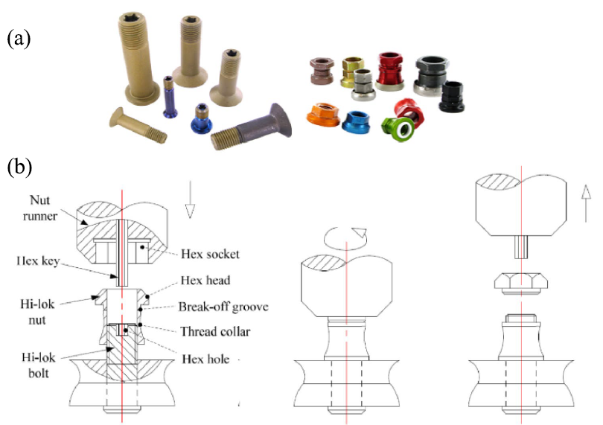
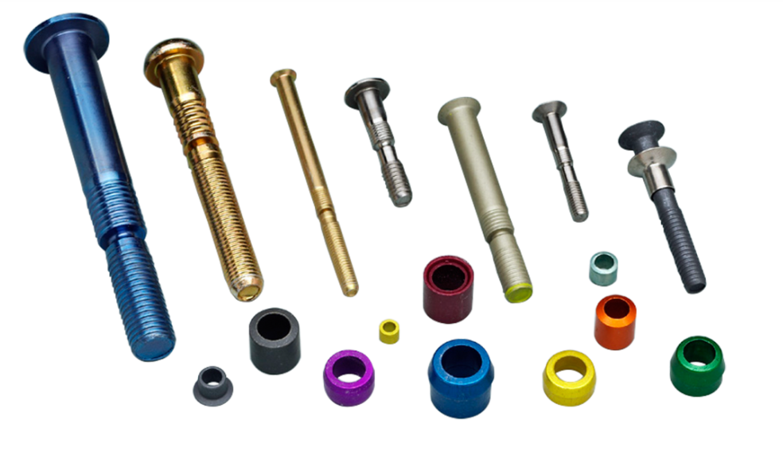
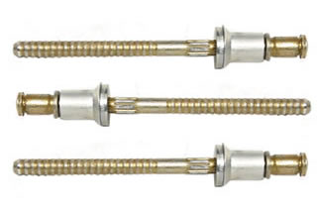
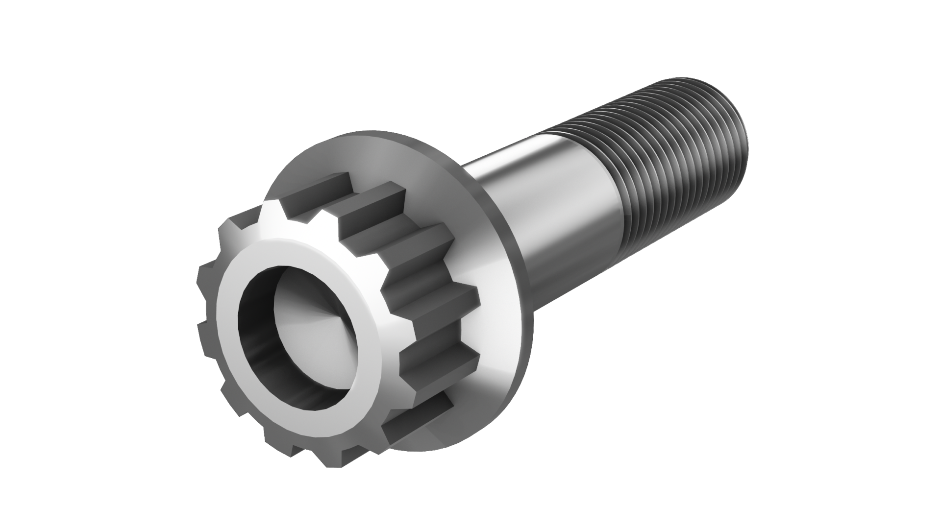
Typical Fastener Types –
Illustration
a) Commercially available Hi-Lok pin system and b) their installation process
Lock bolts
Aerospace grade rivets
Aerospace titanium bolt

Slide 9
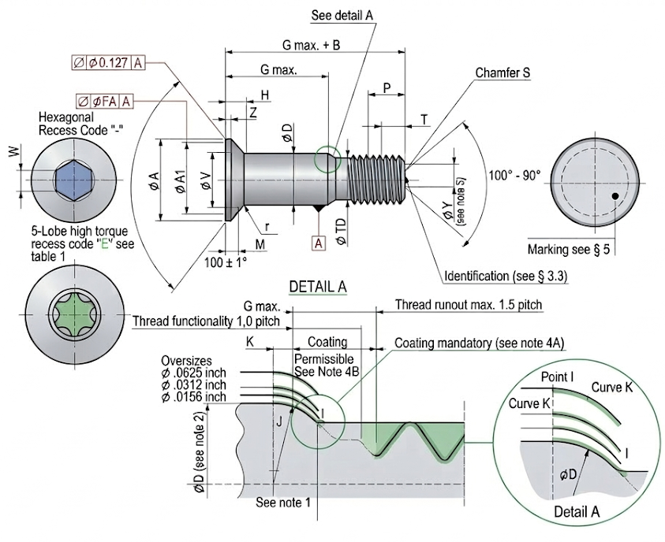
Typical Fastener Types –
EN Fastener Designation Philosophy
EN = European Standard
Fastener part numbers follow a coded designation system, not a descriptive name
Purpose
Standardisation across design and procurement
Traceability in manufacturing and maintenance
Reduced ambiguity in specification and documentation
Typical designation structure
Standard number | Material code | Diameter code | Length code | Optional treatment or recess code
Bolt example EN6114V4-8
EN6114 = standard number
V = titanium alloy 6Al-4V with IVD coating per EN6118
4 = diameter code (4B meaning nominal shank diameter)
8 = length code (G max. + B ± 0.254 mm)
- = separator used only where required by the coding rules
Key point
The designation identifies the standard, material, size, and configuration of the fastener
Notes:
T
Material: Titanium alloy 6Al-4V
Finish: Sulfuric acid anodizing as per ISO8080
Recess form: Hexagonal
Diameter range: 2 to 22
Bolt identification: None
V
Material: Titanium alloy 6Al-4V
Finish: IVD as per EN6118
Recess form: Hexagonal
Diameter range: 2 to 22
Bolt identification: None
K
Material: Titanium alloy 6Al-4V
Finish: Aluminium coating as per EN4473
Recess form: Hexagonal
Diameter range: 2 to 22
Bolt identification: A white paint identification at thread end
B
Material: Titanium alloy 6Al-4V
Finish: Sulfuric acid anodizing as per ISO8080 plus aluminium coating as per EN4473 on threads
Recess form: 5 lobe high torque recess or hexagonal depending on diameter range
Bolt identification: None
L
Material: Inconel 718
Finish: Aluminium coating as per EN4473
Bolt identification: A blue paint identification at thread end
M
Material: Inconel 718
Finish: IVD as per EN6118
Bolt identification: A black paint identification at thread end
P
Material: Inconel 718
Finish: Passivation as per AMS2700
Bolt identification: A yellow paint identification at thread end
–
Material: Alloy steel 4340 / 4140 / 8740 or equivalent
Finish: Cadmium plating as per AMS-QQ-P-416, Type II, class 2
Bolt identification: A green paint identification at thread end

Slide 10
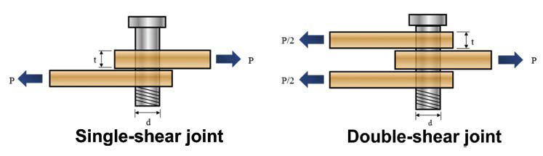
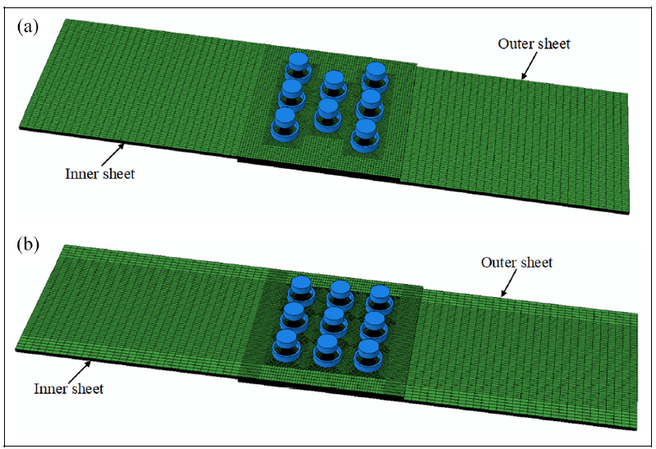
Joint Configurations
Single-lap joint
Simple configuration, but eccentric load path introduces secondary bending
Double-lap joint
More symmetric load transfer with reduced bending and more uniform bearing
Multi-row joint
Used for higher load transfer; rows may be staggered or non-staggered
Load sharing between rows is non-uniform, with end fasteners often carrying higher loads

Slide 11
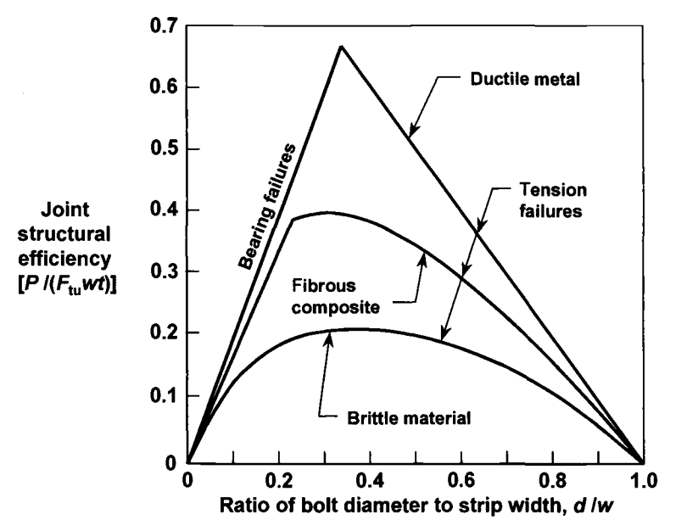
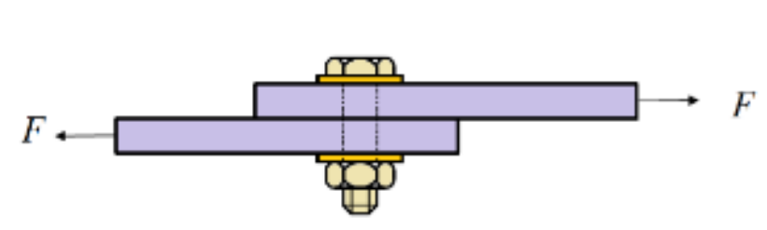
Joint Efficiency
Composite vs Metallic
Keynote: Joint efficiency is controlled by the material’s capacity to redistribute the severe local stresses introduced by the fastener hole.
Bolted joints in ductile metals achieve higher structural efficiency because local plasticity redistributes stresses around the hole.
Fibrous composites show lower joint efficiency because anisotropy and limited plastic redistribution make the joint highly notch-sensitive.
For small 𝑑/𝑤, failure is often bearing dominated; as 𝑑/𝑤 increases, the net section weakens and tension failures become dominant.
Brittle materials show the lowest efficiency, illustrating the penalty of limited redistribution capacity.
P
P

Slide 12
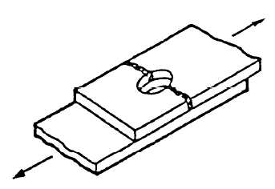
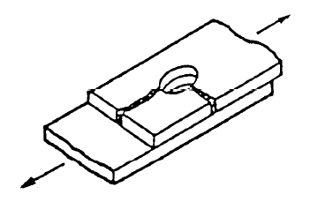
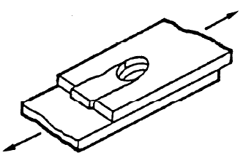
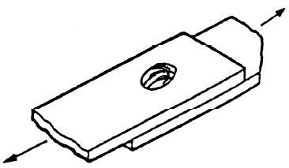
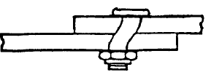
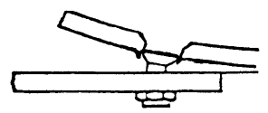
Principal Failure Modes in Mechanically Fastened Composite Joints
Net Tension failure
Cleavage failure
Shear-out failure
Bearing failure
Fastener shear failure
Fastener pull-through

Slide 13
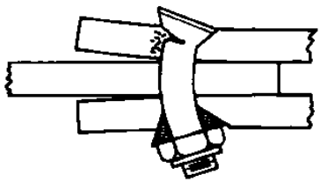
Principal Failure Modes in Mechanically Fastened Composite Joints
For example, the strength of 3B EN6115 bolt is 14,150 N whereas the strength of 3B NSA5472 (3K7) nut is 14,234 N.
Fastener tensile failure
Nut failure
If there is combined shear force and tensile load in the fastener
Fastener-system checks are often treated less comprehensively in introductory composite-joint texts than laminate failure modes, but they remain necessary in aerospace substantiation.
Fastener tensile-shear interaction failure

Slide 14
Principal Failure Modes in Mechanically Fastened Composite Joints
Laminate in-plane failure | Through-thickness and fastener-system failure | Interaction effects
Bearing | Fastener shear | Bearing–bypass
Net tension | Fastener tension | Fastener tension–shear
Shear-out | Nut or collar failure | Bearing with secondary bending
Cleavage / splitting | Pull-through | —
Keynote: Joint substantiation must address laminate failure, through-thickness failure, fastener-system failure and the relevant interaction modes separately.

Slide 15
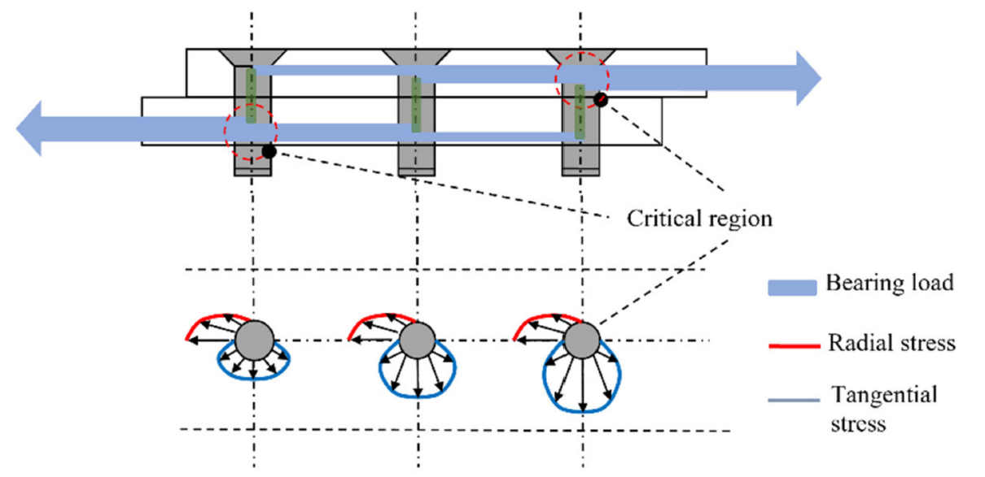
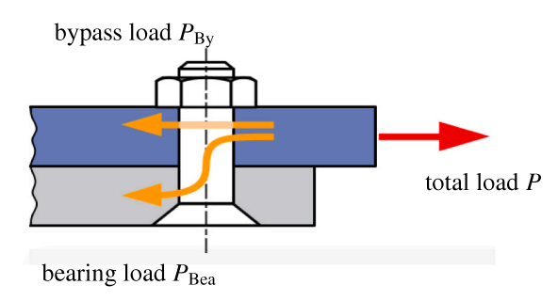
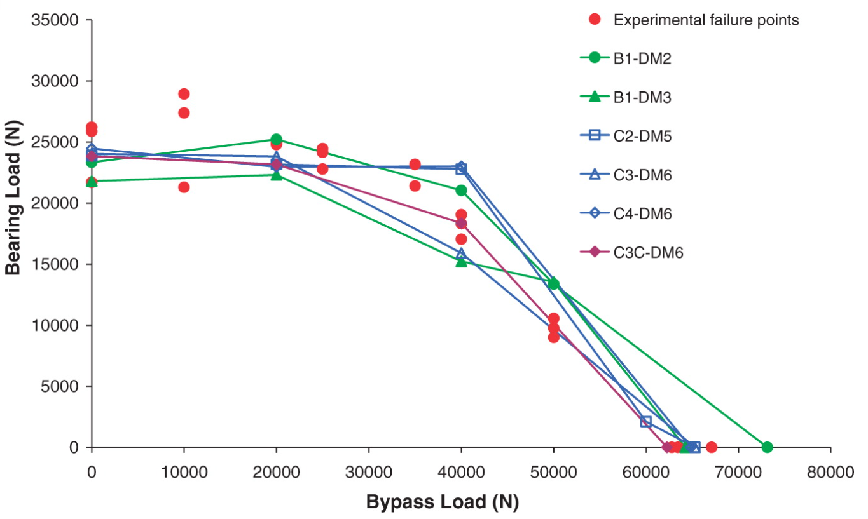
Bearing–Bypass Interaction in Composite Bolted Joints
Load is transferred locally by bearing through fastener–hole contact.
The remaining load continues through the laminate as bypass.
The hole-edge stress field is therefore governed by the combined bearing–bypass state.
Bearing contact is always compressive.
Bypass loading may be tensile or compressive.
Important: Bearing denotes local compressive contact; tension or compression refers to the bypass component.
Pure bearing represents only one point on the interaction envelope.
Most structural joints operate under combined bearing and bypass loading.
The operating point must be assessed against a material- and configuration-specific experimental envelope.

Slide 16
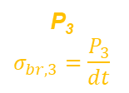



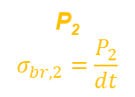
Evolution of Bearing and Bypass Loads in Multi-Fastener Joints
Bypass load is the portion of the applied load that remains in the laminate and passes across a fastener row through the net section
Bearing load is the portion transferred locally through contact between the fastener shank and the CFRP hole wall
In CFRP joints, bearing and bypass loads interact. The local failure state depends on bearing compression, bypass tension or compression, laminate orientation, hole quality, clearance, clamp up and progressive damage.
Bypass load
Bypass load
Bypass load
Bypass load
B_{t0}=0
B_{t1}
B_{t2}
B_{t3}=F
F
F
B_{b0}=F
B_{b1}
B_{b2}
B_{b3}=0
$$P_{1}=P_{3}>P_{2}$$
$$P_{1}=B_{b0}−B_{b1}=B_{t1}−B_{t0}$$
$$P_{2}=B_{b1}−B_{b2}=B_{t2}−B_{t1}$$
$$P_{3}=B_{b2}−B_{b3}=B_{t3}−B_{t2}$$
$$P_{1}+P_{2}+P_{3}=F$$
P₁
$$σ_{br,1}=\frac{P_{1}}{dt}$$
P₂
$$σ_{br,2}=\frac{P_{2}}{dt}$$
P₃
$$σ_{br,3}=\frac{P_{3}}{dt}$$
Fastener load:
Fastener bearing
stress:

Slide 17
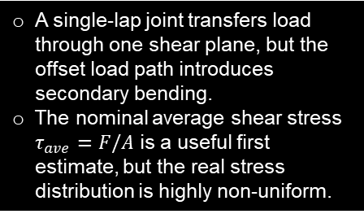
Single-Lap Joint-
Geometry and Load Transfer
d
F
F
t
Load per shear plane
P = F
F
A single-lap joint transfers load through one shear plane, but the offset load path introduces secondary bending.
The nominal average shear stress $τ_{ave}=F/A$ is a useful first estimate, but the real stress distribution is highly non-uniform.
Notes:
A single-lap joint transfers load through one shear plane, but the offset load path introduces secondary bending.
The nominal average shear stress $τ_{ave}=F/A$ is a useful first estimate, but the real stress distribution is highly non-uniform.

Slide 18
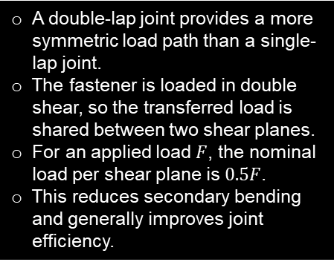
Double-Lap Joint-
Geometry and Load Transfer
0.5F
F
0.5F
A double-lap joint provides a more symmetric load path than a single-lap joint.
The fastener is loaded in double shear, so the transferred load is shared between two shear planes.
For an applied load $F$, the nominal load per shear plane is $0.5F$.
This reduces secondary bending and generally improves joint efficiency.
P = 0.5F
Load per shear plane
F
P = 0.5F
Notes:
A double-lap joint provides a more symmetric load path than a single-lap joint.
The fastener is loaded in double shear, so the transferred load is shared between two shear planes.
For an applied load $F$, the nominal load per shear plane is $0.5F$.
This reduces secondary bending and generally improves joint efficiency.

Slide 19
Double-Strip Butt Joint-
Geometry and Load Transfer
A butt splice joins two aligned members using one or more cover straps and fasteners.
The load path is more symmetric than in a single-lap joint, reducing eccentricity and secondary bending.
In a simplified idealisation, the transferred load is shared through the fastener shear planes.
Actual fastener loads are generally non-uniform and depend on stiffness, spacing, and joint geometry.
F
F
F
P = F
Load per shear plane
Notes:
A butt splice joins two aligned members using one or more cover straps and fasteners.
The load path is more symmetric than in a single-lap joint, reducing eccentricity and secondary bending.
In a simplified idealisation, the transferred load is shared through the fastener shear planes.
Actual fastener loads are generally non-uniform and depend on stiffness, spacing, and joint geometry.
single-lap → eccentric, bending sensitive
double-shear / double-lap → more symmetric
butt splice → aligned load transfer with splice plates, but multi-fastener load sharing becomes important

Slide 20
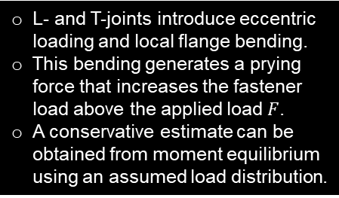
L- and T-Joints-
Prying Action in a Single-Bolt Configuration
L- and T-joints introduce eccentric loading and local flange bending.
This bending generates a prying force that increases the fastener load above the applied load $F$.
A conservative estimate can be obtained from moment equilibrium using an assumed load distribution.
F
F
Prying force can be obtained by conservatively approximating a triangular load distribution and taking moment about the axis of the bolt (see next slide for illustration).
Prying effect
P = F * C_{pr}
Notes:
L- and T-joints introduce eccentric loading and local flange bending.
This bending generates a prying force that increases the fastener load above the applied load $F$.
A conservative estimate can be obtained from moment equilibrium using an assumed load distribution.

Slide 21
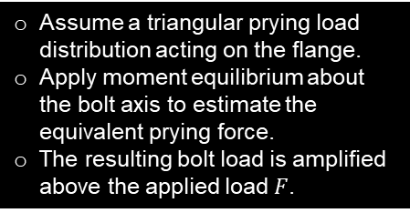
Prying Force Calculation by Moment Equilibrium
F
Assume a triangular prying load distribution acting on the flange.
Apply moment equilibrium about the bolt axis to estimate the equivalent prying force.
The resulting bolt load is amplified above the applied load $F$.
c
e
2/3*(e-0.5d)
P_{pr-eq}
P_{pr}
P
Notes:
Assume a triangular prying load distribution acting on the flange.
Apply moment equilibrium about the bolt axis to estimate the equivalent prying force.
The resulting bolt load is amplified above the applied load $F$.

Slide 22
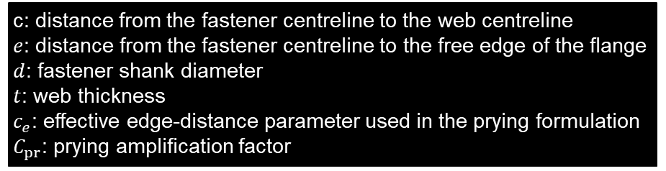

Multi-Bolt L- and T-Joints: Preliminary Prying Assessment
c: distance from the fastener centreline to the web centreline
$e$: distance from the fastener centreline to the free edge of the flange $d$: fastener shank diameter
$t$: web thickness
$c_{e}$: effective edge-distance parameter used in the prying formulation $C_{pr}$: prying amplification factor
F
Assuming $P_{2}=0$ may be conservative for the present idealisation, but this should be verified for the actual flange stiffness, contact condition and fastener arrangement.
A representative engineering formulation for the prying factor is:
F
c
e
t
d
Prying effect
P₁ = F * C_{pr}
P₂ = 0

Slide 23
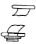

Transition of Governing Failure Modes under Shear Loading
Increasing $t/d$ increases laminate bearing capacity until fastener shear becomes the governing failure mode.
Nominal diameter of the fastener
Fastener shear-governed
Bearing–fastener interaction
Applied shear load
Bearing-governed
Plate thickness

Slide 24
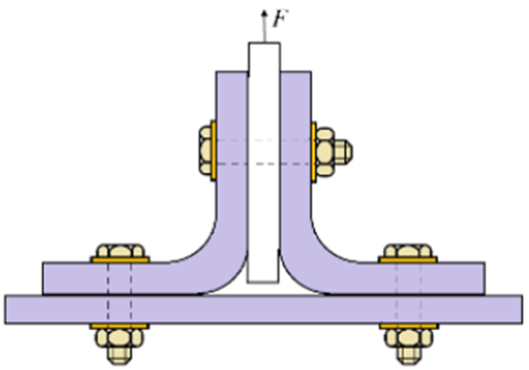
Transition of Governing Failure Modes under Tensile Loading
Increasing laminate thickness delays pull-through until fastener tensile capacity governs.
Fastener tensile failure
Laminate pull-through
Applied tensile load

Slide 25


Critical Sections Around a Fastener Hole
Shear-out is associated with the two ligaments between the loaded hole and the free edge. In CFRP, the mode involves coupled matrix cracking, fibre splitting and delamination and normally requires a composite-specific allowable or validated interaction method.
Shear-out planes
Bearing plane
Net-tension plane
$$σ_{net}=\frac{F_{by}}{\left(w−d\right)t}$$
$$σ_{bea}=\frac{P}{dt}$$
F
F
F

Slide 26
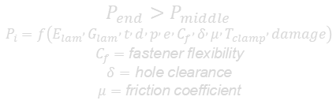
Effect of Fastener Flexibility on Multi-Fastener Load Sharing
In CFRP, actual load sharing depends on laminate stiffness, bearing compliance, fastener flexibility, hole clearance, clamp up, friction and damage evolution. Unlike ductile metals, CFRP has limited plastic redistribution, so end fasteners commonly remain critical.
Infinitely stiff fasteners:
Upper bound: end fasteners dominate
F
F
Fastener load:
0.5F
0
0.5F
Infinitely flexible fasteners:
Lower bound: equal load sharing
F
F
Fastener load:
0.33F
0.33F
0.33F
Actual fasteners:
F
$$P_{end}>P_{middle}$$
$$P_{i}=f\left(E_{lam} , G_{lam} , t , d , p , e , C_{f} , δ , μ , T_{clamp} , damage\right)$$
$$C_{f}=\text{fastener} \text{flexibility}$$
$$δ=\text{hole} \text{clearance}$$
$$μ=\text{friction} \text{coefficient}$$
F
Fastener load:
P1
P2
P3
Notes:
In CFRP, actual load sharing depends on laminate stiffness, bearing compliance, fastener flexibility, hole clearance, clamp up, friction and damage evolution. Unlike ductile metals, CFRP has limited plastic redistribution, so end fasteners commonly remain critical.

Slide 27
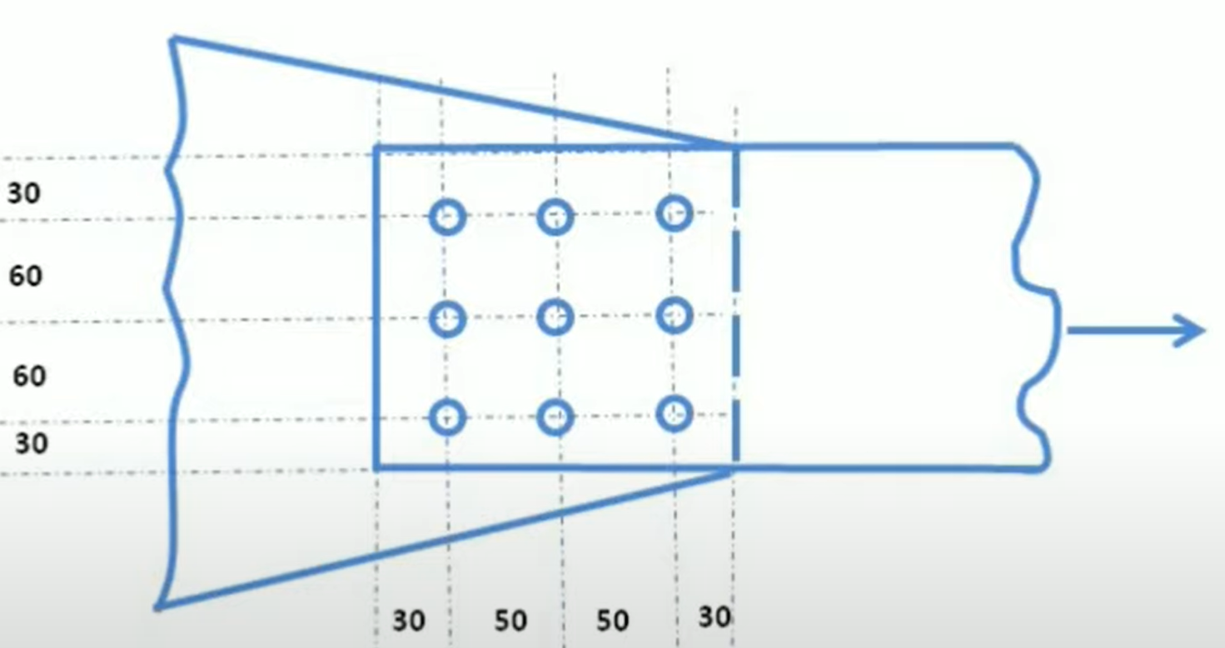
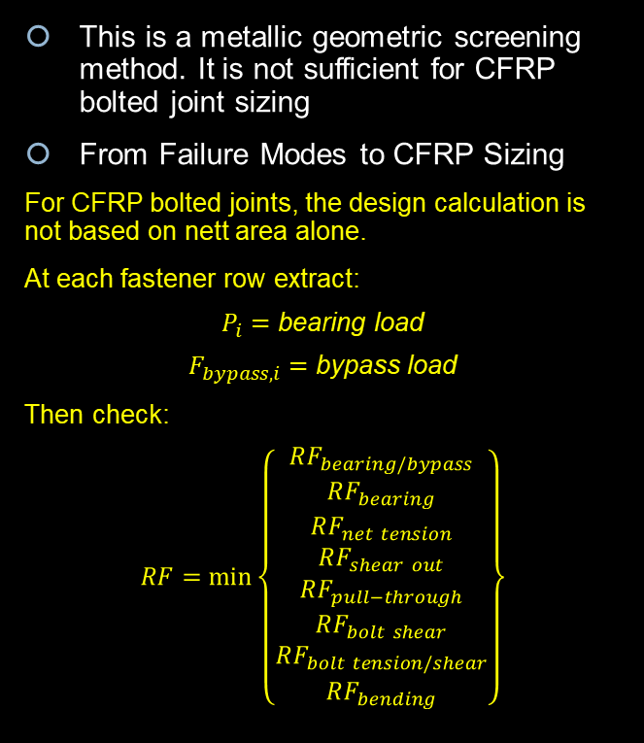
Metallic Nett Section Method: Background Only
This is a metallic geometric screening method. It is not sufficient for CFRP bolted joint sizing
From Failure Modes to CFRP Sizing
For CFRP bolted joints, the design calculation is not based on nett area alone.
At each fastener row extract:
$$P_{i}=\text{bearing} \text{load}$$
$$F_{bypass,i}=\text{bypass} \text{load}$$
Then check:
$$RF=\min\left\{\begin{matrix}RF_{bearing/bypass} \\ RF_{bearing} \\ RF_{net tension} \\ RF_{shear out} \\ RF_{pull−through} \\ RF_{bolt shear} \\ RF_{bolt tension/shear} \\ RF_{bending}\end{matrix}\right\}$$
Assume bolt diameter of 16mm and the plate thickness of 10mm

Slide 28
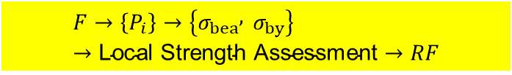
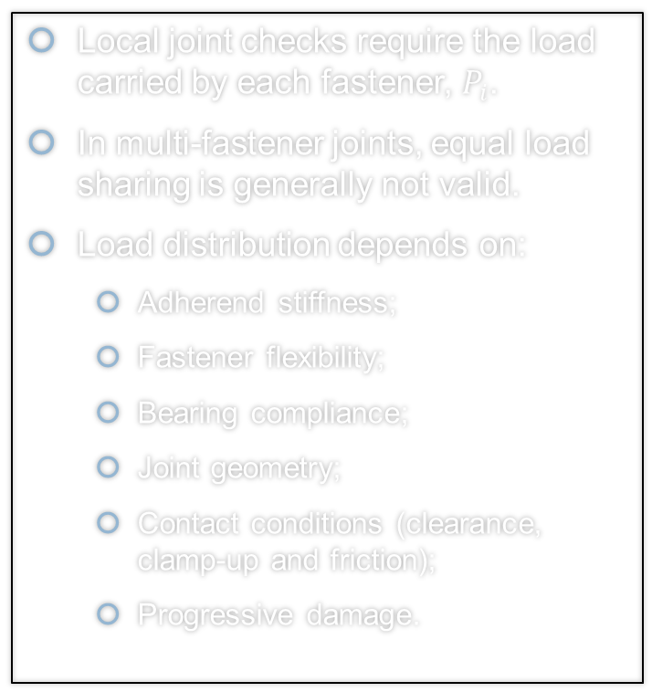
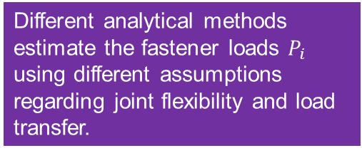
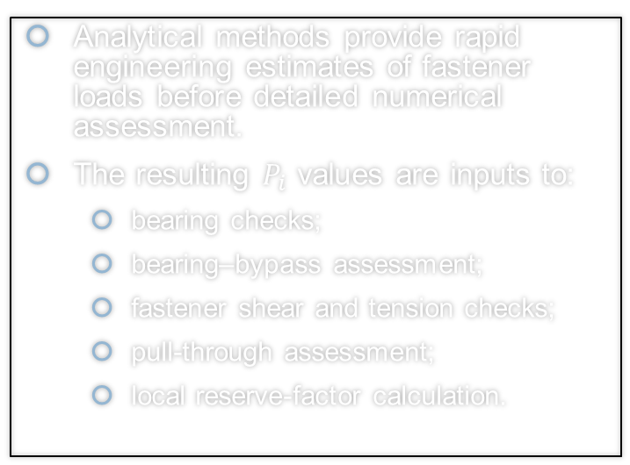
Why Fastener Load-Distribution Methods Are Required
Different analytical methods estimate the fastener loads $P_{i}$ using different assumptions regarding joint flexibility and load transfer.
Local joint checks require the load carried by each fastener, $P_{i}$.
In multi-fastener joints, equal load sharing is generally not valid.
Load distribution depends on:
  Adherend stiffness;
  Fastener flexibility;
  Bearing compliance;
  Joint geometry;
  Contact conditions (clearance, clamp-up and friction);
  Progressive damage.
Analytical methods provide rapid engineering estimates of fastener loads before detailed numerical assessment.
The resulting $P_{i}$ values are inputs to:
  bearing checks;
  bearing–bypass assessment;
  fastener shear and tension checks;
  pull-through assessment;
  local reserve-factor calculation.
$$F→\left\{P_{i}\right\}→\left\{σ_{bea} , σ_{by}\right\}→\text{Local} \text{Strength} \text{Assessment}→RF$$
Keynote: Reliable joint sizing begins with a defensible fastener-load distribution; all subsequent local strength checks depend on it.

Slide 29
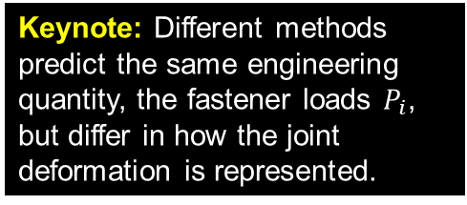
Methods for Predicting Fastener Load Distribution
Keynote: Different methods predict the same engineering quantity, the fastener loads $P_{i}$, but differ in how the joint deformation is represented.
Several analytical and numerical methods have been developed to estimate fastener load distribution. They differ primarily in how they represent joint flexibility and load transfer.
This lecture focuses on the Huth and Rutman methods because they are widely used in aerospace engineering and illustrate two different levels of joint idealisation.
Method | Representation | Typical application
Douglas / Boeing / Grumman | Closed-form or empirical engineering formulations | Preliminary sizing
Huth | Single effective joint flexibility | Preliminary multi-fastener load distribution and independent checks
Rutman | Assembled bearing, shear, bending and rotational stiffness components | Matrix-based or FE joint idealisation
Detailed FEA | Connector-based or explicit bolt–hole/contact model | Refined redistribution and nonlinear assessment

Slide 30
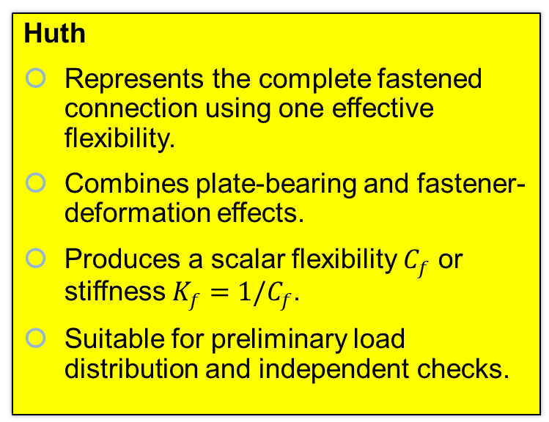
Comparison of Huth and Rutman Joint Idealisations
Huth
Represents the complete fastened connection using one effective flexibility.
Combines plate-bearing and fastener-deformation effects.
Produces a scalar flexibility $C_{f}$ or stiffness $K_{f}=1/C_{f}$.
Suitable for preliminary load distribution and independent checks.
Rutman
Separates the connection into individual stiffness components.
Includes translational and rotational bearing, fastener shear and fastener bending.
Produces an assembled joint-element stiffness representation.
Suitable for matrix-based or FE implementation.
Keynote: Huth reduces the connection to one effective flexibility, whereas Rutman assembles the connection from multiple physical deformation components.
Notes:
N: nut
C: collar

Slide 31
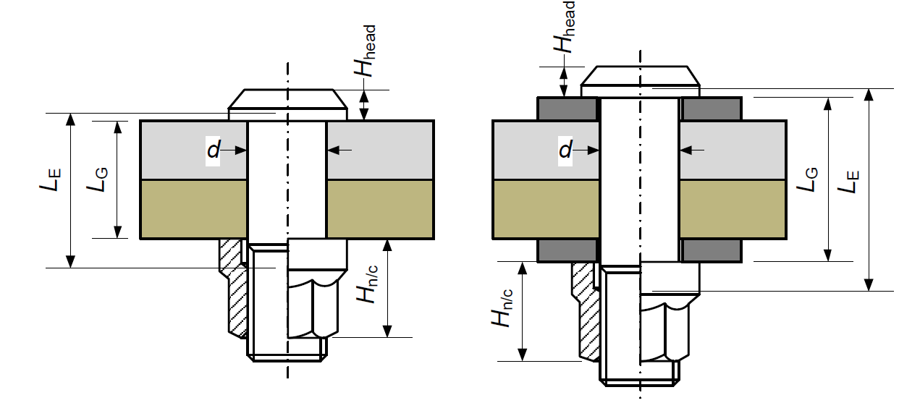
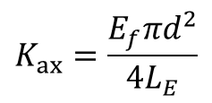

Fastener Axial Stiffness for Tension-Loaded Joints
The effective length is longer than the grip because deformation also occurs beneath the fastener head and nut/collar.
Axial fastener stiffness is required when the fastener carries through-thickness tension, including pull-through, prying and combined tension–shear loading.
It is distinct from the in-plane flexibility used to distribute shear load between fasteners.
$$K_{ax}=\frac{E_{f}πd^{2}}{4L_{E}}$$
Definitions
$E_{f}$: fastener Young's modulus
$d$: fastener shank diameter
$L_{G}$: grip length
$L_{E}$: effective tensile length
$H_{head}$: head height
$H_{n/c}$: nut or collar height
$K_{ax}$: axial fastener stiffness
Keynote: Axial fastener stiffness governs through-thickness deformation and is required for fastener tension, pull-through and prying analyses. It is distinct from the in-plane flexibility used for shear load distribution.
Notes:
N: nut
C: collar

Slide 32

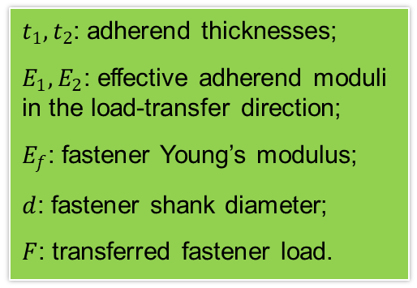

Huth Method: Effective Joint Flexibility
Huth replaces the real fastened connection with one equivalent flexibility that combines:
  fastener deformation;
  local bearing deformation in Adherend 1;
  local bearing deformation in Adherend 2.
E_{f}
E₁
F
F
E₂
$t_{1},t_{2}$: adherend thicknesses;
$E_{1},E_{2}$: effective adherend moduli in the load-transfer direction;
$E_{f}$: fastener Young’s modulus;
$d$: fastener shank diameter;
$F$: transferred fastener load.
For CFRP adherends, $E_{1}$ and $E_{2}$ must be the effective laminate moduli in the local load-transfer direction.
Fastener deformation:
$$C_{f}=\frac{δ}{F}=\frac{1}{K_{f}}$$
Single shear joint n=1
Double shear joint n=2
Bolted metallic joint a=2/3, b=3.0
Riveted metallic joint a=2/5, b=2.2
Bolted composite joint a=2/3, b=4.2
Bearing deformation:

Slide 33
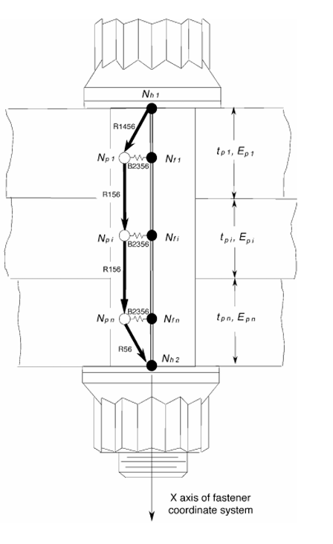
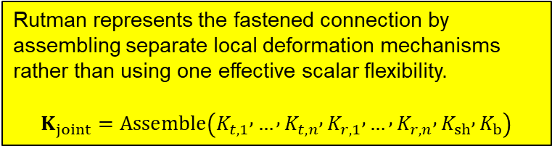

Rutman Method: Component Architecture
Rutman represents the fastened connection by assembling separate local deformation mechanisms rather than using one effective scalar flexibility.
$$K_{joint}=\operatorname{Assemble}\left(K_{t,1} , … , K_{t,n} , K_{r,1} , … , K_{r,n} , K_{sh} , K_{b}\right)$$
Component | Physical response
Translational plate bearing | Local indentation of the adherend
Translational fastener bearing | Local fastener deformation at the plate interface
Rotational plate bearing | Plate-bearing deformation due to relative rotation
Rotational fastener bearing | Fastener-bearing deformation due to relative rotation
Fastener shear | Transverse deformation of the shank
Fastener bending | Flexural deformation through the stack
Matrix-based joint-element representation
Suitable for stiffness-matrix or FE implementation
Retains the local deformation mechanisms separately
Requires consistent fastener and laminate local axes
Pretension, fit, clearance, friction and contact nonlinearity are excluded unless explicitly modelled
$K_{t,i}$: combined translational bearing stiffness at interface $i$
$K_{r,i}$: combined rotational bearing stiffness at interface $i$
$K_{sh}$: fastener shear stiffness
$K_{b}$: fastener bending stiffness

Slide 34
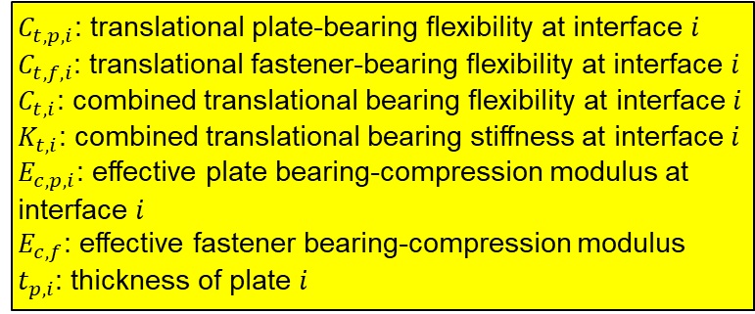
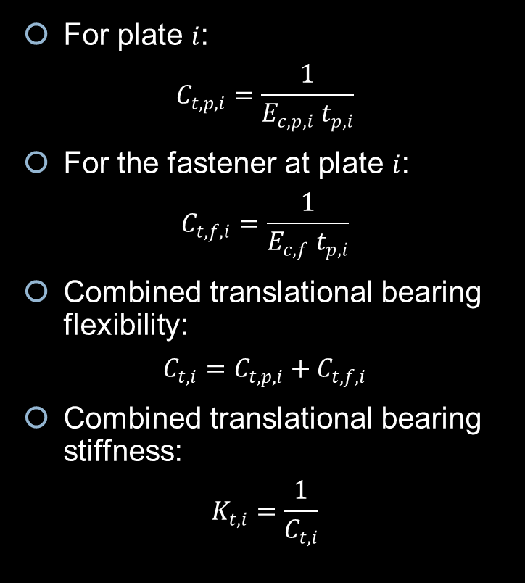

Rutman Translational Bearing Flexibility
For plate $i$:
$$C_{t,p,i}=\frac{1}{E_{c,p,i} t_{p,i}}$$
For the fastener at plate $i$:
$$C_{t,f,i}=\frac{1}{E_{c,f} t_{p,i}}$$
Combined translational bearing flexibility:
$$C_{t,i}=C_{t,p,i}+C_{t,f,i}$$
Combined translational bearing stiffness:
$$K_{t,i}=\frac{1}{C_{t,i}}$$
$C_{t,p,i}$: translational plate-bearing flexibility at interface $i$
$C_{t,f,i}$: translational fastener-bearing flexibility at interface $i$
$C_{t,i}$: combined translational bearing flexibility at interface $i$
$K_{t,i}$: combined translational bearing stiffness at interface $i$
$E_{c,p,i}$: effective plate bearing-compression modulus at interface $i$
$E_{c,f}$: effective fastener bearing-compression modulus
$t_{p,i}$: thickness of plate $i$
Plate and fastener bearing deformations occur in series at each interface; therefore, their flexibilities add.
For CFRP, $E_{c,p,i}$ must be the effective laminate bearing-compression modulus in the local bearing-load direction, not a generic isotropic Young’s modulus.
Keynote: Translational bearing stiffness at each interface is obtained by combining the plate and fastener bearing compliances in series.

Slide 35






Rutman Rotational Bearing Flexibility
Keynote: Rotational bearing compliance arises from the through-thickness variation of bearing deformation and scales with $t^{−3}$.
Governing kinematics
$$δ\left(x\right)=x φ$$
$x$: through-thickness coordinate measured from the plate mid-plane;
$φ$: relative plate–fastener rotation;
$δ\left(x\right)$: local bearing deformation.
Plate contribution
  Moment equilibrium gives:
$$M=E_{c,p,i} φ\int_{−t_{p,i}/2}^{t_{p,i}/2}{x^{2}} dx$$
$$M=E_{c,p,i} φ \frac{t_{p,i}^{3}}{12}$$
$$C_{r,p,i}=\frac{φ}{M}=\frac{12}{E_{c,p,i} t_{p,i}^{3}}$$
Fastener contribution
$$C_{r,f,i}=\frac{12}{E_{c,f} t_{p,i}^{3}}$$
Combined interface response
$$C_{r,i}=C_{r,p,i}+C_{r,f,i}$$
$$K_{r,i}=\frac{1}{C_{r,i}}$$
$C_{r,p,i}$: rotational plate-bearing flexibility at interface $i$
$C_{r,f,i}$: rotational fastener-bearing flexibility at interface $i$
$C_{r,i}$: combined rotational bearing flexibility
$K_{r,i}$: combined rotational bearing stiffness
$E_{c,p,i}$: effective plate bearing-compression modulus
$E_{c,f}$: effective fastener bearing-compression modulus
$t_{p,i}$: plate thickness
$M$: interface moment

Slide 36



Rutman Overall Joint Flexibility Assembly
$P$: applied joint load in the selected direction
$Δ$: corresponding relative displacement
$C_{eq}$: equivalent directional joint flexibility
$K_{eq}$: equivalent directional joint stiffness
Keynote: Rutman produces a coupled joint-stiffness model; any scalar equivalent flexibility is extracted afterwards for a specified loading direction.
Rutman does not produce one empirical scalar flexibility directly. The local translational, rotational, shear and bending stiffness components are assembled into a coupled joint model.
Interface stiffness terms
For each plate interface $i$:
$$K_{t,i}=\frac{1}{C_{t,i}}$$
$$K_{r,i}=\frac{1}{C_{r,i}}$$
$K_{t,i}$: combined translational bearing stiffness at interface $i$
$K_{r,i}$: combined rotational bearing stiffness at interface $i$
Global assembly
$K_{joint}=\operatorname{Assemble}\left(K_{t,1} , … , K_{t,n} , K_{r,1} , … , K_{r,n} , K_{sh} , K_{b}\right)$
The components are coupled through compatibility and equilibrium; they are not added directly as independent scalar stiffnesses.
Equivalent directional response
For a selected loading direction:
$$C_{eq}=\frac{Δ}{P}$$
$$K_{eq}=\frac{P}{Δ}=\frac{1}{C_{eq}}$$

Slide 37


Rutman FE Implementation
FE Idealisation
Rutman represents the joint using:
  Beam elements for fastener shear and bending stiffness ($K_{sh}, K_{b}$)
  Connector, spring or bush elements for translational and rotational bearing stiffness ($K_{t,i}, K_{r,i}$)
  Compatibility elements (or equivalent MPC/RBE constraints) linking plate and fastener nodes
  Coincident plate and fastener interface nodes in a local fastener coordinate system
Physical quantity | Typical element
Fastener shank | CBAR / CBEAM
Bearing stiffness | CBUSH / CELAS
Compatibility | RBE2 / RBE3 / RBAR / MPC

Slide 38

Worked Example: Rutman Stiffness Components for a Single-Lap Joint

Slide 39




Classical Eccentric Bolt-Group Analysis –
Step 1: Locate the Fastener-Group Centroid
Keynote: The first step in classical eccentric bolt-group analysis is locating the fastener-group centroid. For identical fasteners, the centroid is simply the arithmetic mean of the fastener coordinates and becomes the reference point for calculating moment-induced fastener loads.
Purpose
  Determine the centroid of the fastener group, which is assumed to be the centre of rotation under an eccentric in-plane load.
Assumptions
Linear elastic behaviour.
Identical fasteners (equal stiffness and diameter).
Rigid connected plates.
Small displacements.
Equal load transfer capability for each fastener.
Centroid of the Fastener Group
For a group of n fasteners: $\overline{x}=\frac{\sum_{i=1}^{n}{A_{i}}x_{i}}{\sum_{i=1}^{n}{A_{i}}}, \overline{y}=\frac{\sum_{i=1}^{n}{A_{i}}y_{i}}{\sum_{i=1}^{n}{A_{i}}}$
For identical fasteners: $A_{1}=A_{2}=⋯=A_{n}$
$$\boxed{\overline{x}=\frac{1}{n}\sum_{i=1}^{n}{x_{i}}}$$
$$\boxed{\overline{y}=\frac{1}{n}\sum_{i=1}^{n}{y_{i}}}$$

Slide 40


Classical Eccentric Fastener-Group Analysis –
Step 2 – Direct and Moment-Induced Shear
The direct shear component has the same direction at every fastener.
The moment-induced component acts tangentially about the fastener-group centroid.
Primary shear due to shear force V
M=Ve
Secondary shear due to moment M
For this symmetric fastener pattern, the centroid $O$ lies at the geometric centre of the group.

Slide 41


Classical Eccentric Fastener-Group Analysis
Step 3 –
Calculate Individual Fastener Loads
Assumptions
Rigid connected members.
Linear-elastic fasteners.
Small displacement and rotation.
Equal fastener stiffness.
No clearance or slip.
Plate flexibility and laminate anisotropy are not explicitly represented.
1. Direct Shear Distribution
The applied shear force is shared equally by all fasteners:
$$F_{i}^{′}=\frac{V}{n}$$
$V$= applied shear force , $n$= number of fasteners
2. Eccentric Moment
The eccentric load produces a moment about the fastener-group centroid:
$$M=Ve$$
$e$= perpendicular distance from the load line to the centroid.
3. Moment-Induced Shear
The moment-induced load carried by fastener $i$is
$$\boxed{F_{i}^{′′}=\frac{Mr_{i}}{\sum_{j=1}^{n}{r_{j}^{ 2}}}}$$
$r_{i}$= radial distance from the centroid to fastener $i$.
The force acts tangentially about the fastener-group centroid.
4. Resultant Fastener Load
Resolve the two load components into global axes:
$$F_{x,i}=F_{x,i}^{′}+F_{x,i}^{′′}$$
$$F_{y,i}=F_{y,i}^{′}+F_{y,i}^{′′}$$
The resultant fastener load is
$$\boxed{F_{i}=\sqrt{F_{x,i}^{ 2}+F_{y,i}^{ 2}}}$$
Notes:
Notation:
$F^{′}$is the primary shear component from the direct applied shear force $V$.
$F^{′′}$is the secondary shear component from the eccentric moment $M=Ve$.
The bolt load is the vector sum of $F^{′}$and $F^{′′}$, not a simple scalar addition unless used deliberately as a conservative approximation.
Total fastener load consists of two components:
$$F^{′}=\frac{V}{n}$$
Primary shear from the applied shear force $V$. Same direction for all fasteners.
$$F_{i}^{′′}=\frac{Mr_{i}}{\sum{r_{j}^{2}}}$$
Secondary shear from the eccentric moment $M=Ve$. Its magnitude increases with distance $r_{i}$from the bolt group centroid.
$$F_{i}={\vec{F}}_{i}^{′}+{\vec{F}}_{i}^{′′}$$
The resultant fastener load must be obtained vectorially.
For example:
You currently have:
$$F^{′}=\frac{16}{4}=4 \text{kN}$$
$$F^{′′}=\frac{Mr}{4r^{2}}=\frac{6800}{4×96}=17.7 \text{kN}$$
That means:
$$F^{′}=4 \text{kN}$$
is the direct vertical shear per bolt.
$$F^{′′}=17.7 \text{kN}$$
is the moment induced shear at each bolt, because all four bolts are the same distance from the centroid:
$$r=\sqrt{{60}^{2}+{75}^{2}}=96 \text{mm}$$
Then each bolt resultant is found by vector addition. In your plotted solution, bolts A and B become critical because $F^{′}$and $F^{′′}$combine less favourably there, giving about:
$$F_{A}=F_{B}≈21 \text{kN}$$
while bolts C and D are lower, about:
$$F_{C}=F_{D}≈14.8 \text{kN}$$

Slide 42


Classical Eccentric Fastener-Group Analysis
Step 4 –
Worked Example: Four-Fastener Group
A four-fastener group carries an applied shear load:
$$V=16 \text{kN}$$
acting at eccentricity $e$from the fastener-group centroid.
Determine:
the direct shear load at each fastener;
the moment-induced shear load;
the resultant load at each fastener;
the critical fastener.
Show the four-fastener pattern with fasteners labelled:
$A, B, C, D$ and centroid $O$.

Slide 43
Solution of example 2

Slide 44

Solution of example 2
The shear forces are plotted to scale, and the resultant is obtained using parallelogram rule
F’’ is perpendicular to the radial line
Often as a conservative approach and saving time, F’ is added to F’’ (17.7 + 4 = 23.7kN)

Slide 45
Solution of example 2
The minimum total length of the bolt required is 43.8 mm to avoid bad practice of thread in the plate
  The M16 bolt length is 25 mm.
  The height of the nut is 14.8 mm
  The height of washer is 2 mm
  Two threads beyond the nut 2 mm
The next available standard size id bolt length of 46 mm
The shearing area is 144 mm²

Slide 46
Solution of example 2
The channel is thinner than the bar
Bearing will be critical in the channel

Slide 47
Solution of example 2
The critical section in bending is assumed to be parallel to y axis through bolts A and B

Slide 48

CFRP Bolted Joint Sizing Workflow
Applied load
Fastener load distribution
P_{i}​, F_{by,i}​, M_{i​}
Local CFRP checks
RF_{min}​
$$P_{i}=\text{bearing} \text{load} \text{at} \text{fastener} i$$
$$F_{by,i}=\text{bypass} \text{load} \text{at} \text{fastener} i$$
$$M_{i}=\text{local} \text{out} \text{of} \text{plane} \text{moment} \text{at} \text{fastener} i$$
$$σ_{bea,i}=\frac{P_{i}}{dt}$$
$$σ_{by,i}=\frac{F_{by,i}}{wt}$$
Keynote: The fastener load is only the input. CFRP joint strength is governed by the local bearing bypass state, laminate architecture, edge distance, clamp up, fit, secondary bending and damage mechanisms.

Slide 49




Edge Distance $e/d$: Definition and Measurement
Edge distance ($\frac{e}{d})$ must be measured relative to the local bearing load direction, not simply to the nearest edge
  $e=\text{distance} \text{from} \text{hole} \text{centre} \text{to} \text{the} \text{relevant} \text{free} \text{edge}$
  $d=\text{fastener} \text{shank} \text{diameter} \text{or} \text{design} \text{hole} \text{diameter}$
For arbitrary bearing load directions, define:
  $e_{calc}=\text{calculated} \text{edge} \text{distance} \text{in} \text{the} \text{bearing} \text{load} \text{direction}$
  $e_{perp}=\text{calculated} \text{edge} \text{distance} \text{perpendicular} \text{to} \text{the} \text{bearing} \text{load} \text{direction}$
Minimum method checks:
$$\frac{e_{x}}{d}≥1, \frac{e_{y}}{d}≥1$$
$$\frac{e_{calc}}{d}≥1, \frac{e_{perp}}{d}≥1$$
$$\frac{e_{x}+e_{y}}{d}≥2$$
Preferred preliminary CFRP design target:
$$\frac{e}{d}≥3$$
Design note: Values below $e/d=3$ may be acceptable only with project specific knock down factors, repair justification, or test evidence. They should not be treated as good general CFRP design practice.
For angled bearing loads, check both $e_{calc}/d$and $e_{perp}/d$. Low edge distance increases risk of shear out, cleavage, edge affected bearing failure and local delamination

Slide 50





Effect of Edge Distance Ratio $e/d$ on Allowable
Low edge distance reduces the allowable bearing or bolt bearing capacity.
When the fastener is close to a free edge, the laminate ligament becomes weaker, and the failure mode can shift from progressive bearing to edge dominated failure.
$\frac{e_{calc}}{d}<3$ requires an edge distance knock down factor: $C_{e/d}<1$
Design interpretation$:$
  $\frac{e}{d}≥3:$ Full edge distance factor:$C_{e/d}=1,$
  $1≤e/d<3$: Reduced allowable:$C_{e/d}<1$
Keynote: Low $e/d$ does not only reduce geometric margin. It reduces the allowable and increases the risk of shear out, cleavage, edge affected bearing failure and local delamination.
Pure bearing failure: DLS and SLS
$$C_{e/d}=\left\{\begin{matrix}\frac{e_{calc}}{3d}, & 1.0≤\frac{e_{calc}}{d}<3.0 \\ 1, & \frac{e_{calc}}{d}≥3.0\end{matrix}\right.$$
Single lap bolt bearing failure: CSK head bolts
$$C_{e/d}=\left\{\begin{matrix}\frac{e_{calc}}{3d}, & 1.0≤\frac{e_{calc}}{d}<3.0 \\ 1, & \frac{e_{calc}}{d}≥3.0\end{matrix}\right.$$
Single lap bolt bearing failure: pan head bolts
$$C_{e/d}=\left\{\begin{matrix}\frac{5e_{calc}}{12d}, & 1.0≤\frac{e_{calc}}{d}<2.0 \\ \frac{1}{2}+\frac{e_{calc}}{6d}, & 2.0≤\frac{e_{calc}}{d}<3.0 \\ 1, & \frac{e_{calc}}{d}≥3.0\end{matrix}\right.$$
Notes:
The key distinction is that $e/d=3$ is not a magic failure boundary. It is the point beyond which the edge distance knock down becomes unity in this method. Below this value, the joint may still be allowable, but the capacity is reduced because the free edge begins to influence the bearing and bolt bearing failure modes. In CFRP this is more serious than in ductile metals because the laminate cannot plastically redistribute the local stress field. Low edge distance therefore promotes shear out, splitting, edge affected bearing and delamination.

Slide 51





Working Width $w_{i}$ and Pitch Ratio $p/d$ Around a Fastener
The local bypass stress at a fastener is not calculated using the full panel width. It must be calculated using the effective working width around that fastener.
$$σ_{by,i}=\frac{F_{by,i}}{w_{i}t}$$
$$F_{by,i}=\text{bypass} \text{load} \text{at} \text{fastener} i$$
$$w_{i}=\text{effective} \text{working} \text{width} \text{assigned} \text{to} \text{fastener} i$$
$$t=\text{laminate} \text{thickness}$$
Pitch ratio:$\frac{p}{d}$
where:
$$p=\text{fastener} \text{pitch}$$
$$d=\text{fastener} \text{diameter}$$
Small pitch causes overlapping bearing stress fields and stronger fastener to fastener interaction.
A practical preliminary rule from composite joint layout guidance is:
$$4≤p/d≤6$$
A small working width increases bypass stress:
$$w_{i}↓ ⇒ σ_{by,i}↑$$
This increases the risk of:
$\text{net} \text{tension}$
$\text{bearing} \text{bypass} \text{failure}$
$\text{local} \text{delamination}$
$\text{interaction} \text{with} \text{neighbouring} \text{fasteners}$

Slide 52




Effective Working Width $w_{i}$: How It Is Obtained
Effective working width $w_{i}$ is the laminate width assigned to fastener $i$ for bypass stress calculation
It is controlled by the nearest free edges, adjacent fasteners, and a maximum effective width cap
$$σ_{by,i}=\frac{F_{by,i}}{w_{i}t}$$
For a simple aligned fastener row:
$$w_{i}≈min⁡(P, 2e, 5D)$$
  $$p=\text{pitch} \text{to} \text{adjacent} \text{fastener}$$
  $$e=\text{relevant} \text{edge} \text{distance}$$
  $$D=\text{fastener} \text{diameter}$$
For a generic multi fastener layout, some methods defines $w$ from the minimum of edge distances and projected distances to adjacent fasteners, with a $2.5D$ half width cap; $D$ is fastener diameter, $C_{ik}$ is the distance from fastener $i$ to adjacent fastener $k$, and $α_{ik}$ is the angle between them.
Do not use the full panel width unless it is the controlling assigned width. In practice, $w_{i}$ is usually governed by pitch, edge distance, or the $5D$ cap.

Slide 53



From Nominal Stress to Corrected Stress
Correction factors may account for:
  $\text{layup}$
  $\text{countersink}$
  $\text{diameter}$
  $t/d$
  $w/d$
  $\text{shimming}$
  $\text{environment}$
  $\text{statistical} \text{basis}$
Nominal stresses are only the starting point:
$$σ_{by,i}=\frac{F_{by,i}}{w_{i}t}$$
$$σ_{bea,i}=\frac{P_{i}}{D_{i}t}$$
$$F_{by,i}=\text{bypass} \text{load} \text{at} \text{fastener} i$$
$$P_{i}=\text{bearing} \text{load} \text{at} \text{fastener} i$$
$$w_{i}=\text{effective} \text{working} \text{width}$$
$$D_{i}=\text{fastener} \text{diameter}$$
$$t=\text{laminate} \text{thickness}$$
Industrial CFRP joint methods modify these nominal stresses using configuration dependent correction factors before comparing with allowables.
$\text{local} \text{loads}\text{→}\text{nominal} \text{stresses}\text{→}\text{correction} \text{factors}$
$$\text{→}\text{allowable} \text{check}\text{→}\text{RF}$$
Do not use $P/\left(Dt\right)$ or $F_{by}/\left(wt\right)$ alone as the final CFRP joint strength check. These are nominal stress inputs. The corrected check depends on laminate architecture, fastener geometry, countersink, thickness, width, shimming, environment and statistical basis.

Slide 54





Filled Hole Bypass Stress Concentration $K_{BY}$
For filled hole compression or tension bypass, the nominal bypass stress is corrected using a bypass stress concentration factor
$$σ_{by,i}=\frac{F_{by,i}}{w_{i}t}$$
$$σ_{by,i}^{corr}=K_{BY}σ_{by,i}$$
A typical aerospace sizing method may define the bypass stress concentration factor as:
$$K_{BY}=\frac{f_{layup}^{BY}}{C_{CSK}^{BY}C_{d}^{BY}}$$
$$f_{layup}^{BY}=\text{layup} \text{and} \text{material} \text{family} \text{influence}$$
$$C_{CSK}^{BY}=\text{countersink} \text{influence}$$
$$C_{d}^{BY}=\text{fastener} \text{diameter} \text{influence}$$
The laminate stiffness ratio matters. A highly directional laminate does not redistribute bypass stress around a filled hole in the same way as a quasi-isotropic laminate.
$$E_{x}=\text{principal}\text{−}\text{axis} \text{modulus}$$
$F_{by}/\left(w_{i}t\right)$ is only the nominal bypass stress. The corrected bypass check depends on layup, material family, countersink geometry and fastener diameter. The detailed coefficients are programme specific and should come from the approved project method or test based allowables.
Notes:
The important lesson is that $F_{by}/\left(wt\right)$ is only a nominal bypass stress. In a filled hole, the stress field depends on the laminate architecture and the presence of the fastener. In an industrial method, this is captured by a stress concentration factor $K_{BY}$, which is itself built from layup, countersink and diameter correction terms. The detailed coefficients are material and programme specific, so the lecture should teach the structure of the method rather than the Airbus table values.

Slide 55

Bearing Stress Concentration in Bearing Bypass: Concept
Bearing bypass interaction starts from two nominal stresses:
$$σ_{by,i}=\frac{F_{by,i}}{w_{i}t}$$
$$σ_{bea,i}=\frac{P_{i}}{D_{i}t}$$
but neither stress should be used directly as the final check input
$$σ_{by,i}^{corr}=K_{BY}σ_{by,i}$$
$$σ_{bea,i}^{corr}=K_{BEA}σ_{bea,i}$$
Therefore, the local CFRP joint check is based on:
$$\left(σ_{by,i}^{corr} , σ_{bea,i}^{corr}\right)=\left(K_{BY}σ_{by,i} , K_{BEA}σ_{bea,i}\right)$$
Notes:
This is the combined bearing bypass check. It is not pure bypass and it is not pure bearing. It checks the corrected local stress state at the fastener hole.

Slide 56

Bearing Stress Concentration in Bearing Bypass: Concept
Notes:
This is the combined bearing bypass check. It is not pure bypass and it is not pure bearing. It checks the corrected local stress state at the fastener hole.

Slide 57


What Controls $K_{BY}$ and $K_{BEA}$?
A typical aerospace sizing method treats both correction factors as configuration dependent
$$K_{BY}=f\left(\text{layup} , CSK , d\right)$$
$$K_{BEA}=f(layup,\frac{E_{x}}{G_{xy}},\frac{t}{d},\frac{w}{d},CSK,d,shim,environment,basis)$$
$$K_{BY}=\text{filled} \text{hole} \text{bypass} \text{stress} \text{concentration} \text{factor}$$
$$K_{BEA}=\text{bearing} \text{stress} \text{concentration} \text{factor} \text{in} \text{bearing} \text{bypass}$$
$$E_{x}=\text{principal} \text{axis} \text{modulus}$$
$$G_{xy}=\text{in}\text{−}\text{plane} \text{shear} \text{modulus}$$

Slide 58


What Controls $K_{BY}$ and $K_{BEA}$?
Factor | Mainly affects bypass $K_{BY}$ | Mainly affects bearing $K_{BEA}$
Layup | Yes | Yes
E_{x}/G_{xy} | sometimes via layup term | Yes
w/d | no or limited | Yes
t/d | no or limited | Yes
CSK | Yes | Yes
Diameter | Yes | Yes
Shimming | usually not bypass | Yes
Environment and basis | through allowable framework | Yes
The detailed coefficients are not universal CFRP constants. They are programme specific and must come from the approved project method or test based allowables.

Slide 59



Countersink as a Geometry Modifier in CFRP Joint Checks
In filled hole tension or bypass tension, a countersink increases the effective bore hole diameter. Some sizing methods therefore use a smeared diameter $d^{∗}$ for that tension calculation.
Nominal stresses remain:
$$σ_{by,i}=\frac{F_{by,i}}{w_{i}t}$$
$$σ_{bea,i}=\frac{P_{i}}{D_{i}t}$$
The corrected joint check may still use countersink dependent factors:
$$σ_{by,corr}=K_{BY}σ_{by}$$
$$σ_{bea,corr}=K_{BEA}σ_{bea}$$
For countersink affected filled hole tension or bypass tension only, some methods use:
$$d^{∗}=d+\frac{H_{CSK}\left(D_{CSK}−d\right)}{2t_{total}}$$
D_{csk}
H_{csk}
t_{total}
d
Countersink is a geometry modifier, not an independent failure mode. In tension filled hole or bypass tension checks, it may be represented by a smeared diameter $d^{∗}$. Bearing, pull through, bolt shear and compression checks require their own approved diameters and correction factors.
Do not use $d^{∗}$as the bearing contact diameter, bolt shear diameter, pull through diameter, or generic compression check diameter.
Notes:
The smeared diameter is a thickness averaged equivalent hole diameter. It accounts for the extra material removed by the countersink in filled hole tension or bypass tension checks. It must not be used blindly as the bearing diameter for bolt hole contact.
This does not mean the bolt shank diameter has changed. It means the laminate no longer behaves like a plate with a neat cylindrical filled hole of diameter $d$. The countersink removes extra material near the surface, so the filled hole tension or bypass tension stress concentration is closer to that of a larger effective hole.
The method uses $d^{∗}$ to feed the stress concentration calculation. In the A380 method, $d^{∗}$ is used in the filled hole tension bearing bypass formulation, including $R=d^{∗}/2$, which confirms that it is being used as an equivalent hole size for the stress concentration problem, not as the physical shank diameter for bearing contact.

Slide 60


What Controls $K_{BY}$ and $K_{BEA}$?
The detailed values of $K_{BY}$, $K_{BEA}$ and the final allowables are not universal CFRP constants. They depend on the approved material system, test evidence, environmental condition and A or B basis statistical allowable.
Notes:
Meaning
$$A\text{−}\text{basis}$$
means a value that at least 99 percent of the population is expected to exceed, usually with 95 percent confidence.
$$B\text{−}\text{basis}$$
means a value that at least 90 percent of the population is expected to exceed, usually with 95 percent confidence.
So if the average bearing strength from tests is high, the design allowable is still reduced to account for scatter, batch variability, environment, manufacturing variation and limited test sample size.

Slide 61



Pure Bearing Check and Bearing Allowable $f_{bal}$
Pure bearing is checked separately from bearing-bypass interaction.
Bearing bypass checks the combined corrected stress state.
Pure bearing checks whether the local bolt hole contact stress exceeds the corrected bearing allowable.
The pure bearing check uses the local bearing load only:
$$σ_{bea,i}=\frac{P_{i}}{D_{i}t}$$
The check is then:
$$RF_{bearing}=\frac{f_{bal}}{σ_{bea,i}}$$
$$P_{i}=\text{bearing} \text{load} \text{at} \text{fastener} i$$
$$D_{i}=\text{fastener} \text{diameter}$$
$$t=\text{laminate} \text{thickness}$$
$$f_{bal}=\text{corrected} \text{bearing} \text{allowable}$$
The bearing allowable is not a single CFRP material number. It is a corrected, test based allowable:
$$f_{bal}=f_{base}⋅C_{mod}⋅C_{d/t}⋅C_{ENV}⋅C_{CSK}⋅C_{SLS}⋅C_{torque}⋅C_{B}⋅C_{manuf}$$
Notes:
Meaning of correction factors
$$f_{base}=\text{base} \text{bearing} \text{strength} \text{from} \text{tests}$$
$$C_{mod}=\text{laminate} \text{modulus} \text{or} \text{layup} \text{correction}$$
$$C_{d/t}=\text{diameter} \text{to} \text{thickness} \text{correction}$$
$$C_{ENV}=\text{environmental} \text{correction}$$
$$C_{CSK}=\text{countersink} \text{correction}$$
$$C_{SLS}=\text{single} \text{lap} \text{secondary} \text{bending} \text{correction}$$
$$C_{torque}=\text{clamp} \text{up} \text{or} \text{torque} \text{correction}$$
$$C_{B}=\text{statistical} \text{basis} \text{correction}$$
$$C_{manuf}=\text{manufacturing} \text{correction}$$

Slide 62

Bearing Load Direction Relative to Laminate Axis
In simple examples, bearing load is often assumed to act parallel to the bypass load or principal material axis.
In real joint groups, the local bearing load at each fastener may act at an angle:
$$α=\text{bearing} \text{load} \text{angle} \text{relative} \text{to} \text{the} \text{principal} \text{material} \text{axis}$$
Because CFRP is direction dependent:
$$K_{BEA,α}≠K_{BEA,0^{∘}}$$
A programme specific method may interpolate between the parallel and perpendicular bearing cases:
$$K_{BEA,α}^{T}=K_{BEA,0^{∘}}^{T}+C_{α}\left(K_{BEA,{90}^{∘}}^{T}−K_{BEA,0^{∘}}^{T}\right)$$
$$C_{α}=\frac{1}{2}\left(1−\cos{2}α\right)$$
Interpretation
$$α=0^{∘}⇒C_{α}=0⇒K_{BEA,α}^{T}=K_{BEA,0^{∘}}^{T}$$
$$α={90}^{∘}⇒C_{α}=1⇒K_{BEA,α}^{T}=K_{BEA,{90}^{∘}}^{T}$$

Slide 63

Bearing Load Direction Relative to Laminate Axis

Slide 64
Worked Example: Composite to Composite Single Lap Joint
A two fastener, single row, composite to composite single lap shear joint transfers an axial tensile load in the laminate 0° direction.
Adherend A carries the applied load into the joint. The load is transferred progressively through the two fasteners into Adherend B.
Adherend B is 0° dominant because its principal function is to carry axial load in the 0° direction.
Determine:
  The effective working width
  The bearing load at each fastener
  The bypass load in each adherend at each fastener
  The nominal bearing and bypass stresses
  The bearing bypass reserve factors
  The pure bearing reserve factors
  The governing location and failure check
All geometry, loads, laminate proportions, correction factors and allowables in this example are fictitious teaching values. They are not representative of any real aircraft structure and must not be used for design or structural substantiation.

Slide 65

Problem Definition: Geometry and Loading
The main geometry ratios are:
$$\frac{p}{d}=\frac{31.75}{6.35}=5.0$$
$$\frac{e}{d}=\frac{19.05}{6.35}=3.0$$
$$\frac{w}{d}=5.0$$
Titanium protruding head fasteners are assumed so that countersink effects do not obscure the bearing bypass calculation.
F
A
1
2
B
F
Parameter | Value
Fastener diameter, (d) | 6.35 mm
Fastener pitch, (p) | 31.75 mm
Longitudinal end distance, (e) | 19.05 mm
Joint strip width (w) | 31.75 mm
Thickness of Adherend A, (t_{A}) | 4.80 mm
Thickness of Adherend B, (t_{B}) | 6.40 mm
Applied membrane flux, (N_{x}) | 600 N/mm

Slide 66



Problem Definition: Laminate Architecture
Both laminates are symmetric and balanced. The percentages are nominal teaching values.
The bearing load and bypass load are parallel to the laminate 0° direction: $θ_{bea}=0^{∘}$
Adherend A
Adherend A has a comparatively distributed laminate architecture.
Adherend B
Adherend B is 0° dominant, reflecting a predominantly axial structural function.
Orientation | Percentage
$$0^{∘}$$ | 40%
$$+{45}^{∘}$$ | 20%
$$−{45}^{∘}$$ | 20%
$${90}^{∘}$$ | 20%
Orientation | Percentage
$$0^{∘}$$ | 60%
$$+{45}^{∘}$$ | 15%
$$−{45}^{∘}$$ | 15%
$${90}^{∘}$$ | 10%

Slide 67

Preliminary Fastener Load Distribution
Preliminary Fastener Load Distribution
$$F=N_{x}w=600\left(31.75\right)=19.05 \text{kN}$$
Assume equal preliminary load sharing:
$$P_{1}=P_{2}=\frac{F}{2}$$
$$P_{1}=P_{2}=\frac{19.05}{2}$$
$$\boxed{P_{1}=P_{2}=9.525 \text{kN}}$$
Assumptions
Identical fasteners · regular geometry · no clearance · no friction · no secondary bending · linear elastic behaviour
Keynote: Equal load sharing is a preliminary hand calculation assumption. The refined assessment replaces $F/2$ with fastener loads from flexibility analysis or FEA.

Slide 68

Load Transfer per Unit Width
Each fastener transfers half the joint load:
$$P_{1}=P_{2}=9.525 \text{kN}$$
Convert this to load transferred per unit width:
$$\frac{P_{i}}{w}=\frac{9525}{31.75}$$
$$\boxed{\frac{P_{i}}{w}=300 \text{N}\text{/}\text{mm}}$$
Therefore, each fastener removes or introduces:
$$\boxed{300 \text{N}\text{/}\text{mm}}$$
from one adherend to the other.
Keynote: The fastener bearing loads are equal, but the bypass fluxes in Adherend A and Adherend B are not the same.

Slide 69

Bypass Flux in Adherend A
Adherend A enters the joint carrying the full applied flux:
$$N_{x}=600 \text{N}\text{/}\text{mm}$$
Fastener 1 transfers:
$$300 \text{N}\text{/}\text{mm}$$
So, after Fastener 1:
$$N_{by,A1}=600−300$$
$$\boxed{N_{by,A1}=300 \text{N}\text{/}\text{mm}}$$
Fastener 2 transfers the remaining:
$$N_{by,A2}=300−300$$
$$\boxed{N_{by,A2}=0}$$
Keynote: Adherend A loses load through the fastener row. Its most severe bearing bypass state occurs at Fastener 1.

Slide 70

Bypass Flux in Adherend B
Adherend B enters the joint carrying no load:
$$N_{by,B1}=0$$
Fastener 1 introduces:
$$300 \text{N}\text{/}\text{mm}$$
So, before Fastener 2:
$$N_{by,B2}=300 \text{N}\text{/}\text{mm}$$
After Fastener 2:
$$N_{out,B}=300+300$$
$$\boxed{N_{out,B}=600 \text{N}\text{/}\text{mm}}$$
Keynote: Adherend B gains load through the fastener row. Its most severe bearing bypass state occurs at Fastener 2.

Slide 71


Nominal Stresses in Adherend A
For Adherend A:
$$t_{A}=4.80 \text{mm}$$
Bearing stress
$$σ_{bea,A_{i}}=\frac{P_{i}}{d t_{A}}$$
Since:
$$P_{1}=P_{2}=9525 \text{N}$$
the bearing stress at both fasteners is:
$$σ_{bea,A1}=σ_{bea,A2}=\frac{9525}{6.35\left(4.80\right)}$$
$$\boxed{σ_{bea,A1}=σ_{bea,A2}=312.5 \text{MPa}}$$
Bypass stress at Fastener 1
$$σ_{by,A1}=\frac{N_{by,A1}}{t_{A}}$$
$$σ_{by,A1}=\frac{300}{4.80}$$
$$\boxed{σ_{by,A1}=62.5 \text{MPa}}$$
Bypass stress at Fastener 2
$$N_{by,A2}=0$$
$$\boxed{σ_{by,A2}=0}$$
Keynote: These stresses apply only to Adherend A. Adherend B must be assessed separately using its thickness $t_{B}=6.40 \text{mm}$.

Slide 72


Nominal Stresses in Adherend B
For Adherend B:
$$t_{B}=6.40 \text{mm}$$
Bearing stress
$$σ_{bea,B_{i}}=\frac{P_{i}}{d t_{B}}$$
Since:
$$P_{1}=P_{2}=9525 \text{N}$$
the bearing stress at both fasteners is:
$$σ_{bea,B1}=σ_{bea,B2}=\frac{9525}{6.35\left(6.40\right)}$$
$$\boxed{σ_{bea,B1}=σ_{bea,B2}=234.4 \text{MPa}}$$
Bypass stress at Fastener 1
$$N_{by,B1}=0$$
$$\boxed{σ_{by,B1}=0}$$
Bypass stress at Fastener 2
$$σ_{by,B2}=\frac{N_{by,B2}}{t_{B}}$$
$$σ_{by,B2}=\frac{300}{6.40}$$
$$\boxed{σ_{by,B2}=46.9 \text{MPa}}$$
Keynote: Adherend B is thicker than Adherend A, so it develops lower nominal bearing and bypass stresses for the same fastener load and transferred flux.

Slide 73

Bearing–Bypass Interaction Diagram
For Adherend A, Fastener 1:
$$σ_{by,A1}=62.5 \text{MPa}$$
$$σ_{bea,A1}=312.5 \text{MPa}$$
Operating point:
$$\left(62.5 , 312.5\right) \text{M}p\text{a}$$
For Adherend A, Fastener 2:
$$\left(0 , 312.5\right) \text{M}p\text{a}$$
Assessment logic
  point inside envelope → safe
  point on envelope → limit
  point outside envelope → failure
Keynote: The bearing–bypass check is best understood as plotting the local operating point on an experimentally derived interaction envelope.

Slide 74

Bearing–Bypass Interaction Diagram
For Adherend B, Fastener 1:
$$σ_{by,B1}=0 \text{MPa}$$
$$σ_{bea,B1}=234.4 \text{MPa}$$
Operating point:
$$\boxed{\left(0 , 234.4\right) \text{MPa}}$$
For Adherend B, Fastener 2:
$$σ_{by,B2}=46.9 \text{MPa}$$
$$σ_{bea,B2}=234.4 \text{MPa}$$
Operating point:
$$\boxed{\left(46.9 , 234.4\right) \text{MPa}}$$
Keynote: Fastener 1 in Adherend B is subjected to bearing without bypass. At Fastener 2, the load introduced through Fastener 1 bypasses the second hole, producing a combined bearing–bypass operating point.

Slide 75

Illustrative teaching envelope based on fictitious values; not test data and not valid for design or substantiation

Slide 76


Reserve Factor from Bearing Bypass Envelope
For an operating point:
$$\left(σ_{by} , σ_{bea}\right)$$
draw a radial line from the origin through the point until it intersects the envelope.
At failure:
$$(RFσ_{by},RFσ_{bea})$$
For the teaching envelope:
$${\left(\frac{σ_{by}}{180}\right)}^{2}+{\left(\frac{σ_{bea}}{735}\right)}^{2}=1$$
$$RF=\frac{1}{\sqrt{{\left(\frac{σ_{by}}{180}\right)}^{2}+{\left(\frac{σ_{bea}}{735}\right)}^{2}}}$$
Example: Adherend A, Fastener 1
$$σ_{by}=62.5 \text{MPa}, σ_{bea}=312.5 \text{MPa}$$
$$RF=\frac{1}{\sqrt{{\left(\frac{62.5}{180}\right)}^{2}+{\left(\frac{312.5}{735}\right)}^{2}}}$$
$$\boxed{RF=1.82}$$
Keynote: The reserve factor is the proportional load multiplier from the operating point to the envelope, not the horizontal or vertical distance to the curve.

Slide 77



Reserve Factors for All Bearing Bypass Points
${\left(\frac{σ_{by}}{180}\right)}^{2}+{\left(\frac{σ_{bea}}{735}\right)}^{2}=1, RF=\frac{1}{\sqrt{{\left(\frac{σ_{by}}{180}\right)}^{2}+{\left(\frac{σ_{bea}}{735}\right)}^{2}}}$
Location | Operating point $\left(σ_{by} , σ_{bea}\right)$MPa | RF
Adherend A, Fastener 1 | $$\left(62.5 , 312.5\right)$$ | 1.82
Adherend A, Fastener 2 | $$\left(0 , 312.5\right)$$ | 2.35
Adherend B, Fastener 1 | $$\left(0 , 234.4\right)$$ | 3.14
Adherend B, Fastener 2 | $$\left(46.9 , 234.4\right)$$ | 2.43
Keynote: The governing bearing bypass point is Adherend A at Fastener 1 because it combines the highest bypass stress with the highest bearing stress.
$$\boxed{RF_{\min{,}BB}=1.82}$$

Slide 78

Pure Bearing Check for Both Adherends
The nominal bearing stresses calculated earlier from:
$$σ_{bea}=\frac{P}{dt}$$
with the preliminary equal fastener load:
$$P=\frac{19.05}{2}=9.525 \text{kN}=9525 \text{N}$$
Adherend A
$$d=6.35 \text{mm}, t_{A}=4.80 \text{mm}$$
$$σ_{bea,A}=\frac{9525}{6.35×4.80}=\frac{9525}{30.48}=\boxed{312.5 \text{MPa}}$$
Adherend B
$$d=6.35 \text{mm}, t_{B}=6.40 \text{mm}$$
$$σ_{bea,B}=\frac{9525}{6.35×6.40}=\frac{9525}{40.64}=\boxed{234.4 \text{MPa}}$$

Slide 79



Pure Bearing Check for Both Adherends
Corrected bearing allowable:
$$F_{BEA,allow}=F_{base}C_{JT}C_{e/d}C_{ENV}C_{torq}C_{shim}C_{mod}C_{B}$$
For this teaching example:
Quantity | Adherend A | Adherend B
$$σ_{bea}$$ | 312.5 MPa | 234.4 MPa
$$F_{BEA,allow}$$ | 585 MPa | 650 MPa
Keynote: Pure bearing is a separate laminate failure check. It uses the local bearing stress only, whereas bearing bypass uses the combined bearing and bypass stress state.
$$RF_{BEA,A}=\frac{585}{312.5}=\boxed{1.87}$$
$$RF_{BEA,B}=\frac{650}{234.4}=\boxed{2.77}$$
Both fasteners have the same pure bearing RF in each adherend because equal load sharing was assumed.

Slide 80

Pure Bolt Shear Check
Pure bolt shear uses the fastener shear load:
$$V_{i}=P_{i}$$
for this simplified single-shear teaching example.
Assume a fictitious fastener shear allowable:
$$V_{allow}=24.0 \text{kN}$$
$$RF_{bolt shear}=\frac{V_{allow}}{V_{i}}$$
$$RF_{bolt shear}=\frac{24.0}{9.525}=\boxed{2.52}$$
This applies to both fasteners because equal preliminary load sharing was assumed.
Keynote: Pure bolt shear is a fastener failure check, not a laminate failure check. It must be compared with bearing bypass and pure bearing before selecting the governing reserve factor.

Slide 81

Shear Out in CFRP Bolted Joints
Shear out is a recognised composite joint failure mode, but it is not assessed using a simple metallic ${45}^{∘}$ shear plane RF
It is promoted by $\frac{e}{d} \text{too} \text{small}$
where:$e=\text{edge} \text{distance} \text{from} \text{hole} \text{centre} \text{to} \text{free} \text{edge}$ and $d=\text{fastener} \text{diameter}$
For this worked example: $\frac{e}{d}=\frac{19.05}{6.35}=3.0$
This is a geometry screening indicator, not a reserve factor
Composite shear out involves coupled:
$$\text{bearing} \text{damage}+\text{matrix} \text{shear} \text{cracking}+\text{fibre} \text{splitting}+\text{delamination}$$
Published studies describe shear out as one of the catastrophic composite bolted joint modes and link it strongly to insufficient edge distance

Slide 82

Governing Analytical Result
Check | Location | RF
Bearing bypass | Adherend A, Fastener 1 | 1.82
Bearing bypass | Adherend A, Fastener 2 | 2.35
Bearing bypass | Adherend B, Fastener 1 | 3.14
Bearing bypass | Adherend B, Fastener 2 | 2.43
Pure bearing | Adherend A | 1.87
Pure bearing | Adherend B | 2.77
Pure bolt shear | Fasteners 1 and 2 | 2.52
Shear out | $$\frac{e}{d}=3$$ | Screening only
Keynote: The worked example is governed by bearing bypass in Adherend A at Fastener 1; shear out is recognised as a possible failure mode but is not assigned a metallic-style reserve factor.
RF_{min}​=1.82​

Slide 83




FE Idealisation of Fastened Composite Joints
Rigid connections (RBE2)
Fastener represented by one connector or CBUSH element between coincident plate nodes.
Advantage: efficient, suitable for extracting fastener load distribution.
Limitation: does not resolve the local hole contact stress field.
Explicit hole and contact model
Bolt, hole and contact surfaces are modelled directly.
Advantage: better local contact representation.
Limitation: higher cost and risk of double counting if local FE stresses are combined with empirical stress concentration factors.
Mechanically fastened composite joints are commonly studied using both simplified load-transfer models and detailed FE/contact models; detailed FE models are needed when clearance, clamp-up, secondary bending or local damage progression must be resolved.
4- or 8-point connector model
Fastener load is distributed around several points near the hole.
Advantage: smoother load introduction around the hole.
Limitation: more modelling effort and mesh dependency.

Slide 84

From Hand Calculation to FEA Load Extraction
The hand calculation assumed:
$$P_{1}=P_{2}=\frac{F}{2}$$
In FEA, this is replaced by connector force extraction.
For a fastener modelled by a connector or CBUSH element, use the in-plane force components in the local fastener coordinate system:
$$P_{i}=\sqrt{F_{1,i}^{2}+F_{2,i}^{2}}$$
$$P_{i}=\text{resultant} \text{bearing} \text{load} \text{at} \text{fastener} i$$
$$F_{1,i},F_{2,i}=\text{in}\text{−}\text{plane} \text{connector} \text{force} \text{components}$$
$$σ_{bea,i}=\frac{P_{i}}{d t}$$
The through thickness connector force is not bearing load. It is used for bolt tension, pull through or laminate crushing checks.
Keynote: Bearing load is obtained from the in-plane connector force resultant; it is not the bypass load, and it is not the peak shell stress near the hole.

Slide 85

2D FE Load Extraction Levels
FE model levels
GFEM
  Fasteners are not represented. Bearing and bypass require engineering assumptions.
Intermediate 2D model
  Plates are represented by shell elements. Fasteners are represented by BUSH or CBUSH elements.
Refined 2D joint model
  Local shell mesh is controlled around the fastener so membrane fluxes can be extracted around the joint.
Required outputs
  $P_{i}=\text{bearing} \text{load} \text{from} \text{fastener} \text{element}$
  $N_{by,i}=\text{bypass} \text{membrane} \text{flux} \text{from} \text{shell} \text{elements}$
  $M_{i}=\text{local} \text{moment} \text{flux}\text{, }\text{if} \text{bending} \text{is} \text{relevant}$
Keynote: The purpose of the FE model level is to extract reliable local loads; GFEM gives assumptions, while 2D shell plus BUSH models can provide fastener forces and bypass fluxes.

Slide 86


Refined vs Intermediate Extraction Points
Refined 2D extraction scheme using regularly distributed points around the fastener to recover local membrane fluxes.
Intermediate 2D shell-model extraction scheme using geometric points around the fastener node to recover direct and shear membrane fluxes when points do not necessarily coincide with mesh nodes.

Slide 87


Load Extraction Square Around the Fastener
Use the square extraction area centred on the fastener node.
$$a=\text{side} \text{length} \text{of} \text{extraction} \text{square}$$
The four sides are used to recover shell membrane fluxes:
$$N_{x}, N_{y}, N_{xy}$$
Bearing load is extracted at the fastener element:
$$P_{i}=\sqrt{F_{x,i}^{2}+F_{y,i}^{2}}$$
Bypass flux is extracted from the surrounding shell force field.
Keynote: Bearing load comes from the fastener element; bypass flux comes from shell membrane forces around the extraction square.

Slide 88




Size of the Extraction Square
Keynote: The $e_{ij}$ values are geometric measurements, not assumed constants. When the edges are remote, the extraction width is governed by fastener spacing or the $5d$ cap.
First define the working pitch:
$$w=2\min\left(e_{i1} , e_{i2} , e_{i3} , e_{i4} , C_{ik}\frac{D_{i}}{D_{i}+D_{k}} , 2.5D_{i}\right)$$
If edge distance controls:
$$a=w−ε$$
If neighbouring fastener spacing controls:
$$a=max⁡\left(w\cos{α} , w\sin{α}\right)−ε$$
If the $5D_{i}$ cap controls:
$$a=2\min\left(e_{i1} , e_{i2} , e_{i3} , e_{i4} , C_{ik}\frac{D_{i}}{D_{i}+D_{k}}\right)−ε$$
Notes:
Equal-diameter aligned fasteners
For:
$$D_{i}=D_{k}=d$$
and:
$$C_{ik}=p$$
the neighbouring-fastener term becomes:
$$C_{ik}\frac{D_{i}}{D_{i}+D_{k}}=p\frac{d}{2d}=\frac{p}{2}$$
Therefore:
$$w=2\min\left(\frac{p}{2} , 2.5d\right)$$
or:
$$\boxed{w=min⁡\left(p , 5d\right)}$$
Current worked example
$$d=6.35 \text{mm}$$
$$p=31.75 \text{mm}=5d$$
Hence:
$$\frac{p}{2}=15.875 \text{mm}$$
$$2.5d=15.875 \text{mm}$$
Provided:
$$e_{i1},e_{i2},e_{i3},e_{i4}>15.875 \text{mm}$$
the edges do not control, and:
$$\boxed{w=31.75 \text{mm}}$$
For an aligned row, $α=0^{∘}$, giving approximately:
$$\boxed{a=31.75−ε \text{mm}}$$
for this particular geometry.

Slide 89




Direct Bypass Flux Extraction: $N_{x}$ and $N_{y}$
First, centre a square extraction area on the fastener node.
For each side:
$${\overset{‾}{N}}_{s}=\frac{\sum_{j=1}^{m}{ℓ_{j}}N_{j}}{\sum_{j=1}^{m}{ℓ_{j}}}$$
where $N_{j}$ is element membrane flux, $ℓ_{j}$ is element edge length, and $m$ is the number of elements along that side.
For $x$-direction bypass, use the opposing vertical sides:
$$N_{x}^{bypass}=\text{signed} \text{minimum} \text{of} \left(∣{\overset{‾}{N}}_{x}^{side2}∣ , ∣{\overset{‾}{N}}_{x}^{side4}∣\right)$$
For $y$-direction bypass, use the opposing horizontal sides:
$$N_{y}^{bypass}=\text{signed} \text{minimum} \text{of} \left(∣{\overset{‾}{N}}_{y}^{side1}∣ , ∣{\overset{‾}{N}}_{y}^{side3}∣\right)$$
Notes:
The sign of the selected side average must be retained

Slide 90

Shear Flux and Bending Contribution
For shear bypass, use all four sides of the extraction square:
$$N_{xy}^{bypass}=\text{signed} \text{min}\left(\left|{\overset{‾}{N}}_{xy}^{side1}\right|,\left|{\overset{‾}{N}}_{xy}^{side2}\right|,\left|{\overset{‾}{N}}_{xy}^{side3}\right|,\left|{\overset{‾}{N}}_{xy}^{side4}\right|\right)$$
For bending contribution:
$$M_{xy}^{FH}=\frac{1}{4}\left({\overset{‾}{M}}_{xy}^{side1}+{\overset{‾}{M}}_{xy}^{side2}+{\overset{‾}{M}}_{xy}^{side3}+{\overset{‾}{M}}_{xy}^{side4}\right)$$
If required by the sizing method:
$$N_{xy}^{total\left(bypass\right)}=N_{xy}^{bypass}+K_{b}N_{xy}^{EquBend}$$
$$K_{b}=\text{bending}\text{−}\text{moment} \text{reduction} \text{coefficient}$$
$$N_{xy}^{EquBend}=\text{equivalent} \text{membrane} \text{flux} \text{from} M_{xy}^{FH}$$

Slide 91


Out-of-Plane Moment Contribution
If included by the selected sizing method:
$$N_{i}^{total\left(bypass\right)}=N_{i}^{bypass}+K_{b}N_{i}^{EquBend}, i=x,y,xy$$

Slide 92



Mesh Relaxation in the Extraction Area
The extraction square is geometric. It does not need to match element edges.
Allowed approaches:
  $\text{refined} \text{mesh}, \text{regular} \text{mesh}, \text{mixed} \text{free} \text{mesh}$
Requirements:
  $\text{fastener} \text{node}\text{ = }\text{mesh} \text{passing} \text{point}$
  $\text{minimum} \text{extraction} \text{density}≈6×6$
Geometrical offsets are not allowed inside the extraction area.
Keynote: A free or regular mesh can be used if the extraction square is respected, the fastener is a mesh point, and the extraction area is sufficiently resolved.

Slide 93


Line Integration of Membrane Forces
Sample membrane force resultants along each extraction line:
$$N\left(s\right)=\text{membrane} \text{force} \text{resultant} \text{along} \text{the} \text{side}$$
Integrate by trapezoidal rule:
$$F_{s}=\sum_{j=0}^{m−1}{\frac{N_{j}+N_{j+1}}{2}}Δs_{j}$$
Convert to average side flux:
$${\overset{‾}{N}}_{s}=\frac{F_{s}}{a}$$
$$a=\text{side} \text{length} \text{of} \text{extraction} \text{square}$$
$$Δs_{j}=s_{j+1}−s_{j}$$
Keynote: Line integration converts sampled shell membrane resultants along the extraction boundary into the average bypass flux used for joint sizing.

Slide 94


FEA Equilibrium Check Around Each Fastener
For each fastener, check local force equilibrium:
$$r_{i}=P_{i}+\sum_{s=1}^{4}{F_{Γs}}≈0$$
$$P_{i}=\text{connector} \text{force} \text{resultant}$$
$$F_{Γs}=\text{integrated} \text{shell} \text{resultant} \text{on} \text{side} s$$
Normalised residual:
$$η_{i}=\frac{∥r_{i}∥}{max⁡\left(P_{i} , F_{ref}\right)}$$
This should be small and documented.
Keynote: The extracted connector force and surrounding shell fluxes must balance; otherwise, the bearing and bypass inputs are not trustworthy.

Slide 95



Stress Concentration Around an Open Circular Hole
$r$= hole radius
$ρ$= radial distance from hole centre to point $P$
$θ$= polar angle
$σ$= remote applied tensile stress
For a thin plate under remote uniaxial tension: $σ_{x}^{∞}=\frac{N_{x}^{∞}}{t}$
For a large isotropic plate with a small circular open hole under remote uniaxial tension $σ$, the circumferential stress in polar coordinates is:
$$σ_{θ}=\frac{1}{2}σ\left[1+\left(\frac{r^{2}}{ρ^{2}}\right)\right]−\frac{1}{2}σ\left[1+3\left(\frac{r^{4}}{ρ^{4}}\right)\right]\cos{2}θ$$
At the hole boundary: $ρ=r$
The circumferential stress becomes:
$$σ_{θ}=σ\left(1−2\cos{2}θ\right)$$
The maximum stress occurs at the sides of the hole:
$$θ=\frac{π}{2}, \frac{3π}{2}$$
therefore: $σ_{θ,max}=3σ$
Hence the theoretical stress concentration factor is:
$$K_{t}=\frac{σ_{θ,max}}{σ}=3$$

Slide 96

Orthotropic Stress Concentration Around an Open Hole
For an aligned orthotropic infinite plate under uniaxial tension:
$$K_{t}=1+\sqrt{2\left(\sqrt{\frac{E_{x}}{E_{y}}}−ν_{xy}\right)+\frac{E_{x}}{G_{xy}}}$$
$$E_{x},E_{y}=\text{effective} \text{laminate} \text{moduli}$$
$$G_{xy}=\text{effective} \text{in}\text{−}\text{plane} \text{shear} \text{modulus}$$
$$ν_{xy}=\text{effective} \text{Poisson}\text{’}\text{s} \text{ratio}$$
For isotropic material:
$$E_{x}=E_{y}, G_{xy}=\frac{E}{2\left(1+ν\right)}⇒K_{t}=3$$
This applies to an open traction-free hole, not a filled fastener hole.
Keynote: Composite hole stress concentration is laminate dependent; $K_{t}=3$ is only the isotropic reference case, not a universal composite value.

Slide 97

Orthotropic Stress Concentration Around an Open Hole –
Semi‑log plot of flux (stress‑resultant concentration factor) versus Ex/Ey for uniaxial loading, with stiffness given in GPa.

Slide 98

Experimental Signature of Bearing Damage
Seating or slip
Linear bearing
Damage initiation
Stiffness loss
Progressive bearing damage
Main mechanisms:
  $\text{matrix} \text{cracking}$
  $\text{fibre} \text{microbuckling} \text{and} \text{kinking}$
  $\text{local} \text{delamination} \text{near} \text{the} \text{hole}$
Do not use ultimate load alone. Identify:
  $P_{init}, P_{ult}, δ_{hole}$
Keynote: Bearing failure is valuable because it gives warning through stiffness degradation; catastrophic net tension or shear out usually does not.

Slide 99

Experimental Signature of Bearing Damage – Illustration

Slide 100

Assembly State: Clearance, Clamp Up and Washer Effects
Bolt hole clearance:
$$λ=\frac{d_{hole}−d_{pin}}{d_{hole}}$$
Clearance changes the joint before failure:
$$λ↑⇒\text{contact} \text{angle}↓⇒\text{local} \text{bearing} \text{stress}↑$$
Observed effects:
  $\text{initial} \text{load} \text{transfer} \text{delayed}$
  $\text{joint} \text{stiffness} \text{reduced}$
  $\text{4}\text{\%} \text{bearing} \text{strength} \text{reduced}$
Clamp up changes the response:
$$\text{washer} \text{friction}→\text{initial} \text{resistance}$$
$$\text{washer} \text{support}→\text{suppressed} \text{brooming} \text{and} \text{altered} \text{damage} \text{location}$$
But clamp up is not a free strength increase. It depends on torque, washer diameter, friction, laminate thickness and through thickness strength.
Keynote: Assembly state is part of the mechanics; clearance, clamp up and washer support change contact area, stiffness, damage onset and the bearing strength reported from the test.

Slide 101




Clearance and Clamping Effects in CFRP Bolted Joints
Bolt–hole contact angle
Pinned: load is transferred mainly by direct bearing contact between the pin and the hole.
Clamped: load is transferred by bearing contact plus interface friction and washer restraint.
Pinned versus clamped response
Pinned versus clamped bearing behaviour
Clearance effect on bearing response

Slide 102


Hole Manufacture: Damage Before Loading
Drilling can introduce damage before the joint is ever loaded:
$$\text{thrust} \text{force}↑⇒\text{peel}\text{−}\text{up} \text{and} \text{push}\text{−}\text{out} \text{delamination}↑$$
Key defects:
  $\text{delamination}\text{, }\text{fibre} \text{pull}\text{−}\text{out}\text{, }\text{matrix} \text{cracking}\text{, }\text{thermal} \text{damage}\text{, }\text{poor} \text{hole} \text{circularity}$
Why it matters:
  $$\text{hole} \text{quality}→\text{contact} \text{stress}→\text{bearing} \text{strength} \text{and} \text{fatigue} \text{life}$$
Keynote: A bolted-joint strength check starts with the manufactured hole; poor drilling can consume bearing and fatigue margin before service loading begins.

Slide 103

Drilling Quality Controls for Composite Joints
Control variables:
$$F_{thrust}, n, f, d, \text{tool} \text{wear}$$
where $n$ is spindle speed, $f$is feed rate, and $d$is drill diameter.
Damage mechanisms:
  $\text{peel} \text{up} \text{at} \text{entry}$
  $\text{push} \text{out} \text{at} \text{exit}$
  $\text{bore} \text{wall} \text{damage} \text{and} \text{fibre} \text{pull} \text{out}$
Inspection metrics:
$$D_{delam}, F_{d}=\frac{D_{max}}{D_{0}}$$
where $D_{0}$ is nominal hole diameter and $D_{max}$ is maximum diameter of the delaminated zone
Keynote: Hole manufacture is not preparation work; it is part of joint strength, fatigue performance and certification evidence.

Slide 104


Push out delamination increases with feed rate during drilling of GFRP laminates.
Effect of feed rate, $f$(mm/rev), on push-out delamination in a GFRP laminate drilled with a 13 mm diameter drill at a cutting speed of 20.253 m/min.
Key point: Higher feed rate increases thrust force, which increases exit delamination.

Slide 105

Fatigue Sensitivity of Composite Bolted Joints
Fatigue drivers:
$$ΔP, R=\frac{P_{min}}{P_{max}}, λ, T_{clamp}, d/t, e/d$$
Damage evolves by:
$$\text{matrix} \text{cracking}→\text{delamination}→\text{bearing} \text{wear}→\text{fibre} \text{fracture}$$
Design checks should separate:
  $\text{bolt} \text{fatigue}$
  $\text{laminate} \text{bearing} \text{fatigue}$
  $\text{hole} \text{damage} \text{growth}$
Keynote: Composite bolted joints are fatigue sensitive because cyclic contact, clearance and drilling damage progressively change the local bearing field.

Slide 106



Effect of Bolt Clamping Pressure on the Fatigue Life of a GFRP Bolted Joint
Material: unidirectional glass-fibre/epoxy, UGN 150.
Laminate: ${\left[0_{2}/±{45}_{3}/{90}_{2}\right]}_{s}$
Joint: single-fastener, single-shear pin/bolt-loaded coupon configuration.
Fastener: M6 steel bolt with washers.
Geometry:
$$d=6 \text{mm}, t=2.3 \text{mm}, w/d=5.5, e/d=4.2$$
Loading: constant-amplitude tension–tension fatigue under load control.
Stress ratio:
$$R=\frac{σ_{min}}{σ_{max}}=0$$
Frequency: $10 \text{Hz}$.
Clamping conditions compared: finger-tightened, $p_{c}=0$, and clamped, $p_{c}=35 \text{MPa}$.
Failure response: bearing-dominated fatigue damage.
Keynote: Bolt clamp-up improves the absolute fatigue resistance of the joint, but the apparent benefit must be interpreted relative to the corresponding static joint strength.
Notes:
Test configuration summary
Material: unidirectional glass-fibre/epoxy, UGN 150.
Laminate:
$${\left[0_{2}/±{45}_{3}/{90}_{2}\right]}_{s}$$
Joint: single-fastener, single-shear pin/bolt-loaded coupon configuration.
Fastener: M6 steel bolt with washers.
Geometry:
$$d=6 \text{mm}, t=2.3 \text{mm}, w/d=5.5, e/d=4.2$$
Loading: constant-amplitude tension–tension fatigue under load control.
Stress ratio:
$$R=\frac{σ_{min}}{σ_{max}}=0$$
Frequency: $10 \text{Hz}$.
Clamping conditions compared: finger-tightened, $p_{c}=0$, and clamped, $p_{c}=35 \text{MPa}$.
Failure response: bearing-dominated fatigue damage.
Keynote
Bolt clamp-up improves the absolute fatigue resistance of the joint, but the apparent benefit must be interpreted relative to the corresponding static joint strength.

Slide 107



Effect of interference fit on CFRP joint fatigue life
Material: T700/BP9916 carbon-fibre-reinforced polymer. Joint type: double-lap, single-bolt joint.
Main laminate: 20 plies,${\left[45/0/45/90/0/0/45/0/45/0\right]}_{s}$
Outer laminates: two 16-ply straps, ${\left[45/0/45/90\right]}_{2s}$
Ply thickness: $0.15 \text{mm}$.
Fastener: 5 mm diameter blind bolt.
Geometry: $w/d=5, e/d=3$
Interference levels: $I=0, 0.5, 1.8, 3\%$
Loading: fully reversed tension–compression fatigue.
Stress ratio: $R=−1$
Waveform: constant-amplitude sinusoidal loading.
Frequency: $2$–$8 \text{Hz}$, adjusted to limit bolt-surface temperature.
Failure criterion: approximately 4% bolt-hole deformation or run-out at ${10}^{6}$cycles.

Slide 108


Effect of Interference Fit on Static and Fatigue Performance
$$I=\frac{D−d}{D}×100\%$$
where $D$ is bolt diameter and $d$ is bolt-hole diameter.

Slide 109

Key Lessons for CFRP Bolted Joint Assessment
A reliable assessment must demonstrate: $P_{i}, N_{by,i}, M_{i}$ are extracted consistently for each fastener.
Check separately:
  $\text{bearing} \text{bypass}$
  $\text{pure} \text{bearing}$
  $\text{bolt} \text{shear} \text{/ }\text{tension}$
  $\text{pull} \text{through}$
  $\text{fatigue} \text{and} \text{damage} \text{tolerance}$
Never treat FEA stress plots as proof of strength without:
  $\text{load} \text{equilibrium}\text{ + }\text{mesh} \text{sensitivity}\text{ + }\text{independent} \text{validation}$
Manufacture and assembly matter:
  $\text{hole} \text{quality}\text{ + }\text{clearance}\text{ + }\text{clamp} \text{up}\text{ + }\text{interference} \text{fit}$
Keynote: CFRP bolted joint sizing is not a single stress check; it is an evidence chain from load extraction to failure mode, manufacturing quality, fatigue and validation.

Slide 110
Bibliography
Damghani, M., Harrison, C. and Kennedy, D. (2018) ‘The effects of composite laminate stiffness and loading on stress resultant concentration factor around a hole’, Proceedings of the Institution of Mechanical Engineers, Part C: Journal of Mechanical Engineering Science, 232(6), pp. 1033–1049. doi: 10.1177/0954406218755187.
Galińska, A. (2020) ‘Mechanical joining of fibre reinforced polymer composites to metals—A review. Part I: Bolted joining’, Polymers, 12(10), article 2252. doi: 10.3390/polym12102252.
Thoppul, S.D., Finegan, J. and Gibson, R.F. (2009) ‘Mechanics of mechanically fastened joints in polymer–matrix composite structures—A review’, Composites Science and Technology, 69(3–4), pp. 301–329. doi: 10.1016/j.compscitech.2008.09.037.
Kelly, G. and Hallström, S. (2004) ‘Bearing strength of carbon fibre/epoxy laminates: Effects of bolt-hole clearance’, Composites Part B: Engineering, 35(4), pp. 331–343. doi: 10.1016/j.compositesb.2003.11.001.
Xiao, Y. and Ishikawa, T. (2005) ‘Bearing strength and failure behavior of bolted composite joints. Part I: Experimental investigation’, Composites Science and Technology, 65(7–8), pp. 1022–1031. doi: 10.1016/j.compscitech.2005.02.011.
Xiao, Y. and Ishikawa, T. (2005) ‘Bearing strength and failure behavior of bolted composite joints. Part II: Modeling and simulation’, Composites Science and Technology, 65(7–8), pp. 1032–1043. doi: 10.1016/j.compscitech.2004.12.049.
Sun, H.-T., Chang, F.-K. and Qing, X. (2002) ‘The response of composite joints with bolt-clamping loads. Part I: Model development’, Journal of Composite Materials, 36(1), pp. 47–67. doi: 10.1177/0021998302036001301.
Sun, H.-T., Chang, F.-K. and Qing, X. (2002) ‘The response of composite joints with bolt-clamping loads. Part II: Model verification’, Journal of Composite Materials, 36(1), pp. 69–92. doi: 10.1177/0021998302036001302.

Slide 111
Bibliography –
Continued
McCarthy, M.A., Lawlor, V.P., Stanley, W.F. and McCarthy, C.T. (2002) ‘Bolt-hole clearance effects and strength criteria in single-bolt, single-lap, composite bolted joints’, Composites Science and Technology, 62(10–11), pp. 1415–1431. doi: 10.1016/S0266-3538(02)00088-X.
Lim, T.S., Kim, B.C. and Lee, D.G. (2006) ‘Fatigue characteristics of the bolted joints for unidirectional composite laminates’, Composite Structures, 72(1), pp. 58–68. doi: 10.1016/j.compstruct.2004.10.013.
Wei, J., Jiao, G., Jia, P. and Huang, T. (2013) ‘The effect of interference fit size on the fatigue life of bolted joints in composite laminates’, Composites Part B: Engineering, 53, pp. 62–68. doi: 10.1016/j.compositesb.2013.04.048.
Persson, E., Eriksson, I. and Zackrisson, L. (1997) ‘Effects of hole machining defects on strength and fatigue life of composite laminates’, Composites Part A: Applied Science and Manufacturing, 28(2), pp. 141–151. doi: 10.1016/S1359-835X(96)00106-6.
Irisarri, F.-X., Laurin, F., Carrere, N. and Maire, J.-F. (2012) ‘Progressive damage and failure of mechanically fastened joints in CFRP laminates—Part I: Refined Finite Element modelling of single-fastener joints’, Composite Structures, 94(8), pp. 2269–2277. doi: 10.1016/j.compstruct.2011.07.023.
Starikov, R. and Schön, J. (2002) ‘Fatigue resistance of composite joints with countersunk composite and metal fasteners’, International Journal of Fatigue, 24(1), pp. 39–47. doi: 10.1016/S0142-1123(01)00061-5.
Chen, H.S. (2001) ‘The static and fatigue strength of bolted joints in composites with hygrothermal cycling’, Composite Structures, 52(3–4), pp. 295–306. doi: 10.1016/S0263-8223(01)00022-8.

