Slide 1
Laminate Theory
By Dr. Mahdi Damghani

Slide 2
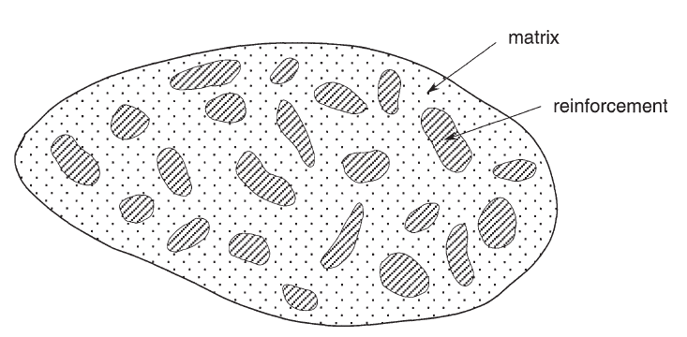
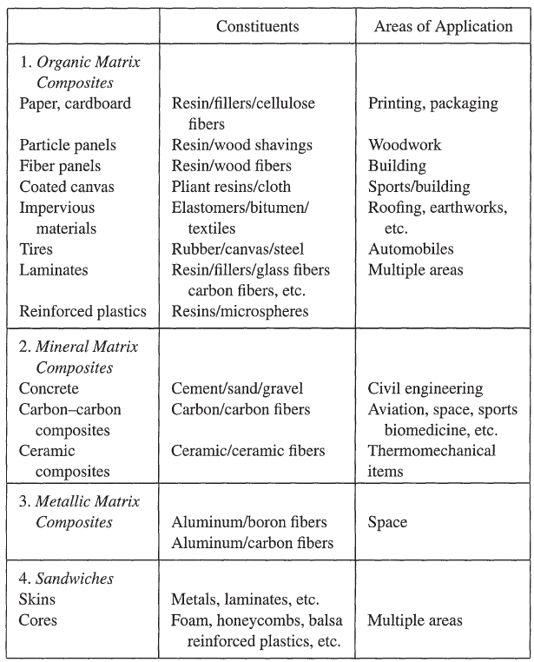
Composite materials
Materials having strong fibres (continuous or noncontinuous) surrounded by a weaker matrix material.
The matrix serves to
  Distribute the fibres.
  Transmit the load to the fibres.
Notes:
Intro
“This slide introduces the fundamental idea of composite materials: a combination of strong reinforcement and a weaker matrix, engineered to achieve properties unattainable by either alone.”
Concept
Reinforcement (fibres or particles): carries most of the load, providing stiffness and strength.
Matrix (polymer, metal, or ceramic): surrounds the reinforcement and has two key roles:
Distributes and supports the fibres.
Transfers external load into the reinforcement.
This synergy is what gives composites their superior performance-to-weight ratio.
Details
The figure illustrates fibres (dark regions) embedded in a matrix (lighter region).
The table highlights the main families of composites:
Organic matrix composites (paper, plastics, laminates).
Mineral matrix composites (concrete, carbon–carbon, ceramics).
Metallic matrix composites (aluminium with boron or carbon).
Sandwich structures (skins and cores for stiffness-to-weight efficiency).
Applications span from packaging and construction to aerospace and automotive, showing the versatility of composites.

Slide 3
Composite Materials (1): Polymer Matrix Composites
Composite | Matrix | Reinforcement or filler | Typical applications | Key advantage (why it is used)
1. Organic (polymer) matrix composites
Paper, cardboard | Resin | Cellulose fibres, fillers | Printing, packaging | Very low cost and weight; resin binds the fibres and improves wet strength and stiffness
Particle board | Resin | Wood shavings | Woodwork | Turns wood waste into large, flat, dimensionally stable panels at low cost
Fibreboard | Resin | Wood fibres | Building | Uniform, grain-free and knot-free; easy to machine with a smooth finish
Coated fabrics | Flexible resin | Woven cloth | Sports, building | Cloth carries tension and resists tearing; resin seals the fabric and resists weather
Waterproof membranes | Elastomer, bitumen | Textiles | Roofing, earthworks | Impermeable and flexible; textile adds tensile and puncture resistance
Tyres | Rubber | Fabric and steel cords | Automotive | Rubber gives grip, damping and sealing; cords carry inflation and road loads and control deformation
Fibre-reinforced laminates | Resin with fillers | Glass, carbon fibres, etc. | Aerospace, marine, automotive, sport | High specific stiffness and strength; properties tailored by ply orientation; good fatigue and corrosion resistance
Syntactic foams | Resin | Hollow microspheres | Lightweight fillers, sandwich cores | Low density with high compressive strength and low water uptake, e.g. deep-sea buoyancy

Slide 4
Composite Materials (2): Mineral, Metal Matrix and Sandwich
Composite | Matrix | Reinforcement or filler | Typical applications | Key advantage (why it is used)
2. Mineral and ceramic matrix composites
Concrete | Cement | Sand, gravel | Civil engineering | Cheap, mouldable, durable and strong in compression; aggregate reduces cost and shrinkage (weak in tension, so steel reinforcement is added)
Carbon–carbon | Carbon | Carbon fibres | Aircraft brakes, rocket nozzles, space, sport, biomedical | Retains strength at very high temperature with excellent thermal shock resistance and low density; oxidises in air at high temperature unless coated
Ceramic matrix composites | Ceramic | Ceramic fibres | High-temperature thermomechanical parts | Ceramic heat resistance with much higher toughness: fibres bridge cracks and prevent sudden brittle failure; lighter than superalloys
3. Metal matrix composites
Aluminium–boron | Aluminium | Boron fibres | Space | Very stiff, strong boron fibres provide high specific stiffness, including in compression; the metal matrix adds good transverse and shear strength, high temperature capability, no moisture absorption, and very low vacuum outgassing.
Aluminium–carbon | Aluminium | Carbon fibres | Space | Very high specific stiffness and near-zero, tailorable thermal expansion for dimensional stability; high thermal and electrical conductivity; no outgassing
4. Sandwich structures (a structural form, not a material)
Skins (face sheets) | — | Metals, fibre-reinforced laminates | Aircraft panels, marine, transport | Skins carry the bending stresses as in-plane tension and compression
Cores | — | Foam, honeycomb, balsa, syntactic foam | Aircraft panels, marine, transport | Light core separates the skins, greatly raising bending stiffness for little added mass, and carries the transverse shear
Notes:
Outgassing is the release of trapped or absorbed gases and volatile substances from a material when exposed to vacuum.

Slide 5
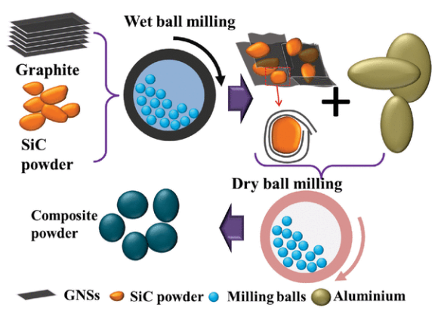
Example-
Metal Matrix Composite
SiC (Silicon Carbide):
Increases strength and stiffness.
Improves wear resistance due its hardness.
Excellent thermal stability.
High thermal conductivity.
Reduced thermal fatigue.
Improves creep resistance
Improves corrosion resistance.
Aluminum matrix composites reinforced with SiC-Graphene Core-Shell Nano particles:
  Metal matrix composites (MMCs) are an advanced group of structural and functional materials, which combine and tailor the properties of metal matrix and reinforcements.
  MMCs have a combination of the inherit ductility and toughness of the matrix (the metal), and high modulus and strength of the reinforcements (such as ceramic particulates).
    The tensile modulus (1.002 TPa) and strength (130 GPa) of graphene is 100 times higher than steel.
    Graphene has excellent electrical conductivity.
    Aluminum is ductile, light weight, corrosion resistant, and has outstanding conductivity
Notes:
Intro
“This slide shows an example of a metal matrix composite (MMC): aluminum reinforced with SiC–graphene core–shell nanoparticles. It demonstrates how metals can be enhanced by combining them with high-performance ceramic and carbon nanomaterials.”
Concept
MMC definition: Structural and functional materials where a metallic matrix (e.g., aluminum) is reinforced with ceramics (SiC) or carbon nanostructures (graphene).
Synergy:
Matrix (aluminum): ductile, lightweight, corrosion-resistant, high conductivity.
Reinforcements (SiC + graphene): high stiffness, hardness, modulus, and excellent thermal/electrical properties.
Processing: ball milling techniques allow uniform distribution of nanoparticles within the aluminum.
Details
SiC (Silicon Carbide) contributions:
Increases stiffness and strength.
Improves wear, creep, and corrosion resistance.
Enhances thermal conductivity and stability.
Graphene contributions:
Exceptional tensile modulus (≈1 TPa) and strength (≈130 GPa) — about 100× steel.
Outstanding electrical conductivity.
Aluminum contributions:
Lightweight, ductile, corrosion-resistant, high conductivity.
Combined result: a composite that is lightweight yet extremely strong, thermally stable, and multifunctional.
For Al SiC graphene metal matrix composites, the main potential applications are where low mass, high stiffness, wear resistance and thermal management are required:
Aerospace: lightweight structural components, brake and wear components, thermal management hardware.
Automotive: brake discs, pistons, cylinder liners and other wear resistant lightweight parts.
Electronics: heat sinks and electronic packaging because of high thermal conductivity and controllable thermal expansion.
Tribological components: bearings, gears and sliding components where SiC and graphene can reduce wear.

Slide 6
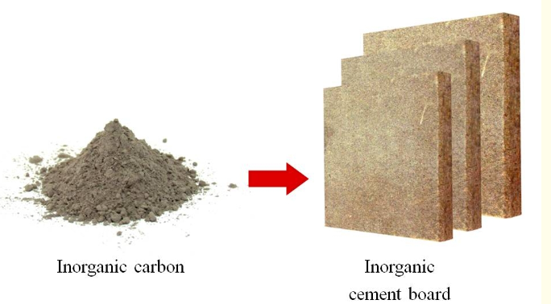
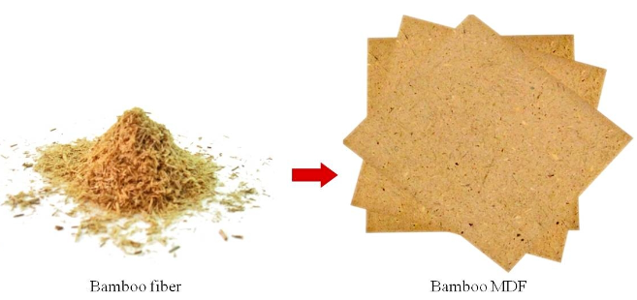
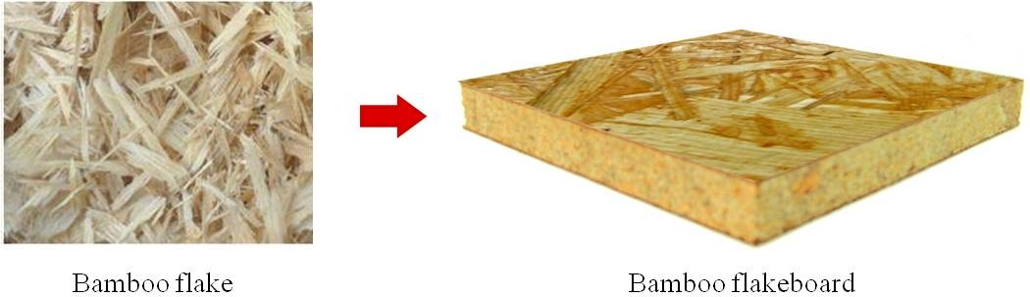
Example-
Bio composite
Thermoplastic polypropylene matrices
Notes:
Intro
“This slide presents an example of a bio-composite — composites that use natural fibers such as bamboo combined with inorganic fillers or polymer matrices to create sustainable structural materials.”
Concept
Bio-composites: Reinforced with natural, renewable fibers (bamboo, flax, hemp, jute) and combined with either polymeric or inorganic matrices.
Motivation: Low cost, renewable resources, reduced environmental impact, biodegradability, and moderate mechanical performance.
Bamboo case: Bamboo is abundant, has high specific strength, and is easily processed into fibers, flakes, or MDF panels.
Details
Reinforcements shown:
Bamboo fibers (fine scale).
Bamboo flakes (larger elements).
Bamboo MDF (medium-density fibreboard).
Bamboo flakeboard.
Matrix options:
Thermoplastic polypropylene.
Inorganic binders (cement boards, inorganic carbons).
Applications:
Panels, furniture, flooring, and eco-friendly construction materials.
Packaging and automotive interior parts when combined with polypropylene.
Performance:
Not as strong as metal or carbon composites, but sufficient for low- to medium-load structural elements.
Key advantage is sustainability and reduced lifecycle environmental footprint.

Slide 7
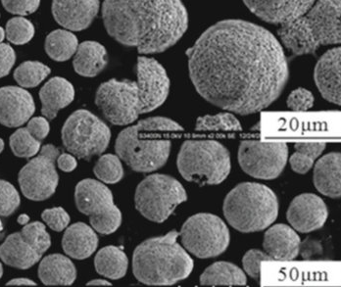
Classification of composite materials
Classification by the form of constituents
  Fibre composites (reinforcement is in the form of continuous or discontinuous fibres)
  Particles composites (reinforcement is particles)
    Example 1: ceramic-metal (cermet) composites adapted to high temperature applications. For example, oxide-based cermet are used for high-speed cutting tools and for protectors at high temperatures.
    Example 2: lead inclusions in copper alloys make them easier to machine. Particles of brittle metals such as tungsten, chromium, and molybdenum incorporated in ductile metals improves their properties at higher temperatures while preserving their ductility at room temperatures.
Notes:
Cermet-ceramic composites refer to a type of material that combines ceramics and metals to enhance the desirable properties of both constituents. These composites are sometimes referred to as cermets (a combination of the words ceramic and metal). They are designed to provide the hardness, wear resistance, and high-temperature stability of ceramics with the toughness, ductility, and thermal conductivity of metals. This balance allows Cermet-ceramic composites to be used in a variety of advanced applications, including aerospace, defense, and high-temperature industrial settings.
Characteristics of Cermet-Ceramic Composites:
High Hardness and Strength: The ceramic component provides high hardness and resistance to wear, making these materials useful in abrasive environments.
Thermal Resistance: Ceramics are generally stable at high temperatures, allowing cermet composites to be used in high-heat applications like gas turbines, cutting tools, and high-temperature engine components.
Toughness and Ductility: The metal component enhances the toughness and ductility of the composite, which can mitigate the brittleness often associated with ceramics alone.
Resistance to Oxidation and Corrosion: Many cermet composites also exhibit excellent resistance to oxidation and corrosion due to the inert nature of ceramics, making them suitable for harsh environments.
Tailored Properties: The proportions of ceramic to metal can be adjusted to create materials with specific mechanical, thermal, and electrical properties for different applications.
Common Applications:
Cutting Tools: Due to their hardness and wear resistance, cermets are used in cutting tools, where they offer a balance between tool life and cost-effectiveness.
Aerospace Components: Cermet composites are employed in high-performance turbine blades and other aerospace parts that must endure extreme temperatures and mechanical stresses.
Armor: The combination of hardness and toughness makes these composites ideal for use in military armour systems, where they provide resistance to penetration without being excessively brittle.
Medical Devices: Cermets can be used in medical applications, such as dental implants or joint replacements, where both biocompatibility and mechanical strength are essential.
Fabrication Techniques:
Powder Metallurgy: A common method where ceramic and metal powders are mixed, pressed, and sintered at high temperatures to create dense composites.
Thermal Spray Coating: Cermet composites can also be applied as coatings to improve the surface properties of metals, such as increasing wear resistance.
Hot Pressing: Involves the application of heat and pressure simultaneously to densify the composite material, producing a more uniform structure with enhanced properties.

Slide 8
Classification of composite materials
Composite materials with an organic matrix can be used only in a temperature range not exceeding 200 to 300°C.
Composite materials with a metallic or mineral matrix are used beyond that up to 600°C for a metallic matrix and up to 1,000°C for a ceramic matrix.
Classification by the nature of constituents
  Organic matrix composites (polymer resins with fillers)
    Natural fibres: jute, hemp, flax, bamboo, cotton, etc.
    Synthetic polymeric fibres: Kevlar (aramid), polyamides, UHMWPE, etc.
    Mineral fibres: glass, carbon.
    Metallic fibres: boron, aluminium.
  Metallic matrix composites (light and ultralight alloys of aluminium, magnesium, titanium)
    Mineral fibres: carbon, silicon carbide (SiC).
    Metallic fibres: boron.
    Metallo-mineral fibres: boron fibres coated with silicon carbide (BorSiC).
  Mineral matrix composites (ceramic)
    Metallic fibres: boron.
    Metallic particles: cermets.
    Mineral particles: carbides, nitrides, etc.
Silicon carbide CMCs are capable of operating temperatures as high as 1,600℃ and have excellent radiation resistance. They have been identified as viable candidates to withstand the conditions within a future fusion reactor. It’s been calculated that a future fusion reactor exhibits a +200% energy yield if SiC/SiC CMCs are deployed instead of steels.
Notes:
Intro
“This slide presents the classification of composite materials based on the nature of their constituents: organic, metallic, and mineral matrix systems.”
Purpose
“The goal is to highlight how different matrix types dictate processing routes, service temperature, and performance limits. This classification helps engineers choose appropriate systems for structural, thermal, or multifunctional applications.”
Concept
Organic matrix composites (OMCs): Polymer resins reinforced with mineral, organic, or metallic fibres. They are lightweight and easily processed but limited to service temperatures of 200–300 °C.
Metallic matrix composites (MMCs): Light alloys of Al, Mg, or Ti reinforced with ceramic or metallic fibres/particles. They extend service temperatures up to 600 °C.
Mineral (ceramic) matrix composites (CMCs): Reinforced ceramics such as carbides and nitrides. They achieve service limits up to 1000 °C or higher.
Details
Organic matrix composites
Reinforcements: mineral fibres (glass, carbon), synthetic polymeric fibres (Kevlar, polyamides), metallic fibres (boron, aluminium).
Applications: aerospace primary structures, automotive components, sporting goods.
Metallic matrix composites
Reinforcements: carbon, SiC, boron, BorSiC (boron fibres coated with silicon carbide).
Applications: aerospace engine components, automotive brakes, armour systems.
Mineral (ceramic) matrix composites
Reinforcements: boron fibres, cermets, carbides, nitrides.
Applications: turbines, high-temperature reactors, hypersonic vehicles.
Special case (highlight box)
SiC-based CMCs can withstand up to 1600 °C and resist radiation.
Fusion energy potential: predicted +200% energy yield if steels are replaced with SiC/SiC composites in reactor environments.
Teaching Point
“Classification is more than labels: it reflects the balance between weight, toughness, thermal stability, and manufacturability. Each system is chosen according to performance–cost–environment trade-offs.”

Slide 9
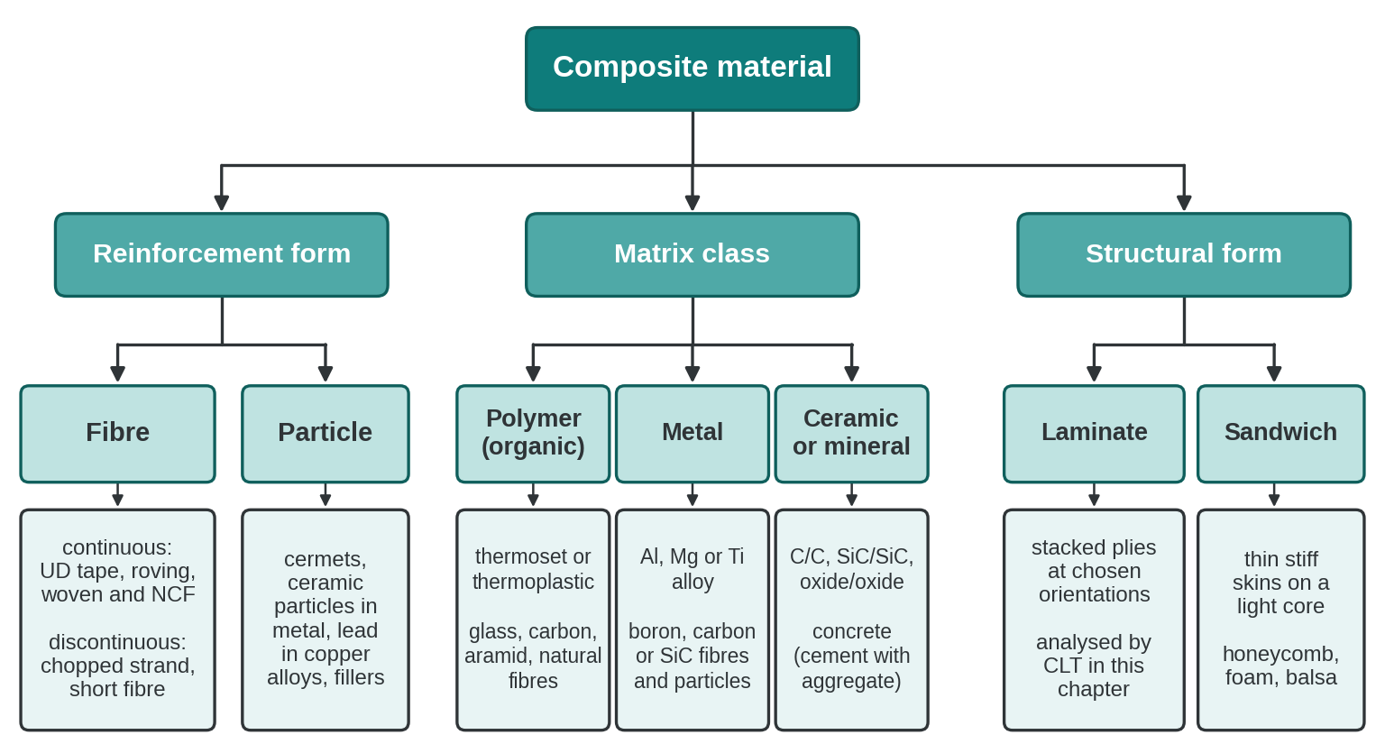
Classification of composite materials by reinforcement form, matrix class and structural form

Slide 10
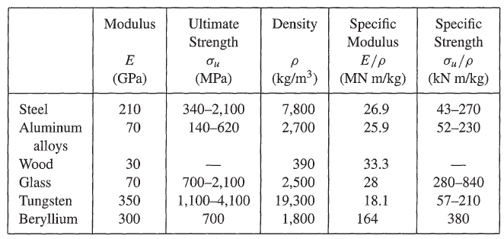
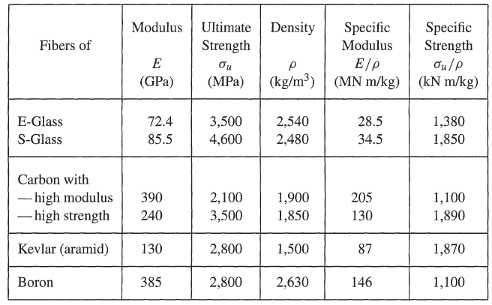
Mechanical characteristics of materials
Common materials made in bulk
Materials made in the form of fibres
Notes:
Intro
“This slide presents the mechanical characteristics of materials, comparing bulk engineering materials with materials made in the form of fibres.”
Purpose
“The goal is to illustrate how strength and stiffness per unit weight differ between bulk materials and high-performance fibres. This comparison underlines why fibres such as carbon, aramid, and boron are preferred in advanced composite design.”
Concept
Bulk materials: Conventional engineering materials like steel, aluminium, wood, glass, tungsten, and beryllium. Their properties depend heavily on density and processing route.
Fibres: Engineered at smaller scales, fibres achieve much higher specific modulus and specific strength compared to bulk forms, making them ideal reinforcements in composites.
Details
Common materials made in bulk
Examples: Steel (E ≈ 210 GPa), aluminium alloys (E ≈ 70 GPa), tungsten (E ≈ 350 GPa), beryllium (E ≈ 300 GPa).
Specific properties: Aluminium has lower density (2700 kg/m³) than steel (7800 kg/m³), which improves specific modulus despite lower absolute stiffness. Tungsten is extremely stiff but very dense, reducing efficiency in weight-sensitive applications.
Applications: Structural frames, load-bearing components, and traditional engineering uses.
Materials made in the form of fibres
Examples: E-glass (E ≈ 72 GPa), S-glass (E ≈ 85 GPa), carbon fibres (high modulus up to 390 GPa, high strength ~240 GPa), Kevlar (130 GPa), boron (385 GPa).
Specific properties: Carbon fibres exhibit outstanding specific modulus (up to 205 MN·m/kg) and specific strength (>1800 kN·m/kg). Kevlar has excellent strength-to-weight ratio, while boron offers high modulus with moderate density.
Applications: Aircraft fuselages, automotive composites, protective gear, turbine blades, and sporting goods.
Special case (highlight box)
Carbon fibres represent a breakthrough: with densities near 1900 kg/m³, they outperform metals in stiffness-to-weight and strength-to-weight metrics.
Kevlar and boron fibres provide unique combinations of toughness, stiffness, and low density, making them indispensable for ballistic protection and aerospace structures.
Teaching Point
“Comparing bulk materials with fibres shows why composite technology is transformative: fibres deliver far superior specific properties, which means higher performance without weight penalties. This is the foundation for lightweight, high-strength engineering design.”
E-glass (Electrical glass) and S-glass (Structural glass) are both types of fiberglass used in composites, but they have distinct differences in terms of their composition, mechanical properties, and applications. Here is a comparison between the two:
1. Composition:
E-glass:
Primarily composed of silica (SiO₂), with additions of alumina (Al₂O₃), calcium oxide (CaO), and other oxides.
It is specifically formulated for excellent electrical insulation properties.
S-glass:
Composed of silica (SiO₂) and alumina (Al₂O₃), but with a higher percentage of alumina compared to E-glass.
S-glass is designed for superior mechanical properties, especially strength.
2. Mechanical Properties:
Strength:
E-glass: Lower tensile strength compared to S-glass. Tensile strength typically ranges from 2000 to 3500 MPa.
S-glass: Has significantly higher tensile strength, typically around 4500 MPa. This makes it ideal for applications requiring high structural integrity.
Modulus of Elasticity:
E-glass: The modulus of elasticity is around 72-73 GPa, which is adequate for many general-purpose applications.
S-glass: Offers a higher modulus of elasticity, typically around 85-90 GPa, providing greater stiffness.
3. Thermal Properties:
E-glass:
Has lower thermal resistance compared to S-glass, with a maximum service temperature of around 300°C.
S-glass:
Higher thermal resistance and can withstand temperatures up to 450°C, making it more suitable for high-temperature environments.
4. Density:
E-glass:
The density of E-glass is typically around 2.54 g/cm³.
S-glass:
Slightly higher density, around 2.48 g/cm³, due to its higher alumina content.
5. Cost:
E-glass:
Less expensive and widely used in various industries due to its lower cost and good balance of properties.
S-glass:
More expensive than E-glass due to its superior mechanical and thermal properties. It is used in specialized applications where higher performance is required.
6. Applications:
E-glass:
Widely used in general-purpose applications such as electrical insulation, boat hulls, automotive parts, pipes, and structural panels. It is the most common form of fiberglass.
S-glass:
Primarily used in high-performance applications such as aerospace components, military armor, ballistic protection, sporting goods (e.g., golf clubs, tennis rackets), and high-stress structural parts in aircraft and spacecraft.
7. Electrical Properties:
E-glass:
Designed for excellent electrical insulation properties, making it suitable for electrical and electronic applications.
S-glass:
While it has good electrical properties, it is not primarily designed for this purpose and is instead optimized for mechanical performance.

Slide 11
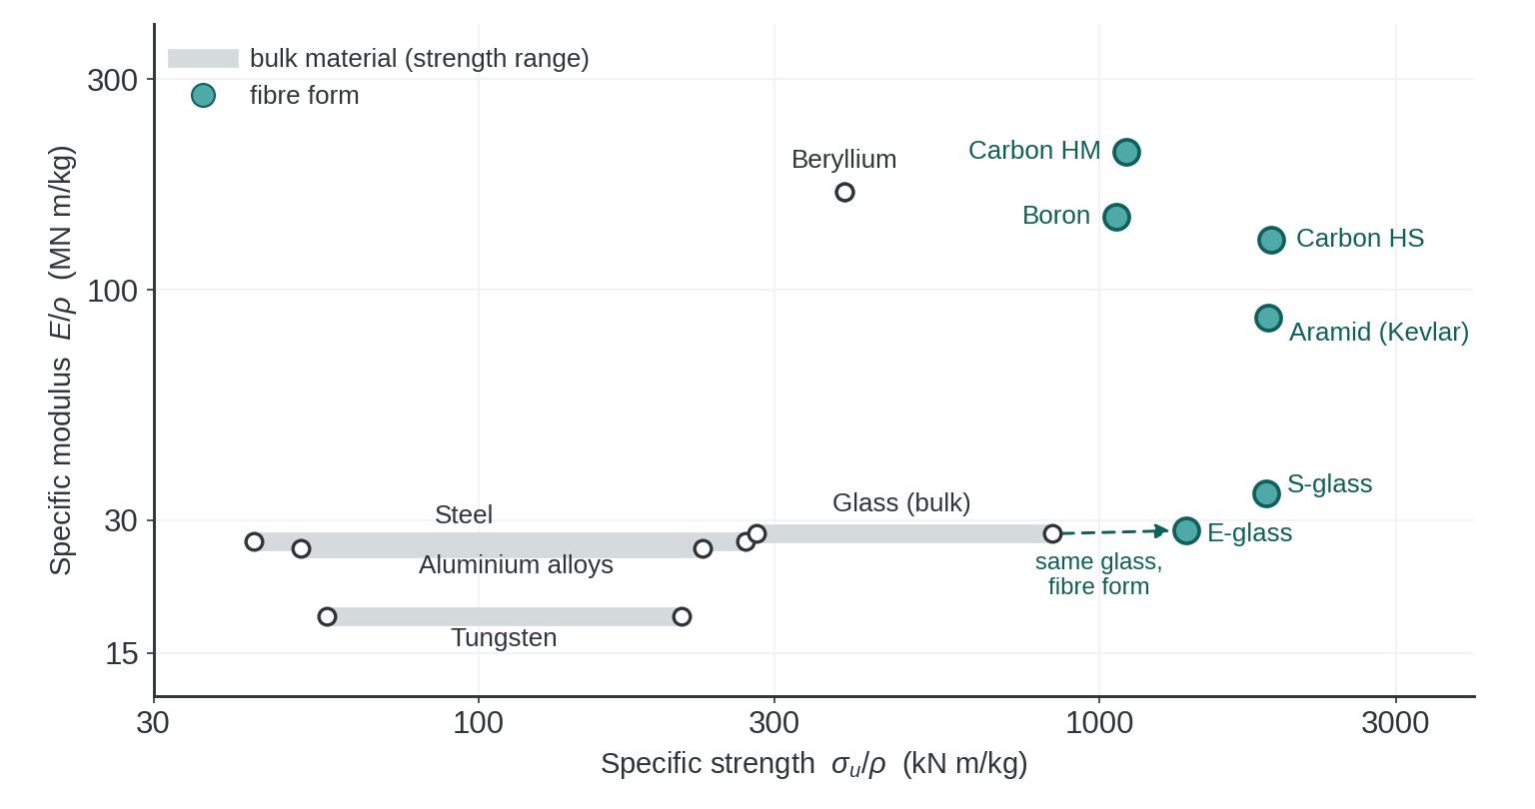
Specific modulus and specific strength of representative bulk materials and fibre forms. The plotted values are comparative rather than design allowables

Slide 12
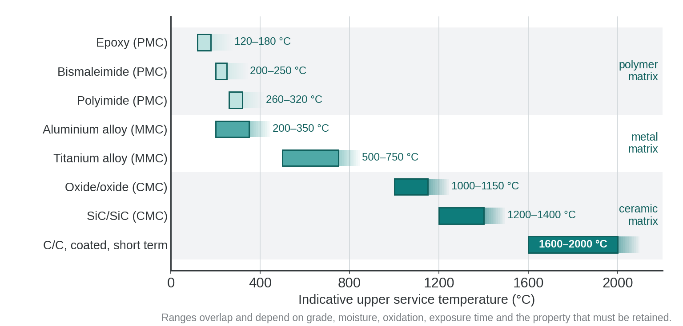
Indicative upper service-temperature ranges for selected polymer-, metal- and ceramic-matrix composite systems

Slide 13
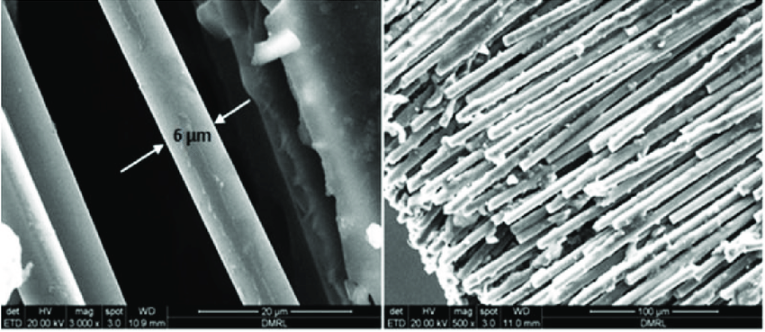
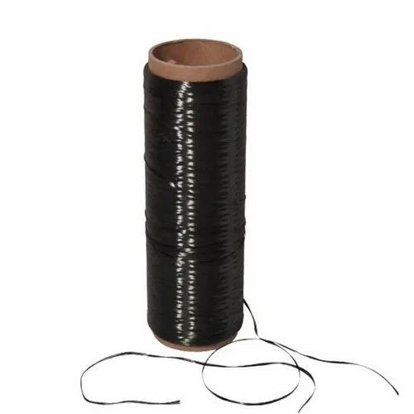
Fibre and cloth reinforcements
Fibre forms:
  Fibers are made with a diameter of a few microns (ten or so).
  Fibres cannot be used in a single form.
  Fibers are gathered into a bundle called a strand or yarn.
  A single fibre is usually called an elementary filament, or monofilament.
Surface tissues: strands and yarns can be used to make surface tissues of various types:
  Mats
  Woven fabrics
  Ribbons
Carbon fibres
Carbon yarns
Notes:
Composites made from woven fabric ribbons and mats are widely used in structural and functional materials due to their superior mechanical properties and flexibility in design. These types of composites are generally based on reinforcing fibers (like glass, carbon, or aramid fibers) embedded in a polymer matrix, though metal matrices and ceramics are also used. Let’s break down these materials:
1. Composite Mats:
Composite mats refer to non-woven or semi-woven fiber reinforcements that are used in composites. These mats are typically used for laminating and reinforcing resin-based systems, offering good mechanical strength and bonding with the matrix.
Types of Mats:
Chopped Strand Mat (CSM): Composed of randomly oriented fibers that are bonded together. It's commonly made of glass fibers and is often used in hand lay-up or spray-up processes.
Advantages: Good isotropic properties (strength is fairly equal in all directions), relatively inexpensive, and offers good bonding with resins.
Applications: Boat hulls, automotive components, and general-purpose fiberglass laminates.
Continuous Filament Mat (CFM): Similar to chopped strand mats, but the fibers are continuous and provide improved mechanical properties, particularly in tension and bending.
Needle Mat: Consists of fibers that are mechanically interlocked through a needling process, offering improved thickness and toughness compared to chopped strand mats.
Stitched Mat: Made from layers of non-woven fiber sheets stitched together. These mats have improved strength and stiffness due to the stitched reinforcement.
2. Woven Fabric Ribbon:
Woven fabrics are produced by interlacing yarns (or fibers) in a systematic manner (warp and weft), creating a two-dimensional fabric with high strength. Woven ribbons are typically narrow strips of these fabrics that are used in specific reinforcement areas where localized strength is needed.
Characteristics of Woven Fabric:
Increased Strength and Stiffness: The systematic interlacing of fibers in the warp and weft directions provides anisotropic mechanical properties, which can be tailored depending on the direction of applied loads.
Flexibility in Design: Woven fabrics can be produced in a wide variety of architectures, such as plain weave, twill weave, and satin weave, depending on the required mechanical performance and flexibility.
Tightly Controlled Thickness: The woven nature of the fabric allows for precise control over thickness and fiber content, which is critical in applications like aerospace, automotive, and sports equipment.
Common Types of Woven Fabrics in Composites:
Glass Fiber Fabrics: These are the most commonly used woven fabrics, providing good strength, stiffness, and chemical resistance at a relatively low cost.
Carbon Fiber Fabrics: Offer superior stiffness-to-weight ratios, excellent fatigue resistance, and high thermal conductivity, making them ideal for high-performance applications like aerospace, automotive, and sporting goods.
Aramid (Kevlar) Fabrics: Known for their impact resistance and toughness, these fabrics are often used in ballistic and impact-resistant applications such as body armor or helmets.
Applications of Woven Fabric Ribbons:
Localized Reinforcement: Woven fabric ribbons can be applied to specific areas where localized strength or stiffness is needed (e.g., edge reinforcements in aerospace or automotive panels).
Tapes for Seam Strengthening: In structures like boat hulls or tanks, woven fabric ribbons can reinforce seams or joints to improve structural integrity.
Structural Components: Woven fabric composites are used in load-bearing structures due to their superior strength, particularly in aerospace and automotive industries.
3. Differences Between Mats and Woven Fabrics:
Fiber Orientation: Mats generally have random or semi-random fiber orientation, providing more isotropic mechanical properties, whereas woven fabrics have oriented fibers that provide anisotropic properties tailored to specific load directions.
Strength: Woven fabrics generally offer higher strength and stiffness compared to mats due to their orderly structure, but mats can be more cost-effective and easier to handle, especially in large-scale applications.
Application: Mats are often used for bulk reinforcement or as a base layer, while woven fabrics (especially in ribbon form) are used in applications that require precise strength and stiffness, such as aerospace components, sporting goods, and automotive body panels.
Manufacturing Processes:
Hand Lay-Up: Involves placing woven fabric or mat reinforcements into a mould and manually applying resin. This is a traditional process used in boat building, automotive parts, and more.
Resin Transfer Moulding (RTM): A closed-mould process where resin is injected into a mould containing pre-placed woven fabrics or mats, leading to high-quality, high-strength composites.
Filament Winding: Used to create cylindrical or spherical parts (such as pipes or tanks) by winding continuous fibers (often in the form of woven ribbons or tapes) onto a rotating mandrel.
Conclusion:
Composite mats are cost-effective, generally isotropic reinforcements used for bulk properties, while woven fabric ribbons offer high precision and strength for specific, directional reinforcements. Both materials are crucial in different industries, including aerospace, automotive, marine, and construction, and the choice between mats and woven fabrics depends on the performance requirements and application specifics.

Slide 14
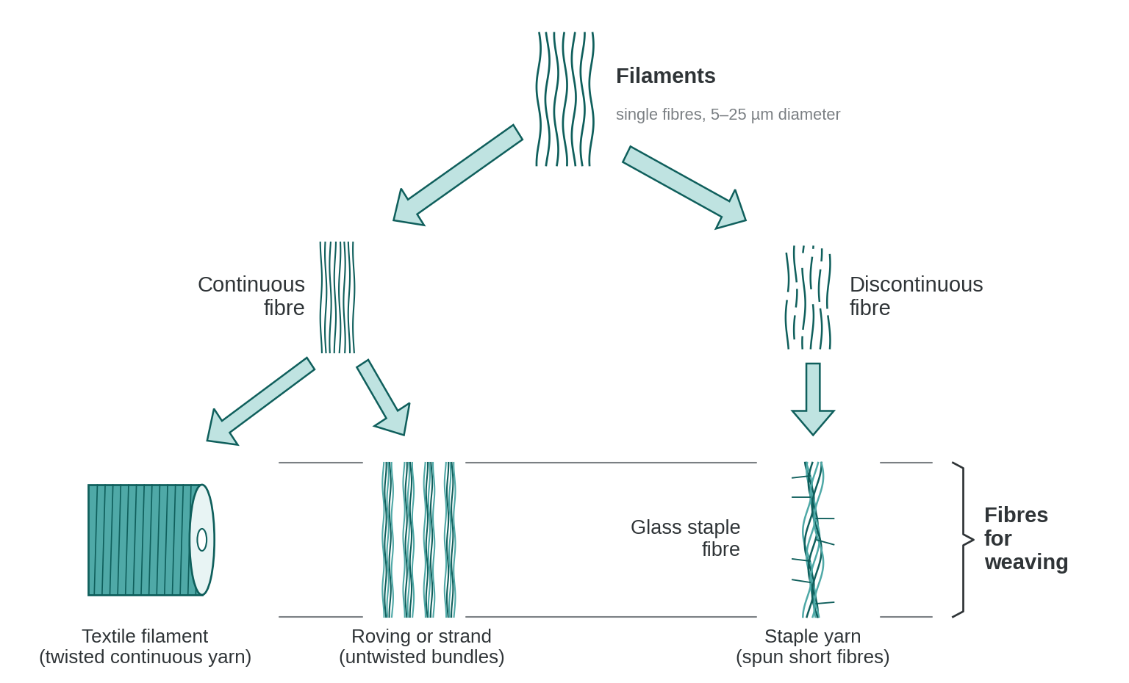
Fibre and cloth reinforcements-
Different fibre forms
Notes:
Breakdown:
Filaments: The basic building blocks, which can be classified into:
Continuous fibers: These are long, uninterrupted fibers that are typically used in applications requiring high strength and stiffness, such as roving or strand.
Discontinuous fibers: These are shorter fibers, which are often used in applications where ease of processing and more isotropic properties are required.
Continuous Fiber Pathway:
Textile Filament: Continuous filaments can be processed into textile filaments, which can be woven into fabric or ribbons for reinforcement.
Roving or Strand: Continuous filaments are also bundled together to form roving or strands, which are often used in processes like filament winding or pultrusion.
Discontinuous Fiber Pathway:
Glass Staple Fiber: This refers to chopped or staple glass fibers, which are often used in chopped strand mats or for molding applications.
Fibers for Weaving: Both types of fibers can be further processed into materials suited for weaving, contributing to the fabrication of composite structures.
This process highlights the versatility of fiber reinforcements in composite materials, where the form of the fiber (continuous or discontinuous) plays a key role in determining the properties of the final composite structure. Continuous fibers offer superior directional strength, while discontinuous fibers are used when more uniform, isotropic properties are needed.

Slide 15
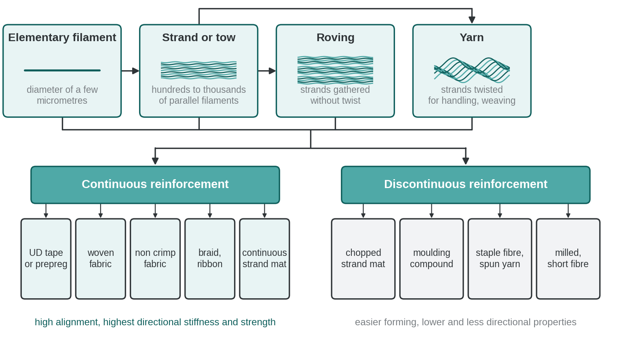
Relationship between elementary filaments, strand or tow, roving, yarn, and representative continuous and discontinuous reinforcement products.

Slide 16
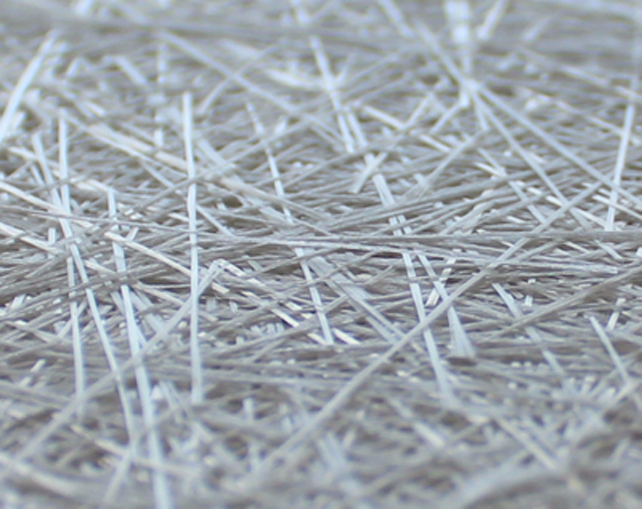
Fibre and cloth reinforcements-
Mats
Mats
  Sheets of continuous or chopped strands randomly distributed in the plane.
  Fibres are held together using a soluble binder.
  Random fibre orientation gives approximately isotropic in plane properties, although the material remains anisotropic through the thickness.
  There are often two types, i.e. chopped strand mats (hardly deformable) and continuous strand mats (complex curves by regular stretching in all directions good for moulding).
Notes:
Definition
“Mats are sheets of fibres—either continuous filaments or chopped strands—laid down in random orientations within a single plane. Unlike a woven fabric, there’s no deliberate pattern. The fibres are lightly bonded with a binder that can dissolve or soften during resin infusion so the mat stays intact until we wet it out.”
Key property
“Because the fibres point in all directions, the mat behaves almost isotropically in its own plane. That means the mechanical properties—stiffness, strength—are roughly the same no matter which way you pull, which is quite different from a unidirectional tape where properties are very directional.”
Types of mats
“We usually talk about two commercial types.
• Chopped-strand mats—these are made from short pieces of glass or carbon fibre. They’re stiff, not very drapable, and give good bulk but limited directional strength.
• Continuous-strand mats—these use long continuous filaments that loop and swirl. They can stretch and drape, so they conform to complex mould shapes and curves much more easily.”
Design implications
“So if you need an inexpensive reinforcement for a part with gentle curves and you don’t need high directional strength—think boat hulls, panels, fairings—a chopped-strand mat is ideal. If you’re trying to cover complex geometry and need better in-plane properties, a continuous-strand mat lets you do that without breaking fibres.”
Wrap-up
“The takeaway is that mats are the go-to when you want quasi-isotropic reinforcement, fast lay-up, and the ability to fill space, but you accept lower strength and stiffness than carefully oriented fabrics or tapes.”

Slide 17
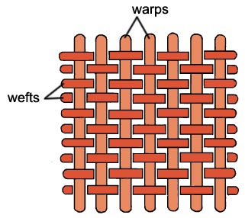
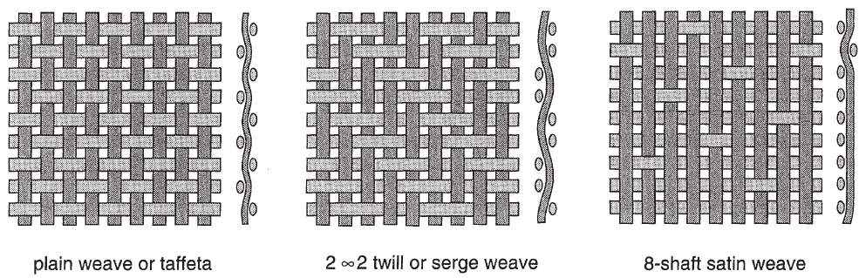
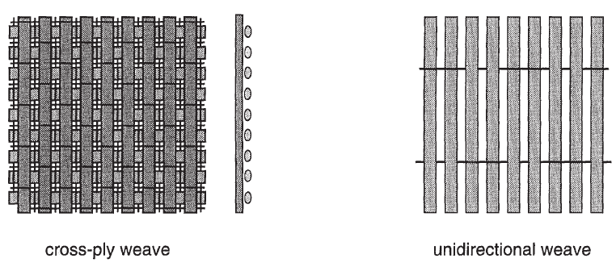
Fibre and cloth reinforcements-
Woven fabrics
Woven fabrics
  Lengthwise strand is called warp.
  Crosswise strand is called weft (or fill).
  They may have various types of weave as shown in the opposite figure.
Notes:
Basic structure
“Woven fabrics are made from two perpendicular sets of fibres.
• The warp runs lengthwise—the long direction of the roll.
• The weft, sometimes called the fill, runs crosswise.
The warp provides continuous strength along the roll, while the weft locks everything together across the width.”
Weave types
“By changing the way warp and weft interlace, we create different mechanical behaviours and drape characteristics. Look at the figures:
Plain weave or taffeta: a simple over-under pattern. It gives excellent stability and resists fraying, but it’s stiff and not very drapable.
2×2 twill: each weft passes over two warp strands, then under two. This produces the familiar diagonal rib and more flexibility—ideal when we need the fabric to conform to complex shapes.
8-shaft satin: long floats of yarn produce a smooth surface and high drape, often used for aerospace skins where we need a good surface finish.
Cross-ply weave: essentially two layers oriented at 0 and 90 degrees for balanced properties.
Unidirectional: technically not a traditional “weave,” but a fabric where almost all fibres run in one direction and a light transverse thread just holds them together. This maximises strength along a single axis.”
Design implications
“Choice of weave influences resin flow, surface finish, and how stresses transfer between fibres. Plain weave resists distortion, twill is easier to drape, satin gives high fibre straightness and smoothness, and unidirectional offers the highest directional stiffness.”
Wrap-up
“So when you specify a composite lay-up, you’re not just choosing carbon or glass—you’re also choosing the weave, which directly sets how the laminate will handle loads and conform to a mould.”

Slide 18
Fibre and cloth reinforcements-
Woven fabrics
Plain weave
  Mechanical properties identical in both weft and warp directions.
  It is not very deformable.
Twill weave (2 x 1 or 2 x 2)
  Good drapability in the case of complex shapes.
  In a 2 x 1 twill weave, weft threads pass over one and under two warp threads, and in a 2 x 2 twill the weft threads pass over two and under two warp threads.
Satin weave (4 or 8)
  Excellent drapability of complex shapes (such as wing skin).
  4 or 8, indicating that the warp threads pass over 4 or 8 weft threads.
Cross-ply weave
  Crossed threads are held together by fine thread.
  Very high performance.
Unidirectional weave
  Best performance.
Notes:
Plain weave
“Start with the simplest: the plain weave, sometimes called taffeta.
Warp and weft alternate one over, one under.
Because the fibres are locked in tightly and evenly, the mechanical properties are virtually identical in the warp and weft directions, giving balanced strength.
But that tight interlacing also makes it the least drapable—hard to form over compound curves.”
Twill weave (2×1 or 2×2)
“Next is twill. You’ll notice the diagonal pattern in the figure.
Here the weft goes over one and under two warps for a 2×1, or over two and under two for a 2×2.
That extra float gives better drape and flexibility, so it’s easier to fit complex shapes while still keeping good in-plane strength.
Many aerospace and automotive skins use 2×2 twill for precisely that reason.”
Satin weave (4 or 8)
“Push the floats even longer and you have satin weaves—4-shaft or 8-shaft in the examples.
Warp fibres pass over 4 or 8 weft threads before dipping under.
The result is a very smooth surface and exceptional ability to conform to complex moulds, such as wing skins, but with a little less interlacing stability than plain or twill.”
Cross-ply weave
“Here layers are woven at 0 and 90 degrees and held by fine stitching or binder threads.
It’s a way to create quasi-isotropic laminates in a single fabric, giving high stiffness and strength in both principal directions.”
Unidirectional weave
“Finally, unidirectional fabric isn’t a true weave.
Almost all fibres run in one direction with a light cross thread just to hold them together.
It provides the highest strength and stiffness along that primary axis and is the go-to when you need maximum performance in a single load direction.”
Closing
“The key takeaway: weave style controls fibre alignment, drapability, surface finish, and resin flow.
When you design a composite lay-up, you choose not only the fibre type but also the weave that best balances strength, formability, and manufacturing ease.”

Slide 19
Laminate theory
This section aims to address mechanical analysis of continuous Fibre Reinforced Composite Polymers (CFRP).
The fundamentals required to understand the mechanical behaviour through the theory of elasticity will be discussed.
In considering the forthcoming behaviours, simplified assumption are made:
  The laminate is assumed to be thin.
  The behaviour is 2-Dimensional (2D) elastic.
Notes:
Opening
“Now we move into laminate theory, the backbone of mechanical analysis for continuous fibre-reinforced polymer composites, or CFRPs.”
Purpose
“This section introduces the fundamentals of how a composite laminate carries load, using classical elasticity as our starting point.
We’re not solving the full 3-D continuum just yet—we start with simplifying assumptions to keep the maths tractable and to highlight the dominant behaviour.”
Simplified assumptions
“Two key simplifications guide the classical laminate theory:
Thin-laminate assumption
We treat each laminate as thin relative to its in-plane dimensions.
That lets us neglect through-thickness stresses and assume that plane sections remain plane after deformation.
Two-dimensional elastic behaviour
Because through-thickness stresses are small, we model each ply with 2-D orthotropic elasticity.
This means we consider only in-plane stresses—normal and shear in the x-y plane—and their coupling to bending.”
Implication
“These assumptions allow us to build the A-B-D matrices you’ll see later, which relate in-plane forces and bending moments to strains and curvatures.
It’s a powerful framework that captures how stacking sequence, fibre orientation, and material properties combine to give the overall laminate response.”

Slide 20
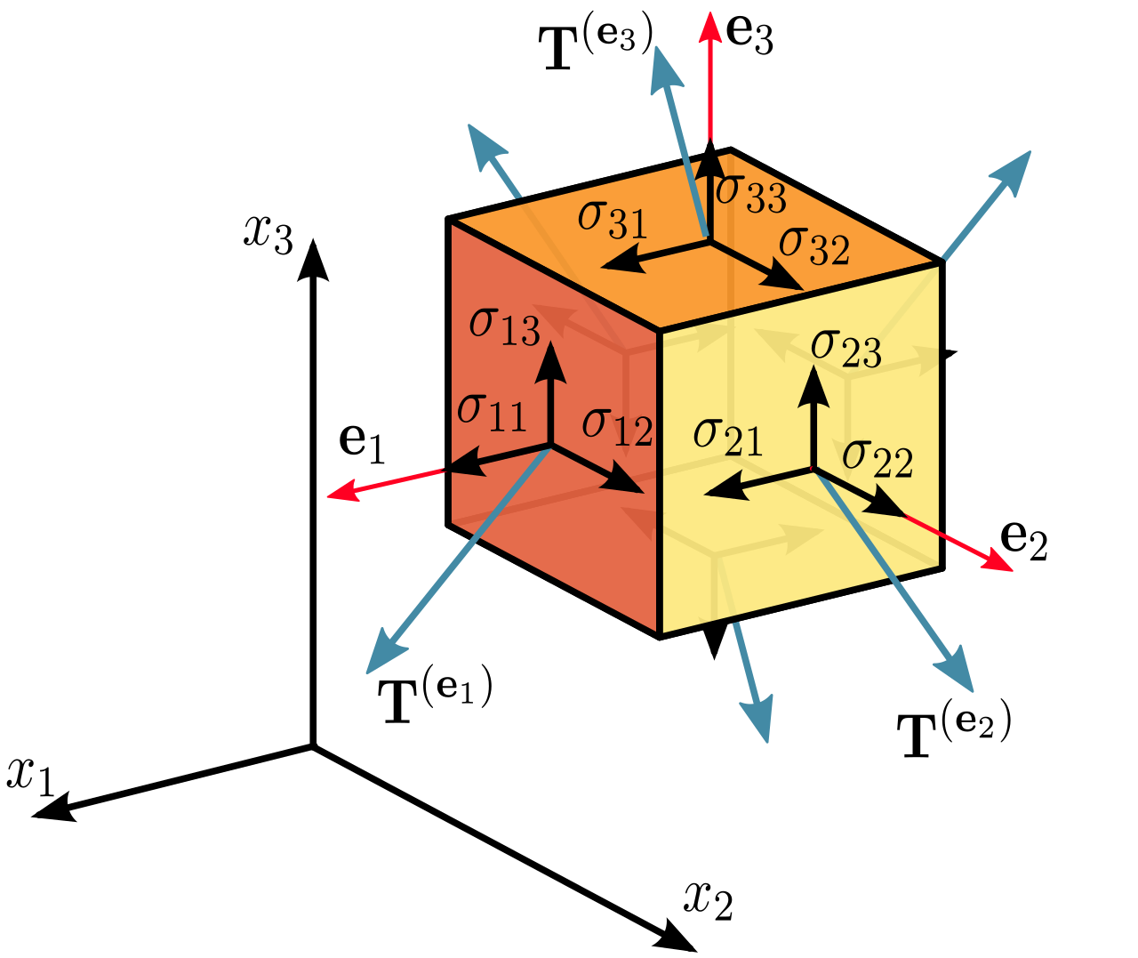
Elastic theory-
Reminder
Direct stresses are positive if they point out of the surface, i.e. tensile stresses.
Shear stresses are positive if they act in the positive direction of the relevant axis in a plane on which the direct tensile stress is in the positive direction of the axis.
Notes:
Intro
“Before we jump deeper into laminate mechanics, let’s pause for a quick elastic theory reminder—a refresher on stress sign conventions and the stress tensor.”
Direct stresses
“Start with the normal or direct stresses, the σ11, σ22, σ33 on the cube faces.
By convention, these are positive when they act outward from the surface.
In other words, tensile stresses—pulling the face away from the body—are positive.
Compressive stresses, pushing in, are negative.”
Shear stresses
“Now for the shear components, like σ12 or σ13.
These are positive if they act in the positive direction of the axis they’re named for, on the plane whose normal is the first subscript.
So σ12 is the shear stress acting in the x2 direction on the plane whose normal is x1.
Think ‘first index = plane normal, second index = direction of action.’”
Visualising the cube
“On the right, each face of the cube shows the stresses.
The arrows coming off each face are the traction vectors T(e1), T(e2), T(e3).
Together these nine components form the stress tensor, which we’ll use in two-dimensional form when we analyse a thin laminate.”
Why it matters
“Getting these signs right is critical.
If you reverse a sign convention in composite calculations, you can predict the wrong failure mode or incorrectly transform stresses between coordinate systems.”

Slide 21
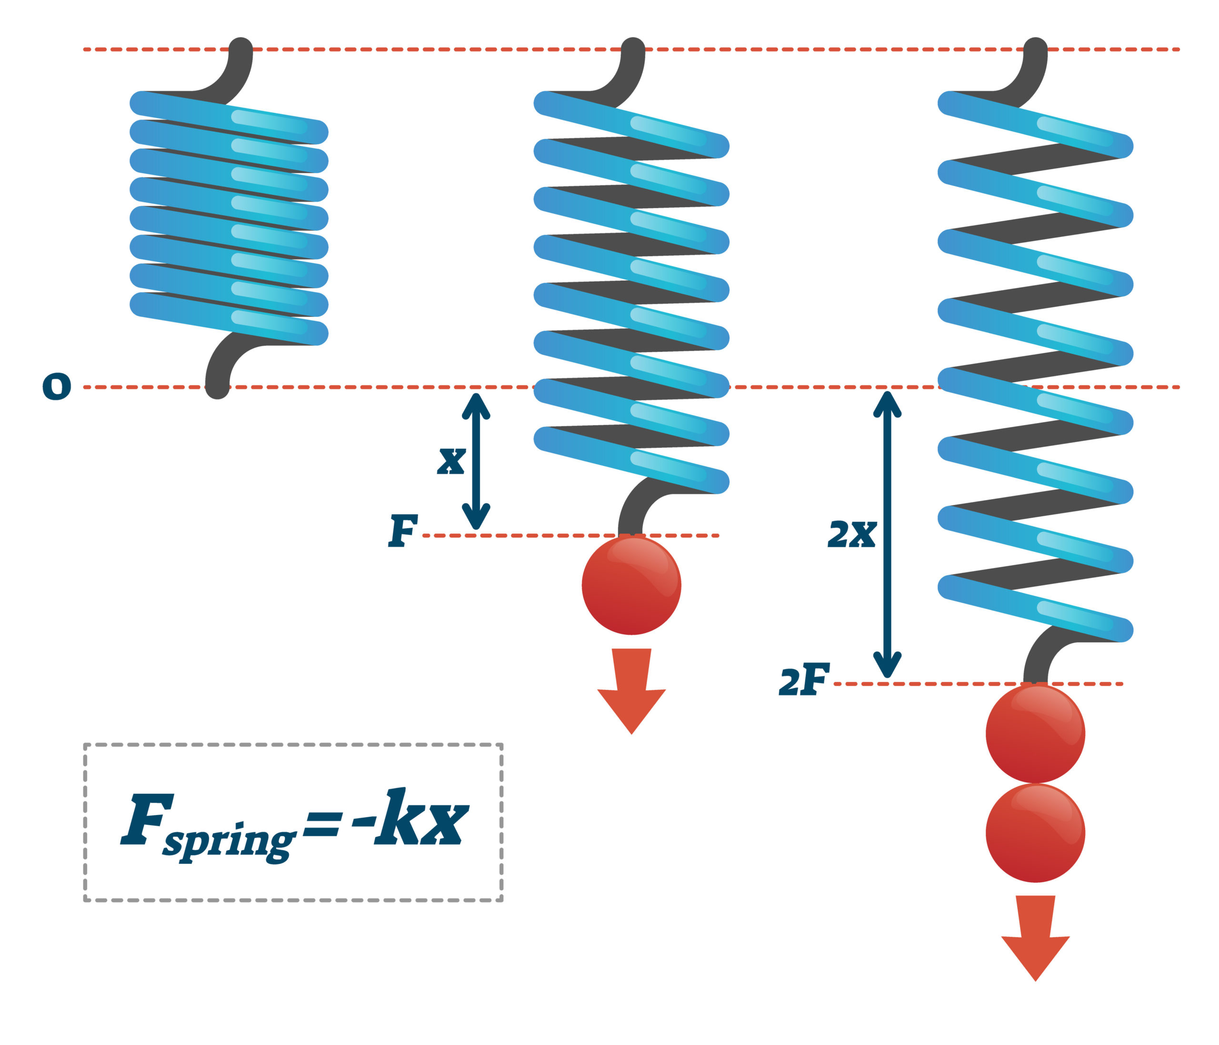
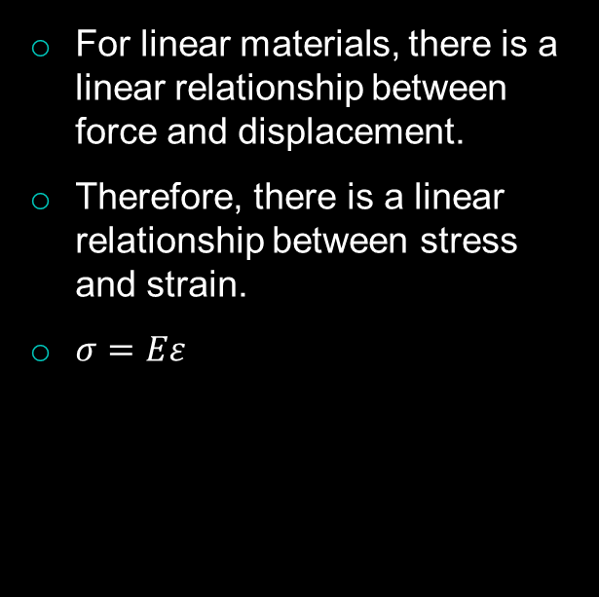
Hooke’s law-
Reminder
For linear materials, there is a linear relationship between force and displacement.
Therefore, there is a linear relationship between stress and strain.
$σ=Eε$
Notes:
Opening
“Before we dive deeper into composite stress analysis, let’s revisit a cornerstone of elasticity—Hooke’s law.”
Concept
“For materials that respond linearly, force and displacement are proportional.
If you double the force on a spring, the displacement doubles.
This is captured by the familiar equation $F=kx$, where $k$is the spring constant.”
From force–displacement to stress–strain
“Scale that idea up to a solid material.
Instead of a single wire or spring, we talk about stress—force per unit area—and strain—the fractional change in length.
The same proportionality applies:
$$σ=E ε$$
where $E$is the Young’s modulus.
So doubling the strain doubles the stress, as long as we stay in the elastic region.”
Visual on the slide
“Look at the right side:
– The first spring is unloaded.
– Add a force $F$, it stretches by $x$.
– Double the force to $2F$, the stretch doubles to $2x$.
That’s the linear response we assume for many metals and for composite fibres in their elastic range.”
Key reminder
“This relationship is the foundation for the laminate theory we’re building toward.
Once we know $E,$for a given ply direction, we can predict stresses from measured strains and vice versa—essential for design and failure analysis.”

Slide 22

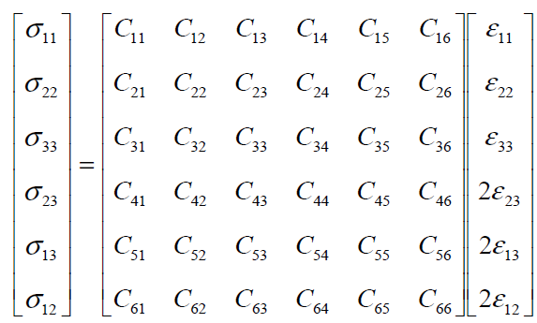
Elastic theory-
Stiffness matrix 1
The stiffness matrix is symmetric
Only 21 of the 36 elastic constants are unknown
Generalised Hooke’s law:
For material with no plane of symmetry (anisotropic):
Symmetric
Notes:
Opening
“Moving deeper into elastic theory, we introduce the stiffness matrix—the mathematical backbone that links stress and strain in three dimensions.”
Generalised Hooke’s law
“Recall that in simple tension we wrote σ = E ε.
For a fully anisotropic solid we need the tensor form:
$$σ_{i}=C_{ij} ε_{j}$$
Here σ is the stress vector, ε is the strain vector, and C is the stiffness matrix that holds all the elastic constants.”
Anisotropic material
“In the most general case—no planes of symmetry—the material could respond differently along every direction and shear combination.
That means six independent stress components and six independent strain components, so C is a 6×6 matrix with 36 coefficients.”
Symmetry of the matrix
“But energy conservation requires C to be symmetric.
That cuts the number of unique elastic constants from 36 to 21, as highlighted on the slide.
So Cij = Cji, which halves the experimental work needed to characterise a material.”
Visual cue
“On the cube to the right you see the stress components σ11, σ22, σ33, and the shear terms like σ12 and σ23.
These populate the stress vector.
Each is linearly related to all six strains through the C matrix.”
Why it matters for composites
“For composites like CFRP, additional material symmetries—orthotropy, transversely isotropy—reduce the unknowns even further.
We’ll exploit those reductions to simplify the stiffness matrix for plies and then build up the laminate stiffness matrices A, B, and D.”
Note:
For ordinary engineering solids—metals, polymers, ceramics, fibre composites—the stiffness matrix is always symmetric. That symmetry follows from two very general requirements:
the existence of a strain-energy function: A strain-energy function exists when the energy stored in a unit volume of material depends only on its current strain, W = W(ε). How that strain was reached makes no difference. When it exists, stress is the derivative of W with respect to strain, and the stiffness matrix is symmetric automatically.
Maxwell–Betti reciprocity: For an elastic body, the work done by the loads is stored entirely as strain energy. That energy depends only on the final deformed state, not on how the body got there. Apply load A then load B, or B then A, or both together in any proportion: if the final loads are the same, the stored energy is the same. Nothing is dissipated, and no energy is supplied from inside the material.
To break that symmetry a material must violate one of those conditions. Several research-grade examples exist, but they are not conventional structural materials:
Active or “odd” elastic media – Suspensions of self-propelled particles, active gels, or specially driven metamaterials can display odd elasticity, where internal energy is continually supplied and the elastic tensor gains antisymmetric parts. (Chen et al., Nature Physics 2021).
Nonreciprocal/gyroscopic lattices – Mechanical metamaterials with rotating masses or gyroscopic elements break time-reversal symmetry and show effective nonsymmetric stiffness under dynamic excitation (Nash et al., PNAS 2015).
Willis-type dynamic composites – Periodic media under high-frequency loading can exhibit effective constitutive relations with coupling terms that are not symmetric, though the underlying constituents remain ordinary (Milton & Willis, Proc. R. Soc. A 2007).
Cosserat or micropolar solids – Engineered lattices with couple-stresses and micro-rotations possess asymmetric stress and need extra moduli beyond the classical 6×6 matrix.
So yes, materials with an effective nonsymmetric stiffness matrix exist, but they are exotic active or architected metamaterials, not everyday metals, ceramics, or polymer composites. For all passive, static engineering materials you design with, the classical 6×6 stiffness matrix remains symmetric.

Slide 23
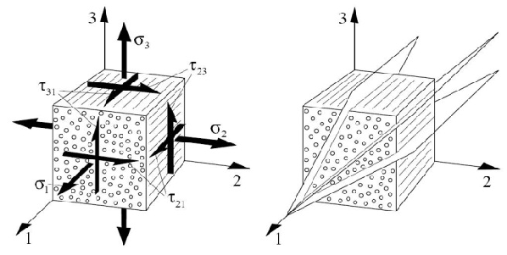
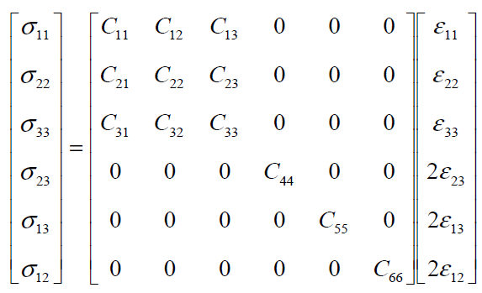
Elastic theory-
Stiffness matrix 2
If material symmetry exists, then the stiffness matrix reduces.
See the example below which is shown for an orthotropic material:
[C] is called the stiffness matrix.
In this case, elastic constants have reduced from 21 to 9.
A material is orthotropic if its mechanical or thermal properties are unique and independent in three mutually perpendicular directions.
Examples of orthotropic materials are wood, many crystals, CFRP laminates, and rolled metals.
Notes:
Introduction
“Having seen the fully anisotropic stiffness matrix with 21 independent constants, let’s look at what happens when a material has symmetry—specifically orthotropic symmetry.”
Material symmetry cuts down constants
“When planes of material symmetry exist, many coupling terms in the stiffness matrix drop to zero or become equal.
For an orthotropic material—one with three mutually perpendicular planes of symmetry—the independent elastic constants shrink from 21 to just 9.”
Matrix form
“On the left you can see the 6×6 stiffness matrix [C].
Notice the zeros in the off-diagonal shear–normal coupling blocks.
Those zeros represent directions where stress and strain are uncoupled because of the orthotropic symmetry.”
Definition of orthotropy
“A material is orthotropic if its mechanical properties are unique and independent along three perpendicular directions.
That means the 1, 2, and 3 axes shown in the figure are principal material directions—properties along each are different, but there’s no coupling between them.”
Examples
“Classic examples include:
• Wood, which has different stiffness along grain, across grain, and through the thickness.
• Continuous-fibre composites such as CFRP laminates, where fibre, transverse, and through-thickness properties differ.
• Rolled or extruded metals, where processing creates strong directionality.”
Key point
“By recognising and exploiting material symmetry, we greatly simplify analysis and reduce the amount of experimental testing needed to characterise a material—from 21 independent stiffness constants down to just 9.”

Slide 24

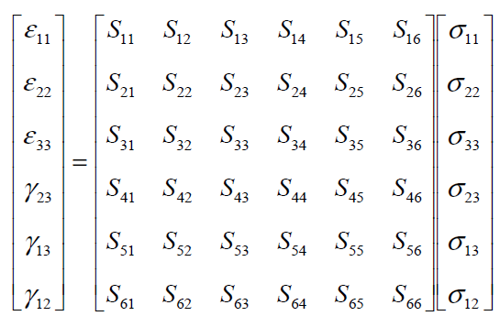
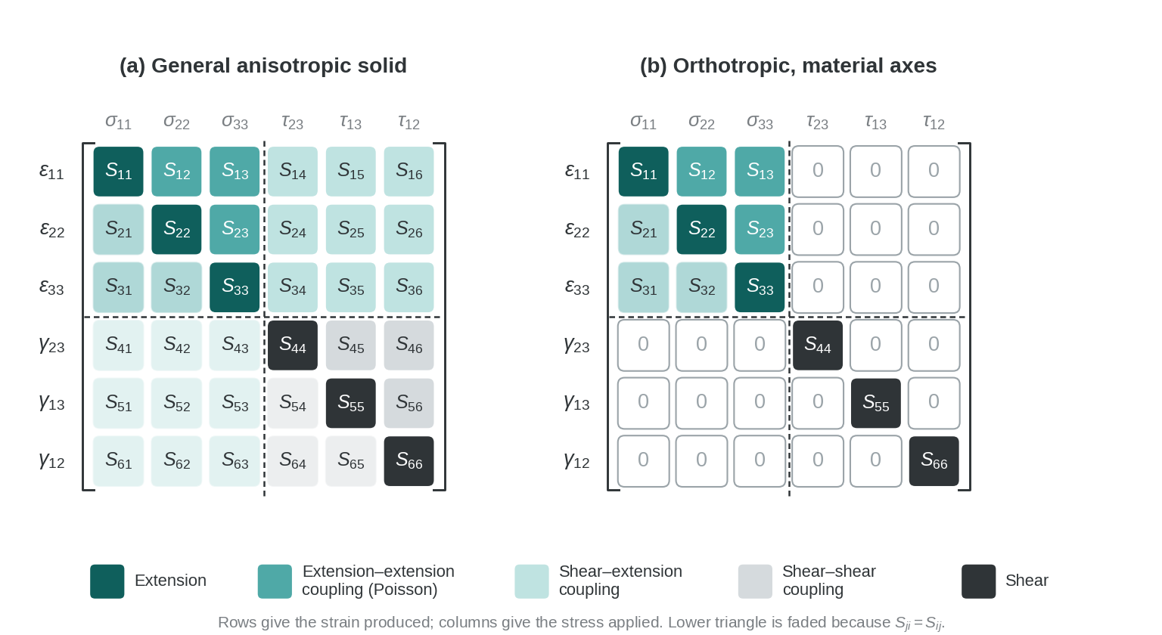
Elastic theory-
Compliance matrix 1
Solving the generalised Hooke’s law for strains leads to:
[S] is called the compliance matrix.
For an anisotropic material, there is marked coupling between applied stresses and the resulting deformations (strains):
Notes:
Intro
“Having covered the stiffness matrix [C], we now look at its inverse—the compliance matrix, noted [S].”
From stiffness to compliance
“Generalised Hooke’s law can be rearranged from
$$σ_{i}=C_{ij} ε_{j}$$
to give strain as a function of stress:
$$ε_{i}=S_{ij} σ_{j},$$
where [S] is simply the inverse of [C].
Every entry $S_{ij}$ tells you how much strain in the i-direction results from a unit stress in the j-direction.”
Matrix structure
“On the left you see the full 6×6 form for a completely anisotropic solid.
The diagonal terms, like S11 or S22, represent the familiar direct relationships—extension along one axis due to stress along the same axis.
The off-diagonal terms capture coupling between directions.”
Coupling effects
“Check the highlighted blocks on the right:
Extension–extension coupling: terms like S12 show that stress in direction 2 can cause strain in direction 1.
Shear–extension coupling: terms S14, S15, etc., indicate that a pure shear stress can produce a normal strain.
Shear–shear coupling: off-diagonal shear terms represent interaction between different shear planes.
Such couplings are pronounced in anisotropic composites such as unidirectional CFRP.”
Key point
“The compliance matrix is powerful because it tells you directly how an applied stress state transforms into measurable strains, which is exactly what we use in strain-gauge experiments or laminate analysis.”

Slide 25
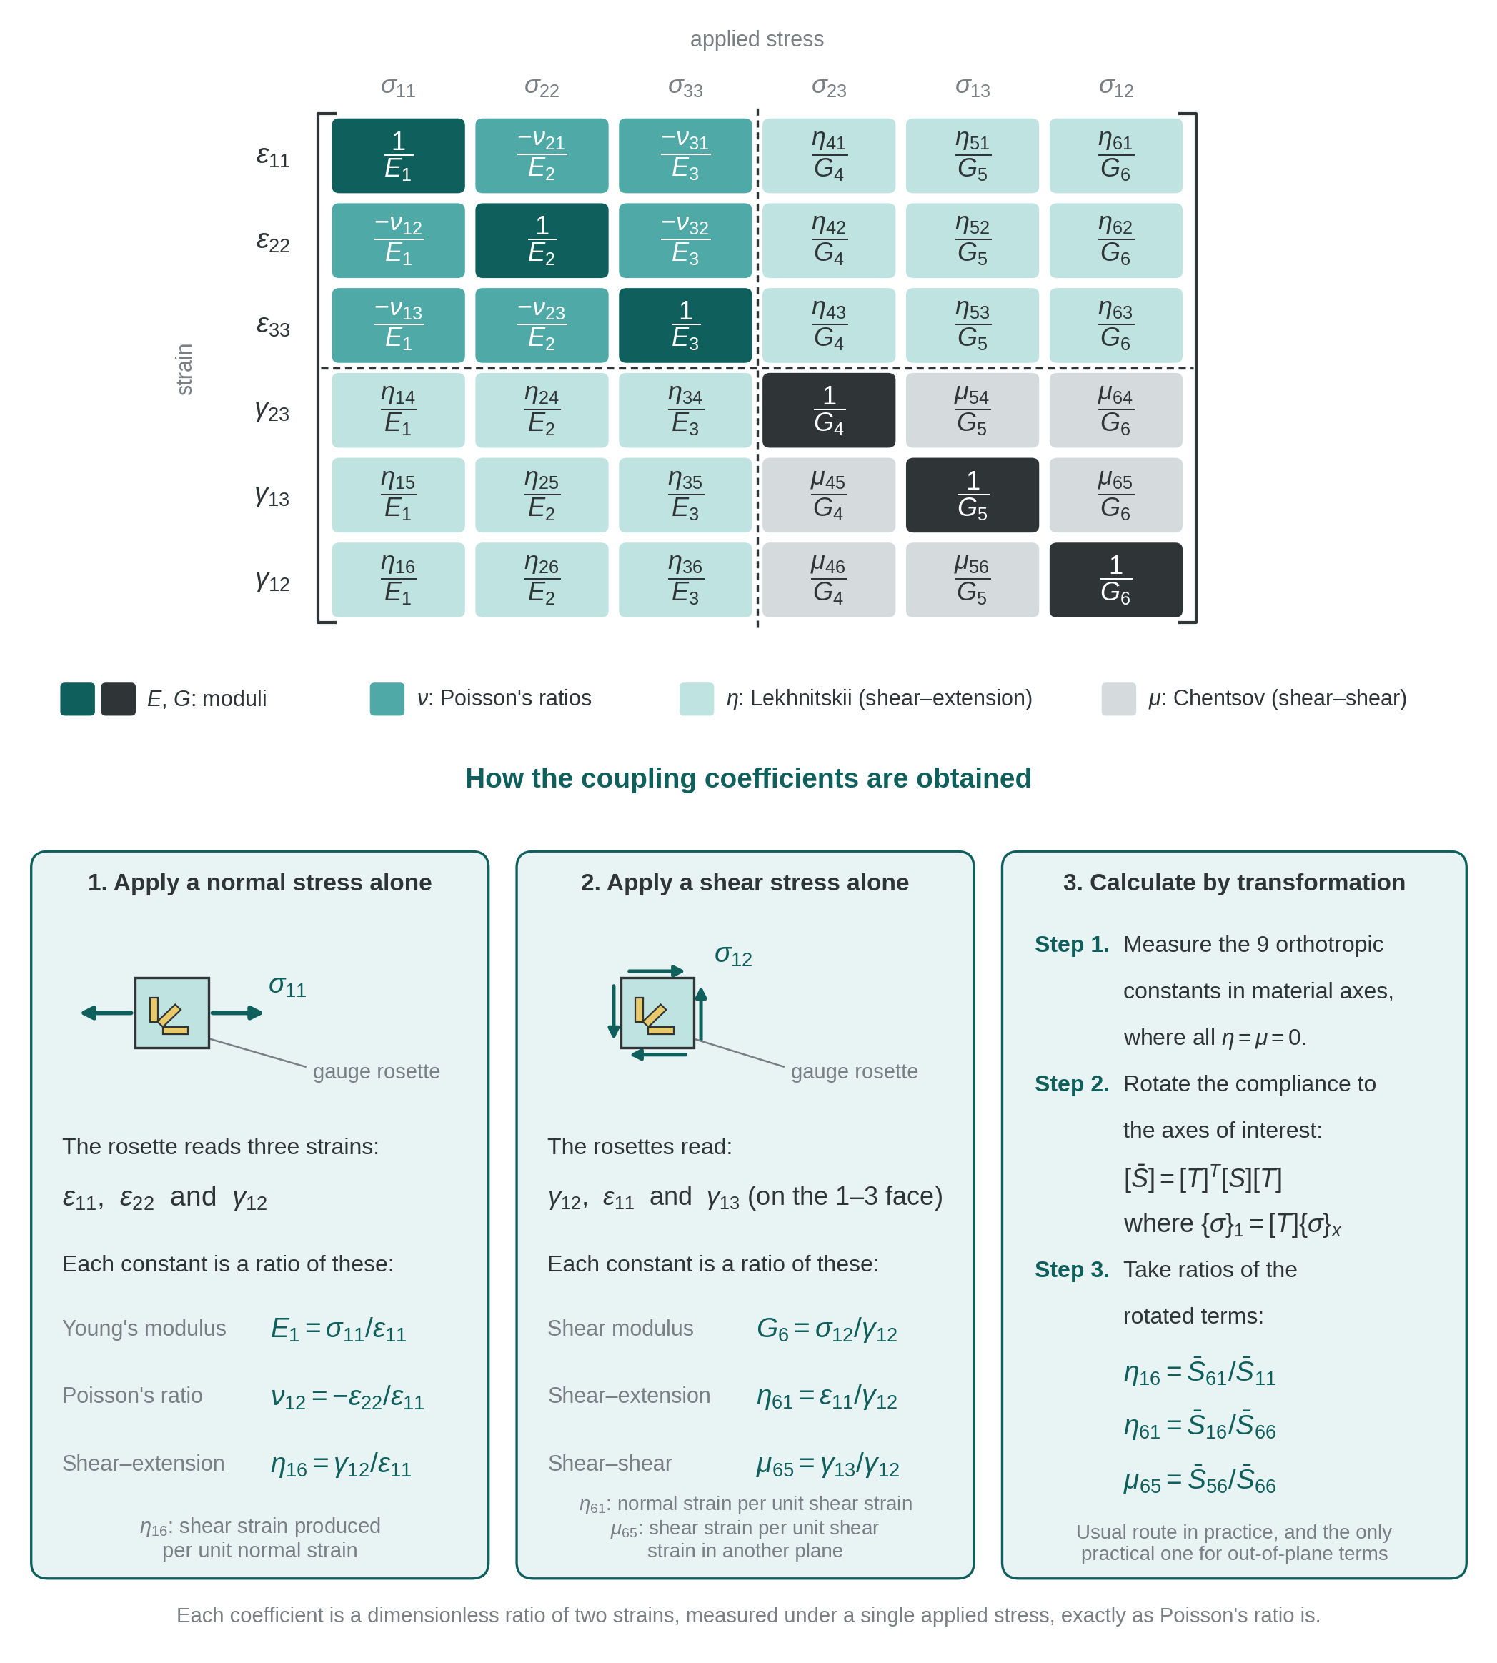
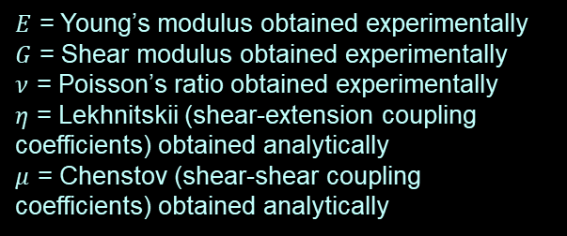
Elastic theory-
Compliance matrix 2
The compliance matrix can be expressed in terms of engineering constants as shown below:
$E$ = Young’s modulus obtained experimentally
$G$ = Shear modulus obtained experimentally
$ν$ = Poisson’s ratio obtained experimentally
$η$ = Lekhnitskii (shear-extension coupling coefficients) obtained analytically
$μ$ = Chenstov (shear-shear coupling coefficients) obtained analytically
Notes:
Intro
“We’ve defined the compliance matrix [S] as the inverse of the stiffness matrix.
Now let’s express [S] directly in terms of the engineering constants we measure in the lab.”
Engineering constants
“Each entry of [S] can be written with familiar properties:
E – the Young’s moduli along the principal material axes (E₁, E₂, E₃).
G – the shear moduli for the three orthogonal shear planes (G₄, G₅, G₆).
ν – the Poisson’s ratios, like ν₁₂ or ν₂₃, which describe how a material contracts laterally when stretched longitudinally.”
Coupling coefficients
“Anisotropic materials can also have special coupling terms:
η – the Lekhnitskii coefficients, which capture shear–extension coupling.
μ – the Chenstov coefficients, which represent shear–shear coupling.
These appear as the η and μ terms off the diagonal in the matrix.”
Matrix layout
“Notice the pattern:
– The top-left 3×3 block shows normal strains related to normal stresses, with the familiar 1/E on the diagonal and the negative Poisson ratios off-diagonal.
– The lower-right block involves the inverse shear moduli 1/G along the diagonal.
– The off-diagonal η and μ terms show how shear and normal responses couple in a fully anisotropic medium.”
Key takeaway
“This form of the compliance matrix lets you plug in directly measurable constants—E, G, ν—from experiments, plus analytically derived coupling coefficients, to predict strain for any applied stress.
For orthotropic composites many η and μ terms drop out, simplifying the matrix dramatically.”
***Note:
1. Lekhnitskii shear-extension coupling $η$
Origin
Named after S. G. Lekhnitskii, who developed the anisotropic elasticity framework used for layered composites (Anisotropic Plates, Gordon & Breach, 1968).
Meaning
In a fully anisotropic (triclinic) solid, an in-plane shear stress (for example $τ_{23}$) can produce a normal strain (for example $ε_{11}$) even when no direct normal stress is applied.
This cross-effect is called shear–extension coupling.
Appearance in compliance matrix
The $η$terms occupy positions such as $S_{14},S_{15},S_{16}$etc. in the 6 × 6 compliance matrix:
$$ε_{i}=S_{ij} σ_{j},$$
where an off-diagonal coefficient $η_{41}$means “shear strain $γ_{23}$produced per unit normal stress $σ_{11}$.”
Analytical determination
For a crystal or composite with no planes of symmetry, these coefficients are derived from the fundamental stiffness tensor $C_{ijkl}$by tensor inversion:
$$η_{41}=S_{41}=\left(C^{−1}{\left.)\right.}_{41}.\right.$$
Because they involve no simple experiment (you can’t independently apply a “pure” state to isolate them), they are usually calculated from single-crystal or ply-level elastic constants once those are measured.
References
– Lekhnitskii, Anisotropic Plates (1968)
– Jones, Mechanics of Composite Materials, 2nd ed., Ch. 2–3.
2. Chenstov shear-shear coupling $μ$
Origin
Associated with M. M. Chentsov (also transliterated Chenstov), who extended Lekhnitskii’s work to the general coupling of different shear planes.
Meaning
These coefficients quantify how a shear stress in one plane causes shear strain in a different plane—for example, $τ_{23}$causing $γ_{13}$.
That is shear–shear coupling.
Appearance in matrix
They are the off-diagonal terms in the 3 × 3 shear block of [S], e.g. $S_{45},S_{46}$.
A value $μ_{45}$represents strain $γ_{23}$per unit stress $τ_{13}$.
Analytical determination
Again obtained from the inverse stiffness tensor.
Given the full 21 independent elastic constants for a triclinic material, the sub-matrix for shear components is inverted to give $μ$.
References
– Ting, Anisotropic Elasticity: Theory and Applications (1996), Sect. 2.2–2.4.
– Jones, Mechanics of Composite Materials, Appendix on triclinic elasticity.
Engineering relevance
Most engineering composites (orthotropic laminas, isotropic metals) have enough symmetry that all $η$ and $μ$ terms are zero.
They matter only in materials with the least symmetry—triclinic single crystals, low-symmetry polymer crystals, or specially tailored metamaterials.
So, $η$ and $μ$ are formal placeholders in the general compliance matrix. They remind us that in the absolute most general anisotropic solid, normal and shear behaviours can couple in every possible way, and those couplings can be computed once the full stiffness tensor is known.

Slide 26
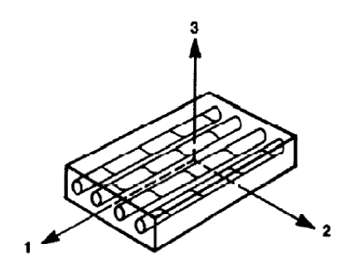


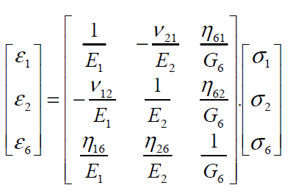
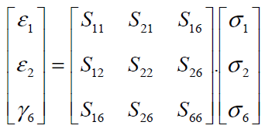
Elastic theory-
Compliance matrix 3
In engineering problems of thin plates (panel type composites), 2D plane stress is often encountered leading to further simplification as below:
Therefore, the compliance matrix reduces to:
Notes:
Intro
“Now we simplify the compliance matrix for plane-stress conditions—exactly what we use for thin laminated plates.”
Concept
“For thin composite panels the through-thickness normal and transverse shear stresses are negligible.
So we set
$σ_{3}=σ_{23}=σ_{31}=0$.
That collapses the 6×6 compliance relationship down to just the in-plane components.”
Reduced strain relations
“The only remaining strains are the in-plane normal strains $ε_{1},ε_{2}$ and the in-plane shear strain $γ_{6}$.
Through-thickness strain is given by
$$ε_{3}=S_{13}σ_{1}+S_{23}σ_{2}$$
but it doesn’t feed back into the in-plane response.”
Resulting matrix
“The compliance matrix therefore reduces to
$$\left[\begin{matrix}ε_{1} \\ ε_{2} \\ γ_{6}\end{matrix}\right]=\left[\begin{matrix}S_{11} & S_{12} & S_{16} \\ S_{12} & S_{22} & S_{26} \\ S_{16} & S_{26} & S_{66}\end{matrix}\right]\left[\begin{matrix}σ_{1} \\ σ_{2} \\ σ_{6}\end{matrix}\right].$$
If we express it with engineering constants you see the familiar 1/E terms on the diagonal and Poisson ratios in the off-diagonals, plus any shear-extension couplings $η$ if the laminate is fully anisotropic.”
Engineering relevance
“This 3×3 form is exactly what we use in classical laminate theory to build the A, B and D matrices for composite plate analysis.”

Slide 27
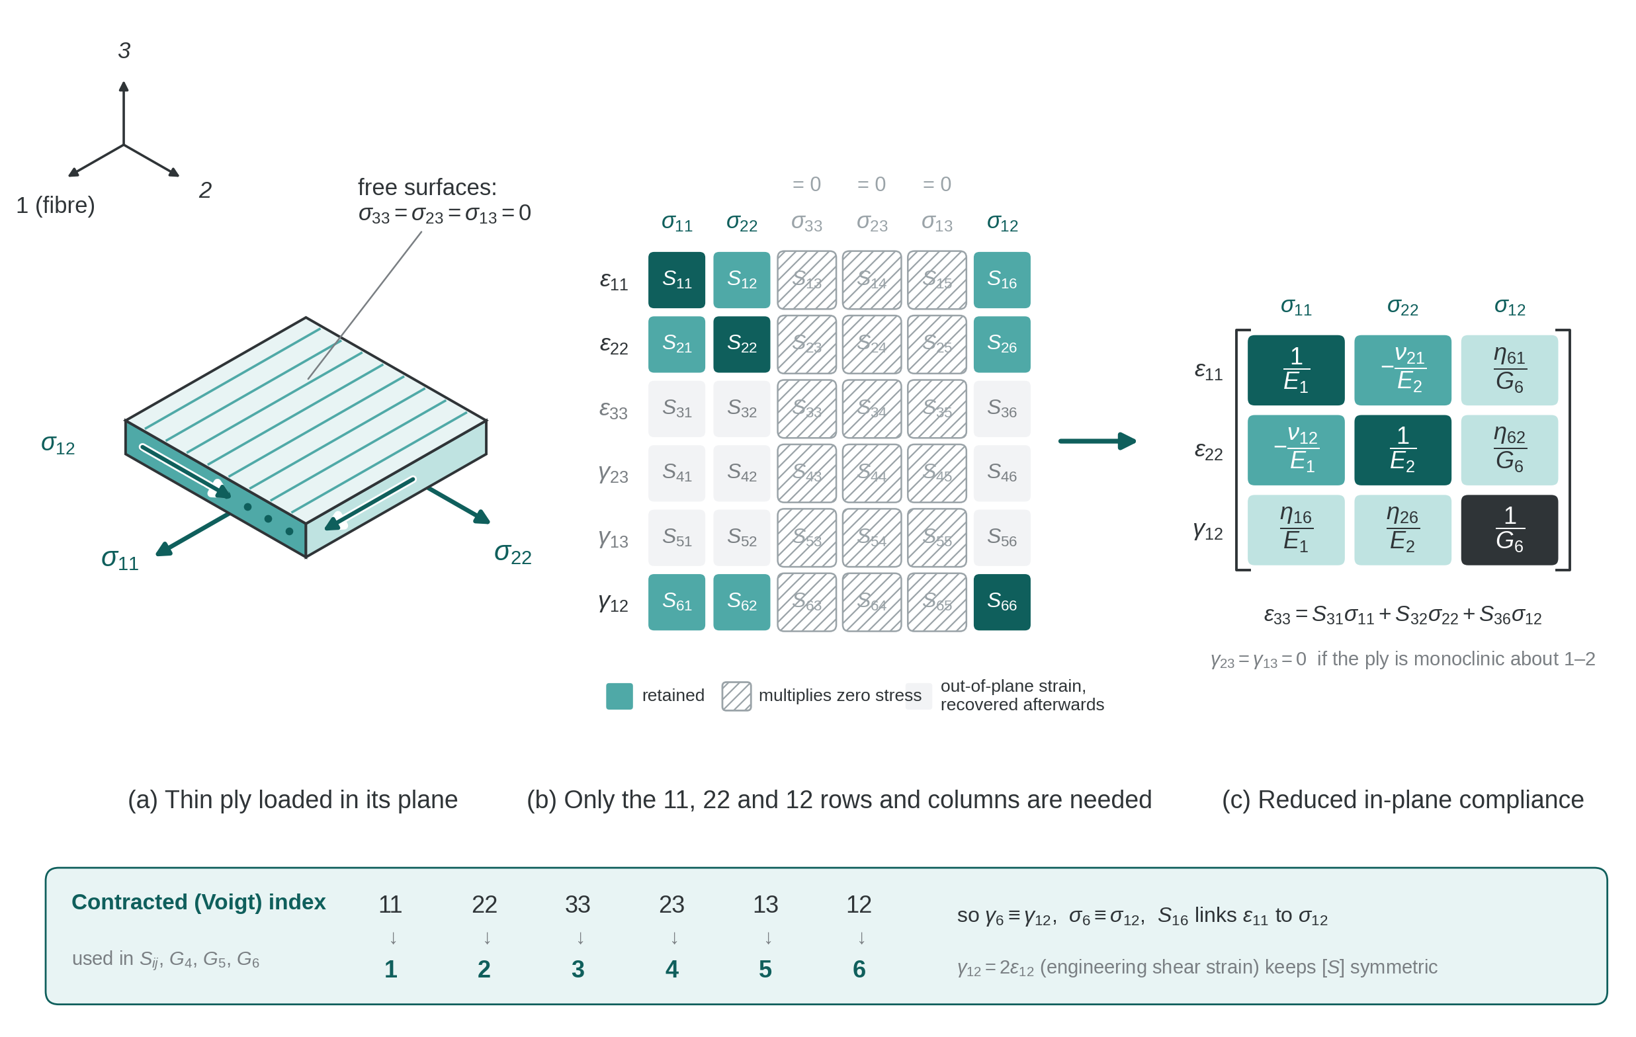
Plane stress reduction of the compliance matrix for a thin ply

Slide 28
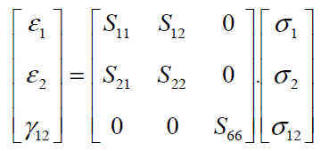
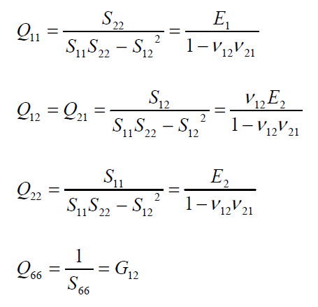

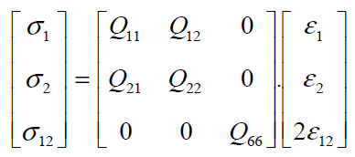

Elastic theory-
Orthotropic lamina
A composite lamina is orthotropic:
4 independent constants exist:
Expressing in terms of Hooke’s law:
$Q_{ij}$ are the reduced stiffness of the lamina
Notes:
Intro
“This slide wraps up our move from the general anisotropic case to the special case of an orthotropic lamina—the single composite ply with three mutually perpendicular planes of symmetry.”
Concept
“Because of that symmetry, all shear–extension couplings vanish and the in-plane elastic behaviour can be described with only four independent engineering constants:
$E_{1}, E_{2}, G_{12}, ν_{12}$( with $ν_{21}=ν_{12}E_{2}/E_{1}$).
That greatly simplifies both the compliance matrix and the stiffness matrix used in laminate theory.”
Details
Compliance form
$$\left[\begin{matrix}ε_{1} \\ ε_{2} \\ γ_{12}\end{matrix}\right]=\left[\begin{matrix}S_{11} & S_{12} & 0 \\ S_{12} & S_{22} & 0 \\ 0 & 0 & S_{66}\end{matrix}\right]\left[\begin{matrix}σ_{1} \\ σ_{2} \\ σ_{12}\end{matrix}\right],$$
where
$S_{11}=1/E_{1}, S_{22}=1/E_{2}, S_{12}=−ν_{12}/E_{1}, S_{66}=1/G_{12}$.
Reduced stiffness form
Inverting gives
$$\left[\begin{matrix}σ_{1} \\ σ_{2} \\ τ_{12}\end{matrix}\right]=\left[\begin{matrix}Q_{11} & Q_{12} & 0 \\ Q_{12} & Q_{22} & 0 \\ 0 & 0 & Q_{66}\end{matrix}\right]\left[\begin{matrix}ε_{1} \\ ε_{2} \\ γ_{12}\end{matrix}\right],$$
with
$$Q_{11}=\frac{E_{1}}{1−ν_{12}ν_{21}}, Q_{22}=\frac{E_{2}}{1−ν_{12}ν_{21}}, Q_{12}=\frac{ν_{12}E_{2}}{1−ν_{12}ν_{21}}, Q_{66}=G_{12}.$$
These $Q_{ij}$ values are the reduced stiffness terms used to build the laminate A, B and D matrices.

Slide 29
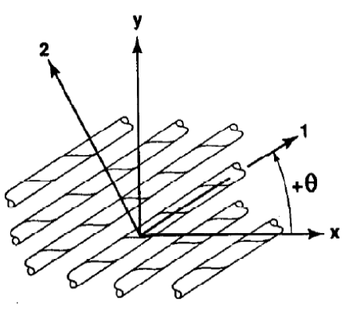
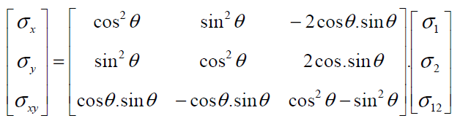
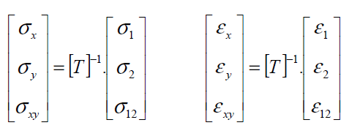
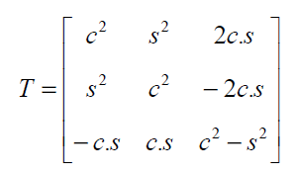
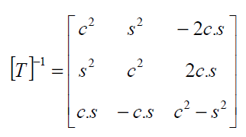
Elastic theory-
Ply orientation
It is often necessary to move between the principal coordinates and oriented coordinates of the lamina.
Notes:
Intro
“This slide introduces ply orientation transformations—the mathematics we use to move between a lamina’s material axes (1–2) and the global laminate axes (x–y).”
Concept
“In a laminate, each ply can be laid at an angle θ relative to the global reference.
To analyse the entire laminate, we must transform stresses and strains from the local fibre axes (1, 2) to the global axes (x, y).
This requires the transformation matrix T and its inverse.”
Details
Stress transformation
$$\left[\begin{matrix}σ_{x} \\ σ_{y} \\ τ_{xy}\end{matrix}\right]=\left[\begin{matrix}{\cos{}}^{2}θ & {\sin{}}^{2}θ & −2\cos{θ}\sin{θ} \\ {\sin{}}^{2}θ & {\cos{}}^{2}θ & 2\cos{θ}\sin{θ} \\ \cos{θ}\sin{θ} & −\cos{θ}\sin{θ} & {\cos{}}^{2}θ−{\sin{}}^{2}θ\end{matrix}\right]\left[\begin{matrix}σ_{1} \\ σ_{2} \\ τ_{12}\end{matrix}\right].$$
Matrix shorthand
This is compactly written as
$$\left\{σ{\left.\}\right.}_{x}=\left[T{\left.]\right.}^{−1}\left\{σ{\left.\}\right.}_{1}\right.\right.\right.$$
and similarly for strains
$\left\{ε{\left.\}\right.}_{x}=\left[T\right]\left\{ε{\left.\}\right.}_{1}\right.\right.$.
Transformation matrix
$$\left[T\right]=\left[\begin{matrix}c^{2} & s^{2} & 2cs \\ s^{2} & c^{2} & −2cs \\ −cs & cs & c^{2}−s^{2}\end{matrix}\right],$$
with $c=\cos{θ}, s=\sin{θ}$.
Diagram
The figure shows local axes 1–2 rotated by θ relative to the global x–y axes of the panel.

Slide 30
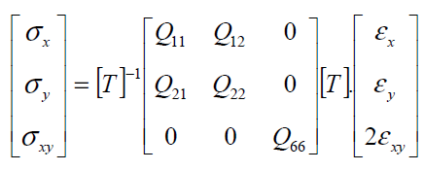
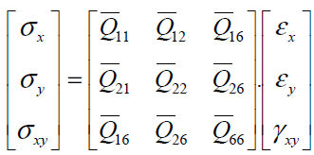

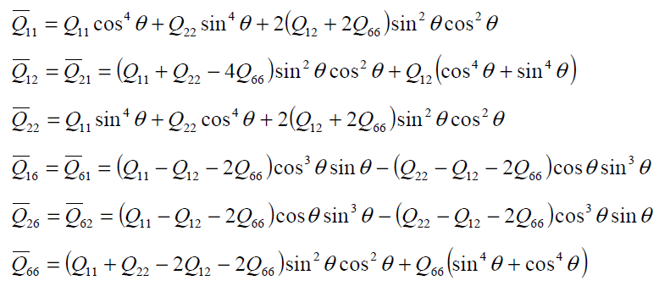
Elastic theory-
Transformed stiffness matrix
Stress-strain in oriented or off-axis coordinates can be expressed in the form:
Transformed reduced stiffness matrix
Notes:
Intro
“This slide shows how we obtain the transformed reduced stiffness matrix $\left[\overset{ˉ}{Q}\right]$for a lamina oriented at an angle θ to the global x–y axes.”
Concept
“When a ply is rotated, the local 1–2 stiffnesses $\left[Q\right]$must be expressed in the global axes to analyse the whole laminate.
We do this with the transformation
where [T] is the stress–strain transformation matrix from the previous slide.”
Details
Stress–strain relation in global coordinates
$$\left[\begin{matrix}σ_{x} \\ σ_{y} \\ τ_{xy}\end{matrix}\right]=\left[\begin{matrix}{\overset{ˉ}{Q}}_{11} & {\overset{ˉ}{Q}}_{12} & {\overset{ˉ}{Q}}_{16} \\ {\overset{ˉ}{Q}}_{12} & {\overset{ˉ}{Q}}_{22} & {\overset{ˉ}{Q}}_{26} \\ {\overset{ˉ}{Q}}_{16} & {\overset{ˉ}{Q}}_{26} & {\overset{ˉ}{Q}}_{66}\end{matrix}\right]\left[\begin{matrix}ε_{x} \\ ε_{y} \\ γ_{xy}\end{matrix}\right].$$
Transformed stiffness terms
$$\begin{matrix}{\overset{ˉ}{Q}}_{11} & =Q_{11}{\cos{}}^{4}θ+Q_{22}{\sin{}}^{4}θ+2\left(Q_{12}+2Q_{66}\right){\sin{}}^{2}θ{\cos{}}^{2}θ, \\ {\overset{ˉ}{Q}}_{12} & =\left(Q_{11}+Q_{22}−4Q_{66}\right){\sin{}}^{2}θ{\cos{}}^{2}θ+Q_{12}\left({\cos{}}^{4}θ+{\sin{}}^{4}θ\right), \\ {\overset{ˉ}{Q}}_{22} & =Q_{11}{\sin{}}^{4}θ+Q_{22}{\cos{}}^{4}θ+2\left(Q_{12}+2Q_{66}\right){\sin{}}^{2}θ{\cos{}}^{2}θ, \\ {\overset{ˉ}{Q}}_{16} & =\left(Q_{11}−Q_{12}−2Q_{66}\right){\cos{}}^{3}θ\sin{θ}−\left(Q_{22}−Q_{12}−2Q_{66}\right)\cos{θ}{\sin{}}^{3}θ, \\ {\overset{ˉ}{Q}}_{26} & =\left(Q_{11}−Q_{12}−2Q_{66}\right)\cos{θ}{\sin{}}^{3}θ−\left(Q_{22}−Q_{12}−2Q_{66}\right){\cos{}}^{3}θ\sin{θ}, \\ {\overset{ˉ}{Q}}_{66} & =\left(Q_{11}+Q_{22}−2Q_{12}−2Q_{66}\right){\sin{}}^{2}θ{\cos{}}^{2}θ+Q_{66}\left({\sin{}}^{4}θ+{\cos{}}^{4}θ\right).\end{matrix}$$
These relations let us combine plies of different fibre orientations into a single laminate stiffness matrix.
Diagram
The figure shows the global x–y axes and the local 1–2 fibre directions rotated by angle θ.

Slide 31
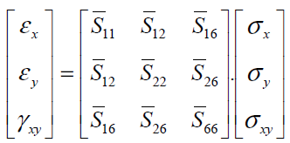
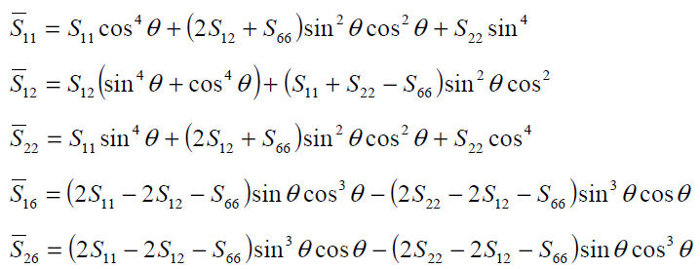

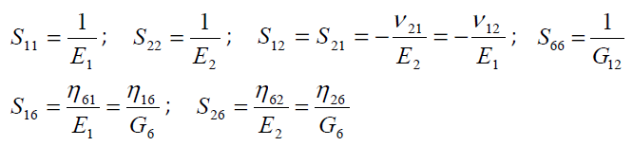
Elastic theory-
Transformed compliance matrix
Stress-strain in oriented or off-axis coordinates can be expressed in the form:
Notes:
Intro
“This slide presents the transformed compliance matrix—how we express strain–stress relations for a lamina rotated by an angle θ relative to the global x–y axes.”
Concept
“When a ply is oriented off-axis, the in-plane compliance matrix [S] in its local 1–2 coordinates must be transformed to the global x–y system.
This is the inverse of the transformed stiffness matrix you saw earlier and is required for strain calculations under global stress states.”
Details
Global compliance relation
$$\left[\begin{matrix}ε_{x} \\ ε_{y} \\ γ_{xy}\end{matrix}\right]=\left[\begin{matrix}{\overset{ˉ}{S}}_{11} & {\overset{ˉ}{S}}_{12} & {\overset{ˉ}{S}}_{16} \\ {\overset{ˉ}{S}}_{12} & {\overset{ˉ}{S}}_{22} & {\overset{ˉ}{S}}_{26} \\ {\overset{ˉ}{S}}_{16} & {\overset{ˉ}{S}}_{26} & {\overset{ˉ}{S}}_{66}\end{matrix}\right]\left[\begin{matrix}σ_{x} \\ σ_{y} \\ τ_{xy}\end{matrix}\right].$$
Key transformation formulas
$$\begin{matrix}{\overset{ˉ}{S}}_{11} & =S_{11}{\cos{}}^{4}θ+\left(2S_{12}+S_{66}\right){\sin{}}^{2}θ{\cos{}}^{2}θ+S_{22}{\sin{}}^{4}θ, \\ {\overset{ˉ}{S}}_{12} & =S_{12}\left({\sin{}}^{4}θ+{\cos{}}^{4}θ\right)+\left(S_{11}+S_{22}−S_{66}\right){\sin{}}^{2}θ{\cos{}}^{2}θ, \\ {\overset{ˉ}{S}}_{22} & =S_{11}{\sin{}}^{4}θ+\left(2S_{12}+S_{66}\right){\sin{}}^{2}θ{\cos{}}^{2}θ+S_{22}{\cos{}}^{4}θ, \\ {\overset{ˉ}{S}}_{16} & =\left(2S_{11}−2S_{12}−S_{66}\right)\sin{θ}{\cos{}}^{3}θ−\left(2S_{22}−2S_{12}−S_{66}\right){\sin{}}^{3}θ\cos{θ}, \\ {\overset{ˉ}{S}}_{26} & =\left(2S_{11}−2S_{12}−S_{66}\right){\sin{}}^{3}θ\cos{θ}−\left(2S_{22}−2S_{12}−S_{66}\right)\sin{θ}{\cos{}}^{3}θ, \\ {\overset{ˉ}{S}}_{66} & =2\left(S_{11}+S_{22}−4S_{12}−S_{66}\right){\sin{}}^{2}θ{\cos{}}^{2}θ+S_{66}\left({\sin{}}^{4}θ+{\cos{}}^{4}θ\right).\end{matrix}$$
These follow directly from the transformation
$\left[\overset{ˉ}{S}\right]=\left[T\right]\left[S\right]\left[T{\left.]\right.}^{\text{ ⁣}−1}\right.$.
Engineering constants reminder
$S_{11}=1/E_{1}, S_{22}=1/E_{2}, S_{12}=−ν_{12}/E_{1}, S_{66}=1/G_{12}$.
Diagram
The figure again shows a ply at an angle θ relative to global x–y axes.

Slide 32
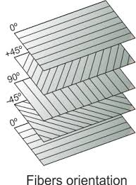
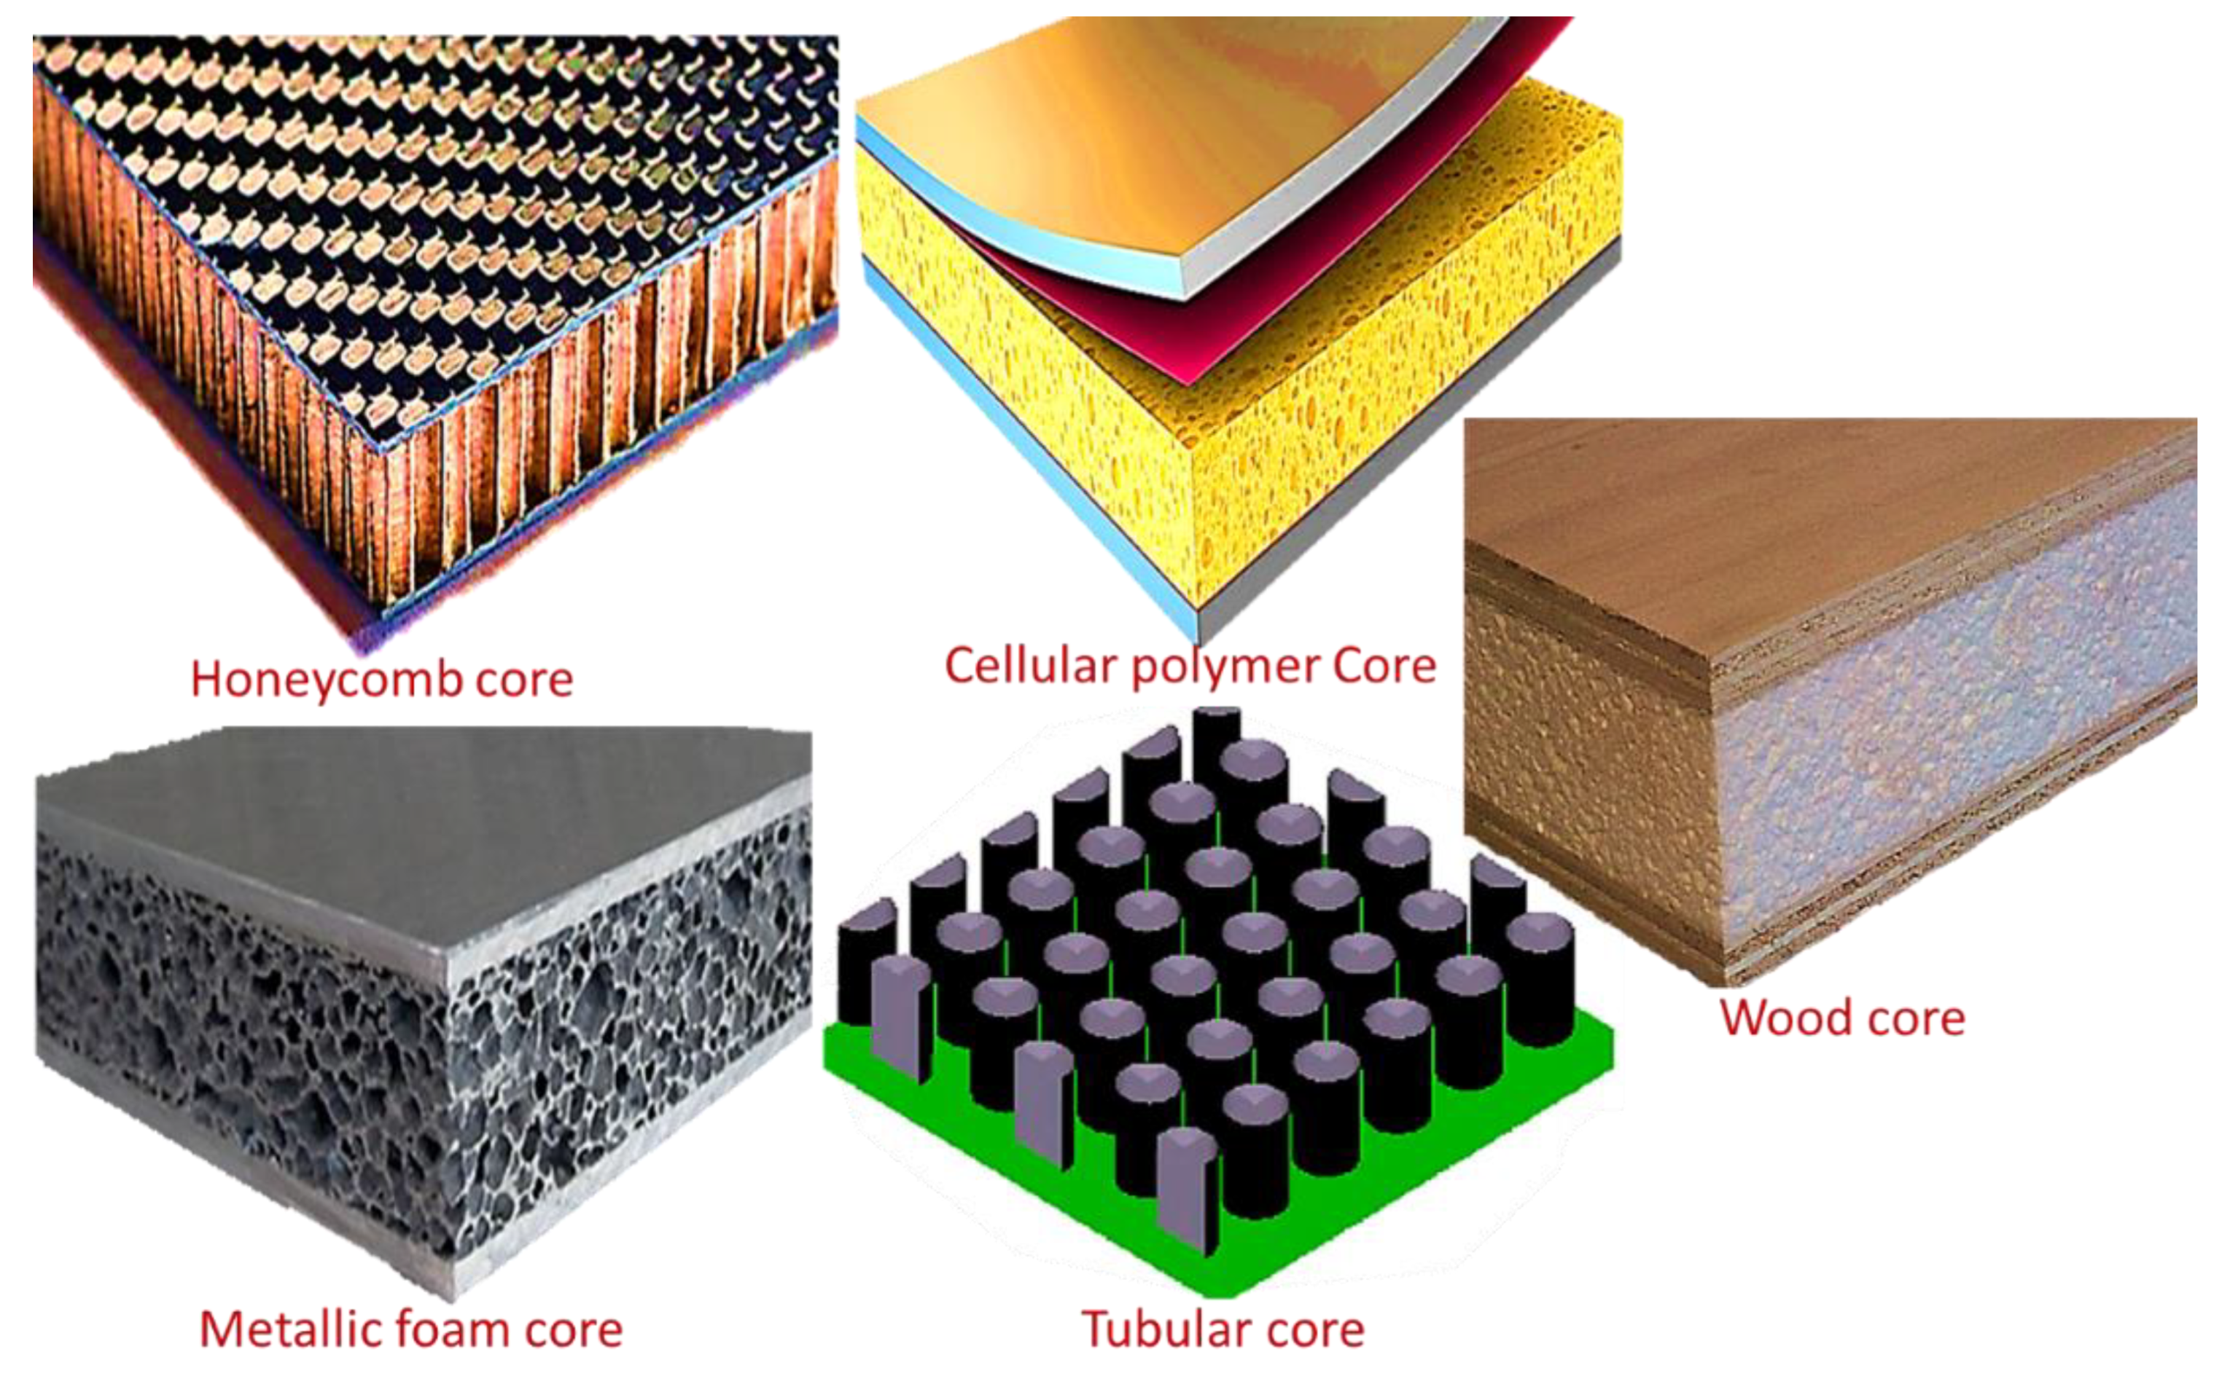
Laminate formulation
Thus far, we have discussed the mechanical properties of a single ply (lamina) in detail.
However, a laminate is comprised of multiple plies each with different orientation.
The question now is how to characterise the mechanical behaviour of a laminate based on the properties of each individual lamina.
Notes:
Intro
“This slide makes the transition from analysing a single ply to analysing a full laminate—a stack of many plies, each with its own fibre orientation and material properties.”
Concept
“So far we examined the mechanics of one lamina using compliance and stiffness matrices.
A real composite structure is a laminate: multiple plies at different angles bonded together.
The mechanical response of the whole laminate depends on how these plies interact.”
Details
Key idea
– Each ply (0°, ±45°, 90° etc.) contributes its transformed stiffness $\left[\overset{ˉ}{Q}{\left.]\right.}_{k}\right.$.
– Laminate theory integrates these contributions through the A, B, and D matrices to capture in-plane, coupling, and bending behaviour.
– The images on the right illustrate common sandwich or core constructions—honeycomb, cellular polymer, metallic foam, tubular, and wood cores—which can all be part of a laminate system.
Next step
“The question now is how to combine the individual lamina properties to predict the overall in-plane and bending stiffness of the laminate. This is the foundation of classical laminate theory.”

Slide 33





Laminate formulation
Based on the Kirchhoff hypothesis, for thin laminates:
  A line that is originally straight and perpendicular to the middle surface of the laminate before deformation is assumed to remain straight and perpendicular to the middle surface after laminate deformation.
  The assumption implies the absence of shear strains in planes perpendicular to the mid-surface ($γ_{xz}=γ_{yz}=0$).
  Plane strain condition is also assumed ($ε_{z}=0$).
Notes:
Intro
“This slide introduces the Kirchhoff hypothesis—the key assumption behind classical laminate plate theory for thin laminates.”
Concept
“The hypothesis states: a line initially straight and perpendicular to the laminate mid-surface remains straight and perpendicular after deformation.
This simplifies the kinematics by eliminating transverse shear deformation.”
Details
Implications
– Because normals remain perpendicular, transverse shear strains vanish:
$γ_{xz}=γ_{yz}=0$.
– Plane strain in the thickness direction is assumed:
$ε_{z}=0$.
– Displacements u, v, w vary linearly through the thickness, enabling the use of the A, B, D stiffness matrices to relate mid-plane strains and curvatures to forces and moments.
Illustration
The figure shows a laminate plate with a normal AB before and after bending.
Even as the plate deflects (w) and twists (β), the AB line remains straight and orthogonal to the mid-surface, consistent with Kirchhoff kinematics.

Slide 34









Laminate formulation
Mid-plane strains
Stress in k-th lamina
Coordinate of kth lamina
Mid-plane curvatures
Notes:
Intro
“This slide assembles the full classical laminate plate formulation—linking mid-plane displacements and curvatures to strains and stresses through the laminate thickness.”
Concept
“In Kirchhoff thin-plate theory, displacements u and v vary linearly through the thickness z while the transverse displacement w is constant through z.
From these kinematics we derive in-plane strains and curvatures, then compute stresses in any ply k using its transformed stiffness matrix $\left[\overset{ˉ}{Q}{\left.]\right.}^{k}\right.$.”
Details
Displacement field
$$u=u_{0}−z\frac{∂w_{0}}{∂x}, v=v_{0}−z\frac{∂w_{0}}{∂y}.$$
Strain–displacement relations
$$\begin{matrix}ε_{x} & =\frac{∂u}{∂x}=\frac{∂u_{0}}{∂x}−z\frac{∂^{2}w_{0}}{∂x^{2}}, \\ ε_{y} & =\frac{∂v}{∂y}=\frac{∂v_{0}}{∂y}−z\frac{∂^{2}w_{0}}{∂y^{2}}, \\ γ_{xy} & =\frac{∂u}{∂y}+\frac{∂v}{∂x}=\frac{∂u_{0}}{∂y}+\frac{∂v_{0}}{∂x}−2z\frac{∂^{2}w_{0}}{∂x∂y}.\end{matrix}$$
Mid-plane strain/curvature split
$$\left\{ε\right\}=\left\{ε^{0}\right\}+z\left\{κ\right\},$$
where $\left\{ε^{0}\right\}$are mid-plane strains and $\left\{κ\right\}$are curvatures.
Stress in the k-th lamina
$$\left\{σ{\left.\}\right.}^{k}=\left[\overset{ˉ}{Q}{\left.]\right.}^{k}\left(\left\{ε^{0}\right\}+z\left\{κ\right\}\right).\right.\right.$$
This is the foundation for integrating through the thickness to obtain the global laminate A, B, D stiffness matrices.

Slide 35


Laminate formulation
The components of the stiffness matrix $\overline{Q_{ij}}$ can be different for each ply.
Stresses through the thickness are discontinuous.
Strains through the thickness are continuous.
Notes:
Intro
“This slide highlights how stresses and strains vary through the laminate thickness, and why their behaviour differs from ply to ply.”
Concept
“Each ply can have a different transformed stiffness matrix $\left[{\overset{ˉ}{Q}}_{ij}\right]$because of fibre orientation and material properties.
When the laminate bends or stretches, the strain field is continuous through the thickness, but the stress field changes abruptly at each interface.”
Details
Key points
– Different Qij per ply: Every lamina may have its own stiffness values, so the constitutive relation $σ=\left[\overset{ˉ}{Q}\right]ε$ is ply-dependent.
– Continuous strain (ε): Mid-plane strain varies linearly with z and must remain continuous to satisfy compatibility—no sudden jumps across interfaces.
– Discontinuous stress (σ): Because $\left[\overset{ˉ}{Q}\right]$changes from ply to ply, the same strain produces different stresses, giving step changes at each interface (as the right-hand plot shows).
– Interlaminar shear (Q): The central diagram emphasises shear force (Q) and its distribution; interlaminar stresses must equilibrate these jumps.
Illustration
The graphic shows a 4-ply laminate with
– blue band: continuous strain profile,
– red band: variable Q matrix,
– yellow band: piecewise stress profile.

Slide 36

Laminate formulation
So far, stresses and curvatures are obtained for a laminate and each lamina within it.
The final stage is to relate forces and moments to the strains and curvatures.
Force per unit width (N/mm)
Moment per unit width (N.mm/mm)
Notes:
Intro
“This slide completes the laminate formulation by connecting laminate-level forces and moments to the mid-plane strains and curvatures.”
Concept
“In classical laminate theory, once we know the strain and curvature fields, we integrate the ply stresses through the thickness to obtain resultant forces $N_{x},N_{y},N_{xy}$ and resultant moments $M_{x},M_{y},M_{xy}$. These represent forces and bending/twisting moments per unit width of the laminate.”
Details
Definitions
– Force resultants $N_{x},N_{y},N_{xy}$ have units of N/mm (or N/m in SI) and represent the in-plane loads.
– Moment resultants $M_{x},M_{y},M_{xy}$ have units of N·mm/mm and represent bending and twisting moments.
– These are related to mid-plane strain $\left\{ε^{0}\right\}$and curvature $\left\{κ\right\}$through the ABD matrix:
$$\left[\begin{matrix}\left\{N\right\} \\ \left\{M\right\}\end{matrix}\right]=\left[\begin{matrix}A & B \\ B & D\end{matrix}\right]\left[\begin{matrix}\left\{ε^{0}\right\} \\ \left\{κ\right\}\end{matrix}\right].$$
Here, A is the extensional stiffness, D the bending stiffness, and B captures bending–extension coupling.
Illustration
The figure shows a laminate element with all in-plane forces $N_{x},N_{y},N_{xy}$and bending/twisting moments $M_{x},M_{y},M_{xy}$acting about the mid-surface.

Slide 37






Laminate formulation
Notes:
Intro
“This slide shows how laminate forces and moments are calculated by integrating ply stresses through the thickness, arriving at the final A, B, D matrix formulation.”
Concept
“In classical laminate theory, in-plane force resultants $\left\{N\right\}$and moment resultants $\left\{M\right\}$are obtained by summing the contributions of all plies.
The stress in each ply, expressed as $\left\{σ{\left.\}\right.}^{k}=\left[\overset{ˉ}{Q}{\left.]\right.}^{k}\left(\left\{ε^{0}\right\}+z\left\{κ^{0}\right\}\right)\right.\right.$, is integrated across the thickness to give the laminate-level resultants.”
Details
Force resultants
Moment resultants
Substituting $\left\{σ{\left.\}\right.}^{k}\right.$gives
$$\left\{N\right\}=A\left\{ε^{0}\right\}+B\left\{κ^{0}\right\}, \left\{M\right\}=B\left\{ε^{0}\right\}+D\left\{κ^{0}\right\},$$
where
These A, B, D matrices are the extensional, bending–extension coupling, and bending stiffnesses of the laminate.
Illustration
The diagram highlights the layer-by-layer integration of stresses, with coloured bands showing the different plies and how their individual stiffness matrices $\left[\overset{ˉ}{Q}{\left.]\right.}^{k}\right.$contribute to the global resultants.

Slide 38

Laminate formulation
Finally, the equation becomes:

Slide 39


Laminate formulation-
ABD stiffness matrix
Some key and important points:
  $A_{ij}$ are extensional stiffness.
    $A_{16}$and $A_{26}$ are shear-extension coupling.
  $B_{ij}$ are bending-extension coupling stiffness.
  $D_{ij}$ are bending stiffness.
    $D_{16}$and $D_{26}$ are bending-twisting coupling.
Notes:
Intro
“This slide presents the ABD stiffness matrix, the core of classical laminate theory, which links in-plane forces and bending moments to mid-plane strains and curvatures.”
Concept
“The laminate stiffness matrix is partitioned into three key submatrices:
$$\left[\begin{matrix}\left\{N\right\} \\ \left\{M\right\}\end{matrix}\right]=\left[\begin{matrix}A & B \\ B & D\end{matrix}\right]\left[\begin{matrix}\left\{ε^{0}\right\} \\ \left\{κ^{0}\right\}\end{matrix}\right].$$
Here,
A is the extensional stiffness, relating in-plane loads to in-plane strains.
B is the bending–extension coupling stiffness, capturing coupling between bending and stretching.
D is the bending stiffness, relating bending moments to curvatures.”
Details
$A_{ij}($extensional stiffness): in-plane forces vs. mid-plane strains.
– $A_{16},A_{26}$describe shear–extension coupling when the laminate is unsymmetric.
$B_{ij}($bending–extension coupling): coupling between in-plane loads and bending curvatures.
– Vanishes for symmetric laminates.
$D_{ij}($bending stiffness): bending moments vs. curvatures.
– $D_{16},D_{26}$represent bending–twisting coupling.
The adjacent diagram effectively illustrates how each submatrix produces specific deformation modes.

Slide 40

Important note-1
Normally, applied forces are known and what we seek for are strains and curvatures.
Therefore, we can re-write the equation as below:
-1
Notes:
Intro
“This slide shows how to invert the ABD matrix to obtain mid-plane strains $\left\{ε^{0}\right\}$and curvatures $\left\{κ\right\}$directly from the known in-plane forces and bending moments $\left\{N\right\}$and $\left\{M\right\}$.”
Concept
“In practice we usually know the applied loads, not the deformations.
The original relation
$$\left[\begin{matrix}\left\{N\right\} \\ \left\{M\right\}\end{matrix}\right]=\left[\begin{matrix}A & B \\ B & D\end{matrix}\right]\left[\begin{matrix}ε^{0} \\ κ\end{matrix}\right]$$
is inverted to
$$\left[\begin{matrix}ε^{0} \\ κ\end{matrix}\right]=\left[\begin{matrix}α & β \\ β^{T} & δ\end{matrix}\right]\left[\begin{matrix}N \\ M\end{matrix}\right].$$
The submatrices are:
$α$: in-plane compliance (inverse of extensional stiffness adjusted for coupling)
$β$: coupling between in-plane forces and curvatures
$δ$: bending compliance.”
Details
“The right-side expressions define these submatrices:
Correct inverse of the ABD system (via the Schur complement $S=D−BA^{−1}$
$$α=A^{−1}+A^{−1}BS^{−1}BA^{−1}, β=−A^{−1}BS^{−1}, δ=S^{−1}.$$
These follow directly from the Schur complement of the ABD matrix.”

Slide 41
Important note-2
We may have various lay-ups.
The most common of them are:
  Symmetric
  Balanced
  Cross-ply
  Angle-ply
  Quasi-isotropic

Slide 42

Important note-3
Symmetric: symmetric stacking sequence with respect to the mid-plane such as:
Notes:
Intro
“This slide explains the special case of a symmetric laminate where the stacking sequence is mirrored about the mid-plane. In this situation the coupling matrix $B$in the ABD formulation vanishes, greatly simplifying the inversion used to obtain mid-plane strains $\left\{ε^{0}\right\}$and curvatures $\left\{κ\right\}$from the known in-plane forces $\left\{N\right\}$and bending moments $\left\{M\right\}$.”
Concept
“For a symmetric lay-up the extensional–bending coupling is zero:
$$\left[\begin{matrix}N \\ M\end{matrix}\right]=\left[\begin{matrix}A & 0 \\ 0 & D\end{matrix}\right]\left[\begin{matrix}ε^{0} \\ κ\end{matrix}\right].$$
The absence of $B$means that in-plane loads and bending moments are uncoupled. Mid-plane strains depend only on $A$, and curvatures depend only on $D$.”
Details
“The inverse of the ABD system reduces directly to
$$α=A^{−1}, β=0, δ=D^{−1}.$$
Thus
$$\left[\begin{matrix}ε^{0} \\ κ\end{matrix}\right]=\left[\begin{matrix}α & 0 \\ 0 & δ\end{matrix}\right]\left[\begin{matrix}N \\ M\end{matrix}\right].$$
This follows from the general Schur-complement form
$$α=A^{−1}+A^{−1}BS^{−1}BA^{−1}, β=−A^{−1}BS^{−1}, δ=S^{−1}$$
with $S=D−BA^{−1}B$. Setting $B=0$gives the simplified relations above.”

Slide 43


Important note-4
Balanced: for each $+θ$ ply, there is $−θ$ of the same material type and thickness in the laminate.
Notes:
Intro
“This slide defines the cross-ply laminate, a fundamental lay-up in composite design used for panels requiring high in-plane stiffness in two orthogonal directions.”
Concept
“A cross-ply laminate consists solely of 0° and 90° plies, typically arranged symmetrically, for example $[0 , 0 , 9090{\left.]\right.}_{s},$.
Because plies are oriented only along the principal material axes, the extensional stiffness matrix $A$becomes nearly orthotropic with negligible coupling terms $A_{16}$and $A_{26}$.”
Details
Mechanical behaviour – High longitudinal stiffness from 0° plies, transverse stiffness from 90° plies, and good dimensional stability.
Analysis simplification – The ABD matrix reduces to an orthotropic form: no in-plane shear–normal coupling.
Applications – Common in aerospace fuselage skins and stiffened panels where bidirectional load capacity is required.
Reference – See Jones, Mechanics of Composite Materials, Ch. 4, which provides full derivation of the ABD matrix for [0/90] cross-ply laminates.

Slide 44


Important note-5
Cross-ply: contain only $0^{°}$ or ${90}^{°}$ plies such as ${[0, 0, 90, 90]}_{s}$.
Notes:
Intro
“This slide introduces angle-ply laminates, which are built from plies placed at oblique angles rather than the principal 0° or 90° directions.”
Concept
“Angle-ply laminates contain only off-axis plies, for example $[+ , 45 , −45+60−60{\left.]\right.}_{s},$.
Because no ply is aligned with the main material axes, the laminate exhibits strong in-plane shear stiffness and improved torsional behaviour.
The absence of pure 0° or 90° plies also creates coupling between normal and shear responses, giving nonzero $A_{16}$and $A_{26}$terms in the ABD matrix unless the lay-up is both symmetric and balanced.”
Details
Mechanical traits – High in-plane shear strength, good fatigue resistance in torsion, and more uniform stress distribution under multiaxial loading.
Design notes – To suppress bending–twisting coupling, the laminate is usually arranged in balanced ±θ pairs, e.g. $\left[+45/−45{\left.]\right.}_{s}\right.$.
Applications – Helicopter blades, pressure vessels, and structures requiring combined shear and axial load capacity.
Typo – Slide heading spells “Anlge-ply”; correct spelling is Angle-ply.
Reference: Jones, Mechanics of Composite Materials, Chapter 5, for full ABD derivations of ±θ laminates.

Slide 45


Important note-6
Anlge-ply: do not contain $0^{°}$ or ${90}^{°}$ plies.
Notes:
Intro
“This slide introduces angle-ply laminates, which are built from plies placed at oblique angles rather than the principal 0° or 90° directions.”
Concept
“Angle-ply laminates contain only off-axis plies, for example $[+ , 45 , −45+60−60{\left.]\right.}_{s},$.
Because no ply is aligned with the main material axes, the laminate exhibits strong in-plane shear stiffness and improved torsional behaviour.
The absence of pure 0° or 90° plies also creates coupling between normal and shear responses, giving nonzero $A_{16}$and $A_{26}$terms in the ABD matrix unless the lay-up is both symmetric and balanced.”
Details
Mechanical traits – High in-plane shear strength, good fatigue resistance in torsion, and more uniform stress distribution under multiaxial loading.
Design notes – To suppress bending–twisting coupling, the laminate is usually arranged in balanced ±θ pairs, e.g. $\left[+45/−45{\left.]\right.}_{s}\right.$.
Applications – Helicopter blades, pressure vessels, and structures requiring combined shear and axial load capacity.
Typo – Slide heading spells “Anlge-ply”; correct spelling is Angle-ply.

Slide 46


Important note-7
Quasi-isotropic: have the same stiffness (analogous to isotropic material) in any direction in their plane $xy$.
Notes:
Intro
“This slide introduces quasi-isotropic laminates, which are designed to behave as if they were isotropic in their in-plane stiffness. In other words, the laminate shows nearly identical elastic properties in every direction of its plane.”
Concept
“A quasi-isotropic lay-up mixes plies at 0°, ±45°, and 90° in a symmetric and balanced pattern. Typical sequences include [0/45/90/−45]s or [45/−45/0/90]s.
This arrangement averages the directional properties so that the in-plane response—stiffness, Poisson’s ratio, and thermal expansion—appears the same regardless of the loading direction.”
Details
Key feature – In-plane stiffness is uniform (Ex ≈ Ey) and bending–twisting coupling is suppressed.
Design note – The laminate must be both symmetric and balanced to achieve this behaviour.
Applications – Aerospace skins, wind-turbine blades, and automotive panels where isotropic in-plane performance is desired with minimal weight.

Slide 47

Why a quasi-isotropic laminate has the same in-plane stiffness in every direction

Slide 48

Example
Determine ABD matrices of the following laminate using hand calculation methods and formulation mentioned in previous slides with stacking sequence [0/45]. The material used is unidirectional glass fibre epoxy with mechanical properties given below.
Notes:
Intro
“Let’s work the example: a two-ply laminate $\left[0/45\right]$with ply thicknesses 3 mm and 5 mm made from UD glass–epoxy. We’ll compute the ABD matrices by hand-method formulas.”
Given
$E_{L}=46$GPa, $E_{T}=10$GPa, $G_{LT}=4.6$GPa, $ν_{LT}=0.31$.
Reciprocity: $ν_{TL}=ν_{LT}E_{T}/E_{L}=0.06739$. Denominator $1−ν_{LT}ν_{TL}=0.97911$.
Ply reduced stiffness $\left[Q\right]$(UD lamina)
$Q_{11}=46.98$GPa, $Q_{22}=10.21$GPa, $Q_{12}=3.166$GPa, $Q_{66}=4.60$GPa.
Transformed $\left[\overset{ˉ}{Q}\right]$
$0^{∘}$: $\overset{ˉ}{Q}=$diag$\left(Q_{11} , Q_{22} , Q_{66}\right)$ with ${\overset{ˉ}{Q}}_{12}=3.166$GPa, ${\overset{ˉ}{Q}}_{16}={\overset{ˉ}{Q}}_{26}=0$.
${45}^{∘}$: ${\overset{ˉ}{Q}}_{11}={\overset{ˉ}{Q}}_{22}=20.482$GPa, ${\overset{ˉ}{Q}}_{12}=11.282$GPa, ${\overset{ˉ}{Q}}_{16}={\overset{ˉ}{Q}}_{26}=9.192$GPa, ${\overset{ˉ}{Q}}_{66}=12.716$GPa.
Layer boundaries (about mid-plane, thickness $t=8$mm):
$z_{0}=−4$mm, $z_{1}=−1$mm (after 3-mm 0° ply), $z_{2}=+4$mm (after 5-mm 45° ply).
ABD results
Units below are per unit width. I show the convenient engineering units (N/mm, N·mm, N·mm) and keep 3 sig figs for readability.
A (N/mm):
$$A≈\left[\begin{matrix}2.43 × {10}^{5} & 6.59 × {10}^{4} & 4.60 × {10}^{4} \\ 6.59 × {10}^{4} & 1.33 × {10}^{5} & 4.60 × {10}^{4} \\ 4.60 × {10}^{4} & 4.60 × {10}^{4} & 7.74 × {10}^{4}\end{matrix}\right]$$
B (N·mm):
$$B≈\left[\begin{matrix}−1.99 × {10}^{8} & 6.09 × {10}^{7} & 6.89 × {10}^{7} \\ 6.09 × {10}^{7} & 7.70 × {10}^{7} & 6.89 × {10}^{7} \\ 6.89 × {10}^{7} & 6.89 × {10}^{7} & 6.09 × {10}^{7}\end{matrix}\right]$$
D (N·mm):
$$D≈\left[\begin{matrix}1.43 × {10}^{6} & 3.11 × {10}^{5} & 1.99 × {10}^{5} \\ 3.11 × {10}^{5} & 6.58 × {10}^{5} & 1.99 × {10}^{5} \\ 1.99 × {10}^{5} & 1.99 × {10}^{5} & 3.72 × {10}^{5}\end{matrix}\right]$$
Notes and checks
The lay-up $\left[0/45\right]$is unsymmetric, so $B≠0$(bending–extension coupling present).
Signs and magnitudes are consistent with $z$measured from the mid-plane (bottom ply is 0°, top is 45°).
If you mirror the stack to $\left[[0/45{\left.]\right.}_{s}\right.$, all $B$terms cancel and bending–extension coupling vanishes.

Slide 49


Solution
See the excel file solution named “ABD matrix.xls” for detailed information and solution.

Slide 50





Laminate membrane homogenized stiffnesses
Hooke’s law ($σ=Eε$) can be generalised to the laminated composites.
Force per unit width (N/mm)
Moment per unit width (N.mm/mm)
Notes:
Intro
This slide generalizes Hooke’s law ($σ=Eε$) to laminated composite plates.
For a multi-ply laminate, the in-plane load–strain relationship can be expressed in homogenized form by defining equivalent membrane stiffnesses that act analogously to the modulus and Poisson ratio of an isotropic sheet.
These equivalent constants are obtained from the α-matrix, which is the in-plane (membrane) compliance submatrix of the inverse [ABD] stiffness matrix.
Concept
A laminate does not have a single modulus like a monolithic material.
Instead, it carries in-plane loads ($N_{x},N_{y},N_{xy}$) per unit width (N/mm), which relate to midplane strains $\left(ε_{x} , ε_{y} , γ_{xy}\right)$through:
$$\left\{\begin{matrix}ε_{x} \\ ε_{y} \\ γ_{xy}\end{matrix}\right\}=\left[α\right]\left\{\begin{matrix}N_{x} \\ N_{y} \\ N_{xy}\end{matrix}\right\},$$
where $\left[α\right]$is the membrane compliance matrix extracted from the inverted ABD matrix:
$$\left[α\right]=\left[\begin{matrix}α_{11} & α_{12} & 0 \\ α_{12} & α_{22} & 0 \\ 0 & 0 & α_{66}\end{matrix}\right].$$
By analogy to Hooke’s law, these coefficients define the laminate’s effective in-plane engineering constants — the homogenized moduli and Poisson’s ratios.
Details
From the above relation, the equivalent in-plane stresses can be written as:
$$σ_{x}=\frac{N_{x}}{t}, σ_{y}=\frac{N_{y}}{t}, τ_{xy}=\frac{N_{xy}}{t}.$$
Substituting into the laminate constitutive form gives the homogenized elastic constants per unit width:
$$E_{x}=\frac{1}{t α_{11}}, E_{y}=\frac{1}{t α_{22}}, G_{xy}=\frac{1}{t α_{66}}.$$
The membrane Poisson’s ratios follow directly from the off-diagonal compliance term:
$$ν_{xy}=− \frac{α_{12}}{α_{11}}, ν_{yx}=− \frac{α_{12}}{α_{22}}.$$
Interpretation:
For a unit-width laminate, $N_{x}$ and $N_{y }$are force resultants (N/mm).
They act on a plate of thickness $t$, producing average in-plane stresses $σ_{x},σ_{y},τ_{xy}$.
This formulation provides equivalent elastic constants $E_{x},E_{y},G_{xy}$ that describe the laminate’s membrane response as if it were a single orthotropic sheet.
Key Takeaway
The laminate’s membrane stiffness is defined through the $α$-matrix, linking in-plane forces per unit width to midplane strains.
By inverting this relation, we obtain homogenized moduli and Poisson’s ratios that represent the laminate’s effective orthotropic behaviour.
This allows complex multi-ply systems to be replaced by an equivalent homogeneous orthotropic layer for in-plane stress analysis.

Slide 51



Laminate bending homogenized stiffnesses
Force per unit width (N/mm)
Moment per unit width (N.mm/mm)
Notes:
Intro
“This slide defines homogenized bending properties of a laminate by equating the laminate’s bending response to that of an equivalent isotropic plate/beam of thickness $t$.”
Concept
“For unit width, an isotropic plate has bending rigidity $E I=E t^{3}/12$.
In laminate theory the bending compliance submatrix $δ$(bottom-right block of the inverse ABD) maps moments $\left\{M\right\}$ to curvatures $\left\{κ\right\}$: $\left\{κ\right\}=δ \left\{M\right\}$.
By matching these two descriptions we extract effective bending moduli and bending Poisson ratios.”
Details
Using $δ=\left[\begin{matrix}δ_{11} & δ_{12} & ⋯ \\ δ_{12} & δ_{22} & ⋯ \\ ⋯ & ⋯ & δ_{66}\end{matrix}\right]$ and plate thickness $t$:
Effective bending moduli (per unit width):
$$E_{x}^{\left(b\right)}=\frac{12}{t^{3}δ_{11}}, E_{y}^{\left(b\right)}=\frac{12}{t^{3}δ_{22}}, G_{xy}^{\left(b\right)}=\frac{12}{t^{3}δ_{66}}.$$
Bending Poisson ratios:
$$ν_{xy}^{\left(b\right)}=−\frac{δ_{12}}{δ_{11}}, ν_{yx}^{\left(b\right)}=−\frac{δ_{12}}{δ_{22}}.$$
Interpretation: apply a unit bending moment $M_{x}$; curvature is $κ_{x}=δ_{11}M_{x}$.
Setting $κ_{x}=M_{x}/\left(E_{x}^{\left(b\right)}t^{3}/12\right)$ gives the first relation; the others follow analogously.

Slide 52


Example
Determine the homogenised membrane and bending stiffnesses for a laminated CFRP with lay-up ${[+45/−45/60/90\text{/0}]}_{s}$ made of the following composite material.

Slide 53


Solution
Use the tool provided to obtain ABD matrices.
Note: Delve into the tool to familiarise yourself with how ABD matrices are calculated.

Slide 54



Solution-
Membrane stiffnesses
B matrix is almost ZERO as the lay-up is symmetric (small non-zero numbers of B matrix are numerical rounding off errors).
0
0
Notes:
Given
Lay-up (symmetric): $\left[[+45/−45/60/90/0{\left.]\right.}_{s}\right.$⇒ 10 plies, $t_{\text{ply}}=0.15 \text{mm}$⇒ total $h=1.50\text{ mm}$.
UD ply properties (plane-stress):
$$E_{1}=131 \text{GPa}, E_{2}=11.7 \text{GPa}, G_{12}=4.82 \text{GPa}, ν_{12}=0.29$$
$ν_{21}=ν_{12} E_{2}/E_{1}$.
From these,
$$\begin{matrix}Q_{11} & =\frac{E_{1}}{1−ν_{12}ν_{21}}=131.991 \text{GPa}, \\ Q_{22} & =\frac{E_{2}}{1−ν_{12}ν_{21}}=11.789 \text{GPa}, \\ Q_{12} & =\frac{ν_{12}E_{2}}{1−ν_{12}ν_{21}}=3.4187 \text{GPa}, \\ Q_{66} & =G_{12}=4.820 \text{GPa}.\end{matrix}$$
For each ply at angle $θ∈\left\{45 , − , 45 , 60 , 90 , 0 , 0 , 90 , 60 , −4545\right\}$the transformed reduced stiffness $\overset{ˉ}{Q}\left(θ\right)$is formed and integrated through thickness.
Because the stacking is symmetric, $B=0$. It is not balanced (there is no $−{60}^{∘}$ply), so $A_{16},A_{26}≠0$.
Results (per unit width)
Membrane stiffness $A=\sum{{\overset{ˉ}{Q}}^{\left(k\right)}} t_{k}\left[N/mm\right]$
$$A = \left[\begin{matrix} 74551.8 & 29395.9 & 3986.2 \\ 29395.9 & 92582.3 & 11628.6 \\ 3986.2 & 11628.6 & 31497.9\end{matrix}\right]$$
Bending stiffness $D=\sum{{\overset{ˉ}{Q}}^{\left(k\right)}}\frac{\left(z_{k}^{3}−z_{k−1}^{3}\right)}{3}\left[N⋅mm\right]$
$$D = \left[\begin{matrix}10693.7 & 8390.79 & 2190.77 \\ 8390.79 & 14885.80 & 3279.82 \\ 2190.77 & 3279.82 & 8784.92\end{matrix}\right]$$
(Units: $1\text{ GPa}=1000 N/mm^{2}$.)
Homogenised in-plane engineering constants (from $A^{−1}$)
Let $a=A^{−1}$and $h=1.50\text{ mm}$. Then
$$E_{x}^{\text{eff}}=\frac{1}{a_{11}h}, E_{y}^{\text{eff}}=\frac{1}{a_{22}h}, G_{xy}^{\text{eff}}=\frac{1}{a_{66}h}, ν_{xy}^{\text{eff}}=−\frac{a_{12}}{a_{11}}, ν_{yx}^{\text{eff}}=−\frac{a_{12}}{a_{22}}.$$
Numerically:
$$E_{x}^{\text{eff}}≈43.5 \text{GPa}$$
$$E_{y}^{\text{eff}}≈51.8 \text{GPa}$$
$$G_{xy}^{\text{eff}}≈20.0 \text{GPa}$$
$ν_{xy}^{\text{eff}}≈0.316$, $ν_{yx}^{\text{eff}}≈0.377$
Notes for students
Symmetry ⇒ $B=0$(no bending–extension coupling).
Not balanced ⇒ $A_{16},A_{26}≠0$( extension–shear coupling present).
The relatively high $G_{xy}^{\text{eff}}$is expected for a near-quasi-isotropic lay-up with strong off-axis content (±45°, 60°).

Slide 55


Solution-
Bending stiffnesses
0
0

Slide 56

Temperature and moisture effects
Notes:
Intro
This slide introduces the effects of temperature and moisture on a unidirectional composite ply. A temperature change or moisture uptake causes the ply to change its dimensions even when no mechanical load is applied. This stress-free dimensional change is called free strain, eigenstrain or hygrothermal strain.
Concept
The total free strain is the sum of the thermal and moisture induced strains:
ε* = ε_thermal + ε_swelling = α ΔT + β ΔC
Here, α is the coefficient of thermal expansion, β is the coefficient of moisture expansion, ΔT is the temperature change from the stress-free reference temperature, and ΔC is the change in moisture concentration from the stress-free reference condition.
The total strain ε contains both free strain and stress producing mechanical strain. Therefore:
Mechanical strain = ε − ε*
The constitutive relation becomes:
σ = C(ε − ε*)
A temperature or moisture change does not automatically produce stress. Stress develops only when some or all the free deformation is restrained.
Details
For a unidirectional ply, the fibre direction is axis 1. The transverse directions are axes 2 and 3. The coefficient α₁ is normally much smaller than α₂ because the fibres strongly restrain expansion in the longitudinal direction. Moisture expansion is also usually much greater in the matrix dominated transverse directions.
The individual free normal strains in the material axes are:
ε₁₁* = α₁ ΔT + β₁ ΔC
ε₂₂* = α₂ ΔT + β₂ ΔC
ε₃₃* = α₃ ΔT + β₃ ΔC
For a unidirectional ply idealised as transversely isotropic:
α₃ = α₂
β₃ = β₂
In the material axes, uniform temperature and moisture changes do not produce free shear strain:
γ₂₃* = γ₁₃* = γ₁₂* = 0
The full three-dimensional constitutive relationship is:
{σ₁₁, σ₂₂, σ₃₃, σ₂₃, σ₁₃, σ₁₂}ᵀ = C {ε₁₁ − ε₁₁*, ε₂₂ − ε₂₂*, ε₃₃ − ε₃₃*, γ₂₃, γ₁₃, γ₁₂}ᵀ
For a thin composite ply under plane stress:
σ₃₃ = σ₂₃ = σ₁₃ = 0
Plane stress does not mean that ε₃₃* is zero. The ply remains free to expand or contract through its thickness. Plane stress only states that the through thickness normal stress and transverse shear stresses are negligible.
After eliminating the through thickness response, the in-plane constitutive relationship is written using the reduced stiffness matrix Q:
{σ₁₁, σ₂₂, σ₁₂}ᵀ = Q {ε₁₁ − ε₁₁*, ε₂₂ − ε₂₂*, γ₁₂ − γ₁₂*}ᵀ
In the material axes, γ₁₂* = 0. The reduced stiffness matrix contains Q₁₁, Q₁₂, Q₂₂ and Q₆₆. For an off-axis ply, the free strain vector and the reduced stiffness matrix must both be transformed into the laminate axes before calculating stress.
Three limiting cases help explain the physics:
A completely free ply develops ε = ε*, so σ = 0.
A fully restrained ply has ε = 0, so σ = −Q ε*.
A ply inside a laminate is partially restrained by neighbouring plies. Compatibility determines the actual laminate strain, and the difference ε − ε* produces the ply stress.
Keynote
Temperature change and moisture uptake create free strains, not stresses directly. Hygrothermal stresses arise when the surrounding structure prevents the ply from developing its preferred free deformation. Always subtract the free strain from the total strain before applying the stiffness matrix.

Slide 57

Temperature and moisture effects
Notes:
The clearest way to explain it is through the square's two diagonals. A square changes its corner angles only when its diagonals stretch by different amounts. In an off-axis ply they always do, because one diagonal lies closer to the fibres and the other lies across them.
Step 1. Every direction stretches by a different amount. Heat a UD ply and it grows very little along the fibres and a lot across them. In between, a line grows by an amount that depends on its angle to the fibres.
Step 2. Draw a square on the ply, with its edges along x and y. With the fibres at θ = 30°, the square's two diagonals sit at 45° and 135°.
The 45° diagonal is only 15° away from the fibres, so it grows a little.
The 135° diagonal is only 15° away from direction 2, across the fibres, so it grows a lot.
Step 3. Unequal diagonals mean shear. If one diagonal of a square gets longer than the other, the square must turn into a parallelogram. Its corners can no longer stay at 90°, and that change of corner angle is γ*xy. It is exactly the difference between the two diagonal stretches:
γxy = ε(45° diagonal) − ε*(135° diagonal) = 2 sinθ cosθ (ε11 − ε22)
Here the 135° diagonal wins, so the corner between +x and +y opens to about 99°, and γ*xy is negative.
Step 4. This explains the graph without any algebra.
θ = 0° or 90°: both diagonals sit symmetrically about the fibres, so they grow equally and there is no shear.
θ = 45°: one diagonal lies exactly along the fibres and the other exactly across them, so the difference is largest and the shear is at its maximum.
θ beyond 90°: the fibres lean the other way, the other diagonal becomes the long one, and the shear changes sign.
Step 5. Why it matters. A free ply simply takes this shape and carries no stress. In a laminate its neighbours at other angles want different shapes, so the ply is held square. The shear it is prevented from taking becomes shear stress, and that is the origin of the residual stresses after curing.

Slide 58

Temperature and moisture effects –
Ply level
Notes:
Intro
This slide compares three responses to the same temperature or moisture change: a freely expanding ply, a fully restrained ply and a ply constrained by neighbouring plies within a laminate. The comparison shows that temperature and moisture changes create free strain, while restraint converts the mismatch between free strain and actual strain into stress.
Concept
Under plane stress, σzz = σyz = σxz = 0. The in-plane constitutive relationship in the laminate axes is:
{σxx, σyy, σxy}ᵀ = Q̄{εxx, εyy, γxy}ᵀ − Q̄{εxx*, εyy*, γxy*}ᵀ
This can be written more compactly as:
σ = Q̄(ε − ε*)
The vector ε is the total strain that the ply actually experiences while bonded to the laminate. The vector ε* is the free hygrothermal strain that the ply would develop if it could expand or contract without restraint.
The stress producing mechanical strain is therefore ε − ε*. Stress develops only when the actual strain differs from the free strain.
Details
The free strain includes both temperature and moisture effects:
ε* = αΔT + βΔC
For an off-axis ply, αΔT + βΔC must first be transformed from the material axes 1–2 into the laminate axes x–y. The transformed free strain can contain the engineering shear component γxy* even though the material-axis free shear strain is zero.
The same transformed reduced stiffness matrix Q̄ appears in both terms of the constitutive equation. Therefore:
Stress caused by total deformation = Q̄ε
Stress correction associated with free deformation = Q̄ε*
The final ply stress is the difference between these two contributions.
In case (a), the ply is free to deform. Its actual strain equals its preferred free strain, so ε = ε*. Substitution gives σ = Q̄(ε* − ε*) = 0. The ply changes dimensions but carries no stress.
In case (b), the ply is fully restrained. Its actual strain is zero, so ε = 0. The stress becomes σ = −Q̄ε*. If the ply wants to expand, the restraint normally produces compression. If the ply wants to contract, the restraint normally produces tension. Because the equation is vectorial, an off-axis ply can also develop shear stress through Q̄₁₆, Q̄₂₆ and γxy*.
In case (c), neighbouring plies provide partial restraint. For the positive expansion illustrated, the actual strain lies between zero and the free strain, so 0 < ε < ε*. The difference ε − ε* is negative and the illustrated ply develops compression.
This inequality is illustrative rather than universal. A ply can develop tension if the compatible laminate strain exceeds that ply’s own free strain. The sign of each stress component must always be determined from the complete vector calculation.
Within a laminate, bonded plies must satisfy compatibility. At a through-thickness position z, the actual in-plane strain is:
ε(z) = ε⁰ + zκ
The mid-plane strain ε⁰ and curvature κ are determined from laminate equilibrium. Each ply has its own Q̄ and transformed ε*, so different plies generally develop different stresses even though they share a compatible deformation.
This is the origin of self-equilibrating residual stresses in a laminate with no externally applied force or moment. Individual ply stresses can be non-zero while the integrated laminate force and moment resultants remain zero. An unsymmetric laminate may also develop curvature as it seeks equilibrium.
For a cured laminate, the stress-free reference condition must be stated. Cooling from the cure temperature gives ΔT < 0. Moisture uptake normally gives ΔC > 0. The final stress depends on the combined thermal and moisture free strains, the stacking sequence and the restraint imposed by the neighbouring plies.
Keynote
A change in temperature or moisture does not produce stress by itself. Ply stress is generated by the mismatch between the strain the ply actually experiences and the free strain it would prefer to develop:
σ = Q̄(ε − ε*)

Slide 59

Temperature and moisture effects –
Ply level
Notes:
Intro
This slide explains how restraint converts thermal or moisture induced free strain into stress. The same ply can carry zero stress, compressive stress or tensile stress depending on how much of its preferred deformation the surrounding structure allows.
Concept
Under plane stress, σzz = σyz = σxz = 0. The in-plane constitutive equation is:
{σxx, σyy, σxy}ᵀ = Q̄{εxx, εyy, γxy}ᵀ − Q̄{εxx*, εyy*, γxy*}ᵀ
The compact form is:
σ = Q̄(ε − ε*)
The vector ε is the actual strain imposed on the ply by the laminate. The vector ε* is the free hygrothermal strain that the ply would develop without restraint.
The difference ε − ε* is the stress producing mechanical strain.
Details
The free strain combines the temperature and moisture contributions:
ε* = αΔT + βΔC
For an off-axis ply, ε* must first be transformed into the laminate axes x–y. The transformed free strain can include γxy* even though the free shear strain is zero in the material axes.
The transformed reduced stiffness matrix Q̄ then converts the mechanical strain into stress.
In case (a), the ply is free to deform. Its actual strain equals its free strain, so ε = ε*. Therefore:
σ = Q̄(ε* − ε*) = 0
The ply expands or contracts but carries no stress. The left boundary shown in the figure must be interpreted only as a positional reference. A truly free ply cannot be mechanically fixed.
In case (b), the ply is fully restrained. Its actual strain is zero, so ε = 0. Therefore:
σ = −Q̄ε*
For the positive free expansion illustrated, the resulting stress is compressive. If the free strain represents contraction instead, the fully restrained ply develops tension.
In case (c), the neighbouring plies permit some deformation but prevent the ply from reaching its complete free strain. For the expansion case illustrated:
0 < ε < ε*
Therefore, ε − ε* < 0 and the ply develops compression.
This inequality is not universal. If neighbouring plies impose a strain greater than the ply’s own free strain, then ε > ε* and the ply develops tension. The sign must be obtained from the complete vector ε − ε*.
In a laminate, all bonded plies must satisfy compatibility. Each ply shares the laminate strain ε⁰ + zκ at a given through-thickness coordinate z, but each ply can have a different Q̄ and ε*. The resulting ply stress is:
σk = Q̄k(ε⁰ + zκ − εk*)
This mismatch explains why a cured laminate can contain residual stresses before any service load is applied. Individual ply stresses can be non-zero even when the net laminate force and moment resultants are zero.
Keynote
Temperature and moisture changes create free strain. Stress develops only when restraint causes the actual strain to differ from that free strain:
σ = Q̄(ε − ε*)

Slide 60

Temperature and moisture effects –
Laminate
Notes:
Intro
This slide extends the ply level hygrothermal relationship to the complete laminate. Each ply has its own transformed stiffness Q̄ and transformed free strain ε*. Integrating the resulting ply stresses through the laminate thickness produces equivalent hygrothermal force and moment resultants.
Concept
The laminate constitutive equation becomes:
{N, M}ᵀ = [A B; B D]{ε⁰, κ}ᵀ − {N*, M*}ᵀ
Here, N and M are the externally applied force and moment resultants. The vectors N* and M* are the equivalent force and moment resultants generated by the free thermal and moisture strains.
Rearranging the equation gives the form used to calculate laminate deformation:
[A B; B D]{ε⁰, κ}ᵀ = {N + N*, M + M*}ᵀ
After solving for the mid-plane strains ε⁰ and curvatures κ, the stress in ply k at coordinate z is recovered from:
σk = Q̄k(ε⁰ + zκ − εk*)
Details
For ply k extending from hk−1 to hk, the hygrothermal force resultants are obtained by integrating Q̄kεk* through the ply thickness. The corresponding moment resultants include the additional lever arm z.
The x-direction resultants are:
Nx* = Σ ∫(Q̄₁₁εxx* + Q̄₁₂εyy* + Q̄₁₆γxy*)k dz
Mx* = Σ ∫z(Q̄₁₁εxx* + Q̄₁₂εyy* + Q̄₁₆γxy*)k dz
The y-direction resultants are:
Ny* = Σ ∫(Q̄₁₂εxx* + Q̄₂₂εyy* + Q̄₂₆γxy*)k dz
My* = Σ ∫z(Q̄₁₂εxx* + Q̄₂₂εyy* + Q̄₂₆γxy*)k dz
The in-plane shear and twisting resultants are:
Nxy* = Σ ∫(Q̄₁₆εxx* + Q̄₂₆εyy* + Q̄₆₆γxy*)k dz
Mxy* = Σ ∫z(Q̄₁₆εxx* + Q̄₂₆εyy* + Q̄₆₆γxy*)k dz
The summation extends over all n plies. For a uniform temperature and moisture change, εk* is constant within each ply. The required thickness integrals therefore reduce to:
∫dz = hk − hk−1
∫z dz = 0.5(hk² − hk−1²)
The factor 1 produces the force resultant N*. The factor z produces the moment resultant M*. The units are N/mm for N* and N·mm/mm for M*, which simplifies to N when moments are expressed per unit laminate width.
The resultants N* and M* are equivalent hygrothermal loads. They are not externally applied mechanical loads. They represent the integrated effect of each ply attempting to undergo its own free strain while remaining bonded to all other plies.
When N = 0 and M = 0, the laminate equation becomes:
[A B; B D]{ε⁰, κ}ᵀ = {N*, M*}ᵀ
The laminate can therefore develop mid-plane strain and curvature even when no external load acts.
For a symmetric laminate subjected to a uniform temperature and moisture change, the contributions above and below the mid-plane normally cancel in M*, so M* = 0. If B = 0 as well, the laminate develops mid-plane strain without hygrothermal curvature.
For an unsymmetric laminate, or for a temperature or moisture gradient through the thickness, M* will generally be non-zero. The laminate can then bend or twist freely as it seeks equilibrium.
The diagram shows a symmetric cross-ply laminate cooled from its stress-free reference temperature. The 0° and 90° plies have different free contractions. Compatibility forces them to share a common laminate deformation. For the typical unidirectional material illustrated, the 0° plies develop longitudinal compression while the 90° plies develop longitudinal tension.
These ply stresses balance through the thickness, so the net external force can remain zero. This is why a laminate can contain residual stresses before any service load is applied.
The stress sense shown is specific to the stated cross-ply arrangement, material properties and negative temperature change. It must not be assumed for every laminate. The signs must be obtained from ε⁰ + zκ − εk* for each ply.
Keynote
Hygrothermal free strains generate equivalent laminate resultants N* and M*. These resultants determine the compatible mid-plane strains and curvatures, while the difference between the compatible laminate strain and each ply’s own free strain produces residual ply stress.

Slide 61

Worked example –
Separating total and free strain –
One 0° UD ply in material axes 1–2 under plane stress

Slide 62

Worked example –
Converting mechanical strain to stress –
Use the reduced stiffness of the 0° ply, then interpret every sign

Slide 63

Worked example –
Mechanical, thermal and Moisture –
One 30° UD ply under plane stress

Slide 64

Worked example –
Stress transformation and strain superposition –
Mechanical strain + thermal strain + moisture strain

Slide 65

Worked example –
Residual hygrothermal stress –
Cure cool down

Slide 66

Worked example –
Residual hygrothermal stress –
Cure cool down

Slide 67

Worked example –
Residual hygrothermal stress –
Cure cool down

Slide 68



Example
Consider the case of a symmetric cross-ply laminate made of three unidirectional layers 1 mm thick, with the mechanical characteristics:
The curing process of the laminate was carried out at a temperature of $120 ℃$. We need to determine the residual stresses at the working temperature of $20 ℃$.
Notes:
Example – Residual thermal stresses in a symmetric cross-ply
Lay-up: $\left[90/0/90\right]$each ply $t=1\text{ mm}$; total $h=3\text{ mm}$)
Material (UD, principal axes 1–2): $E_{1}=45 \text{GPa}$, $E_{2}=10 \text{GPa}$, $ν_{12}=0.31$, $G_{12}=4.5 \text{GPa}$
CTEs: $α_{1}=5×{10}^{−6}/^{∘}\text{C}$, $α_{2}=20×{10}^{−6}/^{∘}\text{C}$
Thermal history: cure at ${120}^{∘}\text{C}$→ work at ${20}^{∘}\text{C}$⇒ $ΔT=−{100}^{∘}\text{C}$
Intro
We want the residual ply stresses at ${20}^{∘}\text{C}$ caused by cooldown from cure. The laminate is free (no external $N$or $M$), so any mismatch in free thermal strain between the 0° and 90° plies must self-equilibrate internally.
Concept
Use the final constitutive equation with $\left\{N , M\right\}=0$and uniform $ΔT$.
Symmetry ⇒ $\left[B\right]=0$and, under uniform $ΔT$, $κ=0$.
Solve $\left[A\right]ε^{0}=N^{∗}$for the mid-plane strains.
Recover ply stresses by
$$σ^{\left(k\right)}={\overset{ˉ}{Q}}^{\left(k\right)}\left(ε^{0}−ε^{∗\left(k\right)}\right), ε^{∗\left(k\right)}=α^{\left(k\right)}ΔT.$$
Details
Reduced stiffness (orthotropic, plane stress) with $ν_{21}=ν_{12}E_{2}/E_{1}$:
$$Q_{11}=\frac{E_{1}}{1−ν_{12}ν_{21}}, Q_{22}=\frac{E_{2}}{1−ν_{12}ν_{21}}, Q_{12}=\frac{ν_{12}E_{2}}{1−ν_{12}ν_{21}}, Q_{66}=G_{12}.$$
Numerically:
$Q_{11}=45.98 \text{GPa}$, $Q_{22}=10.22 \text{GPa}$, $Q_{12}=3.168 \text{GPa}$, $Q_{66}=4.50 \text{GPa}$.
Transformed $\overset{ˉ}{Q}$:
0 ° ply → $\overset{ˉ}{Q}=Q$.
90 ° ply → swap 11↔22 (no $16/26$terms for 0/90).
Thermal strains in laminate axes:
0°: $ε^{∗}=[α_{1} , α_{2}0{\left.]\right.}^{T}ΔT,$.
90°: ${ ε}^{∗}=[α_{2} , α_{1}0{\left.]\right.}^{T}ΔT,$.
Assemble $\left[A\right]=\sum{{\overset{ˉ}{Q}}^{\left(k\right)}}t_{k}$and $N^{∗}=\sum{{\overset{ˉ}{Q}}^{\left(k\right)}}ε^{∗\left(k\right)}t_{k}$over the three plies, solve
$$\left[A\right]\{ε_{xx}^{0} , ε_{yy}^{0}γ_{xy}^{0}{\left.\}\right.}^{T}=\{N_{x}^{∗} , N_{y}^{∗}N_{xy}^{∗}{\left.\}\right.}^{T}.,,$$
Result (mid-plane strains):
$ε_{xx}^{0}=−1.005×{10}^{−3}$, $ε_{yy}^{0}=−6.96×{10}^{−4}$, $γ_{xy}^{0}=0$.
(Uniform contraction; no mid-plane shear; curvature zero by symmetry.)
Ply stresses (laminate axes = material axes for 0/90):
0° ply (middle)
$σ_{xx}=−19.1 \text{MPa}$(longitudinal compressive)
$σ_{yy}=+11.7 \text{MPa}$(transverse tensile)
$$σ_{xy}=0$$
90° plies (top & bottom; identical)
$σ_{xx}=+9.55 \text{MPa}$(along laminate $x$, i.e., transverse to fibers)
$σ_{yy}=−5.86 \text{MPa}$(along fibers of the 90° plies)
$$σ_{xy}=0$$
Self-equilibration check:
$\sum{t_{k}} σ_{xx}^{\left(k\right)}=0$, $\sum{t_{k}} σ_{yy}^{\left(k\right)}≈0$⇒ no external resultants, as required.
Key Takeaway
Cooling from cure creates balanced internal stresses even when the laminate is free: the stiff/low-CTE direction (0°) goes into compression along its fibers while the compliant/high-CTE direction (90°) takes tension in the orthogonal sense. Symmetry kills curvature, but ply-level residual stresses survive and must be considered in failure checks (matrix cracking in 90°, transverse tension in 0°) and in warpage risk if the lay-up isn’t symmetric.

Slide 69


Solution
It should be noted that the stress in the 0° layer reaches the value of 11.7 MPa in the direction transverse to the fibres, of the order of a quarter to a third of the strength in this direction.
It appears that the stresses of thermal origin, related to the method of fabrication (curing at a temperature higher than the working temperature) must be taken into consideration in some design processes.
See “Thermal Expansion.xls” file for full detailed solution.

