Slide 1
Failure Modes and Theories of Laminated CFRP
By Dr. Mahdi Damghani

Slide 2
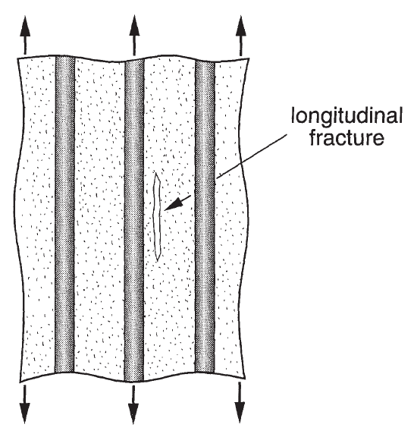
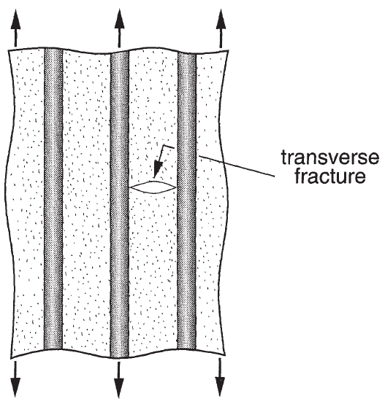
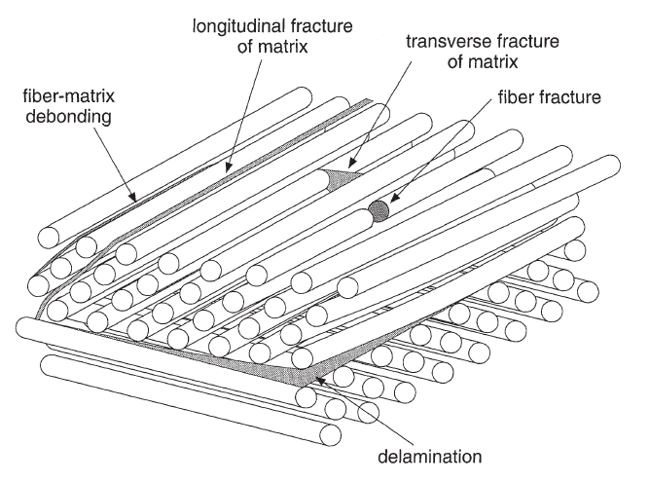
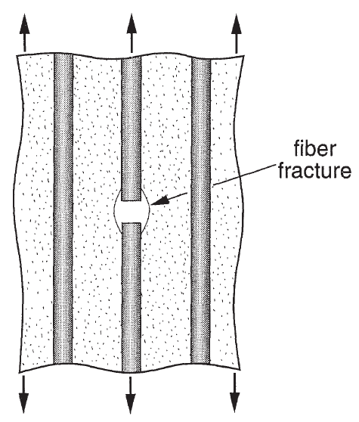
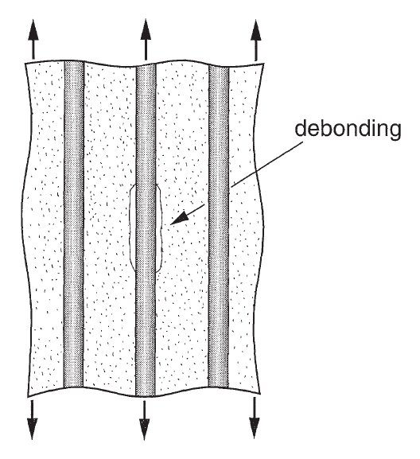
Failure modes-
Introduction
Shear stress in the matrix reaches matrix shear strength
Tensile stress in the matrix reaches matrix tensile strength
Basic mechanisms of laminate failure are:
  Longitudinal fracture of matrix
  Transverse matrix fracture
  Fibre-matrix debonding
  Fibre fracture
  Delamination
Debonding stress is higher than shear strength of the matrix
Notes:
Intro
“This slide explains the main ways a composite laminate can fail. Knowing these failure modes helps engineers understand why damage starts and how to design stronger, safer composite parts.”
Concept
Composite materials can fail in several ways depending on how the load is applied and how well the fibres and matrix work together:
Longitudinal matrix fracture happens when the shear stress in the matrix becomes too high, causing cracks that run along the fibres.
Transverse matrix fracture occurs when tension across the fibres is greater than what the matrix can handle, creating cracks that cut across the fibre direction.
Fibre–matrix debonding occurs when the bond between the fibre and matrix breaks, meaning the load can no longer transfer properly between them.
Fibre fracture takes place when the fibres themselves snap because the stress is higher than their strength.
Delamination is when layers of the laminate separate from each other, usually from out-of-plane stresses or impact.
Details
The figures show how each failure mode looks inside a laminate. The cracks can start in the matrix (either along or across the fibres), at the interface (debonding), or within the fibres themselves. Delamination usually spreads between layers and can grow over time with repeated loading. In real components, these failures often happen together, leading to progressive damage that reduces stiffness and strength before total failure.
Key Takeaway
Composite laminates don’t usually fail in a single way. Instead, several damage mechanisms interact — cracks form, fibres break, layers separate — and this progressive failure defines how the material behaves under real service loads. Understanding each mode helps engineers predict failure and design more damage-tolerant structures.

Slide 3
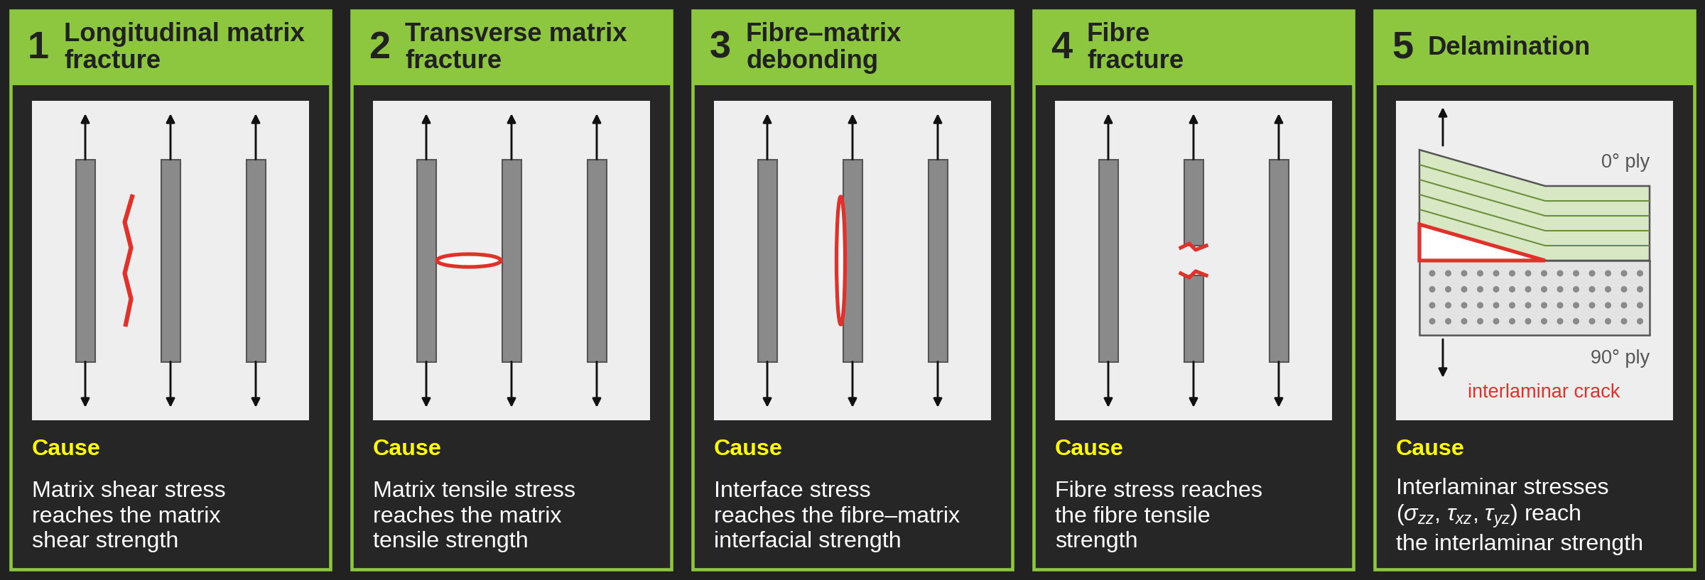
Failure modes-
Introduction

Slide 4
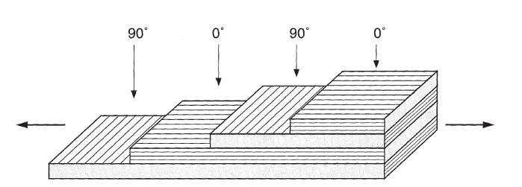
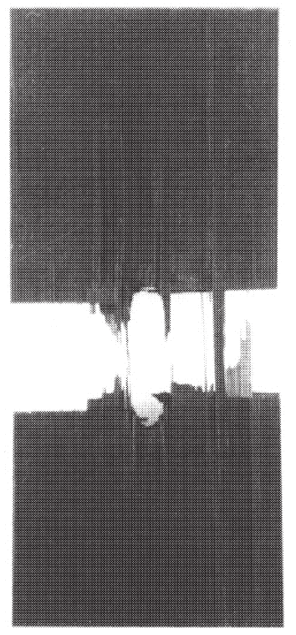
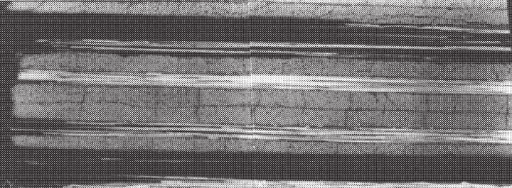
Fracture modes-
Example 1
Half the laminate is shown
The fracture mechanism depends on:
  The nature of constituents
  The architecture of the layer
  Mode of mechanical loading
For example, for a cross-ply laminate subject to tensile loading:
  Longitudinal fracture of the matrix and/or fracture at the fibre-matrix interface in the layers oriented at 90°
  Fracture of the fibres in the layers at 0°
  The transverse fracture of the matrix in the layers at 0°
Side view of fracture of a [0/90]_{2s} CFRP with a hole at the centre showing transverse fracture of 90º plies.
Notes:
Intro
“This slide gives an example of how different failure modes appear in a cross-ply laminate. It shows how the stacking sequence, materials, and type of loading combine to control where and how damage begins.”
Concept
The way a composite laminate fractures depends on three main factors:
Nature of constituents: the stiffness and strength of the fibres and matrix.
Layer architecture: fibre orientation and ply stacking (e.g., 0°/90° cross-ply).
Mechanical loading: whether the stress is tensile, compressive, or shear.
For a cross-ply laminate under tensile loading, the sequence of damage typically follows this pattern:
Longitudinal fracture of the matrix or cracking along the fibre–matrix interface in the 90° plies, where stress concentrations are high.
Fibre fracture in the 0° plies as the load increases and the fibres reach their tensile limit.
Transverse matrix cracking in the 0° layers, completing the failure process.
Details
The top schematic shows alternating 0° and 90° plies, half of the laminate for simplicity. The micrograph displays a side view of a [0/90]₂ₛ carbon fibre reinforced polymer (CFRP) specimen with a central hole—an intentional stress raiser. The 90° plies exhibit transverse matrix cracking initiated by local tensile stresses around the hole, while the 0° plies carry most of the load until fibre fracture occurs. These progressive events demonstrate how ply orientation controls damage evolution in multi-directional laminates.
Key Takeaway
In cross-ply CFRP laminates, fracture begins in the weaker 90° plies through matrix cracking and debonding, then progresses to fibre failure in the 0° plies. The overall fracture pattern is strongly influenced by fibre orientation and local stress concentrations such as holes or notches.

Slide 5
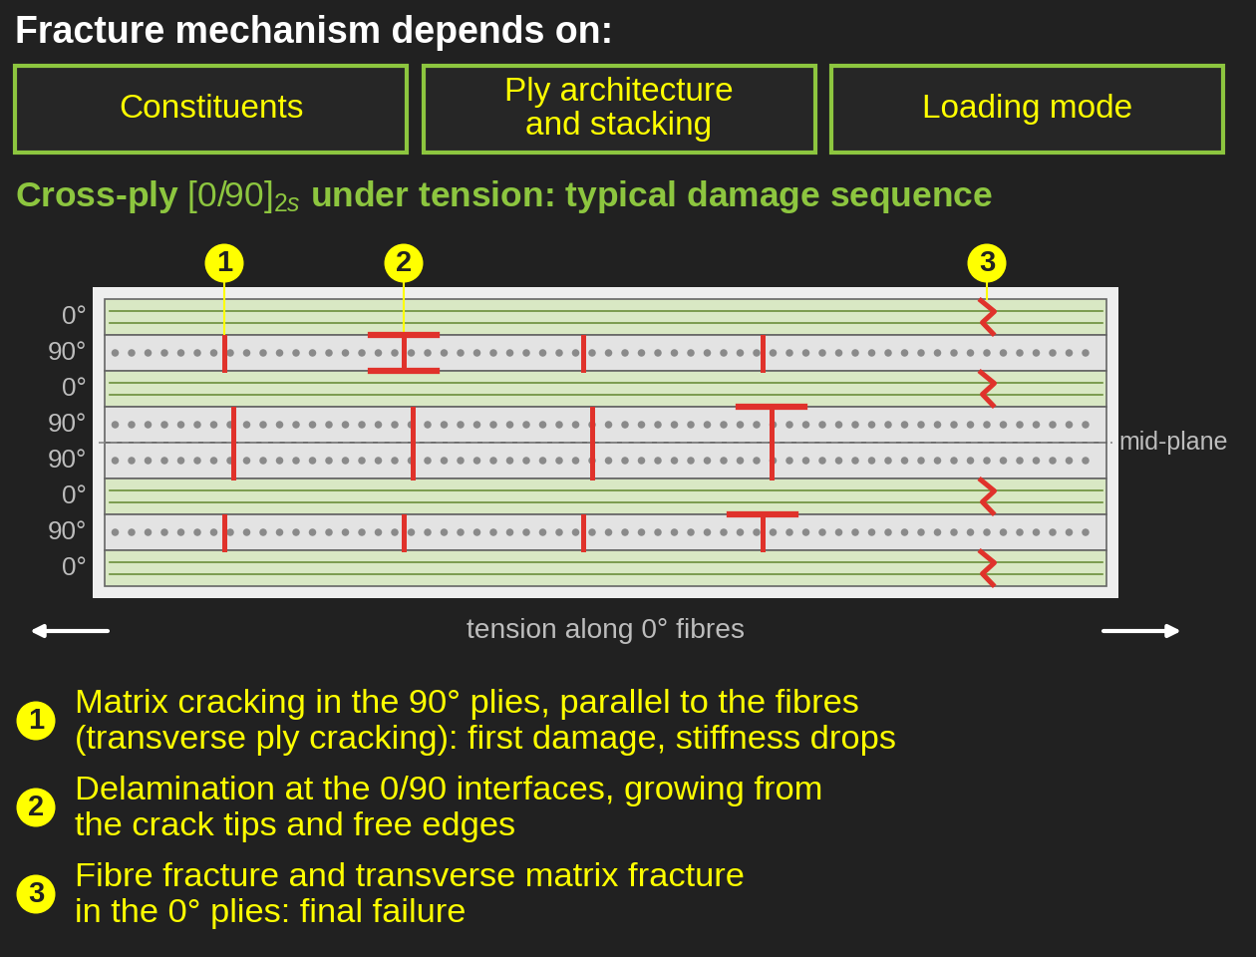
Fracture modes-
Example 1

Slide 6
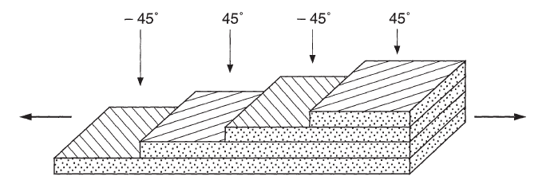
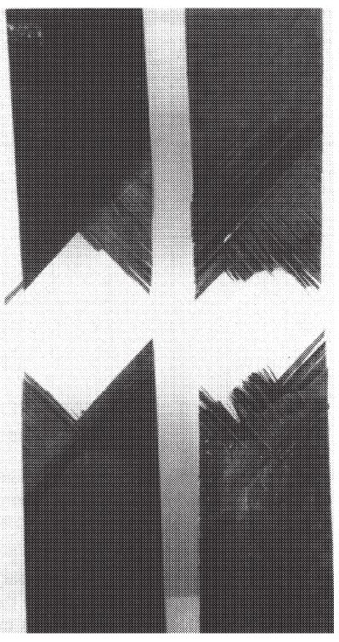
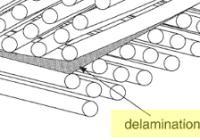
Fracture modes-
Example 2
Half the laminate is shown
For example, for an angle-ply laminate subject to tensile loading:
  The longitudinal matrix fracture in the ±45° layers
  Delamination between layers
Notes:
Intro
“This slide shows how fracture develops in an angle-ply laminate. The example helps visualise how off-axis fibre orientations affect both the direction and type of damage under tension.”
Concept
When an angle-ply laminate (such as ±45°) is stretched, the fibres are not aligned with the loading direction, so the matrix carries a larger share of the shear load. Two main failure modes appear:
Longitudinal matrix fracture along the ±45° fibre directions, caused by high shear stress between fibres and matrix.
Delamination between layers, where cracks from one ply grow into neighbouring plies with opposite orientation, leading to layer separation.
Details
The schematic shows alternating ±45° plies in half of the laminate. The experimental image reveals diagonal cracks following fibre paths in the ±45° layers—evidence of matrix shear failure. As these cracks grow, they reach the ply interfaces, where mismatched orientations and interlaminar stresses trigger delamination. This is typical of angle-ply laminates because the fibres’ off-axis alignment transfers load through shear rather than direct tension, making the matrix–interface regions more vulnerable.
Key Takeaway
In angle-ply laminates, failure is dominated by shear-driven matrix cracking and delamination. The ±45° fibre orientation promotes diagonal crack growth and layer separation, showing how ply angle directly controls the failure pattern and load-carrying efficiency of composite laminates.

Slide 7
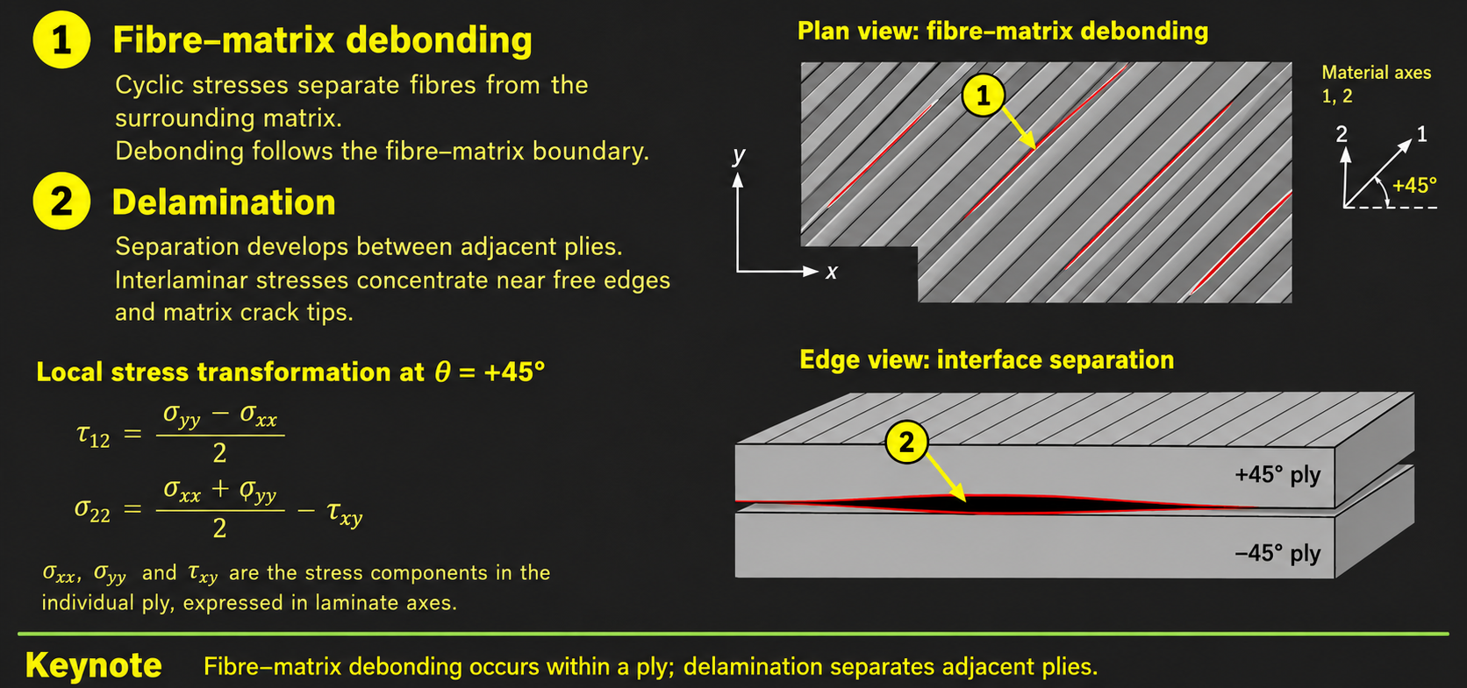
Fracture modes-
Example 2

Slide 8
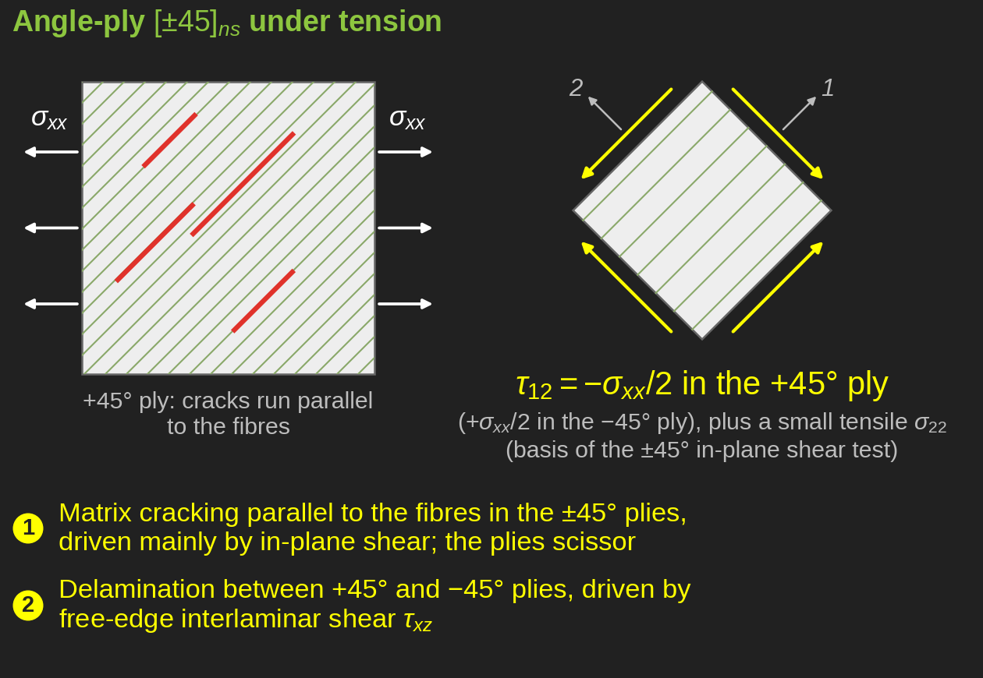
Fracture modes-
Example 2

Slide 9

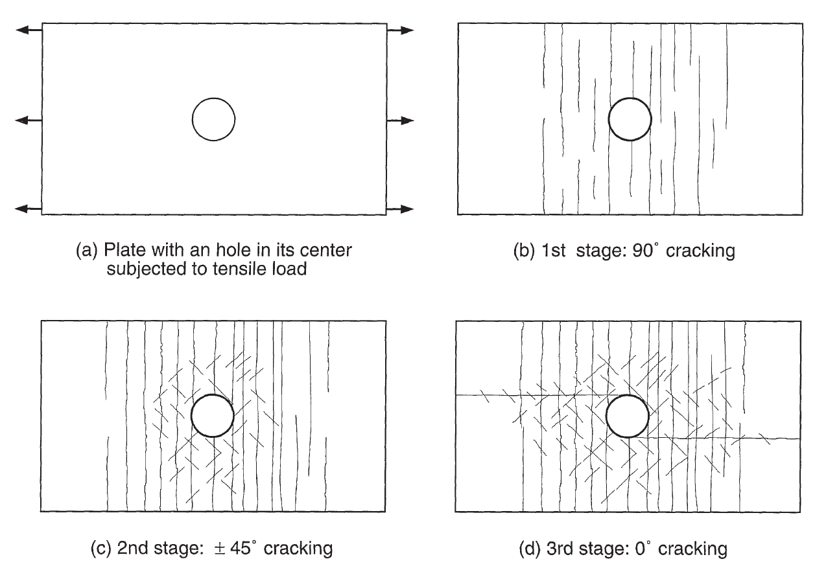
Fracture modes-
Example 3
For example, for a Quasi-isotropic ply laminate subject to tensile loading:
  First, longitudinal cracking of the matrix is induced in the 90° layers
  Matrix cracking is initiated in the ±45° layers from the cracks propagated in the 90° layers with a limited propagation of the cracks at ±45°
  Initiation of longitudinal matrix cracks initiated from the hole, which propagate in the 0° layers
  These cracks also generate secondary cracks in ±45° layers
  In the last stage, the longitudinal cracks in 0° layers induce a delamination of the layers followed by the fracture of 90° layers, then of ±45°, and lastly by the fracture of fibres in 0° layers, leading to the final fracture of the plate
Notes:
Intro
“This slide illustrates how a quasi-isotropic laminate fails under tensile loading. Because it includes plies at 0°, ±45°, and 90°, it shows a progressive and complex failure pattern similar to that seen in real composite aircraft components.”
Concept
Quasi-isotropic laminates have plies in multiple orientations (0°, ±45°, 90°), giving nearly equal in-plane stiffness in all directions.
Under tensile loading, different plies fail at different stages due to varying stress states:
90° plies fail first through matrix cracking.
±45° plies fail next as cracks spread through shear.
0° plies carry the most load and fail last by fibre fracture.
The failure process is sequential and highly dependent on the interaction between layers.
Details
The 90° plies develop longitudinal matrix cracks first, especially near holes or notches where stresses are highest.
These cracks extend into the ±45° plies, causing limited shear cracking.
Longitudinal cracks then appear in the 0° plies, starting from stress concentrations at the hole edges.
Secondary cracking forms in the ±45° plies, and delamination begins between layers.
Final failure occurs as delamination spreads and the 0° fibres fracture, leading to total laminate separation.
The diagrams show this step-by-step progression: 90° cracking (yellow), ±45° cracking (blue), and finally 0° cracking (purple).
Key Takeaway
Quasi-isotropic laminates fail progressively, starting with matrix cracking in 90° plies and ending with fibre breakage in 0° plies.
Each ply orientation plays a distinct role in damage evolution, making the sequence of failure predictable but complex.
Understanding this sequence helps engineers design balanced laminates that delay catastrophic failure and maintain load capacity even after initial cracking.

Slide 10
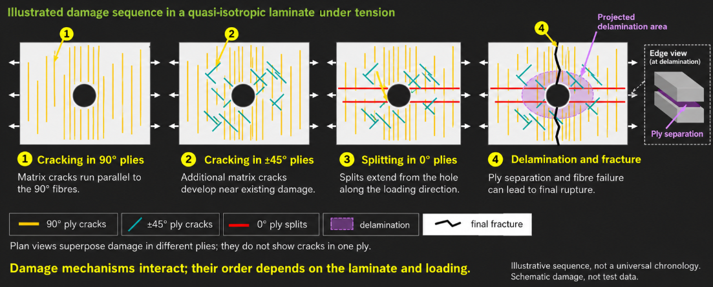
Fracture modes-
Example 3

Slide 11
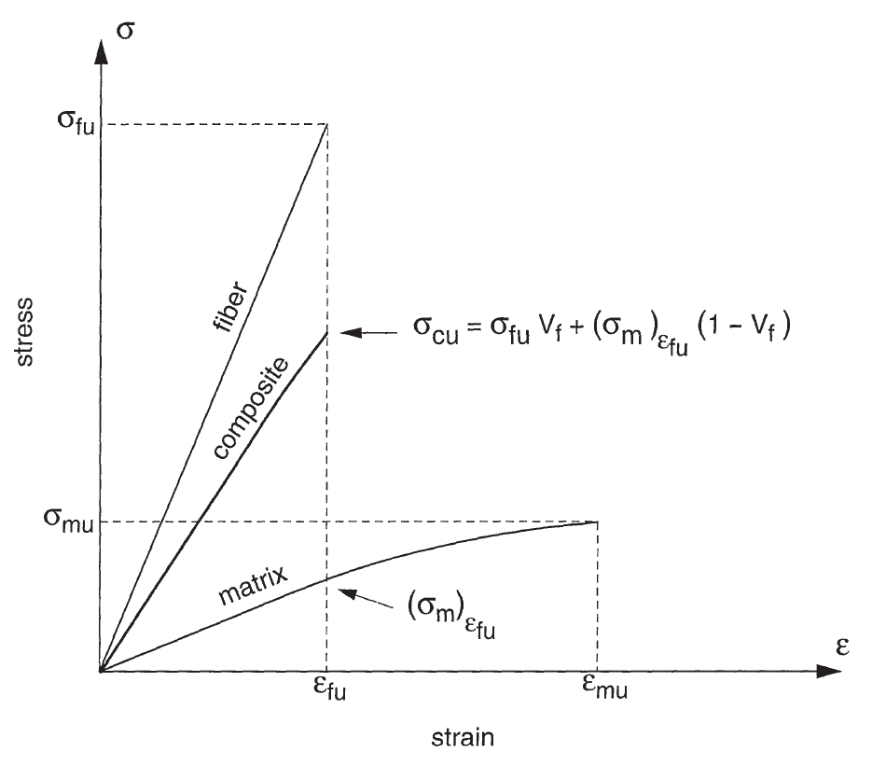

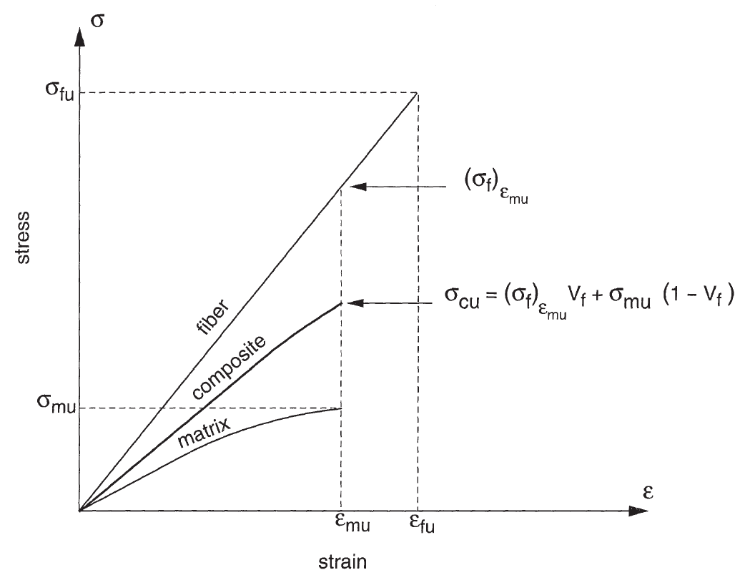
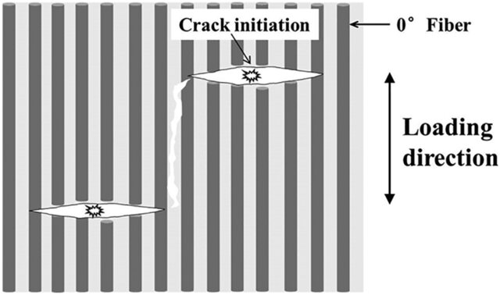


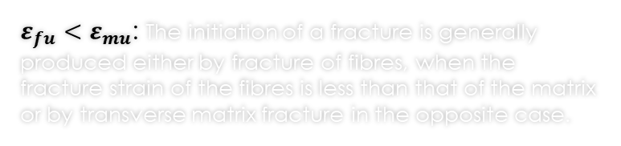
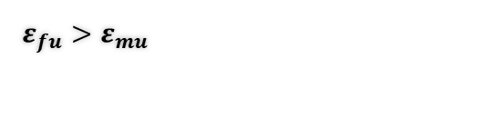
Failure modes-
Unidirectional composite subjected to longitudinal tension
The matrix does not allow us to benefit from the fibre reinforcement
Ultimate stress of the composite
Stress in matrix at strain equal to the ultimate strain of the fibres
Ultimate stress of the matrix
Volume fraction
Stress in the fibre at strain equal to the ultimate strain of the matrix
$ε_{fu}<ε_{mu}$: The initiation of a fracture is generally produced either by fracture of fibres, when the fracture strain of the fibres is less than that of the matrix or by transverse matrix fracture in the opposite case.
$$ε_{fu}>ε_{mu}$$
Notes:
Intro
“This slide explains how a unidirectional composite behaves when it is pulled along the fibre direction. It shows how the relative strength and strain capacity of fibres and matrix determine whether failure begins in the matrix or the fibres.”
Concept
Unidirectional composites are designed so that fibres carry most of the load along their length, with the matrix transferring stress between fibres.
The overall composite strength depends on both constituent strengths and their volume fractions (Vf for fibres, Vm = 1–Vf for matrix).
Two main cases define the failure behaviour:
Case 1: Fibre strain at failure (εfu) < Matrix strain at failure (εmu) → Fibres break first.
Case 2: Fibre strain at failure (εfu) > Matrix strain at failure (εmu) → Matrix cracks first.
Details
Case 1 (εfu < εmu):
Typical for stiff, brittle fibres (e.g., carbon).
Fibres reach their fracture strain first, causing composite failure even though the matrix can still deform.
The composite’s ultimate stress (σcu) ≈ σfu × Vf, meaning failure strength scales with fibre strength and volume fraction.
Case 2 (εfu > εmu):
Common for ductile fibres (e.g., glass or aramid) in a brittle matrix.
The matrix cracks first when its tensile strain limit is exceeded, preventing full fibre reinforcement benefit.
The composite fails at lower stress since the load can no longer transfer effectively through the cracked matrix.
The stress–strain plots show that the composite behaviour lies between the individual fibre and matrix curves. The slope (modulus) and ultimate stress are controlled by fibre content and relative strain limits.
Key Takeaway
Whether a unidirectional composite fails by fibre fracture or matrix cracking depends on which constituent reaches its strain limit first.
For carbon/epoxy systems, fibres usually fail first; for glass or aramid composites, matrix cracking dominates.
Designing effective composites means matching fibre and matrix properties to balance stiffness, strength, and strain capacity for the intended load direction.

Slide 12
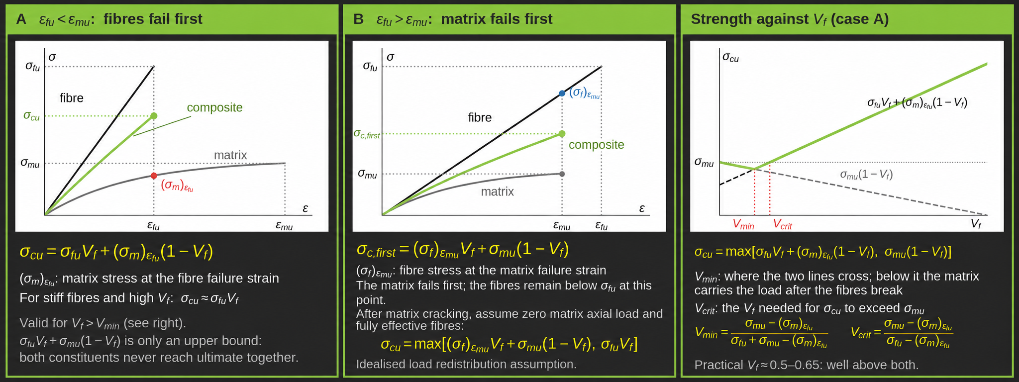
Failure modes-
Unidirectional composite subjected to longitudinal tension
Notes:
This slide shows how a unidirectional composite fails when it is pulled along the fibres. Under this load the fibres and matrix stretch by the same amount, so whichever constituent has the lower failure strain breaks first, and that controls the strength. Keep an eye on two numbers: the fibre failure strain, εfu, and the matrix failure strain, εmu.
Panel A: fibres fail first (εfu < εmu). This is the normal case for polymer composites such as carbon/epoxy. The black line is the fibre, the grey curve is the matrix, and the green line is the composite, which lies between them. When the strain reaches εfu the fibres break at their full strength, σfu. At that moment the matrix is carrying only a small stress, marked in red as (σm)εfu. The composite strength is therefore the fibre contribution plus that small matrix contribution: σcu = σfu Vf + (σm)εfu(1 − Vf). Because the matrix term is small, σcu is approximately σfu Vf. The expression σfu Vf + σmu(1 − Vf) is only an upper bound, because the two constituents never reach their ultimate stresses at the same strain.
Panel B: matrix fails first (εfu > εmu). This happens with brittle matrices. The matrix now breaks first, at εmu, while the fibres are still below their strength. The blue point shows the fibre stress at that strain, (σf)εmu. The strength is σcu = (σf)εmu Vf + σmu(1 − Vf). The fibres are only partly used, so the matrix limits the composite. Neither case is "better"; they are different material combinations. Case A uses the fibres fully, which is why we generally choose a matrix that can stretch more than the fibre. The grey note: if there are enough fibres, they can carry σfu Vf on their own after the matrix cracks, and the strength is then the larger of the two values.
Panel C: strength against fibre volume fraction (case A). This panel answers how many fibres are needed before they actually help. There are two possible strengths:
The black dashed line: the fibres carry the load until they break. It rises as Vf increases.
The grey dashed line: after the fibres break, the remaining matrix carries the load alone. It falls as Vf increases, because there is less matrix.
The real strength is whichever is higher, shown by the green line. This gives two thresholds:
Vmin is where the two lines cross. Below it the fibres make little difference, because the matrix still holds after they break.
Vcrit is where the green line climbs back up to the matrix strength, σmu. Below Vcrit the composite is actually weaker than the plain matrix: the fibres break early and pull the matrix stress down with them. Only above Vcrit do the fibres strengthen it.
Both thresholds are only a few per cent. Real composites use Vf of about 0.5 to 0.65, so they are well above both, and the simple rule σcu ≈ σfu Vf applies.
Key message. The constituent with the lower failure strain controls the strength. Design so that the fibres fail first, and use enough fibre to be well above Vcrit.

Slide 13
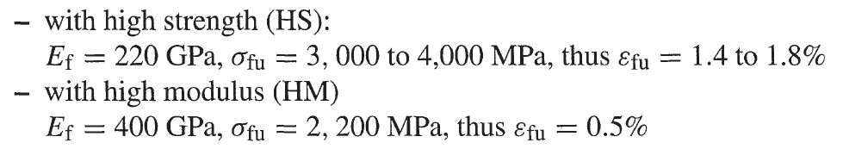
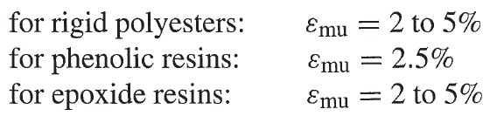
Failure modes-
Unidirectional composite subjected to longitudinal tension
For carbon fibres:
  High Strength (HS)
  High Modulus (HM)
For E-glass fibres:
Typical resins:
Notes:
Intro
“This slide presents typical mechanical properties of carbon and glass fibres, as well as common resin systems. Comparing their stiffness, strength, and strain-to-failure helps predict which constituent will fail first when the composite is loaded in tension.”
Concept
Fibre type determines both strength and stiffness of the composite.
Matrix type governs ductility and strain-to-failure.
The balance between fibre and matrix properties defines whether the composite behaves in a brittle or ductile manner under longitudinal tension.
Details
Carbon fibres:
High Strength (HS):
$$E_{f}=220 \text{GPa}$$
$$σ_{fu}=3000\text{–}4000 \text{MPa}$$
$$ε_{fu}=1.4\text{–}1.8\%$$
High Modulus (HM):
$$E_{f}=400 \text{GPa}$$
$$σ_{fu}=2200 \text{MPa}$$
$$ε_{fu}=0.5\%$$
Carbon fibres are very stiff and strong but have low strain capacity, so they tend to fracture before the matrix (εfu < εmu).
E-glass fibres:
$$E_{f}=70 \text{GPa}$$
$$σ_{fu}=2400\text{–}3400 \text{MPa}$$
$$ε_{fu}=3.4\text{–}4.8\%$$
These fibres are more ductile than carbon and can stretch beyond the matrix limit (εfu > εmu), so matrix cracking occurs first.
Typical resin matrices:
Rigid polyesters: $ε_{mu}=2\text{–}5\%$
Phenolic resins: $ε_{mu}=2.5\%$
Epoxy resins: $ε_{mu}=2\text{–}5\%$
Resins are relatively ductile but much weaker and less stiff than fibres; their role is mainly load transfer and crack resistance.
Key Takeaway
High-strength carbon fibres fail before the matrix (brittle response).
E-glass fibres outlast the matrix in strain (ductile response).
Choosing fibre and resin combinations with compatible strain limits ensures balanced and predictable composite behaviour under longitudinal tension.

Slide 14
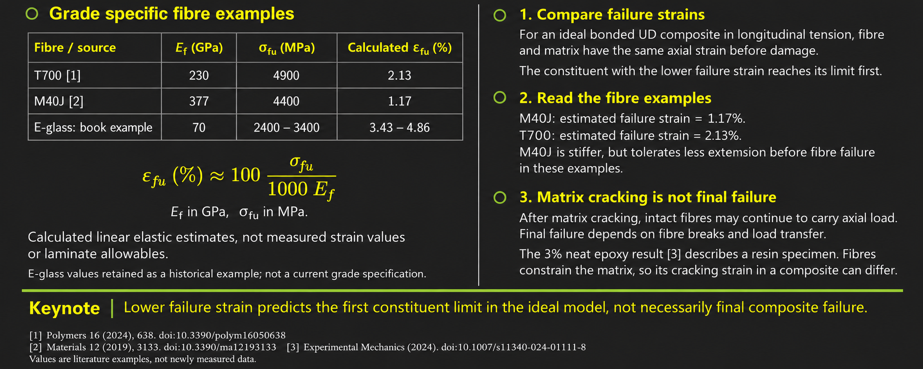
Failure modes-
Unidirectional composite subjected to longitudinal tension

Slide 15
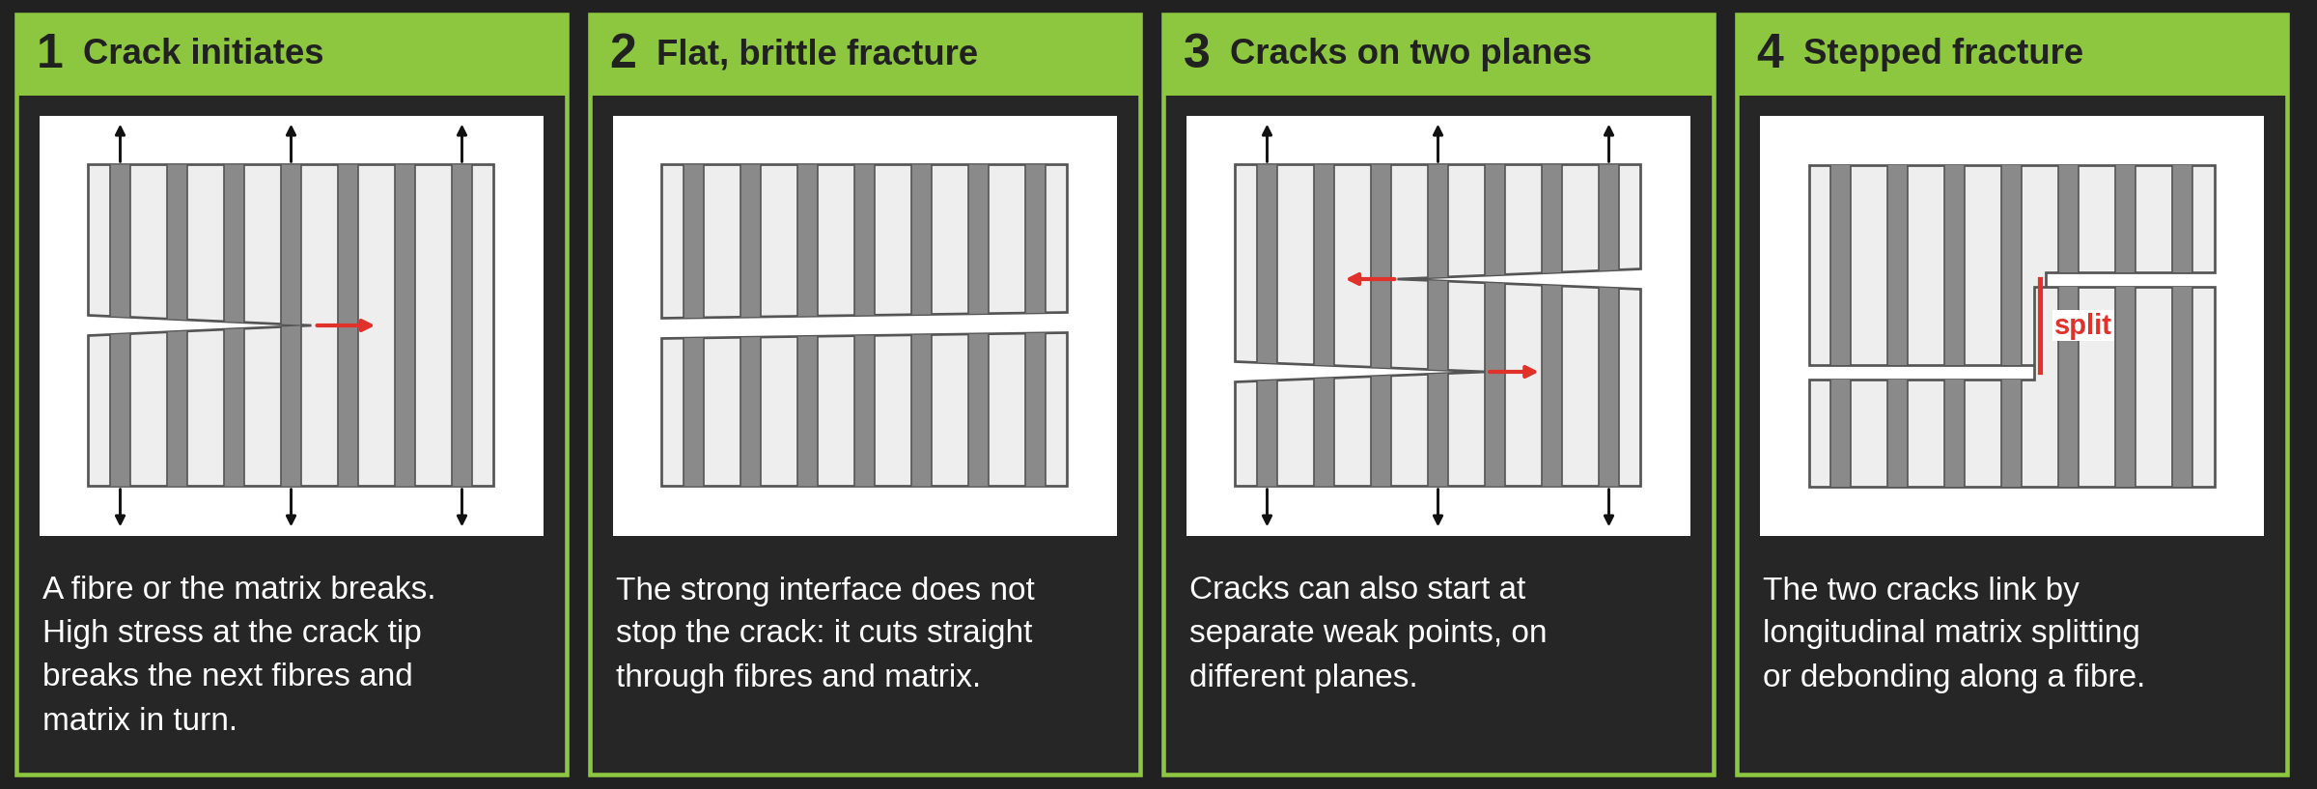
Failure modes-
Unidirectional composite subjected to longitudinal tension-
Fracture propagation of high fibre-matrix bonding
Notes:
Intro
“This slide illustrates how cracks grow in a unidirectional composite when the fibre–matrix bond is strong. It shows the step-by-step development of fracture under longitudinal tension and explains how high interfacial bonding influences failure behaviour.”
Concept
In composites with strong fibre–matrix bonding, cracks cannot easily deflect or stop at the interface.
As a result, stress concentrates at the crack tip, and fracture propagates directly through both matrix and fibres.
The process involves several stages:
Crack initiation in either the fibre or the matrix.
Rapid crack growth through high-stress regions near the crack tip.
Possible fibre–matrix debonding or bridging between multiple cracks.
Details
Stage 1: Fracture starts in either the fibre or the matrix, usually at a weak spot or defect.
Stage 2: High local stress at the crack tip drives further propagation through the surrounding material.
Stage 3: Brittle fracture develops, with cracks spreading quickly across the load path.
Stage 4: In some regions, bridging occurs — cracks in different zones connect through longitudinal splitting and limited fibre–matrix debonding.
Strong bonding limits energy absorption because cracks do not easily deflect along the interface, producing a clean, brittle fracture surface.
Key Takeaway
High fibre–matrix bonding increases stiffness and load transfer efficiency but reduces toughness.
Cracks in such systems propagate rapidly and directly through both phases, resulting in a brittle failure mode.
Optimising the interfacial bond is key: too strong leads to brittle fracture, too weak causes premature debonding and strength loss.

Slide 16
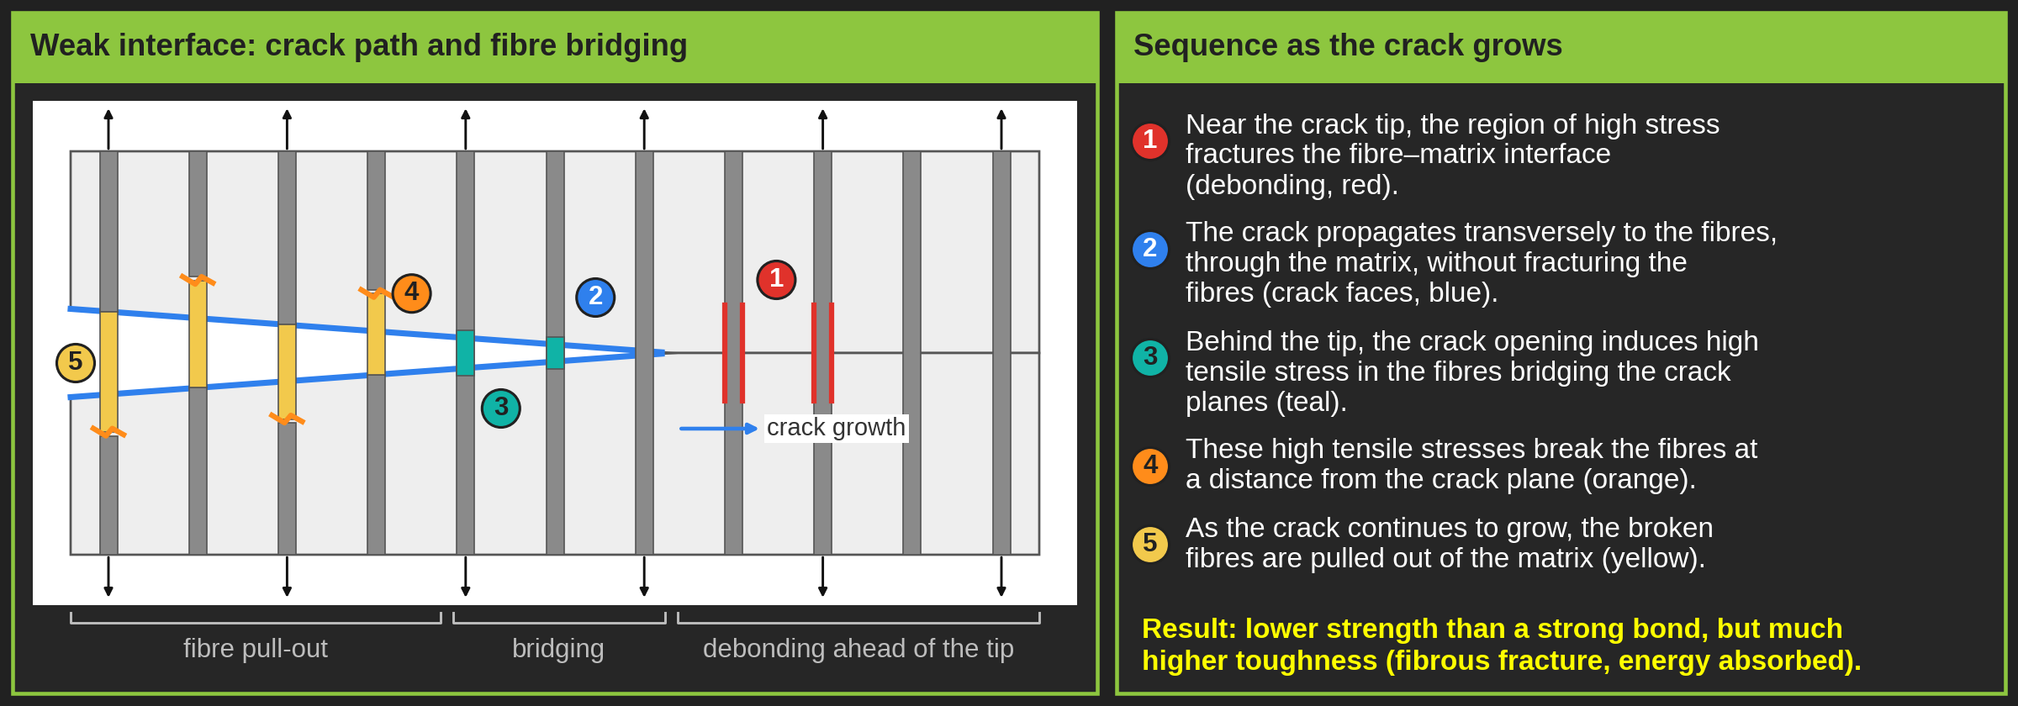
Failure modes-
Unidirectional composite subjected to longitudinal tension-
Fracture propagation of poor fibre-matrix bonding
Notes:
Intro
“This slide explains how cracks grow in a unidirectional composite when the fibre–matrix bonding is poor. It contrasts with the previous case by showing a more gradual and energy-absorbing failure process involving debonding and fibre pull-out.”
Concept
Poor interfacial bonding means the matrix cannot transfer stress efficiently to the fibres.
Cracks propagate mainly along the fibre–matrix interface, not through the fibres themselves.
The process involves progressive debonding, fibre pull-out, and delayed fibre fracture, which increases toughness but reduces stiffness and strength.
Details
At the crack tip, high local stresses produce shear fracture along the interface, causing the fibres to separate from the matrix without breaking.
The crack then moves transversely to the fibres, bypassing them rather than cutting through.
Behind the crack tip, tensile stresses develop in the bridging fibres, which resist opening of the crack.
As the load rises, these fibres eventually fracture some distance behind the crack front, and their broken ends are pulled out of the matrix.
The figure shows this progression—starting with debonding, followed by crack advance, fibre breakage, and pull-out.
Key Takeaway
Poor fibre–matrix bonding results in a more ductile and energy-dissipative failure mode through debonding and fibre pull-out.
This mechanism improves toughness but significantly lowers stiffness and tensile strength compared to composites with strong interfacial bonding.
Balancing interfacial strength is crucial: enough to transfer load effectively, but weak enough to allow controlled energy absorption through fibre pull-out.

Slide 17
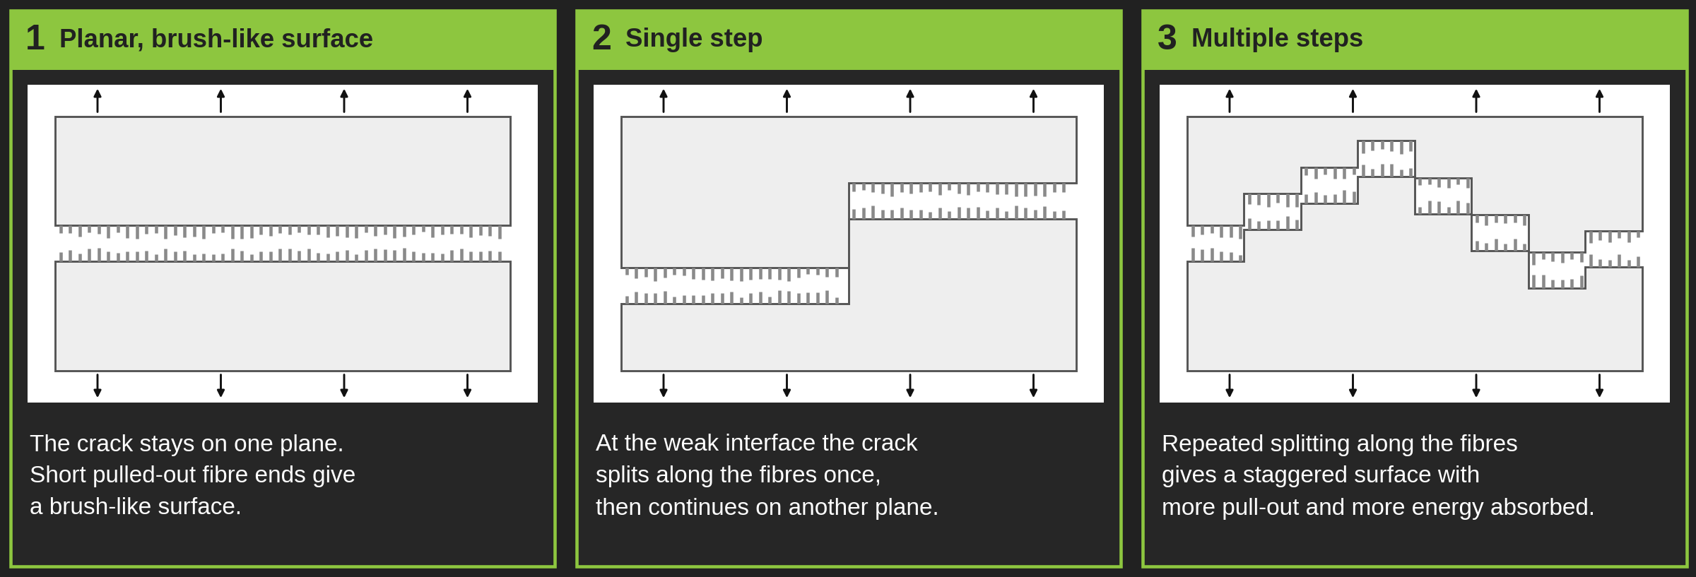
Failure modes-
Unidirectional composite subjected to longitudinal tension-
Fracture surfaces of poor fibre-matrix bonding
Notes:
Intro
“This slide shows the characteristic fracture surfaces of unidirectional composites when fibre–matrix bonding is poor. It highlights how cracks split, bridge, and form stepped or brush-like patterns rather than clean fractures.”
Concept
Poor bonding between fibre and matrix leads to interfacial crack splitting instead of through-fibre fracture.
The crack path follows the fibre–matrix interface, resulting in bridging and multiple step formations.
These surfaces reflect energy-dissipative failure, where fibres pull out and bridge across cracks, slowing propagation.
Details
When the advancing crack reaches the fibre–matrix interface, it can split and run parallel to the fibres.
This produces a brush-like appearance on the fracture surface due to partial fibre pull-out.
Bridging zones appear where intact fibres span across the crack, maintaining some load transfer.
With continued loading, multiple bridging regions develop, giving a stepped or serrated fracture pattern.
Such surfaces indicate that failure occurred by interfacial debonding rather than clean fibre breakage, showing that the interface absorbed part of the fracture energy.
Key Takeaway
Poor fibre–matrix bonding leads to rough, stepped fracture surfaces with clear evidence of fibre bridging and pull-out.
These features indicate enhanced toughness but reduced stiffness and strength.
Understanding these surface features helps diagnose interfacial quality in composite testing and failure analysis.

Slide 18
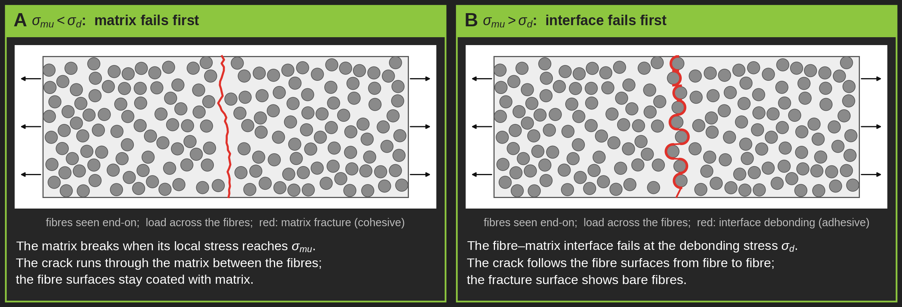
Failure modes-
Unidirectional composite subjected to transverse tension
Notes:
Intro
“This slide explains how a unidirectional composite behaves under transverse tension, where the applied load is perpendicular to the fibres. The failure mode depends on whether the matrix or the fibre–matrix interface is weaker.”
Concept
Transverse tension primarily loads the matrix and the fibre–matrix interface, not the fibres themselves.
Two main cases determine the mode of failure:
$σ_{mu}<σ_{d}$: The matrix fails first because its tensile strength is lower than the interface debonding stress.
$σ_{mu}>σ_{d}$: The interface fails first, leading to fibre–matrix debonding.
Details
When $σ_{mu}<σ_{d}$:
The matrix cracks once the applied tensile stress equals its ultimate strength $σ_{mu}$.
Cracks propagate through the resin-rich regions between fibres, often forming perpendicular to the loading direction.
The figure shows a clean transverse matrix crack, typical of brittle polymers like epoxies.
When $σ_{mu}>σ_{d}$:
The fibre–matrix interface debonds first because it cannot sustain the tensile stress transferred from the matrix.
This causes interfacial cracking and local stress redistribution around fibres.
The lower image depicts this interfacial failure pattern, which is less brittle but leads to reduced stiffness.
Key Takeaway
Under transverse tension, unidirectional composites fail either by matrix cracking or interface debonding, depending on which constituent is weaker.
The matrix-dominated direction has low tensile strength, making it a common site for microcrack initiation in service.
Enhancing transverse strength requires improving matrix toughness and interface adhesion without compromising flexibility.

Slide 19
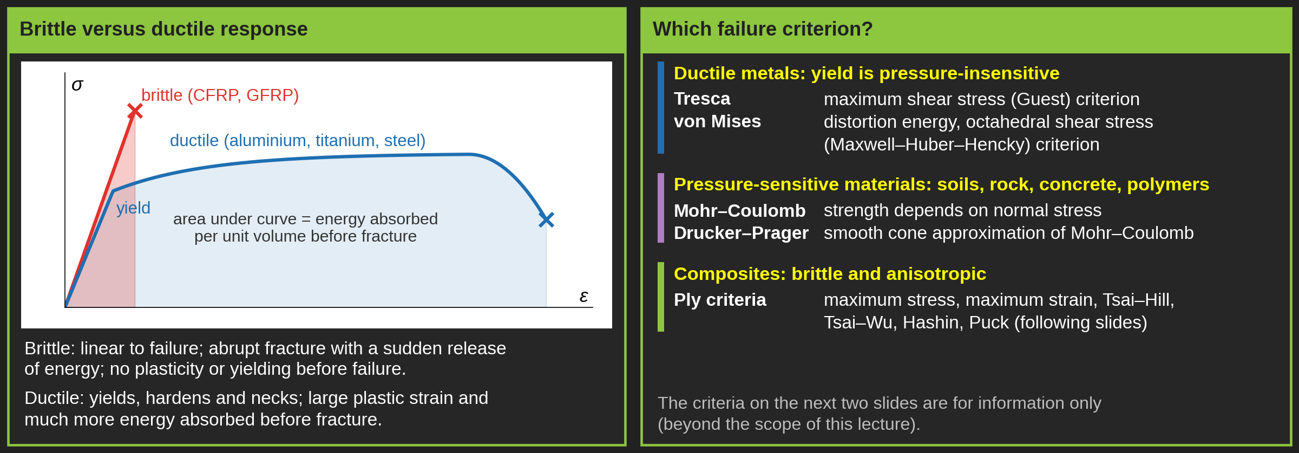
Failure criteria-
Introduction
Notes:
Intro
“This slide introduces the concept of failure criteria, distinguishing between brittle and ductile materials. It explains why composite materials such as CFRP and GFRP fail suddenly without yielding, unlike metals that deform plastically before fracture.”
Concept
Composites (CFRP, GFRP) behave as brittle materials:
Failure is abrupt, with little or no plastic deformation.
There is no yielding phase—failure occurs when the maximum stress exceeds the material’s limit.
Energy absorption is low, represented by the small area under the stress–strain curve.
Ductile materials (e.g., aluminium, titanium, steel) exhibit:
Gradual yielding and plastic deformation before fracture.
Larger energy absorption due to significant strain hardening.
Predictable behaviour defined by yield criteria.
Details
For ductile materials, the following classical failure criteria apply:
Von Mises criterion – also known as Maxwell–Huber–Hencky or octahedral shear stress theory; based on distortion energy.
Tresca criterion – also called the maximum shear stress or Guest yield criterion; simpler but more conservative.
Mohr–Coulomb and Drucker–Prager criteria – used for pressure-dependent or frictional materials (e.g., soils, polymers).
The plot compares brittle vs ductile stress–strain behaviour:
Brittle materials show sharp fracture near the elastic limit.
Ductile materials exhibit extended plastic deformation before failure.
The area under the curve represents the energy absorbed prior to failure—large for ductile metals, small for composites.
Key Takeaway
CFRP and GFRP laminates are brittle—they fail suddenly without yielding.
Metals are ductile, showing visible plastic deformation before failure.
Understanding this contrast is crucial: composites require failure criteria based on strength rather than yield, unlike metals that rely on plastic flow theories.

Slide 20
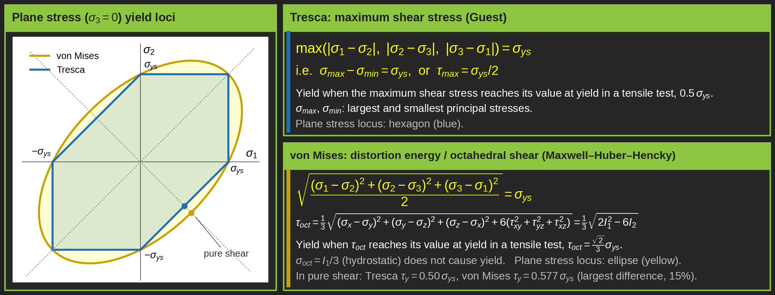
Failure criteria-
Ductile material
Notes:
Intro
“This slide compares the Von Mises and Tresca yield criteria for ductile materials, explaining how each predicts the onset of yielding under multi-axial stress states. Both are essential for metals but not applicable to brittle materials like composites.”
Concept
Von Mises criterion:
Yielding begins when the distortion energy in a material reaches the same value as in a uniaxial tension test at yield.
It assumes yielding is independent of hydrostatic stress (no effect from pure pressure).
Expressed as:
$$\sqrt{\frac{\left(σ_{1}−σ_{2}{\left.)\right.}^{2}+\left(σ_{2}−σ_{3}{\left.)\right.}^{2}+\left(σ_{3}−σ_{1}{\left.)\right.}^{2}\right.\right.\right.}{2}}=σ_{ys}$$
Tresca criterion:
Yielding occurs when the maximum shear stress equals the shear stress at yield in a simple tension test.
Expressed as:
Both criteria describe yielding for ductile materials like steel, aluminium, and titanium alloys but predict slightly different yield surfaces.
Details
In 3D stress space, the Von Mises surface is a smooth cylinder, while the Tresca surface is a hexagonal prism—Tresca is more conservative (predicts earlier yield).
In 2D, both appear as curves in the σ₁–σ₂ plane:
Von Mises → elliptical shape (distortion energy).
Tresca → hexagonal shape (maximum shear).
The octahedral shear stress (τₒct) describes yielding when distortion energy equals that at yield:
$$τ_{oct}=\frac{1}{3}\sqrt{2J_{2}}$$
where $J_{2}$is the second invariant of the deviatoric stress tensor.
These criteria help engineers predict failure in complex stress states (pressure vessels, shafts, thin-walled structures).
Key Takeaway
Von Mises gives a smooth, accurate prediction of ductile yielding; Tresca offers a simpler, more conservative approximation.
Both apply only to ductile materials capable of plastic deformation—not to composites, which fail by fracture rather than yield.
Understanding these criteria provides a foundation for appreciating why composite failure theories use strength-based, not yield-based, formulations.

Slide 21
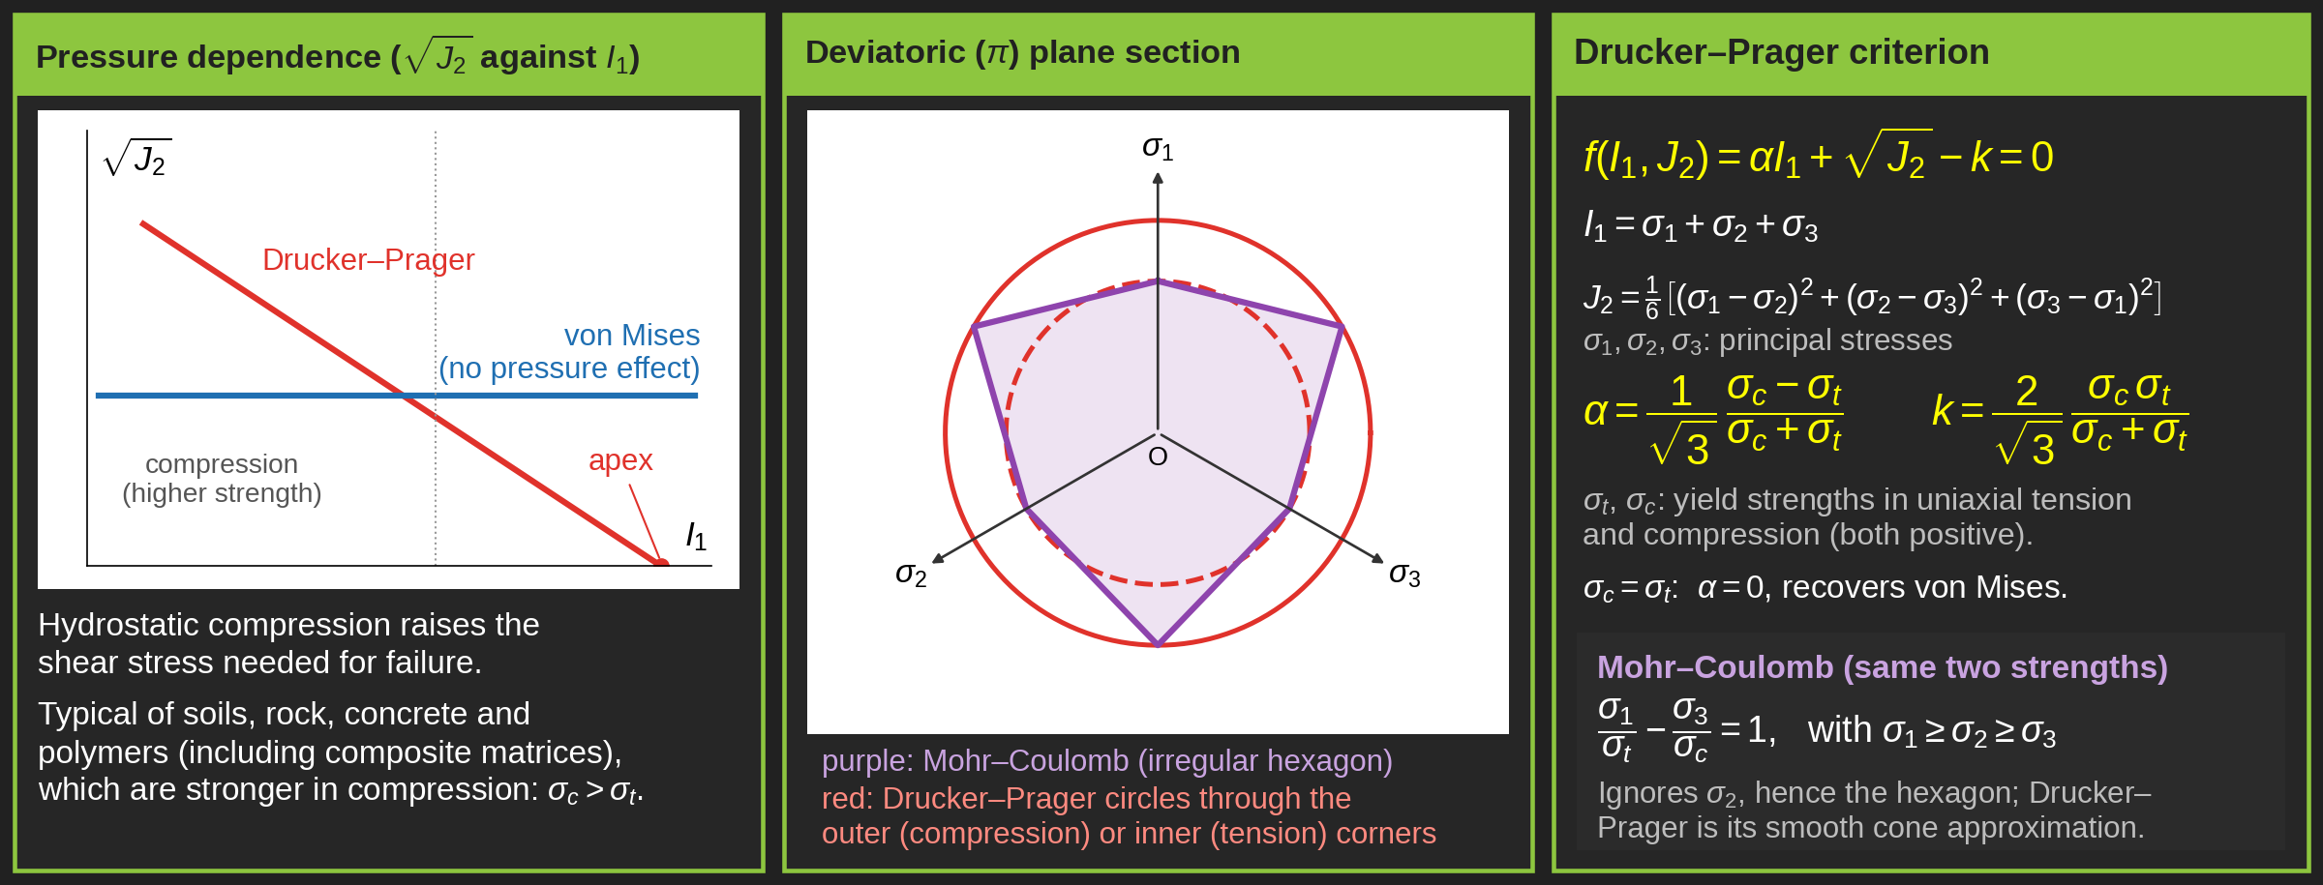
Failure criteria-
Ductile material
Notes:
Intro
“This slide introduces the Drucker–Prager failure criterion, an extension of the Von Mises model that incorporates the effect of hydrostatic pressure. It is particularly useful for pressure-sensitive, ductile, or frictional materials such as soils, polymers, and some metals under complex stress states.”
Concept
The Drucker–Prager criterion generalises Von Mises by including the influence of mean (hydrostatic) stress on yielding.
It assumes that yielding depends on both:
Deviatoric stress (shear-related distortion, $J_{2}$).
Hydrostatic stress (pressure, $I_{1}$).
The criterion is expressed as:
$$f\left(I_{1} , J_{2}\right)=αI_{1}+\sqrt{J_{2}}−k=0$$
where $I_{1}=σ_{1}+σ_{2}+σ_{3}$and $J_{2}$is the second invariant of the deviatoric stress tensor.
Details
The parameters $α$and $k$are material constants derived from tensile ($σ_{t}$) and compressive ($σ_{c}$) yield stresses:
$$α=\frac{1}{\sqrt{3}}\left(\frac{σ_{t}−σ_{c}}{σ_{c}+σ_{t}}\right), k=\frac{2}{\sqrt{3}}\left(\frac{σ_{c}σ_{t}}{σ_{c}+σ_{t}}\right)$$
Geometrically, the Drucker–Prager surface is a smooth cone in principal stress space, enclosing the hexagonal Mohr–Coulomb surface.
The figure shows that Drucker–Prager offers a convenient, differentiable approximation of Mohr–Coulomb behaviour.
The model predicts that yielding depends on both shear and pressure, making it suitable for non-metallic ductile materials that show different strengths in tension and compression (e.g., concrete, polymers, certain adhesives).
Key Takeaway
The Drucker–Prager criterion accounts for the effect of hydrostatic pressure, unlike Von Mises or Tresca.
It bridges the gap between metallic yield models (pressure-insensitive) and frictional materials (pressure-sensitive).
This approach underpins modern constitutive models for polymers, soils, and composite matrices, especially under combined tension and compression.

Slide 22
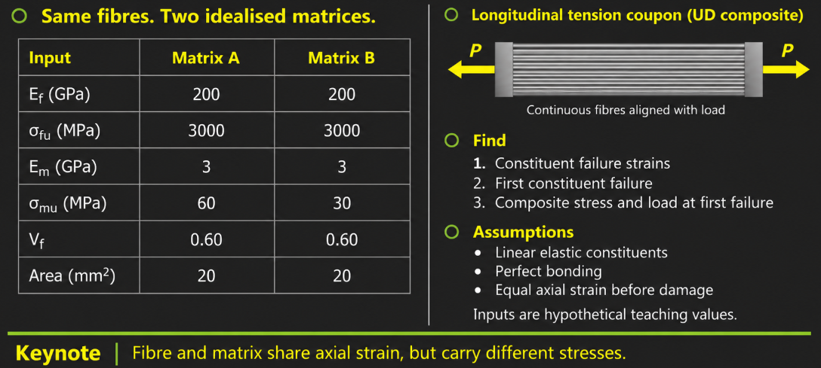
Worked example –
Longitudinal tension –
Which constituent reaches its failure strain first?

Slide 23
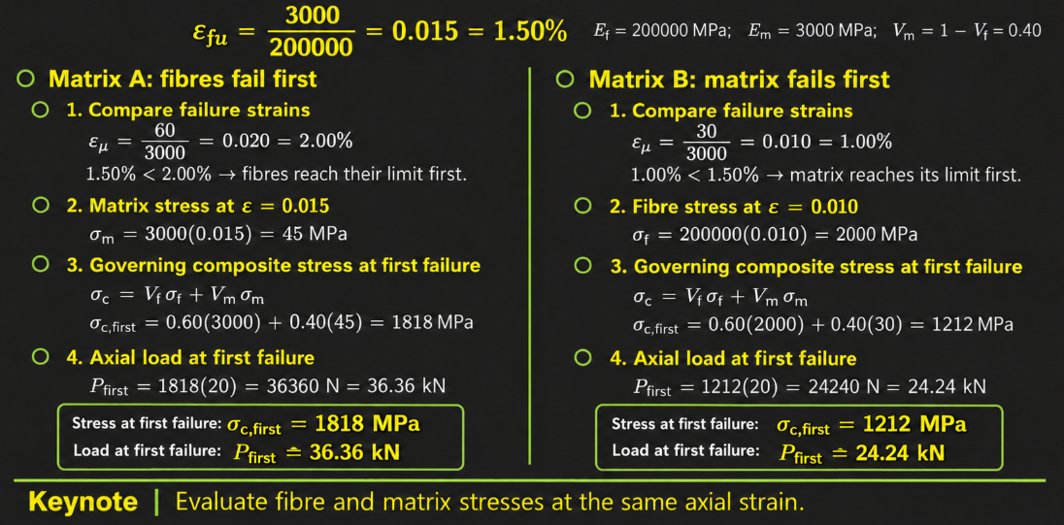
Worked example –
Longitudinal tension –
Which constituent reaches its failure strain first?

Slide 24
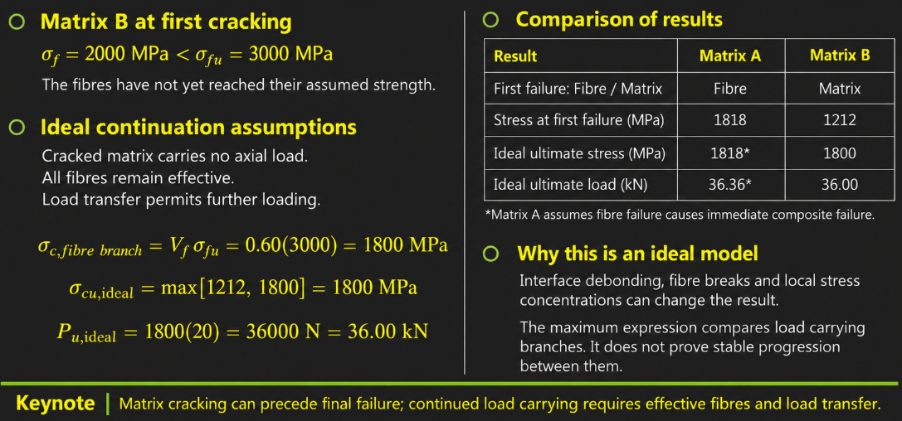
Worked example –
Longitudinal tension –
Which constituent reaches its failure strain first?

Slide 25
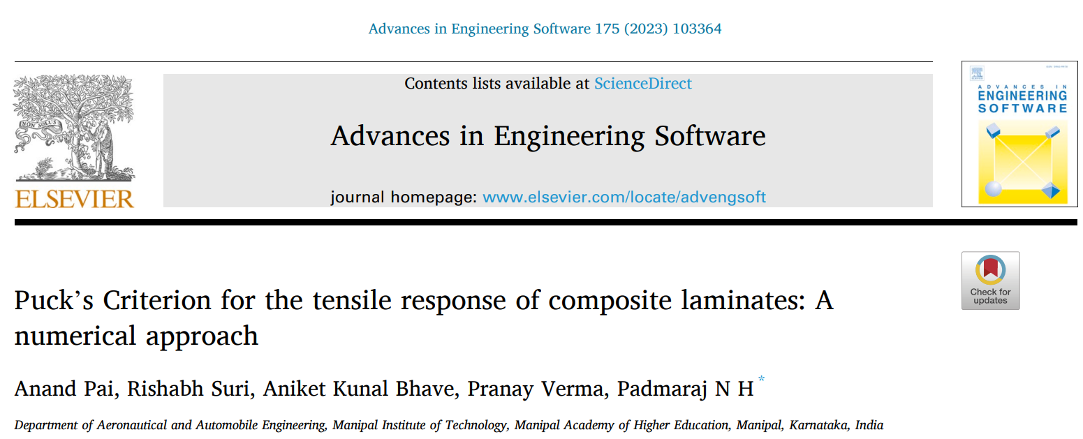

Failure criteria-
Brittle composites
2D stress state:
  Unidirectional CFRP/GFRP
    Maximum stress failure theory
    Maximum strain failure theory
    Tsai-Hill
    Hoffman
    Tsai-Wu
    Hashin-Rotem
    Puck
    Yamada Sun
    LaRC03
2D stress state:
  Bi-directional CFRP/GFRP (woven)
    See the opposite paper:
    Chang-chang
    Puck
3D stress state:
  Modification of the abovementioned criteria (3D Hashin, Yamada Sun)
  3D Puck
Notes:
Intro
“This slide summarises the main failure criteria used for brittle composite materials such as CFRP and GFRP. Unlike ductile metals, composites fail without yielding, so their failure prediction is based on stress or strain limits within the laminate.”
Concept
Brittle composite laminates (CFRP, GFRP) are analysed using strength-based criteria, not yield theories.
These criteria relate applied stresses or strains to the material’s strength in different directions—fibre, matrix, and shear.
Models differ based on laminate type and stress state:
2D stress state: in-plane loading for unidirectional or woven laminates.
3D stress state: through-thickness stresses and interlaminar effects.
Details
For unidirectional CFRP/GFRP (2D):
Maximum stress theory – failure occurs when any stress component exceeds its respective strength.
Maximum strain theory – similar, but based on strain limits.
Tsai–Hill and Tsai–Wu – energy-based interaction criteria accounting for combined stresses.
Hoffman and Hashin–Rotem – separate fibre and matrix failure modes.
Puck criterion – distinguishes between fibre failure and inter-fibre (matrix-dominated) failure, offering high accuracy.
Yamada–Sun and LaRC03 – advanced criteria that incorporate non-linear shear and multi-axial stress effects.
For bi-directional (woven) CFRP/GFRP (2D):
Chang–Chang – empirical model that captures tension, compression, and shear damage modes for woven fabrics.
Puck – extended to woven composites through modified stress interaction terms.
Examples: analytical and numerical validations in Puck (2023) and Damghani et al. (2021) papers.
For 3D stress states:
2D criteria are extended to account for out-of-plane stresses and interlaminar failure.
3D Puck and 3D Hashin–Yamada–Sun include delamination and transverse cracking effects.
Key Takeaway
Failure in brittle composites is governed by strength-based failure theories rather than yield criteria.
The Puck criterion is widely regarded as one of the most accurate models, capable of distinguishing between fibre and matrix failures under complex multi-axial loading.
Advanced models (LaRC03, 3D Puck) form the foundation of modern finite element implementations used in aerospace composite design and certification.

Slide 26
Maximum Stress Failure Criterion

Slide 27
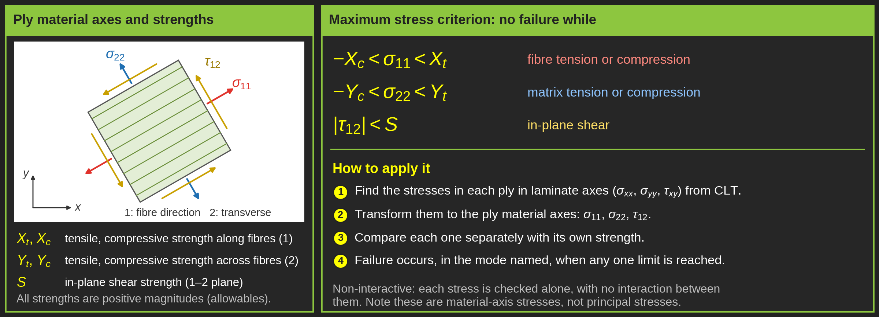
Failure criteria-
Composite-Unidirectional-
Maximum stress failure criterion
Notes:
Intro
“This slide introduces the Maximum Stress Failure Criterion for unidirectional composite laminates. It is one of the simplest and most widely used strength-based approaches for predicting when a ply will fail under combined loading.”
Concept
The maximum stress criterion assumes each ply fails when any of its principal stress components exceed the corresponding material strength.
Failure is predicted independently for each stress direction—no interaction between stresses is considered.
The criterion uses allowable stresses (measured experimentally) in fibre, transverse, and shear directions.
Details
The ply’s principal stresses $\left(σ_{x} , σ_{y} , τ_{xy}\right)$are compared with corresponding strength values:
$X^{t}$: tensile strength along the fibre (direction 1).
$X^{c}$: compressive strength along the fibre (direction 1).
$Y^{t}$: tensile strength transverse to fibre (direction 2).
$Y^{c}$: compressive strength transverse to fibre (direction 2).
$S$: in-plane shear strength ($1\text{–}2$ plane).
Failure conditions:
$σ_{x}<X^{t} \text{or }X^{c}$depending on whether the stress is tensile or compressive.
$σ_{y}<Y^{t} \text{or }Y^{c}$depending on whether the stress is tensile or compressive.
$∣τ_{xy}∣<S$.
A ply is considered failed when any one of these conditions is violated.
The approach is easy to implement but ignores stress coupling and interaction effects between fibre and matrix.
The diagrams show how stress is resolved along fibre (1-direction) and transverse (2-direction) axes for unidirectional and cross-ply laminates.
Key Takeaway
The Maximum Stress Criterion provides a quick, conservative check for ply failure by comparing applied stresses to allowable limits.
It is best suited for preliminary design or cases where one stress component dominates.
For more complex multiaxial stress states, advanced interaction criteria (e.g., Tsai–Hill, Tsai–Wu) offer more accurate failure predictions.

Slide 28
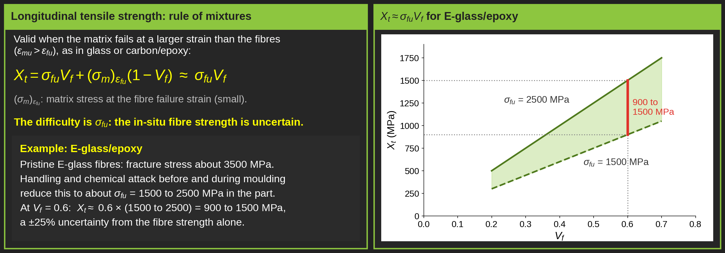
Failure criteria-
Composite-Unidirectional-
Maximum stress failure criterion-Orders of magnitude of stresses at a fracture
Notes:
Intro
“This slide explains how to estimate the longitudinal tensile strength of a unidirectional composite using the law of mixtures. It highlights how fibre strength, matrix contribution, and fibre volume fraction together determine the composite’s tensile capability.”
Concept
When the matrix elongation at failure is higher than that of the fibres, the fibre strength dominates the composite’s overall tensile strength.
The law of mixtures provides a first-order estimate:
$$X_{t}=σ_{fu}V_{f}+{(σ}_{m}{\left.)\right.}_{ε_{fu}}\left(1−V_{f}\right)$$
where:
$X_{t}$: longitudinal tensile strength of the composite,
$σ_{fu}$: ultimate fibre strength,
$V_{f}$: fibre volume fraction,
${(σ}_{m}{\left.)\right.}_{ε_{fu}}$: stress in the matrix at the fibre’s ultimate strain.
Since the fibre contribution is dominant, this simplifies to:
$$X_{t}≈σ_{fu}V_{f}$$
Details
Practical limitations:
Measuring $σ_{fu}$ accurately is difficult because fibres are fragile and can suffer surface damage, chemical degradation, or handling flaws before embedding.
Fibre strength measured in isolation tends to be higher than when fibres are incorporated into a matrix.
Example:
E-glass fibres have a nominal fracture strength of about 3,500 MPa, but this drops to 1,500–2,500 MPa once embedded, due to processing damage and imperfect fibre–matrix bonding.
The figure shows the linear increase of $X_{t}$ with fibre volume fraction $V_{f}$, bounded by these reduced strength values.
In practical composites, typical $V_{f}$ ranges between 0.4 and 0.7, giving realistic tensile strengths around 900–1,500 MPa.
Key Takeaway
The longitudinal tensile strength of unidirectional composites primarily depends on the fibre strength and volume fraction.
While the law of mixtures gives a good approximation, real-world values are always lower due to processing defects, fibre damage, and non-ideal bonding.
Accurate experimental characterisation remains essential for reliable strength prediction and certification of composite structures.

Slide 29
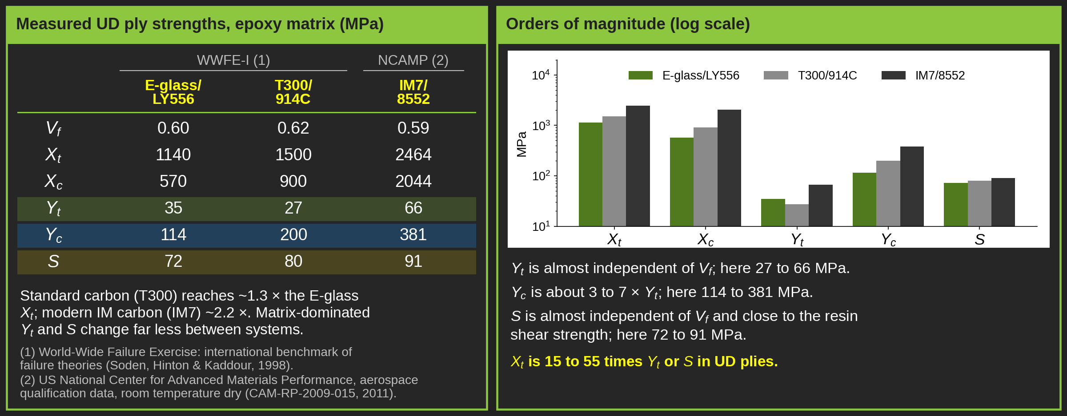
Failure criteria-
Composite-Unidirectional-
Maximum stress failure criterion-Orders of magnitude of stresses at a fracture
Notes:
Intro
“This slide presents typical strength values for unidirectional and balanced-cloth epoxy composites. These data illustrate how fibre type and volume fraction affect tensile, compressive, and shear strengths along and across the fibres.”
Concept
Each composite’s strength depends on the fibre material, orientation, and volume fraction (Vf).
The table compares unidirectional composites (E-glass, carbon, Kevlar) and a balanced carbon cloth laminate.
The main strength parameters are:
$X_{t},X_{c}$: longitudinal tensile and compressive strengths.
$Y_{t},Y_{c}$: transverse tensile and compressive strengths.
$S$: in-plane shear strength.
Details
Typical values (for epoxy matrix composites):
$V_{f}$: 0.4-0.6 most unidirectional systems.
$X_{t}$: 1300-1400 MPa for unidirectional composites; ~500 MPa for balanced woven carbon fabric.
$X_{c}$: ranges from 280 MPa (Kevlar) to 1,430 MPa (carbon).
$Y_{t}$: typically, 15–50 MPa for unidirectional laminates; up to 460 MPa for woven carbon due to multi-directional reinforcement.
$Y_{c}$: 100-350 MPa consistently higher than $Y_{t}$.
$S$: 35-70 MPa relatively constant across materials since it is dominated by the matrix shear strength.
Observed relationships:
$Y_{t}$ remains nearly independent of fibre content—controlled mainly by matrix tensile properties.
$Y_{c}$ is significantly higher than $Y_{t}$, typically $100≤Y_{c}≤150 \text{MPa}$, reflecting matrix confinement.
$S$ depends on resin shear strength rather than fibre type or content, generally 35–70 MPa for epoxies.
Key Takeaway
Longitudinal strengths ($X_{t},X_{c}$) are fibre-dominated, while transverse and shear strengths ($Y_{t},Y_{c},S$) are matrix-controlled.
Transverse compression ($Y_{c}$) consistently exceeds transverse tension ($Y_{t}$), and shear strength remains relatively constant across composite systems.
These typical values serve as practical benchmarks for validating analytical models and material test data in composite design and certification.

Slide 30
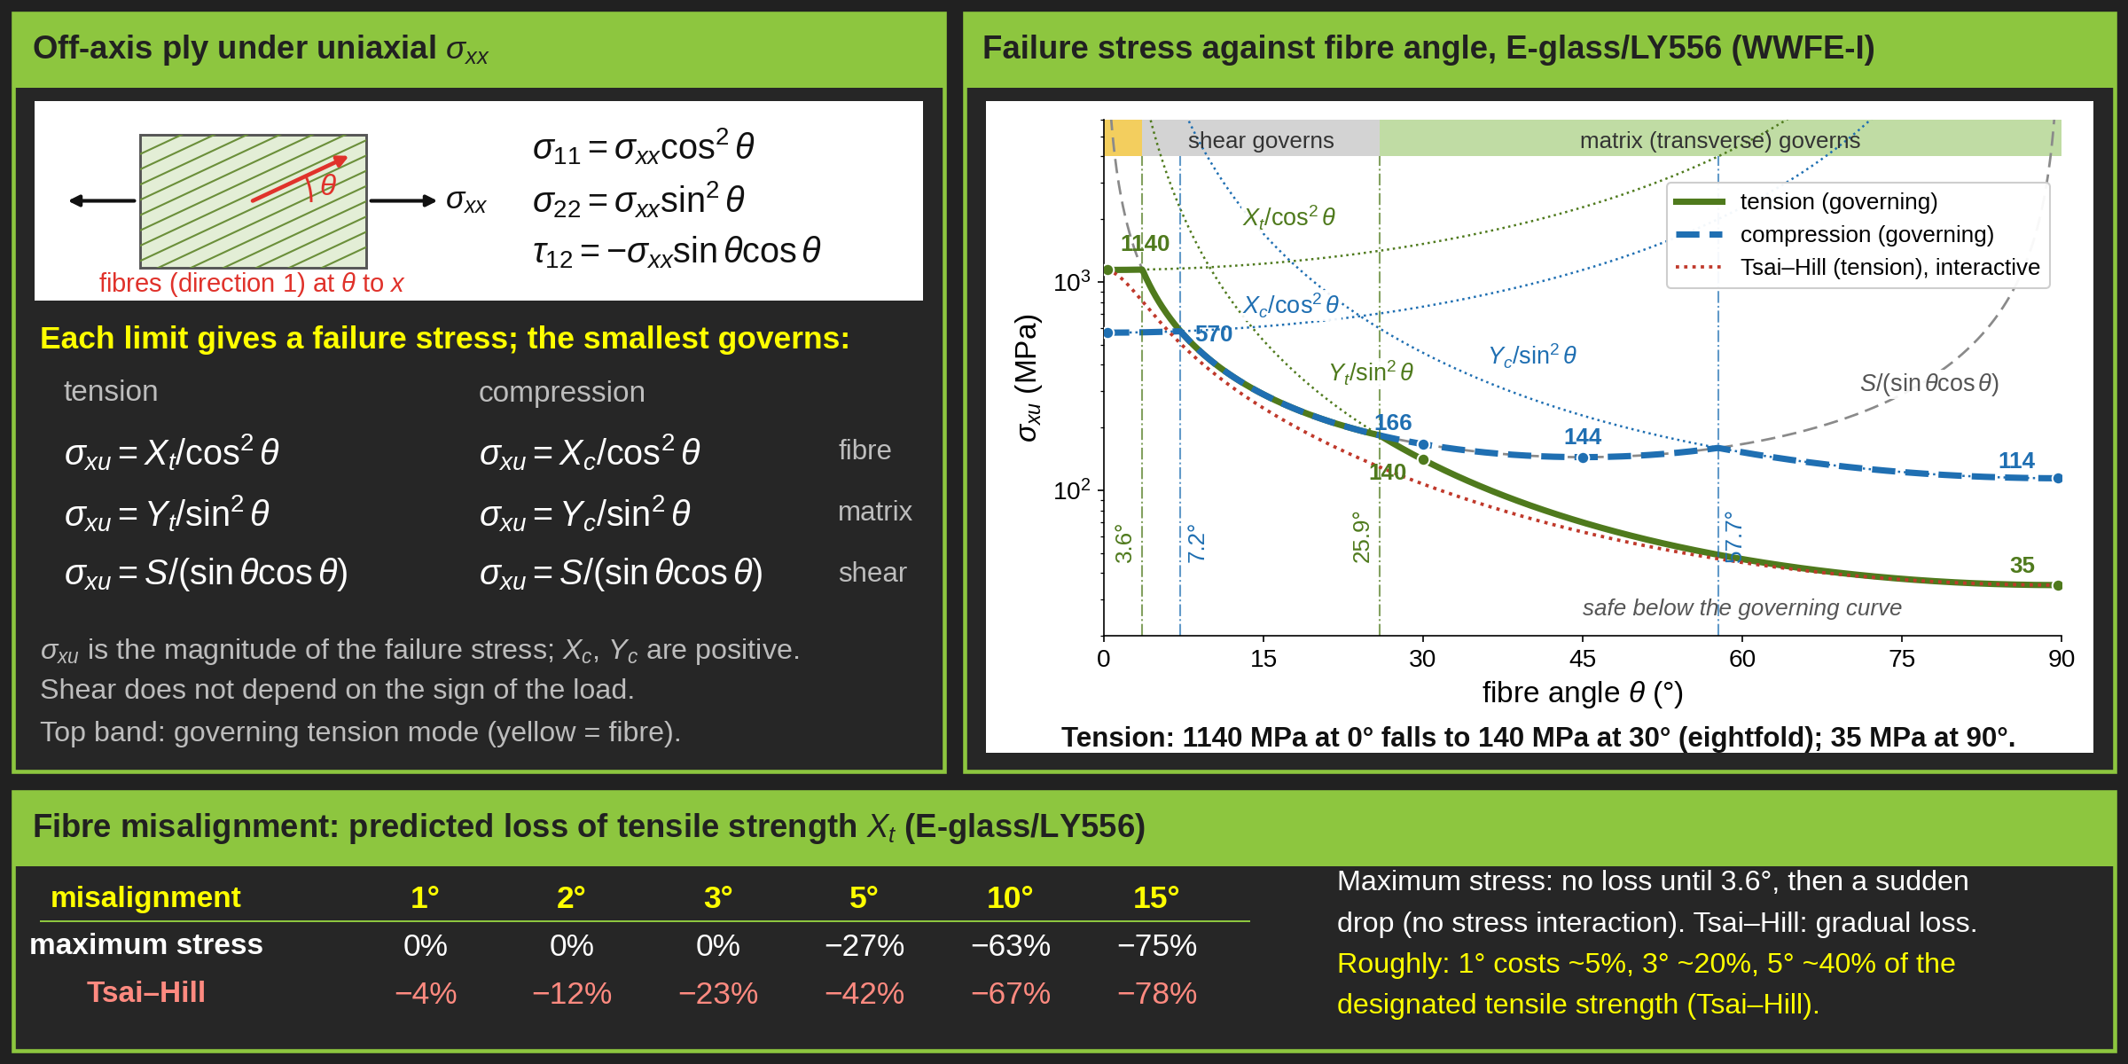
Failure criteria-
Composite-Unidirectional-
Maximum stress failure criterion-Off-axis Tension or Compression
Notes:
MAXIMUM STRESS CRITERION, OFF-AXIS LOADING
This slide applies the maximum stress criterion to a single unidirectional ply loaded by a uniaxial stress sigma_xx, with the fibres at an angle theta to the load.
LEFT PANEL: STRESS TRANSFORMATION
The applied stress is first transformed into the ply material axes:
sigma_11 = sigma_xx cos^2(theta)
sigma_22 = sigma_xx sin^2(theta)
tau_12 = -sigma_xx sin(theta) cos(theta)
Each material-axis stress is then compared with its own strength. This gives three possible failure stresses:
- Fibre failure: sigma_xu = X / cos^2(theta)
- Matrix (transverse) failure: sigma_xu = Y / sin^2(theta)
- In-plane shear failure: sigma_xu = S / (sin(theta) cos(theta))
X and Y are the tensile or compressive strengths as appropriate. The smallest of the three governs. sigma_xu is the magnitude of the applied stress at failure, and all strengths are positive values. Shear strength does not depend on the sign of the load, so the shear limit is the same in tension and compression.
RIGHT PANEL: FAILURE STRESS AGAINST FIBRE ANGLE
The chart uses measured E-glass/LY556 data from the World-Wide Failure Exercise: Xt = 1140 MPa, Xc = 570 MPa, Yt = 35 MPa, Yc = 114 MPa and S = 72 MPa. The strength axis is logarithmic.
The dotted and dashed lines are the individual limits. The thick lines are the governing envelopes: solid green for tension and dashed blue for compression. The ply is safe below the governing curve. The band along the top shows which mode governs in tension.
The mode changes where two limits are equal:
- Tension: fibre to shear at tan(theta) = S/Xt, which is 3.6 degrees. Shear to matrix at tan(theta) = Yt/S, which is 25.9 degrees.
- Compression: fibre to shear at 7.2 degrees (tan(theta) = S/Xc). Shear to matrix at 57.7 degrees (tan(theta) = Yc/S).
The key message is how quickly strength falls with angle. In tension, the strength falls from 1140 MPa at 0 degrees to 140 MPa at 30 degrees, about eightfold, and to 35 MPa at 90 degrees. A few degrees of fibre rotation moves failure from the fibres to the much weaker matrix and interface.
In compression, the 144 MPa near 45 degrees is only a local minimum. The curve rises slightly up to 57.7 degrees, where matrix compression takes over, and then falls to its lowest value, Yc = 114 MPa, at 90 degrees. This happens because Yc is larger than S for this material.
RED DOTTED CURVE: TSAI-HILL
The maximum stress criterion checks each stress on its own, which is why the envelope has sharp corners. For comparison, the Tsai-Hill criterion is shown for tension:
1/sigma_xu^2 = cos^4(theta)/Xt^2 + (1/S^2 - 1/Xt^2) cos^2(theta) sin^2(theta) + sin^4(theta)/Yt^2
Tsai-Hill lets the stresses interact, so its curve is smooth and lies below the maximum stress curve. Off-axis test data generally follow the interactive curve more closely.
BOTTOM PANEL: FIBRE MISALIGNMENT
Misalignment from layup, draping or fibre waviness acts exactly like a small off-axis angle. For this material, the predicted loss of the rated tensile strength is:
- 1 degree: maximum stress 0 percent, Tsai-Hill 4 percent
- 2 degrees: maximum stress 0 percent, Tsai-Hill 12 percent
- 3 degrees: maximum stress 0 percent, Tsai-Hill 23 percent
- 5 degrees: maximum stress 27 percent, Tsai-Hill 42 percent
- 10 degrees: maximum stress 63 percent, Tsai-Hill 67 percent
- 15 degrees: maximum stress 75 percent, Tsai-Hill 78 percent
The mamum stress criterion predicts no loss up to 3.6 degrees and then a sudden drop. This comes from ignoring stress interaction and is not real behaviour. Tsai-Hill predicts a gradual loss. As a rough guide for this glass/epoxy, 1 degree of misalignment costs about 5 percent of Xt, 3 degrees about 20 percent and 5 degrees about 40 percent.
CAVEATS
1. The sensitivity depends mainly on the ratio Xt/S. Carbon/epoxy has a higher ratio, about 27 for IM7/8552 against 16 here, so it is more sensitive to misalignment. These percentages apply to this material only and are not a universal rule.
2. The percentages above are for tension only. In compression, misalignment is even more critical than either criterion shows. Longitudinal compressive failure is governed by fibre kinking, which starts from an initial misalignment of only 1 to 3 degrees. Argon's model gives Xc approximately equal to tau_y / phi, where tau_y is the matrix shear yield stress and phi is the misalignment in radians. Halving the misalignment roughly doubles the compressive strength, which is why fibre alignment is so tightly controlled in aerospace manufacture.
TAKEAWAY
UD plies are extremely strong only along the fibres. Keep the fibres aligned with the load path, control misalignment in manufacture, and use a multidirectional layup so that no ply is loaded far off its axis.

Slide 31
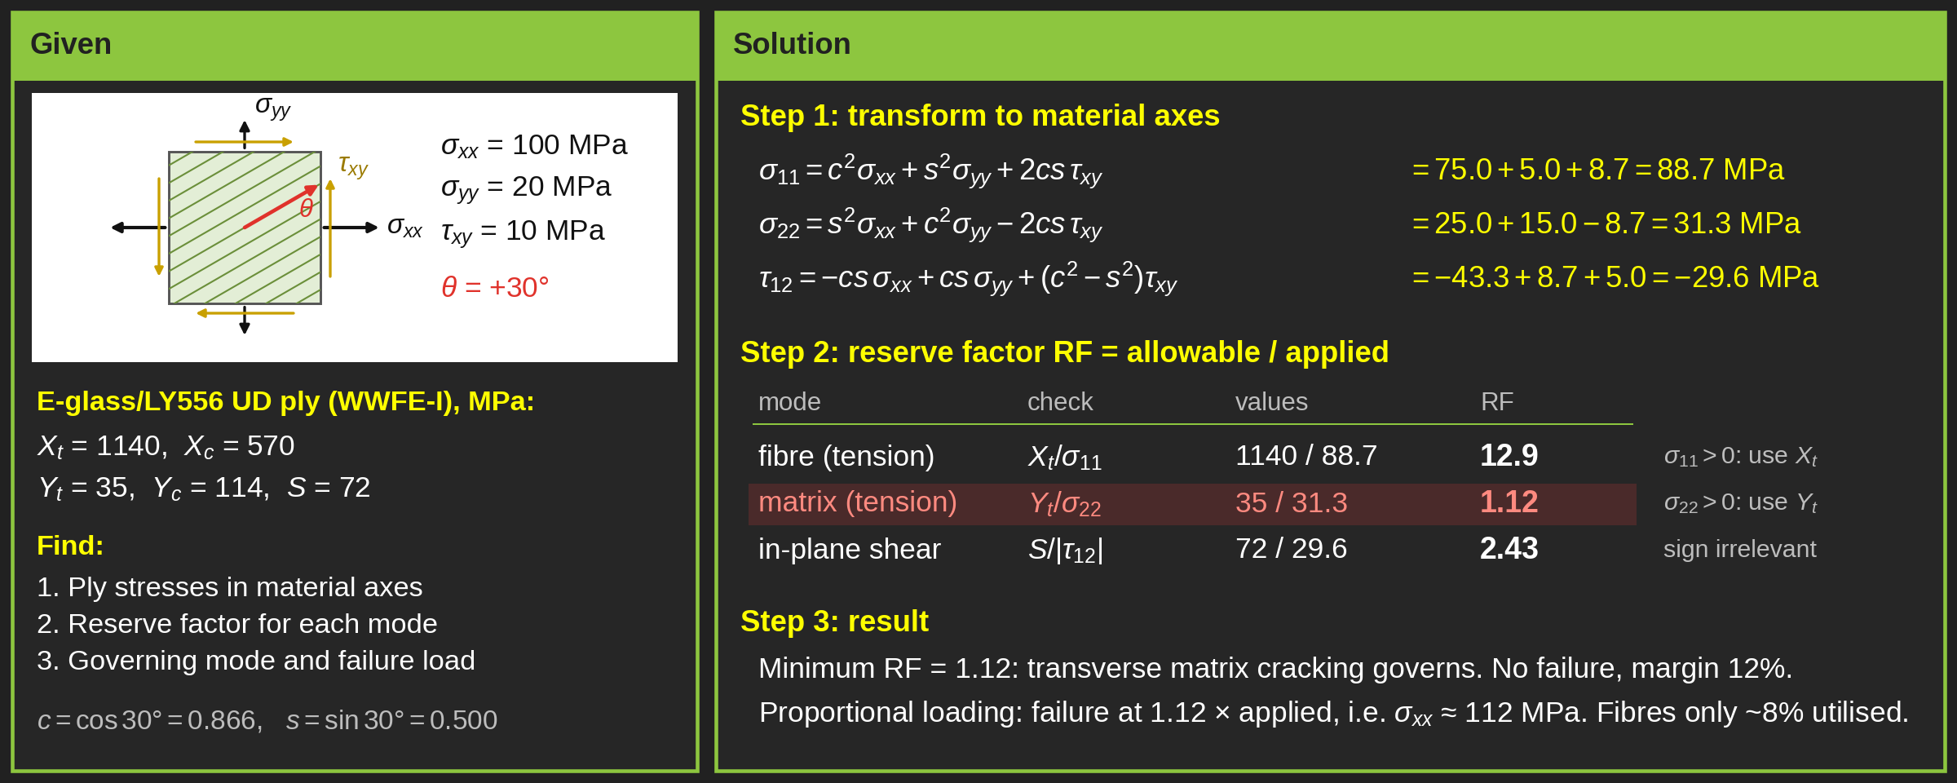
Failure criteria-
Composite-Unidirectional-
Maximum stress failure criterion-Worked example

Slide 32
Maximum Strain Failure Criterion

Slide 33
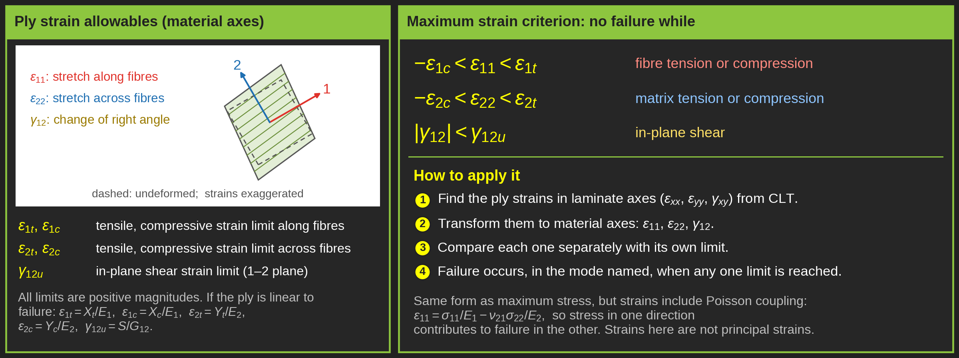
Failure criteria-
Composite-Unidirectional-
Maximum strain failure criterion
Notes:
Intro
“This slide presents the Maximum Strain Failure Criterion for unidirectional composites. It is similar in philosophy to the Maximum Stress Criterion but evaluates failure based on strain limits rather than stress values.”
Concept
Each ply fails when any of its principal strains exceed the corresponding strain allowable.
The method compares the measured or calculated strains $\left(ε_{x} , ε_{y} , γ_{xy}\right)$ in each ply to their allowable values:
$ε_{xu}^{t},ε_{xu}^{c}$: allowable longitudinal tensile and compressive strains (direction 1).
$ε_{yu}^{t},ε_{yu}^{c}$: allowable transverse tensile and compressive strains (direction 2).
$γ_{xyu}$: allowable in-plane shear strain.
Failure occurs when any one component exceeds its corresponding allowable, ignoring interaction effects.
Details
For longitudinal direction (1-axis):
$ε_{x}<ε_{xu}^{t}$or $ε_{x}<ε_{xu}^{c}$, depending on whether loading is tensile or compressive.
For transverse direction (2-axis):
$ε_{y}<ε_{yu}^{t}$or $ε_{y}<ε_{yu}^{c}$.
For in-plane shear:
$∣γ_{xy}∣<γ_{xyu}$.
This method is practical because strain data are directly measurable using strain gauges or digital image correlation (DIC).
The diagrams show unidirectional and cross-ply laminates with local ply coordinate systems, reinforcing that strain limits must be applied in each ply’s material axes.
The approach is often used in FEA post-processing, where ply-level strain outputs are compared to experimental allowables to identify first-ply failure.
Key Takeaway
The Maximum Strain Criterion is easy to apply and directly linked to experimental strain data.
It provides a conservative estimate of failure, especially useful when stress interactions are uncertain.
However, it ignores coupling between tension, compression, and shear, so for complex load cases, interaction-based models (Tsai–Hill, Tsai–Wu, or Puck) are preferred.

Slide 34
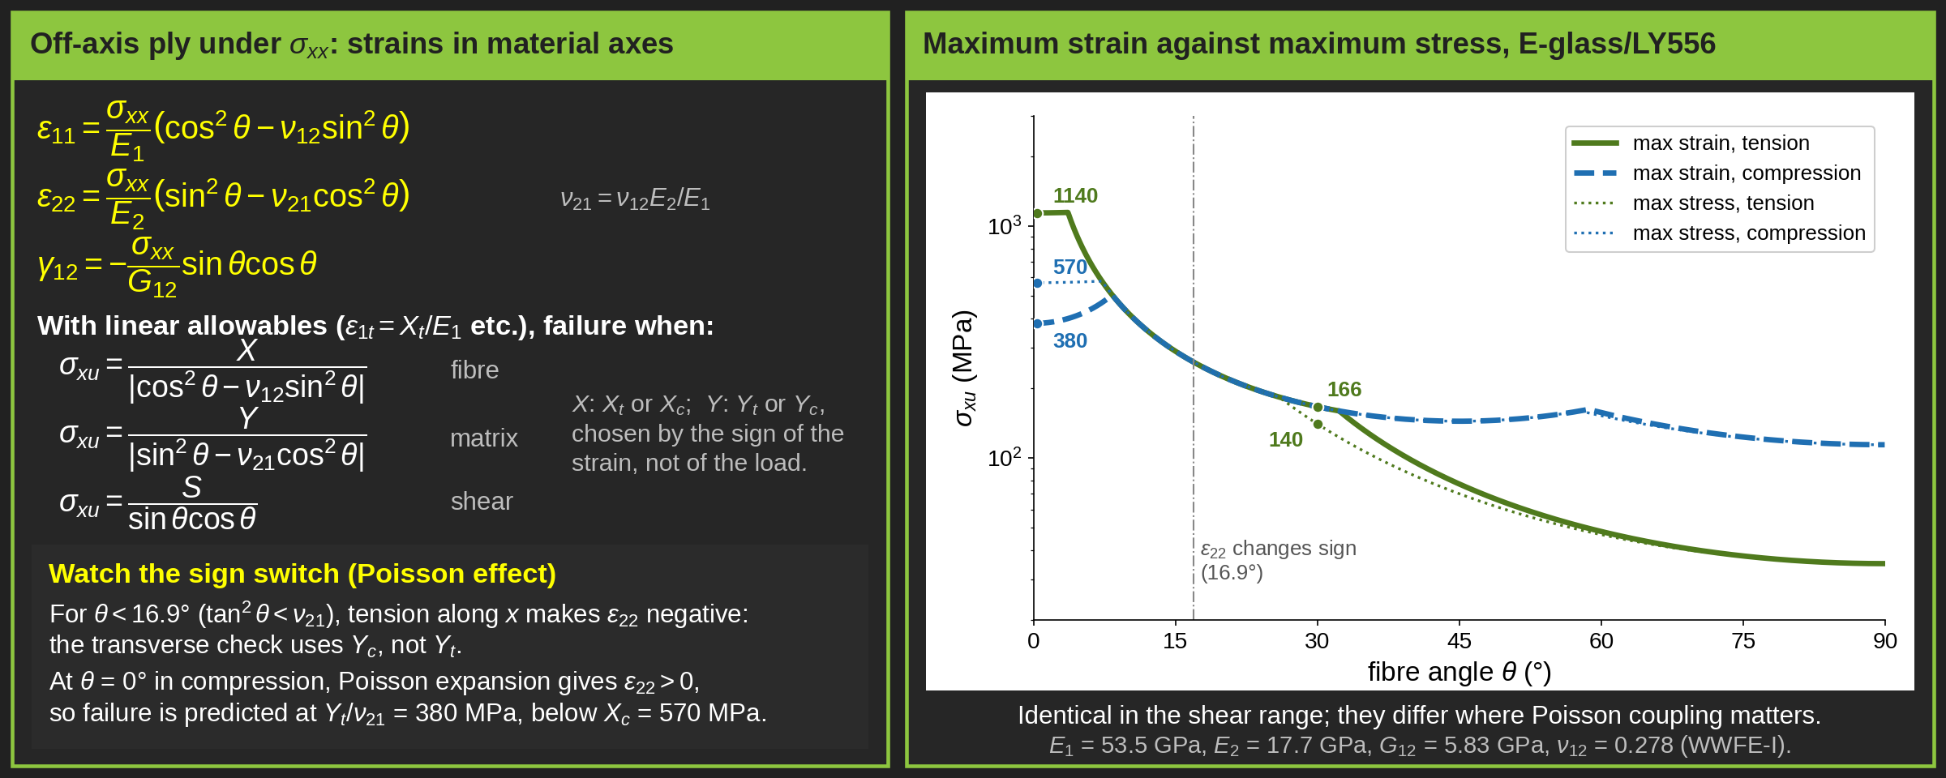
Failure criteria-
Composite-Unidirectional-
Maximum strain failure criterion-Off-axis Tension or Compression
Notes:
Intro
“This slide extends the Maximum Strain Failure Criterion to off-axis tension and compression in unidirectional composites. It explains how strain transformation equations are used to predict failure when the applied load is not aligned with the fibre direction.”
Concept
When a unidirectional laminate is loaded at an angle $θ$, the applied strain components are transformed from the global coordinate system to the local ply coordinates (L, T).
The Maximum Strain Criterion checks whether the principal strains in the ply exceed their corresponding tensile or compressive allowables.
The critical stress causing failure depends on both fibre orientation and material anisotropy.
Details
Transformed strain relations:
$$ε_{L}=\frac{1}{E_{L}}\left({\cos{}}^{2}θ−ν_{LT}{\sin{}}^{2}θ\right)σ_{xx}$$
$$ε_{T}=\frac{1}{E_{T}}\left({\sin{}}^{2}θ−ν_{TL}{\cos{}}^{2}θ\right)σ_{xx}$$
$$γ_{LT}=\frac{1}{G_{LT}}\sin{θ}\cos{θ}σ_{xx}$$
Failure conditions:
Tensile or compressive limits are reached when any transformed strain exceeds the allowable:
$$−X_{c}<σ_{xx}{\cos{}}^{2}θ<X_{t}$$
$$−Y_{c}<σ_{xx}{\sin{}}^{2}θ<Y_{t}$$
$$−S<−σ_{xx}\sin{θ}\cos{θ}<S$$
Determination of off-axis strength:
For tension:
$$σ_{xu}=\min\left(\frac{X_{t}}{{\cos{}}^{2}θ−ν_{LT}{\sin{}}^{2}θ} , \frac{Y_{t}}{{\sin{}}^{2}θ−ν_{LT}{\cos{}}^{2}θ} , \frac{S}{\sin{θ}\cos{θ}}\right)$$
For compression:
$$σ_{xu}=\min\left(\frac{∣X_{c}∣}{{\cos{}}^{2}θ−ν_{LT}{\sin{}}^{2}θ} , \frac{∣Y_{c}∣}{{\sin{}}^{2}θ−ν_{LT}{\cos{}}^{2}θ} , \frac{S}{\sin{θ}\cos{θ}}\right)$$
The smallest calculated value corresponds to the off-axis strength of the ply.
As fibre angle increases, fibre contribution decreases and failure transitions from fibre-dominated (low θ) to matrix-dominated (high θ) behaviour.
Key Takeaway
The Maximum Strain Criterion for off-axis loading captures how fibre orientation affects tensile and compressive response.
Strength drops steeply with increasing angle due to lower stiffness and greater shear interaction.
This method provides a first-order but insightful prediction of directional dependence in composite failure, supporting more advanced multi-axial criteria like Tsai–Wu or Puck.

Slide 35
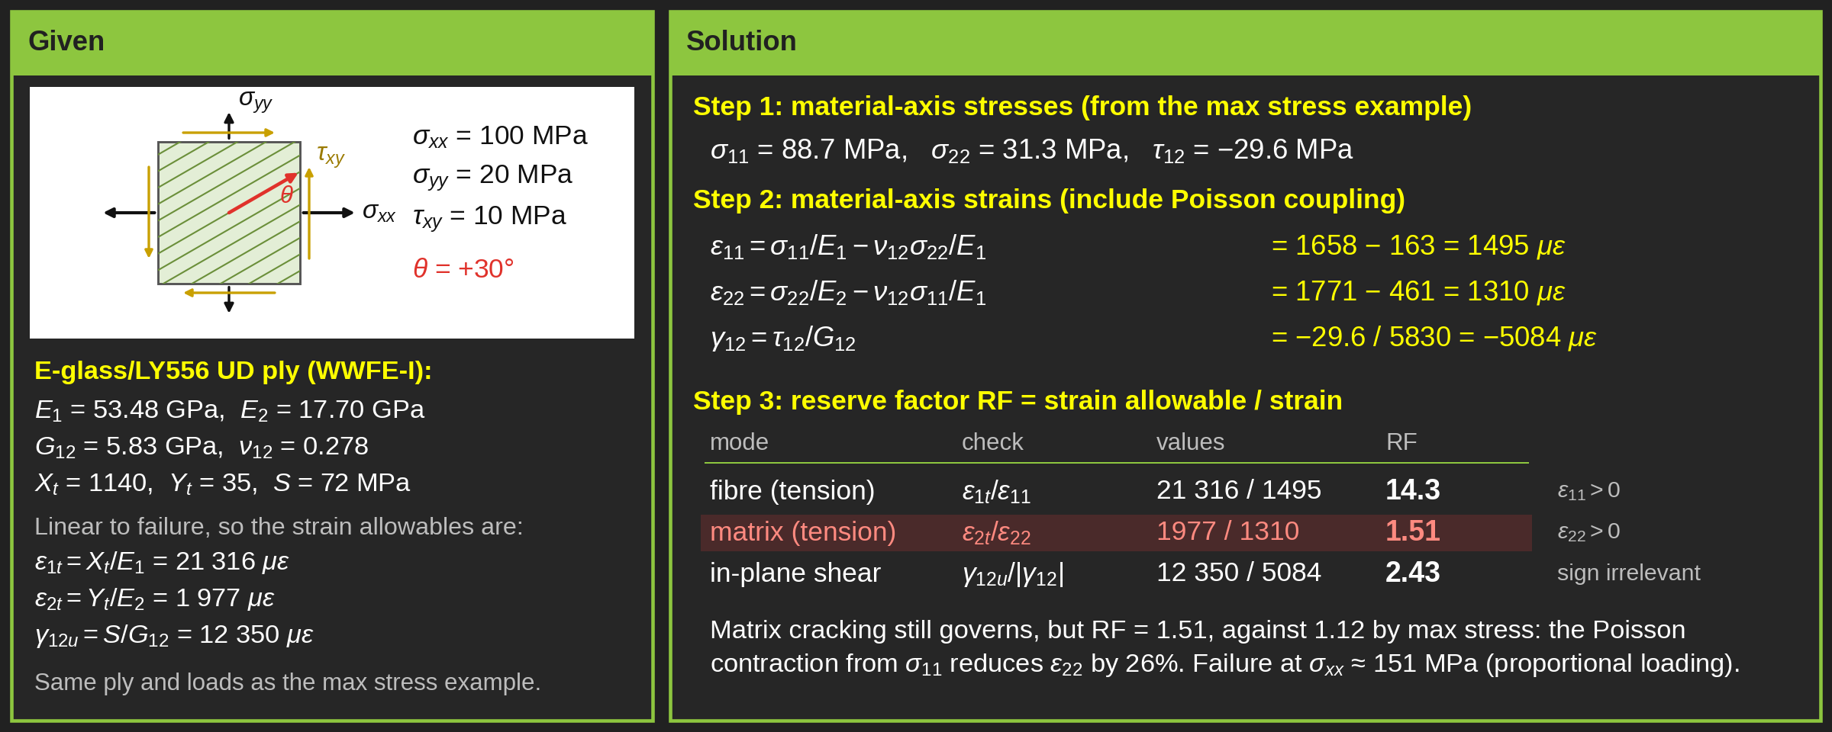
Failure criteria-
Composite-Unidirectional-
Maximum strain failure criterion-Worked example

Slide 36
Tsai-Hill Failure Criterion

Slide 37
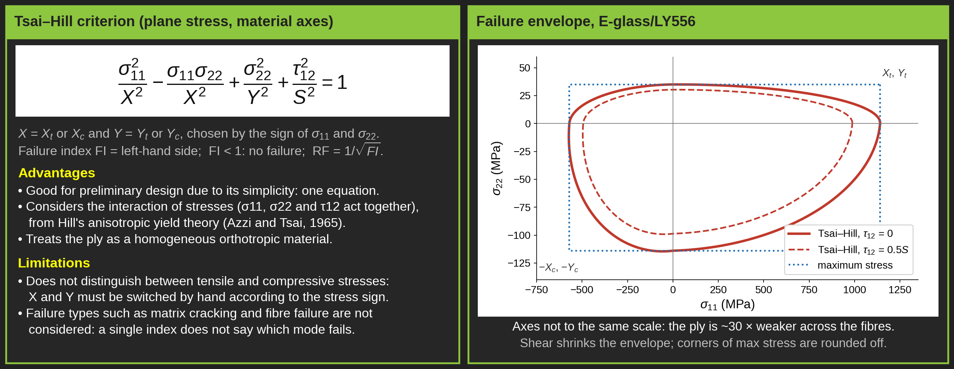
Failure criteria-
Composite-Unidirectional-
Tsai-Hill failure criterion
Notes:
Intro
“This slide introduces the Tsai–Hill failure criterion, one of the earliest and simplest interaction-based theories used for composite laminates. It extends the von Mises yield concept to orthotropic materials such as unidirectional CFRP or GFRP plies.”
Concept
The Tsai–Hill criterion predicts failure when the combined effect of normal and shear stresses exceeds a critical limit.
It is based on the distortion energy theory, adapted to anisotropic (direction-dependent) materials.
The criterion assumes the composite behaves as a homogeneous orthotropic layer, smearing out fibre and matrix behaviour.
It is independent of the sign of the stresses, meaning it cannot distinguish between tension and compression failures.
Details
For a single ply under plane stress, the failure condition is given by:
$${\left(\frac{σ_{x}}{X}\right)}^{2}−\frac{σ_{x}σ_{y}}{X^{2}}+{\left(\frac{σ_{y}}{Y}\right)}^{2}+{\left(\frac{τ_{xy}}{S}\right)}^{2}=1$$
where:
$X$: longitudinal strength (fibre direction),
$Y$: transverse strength (matrix direction),
$S$: in-plane shear strength.
The terms $F_{x},F_{y},F_{xy},F_{s}$are empirical coefficients often written as:
$$F_{x}=\frac{1}{X^{2}}, F_{y}=\frac{1}{Y^{2}}, F_{s}=\frac{1}{S^{2}}$$
Advantages:
Simple to apply and widely implemented in FEA software.
Accounts for interaction between σx, σy, and τxy, unlike the Maximum Stress or Strain criteria.
Suitable for preliminary design and laminate-level optimisation.
Limitations:
Cannot differentiate between tension and compression failures.
Does not predict fibre vs. matrix failure modes.
Not suitable for post-failure progression or damage-tolerant analysis.
Key Takeaway
The Tsai–Hill criterion is an effective, easy-to-use tool for quick failure screening in composite laminates.
It provides reasonable accuracy for early design stages but should be replaced by more advanced criteria (Tsai–Wu, Hashin, or Puck) when mode-specific or directional failure mechanisms must be captured.
-----------------------------------------------------------------------------------------------------------------------------------------------------------------------------
Critical Note:
Intro
The distortion energy method, also called the von Mises criterion in metals, predicts material failure by focusing on the energy that changes shape rather than the energy that merely changes volume. This concept provides the foundation for several composite failure models, including the Tsai–Hill criterion.
Concept
Total strain energy in a material under load can be split into two parts:
Volumetric energy — from uniform expansion or compression.
Distortion energy — from shape change or shear deformation.
Ductile materials (like metals) fail when the distortion energy reaches a critical value equal to that at yielding in a simple tension test.
For anisotropic materials like composites, this same philosophy is extended: failure is assumed to occur when the combined distortion effects from all normal and shear stresses reach a critical value related to the material’s directional strengths.
Details
The von Mises criterion (for isotropic metals) is expressed as
$$\left(σ_{1}−σ_{2}{\left.)\right.}^{2}+\left(σ_{2}−σ_{3}{\left.)\right.}^{2}+\left(σ_{3}−σ_{1}{\left.)\right.}^{2}=2σ_{y}^{2}\right.\right.\right.$$
where $σ_{y}$is the yield stress.
The Tsai–Hill criterion adapts this concept to orthotropic composite plies, combining fibre-directional stresses and shear:
$${\left(\frac{σ_{1}}{X_{t}}\right)}^{2}−\frac{σ_{1}σ_{2}}{X_{t}^{2}}+{\left(\frac{σ_{2}}{Y_{t}}\right)}^{2}+{\left(\frac{τ_{12}}{S}\right)}^{2}=1$$
where:
$X_{t},Y_{t}$= tensile strengths along fibre and transverse directions,
$S$= in-plane shear strength,
$σ_{1},σ_{2},τ_{12}$= stresses in ply coordinates.
The criterion assumes that failure is governed by total distortion energy, not by any single stress component.
Tension, compression, and shear all contribute to the same “shape-changing energy bucket.”
In composites, this gives a smooth, continuous failure surface rather than abrupt “box-like” limits seen in maximum stress or strain theories.
Key Takeaway
The distortion energy method connects metallic and composite failure logic.
It says: a structure fails when its internal shape-changing energy matches that at failure in a simpler uniaxial test.
In composites, Tsai–Hill generalises this principle to anisotropic materials—summing the effects of tension, compression, and shear into one energy-based criterion that captures how real laminates fail under complex loads.

Slide 38
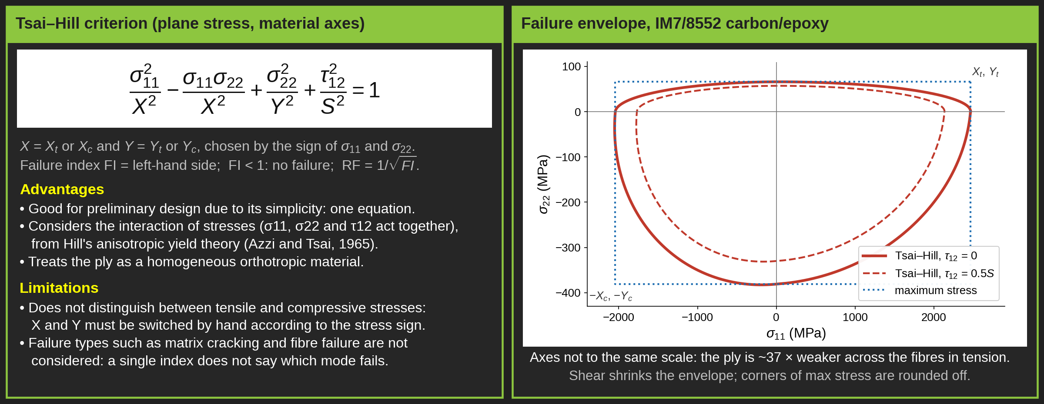
Failure criteria-
Composite-Unidirectional-
Tsai-Hill failure criterion
Notes:
Intro
“This slide introduces the Tsai–Hill failure criterion, one of the earliest and simplest interaction-based theories used for composite laminates. It extends the von Mises yield concept to orthotropic materials such as unidirectional CFRP or GFRP plies.”
Concept
The Tsai–Hill criterion predicts failure when the combined effect of normal and shear stresses exceeds a critical limit.
It is based on the distortion energy theory, adapted to anisotropic (direction-dependent) materials.
The criterion assumes the composite behaves as a homogeneous orthotropic layer, smearing out fibre and matrix behaviour.
It is independent of the sign of the stresses, meaning it cannot distinguish between tension and compression failures.
Details
For a single ply under plane stress, the failure condition is given by:
$${\left(\frac{σ_{x}}{X}\right)}^{2}−\frac{σ_{x}σ_{y}}{X^{2}}+{\left(\frac{σ_{y}}{Y}\right)}^{2}+{\left(\frac{τ_{xy}}{S}\right)}^{2}=1$$
where:
$X$: longitudinal strength (fibre direction),
$Y$: transverse strength (matrix direction),
$S$: in-plane shear strength.
The terms $F_{x},F_{y},F_{xy},F_{s}$are empirical coefficients often written as:
$$F_{x}=\frac{1}{X^{2}}, F_{y}=\frac{1}{Y^{2}}, F_{s}=\frac{1}{S^{2}}$$
Advantages:
Simple to apply and widely implemented in FEA software.
Accounts for interaction between σx, σy, and τxy, unlike the Maximum Stress or Strain criteria.
Suitable for preliminary design and laminate-level optimisation.
Limitations:
Cannot differentiate between tension and compression failures.
Does not predict fibre vs. matrix failure modes.
Not suitable for post-failure progression or damage-tolerant analysis.
Key Takeaway
The Tsai–Hill criterion is an effective, easy-to-use tool for quick failure screening in composite laminates.
It provides reasonable accuracy for early design stages but should be replaced by more advanced criteria (Tsai–Wu, Hashin, or Puck) when mode-specific or directional failure mechanisms must be captured.
-----------------------------------------------------------------------------------------------------------------------------------------------------------------------------
Critical Note:
Intro
The distortion energy method, also called the von Mises criterion in metals, predicts material failure by focusing on the energy that changes shape rather than the energy that merely changes volume. This concept provides the foundation for several composite failure models, including the Tsai–Hill criterion.
Concept
Total strain energy in a material under load can be split into two parts:
Volumetric energy — from uniform expansion or compression.
Distortion energy — from shape change or shear deformation.
Ductile materials (like metals) fail when the distortion energy reaches a critical value equal to that at yielding in a simple tension test.
For anisotropic materials like composites, this same philosophy is extended: failure is assumed to occur when the combined distortion effects from all normal and shear stresses reach a critical value related to the material’s directional strengths.
Details
The von Mises criterion (for isotropic metals) is expressed as
$$\left(σ_{1}−σ_{2}{\left.)\right.}^{2}+\left(σ_{2}−σ_{3}{\left.)\right.}^{2}+\left(σ_{3}−σ_{1}{\left.)\right.}^{2}=2σ_{y}^{2}\right.\right.\right.$$
where $σ_{y}$is the yield stress.
The Tsai–Hill criterion adapts this concept to orthotropic composite plies, combining fibre-directional stresses and shear:
$${\left(\frac{σ_{1}}{X_{t}}\right)}^{2}−\frac{σ_{1}σ_{2}}{X_{t}^{2}}+{\left(\frac{σ_{2}}{Y_{t}}\right)}^{2}+{\left(\frac{τ_{12}}{S}\right)}^{2}=1$$
where:
$X_{t},Y_{t}$= tensile strengths along fibre and transverse directions,
$S$= in-plane shear strength,
$σ_{1},σ_{2},τ_{12}$= stresses in ply coordinates.
The criterion assumes that failure is governed by total distortion energy, not by any single stress component.
Tension, compression, and shear all contribute to the same “shape-changing energy bucket.”
In composites, this gives a smooth, continuous failure surface rather than abrupt “box-like” limits seen in maximum stress or strain theories.
Key Takeaway
The distortion energy method connects metallic and composite failure logic.
It says: a structure fails when its internal shape-changing energy matches that at failure in a simpler uniaxial test.
In composites, Tsai–Hill generalises this principle to anisotropic materials—summing the effects of tension, compression, and shear into one energy-based criterion that captures how real laminates fail under complex loads.

Slide 39
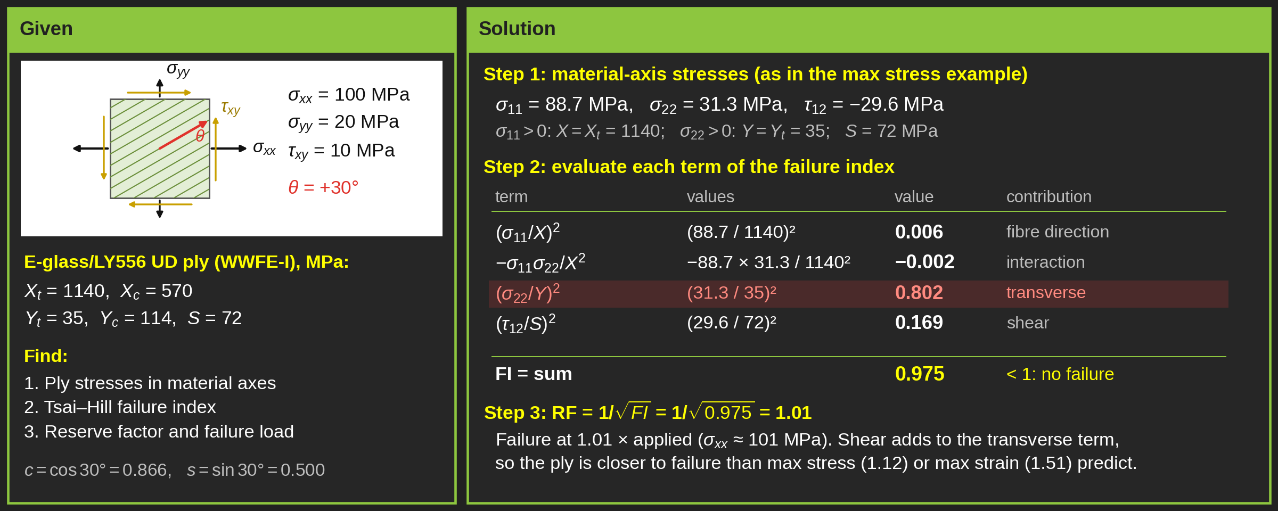
Failure criteria-
Composite-Unidirectional-
Tsai-Hill failure criterion-Worked example

Slide 40
Hoffman Failure Criterion

Slide 41

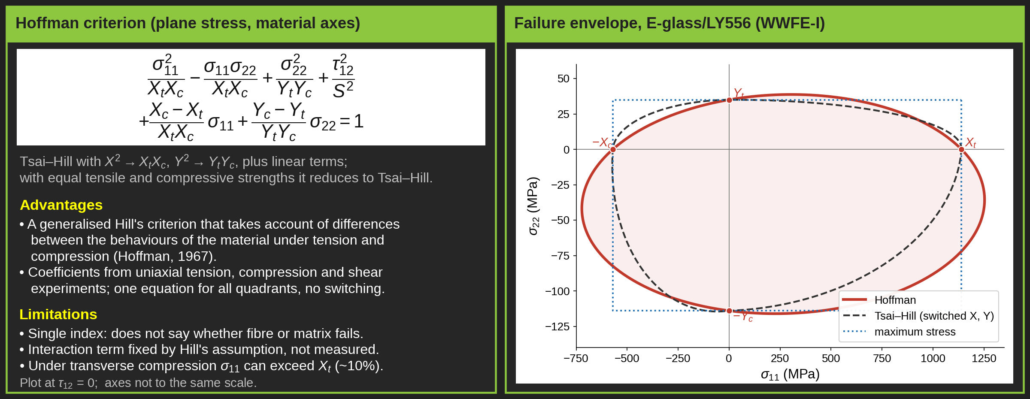
Failure criteria-
Composite-Unidirectional-
Hoffman failure criterion
Tsai-Hill
Notes:
Intro
“This slide introduces the Hoffman failure criterion, an extension of Hill’s theory that accounts for the different tensile and compressive strengths of composite materials. It improves on Tsai–Hill by incorporating material asymmetry under tension and compression.”
Concept
The Hoffman criterion is an experimental generalisation of Hill’s theory, designed to model the anisotropic and non-symmetric strength behaviour of fibre composites.
It recognises that composites are stronger in tension than in compression (or vice versa), particularly along the fibre and transverse directions.
This makes Hoffman more realistic than Tsai–Hill for predicting failure under combined tension–compression states.
Details
Failure occurs when the following condition is satisfied:
$$C_{1}\left(σ_{T}−σ_{T^{′}}{\left.)\right.}^{2}+C_{2}\left(σ_{T^{′}}−σ_{L}{\left.)\right.}^{2}+C_{3}\left(σ_{L}−σ_{T}{\left.)\right.}^{2}+C_{4}σ_{L}+C_{5}σ_{T}+C_{6}σ_{T^{′}}+C_{7}σ_{T^{′}}^{2}+C_{8}σ_{LT}^{2}+C_{9}σ_{LT^{′}}^{2}=1\right.\right.\right.$$
The coefficients $C_{1}$to $C_{9}$are defined using the material strengths in each principal direction (L = fibre, T = transverse, T′ = through-thickness):
$$C_{1}=\frac{1}{2}\left(\frac{1}{Y_{t}Y_{c}}+\frac{1}{Z_{t}Z_{c}}−\frac{1}{X_{t}X_{c}}\right), C_{4}=\frac{1}{X_{t}}−\frac{1}{X_{c}}, C_{7}=\frac{1}{S_{TT^{′}}^{2}}, \text{etc.}$$
Under plane stress conditions (σ3 = 0), the full 3D equation simplifies to:
$$\frac{σ_{L}^{2}}{X_{t}X_{c}}+\frac{σ_{T}^{2}}{Y_{t}Y_{c}}−\frac{σ_{L}σ_{T}}{X_{t}X_{c}}+\frac{X_{c}−X_{t}}{X_{t}X_{c}}σ_{L}+\frac{Y_{c}−Y_{t}}{Y_{t}Y_{c}}σ_{T}+\frac{τ_{LT}^{2}}{S_{LT}^{2}}=1$$
This form retains the stress interaction terms like Tsai–Hill but adds linear terms in σL and σT to represent the tension–compression asymmetry.
The figure illustrates how principal stresses (σL, σT, σLT) vary with fibre orientation and how the Hoffman surface differs from the symmetric Tsai–Hill ellipse.
Key Takeaway
The Hoffman criterion improves upon Tsai–Hill by distinguishing between tensile and compressive strengths, making it more accurate for non-symmetric composite behaviour.
It remains computationally simple and suitable for FEA applications and preliminary failure prediction.
However, it still cannot distinguish between fibre-dominated and matrix-dominated failure modes, requiring more advanced criteria (e.g., Hashin, Puck) for progressive damage analysis.
## Lecture: The Hoffman Failure Criterion 🧪
When a composite material is subjected to a complex combination of stresses (tension, compression, and shear all at once), how do we predict when it will fail? We can't just compare one stress to one strength. Instead, we use a failure criterion—a mathematical equation that combines all the stresses into a single condition for failure.
Today, we'll look at the Hoffman failure criterion, a powerful tool for this purpose.
## Background: The Tsai-Hill Criterion
Before Hoffman, a common model was the Tsai-Hill criterion. It's a good starting point but has one major limitation.
Tsai-Hill Equation:
The Problem: This equation uses single strength values ( for longitudinal, for transverse). It assumes the material is equally strong in tension and compression, which is rarely true for composites. For example, a carbon fibre composite is much stronger in longitudinal tension than in longitudinal compression.
## The Hoffman Criterion: A More Realistic Model ✅
The Hoffman criterion is a generalized, experimental model that improves upon Tsai-Hill by addressing its key weakness.
Key Advantage: It explicitly accounts for the different strengths of the material under tension and compression.
The Hoffman Equation (for 2D Plane Stress):
This equation looks complex, but it's just combining the applied stresses (σL​,σT​,τLT​) with the material's known strengths.
## How to Use the Criterion 💥
To use the Hoffman criterion, you need five fundamental material strength properties:
: Longitudinal Tensile Strength (along the fibres)
: Longitudinal Compressive Strength
: Transverse Tensile Strength (perpendicular to fibres)
: Transverse Compressive Strength
: In-Plane Shear Strength
The process is simple:
Determine the stresses acting on the material in its principal directions ().
Plug these stresses and the five material strengths into the left-hand side of the Hoffman equation. This value is called the Failure Index (FI).
Check the result:
If FI < 1, the material is considered safe.
If FI ≥ 1, the material is predicted to have failed.
## Key Takeaway
The Hoffman criterion is a robust method for predicting composite failure under combined loading. Its primary advantage is its ability to differentiate between tensile and compressive strengths, leading to more accurate and realistic failure predictions than simpler models.

Slide 42
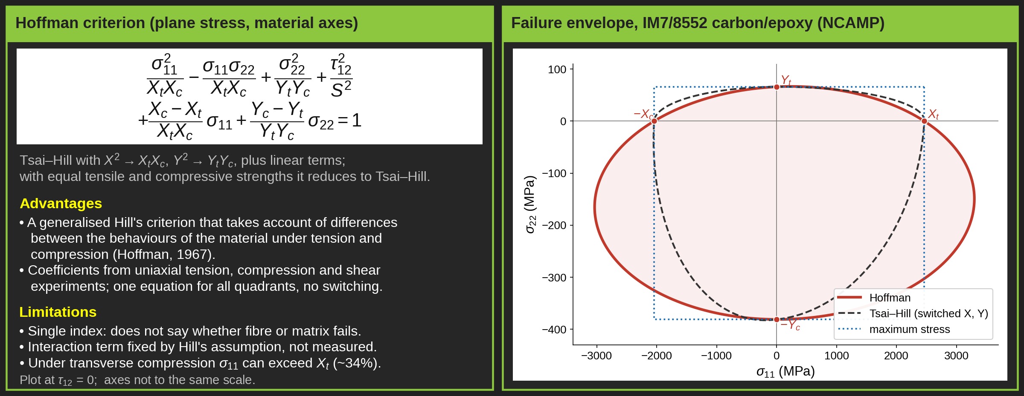
Failure criteria-
Composite-Unidirectional-
Hoffman failure criterion
Tsai-Hill
Notes:
Intro
“This slide introduces the Hoffman failure criterion, an extension of Hill’s theory that accounts for the different tensile and compressive strengths of composite materials. It improves on Tsai–Hill by incorporating material asymmetry under tension and compression.”
Concept
The Hoffman criterion is an experimental generalisation of Hill’s theory, designed to model the anisotropic and non-symmetric strength behaviour of fibre composites.
It recognises that composites are stronger in tension than in compression (or vice versa), particularly along the fibre and transverse directions.
This makes Hoffman more realistic than Tsai–Hill for predicting failure under combined tension–compression states.
Details
Failure occurs when the following condition is satisfied:
$$C_{1}\left(σ_{T}−σ_{T^{′}}{\left.)\right.}^{2}+C_{2}\left(σ_{T^{′}}−σ_{L}{\left.)\right.}^{2}+C_{3}\left(σ_{L}−σ_{T}{\left.)\right.}^{2}+C_{4}σ_{L}+C_{5}σ_{T}+C_{6}σ_{T^{′}}+C_{7}σ_{T^{′}}^{2}+C_{8}σ_{LT}^{2}+C_{9}σ_{LT^{′}}^{2}=1\right.\right.\right.$$
The coefficients $C_{1}$to $C_{9}$are defined using the material strengths in each principal direction (L = fibre, T = transverse, T′ = through-thickness):
$$C_{1}=\frac{1}{2}\left(\frac{1}{Y_{t}Y_{c}}+\frac{1}{Z_{t}Z_{c}}−\frac{1}{X_{t}X_{c}}\right), C_{4}=\frac{1}{X_{t}}−\frac{1}{X_{c}}, C_{7}=\frac{1}{S_{TT^{′}}^{2}}, \text{etc.}$$
Under plane stress conditions (σ3 = 0), the full 3D equation simplifies to:
$$\frac{σ_{L}^{2}}{X_{t}X_{c}}+\frac{σ_{T}^{2}}{Y_{t}Y_{c}}−\frac{σ_{L}σ_{T}}{X_{t}X_{c}}+\frac{X_{c}−X_{t}}{X_{t}X_{c}}σ_{L}+\frac{Y_{c}−Y_{t}}{Y_{t}Y_{c}}σ_{T}+\frac{τ_{LT}^{2}}{S_{LT}^{2}}=1$$
This form retains the stress interaction terms like Tsai–Hill but adds linear terms in σL and σT to represent the tension–compression asymmetry.
The figure illustrates how principal stresses (σL, σT, σLT) vary with fibre orientation and how the Hoffman surface differs from the symmetric Tsai–Hill ellipse.
Key Takeaway
The Hoffman criterion improves upon Tsai–Hill by distinguishing between tensile and compressive strengths, making it more accurate for non-symmetric composite behaviour.
It remains computationally simple and suitable for FEA applications and preliminary failure prediction.
However, it still cannot distinguish between fibre-dominated and matrix-dominated failure modes, requiring more advanced criteria (e.g., Hashin, Puck) for progressive damage analysis.
## Lecture: The Hoffman Failure Criterion 🧪
When a composite material is subjected to a complex combination of stresses (tension, compression, and shear all at once), how do we predict when it will fail? We can't just compare one stress to one strength. Instead, we use a failure criterion—a mathematical equation that combines all the stresses into a single condition for failure.
Today, we'll look at the Hoffman failure criterion, a powerful tool for this purpose.
## Background: The Tsai-Hill Criterion
Before Hoffman, a common model was the Tsai-Hill criterion. It's a good starting point but has one major limitation.
Tsai-Hill Equation:
The Problem: This equation uses single strength values ( for longitudinal, for transverse). It assumes the material is equally strong in tension and compression, which is rarely true for composites. For example, a carbon fibre composite is much stronger in longitudinal tension than in longitudinal compression.
## The Hoffman Criterion: A More Realistic Model ✅
The Hoffman criterion is a generalized, experimental model that improves upon Tsai-Hill by addressing its key weakness.
Key Advantage: It explicitly accounts for the different strengths of the material under tension and compression.
The Hoffman Equation (for 2D Plane Stress):
This equation looks complex, but it's just combining the applied stresses (σL​,σT​,τLT​) with the material's known strengths.
## How to Use the Criterion 💥
To use the Hoffman criterion, you need five fundamental material strength properties:
: Longitudinal Tensile Strength (along the fibres)
: Longitudinal Compressive Strength
: Transverse Tensile Strength (perpendicular to fibres)
: Transverse Compressive Strength
: In-Plane Shear Strength
The process is simple:
Determine the stresses acting on the material in its principal directions ().
Plug these stresses and the five material strengths into the left-hand side of the Hoffman equation. This value is called the Failure Index (FI).
Check the result:
If FI < 1, the material is considered safe.
If FI ≥ 1, the material is predicted to have failed.
## Key Takeaway
The Hoffman criterion is a robust method for predicting composite failure under combined loading. Its primary advantage is its ability to differentiate between tensile and compressive strengths, leading to more accurate and realistic failure predictions than simpler models.

Slide 43

Failure criteria-
Composite-Unidirectional-
Hoffman criterion-Worked example

Slide 44
Tsai-Wu Failure Criterion

Slide 45


Failure criteria-
Composite-Unidirectional-
Tsai-Wu failure criterion
Hoffman
Tsai-Hill
Notes:
Intro
“This slide expands on the Tsai–Wu failure criterion, one of the most widely used theories for predicting the onset of failure in anisotropic composites such as CFRP and GFRP. It provides a unified quadratic formulation that considers both tensile–compressive asymmetry and stress interactions.”
Concept
The Tsai–Wu criterion was developed to extend Tsai–Hill by incorporating different strengths in tension and compression for anisotropic materials.
It defines a quadratic failure surface that predicts failure when the combined stresses exceed a material-dependent limit.
The model captures interaction effects between normal and shear stresses and can represent multi-axial stress states in laminates.
Failure is assumed to occur when the stress state reaches the boundary of a failure envelope in stress space.
Details
The general Tsai–Wu equation under plane stress is:
$$\frac{σ_{x}^{2}}{X_{t}X_{c}}+\frac{σ_{y}^{2}}{Y_{t}Y_{c}}−\sqrt{\frac{1}{X_{t}X_{c}Y_{t}Y_{c}}} σ_{x}σ_{y}+\left(\frac{1}{X_{t}}−\frac{1}{X_{c}}\right)σ_{x}+\left(\frac{1}{Y_{t}}−\frac{1}{Y_{c}}\right)σ_{y}+\frac{τ_{xy}^{2}}{S^{2}}=1$$
Key features:
Includes tensile and compressive strength asymmetry through linear terms.
Quadratic terms define the interaction between stress components.
Defines a failure envelope: stresses inside are safe; stresses outside cause failure.
Failure modes considered implicitly:
Longitudinal and transverse tension/compression (σx, σy).
In-plane shear (τxy).
Although it does not explicitly separate fibre, matrix, or delamination failure, it provides an overall laminate failure prediction.
Advantages
Comprehensive interaction: captures coupling between normal and shear stresses.
Tension–compression distinction: includes separate strengths for tension and compression.
Versatile application: suitable for both unidirectional and woven CFRP/GFRP laminates.
Broad FEA compatibility: implemented in software such as ANSYS, Abaqus, and NASTRAN for composite failure prediction.
Good for preliminary and laminate-level design: gives conservative and realistic predictions for most loading types.
Limitations
No explicit fibre–matrix mode separation: cannot distinguish matrix cracking from fibre breakage.
No progressive damage modelling: only predicts first-ply failure, not subsequent load redistribution.
Material constants required: needs accurate tension and compression strengths in all directions.
No delamination prediction: interlaminar effects are outside its scope.
Biaxial loading sensitivity: may produce unrealistic results under certain combined compressive stress states.
Key Takeaway
The Tsai–Wu criterion is a robust, general-purpose failure model for composites that effectively handles multi-directional stress interactions.
It provides reliable predictions for first-ply failure in both unidirectional and woven laminates, especially under complex loading.
For complete failure analysis, Tsai–Wu is often combined with progressive damage models or mode-specific criteria such as Hashin or Puck to capture fibre breakage, matrix cracking, and delamination more precisely.
ChatGPT can make mista

Slide 46

Failure criteria-
Composite-Unidirectional-
Tsai-Wu failure criterion
Hoffman
Tsai-Hill
Notes:
Intro
“This slide expands on the Tsai–Wu failure criterion, one of the most widely used theories for predicting the onset of failure in anisotropic composites such as CFRP and GFRP. It provides a unified quadratic formulation that considers both tensile–compressive asymmetry and stress interactions.”
Concept
The Tsai–Wu criterion was developed to extend Tsai–Hill by incorporating different strengths in tension and compression for anisotropic materials.
It defines a quadratic failure surface that predicts failure when the combined stresses exceed a material-dependent limit.
The model captures interaction effects between normal and shear stresses and can represent multi-axial stress states in laminates.
Failure is assumed to occur when the stress state reaches the boundary of a failure envelope in stress space.
Details
The general Tsai–Wu equation under plane stress is:
$$\frac{σ_{x}^{2}}{X_{t}X_{c}}+\frac{σ_{y}^{2}}{Y_{t}Y_{c}}−\sqrt{\frac{1}{X_{t}X_{c}Y_{t}Y_{c}}} σ_{x}σ_{y}+\left(\frac{1}{X_{t}}−\frac{1}{X_{c}}\right)σ_{x}+\left(\frac{1}{Y_{t}}−\frac{1}{Y_{c}}\right)σ_{y}+\frac{τ_{xy}^{2}}{S^{2}}=1$$
Key features:
Includes tensile and compressive strength asymmetry through linear terms.
Quadratic terms define the interaction between stress components.
Defines a failure envelope: stresses inside are safe; stresses outside cause failure.
Failure modes considered implicitly:
Longitudinal and transverse tension/compression (σx, σy).
In-plane shear (τxy).
Although it does not explicitly separate fibre, matrix, or delamination failure, it provides an overall laminate failure prediction.
Advantages
Comprehensive interaction: captures coupling between normal and shear stresses.
Tension–compression distinction: includes separate strengths for tension and compression.
Versatile application: suitable for both unidirectional and woven CFRP/GFRP laminates.
Broad FEA compatibility: implemented in software such as ANSYS, Abaqus, and NASTRAN for composite failure prediction.
Good for preliminary and laminate-level design: gives conservative and realistic predictions for most loading types.
Limitations
No explicit fibre–matrix mode separation: cannot distinguish matrix cracking from fibre breakage.
No progressive damage modelling: only predicts first-ply failure, not subsequent load redistribution.
Material constants required: needs accurate tension and compression strengths in all directions.
No delamination prediction: interlaminar effects are outside its scope.
Biaxial loading sensitivity: may produce unrealistic results under certain combined compressive stress states.
Key Takeaway
The Tsai–Wu criterion is a robust, general-purpose failure model for composites that effectively handles multi-directional stress interactions.
It provides reliable predictions for first-ply failure in both unidirectional and woven laminates, especially under complex loading.
For complete failure analysis, Tsai–Wu is often combined with progressive damage models or mode-specific criteria such as Hashin or Puck to capture fibre breakage, matrix cracking, and delamination more precisely.
ChatGPT can make mista

Slide 47

Failure criteria-
Composite-Unidirectional-
Tsai-Wu failure criterion
Hoffman
Tsai-Hill
Notes:
Intro
“This slide expands on the Tsai–Wu failure criterion, one of the most widely used theories for predicting the onset of failure in anisotropic composites such as CFRP and GFRP. It provides a unified quadratic formulation that considers both tensile–compressive asymmetry and stress interactions.”
Concept
The Tsai–Wu criterion was developed to extend Tsai–Hill by incorporating different strengths in tension and compression for anisotropic materials.
It defines a quadratic failure surface that predicts failure when the combined stresses exceed a material-dependent limit.
The model captures interaction effects between normal and shear stresses and can represent multi-axial stress states in laminates.
Failure is assumed to occur when the stress state reaches the boundary of a failure envelope in stress space.
Details
The general Tsai–Wu equation under plane stress is:
$$\frac{σ_{x}^{2}}{X_{t}X_{c}}+\frac{σ_{y}^{2}}{Y_{t}Y_{c}}−\sqrt{\frac{1}{X_{t}X_{c}Y_{t}Y_{c}}} σ_{x}σ_{y}+\left(\frac{1}{X_{t}}−\frac{1}{X_{c}}\right)σ_{x}+\left(\frac{1}{Y_{t}}−\frac{1}{Y_{c}}\right)σ_{y}+\frac{τ_{xy}^{2}}{S^{2}}=1$$
Key features:
Includes tensile and compressive strength asymmetry through linear terms.
Quadratic terms define the interaction between stress components.
Defines a failure envelope: stresses inside are safe; stresses outside cause failure.
Failure modes considered implicitly:
Longitudinal and transverse tension/compression (σx, σy).
In-plane shear (τxy).
Although it does not explicitly separate fibre, matrix, or delamination failure, it provides an overall laminate failure prediction.
Advantages
Comprehensive interaction: captures coupling between normal and shear stresses.
Tension–compression distinction: includes separate strengths for tension and compression.
Versatile application: suitable for both unidirectional and woven CFRP/GFRP laminates.
Broad FEA compatibility: implemented in software such as ANSYS, Abaqus, and NASTRAN for composite failure prediction.
Good for preliminary and laminate-level design: gives conservative and realistic predictions for most loading types.
Limitations
No explicit fibre–matrix mode separation: cannot distinguish matrix cracking from fibre breakage.
No progressive damage modelling: only predicts first-ply failure, not subsequent load redistribution.
Material constants required: needs accurate tension and compression strengths in all directions.
No delamination prediction: interlaminar effects are outside its scope.
Biaxial loading sensitivity: may produce unrealistic results under certain combined compressive stress states.
Key Takeaway
The Tsai–Wu criterion is a robust, general-purpose failure model for composites that effectively handles multi-directional stress interactions.
It provides reliable predictions for first-ply failure in both unidirectional and woven laminates, especially under complex loading.
For complete failure analysis, Tsai–Wu is often combined with progressive damage models or mode-specific criteria such as Hashin or Puck to capture fibre breakage, matrix cracking, and delamination more precisely.
ChatGPT can make mista

Slide 48

Failure criteria-
Composite-Unidirectional-
Tsai-Wu failure criterion-Worked example

Slide 49

Failure criteria-
Composite-Unidirectional-
Tsai-Wu failure criterion-Worked example

Slide 50
LARC03 Failure Criterion

Slide 51

Failure criteria-
Composite-Unidirectional-
LARC03
Notes:
Intro
“This slide presents the LARC03 (Laminated Analysis of Realistic Composites, version 03) failure model — a NASA-developed progressive damage criterion for fibre-reinforced composites. Unlike simpler static failure theories, LARC03 predicts both damage initiation and subsequent degradation of material properties under complex loading.”
Concept
LARC03 was developed to improve on earlier criteria such as Hashin and Chang–Chang, addressing their inability to model progressive damage and the transition between fibre- and matrix-dominated failures.
It provides separate equations for each major failure mode — fibre tension, fibre compression, matrix tension, and matrix compression — while accounting for interlaminar shear and fibre-misalignment effects.
The model is designed for laminated CFRP/GFRP structures in aerospace and high-performance engineering, where accurate life prediction under multiaxial loading is critical.
Details
Failure Modes Defined in LARC03:
Fibre Tension (FT): Occurs when longitudinal stress σ₁₁ ≥ 0 exceeds the fibre tensile strength Xᵗ. Leads to fibre breakage or splitting.
Fibre Compression (FC): Initiated when σ₁₁ ≤ 0 and fibres buckle or kink; depends on shear coupling between matrix and fibre.
Matrix Tension (MT): Driven by tensile stress σ₂₂ ≥ 0 in the transverse direction, resulting in matrix cracking, debonding, or fibre–matrix separation.
Matrix Compression (MC): Triggered when σ₂₂ ≤ 0, causing crushing, shear failure, or micro-buckling in the matrix.
Mathematical Framework (examples shown in figure):
The model defines matrix cracking functions (Fᴹ) for tension and compression and fibre failure functions (Fᶠ) for tension and compression using strength allowables Yᵗ, Yᶜ, Xᵗ, Xᶜ and in-situ strengths Sᴸᵢₛ, Yᵢₛ.
Failure initiation occurs when Fᴹ or Fᶠ ≥ 1.
Optional parameters α₀ and ηᴸ describe ply thickness and misalignment effects.
In-situ strengths Yᵢₛ and Sᴸᵢₛ are derived from fracture-mechanics-based scaling relations involving energy release rates Gᵢ꜀(L).
Progressive Damage Implementation:
After initiation, stiffness and strength are reduced iteratively in the damaged elements (often by material degradation or element deactivation in FEA).
This allows load redistribution and simulation of global failure progression.
The model supports 2D and 3D applications in finite element codes for realistic composite structures.
Advantages:
Handles multiple failure mechanisms with clear physical meaning.
Models progressive stiffness and strength degradation, not just first-ply failure.
Incorporates fibre-misalignment and thickness effects, improving predictive accuracy.
Readily implemented in FEA tools (e.g. Abaqus, MSC Nastran, ANSYS).
Limitations:
Requires extensive material characterisation (E₁, E₂, G₁₂, ν₁₂, Xᵗ, Xᶜ, Yᵗ, Yᶜ, Sᴸ, Gᵢ꜀).
Computationally intensive compared with simpler static models.
May need coupling with delamination criteria for full interlaminar failure prediction.
Key Takeaway
LARC03 is a high-fidelity, physics-based progressive damage model capable of predicting both initiation and growth of fibre and matrix failures in laminated composites.
It combines fracture-mechanics scaling with in-situ strength formulations to simulate realistic behaviour under multiaxial stress states.
The model has become a benchmark for aerospace-grade CFRP design, offering greater predictive power than static criteria like Tsai-Wu or Hashin, particularly in multi-ply, damage-tolerant analysis.

Slide 52

Failure criteria-
Composite-Unidirectional-
LARC03
Notes:
Intro
“This slide presents the LARC03 (Laminated Analysis of Realistic Composites, version 03) failure model — a NASA-developed progressive damage criterion for fibre-reinforced composites. Unlike simpler static failure theories, LARC03 predicts both damage initiation and subsequent degradation of material properties under complex loading.”
Concept
LARC03 was developed to improve on earlier criteria such as Hashin and Chang–Chang, addressing their inability to model progressive damage and the transition between fibre- and matrix-dominated failures.
It provides separate equations for each major failure mode — fibre tension, fibre compression, matrix tension, and matrix compression — while accounting for interlaminar shear and fibre-misalignment effects.
The model is designed for laminated CFRP/GFRP structures in aerospace and high-performance engineering, where accurate life prediction under multiaxial loading is critical.
Details
Failure Modes Defined in LARC03:
Fibre Tension (FT): Occurs when longitudinal stress σ₁₁ ≥ 0 exceeds the fibre tensile strength Xᵗ. Leads to fibre breakage or splitting.
Fibre Compression (FC): Initiated when σ₁₁ ≤ 0 and fibres buckle or kink; depends on shear coupling between matrix and fibre.
Matrix Tension (MT): Driven by tensile stress σ₂₂ ≥ 0 in the transverse direction, resulting in matrix cracking, debonding, or fibre–matrix separation.
Matrix Compression (MC): Triggered when σ₂₂ ≤ 0, causing crushing, shear failure, or micro-buckling in the matrix.
Mathematical Framework (examples shown in figure):
The model defines matrix cracking functions (Fᴹ) for tension and compression and fibre failure functions (Fᶠ) for tension and compression using strength allowables Yᵗ, Yᶜ, Xᵗ, Xᶜ and in-situ strengths Sᴸᵢₛ, Yᵢₛ.
Failure initiation occurs when Fᴹ or Fᶠ ≥ 1.
Optional parameters α₀ and ηᴸ describe ply thickness and misalignment effects.
In-situ strengths Yᵢₛ and Sᴸᵢₛ are derived from fracture-mechanics-based scaling relations involving energy release rates Gᵢ꜀(L).
Progressive Damage Implementation:
After initiation, stiffness and strength are reduced iteratively in the damaged elements (often by material degradation or element deactivation in FEA).
This allows load redistribution and simulation of global failure progression.
The model supports 2D and 3D applications in finite element codes for realistic composite structures.
Advantages:
Handles multiple failure mechanisms with clear physical meaning.
Models progressive stiffness and strength degradation, not just first-ply failure.
Incorporates fibre-misalignment and thickness effects, improving predictive accuracy.
Readily implemented in FEA tools (e.g. Abaqus, MSC Nastran, ANSYS).
Limitations:
Requires extensive material characterisation (E₁, E₂, G₁₂, ν₁₂, Xᵗ, Xᶜ, Yᵗ, Yᶜ, Sᴸ, Gᵢ꜀).
Computationally intensive compared with simpler static models.
May need coupling with delamination criteria for full interlaminar failure prediction.
Key Takeaway
LARC03 is a high-fidelity, physics-based progressive damage model capable of predicting both initiation and growth of fibre and matrix failures in laminated composites.
It combines fracture-mechanics scaling with in-situ strength formulations to simulate realistic behaviour under multiaxial stress states.
The model has become a benchmark for aerospace-grade CFRP design, offering greater predictive power than static criteria like Tsai-Wu or Hashin, particularly in multi-ply, damage-tolerant analysis.

Slide 53

Failure criteria-
Composite-Unidirectional-
LARC03 failure criterion-Worked example

Slide 54

Failure criteria-
Composite-Unidirectional-
LARC03 failure criterion-Worked example

Slide 55

Failure criteria-
Composite-Unidirectional-
LARC03 failure criterion-Worked example

Slide 56

Failure criteria-
Composite-Unidirectional-
LARC03 failure criterion-Worked example

Slide 57
Hashin-Rotem Failure Criterion

Slide 58

Failure criteria-
Composite-Unidirectional-
Hashin-Rotem failure criterion
Notes:
Intro
“This slide presents the Hashin–Rotem failure criterion, a physically based approach for predicting distinct failure modes in fibre-reinforced composites such as CFRP and GFRP. Unlike earlier isotropic theories, Hashin–Rotem separates fibre- and matrix-dominated failures, providing a more realistic description of anisotropic composite behaviour under multi-axial loading.”
Concept
Developed by Zvi Hashin and Avraham Rotem, this criterion identifies four independent failure modes corresponding to the fibre and matrix under tension and compression.
The theory is based on the stress state in the local ply coordinate system (1–2 axes).
It assumes that failure occurs when the corresponding stress combination in fibre or matrix exceeds the respective strength limit.
The separation of fibre and matrix contributions allows the model to better represent the anisotropic nature of laminated composites.
Details
Fibre tension failure (FT):
Occurs when σ₁ ≥ 0 and σ₁/Xᵗ ≥ 1.
Represents fibre breakage or splitting along the fibre direction.
Typical in high axial tension or load-aligned conditions.
Fibre compression failure (FC):
Occurs when σ₁ ≤ 0 and |σ₁|/Xᶜ ≥ 1.
Represents fibre buckling or kinking under compressive loads.
Common in bending-dominated or impact-loaded laminates.
Matrix tension failure (MT):
For σ₂ ≥ 0, failure occurs when
$${\left(\frac{σ_{2}}{Y^{t}}\right)}^{2}+{\left(\frac{τ_{12}}{S}\right)}^{2}=1$$
Indicates cracking or fibre–matrix debonding due to transverse tensile stress.
Matrix compression failure (MC):
For σ₂ ≤ 0, failure occurs when
$${\left(\frac{σ_{2}}{Y^{c}}\right)}^{2}+{\left(\frac{τ_{12}}{S}\right)}^{2}=1$$
Represents matrix crushing, shearing, or local instability under transverse compression.
Key assumptions:
The material is transversely isotropic in each ply.
Each failure mode is independent and does not interact with others until progressive damage modelling is introduced.
Strengths Xᵗ, Xᶜ, Yᵗ, Yᶜ, and S are determined experimentally.
Advantages
Distinguishes clearly between fibre- and matrix-dominated failure.
Handles tension and compression asymmetry, a key improvement over Tsai–Hill.
Computationally simple and easily implemented in analytical or finite element frameworks.
Provides good agreement with experimental results for unidirectional laminates.
Limitations
Does not include progressive damage or stiffness degradation.
Ignores interaction between failure modes (e.g. fibre–matrix coupling).
Not directly applicable to woven composites without modification.
Requires separate treatment for delamination or interlaminar shear failure.
Key Takeaway
The Hashin–Rotem criterion provides a physically intuitive and experimentally validated framework for identifying failure in composites, separating fibre tension/compression from matrix tension/compression.
It remains one of the foundational criteria for unidirectional CFRP/GFRP analysis and forms the conceptual basis for advanced progressive damage models such as Hashin (1980), Chang–Chang, and LARC03 used in aerospace structural design.

Slide 59

Failure criteria-
Composite-Unidirectional-
Hashin-Rotem failure criterion-Worked example
Notes:
Intro
“This slide presents the Hashin–Rotem failure criterion, a physically based approach for predicting distinct failure modes in fibre-reinforced composites such as CFRP and GFRP. Unlike earlier isotropic theories, Hashin–Rotem separates fibre- and matrix-dominated failures, providing a more realistic description of anisotropic composite behaviour under multi-axial loading.”
Concept
Developed by Zvi Hashin and Avraham Rotem, this criterion identifies four independent failure modes corresponding to the fibre and matrix under tension and compression.
The theory is based on the stress state in the local ply coordinate system (1–2 axes).
It assumes that failure occurs when the corresponding stress combination in fibre or matrix exceeds the respective strength limit.
The separation of fibre and matrix contributions allows the model to better represent the anisotropic nature of laminated composites.
Details
Fibre tension failure (FT):
Occurs when σ₁ ≥ 0 and σ₁/Xᵗ ≥ 1.
Represents fibre breakage or splitting along the fibre direction.
Typical in high axial tension or load-aligned conditions.
Fibre compression failure (FC):
Occurs when σ₁ ≤ 0 and |σ₁|/Xᶜ ≥ 1.
Represents fibre buckling or kinking under compressive loads.
Common in bending-dominated or impact-loaded laminates.
Matrix tension failure (MT):
For σ₂ ≥ 0, failure occurs when
$${\left(\frac{σ_{2}}{Y^{t}}\right)}^{2}+{\left(\frac{τ_{12}}{S}\right)}^{2}=1$$
Indicates cracking or fibre–matrix debonding due to transverse tensile stress.
Matrix compression failure (MC):
For σ₂ ≤ 0, failure occurs when
$${\left(\frac{σ_{2}}{Y^{c}}\right)}^{2}+{\left(\frac{τ_{12}}{S}\right)}^{2}=1$$
Represents matrix crushing, shearing, or local instability under transverse compression.
Key assumptions:
The material is transversely isotropic in each ply.
Each failure mode is independent and does not interact with others until progressive damage modelling is introduced.
Strengths Xᵗ, Xᶜ, Yᵗ, Yᶜ, and S are determined experimentally.
Advantages
Distinguishes clearly between fibre- and matrix-dominated failure.
Handles tension and compression asymmetry, a key improvement over Tsai–Hill.
Computationally simple and easily implemented in analytical or finite element frameworks.
Provides good agreement with experimental results for unidirectional laminates.
Limitations
Does not include progressive damage or stiffness degradation.
Ignores interaction between failure modes (e.g. fibre–matrix coupling).
Not directly applicable to woven composites without modification.
Requires separate treatment for delamination or interlaminar shear failure.
Key Takeaway
The Hashin–Rotem criterion provides a physically intuitive and experimentally validated framework for identifying failure in composites, separating fibre tension/compression from matrix tension/compression.
It remains one of the foundational criteria for unidirectional CFRP/GFRP analysis and forms the conceptual basis for advanced progressive damage models such as Hashin (1980), Chang–Chang, and LARC03 used in aerospace structural design.

Slide 60

Example
Notes:
Intro
“This slide sets up a worked example: given ply strengths and an off-axis tensile load at angle θ, compute and plot the tensile strength σxu versus θ using the Maximum Stress Criterion.”
Concept
Use the Maximum Stress Criterion under tensile loading.
Resolve the applied stress at angle θ into local ply components and compare each with its allowable.
For tension, governing limits are Xt, Yt, and S only.
Details
Given allowables: $X_{t}=1500 \text{MPa}$, $X_{c}=1700 \text{MPa}$, $Y_{t}=90 \text{MPa}$, $Y_{c}=250 \text{MPa}$, $S=80\text{ MPa}$.
Transform a uniaxial tensile stress $σ_{xx}$applied at angle θ to local ply stresses:
$$σ_{L}=σ_{xx}{\cos{}}^{2}θ$$
$$σ_{T}=σ_{xx}{\sin{}}^{2}θ$$
$$τ_{LT}=−σ_{xx}\sin{θ}\cos{θ}$$
Off-axis tensile strength is the smallest value that trips any limit:
$$σ_{xu}\left(θ\right)=\min{\text{ ⁣}}\left(\frac{X_{t}}{{\cos{}}^{2}θ} , , \frac{Y_{t}}{{\sin{}}^{2}θ} \frac{S}{\sin{θ}\cos{θ}}\right), 0≤θ≤{90}^{∘}$$
Check anchor points to guide the plot:
$θ=0^{∘}: σ_{xu}=X_{t}=1500 \text{MPa}$(fibre-dominated).
(shear-dominated).
$θ={90}^{∘}: σ_{xu}=Y_{t}=90 \text{MPa}$(matrix-dominated).
Expected curve shape: sharp drop from 1500 MPa near $0^{∘}$, passing through a valley controlled by S near ${45}^{∘}$≈ 160 MPa, then approaching Yt = 90 MPa as $θ→{90}^{∘}$.
For a Cartesian plot: graph $σ_{xu}$versus $θ∈\left[0 , {90}^{∘}\right]$.
For a polar plot: plot radius $=σ_{xu}\left(θ\right)$for $θ∈\left[0 , {360}^{∘}\right]$using symmetry (repeat every ${90}^{∘}$).
Key Takeaway
Off-axis tensile strength collapses rapidly with misalignment: fibre-dominated near $0^{∘}$, shear-limited around ${45}^{∘}$, and matrix-limited near ${90}^{∘}$.
With the given allowables, the laminate falls from 1500 MPa at $0^{∘}$to about 160 MPa near ${45}^{∘}$and 90 MPa at ${90}^{∘}$; design should keep primary load paths within ~${15}^{∘}$ of the fibres to avoid this steep strength loss.

Slide 61



Solution
Notes:
INTRO
“This slide presents the numerical solution of the preceding example. It shows how the predicted off-axis tensile strength of a unidirectional orthotropic ply changes as the fibre angle increases from 0° to 90° under the Maximum Stress Criterion.”
CONCEPT
The Maximum Stress Criterion assumes that failure begins when any stress component in the ply material axes reaches its corresponding allowable value.
The applied stress must therefore be transformed from the global x-y axes into the local material axes 1-2.
For uniaxial tension:
σ₁₁ = σₓₓ cos²θ
σ₂₂ = σₓₓ sin²θ
τ₁₂ = −σₓₓ sinθ cosθ
The three possible failure mechanisms are fibre tension, matrix tension and in-plane shear. The governing strength is the smallest applied stress required to activate any of these limits.
DETAILS
Material allowables:
Xₜ = 1500 MPa
X꜀ = 1700 MPa
Yₜ = 90 MPa
Y꜀ = 250 MPa
S = 80 MPa
Because the applied loading is tensile for 0° ≤ θ ≤ 90°, only Xₜ, Yₜ and S are required. The compressive strengths X꜀ and Y꜀ would be used if the corresponding material-axis stress were compressive.
Candidate applied stress for fibre tension:
σₓᵤ, fibre = Xₜ / cos²θ
Candidate applied stress for matrix tension:
σₓᵤ, matrix = Yₜ / sin²θ
Candidate applied stress for in-plane shear:
σₓᵤ, shear = S / |sinθ cosθ|
The predicted off-axis tensile strength is the smallest of these three candidate values:
σₓᵤ(θ) = minimum of [Xₜ / cos²θ, Yₜ / sin²θ, S / |sinθ cosθ|]
The governing failure mode changes where two candidate strengths become equal.
Fibre-to-shear transition:
tanθ = S / Xₜ = 80 / 1500
Therefore:
θ = 3.1°
Shear-to-matrix transition:
tanθ = Yₜ / S = 90 / 80
Therefore:
θ = 48.4°
The predicted governing regions are:
• Fibre tension: 0° ≤ θ < 3.1°
• In-plane shear: 3.1° < θ < 48.4°
• Matrix tension: 48.4° < θ ≤ 90°
At θ = 0°, the load is parallel to the fibres. Fibre tension governs and the predicted strength is 1500 MPa.
At θ = 10°, shear governs and the predicted strength has already fallen to approximately 468 MPa.
At θ = 30°, the three candidate strengths are:
• Fibre tension: 2000 MPa
• Matrix tension: 360 MPa
• In-plane shear: 185 MPa
The shear limit is reached first. The predicted strength is therefore approximately 185 MPa.
At θ = 90°, the load acts transverse to the fibres. Matrix tension governs and the predicted strength is 90 MPa.
The results demonstrate the pronounced directional dependence of unidirectional composite strength. Rotating the fibres only 10° away from the loading direction reduces the predicted tensile strength by approximately 69%. This occurs because the shear and transverse tensile allowables are much lower than the longitudinal fibre tensile allowable.
KEY TAKEAWAY
The Maximum Stress Criterion identifies the first individual material-axis stress component to reach its allowable value.
Three governing regions are predicted:
• Fibre tension close to 0°
• In-plane shear over most intermediate angles
• Matrix tension beyond 48.4°
Even a small fibre misalignment can cause a severe reduction in tensile strength. An acceptable angular tolerance must therefore be determined from the required design load and reserve factor. A universal limit such as ±15° cannot be justified from this example.

Slide 62

Solution
Notes:
INTRO
“This slide presents the Maximum Stress prediction in two complementary forms. The Cartesian graph shows how off-axis tensile strength changes between 0° and 90°, while the polar graph shows the full directional dependence between 0° and 360°.”
CONCEPT
The three dotted curves in the Cartesian graph represent the applied tensile stress required to activate each individual failure mode:
Fibre tension:
σₓᵤ, fibre = Xₜ / cos²θ
Matrix tension:
σₓᵤ, matrix = Yₜ / sin²θ
In-plane shear:
σₓᵤ, shear = S / |sinθ cosθ|
The Maximum Stress Criterion predicts failure when the first of these three limits is reached. The solid red curve is therefore the lower envelope of the three candidate curves:
σₓᵤ(θ) = minimum of [Xₜ / cos²θ, Yₜ / sin²θ, S / |sinθ cosθ|]
The lowest curve at each angle identifies both the predicted tensile strength and the governing failure mode.
DETAILS
The material allowables are:
Xₜ = 1500 MPa
X꜀ = 1700 MPa
Yₜ = 90 MPa
Y꜀ = 250 MPa
S = 80 MPa
Because the remote applied stress is tensile, the transformed normal stresses remain tensile for angles between 0° and 90°. Therefore, Xₜ and Yₜ are used. The compressive strengths X꜀ and Y꜀ are not required for this loading case.
At θ = 0°, cos²θ = 1 and sin²θ = 0. The applied load is parallel to the fibres. Fibre tension governs and:
σₓᵤ = Xₜ = 1500 MPa
The fibre-to-shear transition occurs when the fibre and shear candidate strengths are equal:
Xₜ / cos²θ = S / |sinθ cosθ|
This reduces to:
tanθ = S / Xₜ = 80 / 1500
Therefore:
θ = 3.1°
Between 3.1° and 48.4°, in-plane shear governs. This region explains the rapid reduction in strength immediately after the fibres rotate away from the loading direction.
At θ = 10°:
σₓᵤ = 468 MPa
At θ = 30°:
σₓᵤ = 185 MPa
The shear-to-matrix transition occurs when the shear and matrix candidate strengths are equal:
S / |sinθ cosθ| = Yₜ / sin²θ
This reduces to:
tanθ = Yₜ / S = 90 / 80
Therefore:
θ = 48.4°
Beyond 48.4°, matrix tension governs.
At θ = 60°:
σₓᵤ = 120 MPa
At θ = 90°, the applied load is transverse to the fibres and:
σₓᵤ = Yₜ = 90 MPa
The Cartesian graph therefore contains three governing regions:
• Fibre tension: 0° to 3.1°
• In-plane shear: 3.1° to 48.4°
• Matrix tension: 48.4° to 90°
POLAR GRAPH
The polar graph extends the same calculation through 360°. Because a unidirectional ply has the same fibre line at 0° and 180°, the strength pattern repeats every 180°.
The strongest directions are 0° and 180°, where the applied load is parallel to the fibres.
The weakest directions are 90° and 270°, where the applied load acts transverse to the fibres.
A logarithmic radial scale is used because the longitudinal tensile strength is approximately 17 times the transverse tensile strength:
Xₜ / Yₜ = 1500 / 90 = 16.7
On a linear radial scale, the transverse and intermediate-angle strengths would be compressed close to the centre and would be difficult to distinguish. The logarithmic scale makes the complete directional pattern visible, but distances on the graph must not be interpreted linearly.
KEY TAKEAWAY
The solid red curve is not a separate failure equation. It is the minimum of the fibre, matrix and shear candidate strengths at every angle.
The results show that:
• Fibre tension governs only very close to the fibre direction.
• In-plane shear governs over most intermediate angles.
• Matrix tension governs as the loading direction approaches 90°.
• The strength variation repeats every 180° because fibres have an axis but no preferred forward direction.
The extremely narrow high-strength region around the fibre axis demonstrates the sensitivity of a unidirectional ply to fibre misalignment. Laminate design must therefore align the principal load paths with suitable ply directions and provide off-axis plies for shear and transverse load transfer.

Slide 63

Failure criteria-
Composite-Woven fabrics
Notes:
Intro
“This slide introduces failure criteria for woven fabric composites, highlighting how their complex geometry—interlaced yarns, crimps, and weave architecture—fundamentally changes their failure behaviour compared to unidirectional (UD) composites.”
Concept
Most existing composite failure models (Tsai–Hill, Hashin, Puck, LARC03, etc.) were developed for unidirectional laminates, where fibres are straight and continuous.
Woven fabrics introduce additional mesoscale effects—yarn crimp, interlacing, and local curvature—which alter stress transfer and failure initiation.
These factors require modified or distinct failure models, yet no universal standard has been agreed upon due to the complexity of the woven architecture.
Details
Geometry and waviness effects:
Each woven yarn experiences periodic cross-sectional variation and crimping, creating alternating zones of tension and compression along its path.
Unlike UD composites, fibres in woven yarns are not straight, leading to local misalignment and early matrix micro-cracking under tension.
In-plane waviness (yarn misalignment) and out-of-plane crimping (undulation between warp and weft) reduce stiffness and strength, particularly under combined loading.
Weave interaction:
The warp–weft interaction produces nonlinear stress–strain response and influences failure mode transition under biaxial or shear loading.
Local bending and shear at yarn crossovers induce stress concentrations, especially near interlacement points (weave cells).
Damage mechanisms:
Tow misalignment leads to local shear-induced failure in the matrix between yarns.
Ply wrinkling and binder misalignment in multi-ply woven laminates cause matrix cracking and delamination initiation.
Due to the cellular reinforcement architecture, matrix cracking is constrained within the weave cells—damage growth is more gradual than in UD composites.
Mechanical consequence:
Woven laminates typically exhibit higher damage tolerance but lower stiffness and strength than equivalent UD layups.
Their performance depends strongly on weave type, yarn volume fraction, and crimp angle.
Key Takeaway
Unlike UD laminates, woven composites display multi-scale failure behaviour governed by yarn architecture and crimp.
Their interlaced geometry introduces local stress concentrations and anisotropic stiffness reduction, which complicate direct application of UD failure theories.
The lack of a standardised woven-fabric failure criterion remains an active research area—modern approaches combine mesoscale FEA, micromechanics, and digital image correlation (DIC) to characterise and validate realistic woven damage evolution.

Slide 64

Failure criteria-
Composite-Woven fabrics-Matrix cracking
Notes:
Intro
“This slide illustrates matrix cracking in woven fabric composites, focusing on how the unique weave architecture — with its interlaced yarns and resin-rich zones — localises and controls damage within individual weave cells.”
Concept
In woven composites, the resin matrix lies between crossing yarns (warp and weft).
When the laminate is loaded in tension or shear, the matrix between these yarns experiences high triaxial stresses.
The local stress concentration in resin pockets or at yarn–matrix interfaces initiates matrix microcracking, which often remains confined within each weave cell rather than propagating globally.
Details
Stress localisation:
Under applied load (F), the periodic geometry of warp and weft creates alternating zones of tension and compression.
Matrix regions between yarns act as weak links, where tensile and shear stresses combine to initiate cracks.
The rectangular yellow schematic represents a unit weave cell, showing principal tension along one axis and compressive–shear response along the other.
Crack initiation and orientation:
Cracks often begin near the yarn crossover regions, where resin-rich pockets form.
These cracks are typically inclined, as shown in the deformed yellow cell, due to combined tensile and shear loading.
Out-of-plane crimping and local yarn undulation further amplify local strain fields, promoting diagonal crack paths.
Matrix confinement:
The crimped weave pattern causes cracks to arrest within a single cell rather than spreading across plies.
This explains why woven laminates show higher damage tolerance compared to UD laminates — energy is dissipated locally through small, controlled cracks rather than catastrophic propagation.
Experimental observation:
Microscopy and DIC studies show matrix cracks forming along the shear plane between interlaced tows, correlating with regions of high inter-yarn shear strain.
Key Takeaway
Matrix cracking in woven composites is a localised, geometry-driven failure mode confined by the weave architecture.
The interlacement of yarns enhances damage containment and toughness, but at the cost of reduced stiffness and early onset of microcracking.
Understanding this mechanism is essential for predicting failure initiation, especially in shear-dominated or biaxial loading of woven laminates.

Slide 65
Chang-Chang Failure Criterion

Slide 66

Failure criteria-
Composite-Woven fabrics-
Chang-chang
Chang-chang
Notes:
Intro
The Chang–Chang failure criterion is an experimentally derived model used to predict different failure modes in composite materials, particularly carbon-fibre reinforced polymers (CFRP).
It was developed to capture the behaviour of both fibre and matrix failures under tension and compression, and is especially relevant for woven composites, where fibre crimping and interlacing modify the stress response.
Concept
Chang–Chang separates composite failure into four distinct modes:
Fibre Tension Failure (FT): fibre rupture under longitudinal tensile load.
Fibre Compression Failure (FC): fibre kinking or buckling under longitudinal compressive load.
Matrix Tension Failure (MT): resin cracking or fibre–matrix debonding under transverse tensile load.
Matrix Compression Failure (MC): matrix shear, crushing, or micro-buckling under transverse compressive load.
The model includes a coupling term (β) to account for interaction between shear and normal stresses.
Failure occurs when the mode-specific failure index ≥ 1.
Details
The failure indices are defined as:
$$e_{f}^{2}={\left(\frac{σ_{aa}}{X_{t}}\right)}^{2}+β{\left(\frac{σ_{ab}}{S_{c}}\right)}^{2}−1≥0 \left(\text{fibre tension}\right)$$
$$e_{c}^{2}={\left(\frac{σ_{aa}}{X_{c}}\right)}^{2}−1≥0 \left(\text{fibre compression}\right)$$
$$e_{m}^{2}={\left(\frac{σ_{bb}}{Y_{t}}\right)}^{2}+β{\left(\frac{σ_{ab}}{S_{c}}\right)}^{2}−1≥0 \left(\text{matrix tension}\right)$$
$$e_{d}^{2}={\left[\frac{Y_{c}}{2S_{c}}\right]}^{2}−1+{\left(\frac{σ_{ab}}{S_{c}}\right)}^{2}−1≥0 \left(\text{matrix compression}\right)$$
Stress components correspond to in-plane laminate axes:
$σ_{aa}=σ_{11}, σ_{bb}=σ_{22}, σ_{ab}=σ_{12}$.
The interaction coefficient β is obtained experimentally (typically between 0.3–1.0).
The model is suitable for FEA integration and is implemented in ABAQUS, ANSYS, and other composite solvers.
In woven CFRPs, fibre crimping, warp/weft interlacing, and matrix constraint between weave cells alter the local stress distribution. Chang–Chang remains valid provided homogenised ply properties are used.
Progressive failure can be modelled by degrading stiffness post-initiation.
Key Takeaway
Strength: Captures both fibre and matrix failures, with realistic shear–normal interaction.
Applicability: Effective for woven CFRPs under multiaxial stress states.
Limitation: Does not inherently predict delamination or progressive fibre–matrix decohesion—must be coupled with damage evolution models (e.g. cohesive zone).
Best Use: For preliminary and intermediate-level damage prediction in woven or multi-directional CFRP laminates.

Slide 67

Failure criteria-
Composite-Woven fabrics-
Chang-chang
Chang-chang
Notes:
Intro
The Chang–Chang failure criterion is an experimentally derived model used to predict different failure modes in composite materials, particularly carbon-fibre reinforced polymers (CFRP).
It was developed to capture the behaviour of both fibre and matrix failures under tension and compression, and is especially relevant for woven composites, where fibre crimping and interlacing modify the stress response.
Concept
Chang–Chang separates composite failure into four distinct modes:
Fibre Tension Failure (FT): fibre rupture under longitudinal tensile load.
Fibre Compression Failure (FC): fibre kinking or buckling under longitudinal compressive load.
Matrix Tension Failure (MT): resin cracking or fibre–matrix debonding under transverse tensile load.
Matrix Compression Failure (MC): matrix shear, crushing, or micro-buckling under transverse compressive load.
The model includes a coupling term (β) to account for interaction between shear and normal stresses.
Failure occurs when the mode-specific failure index ≥ 1.
Details
The failure indices are defined as:
$$e_{f}^{2}={\left(\frac{σ_{aa}}{X_{t}}\right)}^{2}+β{\left(\frac{σ_{ab}}{S_{c}}\right)}^{2}−1≥0 \left(\text{fibre tension}\right)$$
$$e_{c}^{2}={\left(\frac{σ_{aa}}{X_{c}}\right)}^{2}−1≥0 \left(\text{fibre compression}\right)$$
$$e_{m}^{2}={\left(\frac{σ_{bb}}{Y_{t}}\right)}^{2}+β{\left(\frac{σ_{ab}}{S_{c}}\right)}^{2}−1≥0 \left(\text{matrix tension}\right)$$
$$e_{d}^{2}={\left[\frac{Y_{c}}{2S_{c}}\right]}^{2}−1+{\left(\frac{σ_{ab}}{S_{c}}\right)}^{2}−1≥0 \left(\text{matrix compression}\right)$$
Stress components correspond to in-plane laminate axes:
$σ_{aa}=σ_{11}, σ_{bb}=σ_{22}, σ_{ab}=σ_{12}$.
The interaction coefficient β is obtained experimentally (typically between 0.3–1.0).
The model is suitable for FEA integration and is implemented in ABAQUS, ANSYS, and other composite solvers.
In woven CFRPs, fibre crimping, warp/weft interlacing, and matrix constraint between weave cells alter the local stress distribution. Chang–Chang remains valid provided homogenised ply properties are used.
Progressive failure can be modelled by degrading stiffness post-initiation.
Key Takeaway
Strength: Captures both fibre and matrix failures, with realistic shear–normal interaction.
Applicability: Effective for woven CFRPs under multiaxial stress states.
Limitation: Does not inherently predict delamination or progressive fibre–matrix decohesion—must be coupled with damage evolution models (e.g. cohesive zone).
Best Use: For preliminary and intermediate-level damage prediction in woven or multi-directional CFRP laminates.

Slide 68

Failure criteria-
Composite-Unidirectional-
Chang-chang failure criterion-Worked example

Slide 69
Puck Failure Criterion

Slide 70

Failure criteria-
Composite-Woven fabrics-
Original Puck
Notes:
READ “Puck’s Criterion for the tensile response of composite laminates: A numerical approach” by Anand Pai, Rishabh Suri, Aniket Kunal Bhave, Pranay Verma, Padmaraj N H published in Advances in Engineering Software 175 (2023) 103364.
Read: https://help.altair.com/hwdesktop/hwx/topics/panels/result_math_composites_operators_puck_criteria_r.htm
Intro
The Puck failure criterion, introduced by Puck and Schürmann, was developed to more accurately predict the distinct failure modes in fibre-reinforced composites.
It modifies the Hashin criterion by explicitly separating fibre failure (FF) and inter-fibre failure (IFF) and linking fibre failure to the intrinsic fibre properties rather than the entire ply response.
Concept
Puck-Schürmann proposed that Fibre Failure (FF) should depend on fibre-level properties (e.g. fibre volume fraction, fibre strength, and stiffness) instead of laminate properties.
The matrix-dominated failures were described through inter-fibre failure (IFF) criteria that consider shear and normal stresses acting on potential fracture planes.
Early versions of the model were 2D, like Hashin, but later extensions introduced 3D formulations that include interlaminar stresses.
The 3D Puck criterion is now considered an action-plane failure theory, meaning that the stress state is projected onto a potential fracture plane to determine when and how failure initiates.
Details
The Puck criterion distinguishes three primary failure mechanisms:
Fibre Failure (FF) in tension and compression
$$\frac{1}{ε_{1T}}\left(ε_{1}+\frac{ν_{12}}{E_{1}}m_{f}σ_{22}\right)=1$$
$$\frac{1}{ε_{1C}}\left(ε_{1}+\frac{ν_{12}}{E_{1}}m_{f}σ_{22}\right)+\left(10τ_{21}{\left.)\right.}^{2}=1\right.$$
Matrix Failure (IFF) under transverse tension, moderate compression, and large compression:
Matrix tension:
$$\sqrt{{\left(\frac{τ_{21}}{S_{21}}\right)}^{2}+{\left(1−p_{v}^{+}\frac{Y_{T}}{S_{21}}\right)}^{2}{\left(\frac{σ_{22}}{Y_{T}}\right)}^{2}}+p_{v}^{+}\frac{σ_{22}}{S_{21}}+\frac{σ_{11}}{σ_{11D}}=1$$
Moderate compression:
$$\frac{1}{S_{21}}\sqrt{\left(τ_{21}{\left.)\right.}^{2}+\left(p_{v}^{−}σ_{22}{\left.)\right.}^{2}\right.\right.}+\frac{σ_{11}}{σ_{11D}}=1$$
Large compression:
$${\left[\frac{τ_{21}}{2\left(1+p_{w}^{−}\right)S_{21}}\right]}^{2}+{\left(\frac{σ_{22}}{Y_{C}}\right)}^{2}+\frac{σ_{11}}{σ_{11D}}=1$$
Here, $p_{v}^{+},p_{v}^{−},p_{w}^{−}$are fracture-plane dependent parameters, $S_{21}$is the shear strength, and $Y_{T},Y_{C}$ are transverse tensile and compressive strengths.
The inter-fibre failure (IFF) concept uniquely considers the local stress state around the fibre–matrix interface, where cracks typically initiate.
This physically based approach makes Puck’s theory superior for multi-directional laminates and woven composites, where matrix-dominated failures are critical.
Key Takeaway
Strength: Puck’s criterion captures fibre and matrix failure mechanisms separately, providing physical insight into initiation and propagation.
Advancement: Later 3D formulations include interlaminar stresses, extending predictive accuracy to thick or complex laminates.
Applicability: Highly suited for woven CFRP/GFRP where local bending, crimping, and inter-fibre shear dominate failure.
Limitation: Computationally intensive; requires calibration of multiple empirical parameters for each material system.
Best Use: For advanced FEA simulations and progressive damage analysis in aerospace-grade composites where detailed damage evolution is critical.

Slide 71

Failure criteria-
Composite-Woven fabrics-
Original Puck
Notes:
READ “Puck’s Criterion for the tensile response of composite laminates: A numerical approach” by Anand Pai, Rishabh Suri, Aniket Kunal Bhave, Pranay Verma, Padmaraj N H published in Advances in Engineering Software 175 (2023) 103364.
Read: https://help.altair.com/hwdesktop/hwx/topics/panels/result_math_composites_operators_puck_criteria_r.htm
Intro
The Puck failure criterion, introduced by Puck and Schürmann, was developed to more accurately predict the distinct failure modes in fibre-reinforced composites.
It modifies the Hashin criterion by explicitly separating fibre failure (FF) and inter-fibre failure (IFF) and linking fibre failure to the intrinsic fibre properties rather than the entire ply response.
Concept
Puck-Schürmann proposed that Fibre Failure (FF) should depend on fibre-level properties (e.g. fibre volume fraction, fibre strength, and stiffness) instead of laminate properties.
The matrix-dominated failures were described through inter-fibre failure (IFF) criteria that consider shear and normal stresses acting on potential fracture planes.
Early versions of the model were 2D, like Hashin, but later extensions introduced 3D formulations that include interlaminar stresses.
The 3D Puck criterion is now considered an action-plane failure theory, meaning that the stress state is projected onto a potential fracture plane to determine when and how failure initiates.
Details
The Puck criterion distinguishes three primary failure mechanisms:
Fibre Failure (FF) in tension and compression
$$\frac{1}{ε_{1T}}\left(ε_{1}+\frac{ν_{12}}{E_{1}}m_{f}σ_{22}\right)=1$$
$$\frac{1}{ε_{1C}}\left(ε_{1}+\frac{ν_{12}}{E_{1}}m_{f}σ_{22}\right)+\left(10τ_{21}{\left.)\right.}^{2}=1\right.$$
Matrix Failure (IFF) under transverse tension, moderate compression, and large compression:
Matrix tension:
$$\sqrt{{\left(\frac{τ_{21}}{S_{21}}\right)}^{2}+{\left(1−p_{v}^{+}\frac{Y_{T}}{S_{21}}\right)}^{2}{\left(\frac{σ_{22}}{Y_{T}}\right)}^{2}}+p_{v}^{+}\frac{σ_{22}}{S_{21}}+\frac{σ_{11}}{σ_{11D}}=1$$
Moderate compression:
$$\frac{1}{S_{21}}\sqrt{\left(τ_{21}{\left.)\right.}^{2}+\left(p_{v}^{−}σ_{22}{\left.)\right.}^{2}\right.\right.}+\frac{σ_{11}}{σ_{11D}}=1$$
Large compression:
$${\left[\frac{τ_{21}}{2\left(1+p_{w}^{−}\right)S_{21}}\right]}^{2}+{\left(\frac{σ_{22}}{Y_{C}}\right)}^{2}+\frac{σ_{11}}{σ_{11D}}=1$$
Here, $p_{v}^{+},p_{v}^{−},p_{w}^{−}$are fracture-plane dependent parameters, $S_{21}$is the shear strength, and $Y_{T},Y_{C}$ are transverse tensile and compressive strengths.
The inter-fibre failure (IFF) concept uniquely considers the local stress state around the fibre–matrix interface, where cracks typically initiate.
This physically based approach makes Puck’s theory superior for multi-directional laminates and woven composites, where matrix-dominated failures are critical.
Key Takeaway
Strength: Puck’s criterion captures fibre and matrix failure mechanisms separately, providing physical insight into initiation and propagation.
Advancement: Later 3D formulations include interlaminar stresses, extending predictive accuracy to thick or complex laminates.
Applicability: Highly suited for woven CFRP/GFRP where local bending, crimping, and inter-fibre shear dominate failure.
Limitation: Computationally intensive; requires calibration of multiple empirical parameters for each material system.
Best Use: For advanced FEA simulations and progressive damage analysis in aerospace-grade composites where detailed damage evolution is critical.

Slide 72

Failure criteria-
Composite-Woven fabrics-
Original Puck
Notes:
READ “Puck’s Criterion for the tensile response of composite laminates: A numerical approach” by Anand Pai, Rishabh Suri, Aniket Kunal Bhave, Pranay Verma, Padmaraj N H published in Advances in Engineering Software 175 (2023) 103364.
Read: https://help.altair.com/hwdesktop/hwx/topics/panels/result_math_composites_operators_puck_criteria_r.htm
Intro
The Puck failure criterion, introduced by Puck and Schürmann, was developed to more accurately predict the distinct failure modes in fibre-reinforced composites.
It modifies the Hashin criterion by explicitly separating fibre failure (FF) and inter-fibre failure (IFF) and linking fibre failure to the intrinsic fibre properties rather than the entire ply response.
Concept
Puck-Schürmann proposed that Fibre Failure (FF) should depend on fibre-level properties (e.g. fibre volume fraction, fibre strength, and stiffness) instead of laminate properties.
The matrix-dominated failures were described through inter-fibre failure (IFF) criteria that consider shear and normal stresses acting on potential fracture planes.
Early versions of the model were 2D, like Hashin, but later extensions introduced 3D formulations that include interlaminar stresses.
The 3D Puck criterion is now considered an action-plane failure theory, meaning that the stress state is projected onto a potential fracture plane to determine when and how failure initiates.
Details
The Puck criterion distinguishes three primary failure mechanisms:
Fibre Failure (FF) in tension and compression
$$\frac{1}{ε_{1T}}\left(ε_{1}+\frac{ν_{12}}{E_{1}}m_{f}σ_{22}\right)=1$$
$$\frac{1}{ε_{1C}}\left(ε_{1}+\frac{ν_{12}}{E_{1}}m_{f}σ_{22}\right)+\left(10τ_{21}{\left.)\right.}^{2}=1\right.$$
Matrix Failure (IFF) under transverse tension, moderate compression, and large compression:
Matrix tension:
$$\sqrt{{\left(\frac{τ_{21}}{S_{21}}\right)}^{2}+{\left(1−p_{v}^{+}\frac{Y_{T}}{S_{21}}\right)}^{2}{\left(\frac{σ_{22}}{Y_{T}}\right)}^{2}}+p_{v}^{+}\frac{σ_{22}}{S_{21}}+\frac{σ_{11}}{σ_{11D}}=1$$
Moderate compression:
$$\frac{1}{S_{21}}\sqrt{\left(τ_{21}{\left.)\right.}^{2}+\left(p_{v}^{−}σ_{22}{\left.)\right.}^{2}\right.\right.}+\frac{σ_{11}}{σ_{11D}}=1$$
Large compression:
$${\left[\frac{τ_{21}}{2\left(1+p_{w}^{−}\right)S_{21}}\right]}^{2}+{\left(\frac{σ_{22}}{Y_{C}}\right)}^{2}+\frac{σ_{11}}{σ_{11D}}=1$$
Here, $p_{v}^{+},p_{v}^{−},p_{w}^{−}$are fracture-plane dependent parameters, $S_{21}$is the shear strength, and $Y_{T},Y_{C}$ are transverse tensile and compressive strengths.
The inter-fibre failure (IFF) concept uniquely considers the local stress state around the fibre–matrix interface, where cracks typically initiate.
This physically based approach makes Puck’s theory superior for multi-directional laminates and woven composites, where matrix-dominated failures are critical.
Key Takeaway
Strength: Puck’s criterion captures fibre and matrix failure mechanisms separately, providing physical insight into initiation and propagation.
Advancement: Later 3D formulations include interlaminar stresses, extending predictive accuracy to thick or complex laminates.
Applicability: Highly suited for woven CFRP/GFRP where local bending, crimping, and inter-fibre shear dominate failure.
Limitation: Computationally intensive; requires calibration of multiple empirical parameters for each material system.
Best Use: For advanced FEA simulations and progressive damage analysis in aerospace-grade composites where detailed damage evolution is critical.

Slide 73

Failure criteria-
Composite-Woven fabrics-
Original Puck
Notes:
READ “Puck’s Criterion for the tensile response of composite laminates: A numerical approach” by Anand Pai, Rishabh Suri, Aniket Kunal Bhave, Pranay Verma, Padmaraj N H published in Advances in Engineering Software 175 (2023) 103364.
Read: https://help.altair.com/hwdesktop/hwx/topics/panels/result_math_composites_operators_puck_criteria_r.htm
Intro
The Puck failure criterion, introduced by Puck and Schürmann, was developed to more accurately predict the distinct failure modes in fibre-reinforced composites.
It modifies the Hashin criterion by explicitly separating fibre failure (FF) and inter-fibre failure (IFF) and linking fibre failure to the intrinsic fibre properties rather than the entire ply response.
Concept
Puck-Schürmann proposed that Fibre Failure (FF) should depend on fibre-level properties (e.g. fibre volume fraction, fibre strength, and stiffness) instead of laminate properties.
The matrix-dominated failures were described through inter-fibre failure (IFF) criteria that consider shear and normal stresses acting on potential fracture planes.
Early versions of the model were 2D, like Hashin, but later extensions introduced 3D formulations that include interlaminar stresses.
The 3D Puck criterion is now considered an action-plane failure theory, meaning that the stress state is projected onto a potential fracture plane to determine when and how failure initiates.
Details
The Puck criterion distinguishes three primary failure mechanisms:
Fibre Failure (FF) in tension and compression
$$\frac{1}{ε_{1T}}\left(ε_{1}+\frac{ν_{12}}{E_{1}}m_{f}σ_{22}\right)=1$$
$$\frac{1}{ε_{1C}}\left(ε_{1}+\frac{ν_{12}}{E_{1}}m_{f}σ_{22}\right)+\left(10τ_{21}{\left.)\right.}^{2}=1\right.$$
Matrix Failure (IFF) under transverse tension, moderate compression, and large compression:
Matrix tension:
$$\sqrt{{\left(\frac{τ_{21}}{S_{21}}\right)}^{2}+{\left(1−p_{v}^{+}\frac{Y_{T}}{S_{21}}\right)}^{2}{\left(\frac{σ_{22}}{Y_{T}}\right)}^{2}}+p_{v}^{+}\frac{σ_{22}}{S_{21}}+\frac{σ_{11}}{σ_{11D}}=1$$
Moderate compression:
$$\frac{1}{S_{21}}\sqrt{\left(τ_{21}{\left.)\right.}^{2}+\left(p_{v}^{−}σ_{22}{\left.)\right.}^{2}\right.\right.}+\frac{σ_{11}}{σ_{11D}}=1$$
Large compression:
$${\left[\frac{τ_{21}}{2\left(1+p_{w}^{−}\right)S_{21}}\right]}^{2}+{\left(\frac{σ_{22}}{Y_{C}}\right)}^{2}+\frac{σ_{11}}{σ_{11D}}=1$$
Here, $p_{v}^{+},p_{v}^{−},p_{w}^{−}$are fracture-plane dependent parameters, $S_{21}$is the shear strength, and $Y_{T},Y_{C}$ are transverse tensile and compressive strengths.
The inter-fibre failure (IFF) concept uniquely considers the local stress state around the fibre–matrix interface, where cracks typically initiate.
This physically based approach makes Puck’s theory superior for multi-directional laminates and woven composites, where matrix-dominated failures are critical.
Key Takeaway
Strength: Puck’s criterion captures fibre and matrix failure mechanisms separately, providing physical insight into initiation and propagation.
Advancement: Later 3D formulations include interlaminar stresses, extending predictive accuracy to thick or complex laminates.
Applicability: Highly suited for woven CFRP/GFRP where local bending, crimping, and inter-fibre shear dominate failure.
Limitation: Computationally intensive; requires calibration of multiple empirical parameters for each material system.
Best Use: For advanced FEA simulations and progressive damage analysis in aerospace-grade composites where detailed damage evolution is critical.

Slide 74
Yamada-Sun Failure Criterion

Slide 75

Failure criteria-
Composite-Woven fabrics-
Yamada Sun
Notes:
Intro
The Yamada–Sun criterion predicts matrix-dominated failure in fibre-reinforced composites, particularly under transverse tension and in-plane shear. It complements fibre-based criteria like Hashin or Tsai–Wu and is widely implemented in commercial FEA tools.
Concept
Developed by Yamada & Sun (1978) for predicting matrix cracking and delamination.
Based on interaction between transverse tensile (σ₂) and in-plane shear (τ₁₂) stresses.
Defines a failure envelope in the σ₂–τ₁₂ stress space.
Used alongside Hashin or Puck for a complete laminate failure description.
Details
Mathematical form:
$$F_{\text{index}}={\left(\frac{σ_{2}}{Y_{t}}\right)}^{2}+{\left(\frac{τ_{12}}{S}\right)}^{2}=1$$
where:
$Y_{t}$= matrix tensile strength (transverse direction)
$S$= in-plane shear strength
Interpretation:
If $F_{\text{index}}<1$: matrix is safe.
If $F_{\text{index}}≥1$: matrix failure initiates (cracking or delamination).
Failure mechanisms captured:
Matrix tension failure: crack initiation perpendicular to fibres.
Shear-driven delamination: ply separation due to τ₁₂–σ₂ coupling.
Matrix compression failure: approximated by combining Yamada–Sun with Hashin modes.
In woven CFRP:
Fibre crimp and resin-rich regions amplify τ₁₂, accelerating matrix cracking.
Criterion valid for both warp and weft directions due to symmetric weave.
Used in progressive damage simulations to predict onset of delamination.
Industrial relevance:
Implemented in Altair OptiStruct, and Ansys ACP under 2D failure modes.
Recommended for impact, bending, and interlaminar shear studies.
Key Takeaway
The Yamada–Sun model is essential for predicting matrix cracking and delamination in woven and unidirectional CFRPs.
It captures transverse–shear coupling, providing more realistic predictions than maximum stress or strain criteria.
However, it must be paired with fibre-based models (Hashin, Puck, Tsai–Wu) for a full laminate-level failure assessment.
Its simplicity and accuracy make it a preferred tool in aerospace composite FEA for early damage detection and certification analyses.

Slide 76

Failure criteria-
Composite-Woven fabrics-
Yamada Sun
Notes:
Intro
The Yamada–Sun criterion predicts matrix-dominated failure in fibre-reinforced composites, particularly under transverse tension and in-plane shear. It complements fibre-based criteria like Hashin or Tsai–Wu and is widely implemented in commercial FEA tools.
Concept
Developed by Yamada & Sun (1978) for predicting matrix cracking and delamination.
Based on interaction between transverse tensile (σ₂) and in-plane shear (τ₁₂) stresses.
Defines a failure envelope in the σ₂–τ₁₂ stress space.
Used alongside Hashin or Puck for a complete laminate failure description.
Details
Mathematical form:
$$F_{\text{index}}={\left(\frac{σ_{2}}{Y_{t}}\right)}^{2}+{\left(\frac{τ_{12}}{S}\right)}^{2}=1$$
where:
$Y_{t}$= matrix tensile strength (transverse direction)
$S$= in-plane shear strength
Interpretation:
If $F_{\text{index}}<1$: matrix is safe.
If $F_{\text{index}}≥1$: matrix failure initiates (cracking or delamination).
Failure mechanisms captured:
Matrix tension failure: crack initiation perpendicular to fibres.
Shear-driven delamination: ply separation due to τ₁₂–σ₂ coupling.
Matrix compression failure: approximated by combining Yamada–Sun with Hashin modes.
In woven CFRP:
Fibre crimp and resin-rich regions amplify τ₁₂, accelerating matrix cracking.
Criterion valid for both warp and weft directions due to symmetric weave.
Used in progressive damage simulations to predict onset of delamination.
Industrial relevance:
Implemented in Altair OptiStruct, and Ansys ACP under 2D failure modes.
Recommended for impact, bending, and interlaminar shear studies.
Key Takeaway
The Yamada–Sun model is essential for predicting matrix cracking and delamination in woven and unidirectional CFRPs.
It captures transverse–shear coupling, providing more realistic predictions than maximum stress or strain criteria.
However, it must be paired with fibre-based models (Hashin, Puck, Tsai–Wu) for a full laminate-level failure assessment.
Its simplicity and accuracy make it a preferred tool in aerospace composite FEA for early damage detection and certification analyses.

Slide 77

Failure criteria-
Composite-Unidirectional-
Yamada Sun failure criterion-Worked example

Slide 78

Summary

Slide 79

Summary

Slide 80

Summary

Slide 81

Laminate failure-
First Ply Failure (FPF)
Notes:
Intro
First Ply Failure (FPF) represents the onset of laminate failure — the point when the first ply in a composite laminate reaches its individual failure criterion (e.g., Hashin, Tsai-Wu, or Puck). Although only one ply has failed, the FPF is often treated as the laminate’s failure for conservative design purposes.
Concept
The laminate consists of k plies, each carrying a different stress level depending on its fibre orientation.
When one ply fails (e.g., due to fibre breakage or matrix cracking), stress redistributes among the remaining intact plies.
In FPF analysis, this redistribution is not modelled — failure is assumed as soon as the first ply fails.
Details
Assumptions:
The laminate fails when the first ply reaches its failure index = 1.
No load sharing or stiffness degradation is considered.
Advantages:
Simple and fast to implement.
Suitable for preliminary design and analytical studies.
Computationally efficient when compared to progressive models.
Limitations:
Overly conservative — ignores remaining load-carrying capacity.
Does not represent real structural behaviour beyond first damage.
Cannot capture damage evolution or residual stiffness.
Use case:
Appropriate for certification margins and initial sizing, where safety and simplicity are prioritised.
Key Takeaway
FPF = laminate failure onset (conservative).
Represents damage initiation, not complete structural collapse.
Valuable in design validation but must be complemented by Progressive Failure Analysis (PFA) for realistic damage-tolerant design.

Slide 82

Laminate failure-
Progressive Failure
Notes:
Intro
In composite laminate analysis, understanding how and when a laminate is considered “failed” is critical. While ply-level criteria (Hashin, Puck, Tsai–Wu, etc.) predict failure initiation within individual layers, laminate failure involves assessing the global integrity of the entire stack.
Concept
A composite laminate consists of multiple plies, each with different fibre orientations and stress states.
Each ply may fail at different loads or strain levels, leading to progressive rather than instantaneous failure.
Designers must define a failure criterion at the laminate level — either at the first indication of local failure or when the structure can no longer sustain load.
Details
First Ply Failure (FPF):
The laminate is considered failed when the first ply reaches its failure criterion (e.g., Hashin index ≥ 1).
Conservative approach — often used in certification or preliminary design.
Does not account for residual strength or load redistribution.
Progressive (Last Ply) Failure (LPF):
The laminate continues to carry load after initial ply failures.
Material properties of failed plies are degraded, and analysis continues until global collapse.
More realistic for actual structures and often used in nonlinear FEA or damage-tolerant design.
Transition between the two:
In aerospace design, FPF defines design allowables, while LPF (progressive failure) defines ultimate load capacity.
Progressive models use stiffness degradation laws (e.g., Puck, LARC03, or continuum damage mechanics).
Key Takeaway
First Ply Failure (FPF) → Conservative, used for safe design limits.
Progressive Failure (LPF) → Realistic, used for damage tolerance and residual strength analysis.
The laminate is not necessarily “failed” when a ply fails — the true structural failure depends on the cumulative damage and residual load-bearing capacity.

Slide 83

Laminate failure-
Progressive Failure
Notes:
Intro
In composite laminate analysis, understanding how and when a laminate is considered “failed” is critical. While ply-level criteria (Hashin, Puck, Tsai–Wu, etc.) predict failure initiation within individual layers, laminate failure involves assessing the global integrity of the entire stack.
Concept
A composite laminate consists of multiple plies, each with different fibre orientations and stress states.
Each ply may fail at different loads or strain levels, leading to progressive rather than instantaneous failure.
Designers must define a failure criterion at the laminate level — either at the first indication of local failure or when the structure can no longer sustain load.
Details
First Ply Failure (FPF):
The laminate is considered failed when the first ply reaches its failure criterion (e.g., Hashin index ≥ 1).
Conservative approach — often used in certification or preliminary design.
Does not account for residual strength or load redistribution.
Progressive (Last Ply) Failure (LPF):
The laminate continues to carry load after initial ply failures.
Material properties of failed plies are degraded, and analysis continues until global collapse.
More realistic for actual structures and often used in nonlinear FEA or damage-tolerant design.
Transition between the two:
In aerospace design, FPF defines design allowables, while LPF (progressive failure) defines ultimate load capacity.
Progressive models use stiffness degradation laws (e.g., Puck, LARC03, or continuum damage mechanics).
Key Takeaway
First Ply Failure (FPF) → Conservative, used for safe design limits.
Progressive Failure (LPF) → Realistic, used for damage tolerance and residual strength analysis.
The laminate is not necessarily “failed” when a ply fails — the true structural failure depends on the cumulative damage and residual load-bearing capacity.

Slide 84

Example

Slide 85

Solution-
Maximum stress vs. Maximum strain criterion
Notes:
Intro
Compare maximum stress vs maximum strain criteria for a UD ply loaded with a fixed stress ratio: $σ_{L}=12 σ_{T}$and $τ_{LT}=0$. Material data: $X_{t}=1400 \text{MPa}, Y_{t}=35 \text{MPa}, S=70\text{ MPa}, E_{L}=46 \text{GPa}, E_{T}=10 \text{GPa}, G_{LT}=4.6 \text{GPa}, ν_{LT}=0.31$.
Concept
Treat loading as a proportional path controlled by $σ_{T}=s$ so $σ_{L}=12s$.
Find the smallest $s$that violates each criterion.
Max stress compares stresses to strengths. Max strain compares strains to strain allowables $X_{t}/E_{L}, Y_{t}/E_{T}, S/G_{LT}$with orthotropic coupling.
Details
Maximum stress criterion
Check: $∣σ_{L}∣≤X_{t}, ∣σ_{T}∣≤Y_{t}, ∣τ_{LT}∣≤S$.
Governing limits along the loading path:
$σ_{L}=X_{t}⇒s=X_{t}/12=116.7 \text{MPa}$.
$σ_{T}=Y_{t}⇒s=35 \text{MPa}$.
Smallest $s$governs ⇒ failure at $s=35\text{ MPa}$.
Prediction: $σ_{T}=35 \text{MPa}, σ_{L}=420 \text{MPa}$(transverse tension governs).
Maximum strain criterion
Orthotropic strains (plane stress):
$ε_{L}=\left(σ_{L}−ν_{LT}σ_{T}\right)/E_{L}=\left(12s−0.31s\right)/E_{L}=11.69s/E_{L}$.
Reciprocity: $ν_{TL}=ν_{LT} E_{T}/E_{L}=0.31⋅10/46=0.06739$.
$ε_{T}=\left(σ_{T}−ν_{TL}σ_{L}\right)/E_{T}=\left(1−12ν_{TL}\right)s/E_{T}=0.19131 s/E_{T}$.
Allowables: $ε_{Lu}=X_{t}/E_{L}=1400/46000=0.03043$, $ε_{Tu}=Y_{t}/E_{T}=35/10000=0.00350$.
Solve:
$ε_{L}=ε_{Lu}⇒11.69s/E_{L}=X_{t}/E_{L}⇒s=X_{t}/11.69=∗∗119.7MPa∗∗$.
$ε_{T}=ε_{Tu}⇒0.19131s/E_{T}=0.00350⇒s=∗∗183.0MPa∗∗$.
Smallest $s$governs ⇒ failure at $s≈119.7\text{ MPa}$.
Prediction: $σ_{T}≈119.7 \text{MPa}, σ_{L}≈1436 \text{MPa}$.
Check shear: $γ_{LT}=τ_{LT}/G_{LT}=0$< $S/G_{LT}$(safe).
Why results differ
Max stress ignores coupling.
Max strain accounts for Poisson interactions; large $σ_{L}$induces negative transverse strain via $ν_{TL}$, delaying the transverse strain limit.
Key Takeaway
With $σ_{L}=12σ_{T}$tension, maximum stress predicts early failure at $σ_{T}=35 \text{MPa}$(very conservative).
Maximum strain predicts failure much later at $σ_{T}≈120 \text{MPa}$dominated by the longitudinal strain limit.
For proportional multiaxial loading, strain-based criteria can be markedly less conservative because they capture orthotropic coupling.
ChatGPT can make

Slide 86

Solution-
Cause of discrepancy

Slide 87

Example
Notes:
Intro
Goal: determine the uniaxial tensile strength of a UD ply loaded at angle $θ$using the Hoffman criterion.
Given allowables: $X_{t}=1500$MPa, $X_{c}=1700$MPa, $Y_{t}=90$MPa, $Y_{c}=250$MPa, $S=80$MPa.
Output: $σ_{xu}\left(θ\right)$in Cartesian $\left(0≤θ≤\frac{π}{2}\right)$and the polar repeat $\left(0≤θ≤2π\right)$.
Concept
Rotate a remote axial stress $σ_{x}$by $θ$into ply axes $\left(1 , =L 2=T\right)$.
Insert transformed stresses $\left(σ_{11} , σ_{22} , τ_{12}\right)$into Hoffman quadratic and solve for $σ_{x}$at failure.
Hoffman distinguishes tension vs compression through asymmetric coefficients so it is more realistic than Tsai-Hill for off-axis loading.
Details
Stress transformation for a uniaxial $σ_{x}$at angle $θ$:
$$m=\cos{θ}, n=\sin{θ}$$
$$σ_{11}=σ_{x}m^{2}$$
$$σ_{22}=σ_{x}n^{2}$$
$$τ_{12}=σ_{x}mn$$
Hoffman plane-stress form (single ply):
$$C_{1}\left(σ_{22}−σ_{22}^{′}{\left.)\right.}^{2}+C_{2}\left(σ_{11}−σ_{11}^{′}{\left.)\right.}^{2}+C_{3}τ_{12}^{2}+C_{4}\left(σ_{11}−σ_{11}^{′}\right)\left(σ_{22}−σ_{22}^{′}\right)+C_{5}\left(σ_{11}−σ_{11}^{′}\right)+C_{6}\left(σ_{22}−σ_{22}^{′}\right)=1\right.\right.$$
With $σ_{11}^{′}=σ_{22}^{′}=0$for zero prestress and coefficients (tension–compression asymmetric):
$$C_{1}=\frac{1}{Y_{t}Y_{c}}$$
$$C_{2}=\frac{1}{X_{t}X_{c}}$$
$$C_{3}=\frac{1}{S^{2}}$$
$$C_{4}=−\frac{1}{2}\text{ ⁣}\left(\frac{1}{X_{t}X_{c}}+\frac{1}{Y_{t}Y_{c}}\right)$$
$$C_{5}=\frac{1}{X_{t}}−\frac{1}{X_{c}}$$
$$C_{6}=\frac{1}{Y_{t}}−\frac{1}{Y_{c}}$$
Insert $σ_{11},σ_{22},τ_{12}$as linear functions of $σ_{x}$to get a quadratic in $σ_{x}$:
$$a\left(θ\right) σ_{x}^{2}+b\left(θ\right) σ_{x}−1=0$$
where
$$\begin{matrix}a\left(θ\right)= & C_{2}m^{4}+C_{1}n^{4}+C_{3}m^{2}n^{2}+C_{4}m^{2}n^{2} \\ b\left(θ\right)= & C_{5}m^{2}+C_{6}n^{2}\end{matrix}$$
Choose the positive root for tensile capacity:
$$σ_{xu}\left(θ\right)=\frac{−b\left(θ\right)+\sqrt{b\left(θ{\left.)\right.}^{2}+4a\left(θ\right)\right.}}{2a\left(θ\right)}$$
For plotting $0≤θ≤\frac{π}{2}$(Cartesian), sweep $θ$and evaluate $σ_{xu}\left(θ\right)$.
For the polar plot, place $σ_{xu}$radially at angle $θ$and mirror to $2π$using orthotropic symmetry.
Sanity checks with given allowables:
$θ=0^{∘}⇒m=1,n=0$: $a=C_{2}$, $b=C_{5}$⇒ $σ_{xu}≈X_{t}$(returns 1500 MPa).
$θ={90}^{∘}⇒m=0,n=1$: $a=C_{1}$, $b=C_{6}$⇒ $σ_{xu}≈Y_{t}$(returns 90 MPa).
$θ={45}^{∘}$gives strong reduction dominated by $S$and $Y_{t}$via $m^{2}n^{2}$terms.
Key Takeaway
Workflow: transform stresses → plug into Hoffman → solve the quadratic for $σ_{xu}\left(θ\right)$→ plot.
Results recover on-axis strengths at $0^{∘}$and ${90}^{∘}$and predict a deep off-axis valley near ${30}^{∘}\text{ ⁣}−\text{ ⁣}{60}^{∘}$controlled by shear and transverse allowables.
Compared with Tsai-Hill, Hoffman’s tension–compression asymmetry yields more conservative strengths in compression-affected orientations and is generally preferred for design screening.

Slide 88

Solution

Slide 89

Solution

Slide 90
Example
For the previous example, compare the maximum stress failure criterion with that of Hoffman.
Notes:
Concept
Rotate the remote axial stress $σ_{x}$by θ into the ply axes:
$$m=\cos{θ}, n=\sin{θ}$$
$σ_{11}=σ_{x}m^{2}, σ_{22}=σ_{x}n^{2}, τ_{12}=σ_{x}mn$.
Maximum stress: failure when any transformed component reaches its allowable.
$σ_{xu}^{\text{MS}}\left(θ\right)=\min{\text{ ⁣}}(\frac{X_{t}}{m^{2}}, \frac{Y_{t}}{n^{2}}, \frac{S}{∣mn∣})$(tension case).
Hoffman: uses the quadratic with tension–compression asymmetry. With zero prestress:
$C_{1}=\frac{1}{Y_{t}Y_{c}}, C_{2}=\frac{1}{X_{t}X_{c}}, C_{3}=\frac{1}{S^{2}}, C_{4}=−\frac{1}{2}\text{ ⁣}\left(\frac{1}{X_{t}X_{c}}+\frac{1}{Y_{t}Y_{c}}\right), C_{5}=\frac{1}{X_{t}}−\frac{1}{X_{c}}, C_{6}=\frac{1}{Y_{t}}−\frac{1}{Y_{c}}$.
Insert the transformed stresses → quadratic $a\left(θ\right)σ_{x}^{2}+b\left(θ\right)σ_{x}−1=0$with
$a=C_{2}m^{4}+C_{1}n^{4}+\left(C_{3}+C_{4}\right)m^{2}n^{2}, b=C_{5}m^{2}+C_{6}n^{2}$.
Tensile capacity: $σ_{xu}^{\text{Hoff}}\left(θ\right)=\frac{−b+\sqrt{b^{2}+4a}}{2a}$.
Details (quick numbers)
Using the given allowables, typical values are:
$$θ=0^{∘}$$
• Max-stress: $1500$MPa (fiber tension limit)
• Hoffman: $≈1500$MPa (recovers $X_{t}$)
$$θ={30}^{∘}$$
• Max-stress: MPa (shear governs)
• Hoffman: $≈159$MPa
$$θ={45}^{∘}$$
• Max-stress: MPa
• Hoffman: $≈115$MPa
$$θ={60}^{∘}$$
• Max-stress: MPa (transverse tension governs)
• Hoffman: $≈98$MPa
$$θ={90}^{∘}$$
• Max-stress: $90$MPa (matrix tension limit)
• Hoffman: $≈90$MPa (recovers $Y_{t}$)
Key takeaways
Both criteria match the on-axis strengths at $0^{∘}$and ${90}^{∘}$.
Off-axis (≈30–60°), Hoffman predicts lower strength than maximum stress because it includes interaction terms and tension–compression asymmetry.
Maximum stress is simple and conservative by component, but it ignores interactions—it picks the smallest of $\left\{X_{t} , / , m^{2} Y_{t}/n^{2} S/\left(mn\right)\right\}$.
Hoffman is generally preferred for design screening of off-axis tensile loading (more realistic), while maximum stress is useful for quick checks and bounding.

Slide 91

Solution
Notes:
Key takeaways
Trend matches theory: both curves meet $X_{t}$ at $0^{∘}$and $Y_{t}$ at ${90}^{∘}$, and Hoffman is consistently more conservative off-axis because it includes interaction + tension/compression asymmetry.
Minimum region: the pronounced “valley” between ~30–60° is controlled by $S$ and $Y_{t},$ the plot shows that clearly.
Relative gap: the green (Hoffman) should sit noticeably below the yellow (Max-Stress) around 30–60° — which it does.

