Slide 1
Buckling of Composite Plates
By Dr. Mahdi Damghani
Notes:
Intro
This lecture examines buckling of composite plates, presented by Dr Mahdi Damghani. The focus is the relationship between laminate stiffness, applied in-plane loads and the out-of-plane deformation that develops at instability.
Concept
Buckling is a loss of stability of an equilibrium configuration. The critical load marks the onset of an alternative deformation pattern. It does not, by itself, specify the ultimate strength or the amount of load the structure can carry after buckling.
Details
The lecture first distinguishes stable post-buckling from collapse, then introduces the stress resultants and governing equations of Classical Laminate Theory. The worked examples examine compression, shear and combinations of these loads. Boundary conditions determine which deformation shapes are admissible, while the laminate bending stiffness determines the resistance to those shapes. Analytical solutions and approximate energy methods provide complementary ways to calculate the critical load.
Key Takeaway
Composite plate buckling depends on the laminate stiffness, geometry, loading and edge restraints. The critical load and the subsequent failure load are different quantities.

Slide 2
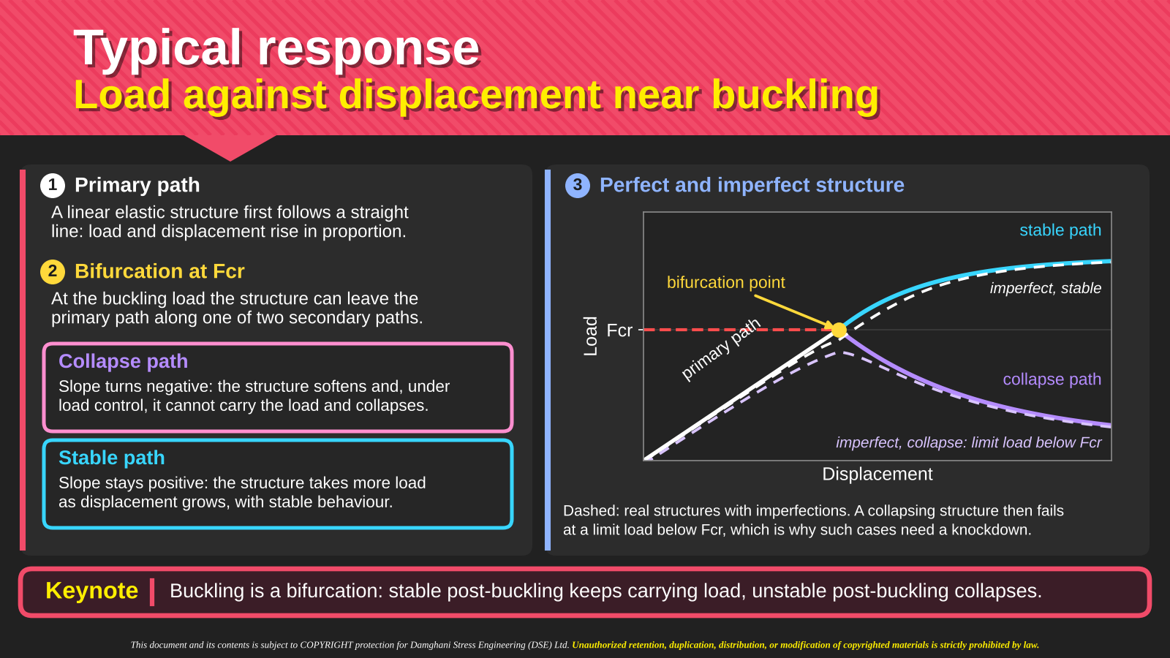
Notes:
Intro
The load–displacement sketch distinguishes the initial response from possible post-buckling paths. It also contrasts the ideal response of a perfect structure with the smoother response of an imperfect structure.
Concept
The primary path represents the initial equilibrium configuration. At the ideal critical load Fcr, a bifurcation permits an alternative configuration. A stable secondary path can sustain increasing load as displacement grows. A descending path indicates decreasing load capacity and can lead to collapse under load control.
Details
Read the vertical axis as load and the horizontal axis as displacement. Follow the initial straight branch to the marked bifurcation point, then compare the rising blue branch with the falling purple branch. The dashed imperfect response shows why a real test may not exhibit a sharp intersection of two paths. Geometric imperfections introduce out-of-plane deformation before the ideal bifurcation. The control method also matters when interpreting a descending branch, because a response traced under displacement control may not remain accessible under load control.
Key Takeaway
Reaching the buckling load does not automatically mean immediate collapse. Post-buckling stability determines whether the structure can continue carrying additional load.

Slide 3
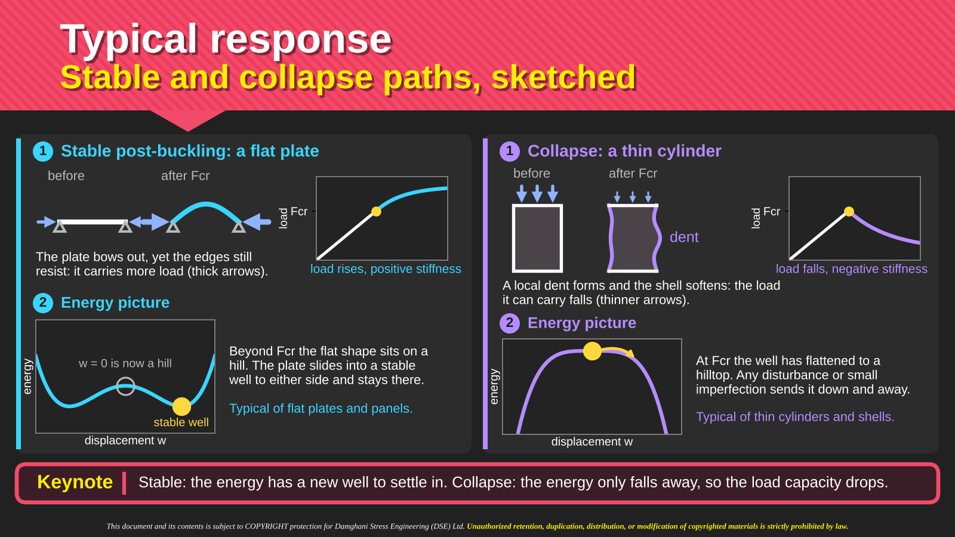
Notes:
Intro
This slide gives a physical and energetic interpretation of the two post-buckling responses. The flat-plate sketch illustrates a stable path, while the thin-cylinder sketch illustrates a possible collapse path.
Concept
An equilibrium state corresponds to a stationary value of total potential energy. A local minimum supports stability against small disturbances. When the initial configuration loses stability, the availability of another stable configuration determines whether the structure can settle into a post-buckled state.
Details
On the left, the plate develops an out-of-plane wave and follows a rising load–displacement branch. The energy sketch depicts a new stable position after the original state loses stability. On the right, a local dent in the cylinder accompanies a falling load branch. The second energy sketch illustrates the absence of a nearby stable state along the depicted path. These are explanatory examples rather than universal rules for every plate or cylinder. Geometry, imperfections, loading and restraints affect the actual response.
Key Takeaway
The energy sketches explain why some structures find a stable post-buckled configuration while others experience a rapid loss of load capacity.

Slide 4
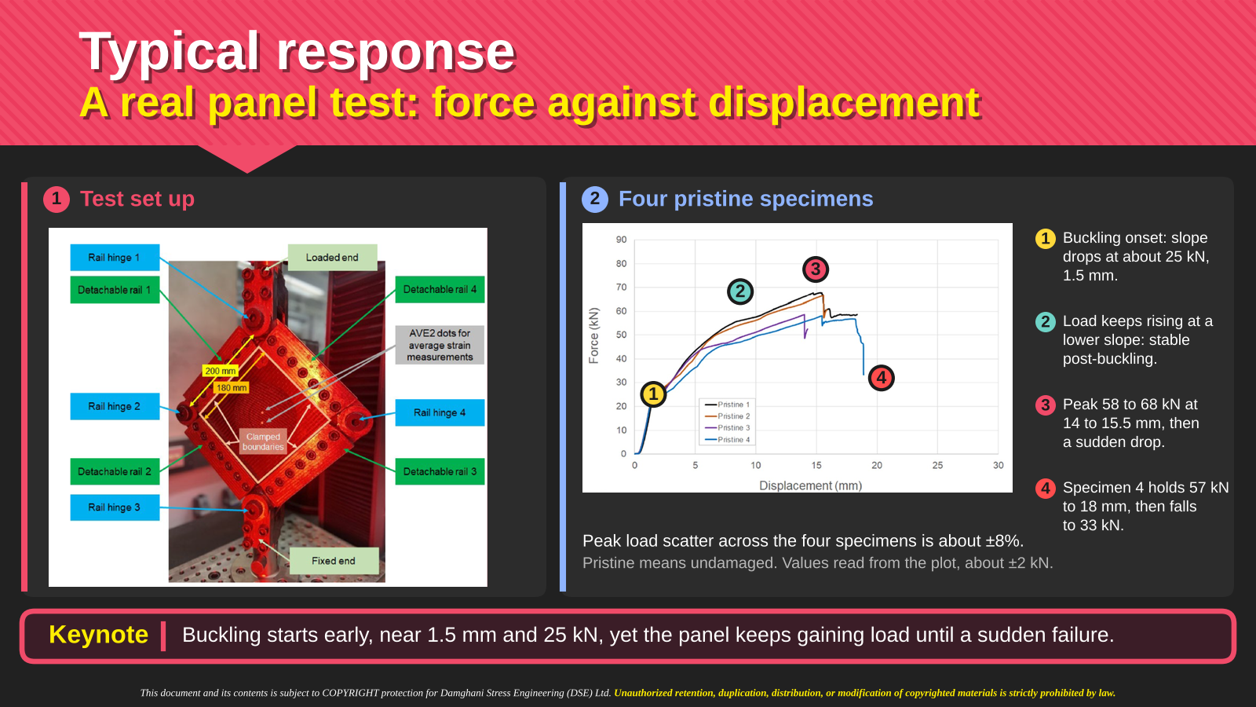
Notes:
Intro
The panel test connects the schematic buckling curves to a measured force–displacement response. The slide combines the test arrangement with curves from four pristine specimens.
Concept
Initial buckling and ultimate failure can occur at substantially different loads. A change in the slope of the force–displacement curve indicates a change in structural stiffness, while continued load increase after that change demonstrates post-buckling load carrying.
Details
Use the photograph to identify the panel, loading arrangement and measurement locations. On the plotted curves, the first marked change occurs around 1.5 mm displacement and 25 kN, as stated on the slide. The specimens then continue gaining load before reaching their peaks and experiencing load drops. Compare the four curves to distinguish the common response trend from specimen-to-specimen variation. A force–displacement trace alone does not identify every damage mechanism, so avoid attributing a particular load drop to an unreported failure mechanism. The slide demonstrates reserve beyond initial buckling without establishing a general allowable design margin.
Key Takeaway
This test separates the onset of buckling from subsequent peak load and failure. The panel continues to carry increasing load after the first stiffness change.

Slide 5
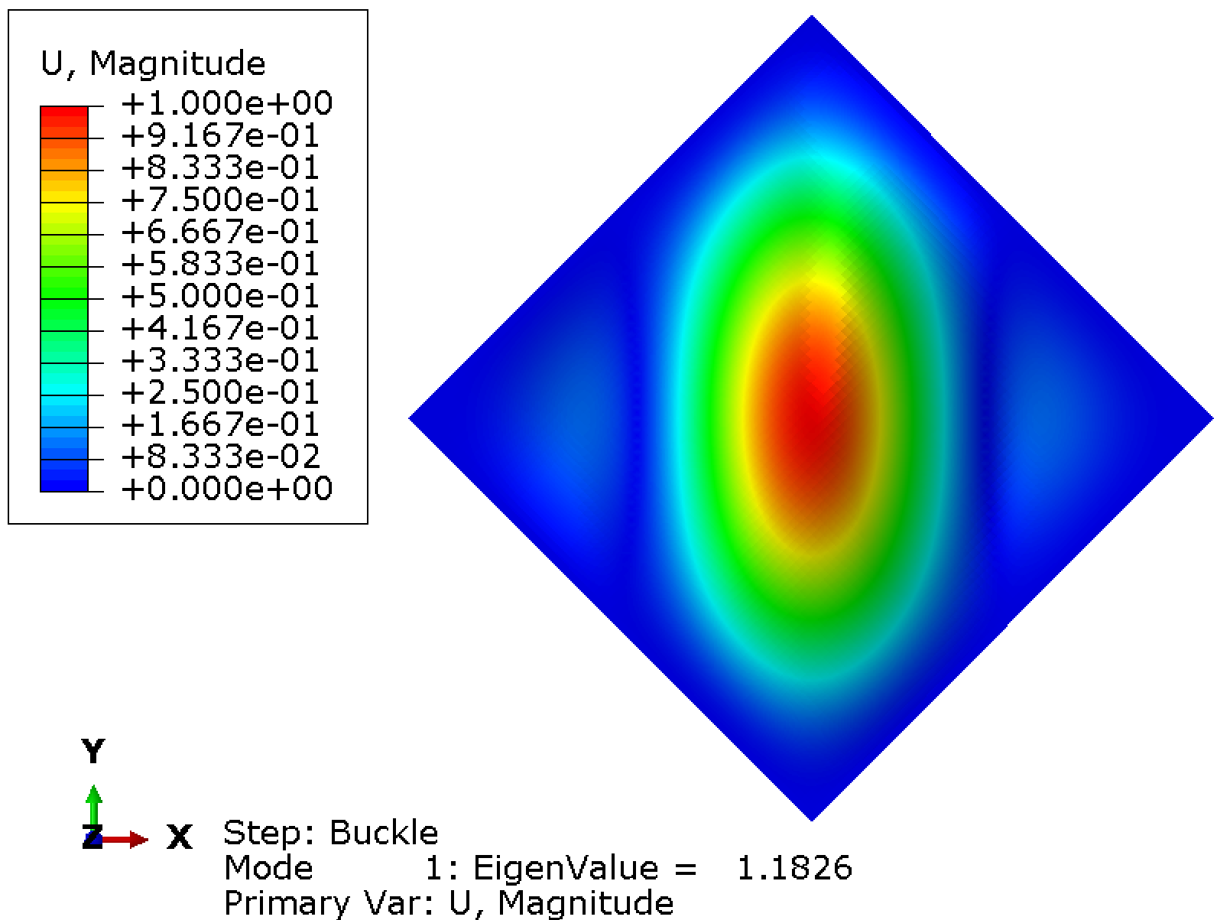
Governing equations of Classical Laminate Theory (CLT)
Prior to addressing the buckling problem, it is of paramount importance to understand the governing equations of a composite laminate.
It is equally important to have awareness of how these equations are obtained.
Then, some practical examples will be provided.
Notes:
Intro
Before deriving a buckling solution, the lecture establishes the governing equations of Classical Laminate Theory. The mode-shape image illustrates the type of structural response these equations help describe.
Concept
A laminate model combines equilibrium, kinematics and a constitutive law. Equilibrium balances forces and moments. Kinematics relates displacements to strains and curvatures. The constitutive law connects those deformations to the stress resultants through the A, B and D matrices.
Details
A represents extensional stiffness, D represents bending stiffness, and B couples extension with bending. For a laminate symmetric about its mid-plane, B vanishes. This simplification does not automatically remove every anisotropic bending effect, so the D16 and D26 terms require their own check. The following derivation begins with three-dimensional stress equilibrium, integrates through thickness and then introduces the laminate stiffness law. Interpret the displayed eigenmode as a deformation pattern rather than a prediction of the actual post-buckling amplitude.
Key Takeaway
A defensible buckling calculation starts with the governing laminate equations and explicit assumptions, rather than an isolated critical-load formula.

Slide 6
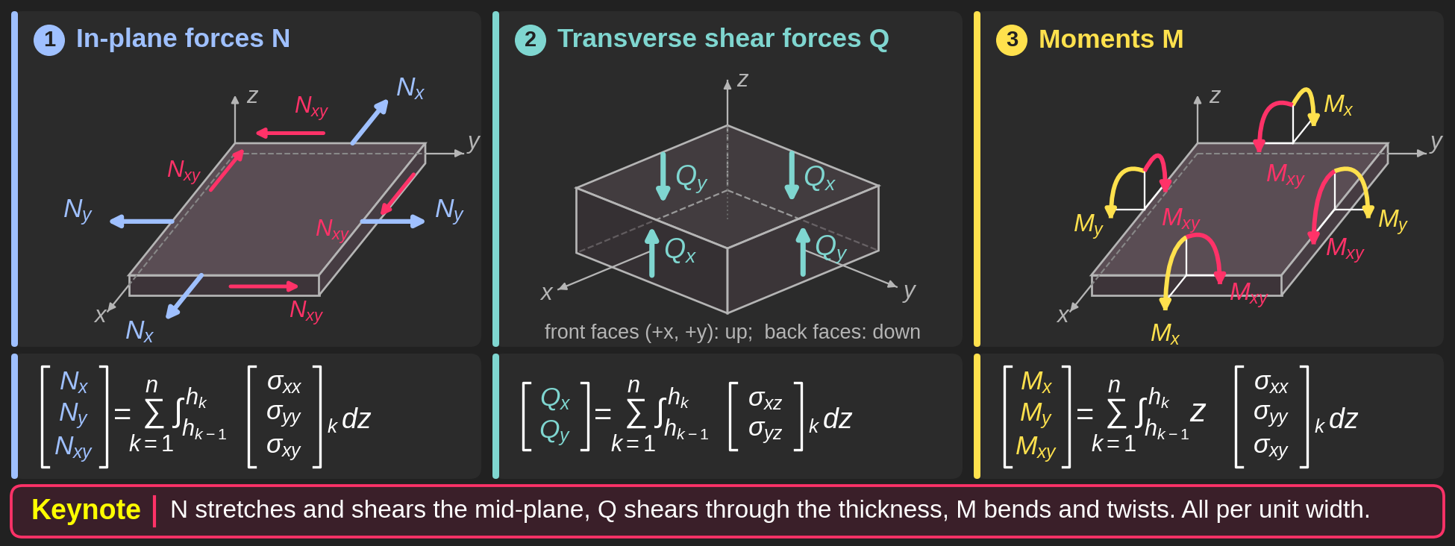
CLT
Notes:
Intro
This slide introduces the force and moment resultants used to describe a laminate. The three panels show in-plane forces N, transverse shear forces Q, and bending and twisting moments M. Each resultant comes from integrating the relevant stresses through the laminate thickness.
Concept
The x and y axes lie in the laminate plane, while z measures distance through the thickness from the mid-plane. Stress can vary from one ply to another, so the equations integrate within each ply and then sum over all n plies. The limits hₖ₋₁ and hₖ identify the lower and upper surfaces of ply k.
Integrating stress gives a force per unit width. Multiplying an in-plane stress by its lever arm z before integrating gives a moment per unit width.
Details
Panel 1: In-plane forces N
Nₓ = Σₖ ∫ σₓₓ dz, Nᵧ = Σₖ ∫ σᵧᵧ dz, and Nₓᵧ = Σₖ ∫ σₓᵧ dz.
Each integral runs from hₖ₋₁ to hₖ, and the sum runs from k = 1 to n. Nₓ and Nᵧ are normal force resultants. Nₓᵧ is the in-plane shear force resultant. These loads act in the laminate plane.
Panel 2: Transverse shear forces Q
Qₓ = Σₖ ∫ σₓz dz and Qᵧ = Σₖ ∫ σᵧz dz, with the same ply limits and summation.
These resultants represent shear forces acting perpendicular to the laminate plane on the corresponding edge faces. The arrows show the illustrated sign convention, with the front faces upward and the back faces downward.
Panel 3: Moments M
Mₓ = Σₖ ∫ zσₓₓ dz, Mᵧ = Σₖ ∫ zσᵧᵧ dz, and Mₓᵧ = Σₖ ∫ zσₓᵧ dz, again using the same ply limits and summation.
Mₓ and Mᵧ are bending moment resultants. Mₓᵧ is the twisting moment resultant. The factor z weights each stress contribution by its signed distance from the mid-plane.
Why Mₓᵧ rather than Mzy? In this plate convention, xy identifies the in-plane shear stress σₓᵧ (also written τₓᵧ) that produces the twisting resultant. The z direction supplies the lever arm in the integral, rather than replacing a subscript. The label does not directly name the axis of the moment vector. Transverse shear stresses instead appear in the Q resultants in panel 2.
Key Takeaway
N describes membrane loading, Q describes transverse shear loading, and M describes bending and twisting. All resultants are per unit width. Integrating stress through the thickness gives force resultants, while integrating z times in-plane stress gives moment resultants. This reduces the through-thickness stress distribution to equivalent laminate loads referenced to the mid-plane.

Slide 7
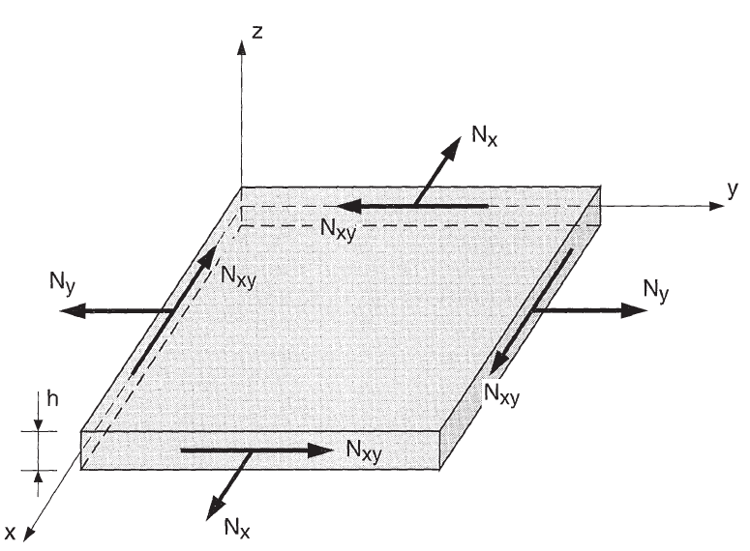
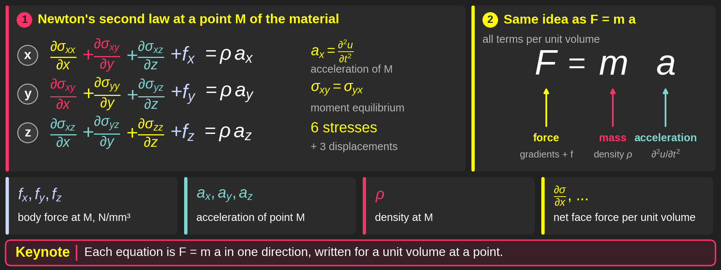
Fundamental equations of the mechanics of materials-General equation
Notes:
Intro
The three equations express Newton’s second law at a material point in the x, y and z directions. They provide the three-dimensional starting point for the laminate equations.
Concept
Stress gradients describe the net internal force per unit volume. Adding body force per unit volume gives density multiplied by acceleration. The compact statement is σij,j + fi = ρai, with consistent index convention and summation over j.
Details
In the x direction, ∂σxx/∂x + ∂σxy/∂y + ∂σxz/∂z + fx = ρax. The y and z equations follow the same pattern with the corresponding normal and shear stresses. The body forces fx, fy and fz have units N/m³, and ρa has the same units. The acceleration components are the second time derivatives of displacement. When acceleration vanishes, the right-hand side becomes zero, giving static equilibrium. The diagram locates the coordinate directions and the stresses that act on the element faces.
Key Takeaway
Each continuum equation is force balance in one direction. Thickness integration converts these local stress equations into plate equations in force and moment resultants.

Slide 8
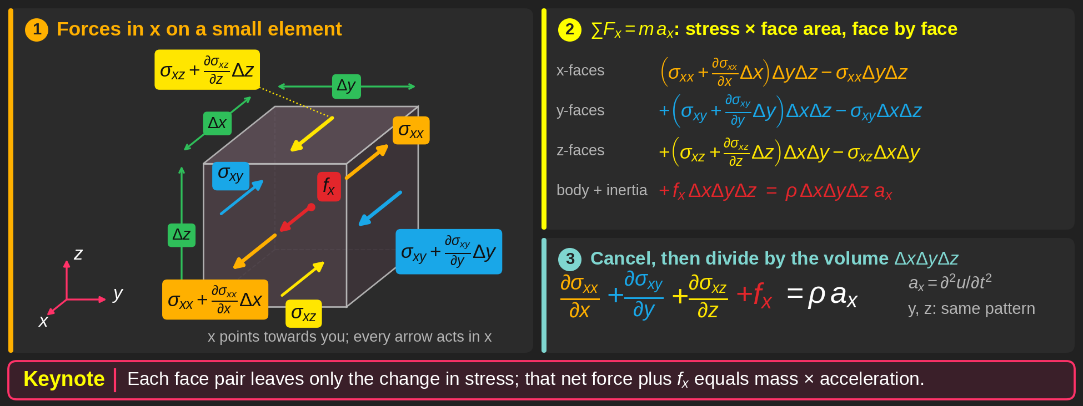
CLT-Illustration
Notes:
Intro
The element diagram explains where the x-direction stress-equilibrium equation comes from. Opposite faces carry slightly different stresses when the stress field varies spatially.
Concept
Force equals stress multiplied by face area. For a small element, a first-order change in stress between opposite faces produces a net force proportional to the relevant stress gradient and the element volume.
Details
The normal stress contribution is (∂σxx/∂x)ΔxΔyΔz. The two shear contributions are (∂σxy/∂y)ΔxΔyΔz and (∂σxz/∂z)ΔxΔyΔz. Add fxΔxΔyΔz for the body force and equate the total to ρaxΔxΔyΔz. The equal stress terms on opposing faces cancel. Dividing by the element volume gives ∂σxx/∂x + ∂σxy/∂y + ∂σxz/∂z + fx = ρax. The different face areas explain why each gradient contributes to the same force balance even though the stresses act on differently oriented faces.
Key Takeaway
Stress gradients arise from the differences between opposing face forces. After division by volume, their sum plus body force equals mass density times acceleration.

Slide 9
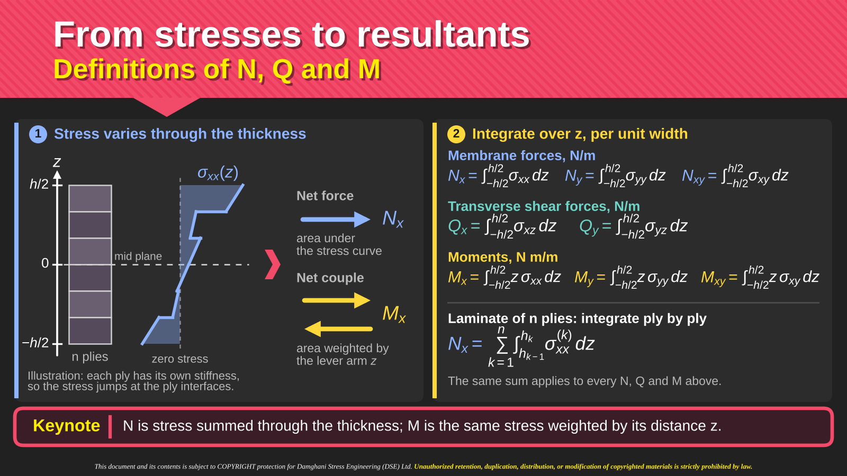
Side note
Notes:
Intro
This slide defines the membrane forces, transverse shear forces and moments obtained from a through-thickness stress distribution. It explains the distinction between a net force and a net couple.
Concept
A resultant replaces the distributed stresses with an equivalent load per unit width. Integrating stress gives a force resultant. Integrating stress multiplied by z gives its first moment about the laminate mid-plane.
Details
Nx = ∫σxx dz, Ny = ∫σyy dz and Nxy = ∫σxy dz. Likewise, Qx = ∫σxz dz and Qy = ∫σyz dz. The moment definitions are Mx = ∫zσxx dz, My = ∫zσyy dz and Mxy = ∫zσxy dz. For a laminate, integrate within each ply between hk−1 and hk, then sum over all plies. Stress can jump across an interface when ply stiffness changes, so a single uniform stress assumption would generally miss the distribution. N and Q have units N/m, while M has units N·m per metre, equivalent to N.
Key Takeaway
The same in-plane stress distribution can generate both a membrane force and a bending moment. The factor z distinguishes the moment integral from the force integral.

Slide 10
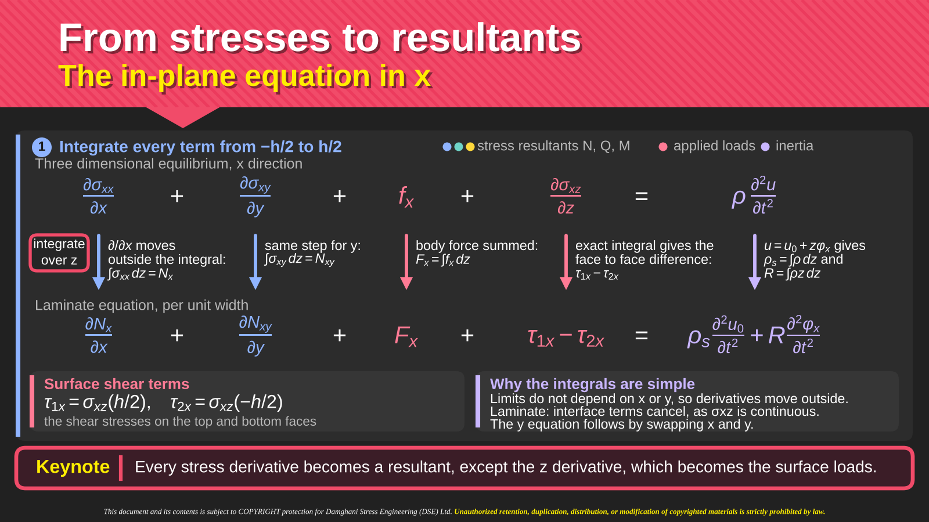
Notes:
Intro
The slide integrates the x-direction continuum equation through the laminate thickness. Each term becomes a force resultant, a surface loading term or a mass-related term.
Concept
For constant thickness and fixed integration limits, differentiation in x or y commutes with thickness integration. A derivative in z instead integrates to the difference between values on the two outer faces.
Details
The first two terms become ∂Nx/∂x and ∂Nxy/∂y. The transverse-shear derivative gives σxz(h/2) − σxz(−h/2) = τ1x − τ2x. Here the τ values denote stress components evaluated on the faces, consistent with the slide’s convention. Perfectly bonded interfaces cancel internally. Define Fx = ∫fx dz. Using u = u0 + zφx gives ∫ρü dz = ρsü0 + Rφ̈x, where ρs = ∫ρ dz and R = ∫ρz dz. The resulting equation is (∂Nx/∂x) + (∂Nxy/∂y) + Fx + τ1x − τ2x = ρsü0 + Rφ̈x.
Key Takeaway
Thickness integration converts in-plane stress gradients into resultant gradients, but the z derivative produces the net loading on the outer faces.

Slide 11
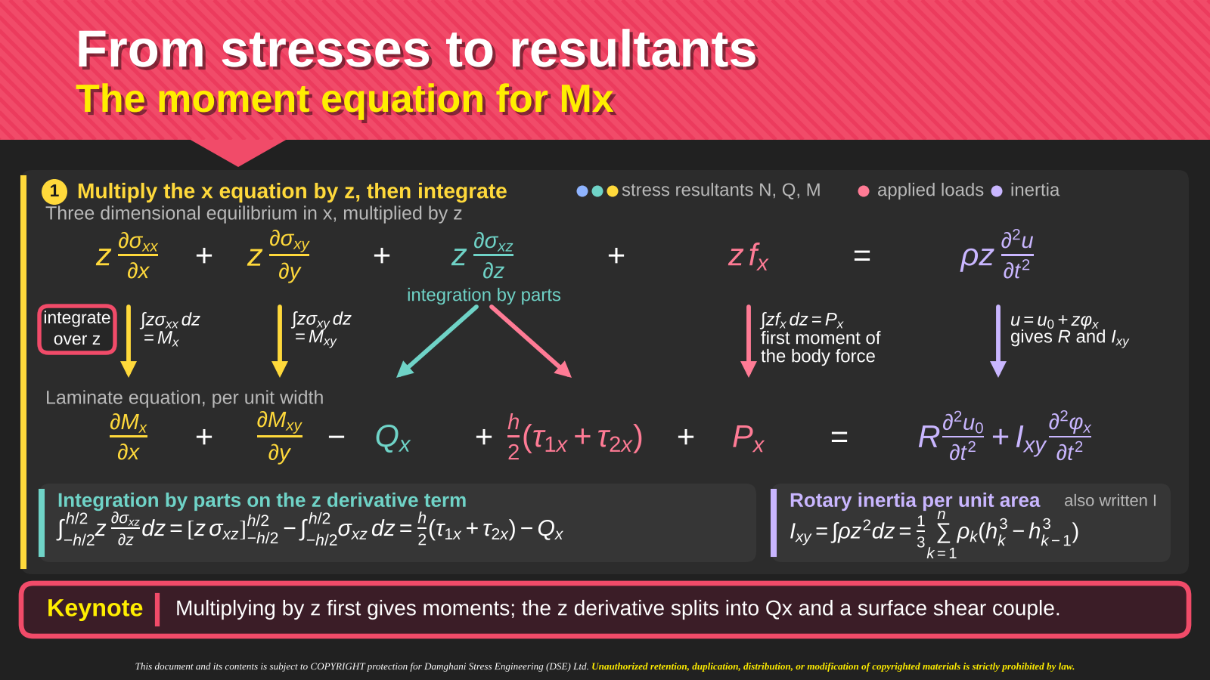
Notes:
Intro
Multiplying the x-direction force equation by z before integrating produces the moment equation. This step explains the appearance of Mx, Mxy and the negative Qx term.
Concept
The multiplier z measures the lever arm from the mid-plane. Integration by parts is necessary for the term containing the z derivative of transverse shear stress.
Details
The in-plane stress terms give ∂Mx/∂x and ∂Mxy/∂y. For the shear term, ∫z(∂σxz/∂z)dz = [zσxz] − ∫σxz dz = (h/2)(τ1x + τ2x) − Qx. The body-force moment is Px = ∫zfx dz. With u = u0 + zφx, the inertia contribution is Rü0 + Ixyφ̈x, using the slide’s symbol Ixy = ∫ρz² dz. Thus (∂Mx/∂x) + (∂Mxy/∂y) − Qx + (h/2)(τ1x + τ2x) + Px = Rü0 + Ixyφ̈x. The sum of the two face stress values follows from their signed lever arms.
Key Takeaway
The moment equation contains both the integrated shear force and the couple caused by face shear stresses. They arise from the same integration-by-parts step.

Slide 12
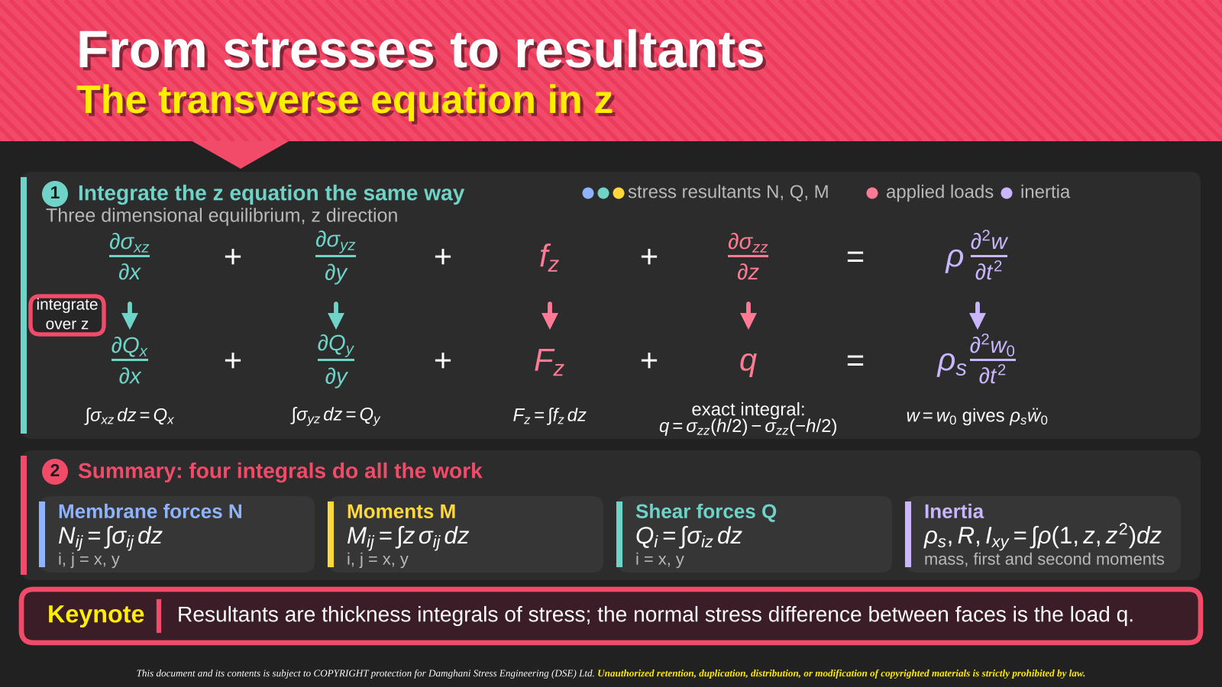
Notes:
Intro
The transverse equilibrium equation follows from integrating the z-direction continuum equation. The lower summary compares the four principal thickness integrals used in the derivation.
Concept
The gradients of transverse shear stress become gradients of Qx and Qy. The normal stress derivative through thickness becomes the net pressure loading on the two outer faces.
Details
Starting with (∂σxz/∂x) + (∂σyz/∂y) + (∂σzz/∂z) + fz = ρẅ, integration gives (∂Qx/∂x) + (∂Qy/∂y) + Fz + q = ρsẅ0. Here Fz = ∫fz dz and q = σzz(h/2) − σzz(−h/2), with signs consistent with the slide. The kinematics assume w = w0, independent of z. The summary distinguishes ∫σ dz for force, ∫zσ dz for moment and the mass integrals ∫ρ dz, ∫ρz dz and ∫ρz² dz. The pressure q is a surface stress difference, not another thickness-integrated force resultant.
Key Takeaway
Transverse equilibrium balances the divergence of shear resultants and applied transverse loading against the inertia of the laminate mid-surface.

Slide 13
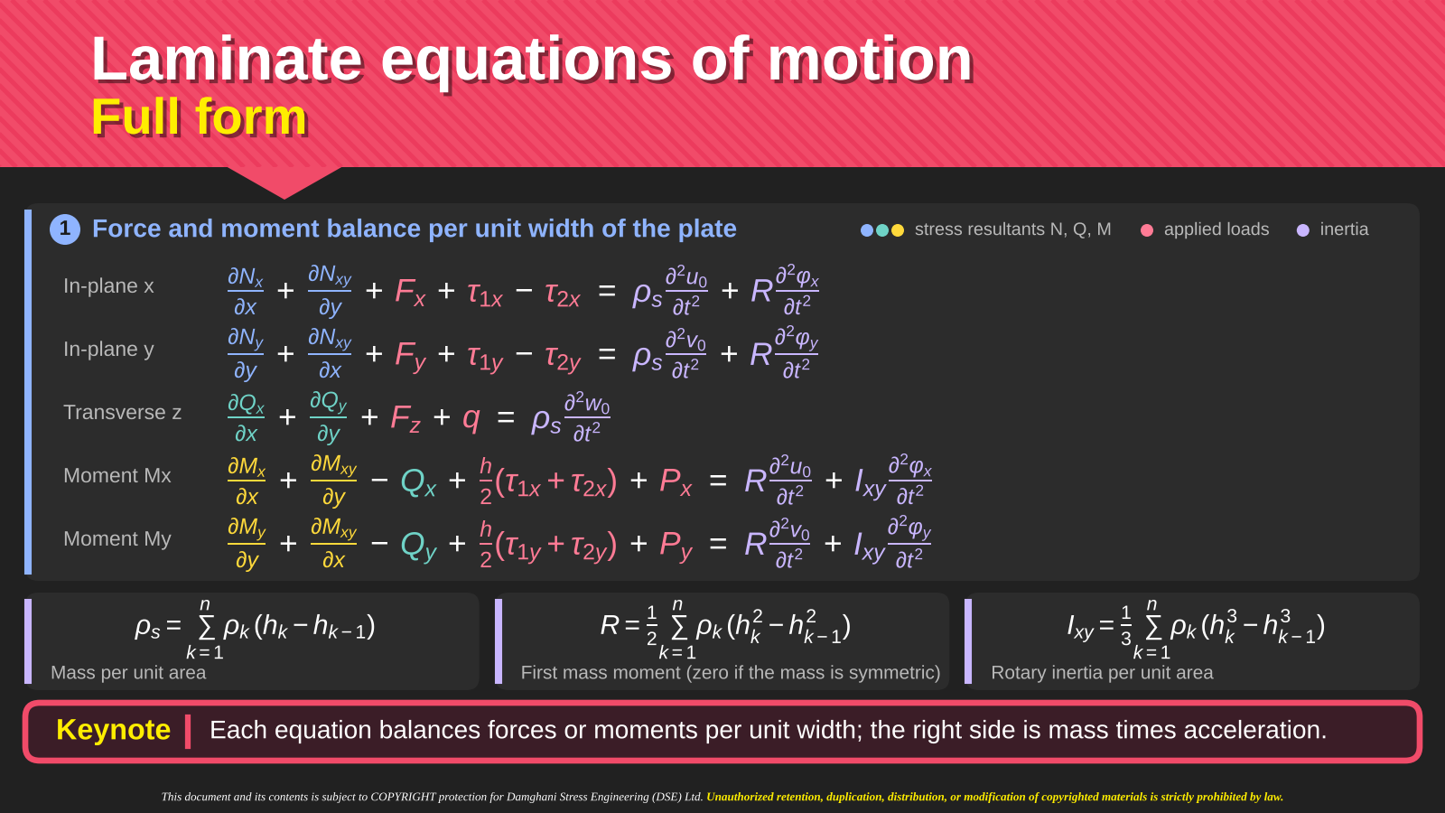
Notes:
Intro
The five displayed equations collect the complete integrated force and moment balances before the simplifying assumptions used later in the lecture.
Concept
Three equations balance translation in x, y and z. Two equations balance moments associated with the in-plane displacement gradients through thickness. The mass quantities connect mid-plane acceleration and rotational acceleration.
Details
The in-plane balances contain (∂Nx/∂x) + (∂Nxy/∂y) and (∂Nxy/∂x) + (∂Ny/∂y), together with body forces and face-shear differences. The transverse balance contains (∂Qx/∂x) + (∂Qy/∂y) + Fz + q. The moment balances contain (∂Mx/∂x) + (∂Mxy/∂y) − Qx and (∂Mxy/∂x) + (∂My/∂y) − Qy, together with body moments and surface-shear couples. The displacement field u = u0 + zφx, v = v0 + zφy, w = w0 gives ρs = ∫ρ dz, R = ∫ρz dz and Ixy = ∫ρz² dz. A mass distribution symmetric about the mid-plane makes R zero. This mass symmetry is distinct from the stiffness symmetry that makes B zero.
Key Takeaway
The full plate equations retain surface loading, body loading and inertia. Each subsequent simplification must identify exactly which term and assumption it removes.

Slide 14
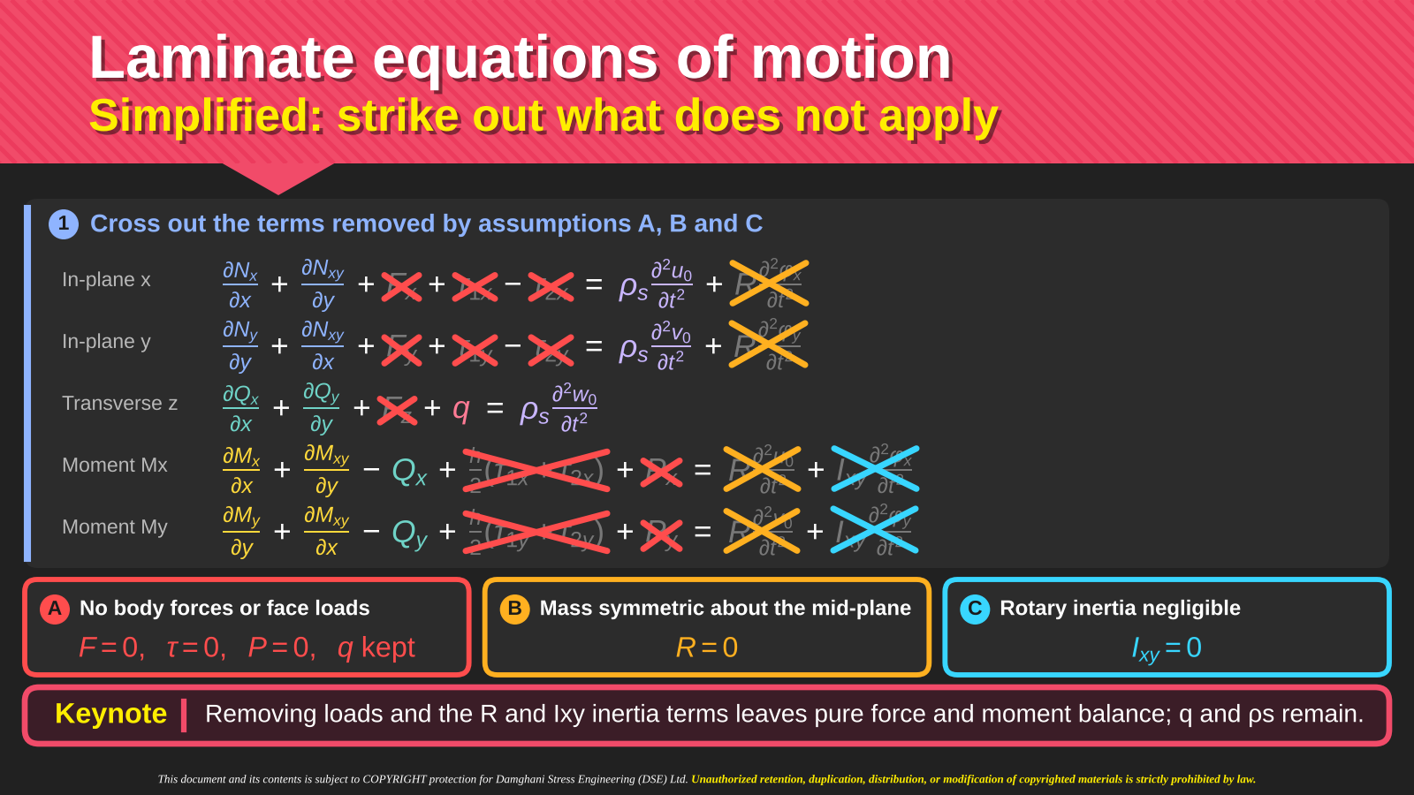
Notes:
Intro
The crossed-out terms show the assumptions that reduce the full laminate equations of motion. The slide keeps transverse loading q and translational inertia.
Concept
Three separate assumptions act on different terms: no body forces or face shear loading, a mass distribution symmetric about the mid-plane, and negligible rotary inertia. None of these assumptions sets the shear resultants Qx and Qy to zero.
Details
Assumption A removes Fx, Fy, Fz, Px, Py and the surface-shear terms, while retaining q. Assumption B gives R = 0 and removes the translation–rotation mass coupling. Assumption C neglects Ixy and the rotary-inertia terms in the moment equations. The moment balances then become (∂Mx/∂x) + (∂Mxy/∂y) − Qx = 0 and (∂Mxy/∂x) + (∂My/∂y) − Qy = 0. The remaining force equations still contain ρs times the mid-plane accelerations. A static model requires the additional step of setting those accelerations to zero.
Key Takeaway
The simplified equations retain pressure, shear resultants and translational inertia. The crossed-out terms correspond to specific loading and mass assumptions.

Slide 15








Laminate equations of motion
Eliminating Qₓ and Q_{y} by substitution
1
Starting equilibrium equations
2
Express shear forces using moments
$$\frac{∂Nₓ}{∂x} + \frac{∂N_{xy}}{∂y} = ρₛ\frac{∂²u₀}{∂t²}$$
$$Qₓ = \frac{∂Mₓ}{∂x} + \frac{∂M_{xy}}{∂y}$$
$$Q_{y} = \frac{∂M_{y}}{∂y} + \frac{∂M_{xy}}{∂x}$$
$$\frac{∂N_{y}}{∂y} + \frac{∂N_{xy}}{∂x} = ρₛ\frac{∂²v₀}{∂t²}$$
3
Substitution into transverse equilibrium
$$\frac{∂Qₓ}{∂x} + \frac{∂Q_{y}}{∂y} + q = ρₛ\frac{∂²w₀}{∂t²}$$
$$\frac{∂}{∂x}(\frac{∂Mₓ}{∂x} + \frac{∂M_{xy}}{∂y}) + \frac{∂}{∂y}(\frac{∂M_{y}}{∂y} + \frac{∂M_{xy}}{∂x}) + q = ρₛ\frac{∂²w₀}{∂t²}$$
$$\frac{∂Mₓ}{∂x} + \frac{∂M_{xy}}{∂y} − Qₓ = 0$$
Result
$$\frac{∂M_{y}}{∂y} + \frac{∂M_{xy}}{∂x} − Q_{y} = 0$$
$$\frac{∂²Mₓ}{∂x²} + 2\frac{∂²M_{xy}}{∂x∂y} + \frac{∂²M_{y}}{∂y²} + q = ρₛ\frac{∂²w₀}{∂t²}$$
The two mixed derivatives add to give the factor 2.
Keynote
Substitution removes Qₓ and Q_{y} as independent unknowns. Recover them later from the moment gradients.
Notes:
Intro
This slide eliminates Qx and Qy algebraically from the transverse equation. It is an equation reduction, not an assumption that transverse shear forces vanish.
Concept
The simplified moment equations express each shear resultant in terms of moment gradients. Substituting these expressions into transverse force equilibrium produces a single equation involving second derivatives of moments.
Details
From moment equilibrium, Qx = (∂Mx/∂x) + (∂Mxy/∂y) and Qy = (∂Mxy/∂x) + (∂My/∂y). Insert these into (∂Qx/∂x) + (∂Qy/∂y) + q = ρsẅ0. Differentiating gives (∂²Mx/∂x²) + 2(∂²Mxy/∂x∂y) + (∂²My/∂y²) + q = ρsẅ0. The coefficient two appears because the mixed derivative of Mxy occurs once through Qx and once through Qy. The two in-plane equations remain unchanged. Once the moments have been found, the same expressions recover Qx and Qy.
Key Takeaway
Eliminating a variable by substitution does not make it physically zero. The shear forces remain recoverable from the gradients of the bending and twisting moments.
Teaching sequence and notation
Begin with five equilibrium equations: two in-plane force equations, one transverse force equation and two moment equations. Here rho_s is mass per unit area and q is transverse load per unit area. Solve the last two equations algebraically for Qx and Qy, then substitute into the transverse equation. The two mixed derivatives are equal when the moment field is sufficiently smooth, giving the factor 2. The in-plane equations are unchanged. This reduction follows the moment-equilibrium assumptions already introduced in the lecture; it is not a new assumption that shear force vanishes. In a static problem, the time-acceleration terms become zero.

Slide 16
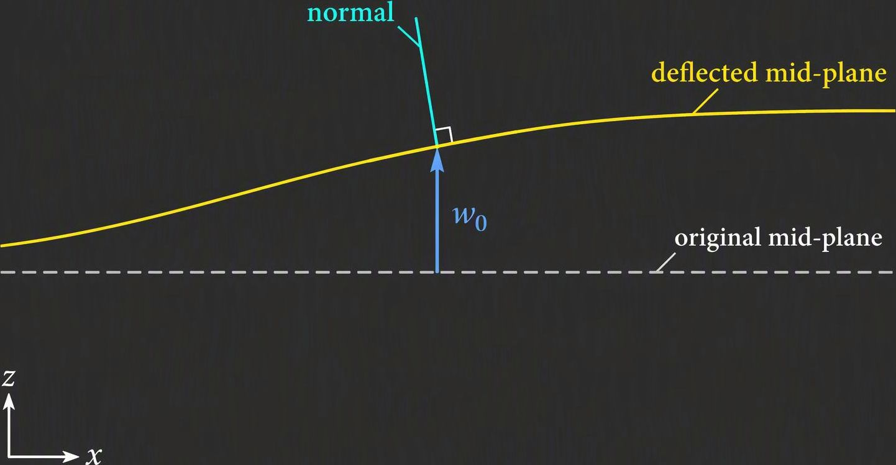
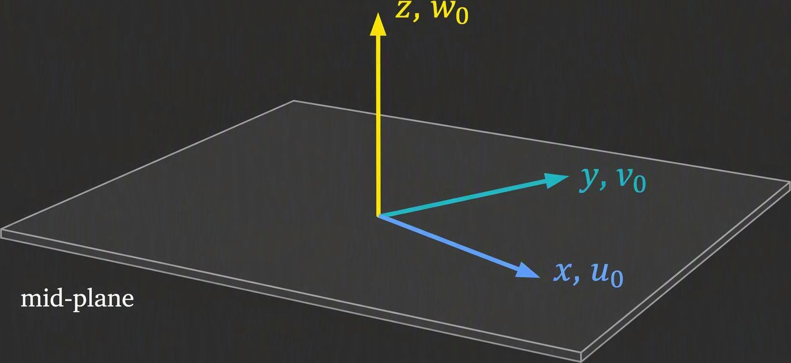

Laminate equations of motion
Kirchhoff plate: displacement, strain and force
1
Three displacement unknowns
2
Plate normals remain perpendicular
u₀, v₀, w₀
Mid-plane motion
$$w = w₀ γ_{xz} = γ_{yz} = 0$$
u₀, v₀: in-plane
w₀: transverse
Subscript 0 denotes the mid-plane.
The normal follows the slope of w₀ and remains perpendicular to the mid-surface.
$$u = u₀ − z\frac{∂w₀}{∂x} v = v₀ − z\frac{∂w₀}{∂y}$$
3
Shear forces remain, and the laminate may couple stretching with bending
Qₓ and Qᵧ need not be zero. Recover them from moment
gradients on the previous slide. Zero shear strain does
not imply zero shear force.
B couples in-plane stretching and bending.
For a symmetric laminate, B = 0, removing
that constitutive coupling.
Keynote
Kirchhoff theory neglects transverse shear deformation. Equilibrium still requires transverse shear forces.
Notes:
Intro
The Kirchhoff plate formulation describes motion using the three mid-plane displacements u0, v0 and w0. The slide explicitly distinguishes zero transverse shear strain from zero transverse shear force.
Concept
Kirchhoff kinematics keeps a material normal perpendicular to the deformed mid-surface. Consequently γxz = γyz = 0, and the rotations follow the slopes of w0 rather than acting as independent unknowns.
Details
The in-plane equations determine u0 and v0. The transverse equation is (∂²Mx/∂x²) + 2(∂²Mxy/∂x∂y) + (∂²My/∂y²) + q = ρsẅ0. The constitutive B matrix can couple this bending response to in-plane motion. A symmetric laminate has B = 0, removing that constitutive extension–bending coupling. Qx and Qy still enforce transverse equilibrium and can be recovered from (∂Mx/∂x) + (∂Mxy/∂y) and (∂Mxy/∂x) + (∂My/∂y). They need not vanish even though the kinematic shear strains vanish.
Key Takeaway
Kirchhoff theory neglects transverse shear deformation. It retains the shear forces required for equilibrium, although they need not appear as independent solution variables.
How this differs from the preceding slide
The preceding slide performs the algebraic elimination of Qx and Qy. This slide explains the kinematics and physical meaning, without repeating the equilibrium derivation. The three independent displacement fields are u0, v0 and w0. For the sign convention shown, u = u0 − z times the x-slope of w0, v = v0 − z times the y-slope of w0, and w = w0. Thus partial u/partial z + partial w/partial x = 0, with the same cancellation in y. Plate normals remain straight and normal to the deformed mid-surface. Their rotations therefore follow the slopes rather than appearing as independent variables.
Why zero shear strain does not eliminate shear force
Classical plate kinematics suppresses transverse shear deformation. The resultant shear forces still provide the transverse equilibrium required by bending and loading. Do not infer Q = 0 by applying a transverse shear constitutive relation to the constrained kinematics. Recover Qx and Qy from moment gradients using the preceding slide. The laminate B matrix introduces constitutive extension–bending coupling; B = 0 for a symmetric laminate. This does not rule out other coupling from geometry, loads or boundary conditions. In a general unsymmetric laminate, solving for all three displacement fields may be necessary before recovering the moments and shear forces.
Illustration teaching guidance
The oblique plate sketch identifies u0 and v0 as mid-plane displacement components in the x and y directions, and w0 as displacement normal to the original mid-plane. The side-view sketch distinguishes the original dashed mid-plane from the deflected curve. The material normal rotates but remains perpendicular to the local tangent. Rotations follow slopes of w0 rather than acting as independent degrees of freedom. The diagrams are schematic, not to scale; the same normality condition applies in both in-plane directions.
Illustration provenance
Two AI-generated conceptual teaching sketches created for this slide. Labels and geometry express the kinematic assumptions already presented in the supplied lecture. Decorative image content is raster; equations, captions, headings and panels remain editable.

Slide 17
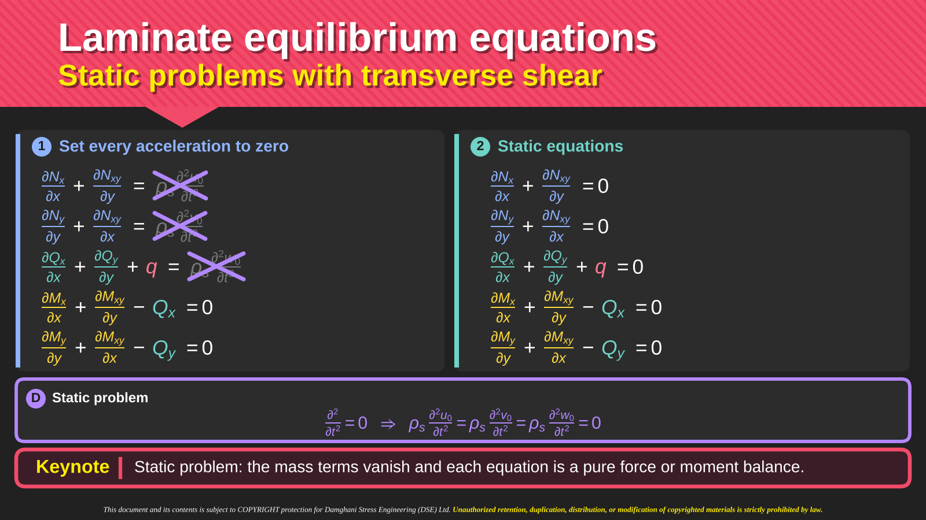
3 Eliminate Q using the moment equations
$$\frac{∂²M_{x}}{∂x²} + 2\frac{∂²M_{xy}}{∂x∂y} + \frac{∂²M_{y}}{∂y²} + q = 0$$
Two in-plane equations + one bending equation
Keynote
Static means zero acceleration. B can still couple stretching and bending; symmetry gives B = 0.
Notes:
Intro
This merged slide combines the static limit and the reduced Kirchhoff equilibrium system. It replaces the former two-slide sequence without repeating the algebraic derivation already taught on slide 15.
Concept
Static equilibrium removes acceleration terms. It does not remove applied loads, internal shear forces or moments. After using moment equilibrium to eliminate Qx and Qy, two in-plane equations and one bending equation remain.
Details
The five static equations appear in the upper-right panel. The upper-left panel shows which acceleration terms disappear. The mass per unit area remains a physical property; only its acceleration contribution is zero. Solve the two moment equations for Qx = partial Mx/partial x + partial Mxy/partial y and Qy = partial Mxy/partial x + partial My/partial y. Substitute into transverse force equilibrium. The two mixed derivatives combine to give 2 partial² Mxy/(partial x partial y), yielding the reduced equation in the lower panel. The pressure q remains. The two in-plane equations remain unchanged. Qx and Qy can still be recovered from moment gradients after solving.
Constitutive coupling
The three equilibrium equations do not automatically yield independent in-plane and bending displacement solutions. The laminate B matrix can couple extension and bending. For a symmetric laminate B = 0, removing that constitutive coupling, although other coupling mechanisms may remain depending on geometry, loads and boundary conditions. Constitutive and kinematic relations are still needed to determine displacements and stresses.
Key Takeaway
Static equilibrium means zero acceleration, while eliminating Q is an algebraic substitution. Neither step removes the internal shear forces required for equilibrium. Independence of stretching and bending depends on the constitutive coupling.

Slide 18
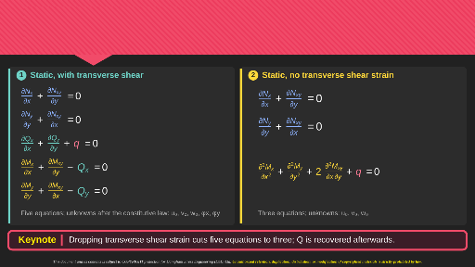








Laminate equilibrium equations
Summary of key equations
1
Static, with transverse shear
2
Static, no transverse shear strain
$$\frac{∂N_{x}}{∂x} + \frac{∂N_{xy}}{∂y} = 0$$
$$\frac{∂N_{x}}{∂x} + \frac{∂N_{xy}}{∂y} = 0$$
$$\frac{∂N_{y}}{∂y} + \frac{∂N_{xy}}{∂x} = 0$$
$$\frac{∂N_{y}}{∂y} + \frac{∂N_{xy}}{∂x} = 0$$
$$\frac{∂Q_{x}}{∂x} + \frac{∂Q_{y}}{∂y} + q = 0$$
$$\frac{∂M_{x}}{∂x} + \frac{∂M_{xy}}{∂y} − Q_{x} = 0$$
$$\frac{∂²M_{x}}{∂x²} + \frac{∂²M_{y}}{∂y²} + 2\frac{∂²M_{xy}}{∂x∂y} + q = 0$$
$$\frac{∂M_{y}}{∂y} + \frac{∂M_{xy}}{∂x} − Q_{y} = 0$$
Five unknowns: u₀, v₀, w₀, φ_{x}, φ_{y}
Three unknowns: u₀, v₀, w₀
Keynote
The reduced form eliminates Q from equilibrium. Recover the shear forces from the moment gradients.
Notes:
Intro
The side-by-side summary compares static equilibrium with explicit shear resultants against the reduced formulation with no transverse shear strain.
Concept
Both descriptions express the same force and moment balances. Their principal difference is the choice of kinematic variables and the elimination of Q, rather than a loss of transverse force equilibrium.
Details
The left side retains five equations and is suited to a formulation with u0, v0, w0 and independent rotations φx and φy. The right side uses the Kirchhoff displacement fields u0, v0 and w0. Its transverse equation contains second derivatives of M instead of first derivatives of Q. The constitutive law must match the chosen kinematics, especially when transverse shear deformation matters. On either side, Qx and Qy have physical meaning. In the reduced system, calculate them after the displacement and moment solution.
Key Takeaway
The five-equation and three-equation forms organize the same equilibrium requirements differently. A consistent kinematic and constitutive model completes either formulation.
Editable recreation
The slide now uses native PowerPoint equations, headings, panels and captions. The left five displacement fields apply to a shear-deformable kinematic model. Algebraically eliminating Q alone does not impose zero transverse shear strain. Kirchhoff kinematics separately removes independent rotations by relating them to slopes of w0. The original header texture and small attribution remain source artwork.

Slide 19
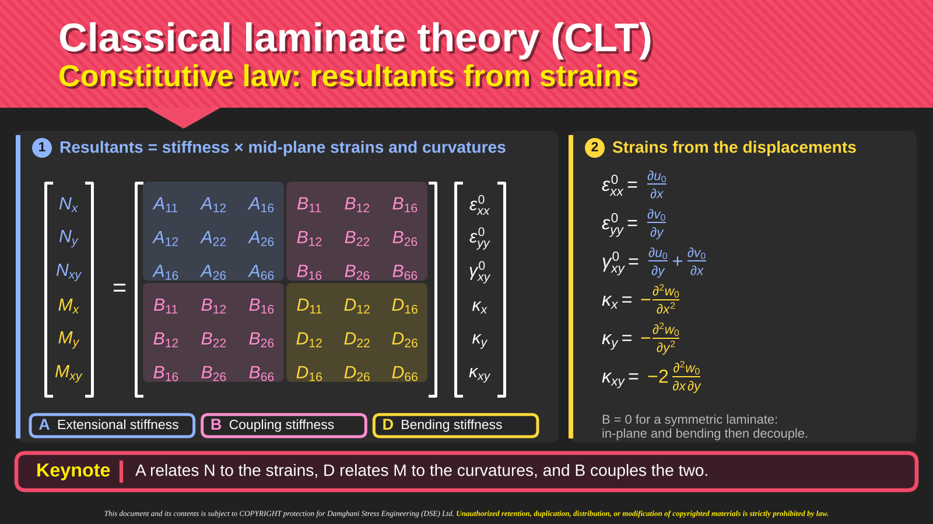
Notes:
Intro
The ABD matrix relates laminate stress resultants to mid-plane strains and curvatures. The adjacent equations relate those deformation measures to displacements.
Concept
The constitutive equations are N = Aε0 + Bκ and M = Bε0 + Dκ. A weights stretching, D weights bending, and B couples the two responses.
Details
The strain vector contains εx0 = (∂u0/∂x), εy0 = (∂v0/∂y) and engineering shear γxy0 = (∂u0/∂y) + (∂v0/∂x). With the slide’s sign convention, κx = −(∂²w0/∂x²), κy = −(∂²w0/∂y²) and κxy = −2(∂²w0/∂x∂y). The factor two belongs to the engineering twisting curvature convention and must remain consistent with D66 and B66. The resultants Nx, Ny and Nxy occupy the first three rows, while Mx, My and Mxy occupy the last three. For a symmetric laminate, B = 0. A and D can still contain anisotropic coupling terms.
Key Takeaway
The ABD relation connects equilibrium variables to deformation. Consistent strain, curvature and sign conventions are essential when expanding its matrix rows.

Slide 20
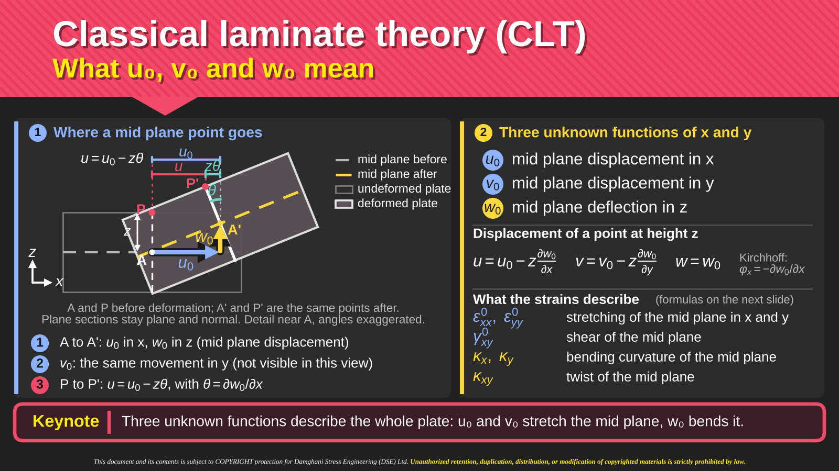
Notes:
Intro
The diagram clarifies what u0, v0 and w0 represent and how they describe points away from the mid-plane.
Concept
The subscript zero identifies the laminate mid-surface. u0 and v0 describe in-plane displacement, while w0 describes transverse displacement. Kirchhoff kinematics reconstructs the displacement of a point at height z from these three functions.
Details
The displacement field is u = u0 − z(∂w0/∂x), v = v0 − z(∂w0/∂y) and w = w0. In the side view, the mid-plane point and a point above it move differently because the normal rotates with the plate slope. The z-dependent contribution accounts for bending, while u0 and v0 account for membrane deformation. Differentiating u0 and v0 gives mid-plane normal and shear strains. Differentiating w0 twice gives curvatures. The sketch separates translation of the reference surface from the additional displacement caused by rotation of its normal.
Key Takeaway
Three mid-plane displacement functions determine the Kirchhoff plate displacement field. Bending produces a displacement contribution that varies linearly through thickness.

Slide 21
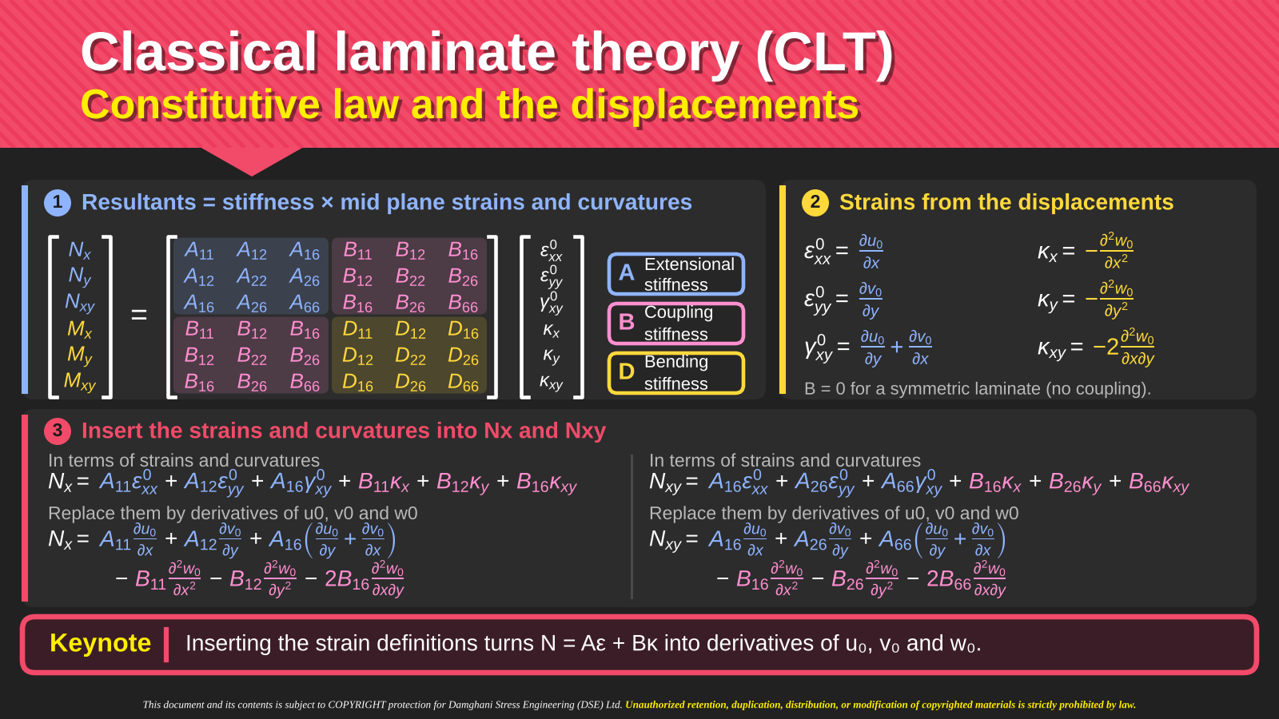
Notes:
Intro
This slide expands Nx and Nxy by replacing strains and curvatures with displacement derivatives. It prepares the expressions needed for the x-direction equilibrium equation.
Concept
Each matrix row is a linear combination of strains and curvatures. Inserting their definitions converts the constitutive law into equations directly in u0, v0 and w0.
Details
Nx = A11(∂u0/∂x) + A12(∂v0/∂y) + A16((∂u0/∂y) + (∂v0/∂x)) − B11(∂²w0/∂x²) − B12(∂²w0/∂y²) − 2B16(∂²w0/∂x∂y). Likewise, Nxy = A16(∂u0/∂x) + A26(∂v0/∂y) + A66((∂u0/∂y) + (∂v0/∂x)) − B16(∂²w0/∂x²) − B26(∂²w0/∂y²) − 2B66(∂²w0/∂x∂y). The signs of the B terms follow from the negative curvature convention. The coefficients of the mixed derivatives retain the engineering shear factors. These formulas assume the displayed linear strain–displacement relations and the same coordinate convention used in the ABD matrix.
Key Takeaway
Substituting kinematics into the constitutive rows provides explicit resultant expressions ready for differentiation in the equilibrium equations.

Slide 22
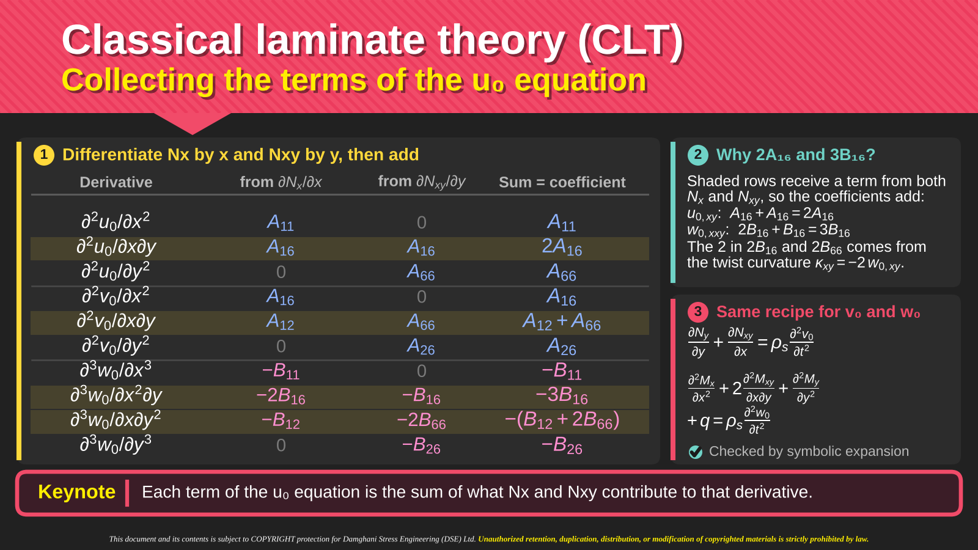
Notes:
Intro
The coefficient table shows how differentiation of Nx and Nxy produces the u0 equilibrium equation. It explains the numerical factors that can look unexpected in the expanded result.
Concept
Different terms can generate the same displacement derivative. Their coefficients must be added after differentiating Nx with respect to x and Nxy with respect to y.
Details
The (∂²u0/∂x∂y) term receives A16 from each resultant, giving 2A16. The (∂²v0/∂x∂y) term receives A12 and A66, giving A12 + A66. The (∂³w0/∂x²∂y) term receives −2B16 from (∂Nx/∂x) and −B16 from (∂Nxy/∂y), giving −3B16. The (∂³w0/∂x∂y²) term receives −B12 and −2B66, giving −(B12 + 2B66). This collection assumes the laminate coefficients are spatially constant, so derivatives act only on the displacement fields. Repeating the process for Ny and the moment rows generates the other governing equations.
Key Takeaway
Factors such as two and three result from collecting repeated derivatives, not from new material constants or additional physical assumptions.

Slide 23
Classical laminate theory (CLT)
Governing equations in u₀, v₀ and w₀ with pre-buckling loads
$$A_{11}\frac{∂^{2}u_{0}}{∂x^{2}} + 2A_{16}\frac{∂^{2}u_{0}}{∂x∂y} + A_{66}\frac{∂^{2}u_{0}}{∂y^{2}} + A_{16}\frac{∂^{2}v_{0}}{∂x^{2}} + (A_{12} + A_{66})\frac{∂^{2}v_{0}}{∂x∂y} + A_{26}\frac{∂^{2}v_{0}}{∂y^{2}}$$
A, B, D as defined on the previous slide
u₀
Membrane forces are already
included in the A and B terms.
$$− B_{11}\frac{∂^{3}w_{0}}{∂x^{3}} − 3B_{16}\frac{∂^{3}w_{0}}{∂x^{2}∂y} − (B_{12} + 2B_{66})\frac{∂^{3}w_{0}}{∂x∂y^{2}} − B_{26}\frac{∂^{3}w_{0}}{∂y^{3}} = ρ_{s}\frac{∂^{2}u_{0}}{∂t^{2}}$$
$$A_{16}\frac{∂^{2}u_{0}}{∂x^{2}} + (A_{12} + A_{66})\frac{∂^{2}u_{0}}{∂x∂y} + A_{26}\frac{∂^{2}u_{0}}{∂y^{2}} + A_{66}\frac{∂^{2}v_{0}}{∂x^{2}} + 2A_{26}\frac{∂^{2}v_{0}}{∂x∂y} + A_{22}\frac{∂^{2}v_{0}}{∂y^{2}}$$
Edge loads enter through boundary
conditions. Distributed in-plane
loads are zero here: pₓ = pᵧ = 0.
v₀
$$− B_{16}\frac{∂^{3}w_{0}}{∂x^{3}} − (B_{12} + 2B_{66})\frac{∂^{3}w_{0}}{∂x^{2}∂y} − 3B_{26}\frac{∂^{3}w_{0}}{∂x∂y^{2}} − B_{22}\frac{∂^{3}w_{0}}{∂y^{3}} = ρ_{s}\frac{∂^{2}v_{0}}{∂t^{2}}$$
$$D_{11}\frac{∂^{4}w_{0}}{∂x^{4}} + 4D_{16}\frac{∂^{4}w_{0}}{∂x^{3}∂y} + 2(D_{12} + 2D_{66})\frac{∂^{4}w_{0}}{∂x^{2}∂y^{2}} + 4D_{26}\frac{∂^{4}w_{0}}{∂x∂y^{3}} + D_{22}\frac{∂^{4}w_{0}}{∂y^{4}}$$
The N⁰ terms retain the effect of
pre-buckling forces acting through
curvature: geometric stiffness.
$$−B_{11}\frac{∂^{3}u_{0}}{∂x^{3}} − 3B_{16}\frac{∂^{3}u_{0}}{∂x^{2}∂y} − (B_{12} + 2B_{66})\frac{∂^{3}u_{0}}{∂x∂y^{2}} − B_{26}\frac{∂^{3}u_{0}}{∂y^{3}}$$
w₀
$$−B_{16}\frac{∂^{3}v_{0}}{∂x^{3}} − (B_{12} + 2B_{66})\frac{∂^{3}v_{0}}{∂x^{2}∂y} − 3B_{26}\frac{∂^{3}v_{0}}{∂x∂y^{2}} − B_{22}\frac{∂^{3}v_{0}}{∂y^{3}} + ρ_{s}\frac{∂^{2}w_{0}}{∂t^{2}}$$
$$= N_{x}^{0}\frac{∂^{2}w_{0}}{∂x^{2}} + 2N_{xy}^{0}\frac{∂^{2}w_{0}}{∂x∂y} + N_{y}^{0}\frac{∂^{2}w_{0}}{∂y^{2}} + q$$
Keynote
N⁰ adds pre-stress effects. For B = 0, the transverse equation decouples.
Notes:
Intro
The three expanded equations express laminate motion in u0, v0 and w0 after combining equilibrium, kinematics and the ABD constitutive law.
Concept
A terms govern in-plane derivatives, D terms govern fourth-order bending derivatives, and B terms connect bending to extension. The translational inertia terms remain, so the displayed equations are dynamic rather than purely static.
Details
The u0 and v0 equations contain second derivatives of in-plane displacement and third derivatives of w0 through B. The w0 equation contains fourth derivatives weighted by D and third derivatives of u0 and v0 weighted by B. D16 and D26 multiply the mixed bending–twisting derivatives. A, B and D are constant over the plate in this expansion. If coefficients vary with position, the product rule introduces additional terms. For B = 0, the transverse equation no longer contains u0 or v0, although anisotropic D16 and D26 terms may remain.
Key Takeaway
The displacement equations show precisely where laminate anisotropy and extension–bending coupling enter. Symmetry removes B coupling, not every mixed derivative.
Pre-buckling force terms
The transverse equation now includes Nx⁰ w0,xx + 2Nxy⁰ w0,xy + Ny⁰ w0,yy, using the same convention as the general buckling equation later in this deck. These are geometric-stiffness contributions from membrane loads present before buckling. The zero superscript identifies the reference membrane state, while the zero subscript on u0, v0 and w0 identifies mid-plane quantities. Tension is positive under the stated convention, so compression is negative.
Relation to the original CLT equations
The original slide showed geometrically linear CLT without pre-stress effects. Membrane resultants were already expressed through A and B in the in-plane equations. For stability about a preloaded equilibrium, the additional initial-stress terms must remain in transverse equilibrium. The displayed extension assumes spatially uniform pre-buckling resultants and constant laminate stiffnesses. Prescribed edge forces enter the in-plane boundary conditions. Setting the pre-buckling resultants to zero recovers the original transverse equation after rearranging inertia. For static buckling without transverse forcing, also set acceleration and q to zero. For a symmetric laminate B = 0, the transverse displacement equation decouples for a prescribed reference stress field.

Slide 24

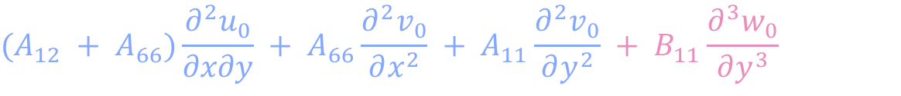
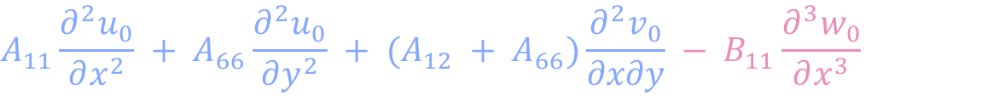


Classical laminate theory (CLT)
Special case: antisymmetric cross-ply laminate
1
Stiffness conditions
$$A_{11} = A_{22}, A_{16} = A_{26} = 0$$
$$D_{11} = D_{22}, D_{16} = D_{26} = 0$$
$$B_{22} = −B_{11}, B_{12} = B_{16} = B_{26} = B_{66} = 0$$
2
Static equations with pre-buckling loads
$$A_{11}\frac{∂^{2}u_{0}}{∂x^{2}} + A_{66}\frac{∂^{2}u_{0}}{∂y^{2}} + (A_{12} + A_{66})\frac{∂^{2}v_{0}}{∂x∂y} − B_{11}\frac{∂^{3}w_{0}}{∂x^{3}} = 0$$
In-plane forces enter via A, B and edge conditions.
u₀
$$(A_{12} + A_{66})\frac{∂^{2}u_{0}}{∂x∂y} + A_{66}\frac{∂^{2}v_{0}}{∂x^{2}} + A_{11}\frac{∂^{2}v_{0}}{∂y^{2}} + B_{11}\frac{∂^{3}w_{0}}{∂y^{3}} = 0$$
pₓ = pᵧ = 0. N⁰ adds pre-stress effects.
v₀
$$D_{11}(\frac{∂^{4}w_{0}}{∂x^{4}} + \frac{∂^{4}w_{0}}{∂y^{4}}) + 2(D_{12} + 2D_{66})\frac{∂^{4}w_{0}}{∂x^{2}∂y^{2}} − B_{11}(\frac{∂^{3}u_{0}}{∂x^{3}} − \frac{∂^{3}v_{0}}{∂y^{3}})$$
w₀
$$= N_{x}^{0}\frac{∂^{2}w_{0}}{∂x^{2}} + 2N_{xy}^{0}\frac{∂^{2}w_{0}}{∂x∂y} + N_{y}^{0}\frac{∂^{2}w_{0}}{∂y^{2}} + q$$
Keynote
B couples membrane and bending responses. N⁰ adds geometric stiffness.
Notes:
Intro
The antisymmetric cross-ply case illustrates a laminate with restricted stiffness terms but nonzero extension–bending coupling.
Concept
The 0° and 90° ply directions remove the A16, A26, D16 and D26 terms in the stated configuration. Antisymmetric placement about the mid-plane leaves B11 and B22 related by B22 = −B11, while the other displayed B terms vanish.
Details
The slide specifies A11 = A22 and D11 = D22 for the selected configuration. The u0 and v0 equations still contain third derivatives of w0 multiplied by B11. The transverse equation retains the corresponding derivatives of u0 and v0. These terms show that membrane and bending responses must be solved together. In this special cross-ply case, describe the surviving effect as extension–bending coupling rather than claiming that every type of twisting coupling remains. The equations shown are static, with acceleration terms omitted.
Key Takeaway
Restricting the ply orientations simplifies the governing equations, but the antisymmetric stacking leaves B nonzero and prevents independent membrane and bending solutions.
Pre-stress extension of the static equations
The static transverse equation now retains Nx⁰ w0,xx + 2Nxy⁰ w0,xy + Ny⁰ w0,yy + q on its right-hand side, consistent with the preceding general equations. The pre-buckling membrane resultants are prescribed and spatially uniform here. Their superscript 0 denotes the reference stress state. The displacement subscript 0 denotes the mid-plane. In-plane force balance already enters through the A and B terms, while applied edge loads enter through boundary conditions. Distributed in-plane loads px and py are zero in the displayed equations. The membrane forces therefore do not disappear when the in-plane right-hand sides are zero. With positive tension, compression is negative. Set q = 0 for an unforced static buckling eigenproblem. The static formulation omits inertia. A compatible pre-buckling equilibrium is required, especially because nonzero B can cause bending under in-plane loading. The stated stiffness equalities apply to the selected antisymmetric cross-ply configuration.

Slide 25
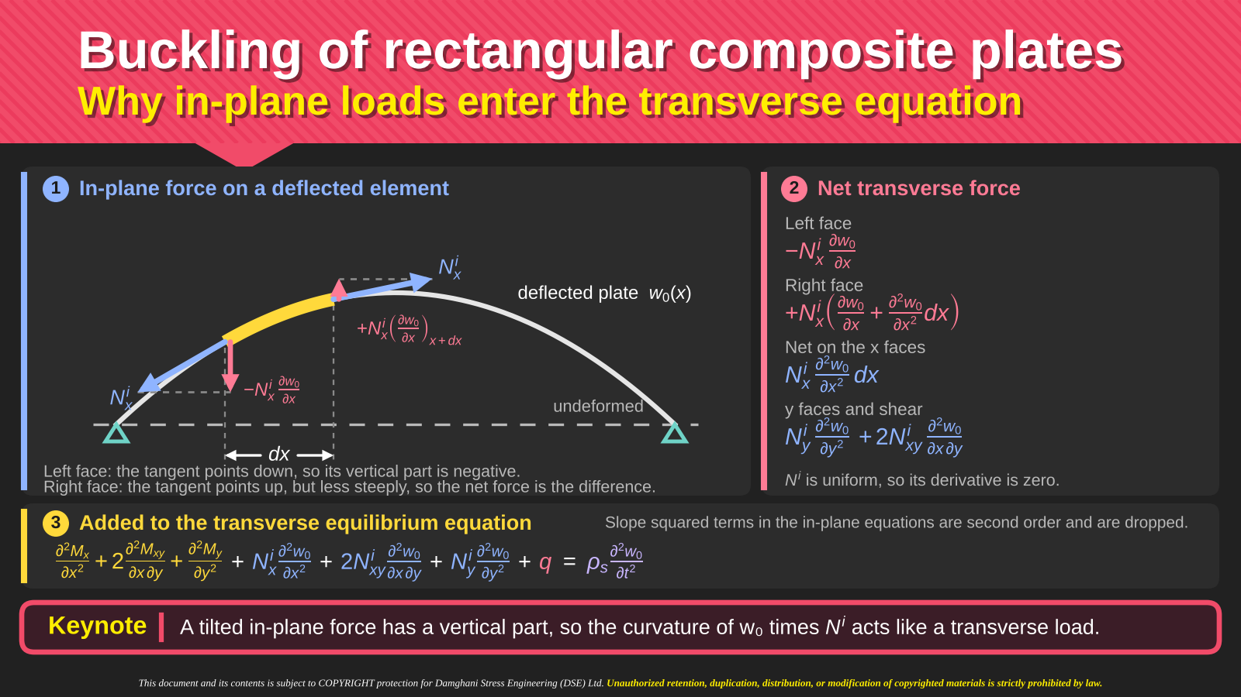
Notes:
Intro
The inclined-element sketch explains why an in-plane load contributes to an out-of-plane buckling equation.
Concept
An in-plane force acting along a deflected surface has a small transverse component proportional to the local slope. Differences in slope between adjacent sections create a net transverse force proportional to curvature.
Details
For the x-direction contribution, compare the vertical force components at the two ends of an element of length dx. With constant Nx0, their difference is Nx0(∂²w0/∂x²) dx to first order in the slopes. The y-direction contribution is Ny0(∂²w0/∂y²), and the two shear contributions combine to give 2Nxy0(∂²w0/∂x∂y). Uniform pre-buckling resultants allow this compact expression. With spatially varying resultants, the fuller differentiated force expression must be considered. The signs must match the tension-positive or compression-positive convention adopted for N.
Key Takeaway
The geometric-stiffness terms come from pre-existing membrane forces acting through the slope and curvature of the deflected plate.

Slide 26



Buckling of rectangular composite plates
Pre-buckling loads and the transverse buckling equation
1
Three balances have different roles
2
First: determine the pre-buckling loads
$$\frac{∂N_{x}}{∂x} + \frac{∂N_{xy}}{∂y} = 0$$
For an admissible flat base state, set the initial deflection to zero.
Use membrane equilibrium and boundary conditions to obtain N⁰.
x-direction membrane equilibrium
3
Preload contributes to transverse equilibrium
Preload × slope gives transverse force. Differentiate and add:
$$G(w_{0}) = \frac{∂}{∂x}({N_{x}}^{0}\frac{∂w_{0}}{∂x} + {N_{xy}}^{0}\frac{∂w_{0}}{∂y}) + \frac{∂}{∂y}({N_{xy}}^{0}\frac{∂w_{0}}{∂x} + {N_{y}}^{0}\frac{∂w_{0}}{∂y})$$
$$\frac{∂N_{xy}}{∂x} + \frac{∂N_{y}}{∂y} = 0$$
$$= N_{x}⁰\frac{∂²{w_{0}}_{}}{∂x²} + 2N_{xy}⁰\frac{∂²{w_{0}}_{}}{∂x∂y} + N_{y}⁰\frac{∂²{w_{0}}_{}}{∂y²}$$
y-direction membrane equilibrium
Moment balance from slides 15–18, with q = 0
4
Moment law from slide 19: use B = 0
$$\frac{∂²M_{x}}{∂x²} + 2\frac{∂²M_{xy}}{∂x∂y} + \frac{∂²M_{y}}{∂y²} = 0$$
M = Bε⁰ + Dκ. Curvature comes from derivatives of w₀.
For B = 0, the moment-derivative sum on the left is −L_{D}[w₀].
(static, no transverse pressure)
5
B = 0: add G(w₀) to the transverse balance
Add G(w₀) to this moment balance for buckling.
Uniform N⁰: tension positive, compression negative.
L_{D}[w₀] − G(w₀) = 0
L_{D}: bending-stiffness operator.
If B ≠ 0, retain the coupled problem.
This includes the preceding laminate.
Keynote
w₀ denotes mid-plane deflection, with initial value zero. Superscript 0 on N denotes the preload.
Notes:
Equation provenance and local derivation
Slides 15–18 derive transverse moment equilibrium by eliminating Qx and Qy. Slide 19 gives M = B epsilon0 + D kappa and the negative curvature convention. Slide 23 expands the bending operator. The G term is an additional geometric-stiffness step, absent from the earlier unloaded linear equations, rather than a direct rearrangement of them.
With a small mid-plane deflection w0, the existing membrane forces have transverse components. In the x direction these are Nx^0 times partial w0/partial x plus Nxy^0 times partial w0/partial y. In the y direction they are Nxy^0 times partial w0/partial x plus Ny^0 times partial w0/partial y. Taking their divergence gives the first expression for G on this slide. For spatially uniform preloads, differentiation gives the second expression. The two equal mixed derivatives give the factor 2. Thus div div M + G(w0) = 0 when q = 0. This is linearization about a preloaded state, not simply setting acceleration to zero.
Notation
Subscript 0 in w0 denotes the mid-plane, consistently with slides 16, 19 and 20. Here w0 is the small buckling displacement measured from the initially flat state. Its initial value is zero, but the nonzero perturbation at buckling is unknown. Superscript 0 in N identifies pre-buckling stress resultants, not a power. The two membrane balances, constitutive relations and boundary conditions determine that preload. Flat pre-buckling equilibrium must be admissible, which is not automatic for an unsymmetric laminate.
Constitutive substitution and sign
For B = 0, M = D kappa with kappa = (-w0,xx, -w0,yy, -2w0,xy). Hence div div M = -L_D[w0]. Substitution gives -L_D[w0] + G(w0) = 0, or equivalently L_D[w0] - G(w0) = 0. Tensile membrane resultants are positive, so compression is negative. For constant stiffness, L_D[w0] = D11 w0,xxxx + 4D16 w0,xxxy + 2(D12+2D66) w0,xxyy + 4D26 w0,xyyy + D22 w0,yyyy. A comma denotes spatial differentiation in these notes. The displayed slide uses explicit fractions instead.
Boundary conditions and coupling
The scalar buckling equation must satisfy the transverse boundary conditions and admit a nonzero w0. When B is nonzero, retain the coupled problem or justify an elimination. The preceding antisymmetric cross-ply laminate has nonzero B and does not automatically satisfy the decoupled assumptions.

Slide 27
Buckling of rectangular composite plates
General governing equation
1
Governing equation with in-plane pre-buckling loads
$$D_{11}\frac{∂^{4}w_{0}}{∂x^{4}} + 4D_{16}\frac{∂^{4}w_{0}}{∂x^{3}∂y} + 2(D_{12} + 2D_{66})\frac{∂^{4}w_{0}}{∂x^{2}∂y^{2}} + 4D_{26}\frac{∂^{4}w_{0}}{∂x∂y^{3}} + D_{22}\frac{∂^{4}w_{0}}{∂y^{4}}$$
$$−B_{11}\frac{∂^{3}u_{0}}{∂x^{3}} − 3B_{16}\frac{∂^{3}u_{0}}{∂x^{2}∂y} − (B_{12} + 2B_{66})\frac{∂^{3}u_{0}}{∂x∂y^{2}} − B_{26}\frac{∂^{3}u_{0}}{∂y^{3}}$$
$$−B_{16}\frac{∂^{3}v_{0}}{∂x^{3}} − (B_{12} + 2B_{66})\frac{∂^{3}v_{0}}{∂x^{2}∂y} − 3B_{26}\frac{∂^{3}v_{0}}{∂x∂y^{2}} − B_{22}\frac{∂^{3}v_{0}}{∂y^{3}} + ρ_{s}\frac{∂^{2}w_{0}}{∂t^{2}}$$
$$= N_{x}^{0}\frac{∂^{2}w_{0}}{∂x^{2}} + 2N_{xy}^{0}\frac{∂^{2}w_{0}}{∂x∂y} + N_{y}^{0}\frac{∂^{2}w_{0}}{∂y^{2}} + q$$
2
Loading of the plate
3
What each term is
4
Reading it
N_{xy}⁰
N_{y}⁰
D
bending stiffness
Superscript 0 marks the in-plane
resultants before buckling.
B
bending and stretching coupling
N_{x}⁰
plate
N_{x}⁰
ρₛ
mass per unit area
N⁰
in-plane loads before buckling
Tension is positive, so compressive
loads enter as negative values.
q
transverse load
N_{y}⁰
Keynote
One equation covers the cases. Each special case removes the terms that do not apply.
Notes:
Intro
The general displayed buckling equation combines bending resistance, extension–bending coupling and the effect of the pre-buckling membrane loads.
Concept
The D terms describe the laminate’s resistance to curvature. B terms retain coupling to in-plane displacement. The pre-buckling resultants multiply second derivatives of deflection and provide the geometric contribution to transverse equilibrium.
Details
The bending operator is D11(∂⁴w/∂x⁴) + 4D16(∂⁴w/∂x³∂y) + 2(D12 + 2D66)(∂⁴w/∂x²∂y²) + 4D26(∂⁴w/∂x∂y³) + D22(∂⁴w/∂y⁴). The superscript zero identifies the membrane state before buckling. Compression is negative under the slide’s stated sign convention. The displayed equation also contains mass and transverse-load terms, which must be removed for a static bifurcation problem without pressure. A homogeneous eigenvalue problem assumes a suitable reference equilibrium state. It predicts the onset and mode of buckling, not the full nonlinear post-buckling response or ultimate strength.
Key Takeaway
Special buckling equations follow by applying explicit assumptions to the general form. The retained terms identify the physical effects included in each example.

Slide 28
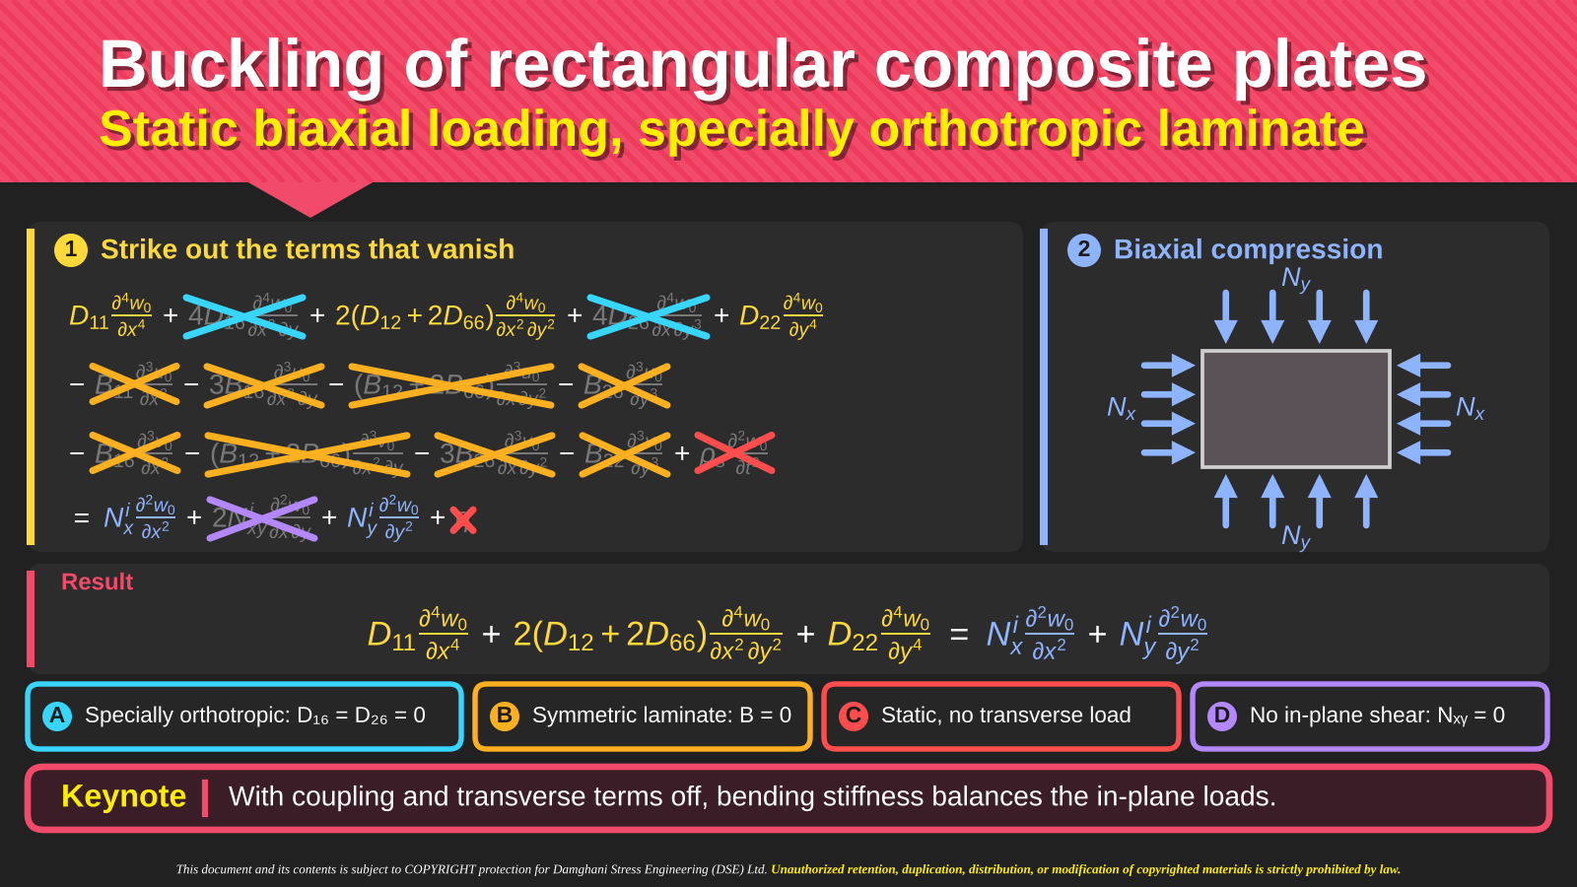
Notes:
Intro
The strike-through derivation specializes the buckling equation to a symmetric, specially orthotropic laminate under static biaxial compression.
Concept
Symmetry sets B = 0. Special orthotropy in the chosen plate axes sets D16 = D26 = 0. Static loading removes acceleration, while the specified load case removes transverse pressure and in-plane shear.
Details
The remaining equation is D11(∂⁴w/∂x⁴) + 2(D12 + 2D66)(∂⁴w/∂x²∂y²) + D22(∂⁴w/∂y⁴) = Nx0(∂²w/∂x²) + Ny0(∂²w/∂y²). Nx0 and Ny0 are negative for compression in this version of the equation. The mixed bending term remains because D12 and D66 still contribute to curvature and twisting resistance. A symmetric laminate alone does not guarantee D16 = D26 = 0, so the two stiffness assumptions must be checked separately. This reduced equation underpins the simply supported compression examples that follow.
Key Takeaway
Biaxial buckling of the stated laminate balances three bending-stiffness contributions against two compressive membrane-load contributions.

Slide 29
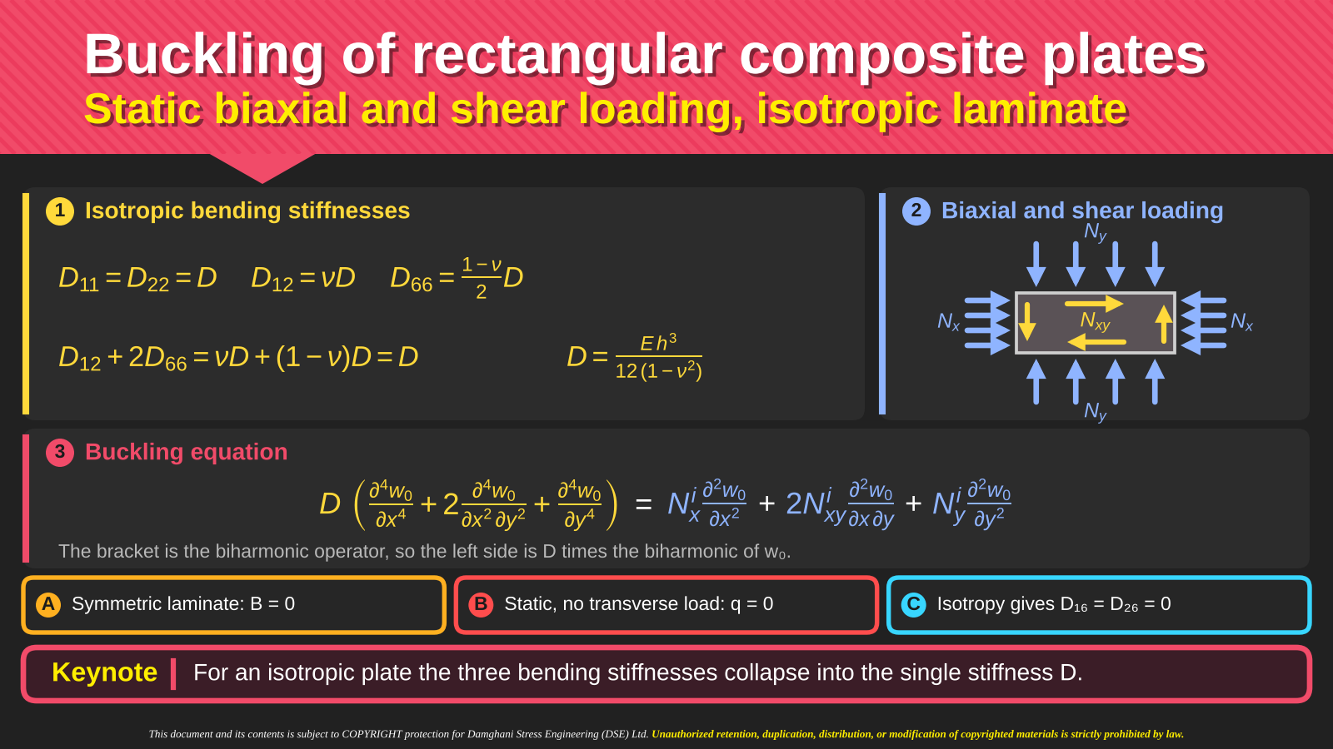
Notes:
Intro
The isotropic case reduces the orthotropic bending operator to one flexural rigidity while retaining biaxial and shear loading.
Concept
For isotropic bending, D11 = D22 = D, D12 = νD and D66 = (1 − ν)D/2. Therefore D12 + 2D66 = D and the bending operator becomes D times the biharmonic operator.
Details
The equation becomes D((∂⁴w/∂x⁴) + 2(∂⁴w/∂x²∂y²) + (∂⁴w/∂y⁴)) = Nx0(∂²w/∂x²) + 2Nxy0(∂²w/∂x∂y) + Ny0(∂²w/∂y²). For a homogeneous isotropic plate, D = Eh³/[12(1 − ν²)]. The displayed assumptions also include symmetry, static response and zero transverse load. For a laminate, an approximately isotropic membrane A matrix does not by itself prove isotropic bending. The D coefficients must satisfy the required identities before using this reduction. The expression retains the shear-load mixed derivative, which becomes important in the later Galerkin solution.
Key Takeaway
An isotropic bending law replaces several D coefficients with one rigidity D, but the loading terms still distinguish compression in each direction from in-plane shear.

Slide 30
Example 1
Critical buckling load of a simply supported plate
1
Problem statement
2
Plate and loading
1
Consider a rectangular plate simply
supported along its four edges, made
of an orthotropic laminate.
Nᵧ
2
The laminate is under biaxial
compressive loading.
Nₓ
b
Nₓ
a
3
Under the above conditions, find the
critical buckling load of the laminate.
Nᵧ
simply supported edges
Keynote
Start from the governing equation for a specially orthotropic laminate of the previous slides.
Notes:
Intro
Example 1 asks for the critical buckling load of a rectangular orthotropic laminate with all four edges simply supported under biaxial compression.
Concept
The critical load depends on the bending stiffnesses, plate dimensions and ratio of the two compressive loads. Simply supported edges constrain transverse displacement while allowing rotation and carrying no normal bending moment.
Details
Identify a as the dimension along x and b as the dimension along y. Nx and Ny are force resultants per unit width rather than total edge forces. The intended solution uses the symmetric, specially orthotropic equation developed immediately beforehand. Orthotropy alone would not remove B, so retain the stated stiffness assumptions when applying that equation. The calculation will introduce a double-sine mode satisfying the edge conditions, substitute it into equilibrium and minimize the resulting load over positive integer mode numbers.
Key Takeaway
The problem requires both an admissible buckling shape and a load relation. The lowest admissible modal load determines the first buckling instability.

Slide 31
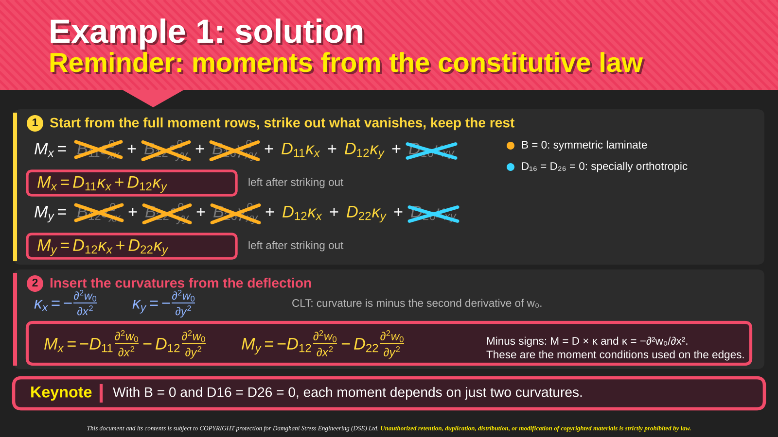
Notes:
Intro
The moment rows of the constitutive law provide the edge moments needed in Example 1. The strike-throughs show which terms vanish under the laminate assumptions.
Concept
When B = 0 and D16 = D26 = 0, Mx and My depend only on the two normal curvatures. The twisting moment still depends on the twisting curvature through D66.
Details
The remaining moment relations are Mx = D11κx + D12κy and My = D12κx + D22κy. Insert κx = −(∂²w/∂x²) and κy = −(∂²w/∂y²) to obtain Mx = −D11(∂²w/∂x²) − D12(∂²w/∂y²) and My = −D12(∂²w/∂x²) − D22(∂²w/∂y²). These expressions apply inside the plate and on its boundaries. At an edge normal to x, the simply supported moment condition is Mx = 0. At an edge normal to y, it is My = 0. Neither condition requires the corresponding slope to be zero.
Key Takeaway
The constitutive law supplies the boundary moments directly. Simply supported edges constrain deflection and normal bending moment, while leaving rotation free.

Slide 32
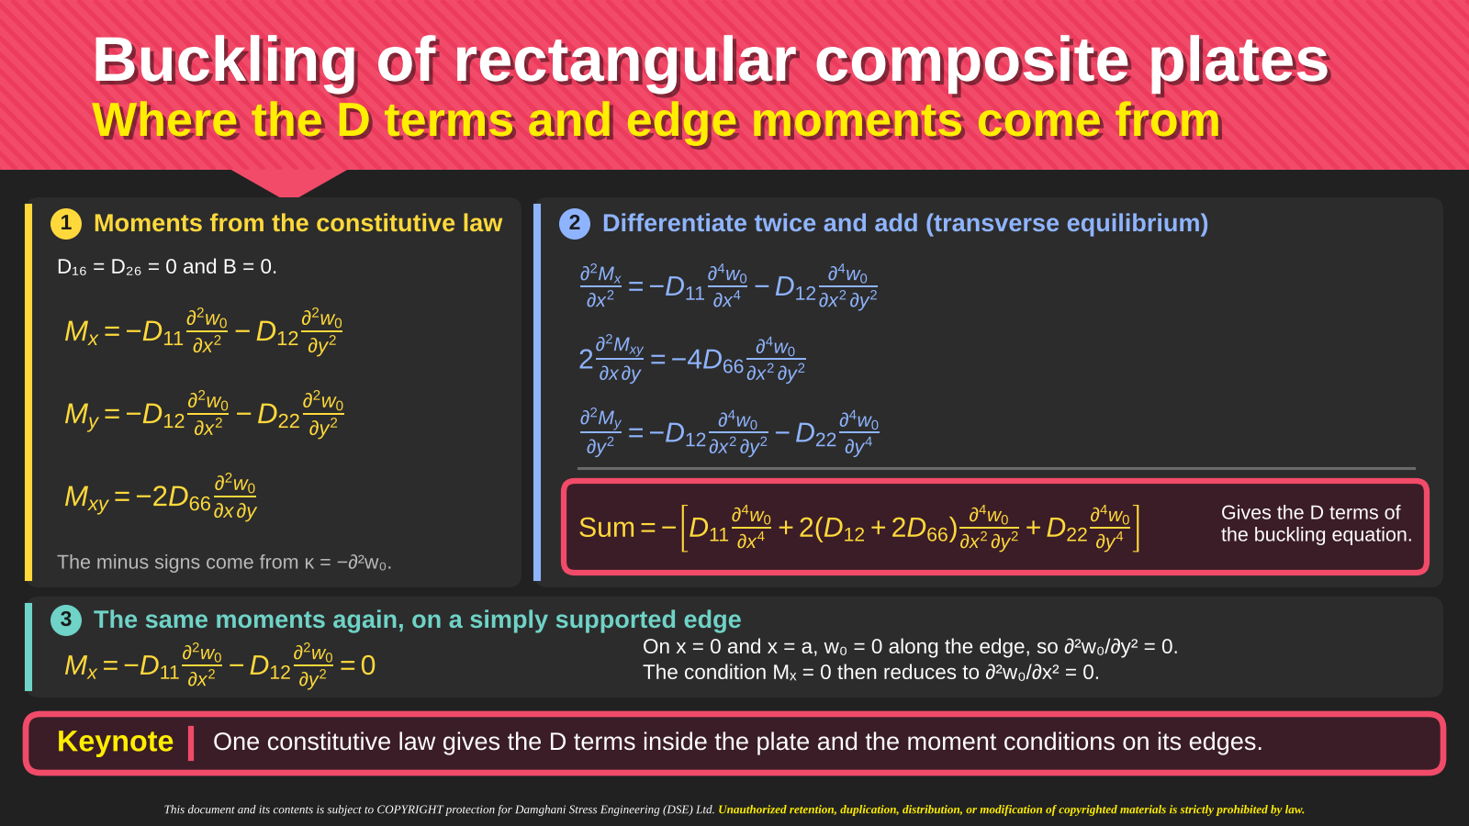
Notes:
Intro
This slide connects the D coefficients in the governing equation to the moments used in the boundary conditions.
Concept
The same moment–curvature law serves two roles. Its derivatives enter transverse equilibrium, and its edge values define bending-moment boundary conditions.
Details
For the stated laminate, Mx = −D11(∂²w/∂x²) − D12(∂²w/∂y²), My = −D12(∂²w/∂x²) − D22(∂²w/∂y²) and Mxy = −2D66(∂²w/∂x∂y). Differentiating and adding (∂²Mx/∂x²) + 2(∂²Mxy/∂x∂y) + (∂²My/∂y²) produces the negative of D11(∂⁴w/∂x⁴) + 2(D12 + 2D66)(∂⁴w/∂x²∂y²) + D22(∂⁴w/∂y⁴). The two D12 contributions and the twisting contribution explain the mixed coefficient. Along an x edge with w = 0 for every y, the tangential derivative (∂²w/∂y²) is zero. The Mx condition then reduces to the remaining normal-curvature requirement. The corresponding argument applies at a y edge.
Key Takeaway
The plate equation and the simply supported moment conditions come from the same constitutive expressions, with no separate boundary stiffness model.

Slide 33
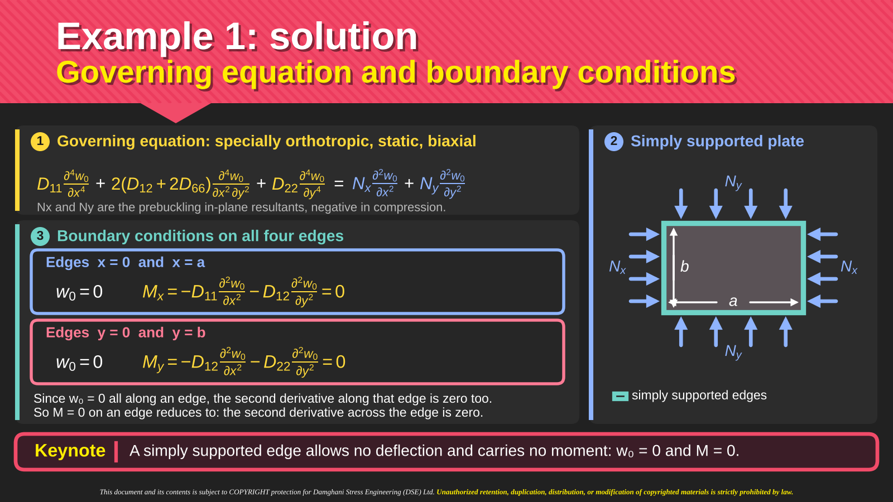
Notes:
Intro
The solution now states the governing equation alongside all four simply supported boundary conditions.
Concept
A fourth-order plate equation requires two transverse conditions on each edge. For a simple support, these are zero deflection and zero normal bending moment.
Details
At x = 0 and x = a, impose w = 0 and Mx = −D11(∂²w/∂x²) − D12(∂²w/∂y²) = 0. At y = 0 and y = b, impose w = 0 and My = −D12(∂²w/∂x²) − D22(∂²w/∂y²) = 0. Because deflection is identically zero along a supported edge, its tangential second derivative also vanishes there. The conditions therefore simplify for the sine-based solution. The slopes need not vanish, which distinguishes these supports from clamped edges. Retain the sign convention that the initial compressive Nx0 and Ny0 are negative in the displayed equilibrium equation.
Key Takeaway
A valid trial function must satisfy both the displacement and moment requirements of the simple supports, not merely be zero at the four corners.

Slide 34
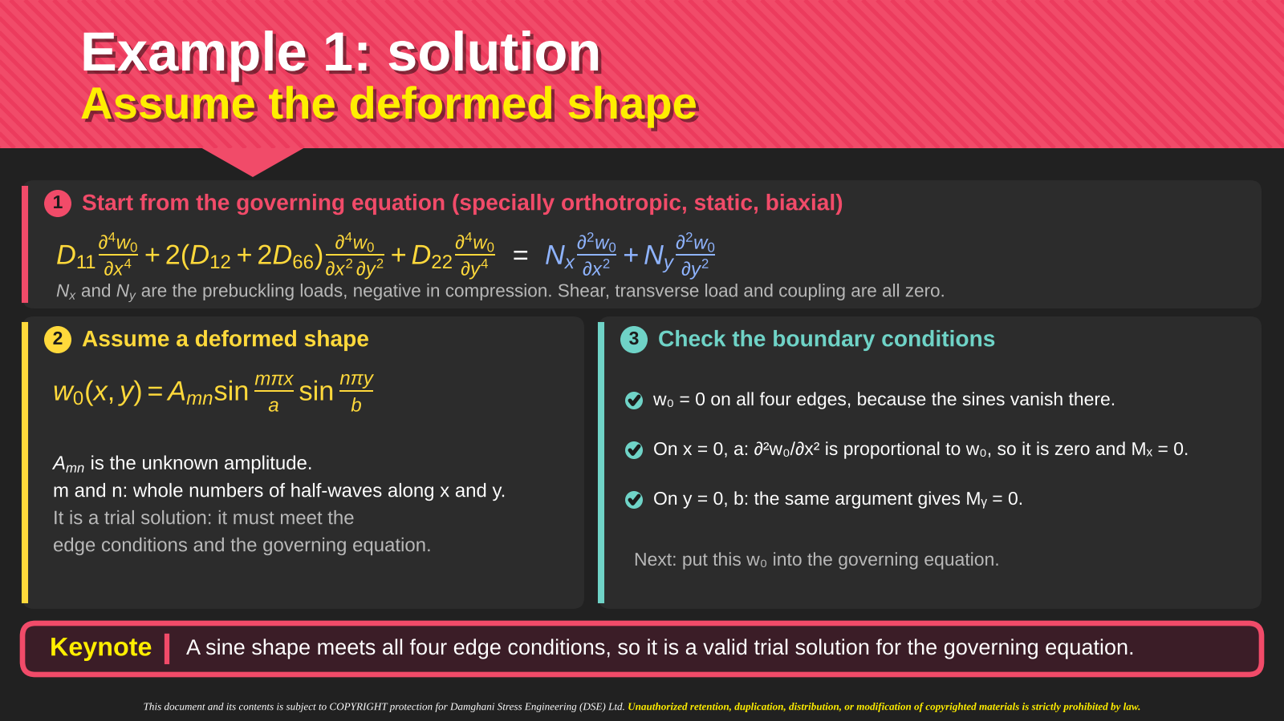
Notes:
Intro
The double-sine function supplies an admissible buckling shape for the simply supported rectangular plate.
Concept
Use w(x,y) = Amn sin(mπx/a)sin(nπy/b), where m and n are positive integers. These integers count half-waves along x and y. Amn is the modal amplitude.
Details
The sine factors make w zero on all four edges. Second derivatives in x or y are proportional to the same function, so the appropriate edge moments vanish as well for the stated specially orthotropic laminate. This confirms admissibility before substituting into equilibrium. The amplitude remains unknown at this stage. In a linear bifurcation calculation, the eigenproblem determines the critical load and relative shape, not a finite post-buckling amplitude. More than one pair of integers must be considered because the geometry and loading can favor a higher longitudinal mode.
Key Takeaway
The double-sine form satisfies the edge conditions and turns the differential buckling equation into a modal algebraic relation.

Slide 35
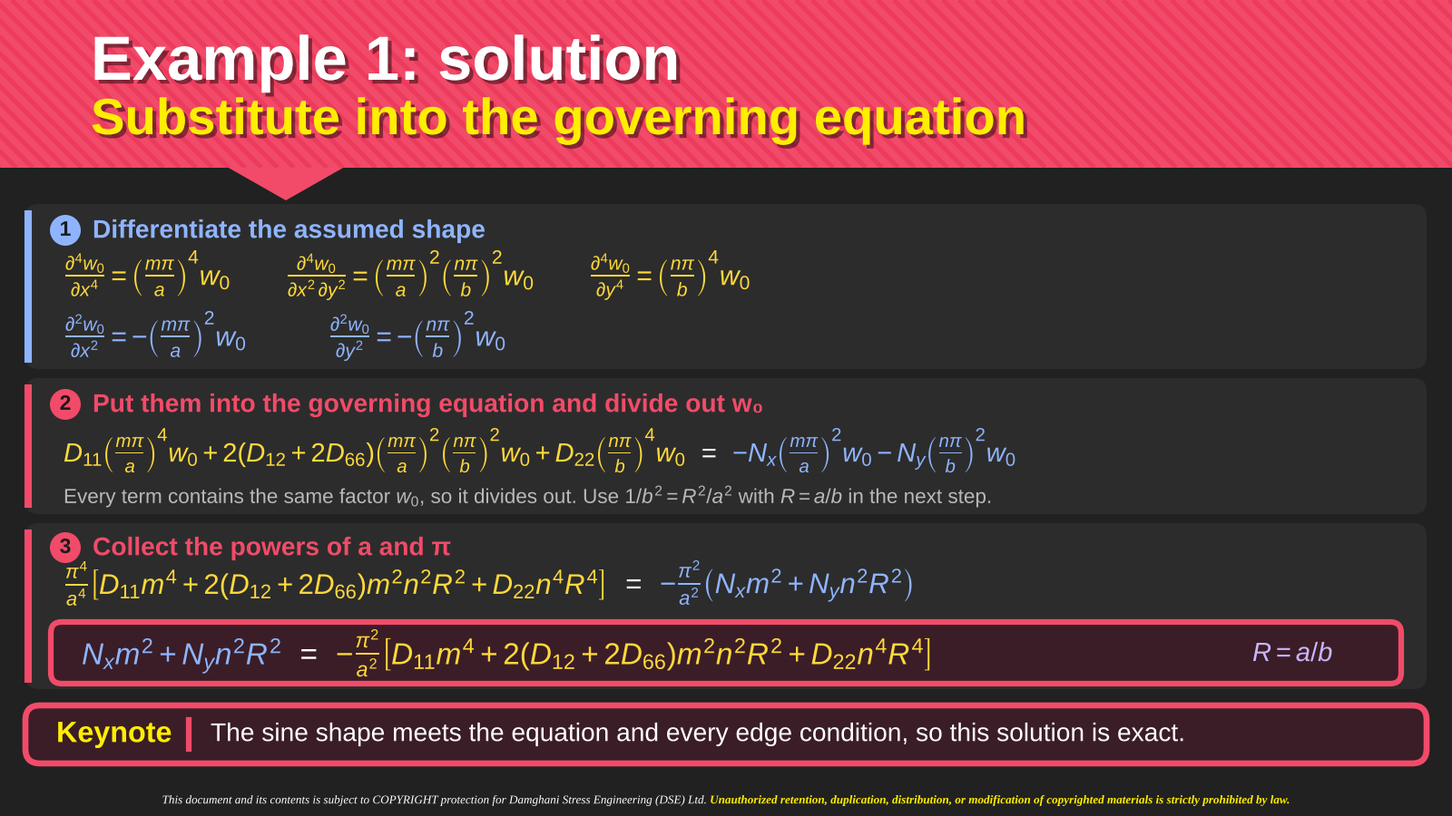
Notes:
Intro
Differentiating the assumed sine shape converts the governing equation into an algebraic condition for each pair of mode numbers.
Concept
Even derivatives preserve the sine pattern. Second derivatives introduce negative squared wave numbers, while fourth derivatives introduce positive fourth powers.
Details
Define αm = mπ/a and βn = nπ/b. Then (∂²w/∂x²) = −αm²w, (∂²w/∂y²) = −βn²w, (∂⁴w/∂x⁴) = αm⁴w, (∂⁴w/∂y⁴) = βn⁴w and (∂⁴w/∂x²∂y²) = αm²βn²w. Substitution gives D11αm⁴ + 2(D12 + 2D66)αm²βn² + D22βn⁴ = −Nx0αm² − Ny0βn² for a nonzero mode. Factoring out w represents equality of the common spatial mode, so division is not a pointwise operation at its nodal lines. Introducing R = a/b gives the aspect-ratio form shown at the bottom of the slide.
Key Takeaway
The sine function reduces every derivative to a known wave-number multiplier. A nonzero amplitude exists only when the resulting stiffness–load relation holds.

Slide 36
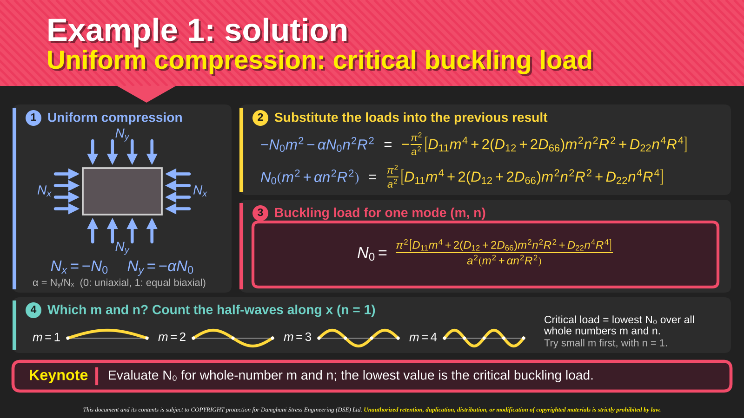
Notes:
Intro
The biaxial loads are written in terms of a positive reference compression N0 and a prescribed load ratio α.
Concept
With the slide’s tension-positive convention, Nx0 = −N0 and Ny0 = −αN0. Thus α = 0 represents uniaxial x compression, and α = 1 represents equal biaxial compression.
Details
For R = a/b, the modal reference load is N0 = (π²/a²)[D11m⁴ + 2(D12 + 2D66)m²n²R² + D22n⁴R⁴]/(m² + αn²R²). The numerator measures resistance to the selected curvature pattern, while the denominator measures how the two applied loads act on that pattern. The sketches illustrate different longitudinal half-wave counts for n = 1. Evaluate N0 for admissible positive integer m and n and select the smallest positive value. A mode number is a count of half-waves, not a material property.
Key Takeaway
The critical reference compression is the minimum modal value. Changing the load ratio can change both the critical load and the governing mode.

Slide 37
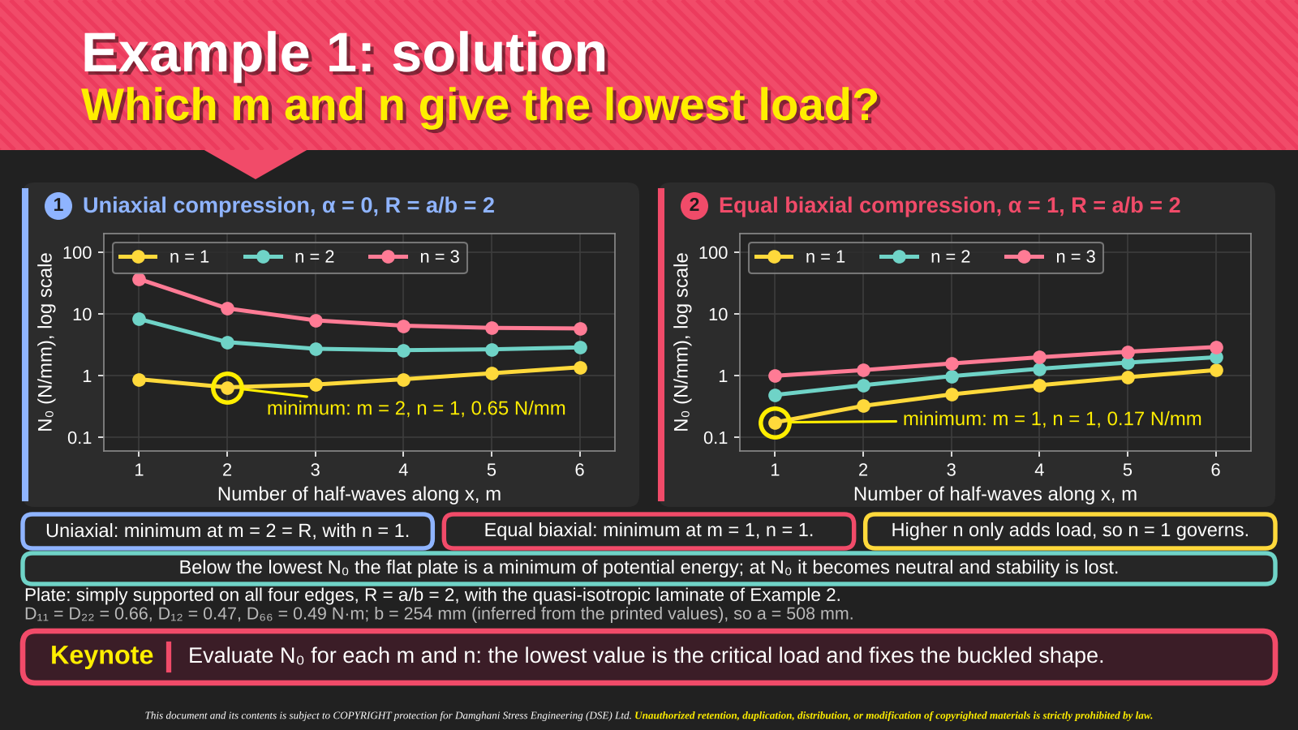
Notes:
Intro
The charts illustrate how a search over integer mode numbers selects the first buckling mode at aspect ratio R = 2.
Concept
Each plotted value is a candidate bifurcation load for a particular wave pattern. The plate first loses stability at the lowest candidate, not necessarily at m = n = 1.
Details
For the displayed uniaxial case α = 0, the highlighted minimum occurs at m = 2 and n = 1. For equal biaxial compression α = 1, the highlighted minimum occurs at m = 1 and n = 1. The curves for higher transverse wave counts lie higher for these inputs. Compare the two charts using the stated common geometry and laminate data. Their purpose is to show the discrete minimization, rather than to imply that the same mode always governs for every laminate or aspect ratio. Below the first critical load, the flat configuration retains stability within the linear model.
Key Takeaway
The governing mode follows from comparing admissible eigenvalues. Biaxial compression can favor a different wave pattern from uniaxial compression.

Slide 38
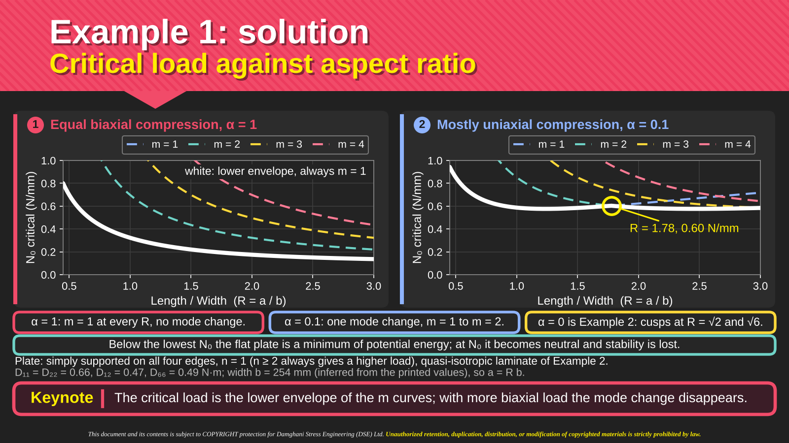
Notes:
Intro
The two plots track the modal loads as the plate aspect ratio changes for two different biaxial load ratios.
Concept
The critical-load curve is the lower envelope of all the individual modal curves. Intersections can cause a change in the mode that controls the minimum.
Details
The equal-biaxial example on the left shows the displayed governing branch without a mode change over the plotted range. The mostly uniaxial case on the right shows a transition between longitudinal mode branches. Follow the lowest curve at each R rather than following a single chosen m across the whole graph. A cusp in the lower envelope indicates equal loads for competing modes, not necessarily a physical discontinuity in displacement during a real imperfect test. The transverse mode count is fixed as stated for these comparisons, and the laminate properties are those identified beneath the charts.
Key Takeaway
Aspect-ratio trends depend on mode selection. The minimum of several smooth modal curves can form a critical-load envelope with cusps.

Slide 39




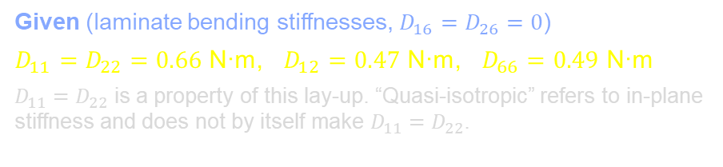



Example 2
Uniaxial compression of the same plate
1
Problem statement
2
Plate and loading
1
Load the plate of Example 1 in uniaxial compression only: $N_{x}=−N_{0}$, $N_{y}=0$, so $α=0$.
2
Hold the width at $b=254$ mm and let the length $a$ change, so $R=a/b$ varies.
3
Find the critical load $N_{0}$ against $R$, and the buckling mode $m$ that governs.
$$N_{x}$$
$$b$$
$$N_{x}$$
$$a$$
Given (laminate bending stiffnesses, $D_{16}=D_{26}=0$)
$D_{11}=D_{22}=0.66$ N·m, $D_{12}=0.47$ N·m, $D_{66}=0.49$ N·m
$D_{11}=D_{22}$ is a property of this lay-up. “Quasi-isotropic” refers to in-plane stiffness and does not by itself make $D_{11}=D_{22}$.
$b=254$ mm fixed; $a=R·b$ varies
simply supported edges
Keynote
Uniaxial compression is Example 1 with $α=0$. The load then depends only on the aspect ratio $R$ and the mode number $m$.
Notes:
Intro
Example 1 asks for the critical buckling load of a rectangular orthotropic laminate with all four edges simply supported under biaxial compression.
Concept
The critical load depends on the bending stiffnesses, plate dimensions and ratio of the two compressive loads. Simply supported edges constrain transverse displacement while allowing rotation and carrying no normal bending moment.
Details
Identify a as the dimension along x and b as the dimension along y. Nx and Ny are force resultants per unit width rather than total edge forces. The intended solution uses the symmetric, specially orthotropic equation developed immediately beforehand. Orthotropy alone would not remove B, so retain the stated stiffness assumptions when applying that equation. The calculation will introduce a double-sine mode satisfying the edge conditions, substitute it into equilibrium and minimize the resulting load over positive integer mode numbers.
Key Takeaway
The problem requires both an admissible buckling shape and a load relation. The lowest admissible modal load determines the first buckling instability.

Slide 40
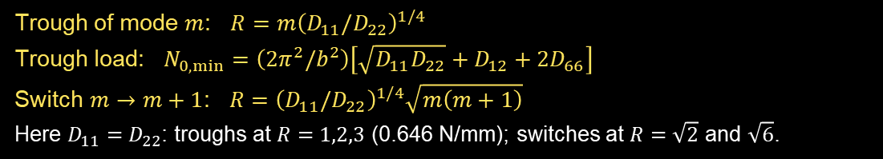
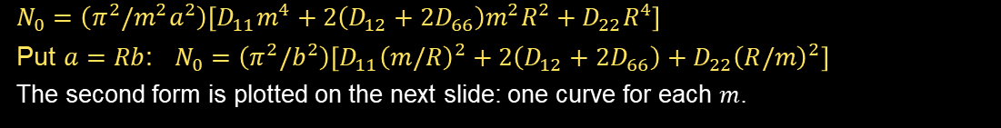
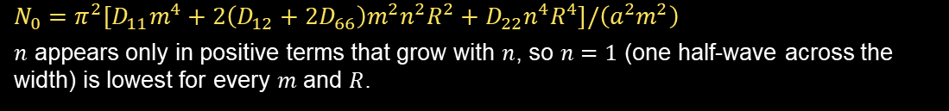


Example 2: solution
Buckling load for each mode $m$
1
Set $α=0$ in Example 1, then $n=1$
4
$m$ is a whole number; $R$ is not
$$N_{0}=π^{2}\left[D_{11}m^{4}+2\left(D_{12}+2D_{66}\right)m^{2}n^{2}R^{2}+D_{22}n^{4}R^{4}\right]/\left(a^{2}m^{2}\right)$$
$n$ appears only in positive terms that grow with $n$, so $n=1$ (one half-wave across the width) is lowest for every $m$ and $R$.
$m$ counts half-waves along $x$. The ends need $w=0$ at $x=0$ and $x=a$, so $w∝sin\left(mπx/a\right)$ with whole $m$.
$R=a/b$ is geometry. It takes any positive value.
Every mode curve exists at every $R$. The critical load is the lowest curve at that $R$.
For $R<1$ the plate still buckles in $m=1$: one half-wave, shorter than the width, so the load is higher.
The envelope minimum is always a mode trough. If $D_{22}>D_{11}$, the $m=1$ trough moves to $R<1$, and it is still $m=1$.
Treating $m$ as continuous gives only the lower bound $N_{0,min}$, reached when $R=m{\left(D_{11}/D_{22}\right)}^{1/4}$.
2
Load for mode $m$ with the width $b$ fixed
$$N_{0}=\left(π^{2}/m^{2}a^{2}\right)\left[D_{11}m^{4}+2\left(D_{12}+2D_{66}\right)m^{2}R^{2}+D_{22}R^{4}\right]$$
Put $a=Rb$: $N_{0}=\left(π^{2}/b^{2}\right)\left[D_{11}{\left(m/R\right)}^{2}+2\left(D_{12}+2D_{66}\right)+D_{22}{\left(R/m\right)}^{2}\right]$
The second form is plotted on the next slide: one curve for each $m$.
3
Trough and switch of each mode
Trough of mode $m$: $R=m{\left(D_{11}/D_{22}\right)}^{1/4}$
Trough load: $N_{0,min}=\left(2π^{2}/b^{2}\right)\left[\sqrt{D_{11}D_{22}}+D_{12}+2D_{66}\right]$
Switch $m→m+1$: $R={\left(D_{11}/D_{22}\right)}^{1/4}\sqrt{m\left(m+1\right)}$
Here $D_{11}=D_{22}$: troughs at $R=1,2,3$ (0.646 N/mm); switches at $R=\sqrt{2}$ and $\sqrt{6}$.
Keynote
Each mode $m$ has its own load curve. At any $R$ the critical load is the lowest of them, and $m$ is always a whole number.
Notes:
Intro
Example 1 asks for the critical buckling load of a rectangular orthotropic laminate with all four edges simply supported under biaxial compression.
Concept
The critical load depends on the bending stiffnesses, plate dimensions and ratio of the two compressive loads. Simply supported edges constrain transverse displacement while allowing rotation and carrying no normal bending moment.
Details
Identify a as the dimension along x and b as the dimension along y. Nx and Ny are force resultants per unit width rather than total edge forces. The intended solution uses the symmetric, specially orthotropic equation developed immediately beforehand. Orthotropy alone would not remove B, so retain the stated stiffness assumptions when applying that equation. The calculation will introduce a double-sine mode satisfying the edge conditions, substitute it into equilibrium and minimize the resulting load over positive integer mode numbers.
Key Takeaway
The problem requires both an admissible buckling shape and a load relation. The lowest admissible modal load determines the first buckling instability.

Slide 41



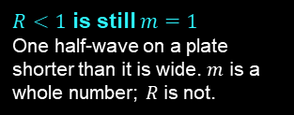





















Example 2: solution
Critical load against aspect ratio
1
Each dashed curve is one mode $m$
2
Mode curves for width $b=254$ mm
$$N_{0}=\frac{π^{2}}{m^{2}a^{2}}\left[D_{11}m^{4}+2\left(D_{12}+2D_{66}\right)m^{2}R^{2}+D_{22}R^{4}\right]$$
$R=1$, $m=1$
$R=2$, $m=2$
$R=3$, $m=3$
$m$ = number of half-waves along $x$, so it is a whole number.
Every curve is defined at every $R$.
$R=a/b$; $D_{11}=D_{22}=0.66$ N·m, $D_{12}=0.47$ N·m, $D_{66}=0.49$ N·m
1.0
$$m=2$$
$$m=3$$
$$m=1$$
2
Trough: best $R$ for one mode
0.8
$$R=m$$
At $R=m$ each half-wave is a square cell ($a/m=b$), because $D_{11}=D_{22}$.
Every trough here is 0.646 N/mm.
The lowest load that mode can reach.
0.6
$R=\sqrt{2}$, 0.70
cusp: $m=1→2$
$R=\sqrt{6}$, 0.66
cusp: $m=2→3$
$N_{0}$ critical (N/mm)
$R=2$, $m=2$
0.4
$m=1$ trough
$m=2$ trough
$m=3$ trough
$R<1$ is still $m=1$
One half-wave on a plate shorter than it is wide. $m$ is a whole number; $R$ is not.
critical load = lower envelope
At every $R$ it is the lowest $m$-curve, so its minimum is always a mode trough.
$$m=1$$
Cusp: the governing mode switches
$$m=2$$
3
0.2
$$m=3$$
critical envelope
=
Neighbours cross at $R=\sqrt{m\left(m+1\right)}$.
The mode switches from $m$ to $m+1$.
Imperfections round off real cusps.
$m=1$ governs
$m=2$ governs
$m=3$ governs
0.0
0.5
1.0
1.5
2.0
2.5
3.0
$$m=1$$
$$m=2$$
Length / Width ($R=a/b$)
Keynote
The critical load at each $R$ is the lowest mode curve. A trough is the best $R$ for one mode; a cusp is where the governing mode switches from $m$ to $m+1$.

Slide 42
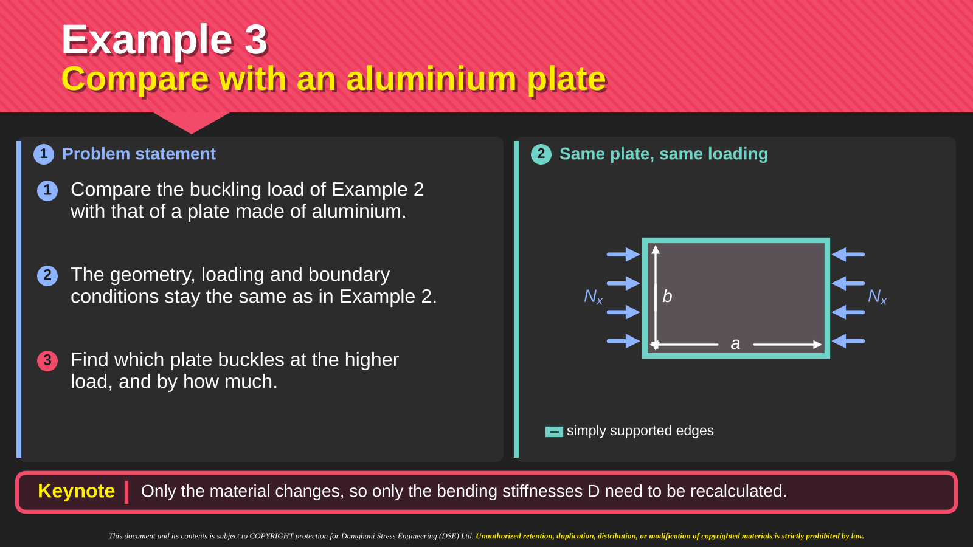
Notes:
Intro
Example 3 compares the composite result with an aluminium plate while keeping geometry, thickness, supports and loading unchanged.
Concept
With the structural configuration fixed, differences in predicted critical load follow from differences in the bending stiffness coefficients. A comparison of Young’s modulus or D11 alone is insufficient.
Details
For aluminium, use isotropic bending identities D11 = D22 = D and D12 + 2D66 = D. Calculate D from the stated elastic modulus, Poisson’s ratio and thickness. For the composite, retain its separate D coefficients from Example 2. Apply the same uniaxial buckling expression and the same mode-selection rule to both. The following slide compares their optimized long-plate minima. That comparison concerns equal dimensions and thickness, not equal mass or a complete assessment of structural efficiency.
Key Takeaway
A fair comparison holds the geometric and loading assumptions constant and changes the full bending-stiffness combination governing the buckling mode.

Slide 43
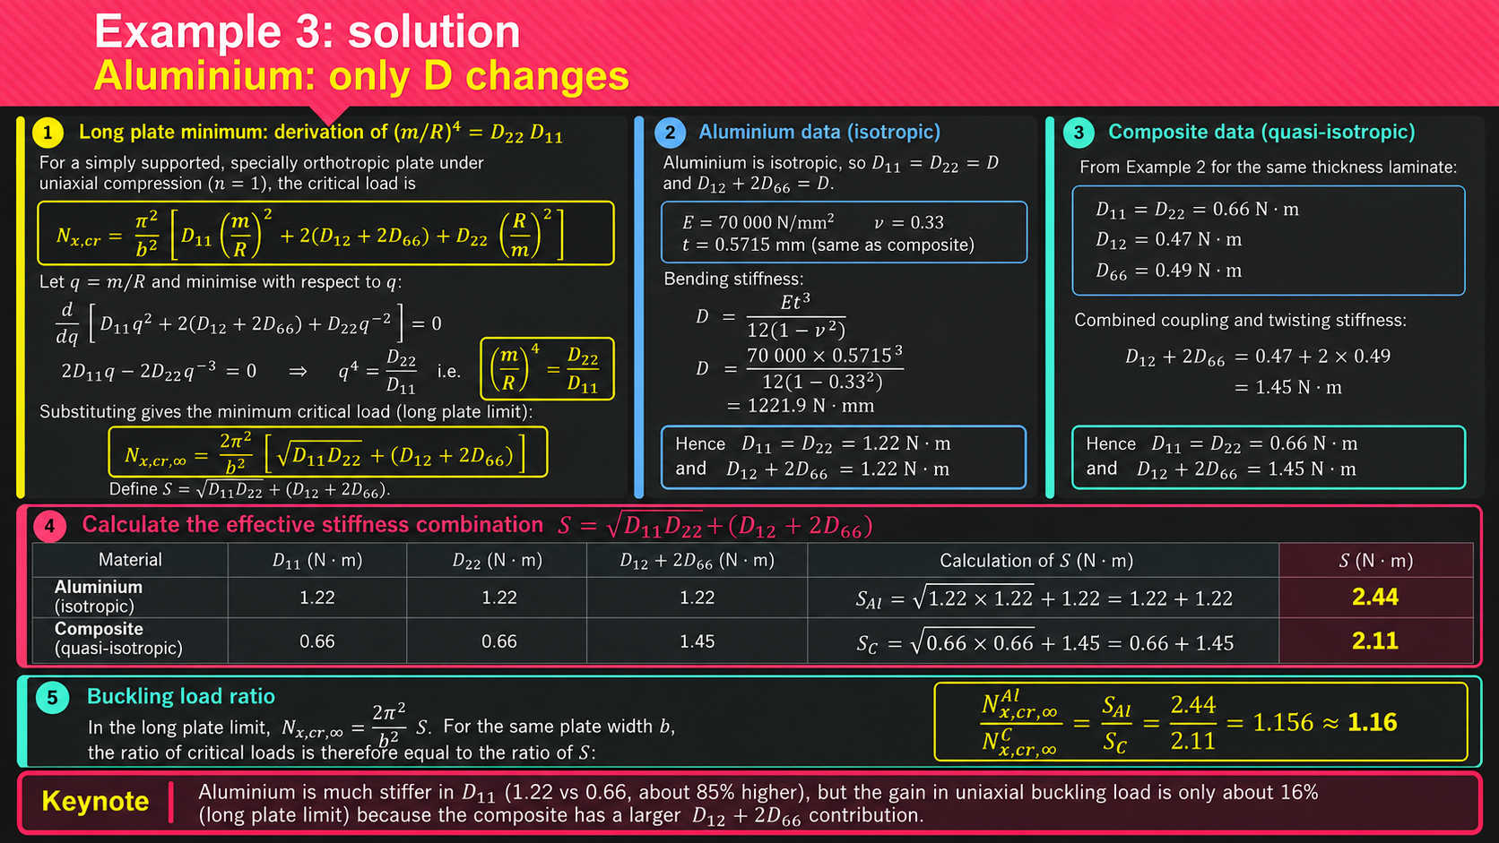
Notes:
Intro
This example compares the critical buckling load of an aluminium plate with that of the quasi-isotropic composite plate from Example 2. Both plates have identical geometry, thickness, boundary conditions and uniaxial compressive loading. Only their bending stiffness properties differ.
The objective is to establish whether the higher longitudinal bending stiffness of aluminium produces a proportionally higher critical buckling load.
Concept
For a simply supported, specially orthotropic rectangular plate under uniaxial compression, the critical buckling load per unit width is Nₓ,cr = (π²/b²)[D₁₁(m/R)² + 2(D₁₂ + 2D₆₆) + D₂₂(R/m)²], where R = a/b, a is the plate length, b is the plate width and m is the number of longitudinal buckling half-waves. The transverse mode number is n = 1.
For a sufficiently long plate, the buckling wavelength can be treated as continuously variable. Minimising the critical load with respect to m/R gives (m/R)⁴ = D₂₂/D₁₁.
Substituting this condition into the governing equation gives Nₓ,cr,∞ = (2π²/b²)[√(D₁₁D₂₂) + D₁₂ + 2D₆₆].
We define S = √(D₁₁D₂₂) + D₁₂ + 2D₆₆ as the effective bending stiffness combination governing the minimum uniaxial buckling load in the long plate limit. S has units of N·m.
Details
3. Aluminium bending stiffness
For an isotropic aluminium plate, D₁₁ = D₂₂ = D and D₁₂ + 2D₆₆ = D. The bending stiffness is D = Et³/[12(1 − ν²)].
Using E = 70,000 N/mm², ν = 0.33 and t = 0.5715 mm gives D = 70,000 × 0.5715³/[12(1 − 0.33²)] = 1221.9 N·mm = 1.22 N·m.
The effective stiffness combination for aluminium is therefore S_Al = √(1.22 × 1.22) + 1.22 = 1.22 + 1.22 = 2.44 N·m.
4. Composite bending stiffness
For the quasi-isotropic composite laminate from Example 2, the bending stiffness coefficients used in this comparison are D₁₁ = D₂₂ = 0.66 N·m, D₁₂ = 0.47 N·m and D₆₆ = 0.49 N·m.
The combined coupling and twisting stiffness contribution is D₁₂ + 2D₆₆ = 0.47 + 2(0.49) = 1.45 N·m.
Therefore, the effective stiffness combination for the composite is S_C = √(0.66 × 0.66) + 1.45 = 0.66 + 1.45 = 2.11 N·m.
The composite has a lower D₁₁ than aluminium but a larger D₁₂ + 2D₆₆ contribution. Consequently, comparing D₁₁ alone would give a misleading indication of their relative buckling resistance.
5. Calculation of the buckling load ratio
Since Nₓ,cr,∞ = (2π²/b²)S, and both plates have the same width b, the common geometric factor cancels when the critical loads are divided.
Therefore, Nₓ,cr,∞(Al)/Nₓ,cr,∞(Composite) = S_Al/S_C = 2.44/2.11 = 1.156 ≈ 1.16.
The percentage difference is (1.156 − 1) × 100 = 15.6%, approximately 16%.
Thus, the aluminium plate has approximately 16% higher predicted minimum uniaxial buckling load than the composite plate, despite having approximately 85% greater D₁₁ bending stiffness, calculated as (1.22/0.66 − 1) × 100.
6. Physical interpretation
The critical buckling load is governed by a combination of longitudinal bending stiffness D₁₁, transverse bending stiffness D₂₂, coupling stiffness D₁₂ and twisting stiffness D₆₆.
Although aluminium is considerably stiffer in longitudinal bending, the composite benefits from its larger D₁₂ + 2D₆₆ contribution. This reduces the difference in their overall buckling resistance.
The comparison demonstrates why individual bending stiffness coefficients should not be used in isolation when assessing composite plate buckling.
7. Important limitation
The expression Nₓ,cr,∞ = (2π²/b²)S represents the minimum critical load in the long plate limit, where the longitudinal buckling wavelength can be optimised continuously.
For a finite rectangular plate, the longitudinal mode number m must be a positive integer. The actual critical load must therefore be obtained by evaluating the admissible integer modes and selecting the lowest positive buckling load.
For the particular stiffness values used here, D₁₁ = D₂₂ for both materials, so the continuous optimum occurs at m/R = 1. The long plate minimum is therefore attained at the troughs R = m shown in the preceding examples.
Key Takeaway
Aluminium has approximately 85% higher longitudinal bending stiffness than the composite, but only approximately 16% higher minimum uniaxial buckling load. The difference arises because composite buckling resistance depends on the combined bending stiffness coefficients, not D₁₁ alone.

Slide 44
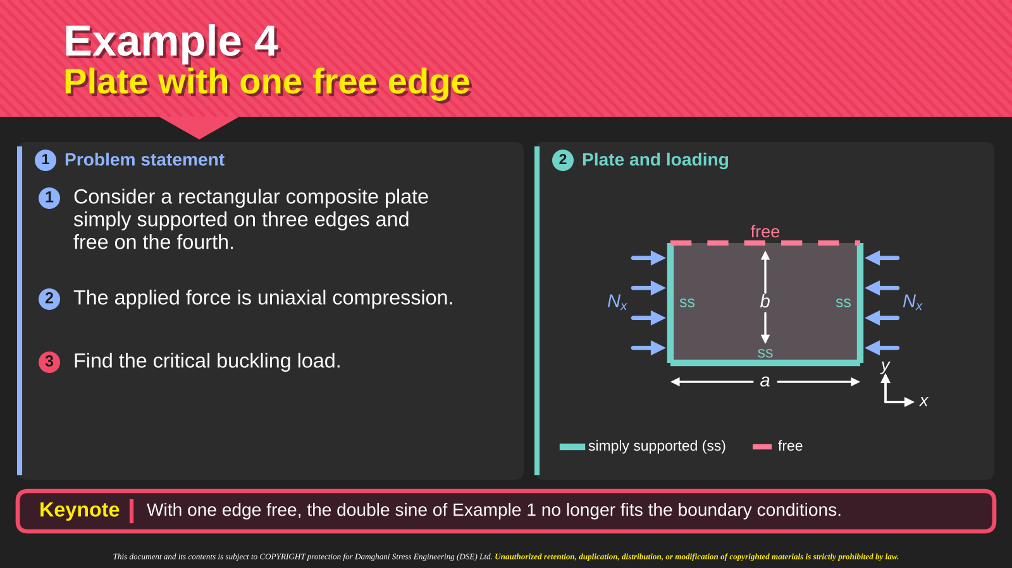
Notes:
Intro
Example 4 replaces one unloaded simply supported edge with a free edge. The plate remains under uniaxial compression.
Concept
A free edge can deflect and rotate. It must satisfy zero normal bending moment and zero effective transverse shear, rather than zero transverse displacement.
Details
The drawing identifies simple supports on three edges and the free edge at y = b. The loaded x edges remain simply supported. A double sine with an integer transverse wave number would force w = 0 on the free edge and therefore impose a restraint that the problem does not have. The solution introduces an adjustable transverse shape and uses an energy approximation. The trial shape must satisfy the essential displacement conditions on the supported edges, while the free-edge natural conditions provide a test of how well the approximation represents the true mode.
Key Takeaway
Changing one boundary condition changes the admissible shape space. The previous four-edge sine solution cannot be reused unchanged.

Slide 45
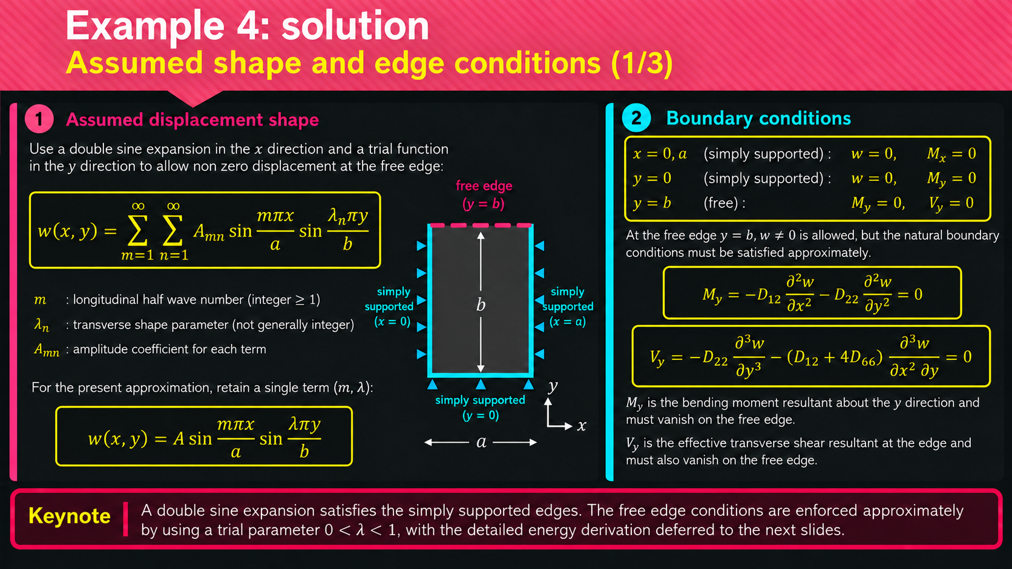
Notes:
Intro
The trial shape for the three-supported-edge plate keeps a sine factor along the loaded direction and introduces a variable transverse parameter λ.
Concept
The single-term form is w = A sin(mπx/a)sin(λπy/b). Integer m satisfies the two loaded supports, while the transverse factor vanishes at y = 0 without necessarily vanishing at the free edge y = b.
Details
The simple supports require w = 0 and the associated normal bending moment to vanish. The free edge requires My = −D12(∂²w/∂x²) − D22(∂²w/∂y²) = 0 and effective shear Vy = −D22(∂³w/∂y³) − (D12 + 4D66)(∂³w/∂x²∂y) = 0. The effective shear includes the twisting-moment derivative, so it differs from Qy alone. A single sine product generally cannot meet both free-edge natural conditions exactly. λ adjusts the shape but does not guarantee an exact solution. The energy method can still use an admissible displacement shape to produce an approximation.
Key Takeaway
The adjustable transverse function permits free-edge deflection. Its ability to satisfy the natural edge conditions determines the quality of the approximation.

Slide 46
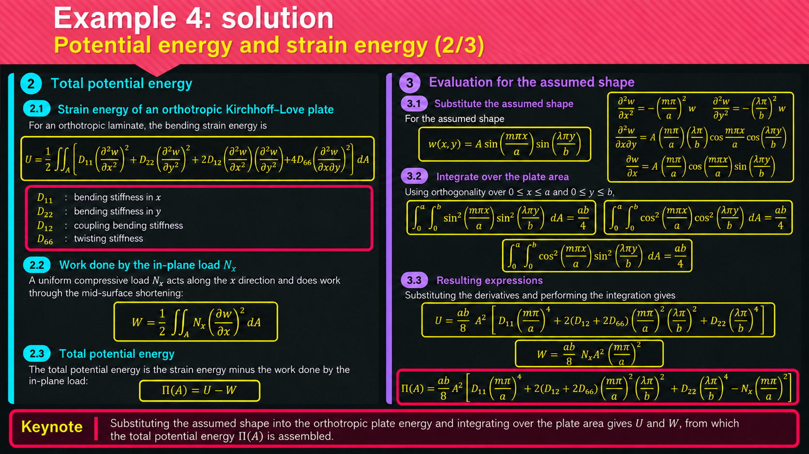
Notes:
Intro
The energy calculation evaluates bending strain energy and the work of the compressive load for the assumed free-edge shape.
Concept
The total potential is Π = U − W. U is quadratic in the curvatures, while W contains the compressive load multiplied by the square of the longitudinal slope.
Details
For the stated specially orthotropic laminate, U = ½∬[D11(∂²w/∂x²)² + 2D12(∂²w/∂x²)(∂²w/∂y²) + D22(∂²w/∂y²)² + 4D66(∂²w/∂x∂y)²]dA. For positive compression N0, W = ½N0∬(∂w/∂x)²dA. Substitute the sine product before integrating over 0 ≤ x ≤ a and 0 ≤ y ≤ b. The slide evaluates the sine-squared and cosine-squared transverse integrals, which differ when λ is not an integer. Keep those factors distinct because the twisting contribution uses cosine terms. The result has an overall A² factor and depends on m, λ, geometry and stiffness.
Key Takeaway
Evaluating the energy of one admissible shape replaces the differential problem with an algebraic expression in its amplitude and shape parameters.

Slide 47
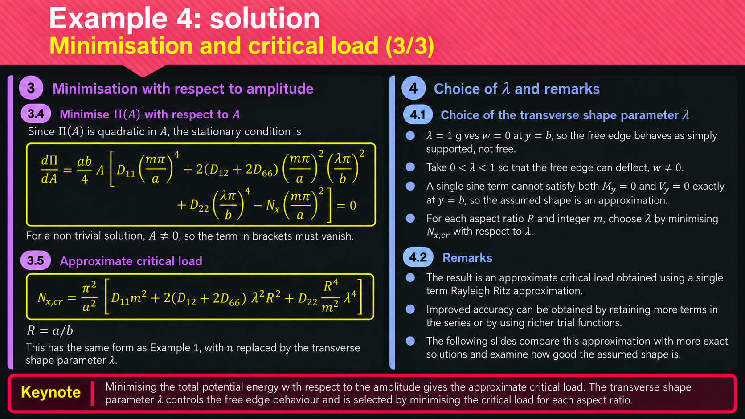
Notes:
Intro
The amplitude stationarity condition produces the approximate buckling load for the selected free-edge trial function.
Concept
Because Π is quadratic in A, setting ∂Π/∂A = 0 gives either the trivial flat state A = 0 or a zero coefficient of A. The latter condition supplies the modal critical load.
Details
Use the integrated expression from the previous slide and isolate N0. The resulting expression depends on the longitudinal count m and the adjustable transverse parameter λ. For each aspect ratio, compare admissible choices and minimize the positive load. λ = 1 forces zero deflection at the nominal free edge and effectively reintroduces an unwanted support. λ = 1/2 allows edge displacement but imposes zero slope there. Other values allow different edge slopes and curvatures. The one-term Ritz approximation may overestimate the true critical load because it restricts the admissible deformation space.
Key Takeaway
Stationarity in amplitude identifies the load for a chosen shape. Additional minimization over the shape parameters improves the approximation but does not make a one-term shape exact.

Slide 48
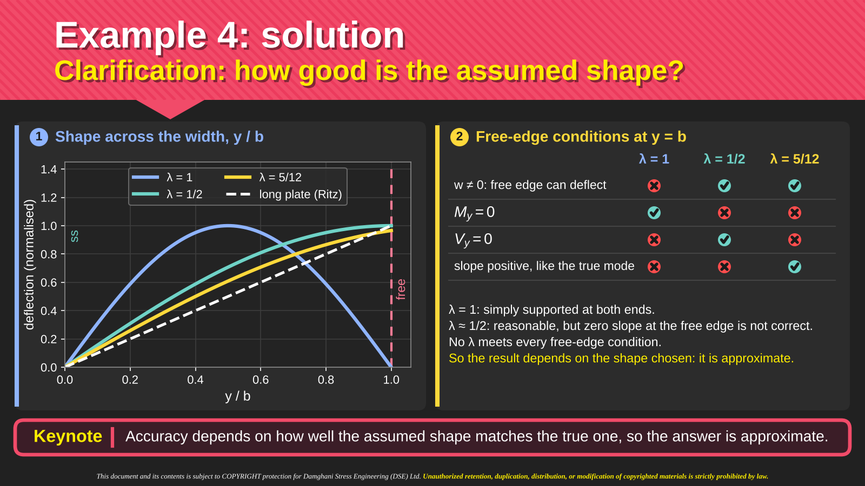
Notes:
Intro
The shape comparison tests how well different λ choices represent the free edge. It contrasts the assumed transverse curves with the exact long-plate trend shown on the slide.
Concept
A plausible-looking displacement curve can still violate moment or shear boundary conditions. Evaluate the edge conditions explicitly rather than judging only the curve’s appearance.
Details
The λ = 1 curve returns to zero at the free edge, imposing a false displacement restraint. The λ = 1/2 curve permits displacement but has zero slope at y = b. The λ = 5/12 curve allows a slope and follows the long-plate shape more closely in the displayed comparison. The table separately checks displacement freedom, My = 0 and Vy = 0. Neither adjustable sine choice satisfies all the natural conditions exactly for the problem shown. The linear long-plate reference helps explain why edge slope matters, but a closer visual fit alone does not quantify load error.
Key Takeaway
The free-edge solution remains approximate because the trial function does not satisfy every natural boundary condition. Shape selection must be checked against both mechanics and load accuracy.

Slide 49
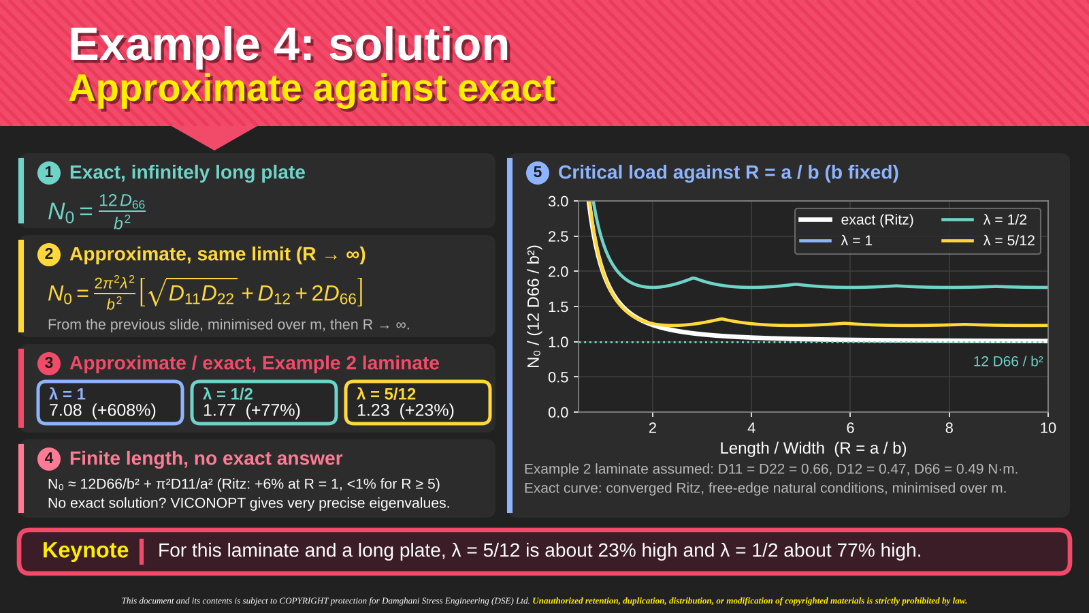
Notes:
Intro
The slide quantifies the error of the assumed-shape solution by comparing it with an exact long-plate limit and a converged finite-length reference.
Concept
The long-plate limit for this edge configuration is N0 = 12D66/b². Compare the approximate result with this limit using the same laminate data and width.
Details
For the Example 2 laminate, the slide reports approximate-to-exact ratios of about 7.08 for λ = 1, 1.77 for λ = 1/2 and 1.23 for λ = 5/12. These correspond to approximately 608%, 77% and 23% overprediction in the long-plate limit. The plot also includes a converged reference for finite aspect ratios, where the long-plate asymptote alone is insufficient. The improved λ choice reduces the error substantially but still overpredicts the critical load. Such an overprediction is not conservative when used as a load-capacity estimate.
Key Takeaway
The closest of these one-term shapes still predicts a long-plate buckling load about 23% high for the stated laminate. Use the comparison to judge the approximation’s limits.

Slide 50

Notes:
Intro
The reading slide points to two papers on exact stiffness analysis and its application to delaminated composite plates.
Concept
The references provide a route beyond the low-order trial functions used in the worked examples. Exact stiffness formulations address buckling through a different representation of the structural field and its boundary conditions.
Details
The first displayed paper is “Critical buckling of delaminated composite plates using exact stiffness analysis,” by M. Damghani, D. Kennedy and C. Featherston, in Computers and Structures 89 (2011), pages 1286–1294. The second is “Global buckling of composite plates containing rectangular delaminations using exact stiffness analysis and smearing method,” in Computers and Structures 134 (2014), pages 32–47, by the same listed authors. The slide links this reading to VICONOPT and the exact stiffness methodology. The references concern delamination problems, so their scope extends beyond the intact simply supported examples developed here.
Key Takeaway
These papers provide further reading on exact stiffness methods and delaminated-plate buckling. Their titles and publication details come from the slide’s reference entries.

Slide 51
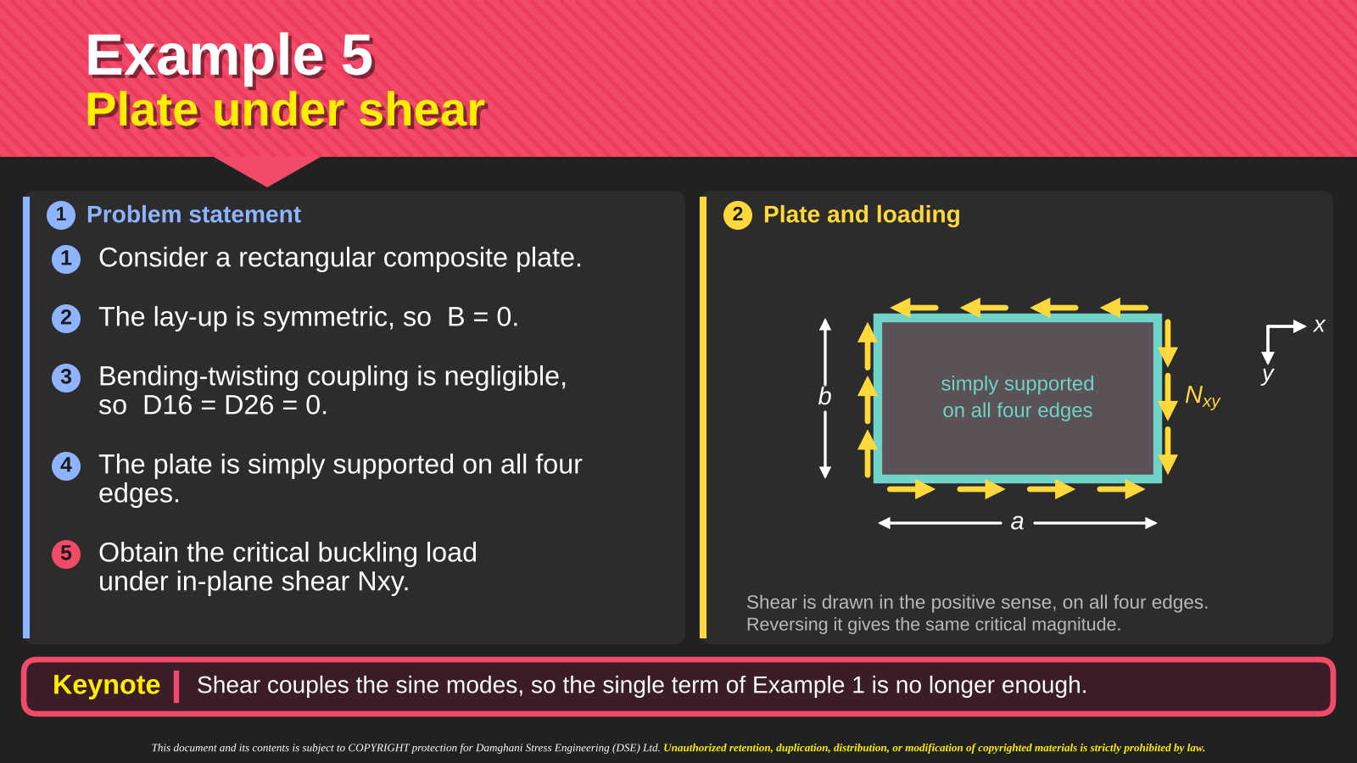
•
•
•
•
•
Notes:
Intro
Example 5 asks for the critical in-plane shear load of a rectangular laminate simply supported on all four edges. The key difference from the earlier compression example is that shear links different deformation patterns through modal coupling.
Concept
Modal coupling means that the equilibrium equation for one deformation pattern contains the amplitude of another pattern. Their amplitudes must therefore be solved together.
Here, “modes” refers to the individual sine basis patterns used to build the solution. The final shear-buckling eigenmode is a combination of these patterns. This is a static buckling calculation, so modal coupling here does not imply vibration or time-dependent energy transfer.
The laminate is symmetric, with B = 0, and its bending–twisting coefficients D16 and D26 are negligible. These assumptions remove particular constitutive couplings, but the applied shear load can still couple the sine patterns through geometric stiffness.
Details
1. The plate and its loading
The diagram shows tangential edge forces in a consistent pure-shear pattern. Nx and Ny are absent, while Nxy remains. Simply supported edges have zero transverse displacement and zero normal bending moment, but they permit rotation. For this symmetric, specially orthotropic model, reversing shear changes the mode orientation without changing the critical load magnitude.
2. What a mode means
A sine basis function is φmn(x,y) = sin(mπx/a)sin(nπy/b). The positive integers m and n count half-waves along x and y. For example, φ11 has one half-wave in each direction, while φ22 has two in each direction.
Write a two-term approximation as w = A11φ11 + A22φ22. The unknown amplitudes A11 and A22 specify how much of each pattern appears in the final buckled shape. They are components of one combined deformation field, rather than two separate buckling events.
3. Why do we sum modes here but not in the earlier compression example?
The distinction is between comparing independent candidate modes and combining basis patterns to represent one buckled shape. In the simply supported compression example, we calculated a load for each (m,n) and selected the smallest. In the shear example, the coefficients of several basis patterns must participate in the same eigenvalue calculation.
Compression: one sine pattern closes the equation
Let φmn = sin(αx)sin(βy), with α = mπ/a and β = nπ/b. Then (∂²φmn/∂x²) = −α²φmn, (∂²φmn/∂y²) = −β²φmn and (∂⁴φmn/∂x²∂y²) = α²β²φmn. The fourth derivatives also remain proportional to φmn.
For the constant-stiffness, specially orthotropic, simply supported plate, the bending operator gives Lb[φmn] = Cmnφmn, where Cmn = D11α⁴ + 2(D12 + 2D66)α²β² + D22β⁴.
Using positive compression magnitudes Px and Py, the equation Lb[w] + Px(∂²w/∂x²) + Py(∂²w/∂y²) = 0 becomes [Cmn − Pxα² − Pyβ²]Amnφmn = 0 for one sine term. Every term has the same spatial pattern, so a single algebraic load condition satisfies equilibrium throughout the plate. The shape also satisfies the simple-support conditions.
We could use a full sine series here, but orthogonality separates it into independent equations. Summing different patterns is unnecessary for finding each candidate eigenvalue. We still compare several integer mode pairs to find the lowest critical load. At a repeated eigenvalue, combinations of the equally critical modes are also possible.
Shear: one sine pattern does not close the equation
Pure shear introduces 2Nxy(∂²w/∂x∂y). For the same basis function, (∂²φmn/∂x∂y) = αβcos(αx)cos(βy). The bending part is proportional to sin(αx)sin(βy), but the shear part is proportional to cos(αx)cos(βy). These are different spatial functions, so no choice of one nonzero amplitude and a constant shear load can make the single-term equation hold everywhere.
We therefore use w = ΣAmnφmn. Galerkin projection turns the mixed-derivative contribution of one basis pattern into nonzero terms in the equations of certain other patterns. Their amplitudes must be determined together. A finite series approximates the combined shear-buckling shape, and increasing the retained terms allows a convergence check.
Why a single-term Galerkin calculation loses the shear effect
A mode projected against its own shear derivative gives ∬φmn(∂²φmn/∂x∂y) dA = αβ[∫₀ᵃsin(αx)cos(αx)dx][∫₀ᵇsin(βy)cos(βy)dy] = 0 for integer m and n.
Consequently a one-term pure-shear equation reduces to KmnAmn = 0, with no load-dependent term. It only allows the flat solution for positive bending stiffness. This does not mean that the real plate cannot buckle under shear. It means that the selected one-term approximation cannot represent the shear instability.
Two or more suitably coupled patterns retain the cross terms. For example, (1,1) couples to (2,2). Simply adding any second pattern is not sufficient, because only certain index combinations have nonzero shear projections.
Energy interpretation
The normal-compression contribution contains integrals such as ∬(∂w/∂x)²dA, which are nonzero for a single sine pattern. The shear contribution contains ∬(∂w/∂x)(∂w/∂y) dA. For one double-sine term that integral is zero, whereas cross terms between suitable different patterns are nonzero. This gives the same explanation from an energy viewpoint.
What about the immediately preceding free-edge example?
The one-free-edge compression example used a one-term Ritz approximation, not an exact single-mode solution. Its compression-work integral was nonzero, so it produced a finite approximate load even though its trial shape did not satisfy all free-edge natural conditions exactly. Additional terms could improve that result. Here, a single double-sine term misses the pure-shear work altogether, making a richer trial shape essential rather than merely an accuracy improvement.
Scope of the comparison
The need for several terms refers to the double-sine representation used here. A single specially constructed trial function can already contain a combination of sine patterns or a skewed wave shape. The underlying requirement is a trial space capable of representing shear work and the coupled buckling deformation. Likewise, compression problems with other restraints, nonuniform loads or additional stiffness coupling may also require a series solution.
4. How the coupling appears in the equations
Using the later matrix slides’ convention, [K − NxyT]{A} = 0. K represents bending resistance, while T represents shear coupling. A two-pattern example has the form:
K1A1 − NxyT12A2 = 0
K2A2 − NxyT21A1 = 0
The first equation contains A2, and the second contains A1. The off-diagonal coefficients T12 and T21 quantify their interaction. The amplitudes cannot be found independently.
For this double-sine basis under uniform shear, a mode’s shear self-projection is zero. A one-term Galerkin model therefore cannot predict a finite pure-shear buckling load. Nonzero coupling occurs for suitable pairs whose indices have opposite parity in both directions, such as (1,1) and (2,2). Not every pair of modes couples.
5. Physical interpretation and the illustrative result
The plate forms a combined wave pattern that can accommodate the shear-driven distortion. The eigenvalue calculation determines the critical load and the relative amplitudes. It does not determine an absolute post-buckling amplitude.
In the illustrative two-mode calculation later in this deck, A22/A11 is approximately −0.25, giving w ≈ A11(φ11 − 0.25φ22). The second pattern modifies the first with the opposite sign and one-quarter of its amplitude. This ratio belongs only to those demonstration inputs and that two-mode truncation. A real calculation must use the actual dimensions and D matrix and check convergence as more modes are retained.
6. Distinction from laminate coupling
B = 0 removes extension–bending coupling in the laminate constitutive law. D16 = D26 = 0 removes the stated bending–twisting stiffness terms. Neither condition removes 2Nxy(∂²w/∂x∂y) from the loaded equilibrium equation. The modal coupling discussed here comes from the applied shear load and the chosen basis representation, even though those constitutive couplings vanish.
Key Takeaway
Modal coupling means that different sine-pattern amplitudes appear in one another’s equilibrium equations. In this shear-buckling problem, the mixed derivative links suitable patterns, so the critical load and their relative amplitudes must be solved together. The resulting buckling eigenmode is a combined shape, even when B = 0 and D16 = D26 = 0.

Slide 52
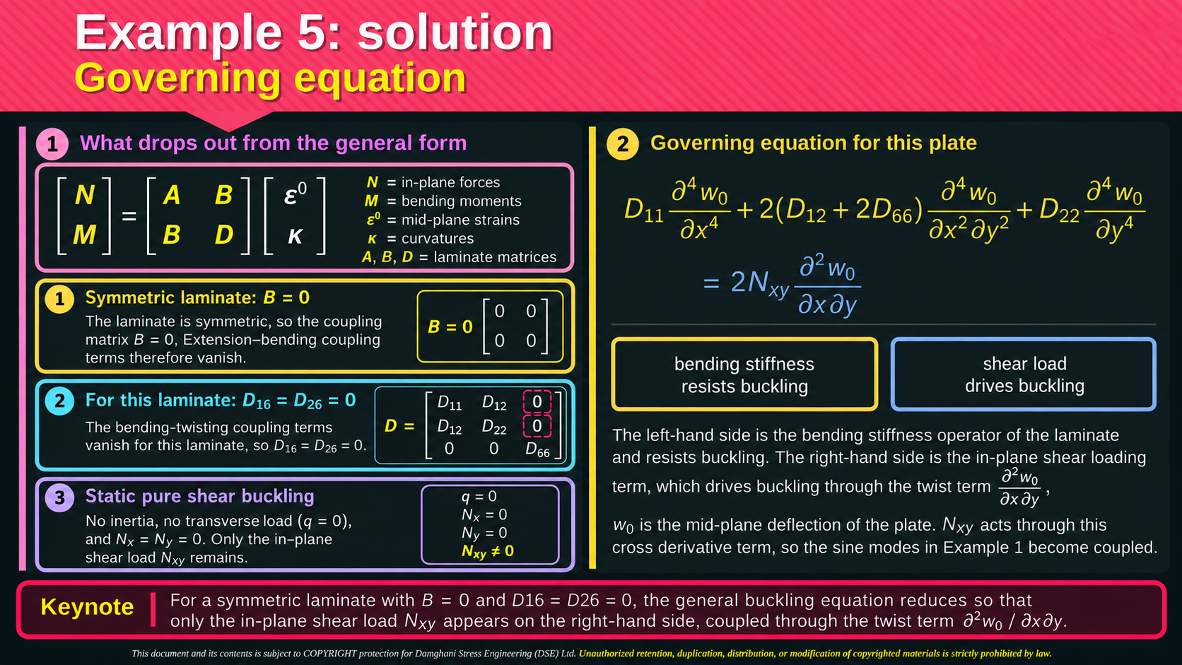

Notes:
Intro
The general laminate equation reduces to the pure-shear buckling equation after applying the assumptions of Example 5.
Concept
B = 0 removes extension–bending coupling. D16 = D26 = 0 removes bending–twisting terms in the stiffness operator. Static pure shear removes inertia, pressure and the two normal membrane loads.
Details
1. Original governing equation
For a thin laminate with constant stiffness coefficients and uniform pre-buckling membrane resultants, the general transverse equation, using the sign convention of this slide, is:
D₁₁(∂⁴w₀/∂x⁴) + 4D₁₆(∂⁴w₀/∂x³∂y) + 2(D₁₂ + 2D₆₆)(∂⁴w₀/∂x²∂y²) + 4D₂₆(∂⁴w₀/∂x∂y³) + D₂₂(∂⁴w₀/∂y⁴) − C_B + I₀(∂²w₀/∂t²) = q + Nₓ⁰(∂²w₀/∂x²) + 2Nₓᵧ⁰(∂²w₀/∂x∂y) + Nᵧ⁰(∂²w₀/∂y²).
Here w₀ is the mid-plane transverse displacement, q is transverse pressure and I₀ = ∫ρ dz is mass per unit area. The superscript 0 on N identifies the pre-buckling membrane state. Normal compression is negative under this convention. The displayed slide omits the superscript on Nₓᵧ.
The extension–bending contribution is C_B = ∂²Mₓᴮ/∂x² + 2∂²Mₓᵧᴮ/∂x∂y + ∂²Mᵧᴮ/∂y², where {Mₓᴮ, Mᵧᴮ, Mₓᵧᴮ}ᵀ = B ε⁰. These are the moment contributions from mid-plane strains, not the total moments. The full constitutive equations are N = Aε⁰ + Bκ and M = Bε⁰ + Dκ, with κ = −{∂²w₀/∂x², ∂²w₀/∂y², 2∂²w₀/∂x∂y}ᵀ. This compact definition retains the B coupling without hiding it inside the D terms.
2. Symmetry removes extension–bending coupling
The symmetric stacking sequence gives B = 0. Therefore Mᴮ = 0 and C_B = 0. The A matrix still determines the in-plane response, but its displacement variables no longer enter the transverse moment law through B. The in-plane solution supplies the pre-buckling loads.
3. Negligible bending–twisting stiffness removes two terms
For this laminate, D₁₆ ≈ D₂₆ ≈ 0. The model neglects 4D₁₆(∂⁴w₀/∂x³∂y) and 4D₂₆(∂⁴w₀/∂x∂y³). Symmetry alone does not imply D₁₆ = D₂₆ = 0. This is a separate assumption. The mixed fourth derivative with coefficient 2(D₁₂ + 2D₆₆) remains.
4. Static buckling without transverse pressure removes inertia and q
At static bifurcation, ∂²w₀/∂t² = 0, and the example has no applied transverse pressure, so q = 0. After these assumptions, the equation becomes:
D₁₁(∂⁴w₀/∂x⁴) + 2(D₁₂ + 2D₆₆)(∂⁴w₀/∂x²∂y²) + D₂₂(∂⁴w₀/∂y⁴) = Nₓ⁰(∂²w₀/∂x²) + 2Nₓᵧ⁰(∂²w₀/∂x∂y) + Nᵧ⁰(∂²w₀/∂y²).
5. Pure shear gives the equation shown on this slide
Pure shear means Nₓ⁰ = Nᵧ⁰ = 0, while Nₓᵧ⁰ remains nonzero. Removing the two normal-load contributions gives exactly:
D₁₁(∂⁴w₀/∂x⁴) + 2(D₁₂ + 2D₆₆)(∂⁴w₀/∂x²∂y²) + D₂₂(∂⁴w₀/∂y⁴) = 2Nₓᵧ(∂²w₀/∂x∂y).
The left-hand side contains bending resistance. The right-hand side contains the geometric effect of the applied in-plane shear. Setting B, D₁₆ and D₂₆ to zero does not remove this load-induced mixed derivative. Simply supported edge conditions constrain the solution but do not themselves delete these differential-equation terms.
6. Sign convention when moving to the matrix formulation
With exactly the same signed Nₓᵧ as this slide, moving the shear term to the left gives L_b[w₀] − 2Nₓᵧ(∂²w₀/∂x∂y) = 0. A later expression with a plus sign requires the opposite signed shear parameter. Define Nₓᵧ(later) = −Nₓᵧ(here) to obtain L_b[w₀] + 2Nₓᵧ(later)(∂²w₀/∂x∂y) = 0. Moving a term alone does not justify retaining its original sign. Keep the chosen definition consistent in K, T and the eigenvalue calculation.
Key Takeaway
The shear buckling equation retains one loading term and the laminate bending operator. The mixed derivative makes a coupled modal solution necessary.

Slide 53

Example 5: solution
Galerkin method: four steps to the buckling load
1
Assume the shape
2
Form the residual
3
Weight and integrate
4
Assemble and solve
Choose known wave patterns that fit the supported edges. Solve for their unknown amplitudes.
Insert the assumed shape into the plate equation. R is the local imbalance that remains.
Use one known wave pattern φₘₙ to test R over the whole plate. Repeat for every retained mode.
Collect the equations into E. Find the shear load that permits nonzero amplitudes.
w̃ = Σᵢ,ⱼ Aᵢⱼ φᵢⱼ
R = Lᵦ[w̃]
− 2Nₓᵧ(∂²w̃/∂x∂y)
∫₀ᵇ∫₀ᵃ R φₘₙ dx dy = 0
E(Nₓᵧ){A} = 0
det E(Nₓᵧ) = 0
φᵢⱼ = sin(iπx/a)sin(jπy/b)
Aᵢⱼ = unknown amplitude
Σ = sum of retained patterns
Lᵦ = bending operator
Nₓᵧ = applied shear load
Exact solution: R = 0 everywhere
φₘₙ = one test pattern
Each test gives one equation.
R need not vanish at every point.
E = coefficient matrix
{A} = amplitude vector
Result: load and relative amplitudes
Add modes and check that the critical load converges.
Keynote
Galerkin converts the differential equation into one algebraic equation for each retained plate mode.
Notes:
Intro
This slide is a map of the Galerkin calculation. We know the plate dimensions and laminate bending stiffnesses, but we do not yet know the critical shear load or the buckled shape. Galerkin replaces the differential equation for an unknown function with a finite set of equations for unknown amplitudes. Explain each panel in order before introducing the matrix notation.
Concept
Start with several known wave patterns that fit the supports. Their amplitudes are unknown. Substitute their weighted sum into the plate equation. The remaining imbalance is the residual R. Test that imbalance against each chosen wave pattern. Each test gives one algebraic equation. Collecting those equations produces the matrix E, whose singularity identifies a candidate buckling load.
Details
1. What every symbol means
x and y are positions on the plate. The plate occupies 0 ≤ x ≤ a and 0 ≤ y ≤ b, so a and b are its side lengths. w₀(x,y) is transverse deflection of the mid-plane. The subscript 0 identifies the mid-plane, not a zero displacement.
φ is the Greek letter phi. Here φᵢⱼ(x,y) = sin(iπx/a)sin(jπy/b) is one known spatial wave pattern, called a basis function. The integers i and j count half-waves in the x and y directions. They are indices, not coordinates and not the imaginary unit.
Basis function and shape function: how the terms relate
In this assumed-mode calculation, each φᵢⱼ can also be called an assumed shape function or trial shape function. It specifies a possible deflection pattern before we know its amplitude. “Basis” emphasises that the chosen linearly independent functions span the finite approximation space. “Shape” emphasises the geometrical pattern each function contributes. The complete buckled shape is the combination ΣAᵢⱼφᵢⱼ, rather than any one basis function in general.
There is a useful finite-element distinction. Finite-element shape functions commonly interpolate nodal degrees of freedom and have support over individual elements or neighbouring elements. The sine functions here extend across the whole plate, and Aᵢⱼ are modal amplitudes rather than nodal displacements. Both serve as building blocks for an approximation, but their coefficients and construction differ. Calling these sine functions “global assumed shape functions” avoids that ambiguity.
What “spatial” means here
Spatial means dependent on position in physical space, here the coordinates x and y across the plate. For φ₁₁ = sin(πx/a)sin(πy/b), the value is zero on the edges and one at the centre. Moving to another point changes the function value and describes how the plate’s deflection varies across its surface. Multiplying by A₁₁ sets the displacement scale. A spatial pattern is therefore a map of relative deflection over the plate. This static buckling calculation does not describe a wave travelling with time or an oscillation. Derivatives with respect to x and y measure changes with position, such as slopes and curvatures.
Aᵢⱼ is the unknown amplitude multiplying φᵢⱼ. With dimensionless sine functions, Aᵢⱼ has units of displacement. Σ means “add the contributions of the retained modes”. The double index means that each retained pair (i,j) identifies one term. It does not mean multiply all the modes together.
R(x,y) is the residual, or local imbalance in the governing equation after inserting the approximate displacement. It is a function over the plate, not a single constant. φₘₙ is a test function. The indices m and n identify the pattern used for one test, while i and j identify the trial patterns being summed.
[E(Nₓᵧ)] is the coefficient matrix, and {A} is the column vector of all retained amplitudes. Square brackets indicate a matrix and braces indicate a vector. E is a name for this assembled matrix, not Young’s modulus or an energy. Nₓᵧ is the applied in-plane shear force per unit edge length. Parentheses in E(Nₓᵧ) mean that the matrix depends on the load.
2. Step 1: assume a shape without guessing its amplitudes
Write w̃(x,y) = Σᵢ,ⱼ Aᵢⱼφᵢⱼ(x,y). The tilde reminds us that a finite sum approximates w₀. We choose the functions φᵢⱼ but solve for their amplitudes Aᵢⱼ.
Each sine product is zero at x = 0, x = a, y = 0 and y = b. Therefore, any linear combination satisfies zero deflection on every supported edge. For this especially orthotropic plate, the relevant normal bending moments also vanish on those edges. These boundary properties follow from the basis and the stated stiffness assumptions.
For example, retain φ₁₁ = sin(πx/a)sin(πy/b) and φ₂₂ = sin(2πx/a)sin(2πy/b). Then w̃ = A₁₁φ₁₁ + A₂₂φ₂₂. We have reduced the unknown spatial function to two unknown numbers. This is an illustrative two-term truncation, not a claim that two terms give a converged answer.
3. Step 2: substitute the shape and define R explicitly
Using the sign convention of the preceding governing-equation slide, define the bending operator by L_b[w] = D₁₁(∂⁴w/∂x⁴) + 2(D₁₂ + 2D₆₆)(∂⁴w/∂x²∂y²) + D₂₂(∂⁴w/∂y⁴). An operator is simply a rule: differentiate the function as shown and multiply the results by the indicated stiffnesses.
The governing equation is L_b[w₀] − 2Nₓᵧ(∂²w₀/∂x∂y) = 0. Insert w̃ and call the resulting left-hand side R:
R(x,y) = L_b[w̃] − 2Nₓᵧ(∂²w̃/∂x∂y).
Because the equation is linear in deflection and the amplitudes are constants with respect to x and y, this becomes R = Σᵢ,ⱼ Aᵢⱼ[L_b[φᵢⱼ] − 2Nₓᵧ(∂²φᵢⱼ/∂x∂y)]. Every derivative acts on a known basis function, not on an amplitude.
An exact solution has R = 0 at every position. A finite assumed shape generally cannot achieve that. R describes the imbalance in the differential equation, not the displacement error itself. Its units here are transverse force per area. For a sine mode, the bending derivatives retain the sine product, whereas the shear derivative creates a cosine product. That difference explains why one sine term cannot balance the pure-shear equation everywhere.
What R physically represents
At each point, R is the bending contribution minus the shear-load contribution evaluated for the assumed deflection. The exact local equilibrium equation requires those contributions to balance. A nonzero R means that this approximate shape leaves an unbalanced transverse force per unit area at that location. R can be positive at one point and negative at another. Its sign follows the adopted equilibrium convention. R is an equation residual, rather than a measured displacement difference or the unknown error w̃ − w_exact. We can calculate R without knowing the exact buckled shape.
4. Step 3: use phi to test the residual
Choose one retained mode φₘₙ and require ∫₀ᵇ∫₀ᵃ R(x,y)φₘₙ(x,y) dx dy = 0. Multiply first, then integrate over the whole plate. The inner integral covers x from 0 to a, and the outer integral covers y from 0 to b. The product dx dy is a small area element.
What is φₖ, and how do we choose it?
φₖ is one known shape function used to test the residual. The subscript k simply numbers functions in our retained list. For a plate, each list entry corresponds to a pair (m,n). Thus k is a convenient single index, not a new coordinate, material property or unknown amplitude.
First choose a family of sufficiently smooth, linearly independent functions that fits the essential support conditions. Here we choose φₘₙ(x,y) = sin(mπx/a)sin(nπy/b). Each function is zero at x = 0,a and y = 0,b. The integers m and n count half-waves along the two directions. For the specially orthotropic plate in this example, these functions also satisfy the relevant normal-moment conditions.
Next choose a finite set of mode pairs from that family. This selects the approximation space, rather than predicting the final shape in advance. For pure shear, the set must include suitable interacting patterns. The pair (1,1) and (2,2) is a useful illustrative choice, but two terms alone do not establish convergence. Enlarge the retained set and check how the critical load changes.
In Galerkin’s method, use those same retained functions as the test functions. We do not invent a different φₖ after calculating R. We take each known function in turn and impose ∬Rφₖ dx dy = 0. Every test supplies one algebraic equation, so r retained shape functions give r equations for r amplitudes at a candidate load.
Two-function example with an explicit k-to-mode mapping
For this illustrative list, k = 1 labels the pair (1,1), so φ₁ = φ₁₁ = sin(πx/a)sin(πy/b). The next list entry, k = 2, labels the pair (2,2), so φ₂ = φ₂₂ = sin(2πx/a)sin(2πy/b). This is a chosen ordering of the retained modes. The index k = 2 does not universally mean the mode pair (2,2).
The assumed deflection is w̃ = A₁φ₁ + A₂φ₂. Here A₁ and A₂ are the modal amplitudes associated with the two entries in this list, equivalent to A₁₁ and A₂₂ in pair-index notation. The functions φ₁ and φ₂ are already known. Only their amplitudes and the buckling load remain to be solved.
After substituting w̃ into the governing equation to form R, perform the first test, ∫₀ᵇ∫₀ᵃ Rφ₁ dx dy = 0, and then the second test, ∫₀ᵇ∫₀ᵃ Rφ₂ dx dy = 0. These give the two rows of the two-mode matrix equation. The singularity condition gives a candidate load, and its null vector gives the relative amplitudes.
In plain language, φₖ is a chosen wave-shaped probe: it asks whether the residual has a component matching that particular pattern. It carries no unknown amplitude when it acts as a test function. The complete deflection remains the unknown combination of all retained shapes.
The test function asks: how much of the residual has this particular spatial pattern? The integral is an inner product, which measures the residual’s component along that pattern. Setting it to zero makes the residual orthogonal to that test function. It does not make R zero everywhere, and it does not minimise the square of R. Positive and negative contributions can cancel after weighting.
Is this the same as mean-square fitting?
There is a broad similarity: both methods choose coefficients for an approximate representation. Their equations impose different conditions. In ordinary data fitting, a residual is often prediction minus observation, and least squares minimises the sum of squared residuals. Here R comes from the governing differential equation, and Galerkin imposes ∬Rφₖ dx dy = 0 separately for every retained test function φₖ. The index k is a single label for a retained pair (m,n).
A least-squares residual method would instead minimise J = ½∬R² dx dy. Dividing by the plate area ab gives a mean-square measure and does not change the minimiser. At a fixed trial load, write the governing operator as L_N so that R = L_N[w̃]. Differentiation with respect to amplitude Aₖ gives ∂J/∂Aₖ = ∬R(∂R/∂Aₖ) dx dy = ∬R L_N[φₖ] dx dy = 0. Least squares therefore uses L_N[φₖ] as the weight, while this Galerkin formulation uses φₖ. Those weights generally differ, so the two methods generally produce different discrete equations.
In the Galerkin integral, positive and negative weighted contributions can cancel. In J, squaring prevents positive and negative residual values from cancelling in the objective. A Galerkin residual may remain nonzero outside the retained test space even when every weighted integral is zero. Thus, the condition is orthogonality to the chosen test functions, not a claim that the mean-square residual is smallest.
There is an extra issue for buckling: this is a homogeneous problem. Setting every amplitude to zero gives R = 0 for every load. Simply minimising J without a nonzero-shape constraint would therefore return the flat solution and would not identify buckling. A least-squares eigenvalue approach would need an additional normalisation or equivalent constraint. For this conservative plate, Galerkin can also connect to stationarity of the potential energy, but potential-energy stationarity differs from minimising ∬R² dx dy.
Why multiply by φ rather than simply integrate R? An unweighted integral would give only one global condition and could miss imbalances with different spatial patterns. A separate test for each retained basis function supplies the independent conditions needed to determine the modal amplitudes.
For the two-term example, perform two tests: ∬φ₁₁R dx dy = 0 and ∬φ₂₂R dx dy = 0. The test functions themselves are known and have no unknown amplitude attached. Choosing test functions from the same family as the trial functions is the Galerkin choice.
5. Step 4: see exactly where E comes from
Insert the expanded R into the weighted integral. Move the finite sum and the constant amplitudes outside the integrals. For the test pair (m,n), the result is Σᵢ,ⱼ Eₘₙ,ᵢⱼ(Nₓᵧ)Aᵢⱼ = 0, where:
Eₘₙ,ᵢⱼ(Nₓᵧ) = ∬φₘₙ L_b[φᵢⱼ] dx dy − 2Nₓᵧ ∬φₘₙ(∂²φᵢⱼ/∂x∂y) dx dy.
Each integral becomes a number once the dimensions, stiffnesses and mode indices are known. One test mode gives one row of E. One trial amplitude gives one column. With r retained modes, E is an r × r matrix and {A} contains r amplitudes. There is no new physical law in E. It is a compact way to collect the coefficients produced by the integrations.
For the two-mode example, the equations are E₁₁A₁₁ + E₁₂A₂₂ = 0 and E₂₁A₁₁ + E₂₂A₂₂ = 0. In these two equations, the subscripts on E label matrix rows and columns in the ordered basis {φ₁₁, φ₂₂}. Off-diagonal entries describe how one trial pattern contributes to the equation obtained by testing another pattern.
For this uniform, especially orthotropic plate, the bending part is diagonal in the double-sine basis. A single sine mode has zero shear self-projection, but suitable different modes have nonzero cross-projections. The pair (1,1) and (2,2) provides such a coupling. This is why retaining more than one suitable pattern matters for pure shear.
6. How the matrix gives the load and the shape
The system E(Nₓᵧ){A} = 0 always permits {A} = 0, representing the flat plate. Buckling requires a nonzero vector. A square matrix admits such a solution only when it is singular, so det E(Nₓᵧ) = 0 gives candidate critical loads. In practice this is normally solved as a generalized eigenvalue problem rather than by expanding a large determinant.
Why singularity signals the onset of buckling
If E is invertible, multiplying E{A} = 0 by E⁻¹ gives {A} = 0. Thus, the linearised equilibrium equations permit only the flat perturbation. At a candidate buckling load, E loses invertibility and acquires a nonzero null vector {A}*: E{A}* = 0. A null vector is a nonzero combination of amplitudes that the matrix maps to zero. Since the retained basis functions are linearly independent, that vector represents a genuinely nonzero deflection pattern.
Physically, E acts as the load-dependent tangent stiffness in the retained approximation space. At criticality, the bending resistance and the destabilising geometric contribution balance for one pattern. That pattern has zero incremental restoring stiffness, so an infinitesimal deflection in it satisfies linearised equilibrium without an additional transverse forcing term. The flat state still solves the equations at the critical load, but the linearised solution is no longer unique.
A one-coordinate analogy makes the algebra transparent: (k − N g)A = 0, with k > 0 and g > 0. If N differs from k/g, the coefficient is nonzero and A must be zero. At N = k/g, the coefficient vanishes, so nonzero A is possible. The matrix condition det E = 0 expresses the same idea for several interacting amplitudes. This analogy illustrates the algebra, not a valid one-sine approximation for pure shear, whose shear self-projection vanishes.
For a properly constrained conservative model that starts from a stable state, the first relevant load-induced loss of positive stiffness marks linear buckling. A singular matrix caused by a rigid-body motion, duplicated basis functions or an assembly error would not establish physical buckling. Higher singular loads correspond to other candidate eigenmodes. We select the lowest relevant load for the specified loading direction and check convergence. The linear eigenproblem gives the relative shape amplitudes, while imperfections and nonlinear analysis govern finite deflections and post-buckling behaviour.
For two modes, the condition is E₁₁E₂₂ − E₁₂E₂₁ = 0. After finding a candidate load, substitute it back to obtain the relative amplitudes, such as A₂₂/A₁₁. Their overall scale remains arbitrary in linear buckling. Multiplying every amplitude by the same constant gives the same eigenmode. Linear buckling predicts the onset and shape, not the post-buckling deflection magnitude.
Select the lowest relevant critical load for the chosen loading direction and repeat with a richer mode set to check convergence. More retained modes provide a larger approximation space, but numerical convergence must be checked rather than assumed from the mode count alone.
7. Sign convention and the later K and T notation
The derivation above follows the preceding slide: L_b[w] − 2Nₓᵧ(∂²w/∂x∂y) = 0. Thus E = K − NₓᵧH if Kₘₙ,ᵢⱼ = ∬φₘₙL_b[φᵢⱼ] dx dy and Hₘₙ,ᵢⱼ = 2∬φₘₙ(∂²φᵢⱼ/∂x∂y) dx dy.
Later slides use L_b[w] + 2Nₓᵧ(later)(∂²w/∂x∂y) = 0 and define T = −H, giving E = K − Nₓᵧ(later)T. To represent the same physical load, Nₓᵧ(later) = −Nₓᵧ(here). Keep that sign change explicit. Do not combine the residual from one convention with the coupling-matrix definition from the other without changing the signed load.
Key Takeaway
The chain is: choose known shapes with unknown amplitudes, calculate the residual, test it against each shape, and collect the resulting coefficients into E. R is the equation imbalance, φ is a known testing pattern, and E is the load-dependent matrix. A singular E allows nonzero modal amplitudes and identifies a candidate buckling load.

Slide 54
Example 5: solution
Step 1: choose a shape that fits the edges
1
Admissible double-sine expansion
w₀(x,y) = Σᵢ,ⱼ Aᵢⱼ sin(iπx/a) sin(jπy/b)
2
Why sine functions?
3
What the mode indices mean
At x = 0 or a, the x-sine is zero. At y = 0 or b, the y-sine is zero. Therefore, every retained term satisfies the displacement boundary conditions.
Each pair (i,j) is one possible wave pattern. Aᵢⱼ is the amplitude of that mode in the final buckled shape.
(1,1)
1 half-wave in x
1 half-wave in y
(2,1)
2 half-waves in x
1 half-wave in y
(1,2)
1 half-wave in x
2 half-waves in y
w₀(0,y)=w₀(a,y)=w₀(x,0)=w₀(x,b)=0
Keynote
The sine basis satisfies zero deflection at all four supported edges before any coefficients are solved.
Notes:
Intro
The first Galerkin step selects a double-sine basis that satisfies the supported-edge displacement conditions before solving for any amplitudes.
Concept
Write w0(x,y) = ΣAij sin(iπx/a)sin(jπy/b). The functions are known, while the coefficients Aij determine their contribution to the buckled shape.
Details
At x = 0 or a, the x sine is zero. At y = 0 or b, the y sine is zero. Every term therefore satisfies w = 0 on every edge. For the stated specially orthotropic plate, the corresponding normal-moment conditions also follow because the relevant second derivatives retain the sine factors. The pair (1,1) has one half-wave in each direction, (2,1) has two longitudinal half-waves, and (1,2) has two transverse half-waves. Interpret the slide’s short labels as half-wave counts. A sum of these patterns can represent the skewed shape created by shear.
Key Takeaway
The basis enforces the simple supports in advance. The eigenproblem then determines the relative amplitudes of the retained admissible patterns.

Slide 55
Example 5: solution
Step 2: what the shear-load term means
1
One displacement pattern for simply supported edges
w₀ = A sin(πx/a) sin(2πy/b)
A = amplitude; a, b = plate dimensions
1 half-wave in x, 2 half-waves in y
One term illustrates differentiation, not the full solution.
2
Differentiate in x, then y
3
Multiply by the shear load
4
Shear load, bending resistance
First, differentiate in x:
∂w₀/∂x = (πA/a) cos(πx/a) sin(2πy/b)
Then differentiate this result in y:
Nₓᵧ is shear force per unit length.
Multiply the mixed derivative by 2Nₓᵧ, as required by the governing equation.
In-plane shear can cause out-of-plane buckling.
Bending stiffness resists the resulting curvature.
∂²w₀/∂x∂y = (2π²A/ab)
× cos(πx/a) cos(2πy/b)
2Nₓᵧ(∂²w₀/∂x∂y)
= (4π²NₓᵧA/ab)
× cos(πx/a) cos(2πy/b)
Cosines appear in the derivative.
Displacement remains sine × sine.
Simply supported: w = 0, Mₙₙ = 0; rotation allowed. Clamped: w = 0, ∂w/∂n = 0; rotation prevented.
Keynote
Supports constrain the displacement and edge rotation. Differentiation changes the mathematical pattern, not the supports.
Notes:
Intro
The illustrative (1,2) mode shows explicitly what the shear-load term does to the assumed displacement.
Concept
The shear term is the applied membrane load multiplied by a mixed derivative of deflection. It contributes geometric loading rather than an additional material stiffness.
Details
Start with w0 = A sin(πx/a)sin(2πy/b). Differentiating once in each direction gives (∂²w0/∂x∂y) = (2π²A/ab)cos(πx/a)cos(2πy/b). Multiplying by 2Nxy gives (4π²NxyA/ab)cos(πx/a)cos(2πy/b). This cosine product differs from the original sine product. Projection onto the basis therefore creates coupling between suitable different modes. The bending D coefficients resist curvature, while the signed shear load determines which coupled pattern can become unstable.
Differentiation and interpretation
Treat A, a and b as constants. Differentiating sin(πx/a) with respect to x produces (π/a)cos(πx/a), while the y factor stays unchanged. Therefore ∂w₀/∂x = (πA/a)cos(πx/a)sin(2πy/b). Differentiating next with respect to y supplies a further factor 2π/b, giving ∂²w₀/∂x∂y = (2π²A/ab)cos(πx/a)cos(2πy/b). Multiplication by 2Nₓᵧ then gives the coefficient 4π²NₓᵧA/ab.
The index pair (1,2) means one half-wave along x and two along y. This single term illustrates differentiation only. Under the stated constant-stiffness, specially orthotropic assumptions, the bending operator preserves its sine–sine pattern, while the shear term creates cosine–cosine. Galerkin tests the resulting residual against the retained sine basis and links suitable pairs. Adding an arbitrary second mode does not guarantee nonzero coupling.
The mixed derivative measures change in slope across the other coordinate. Classical plate theory commonly defines the engineering twisting curvature as κₓᵧ = −2∂²w₀/∂x∂y. The factor 2 in the shear-load contribution comes from the two symmetric in-plane shear contributions to transverse equilibrium. Nₓᵧ contributes load-dependent geometric stiffness, rather than a material coefficient in D. Its sign selects the coupled pattern and must follow the governing-equation convention.
Key Takeaway
The mixed derivative changes the spatial pattern of a trial mode. This explains why shear couples modes and why a single uncoupled sine amplitude is inadequate.

Slide 56

Example 5: solution
Step 3: how Galerkin chooses and uses the test functions
1
One sine family, a trial sum and one test per retained mode
Family: φᵢⱼ(x,y) = sin(iπx/a) sin(jπy/b), i,j = 1,2,3,…
Three-term trial: w̃ = A₁₁ sin(πx/a)sin(πy/b) + A₂₂ sin(2πx/a)sin(2πy/b)
+ A₃₃ sin(3πx/a)sin(3πy/b)
2
Why choose these functions?
3
What do the indices mean?
4
Three modes give three tests
Each sine product is zero at x = 0,a and y = 0,b. These independent modes fit the simply supported model used here. Retain a finite set to approximate the unknown shape.
i,j label terms in the trial sum.
m,n label the mode used for one test.
Both use the SAME sine formula.
Here retain (1,1), (2,2) and (3,3).
Test with (m,n) = (1,1), then (2,2),
then (3,3). Each known test gives
one equation for the three unknown
amplitudes in the trial sum.
A “family” is the collection of modes:
φ₁₁, φ₁₂, φ₂₁, φ₂₂, …
∬ R φ₁₁ dA = 0
∬ R φ₂₂ dA = 0
∬ R φ₃₃ dA = 0
w̃ = A₁₁φ₁₁ + A₂₂φ₂₂ + A₃₃φ₃₃
All three amplitudes are unknown.
R(x,y) = D₁₁(∂⁴w̃/∂x⁴) + 2(D₁₂ + 2D₆₆)(∂⁴w̃/∂x²∂y²) + D₂₂(∂⁴w̃/∂y⁴) − 2Nₓᵧ(∂²w̃/∂x∂y)
Keynote
Three terms illustrate the method. A converged buckling solution may need more modes from the same sine family.
Notes:
Intro
The slide distinguishes the unknown trial displacement from the known test function used in each Galerkin equation.
Concept
The trial displacement is a sum of basis functions with unknown coefficients. A test function is one specified member of the same basis family, with no unknown amplitude attached.
Details
Let φij = sin(iπx/a)sin(jπy/b) and w̃ = ΣAijφij. For row (m,n), choose φmn and impose ∬φmnR dA = 0 over 0 ≤ x ≤ a and 0 ≤ y ≤ b. This removes the residual component aligned with that test pattern within the retained approximation space. It does not require R to vanish at every individual point. The basis must satisfy the essential boundary conditions and be linearly independent. Using the same function family for trial and test functions is the defining Galerkin choice in this derivation.
Key Takeaway
The trial shape carries unknown amplitudes, while each test function measures one residual component. Repeating the test for every retained mode builds the matrix rows.
What “family” means
The family is the collection φᵢⱼ(x,y) = sin(iπx/a)sin(jπy/b), with positive integer indices. Each pair specifies one known spatial pattern. The family contains infinitely many functions. A practical approximation retains a finite subset. The family is not itself a three-term displacement: a displacement is a linear combination of selected family members with unknown coefficients.
Why this basis fits this example
The rectangular domain and simply supported conditions motivate double-sine functions. Every term satisfies w = 0 at x = 0,a and y = 0,b. In the constant-stiffness, specially orthotropic model used in this example, with D₁₆ = D₂₆ = 0, these functions also satisfy the simply supported normal bending-moment conditions. This is not a universal basis for every support or laminate. A clamped edge also requires zero normal slope, so a single ordinary sine product generally does not satisfy clamping.
Why φᵢⱼ and φₘₙ have different subscripts
The formula is identical. Indices i,j enumerate the columns or terms in the trial expansion. Indices m,n identify the test used for a particular matrix row. They are separate labels because the test need not have the same mode pair as a particular trial term. When testing with any retained mode, form the residual from the complete trial A₁₁φ₁₁ + A₂₂φ₂₂ + A₃₃φ₃₃, not from only the matching term. Some projected contributions can vanish by orthogonality.
Three retained terms, three test equations
For illustration choose w̃ = A₁₁φ₁₁ + A₂₂φ₂₂ + A₃₃φ₃₃. All three amplitudes are unknown, while the three sine products are fully specified functions. Substitute the complete three-term trial into the governing equation to obtain R. Require ∬Rφ₁₁ dA = 0, ∬Rφ₂₂ dA = 0 and ∬Rφ₃₃ dA = 0 over the plate area. These give three homogeneous equations in three amplitudes, with the shear load as an eigenvalue parameter. The coefficient matrix is 3 × 3. A nonzero amplitude vector requires a singular coefficient matrix. In this specially orthotropic model, the mixed-derivative shear term couples (1,1) with (2,2), and (2,2) with (3,3). It does not directly couple (1,1) with (3,3). The third mode is therefore connected through (2,2). This subset illustrates assembly, rather than prescribing an optimal or complete mode selection.
Approximation and convergence
The three-term expression is a teaching example, not a claim that three modes give an exact or converged shear-buckling load. Add suitable modes and check whether the predicted critical load and mode shape stabilise. Galerkin makes the residual orthogonal to the retained test space, not zero at every point. A test function has no unknown amplitude of its own.
The explicit residual R on this slide
R(x,y) = D₁₁(∂⁴w̃/∂x⁴) + 2(D₁₂ + 2D₆₆)(∂⁴w̃/∂x²∂y²) + D₂₂(∂⁴w̃/∂y⁴) − 2Nₓᵧ(∂²w̃/∂x∂y). This is the bending resistance minus the shear-load contribution, using the sign convention of the preceding governing equation and Galerkin overview. Use the entire three-term trial displacement w̃ in every derivative. R is the local imbalance of that approximate field. Galerkin sets its three weighted integrals to zero, rather than setting R to zero everywhere.
For an explicit substitution, let αₖ = kπ/a, βₖ = kπ/b and Cₖ = D₁₁αₖ⁴ + 2(D₁₂ + 2D₆₆)αₖ²βₖ² + D₂₂βₖ⁴. Then R(x,y) = Σₖ₌₁³ Aₖₖ[Cₖ sin(αₖx)sin(βₖy) − 2Nₓᵧαₖβₖ cos(αₖx)cos(βₖy)]. The sine products arise from the fourth derivatives in bending, while the cosine products arise from differentiating once in each coordinate in the shear term. This uses constant stiffness, D₁₆ = D₂₆ = 0, and the static pure-shear assumptions already stated in the example.

Slide 57

Example 5: solution
Step 4: from Galerkin integrals to the matrix equation
1
The same residual and three-term trial
2
Substitution separates amplitudes
R = Lᵦ[w̃] − 2Nₓᵧ(∂²w̃/∂x∂y)
Lᵦ[w̃] is bending only. R also includes the shear load.
The subscript b means bending.
w̃ = A₁₁φ₁₁ + A₂₂φ₂₂ + A₃₃φ₃₃
R = Σᵢⱼ Aᵢⱼ [Lᵦ[φᵢⱼ]
− 2Nₓᵧ(∂²φᵢⱼ/∂x∂y)]
Amplitudes are constants in x and y.
Sum over (1,1), (2,2), (3,3).
3
The same weighted integral
4
Why two coefficient matrices?
5
Three tests form three rows
Start with ∬ φₘₙ R dA = 0.
Substitute R and take each Aᵢⱼ
outside the integral. The two
integrals become coefficients:
K collects the bending coefficients.
T collects the shear coefficients.
Keeping Nₓᵧ outside T exposes the
unknown load in the equations.
(K − NₓᵧT){A} = 0
{A} = [A₁₁, A₂₂, A₃₃]ᵀ
Test φ₁₁ gives the first row below.
Repeat with φ₂₂ and φ₃₃.
Kₘₙ,ᵢⱼ = ∬ φₘₙ Lᵦ[φᵢⱼ] dA
Tₘₙ,ᵢⱼ = 2 ∬ φₘₙ × (∂²φᵢⱼ/∂x∂y) dA
Each test gives:
Σᵢⱼ (Kₘₙ,ᵢⱼ − NₓᵧTₘₙ,ᵢⱼ) Aᵢⱼ = 0
K₁₁,₁₁A₁₁ − (32/9)NₓᵧA₂₂ = 0
Here K₁₁,₂₂ = 0, T₁₁,₂₂ = 32/9.
Keynote
K and T collect coefficients from the weighted residual equations. No new physical assumption is introduced.
Notes:
Intro
The matrix equation separates bending resistance K from shear coupling T. Its singularity identifies a buckling eigenvalue.
Concept
With the sign convention used here, Kmn,ij = ∬φmnLb[φij]dA and Tmn,ij = 2∬φmn(∂²φij/∂x∂y) dA. Assembly gives [K − NxyT]A = 0.
Details
The pair (m,n) identifies the test mode and therefore the row. The pair (i,j) identifies the trial mode and therefore the column. Lb contains D11, D22 and 2(D12 + 2D66) multiplying the respective fourth derivatives. Away from an eigenvalue, the homogeneous system has only the flat solution A = 0. At an eigenvalue, the matrix becomes singular and admits a nonzero mode vector. In practice solve the generalized eigenproblem rather than numerically searching a large determinant. Select the physically relevant load magnitude and check convergence with the retained mode count.
Key Takeaway
K measures bending resistance and T measures shear-mediated interaction between modes. The eigenvalue gives the load and the eigenvector gives the relative shape.
The missing step from R to K and T
We continue solving the same weighted residual equations from the preceding slide. Nothing prompts a change of physical model. Substituting the trial sum and collecting its unknown amplitudes converts the differential-equation approximation into algebra. K and T are short names for the numerical coefficients produced by the weighted integrals.
L_b is only part of R
The subscript b stands for bending, not beta. L_b is an operator: it acts on a function. L_b[w̃] = D₁₁(∂⁴w̃/∂x⁴) + 2(D₁₂ + 2D₆₆)(∂⁴w̃/∂x²∂y²) + D₂₂(∂⁴w̃/∂y⁴). The residual is the resulting bending contribution minus the shear-load contribution: R = L_b[w̃] − 2Nₓᵧ(∂²w̃/∂x∂y). R is a function of position measuring local imbalance. The operator L_b, its output L_b[w̃], and the complete residual R are distinct objects.
Step 1: substitute the trial sum
Use w̃ = Σ Aᵢⱼφᵢⱼ, retaining (i,j) = (1,1), (2,2), (3,3). The amplitudes do not depend on x or y. Linearity therefore gives R = Σ Aᵢⱼ[L_b[φᵢⱼ] − 2Nₓᵧ(∂²φᵢⱼ/∂x∂y)]. This is the complete residual for the three-term trial, before any weighting or integration.
Step 2: weight, integrate and collect
For one test φₘₙ, impose ∬φₘₙR dA = 0. Substitute the expanded R. Interchange the finite sum and integral and take the constant amplitudes and uniform Nₓᵧ outside: Σ Aᵢⱼ[∬φₘₙL_b[φᵢⱼ]dA − Nₓᵧ{2∬φₘₙ(∂²φᵢⱼ/∂x∂y)dA}] = 0. The first integral is named Kₘₙ,ᵢⱼ. The second, including its factor 2, is named Tₘₙ,ᵢⱼ. Once the geometry, stiffnesses and basis are specified, each integral yields a scalar coefficient.
Step 3: one test becomes one row
For the first test, the collected equation is (K₁₁,₁₁ − NₓᵧT₁₁,₁₁)A₁₁ + (K₁₁,₂₂ − NₓᵧT₁₁,₂₂)A₂₂ + (K₁₁,₃₃ − NₓᵧT₁₁,₃₃)A₃₃ = 0. In this example it reduces to K₁₁,₁₁A₁₁ − (32/9)NₓᵧA₂₂ + 0A₃₃ = 0. Repeat with φ₂₂ and φ₃₃ to form the second and third rows. The three equations are exactly (K − NₓᵧT){A} = 0.
Why separating K and T is useful
K contains the integrated bending resistance and depends on the laminate bending stiffnesses. T contains the integrated mixed-derivative coupling, with the applied shear load factored out. This separation exposes the unknown load through E(Nₓᵧ) = K − NₓᵧT. We could define one matrix E directly, but the split makes the eigenvalue dependence clear and avoids recomputing the basis integrals for each trial load. K and T add no new physical assumptions.
Bending orthogonality and the final solve
For the constant-stiffness specially orthotropic model, L_b maps each retained sine product to a scalar times that same product. Orthogonality makes K diagonal. At det E = 0, a nonzero amplitude vector can exist. The eigenvalue gives the shear load and the eigenvector gives relative amplitudes. Absolute post-buckling deflection requires additional analysis. The three retained modes remain an illustrative truncation.
Continuing the same three-term example
Use w̃ = A₁₁φ₁₁ + A₂₂φ₂₂ + A₃₃φ₃₃ from the preceding slide. Assign compact row and column numbers 1, 2, 3 to mode pairs (1,1), (2,2), (3,3). Thus E₁₂ means test mode (1,1), trial mode (2,2), whereas A₁₁ labels the amplitude of mode (1,1). The two-index mode labels and compact matrix indices serve different purposes.
Consistent residual and shear sign
The preceding residual is R = Lᵦ[w̃] − 2Nₓᵧ(∂²w̃/∂x∂y). Therefore define Tₘₙ,ᵢⱼ = +2∬φₘₙ(∂²φᵢⱼ/∂x∂y)dA, so E = K − NₓᵧT. The former negative sign in the definition of T was inconsistent with this assembly and has been corrected. This slide uses the same signed shear parameter as the preceding residual.
Worked coefficient: row 1, column 2
φ₁₁ = sin(πx/a)sin(πy/b) and φ₂₂ = sin(2πx/a)sin(2πy/b). The derivative is ∂²φ₂₂/∂x∂y = (4π²/ab)cos(2πx/a)cos(2πy/b). Since ∫₀ᵃ sin(πx/a)cos(2πx/a)dx = −2a/(3π), and the analogous y integral is −2b/(3π), T₁₁,₂₂ = 2(4π²/ab)[−2a/(3π)][−2b/(3π)] = 32/9. Bending retains the φ₂₂ pattern, so orthogonality gives K₁₁,₂₂ = 0. Hence E₁₂ = −(32/9)Nₓᵧ.
The complete three by three example
For the unnormalised sine functions on 0 ≤ x ≤ a, 0 ≤ y ≤ b, define kᵣ = (ab/4)[D₁₁(rπ/a)⁴ + 2(D₁₂ + 2D₆₆)(rπ/a)²(rπ/b)² + D₂₂(rπ/b)⁴], for r = 1,2,3. Then K = diag(k₁,k₂,k₃). The three rows of T are [0, 32/9, 0], [32/9, 0, 288/25], [0, 288/25, 0]. The corresponding rows of E are [k₁, −(32/9)Nₓᵧ, 0], [−(32/9)Nₓᵧ, k₂, −(288/25)Nₓᵧ], [0, −(288/25)Nₓᵧ, k₃]. Multiply each row by [A₁₁,A₂₂,A₃₃]ᵀ to obtain its test equation. Modes (1,1) and (3,3) do not couple directly through the shear term, but both couple to (2,2).
What the eigenvalue calculation determines
For this illustrative truncation det E = k₁k₂k₃ − Nₓᵧ²[k₁(288/25)² + k₃(32/9)²]. Setting it to zero gives candidate signed shear eigenvalues. The null vector gives relative amplitudes, not the absolute post-buckling deflection. The constant-stiffness, specially orthotropic assumptions are essential to the diagonal K used here. Three diagonal-index modes are a teaching subset, not a convergence guarantee. Add suitable other modes and check the critical load.

Slide 58
Example 5: solution
Step 5: calculating the three-mode bending matrix
1
Illustrative inputs for the same three modes
2
Diagonal coefficient on this unit square
a = b = 1 m
D₁₁ = D₂₂ = 10, D₁₂ = 3, D₆₆ = 2 kN·m
Retain φ₁₁, φ₂₂ and φ₃₃, in that order.
Kₘₙ,ₘₙ = ¼[D₁₁(mπ)⁴
+ 2(D₁₂ + 2D₆₆)(mπ)²(nπ)²
+ D₂₂(nπ)⁴]
3
Why the factor ¼?
4
Three diagonal entries
5
The assembled 3 × 3 matrix
Test each mode against itself.
Each squared sine integrates to ½
over its unit interval. Their product
gives the normalization factor ¼.
For (1,1): 10 + 2(3 + 4) + 10 = 34.
k₁ = K₁₁,₁₁ = 8.5π⁴ kN/m.
For (r,r), fourth derivatives give r⁴.
So, k₂ = 16k₁ and k₃ = 81k₁.
Different sine modes are orthogonal.
Their bending cross terms are zero.
K = 8.5π⁴ diag(1, 16, 81) kN/m
[
1 | 0 | 0
0 | 16 | 0
0 | 0 | 81
]
∫₀¹∫₀¹ φₘₙ² dx dy = ¼
For general a,b, this integral is ab/4.
k₁ ≈ 828.0 kN/m
k₂ ≈ 13,247.6, k₃ ≈ 67,066.2 kN/m
8.5π⁴
kN/m
Keynote
Illustrative inputs only. Use the actual plate dimensions and laminate D-matrix for the original problem.
Notes:
Intro
The numerical demonstration evaluates the bending matrix for three retained modes using explicitly illustrative inputs rather than the original problem’s material data.
Concept
The chosen unit-square plate has a = b = 1 m, D11 = D22 = 10, D12 = 3 and D66 = 2 kN·m. The retained basis contains φ11, φ22 and φ33, ordered as in the preceding three-term trial.
Details
For the unit square, ∬φmn²dA = 1/4 m². Substituting a = b = 1 m into the general expression gives Kmn,mn = ¼[D11(mπ)⁴ + 2(D12 + 2D66)(mπ)²(nπ)² + D22(nπ)⁴], with resulting units kN/m. For (1,1), the stiffness sum is 10 + 2(3 + 4) + 10 = 34, so k1 = 8.5π⁴ = 827.977274 kN/m. Scaling both indices to (2,2) multiplies the coefficient by 16; (3,3) multiplies it by 81. Thus k2 = 13247.636381 kN/m and k3 = 67066.159177 kN/m. Round only after computing from the exact expression. Orthogonality removes the bending cross terms in this constant-stiffness specially orthotropic model.
Key Takeaway
The numerical K entries follow directly from the mode derivatives and normalization integral. These demonstration values must not be treated as the actual laminate properties.
Connection to the previous slide
Kₘₙ,ᵢⱼ = ∬φₘₙL_b[φᵢⱼ]dA. This slide evaluates those integrals for the retained pairs (1,1), (2,2), (3,3). Each row uses a test mode, each column a trial mode. Define k1 = K₁₁,₁₁, k2 = K₂₂,₂₂ and k3 = K₃₃,₃₃. These compact labels do not change the underlying mode indices.
General coefficient and units
For α = mπ/a and β = nπ/b, L_b[φmn] = [D11α⁴ + 2(D12 + 2D66)α²β² + D22β⁴]φmn. Therefore Kmn,mn = (ab/4)[D11α⁴ + 2(D12 + 2D66)α²β² + D22β⁴]. D has units kN·m, four derivatives contribute m⁻⁴, and the area integral contributes m², giving kN/m. The displayed unit-square formula uses numerical lengths of 1 m. The factor ¼ is a normalization integral, not an arbitrary stiffness reduction.
Why K is diagonal here
For constant stiffness and D16 = D26 = 0, the bending operator preserves each sine product. Distinct integer sine modes are orthogonal over the rectangle, so the bending integrals between different retained modes vanish. The full matrix is K = 8.5π⁴[[1,0,0],[0,16,0],[0,0,81]] kN/m. This conclusion is specific to the assumed model and basis. It does not say the shear-coupling matrix T is diagonal.
What students should take from this calculation
The factor ab/4 comes from integration, while the r⁴ scaling comes from fourth derivatives. All three diagonal coefficients follow from one exact calculation. K describes bending resistance, not the buckling load by itself. The load follows from the combined matrix K − NxyT. These material inputs are illustrative and must not be presented as the original laminate data. Three selected modes do not establish convergence.

Slide 59
Example 5: solution
Step 6: shear coupling and the three-mode buckling load
1
Differentiate the trial mode, then test it
2
Evaluate one coupling coefficient
φ₂₂ = sin(2πx)sin(2πy), a = b = 1 m
∂²φ₂₂/∂x∂y = 4π²cos(2πx)cos(2πy)
T₁₁,₂₂ = 2 ∬ φ₁₁(∂²φ₂₂/∂x∂y) dA
I = ∫₀¹ sin(πx)cos(2πx) dx = −2/(3π)
T₁₁,₂₂ = 2(4π²)I² = 32/9
The positive definition matches E = K − NₓᵧT.
3
All three modes in T
4
Solve det(K − NT) = 0
5
Recover the relative amplitudes
Mode order: (1,1), (2,2), (3,3).
c = 32/9, d = 288/25
T is symmetric and dimensionless.
Only neighboring pairs here couple.
Use k₁, k₂, k₃ from the previous slide.
Here N = Nₓᵧ and K = diag(k₁,k₂,k₃).
The determinant becomes:
k₁k₂k₃ − N²(k₁d² + k₃c²) = 0.
For the positive root N = +876.4:
First row: A₂₂/A₁₁ = k₁/(Nc).
Third row: A₃₃/A₁₁ = (Nd/k₃)(A₂₂/A₁₁).
The overall amplitude stays arbitrary.
[
0 | c | 0
c | 0 | d
0 | d | 0
]
T =
|Ncr| = √[k₁k₂k₃/(k₁d² + k₃c²)]
≈ 876.4 kN/m
w̃ ∝ φ₁₁ + 0.2657φ₂₂ + 0.0400φ₃₃
Negative N reverses the φ₂₂ sign.
Keynote
Illustrative three-mode result only. Use the actual plate data and add modes to check convergence.
Notes:
Intro
This numerical step continues the same three retained modes and illustrative unit-square data from the preceding slide. It evaluates shear coupling, assembles the three-by-three eigenproblem and obtains the relative modal amplitudes.
Concept
Use R = L_b[w̃] − 2Nxy(∂²w̃/∂x∂y). Therefore Tmn,ij = +2∬φmn(∂²φij/∂x∂y)dA and E = K − NxyT. Keep this signed-load convention throughout. K has units kN/m, T is dimensionless, and Nxy is a membrane force per unit length in kN/m.
Details
Retain φ11, φ22 and φ33, in that order. The preceding exact bending coefficients are k1 = 8.5π⁴ = 827.977273789 kN/m, k2 = 16k1 = 13247.636380624 kN/m, and k3 = 81k1 = 67066.159176911 kN/m. Use exact values until the final rounding.
1. Differentiate and project
For φ22 = sin(2πx)sin(2πy) on a = b = 1 m, ∂²φ22/∂x∂y = 4π²cos(2πx)cos(2πy). Each one-dimensional projection is I = ∫₀¹sin(πx)cos(2πx)dx = −2/(3π). The product-to-sum identity sin(πx)cos(2πx) = [sin(3πx) − sin(πx)]/2 gives this result directly. Thus T11,22 = 2(4π²)I² = 32/9, a positive dimensionless value. Integration of a second derivative over area cancels the length units.
2. Calculate the other entries
For test φ22 and trial φ33, ∂²φ33/∂x∂y = 9π²cos(3πx)cos(3πy). Each projection ∫₀¹sin(2πx)cos(3πx)dx = −4/(5π). Hence T22,33 = 2(9π²)[−4/(5π)]² = 288/25. The reverse entries have the same values. The diagonal projections vanish because ∫sin(rπx)cos(rπx)dx = 0. The (1,1)–(3,3) projection also vanishes. For this subset, T rows are [0,c,0], [c,0,d], [0,d,0], where c = 32/9 and d = 288/25. These zeros do not imply that shear never couples other mode pairs.
3. Assemble the three equations
With N = Nxy, the three rows of E = K − NT are [k1, −Nc, 0], [−Nc, k2, −Nd], [0, −Nd, k3]. They give k1A11 − NcA22 = 0; −NcA11 + k2A22 − NdA33 = 0; and −NdA22 + k3A33 = 0. This is the same weighted-residual construction as before, now evaluated numerically.
4. Find the load
Expanding det E gives k1k2k3 − N²(k1d² + k3c²) = 0. Therefore |Ncr| = sqrt[k1k2k3/(k1d² + k3c²)] = 876.412568499 kN/m. The roots are ±876.412568499 kN/m. This is the eigenvalue of the illustrative three-mode truncation, not a converged prediction for the original plate. In computation, a generalized eigenvalue solver is preferable to explicitly expanding a large determinant.
5. Recover the mode shape
For N = +876.412568499 kN/m, set A11 = 1 as a normalization. The first row gives A22/A11 = k1/(Nc) = 0.2657066051. The third row gives A33/A11 = (Nd/k3)(A22/A11) = 0.0400. Thus w̃ is proportional to φ11 + 0.2657φ22 + 0.0400φ33. For the negative load root the middle amplitude changes sign, while the third remains positive relative to A11. Multiplying all amplitudes by any common scalar gives the same linear buckling mode. Absolute post-buckling deflection requires additional analysis.
Key Takeaway
The mixed derivative supplies the off-diagonal coupling. Combining it with bending resistance gives the load eigenvalue and relative amplitudes. The inputs are explicitly illustrative. Additional suitable modes and actual plate data are needed for a reliable plate prediction.

Slide 60

Example 5: solution
Four-mode estimate and a full-series check
Each basis function: φₘₙ = sin(mπx/a)sin(nπy/b). Indices m,n count half-waves in x,y.
1
An explicit four-mode approximation
2
Error relative to the 196-term series
Nₓᵧ,cr ≈
π⁴b/a³
All pairs m,n = 1,…,14: 14 × 14 = 196 functions.
196 amplitudes give K and T of size 196 × 196.
$$\sqrt{\frac{(32/9)²}{D₁²} + \frac{(32/5)²}{D₁D₂} + \frac{(32/5)²}{D₁D₃}}$$
r = a/b H = D₁₂ + 2D₆₆
D₁ = D₁₁ + 2Hr² + D₂₂r⁴
D₂ = D₁₁ + 18Hr² + 81D₂₂r⁴
D₃ = 81D₁₁ + 18Hr² + D₂₂r⁴
D₁, D₂, D₃ are auxiliary stiffness combinations.
w̃ = A₁₁φ₁₁ + A₂₂φ₂₂ + A₁₃φ₁₃ + A₃₁φ₃₁
Four functions, four amplitudes: K and T are 4 × 4.
This changes the earlier three-mode selection.
Aspect ratio r = a/b
At a/b = 1: 838.9 vs 789.8 kN/m
The four-mode estimate is 6.2% higher.
Illustrative inputs: b = 1 m; D₁₁ = D₂₂ = 10, D₁₂ = 3, D₆₆ = 2 kN·m. Error = 100(Nfour / Nseries − 1).
Keynote
The shortcut overestimates the load. Add modes and check convergence before using the result for design.
Notes:
Intro
This slide replaces the unreadable original closed-form expression and raster comparison graph with a derived four-mode estimate and a newly calculated editable graph. The user selected recalculation using the preceding illustrative example. It does not reproduce the former source-specific formula or its 1–2% claim.
Concept
Use the same simply supported, constant-stiffness laminate assumptions as the preceding Galerkin derivation: D16 = D26 = 0, static pure shear and the residual bending operator minus 2Nxy times the mixed derivative. Retain the four modes (1,1), (2,2), (1,3), (3,1). This differs from the preceding three-mode subset (1,1), (2,2), (3,3).
Details: stiffness combinations
Let r = a/b, H = D12 + 2D66, and q = π⁴ b/(4a³). In that mode order, K = q diag(D1,16D1,D2,D3), with the three positive-sign auxiliary expressions shown on the slide. The original low-resolution expression's uncertain coefficients and signs have not been copied. D1, D2 and D3 have the same stiffness units as the laminate bending entries.
Details: derivation
The only nonzero shear couplings in this four-mode subset are T11,22 = 32/9 and T22,13 = T22,31 = −32/5, plus their symmetric entries. Eliminate the amplitudes in the three modes coupled to (2,2). The nonzero load magnitude satisfies N² = k22 / [(32/9)²/k11 + (32/5)²/k13 + (32/5)²/k31]. Substituting K gives the explicit formula on the slide. Squared coupling terms explain why all denominator contributions are positive. The two shear signs have equal critical magnitudes under these assumptions.
Details: graph calculation
The chart is newly calculated, not traced from the previous image. Use b = 1 m and a = r metres, D11 = D22 = 10, D12 = 3 and D66 = 2 kN·m. For the reference retain all 196 modes with m,n = 1,...,14. The diagonal bending entries are π⁴b/(4a³) times [D11 m⁴ + 2H m²n²r² + D22 n⁴r⁴]. The shear entry for trial (i,j) and test (m,n) is 8ijmn/[(m²−i²)(n²−j²)] when both index sums are odd and zero otherwise. Form S = K^(−1/2) T K^(−1/2). The smallest positive load is the reciprocal of S's largest positive eigenvalue. The plotted error is 100 times (four-mode load / 14-by-14 load − 1). Positive values mean unconservative overprediction relative to this series reference. The embedded workbook contains the calculated points for r from 0.2 to 2 in steps of 0.005 (361 calculated points).
Key numerical result
At r = 1, the four-mode value is 838.8951 kN/m and the 14-by-14 value is 789.8041 kN/m, an overestimate of 6.2156%. At r = 0.5 the error is 9.3755%, so the previous approximately 2% claim does not apply to this rebuilt example. The original interpolation guidance belongs to the former source formula and has been removed rather than transferred without justification.
Convergence and teaching caution
The 14-by-14 series is a numerical reference, not an exact solution. A supplemental 18-by-18 comparison at r = 0.2, 0.5, 1 and 2 is recorded below. More modes remain necessary when finer accuracy is required. For finite trial spaces, simply supported displacement conditions are enforced through the sine products. This illustrative calculation does not establish a design allowable or include bending–twisting coupling.
Supplemental convergence checks
{
"0.2": {
"four_mode": 20440.150609921337,
"series14": 12172.47519944297,
"error_percent": 67.92107007830836,
"series18": 12171.147606198021
},
"0.5": {
"four_mode": 2485.698308168635,
"series14": 2272.627167869732,
"error_percent": 9.375543129611842,
"series18": 2272.5364588285006
},
"1": {
"four_mode": 838.8950767835439,
"series14": 789.8040628476466,
"error_percent": 6.2155939992128095,
"series18": 789.7886624221843
},
"2": {
"four_mode": 621.4245770421587,
"series14": 568.1567919674335,
"error_percent": 9.375543129611753,
"series18": 568.1341147071248
}
}
What the mode count means
A mode here means one assumed sine-product basis function, not a separate buckling event or a finite element. The indices count half-waves along the two directions. Four selected basis functions have four unknown amplitudes and yield four Galerkin equations. Their combination approximates one buckled displacement shape.
Why 14 by 14 gives 196
The reference trial displacement is the double sum of A_mn phi_mn over m=1,...,14 and n=1,...,14. Every pair is included, giving 196 amplitudes and 196 test equations. Before any symmetry reduction, both coefficient matrices are 196 by 196. The notation 14 by 14 describes the index ranges, not the matrix dimensions.
Relation to the previous slide
This four-mode subset is (1,1), (2,2), (1,3), (3,1). The preceding three-mode example used (1,1), (2,2), (3,3). It is a different truncation, not simply that earlier example plus one term. More basis functions allow richer buckled shapes. The 196-term reference is still numerical, so assess convergence rather than treating it as exact.
Graph refinement and the right-hand rise
The curve uses 361 independently recalculated points at aspect-ratio increments of 0.005, with native smooth-line display. No moving average or modification of calculated values is used. The rise towards a/b = 2 is genuine for this approximation: the relative error is 6.2156% at a/b = 1, 5.9311% at 1.5 and 9.3755% at 2. This is the error, not the critical load. The fixed four-function approximation becomes less accurate relative to the 196-term reference near that end. Because D11 = D22 and the retained sets are symmetric under exchanging x and y, the relative-error curve has reciprocal symmetry: the error at r = 2 equals that at r = 0.5. Changes in the governing series mode can also produce legitimate changes in slope, which must not be flattened away.

Slide 61

Notes:
Intro
The long-plate trial shape represents a repeating sequence of skewed shear buckles. The shape retains an adjustable inclination and wavelength.
Concept
The transverse sine factor makes displacement zero on the two long supported edges. A second sine factor creates inclined nodal lines separated along the long direction by a characteristic distance L.
Details
The displayed form is w = w0 sin(πx/a)sin[π(y − x tan α)/L]. Here a is the panel width, α controls the inclination of the zero lines, and L is their spacing along y. The actual buckle pattern can have slightly curved zero lines, while this approximation uses straight lines for tractable integration. The expression describes a representative repeating region of a long panel rather than an exact finite-rectangle solution at arbitrary remote ends. The inclination and wavelength remain variables to be selected by minimizing the critical load.
Key Takeaway
A repeating inclined-wave shape captures the main geometry of long-plate shear buckling while leaving enough freedom to optimize the critical mode.

Slide 62

Notes:
Intro
Example 6 concerns shear buckling of a long, simply supported laminate with symmetric stacking and negligible bending–twisting coupling.
Concept
Far from the ends, a long plate can develop repeated buckles whose characteristic wavelength is much shorter than its total length. A representative wavelength then describes the interior response.
Details
The diagram uses x across the width a and y along the long direction. The skewed dashed lines mark repeating zero-deflection lines separated by L. B = 0 removes extension–bending coupling, and D16 = D26 = 0 simplifies the bending energy. The long-plate approximation reduces sensitivity to the remote end conditions, but it does not eliminate the width-edge support requirements. Distinguish width a, total panel length and buckle spacing L when applying the formulas. The preceding shape slide supplies the assumed periodic pattern for this problem.
Key Takeaway
For a sufficiently long plate, optimize a representative shear-buckle wavelength rather than forcing the whole length into a single global half-wave.

Slide 63

Notes:
Intro
The boundary-condition check identifies what the long-plate trial shape satisfies exactly and what it leaves approximate.
Concept
An energy trial function must satisfy the essential displacement conditions. Natural moment conditions can remain unsatisfied pointwise in a restricted Ritz approximation, contributing to approximation error.
Details
At x = 0 and a, sin(πx/a) = 0, so the displacement is zero on both long edges. The second sine factor vanishes along the inclined lines y = x tan α + kL. However, the required edge moment Mx generally does not vanish everywhere because mixed terms in the second derivatives remain. The assumed straight nodal lines also simplify the slightly curved lines shown as the likely reference pattern. Within the stated conservative linear plate model, a restricted admissible energy space gives an upper-bound buckling estimate. That upper bound can overstate load capacity and should not be mistaken for a conservative design allowable.
Key Takeaway
The long-plate shape enforces displacement supports but does not satisfy every moment condition exactly. Its energy solution is therefore approximate.

Slide 64

U = ½∬ [D₁₁(∂²w/∂x²)² + 2D₁₂(∂²w/∂x²)(∂²w/∂y²) + 4D₆₆(∂²w/∂x∂y)² + D₂₂(∂²w/∂y²)²] dx dy
W = −½∬ 2Nₓᵧ(∂w/∂x)(∂w/∂y) dx dy
Notes:
Intro
The assumed long-plate shape is inserted into bending energy and shear-load work to obtain a load expression.
Concept
Buckling corresponds to a nontrivial stationary point of the quadratic total potential Π = U − W. Both the bending energy and geometric load work depend on the same assumed mode.
Details
For the stated laminate, U = ½∬[D11(∂²w/∂x²)² + 2D12(∂²w/∂x²)(∂²w/∂y²) + 4D66(∂²w/∂x∂y)² + D22(∂²w/∂y²)²]dA. The shear work contains the product (∂w/∂x)(∂w/∂y), with its sign following the selected shear convention. Integrate over the width and one representative buckle region using a domain consistent with the repeating pattern. The slide expresses the evaluated terms through α and AR = a/L. The overall amplitude appears quadratically and cancels from the critical-load condition after differentiation. Keep the signed shear-work term consistent with the orientation of the inclined wave.
Key Takeaway
The energy calculation reduces the long-plate buckling problem to an algebraic load function of inclination, wavelength, geometry and bending stiffness.

Slide 65

Notes:
Intro
The critical long-plate mode follows by minimizing the load expression with respect to the inclination and wavelength parameters.
Concept
Stationarity in amplitude first gives Nxy,cr as a function of α and AR = a/L. The first instability then corresponds to the minimum positive load over the admissible shape parameters.
Details
Set the derivatives with respect to AR and tan α to zero, using the full polynomial in D11, D22 and D12 + 2D66 displayed on the slide. Solve the two stationarity relations together, recover L = a/AR and substitute the resulting parameters into the load expression. Verify that the selected stationary point gives the relevant minimum rather than another stationary solution. The slide notes that a source expression omitted a constant term, so use the corrected expression shown here consistently. The inclination is a geometric outcome of the minimization, not a prescribed material orientation.
Key Takeaway
The optimized shear-buckling shape comes from minimizing the predicted critical load over both wavelength and inclination, rather than choosing either parameter by appearance.

Slide 66

Notes:
Intro
The worked woven-laminate case compares the energy prediction with a long-strip series solution and shows how critical shear load varies with panel width.
Concept
The horizontal axis is the plate width a, not increasing total length. For fixed laminate stiffness in the long-plate regime, the critical load per unit width scales approximately as 1/a².
Details
The slide lists Ex = Ey = 58.9 GPa, Gxy = 4.83 GPa, νxy = 0.05 and ply thickness 0.1905 mm. Its calculation interprets the stated lay-up as eight woven plies with total thickness 1.524 mm. It reports D11 = D22 = 20.37, D12 = 1.02 and D66 = 1.42 N·m, with α about 29.9°, AR about 0.949 and L about 1.054a. The energy curve lies about 6% above the series curve. The displayed comparison supports agreement with that numerical reference, not an independent experimental validation. A different ply-count interpretation would change thickness and stiffness substantially.
Key Takeaway
For the stated eight-ply woven interpretation, the energy estimate is about 6% above the series result. Increasing width reduces the long-plate shear-buckling load.

Slide 67

Vₓ = −D₁₁(∂³w/∂x³) − (D₁₂+4D₆₆)(∂³w/∂x∂y²)
Vᵧ = −D₂₂(∂³w/∂y³) − (D₁₂+4D₆₆)(∂³w/∂x²∂y)
Mₓ = −D₁₁(∂²w/∂x²) − D₁₂(∂²w/∂y²) = 0
Mᵧ = −D₁₂(∂²w/∂x²) − D₂₂(∂²w/∂y²) = 0
Notes:
Intro
Example 7 uses two double-sine terms to represent combined compression and shear buckling of a simply supported plate.
Concept
The two amplitudes represent different admissible wave patterns. Compression acts on their individual slope energies, while shear couples the amplitudes.
Details
The assumed form is w = w1 sin(πx/a)sin(πy/b) + w2 sin(2πx/a)sin(2πy/b). Both terms satisfy w = 0 on all four edges. Under D16 = D26 = 0, their normal edge moments also vanish. The slide lists effective shear expressions Vx and Vy. At a simply supported edge these quantities are support reactions, so they need not vanish. Requiring V = 0 would instead describe a free-edge natural condition and would incorrectly change this problem. Retaining only two modes makes the resulting load approximate even though the support conditions are satisfied.
Key Takeaway
The two-term shape satisfies the simple supports and captures shear coupling. The truncation, rather than an omitted zero-shear support condition, limits its accuracy.

Slide 68

Notes:
Intro
This reminder relates three-dimensional stress equilibrium to the force, moment and shear resultants used in Example 7.
Concept
Integrating through thickness replaces local stresses with plate-level resultants. Moment equilibrium then relates transverse shear resultants to spatial derivatives of the moments.
Details
With the stated static assumptions, the membrane balances are (∂Nx/∂x) + (∂Nxy/∂y) = 0 and (∂Nxy/∂x) + (∂Ny/∂y) = 0. Transverse balance is (∂Qx/∂x) + (∂Qy/∂y) + q = 0, reducing to zero pressure for the current load case. Moment balance gives Qx = (∂Mx/∂x) + (∂Mxy/∂y) and Qy = (∂Mxy/∂x) + (∂My/∂y). These relations connect the stress-based and energy-based descriptions. Q is an internal force resultant and should not be confused with the effective Kirchhoff edge shear V, which also includes a twisting-moment derivative.
Key Takeaway
The energy calculation rests on the same integrated equilibrium model as the earlier differential-equation approach. The force and moment resultants retain their original physical meanings.

Slide 69

ε = {∂u/∂x, ∂v/∂y, ∂u/∂y + ∂v/∂x}
κ = −{∂²w/∂x², ∂²w/∂y², 2∂²w/∂x∂y}
½∬ [D₁₁(∂²w/∂x²)² + 2D₁₂(∂²w/∂x²)(∂²w/∂y²)
+ D₂₂(∂²w/∂y²)² + 4D₁₆(∂²w/∂x²)(∂²w/∂x∂y)
+ 4D₂₆(∂²w/∂y²)(∂²w/∂x∂y)
+ 4D₆₆(∂²w/∂x∂y)²] dx dy
+ ∫₀ᵇ [Nₓδu + Nₓᵧδv + Qₓδw
− Mₓ ∂(δw)/∂x]₀ᵃ dy
+ ∫₀ᵃ [Nₓᵧδu + Nᵧδv + Qᵧδw
− Mᵧ ∂(δw)/∂y]₀ᵇ dx
Notes:
Intro
The energy reminder states the variational principle used to derive the two-amplitude buckling equations.
Concept
For conservative loading, equilibrium requires stationarity of total potential energy. In a buckling problem, the quadratic energy loses positive definiteness at the critical load and admits a nonzero stationary perturbation.
Details
The laminate strain energy contains ½∬[ε0ᵀAε0 + 2ε0ᵀBκ + κᵀDκ]dA. For the symmetric bending problem, B vanishes and the bending block supplies the D-weighted curvature terms. The external-load contribution follows from the membrane loads acting through the additional slopes of the deflected plate. The displayed virtual-work statement accounts for forces at the plate boundary as well as the appropriate area representation. When reducing the model, use the work expression consistent with the prescribed loading and the assumed displacement field.
Key Takeaway
The critical load is the point where the quadratic potential admits a nontrivial stationary mode. Substituting admissible shapes converts this variational statement into algebraic equations.

Slide 70

Π = ½∬ [D₁₁(∂²w/∂x²)² + 2D₁₂(∂²w/∂x²)(∂²w/∂y²)
+ D₂₂(∂²w/∂y²)² + 4D₆₆(∂²w/∂x∂y)²] dx dy
− ½N₀∬(∂w/∂x)² dx dy
− Nₓᵧ∬(∂w/∂x)(∂w/∂y) dx dy
(∂²w/∂x²)² =
w₁² π⁴/(4a⁴) [1−cos(2πx/a)][1−cos(2πy/b)]
+ w₂² 16π⁴/(4a⁴)
[1−cos(4πx/a)][1−cos(4πy/b)]
+ 2w₁w₂ 4π⁴/(4a⁴)
[cos(πx/a)−cos(3πx/a)]
[cos(πy/b)−cos(3πy/b)]
Notes:
Intro
The total potential for combined compression and shear becomes a function of w1 and w2 after substituting the two-mode displacement.
Concept
The bending contribution contains squared curvatures. The compression contribution contains squared longitudinal slope, and the shear contribution contains the product of slopes in the two directions.
Details
Use positive compression magnitude N0 and define the shear ratio k consistently with the slide, so the load pattern is fixed while N0 varies. The two-mode shape generates square terms in w1 and w2 and cross terms proportional to w1w2. Trigonometric identities such as sin²θ = (1 − cos2θ)/2 simplify their area integration. The slide corrects printed intermediate factors in the source expressions, so carry forward the corrected equations shown rather than mixing versions. D16 and D26 vanish under the example’s stiffness assumptions. The remaining energy is quadratic in the two amplitudes.
Key Takeaway
The displacement substitution reduces a field problem to a quadratic two-variable energy function. Its coefficients contain all the geometry, stiffness and load information needed for the eigenproblem.

Slide 71

∬ (∂²w/∂x²)² dx dy
∬ (∂²w/∂y²)² dx dy
∬ (∂²w/∂x²)(∂²w/∂y²) dx dy
∬ (∂²w/∂x∂y)² dx dy
∬ (∂w/∂x)² dx dy
∬ (∂w/∂x)(∂w/∂y) dx dy
Notes:
Intro
The integration table evaluates the energy terms over the full rectangular plate. Orthogonality eliminates most cross terms between the two retained modes.
Concept
Different sine wave numbers are orthogonal over the supported span. This makes the bending and direct-compression terms diagonal, while the shear slope product retains a coupling term.
Details
For the first mode, ∬(∂w/∂x)²dA contributes w1²π²b/(4a). The second mode contributes w2²π²b/a because its longitudinal wave number is doubled. Its bending-energy coefficients are 16 times the first-mode coefficients because curvature is doubled in wave number twice before squaring. The mixed shear integral gives the displayed −32w1w2/9 contribution. This term survives because it combines sine and cosine factors in the required parity pairing. Use the exact integrals before rounding, especially for the coupling coefficient that controls the shear eigenvalue.
Key Takeaway
Orthogonality simplifies the energy but does not remove shear coupling. That surviving cross term is what allows the two-mode model to represent combined-load buckling.

Slide 72

Notes:
Intro
Substituting the integrals into total potential and differentiating with respect to each amplitude gives two linear homogeneous equations.
Concept
Stationarity requires both ∂Π/∂w1 = 0 and ∂Π/∂w2 = 0. A nonzero buckled shape exists only when these equations are linearly dependent.
Details
The bending part is ½K1w1² + 8K1w2², reflecting the 16-fold difference between the two modal stiffnesses. The compression terms reduce the diagonal coefficients, while the shear term contributes off-diagonal coefficients proportional to (32/9)kN0. Differentiate the complete expression, retaining the factor two from squared amplitudes. The resulting equations contain K1 − N0π²b/(4a) and 16K1 − N0π²b/a on the diagonal. The determinant condition gives the critical reference load. Reversing k changes the sign of the coupling and the relative mode orientation, while the determinant depends on k².
Key Takeaway
The two amplitude derivatives produce the buckling matrix. Its determinant must vanish for a nonzero displacement pattern to exist.

Slide 73

Notes:
Intro
The stationary equations are written as a generalized eigenproblem to separate bending resistance from the prescribed load pattern.
Concept
The displayed form is A w = N0 B w, with A containing K1 and 16K1 on its diagonal. Here the matrix named B is a load matrix, not the laminate ABD coupling matrix.
Details
The load matrix contains the compression coefficients on the diagonal and shear-ratio terms off the diagonal. The vector w contains w1 and w2. Its eigenvalue N0 gives the reference compression at instability for the selected k. The slide also converts the system to a standard eigenproblem through B inverse. That algebra requires B to be invertible. A generalized eigenvalue solve avoids the need to form an inverse and can handle the formulation more directly. Select the lowest positive load associated with the stated loading direction rather than an arbitrary algebraic root.
Key Takeaway
The matrix formulation supplies both the critical load and relative modal amplitudes. Distinguishing the load matrix B from the laminate coupling matrix prevents a notation error.

Slide 74

Notes:
Intro
The closed-form expression selects the lower eigenvalue of the two-mode compression–shear problem and compares it with a converged series.
Concept
The two roots correspond to different algebraic branches. The lower physically relevant positive load governs first buckling. The minus-sign branch shown on the slide makes that selection.
Details
The formula combines the bending stiffnesses in Σ and the shear-to-compression ratio in χ. At k = 0 it recovers the first-mode compression result. For increasing shear ratio, the allowable reference compression decreases. The plot compares the two-term approximation with a 14-by-14 modal series for the stated square plate. The two-term curve lies above the converged result at larger k, illustrating the restricted-shape upper bound. The displayed expression has a removable algebraic singularity at χ = 2, so use the appropriate limiting or rationalized form rather than interpreting it as an infinite physical load. The source’s alternate root does not govern first buckling.
Key Takeaway
The smaller relevant eigenvalue determines the critical load. The two-mode formula is a useful approximation, but its overprediction grows as the loading becomes more shear dominated in the example shown.

Slide 75

Notes:
Intro
The interaction diagram normalizes combined compression and shear by the plate’s separate critical loads.
Concept
Define Rc = Nx/Nx,cr and Rs = Nxy/Nxy,cr using consistent load magnitudes and the pure-load critical values for the same plate and boundary conditions. The proposed interaction approximation is Rc + Rs² = 1.
Details
The endpoints represent pure compression at Rc = 1 and pure shear at |Rs| = 1. Intermediate points trade compression capacity against shear capacity. The plotted curves compare the approximation with numerical series results for the displayed laminate and aspect ratios. The slide reports case-specific differences, so do not assume this parabola is exact for every orthotropic stiffness ratio or support configuration. Within this linear-buckling model, points below the relevant curve lie below the predicted instability threshold. This does not constitute a complete strength or damage assessment.
Key Takeaway
Normalization makes the compression–shear trade-off easy to compare. The parabolic interaction is an approximation that must use pure-load limits from the same structural case.

Slide 76
Other boundary conditions
Thus far, we have covered simply supported or free edge boundary conditions.
In practice, we may face clamped or combination of boundary conditions.
There are tables available to tackle such scenarios.
In the next slides these scenarios are presented.
Note that the assumption is that bending-twisting coupling does not exist or is negligible.
Notes:
Intro
The lecture now extends the discussion beyond simply supported and free edges to clamped and mixed boundary conditions.
Concept
Edge restraints change the set of admissible buckling shapes and therefore change the critical load. The following tables summarize selected closed-form or approximate results.
Details
A simple support imposes zero transverse displacement and zero normal bending moment. A clamp imposes zero displacement and zero normal slope. A free edge imposes zero normal moment and zero effective shear. Real structures can have combinations or finite rotational restraint, so match the idealized boundary condition carefully. The table assumptions include absent or negligible bending–twisting coupling, meaning D16 and D26 require checking before use. A formula derived for one boundary configuration should not be transferred to another merely because the plate dimensions match.
Key Takeaway
The boundary conditions are part of the buckling model, not a secondary detail. Use the table corresponding to the actual restraint and the stated laminate assumptions.

Slide 77

Notes:
Intro
The table guide defines edge symbols and the normalized form used to compare critical compression loads across boundary cases.
Concept
The shared scale is N0 = (π²/b²)√(D11D22)K. The dimensionless coefficient K carries the effects of orthotropy, aspect ratio and edge restraint.
Details
The slide introduces λ = (a/b)(D22/D11)^(1/4) and χ = (D12 + 2D66)/√(D11D22). This λ is a transformed aspect ratio and differs from the adjustable transverse trial parameter used in Example 4. Identify the loaded edges and the direction of compression before inserting a and b. For formulas containing an integer m, evaluate admissible values and take the smallest positive N0. The edge sketches distinguish simple supports, clamps and free edges through their displacement, slope, moment and effective-shear conditions. The source formulas are approximations except where an exact series result is explicitly identified.
Key Takeaway
Normalize geometry and stiffness consistently, identify the correct edge case, and minimize over mode number where required. The coefficient K is specific to that combination.

Slide 78

Notes:
Intro
Three compression cases compare all-simple supports with two configurations that introduce clamped edges.
Concept
Clamping restricts rotation as well as displacement, changing the mode shape and the effective buckling coefficient. Loaded-edge clamps and unloaded-edge clamps are distinct configurations.
Details
The first row gives the exact Navier modal result for four simply supported edges under the stated specially orthotropic assumptions. Minimize it over the longitudinal integer m. The second row clamps the loaded edges while retaining simple supports on the unloaded edges. The third does the reverse. Their displayed formulas use piecewise expressions and transformed aspect-ratio limits, so check the applicable branch before calculation. The side annotations compare the approximate formulas with Ritz solutions and report errors for the tested cases. These comparisons do not establish a universal percentage tolerance for arbitrary laminates or restraints.
Key Takeaway
Rotational restraint generally raises the buckling load for an otherwise identical idealized problem, but each clamped-edge arrangement requires its own coefficient and validity range.

Slide 79

Notes:
Intro
The next table covers fully clamped compression, one free unloaded edge and pure in-plane bending of a supported plate.
Concept
The three cases have different support and load patterns. Their coefficients cannot be interchanged, even though they share the same bending-stiffness normalization.
Details
For the fully clamped case, the slide explicitly warns that the second source branch is incorrect and should not be used without a corrected calculation. The one-free-edge result uses the corrected Example 4 treatment and a Ritz comparison, rather than the invalid four-support displacement shape. The pure-bending case refers to an in-plane stress distribution that changes across the loaded edge, not simply an imposed transverse plate moment in the earlier bending equation. Read the load diagram and the definition of the reference bending load carefully. The annotations retain case-specific discrepancies with the comparison calculations.
Key Takeaway
The free edge substantially reduces restraint, while clamping increases it. Respect the slide’s warnings about invalid branches and load definitions before applying any tabulated formula.

Slide 80

Notes:
Intro
The final table combines biaxial compression, pure shear and reduced-load interaction equations. It also records a warning about a shear coefficient that does not reproduce the comparison solution.
Concept
For combined loading, normalize each applied load by its own critical value for the same plate, laminate and boundary conditions. The interaction exponents describe the particular load combination rather than a single universal law.
Details
The biaxial simply supported result requires a mode search with the prescribed Ny-to-Nx ratio. The square-plate shear row includes an explicit warning that the printed coefficient underpredicts the Galerkin reference in the shown check, so it should not be used uncritically. The displayed interaction equations are RM^1.76 + Rc = 1 for bending and compression, RM² + Rs² = 1 for bending and shear, and Rc + Rs² = 1 for compression and shear. RM, Rc and Rs must use the corresponding pure-load critical denominators. The reported comparison errors apply to the checked examples, not every possible laminate.
Key Takeaway
Use exact simply supported results where available, retain the warnings on unreliable approximations, and normalize combined loads with consistent pure-load critical values.

